Slide 1
Improving Structural Estimation with Sequential Neural Posterior Estimation
By Cameron Fen

Slide 2
Motivation
Solving vs Estimation
Solving heterogeneous agent (HA) models, widely becoming the go to approach, requires handling infinite dimensional objects (probability distributions)
Pain to estimate because it’s a pain to solve
Also, estimation must also handle these probability distributions

Slide 3
Current Problems in Bayesian Estimation
Likewise, Bayesian estimation techniques are problematic:
Workhorse Metropolis-Hastings Markov Chain Monte Carlo (MCMC) has difficulty converging in both HA and non-HA models
MCMC has difficulty with under-identified and multi-modal posteriors
MCMC has difficulties with estimating repersentitive agent models
Moving from representative agent to HA → more estimation problems

Slide 4
Sequential Neural Posterior Estimation (SNPE): A Solution to Estimation Problems
As a simulation-based method, SNPE combines the best of both worlds:
No likelihood function required, like MSM, but always efficient when model well specified
Can Bayesian estimate, but greater speed/accuracy vs likelihood-based MCMC
Theoretical reasons why SNPE is more accurate with multi-modal posteriors
Estimation is independent of and not affected by the model or solution method
This is applied computational research so I’m going to walk you through using my method to estimate HA/non-HA models, few if any proofs
Simulation-based Estimation Literature

Slide 5
Bayesian Background

Slide 6


Bayes Rule
Example: Given equation: $X=θ+σε$
...the likelihood is Z-score of $\frac{X^{′}−θ}{σ}$ where $X$’ is the real data
However, simulating from the likelihood involves simulating $X$, conditional on some fixed $θ$ and $σ$, by drawing from $ε$ and building a surrogate function to evaluate $X$’ likelihood
$$P\left(θ | X\right)= \frac{P\left(X | θ\right)P(θ)}{P(X)}$$
Sampling

Slide 7
An Explanation of SNPE

Slide 8
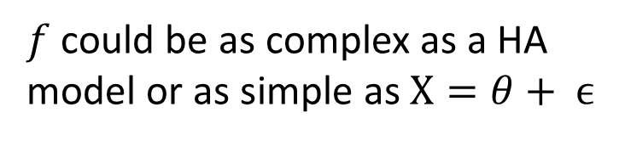



SNPE Toy Model: $X=f(θ,ϵ)$
$f$ could be as complex as a HA model or as simple as $X=θ+ ϵ$
$X^{∗}$ = data, $X$= model simulations, $p\left(θ\right)$ = prior over $θ$, $ε∼N(\overline{0},\overline{1})$
Objective is to approximate posterior: $p(θ|X=X^{∗})$
Step 1: Simulate ${\left\{X_{i},θ_{i} \right\}}_{i=1}^{I}$from joint distribution $p(θ,X)$
Sample $θ_{i}$from $p\left(θ\right)$
Sample $X_{i}$from simulated model conditional on $θ_{i}$, $X_{i} =$ ${f(θ}_{i},ϵ$)
$$P\left(θ | X\right)= \frac{P\left(X | θ\right)P(θ)}{P(X)}$$
Simulate diagram
After this step, no need for the model
SNPE
SNVI

Slide 9
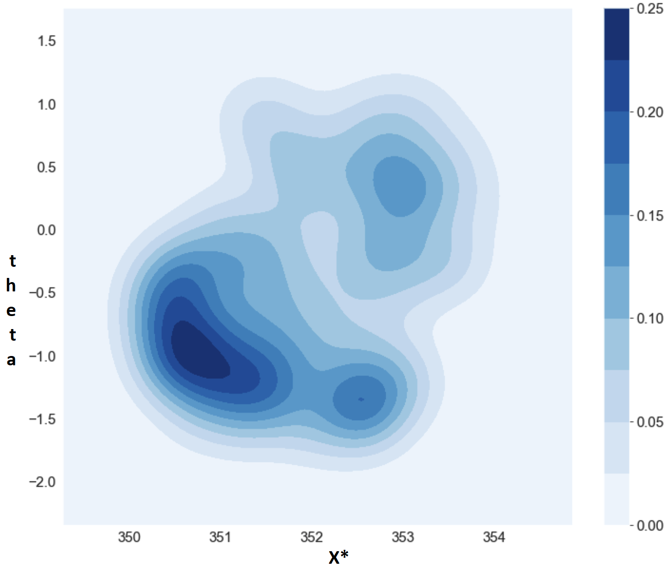

Step 1: Sample${ \left\{X_{i},θ_{i} \right\}}_{i=1}^{I}∼p\left(θ, X\right)$ via Monte Carlo Simulation
Back

Slide 10

Samples from the joint distribution : $$θ,X∼P\left(θ, X\right)= P\left(X | θ\right)P\left(θ\right)$$
Back

Slide 11
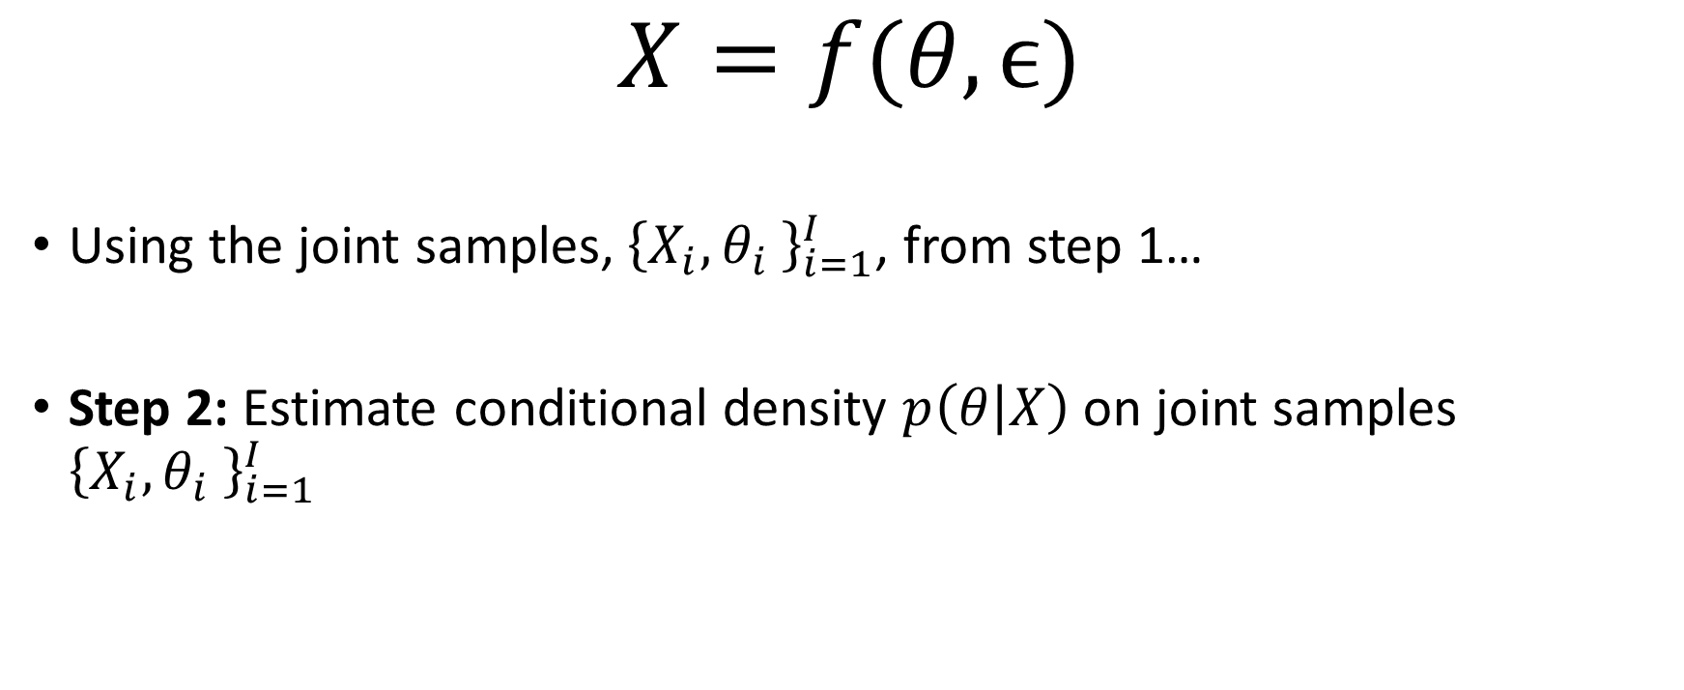
SNPE Toy Model (Step 2):
$$X=f(θ,ϵ)$$
Using the joint samples,${ \left\{X_{i},θ_{i} \right\}}_{i=1}^{I}$, from step 1…
Step 2: Estimate conditional density $p\left(θ | X\right)$ on joint samples ${\left\{X_{i},θ_{i} \right\}}_{i=1}^{I}$
!!!
Estimate diagram
SNPE
SNVI

Slide 12
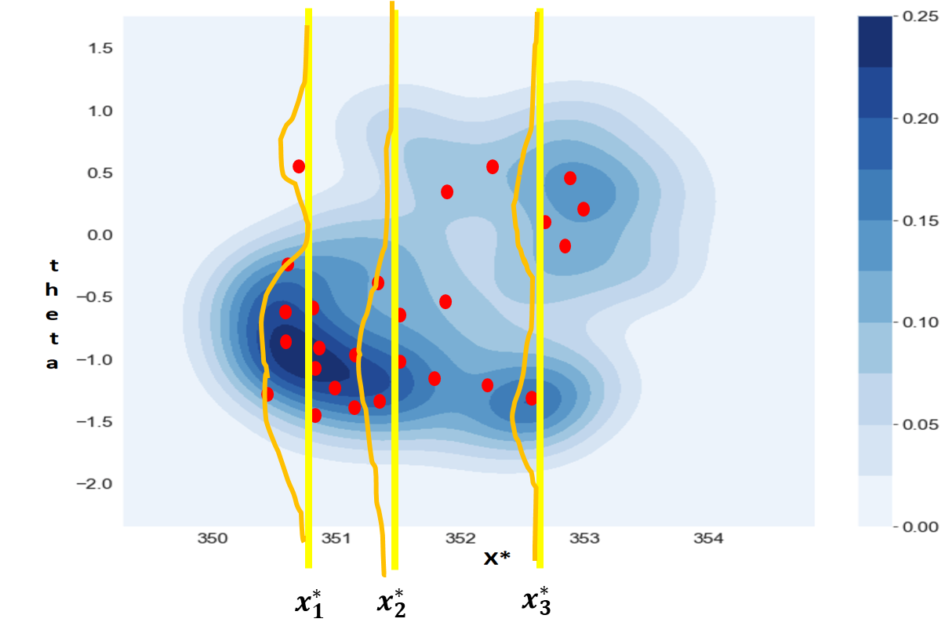
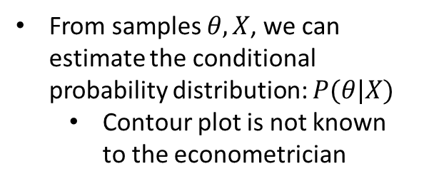
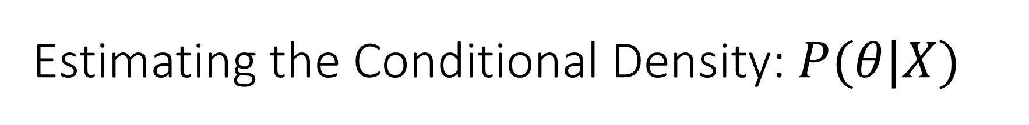



Estimating the Conditional Density: $P(θ|X)$
From samples $θ, X$, we can estimate the conditional probability distribution: $P(θ|X)$
Contour plot is not known to the econometrician
X
$$X_{1}$$
$$X_{2}$$
$$X_{3}$$

Slide 13
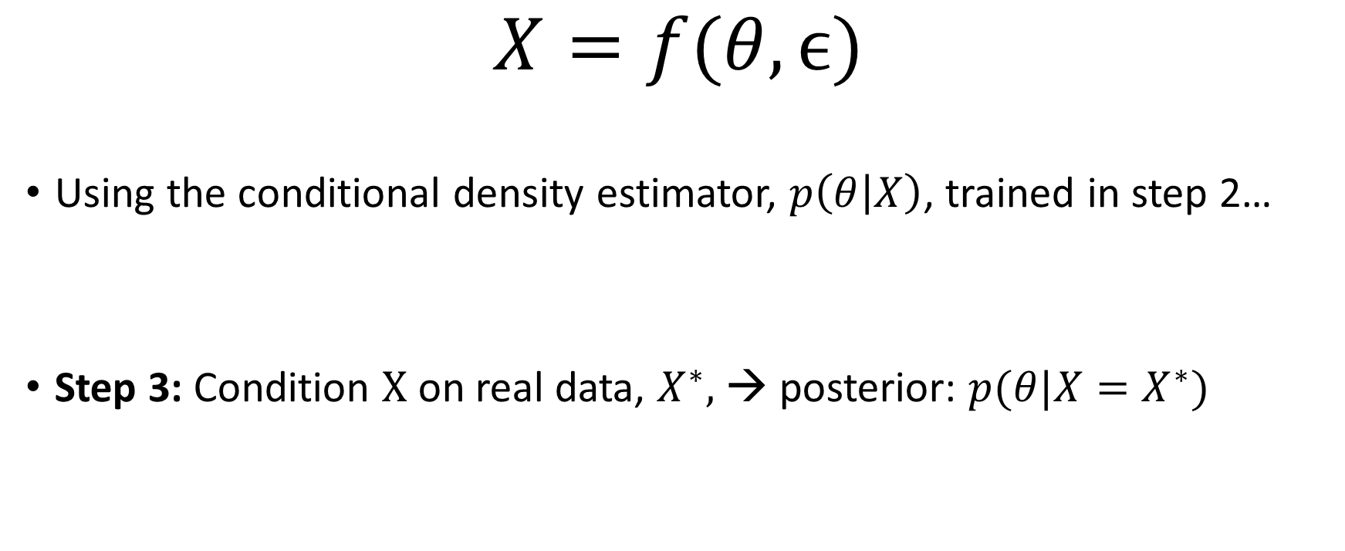
SNPE Toy Model (Step 3)
$$X=f(θ,ϵ)$$
Using the conditional density estimator, $p\left(θ | X\right)$, trained in step 2…
Step 3: Condition $X$ on real data, $X^{∗},$→ posterior: $p(θ|X=X^{∗})$
Condition diagram
SNPE
Sampling
SNVI

Slide 14
Digging Deeper into Step 2: Conditional Density Estimation

Slide 15
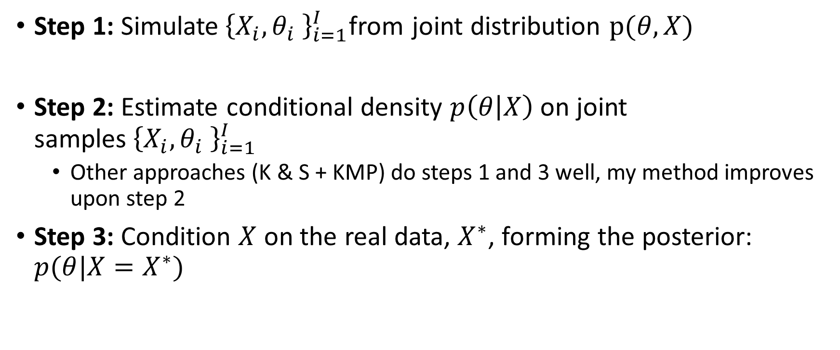

SNPE Toy Model Redux: $X=f(θ, ϵ)$
Step 1: Simulate${ \left\{X_{i},θ_{i} \right\}}_{i=1}^{I}$from joint distribution $p(θ,X)$
Step 2: Estimate conditional density $p\left(θ | X\right)$ on joint samples${ \left\{X_{i},θ_{i} \right\}}_{i=1}^{I}$
Other approaches (K & S + KMP) do steps 1 and 3 well, my method improves upon step 2
Step 3: Condition $X$ on the real data, $X^{∗}$, forming the posterior: $p(θ|X=X^{∗})$
Simulate diagram
Estimate diagram
Condition diagram
SNPE
SNVI
State Space Structure

Slide 16

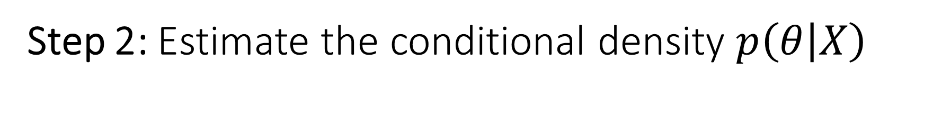

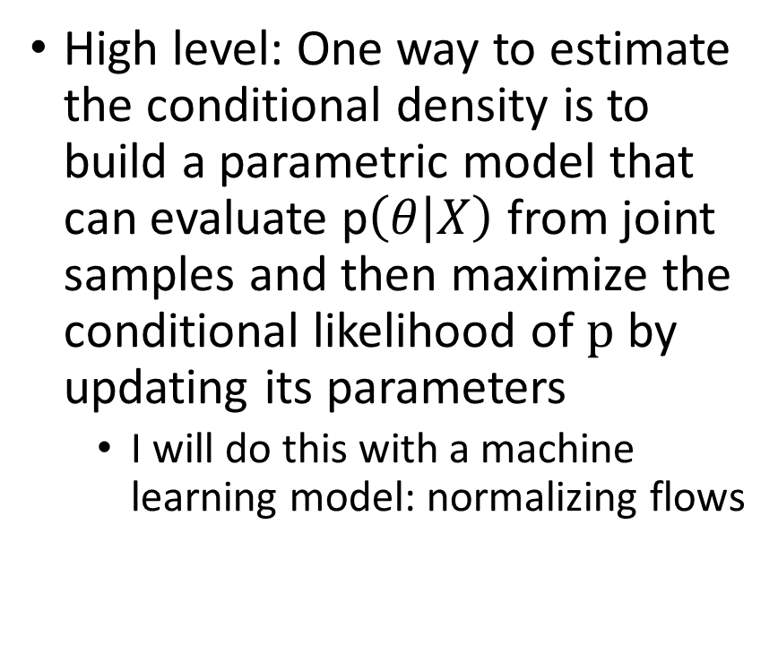

Step 2: Estimate the conditional density $p\left(θ | X\right)$
High level: One way to estimate the conditional density is to build a parametric model that can evaluate p$\left(θ | X\right)$ from joint samples and then maximize the conditional likelihood of $p$ by updating its parameters
I will do this with a machine learning model: normalizing flows
$$X_{1}$$
$$X_{2}$$
$$X_{3}$$
Back

Slide 17
Unconditional Density Estimation with Normalizing Flows First

Slide 18
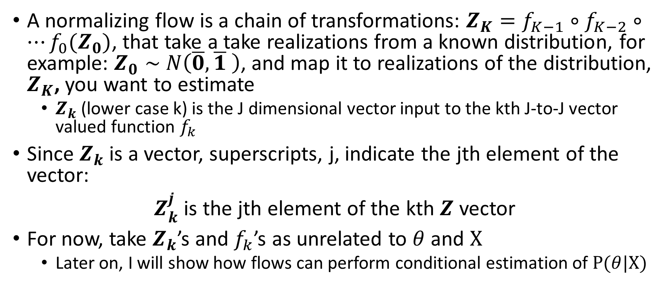
Some Syntax
A normalizing flow is a chain of transformations: $Z_{K}=f_{K−1}∘f_{K−2}∘…f_{0}(Z_{0})$, that take a take realizations from a known distribution, for example: $Z_{0}∼$ $N\left(\overline{0},\overline{1} \right)$, and map it to realizations of the distribution, $Z_{K}$, you want to estimate
$Z_{k}$ (lower case k) is the J dimensional vector input to the kth J-to-J vector valued function $f_{k}$
Since $Z_{k}$ is a vector, superscripts, j, indicate the jth element of the vector:
$Z_{k}^{j}$ is the jth element of the kth $Z$ vector
For now, take $Z_{k}$’s and $f_{k}$’s as unrelated to $θ$ and $X$
Later on, I will show how flows can perform conditional estimation of $P(θ|X)$

Slide 19
Normalizing Flow Main Takeaway
At it’s core a normalizing code learns a mapping from realizations of a distribution that is known, to realizations of a distribution you want to estimate
The mapping is created by a compositions of invertible functions
Using the change of variables function, you can evaluate the likelihood of samples from the distribution you want to estimate
Then you can modify the parameters of the normalizing flow to maximize the likelihood.

Slide 20
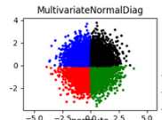
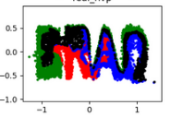

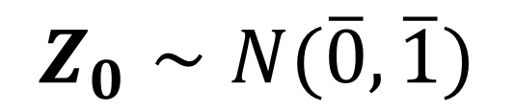
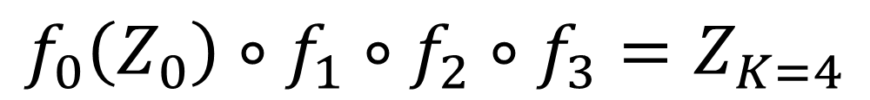
A Composition of Functions in a Flow allows it to become a Flexible Density Estimator
$$f_{0}\left(Z_{0}\right)∘f_{1}∘f_{2}∘f_{3}=Z_{K=4}$$
$$Z_{0}∼N(\overline{0},\overline{1})$$
$$Z_{4}$$

Slide 21
A Composition of Functions in a Flow allows it to become a Flexible Density Estimator
$$f_{0}\left(Z_{0}\right)∘f_{1}∘f_{2}∘f_{3}=Z_{K=4}$$
$$Z_{0}∼N(\overline{0},\overline{1})$$
$$Z_{4}$$

Slide 22
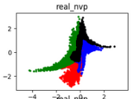
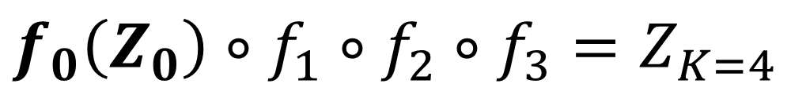
A Composition of Functions in a Flow allows it to become a Flexible Density Estimator
$$f_{0}\left(Z_{0}\right)∘f_{1}∘f_{2}∘f_{3}=Z_{K=4}$$
$$Z_{0}∼N(\overline{0},\overline{1})$$
$$Z_{4}$$

Slide 23
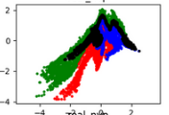
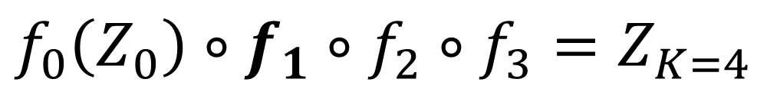
A Composition of Functions in a Flow allows it to become a Flexible Density Estimator
$$f_{0}\left(Z_{0}\right)∘f_{1}∘f_{2}∘f_{3}=Z_{K=4}$$
$$Z_{0}∼N(\overline{0},\overline{1})$$
$$Z_{4}$$

Slide 24
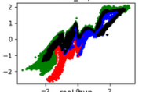
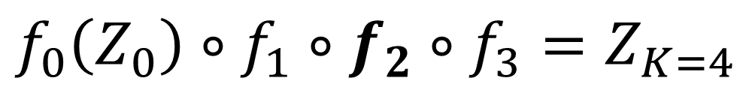
A Composition of Functions in a Flow allows it to become a Flexible Density Estimator
$$f_{0}\left(Z_{0}\right)∘f_{1}∘f_{2}∘f_{3}=Z_{K=4}$$
$$Z_{0}∼N(\overline{0},\overline{1})$$
$$Z_{4}$$

Slide 25
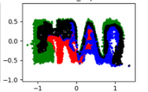
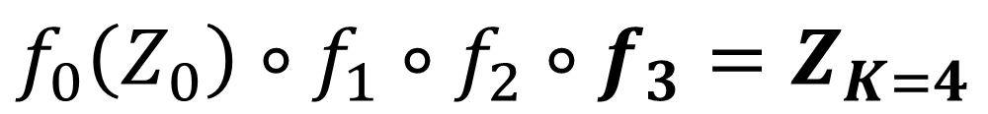
A Composition of Functions in a Flow allows it to become a Flexible Density Estimator
$$f_{0}\left(Z_{0}\right)∘f_{1}∘f_{2}∘f_{3}=Z_{K=4}$$
$$Z_{0}∼N(\overline{0},\overline{1})$$
$$Z_{4}$$

Slide 26
A Composition of Functions in a Flow allows it to become a Flexible Density Estimator
$$f_{0}\left(Z_{0}\right)∘f_{1}∘f_{2}∘f_{3}=Z_{K=4}$$
$$Z_{0}∼N(\overline{0},\overline{1})$$
$$Z_{4}$$

Slide 27
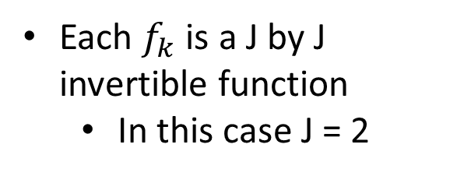
A Composition of Functions in a Flow allows it to become a Flexible Density Estimator
$$f_{0}\left(Z_{0}\right)∘f_{1}∘f_{2}∘f_{3}=Z_{K=4}$$
$$Z_{0}∼N(\overline{0},\overline{1})$$
Each $f_{k}$ is a J by J invertible function
In this case J = 2
$$Z_{4}$$

Slide 28
A Composition of Functions in a Flow allows it to become a Flexible Density Estimator
$$f_{0}\left(Z_{0}\right)∘f_{1}∘f_{2}∘f_{3}=Z_{K=4}$$
$$Z_{0}∼N(\overline{0},\overline{1})$$
$$Z_{4}$$

Slide 29
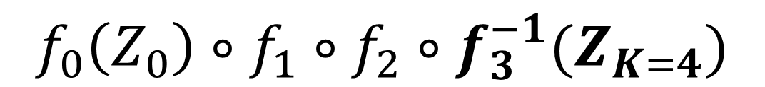
A Composition of Functions in a Flow allows it to become a Flexible Density Estimator
$$f_{0}\left(Z_{0}\right)∘f_{1}∘f_{2}∘f_{3}^{−1}(Z_{K=4})$$
$$Z_{0}∼N(\overline{0},\overline{1})$$
$$Z_{4}$$

Slide 30
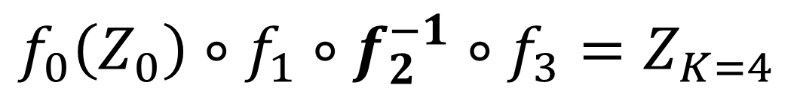
A Composition of Functions in a Flow allows it to become a Flexible Density Estimator
$$f_{0}\left(Z_{0}\right)∘f_{1}∘f_{2}^{−1}∘f_{3}=Z_{K=4}$$
$$Z_{0}∼N(\overline{0},\overline{1})$$
$$Z_{4}$$

Slide 31
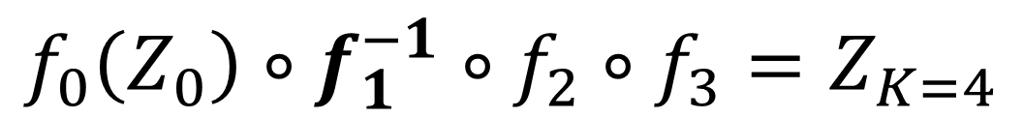
A Composition of Functions in a Flow allows it to become a Flexible Density Estimator
$$f_{0}\left(Z_{0}\right)∘f_{1}^{−1}∘f_{2}∘f_{3}=Z_{K=4}$$
$$Z_{0}∼N(\overline{0},\overline{1})$$
$$Z_{4}$$

Slide 32
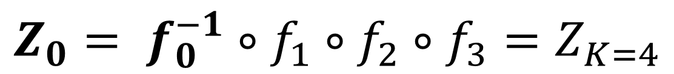
A Composition of Functions in a Flow allows it to become a Flexible Density Estimator
$${Z_{0}= f}_{0}^{−1}∘f_{1}∘f_{2}∘f_{3}=Z_{K=4}$$
$$Z_{0}∼N(\overline{0},\overline{1})$$
$$Z_{4}$$

Slide 33
A Composition of Functions in a Flow allows it to become a Flexible Density Estimator
$$f_{0}\left(Z_{0}\right)∘f_{1}∘f_{2}∘f_{3}=Z_{K=4}$$
$$Z_{0}∼N(\overline{0},\overline{1})$$
$$Z_{4}$$

Slide 34
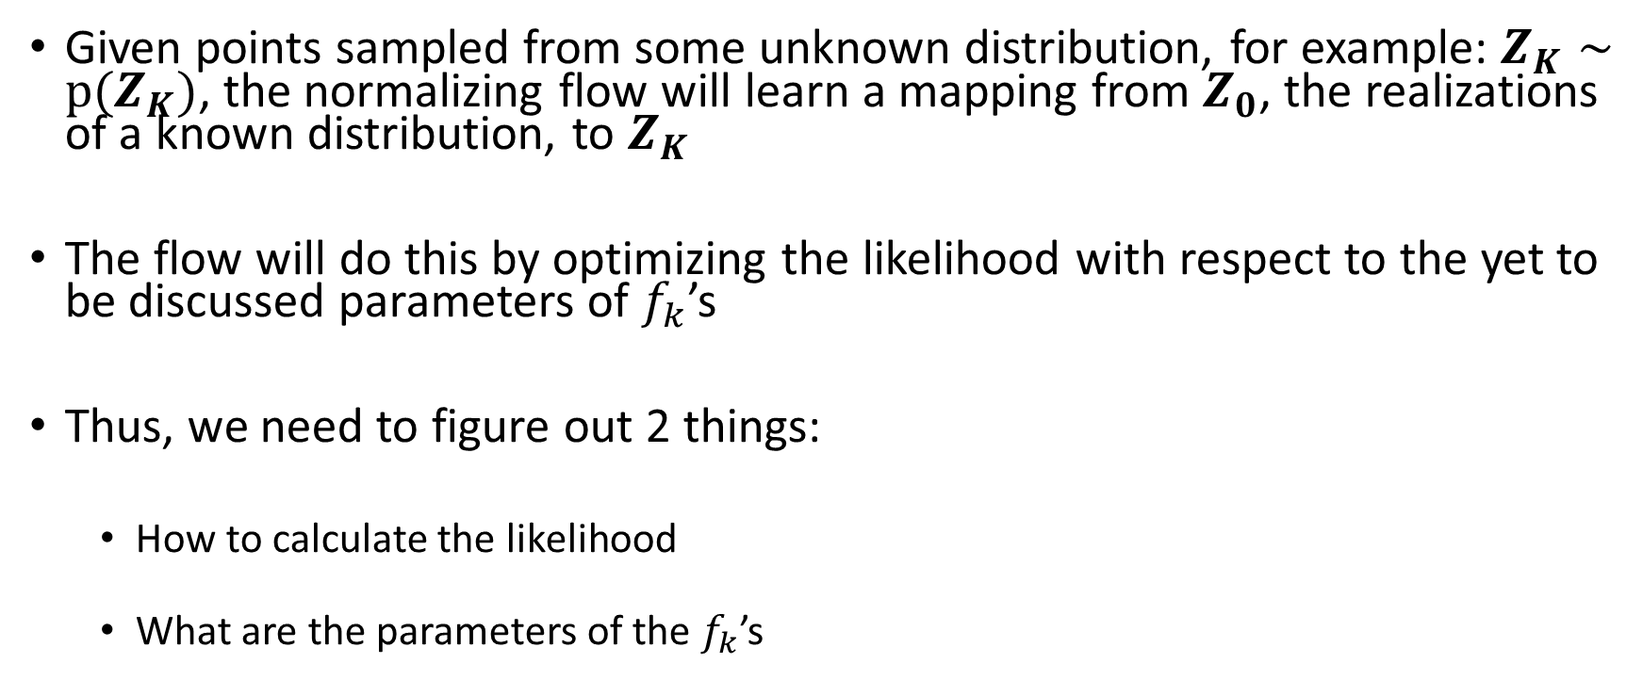
What is the Point of a Flow?
Given points sampled from some unknown distribution, for example: $Z_{K}∼p(Z_{K})$, the normalizing flow will learn a mapping from $Z_{0}$, the realizations of a known distribution, to $Z_{K}$
The flow will do this by optimizing the likelihood with respect to the yet to be discussed parameters of $f_{k}$’s
Thus, we need to figure out 2 things:
How to calculate the likelihood
What are the parameters of the $f_{k}$’s

Slide 35
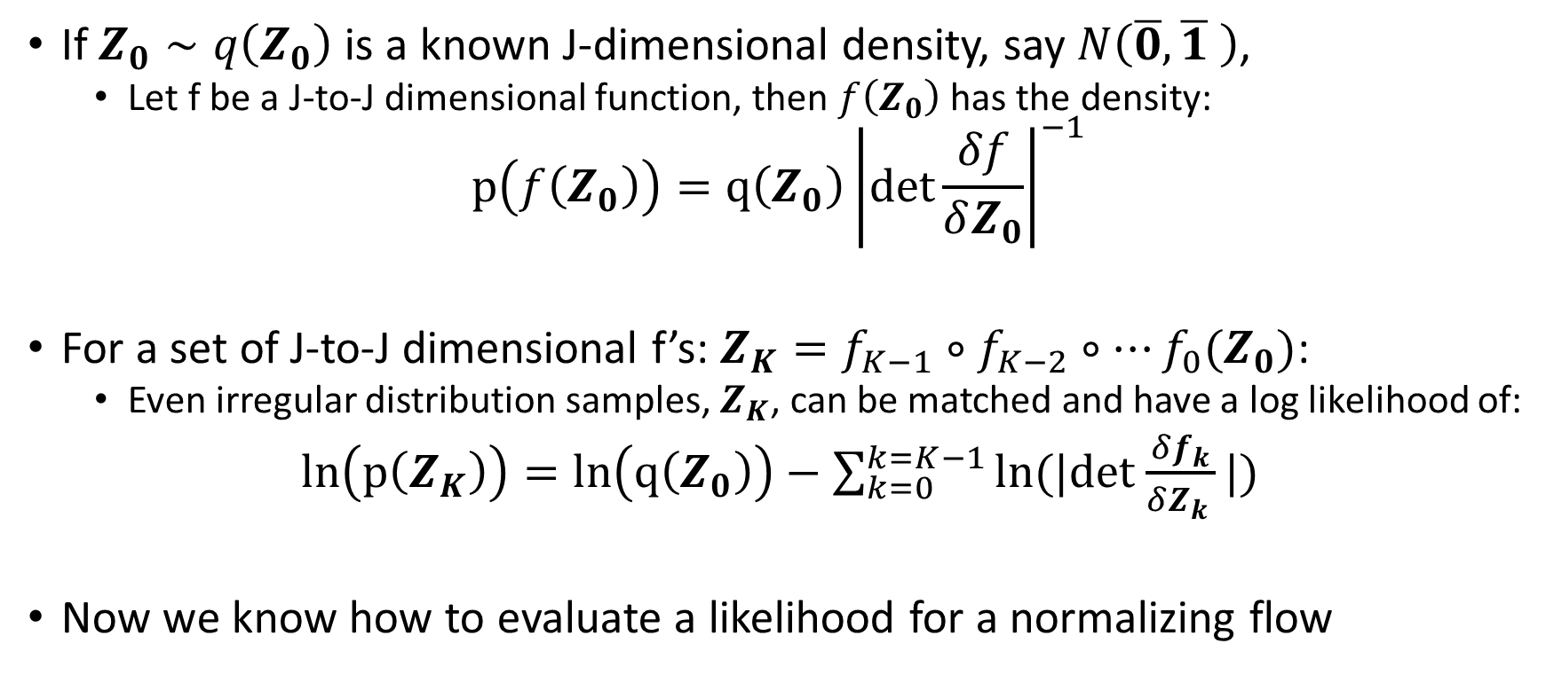
Fundamental Insight Regarding the Likelihood: A Change of Variables
If $Z_{0}∼q\left(Z_{0}\right)$ is a known J-dimensional density, say $N\left(\overline{0},\overline{1} \right)$,
Let f be a J-to-J dimensional function, then $f\left(Z_{0}\right)$ has the density:
$$p\left(f\left(Z_{0}\right)\right)=q\left(Z_{0}\right){\left|det\frac{δf}{δZ_{0}}\right|}^{−1}$$
For a set of J-to-J dimensional f’s: $Z_{K}=f_{K−1}∘f_{K−2}∘…f_{0}(Z_{0})$:
Even irregular distribution samples, $Z_{K}$, can be matched and have a log likelihood of:
$ln\left(p\left(Z_{K}\right)\right)=ln\left(q\left(Z_{0}\right)\right)−\sum_{k=0}^{k=K−1}{ln(|det}$ $\frac{δf_{k}}{δZ_{k }}|)$
Now we know how to evaluate a likelihood for a normalizing flow

Slide 36
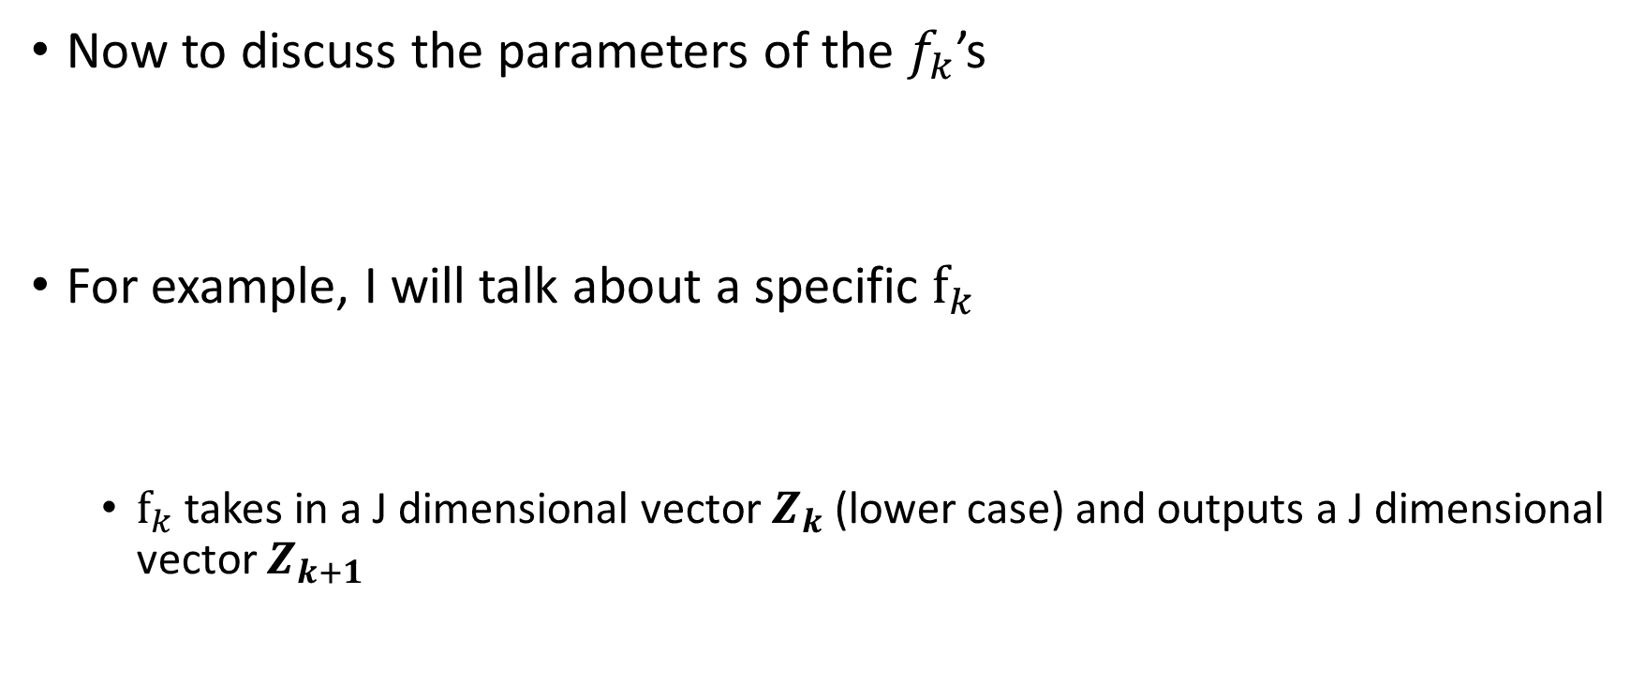
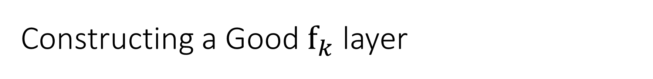
Constructing a Good $f_{k}$ layer
Now to discuss the parameters of the $f_{k}$’s
For example, I will talk about a specific $f_{k}$
$f_{k}$ takes in a J dimensional vector $Z_{k}$(lower case) and outputs a J dimensional vector $Z_{k+1}$

Slide 37
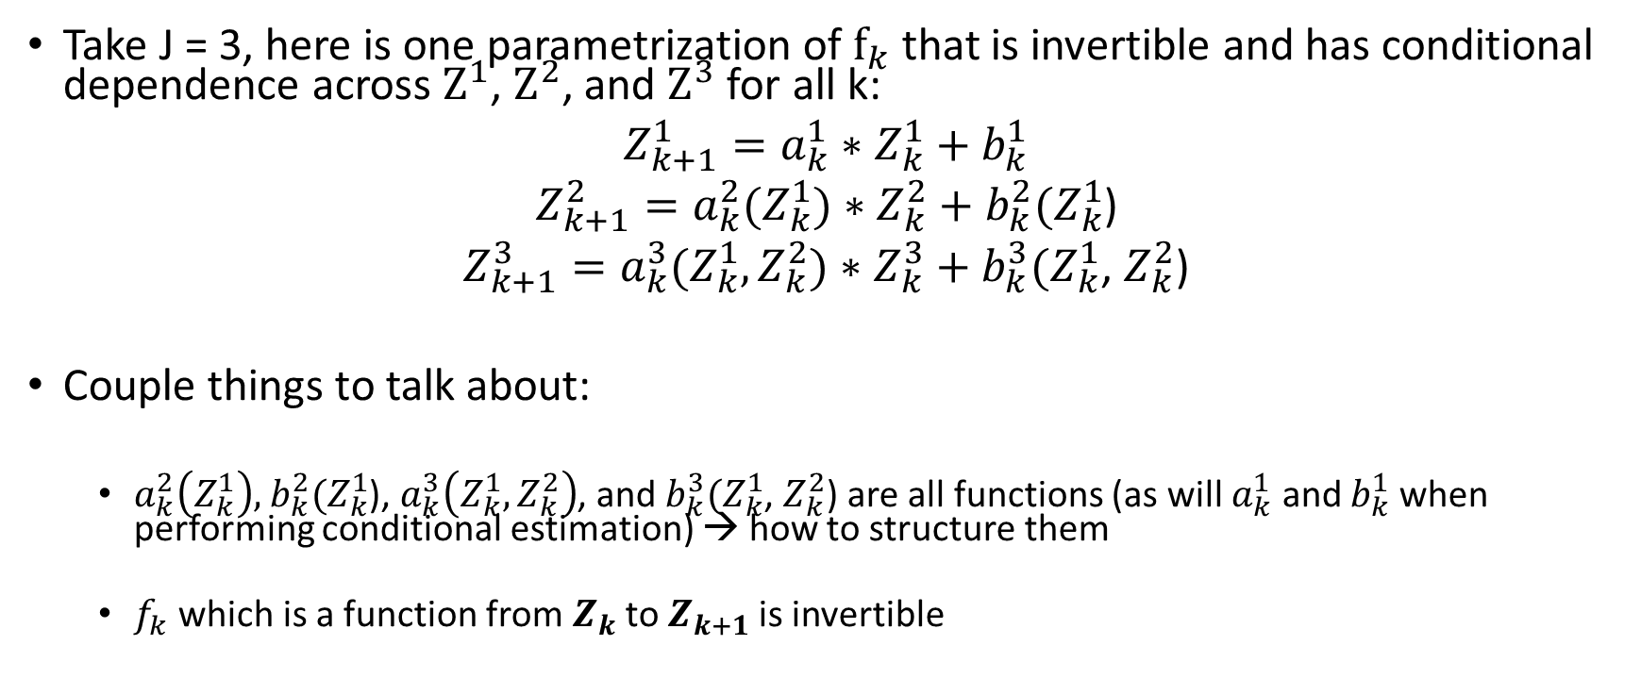
Transform Structure
Take J = 3, here is one parametrization of $f_{k}$ that is invertible and has conditional dependence across $Z^{1}$, $Z^{2}$, and $Z^{3}$ for all k:
$Z_{k+1}^{1}=a_{k}^{1}∗$ $Z_{k}^{1}+b_{k}^{1}$
$Z_{k+1}^{2}=a_{k}^{2}(Z_{k}^{1})∗$ $Z_{k}^{2}+b_{k}^{2}(Z_{k}^{1}$)
$Z_{k+1}^{3}=a_{k}^{3}(Z_{k}^{1},Z_{k}^{2})∗$ $Z_{k}^{3}+b_{k}^{3}(Z_{k}^{1}$, $Z_{k}^{2}$)
Couple things to talk about:
$a_{k}^{2}\left(Z_{k}^{1}\right),$ $b_{k}^{2}(Z_{k}^{1}$), $a_{k}^{3}\left(Z_{k}^{1},Z_{k}^{2}\right)$, and $b_{k}^{3}(Z_{k}^{1}$, $Z_{k}^{2}$) are all functions (as will $a_{k}^{1}$ and $b_{k}^{1}$ when performing conditional estimation) → how to structure them
$f_{k}$ which is a function from $Z_{k}$to $Z_{k+1}$is invertible

Slide 38
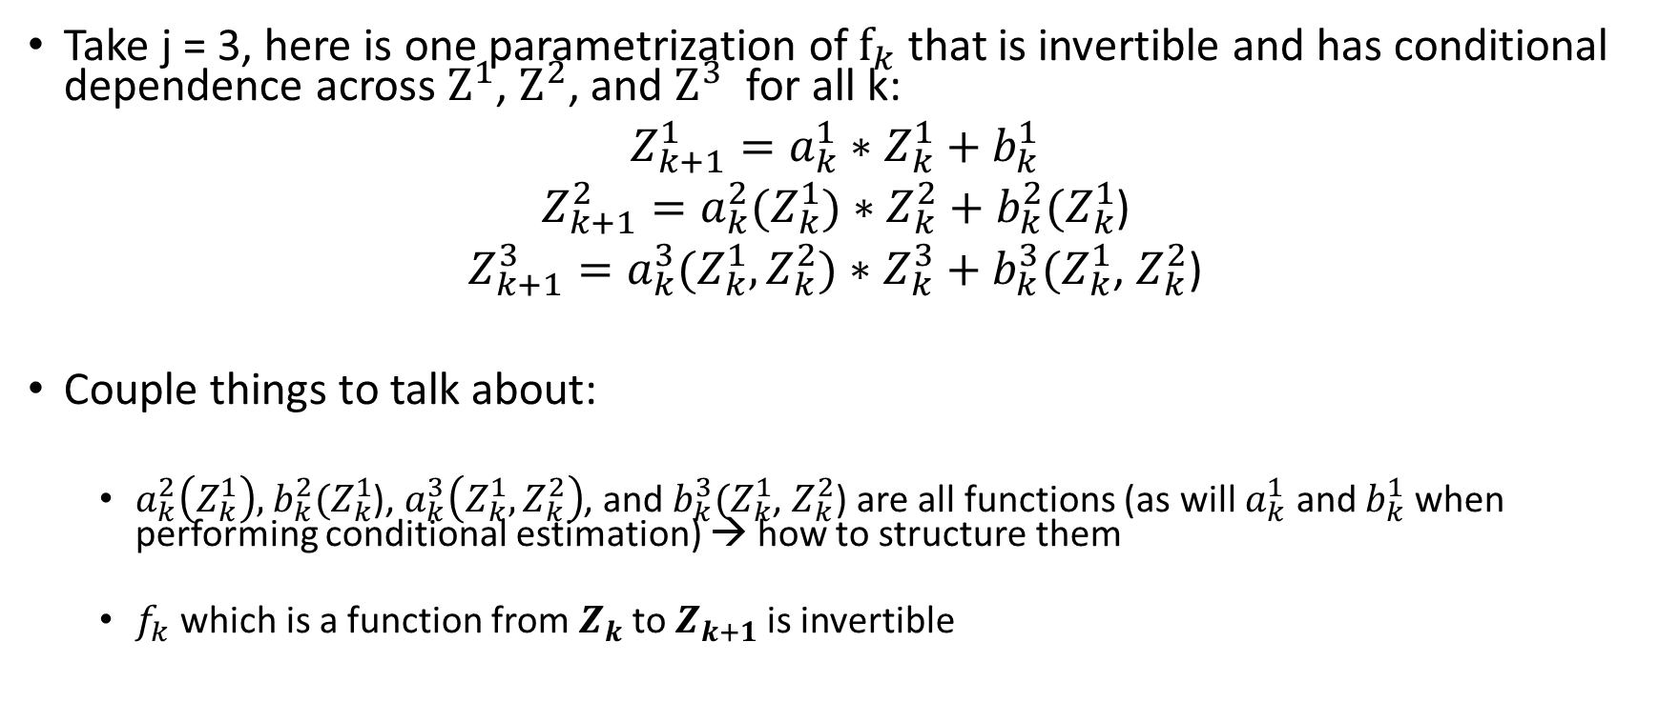
Transform Structure
Take j = 3, here is one parametrization of $f_{k}$ that is invertible and has conditional dependence across $Z^{1}$, $Z^{2}$, and $Z^{3}$ for all k:
$Z_{k+1}^{1}=a_{k}^{1}∗$ $Z_{k}^{1}+b_{k}^{1}$
$Z_{k+1}^{2}=a_{k}^{2}(Z_{k}^{1})∗$ $Z_{k}^{2}+b_{k}^{2}(Z_{k}^{1}$)
$Z_{k+1}^{3}=a_{k}^{3}(Z_{k}^{1},Z_{k}^{2})∗$ $Z_{k}^{3}+b_{k}^{3}(Z_{k}^{1}$, $Z_{k}^{2}$)
Couple things to talk about:
$a_{k}^{2}\left(Z_{k}^{1}\right),$ $b_{k}^{2}(Z_{k}^{1}$), $a_{k}^{3}\left(Z_{k}^{1},Z_{k}^{2}\right)$, and $b_{k}^{3}(Z_{k}^{1}$, $Z_{k}^{2}$) are all functions (as will $a_{k}^{1}$ and $b_{k}^{1}$ when performing conditional estimation) → how to structure them
$f_{k}$ which is a function from $Z_{k}$to $Z_{k+1}$is invertible

Slide 39
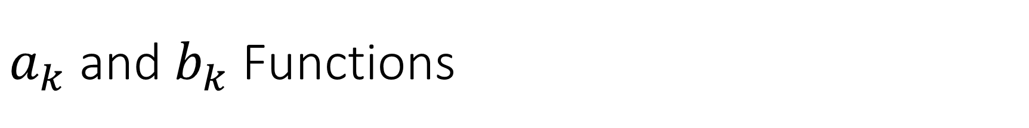
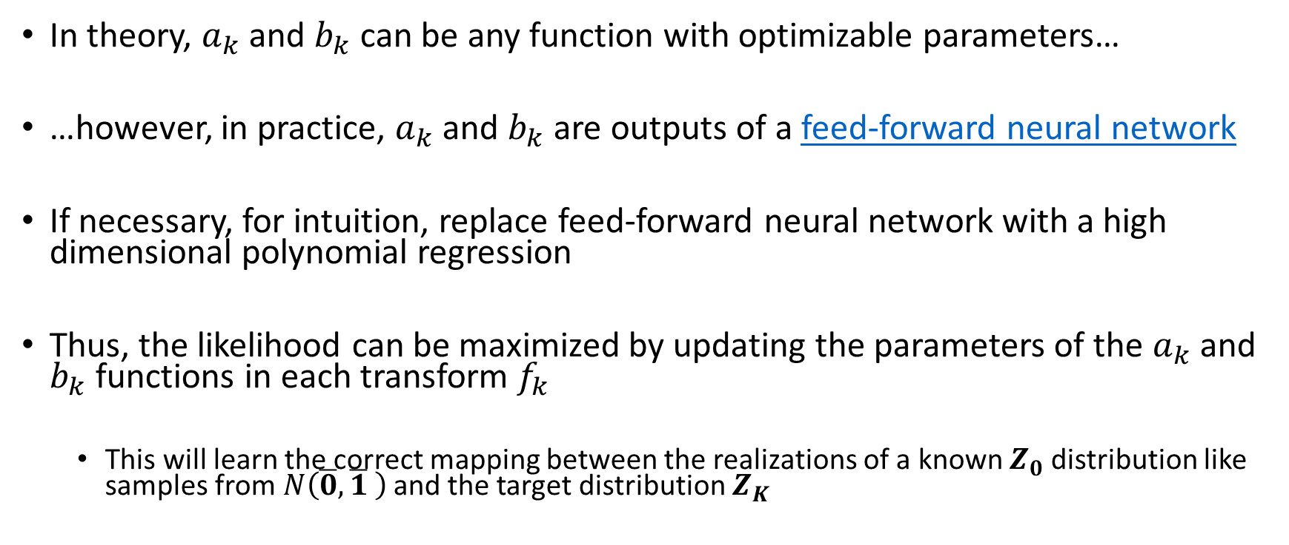
$a_{k}$ and $b_{k}$ Functions
In theory, $a_{k}$ and $b_{k}$ can be any function with optimizable parameters…
…however, in practice, $a_{k}$ and $b_{k}$are outputs of a feed-forward neural network
If necessary, for intuition, replace feed-forward neural network with a high dimensional polynomial regression
Thus, the likelihood can be maximized by updating the parameters of the $a_{k}$ and $b_{k}$ functions in each transform $f_{k}$
This will learn the correct mapping between the realizations of a known $Z_{0}$ distribution like samples from$N\left(\overline{0},\overline{1} \right)$ and the target distribution $Z_{K}$

Slide 40
Transform Structure
Take j = 3, here is one parametrization of $f_{k}$ that is invertible and has conditional dependence across $Z^{1}$, $Z^{2}$, and $Z^{3}$ for all k:
$Z_{k+1}^{1}=a_{k}^{1}∗$ $Z_{k}^{1}+b_{k}^{1}$
$Z_{k+1}^{2}=a_{k}^{2}(Z_{k}^{1})∗$ $Z_{k}^{2}+b_{k}^{2}(Z_{k}^{1}$)
$Z_{k+1}^{3}=a_{k}^{3}(Z_{k}^{1},Z_{k}^{2})∗$ $Z_{k}^{3}+b_{k}^{3}(Z_{k}^{1}$, $Z_{k}^{2}$)
Couple things to talk about:
$a_{k}^{2}\left(Z_{k}^{1}\right),$ $b_{k}^{2}(Z_{k}^{1}$), $a_{k}^{3}\left(Z_{k}^{1},Z_{k}^{2}\right)$, and $b_{k}^{3}(Z_{k}^{1}$, $Z_{k}^{2}$) are all functions (as will $a_{k}^{1}$ and $b_{k}^{1}$ when performing conditional estimation) → how to structure them
$f_{k}$ which is a function from $Z_{k}$to $Z_{k+1}$is invertible

Slide 41
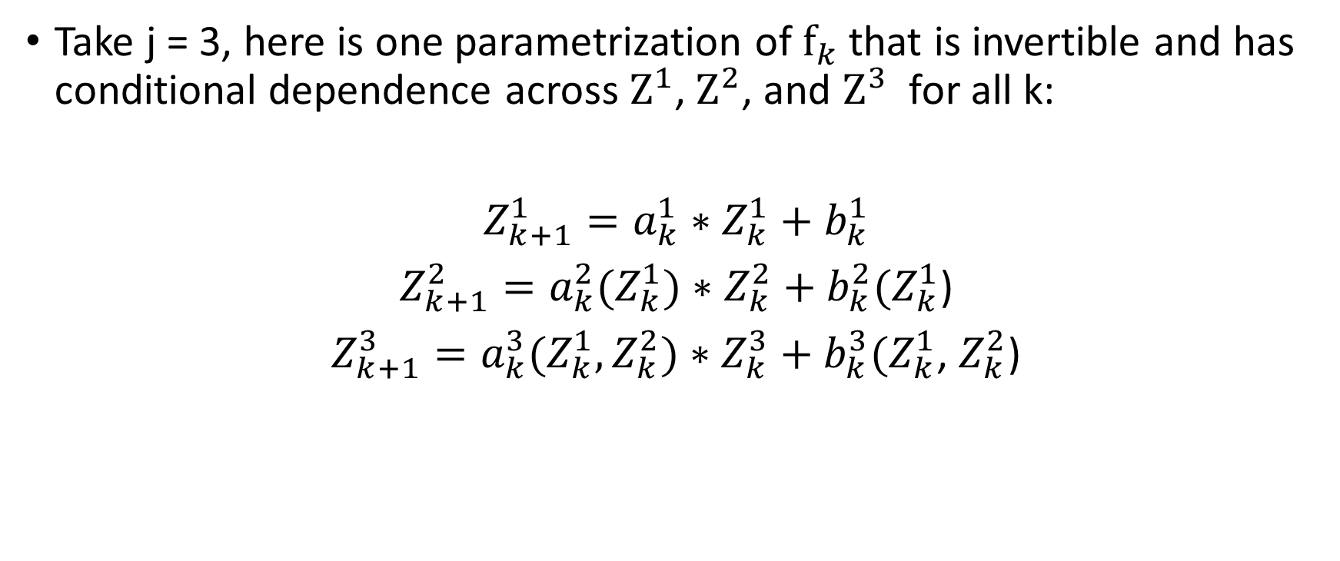

Invertibility from $Z_{k}$ to $Z_{k+1}$
Take j = 3, here is one parametrization of $f_{k}$ that is invertible and has conditional dependence across $Z^{1}$, $Z^{2}$, and $Z^{3}$ for all k:
$Z_{k+1}^{1}=a_{k}^{1}∗$ $Z_{k}^{1}+b_{k}^{1}$
$Z_{k+1}^{2}=a_{k}^{2}(Z_{k}^{1})∗$ $Z_{k}^{2}+b_{k}^{2}(Z_{k}^{1}$)
$Z_{k+1}^{3}=a_{k}^{3}(Z_{k}^{1},Z_{k}^{2})∗$ $Z_{k}^{3}+b_{k}^{3}(Z_{k}^{1}$, $Z_{k}^{2}$)

Slide 42
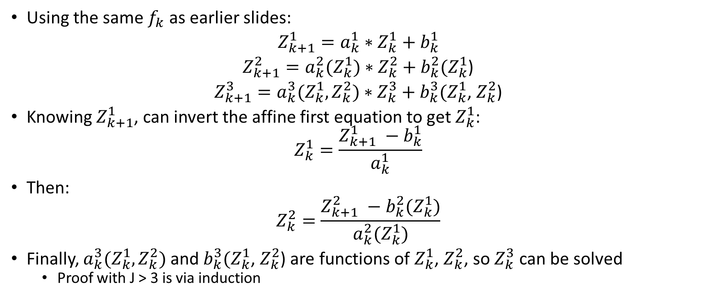

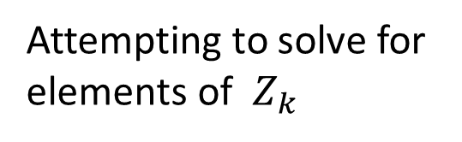
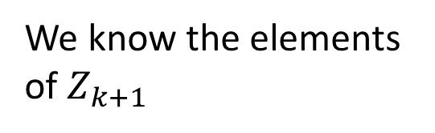
Invertibility from $Z_{k+1}$ to $Z_{k}$
Using the same $f_{k}$ as earlier slides:
$Z_{k+1}^{1}=a_{k}^{1}∗$ $Z_{k}^{1}+b_{k}^{1}$
$Z_{k+1}^{2}=a_{k}^{2}(Z_{k}^{1})∗$ $Z_{k}^{2}+b_{k}^{2}(Z_{k}^{1}$)
$Z_{k+1}^{3}=a_{k}^{3}(Z_{k}^{1},Z_{k}^{2})∗$ $Z_{k}^{3}+b_{k}^{3}(Z_{k}^{1}$, $Z_{k}^{2}$)
Knowing $Z_{k+1}^{1}$, can invert the affine first equation to get $Z_{k}^{1}$:
$$Z_{k}^{1}=\frac{Z_{k+1}^{1} −b_{k}^{1}}{a_{k}^{1}}$$
Then:
$$Z_{k}^{2}=\frac{Z_{k+1}^{2} −b_{k}^{2}(Z_{k}^{1})}{a_{k}^{2}(Z_{k}^{1})}$$
Finally, $a_{k}^{3}(Z_{k}^{1},Z_{k}^{2})$ and $b_{k}^{3}(Z_{k}^{1}$, $Z_{k}^{2}$) are functions of $Z_{k}^{1}$, $Z_{k}^{2}$, so $Z_{k}^{3}$ can be solved
Proof with J > 3 is via induction
We know the elements of $Z_{k+1}$
Attempting to solve for elements of $Z_{k}$

Slide 43
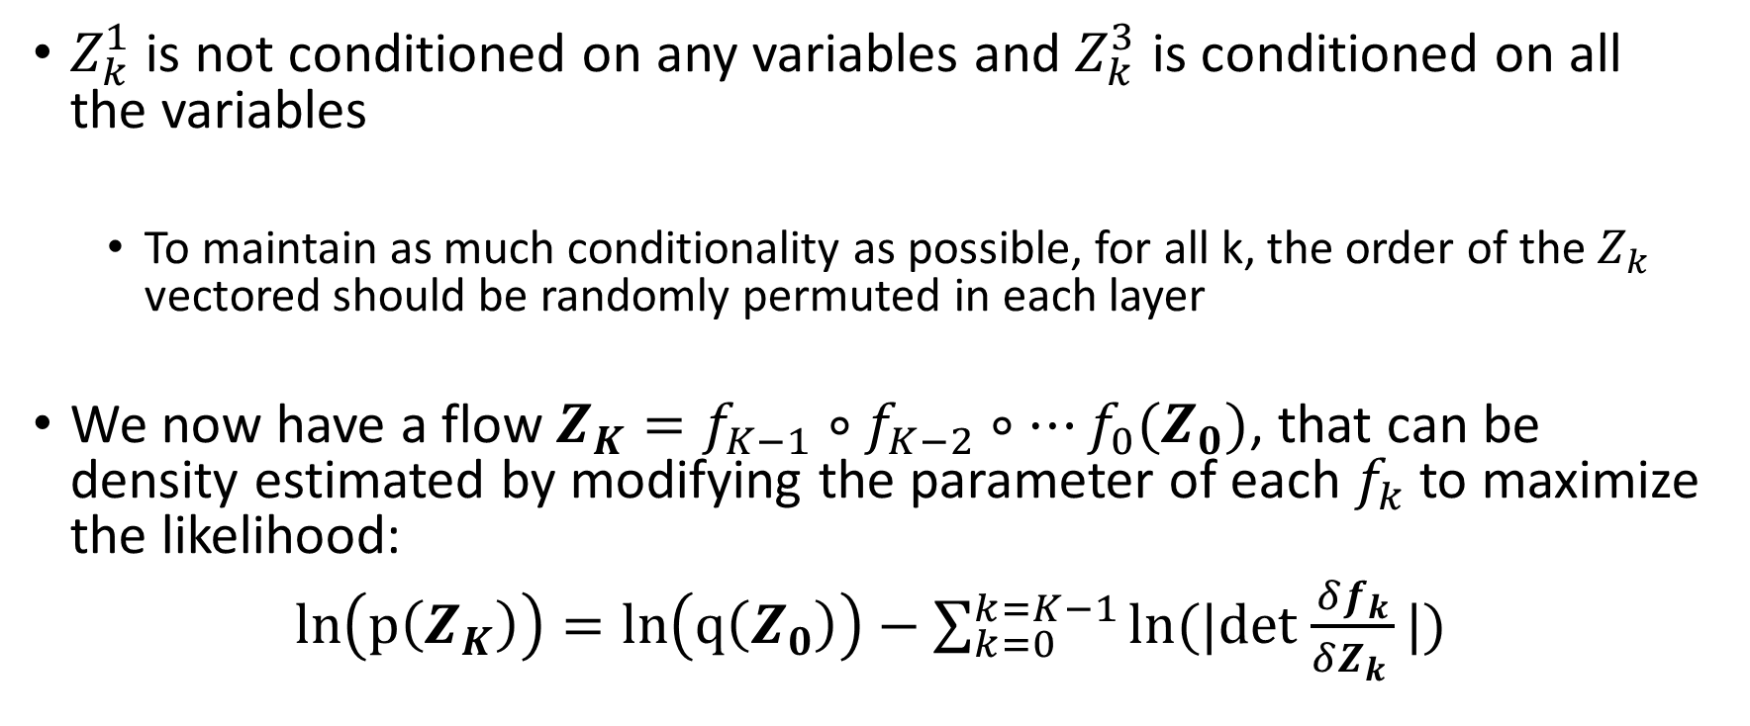
Additional Details
$Z_{k}^{1}$ is not conditioned on any variables and $Z_{k}^{3}$ is conditioned on all the variables
To maintain as much conditionality as possible, for all k, the order of the $Z_{k}$ vectored should be randomly permuted in each layer
We now have a flow $Z_{K}=f_{K−1}∘f_{K−2}∘…f_{0}(Z_{0})$, that can be density estimated by modifying the parameter of each $f_{k}$ to maximize the likelihood:
$ln\left(p\left(Z_{K}\right)\right)=ln\left(q\left(Z_{0}\right)\right)−\sum_{k=0}^{k=K−1}{ln(|det}$ $\frac{δf_{k}}{δZ_{k }}|)$

Slide 44
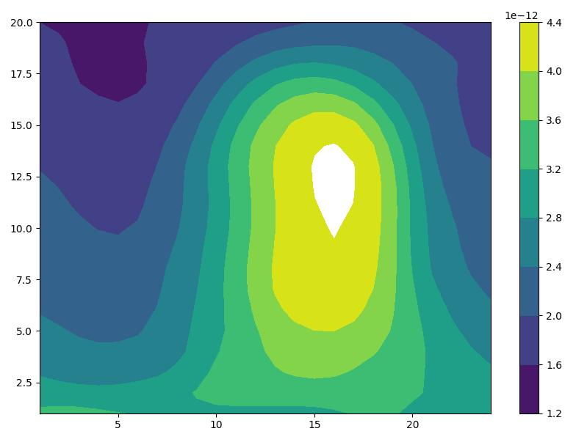


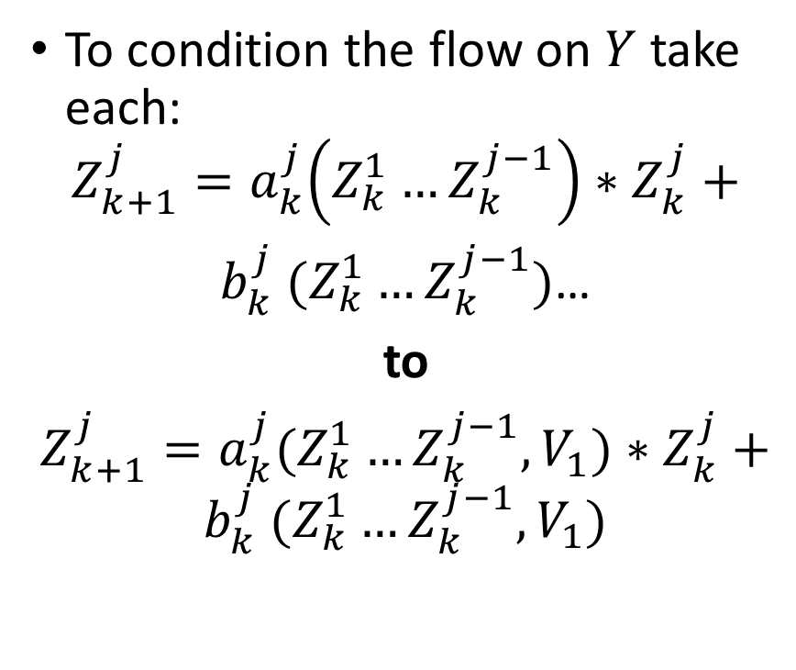







Unconditional to Conditional Normalizing Flow
Previously $Z_{K}$ was 2-D, now 1-D
To condition the flow on $Y$ take each:
$$Z_{k+1}^{j}=a_{k}^{j}\left({Z_{k}^{1}…Z}_{k}^{j−1}\right)∗Z_{k}^{j}+$$
$b_{k}^{j}$ $({Z_{k}^{1}…Z}_{k}^{j−1})$…
to
$Z_{k+1}^{j}=a_{k}^{j}({Z_{k}^{1}…Z}_{k}^{j−1},V_{1})∗Z_{k}^{j}+b_{k}^{j}$ $({Z_{k}^{1}…Z}_{k}^{j−1},V_{1})$
$$Z_{K}$$
$$V$$
$$V_{1}$$
$$V_{2}$$
$$V_{3}$$
$$x_{3}^{∗}$$
$$x_{2}^{∗}$$
$$x_{1}^{∗}$$

Slide 45

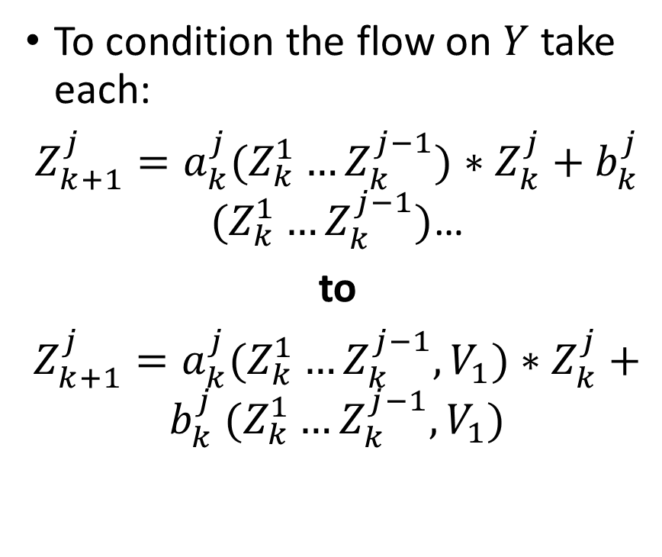


Unconditional to Conditional Normalizing Flow
To condition the flow on $Y$ take each:
$Z_{k+1}^{j}=a_{k}^{j}({Z_{k}^{1}…Z}_{k}^{j−1})∗Z_{k}^{j}+b_{k}^{j}$ $({Z_{k}^{1}…Z}_{k}^{j−1})$…
to
$Z_{k+1}^{j}=a_{k}^{j}({Z_{k}^{1}…Z}_{k}^{j−1},V_{1})∗Z_{k}^{j}+b_{k}^{j}$ $({Z_{k}^{1}…Z}_{k}^{j−1},V_{1})$
P$\left(Z_{K}|V_{1}\right)$
$$Z_{K}$$
$$V$$
$$V_{1}$$
$$V_{2}$$
$$V_{3}$$
$$x_{3}^{∗}$$
$$x_{2}^{∗}$$
$$x_{1}^{∗}$$

Slide 46

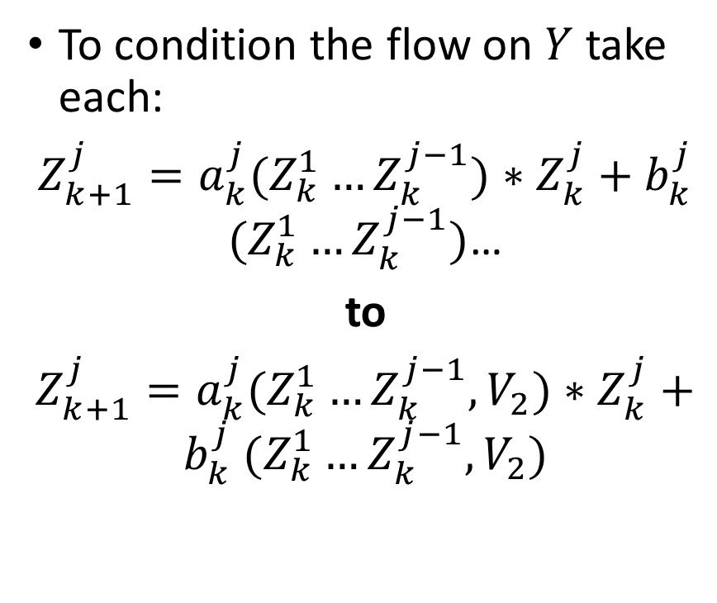

Unconditional to Conditional Normalizing Flow
To condition the flow on $Y$ take each:
$Z_{k+1}^{j}=a_{k}^{j}({Z_{k}^{1}…Z}_{k}^{j−1})∗Z_{k}^{j}+b_{k}^{j}$ $({Z_{k}^{1}…Z}_{k}^{j−1})$…
to
$Z_{k+1}^{j}=a_{k}^{j}({Z_{k}^{1}…Z}_{k}^{j−1},V_{2})∗Z_{k}^{j}+b_{k}^{j}$ $({Z_{k}^{1}…Z}_{k}^{j−1},V_{2})$
$$Z_{K}$$
P$\left(Z_{K}|V_{2}\right)$
$$V$$
$$V_{1}$$
$$V_{2}$$
$$V_{3}$$
$$x_{3}^{∗}$$
$$x_{2}^{∗}$$
$$x_{1}^{∗}$$

Slide 47
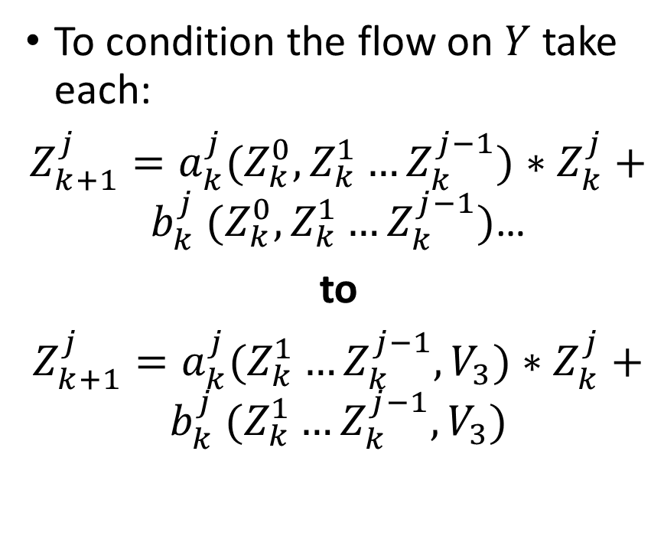


Unconditional to Conditional Normalizing Flow
To condition the flow on $Y$ take each:
$Z_{k+1}^{j}=a_{k}^{j}({Z_{k}^{0},Z_{k}^{1}…Z}_{k}^{j−1})∗Z_{k}^{j}+b_{k}^{j}$ $({Z_{k}^{0},Z_{k}^{1}…Z}_{k}^{j−1})$…
to
$Z_{k+1}^{j}=a_{k}^{j}({Z_{k}^{1}…Z}_{k}^{j−1},V_{3})∗Z_{k}^{j}+b_{k}^{j}$ $({Z_{k}^{1}…Z}_{k}^{j−1},V_{3})$
P$\left(Z_{K}|V_{1}\right)$
$$Z_{K}$$
$$V$$
$$V_{1}$$
$$V_{2}$$
$$V_{3}$$
$$x_{3}^{∗}$$
$$x_{2}^{∗}$$
$$x_{1}^{∗}$$

Slide 48
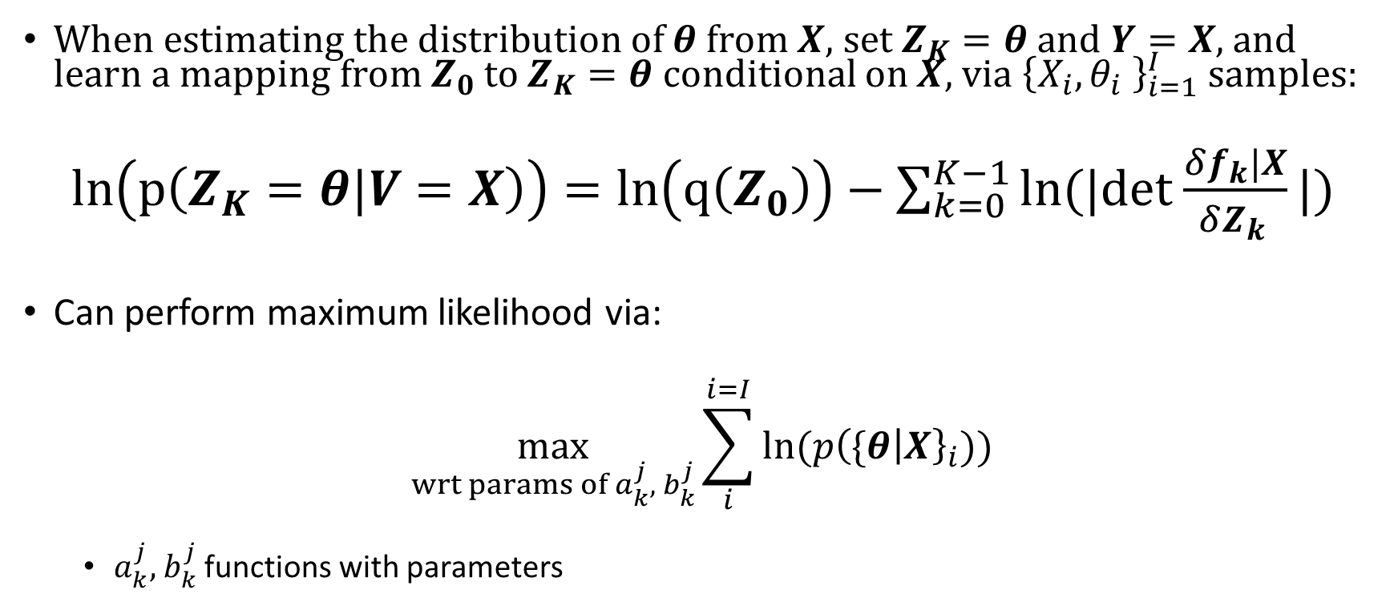

Maximum Likelihood Estimation
When estimating the distribution of $θ$ from $X$, set $Z_{K}=θ$ and $Y=X$, and learn a mapping from $Z_{0}$to $Z_{K}=θ$ conditional on $X$, via ${\left\{X_{i},θ_{i} \right\}}_{i=1}^{I}$ samples:
$ln\left(p\left(Z_{K}=θ|V=X\right)\right)=ln\left(q\left(Z_{0}\right)\right)−\sum_{k=0}^{K−1}{ln(|det}$ $\frac{δf_{k}|X}{δZ_{k }}|)$
Can perform maximum likelihood via:
$$\max_{wrt params of a_{k}^{j}, { b}_{k}^{j}}\sum_{i}^{i=I}{ln⁡(p{\left(\{θ | X\right\}}_{i}))}$$
$a_{k}^{j}, { b}_{k}^{j}$ functions with parameters
Step 1: Simulate ${\left\{X_{i},θ_{i} \right\}}_{i=1}^{I}$from joint distribution $p(θ,X)$

Slide 49





Step 3: Condition $X$ on the real data, $X^{∗}$, Forming the Posterior: $p(θ|X=X^{∗})$
Now that you have $p\left(θ | X\right)$
Random variable conditioned on generic $X$
The posterior is:
$P(θ|X=X^{∗})$
$p\left(θ | X\right)$ is conditioned on the real-world particular data, $X^{∗}$
$$P(θ|X^{∗}=X)$$
$$x^{∗}$$
$$x_{3}$$
$$x_{1}$$
Back
Multi-Round Inference

Slide 50
Results

Slide 51


SNPE vs Bayesian Methods
Perturbation
Projection
Value Function Iteration
HANK Reiter
HANK Winberry

Slide 52
SNPE/MCMC Performance on Smets-Wouters

Slide 53

SNPE after Five Hundred Thousand Iterations (Uniform Prior)
Back

Slide 54

Metropolis-Hastings MCMC after Ten Million Iterations (Uniform Prior)
Back

Slide 55

Theoretical Underpinning for SNPE Accuracy vs Monte Carlo
Sampling from multimodal distributions with MCMC don’t have polynomial computational guarantees (Chewi 2023)
Using a parametric density estimator via maximum likelihood are roughly quadratic/polynomial in cost (Farrell 2021)
Back
Chewi Intuition

Slide 56
SNPE Performance on Heterogenous Agent Models

Slide 57
Liu and Plagborg-Moller Estimation
Following Liu and Plagborg-Moller (2023), likelihood estimate Krusell-Smith (KS) HA model with micro moments
In this case, match output, consumption, investment and wage macro variables and match wealth as micro variables
Liu and Plagborg-Moller estimate by drawing from the state, macro variables conditional on the state, and micro variables conditional on state and macro and evaluating likelihood with measurement error
HANK Reiter

Slide 58

SNPE and MCMC Performance on Krusell Smith with Winberry Solution Method
Liu and Plagborg-Moller (2023) takes 6.5 min. per iteration
Likelihood evaluations compute intensive
My approach that doesn’t have to solve for a likelihood function
→ takes 30 seconds per iteration
Back

Slide 59
Empirical Application

Slide 60
Extending KS/Winberry to Full Information Empirical Application
KS/Winberry model estimated on empirical micro and macro data
Wealth data comes from Survey of Income and Program Participants (SIPP)
Macro data comes from FRED
Not attempted by Liu and Plagborg-Moller (2023)
Difficulties: not all time periods are surveyed and…
…each time step has different number of people surveyed
Solution: break microdata down into percentiles and match distributions

Slide 61

Posteriors for Empirical Application

Slide 62
Conclusion

Slide 63
Conclusion
I introduce the SNPE machine learning algorithm to improve the Bayesian estimation of structural macroeconomic models
SNPE can also handle likelihood free estimation in both a Bayesian and MLE framework
Empirical application estimating Krusell-Smith model solved via Winberry in a full information manner—with micro and macro moments
Extends Liu and Plagborg-Moller (2023)
Code tutorial: https://shorturl.at/pMQ18

Slide 64
Thank You
camfen@umich.edu
https://cameronfen.github.io/
https://twitter.com/cameronfen1

Slide 65
Appendix

Slide 66

Contribution: More Accurate Posteriors than MCMC on Smets-Wouters
SNPE
MCMC
Additional Parameters
Theoretical Rationale

Slide 67
Contribution Explained
I introduce the SNPE machine learning algorithm to improve the Bayesian estimation of structural macroeconomic models
SNPE can also handle likelihood free estimation in both a Bayesian and MLE framework
Within my SNPE procedure, I also introduce normalizing flows, for high dimensional density estimation
Empirical application estimating Krusell-Smith model solved via Winberry in a full information manner—with micro and macro moments
Difficult to do using current state-of-the-art likelihood methods

Slide 68
Literature
Many models are non-smooth so one can’t use perturbation and thus can’t likelihood estimated without measurement error
s-S models: Arrow et. al. 1951, Caplin and Spulber 1987, Bertola and Caballero 1990, House and Leahy 2004, Caplin and Leahy 2006, Kahn and Thomas 2008, Caplin et. al. 2020, Badoczy 2022, etc.
Structural Finance: He, Whited, and Guo 2021, Terry, Whited, and Zakolyukina 2021, Taylor 2012, Whited and Guo 2006
With non-smooth models: One generally must resort to simulation-based estimation:
Method of Simulated Moments: McFadden 1989, Pakes and Pollard 1989, Duffie and Singleton 1990, etc
Machine Learning: Kaji, Manresa, and Pouliot 2020
Back

Slide 69

Overview of How MCMC Works
MCMC samples from the posterior according to the likelihood ratio of points in the space
The likelihood MCMC moves from a point to a point $θ$to a point in question is $θ^{′}$equal to the likelihood ratio $\frac{P\left(X | θ\right)P(θ)}{P\left(X | θ^{′}\right)P(θ^{′})}$
Since the probability of being at any given point is proportional to the joint distribution, this algorithm samples from the posterior

Slide 70



MCMC in a Nutshell: $P\left(θ | X\right)∝P\left(X | θ\right)P(θ)$
You are at the blue point
You want to move to the green point
The blue point has a unnormalized joint probability, $P\left(X | θ\right)P(θ)$, of 1.5
The green point has a unnormalized joint probability, $P\left(X | θ^{′}\right)P(θ′)$, of 1.0
1.5
1.0

Slide 71


$$P\left(θ | X\right)∝P\left(X | θ\right)P(θ)$$
You will move to the green point with a probability equal to the likelihood ratio: 1/1.5 = 2/3
The other 1/3 you stay put and visit your current point again
In this way, you will visit each point in proportion to their unnormalized joint probability, $P\left(X | θ\right)P(θ)$, sampling from the posterior, $P(θ|X)$, without having to calculate $P(X)$

Slide 72
Problems with MCMC
Difficulty dealing with multimodal and unidentified distributions
Over short time intervals samples exhibit serial correlation
cf Bayesian Estimation of DSGE Models (Herbst and Schorfheide)
SNPE can handle both of these

Slide 73


Markov Assumption Versus State-Space Assumption
With MSM, we impose the Markov Assumption on the data
A small number of lags captures all necessary historical information:
$$X_{t−20},X_{t−19}…X_{t−2},X_{t−1},X_{t}$$

Slide 74


Markov Assumption Versus State-Space Assumption
With MSM, we impose the Markov Assumption on the data
A small number of lags captures all necessary historical information:
$$X_{t−20},X_{t−19}…X_{t−2},X_{t−1},X_{t}$$

Slide 75

Markov Assumption Versus State-Space Assumption
With MSM, we impose the Markov assumption on the data
A small number of lags captures all necessary historical information:
$$X_{t−20},X_{t−19}…X_{t−2},X_{t−1},X_{t}$$
With the state-space assumption, no information, no matter how back the data is, is not being conditioned, using the state of the model:
$$X_{t−20},X_{t−19}…X_{t−2},X_{t−1},X_{t}$$
Back

Slide 76

Why Do We Sample from the Joint?
Bayes Rule:
$$P\left(θ | X\right)= \frac{P\left(X | θ\right)P(θ)}{P(X)}$$
By assumption we cannot calculate the likelihood: $P\left(X | θ\right)$
Thus, we sample from the joint:
$${\left\{X_{i}^{∗},θ_{i}^{∗}\right\}}_{i=1}^{I}∼P\left(X | θ\right)P\left(θ\right)=P\left(X^{∗},θ^{∗}\right)$$
Given samples from the joint, one could build a surrogate model, trained on these samples, to produce the unknown likelihood and then multiply by the prior to produce a posterior
Other methods do this (SNLE) and is good intuition, however, SNPE skips a couple steps and builds a surrogate model to estimate the posterior directly
Back Bayes
Back Step 3

Slide 77

High level differences: MCMC vs SNPE
MCMC is a Random Walk Algorithm
SNPE is a Posterior Density Estimator
Back

Slide 78

Gaussian Mixture Model

Slide 79

Gausian Mixture Model Equation
Gaussian Mixture Model:
$$P\left(θ\right)= \sum_{i=1}^{n}{π_{i}∗N(θ;μ,Σ)}$$
Conditional Gaussian Mixture Model:
$$P\left(θ|X\right)= \sum_{i=1}^{n}{π_{i}(X)∗N(θ;μ(X),Σ(X))}$$
where $π_{i}(X)$, $μ(X),$ and $Σ(X)$ are flexible functions like neural networks

Slide 80


Step 2: Estimate the conditional density $p\left(θ | X^{∗}\right)$
High level: One way to estimate the conditional density is to build a parametric model that can evaluate p$\left(θ | X_{2}\right)$ from joint samples and then maximize the conditional likelihood of $p$ by updating its parameters
I will do this with a machine learning model: normalizing flows
$$X_{1}$$
$$X_{2}$$
$$X_{3}$$
Back

Slide 81

Step 2: Estimate the conditional density $p\left(θ | X^{∗}\right)$
High level: One way to estimate the conditional density is to build a parametric model that can evaluate p$\left(θ | X_{3}\right)$ from joint samples and then maximize the conditional likelihood of $p$ by updating its parameters
I will do this with a machine learning model: normalizing flows
$$X_{1}$$
$$X_{2}$$
$$X_{3}$$
Back

Slide 82




Step 3.5: Multi-Round Inference
When sampling from the prior$p\left(θ\right)$, can sampling in places where the likelihood of the real data is small:
$P(X^{∗}=X|θ)$ small
$X^{∗}$ samples far away from $X$ → little information on posterior
Solution: multi-round inference where the best guess of the posterior becomes the proposal distribution for sampling theta in the next round
$P\left(X^{∗} | θ\right)$ large here
$P\left(X^{∗} | θ\right)$ small here
$$x$$
Back

Slide 83

Talking Syntax
Some syntax:
Call $f_{k}$ a bijector (because it will be a bijection…more to follow)
A stack of $f_{k}$’s is a flow
Subscript variables like the $k$ in $f_{k}$ and $z_{k}$ correspond to the composition level
ie $θ_{K}=f_{K}∘f_{K−1}∘…f_{k}…f_{1}(θ_{0})$:
Superscript variables, $θ_{k}^{j}$ and $f_{k}^{j}$ indicate the element in the vector $θ_{k}$or$f_{k}$
$θ_{k}$ is a vector and $f_{k}$ is a vector valued function
Next, will discuss the structure of individual $f_{k}$…
…with the understanding that we will compose many $f_{k}$’s together to form a flow
Back

Slide 84

Flows: Preserving Invertibility
The forward equation gives a way to find $θ_{k+1}$ from vector $θ_{k}$ :
$$θ_{k+1}^{0}=a_{k}^{0}∗θ_{k}^{0}+b_{k}^{0}$$
$θ_{k+1}^{j>0}=a_{k}^{j}({θ_{k}^{0},θ_{k}^{1}…θ}_{k}^{j−1})∗θ_{k}^{j}+b_{k}^{j}$ $({θ_{k}^{0},θ_{k}^{1}…θ}_{k}^{j−1})$
However, if one knows only knows vector $θ_{k+1}$, to find $θ_{k}$
$$θ_{k}^{0}=\frac{θ_{k+1}^{0} −b_{k}^{0}}{a_{k}^{0}}$$
$θ_{k}^{1}=$ $\frac{θ_{k+1}^{1} −b_{k}^{1}(θ_{k}^{0})}{a_{k}^{1}(θ_{k}^{0})}$ …induction for $j>1$
Arbitrary conditioning: Permute $θ_{k}^{0}$ to $θ_{k}^{J−1}$ before each bijector
Back

Slide 85









Feed-Forward Neural Networks
$${Z_{k}^{′′}= σ(W_{2}^{1}∗Z}_{k}^{′}+W_{2}^{2})$$
The W’s indicate the parameters (ie weights) of the feedforward neural network and by extension the normalizing flow
$$Z_{k}^{1}$$
$$a_{k}^{j}$$
$$Z_{k}^{2}$$
$$b_{k}^{j}$$
$$Z_{k}^{j−1}$$
$${Z_{k}^{′}= σ(W_{1}^{1}∗Z}_{k}^{1:j−1}+W_{1}^{2})$$
$${[a_{k}^{j} ,b_{k}^{j}]= W_{3}^{1}∗Z}_{k}^{′′}+W_{3}^{2}$$

Slide 86

Feed-Forward Neural Networks
$${Z_{k}^{′′}= σ(W_{2}^{1}∗Z}_{k}^{′}+W_{2}^{2})$$
$$Z_{k}^{1}$$
$$a_{k}^{j}$$
The subscripts on the W and the primes indicate the layer, l: 1-3
Will discuss $σ$ later
$$Z_{k}^{2}$$
$$b_{k}^{j}$$
$$Z_{k}^{j−1}$$
$${Z_{k}^{′}= σ(W_{1}^{1}∗Z}_{k}^{1:j−1}+W_{1}^{2})$$
$${[a_{k}^{j} ,b_{k}^{j}]= W_{3}^{1}∗Z}_{k}^{′′}+W_{3}^{2}$$

Slide 87
Neural Networks: Composition of Linear Functions
$${Z_{k}^{′′}= σ(W_{2}^{1}∗Z}_{k}^{′}+W_{2}^{2})$$
$$Z_{k}^{1}$$
$$a_{k}^{j}$$
$$Z_{k}^{2}$$
$$b_{k}^{j}$$
$$Z_{k}^{j−1}$$
$${Z_{k}^{′}= σ(W_{1}^{1}∗Z}_{k}^{1:j−1}+W_{1}^{2})$$
$${[a_{k}^{j} ,b_{k}^{j}]= W_{3}^{1}∗Z}_{k}^{′′}+W_{3}^{2}$$

Slide 88





How Lower Layer Matrix Equations Feed into Higher Layers
$${Z_{k}^{′′}= σ(W_{2}^{1}∗Z}_{k}^{′}+W_{2}^{2})$$
$W_{2}^{1}$ is a matrix of arbitrary m and r
$$Z_{k}^{1}$$
$$a_{k}^{j}$$
$$Z_{k}^{2}$$
$$b_{k}^{j}$$
$$Z_{k}^{j−1}$$
$W_{1}^{1}$ is a matrix of arbitrary r by j-1
$Z_{k}^{1:j−1}$ is a vector of length j-1
$W_{3}^{1}$ is a matrix 2 by m, as $a_{k}^{j}$, $b_{k}^{j}$ are the two outputs
$${Z_{k}^{′}= σ(W_{1}^{1}∗Z}_{k}^{1:j−1}+W_{1}^{2})$$
$${[a_{k}^{j} ,b_{k}^{j}]= W_{3}^{1}∗Z}_{k}^{′′}+W_{3}^{2}$$

Slide 89

Intercept Terms
$${Z_{k}^{′′}= σ(W_{2}^{1}∗Z}_{k}^{′}+W_{2}^{2})$$
$$Z_{k}^{1}$$
$$a_{k}^{j}$$
$W_{1}^{2}, W_{2}^{2},$ and $W_{3}^{2}$are (vector) intercept terms for the matrix linear equations wrt each layer, l, 1-3: ${W_{l}^{1}Z}_{k}^{′}+W_{l}^{2}$
$$Z_{k}^{2}$$
$$b_{k}^{j}$$
$$Z_{k}^{j−1}$$
$${Z_{k}^{′}= σ(W_{1}^{1}∗Z}_{k}^{1:j−1}+W_{1}^{2})$$
$${[a_{k}^{j} ,b_{k}^{j}]= W_{3}^{1}∗Z}_{k}^{′′}+W_{3}^{2}$$

Slide 90



What is $σ?$
$${Z_{k}^{′′}= σ(W_{2}^{1}∗Z}_{k}^{′}+W_{2}^{2})$$
$$σ$$
$$Z_{k}^{1}$$
$$a_{k}^{j}$$
$$Z_{k}^{2}$$
$$b_{k}^{j}$$
$$Z_{k}^{j−1}$$
Back
$${Z_{k}^{′}= σ(W_{1}^{1}∗Z}_{k}^{1:j−1}+W_{1}^{2})$$
$${[a_{k}^{j} ,b_{k}^{j}]= W_{3}^{1}∗Z}_{k}^{′′}+W_{3}^{2}$$

Slide 91


Constructing a Flexible Transformation $f_{k}$
To be an invertible$f_{k}$ with conditioning on $θ_{k}$, construct a function:
$$θ_{k+1}^{0}=a_{k}^{0}∗θ_{k}^{0}+b_{k}^{0}$$
$θ_{k+1}^{j>0}=a_{k}^{j}({θ_{k}^{0},θ_{k}^{1}…θ}_{k}^{j−1})∗θ_{k}^{j}+b_{k}^{j}$ $({θ_{k}^{0},θ_{k}^{1}…θ}_{k}^{j−1})$
Superscript, $j$, indicates the $j$th element of the $θ_{k}$ array
$$θ_{K}=f_{K−1}∘f_{K−2}∘…f_{0}(θ_{0})$$
Instead of being parameters, $a_{k}^{j}$ and $b_{k}^{j}$ are now trainable functions that take in ${θ_{k}^{0},θ_{k}^{1}…θ}_{k}^{j−1}$
Syntax
Invertibility Intuition

Slide 92

Constructing a Flexible Transformation $f_{k}$
To be an invertible$f_{k}$ with conditioning on $θ_{k}$, construct a function:
$$θ_{k+1}^{0}=a_{k}^{0}∗θ_{k}^{0}+b_{k}^{0}$$
$θ_{k+1}^{j>0}=a_{k}^{j}({θ_{k}^{0},θ_{k}^{1}…θ}_{k}^{j−1})∗θ_{k}^{j}+b_{k}^{j}$ $({θ_{k}^{0},θ_{k}^{1}…θ}_{k}^{j−1})$
Superscript, $j$, indicates the $j$th element of the $θ_{k}$ array
$$θ_{K}=f_{K−1}∘f_{K−2}∘…f_{0}(θ_{0})$$
Instead of being parameters, $a_{k}^{j}$ and $b_{k}^{j}$ are now trainable functions that take in ${θ_{k}^{0},θ_{k}^{1}…θ}_{k}^{j−1}$
Syntax
Invertibility Intuition

Slide 93
Flow Universal Approximator Intuition
From Huang 2018
First a sum of step functions → universal approximator of monotonic functions
A logit can approximate a step function arbitrarily well → a sum of logit can do the same with monotonic functions
A neural autoregressive flow can universally approximate any set of parameters and thus when using a logit nonlinearity, can approximate logits → step functions → monotonic functions arbitrarily well

Slide 94
Monotonic Functions and Universal Approximators
One can map any uniform density to any distribution via the monotonic CDF
One can map any distribution to the uniform density via the inverse CDF which also is monotonic
Since you can map any distribution to a uniform via monotonic transformations and any uniform to any other distributions via monotonic transformation, then monotonic distributions can map any distribution to any other → universal approximation with flows
Back

Slide 95
Lossless Embedding
I pointed out that in comparison to (Ahn et. al. 2018), the use of an end to end embedding generally leads to lossless compression
Since a small number of parameters generate many sample data points, there likely exists a sufficient statistic the size of the parameter set
Modulo continuity and other regularity conditions
By Rao-Blackwell, if there exists a sufficient statistic, it will maximize likelihood
Caveat regarding global versus local mins
A universal approximator embedding neural network, can arbitrarily approximate any function so given enough parameters can approximate the sufficient statistic and will approximate the sufficient statistic as that will minimize MLE loss
Using PCA like in Ahn et.al. (2018) will not be lossless as it’s not trained end to end with the Bayesian objective

Slide 96

Projection Model
Lucas-Tree estimated via projection
Can see some errors with the posterior not quite aligned with the data generating parameters
No measurement error used when estimating
Back

Slide 97


RBC Model Estimated Two Ways
MCMC Ground Truth Posterior
SNPE Posterior
Back

Slide 98

Bequests Value Function Iteration Model
Liquid and Illiquid asset
Kink at the transition point → No perturbation
Solved via value function iteration
Using measurement error
Back

Slide 99

SNPE
Back

Slide 100

Alternative Algorithm: Sequential Neural Variational Inference
Back

Slide 101

HANK Model Solved via Reiter
Using Reiter’s method, this HANK model has 1000+ states
Easy to simulate from, but takes 20-30 mins to use the Kalman filter for a single likelihood evaluation, which is intractable
Other option is to use dimensionality reductions which loses information (Ahn et. al. 2018)
Back
Back LPM

Slide 102
Discussion on Multimodality

Slide 103
Multimodality and Frequentism
Weak identification and multimodality is a problem for frequentist statistics → what is the right parameter value…
…but is just another posterior in the Bayesian approach
Furthermore, multimodality might provide important feedback to economic research

Slide 104

Taylor Rule Parameter on Inflation
Crpi, the Taylor rule parameter on inflation is unidentified
SW and current data cannot distinguish between the two stories of central bank inflation fighting ability

Slide 105
Multimodality and economic cycles
Like the Diamond Diybvig (1983) model of bank runs, it doesn’t require much imagination to think we coordinate on multiple equilibria
In good times we coordinate on parameter values that lead to high output, but perhaps there is a low consumption, low production equilibrium that we could coordinate on if we get knocked out of the good equilibrium
A deeper understanding of equilibrium coordination, by its nature involves deeper understanding of the multiple modes of parameter posteriors

