Slide 1
CS 6476 Project 6
Cameron Potter
cgpotter@gatech.edu
cpotter8
903465425

Slide 2
Parts 4 & 5: mIoU of different models
Add each of the following (keeping the changes as you move to the next row):
 | Training mIoU | Validation mIoU
Simple Segmentation Net (no pretrained weights) | 0.3838 | 0.3504
ImageNet-Pretrained backbone | 0.5307 | 0.5096
Data augmentation | 0.4147 | 0.4448
ImageNet-Pretrained PSPNet w/ Data Aug. without PPM | 0.5325 | 0.5432
PSPNet with PPM | 0.5362 | 0.5362
PSPNet with auxiliary loss | 0.5189 | 0.5386

Slide 3
Parts 4 & 5: Per class IoUs
Report your model’s IoU for the 11 Camvid classes (you can find the order they are listed in at dataset_lists/camvid-11/camvid-11_names.txt):
Class Index | Class name | Simple Segmentation Net Class IoU | PSPNet Class IoU
0 | Building | 0.5452 | 0.5452
1 | Tree | 0.6363 | 0.6363
2 | Sky | 0.8519 | 0.8519
3 | Car | 0.2300 | 0.2300
4 | SignSymbol | 0.0000 | 0.0000
5 | Road | 0.7198 | 0.7198
6 | Pedestrian | 0.0000 | 0.0000
7 | Fence | 0.0000 | 0.0000
8 | Column_Pole | 0.0000 | 0.0000
9 | Sidewalk | 0.0625 | 0.0625
10 | Bicyclist | 0.0000 | 0.0000

Slide 4
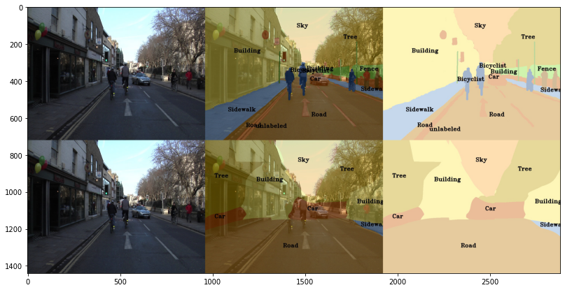
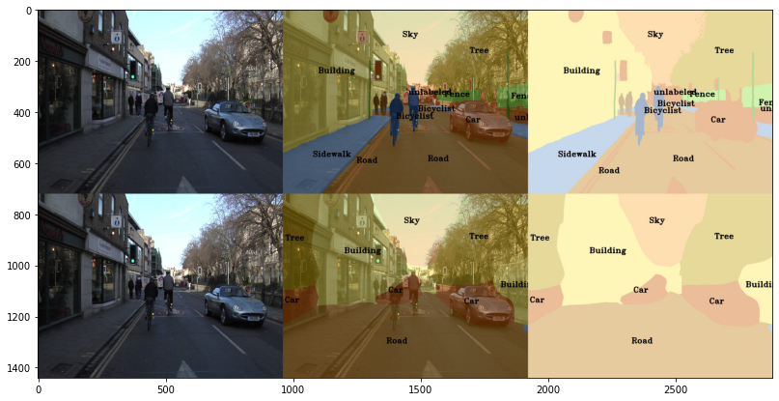
Parts 4 & 5: Most difficult classes
[Which classes have the lowest mIoU? Why might they be the most difficult? Provide an example RGB image from Camvid that illustrates your point]
SignSymbol, Pedestrian, Fence, Column_Pole, and Bicyclist. These are the most difficult as they are smaller, specific features in an image, compared to things like Road or Sky, which are large areas of the image. Differentiating these or noticing them in the middle of one of the larger classes will inherently be more difficult, especially with a smaller feature map, as shown in these plots.

Slide 5
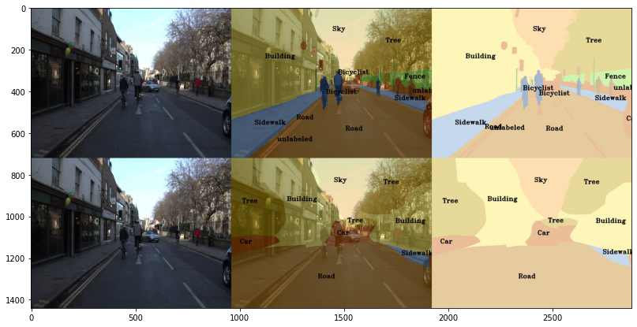
Part 4: Simple segmentation net qualitative results
[Paste a figure of the generated semantic segmentation from Colab. It should be a 2x3 grid, with ground truth on the top row, and your predictions on the bottom row.]

Slide 6
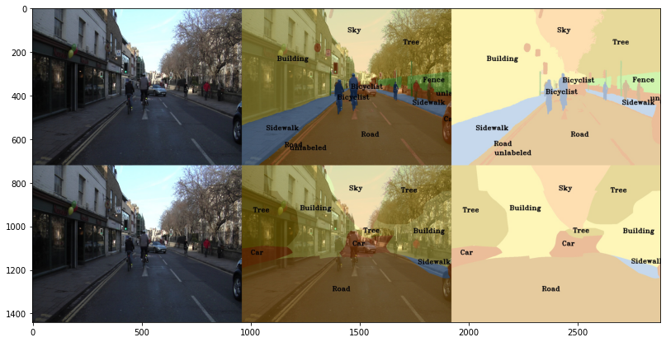
Part 5: PSPNet qualitative results
[Paste a figure of the generated semantic segmentation from Colab. It should be a 2x3 grid, with ground truth on the top row, and your predictions on the bottom row.]

Slide 7
Part 6: Transfer Learning
Report your model’s IoU for the Kitti Dataset.
 | mIoU | mAcc/ | allAcc
Train result | 0.8898 | 0.9344 | 0.9652
Val result | 0.8867 | 0.9334 | 0.9641
Class Index | Class name | iou | accuracy
0 | Road | 0.8161 | 0.8856
1 | Not_Road | 0.9573 | 0.9813

Slide 8
Part 6: Transfer Learning
Compare the training loss generated when training on Kitti dataset and Camvid dataset. Which decreases at a faster rate? If Camvid or Kitti training loss decreases at a faster rate than the other, why do you think this happened? Or, if the loss decreases at a similar rate, why do you think that is so?
The Kitti loss decreases at a much faster rate. This is most likely because it is a binary classifier with just “road” or “not road”. Since Camvid has much more features to analyze, it’s loss is inevitibly going to be harder to decrease. Thus, it is expected that Kitti will decrease loss faster.

