Slide 1
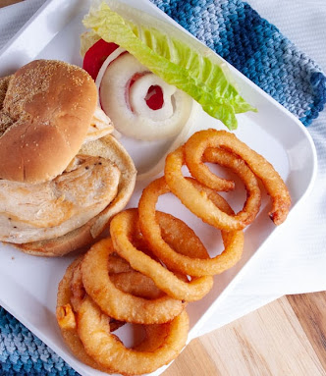
Moraine fish and Chicken’s Stock Database

Slide 2
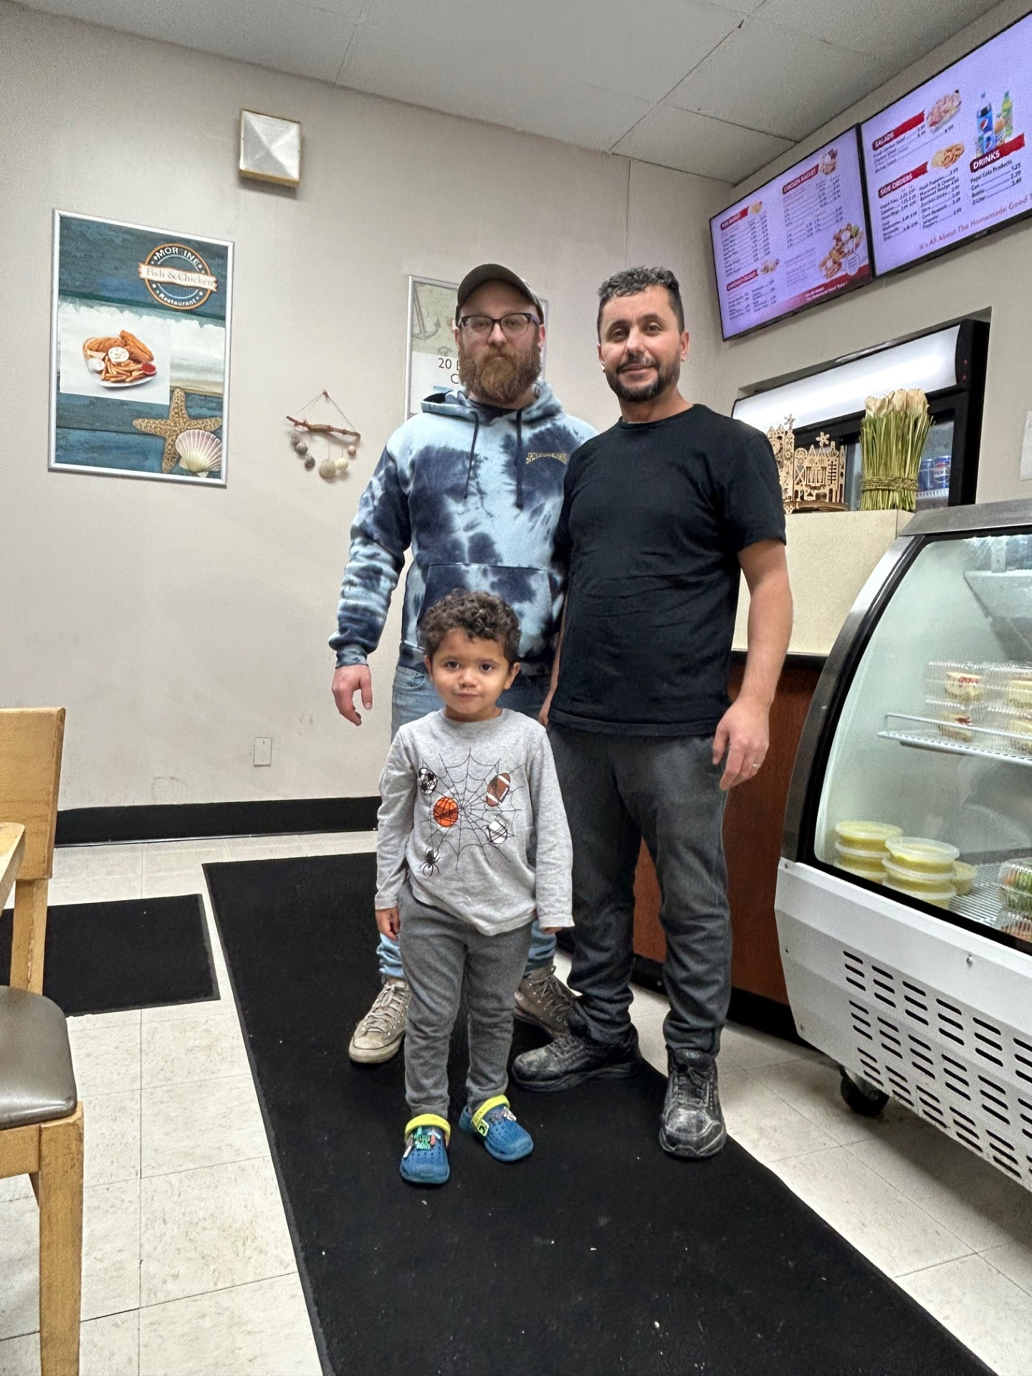
Meet Fred from Moraine Fish and Chicken
Moraine Fish and Chicken is a small business created by Farid, better known as Fred over a decade ago. Like many small businesses, he faces challenges similar to those of larger businesses but does not always have access to the same resources.

Slide 3
What does Fred track and how does he track it?
To begin, I asked Fred about the processes he handles on a weekly basis and the critical data he needs to track.
Having managed one of his restaurants myself, I was already familiar with some of the operational requirements.
While many businesses use Excel spreadsheets to track data, Fred relies on his memory and traditional paper methods.

Slide 4

Transformation
Technology can help small businesses in circumstances like these if utilized properly.
What does this look like? I started by asking Fred what kind of processes he does on a daily and a weekly basis and figured how these things can be transformed into automated processes.
Having experience with his business as I ran one of his stores, I knew Stock processes would be the best candidate.

Slide 5

Requirements
Step 1: Consult with Fred. We identified four key processes to track.
Step 2: Analyze these processes and design database tables and relationships accordingly.
Step 3: Determine the appropriate technologies to use. (This step was revisited after the database design was completed.)
Step 4: Develop the database

Slide 6
What we track
Competing Stock
Just like restaurants compete for our hunger, food suppliers compete for the restaurants business. Who offers what, what they offer and for how much they offer it are important things to track.
Prices
The prices at which suppliers offer stock can change drastically and frequently. But the prices that a restaurant offers their customers are much more “sticky”. Because of this, keeping track of the best deals is important but difficult. And small fluctuations add up.
Alternative Stock
Many stock items that Fred keeps have “alternative” items. Alternative items are items that are similar to their counterparts and can be used as a backup or replacement, whether temporary or permanent.
Stock Troubles
Supply chains can be disrupted (Covid), and knowing if a stock item is available, how much is on hand and when more needs to be ordered is helpful in diminishing the effect of shortages.

Slide 7

What is a database?
A database collects data, organizes it for easy access, creates relationships between data sets and most interestingly, uses equations and functions to manipulate this data and give us access to new and insightful information.
The database technology I used is Microsoft Access.

Slide 8
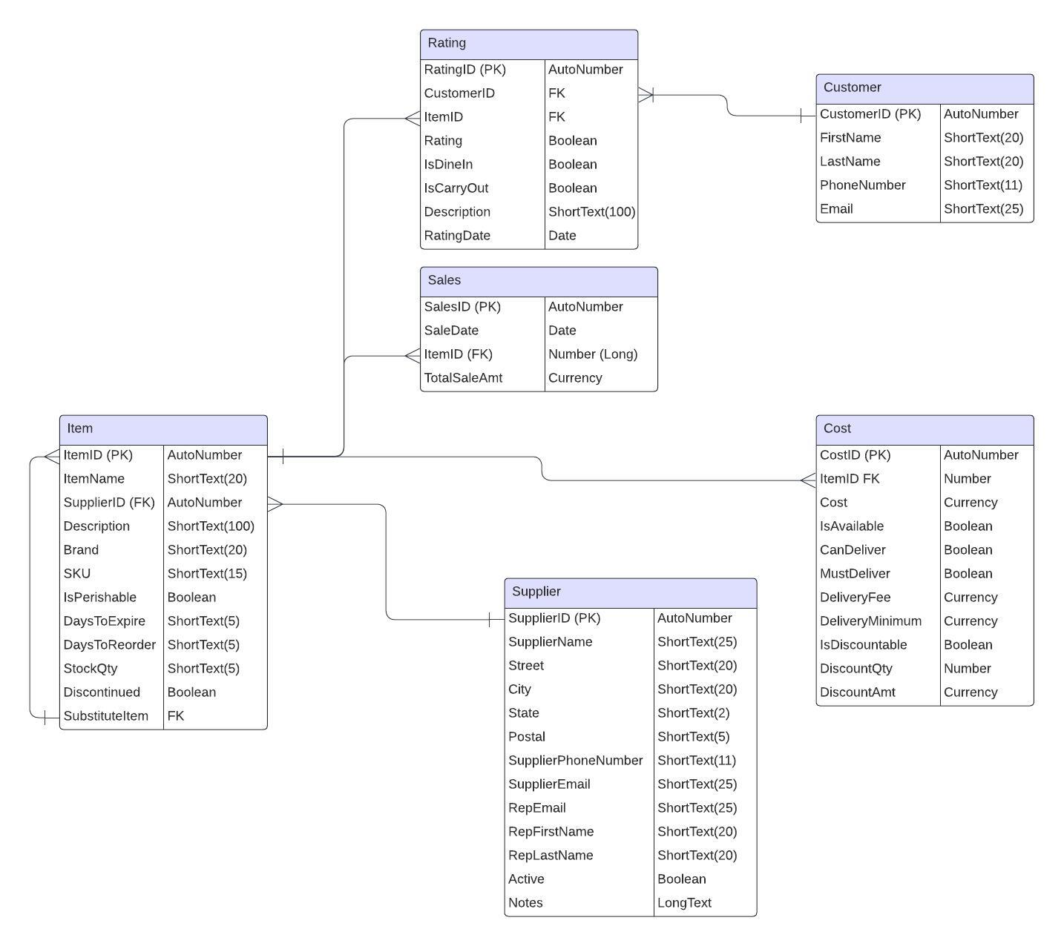
Entities and Relationships
Item Table: The primary table for tracking items. Substitute items are associated with Item IDs and have their own records in the table.
Cost Table: Tracks price changes. Each price update is recorded as a new entry. Fields for discounts and delivery details can be null.
Rating Table: Logs customer reviews. Reviews include descriptions and a Boolean field indicating whether the customer liked the item.
Sales Table: Summarizes the total sales value of items on specific dates.

Slide 9
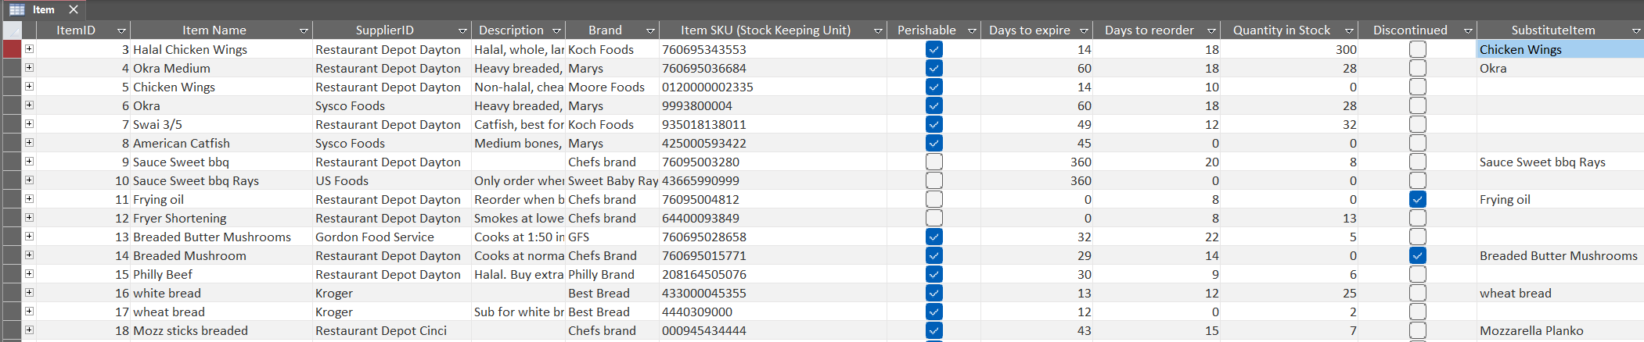
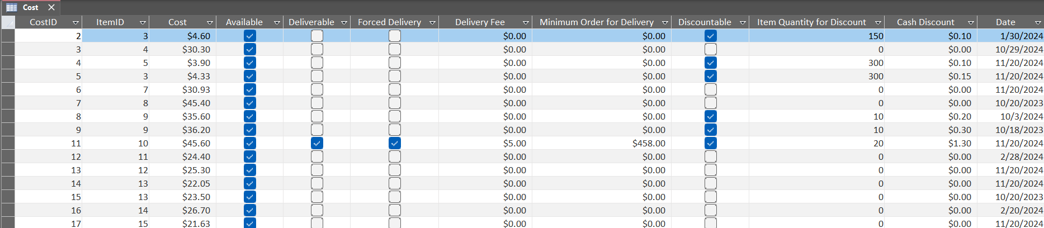
Data
Each entity is represented by a table where the data is stored

Slide 10
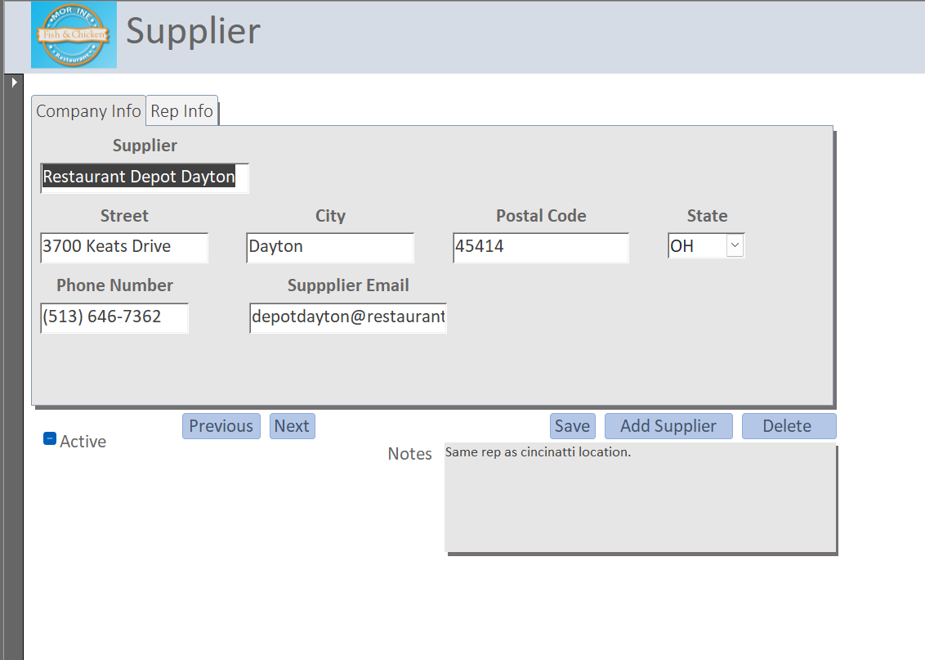
User Interface
Forms are how data will be entered into a database by Fred.
This is the point of access for the user so it should work well and be simple and easy to read.
Here is the supplier form

Slide 11
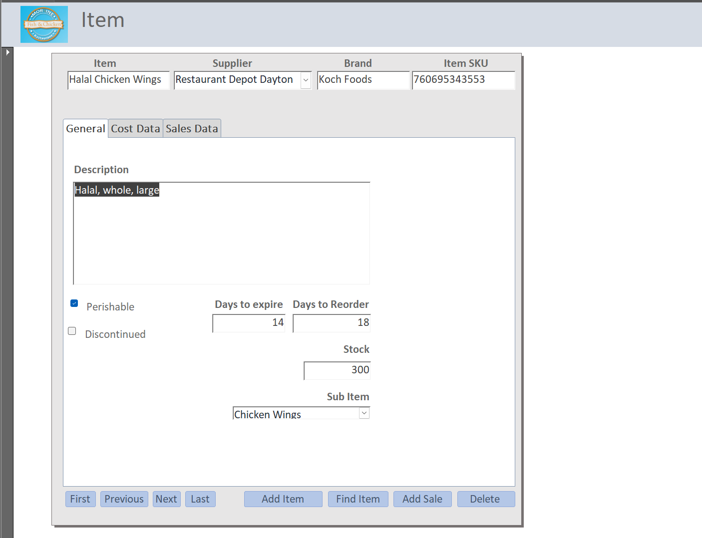
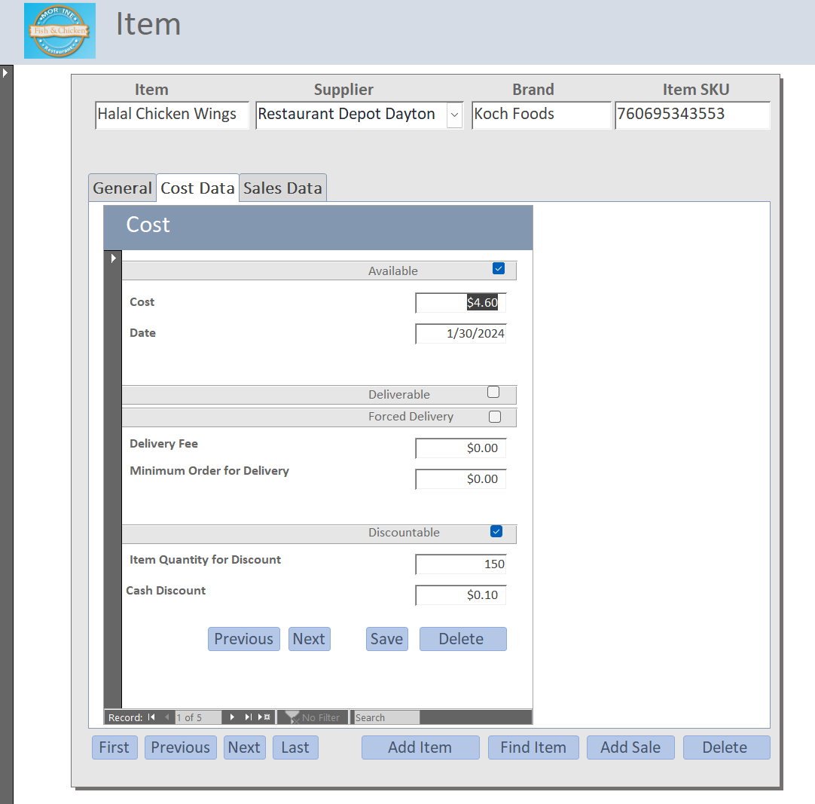
The Item form
Access to multiple tables is easy with tabs

Slide 12
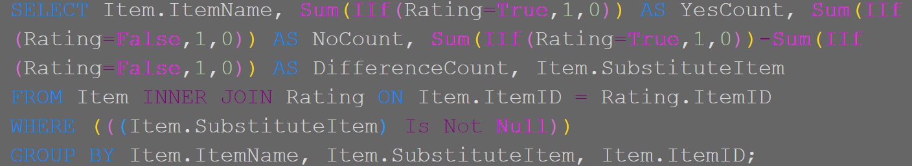
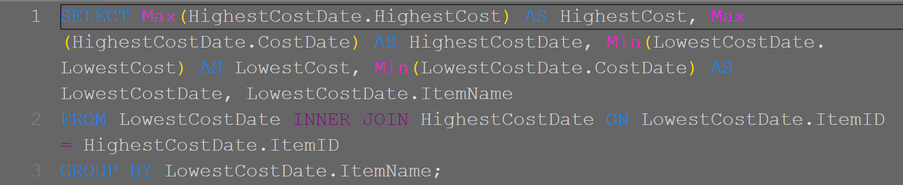
Getting new information using Structured Query Language
Queries are one of the most useful aspects of a database. In this case I used Structured Query Language to figure the highest and lowest cost of a recorded item and associate them with dates.
This code sums the reviews (positive, negative, absolute) but only for items that have substitutes
Selects cost data from 2 different tables and combines them

Slide 13
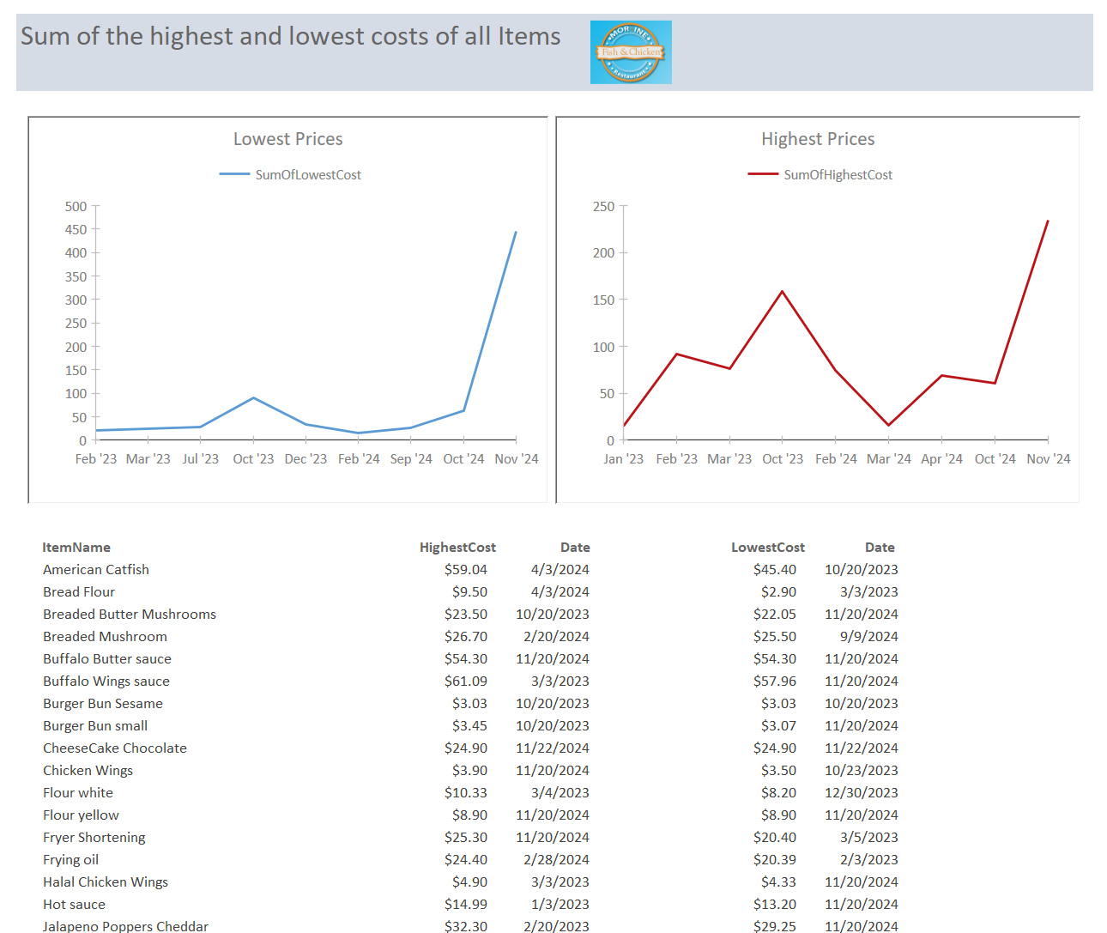
Tracking the business operations
Reports are the main way that Fred will view query information. That way all of the back end is hidden, the information can be placed in a more accessible location and charts can be added to visually represent query data.
Here all the lowest item costs are summed up and charted by date. Same for Highest cost.

Slide 14
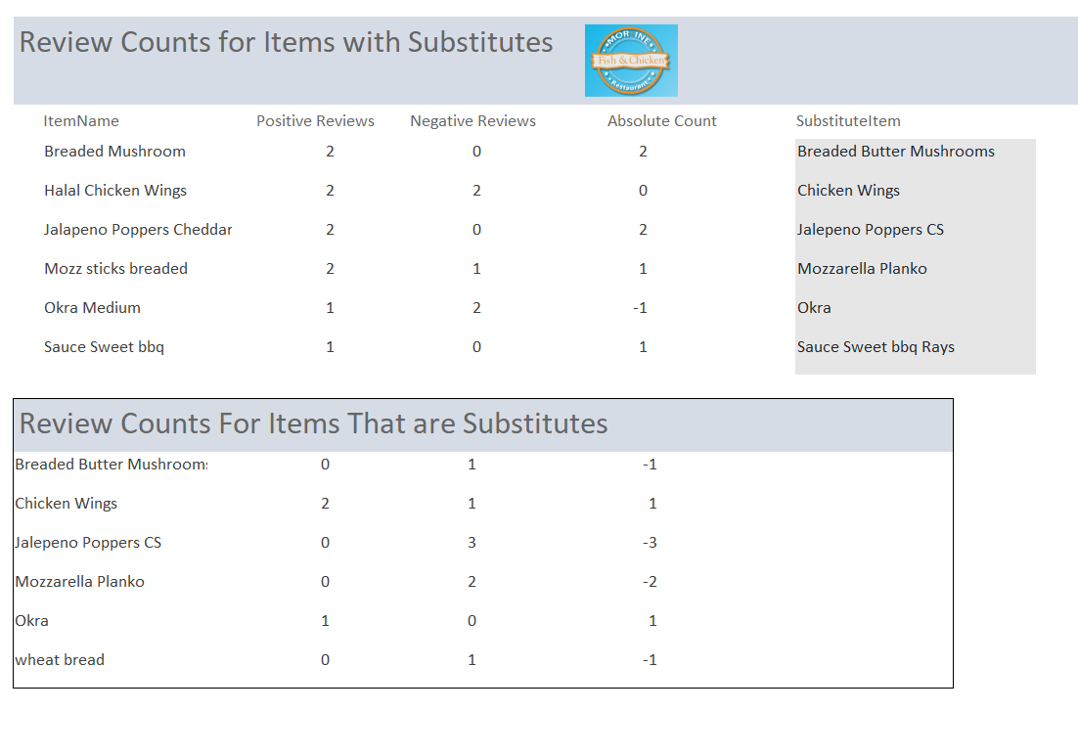
These reports are the result of queries but are formatted and designed so Fred can view them more easily

Slide 15

A better question
Before the database was created, I asked, “How does Fred track data for his business?” A better question is, “Why does Fred track data this way?” While paper and mental tracking are simple, tools like Excel can feel overwhelming for someone juggling multiple business demands. Modern software, though more complex, is easier for users.
How can we further simplify software use while delivering equal or better results?

Slide 16
Adoption is Key
Improving User Adoption Fred’s original processes relied on paper and memory. Modern software, while intuitive, can still be daunting. To ensure adoption, I simplified Fred’s workflows:
Redesigned the review form for direct customer input via tablet, eliminating manual data entry.
Streamlined the item form to minimize navigation steps.
To figure the best method for user adoption I want to analyze the point of contact the user has with the new process.

Slide 17
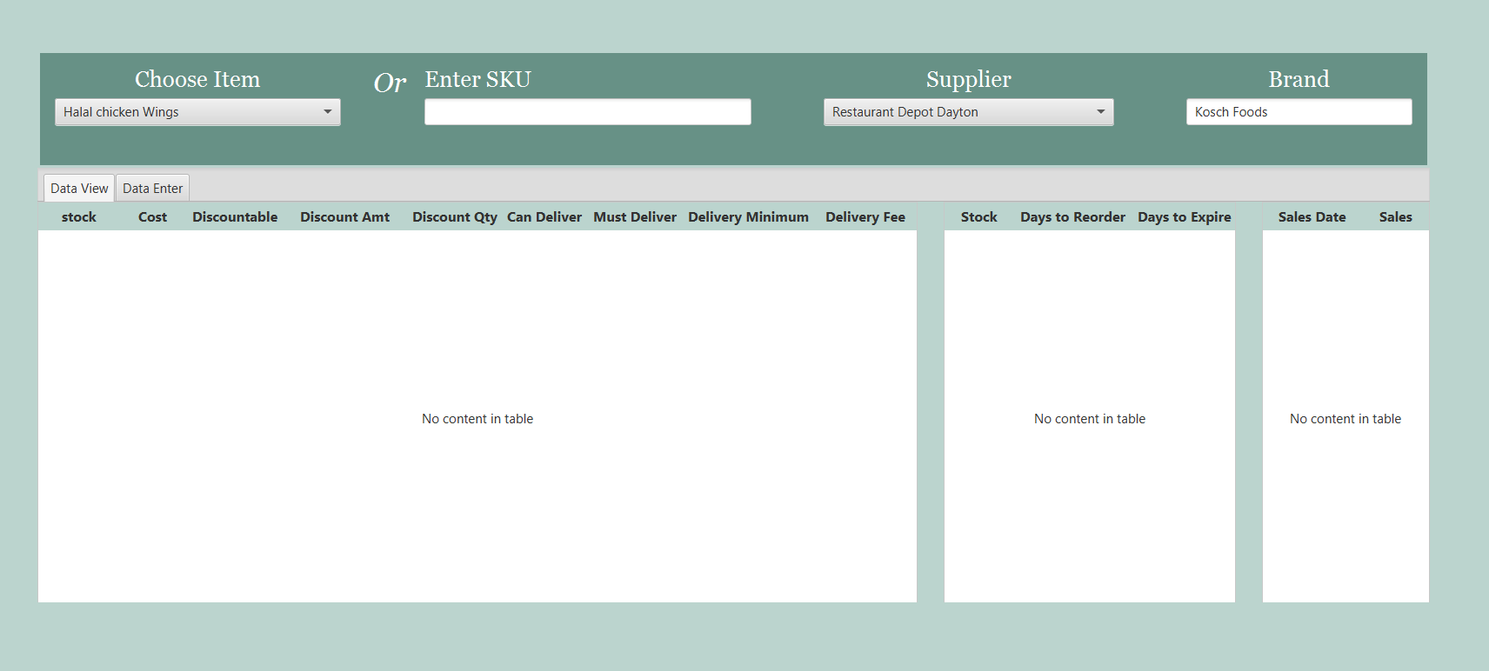
Advanced User Interface
The revised item form
I created outside forms which can be linked to the database

Slide 18
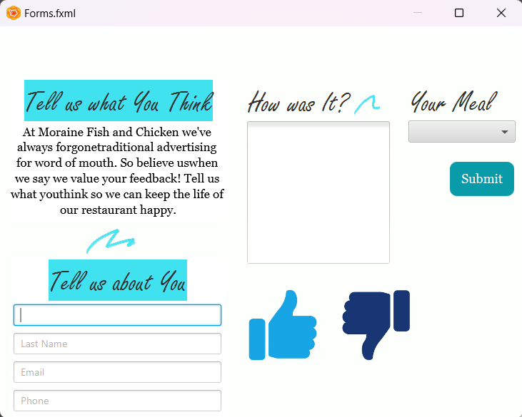
User Rated experience
This new review form can be accessible from a tablet that customers have access to.
The process of review form data entry is now simpler as it does not need to go from the customer to Fred to the database but can directly go from the customer to the database.

Slide 19
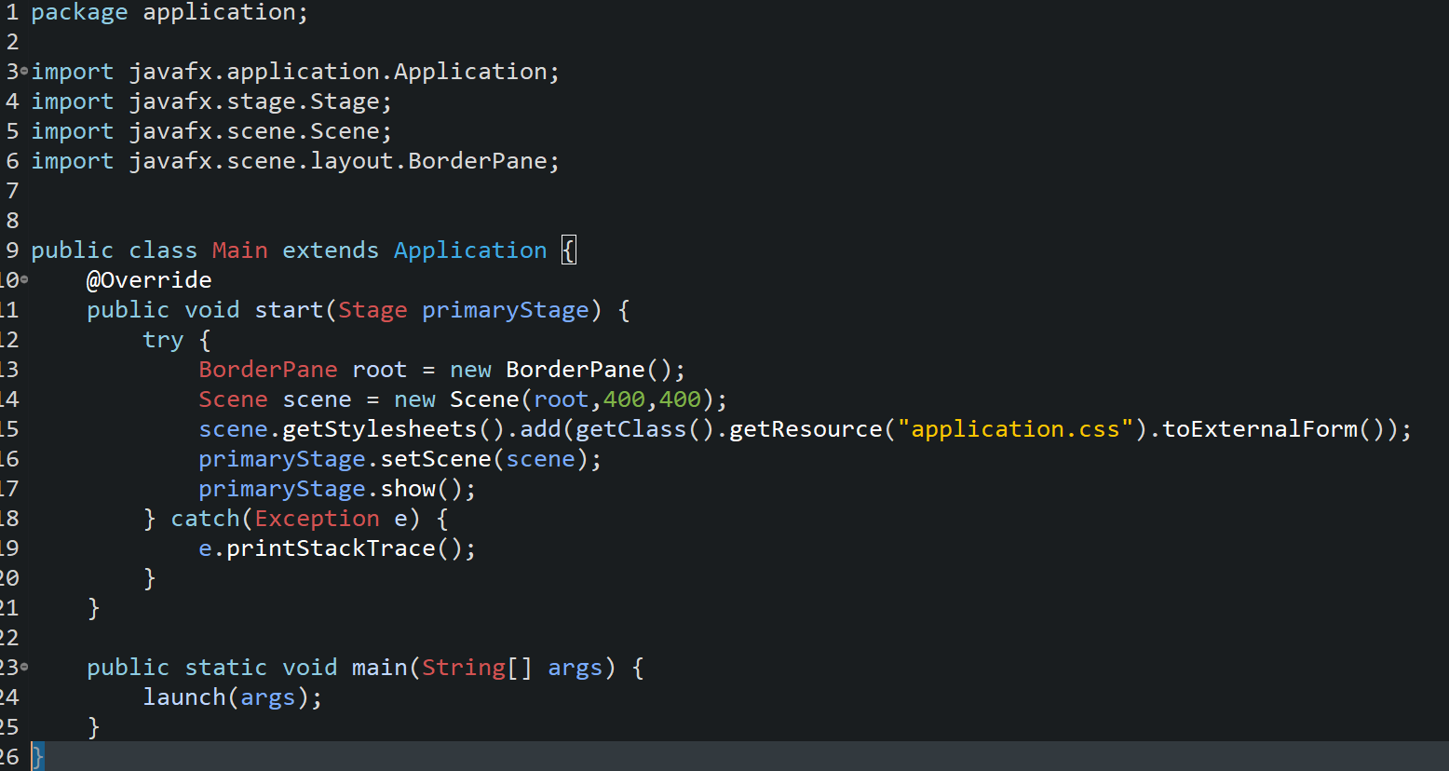
Technology Implemented
Java is a general-purpose Object-Oriented language.
Java FX is a library that allows for creating Graphical Applications.
The main method where the java program starts

Slide 20
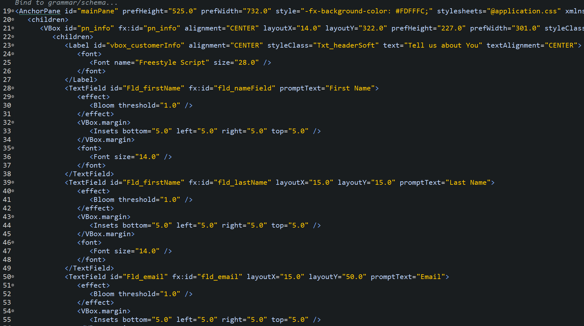
JavaFX uses methods similar to web development.
FXML is similar in structure to a Hyper Text Markup Language.
This FXML file is used to control how the forms are laid out.

Slide 21
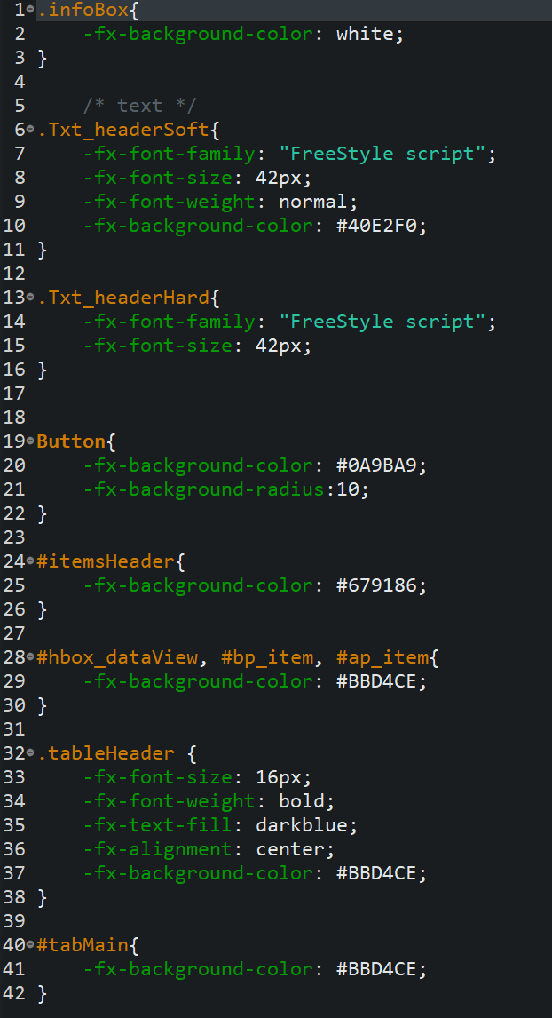
This is a cascading Style Sheet that is common in web pages
It is used to color and style the forms

Slide 22
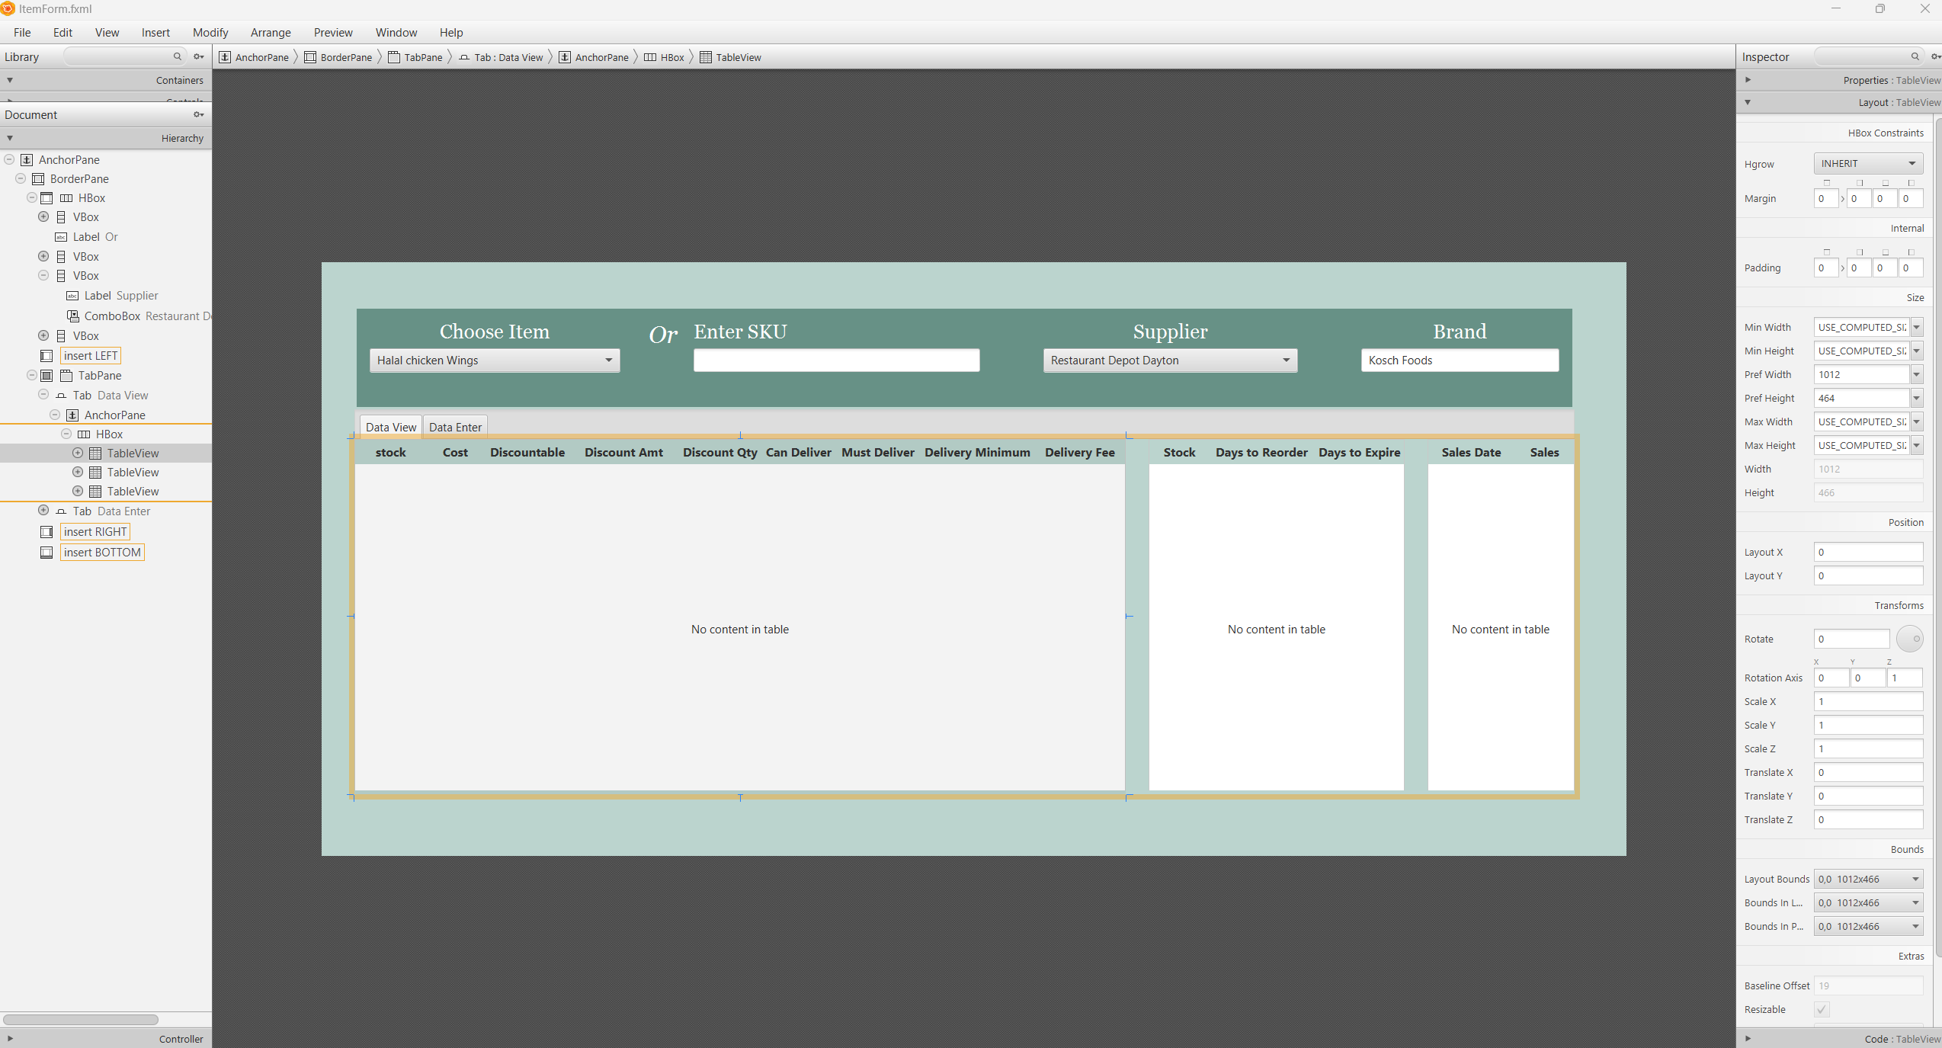
Graphical User Interfaces are best created by…Graphical User Interfaces
SceneBuilder builds JavaFX apps

Slide 23
What I learned
What I would do differently
Creating software is a cycle that loops back to the start.
While technical skills are key, learning to communicate with users and apply effective design principles is equally important and challenging.
I would revisit design steps more frequently while building the database.
For example, including units of measure for items early on would have made sales queries more useful. Adding it now requires extra effort since the database wasn’t designed with this in mind.

Slide 24
Special Thanks
Farid Bargoughi | Owner and Operater of Cyrina Foods LLC
Paul Hansford Associate Professor,Business & Public Services Division,CS Dept.

