Slide 1
List Processor
Cameron, Julia, Katherinne, and Jude

Slide 2
Why make a list processor?
List operations add complexity
Middle ground between the processors we studied.

Slide 3
Assembler Design
What we wanted:
Comments
Labels
Variables
Variable indexing
Register and direct addressing
Jump and Branch statements
List Instructions:
Loop (list prep)
List Add

Slide 4
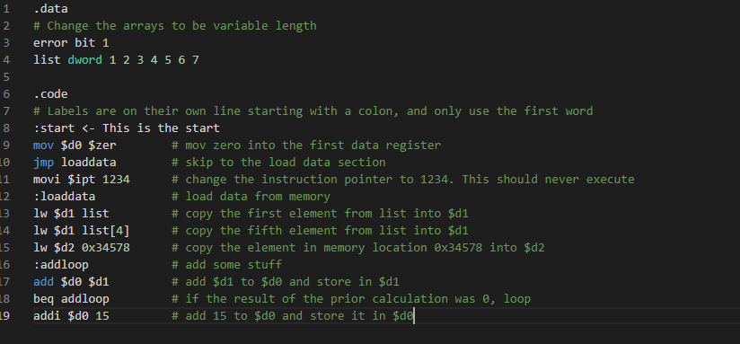
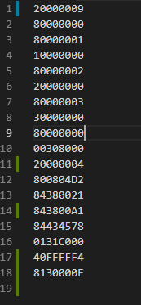

Slide 5
Success and Failure
Pair programming
Achieved all categoric goals
Would like to implement more instructions
Pair programming. Again. It’s that good.
Time constraints
Left and Right are surprisingly hard
String prefixes
Implementing language rules on the fly

Slide 6
Questions?

