Slide 1

Learning “Dark Knowledge” from Teacher
CS 419: Introduction to Machine Learning
Group 23
: 210010044, 22B2463, 22B3314
Guided by: Prof. Abir De
Notes:
Studying Flow over circular cylinders provides a simplified but accurate model that represents the complex patterns of fluid movement over bluff bodies

Slide 2
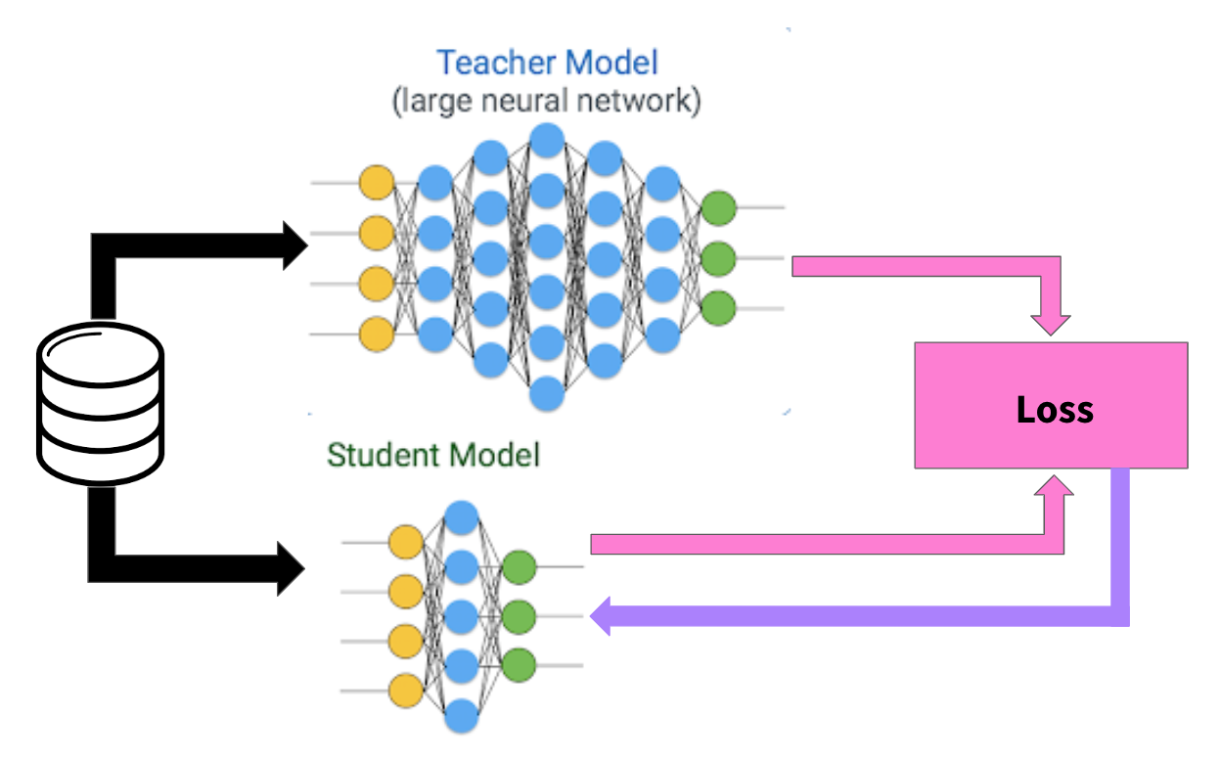
Problem Statement
Take a large pre-trained model (teacher) from PyTorch CNN pre-trained models (choose ResNet models preferably) and a smaller CNN model (code up a custom model in PyTorch). Choose one or more datasets from among the popular image classification datasets - CIFAR100, CIFAR10, TinyImageNet200. Code up the knowledge distillation loss function and train the smaller model with and without KD.
Observe KD helps in improving the accuracy of the smaller model. Experiment to see the effectiveness of KD on the following parameters:
Model Size Gap between teacher and student
Accuracy of the teacher model
Notes:
Our Re = 41000
Sub-critical region

Slide 3
Introduction
CS 419: Introduction to Machine Learning
Knowledge distillation (KD) is a technique used to transfer knowledge from a large, cumbersome model (teacher) to a smaller, more practical model (student). In this experiment, a pre-trained ResNet and a custom DeepNN model is chosen as the teacher, and a custom smaller CNN model is developed as the student. The effectiveness of KD is evaluated on popular image classification dataset CIFAR10

Slide 4
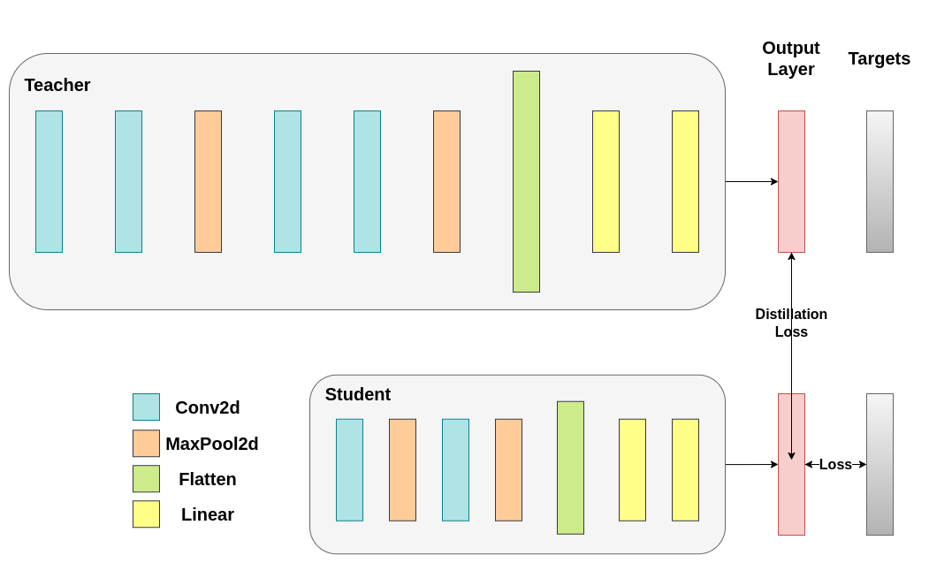
Knowledge Distillation
Soft Target Loss: Utilizes soft targets from teacher network to guide student training
KD incorporates an additional loss into traditional cross entropy loss, utilizing soft targets from the teacher network.
Key Parameters:
Temperature (T): Controls smoothness of output distributions.
Soft target loss weight: Weight for the additional objective.
Cross-entropy loss weight: Weight for traditional loss.

Slide 5
Approach
Teacher Model (ResNet18 / DeepNN)
Student Model (LightNN)
Teacher model represented by using ResNet18. Pretrained Resnet model was used by replacing the FC (fully connected layer) to classify CIFAR10 dataset and the last layer was trained to effectively have a pretrained ResNet model.
A custom teacher model (DeepNN) was coded to compare results between two different teachers
A lightweight neural network class serving as the initial student model.
nn_light: Model running without Teacher
new_nn_light: Another instance of the student model, which will be trained with knowledge distillation.
Notes:
St = 0.2
F =98.46
D = 32.5 mm
U = 16 m/s

Slide 6
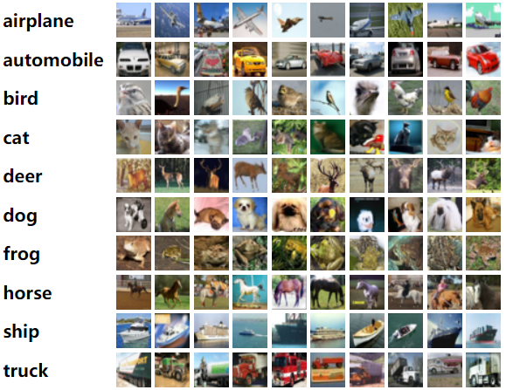
Cifar10 Dataset
The CIFAR-10 dataset contains 60,000 32x32 color images in 10 different classes. The 10 different classes represent airplanes, cars, birds, cats, deer, dogs, frogs, horses, ships, and trucks. There are 6,000 images of each class.

Slide 7
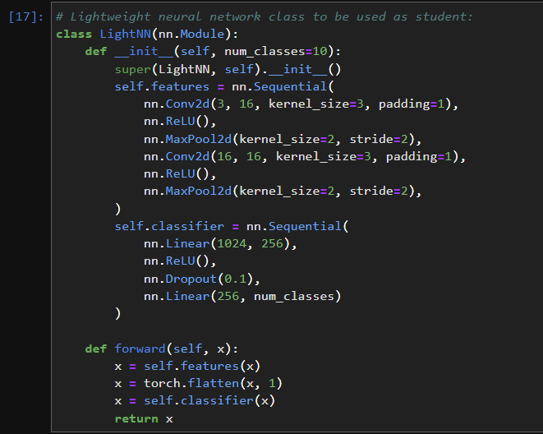
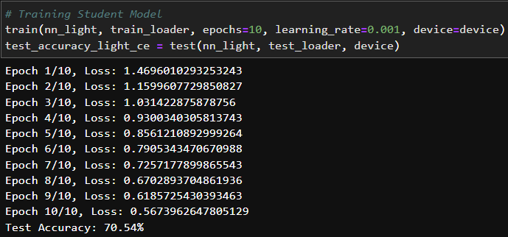
Light NN
Vortex Geometry
Wake Age
Wake Profile

Slide 8
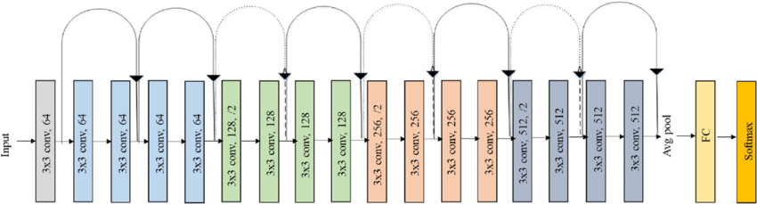
Resnet18:

Slide 9
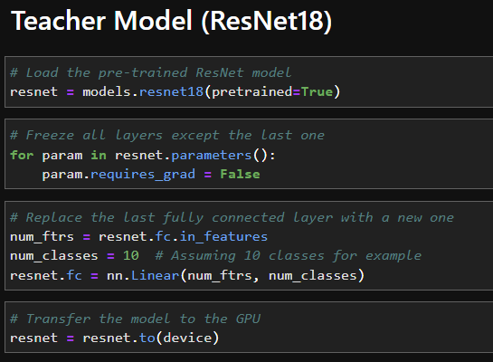
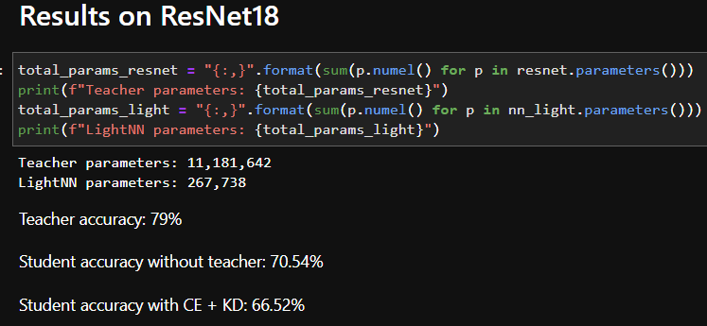
Resnet18:

Slide 10
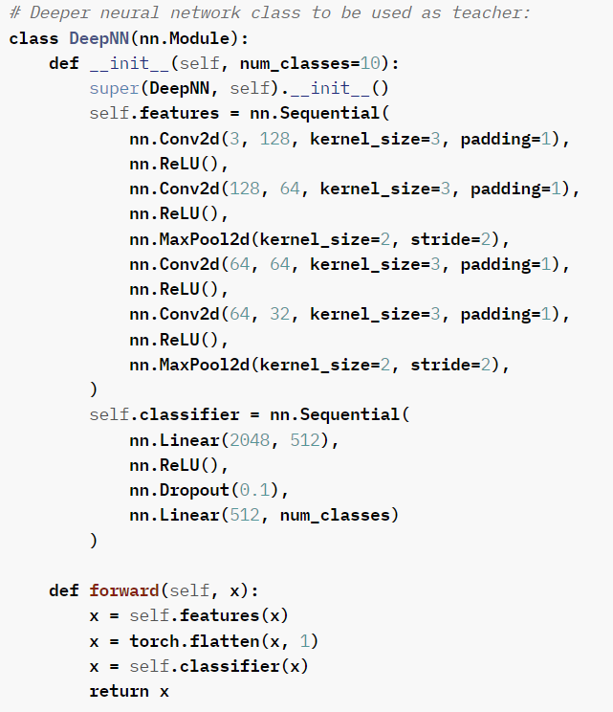
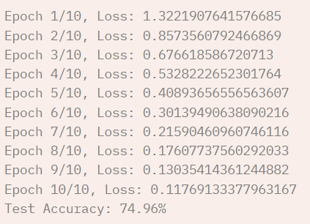
Deep NN:

Slide 11
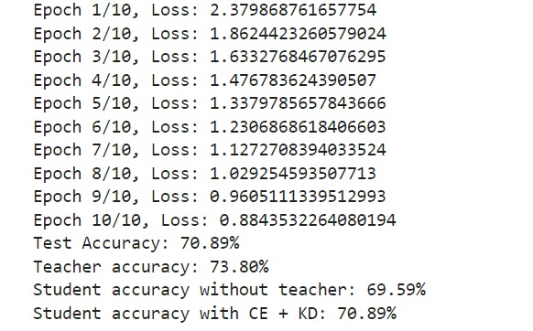
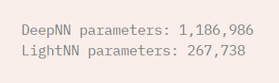
Deep NN:

Slide 12
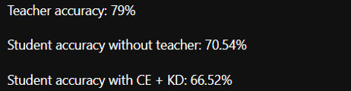
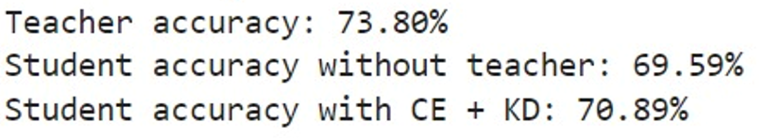

Result Comparison
Resnet18:
DeepNN
ResNet18 has 10x the parameters as DeepNN hence it performs better individually, ideally accuracy of student of resnet18 should be higher but that isn’t observed that might be because Resnet being originally trained on Imagenet Dataset while we used CIFAR10 hence it might cause student with KD accuracy to drop, we can also observe that in case of DeepNN accuracy is increasing as expected

Slide 13
Thank You
210010044
22B2463
22B3314
Indian Institute of Technology Bombay

