Slide 1
MACE - Machine Learning Force Fields
Cameron Gurwell

Slide 2
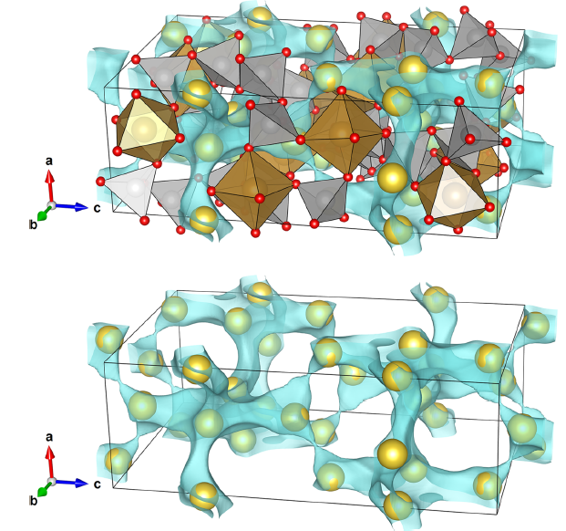
Inspiration for the Project
Na_{4–x}Sn_{2–x}Sb_{x}Ge₅O₁₆, an Air-Stable Solid-State Na-Ion Conductor
Sergei Novikov, Christopher J. Franko, Mengyang Cui, Zan Yang, Gillian R. Goward, and Yurij Mozharivskyj, Inorganic Chemistry 2023 62 (39), 16068-16076
DOI: 10.1021/acs.inorgchem.3c02247
DFT Relaxation
Quantum Espresso
BVEL/BVS

Slide 3
Inspiration for the Project
Na_{4–x}Sn_{2–x}Sb_{x}Ge₅O₁₆, an Air-Stable Solid-State Na-Ion Conductor
Sergei Novikov, Christopher J. Franko, Mengyang Cui, Zan Yang, Gillian R. Goward, and Yurij Mozharivskyj, Inorganic Chemistry 2023 62 (39), 16068-16076
DOI: 10.1021/acs.inorgchem.3c02247
More in-depth parameters:
Exchange correlation energy was in the form of Perdew−Burke−Ernzerhof (PBE) pseudopotentials
Based on generalized gradient approximation (GGA)
Projector-augmented wave (PAW) technique was chosen to model the electron−ion interaction
Wave function cutoff energy was set to 80 Ry
12 × 6 × 4 k mesh was adopted for Brillouin zone integration
Full relaxation of cell parameters and atomic positions
F = <10⁻⁴ eV

Slide 4


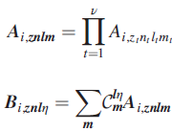

Math of MACE
Tensor-Reduced Atomic Density Representations
James P. Darby, Dávid P. Kovács, Ilyes Batatia, Miguel A. Caro, Gus L. W. Hart, Christoph Ortner, and Gábor Csányi
Phys. Rev. Lett. 131, 028001 – Published 13 July 2023 DOI:https://doi.org/10.1103/PhysRevLett.131.028001
A is rotationally symmetrized to C_{m}^{ln}
Clebsch-Gordon coefficients (n enumerates all possible symmetric couplings for l)
Linear ACE model fit
Invariant atomic property
C_{znln} are model parameters
Truncated radial basis set using
V_{max}, l_{max}, n_{max} := N

Slide 5
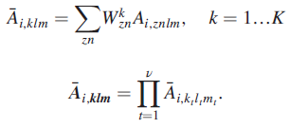


Math of MACE
Tensor-Reduced Atomic Density Representations
James P. Darby, Dávid P. Kovács, Ilyes Batatia, Miguel A. Caro, Gus L. W. Hart, Christoph Ortner, and Gábor Csányi
Phys. Rev. Lett. 131, 028001 – Published 13 July 2023 DOI:https://doi.org/10.1103/PhysRevLett.131.028001
Tensor product causes features to grow rapidly
O(N^{ν}S^{ν})
Previously reduced to O(K^{ν})
First embedded chemical/radial info into K channels
New principled approach to further reduce the basis
O(K), expansion as a sum of products rank-1 tensors
Uses symmetric invariance of the system

Slide 6
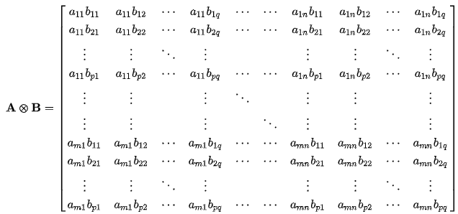


Math Notation of MACE
Tensor-Reduced Atomic Density Representations
James P. Darby, Dávid P. Kovács, Ilyes Batatia, Miguel A. Caro, Gus L. W. Hart, Christoph Ortner, and Gábor Csányi
Phys. Rev. Lett. 131, 028001 – Published 13 July 2023 DOI:https://doi.org/10.1103/PhysRevLett.131.028001
Kronecker Product
Hadamard Product
Commutative
Element-wise
Taking the tensor product over lm and elementwise product over k

Slide 7
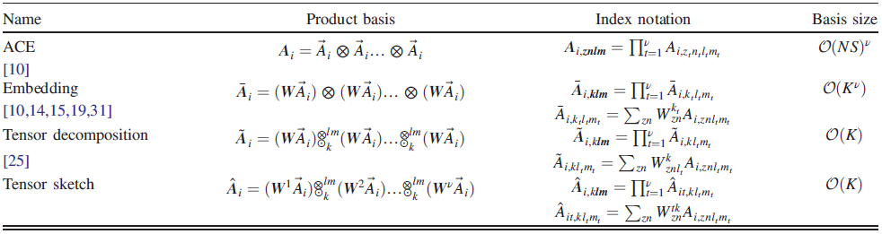
Math of MACE
Tensor-Reduced Atomic Density Representations
James P. Darby, Dávid P. Kovács, Ilyes Batatia, Miguel A. Caro, Gus L. W. Hart, Christoph Ortner, and Gábor Csányi
Phys. Rev. Lett. 131, 028001 – Published 13 July 2023 DOI:https://doi.org/10.1103/PhysRevLett.131.028001

Slide 8

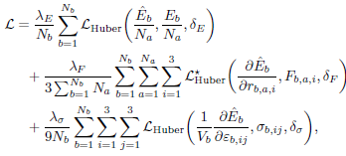
Math of MACE-MP-0
A foundation model for atomistic materials chemistry
Batatia, Ilyes et al. (March 4, 2024) on arXiv:2401.00096v2 [physics.chem-ph] 1 Mar 2024
Normalization of the whole structure energy
K is the total number of message passing layers, ϵ_{a}^{(k)} is the energy of atom a at layer k
μ / σ are mean atomic energies / mean square atomic forces on the training set
Training loss function
λE, λF , λσ predetermined weights energy (E), forces (F), and stress (σ) losses, symbols under hat = predicted values, N_{b} / N_{a} are batch size / number of atoms

Slide 9
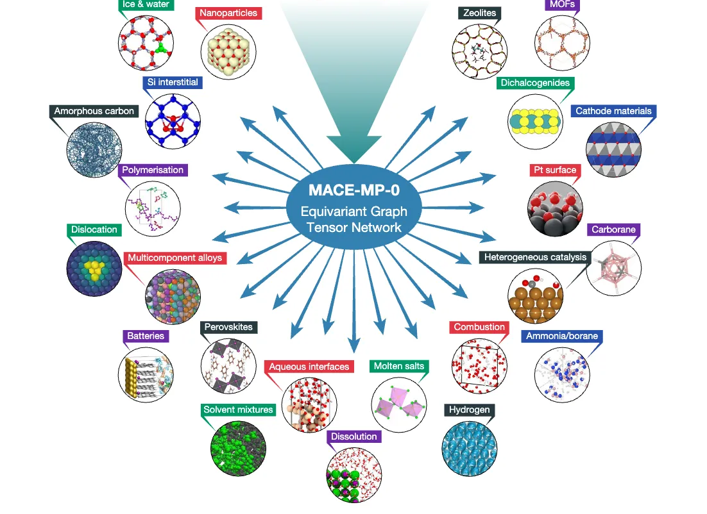
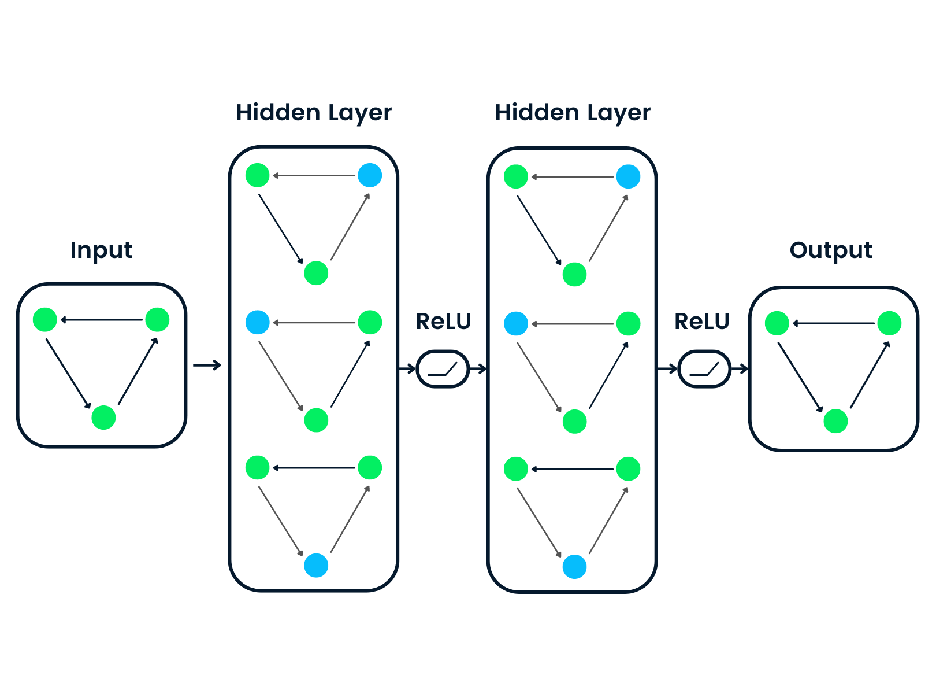
TLDR
Unique innovations:
High body order equivariant features in each layer (only 2 layers of message passing needed)
Only slightly nonlinear (only nonlinearity in the radial basis / final readout layer
Graph Neural Network
Computational cost of evaluation ~ equal to other GNNs
Simulations of ~ 1,000 atoms for nanoseconds / day on GPU
Primary applications
Solid / Liquid (water)
Heterogenous Catalysis
MOFs

