Slide 2



Slide 3
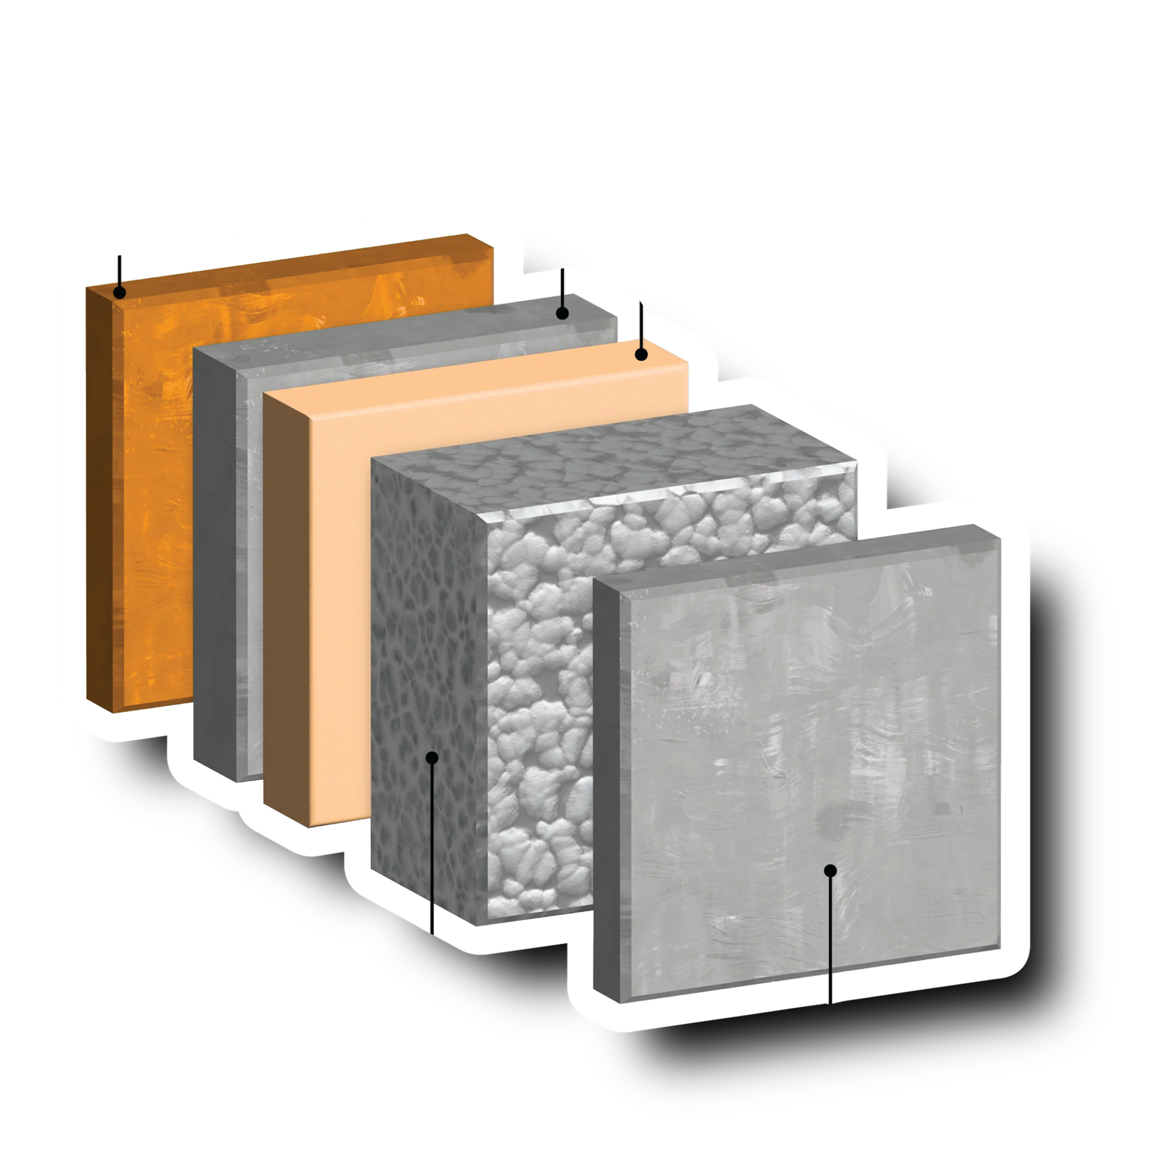

Slide 4
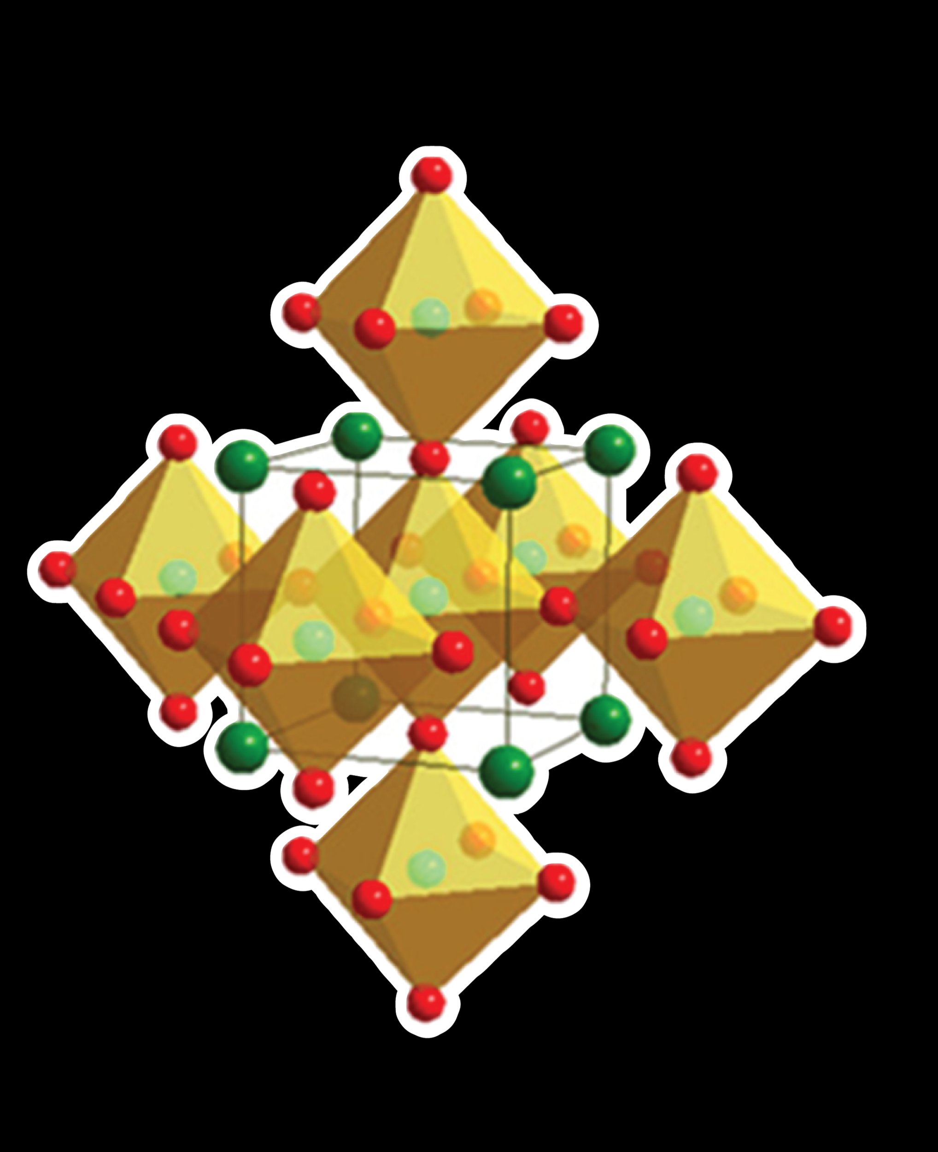
TEMPERATURE
PRESSURE
GEOMETRY

Slide 5


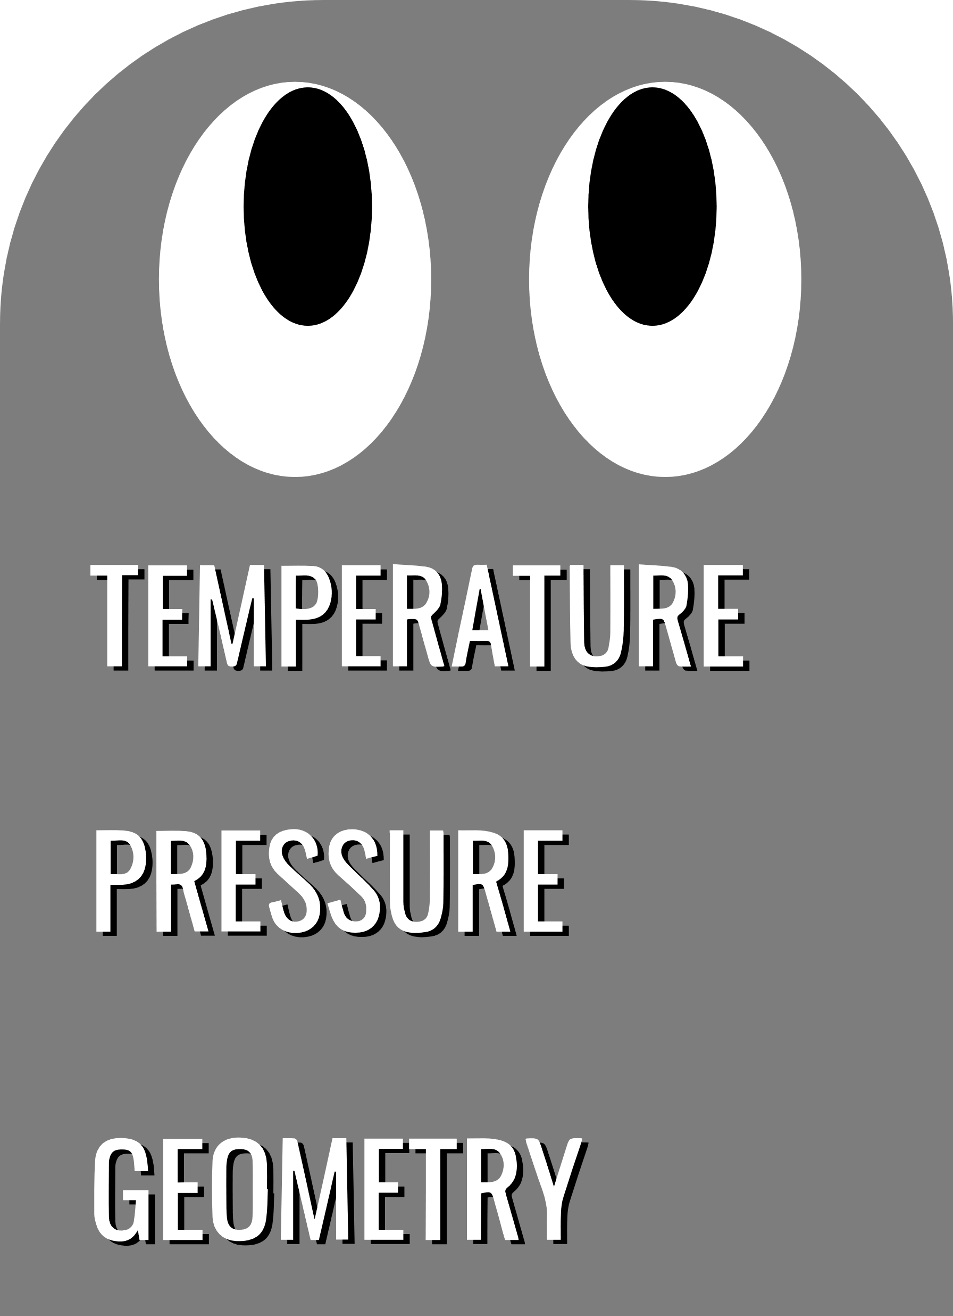


Slide 6



CONDUCTIVITY
+
CONDUCTIVITY
++
CONDUCTIVITY
+++

