Slide 1
pyEMS - Engineering Systems Modelling Framework
Python based systems modelling framework with Supply and Use structure
Prof. Matteo V. Rocco
SESAM group
Department of Energy, Politecnico di Milano

Slide 2
Outline
Comparing modelling systems
pyESM purpose
Generating models from scratch
Application example
Package OOP structure
API reference

Slide 3
Comparing modelling frameworks
Energy modelling frameworks
Several packages already available (Calliope, OSeMOSYS, pyPSA, …)
Open-source packages with high modelling capabilities
Low flexibility (difficulties in developing modelling capabilities)
Designed for end users (difficult to access and to customize model behavior)
General purpose modelling systems
Shareware software available (mainly GAMS available)
Platform to design models from scratch as LP problems
High flexibility, time intensive (for experienced users)
Designed for model developers
Databases handlers
Few packages available (MARIO, pyMRIO)
Open-source packages with nearly zero modelling capabilities

Slide 4

pyESM purpose
Drawbacks of existing modelling frameworks
Design oriented to end-users (low flexibility in designing new features or controlling models’ rationale)
Unprofessional data management systems (no SQL-based databases)
Difficulties in handling and inspecting data (no Business Intelligence support)
pyESM - Engineering Systems Modelling Framework
SUT and IOT model generator
Mathematical model defined as LP problem
Mathematical model fully customizable by user
Data management system based on SQLite
Automatic generation of PowerBI reports
Ideal for model end users and developers
py
Desired features
Flexibility (easy to implement model capabilities)
Open source
Design either for end-users and for developers/research
Possibility to handle a variety of physical complexities
Handling data like a pro
ESM
https://github.com/MIMO-modelling-suite/pyesm.git

Slide 5








Generating models from scratch
Step 1
pyESM generates directory with default setup files
structure_sets.yml
structure_variables.yml
problem.yml
Step 3
pyESM imports setup files and generates Model as Python object. Outputs:
Blank SQLite database
Excel raw data files
Step 5
pyESM performs the following actions:
Imports exogenosu data
Generates and solves numerical problems
Updates SQLite database
Generates PowerBI visual report
Step 2
User fills setup files, defining:
model sets
model variables
problem equations
Step 4
User fills excel files with exogenous model data.
https://github.com/MIMO-modelling-suite/pyesm.git

Slide 6

A simple SUT model
Mathematical model definition (sets, variables, symbolic problem)
gas power plant
households (final demand)
Operational cost
photovoltaic plant
Electricity
Considering the system in figure
It is composed by two technologies (Gas power plant and PV plant).
Technologies produce a substitutable commodity (electricity) delivered to Households, with a given operational cost.
It is asked to determine the least cost mix of technologies activities in future five years, in two scenarios: with and without restrictions in generating power from fossil plants.
Sets definition (problem dimensions)
Scenarios (s): “Reference”, “Energy transition”
Time (y): five years
Technologies (t): “gas power plant”, “photovoltaic plant”
Flows(f): “electricity, gas”, “electricity, pv”
Flows, aggregated (f_agg): “electricity”
Costs (c): “operational costs”
Define problem dimensions

Slide 7
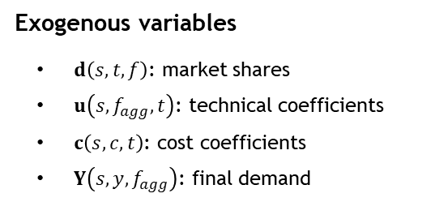
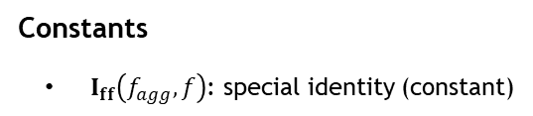
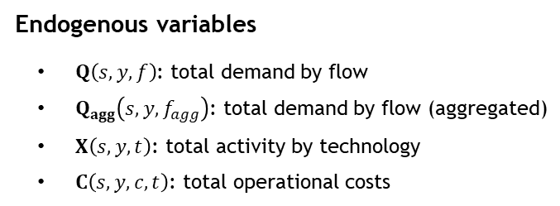
A simple SUT model
Mathematical model definition (sets, variables, symbolic problem)
gas power plant
Sets definition (problem dimensions)
Scenarios (s): “Reference”, “Energy transition”
Time (y): five years
Flows(f): “electricity, gas”, “electricity, pv”
Flows, aggregated (f_agg): “electricity”
Technologies (t): “gas power plant”, “photovoltaic plant”
Costs (c): “operational costs”
households (final demand)
Operational cost
photovoltaic plant
Electricity
Exogenous variables
$d\left(s,t,f\right)$: market shares
$u\left(s,f_{agg},t\right)$: technical coefficients
$c\left(s,c,t\right)$: cost coefficients
$Y\left(s,y,f_{agg}\right)$: final demand
Endogenous variables
$Q\left(s,y,f\right)$: total demand by flow
$Q_{agg}\left(s,y,f_{agg}\right)$: total demand by flow (aggregated)
$X\left(s,y,t\right)$: total activity by technology
$C\left(s,y,c,t\right)$: total operational costs
Define SUT
Linear Programming model
Constants
$I_{ff}\left(f_{agg},f\right)$: special identity (constant)

Slide 8
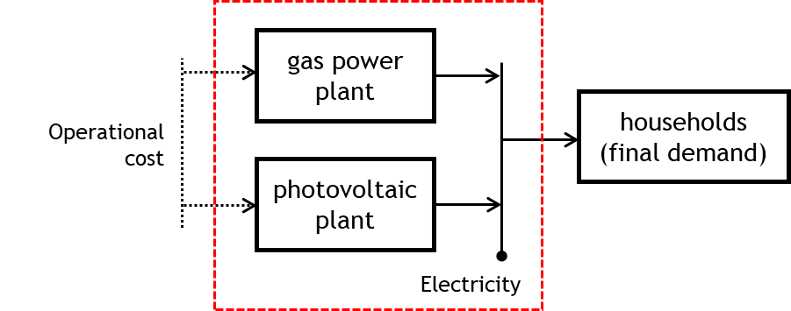


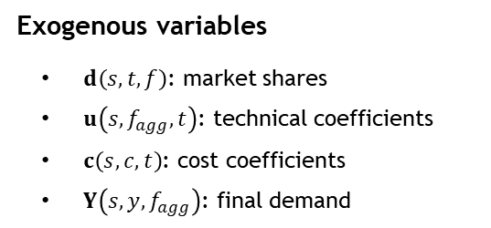


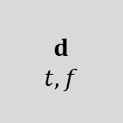

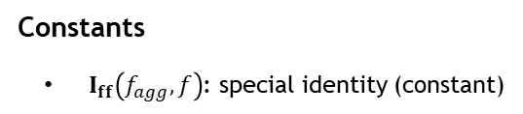

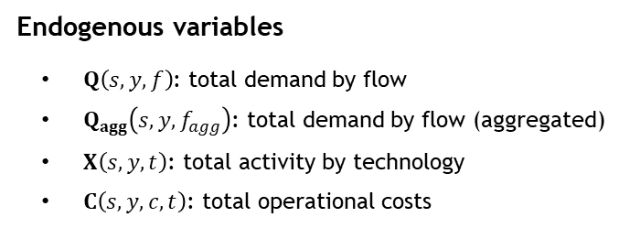


A simple SUT model
Mathematical model definition (sets, variables, symbolic problem)
Exogenous variables
$d\left(s,t,f\right)$: market shares
$u\left(s,f_{agg},t\right)$: technical coefficients
$c\left(s,c,t\right)$: cost coefficients
$Y\left(s,y,f_{agg}\right)$: final demand
$$Y_{ff}$$
$f_{agg},f$
$$u$$
$f_{agg},t$
$$Y$$
$f_{agg},1$
$$Q_{agg}$$
$f_{agg},1$
$$d$$
$t,f$
$$X$$
$t,1$
Constants
$I_{ff}\left(f_{agg},f\right)$: special identity (constant)
$$c$$
$c,t$
$$Q$$
$1,f$
Endogenous variables
$Q\left(s,y,f\right)$: total demand by flow
$Q_{agg}\left(s,y,f_{agg}\right)$: total demand by flow (aggregated)
$X\left(s,y,t\right)$: total activity by technology
$C\left(s,y,c,t\right)$: total operational costs
$$C$$
$c,t$

Slide 9


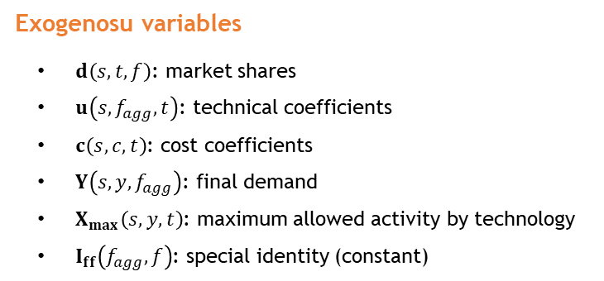


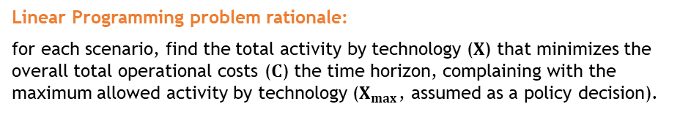




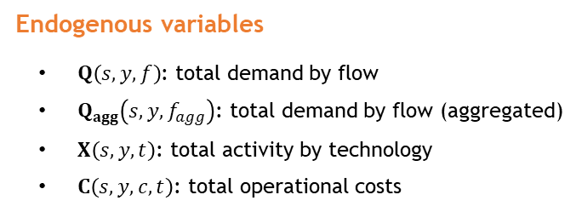


A simple SUT model
Mathematical model definition (sets, variables, symbolic problem)
Linear Programming problem rationale:
for each scenario, find the total activity by technology ($X$) that minimizes the overall total operational costs ($C$) the time horizon, complaining with the maximum allowed activity by technology ($X_{max}$, assumed as a policy decision).
Exogenosu variables
$d\left(s,t,f\right)$: market shares
$u\left(s,f_{agg},t\right)$: technical coefficients
$c\left(s,c,t\right)$: cost coefficients
$Y\left(s,y,f_{agg}\right)$: final demand
$X_{max}\left(s,y,t\right)$: maximum allowed activity by technology
$I_{ff}\left(f_{agg},f\right)$: special identity (constant)
For each scenario ($s$):
$Objective: \operatorname{Min}\left(c X\right)$
$$s.t. :$$
$$Q_{agg}−u X−Y=0$$
Total supply equals total demand
$$Q_{agg}−I_{ff}Q′=0$$
Competition among electricity flows
Endogenous variables
$Q\left(s,y,f\right)$: total demand by flow
$Q_{agg}\left(s,y,f_{agg}\right)$: total demand by flow (aggregated)
$X\left(s,y,t\right)$: total activity by technology
$C\left(s,y,c,t\right)$: total operational costs
$X−d Q′≥0$
Industry-technology assumption
$C=X′\hat{c}$
Total operational costs
$X≤X_{max}$
Total activity constraint
$X≥0$
Positivity of decision variables
$Q≥0$

Slide 10
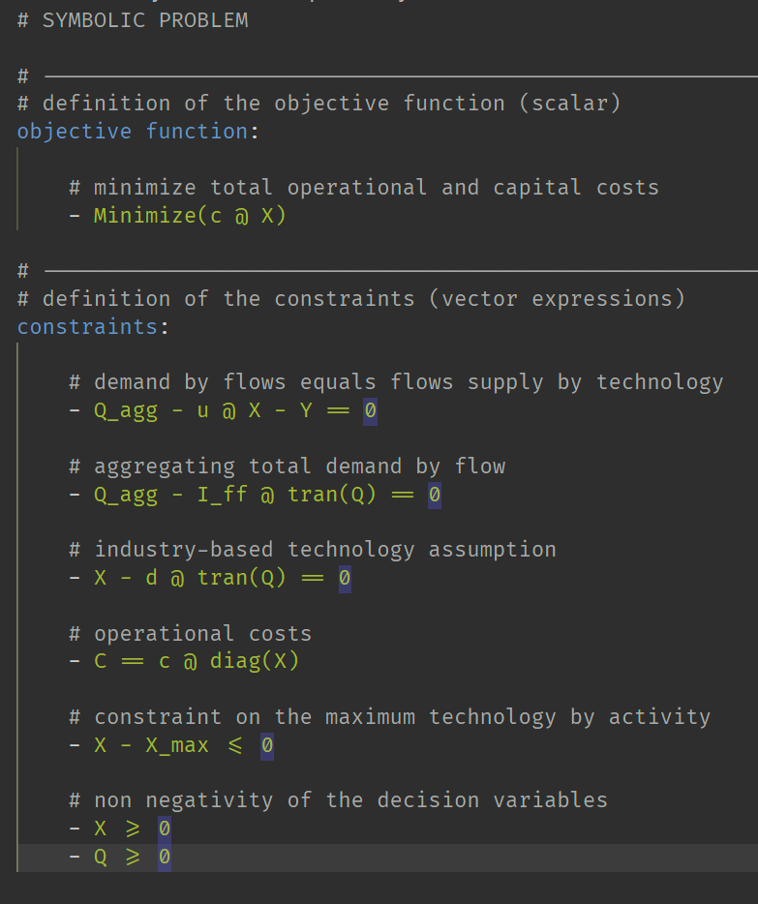
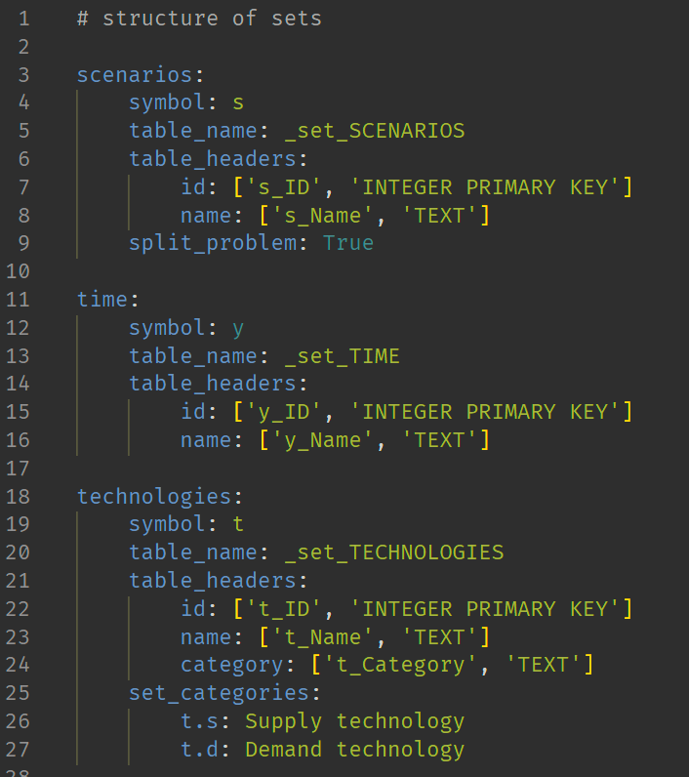
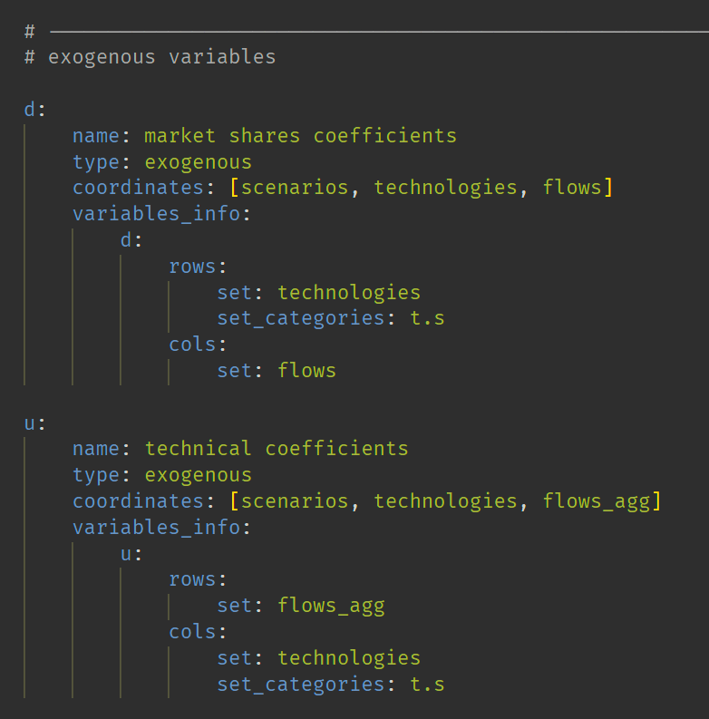
Application example
Solving the example via pyESM
Step 1 - pyESM generates directory with default setup files
Step 2 - User fills setup files, defining model sets, variables, equations
problem.yml
sets.yml
variables.yml

Slide 11
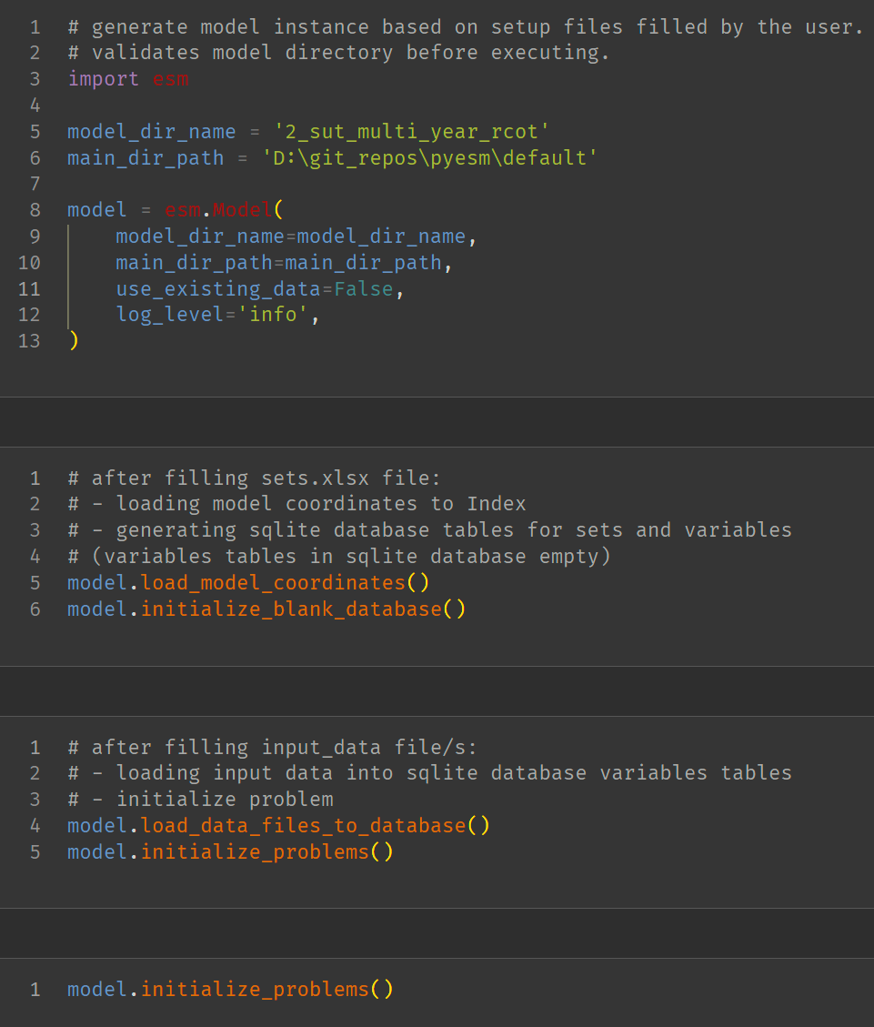
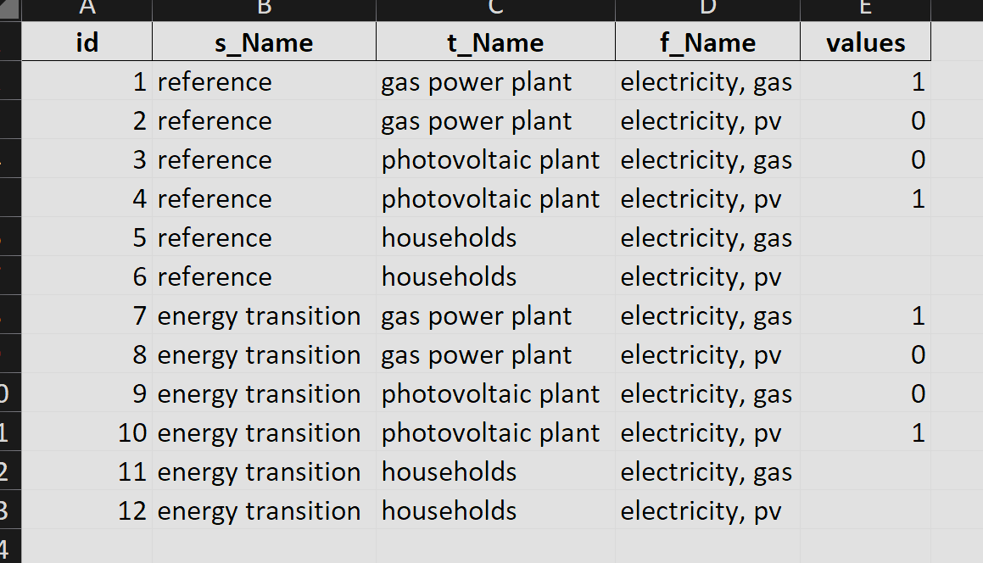
Application example
Solving the example via pyESM
Step 1 - pyESM generates directory with default setup files
Step 2 - User fills setup files, defining model sets, variables, equations
Step 3 - pyESM imports setup files and generates Model as Python object. Outputs: Blank SQLite database, Excel raw data files
Step 4 - User fills excel files with exogenous model data.
excel data file

Slide 12
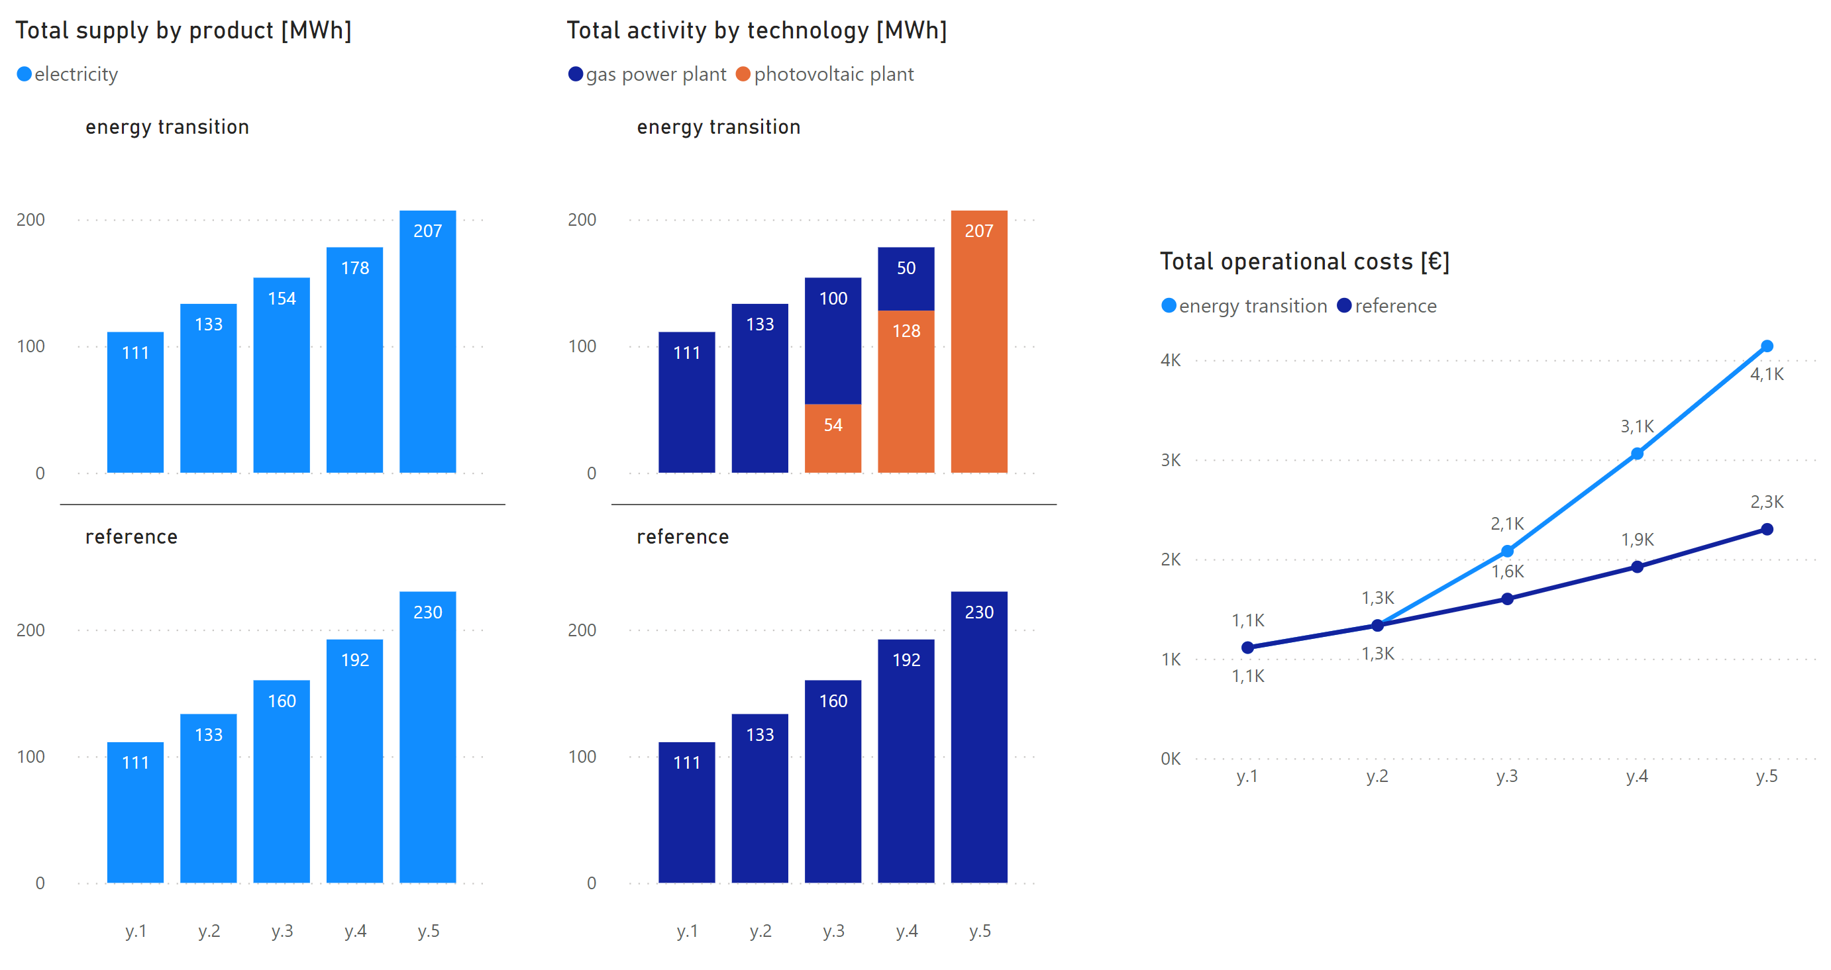
Application example
Solving the example via pyESM
Step 1 - pyESM generates directory with default setup files
Step 2 - User fills setup files, defining model sets, variables, equations
Step 3 - pyESM imports setup files and generates Model as Python object. Outputs: Blank SQLite database, Excel raw data files
Step 4 - User fills excel files with exogenous model data.
Step 5 - pyESM imports exogenous data, generates and solves numerical problems, updates SQLite database, generates PowerBI report

Slide 13
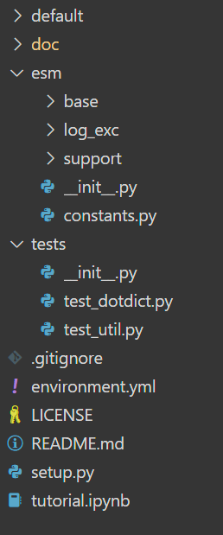
Package OOP structure
“default” directory:
default problems that can be replicated and used as templates to be customized
default files that are essential to configure the model.
“doc” directory:
includes documentation files (in progress)
includes other illustrative materials (presentations, examples, …)
“esm” directory:
base: directory including basic pyESM classes and methods
log_exc: logging and exceptions directory
support: includes util methods and ancillary classes necessary to handle files and SQLite database
“tests” directory includes pytest infrastructure
“tutorial.ipynb” jupyter notebook with examples and tutorials

Slide 14
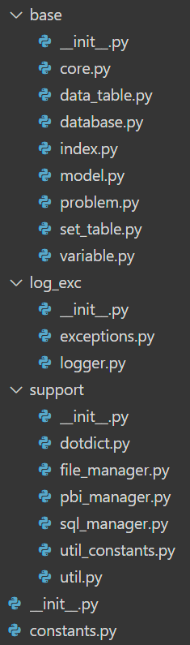
Package OOP structure
esm.base
.model.Model – main class of the package, with main methods accessible to users for creating/manipulating the model
.core.Core – inside Model class, composed by fundamental objects for the model
.index.Index – includes all fundamental information of the conceptual model (data tables, set tables, variables)
.set.DataTable – includes information about SQLite data tables (set coordinates, variables information, …)
.set.SetTable – includes information about SQLite set tables (e.g. technologies, products, …)
.variable.Variable – each instance is a model mathematical variable (use matrix, …)
.database.Database – class in charge of manipulating the SQLite database (data input/output interface with problem)
.problem.Problem – class in charge of manipulating conceptual and numerical problem
esm.log_exc.
exceptions – set of subclasses defining custom exceptions
logger.Logger – handle log messages during model execution
esm.support.
dotdict.Dotdict – ancillary class working as a normal dictionary but accessing keys with dot (.) notation
file_manager.FileManager – includes all methods to manipulate files (create, import, erase, …)
pbi_manager.PBIManager – includes all methods necessary to create and handle PowerBI report
sql_manager.SQLManager – includes all methods necessary to manage and operate on the SQLite database
util, util_constants – ancillary set of support functions (isolated functions)
esm.constants – essential constants required by all other modules

Slide 15
Package OOP structure
esm.base.model.Model
Model()
Logger()
FileManager()
Core()
PBIManager()
Logger()
Logger()
FileManager()
Logger()
SQLManager()
Index()
Database()
Problem()
Logger()
Logger()
FileManager()
Logger()
FileManager()
SQLManager()
Index()
Logger()
FileManager()
Index()
Set()
DataTable()
Variable()
Logger()
Logger()
Logger()

Slide 16
API reference
method esm.support.util.create_model_dir
“””
Create a directory structure for the generation of Model instances.
If no default_model is indicated, only basic setup files are generated.
Args:
model_dir_name (str): Name of the model directory.
main_dir_path (str): Path to the main directory where the model directory will be created.
default_model (str, optional): Name of the default modle to use as a template.
List of available templates in /src/constants.py. Defaults to None.
force_overwrite (bool, optional): if True, avoid asking permission to overwrite existing files/directories. Defaults to False.
”””

Slide 17
API reference
main methods of class esm.base.model.Model
Method | Description
load_model_coordinates | Load information defined by user to the Index object inside the model (definition of sets and variables of the problem).
initialize_blank_database | Gerates SQLite database tables for sets and variables. Generates exogenous parameters input xlsx files.
load_data_files_to_database | Load user data (exogenous variables) to SQLite database.
initialize_problems | Define numerical problem as a series of cvxpy objects based on numerical data and user defined symbolic problem.
update_database_and_problem | In case of modification of exogenous data in xlsx files or symbolic problem, update SQLite database and numerical problem without re-casting Model instance.
run_model | Solve the defined numerical problems.
load_results_to_database | Exports endogenous results to SQLite database.
generate_pbi_report | Generates Power BI report

Slide 18
py
ESM

