Slide 1
[220 / 319] Web 1
Meena Syamkumar
Andy Kuemmel

Slide 2
Learning Objectives Today
Network basics
IP addresses
host/domain names
client/server and request/response
HTTP basics
URLs
GET/POST/etc
headers
status codes
Requests modules
downloading data with requests.get
remote calls with requests.post

Slide 3
Learning Objectives Today
Motivation
Networking Basics
HTTP (Hypertext Transfer Protocol)
Requests Module

Slide 4
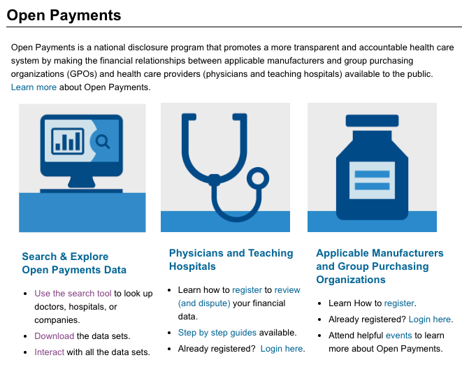
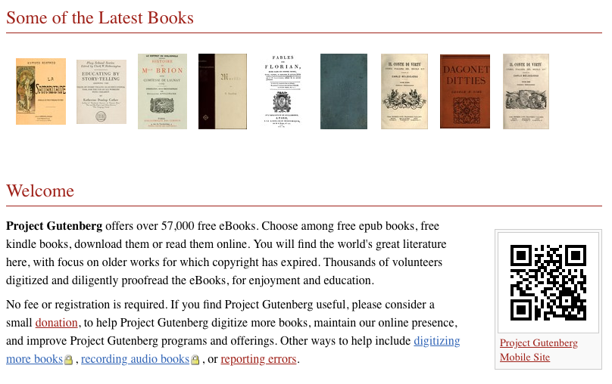
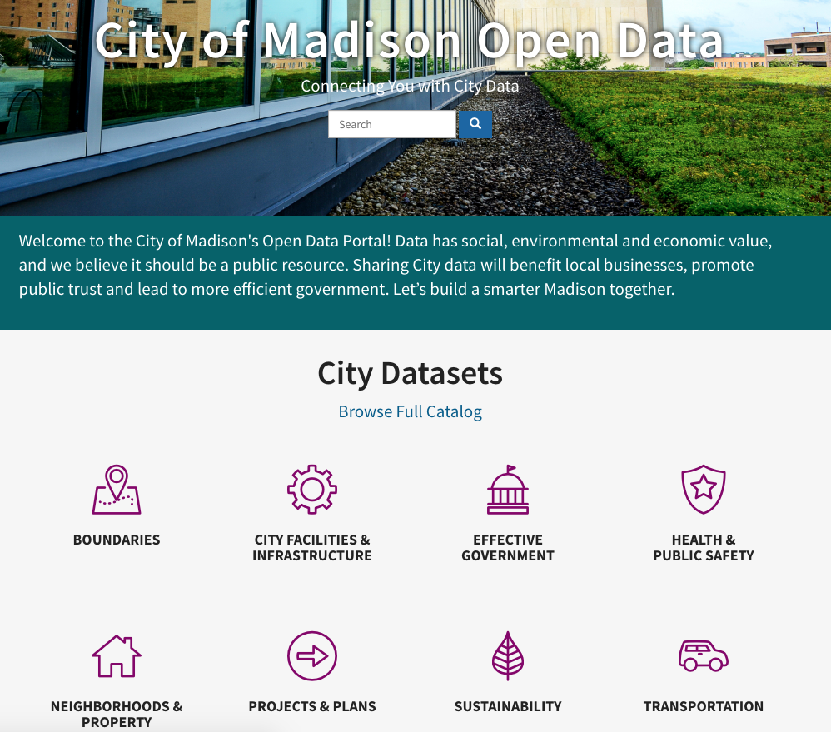
Data Science and the Internet
There are tons of online sources of data
Examples: https://www.msyamkumar.com/cs220/s21/datasets.html
Wide range of topics
healthcare
roads and city planning
astronomy
population
business
entertainment
education
etc

Slide 5
Data Science and the Internet
There are tons of online sources of data
Examples: https://www.msyamkumar.com/cs220/s21/datasets.html
Wide range of topics
healthcare
roads and city planning
astronomy
population
business
entertainment
education
etc
Why not just download data by hand?

Slide 6
Motivation 1: too much data
What if you’re analyzing language trends over time?
Dataset: Project Gutenberg has 57K free books
Too much work to download one by one

Slide 7
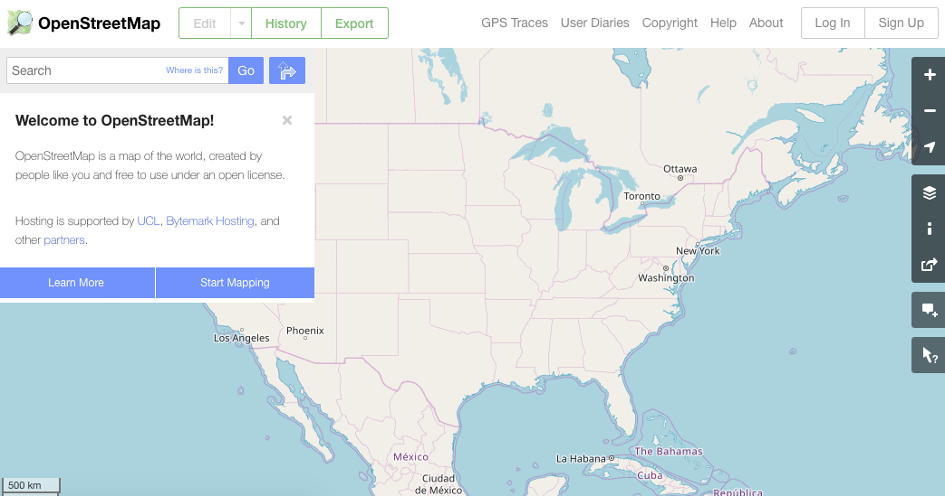
Motivation 2: data doesn’t always come in files
Many datasets are difficult to download complete
Instead, you can make function calls to servers (we’ll learn how) to grab specific data
Dataset: OpenStreetMap
You issue calls to get specific data:
specify latitude/longitude rectangle
specify structures of interest (e.g., bike paths)

Slide 8
Learning Objectives Today
Motivation
Networking Basics
HTTP (Hypertext Transfer Protocol)
Requests Module

Slide 9
Networking Basics
computer 1
computer 2
Computers communicate over a network (e.g., the Internet)
by sending messages to each other

Slide 10
Networking Basics
request for data
computer 1
computer 2
Computers communicate over a network (e.g., the Internet)
by sending messages to each other

Slide 11
Networking Basics
request for data
100100101011001010
computer 1
sometimes requests
upload data too
computer 2
Computers communicate over a network (e.g., the Internet)
by sending messages to each other

Slide 12
Networking Basics
response with data
100100101011001010
computer 1
computer 2
Computers communicate over a network (e.g., the Internet)
by sending messages to each other

Slide 13
Networking Basics
server
client
response with data
100100101011001010
computer 1
computer 2
Computers communicate over a network (e.g., the Internet)
by sending messages to each other

Slide 14
Networking Basics
computer 1
computer 2
Challenge: there are millions of computers.
How do we indicate which machine should get our request?

Slide 15
How do we send a letter?
1
lookup friend's address in phone book
2
put address on the envelope
3
trust postal service to get letter to that address

Slide 16
Internet Protocol
address: 18.216.110.65
computer 1
computer 2
Solution: every machine* has an IP address (Internet Protocol).
Requests are sent to a specific IP address.
*some machines have more multiple addresses

Slide 17
Internet Protocol
address: 18.216.110.65
request for data to 18.216.110.65
computer 1
computer 2
Solution: every machine* has an IP address (Internet Protocol).
Requests are sent to a specific IP address.
*some machines have more multiple addresses

Slide 18
Internet Protocol
address: 18.216.110.65
request for data to 18.216.110.65
computer 1
computer 2
Challenge: it’s hard to remember IP addresses.
Imagine you had to type a number instead of www.google.com!

Slide 19
Domain Names
domain: www.msyamkumar.com
address: 18.216.110.65
request for data to 18.216.110.65
computer 1
computer 2
Solution: use "nicknames" (called domain names)
for IP addresses of machines that serve data

Slide 20
Domain Names
domain: www.msyamkumar.com
if a domain name is used here,
the IP address is looked up here first
address: 18.216.110.65
request for data to 18.216.110.65
computer 1
computer 2
Solution: use "nicknames" (called domain names)
for IP addresses of machines that serve data

Slide 21
Port Numbers
address: 18.216.110.65
Python
program X
program A
request for data to 18.216.110.65
Python
program Y
program B
Python
program Z
computer 1
computer 2
Challenge: there may be multiple programs running on each computer.
How do we get the messages to the right program?

Slide 22
Port Numbers
address: 18.216.110.65
Python
program X
port 8080
program A
request for data to 18.216.110.65
Python
program Y
program B
Python
port 5000
program Z
computer 1
port 80
computer 2
Solution: give each program a unique ID (called a "port number")
(like apartment numbers)

Slide 23
Port Numbers
address: 18.216.110.65
Python
program X
port 8080
program A
Python
request for data to 18.216.110.65:80
program Y
program B
Python
port 5000
program Z
computer 1
port 80
computer 2
Solution: specify port number in request

Slide 24
Port Numbers
defaults are often used
(e.g., browsers default to
80 or 443)
address: 18.216.110.65
Python
program X
port 8080
program A
Python
request for data to 18.216.110.65:80
program Y
program B
Python
port 5000
program Z
computer 1
port 80
computer 2
Solution: specify port number in request

Slide 25
what do requests contain?
request for data
response with data
computer 1
computer 2
what do responses contain?

Slide 26
depends on application! (video chat, web browsing, etc)
we’ll only consider web applications for this semester
what do requests contain?
request for data
response with data
computer 1
computer 2
what do responses contain?

Slide 27
Learning Objectives Today
Motivation
Networking Basics
HTTP (Hypertext Transfer Protocol)
Requests Module

Slide 28
HTTP
Protocol for communicating web data
downloading a specific webpage, image, etc
domain: example.com
address: 12.34.56.78
program B
Python
Python
program Y
port 80
computer 1
computer 2
Note: we won’t talk about HTTPS today, which is HTTP with encryption

Slide 29
HTTP
Protocol for communicating web data
downloading a specific webpage, image, etc
domain: example.com
address: 12.34.56.78
program B
Python
Python
program Y
please send home page
port 80
computer 1
computer 2

Slide 30
HTTP
Protocol for communicating web data
downloading a specific webpage, image, etc
domain: example.com
address: 12.34.56.78
program B
Python
Python
program Y
please send /index.html
port 80
computer 1
computer 2

Slide 31
HTTP
Protocol for communicating web data
downloading a specific webpage, image, etc
domain: example.com
address: 12.34.56.78
program B
Python
Python
program Y
please send /about.html
port 80
computer 1
computer 2

Slide 32
HTTP
Protocol for communicating web data
downloading a specific webpage, image, etc
domain: example.com
address: 12.34.56.78
program B
Python
Python
program Y
please send /logo.gif
port 80
computer 1
computer 2

Slide 33
HTTP
Protocol for communicating web data
downloading a specific webpage, image, etc
domain: example.com
address: 12.34.56.78
program B
Python
Python
program Y
please send /logo.gif
port 80
computer 1
We need three things:
domain name
port number
resource (file name)
computer 2

Slide 34
which computer?
which program
on that computer?
getting specific
about what we want
which resource
from that program?
We need three things:
domain name
port number
resource (file name)

Slide 35
which computer?
which program
on that computer?
getting specific
about what we want
which resource
from that program?
We need three things:
domain name
port number
resource (file name)
URL

Slide 36
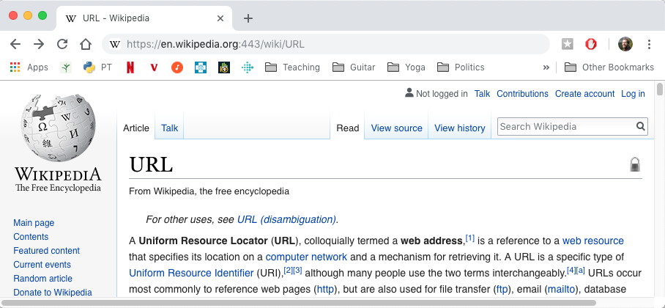
URLs
https://en.wikipedia.org:443/wiki/URL
We need three things:
domain name
port number
resource (file name)
URL

Slide 37
URLs
domain name
resource
https://en.wikipedia.org:443/wiki/URL
port
We need three things:
domain name
port number
resource (file name)
URL

Slide 38
URLs
domain name
resource
https://en.wikipedia.org/wiki/URL
port would have defaulted to 443 if not specified
We need three things:
domain name
port number
resource (file name)
URL

Slide 39
HTTP
Protocol for communicating web data
downloading a specific webpage, image, etc
domain: example.com
address: 12.34.56.78
program B
Python
Python
program Y
please send /about.html
port 80
computer 1
We need three things:
domain name
port number
resource (file name)
computer 2
URL
how do we specify this?

Slide 40
HTTP
Protocol for communicating web data
downloading a specific webpage, image, etc
domain: example.com
address: 12.34.56.78
program B
Python
Python
program Y
please send /about.html
port 80
computer 1
computer 2
GET /about.html HTTP/1.1
Host: example.com
User-Agent: ...
Accept: */*
HTTP Request:

Slide 41
HTTP
Protocol for communicating web data
downloading a specific webpage, image, etc
domain: example.com
address: 12.34.56.78
program B
Python
Python
program Y
response
port 80
computer 1
HTTP/1.0 200 OK
Content-Type: text/html; charset=utf-8
Content-Length: 74
Server: Werkzeug/0.14.1 Python/3.6.6
Date: Sun, 11 Nov 2018 17:00:29 GMT
all the contents
computer 2
HTTP Response:

Slide 42
Request and Response Headers
GET /about.html HTTP/1.1
Host: example.com
User-Agent: ...
Accept: */*
HTTP Request:
HTTP/1.0 200 OK
Content-Type: text/html; charset=utf-8
Content-Length: 74
Server: Werkzeug/0.14.1 Python/3.6.6
Date: Sun, 11 Nov 2018 17:00:29 GMT
all the contents
HTTP Response:
There are LOTS of details here we don’t care about right now

Slide 43
Request and Response Headers
we want the about.html page
GET /about.html HTTP/1.1
Host: example.com
User-Agent: ...
Accept: */*
HTTP Request:
HTTP/1.0 200 OK
Content-Type: text/html; charset=utf-8
Content-Length: 74
Server: Werkzeug/0.14.1 Python/3.6.6
Date: Sun, 11 Nov 2018 17:00:29 GMT
all the contents
HTTP Response:
data in about.html
There are LOTS of details here we don’t care about right now

Slide 44
Request and Response Headers
we want the about.html page
GET /about.html HTTP/1.1
Host: example.com
User-Agent: ...
Accept: */*
HTTP Request:
status code. 200 is good. 404, 500, others are
various errors or other more complicated states
HTTP/1.0 200 OK
Content-Type: text/html; charset=utf-8
Content-Length: 74
Server: Werkzeug/0.14.1 Python/3.6.6
Date: Sun, 11 Nov 2018 17:00:29 GMT
all the contents
HTTP Response:
data in about.html
There are LOTS of details here we don’t care about right now

Slide 45
method. GET is simple download.
POST means we are uploading
data as part of our request. We
won’t talk about others today.
we want the about.html page
GET /about.html HTTP/1.1
Host: example.com
User-Agent: ...
Accept: */*
HTTP Request:
status code. 200 is good. 404, 500, others are
various errors or other more complicated states
HTTP/1.0 200 OK
Content-Type: text/html; charset=utf-8
Content-Length: 74
Server: Werkzeug/0.14.1 Python/3.6.6
Date: Sun, 11 Nov 2018 17:00:29 GMT
all the contents
HTTP Response:
data in about.html
There are LOTS of details here we don’t care about right now

Slide 46
Learning Objectives Today
Motivation
Networking Basics
HTTP (Hypertext Transfer Protocol)
Requests Module

Slide 47
Requests module
Purpose
easily send requests to a server and parse the response
"HTTP for Humans™"
Installation
install: pip install requests
Using it
just import: import requests

Slide 48
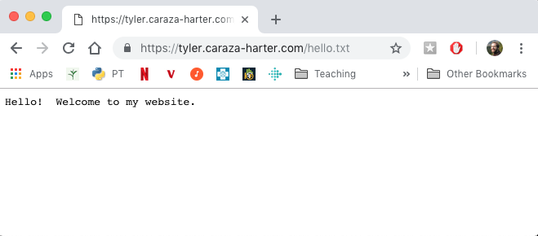
GET Request
import requests
url = "https://www.msyamkumar.com/hello.txt"
requests.get(url)

Slide 49
GET Request
import requests
url = "https://www.msyamkumar.com/hello.txt"
requests.get(url)
sends a GET request to www.msyamkumar.com,
asking for the contents of the /hello.txt page

Slide 50
GET Request
import requests
url = "https://www.msyamkumar.com/hello.txt"
resp = requests.get(url)
put response from www.msyamkumar.com in the resp variable

Slide 51
GET Request
import requests
url = "https://www.msyamkumar.com/hello.txt"
resp = requests.get(url)
# make sure we got 200 (success) back assert(resp.status_code == 200)

Slide 52
GET Request
import requests
url = "https://www.msyamkumar.com/hello.txt"
resp = requests.get(url) resp.raise_for_status() # shortcut

Slide 53
GET Request
import requests
url = "https://www.msyamkumar.com/hello.txt"
resp = requests.get(url) resp.raise_for_status() # shortcut print(resp.text) # "Hello! Welcome to my website."

Slide 54
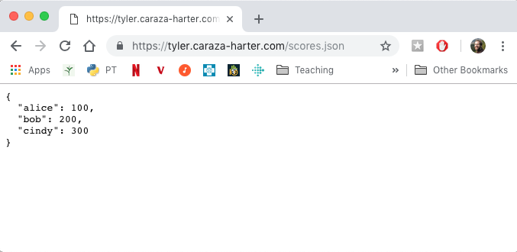
JSON Responses
import requests, json
url = "https://www.msyamkumar.com/scores.json" resp = requests.get(url) scores = json.loads(resp.text)

Slide 55
JSON Responses
import requests, json
url = "https://www.msyamkumar.com/scores.json" resp = requests.get(url) scores = json.loads(resp.text) scores = resp.json() # shortcut

Slide 56
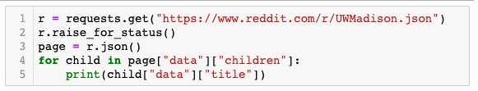
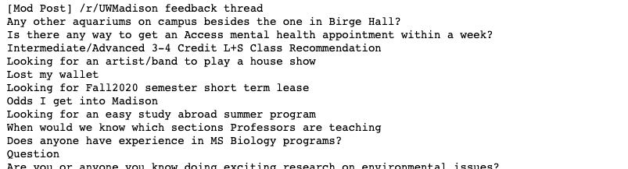
Demo 1: reddit bot
Goal: fetch titles from a subreddit
Let's not all hit reddit at once (feel free to use these snapshots):
https://www.msyamkumar.com/cs220/s21/materials/lectureDemo_code/lec-31/python.json
https://www.msyamkumar.com/cs220/s21/materials/lectureDemo_code/lec-31/UWMadison.json

Slide 57
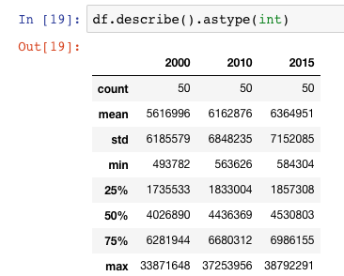
Demo 2: State Populations
Goal: fetch population data for all states and provide summary stats
Input:
List of state files: https://www.msyamkumar.com/cs220/s21/materials/lectureDemo_code/lec-31/data/state_files.txt
The 50 JSON files
Output:
Stats about population: mean, max, min, etc
Bonus! "cache" results to make reruns of notebook faster

Slide 58
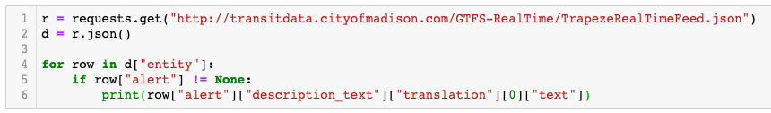
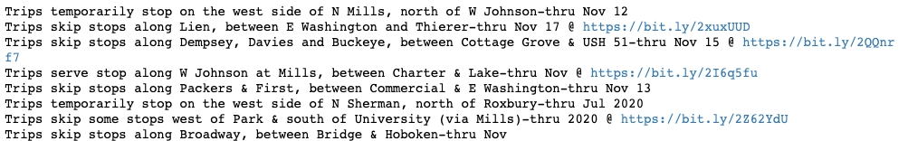
Challenge - Demo 3: Madison bus alerts
Goal: get text of all outstanding alerts
Let's not all hit Madison at once (feel free to use this snapshot):
https://www.msyamkumar.com/cs220/s21/materials/lectureDemo_code/lec-31/TrapezeRealTimeFeed.json

