Slide 1
[220 / 319] Database 1
Meena Syamkumar
Andy Kuemmel

Slide 2
Learning objectives – database topic
Today’s lecture
”narrowing down” specific data from a big table – pandas
SQL Data
schemas: tables, columns, types
advantages over JSON/CSV
SQL Queries
select, where, limit, sort by
sqlite3 module
Pandas/DB integration
Next lecture
Summarizing data
Next to next lecture
worksheets - SQL practice

Slide 3
What we don’t cover …
Schema design:
What tables does a database have?
What columns does a table have?
What are the relationship between the columns?
Changes to database data:
Add a row, remove a row
Concurrency
Performance
Joins:
Combining multiple tables with related information

Slide 4
220 Progress
Languages learned
Python [Programming Language]
HTML [Markup Language]
Data storage
CSV files
JSON files

Slide 5
220 Progress
Languages learned
Python [Programming Language]
HTML [Markup Language]
SQL [Query Language]
Data storage
CSV files
JSON files
SQL databases
structured query language

Slide 6
Learning Objectives Today
SQL Data
schemas: tables, columns, types
advantages over JSON/CSV
SQL Queries
select, where, limit, sort by
sqlite3 module
Pandas/DB integration

Slide 7
Outline
Tabular Data: CSVs vs. Databases
Common SQL Databases
Example: Madison bus-route data
SQL: Structured Query Language
Demos

Slide 8
CSV
SQL Database
capitals
populations
State | Capital
WI | Madison
… | …
State | Population
WI | 5795000
… | …
State | Capital | Population | Area
WI | Madison | 5795000 | 65498
… | … | … | …
counties
areas
County | Pop | un_emp
Dane | 536416 | 0.02
… | … | …
State | Area
WI | 65498
… | …
Characteristics
one table
Characteristics
collection of tables, each named

Slide 9
CSV
SQL Database
capitals
populations
State | Capital
WI | Madison
… | …
State | Population
WI | 5795000
… | …
State | Capital | Population | Area
WI | Madison | 5795000 | 65498
… | … | … | …
counties
areas
County | Pop | un_emp
Dane | 536416 | 0.02
… | … | …
State | Area
WI | 65498
… | …
Characteristics
one table
columns sometimes named
Characteristics
collection of tables, each named
columns always named

Slide 10
CSV
SQL Database
capitals
populations
State | Capital
text | text
text | text
text | text
text | text
State | Population
text | integer
text | integer
text | integer
text | integer
State | Capital | Population | Area
string | string | string | string
string | string | string | string
string | string | string | string
string | string | string | string
string | string | string | string
string | string | string | string
string | string | string | string
counties
areas
County | Pop | un_emp
Dane | 536416 | 0.02
… | … | …
State | Area
WI | 65498
… | …
Characteristics
one table
columns sometimes named
everything is a string
no text allowed
Characteristics
collection of tables, each named
columns always named
types per column (enforced)

Slide 11
Why use a database?
1. More Structure
Database
CSV
JSON
A | B | C
text | integer | real
text | integer | real
text | integer | real
text | integer | real
A,B,C
string,string,string
string,string,string
string,string,string
string,string,string
[{"A":"val", "B":10, "C":3.14},
{"A":"val"},
{"A":"v2", "B": 9, "C":False},
same fields and same
types in every column
everything is a string
types, but…
missing values
types may differ across columns

Slide 12
Why use a database?
1. More Structure
2. Sharing
regular file
yikes!
yikes!
writes
writes
program 1
program 2
Database
writes
writes
this is OK

Slide 13
Why use a database?
1. More Structure
2. Sharing
3. Queries
which actor appeared
in the most movies?
Python code to find
actor who appeared
in most movies
Christopher Lee
regular file
Database

Slide 14
Why use a database?
1. More Structure
2. Sharing
3. Queries
question formulated in SQL
(structured query language)
Python code to find
actor who appeared
in most movies
Christopher Lee
regular file
Database

Slide 15
Why use a database?
1. More Structure
2. Sharing
3. Queries
4. Performance
Let's play a game where we pretend to be a database!

Slide 16
names | age | score
Parker | ? | ?
Heidy | ? | ?
Shirly | ? | ?
Arla | ? | ?
Bella | ? | ?
Bill | ? | ?
Hollis | ? | ?
Maurita | ? | ?
Milda | ? | ?
Pearline | ? | ?
Teresa | ? | ?
Ceola | ? | ?
Milford | ? | ?
Alisha | ? | ?
Antonetta | ? | ?
Ryan | ? | ?
Karma | ? | ?
Lashandra | ? | ?
Breana | ? | ?
Sara | ? | ?
Question 1:
How many people are 23 or younger?
Question 2:
How many people scored 23 or less?

Slide 17
names | age | score
Parker | 26 | ?
Heidy | 22 | ?
Shirly | 27 | ?
Arla | 21 | ?
Bella | 22 | ?
Bill | 28 | ?
Hollis | 26 | ?
Maurita | 22 | ?
Milda | 22 | ?
Pearline | 29 | ?
Teresa | 25 | ?
Ceola | 30 | ?
Milford | 25 | ?
Alisha | 30 | ?
Antonetta | 28 | ?
Ryan | 25 | ?
Karma | 23 | ?
Lashandra | 24 | ?
Breana | 22 | ?
Sara | 28 | ?
Question 1:
How many people are 23 or younger?
Question 2:
How many people scored 23 or less?

Slide 18
names | age | score
Parker | ? | 21
Heidy | ? | 22
Shirly | ? | 22
Arla | ? | 22
Bella | ? | 22
Bill | ? | 22
Hollis | ? | 23
Maurita | ? | 24
Milda | ? | 25
Pearline | ? | 25
Teresa | ? | 25
Ceola | ? | 26
Milford | ? | 26
Alisha | ? | 27
Antonetta | ? | 28
Ryan | ? | 28
Karma | ? | 28
Lashandra | ? | 29
Breana | ? | 30
Sara | ? | 30
Question 1:
How many people are 23 or younger?
Question 2:
How many people scored 23 or less?

Slide 19
names | age | score
Parker | 26 | 21
Heidy | 22 | 22
Shirly | 27 | 22
Arla | 21 | 22
Bella | 22 | 22
Bill | 28 | 22
Hollis | 26 | 23
Maurita | 22 | 24
Milda | 22 | 25
Pearline | 29 | 25
Teresa | 25 | 25
Ceola | 30 | 26
Milford | 25 | 26
Alisha | 30 | 27
Antonetta | 28 | 28
Ryan | 25 | 28
Karma | 23 | 28
Lashandra | 24 | 29
Breana | 22 | 30
Sara | 28 | 30
Question 1:
How many people are 23 or younger?
Question 2:
How many people scored 23 or less?
Which question took longer to answer? Why?

Slide 20
names | age | score
Arla | 21 | 22
Heidy | 22 | 22
Bella | 22 | 22
Maurita | 22 | 24
Milda | 22 | 25
Breana | 22 | 30
Karma | 23 | 28
Lashandra | 24 | 29
Teresa | 25 | 25
Milford | 25 | 26
Ryan | 25 | 28
Parker | 26 | 21
Hollis | 26 | 23
Shirly | 27 | 22
Sara | 28 | 30
Bill | 28 | 22
Antonetta | 28 | 28
Pearline | 29 | 25
Alisha | 30 | 27
Ceola | 30 | 26
names | age | score
Parker | 26 | 21
Heidy | 22 | 22
Shirly | 27 | 22
Arla | 21 | 22
Bella | 22 | 22
Bill | 28 | 22
Hollis | 26 | 23
Maurita | 22 | 24
Milda | 22 | 25
Pearline | 29 | 25
Teresa | 25 | 25
Ceola | 30 | 26
Milford | 25 | 26
Alisha | 30 | 27
Antonetta | 28 | 28
Ryan | 25 | 28
Karma | 23 | 28
Lashandra | 24 | 29
Breana | 22 | 30
Sara | 28 | 30
DBs can keep multiple copies of the same data
which organizations to use are configured (indexing)
which copy to use is used is automatically determined based on the question being asked
copy 1
copy 2

Slide 21
Why use a database?
1. More Structure
2. Sharing
3. Queries
4. Performance
Why not use a database?
It’s often overkill. For many situations, a simple JSON or CSV is easier to use.

Slide 22
Outline
Tabular Data: CSVs vs. Databases
Common SQL Databases
Example: Madison bus-route data
SQL: Structured Query Language
Demos

Slide 23
Popular SQL Databases
There are minor differences in how you use these (e.g., what column types are available and how you query for data).
Most experience with one DB will translate to work with other DBs.

Slide 24
Popular SQL Databases
https://www.sqlite.org/mostdeployed.html
- Every Android device
- Every iPhone and iOS device
- Every Mac
- Every Windows 10 machine
- Every Firefox, Chrome, and Safari web browser
- Every instance of Skype
- Every instance of iTunes
- Every Dropbox client
Why learn SQLite?
easy to install/use
sqlite3 module comes with Python
it’s public domain
several billion deployments
in CS 220

Slide 25
Download bus.db and template notebook from today’s lecture entry to follow along lecture demos

Slide 26
Outline
Tabular Data: CSVs vs. Databases
Common SQL Databases
Example: Madison bus-route data
SQL: Structured Query Language
Demos

Slide 27
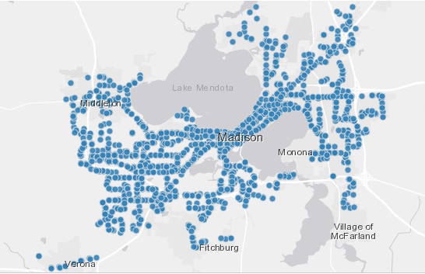
Madison Bus Data: http://data-cityofmadison.opendata.arcgis.com/datasets/metro-transit-ridership-by-route-weekday
"Metro Transit ridership by route weekday. March, 2015. Caution should be used with this data. Daily bus stop boardings were estimated using a 12-day sample of weekday farebox records and AVL logs, and the GTFS file, from March 2015 from Metro Transit."

Slide 28
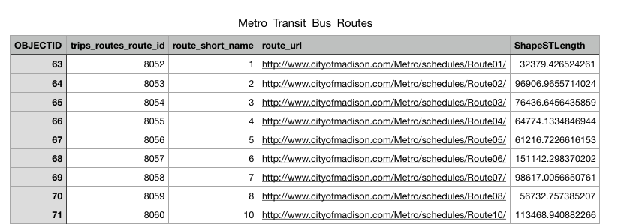
routes
Table
SQLite Database
File: bus.db

Slide 29
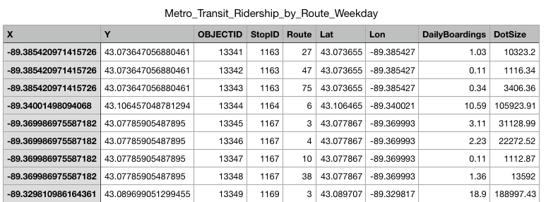
routes
Table
boarding
Table
SQLite Database
File: bus.db

Slide 30
how do we use this data?
routes
Table
boarding
Table
SQLite Database
File: bus.db

Slide 31
Modules we’ve learned this semester
math
collections
json
csv
sys
os
copy
recordclass
requests
bs4 (BeautifulSoup)
pandas
sqlite3
integrates with SQLite
directly access SQLite databases (comes with Python)

Slide 32
python
this semester, we'll only
query data through pandas
your code
pandas
python's sqlite3 module
sqlite3 tool
routes
Table
boarding
Table
SQLite Database
File: bus.db

Slide 33
sqlite3
import sqlite3
conn = sqlite3.connect("file.db")
connect for databases is analogous to open for files
database filename
represented as a string
will create if doesn’t already exist (no "w" necessary)

Slide 34
sqlite3
import sqlite3
conn = sqlite3.connect("file.db")
a connection object for databases is analogous to file object for files

Slide 35
sqlite3
import sqlite3
conn = sqlite3.connect("file.db")
conn.close()
close it at the end

Slide 36
sqlite3
import sqlite3
import pandas as pd conn = sqlite3.connect("file.db")
df = pd.read_sql("select ???? from ????", conn)
conn.close()
ask this question query

Slide 37
Demo Time

Slide 38
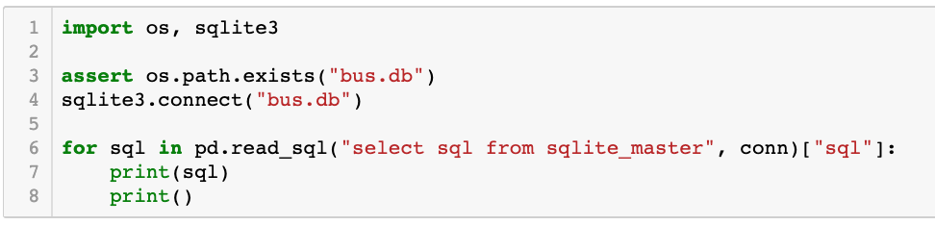
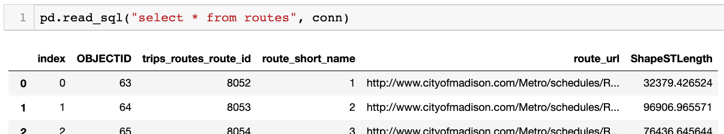
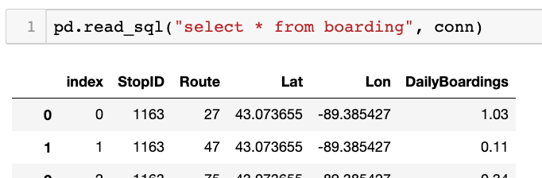
demo: poke around DB
(will explain more soon)

Slide 39
CREATE TABLE IF NOT EXISTS "boarding" (
"index" INTEGER,
"StopID" INTEGER,
"Route" INTEGER,
"Lat" REAL,
"Lon" REAL,
"DailyBoardings" REAL
);
CREATE INDEX "ix_boarding_index"ON "boarding" ("index");
CREATE TABLE IF NOT EXISTS "routes" (
"index" INTEGER,
"OBJECTID" INTEGER,
"trips_routes_route_id" INTEGER,
"route_short_name" INTEGER,
"route_url" TEXT,
"ShapeSTLength" REAL
);
CREATE INDEX "ix_routes_index"ON "routes" ("index");
table names

Slide 40
CREATE TABLE IF NOT EXISTS "boarding" (
"index" INTEGER,
"StopID" INTEGER,
"Route" INTEGER,
"Lat" REAL,
"Lon" REAL,
"DailyBoardings" REAL
);
CREATE INDEX "ix_boarding_index"ON "boarding" ("index");
CREATE TABLE IF NOT EXISTS "routes" (
"index" INTEGER,
"OBJECTID" INTEGER,
"trips_routes_route_id" INTEGER,
"route_short_name" INTEGER,
"route_url" TEXT,
"ShapeSTLength" REAL
);
CREATE INDEX "ix_routes_index"ON "routes" ("index");
look for column names in parens
columns
index
StopID
Route
Lat
Lon
Daily Boardings

Slide 41
CREATE TABLE IF NOT EXISTS "boarding" (
"index" INTEGER,
"StopID" INTEGER,
"Route" INTEGER,
"Lat" REAL,
"Lon" REAL,
"DailyBoardings" REAL
);
CREATE INDEX "ix_boarding_index"ON "boarding" ("index");
CREATE TABLE IF NOT EXISTS "routes" (
"index" INTEGER,
"OBJECTID" INTEGER,
"trips_routes_route_id" INTEGER,
"route_short_name" INTEGER,
"route_url" TEXT,
"ShapeSTLength" REAL
);
CREATE INDEX "ix_routes_index"ON "routes" ("index");
types...

Slide 42
Overview: Narrowing Down
table 1
table 2
table 3

Slide 43
Overview: Narrowing Down
table 1
table 2
table 3
col1
col2
col3
FROM: which table?

Slide 44
Overview: Narrowing Down
table 1
table 2
table 3
col1
col2
col3
FROM: which table?
SELECT: which columns?

Slide 45
Overview: Narrowing Down
table 1
table 2
table 3
col1
col2
col3
FROM: which table?
SELECT: which columns?
WHERE: which rows?

Slide 46
Overview: Narrowing Down
table 1
table 2
table 3
col1
col2
col3
FROM: which table?
SELECT: which columns?
WHERE: which rows?
LIMIT: how many rows?

Slide 47
Overview: Narrowing Down
table 1
table 2
table 3
col1
col2
col3
A
B
C
D
FROM: which table?
SELECT: which columns?
WHERE: which rows?
LIMIT: how many rows?
col1
col3
a query result
looks like a table
A
B
C
D

Slide 48
SQL Queries: How to ask a DB questions
Syntax for SELECT (case and spacing don’t matter):
SELECT
FROM
;

Slide 49
SQL Queries: How to ask a DB questions
Syntax for SELECT (case and spacing don’t matter):
select
from
;

Slide 50
SQL Queries: How to ask a DB questions
Syntax for SELECT (case and spacing don’t matter):
select
from
optional stuff
;

Slide 51
SQL Queries: How to ask a DB questions
Syntax for SELECT (case and spacing don’t matter):
select
from
table name
;

Slide 52
SQL Queries: How to ask a DB questions
Syntax for SELECT (case and spacing don’t matter):
select
from boarding;

Slide 53
SQL Queries: How to ask a DB questions
Syntax for SELECT (case and spacing don’t matter):
select
which columns
from boarding;

Slide 54
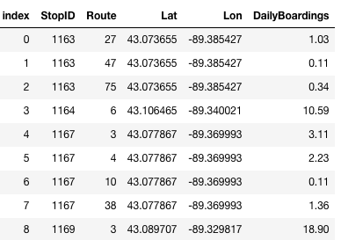
SQL Queries: How to ask a DB questions
Syntax for SELECT (case and spacing don’t matter):
star means all of them
select *
from boarding;
Result:
…

Slide 55
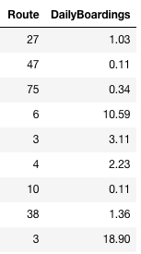
SQL Queries: How to ask a DB questions
Syntax for SELECT (case and spacing don’t matter):
select Route, DailyBoardings
from boarding;
Result:
…

Slide 56
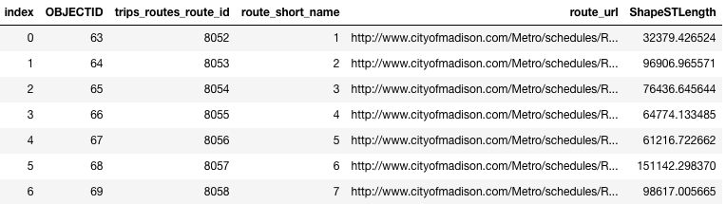
SQL Queries: How to ask a DB questions
Syntax for SELECT (case and spacing don’t matter):
select *
from routes;
Result:
…

Slide 57
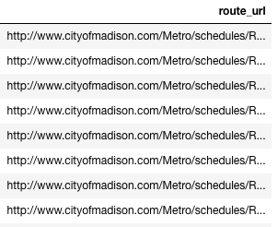
SQL Queries: How to ask a DB questions
Syntax for SELECT (case and spacing don’t matter):
select route_url
from routes;
Result:
…

Slide 58
SQL Queries: How to ask a DB questions
Syntax for SELECT (case and spacing don’t matter):
select
from
optional stuff
;
where
order by
limit

Slide 59
SQL Queries: How to ask a DB questions
Syntax for SELECT (case and spacing don’t matter):
select *
from boarding;
Result:
…

Slide 60
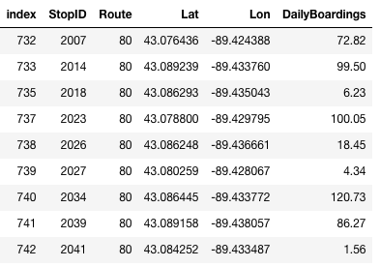
SQL Queries: How to ask a DB questions
Syntax for SELECT (case and spacing don’t matter):
select *
from boarding
where Route = 80;
Note: SQL only has one
equal sign for equality!
But == does work
Result:
…

Slide 61
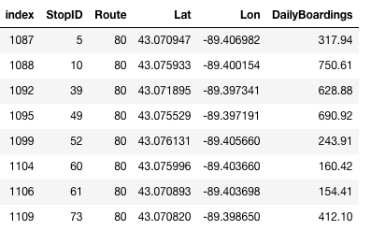
SQL Queries: How to ask a DB questions
Syntax for SELECT (case and spacing don’t matter):
select *
from boarding
where Route = 80
order by StopID;
Result:
…

Slide 62
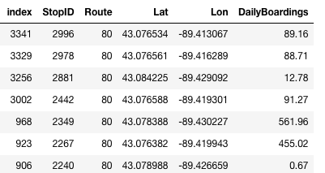
SQL Queries: How to ask a DB questions
Syntax for SELECT (case and spacing don’t matter):
select *
from boarding
where Route = 80
order by StopID DESC;
descending means
biggest first
Result:
…

Slide 63
SQL Queries: How to ask a DB questions
Syntax for SELECT (case and spacing don’t matter):
select *
from boarding
where Route = 80
order by StopID ASC;
ascending means
smallest first
Result:
…

Slide 64
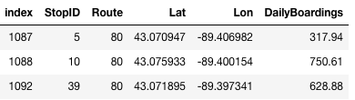
SQL Queries: How to ask a DB questions
Syntax for SELECT (case and spacing don’t matter):
select *
from boarding
where Route = 80
order by StopID ASC
limit 3;
only show the top N results
Result:
3 results

Slide 65
SQL Queries: How to ask a DB questions
Syntax for SELECT (case and spacing don’t matter):
select *
from boarding
where Route = 80
order by StopID ASC
limit 3;
Result:

Slide 66
SQL Queries: How to ask a DB questions
Syntax for SELECT (case and spacing don’t matter):
select *
from boarding
where Route = 80
order by StopID ASC
limit 3;
Result:
You can use any combination of where, order by, and limit.
But whichever you use, they must appear in that order!

Slide 67
Outline
Tabular Data: CSVs vs. Databases
Common SQL Databases
Example: Madison bus-route data
SQL: Structured Query Language
Demos

Slide 68
Demo 1: How Many People Ride the Bus
Goal: add up all boardings across all bus stops/routes
Input:
bus.db
use DailyBoardings column in boarding table
Output:
total riders

Slide 69
Demo 2: West-most Bus Route
Goal: which Madison bus goes farthest west?
Input:
bus.db
Output:
route number of bus that goes farthest west
bigger latitude
N
smaller
longitude
W
E
bigger
longitude
S
smaller latitude

Slide 70
Challenge - Demo 3: Heart of Madison
Goal: what is the central-most location of all bus pickups?
Input:
bus.db
Output:
a latitude and longitude

Slide 71
Challenge - Demo 4: Fifa
Goal: load Fifa.csv to a SQLite DB, then query it
Queries:
who are the youngest players?
who are the oldest players?
who are the five oldest players?
how many players are from Brazil?
who are the oldest players from Brazil?
who are the 5 oldest players from Brazil?
what percent of leagues have players from Brazil? DISTINCT

Slide 72
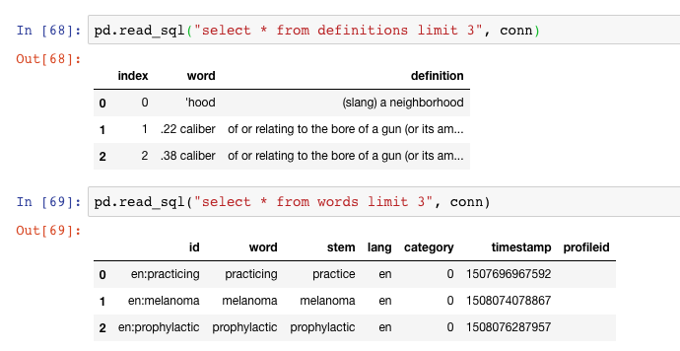
Challenge - Demo 5: Vocabulary Quiz
Goal: quiz user on words looked up while reading a Kindle
Input (vocab.db):
table of kindle words lookups
table of definitions
Output:
random word
real definition
fake definitions

