Slide 1
Notes:
Good afternoon, everybody. I am Cami De Decker and I’m going to be presenting the project I worked on during my internship at the Institute of Tropical Medicine in Antwerp.

Slide 2

Pathogenicity of Nontuberculous Mycobacteria
Intern: Cami De Decker
Supervisors: Conor Meehan, Wim Mulders, Oren Tzfadia
Notes:
Here I worked together with Conor Meehan, Wim Mulders and Oren Tzfadia. I’ll be talking about the bioinformatics methods I used to gain information about the pathogenicity of nontuberculous mycobacteria.

Slide 3
Introduction
Nontuberculous mycobacteria or NTMs
Genus Mycobacterium
NTMs
M. tuberculosis
M. leprae
Little knowledge about pathogenicity → need for research
Notes:
Nontuberculous mycobacteria or NTMs (the abbreviation I will be using throughout this presentation) is a group of bacteria that belongs to the genus Mycobacterium. NTMs are bacteria that cause disease and are not Mycobacterium tuberculosis nor Mycobacterium leprae. These last two bacteria cause tuberculosis and leprosy, respectively. Two well known diseases, so most of the research focuses on these last two. However, in the past years there has been an increased interest in understanding the cases where NTMs cause disease in humans. Little is known about their pathogenicity, the treatment options are scarce. That is why research to their pathogenicity is very much needed.

Slide 4


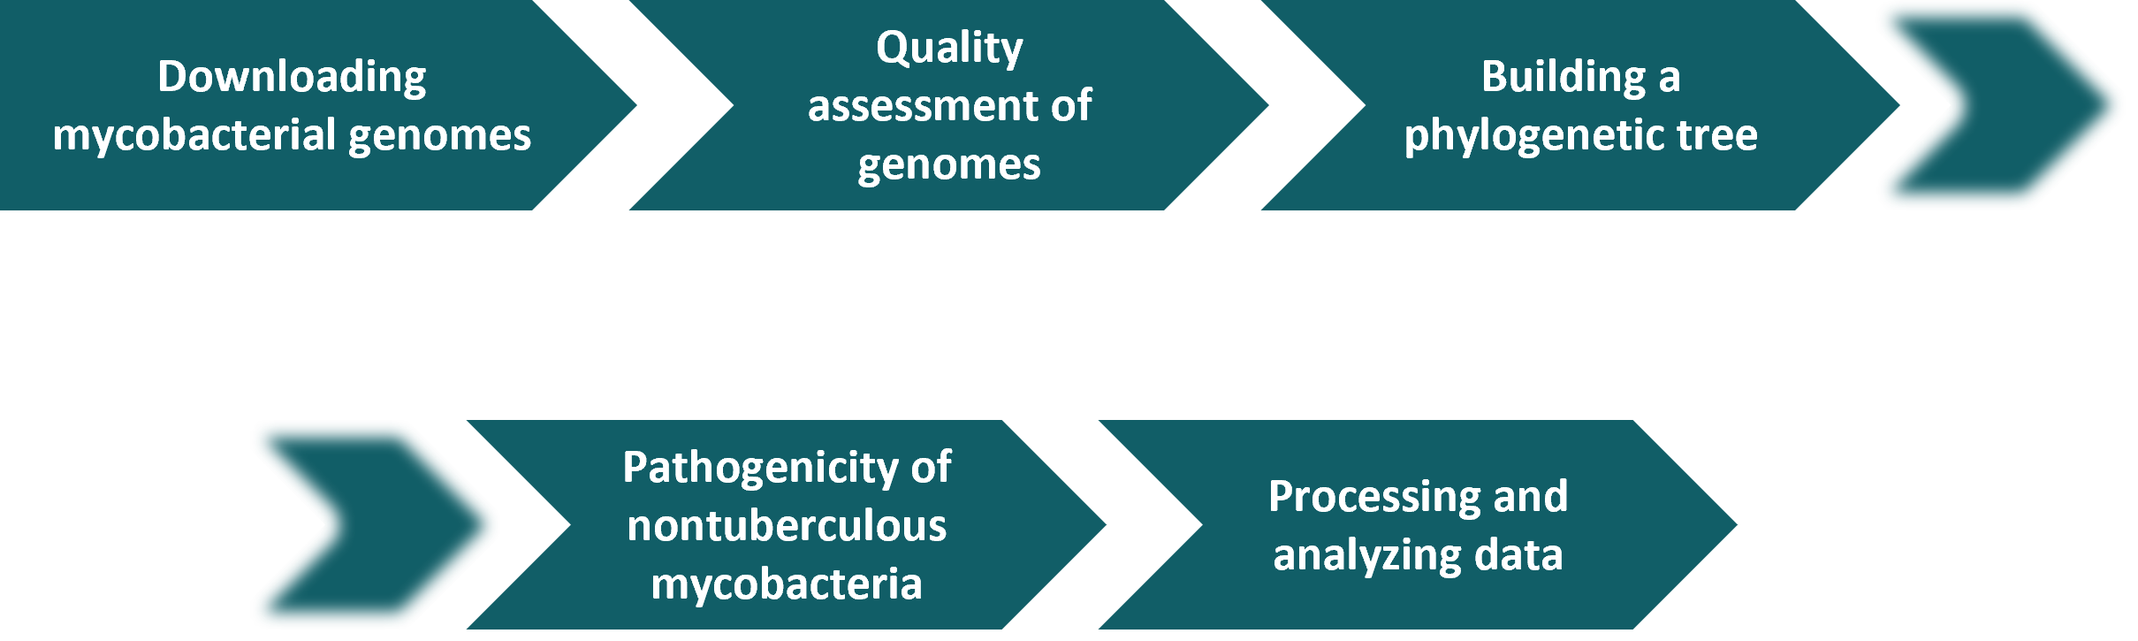




Aim of project
High quality mycobacterial genomes
Pathogenicity of NTMs
Notes:
The aim of this project is on the one hand to create a collection of high quality mycobacterial genomes and on the other hand to use these genomes to assess the pathogenicity of NTMs.
On the slide here, you can see a picture of all the steps that I performed. In the next slides, I will be explaining these steps in a little bit more in detail.

Slide 5
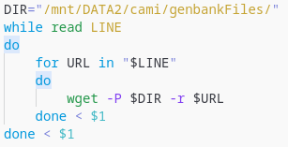
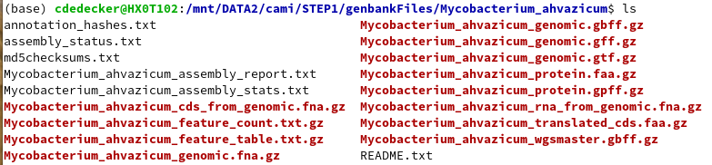
Downloading mycobacterial genomes
255 genomes
Download data with shell script
FTP path
Renaming
Notes:
The first step was downloading the mycobacterial genomes from NCBI. I filtered the list of all the publicly available prokaryote genomes on NCBI. Only the genomes that belong to the genus Mycobacterium and have less than 10 scaffolds were retained. Eventually I obtained a list of 255 genomes. Then I downloaded the data of these genomes with a shell script. The script made use of the ftp path (site from NCBI to download all the data) to the folder that contained the data. The script also moved the data and renamed the folder and files within to an appropriate name. Here you can see an example of a downloaded folder with all of the files within and the folder having the appropriate name.
Extra:
The options on wget command:
-P = directory prefix (all of the downloaded folders and files are saved here)
-r = recursive (all the folders and files of that url)

Slide 6
Quality assessment of genomes
Tool: BUSCO (v5.4.4)
Command:
$ for i in *.fna; do name=$(echo $i | sed ‘s/_genomic.fna//g’); echo $name; busco -c 8 -m genome -i $i -o BUSCO-$name -l /Busco_downloads/lineages/bacteria_odb10; done
Notes:
Then the quality of the downloaded genomes was assessed. This was done with a tool called BUSCO. BUSCO stands for Benchmarking Universal Single-Copy Orthologs and is used to assess genome assemblies and annotation completeness. I used the following command. Since BUSCO runs for one genome at the time, I automated it with a for loop. This is the initial Busco command. I will briefly go over the options. So -c is the number of threads, -m is the mode BUSCO has to use (in this case genome since we are working with genome assemblies), then you have the input file and output folder and lastly the path to the database that I downloaded.

Slide 7

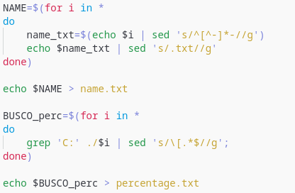
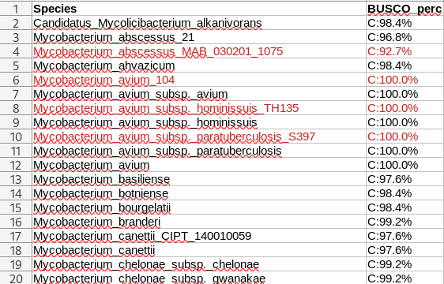
Quality assessment of genomes
Notes:
For each genome, a folder with the data was generated. With this data was the short_summary.txt file. This file held the complete BUSCO percentage. So all the percentages were extracted from the file with the use of a shell script. This created two .txt files that I then copy and pasted in 1 Excel sheet. This data was used to retain only the high quality genomes. Those were the ones where the percentage was 95% or higher. The list of 255 genomes that I previously had, became a list of 202 high quality genomes. (The institute had sequenced and assembled 10 NTM genomes themselves. So these were added to my list. So in total my list comprised of 212 high quality genomes.)

Slide 8
Building a phylogenetic tree
TWO PARTS
Produce core genome → Panaroo, SCARAP
Infer phylogenetic tree → RAxML-ng
Problems Panaroo:
Faulty input format
Small core genome
Notes:
The next step was building the phylogenetic tree. This was done to better understand the evolutionary history within the genus.
To build a phylogenetic tree, two parts had to happen. First the core genome had to get produced. This was firstly done with a tool called Panaroo and eventually done with SCARAP. Then the output of this part was used to infer a phylogenetic tree with the use of another tool called RAxML-ng.
Panaroo, however, gave a lot of problems. It started with the input files. These had to be .gff format so annotation files, but the downloaded .gff files from NCBI had a slightly different format than what was required. Eventually I annotated all of the genomes again with Prokka. This tool was recommended by the Panaroo documentation. I ran Prokka, ran Panaroo and immediately after I got the results I started RAxML-ng. I was warned beforehand that this tool might take a very long time to run. However, it was done within 3 hours. This was a clear indication that something was not right. The reason for this was that Panaroo had generated a very small core genome of about 60 genes. The expected core genome would’ve been around a 1 000 genes. So it was decided that Panaroo would not be used. Instead SCARAP was going to be used.

Slide 9
Building a phylogenetic tree
Produce core genome
Tool: SCARAP (v0.4.0)
Commands:
Infer phylogenetic tree
Tool: RAxML-ng (v1.2.0)
Command:
$ scarap core ./scarap_input ./scarap_output -t 4
$ scarap concat ./scarap_input ./scarap_output/genes.tsv ./supermatrix -t 4
$ raxml-ng --search --msa supermatrix_aas.fasta --prefix MycoGenomes --threads 20 --model LG+G
Notes:
So to produce the core genome, SCARAP was used. SCARAP is a toolkit for comparative genomics of prokaryotes. I had to use two commands to get the data we needed for the next part. The first part was to infer the core genome. For this I used the mode core. The input files were the .faa or fasta AA files. The output of this command said that there were 1413 core genes (which is a lot better than what Panaroo found). This command also generated a genes.tsv file. This file was then used in the next part to make one big concatenated alignment. For this I used the mode concat. I had to specify the input folder with the .faa files, the genes.tsv file (generated by the first command), the output folder and the number of threads. This created a fasta file with the concatenated alignment or also called “supermatrix”. This file was then used by RAxML-ng as input to create the phylogenetic tree.
RAxML-ng or Randomized Axelerated Maximum Likelihood is a phylogenetic inference tool which uses maximum-likelihood optimality criterion. I used the --search option which finds the best-scoring ML tree. --msa is the big concatenated alignment file. And here I specified the model that was used. In this case LG was used as the substitution matrix and +G was to the use discrete GAMMA model of rate heterogeneity with 4 categories.

Slide 10
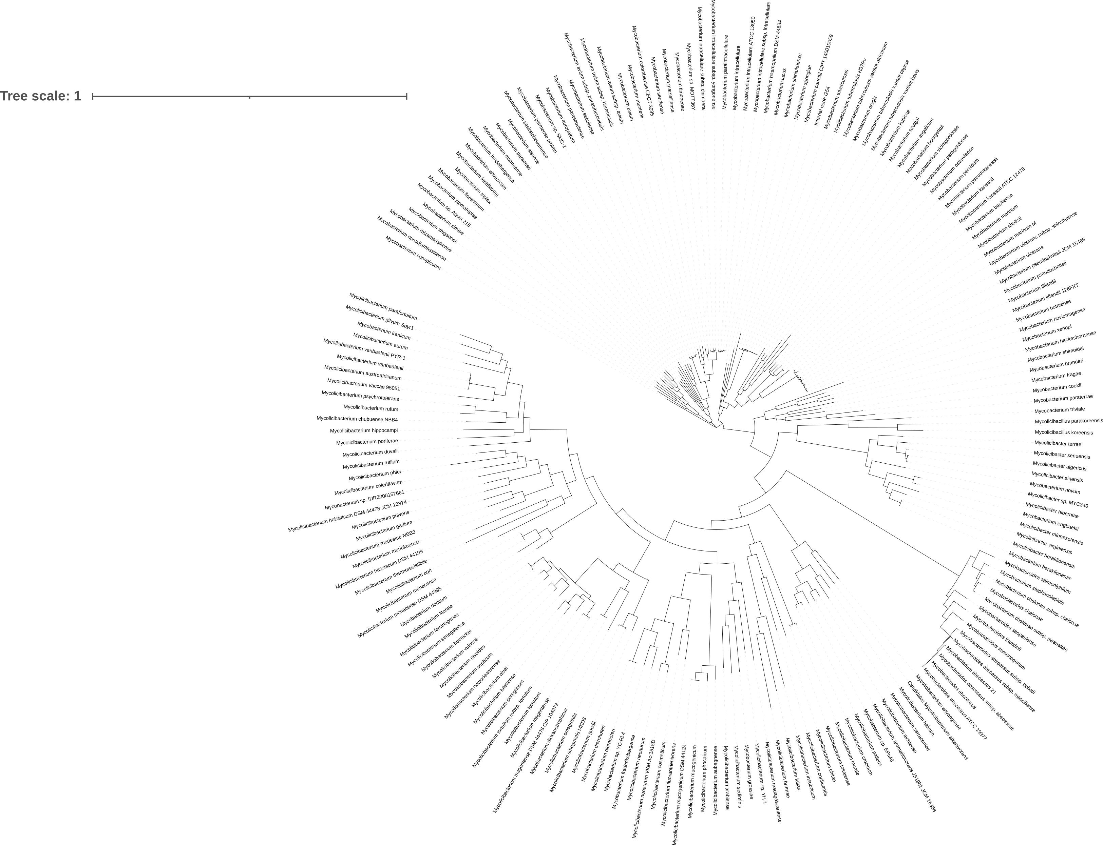
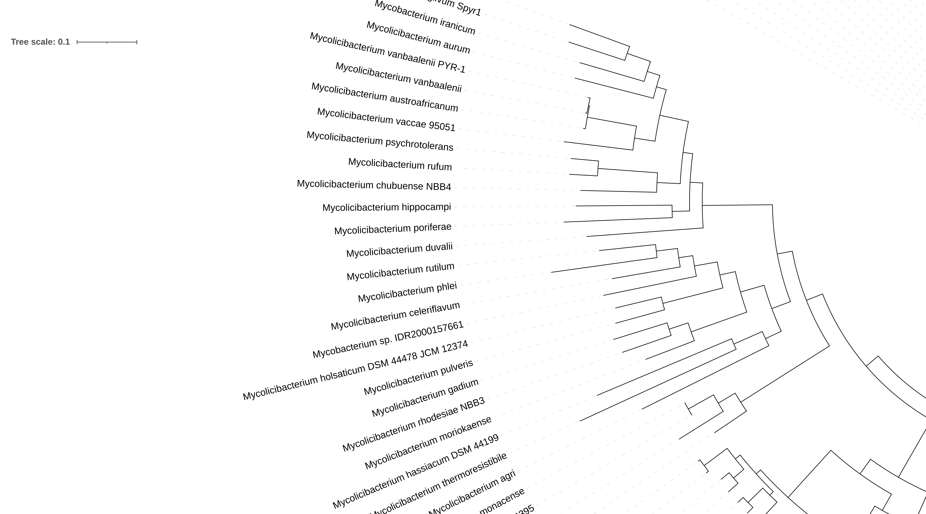
Notes:
This tool ran very slow. In total 20 ML trees were inferred and then the best one was chosen. It did about 35-24 hours per tree. It only finished last Thursday. So this is just a quick result of the tree. I created it with iTOL.

Slide 11
Pathogenicity of nontuberculous mycobacteria
Focus on:
Presence/absence of genes involved in cell wall synthesis → BLAST+
Predicting plasmids → PlasForest
Detecting prophages → PHASTER
Detecting genomic islands → IslandViewer4
Detecting virulence factors → VFDB (db)
Notes:
The last big step was to assess the pathogenicity of NTMs. The focus here was on 5 things, determining the presence/absence of genes involved in cell wall synthesis. It was also on predicting plasmids as well as detecting virulence factors, prophages and genomic islands. The method for the first thing in the list was already determined beforehand. For the other 4, tools still had to get selected. I selected them through a literature search. And I selected 3 tools and one db. I was able to run the first two tools in the list and process their data. The other tools still need to get done.

Slide 12
Pathogenicity of nontuberculous mycobacteria
Presence/absence of genes involved in cell wall synthesis
Tool: BLAST+ (v2.14.0)
Reference genome: M. tuberculosis H37Rv
Commands:
$ makeblastdb -in MA_DIM.fasta -title MA_DIM_db -dbtype nucl -out MA_DIM -parse_seqids
$ for i in *.fna;do name=$(echo $i | sed ‘s/_genomic.fna//g’);blastn -query $i
-db db/MA_DIM -out $name.txt -evalue 1e-10;done
Notes:
For the presence or absence of certain genes, a blast database was made with the tool BLAST+. The genes that were of interest, were the ones that are involved in mycolic acid (MA) and dimycocerosate (DIM) biosynthesis. So those genes that were annotated from the genome of M. tuberculosis H37Rv were used as a reference. The sequences of these genes were downloaded from Mycobrowser and a database was made. -in is the file with all the fasta sequences of the reference genes. The db type was in this case nucleotides. The option -parse_seqids was specified to use the full name of each sequence. Then a BLAST search was performed for each genome. The evalue was 1 to the power -10 (since it is only a small database, 80 seq).

Slide 13
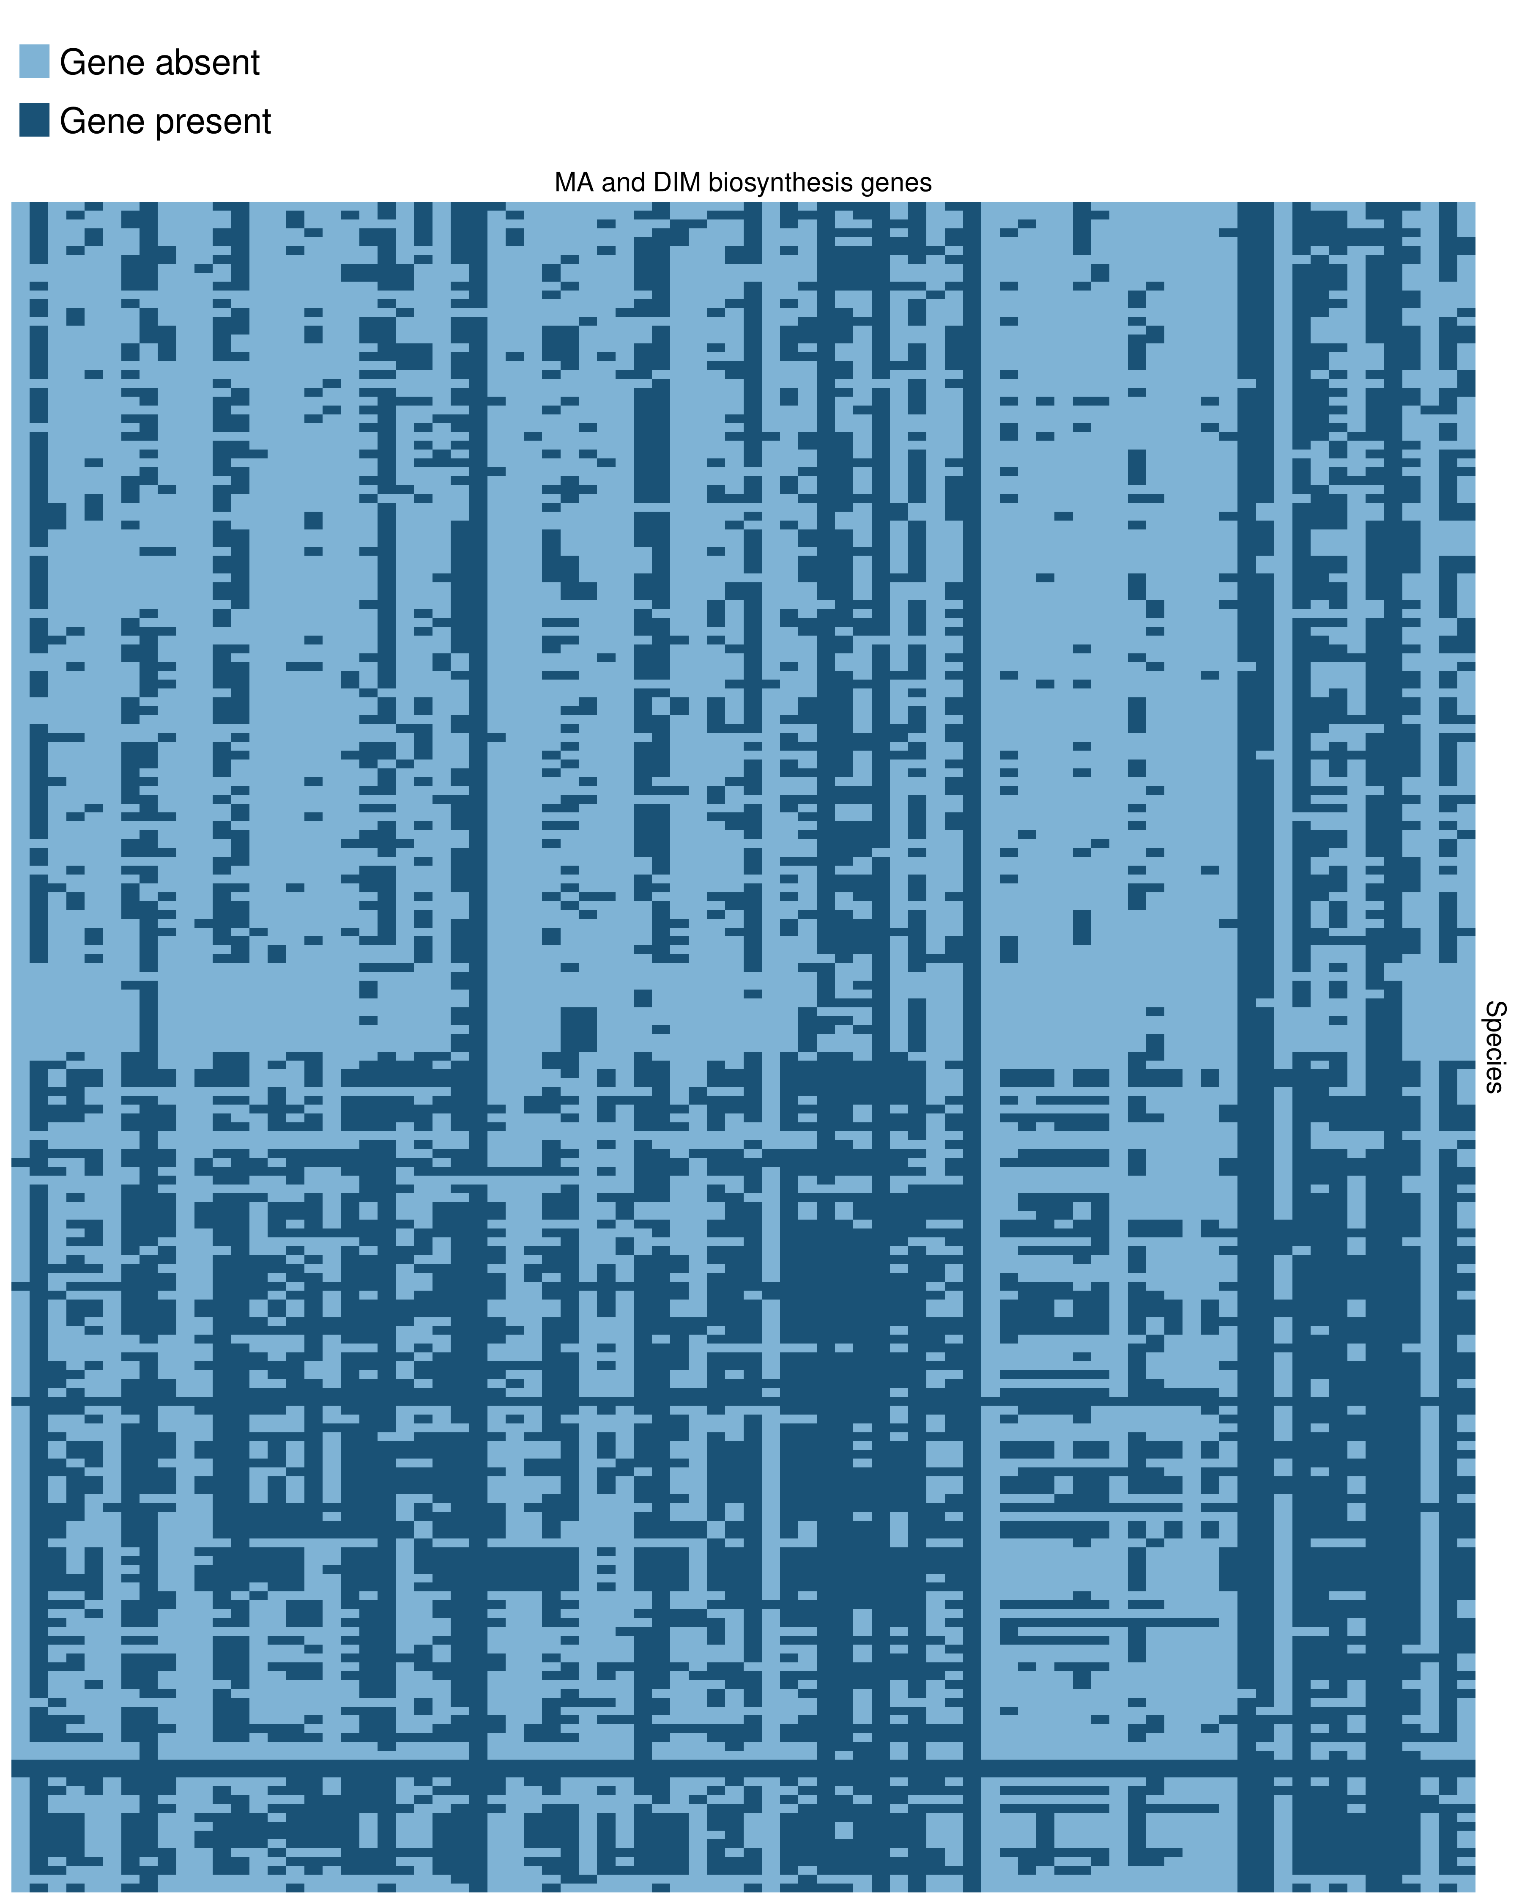
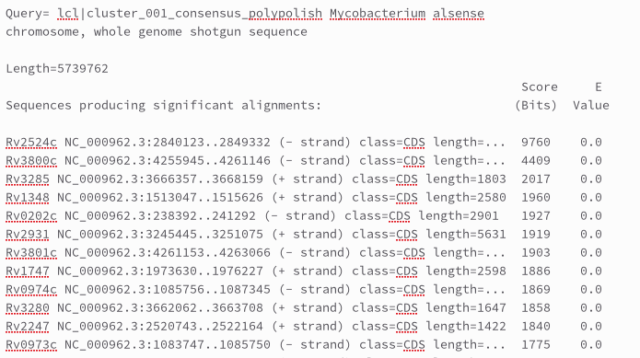
Processing and analyzing data
Presence/absence of genes involved in cell wall synthesis
Notes:
For each genome a .txt file was generated with the blast hits. To make one big overview file, I created a python script. This script created an Excel sheet. I used that Excel sheet to make a heatmap of all the results with the use of an R script.

Slide 14
Pathogenicity of nontuberculous mycobacteria
Prediction of plasmids
Tool: PlasForest (v1.4)
Command:
$ for i in ../Input_PlasForest/* ;do name=$(echo $i | sed 's/_genomic.fna/_Result.csv/g' | sed 's/..\/Input_PlasForest\///g') ; ./PlasForest.py -i ../Input_PlasForest/$i -o ../Output_PlasForest/$name --threads 4;done
Notes:
For the prediction of plasmids, a tool called PlasForest was used. This tool is a random forrest classifier to identify contigs of plasmid origin in contig and scaffold genomes. Here you can see the command that I used to run it. The input files were just the fasta files.

Slide 15
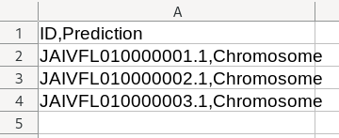
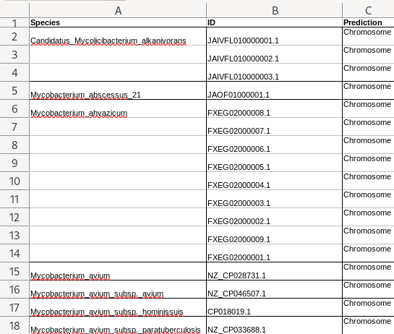
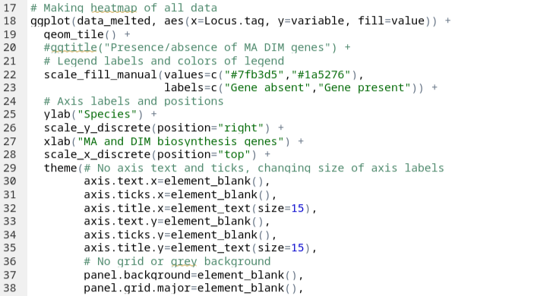
Processing and analyzing data
Notes:
For each genome a .csv file was made. To make one big overview file of the data, I created a python script. It made a csv file and I saved it as an .xlsx file. So the file looks like this.

Slide 16
Conclusion
Future work
202 high quality mycobacterial genomes
Information about:
Presence/absence genes involved in cell wall synthesis
Plasmids
Run PHASTER, IslandViewer4 and use VFDB
Correlate data to clinical relevance
Notes:
It can be concluded that 202 high quality mycobacterial genomes were obtained. Some information about the presence/absence of genes involved in cell wall synthesis of mycobacteria as well as the presence/absence of plasmids in NTMs was gained.
In the future, the other tools still have to run and their data needs to get processed. If all the data is obtained, a correlation of the data with the clinical relevance about NTMs can be made.

Slide 17
Questions
Notes:
Thank you for your attention. I hope it was somewhat interesting. If there are any questions, feel free to ask.

Slide 18
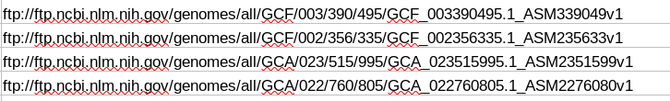
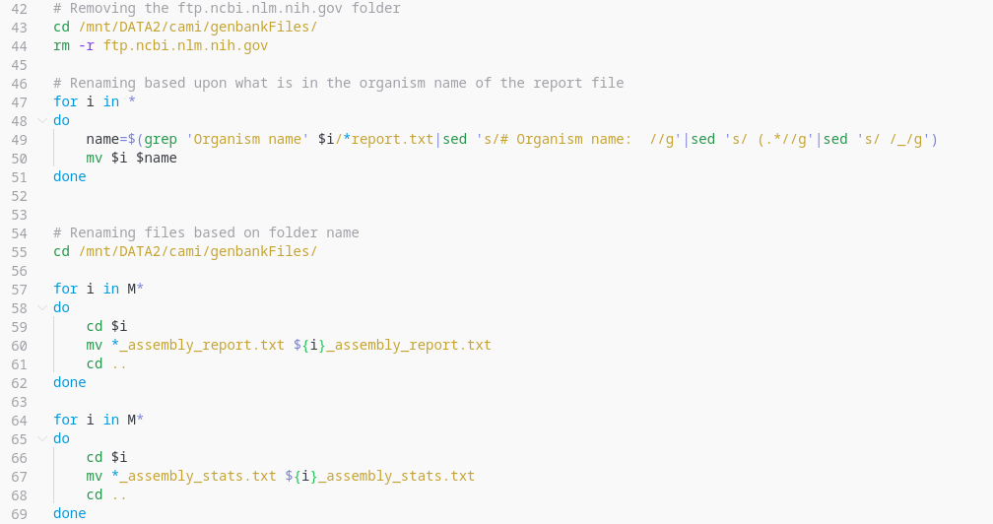
Extra
Downloading mycobacterial genomes
FTP path
Renaming folder and files
Notes:
FTP or File Transfer Protocol → standard network protocol to transfer files from one host to another.

Slide 19
Extra
Quality assessment of genomes
Tool: BUSCO (v5.4.4)
Workflow:
OrthoDB
Prodigal
HMMER
Single-copy orthologous genes (SCO)
Prediction of protein-coding genes
Match = orthologous?
Notes:
BUSCO uses the orthoDB database to get single-copy ortholog (SCO) genes (that is the db that I downloaded). So SCO are genes that have remained in single copy (so no duplication or loss) since the last common ancestor. If these genes would be absent in a genome, it could indicate incomplete sampling. With the use of prodigal (a tool for protein-coding gene prediction) the protein-coding genes will be predicted in your input fasta file. It then it searches for these SCO genes in your given fasta sequences. BUSCO also uses HMMER. This is a software package that provides tools for making probabilistic (are the events likely to happen or not) models of protein and DNA sequence domain families. They are called profile hidden Markov models. BUSCO uses this to assess whether the BUSCO gene matches are orthologous or not. It will then classify positive matches as complete or fragmented.

Slide 20
Extra
Building a phylogenetic tree
Panaroo command:
SCARAP workflow:
$ panaroo -i *.gff -o ./panaroo_output --clean-mode strict --remove-invalid-genes --threads 24 -a core --core_threshold 1.0 -f 0.5
n seed genomes
Candidate SCGs
Determination of final SCGs
Identification of SCGs
SCG or single-copy core genes
Notes:
Panaroo:
--clean-mode strict = this is the more aggressive approach to contamination and erroneous annotation removal since we are not interested in rare plasmids
--remove-invalid-genes = removes annotations that do not conform to the expected Prokka format such as including premature stop codons
-a core = output alignments of core genes in this case
--core_threshold 1.0 = core-genome sample threshold
-f 0.5 = protein family sequence identity threshold (threshold for assigning orthologous groups was too high probably → splits them and says that there aren’t many orthologous genes shared by the species)
SCARAP:
There are four steps in the workflow of SCARAP. The first step is the random selection of n seed genomes. The genes of these genomes were clustered into gene families (with the use of OrthoFinder). Then the candidate SCGs were selected from all seed gene families (by identifying gene families present in more than k seed genomes). The third step was the identification of these candidate SCGs in all the genomes. (Tools like MAFFT to align the seed sequences for each candidate SCGs and HMMER to make profile HMM were used). The fourth step was the determination of the final SCGs. This was done by retaining only candidate SCGs with exactly one gene in at least 90% of all genomes.

Slide 21
Extra
Pathogenicity of nontuberculous mycobacteria
Possible tools for prediction of plasmids
Tool | Reason to not use it
PlaSquid | Crashed each time
PlasFlow | Not maintained
PlasmidSeeker | Input type was fastq file of WGS reads
Possible tools for detection of prophages
Tool | Reason to not use it
PhySpy | Prediction instead of detection
VirFinder | For viral sequences + prediction instead of detection
Notes:
On this slide you can see some tools that I selected for the prediction of plasmids and the detection of prophages and the reason why they weren’t chosen. E.g. for the plasmid prediction, I had found some other tools, like PlaSquid, PlasFlow and PlasmidSeeker. With PlaSquid, the tool kept on crashing without an error showing or a possible log file with where it went wrong. With PlasmidSeeker, the input type that was required were files that I didn’t have. …

Slide 22
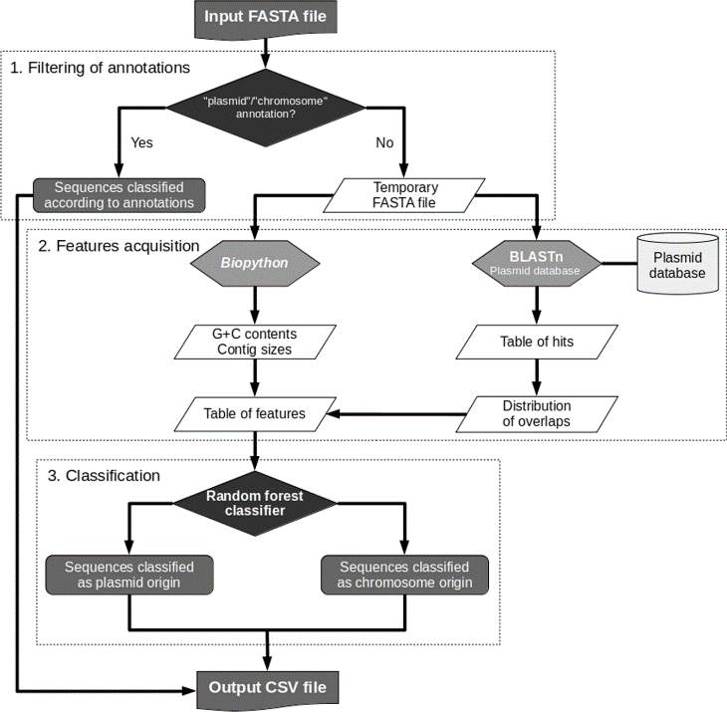
Extra
Pathogenicity of nontuberculous mycobacteria
Workflow of PlasForest:

