Slide 1

Asset Management and Graph Theory
Master 1 Econométrie-Statistiques
Armand L’Huillier, Camil Zahi, Yanis Rehoune
Supervised by Philippe De Peretti
February, 3rd, 2022

Slide 2
Contents
Theoretical approach
Performance attribution models
The traditional measure
Multifactor models
The limits of modern financial theory
Graphs Theory
General concept
The concept of centrality
The different types of clustering
2. Empirical approach
The Dataset
Application: Outperform a stock index
Data Structure
Correlations and clustering coefficients
Management of a simulated portfolio

Slide 3
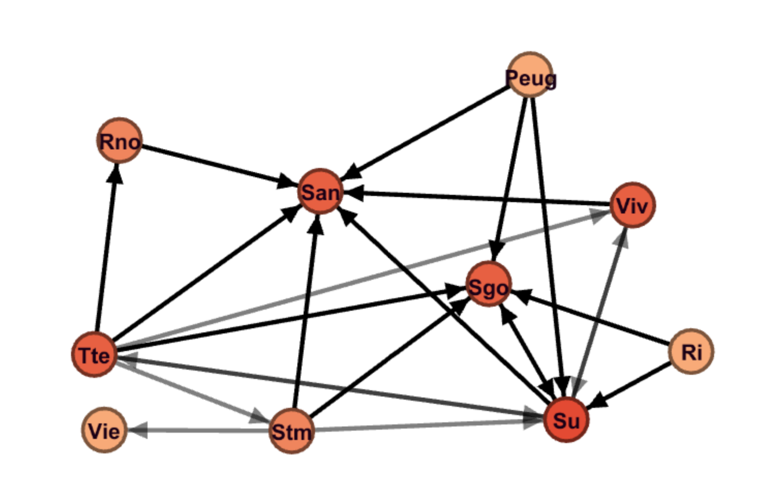
Partial representation of an adjacency matrix

Slide 4

The Data set
Limits
Some missing values and unexplained 0
CAC40 entry-exit: partial representation of the index (27 assets)
Short period (2005-2009)

Slide 5
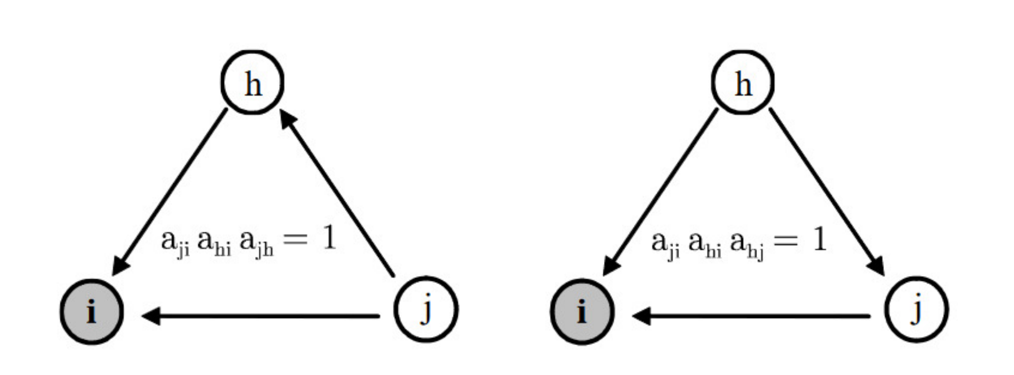
Topology of triangles

Slide 6
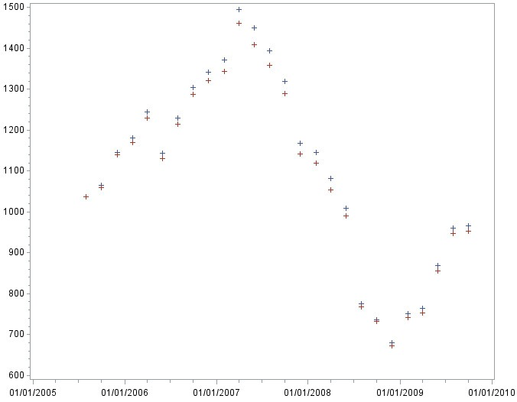
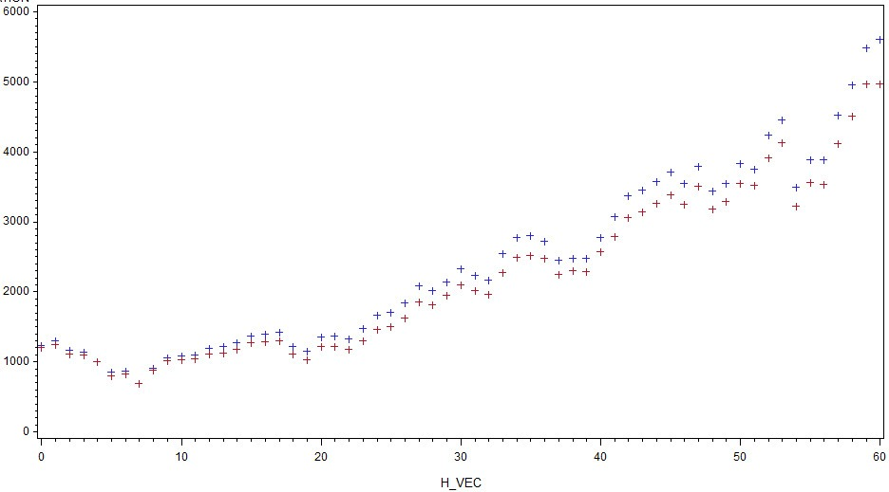
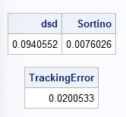
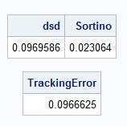
Outperform a stock index
01/01/2002
31/012/2021

Slide 7
Bibliography
Cohen L., Frazzini A., (2008), Economic links and predictable returns, In Journal of Finance, volume 63(4), pages 1977–2011.
El Himdi K., Roy R., (1997), Tests for Noncorrelation of Two Multivariate ARMA Time Series, The Canadian Journal of Statistics / La Revue Canadienne de Statistique, Jun.,1997, Vol. 25, No. 2, pp. 233-256.
Fagiolo G., (2006), Clustering in Complex Directed Networks, Sant’Anna School of Advanced Studies,Laboratory of Economics and Management, Piazza Martiri della Libert‘a 33, I-56127 Pisa, Italy.
Kharoubi C., (2016), Hedge Funds, une analyse critique, RB edition.
Pacreau G., Lezmi E., Xu J., (2021), Graph Neural Networks for Asset Management, 119-2021, Amundi Asset Management, Working Paper.
Wu J., Birge J.R., (2014), Supply chain network structure and firm returns. SSRN, 238547.
Wu L., (2015), Centrality of the supply chain network. SSRN, 2651786.
Zhu Z., Peng Q., Guan X. (2016), A time series clustering method based on hypergraph partitioning. In 2016 International Conference on Progress in Informatics and Computing (PIC 2016), pages 27–31.

Slide 8
Thanks for your attention !
Armand L’Huillier, Camil Zahi, Yanis Rehoune

