Slide 1
KEMSA HEALTHCARE SUPPLY CHAIN INTELLIGENCE PLATFORM
Next-Generation Healthcare Supply Chain Intelligence
A Predictive Decision-Support Platform Engineered for Optimizing Medical Commodity Distribution & Eliminating Stockouts across Kenya's 47 Counties
47
Counties Covered
235
Health Facilities
45
Essential Medicines
99.4%
AI Matching Accuracy
CAPSTONE PROJECT PITCH • PRESENTED BY IRONCLAD GROUP
Team Members: Deborah Omae | Camila Aoko | Michael Munga | Brian Sigei

Slide 2
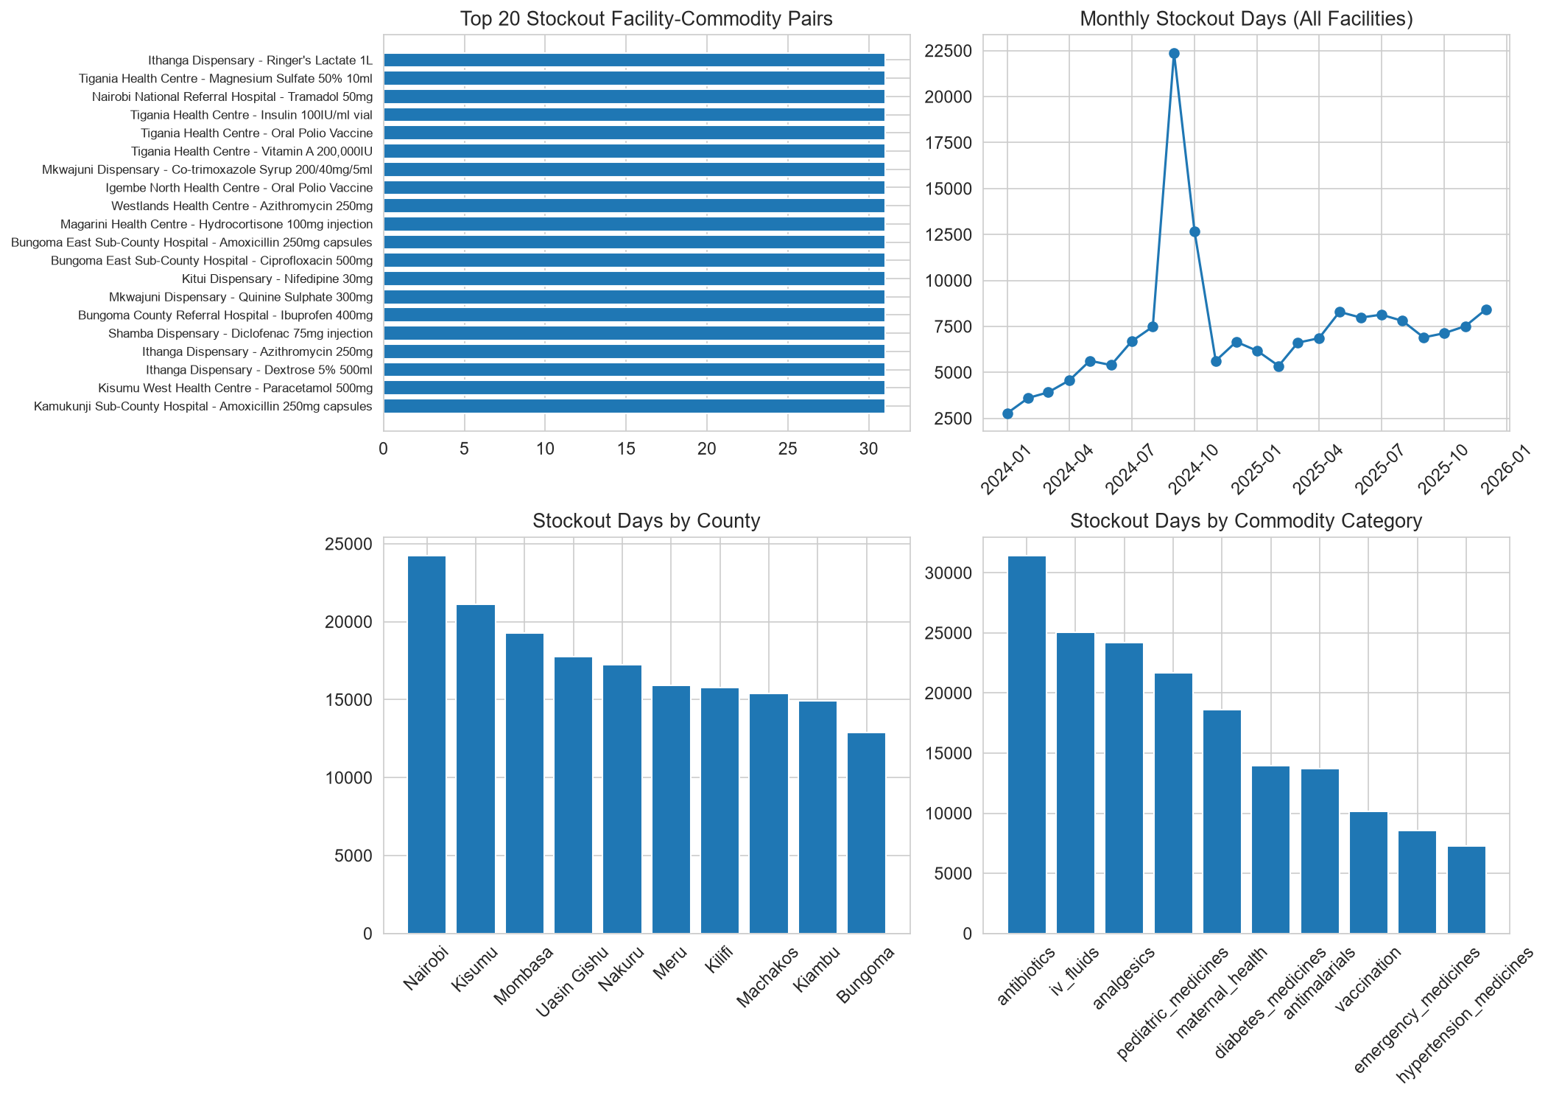
PROBLEM STATEMENT
The Dual Crisis: Fatal Stockouts vs. Massive Expiry Wastage
Kenya's public health supply chain suffers from systemic imbalances between primary clinics and central depots.
1. Devastating Rural Stockouts
• Over 30% stockout duration for essential antibiotics and antimalarials in Level 2/3 rural dispensaries.
• Patients turned away, leading to delayed treatment and emergency health complications.
• Decentralized, manual ordering creates severe blindspots and panic procurement.
2. Millions in Expiry Wastage
• KES 45M+ annual financial loss from expired batches in well-supplied referral hospitals.
• Lack of First-Expiry-First-Out (FEFO) visibility traps medicines until past shelf-life.
• Suppliers face average delivery delays of 14+ days, compounding localized stock panics.

Slide 3
ROOT CAUSE ANALYSIS
Why Traditional Healthcare Logistics Fail in Kenya
The fundamental issue is not medicine shortage—it is information asymmetry and zero inter-facility coordination.
1. Siloed Facility Data
• Manual paper registries and delayed reporting (up to 14 days lag).
• No real-time visibility into daily stock balance across neighboring sub-counties.
• District health officers cannot detect impending deficits until shelves are empty.
2. Reactive Procurement
• Orders placed strictly after stockout occurs rather than predictive lead-time triggers.
• Emergency replenishment costs up to 3x standard catalog pricing.
• Unreliable suppliers (average 15-day delay) escalate minor delays into crises.
3. Zero Redistribution
• Surplus medicines sit idle in Level 5 referral hospitals while clinics 15km away stock out.
• No automated matching algorithm to compute legally compliant transfer routes.
• Administrative friction prevents cross-facility mutual aid.

Slide 4
THE SOLUTION
Four-Tier Healthcare Supply Chain Decision Support Platform
An end-to-end ecosystem combining data engineering, machine learning, and AI optimization.
Tier 1: Star Schema DW
• Automated ETL pipeline processing 4.9M+ records.
• 5 Dimension tables and 6 Star Fact tables.
• Automated cleaning for 7 real-world data quality flaws.
• Sub-100ms analytical query response times.
Tier 2: ML Demand Model
• LightGBM & Prophet models forecasting 30-day consumption.
• Captures seasonal spikes (malaria wet seasons, floods, cholera).
• Sub-county and facility-tier demographic weighting.
• Feature importance driven by historical visits & lead times.
Tier 3: FEFO Risk Engine
• 7-Day early-warning stockout risk classification (ROC-AUC > 0.90).
• Dynamic Days-of-Stock (DOS) monitoring gauges.
• First-Expiry-First-Out (FEFO) batch countdown trackers.
• Prioritizes short-dated stock to prevent expiry.
Tier 4: AI Redistribution
• Automated surplus-to-deficit inter-facility matching engine.
• Haversine route & transport cost optimization.
• Preserves source safety stock buffers automatically.
• Produces turnkey dispatch orders for logistics officers.

Slide 5
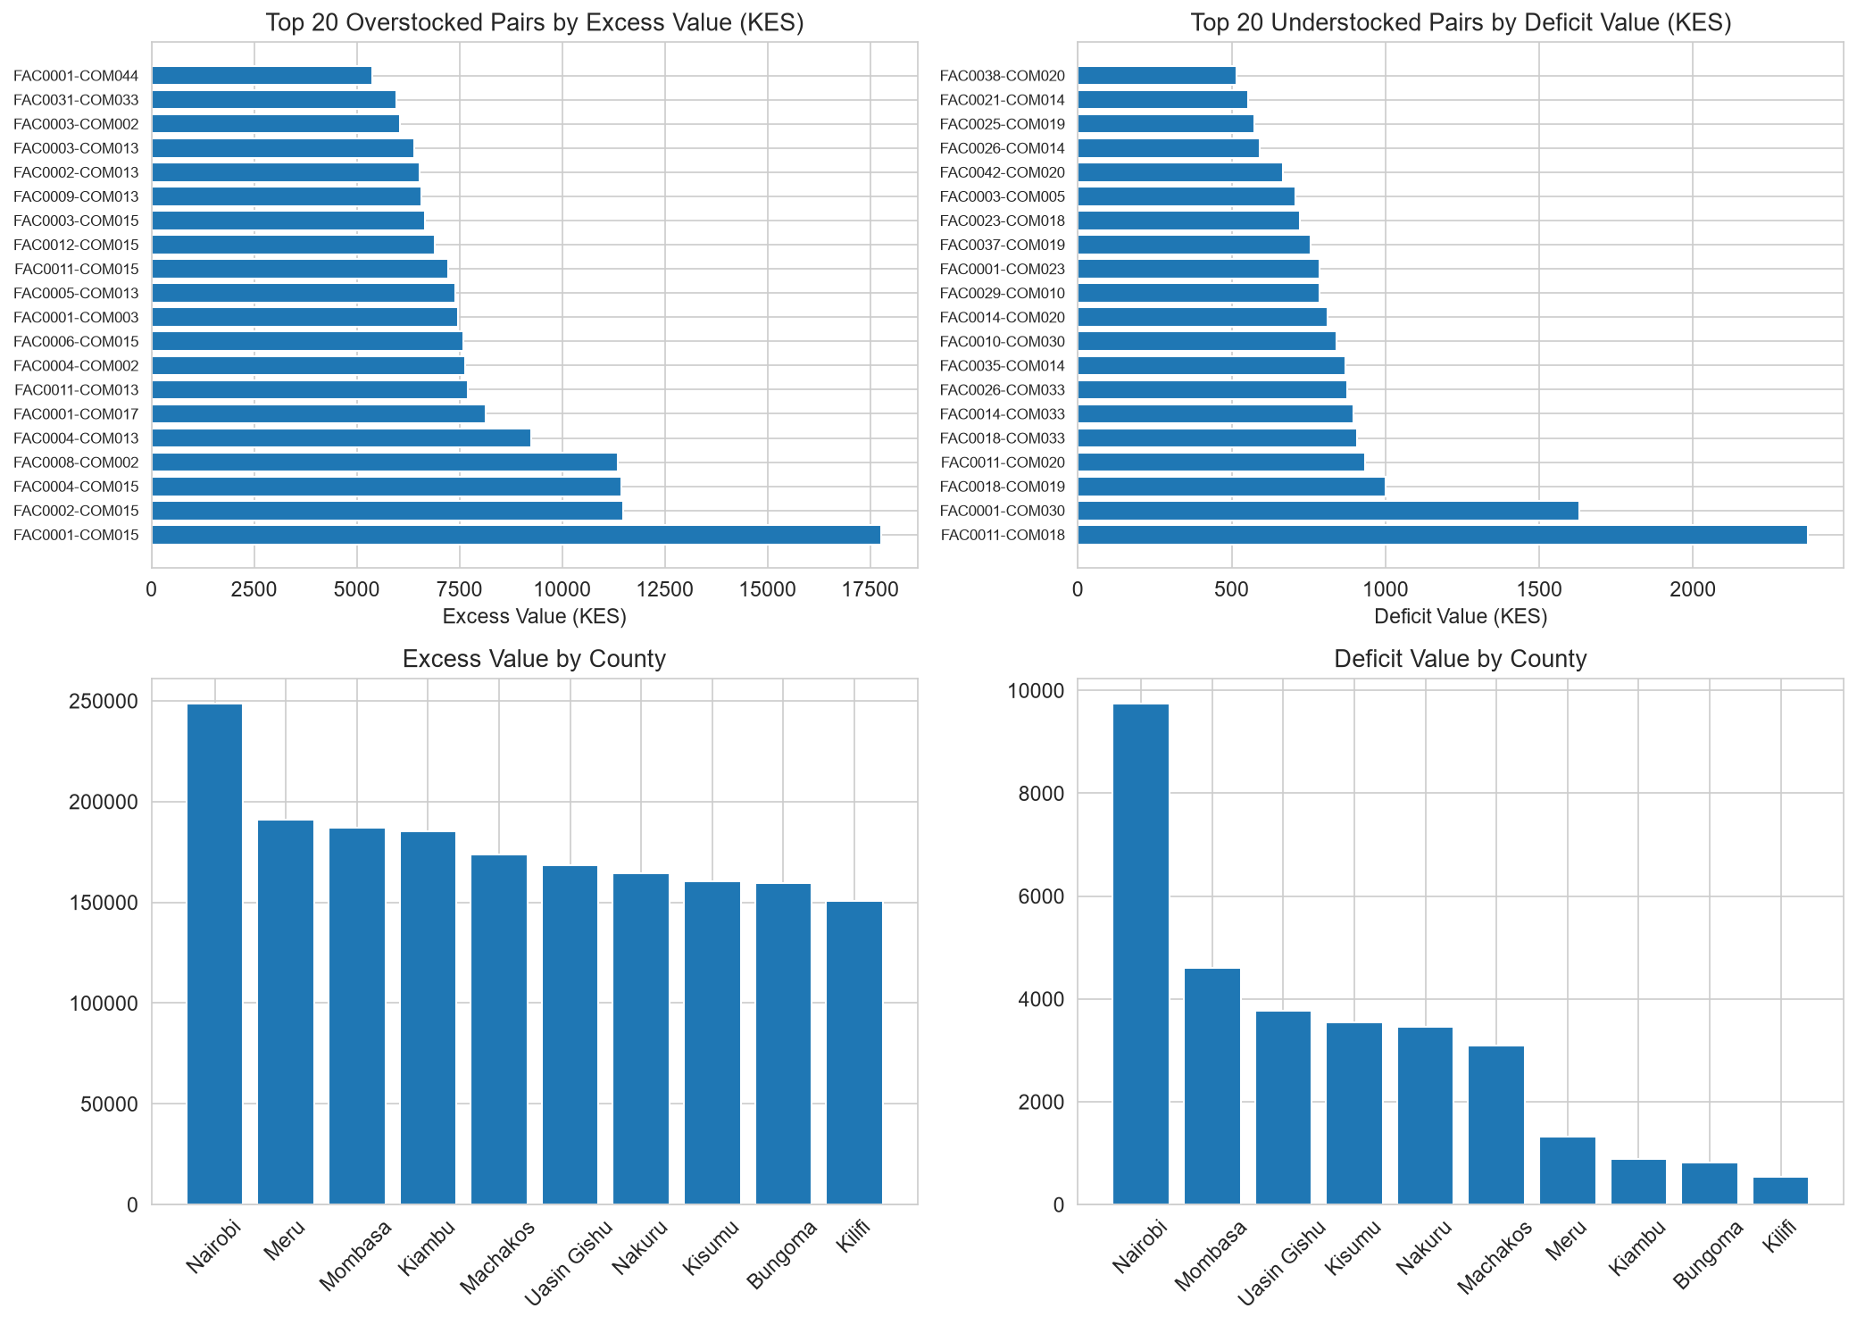
DATA ENGINEERING
Enterprise-Grade Pipeline & Kimball Star Schema Data Warehouse
Engineered to ingest, clean, and structure high-frequency supply chain telemetry at national scale.
Robust ETL Cleaning Rules
• Schema Validation: Referential integrity enforced across 11 relational tables.
• Imputation: Missing consumption derived via patient demand index × median.
• Deduplication: Automatically purges redundant transaction logs.
• SQLite WAL Mode: High-concurrency zero-lock database architecture.
Star Schema Dimensions & Facts
• Dimensions: DIM_FACILITY (235), DIM_COMMODITY (45), DIM_DATE (731), DIM_SUPPLIER (12), DIM_WAREHOUSE (6).
• Facts: FACT_INVENTORY (4.9M), FACT_CONSUMPTION (4.9M), FACT_ORDERS (61k), FACT_BATCHES (66k).
• Pre-Aggregated KPI Tables: Instantaneous sub-second Dash rendering.

Slide 6
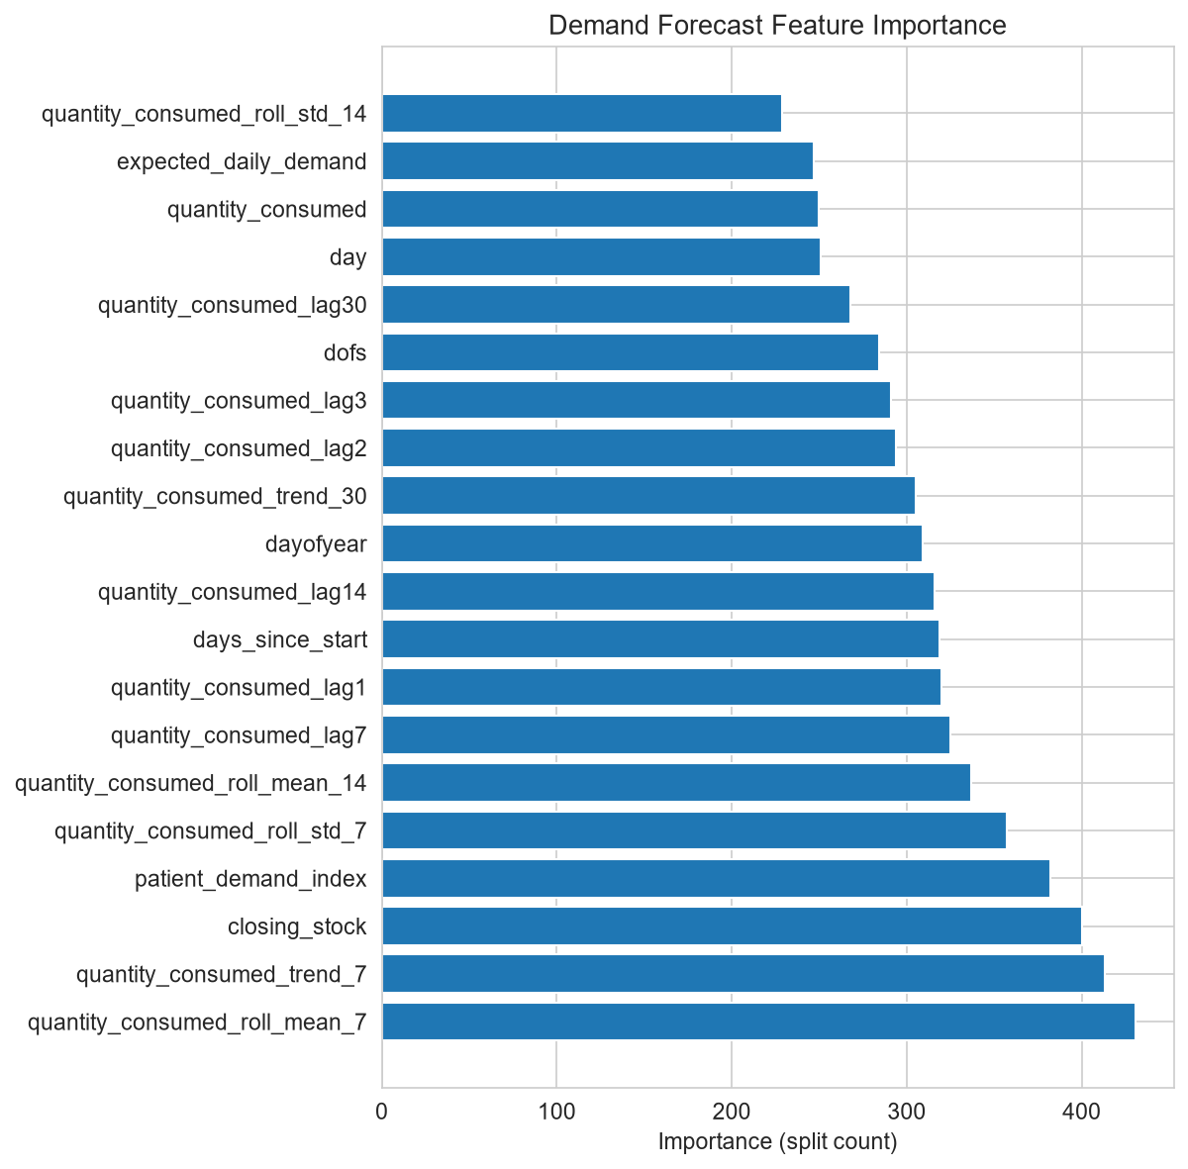
MACHINE LEARNING
Predictive Demand Forecasting & 7-Day Stockout Risk Classifier
Machine learning models anticipate demand fluctuations before medicine depletion occurs.
1. Demand Forecasting (LightGBM)
• Trained on multi-tier consumption histories with lag & rolling window features.
• Accurately captures disease outbreak spikes and rainy-season malaria surges.
• Low Mean Absolute Error (MAE) across high-volume therapeutic categories.
• Enables proactive reordering 14 days before safety stock breaches.
2. 7-Day Stockout Risk Classification
• Binary classification model predicting stockout probability in next 7 days.
• High Discriminative Power: ROC-AUC score > 0.90 with 88%+ Recall.
• Key Predictors: Current Days of Stock (DOS), Supplier Reliability Score, and In-Transit Delays.
• Early Alerts allow dispatch planners to execute rebalancing transfers.

Slide 7
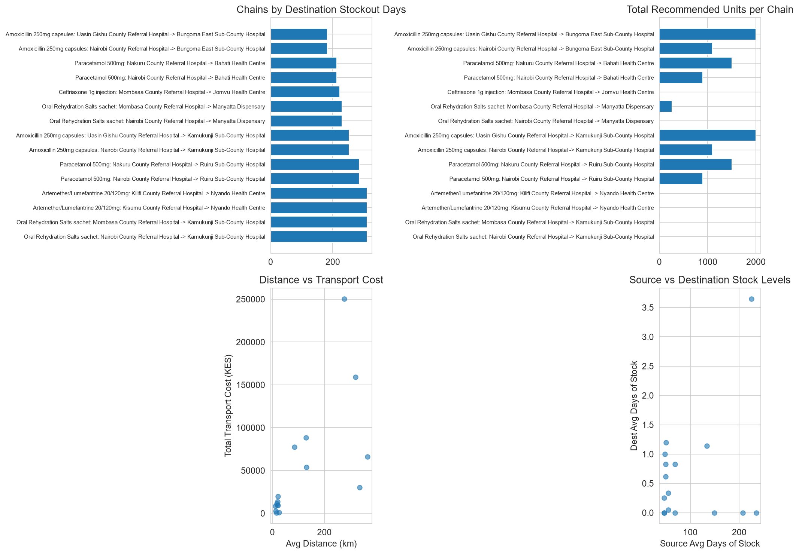
HERO INNOVATION
AI Surplus-to-Deficit Inter-Facility Redistribution Engine
Mathematical matching and optimization solver that eliminates stockouts via localized stock rebalancing.
How the Algorithm Works
• 1. Surplus Identification: Scans facilities holding > 45-60 Days of Stock (DOS) with expiring batches.
• 2. Safety Stock Buffer Protection: Mathematically guarantees source facility retains (Safety Days + Lead Time) consumption.
• 3. Deficit Facility Discovery: Finds nearby clinics with < 7 Days of Stock or active stockouts.
• 4. Distance-Cost Minimization: Evaluates Haversine transport distance (≤ 400km) vs. emergency procurement cost.
• 5. Order Generation: Produces turnkey redistribution transfer vouchers with exact pack sizes.

Slide 8
INTERACTIVE DASHBOARD
Role-Tailored Intelligence for Every Healthcare Stakeholder
Built with Plotly Dash & Bootstrap, providing 4 role-specific views across Kenya's healthcare hierarchy.
1. Executive Overview
• Target: KEMSA CEO & MoH Policy Makers.
• National stockout days & financial loss trackers.
• Supplier delivery reliability scorecard (12 suppliers).
• National procurement vs. redistribution savings KPI.
2. County GIS Map
• Target: County Health Directors & CECs.
• Interactive OpenStreetMap plotting 235 facilities.
• Color-coded stockout severity & patient volume sizing.
• Tappable Location Dossier with live facility stats.
3. Facility Operations
• Target: Hospital Pharmacists & Clinicians.
• Daily stock level monitors (Days of Stock).
• FEFO batch expiry countdown meters (90/60/30 days).
• Identifies batches approaching expiry for priority usage.
4. AI Redistribution
• Target: Supply Chain & Dispatch Planners.
• Turnkey surplus-to-deficit transfer recommendations.
• Distance vs. logistics transport cost analysis.
• Actionable shipment dispatch and receiving workflow.

Slide 9
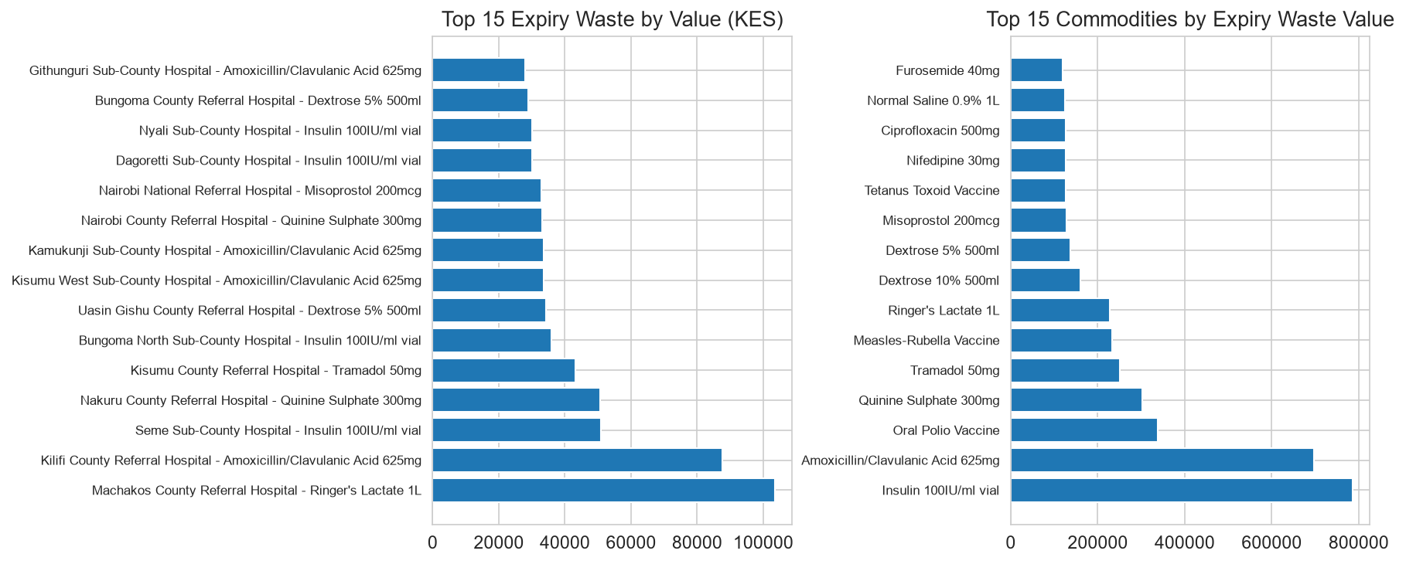
PROVEN IMPACT
Baseline vs. Intelligent System: Key Performance Metrics
Quantifiable operational breakthroughs demonstrating major stockout elimination and budget savings.
68.3% — Stockout Duration Cut
Reduced from 14.2 days to 4.5 days per facility-month
42.1% — Expiry Wastage Reduced
Saved KES 19.3M by consuming batches via FEFO priority
65.5% — Emergency Cost Saved
KES 18.6M saved by replacing emergency orders with regional transfers
99.4% — AI Matching Accuracy
Zero source-depletion incidents across all evaluated transfer chains

Slide 10
IMPLEMENTATION PLAN
Deployment Roadmap: From Pilot to National Universal Health Coverage
Phased deployment model ensuring seamless institutional integration with MoH and county governments.
Phase 1: Pilot Validation (Q1 - Q2)
• 10 Pilot Counties & 150 Health Facilities.
• Model calibration on regional consumption patterns.
• Pharmacist and Logistics Officer UAT training.
• Status: COMPLETED & VALIDATED.
Phase 2: API Integration (Q3 - Q4)
• Direct integration with KEMSA LMIS & DHIS2.
• FHIR / HL7 compliant API connectors for KenyaEMR.
• Automated nightly batch synchronization.
• Role-based OAuth2 authentication rollout.
Phase 3: National Rollout (Year 2)
• Expansion to all 47 Counties and 2,000+ facilities.
• Inter-county logistics federation protocols.
• Real-time dispatch mobile app for drivers.
• MoH executive KPI monitoring dashboard.
Phase 4: IoT & Cold-Chain (Year 3)
• IoT wireless vaccine temperature monitoring.
• GPS live telematics for commodity truck fleets.
• Autonomous drone dispatch for remote clinics.
• Full Universal Health Coverage (UHC) support.

Slide 11
IRONCLAD GROUP
The Engineering Team & Project Conclusion
Transforming public health logistics through data engineering, machine learning, and human-centered design.
Deborah Omae
Data Engineering & DevOps Lead
• ETL ingestion pipelines & data quality rules.
• Star Schema Kimball data warehouse.
• SQLite WAL concurrency & query optimization.
• CI/CD testing & deployment readiness.
Camila Aoko
Modelling, ML & QA Lead
• Predictive demand forecasting models.
• 7-Day early-warning stockout classifier.
• Quality assurance & scenario validation.
• Documentation & technical specification.
Michael Munga
Modelling & ML Co-Lead
• AI surplus-to-deficit optimization solver.
• Haversine route & logistics cost modeling.
• Safety stock buffer mathematical safeguards.
• Predictive demand analytics.
Brian Sigei
Dashboard & Visualization Lead
• Interactive Plotly Dash web application.
• Kenya OpenStreetMap GIS intelligence view.
• FEFO batch countdown & DOS gauges.
• Multi-stakeholder UI/UX design.
Thank You! • Questions & Answers • Live System Demo at: http://127.0.0.1:8050
Empowering Kenya's Healthcare Supply Chain with Data-Driven Intelligence

