Slide 1
Maximum Extractable Value (MEV) Mitigation Approaches in Ethereum and Layer-2 Chains: A Comprehensive Survey
ZEINAB ALIPANAHLOO, ABDELHAKIM SENHAJI HAFID AND KAIWEN ZHANG (Member, IEEE 2024)
MAGISTRELLO CAMILLA (4512554)

Slide 2
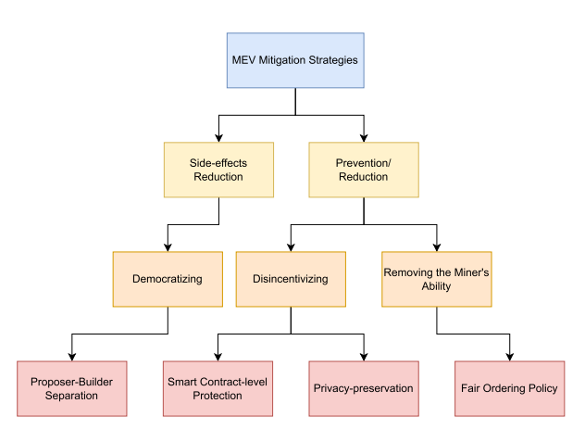
MITIGATION STRATEGIES
Two major categories:
Prevention/Reduction: try to eliminate or reduce MEV opportunities.
Side-effects Reduction: try to reduce the negative effects.

Slide 3
PREVENTION/REDUCTION: FAIR ORDERING POLICIES
If the problem arise because sequencer can reorder transaction then precise rule must be introduce.
Problems:
the sequencer could still censor or delay transactions;
the sequencer could leak information to external bots;
in systems with a single sequencer, a strong level of trust is still required

Slide 4
PREVENTION/REDUCTION: FAIR ORDERING POLICIES
Single Sequencer
First Come First Serve policy:
transactions are ordered according to their arrival time;
whoever arrives first is processed first.
New problems emerge:
Latency wars
Spam attacks

Slide 5

PREVENTION/REDUCTION: FAIR ORDERING POLICIES
TimeBoost
Each transaction receives a score calculated using:
a timestamp
an economic bid
$t_{i}$ = transaction arrival timestamp
𝑡_𝑖 = transaction arrival timestamp
$b_{i}$ = bid (the tip paid by the user to gain priority)
𝑏_𝑖 = bid (the tip paid by the user to gain priority)
𝜋($b_{i}$) = bid priority function
𝜋(𝑏_𝑖) = bid priority function

Slide 6

PREVENTION/REDUCTION: FAIR ORDERING POLICIES
Decentralized Sequencing
Several nodes collaborate to decide transaction ordering instead of relying on a single operator.
Themis and Wendy: temporary leaders or synchronized timestamp across nodes
Require significant coordination and increase complexity and network overhead.

Slide 7
PREVENTION / REDUCTION: PRIVACY-PRESERVING METHODS
Transaction contents are hidden until the ordering has already been decided.
Threshold Encryption
Transactions are encrypted
Decryption key is distributed among multiple parties
Delay Encryption
The transaction remains encrypted for a certain period of time
Can only be obtained after solving a computational problem
Trusted Execution Environments
Transactions are processed inside protected enclaves
Published only after execution

Slide 8

PREVENTION / REDUCTION: SMART CONTRACT SOLUTIONS
Reduce the possibility of front-running directly inside applications.
Two main families:
Entirely on-chain and remains inside smart contracts.
Off-chain components connected to the blockchain ecosystem. Some important example are CoW Swap and Fair MM.

Slide 9

SIDE-EFFECT REDUCTION: PROPOSER-BUILDER SEPARATION
who builds the block
who proposes it to the network
The most important implementation today is MEV-Boost
In this model:
• searchers identify MEV opportunities;
• builders construct blocks;
• relays verify blocks;
• validators choose which block to propose.
Reduces the power of individual validators
Introduces new centralization risks around relays and builders

Slide 10
CONCLUSION
APPROACH​ | PROS​ | CONS​
Fair Ordering Policies​ | Improves fairness and reduces transaction manipulation​ | Coordination overhead and latency issues​
Privacy-Preserving Methods​ | Protects transaction privacy​ | High cryptographic complexity, increased latency and scalability challenges​
Smart Contract-Level​ | No protocol changes required​ | Limited to specific applications​
Proposer-Builder Separation​ | Improves scalability and efficiency and reduces validator power​ | New centralization risks (builders/relays) and higher ecosystem complexity​
MEV cannot be completely eliminated, because it emerges directly from the structure of blockchains based on transaction ordering.

