Slide 1

Second Sprint Release
SCRUM APPROACH

Slide 2
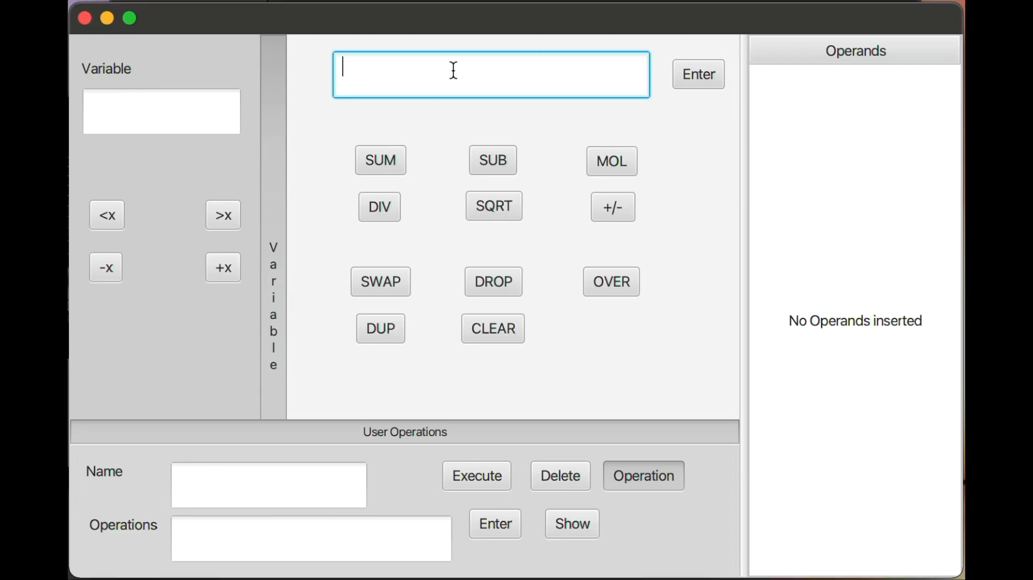
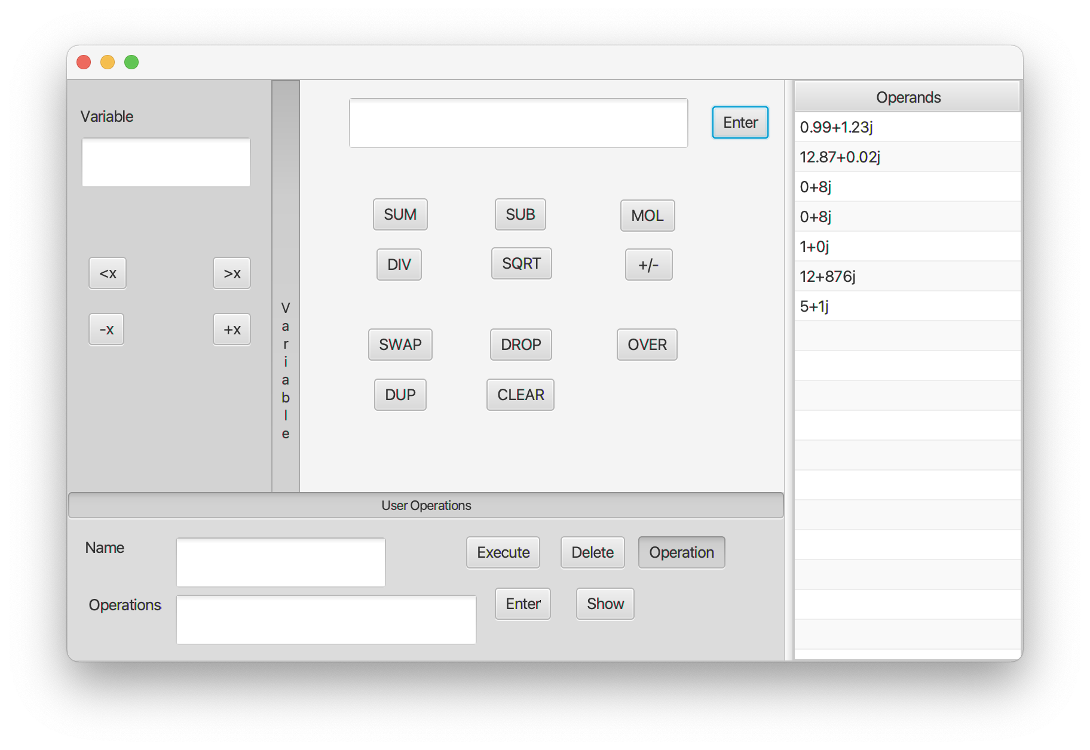
Potentially shippable increment
In the video there is a short demonstration of the system working. The calculator, after the second sprint, has been updated, allowing user to execute operation with variables and also to define his operations giving them a name and execute it on the inserted operands, delete or update them.
What we have
achieved
What we aspected to achieve

Slide 3
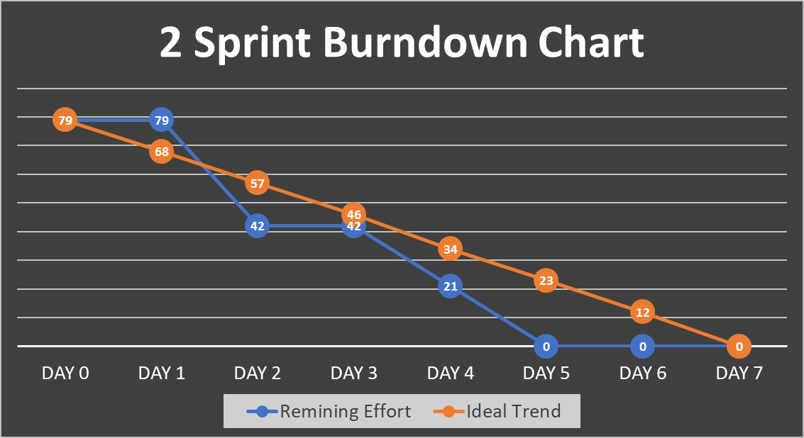
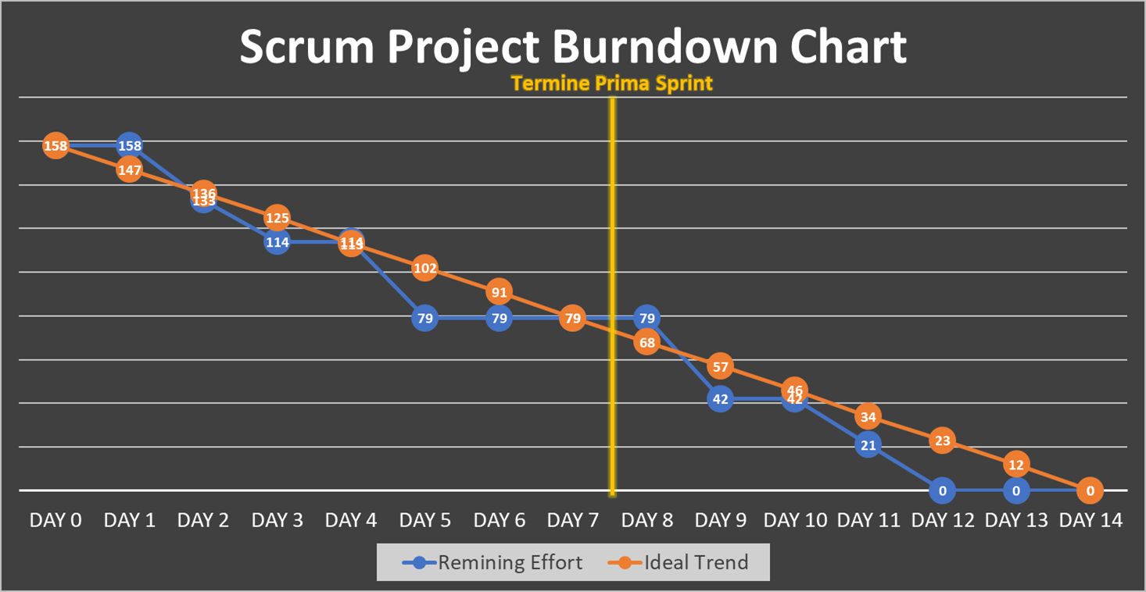
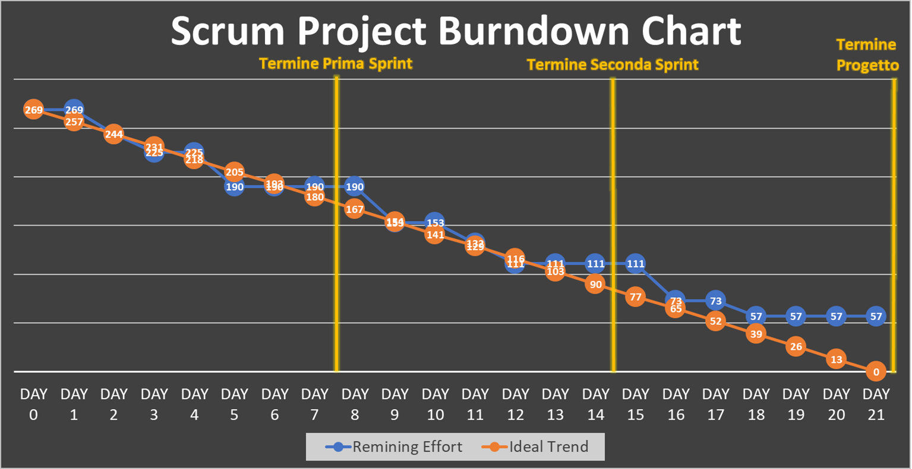
Second SprintBurndown Chart
We have been working since the DAY2 and we concluded all the tasks associated with the 24 User Stories chosen for the Second Sprint on the DAY5.
The Burndown chart of the Second Sprint.
The Burndown chart relating the First and the Second Sprint, with a total duration of 14 days in which we perfromed a total of 158 Story Points
The Burndown chart relating the First, the Second and the estimate for the Third Sprint, with a total duration of 21 days in which we will perform 212 Story Points .

Slide 4







Sprint Review and Sprint Retrospective
Sprint Review
Sprint Retrospective
We discussed about the application of SCRUM methodology, and about what to improve and about what went well in the process
We discussed about the released product, the positive and negative aspects.
We pay attention to issues encountered implementing the release, due to substimation of a User Story.
START
STOP
MORE OF
LESS OF
We also discussed the need for refactoring and the possibility of improving the user experience by making the Gui friendlier.
KEEP DOING
See it
See it
SECOND SPRINT REVIEW REPORT
SECOND SPRINT RETROSPECTIVE REPORT

Slide 5
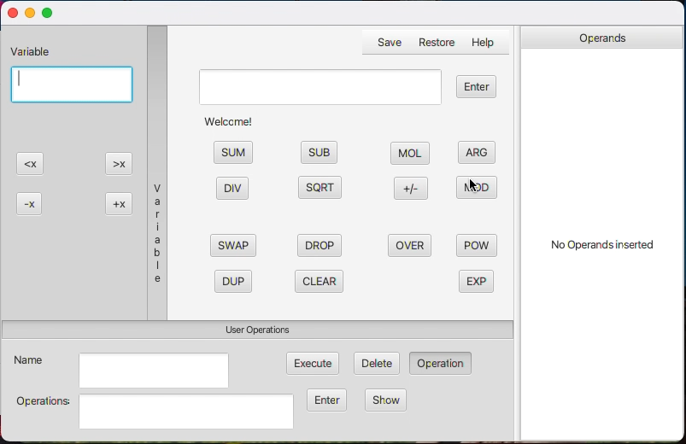
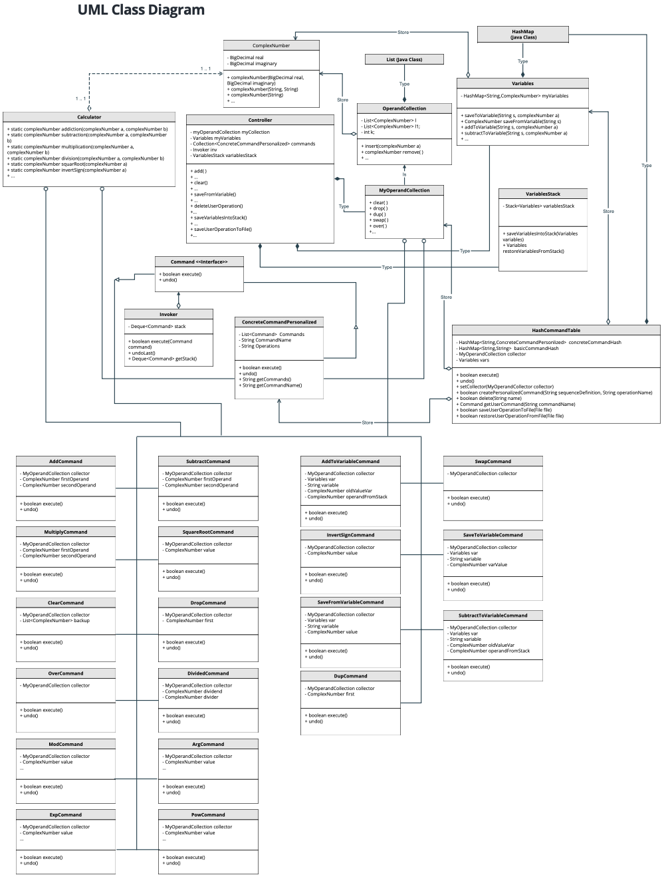
System architecture refinement
A short illustration of “look-and-feel” and the user interaction with the graphical user interface.
The UML Class Diagram shows a refinement of the previous architecture in relation to the changes made in the Sprint just passed and in anticipation of the next Sprint.
A The UML Class Diagram
See it

Slide 6







Updated Product Backlog and Third Sprint Backlog
Starting from the "Backlog iceberg" now none of User Epics have been left as such. There are no more User Stories in an embryonic state, but all are well detailed with associated acceptance criteria well defined.
THIRD PRODUCT BACKLOG
ESTIMATED TEAM VELOCITY:
56 Story Points
THIRD SPRINT PRODUCT BACKLOG:
54 Story Points
The 16 next high priority User Stories
See it
See it
We have decided to decrease the number of story points for this sprint, not because we were unable to meet the estimated speed in the previous sprints, but rather because we decided to allocate three of the weekly working hours to the code restructure to align with the planned architectural changes.

Slide 7
Thanks for the attention

