Slide 1



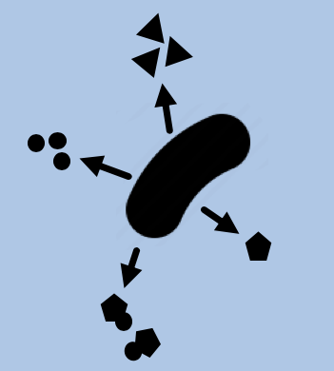


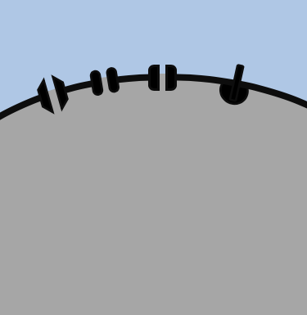


SPORULATION
RELATIVE ABUNDANCE
ECOLOGY
Between hosts transmission
Within hosts competition
-
+
POPULATION GENETICS
RELATEDNESS
+
+
+
-
+
+
+
COOPERATION
+
+
+
+
COVARIATE(S)
: significant effect
: marginally significant effect
+/-
: direction of the effect

Slide 2
MIGRATION
GROUP SIZE
ECOLOGY
Sporulation
Within host relative abundance
-
+
POPULATION GENETICS
RELATEDNESS
+
+
+
-
+
+
+
COOPERATION
a
b
c
d
e
f
+
+
+
+
COVARIATE(S)
: significant effect
: marginally significant effect
Genome size
+/-
: direction of the effect

