Slide 1
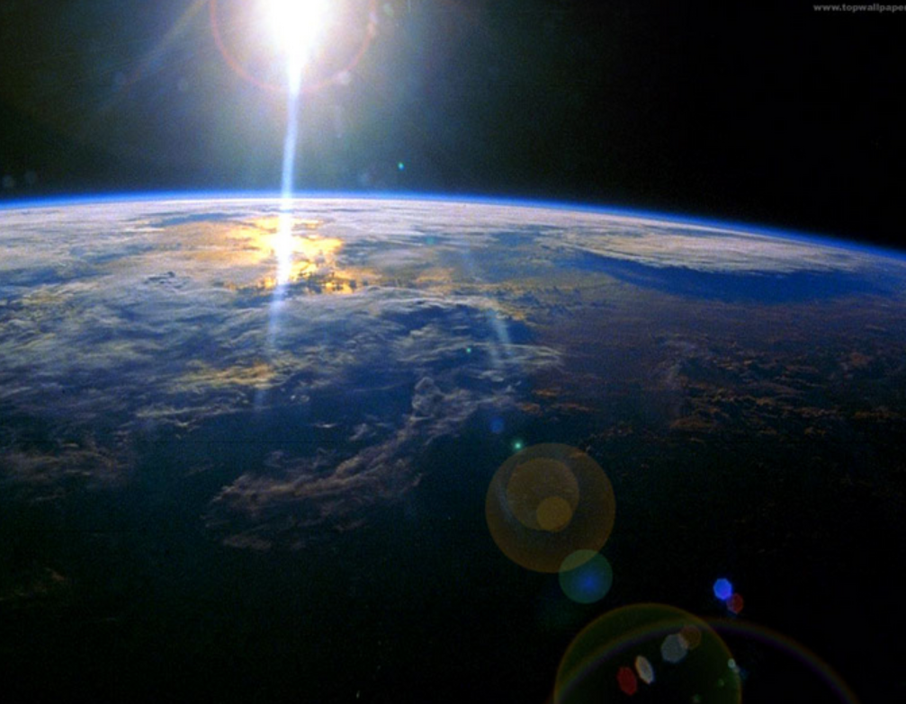
On the need for large scale analyses
By Camilo Mora

Slide 2
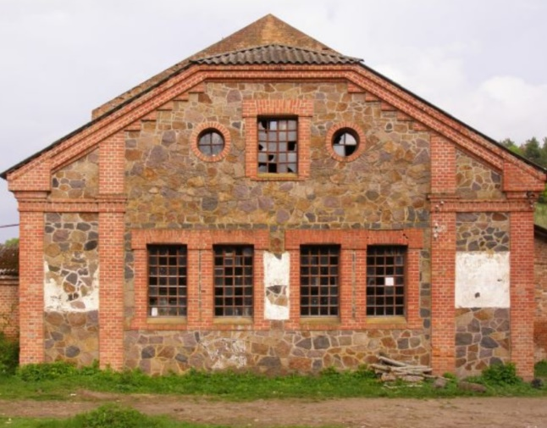
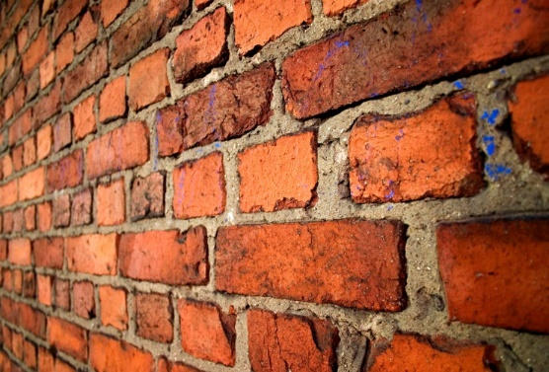
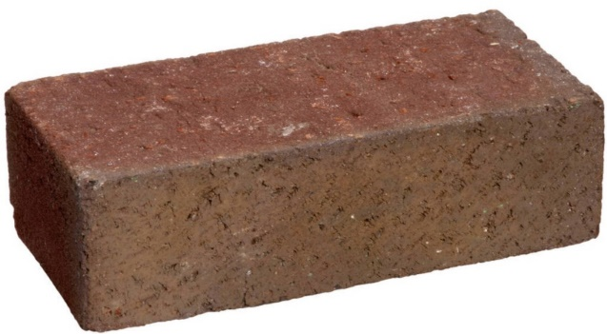
What is the purpose of this analogy?
Did you see the pattern?
What does it said about those that responded?
Skills #1: Imagination / vision
Skills #2: Can you see patterns where no one sees them? Can you get hints/imagination from trivial observations?

Slide 3
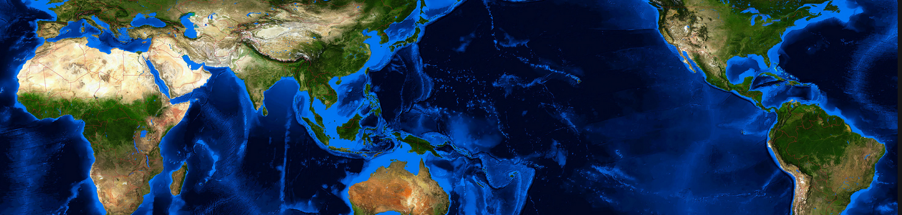
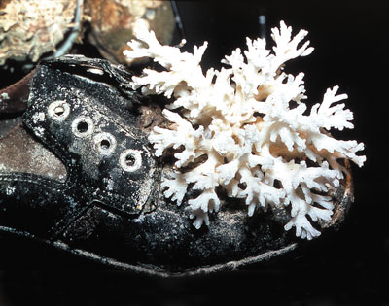
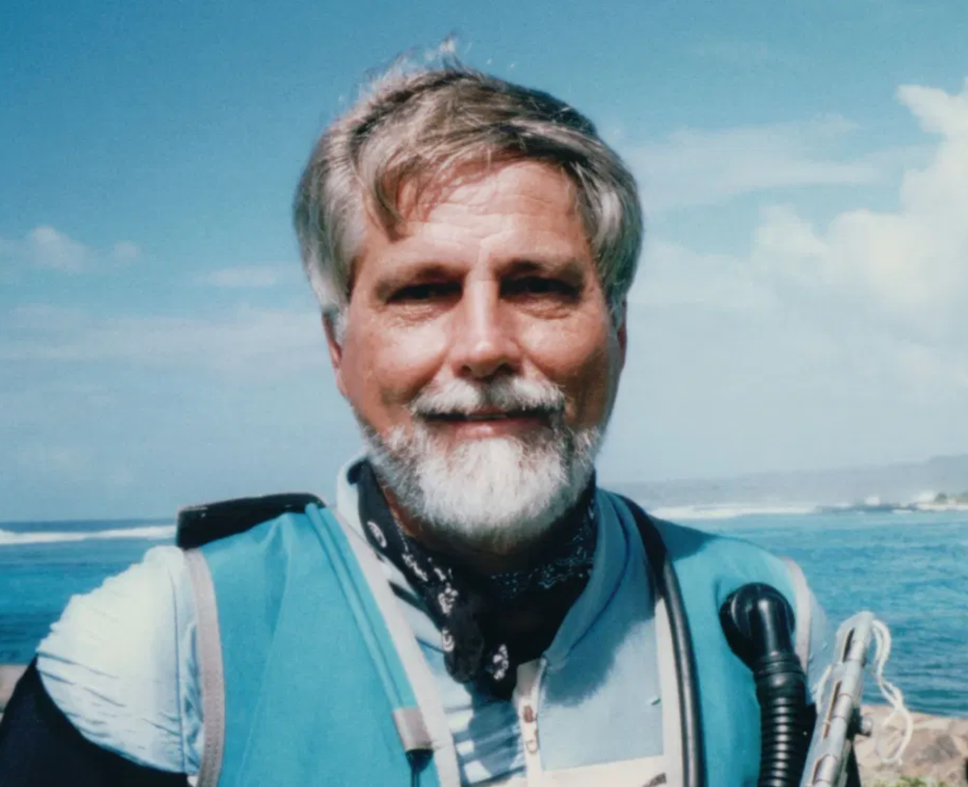
An example about critical observation: The multiple origin controversy
The same species cannot originate in different places, if so, then why are there coral reefs in the Caribbean, if we know the oldest species are in the Indian Ocean
Eastern
Pacific
Barrier
Panama Isthmus
What do you see?
Cited on every ecology and evolution book
Big discoveries not always are complicated, and can come from the most trivial of places.
Peter Jokiel, Ph.D.

Slide 4
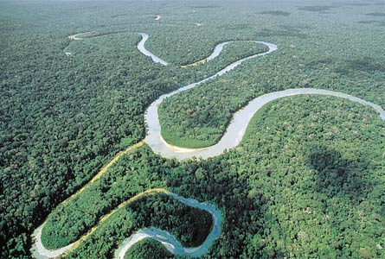
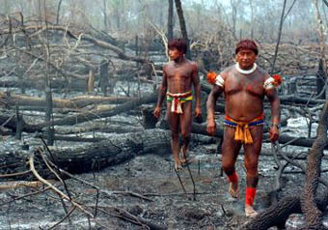
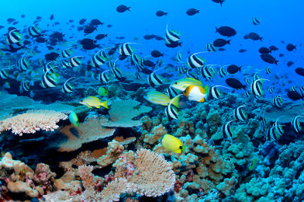
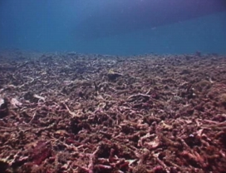
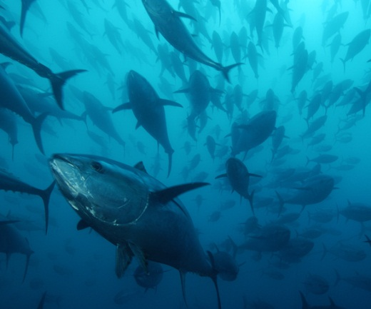

As statement of fact: marine and terrestrial biodiversity are being loss at a global scale
Habitat loss
Overexploitation
Climate change
…
…
…
Notes:
Biodiversity is being loss everywhere. But beffore discribing that pattern we need to know what is at stake here.

Slide 5
And the statistics are staggering
100% of the world’s oceans affected by human activities (Halpern et al. Science 2008)
83% of the world’s land affected by human activities (Sanderson et al. BioScience 2002)
6 million hectares of forest deforested annually (Global Biodiversity outlook 2)
Global mangroves declined from 18.8 million ha in 1980 to 15.2 million ha in 2000 (The world’s mangroves 1980-2005)
Sea-grasses are disappearing at 110 km²/yr since 1980. Globally, up to 29% are gone (Waycott et al. PNAS 2009)
Caribbean coral reefs declined by 80% in three decades (Gardner et al Science 2005)
Indo-Pacific coral reefs decline at 0.72% per year since 1997 (Bruno & Selig, PlosOne, 2007)
Large predatory fish declined by 90% since the 50’s (Myers & Worm, Nature 2003)
World’s fisheries could be lost by 2048 (Worm et al., Science 2006)
On average, some ~3000 monitored wild populations have declined by about 30% since 1970 (Living Planet Index 2010)
One third of the world’s corals are threatened with extinction (Carpenter et al., Science 2008)
Up to 48% of the world’s amphibians have declining populations (Stuart et al., Science 2004)
Populations of vertebrates had declined by an average of 30% in the past 40 years (Hoffmann et al., Science 2010)

Slide 6
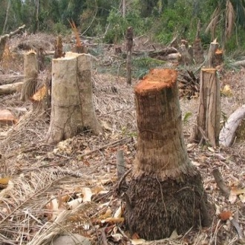
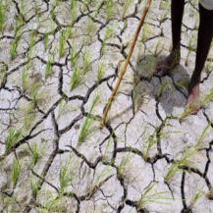

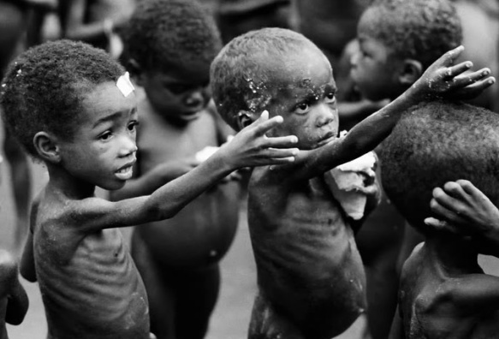
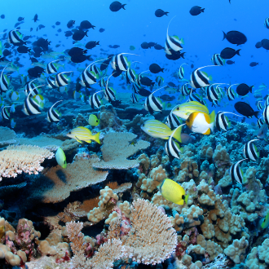

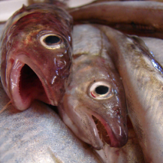
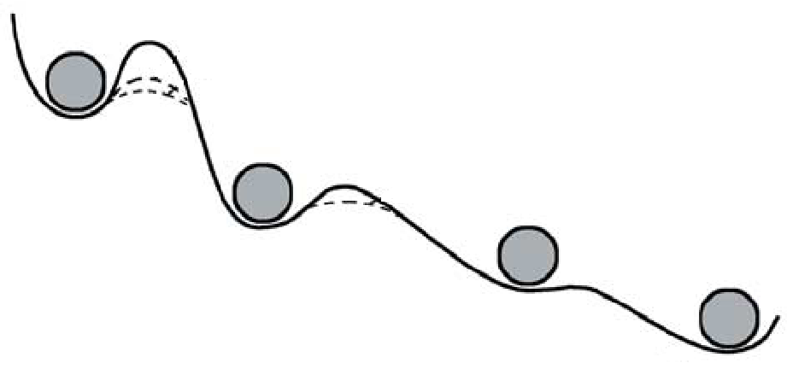
...and the consequences could be even worse…
Loss of goods and services
Loss of human welfare
The number of malnourished people in the world is ~1 billion, about a sixth of the world's total population (“FAO, The State of Food Insecurity in the World, 2008 ).
Biodiversity….
….loss is real
On average, a person dies every second as a direct or indirect result of poor nutrition (“The right to food : Commission on Human Rights resolution 2002/25”).
Some of the damages can be definitive
Alternative equilibrium states
On average, a child under five dies every five seconds as a direct or indirect result of poor nutrition (“The State of Food Insecurity in the World, 2002).
Stressor
Depensation
The scale of the loss and nature of the treats is so pervasive that only large scale analysis can really tell us what the deal and solutions are
Genetic variability loss
Notes:
5:19min we end up with systems that cannot return to their original states even if the stressors are removed.
5:45min Even now in the first world the thing is turning scary. For instance in the US 50 million people are suffering hunger or at risk of it. In Countries from africa and asia and the southpacific the situation is truly scary.
6:30 min today about 1 billion people, 20% of the world’s human population live near environments that are so deteriorated that basic food supply to humanity is not ensured anymore. The situation is even more critical when you consider future scenarios of clean water supply.
7:05 min Those statisitics are just sad…how, we, as a developed and smart’ species are letting this to happen.

Slide 7
So we need an urgent shift on the scales at which we do ecology without changing the basic premises of ecology itself
The approach
Obtain data
Build pattern
Test hypotheses
Small scale
experiments
Large scale and meta analytical studies
Old days
Time
Recent times

Slide 8
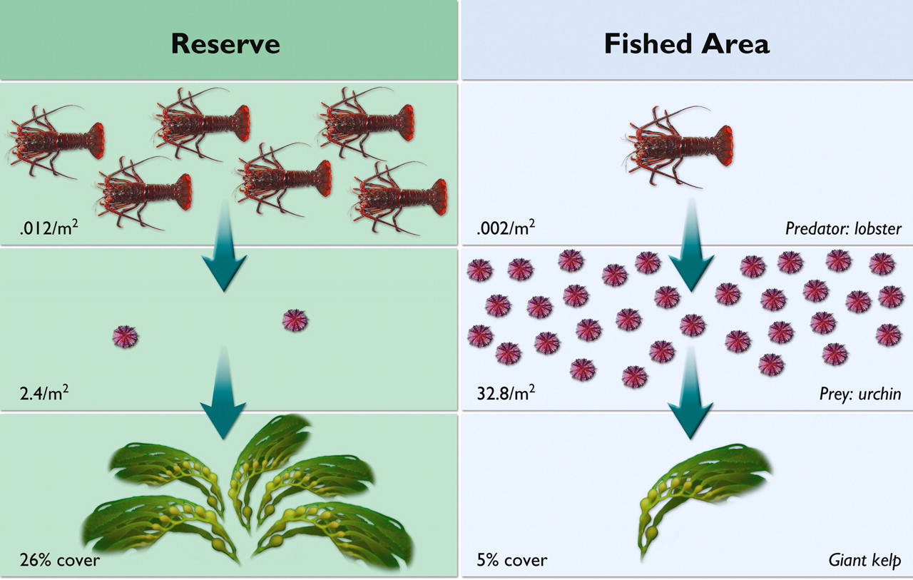
Why do we need large scale analyses: a case study with protected areas
Grorud-Colvert K et al. PNAS 2010;107:18306-18311
©2010 by National Academy of Sciences
Notes:
Depiction of numeric data from a marine reserve study by Behrens and Lafferty (45) in a nonnumeric format for general audiences. In the Anacapa Island marine reserve in California, abundant lobsters keep their urchin prey in check, allowing kelp forests to flourish. Reprinted with permission from The Science of Marine Reserves, published by the Partnership for Interdisciplinary Studies of Coastal Oceans.

Slide 9
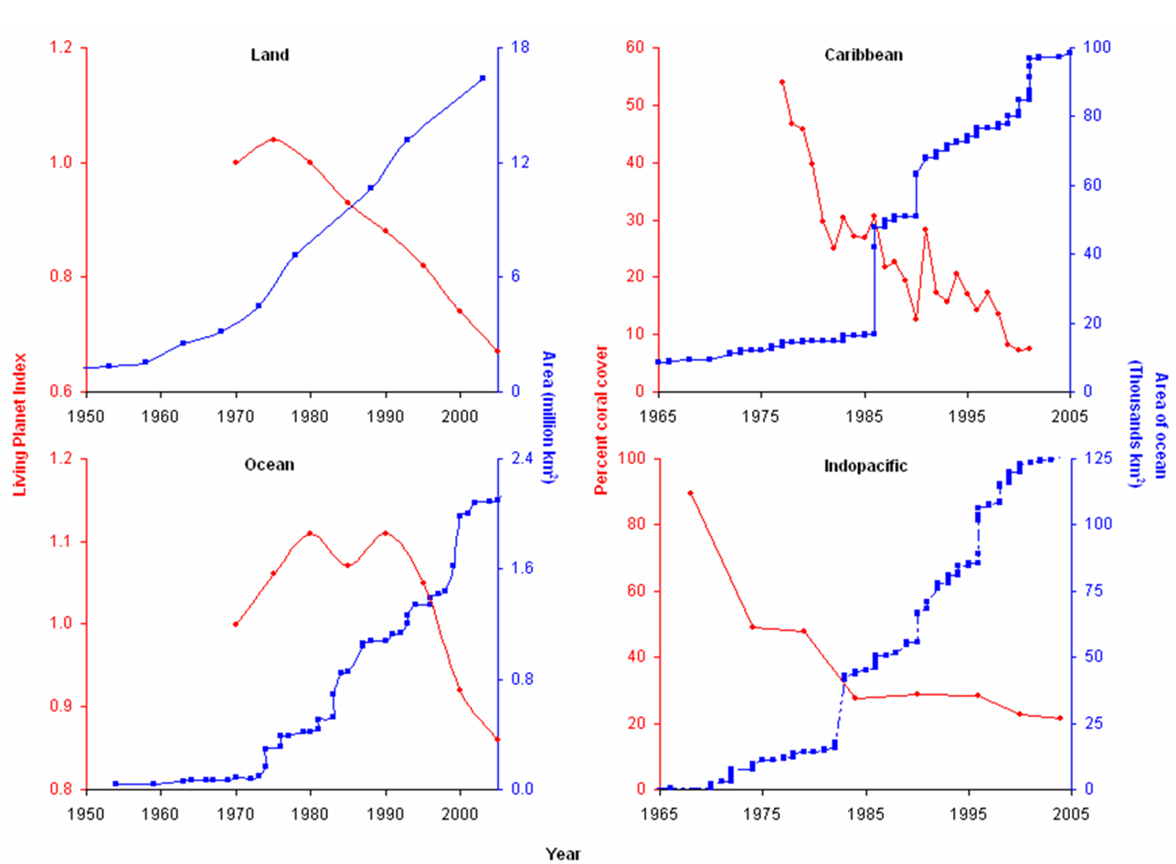
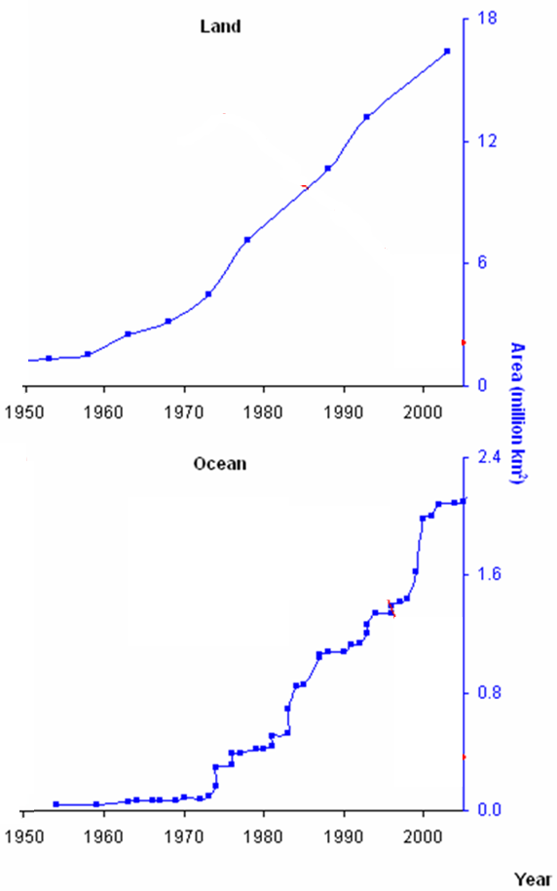
How are protected areas doing at the global scale?
Mora, Cambridge book on MPAs 2011

Slide 10
BUT, IF WE TAKE FOR GRANTED THAT PAs DO WORK; ARE THEY A FEASIBLE SOLUTION TO THE GLOBAL BIODIVERSITY CRISIS?
The problem of scale
Analogy
A
How to displace from A to B?
Walking
B
Bed
Bathroom
Walking is a perfect solution
First floor
Second floor
Walking is a perfect solution although many will take the elevator
Manoa
Waikiki
Walking is a solution although most will drive
Honolulu
Paris
Walking is an impossible solution
If you get your facts at a small scale, that does not mean they will apply to a larger scale

Slide 11
So why is this shift to large scale ecology has not happened?
Reason 1: Interest
Lots of fun!!!
Very, very boring
Boring
We have millions of data, yet a handful of large scale analyses
Notes:
How many people will like to go around the world?. Visiting all countries and their ecosystems, the Great barrier reef, Indonesia, Chagos, uh, the blue hole in belize? I sort of anticipate that response, so here you see the balance.
Now, how many of you would like to sit down in front of a desk 12 to 18 hours a day every day…..Stearing to a computer screen so long that your ass start getting flat, or if you have a confi chair your ass start getting shape on it. So long that over time you loose your eye sight. And after all that effort, you get hammer because most people think that what you have done all that time is trash?. Well I anticipated that result as well.
And this simple quantification of our interest is reflected in our advance of large scale ecology.

Slide 12
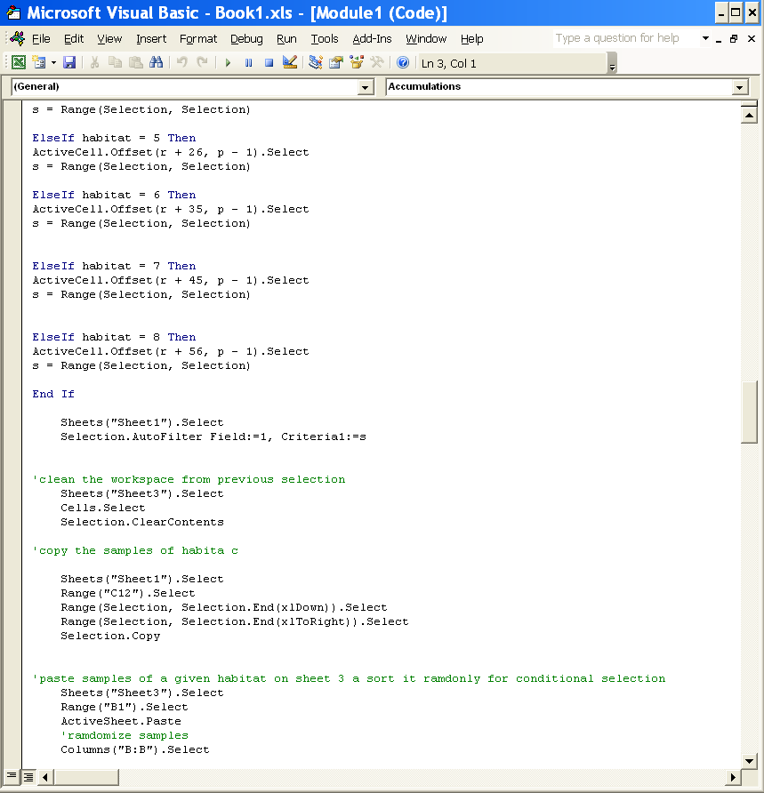
So why is this shift has not happened?
Reason 2: One will need to learn new tools, often outside our field of expertise
MEGA
→ management
→ analysis
→ visualization
The array of tools includes:
Statistica, R, SPlus, Matlab, Aurora, etc
Very intimidating
More friendly interfaces
Access, Excel, Pivot table, ArcGis, Visual Basic

Slide 13
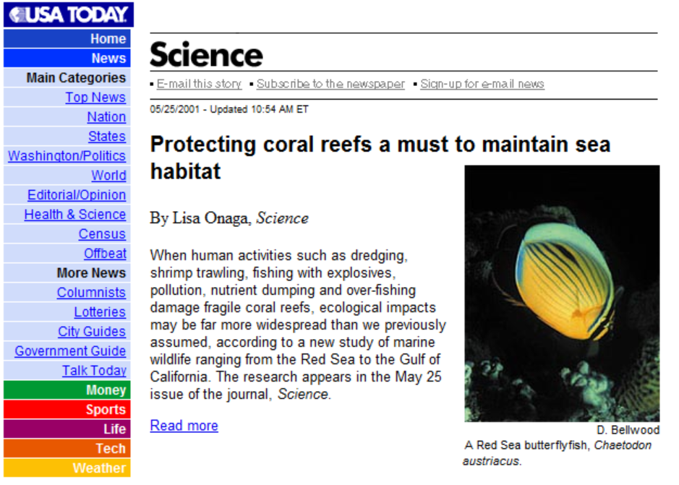
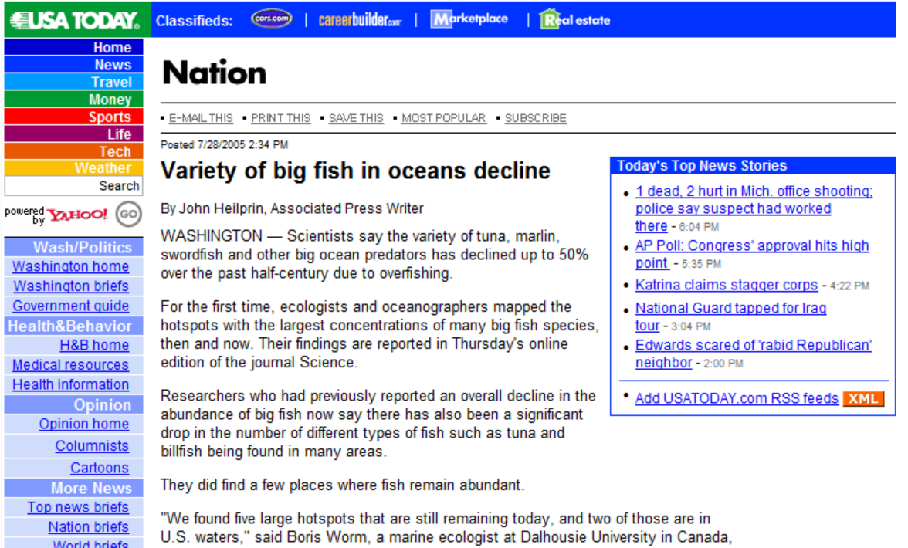
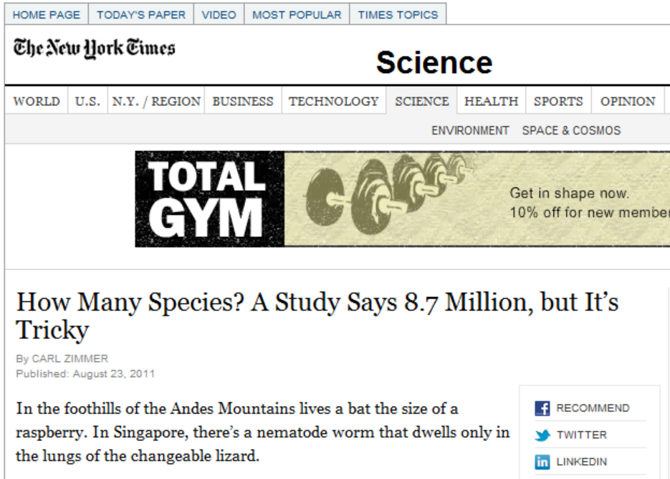
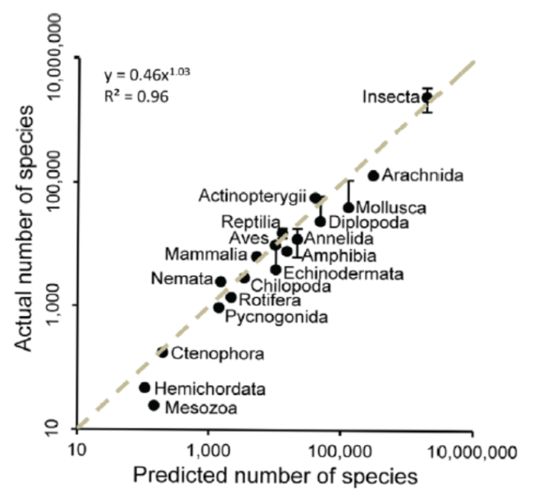
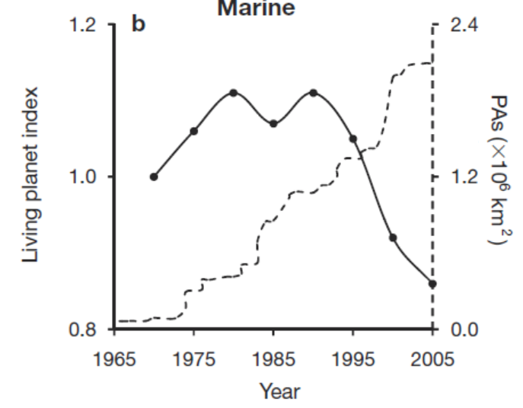
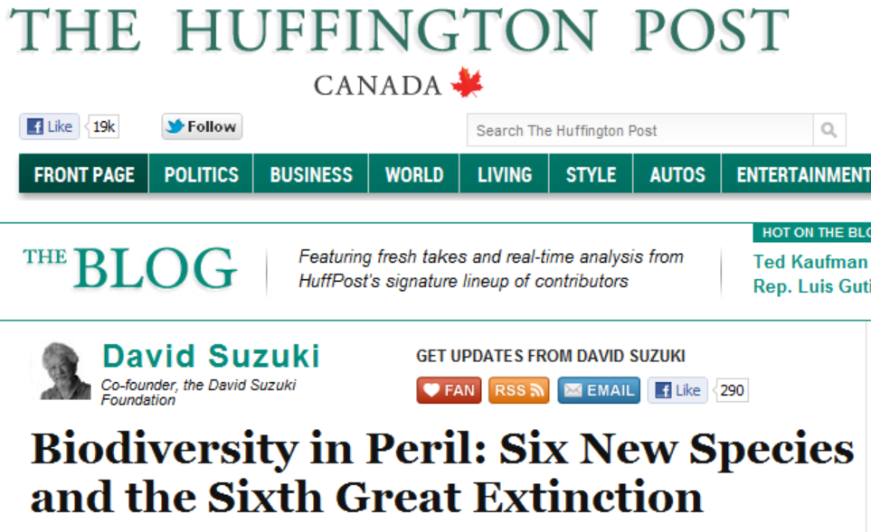
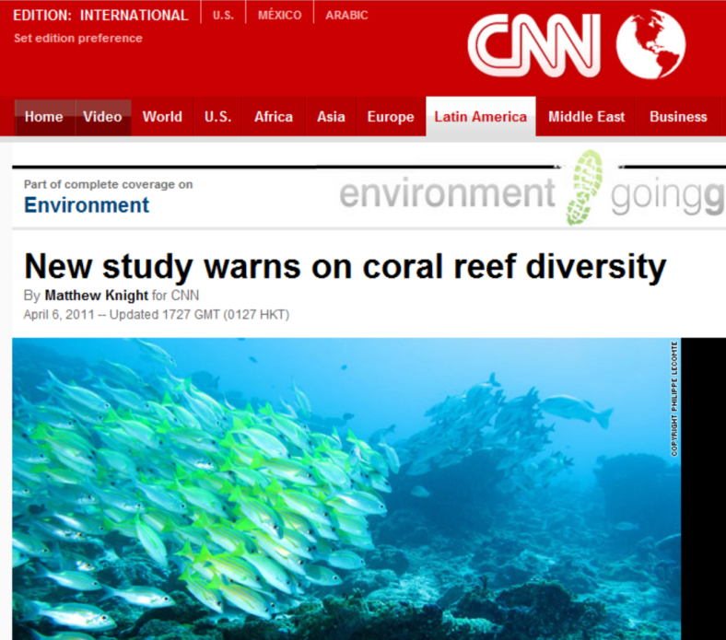
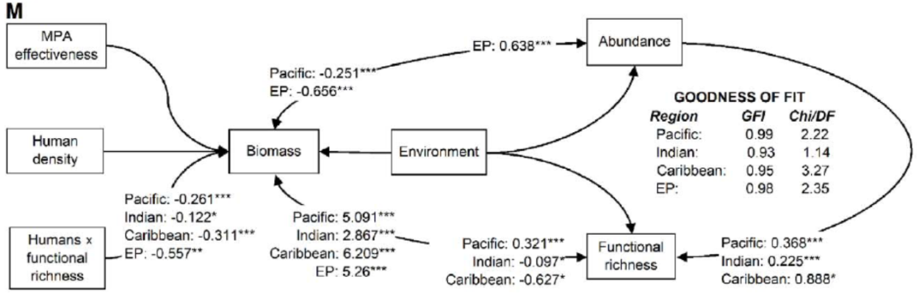
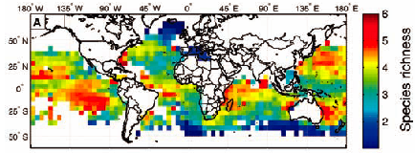
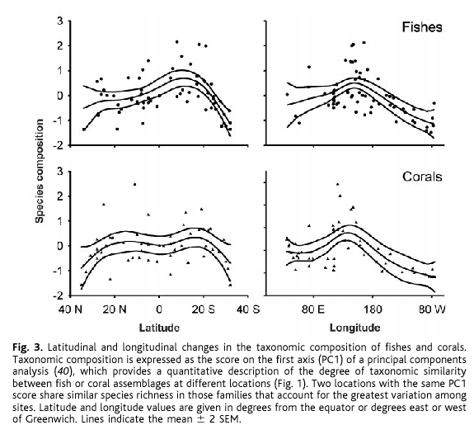
However, at times the effort pays off!!
Global patterns of fish and coral diversity
Global patterns of predator diversity
How many species are there on Earth and in the Ocean?
Bellwood and Hughes, Science 2001
Mora et al, PlosBiology 2011
The collapse of biodiversity despite protected areas
Worm et al, Science 2005
Mora & Sale MEPS 2011
The human footprint on coral reefs
Mora et al., PlosBiology 2011

Slide 14
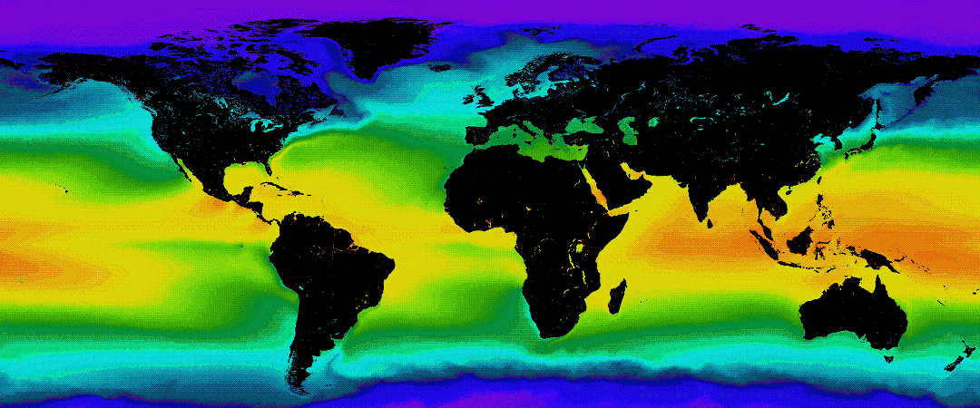
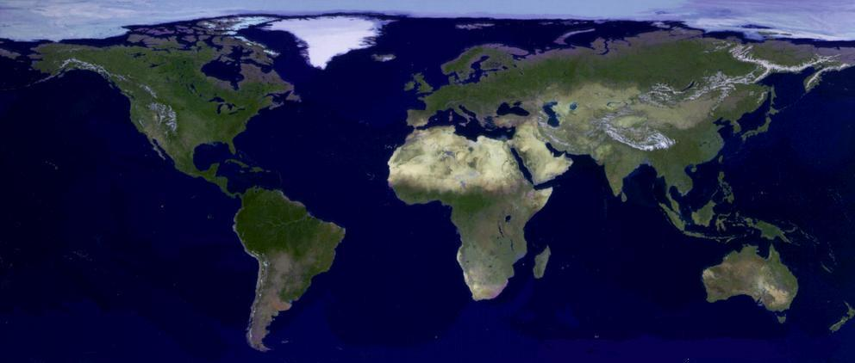
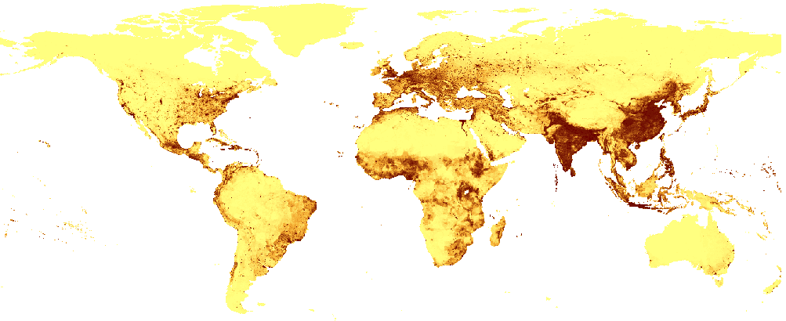
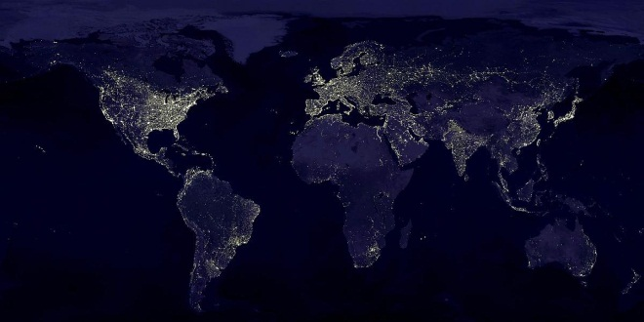
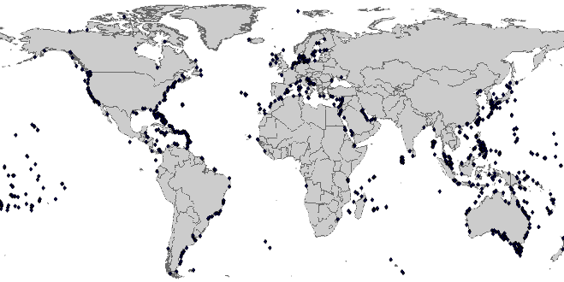
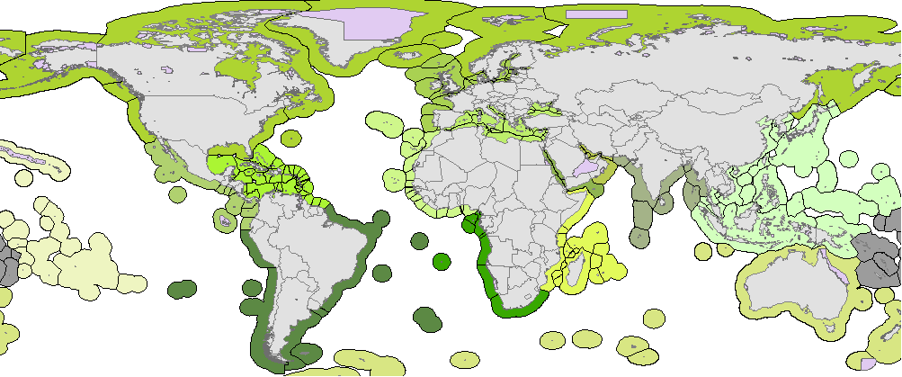
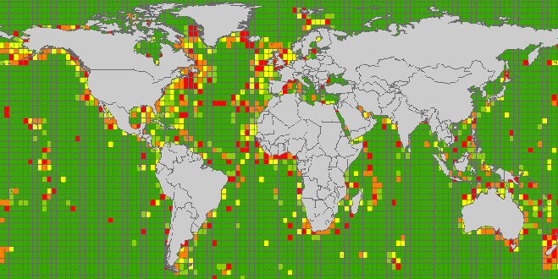
…and the possibilities are endless…
Obtain data
Hundreds not to say thousands of resources are already available
Build pattern
Test hypotheses
So what is needed
1) Novel ideas on what to do with these databases

