Slide 1

Why learn
1
Open source
2
Large community
3
Contains all you may needed
4
Used on every field
5
Free
6
Gateway to a well paid job

Slide 2
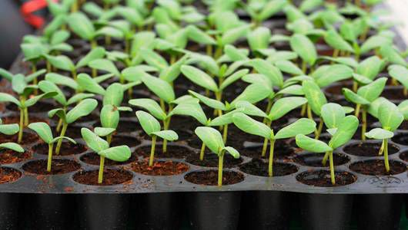
Expensive
High mortality

Slide 3






The Individual
The Sample
The Population

Slide 5

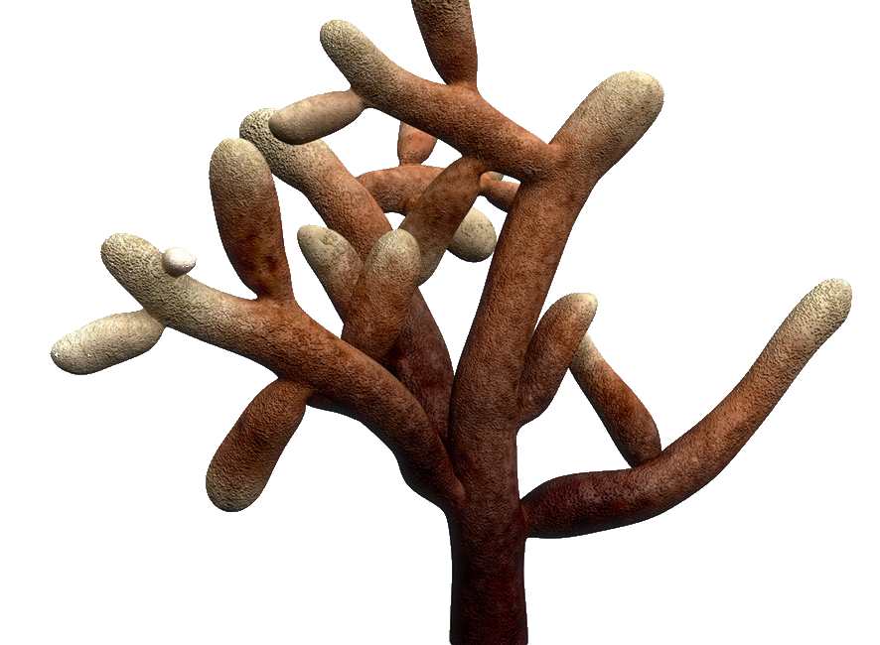
Replicates
0mg
10mg
20mg
Control
Treatments
Independent variable

Slide 6
0mg
10mg
20mg

Slide 7
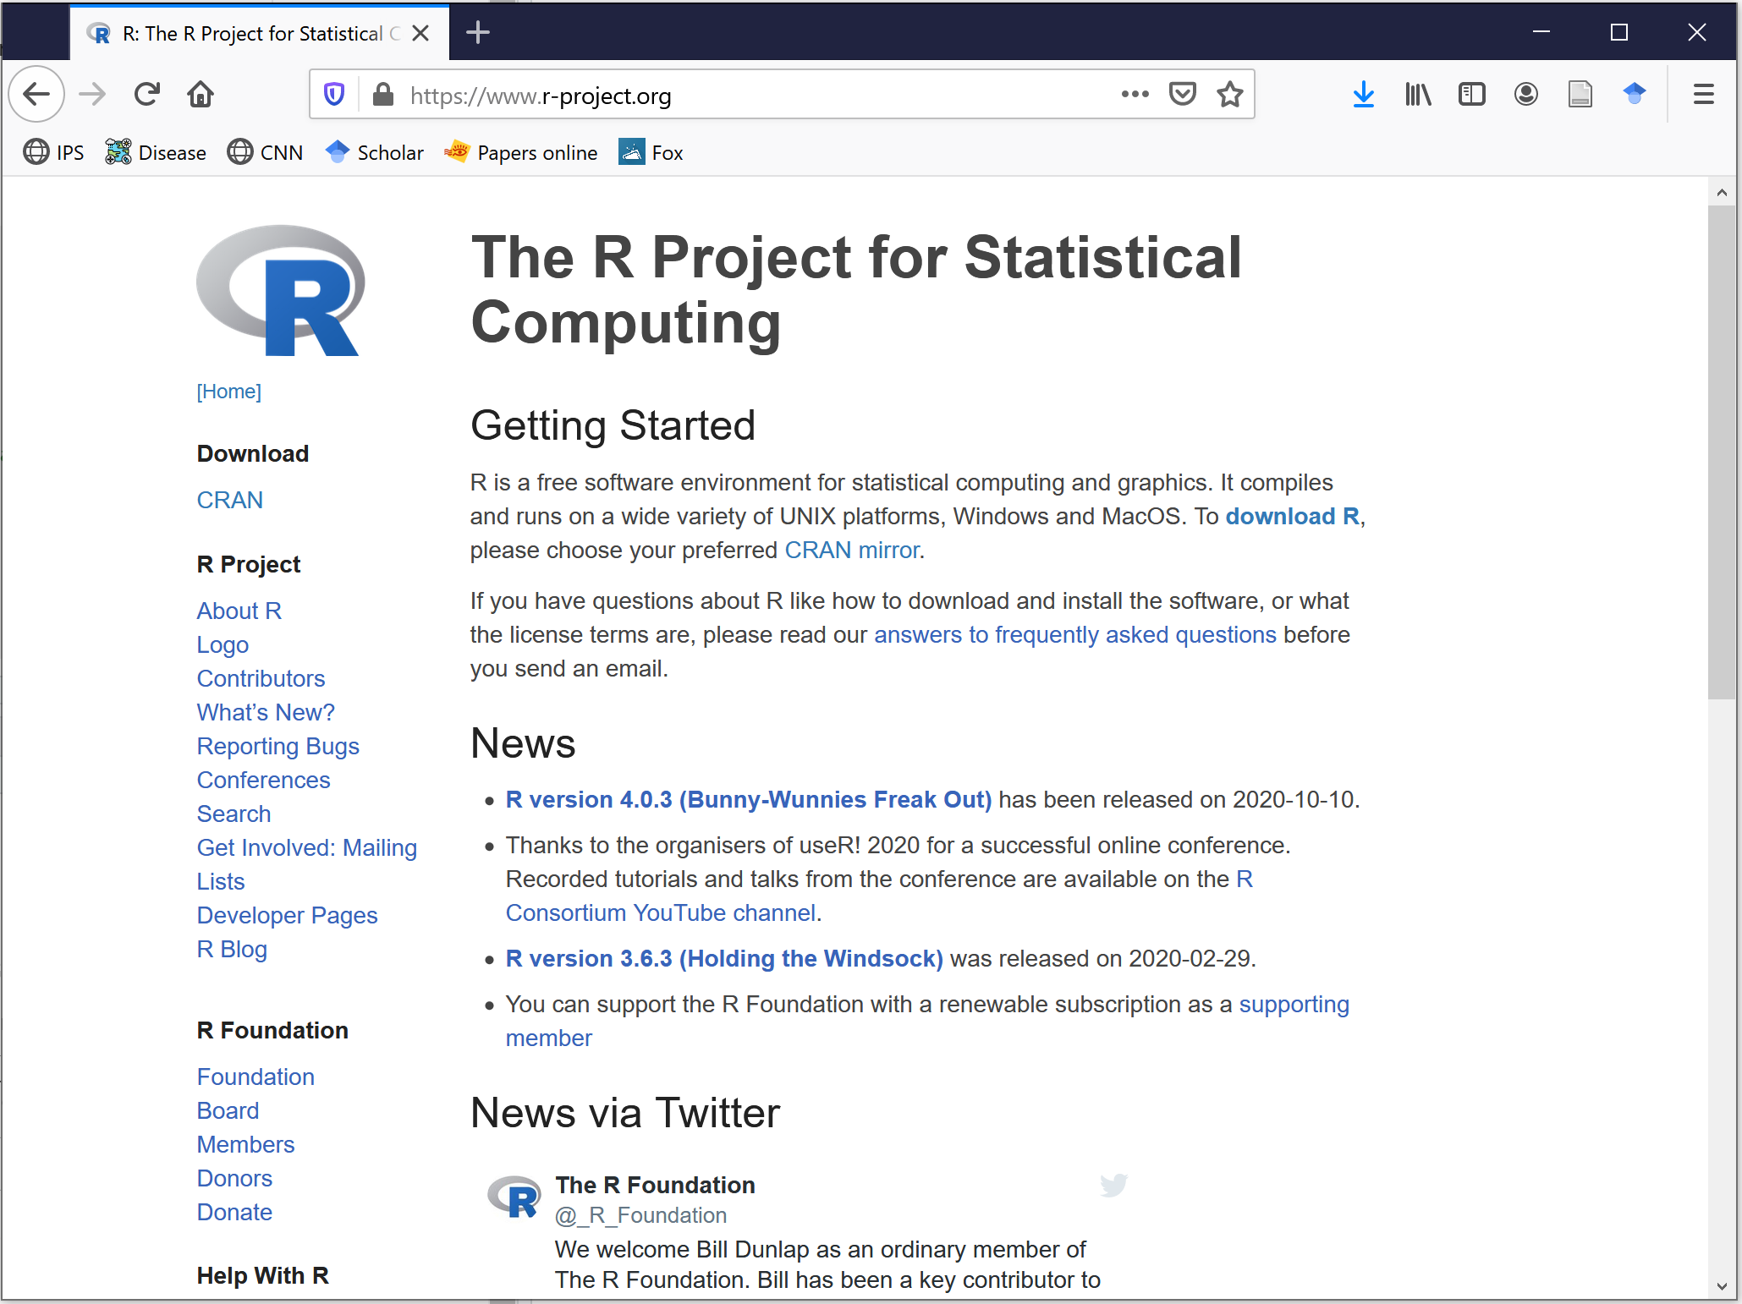

Slide 8
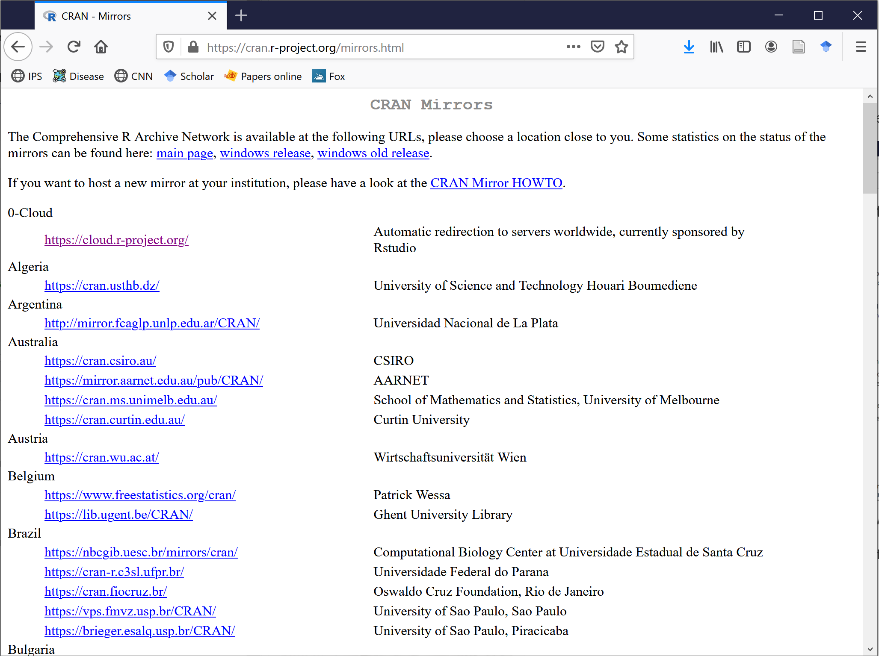

Slide 9
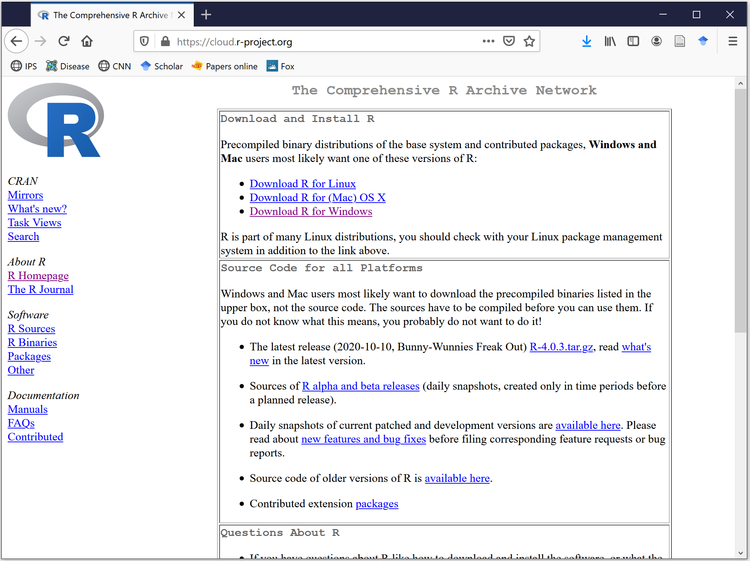

Slide 10
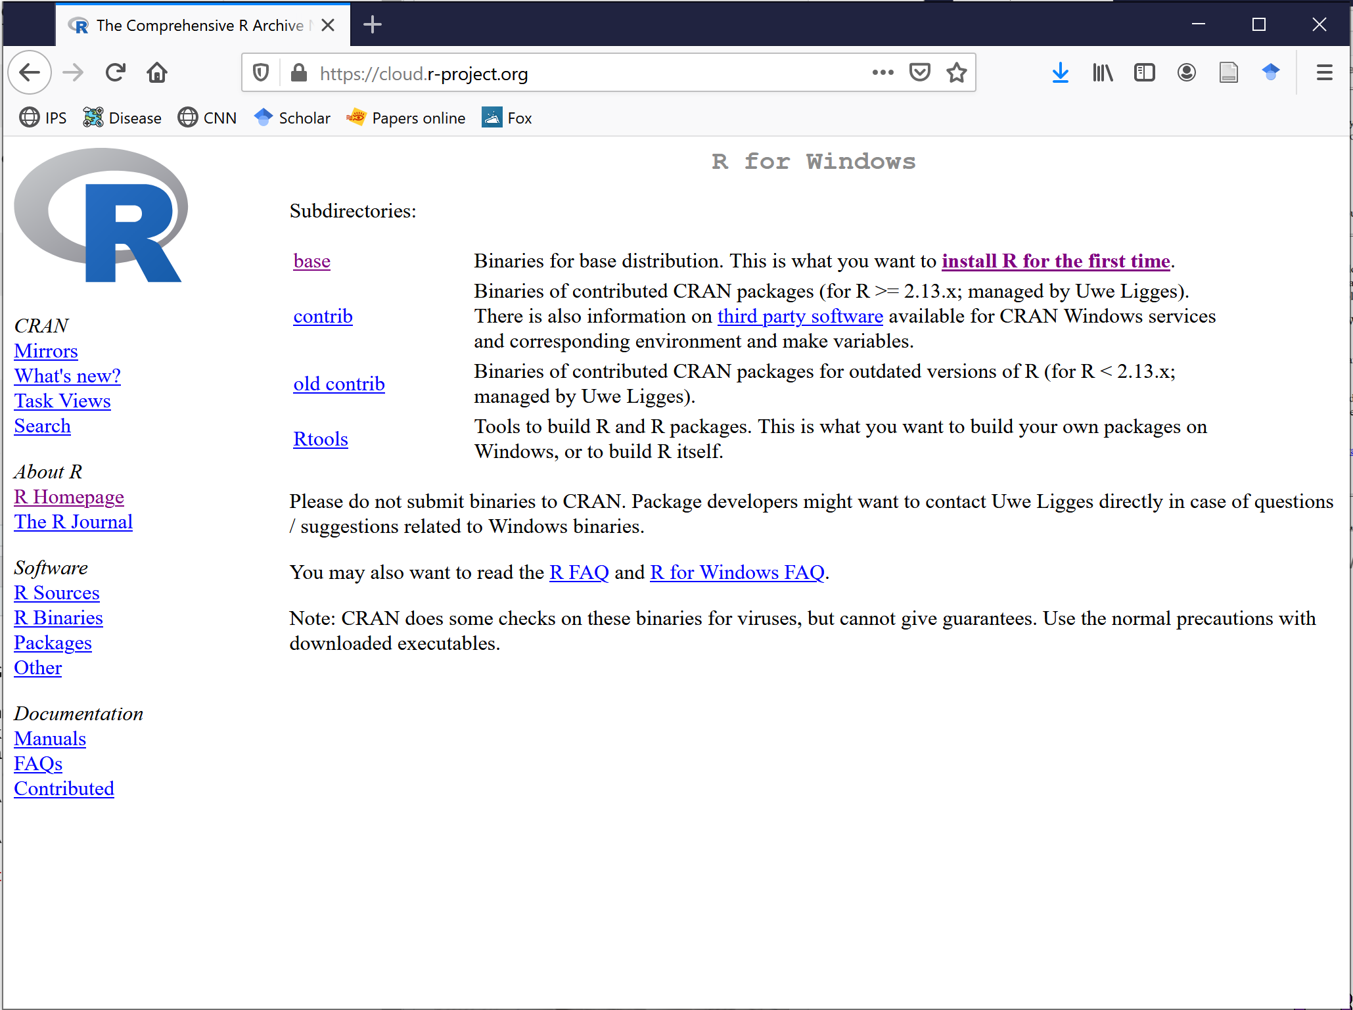

Slide 11
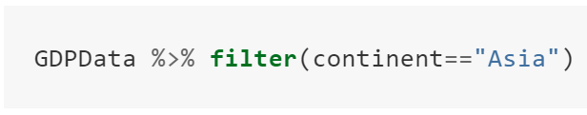
Dataframe
Function
Pipe
Condition

Slide 12
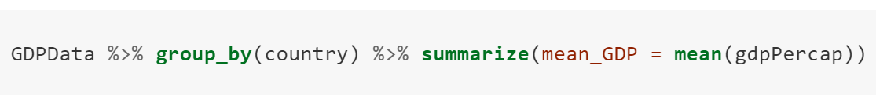
Dataframe
Operation #1
Operation #2
Function to apply
Pipe #1
Pipe #2
Variable name of result
Data to apply function to

Slide 13
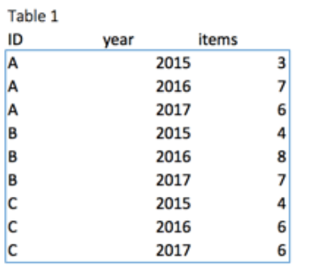
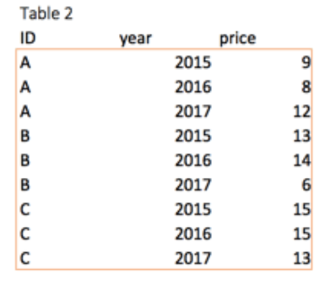
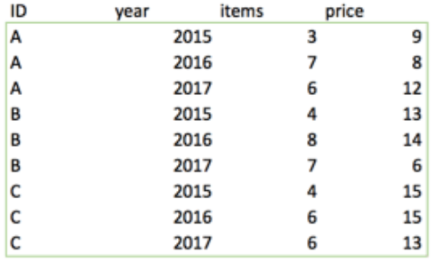
+

Slide 14
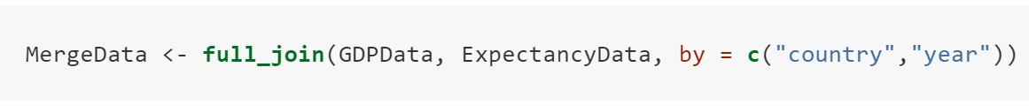
Name for results
Common columns to merge by
Function
Database 1
Database 2
Merge by

Slide 15
Measures of central tendency
Median
Mean
Mode
Trimmed mean
Geometric mean
Harmonic mean
Weighted mean

Slide 16











10% 20% 30% 40% 50% 60% 70% 80% 90 %
45cm
10% 20% 30% 40% 50% 60% 70% 80% 90 %

Slide 17
