Slide 1
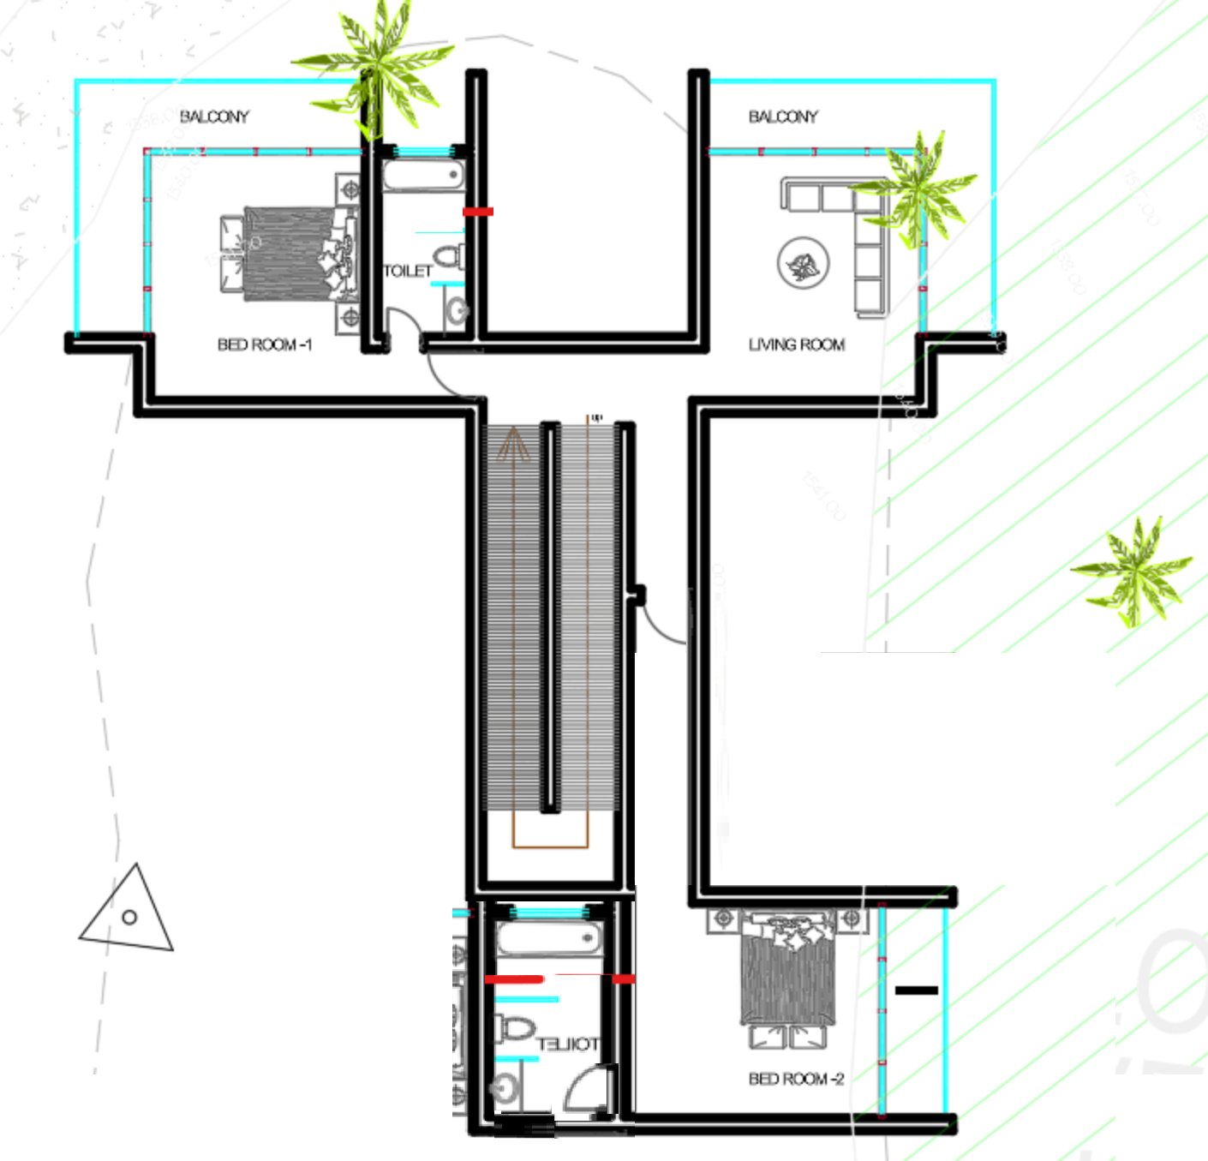
4. Is this half wall needed?
3. Remove balcony, and make this room bigger
1. Make the wall straight
2. Move room to add large full bathroom

Slide 2
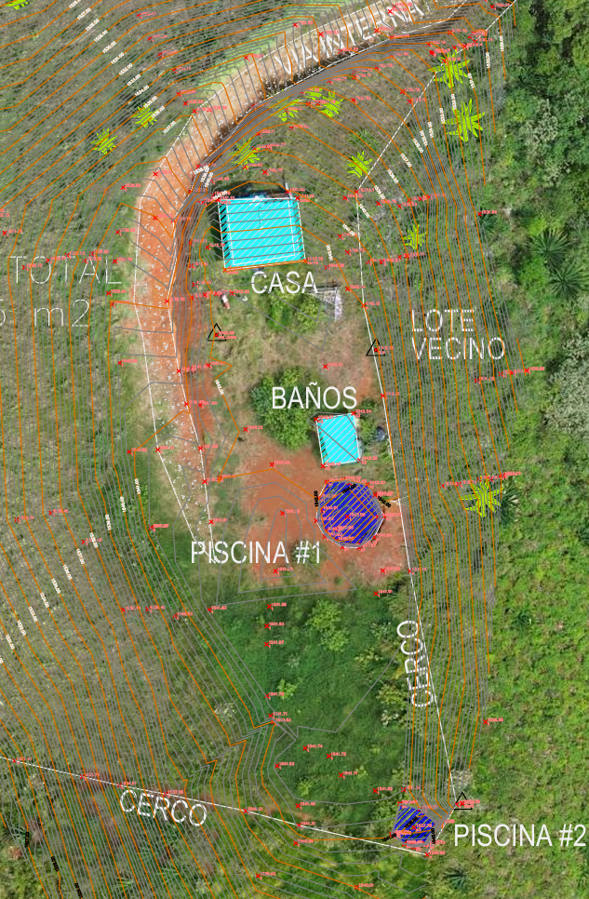
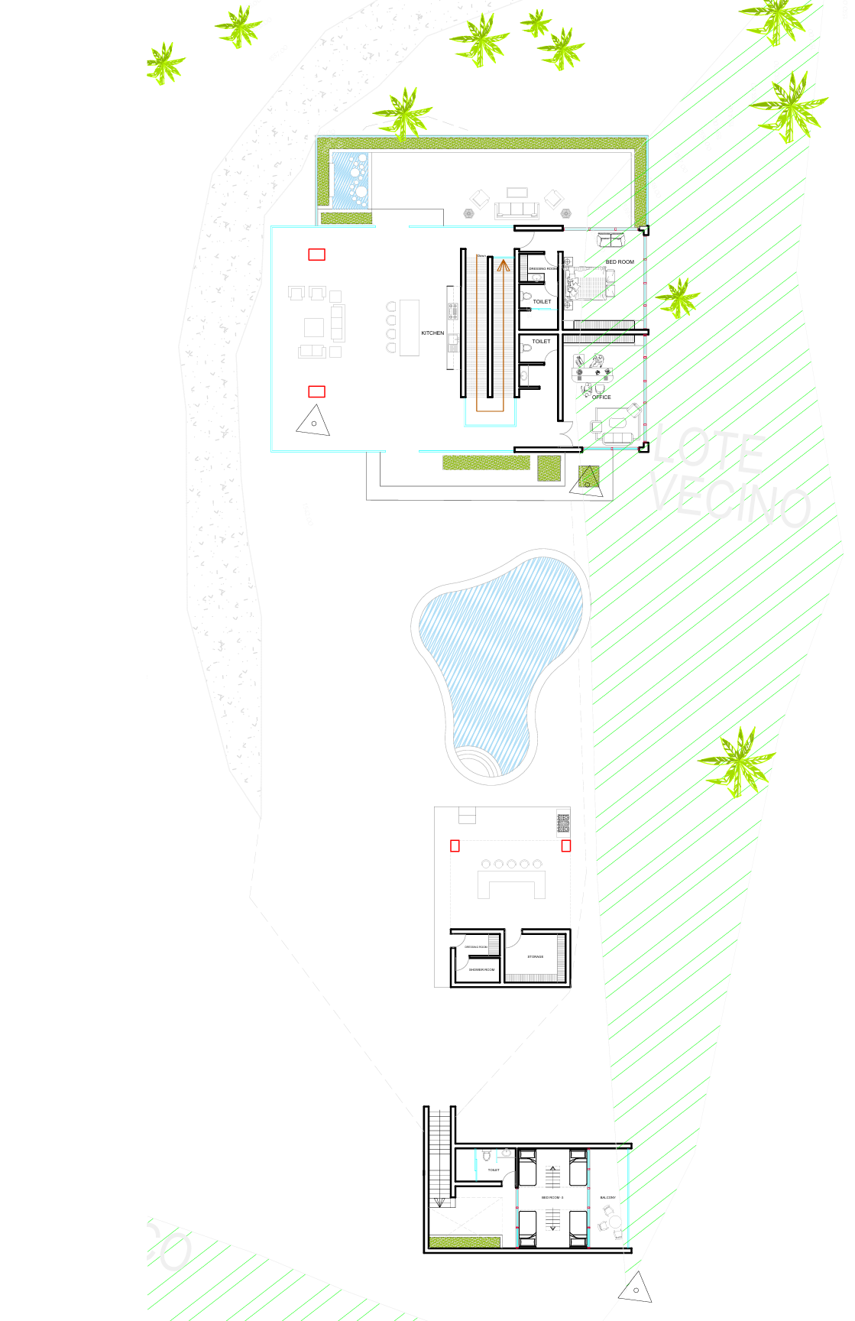

Slide 3
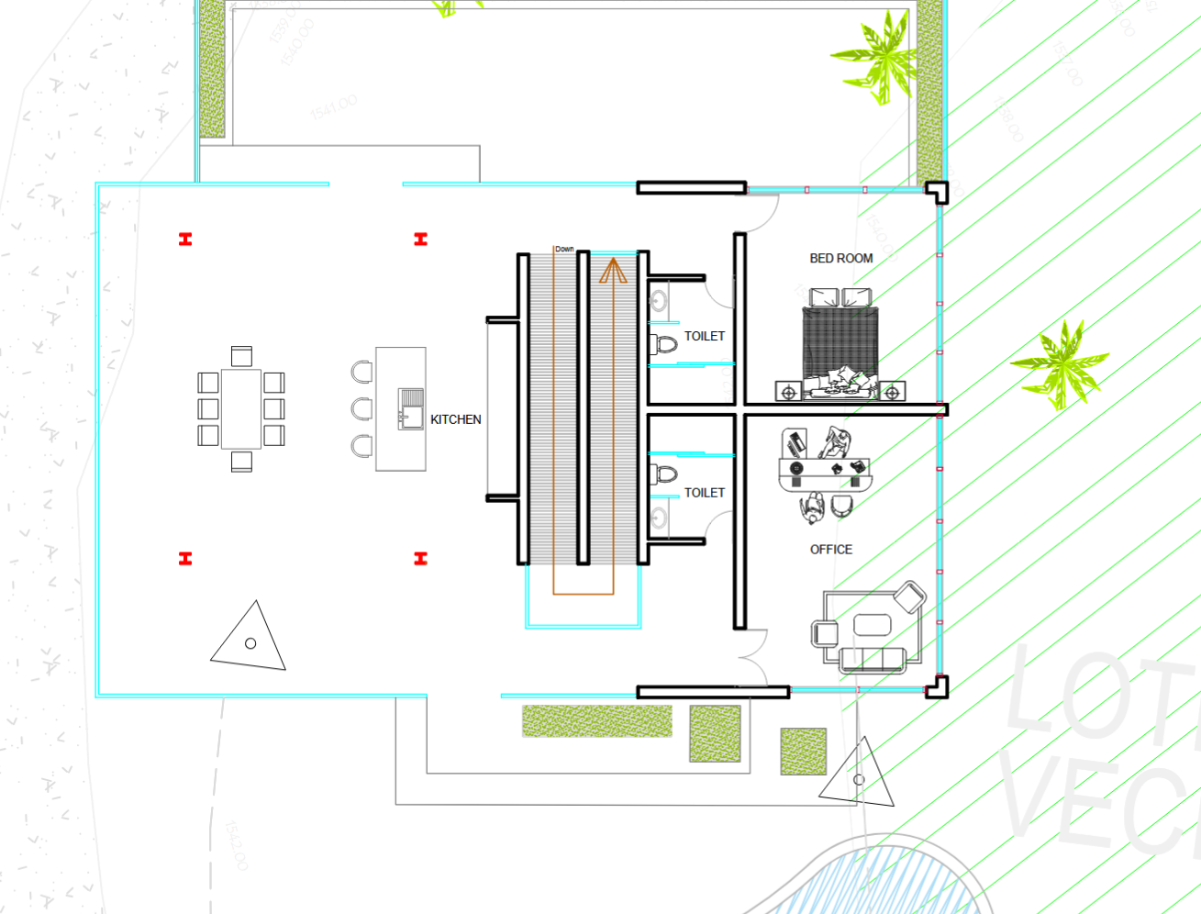
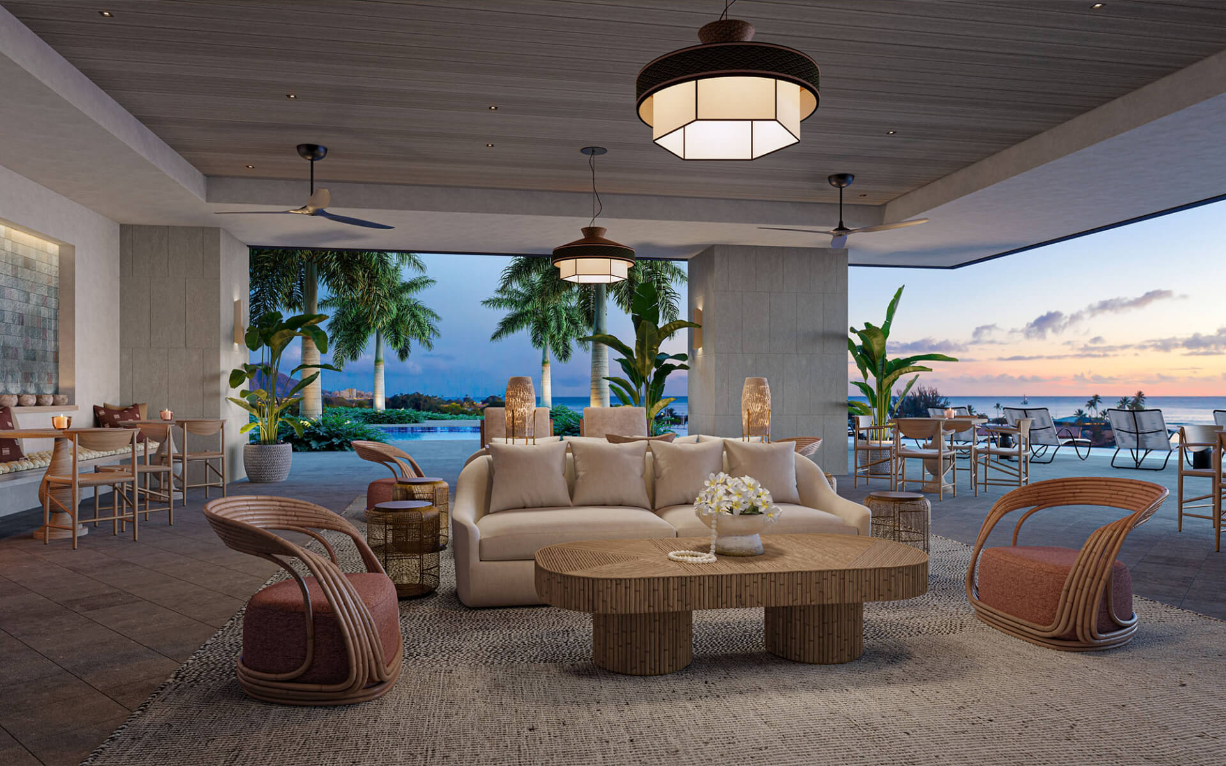
6. Move this door so the bathroom will be in the room You may have to adjust the wall.
5. Remove sink from this island. This island will be used as dining table
7. No shower in this bathroom. Add this new space to the shower of the other room. Alternatively move the separating wall to increase the size of the room.
8. I want a living room like this. It should accommodate 8 people. So you may need to elongate this space. I anticipate people will be standing in this space withg the blue arrow, so make that space larger.
9. I would like big concrete or brick columns for these corners

Slide 4
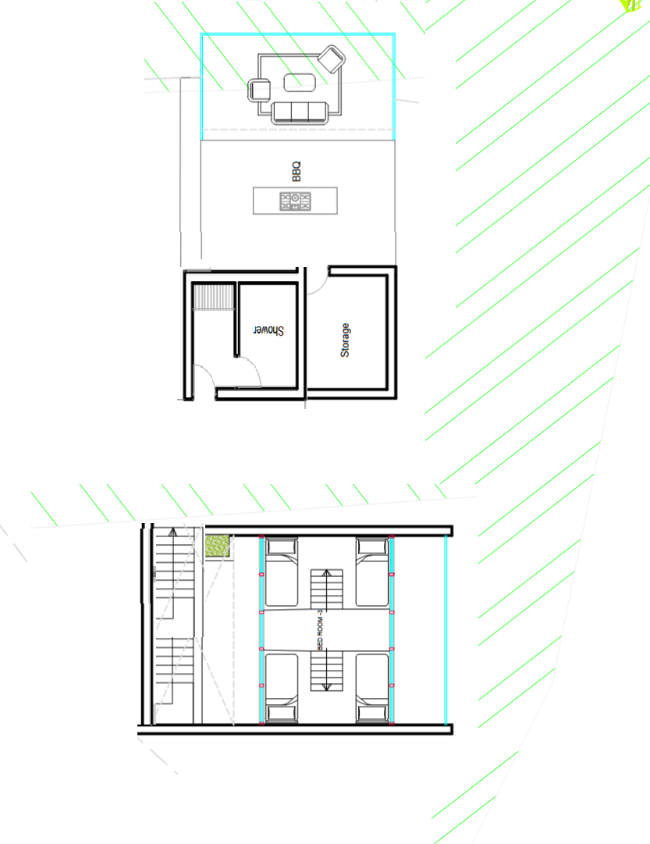
12. Rotate these two structures to look like this
11. A U-Shape bar. May be like images #66 or #67.
10. Missing a full bathroom.

Slide 5
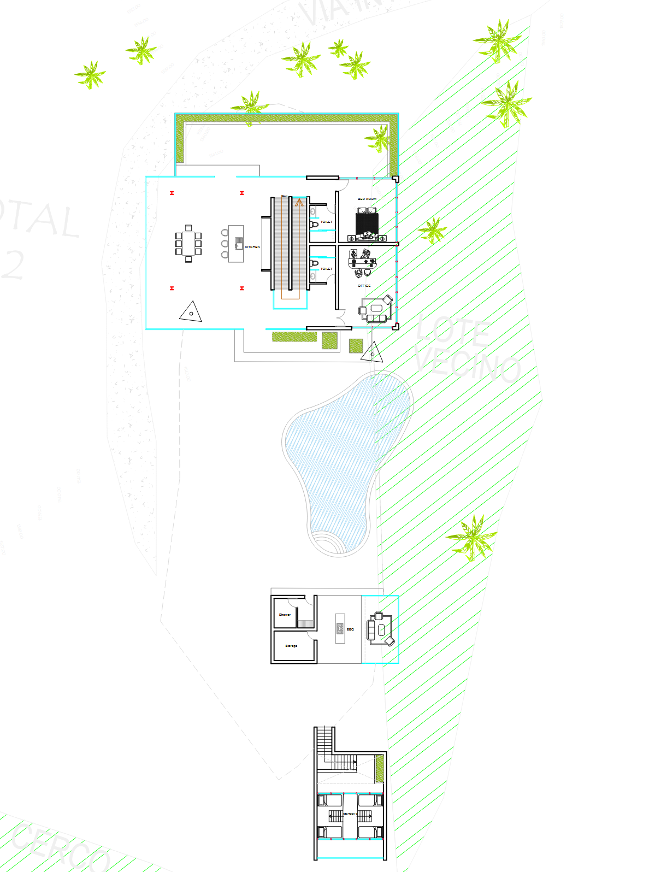
13. Add underground parking space. I added image to website.

Slide 6
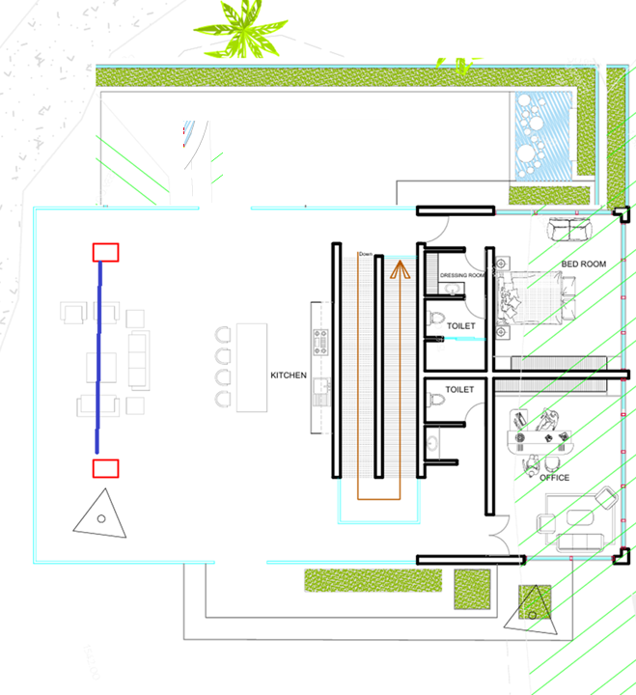
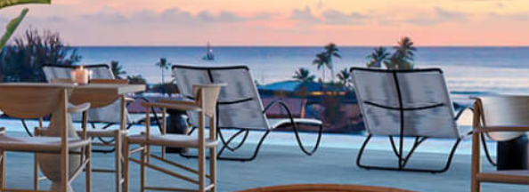
2. Flip the look out. The view area is from the living room. Plus we do not want people walking into the room.
4. Put this type of furniture in the lookout.
View
3.Move toiled by the sink… I want a large shower, with no curtain
1. There will be a wall here; so you need to make the core area longer, so the furniture is inside the home

Slide 7
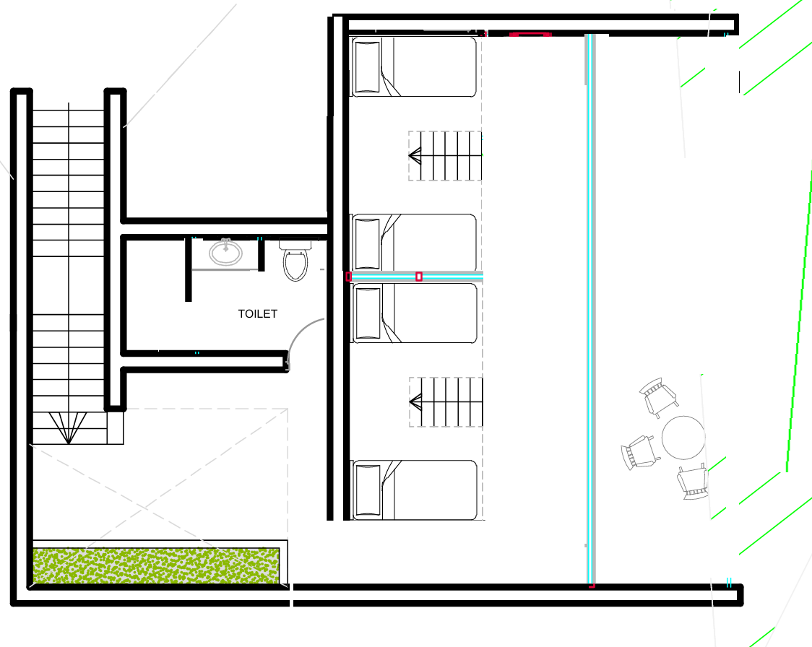
6. flip the order. Check the internal walls. I do not want curtains in the showers. Use this style in other bathrooms
5. Place the beds this way, so from the bed you can see the forest.

Slide 8
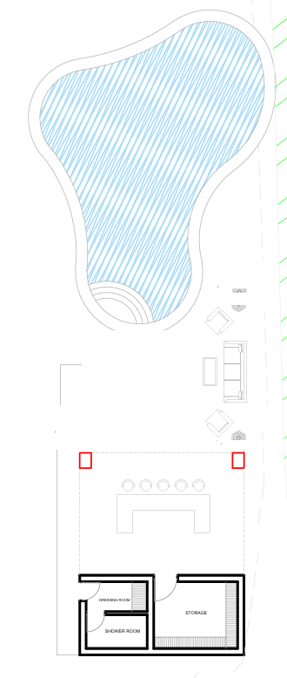
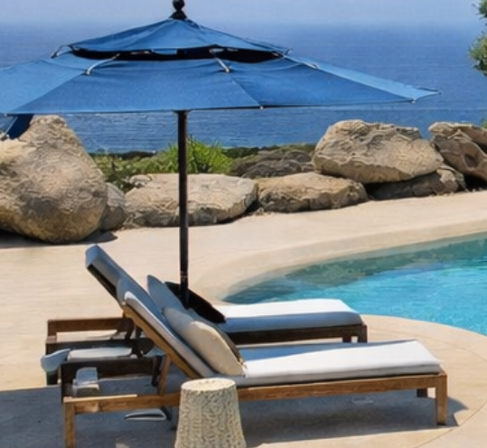

9. Place a hottub here
8. Place furniture along the pool
7. Grill here

Slide 9
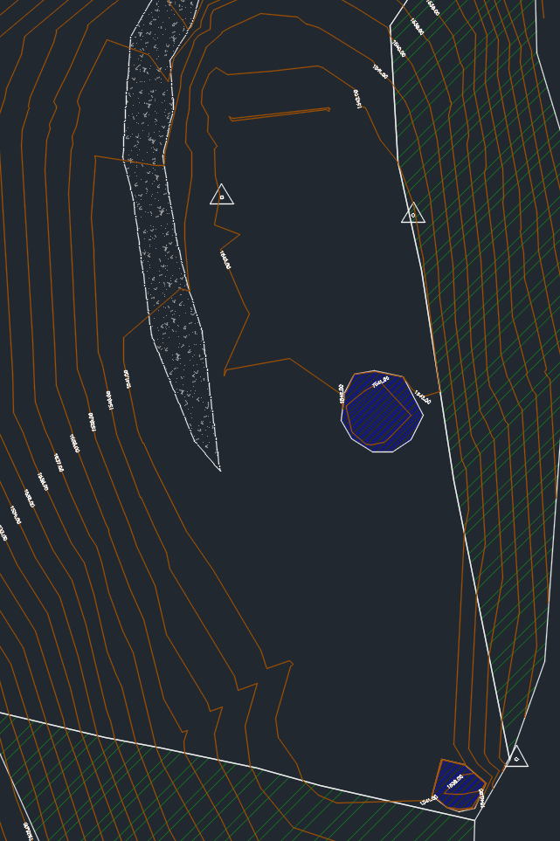
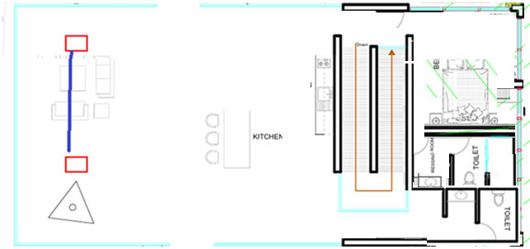
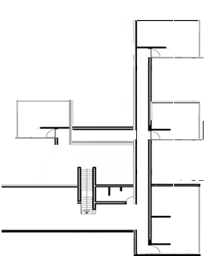
Ground level
1.Lookout some2.5 x6
Underground level
2. One room has to be eliminated from here. Leave only a bedroom and a living room
3. Core area has to fit here. I think it is about 12 x 6
4. Pool has to be turned a bit, so it is on the flat area
5. BBQ area 5x5 about
6. We need to move bedrooms to this side (each room should be about 4m x 7m)

Slide 10
7 reduce this room. And move bathroom to the back
8. Halfbathroom here

