Slide 1
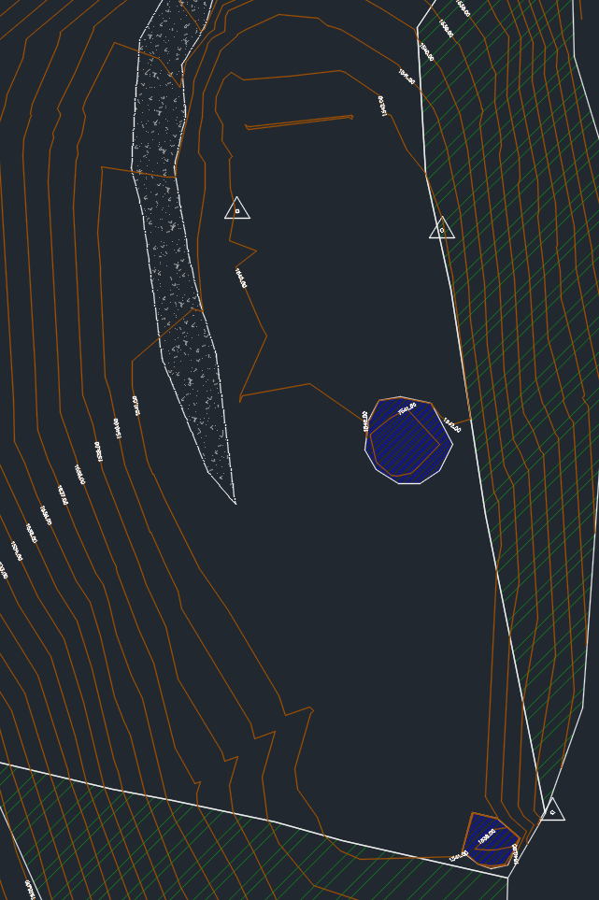
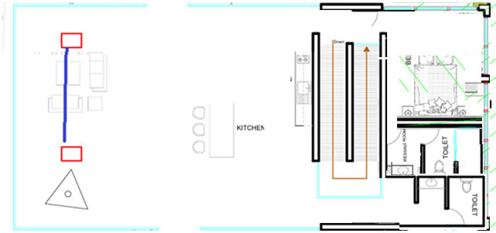
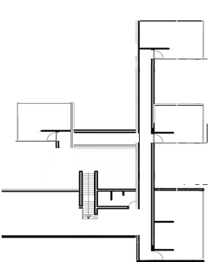
Ground level
1.Lookout some2.5 x6
Underground level
2. One room has to be eliminated from here. Leave only a bedroom and a living room
3. Core area has to fit here. I think it is about 12 x 6
4. Pool has to be turned a bit, so it is on the flat area
5. BBQ area 5x5 about
6. We need to move bedrooms to this side (each room should be about 4m x 7m)

Slide 2
7 reduce this room. And move bathroom to the back
8. Halfbathroom here

