Slide 1


PRINCIPAL COMPONENT ANALYSIS (PCA)

Slide 2

Background-Feature or variable
Feature or variable
A feature in a database refers to specifying an attribute or characteristic that is significant for analysis, prediction, or interpretation within the context of data science and machine learning.

Slide 3
Background-Feature or variable
Feature or variable
In database terms, a feature is analogous to a column in a table, representing a specific type of data or attribute of the entities stored in that table.

Slide 4
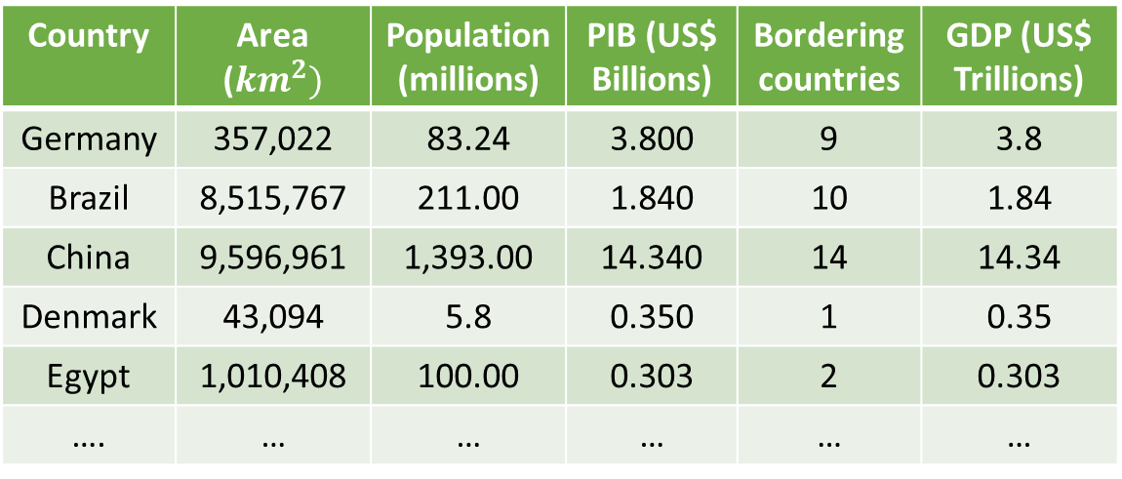
Background-Feature or variable
Feature or variable
Country | Area (${km}^{2})$ | Population (millions) | PIB (US$ Billions) | Bordering countries | GDP (US$ Trillions)
Germany | 357,022 | 83.24 | 3.800 | 9 | 3.8
Brazil | 8,515,767 | 211.00 | 1.840 | 10 | 1.84
China | 9,596,961 | 1,393.00 | 14.340 | 14 | 14.34
Denmark | 43,094 | 5.8 | 0.350 | 1 | 0.35
Egypt | 1,010,408 | 100.00 | 0.303 | 2 | 0.303
…. | … | … | … | … | …
Notes:
GDP: suma total del precio en el mercado de todos los bienes y servicios finales producidos por un país durante un período de tiempo fijo

Slide 5

Background-Feature Scaling
Divide by the maximum: data between 0 and 1.
Mean normalization: features are centered around cero. Positive and negative values.
$$x_{n}=\frac{x−μ}{max−min}$$

Slide 6
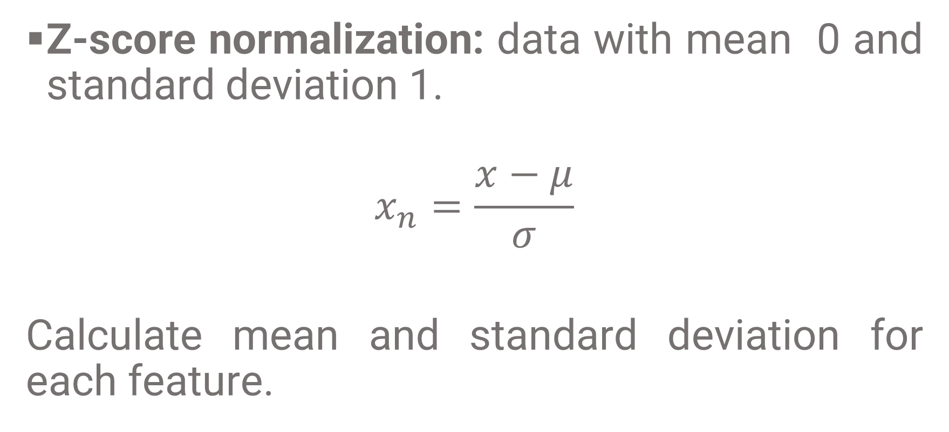
Background-Feature Scaling
Z-score normalization: data with mean 0 and standard deviation 1.
$$x_{n}=\frac{x−μ}{σ}$$
Calculate mean and standard deviation for each feature.

Slide 7

Background-Covariance Matrix
Covariance Matrix
From Matrix $X$, where rows are observations and columns are variables (features):
Center the data: subtract the mean of each variable. For each columna $j$ in $X$, calculate the mean $μ_{j}$ and subtract $μ_{j}$ from every element in the column

Slide 8
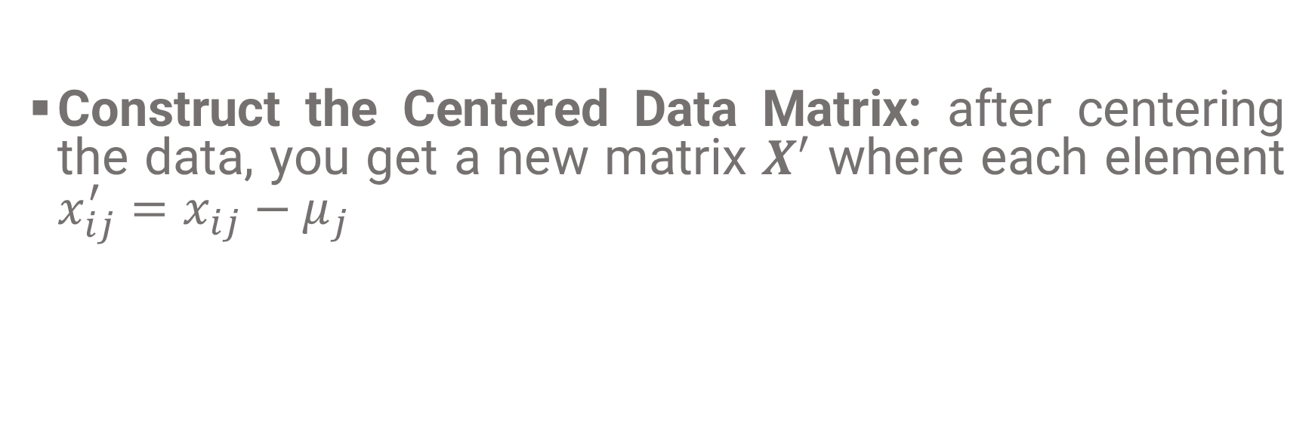
Background-Covariance Matrix
Construct the Centered Data Matrix: after centering the data, you get a new matrix $X^{′}$ where each element $x_{ij}^{′}=x_{ij}−μ_{j}$

Slide 9

Background-Covariance Matrix
Calculate the Covariance Matrix: the covariance matrix $C$ is a square $n x n$ matrix where $n$ is the number of variables. Each element $c_{ij}$of the covariance matrix is calculated as the average of the products of the deviations of each element from its mean for variables i and $j$, like this:
$$c_{ij}=\frac{1}{m−1}\sum_{k=1}^{m}{x_{ki}^{′}∙}x_{kj}^{′}$$
$m$ is the number of observations

Slide 10

Background-Covariance Matrix
Example: Let’s consider a 3x2 matrix (3 observations, 2 variables) as follows,
$$X=\left[\begin{matrix}2 & 4 \\ 5 & 10 \\ 7 & 8\end{matrix}\right]$$
First, calculate the mean for each variable (column):
$$μ=\left[\begin{matrix}\frac{2+5+7}{3} \\ \frac{4+10+8}{3}\end{matrix}\right]=\left[\begin{matrix}4.67 \\ 7.33\end{matrix}\right]$$

Slide 11

Background-Covariance Matrix
Center the data by subtracting these means:
$$X^{′}=\left[\begin{matrix}2−4.67 & 4−7.33 \\ 5−4.67 & 10−7.33 \\ 7−4.67 & 8−7.33\end{matrix}\right]=\left[\begin{matrix}−2.67 & −3.33 \\ 0.33 & 2.67 \\ 2.33 & 0.67\end{matrix}\right]$$

Slide 12

Background-Covariance Matrix
Finally, to compute the covariance matrix, the centered values of one variable must be multiplied by the center values of another, and average is calculated,
For $Cov(X_{1},$ $X_{1}$):
$$\frac{1}{3−1}\left(\left(−2.67∗−2.67\right)+\left(0.33∗0.33\right)+\left(2.33∗2.33\right)\right)=6.33$$

Slide 13

Background-Covariance Matrix
For $Cov(X_{2},$ $X_{2}$):
$$\frac{1}{3−1}\left(\left(−3.33∗−3.33\right)+\left(2.67∗2.67\right)+\left(0.67∗0.67\right)\right)=9.33$$
For $Cov(X_{1},$ $X_{2}$):
$$\frac{1}{3−1}\left(\left(−2.67∗−3.33\right)+\left(0.33∗2.67\right)+\left(2.33∗0.67\right)\right)=5.66$$

Slide 14

Background-Covariance Matrix
Thus, the covariance matrix is:
$$C=\left[\begin{matrix}6.33 & 5.66 \\ 5.66 & 9.33\end{matrix}\right]$$
The diagonal elementes (6.33 and 9.33) are the variances of $X_{1}$ and $X_{2}$, respectively, and the off-diagonal elements (5.66) are the covariances between $X_{1}$ and $X_{2}$.

Slide 15
Background-Covariance Matrix
A positive covariance indicates that the variables tend to increase together, as one variable increases, the other tends to increase as well.
The diagonal elements of the covariance matrix represent the variance of each variable. This is a measure of the spread of the data around the mean.
Notes:
Dataset of houses, variables (or features) might include the size of the house in square feet, the number of bedrooms, the age of the house, the distance to the nearest school, etc. Each of these features can be used by a machine learning model to learn from the data and predict outcomes like the price of a house.

Slide 16

Background-Eigenvalues and Eigenvectors
Eigenvectors and Eigenvalues:
An eigenvector of a square matrix $A$ is a non-zero vector $x$ that, when $A$ is multiplied by $x$, does not change direction. Mathematically, for a given matrix $A$ and a vector $x$, if $A∙x$ results in a vector that is scalar multple of $x$, then $x$ is an eigenvector of $A$. This can be expressed by the equation
$A∙x=λ∙x$
Where $λ$ is a scalar known as the eigenvalue associated with the eigenvector $x$

Slide 17
Motivation
PCA is an unsupervised algorithm
It is commonly used for data visualization
It allows data with a lot of features to be reduced in order to plot it and visualize it.
It is highly used in data science for visualization

Slide 18
Motivation
Solution to a number of problems in Pattern Recognition can be achieved by choosing a better feature space
Dimensionality: number of examples needed to train classifier function grows exponentially with number of dimensions
What features best characterize a class

Slide 19
Motivation
PCA is widely used for applications such as dimensionality reduction, lossy data compression, feature extraction, and data visualization (Jolliffe, 2002).
The goal is to project the data onto a space having less dimensionality, while maximizing the variance of the projected data.

Slide 20
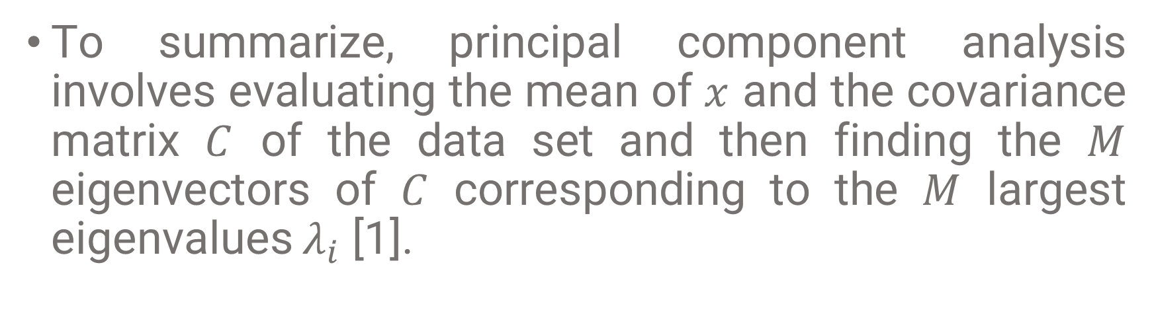
Motivation
To summarize, principal component analysis involves evaluating the mean of $x$ and the covariance matrix $C$ of the data set and then finding the $M$ eigenvectors of $C$ corresponding to the $M$ largest eigenvalues $λ_{i}$ [1].

Slide 21




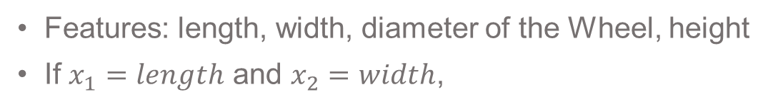

How does PCA work?
For example, car measurements:
Features: length, width, diameter of the Wheel, height
If $x_{1}=length$ and $x_{2}=width$,
Height
$$x_{2}$$
Diameter
Length
Width
$$x_{1}$$
Only take $x_{1}$which has more variance,
to reduce de number of features

Slide 22
How does PCA work?
PCA automaticaly decides which features are relevant (more variance)
It is very useful to visualize data to understand how it looks like, what is happening in the data.

Slide 23

How does PCA work?
For example, car measurements:
If $x_{1}=length$ and $x_{2}=height$,
Height
Which one to pick?
$$x_{2}$$
Diameter
Length
Width
$$x_{1}$$
Both features have useful information
(more variance)

Slide 24

How does PCA work?
For example, car measurements:
If $x_{1}=length$ and $x_{2}=height$,
Height
Which one to pick?
$$x_{2}$$
$$z$$
Diameter
Length
Width
$$x_{1}$$
PCA finds new axis

Slide 25
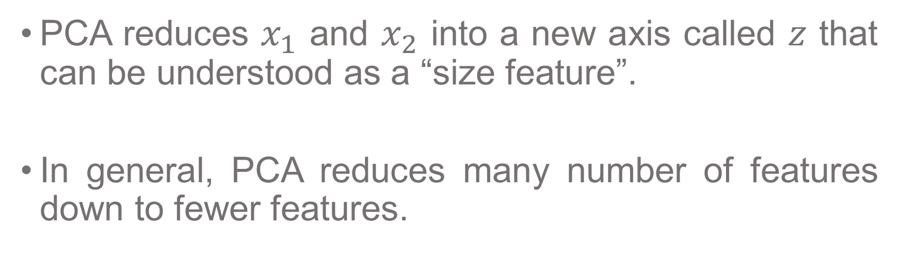
How does PCA work?
PCA reduces $x_{1}$ and $x_{2}$ into a new axis called $z$ that can be understood as a “size feature”.
In general, PCA reduces many number of features down to fewer features.

Slide 26
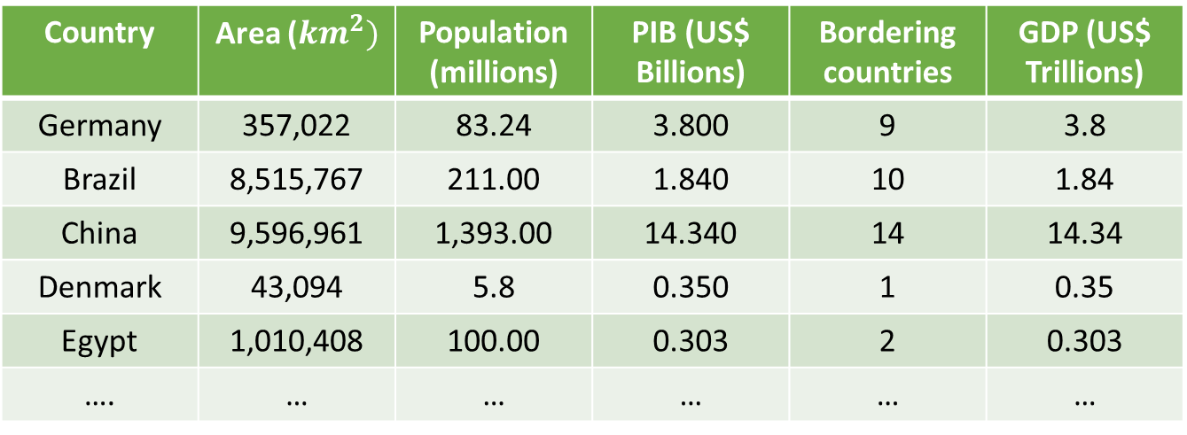
How does PCA work?
Another example:
Country | Area (${km}^{2})$ | Population (millions) | PIB (US$ Billions) | Bordering countries | GDP (US$ Trillions)
Germany | 357,022 | 83.24 | 3.800 | 9 | 3.8
Brazil | 8,515,767 | 211.00 | 1.840 | 10 | 1.84
China | 9,596,961 | 1,393.00 | 14.340 | 14 | 14.34
Denmark | 43,094 | 5.8 | 0.350 | 1 | 0.35
Egypt | 1,010,408 | 100.00 | 0.303 | 2 | 0.303
…. | … | … | … | … | …
How to visualize the data?

Slide 27
Feature Scaling
Divide by the maximum: data between 0 and 1.
Mean normalization: features are centered around cero. Positive and negative values.
$$x_{n}=\frac{x−μ}{max−min}$$

Slide 28
Feature Scaling
Z-score normalization: data with mean 0 and standard deviation 1.
$$x_{n}=\frac{x−μ}{σ}$$
Calculate mean and standard deviation for each feature.

Slide 29
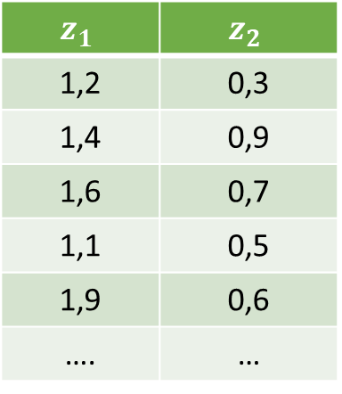
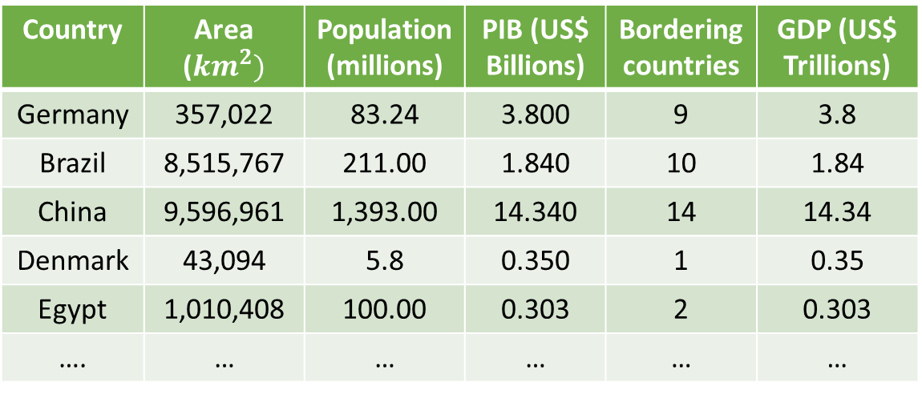
How does PCA work?
Another example:
Country | Area (${km}^{2})$ | Population (millions) | PIB (US$ Billions) | Bordering countries | GDP (US$ Trillions)
Germany | 357,022 | 83.24 | 3.800 | 9 | 3.8
Brazil | 8,515,767 | 211.00 | 1.840 | 10 | 1.84
China | 9,596,961 | 1,393.00 | 14.340 | 14 | 14.34
Denmark | 43,094 | 5.8 | 0.350 | 1 | 0.35
Egypt | 1,010,408 | 100.00 | 0.303 | 2 | 0.303
…. | … | … | … | … | …
$$z_{1}$$ | $$z_{2}$$
1,2 | 0,3
1,4 | 0,9
1,6 | 0,7
1,1 | 0,5
1,9 | 0,6
…. | …

Slide 30
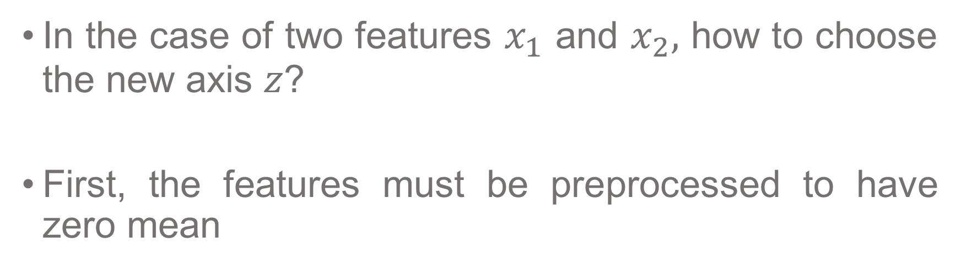




PCA Algorithm
In the case of two features $x_{1}$ and $x_{2},$ how to choose the new axis $z$?
First, the features must be preprocessed to have zero mean
$$x_{2}$$
$$x_{2}$$
$$x_{1}$$
$$x_{1}$$

Slide 31
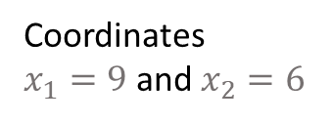


PCA Algorithm
$$x_{2}$$
Coordinates
$x_{1}=9$ and $x_{2}=6$
6
9
$$x_{1}$$

Slide 32
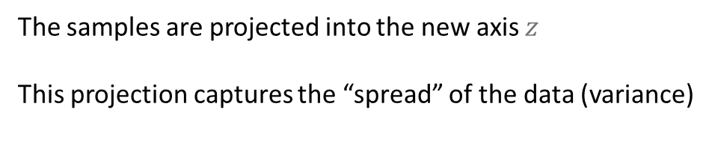

PCA Algorithm
The samples are projected into the new axis $z$
This projection captures the “spread” of the data (variance)
$$z$$
If the variance if large, important information is being captured from the original samples

Slide 33

PCA Algorithm
$$z$$
Less variance: it is capturing les information from
The original data
Not a good choice

Slide 34


PCA Algorithm
Much better choice
More variation in the data
$$z$$
Principal component: maximum variance

Slide 35
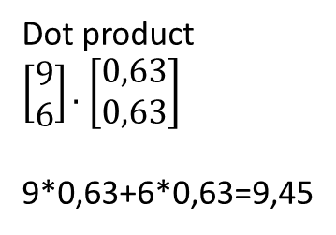
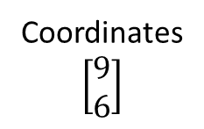


PCA Algorithm
$$x_{2}$$
Coordinates
$$\left[\begin{aligned}9 \\ 6\end{aligned}\right]$$
Dot product
$\left[\begin{aligned}9 \\ 6\end{aligned}\right].$ $\left[\begin{aligned}0,63 \\ 0,63\end{aligned}\right]$
9*0,63+6*0,63=9,45
6
$$z$$
9,45
9
$$x_{1}$$
Lenght vector
$$\left[\begin{aligned}0,63 \\ 0,63\end{aligned}\right]$$
Notes:
Valores Propios (Eigenvalues): Los valores propios en PCA corresponden a la varianza que cada componente principal retiene de los datos originales. En otras palabras, un valor propio más grande significa que ese componente principal tiene más 'información' o variación de los datos originales.
Vectores Propios (Eigenvectors): Los vectores propios determinan las direcciones de los nuevos ejes (componentes principales) en el espacio de características. Estos son los vectores que no cambian su dirección durante la transformación lineal aplicada por la matriz de covarianza de los datos. La propiedad importante de estos vectores en PCA es que son ortogonales entre sí, lo que significa que están descorrelacionados.

Slide 36





PCA Algorithm
Principal components are penpendicular
All principal components must be orthogonal to ensure they are uncorrelated
$$z_{3}$$
$$z_{2}$$
$$z_{1}$$
$$z_{1}$$
$$z_{2}$$
Second Principal component
First Principal component

Slide 37

PCA Algorithm
$$x_{2}$$
Coordinates
$$\left[\begin{aligned}9 \\ 6\end{aligned}\right]$$
Given z=9,45
9,45 x $\left[\begin{aligned}0,63 \\ 0,63\end{aligned}\right]$= $\left[\begin{aligned}5,95 \\ 5,95\end{aligned}\right]$
Find the approximately the
original data: “reconstruction”
6
$$z$$
9,45
9
$$x_{1}$$
Lenght vector
$$\left[\begin{aligned}0,63 \\ 0,63\end{aligned}\right]$$
Notes:
Valores Propios (Eigenvalues): Los valores propios en PCA corresponden a la varianza que cada componente principal retiene de los datos originales. En otras palabras, un valor propio más grande significa que ese componente principal tiene más 'información' o variación de los datos originales.
Vectores Propios (Eigenvectors): Los vectores propios determinan las direcciones de los nuevos ejes (componentes principales) en el espacio de características. Estos son los vectores que no cambian su dirección durante la transformación lineal aplicada por la matriz de covarianza de los datos. La propiedad importante de estos vectores en PCA es que son ortogonales entre sí, lo que significa que están descorrelacionados.

Slide 38

PCA Algorithm
PCA algorithm ($A$; $k$): top $k$ eigenvalues/eigenvectors
DATA: $A$ $m$ $x$ $n$ data matrix
Each point $x_{n}$ is a column vector of $A$
Substract the mean from each column of $A$ (center the data)
Compute de covariance matrix of $A$
Notes:
Subtract the mean from each column of �X (center the data): The first step in PCA is to center the data by subtracting the mean of each variable (column) from the data for that variable. This is done because PCA seeks the directions (principal components) that maximize the variance, and having data centered around zero is essential for calculating the covariance matrix correctly.
Compute the covariance matrix of �X: Once the data is centered, the next step is to calculate the covariance matrix. This matrix provides a measure of how much each of the variables varies from the mean with respect to each other.
Perform SVD decomposition of �S: SVD stands for Singular Value Decomposition. It's a method of decomposing a matrix into three other matrices, where �S is the covariance matrix of the centered data. The decomposition yields eigenvalues ��λi​ and eigenvectors ��ui​ of �S, which are crucial for PCA. The eigenvectors represent the directions of maximum variance, and the eigenvalues represent the magnitude of the variance in the directions of their corresponding eigenvectors.
Return the �k principal components: The eigenvectors are ranked according to their corresponding eigenvalues, with the largest eigenvalue having the most significant principal component. The number �k is how many principal components you choose to keep. The decision on the value of �k depends on how much of the data's variance you wish to capture. By selecting the top �k eigenvectors, you reduce the dimensionality of the data while retaining the components that account for the most variance.

Slide 39

PCA Algorithm
Perform Singular Value Decomposition (SVD) decomposition of $C$ so that {$λ_{i}, u_{i}\}$are the eigenvalues and eigenvectors of $C$
Return the $k$ principle components so that $k≤m$ (retain a given percentage of the data variance)
Notes:
Subtract the mean from each column of �X (center the data): The first step in PCA is to center the data by subtracting the mean of each variable (column) from the data for that variable. This is done because PCA seeks the directions (principal components) that maximize the variance, and having data centered around zero is essential for calculating the covariance matrix correctly.
Compute the covariance matrix of �X: Once the data is centered, the next step is to calculate the covariance matrix. This matrix provides a measure of how much each of the variables varies from the mean with respect to each other.
Perform SVD decomposition of �S: SVD stands for Singular Value Decomposition. It's a method of decomposing a matrix into three other matrices, where �S is the covariance matrix of the centered data. The decomposition yields eigenvalues ��λi​ and eigenvectors ��ui​ of �S, which are crucial for PCA. The eigenvectors represent the directions of maximum variance, and the eigenvalues represent the magnitude of the variance in the directions of their corresponding eigenvectors.
Return the �k principal components: The eigenvectors are ranked according to their corresponding eigenvalues, with the largest eigenvalue having the most significant principal component. The number �k is how many principal components you choose to keep. The decision on the value of �k depends on how much of the data's variance you wish to capture. By selecting the top �k eigenvectors, you reduce the dimensionality of the data while retaining the components that account for the most variance.

Slide 40
Singular Value Decomposition (SVD)
It is a mathematical method used in PCA to decompose a matrix into its components
SVD breaks down the covariance matrix into three separate matrices.
Notes:
Subtract the mean from each column of �X (center the data): The first step in PCA is to center the data by subtracting the mean of each variable (column) from the data for that variable. This is done because PCA seeks the directions (principal components) that maximize the variance, and having data centered around zero is essential for calculating the covariance matrix correctly.
Compute the covariance matrix of �X: Once the data is centered, the next step is to calculate the covariance matrix. This matrix provides a measure of how much each of the variables varies from the mean with respect to each other.
Perform SVD decomposition of �S: SVD stands for Singular Value Decomposition. It's a method of decomposing a matrix into three other matrices, where �S is the covariance matrix of the centered data. The decomposition yields eigenvalues ��λi​ and eigenvectors ��ui​ of �S, which are crucial for PCA. The eigenvectors represent the directions of maximum variance, and the eigenvalues represent the magnitude of the variance in the directions of their corresponding eigenvectors.
Return the �k principal components: The eigenvectors are ranked according to their corresponding eigenvalues, with the largest eigenvalue having the most significant principal component. The number �k is how many principal components you choose to keep. The decision on the value of �k depends on how much of the data's variance you wish to capture. By selecting the top �k eigenvectors, you reduce the dimensionality of the data while retaining the components that account for the most variance.

Slide 41

Singular Value Decomposition (SVD)
$U$ is a matrix whose columns are the eigenvectors of ${CC}^{T}$
Σ is a diagonal matrix whose diagonal elements are the square roots of the eigenvalues of $C$ and $C^{T}.$These values are known as the singular values
$V^{T}$ is a matrix whose rows are the eigenvectors of $C^{T}C$
Notes:
Subtract the mean from each column of �X (center the data): The first step in PCA is to center the data by subtracting the mean of each variable (column) from the data for that variable. This is done because PCA seeks the directions (principal components) that maximize the variance, and having data centered around zero is essential for calculating the covariance matrix correctly.
Compute the covariance matrix of �X: Once the data is centered, the next step is to calculate the covariance matrix. This matrix provides a measure of how much each of the variables varies from the mean with respect to each other.
Perform SVD decomposition of �S: SVD stands for Singular Value Decomposition. It's a method of decomposing a matrix into three other matrices, where �S is the covariance matrix of the centered data. The decomposition yields eigenvalues ��λi​ and eigenvectors ��ui​ of �S, which are crucial for PCA. The eigenvectors represent the directions of maximum variance, and the eigenvalues represent the magnitude of the variance in the directions of their corresponding eigenvectors.
Return the �k principal components: The eigenvectors are ranked according to their corresponding eigenvalues, with the largest eigenvalue having the most significant principal component. The number �k is how many principal components you choose to keep. The decision on the value of �k depends on how much of the data's variance you wish to capture. By selecting the top �k eigenvectors, you reduce the dimensionality of the data while retaining the components that account for the most variance.

Slide 42

Singular Value Decomposition (SVD)
Using SVD, the decomposition of the covariance matrix is,
$$C=UΣV^{T}$$
Columns of $U$ give us the principal components (eigenvectors). The first column will be the first principal component, which is the direction of maximum variance, and the second column will be the second principal component, orthogonal to the first
Notes:
Subtract the mean from each column of �X (center the data): The first step in PCA is to center the data by subtracting the mean of each variable (column) from the data for that variable. This is done because PCA seeks the directions (principal components) that maximize the variance, and having data centered around zero is essential for calculating the covariance matrix correctly.
Compute the covariance matrix of �X: Once the data is centered, the next step is to calculate the covariance matrix. This matrix provides a measure of how much each of the variables varies from the mean with respect to each other.
Perform SVD decomposition of �S: SVD stands for Singular Value Decomposition. It's a method of decomposing a matrix into three other matrices, where �S is the covariance matrix of the centered data. The decomposition yields eigenvalues ��λi​ and eigenvectors ��ui​ of �S, which are crucial for PCA. The eigenvectors represent the directions of maximum variance, and the eigenvalues represent the magnitude of the variance in the directions of their corresponding eigenvectors.
Return the �k principal components: The eigenvectors are ranked according to their corresponding eigenvalues, with the largest eigenvalue having the most significant principal component. The number �k is how many principal components you choose to keep. The decision on the value of �k depends on how much of the data's variance you wish to capture. By selecting the top �k eigenvectors, you reduce the dimensionality of the data while retaining the components that account for the most variance.

Slide 43
References
Christopher M Bishop et al. Pattern recognition and machine learning. Springer New York, 2006.
Ng, A. (2023). Machine Learning Specialization Coursera. Standford University, DeepLearning.AI
https://sites.calvin.edu/scofield/courses/m256/materials/eigenstuff.pdf
https://colab.research.google.com/github/jakevdp/PythonDataScienceHandbook/blob/master/notebooks/05.09-Principal-Component-Analysis.ipynb#scrollTo=DQaxglSpCBkH

Slide 44


