Slide 1
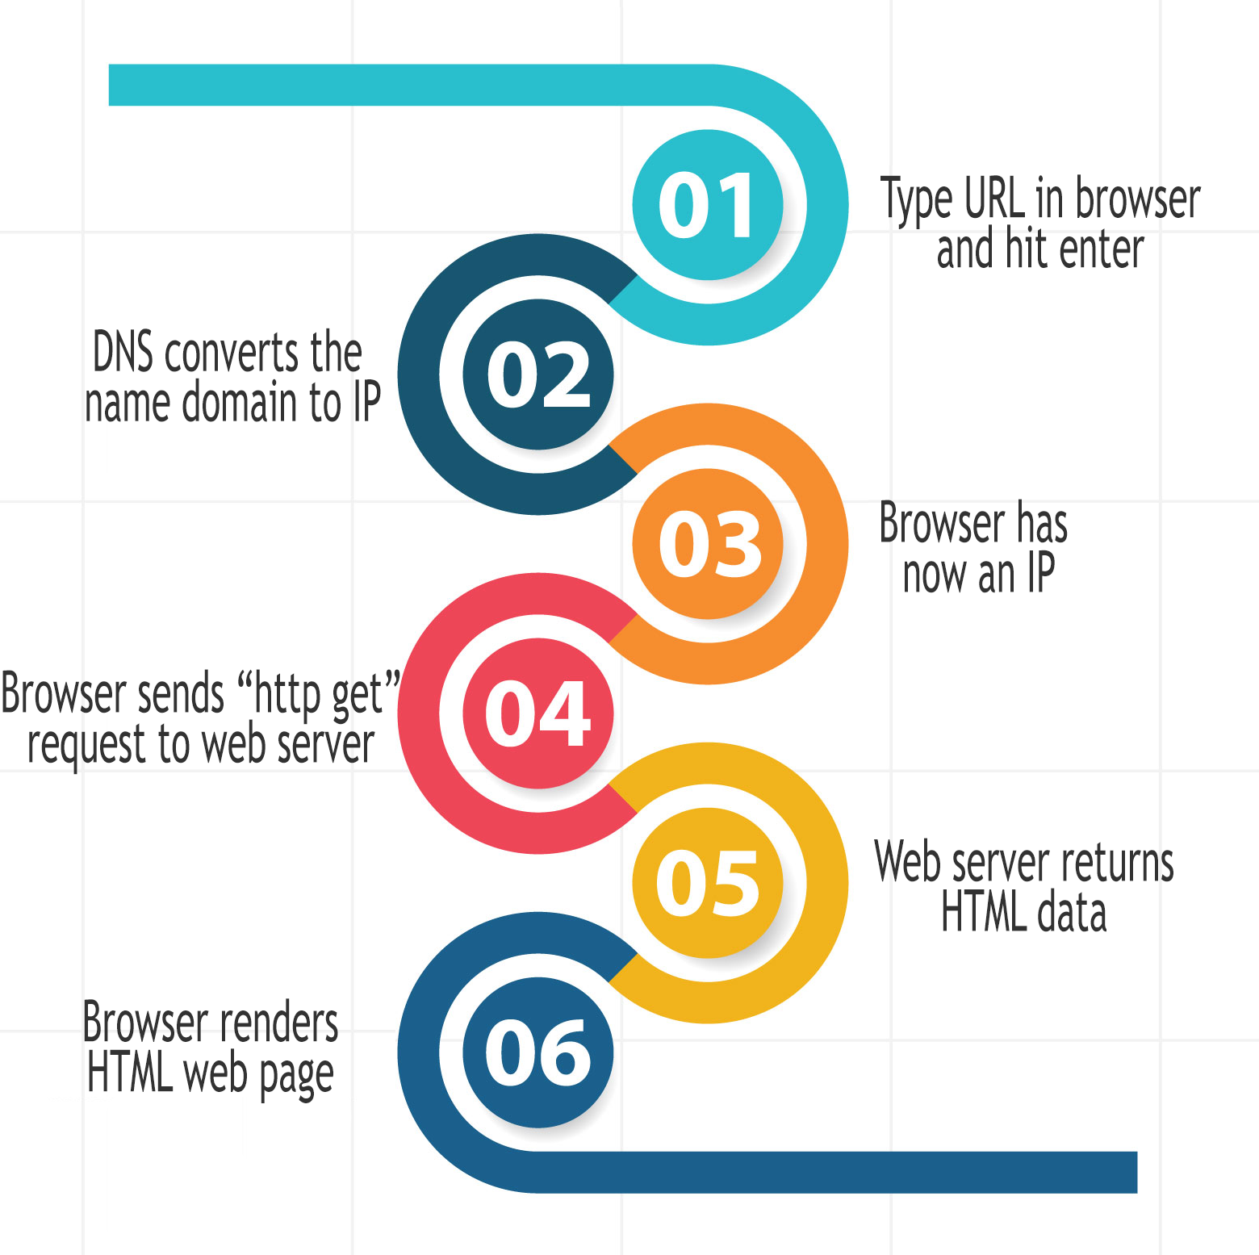
WWW Lifecycle
What happens behind the scenes, from the moment you type a website name until you receive his content into your browser?
This image contains the six steps that can define this process.
In the following slides i will present more details about each step.

Slide 2
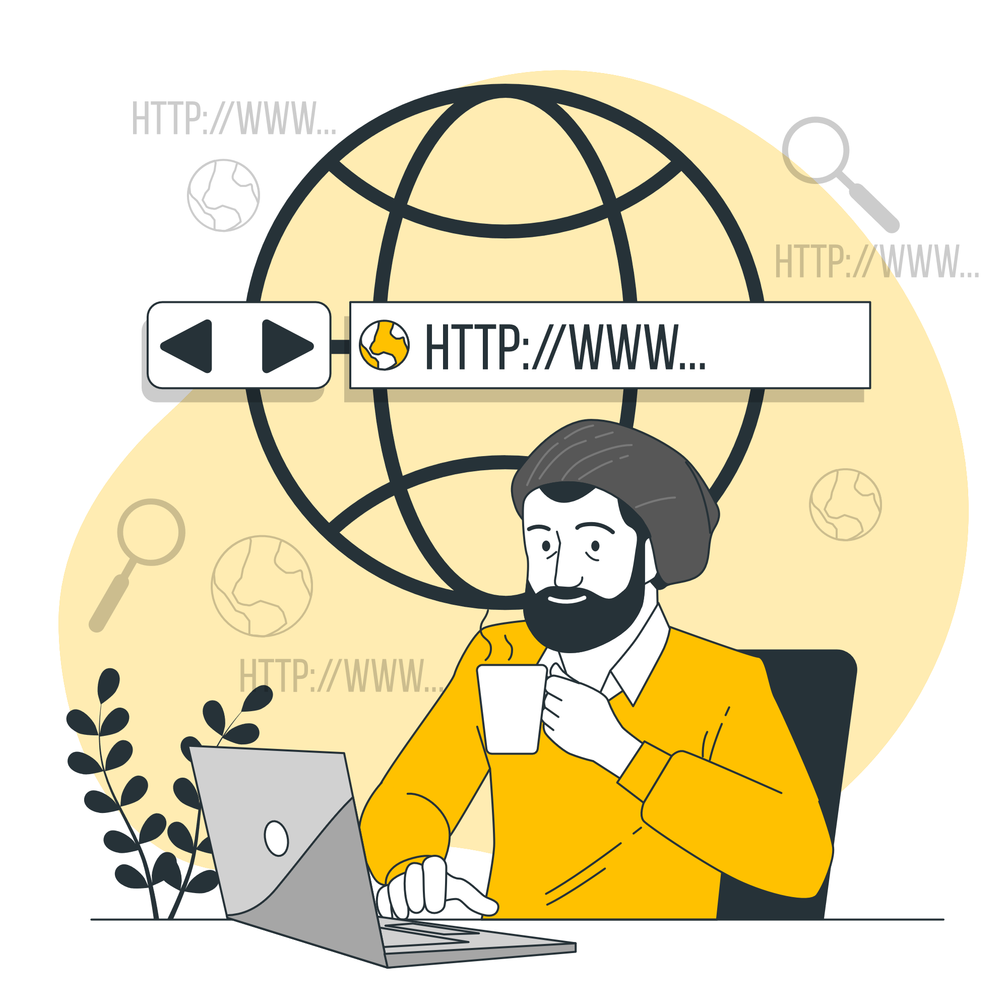
1. Type URL in browser and hit enter
Open your favorite browser
Type the URL for the website you want to access
Hit enter
To get the content of our searched website,
let’s say “http://example.com”,
it will be used the TCP/IP protocol suite.
TCP = Transmission Control Protocol
IP = Internet Protocol

Slide 3
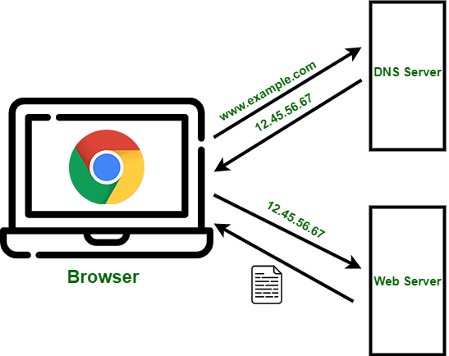
2. DNS converts domain name to IP
DNS = Domain Name Server
We need to know the IP address of the domain name because the files that represents the website we searched are stored at that address.
For this step DNS takes care because it maintain a directory of domain names and translate them to Internet Protocol (IP) addresses.

Slide 4

3. Browser now has IP address
Browser requested the IP address from
the DNS and the response came back to the
Browser.
Now it knows where the files are stored so it
can request them.

Slide 5
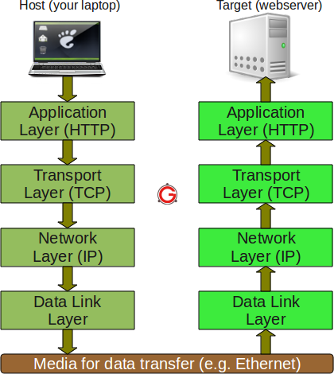
4. Browser sends “http get” request to web server
HTTP = Hyper Text Transfer Protocol
It’s a Client-server protocol for transferring Web resources based on request-response model.
Application layer has this protocol that helps to set rules with those which are gonna send back the requested resource.
The http message it’s sent and we get to transport layer. At this level, TCP is responsible for dividing the data into small packets and all, including the rules by which packets must be reassembled, are sent to the network layer.
The network layer handles packet routing so it knows how to get to the destination.

Slide 6
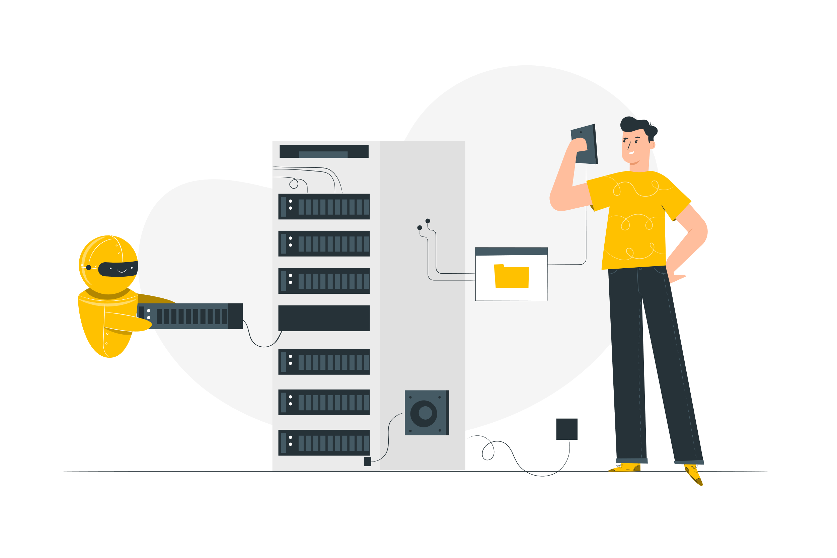
5. Web server return HTML data
Data layer - here we arrive after entering the destination network.
Then the data transfer will happen and the packages will go back to data layer -> network layer -> transport layer.
In transport layer the packages are unpacked and reassembled by the rules specified at the beginning in the transport layer, and then are sent to the application layer.

Slide 7
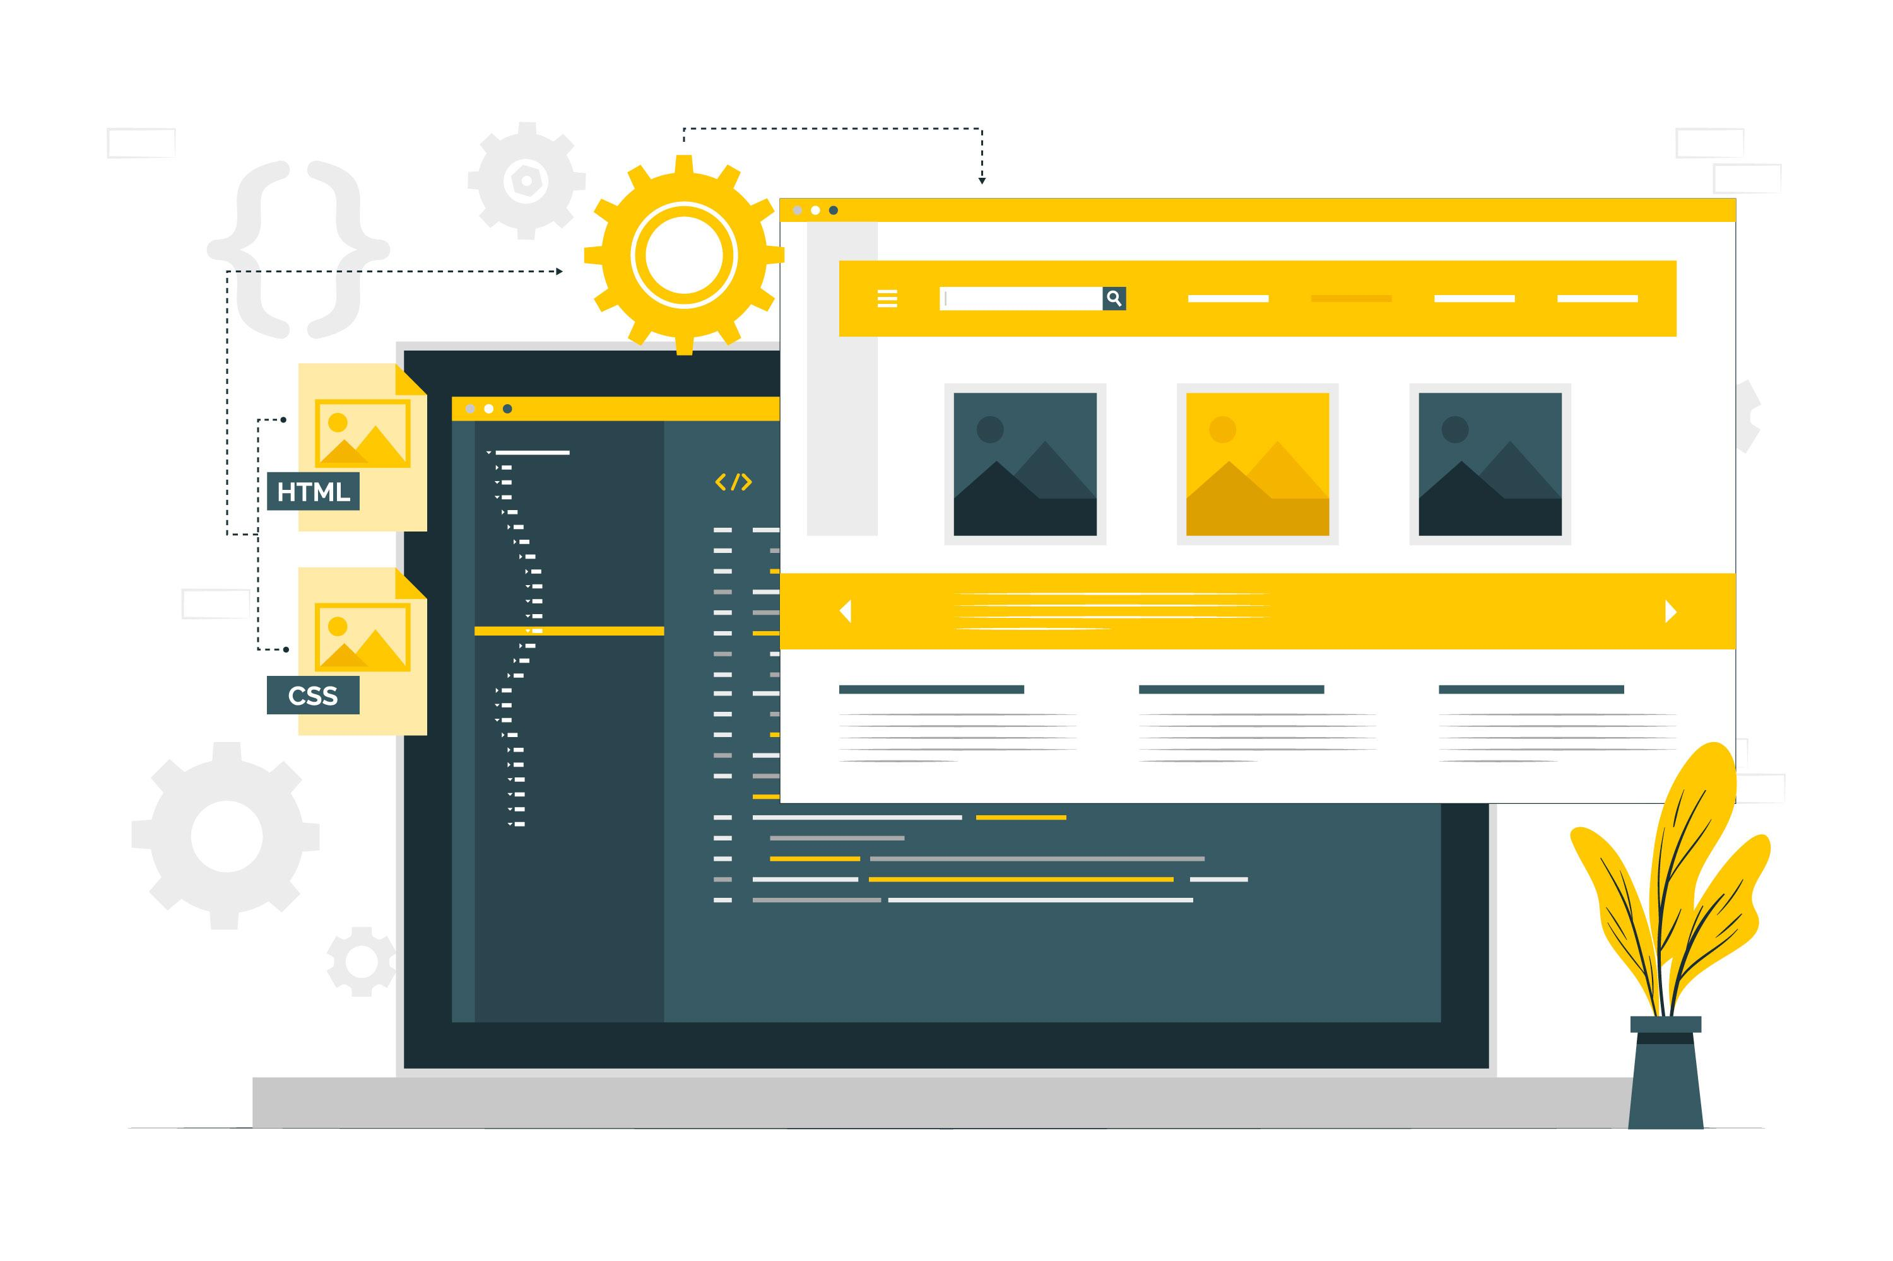
Web browser rendes HTML web page
And now the response contains all the web page data files. After receiving it
browser knows how to render so the user can see all the information, design
and functionality of the page.

Slide 8

Thank You!
Enjoy browsing online.

