Slide 1

“Never miss another birthday again”
Cameron Manchester

Slide 2

Agenda
The
The Problem
The Brilliant, Seamless Solution
Watch Birthday Buddy in Action
Join the Celebration

Slide 3

The Problem: Forgotten Birthdays
"I missed three birthdays this quarter—and my team noticed."
omargurnah. (2017). Man, cries at desk [Photograph]. Flickr. CC BY. Retrieved from http://j.mp/1SPGCl0
Sound familiar?
Important milestones lost in overflowing calendars
Manual reminders are unreliable and easily overlooked
Missed birthdays lead to lower team morale and engagement

Slide 4





The Brilliant, Seamless Solution – Birthday Buddy!
Centralized birthday database with multi-tenant support
Redis caching for lightning-fast lookups
Scheduler service triggering daily checks
Automated Slack notifications via webhook
Integrated secure JSON Web Token authentication & RBAC

Slide 5
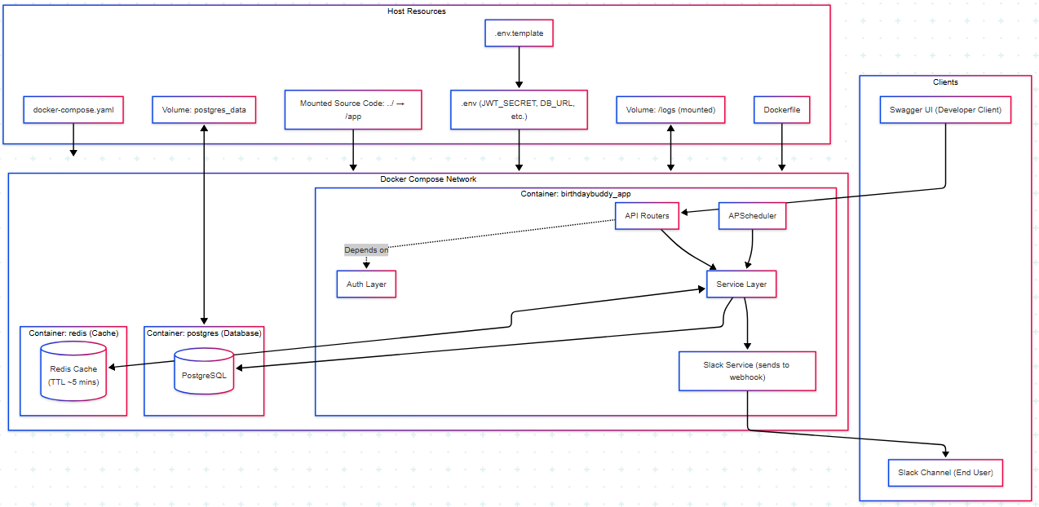
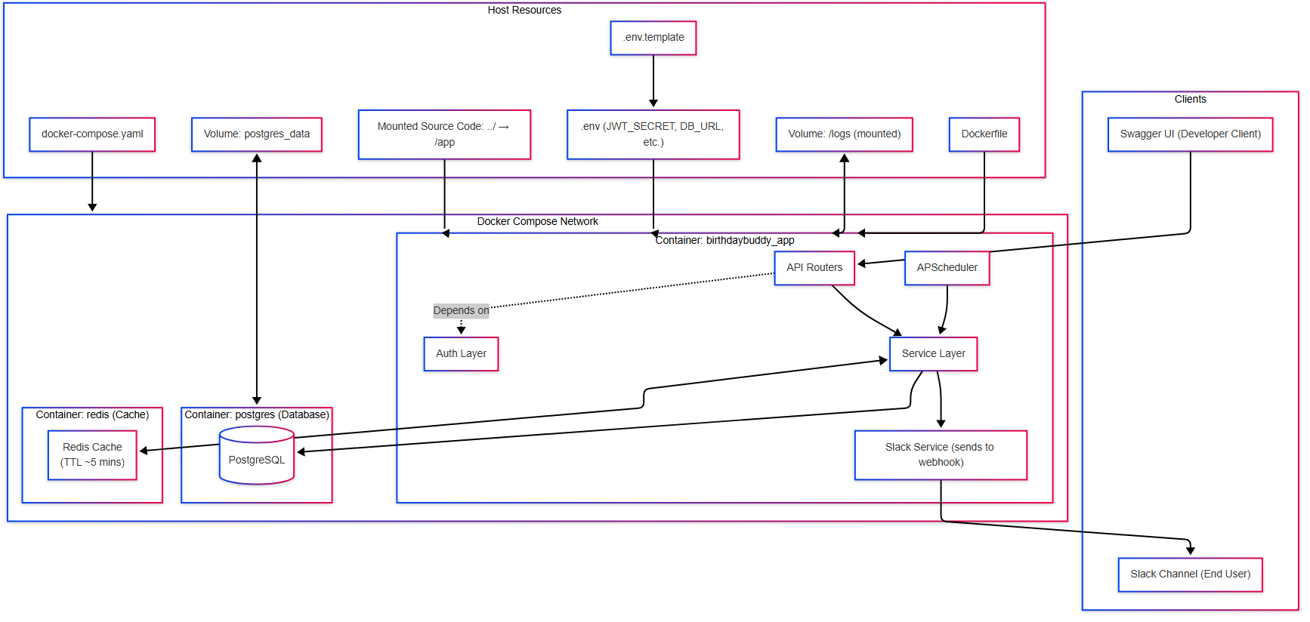
Under The Hood

Slide 6
Put Your Party Hats On!
Register New User
Get Birthdays in Workspace
Run Birthday Job
Admin Utilities

