Slide 1
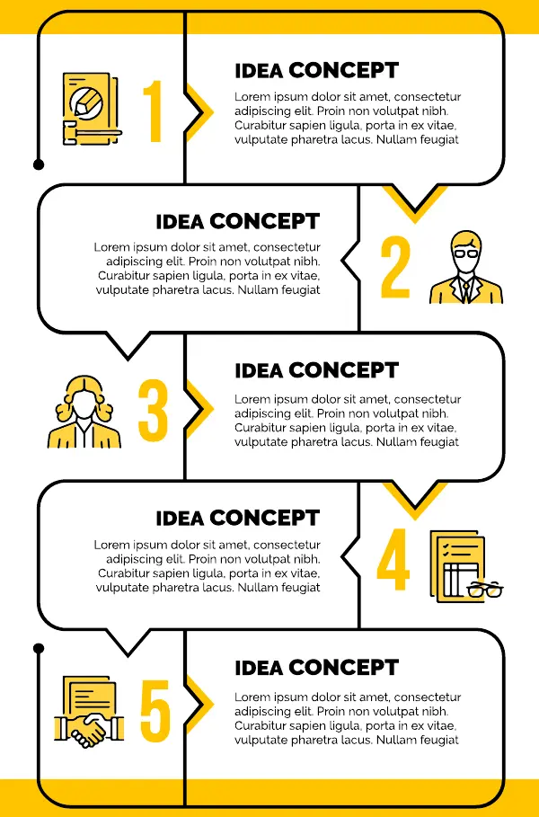
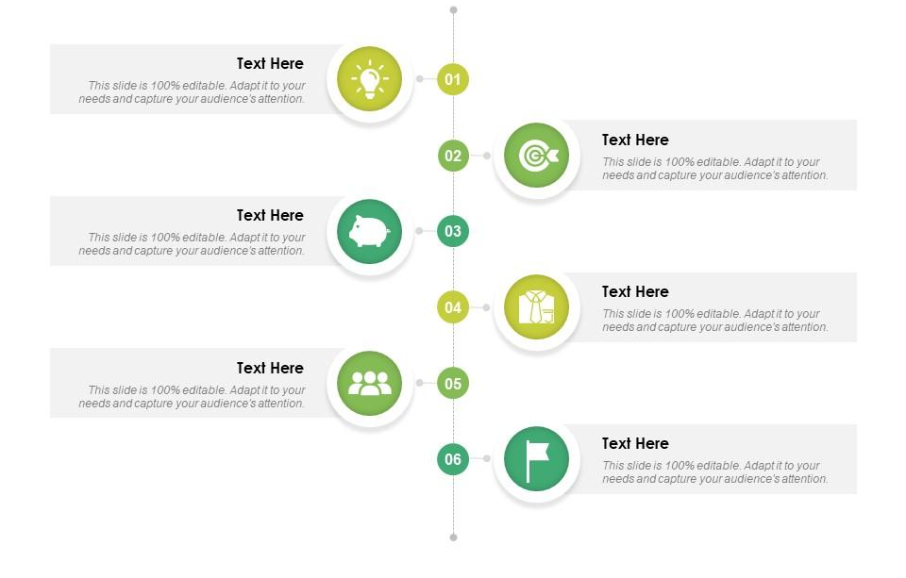
Audience
Consider the audience that you are writing the content for. What is their profession? Are they working part-time or full-time? And they looking at your content in leisure or for a specific objective? All these questions will help you define your audience and refine your content.
Need of audience There are multiple reasons why the audience will read your content. Are they trying to learn something new? Are they setting up something new? Are they trying to troubleshoot a specific issue with the help of your content? Answering these questions will help to answer the needs to the audience in the content.
Business goal Along with the audience, we need to think about our business goal to provide the content also. Are we trying to introduced something new with our content? Are we creating content that would improve our competitiveness level? Is the content support content that will help the audience?
Constraints You must keep in mind the constraints you may have before starting to create the content. You will always have a time-limit under which you need to develop the content. Also, at times, there are certain cost-limits with regards to resources, expertise, tools and software’s to be used.
Content breakup Some content might be hard to understand. The best way to present this content is to break it up into smaller chunks of easy-to-understand content. You can also try to show the content in a diagram, image, or infographic format. To better explain the content, you may want to put the content in tables, checklists, etc.
SEO An important point to work on is about the organic way in which the customer will find the content. For this Search Engine Optimization (SEO) is a must. This can include identifying the search terms and also social media promotion through blogs, tweets, etc.
Device You must also have an idea about the devices on which the content would be displayed. Ever device would have a different layout so the best experience across most devices must be planned. The devices can be laptops, desktops, tablets, phones, etc.
Global customization At times the content needs to be translated and localization for any specific countries for global reach so plan accordingly.
Success measurement You may define certain targets that can be achieved with the content. Examples of these parameters can be number of leads generated, clicks, views, etc.
Note to Graphics: This is a representative infographic. You can also use a different design as the ones on the side.
Note to Graphics: The icons are representative. You can change/enhance the icons or style of icons (3D icons, etc.) if you have other options or icon library.

