Slide 1


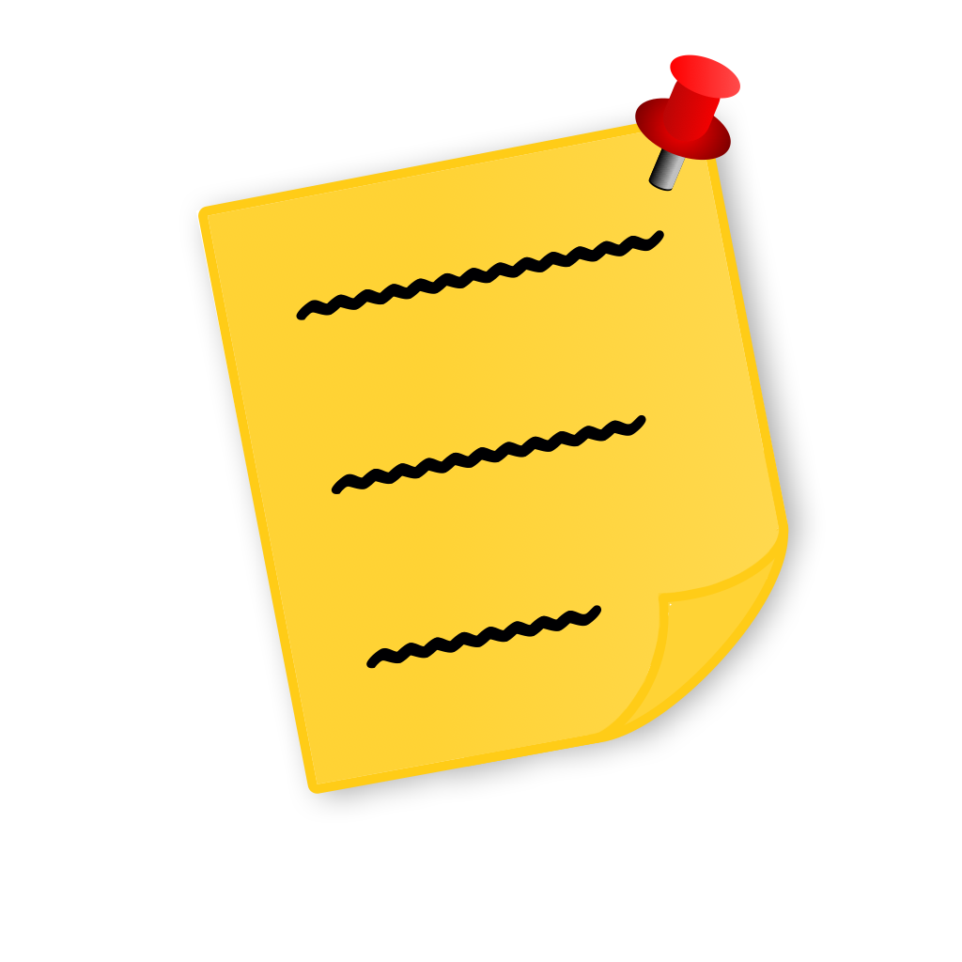
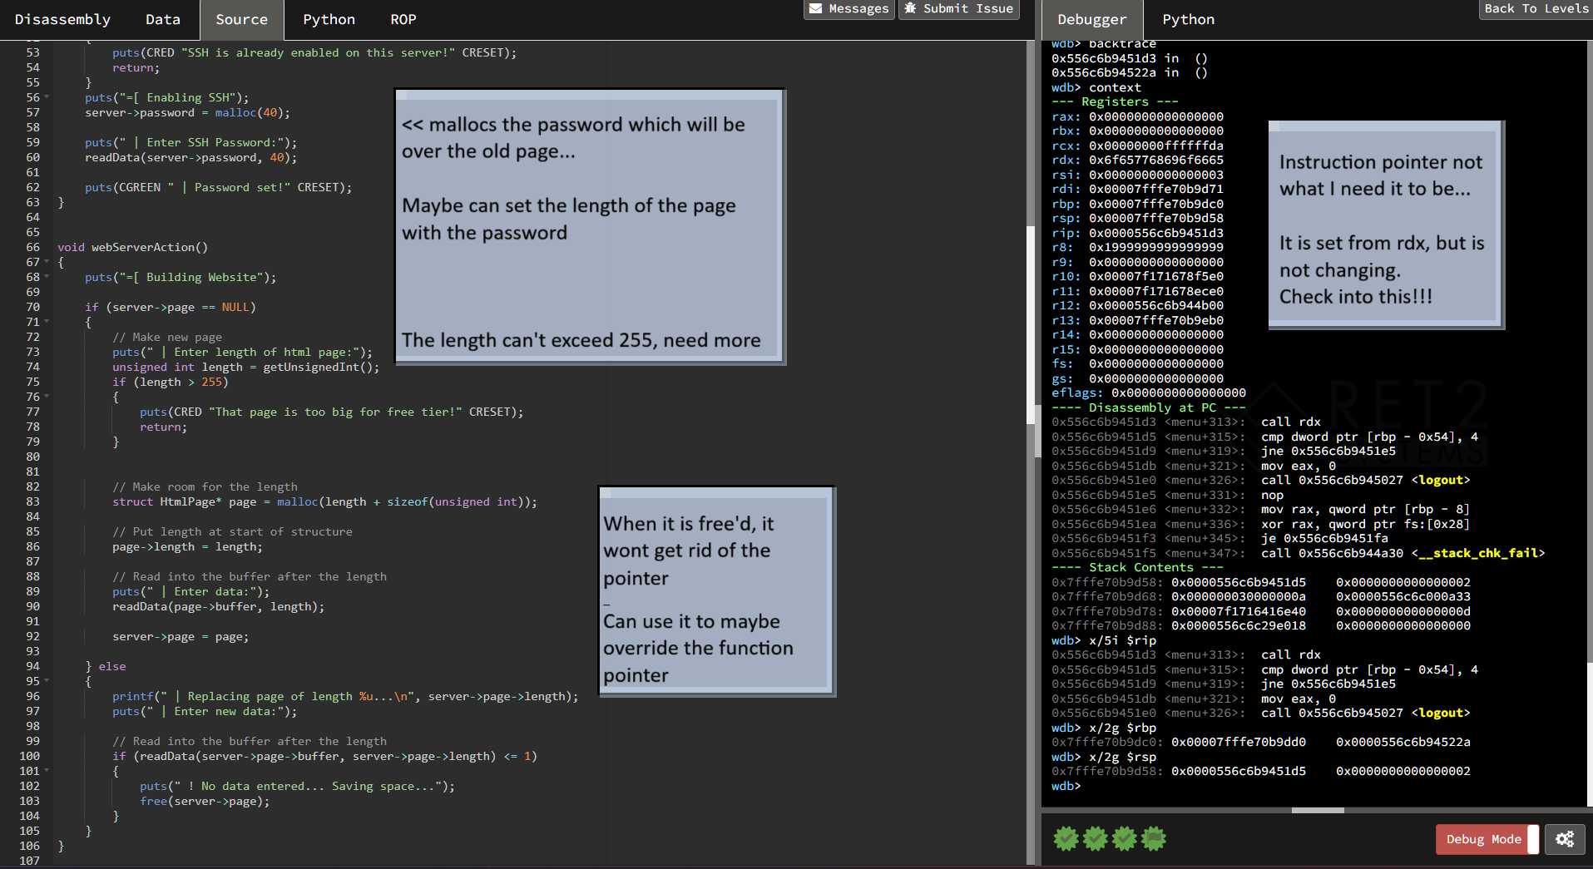


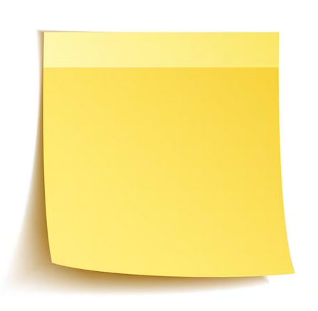
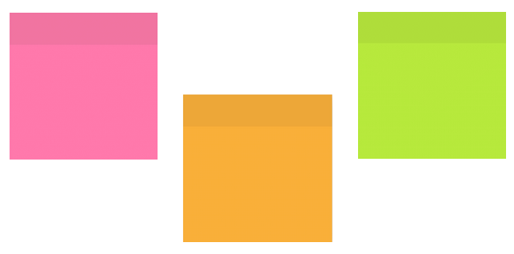


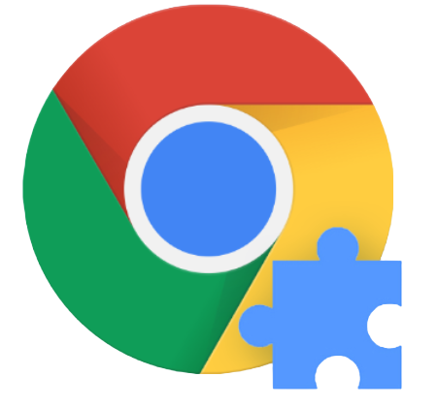
StickyNote
Never again lose your web of thoughts!
Notepad exists… why make it?
Devin Ross
Well one day while surfing the web, I tried to save some information from the website I was currently on. This is a simple enough task, or at least I that is what I also thought.
I ended up having to launch a new application and juggle both my browser and notepad at the same time, the notepad disappearing behind the browser because it isn’t locked to the top of my screen.
If I wanted to scroll on the page or follow a link I once again had to do this.
If I wanted to copy something from the text to my notepad I would once again have to find where the notepad is and orient it in such a way that the applications’ placement complimented one another,
and if I had the audacity of wanting to access that information later in the day or week, I would either have to save that note, and every time I wanted it navigate through my file system to find it, or don’t save it and hope my computer didn’t restart overnight and lose the note I had all of my information on.
Now… admittedly I am phrasing this problem as if it spans a much grander scale than it actually does. It isn’t the end of the world when I have to look for a note to see what I saved a few days ago, but it does take a large amount of time when I have to do this a lot which ends up being an inconvenience sometimes.
This is why I wanted to make StickyNote.
What will it look like on my screen?
I know it doesn’t look the best right now… soon I will add animations, colors, fonts, markdown and more customization options than you could ever ask for
React Bootstrap
What was used to make the project?
Okay sounds cool, what will it do?
React Bootstrap
TypeScript
StickyNote is meant to be a solution to “single-tasking” problems. StickyNote brings information from tab to tab, essay to essay, or just to a different part of your screen; it can be used to take excerpts from textbooks that you need to commit to memory or just act as a way to jot down your quick thoughts for a project idea.
What I want in the end is for StickyNote not to be the one savior extension for all of your web browsing problems, but for it to be the hero for those times you just need to jot something down quickly for later and don’t want to put much brain or processing power to do it.
In the most basic of forms, StickyNote will be a text container that you can morph and move to your hearts content, and it will always be right there on the top of your screen. Unless, that is, you want it hidden, or on a different part of your screen, it can do that too!
Chrome Extension

