Slide 1
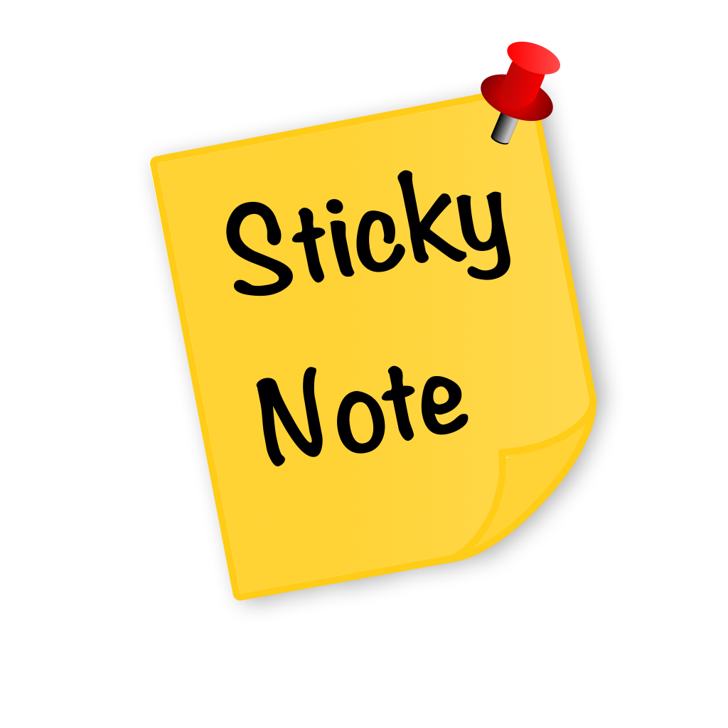
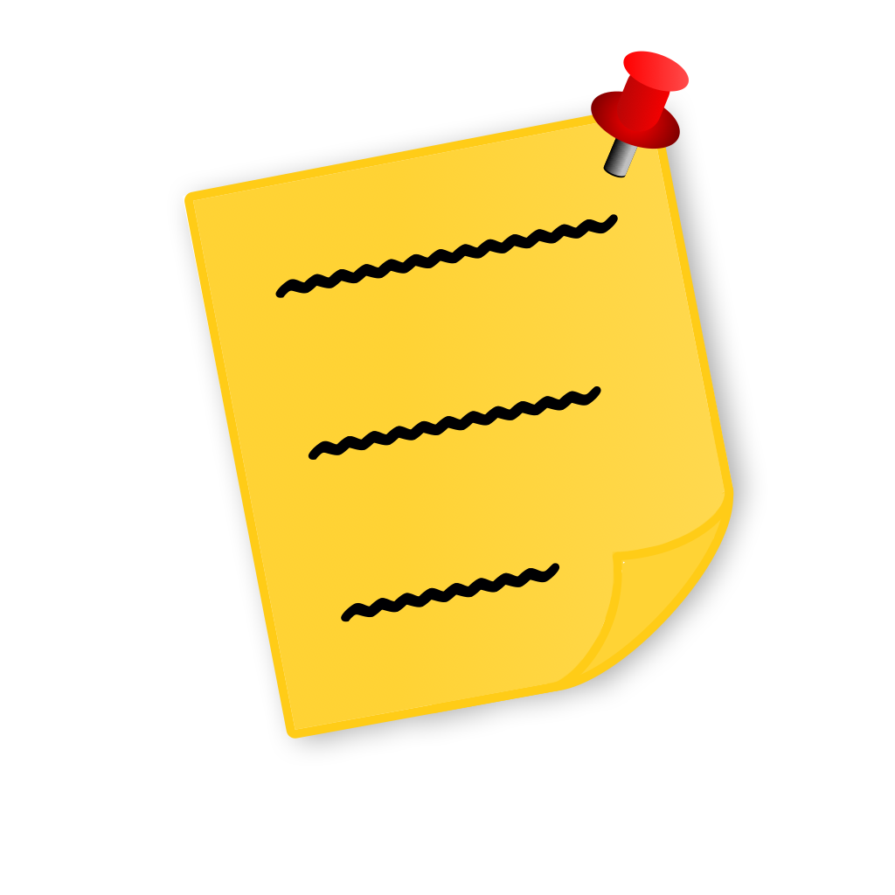


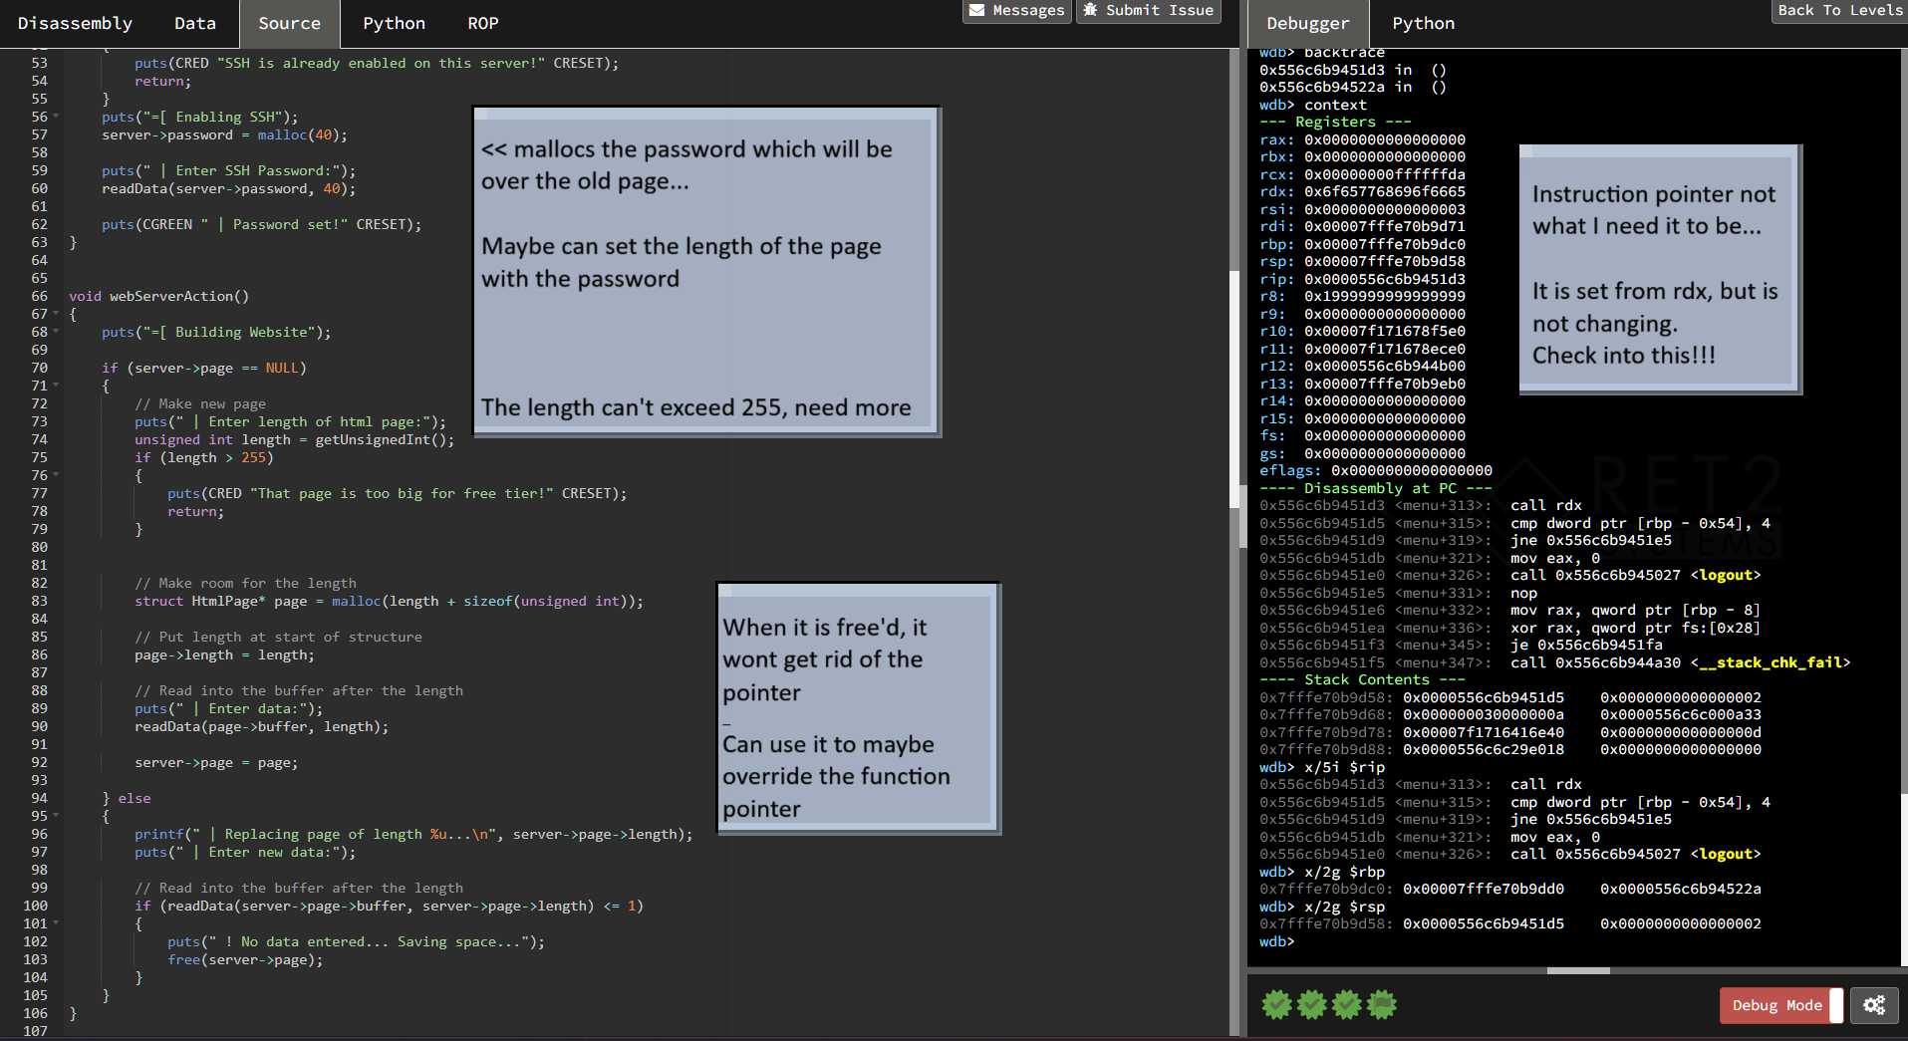




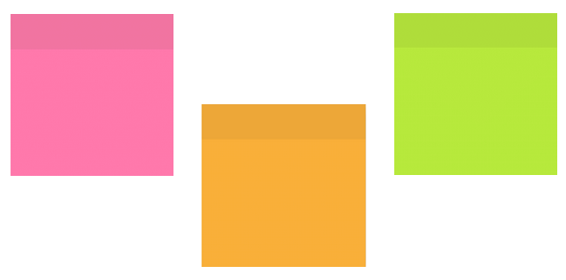

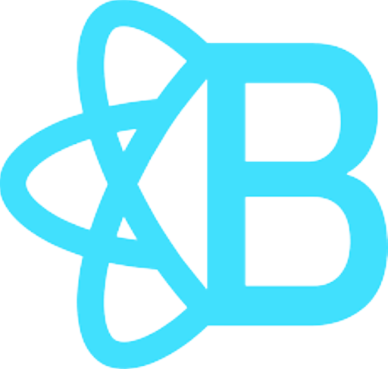


StickyNote
Never again lose your web of thoughts!
Can I download it right now???
Notepad exists… why make it?
Devin Ross
Well one day while surfing the web, I tried to save some information from the website I was currently on. This is a simple enough task, or at least I that is what I also thought.
I ended up having to launch a new application and juggle both my browser and notepad at the same time, the notepad disappearing behind the browser because it isn’t locked to the top of my screen.
If I wanted to scroll on the page or follow a link I once again had to do this.
If I wanted to copy something from the text to my notepad I would once again have to find where the notepad is and orient it in such a way that the applications’ placement complimented one another,
and if I had the audacity of wanting to access that information later in the day or week, I would either have to save that note, and every time I wanted it navigate through my file system to find it, or don’t save it and hope my computer didn’t restart overnight and lose the note I had all of my information on.
Now… admittedly I am phrasing this problem as if it spans a much grander scale than it actually does. It isn’t the end of the world when I have to look for a note to see what I saved a few days ago, but it does take a large amount of time when I have to do this a lot which ends up being an inconvenience sometimes.
This is why I wanted to make StickyNote.
In it’s current state, the StickyNote chrome extension can create the notes, resize them, pin those notes so it scrolls with the page, and add text. While this is most of the intended functionality, it is far from what I want to deliver in the end.
Another point to make regarding this is that currently StickyNote is only on Chrome because I am using the Chrome Extension for the popup and settings page
What will it look like on my screen?
I know it doesn’t look the best right now… soon I will add animations, colors, fonts, markdown and more customization options than you could ever ask for
What is going to be added?
The hope is that soon I will get every basic function of the extension both polished and bug-free. Once I have the skeleton of the project done, I will be adding color customization, maybe shape customization (other than just differently sized rectangles), different fonts, markdown for formatting, and even mathematical formats for jotting down formulas for your math class.
I also hope to bring the extension to different browsers. I currently use Firefox but with how the extension is built, I couldn’t even use my own project. This will come later down the line because I need the entire extension to work before I can start porting it, but eventually StickyNote will have support for Chrome, Firefox, and Safari.
What was used to make the project?
Okay sounds cool, what will it do?
I decided to make StickyNote a chrome extension because the whole point is to have it be an “application” that didn’t have to boot up every time you wanted to use it, like notepad. An extension just will run whenever the user does something of interest on the given tab, an automatic way to boot up an application.
StickyNote is meant to be a solution to “single-tasking” problems. StickyNote brings information from tab to tab, essay to essay, or just to a different part of your screen; it can be used to take excerpts from textbooks that you need to commit to memory or just act as a way to jot down your quick thoughts for a project idea.
What I want in the end is for StickyNote not to be the one savior extension for all of your web browsing problems, but for it to be the hero for those times you just need to jot something down quickly for later and don’t want to put much brain or processing power to do it.
In the most basic of forms, StickyNote will be a text container that you can morph and move to your hearts content, and it will always be right there on the top of your screen. Unless, that is, you want it hidden, or on a different part of your screen, it can do that too!
React Bootstrap
TypeScript
The team and our workflow
Well it’s actually only me. I work on the logo, the idea, and the execution. This means I have full control of the development of StickyNote and the direction it takes. This also means production is very slow as I need to learn every technology that will be used and with that comes all of the bad choices and bugs I create on the way. But, even with that said it StickyNote has been a great way for me to learn new things like React and TypeScript and I think will be a great tool even if it is only in my toolbox.
If you want to follow progress for some reason here is the GitHub of StickyNote - https://github.com/CamoGuy3000/StickyNote
Chrome Extension

