Slide 1
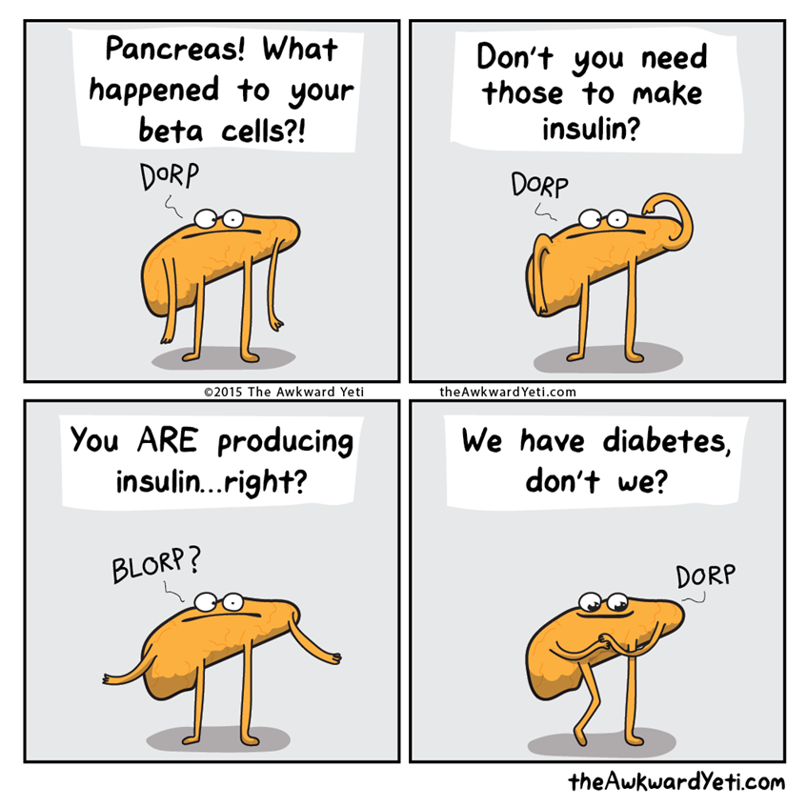
Diabetes Mellitus
CMM: Endocrinology
Fall Semester
Sarah Brandell, MPAS, PA-C

Slide 2
Outline
Pancreas Function
Epidemiology
Introduction to DM Types
  Type 1 DM
    Epidemiology
    Pathophysiology
  Impaired Fasting Glucose
  Type 2 DM
    Epidemiology
    Pathophysiology
What are we dealing with?
  T1
  T2
  Diabetes Variants
T1DM
  Clinical presentation
  Diagnosis
  Treatment
T2DM
  Risk Factors
  Clinical presentation
  Diagnosis
  Treatment
Health Maintenance in Diabetes
Cultural Considerations

Slide 3
Normal Pancreas Function
“Exocrine” cells- produce enzymes that help with digestion of food that are released into ducts.
“Endocrine” cells- Composed of small islands of cells called islets of Langerhans.
Release their hormones into the blood stream
  Insulin
  Glucagon
Function is to help control blood glucose levels
Notes:
http://pathology.jhu.edu/pancreas/basicoverview3.php?area=ba

Slide 4
Normal Pancreas Function
Islets of Langerhans- Beta cells:
Produces and releases insulin, amylin, and C-peptide
When BG levels ↑ beta cells quickly respond by secreting stored insulin while at the same time increasing production of the hormone.
Response to a spike in BG usually takes about 10 min
Notes:
http://pathology.jhu.edu/pancreas/basicoverview3.php?area=ba

Slide 5
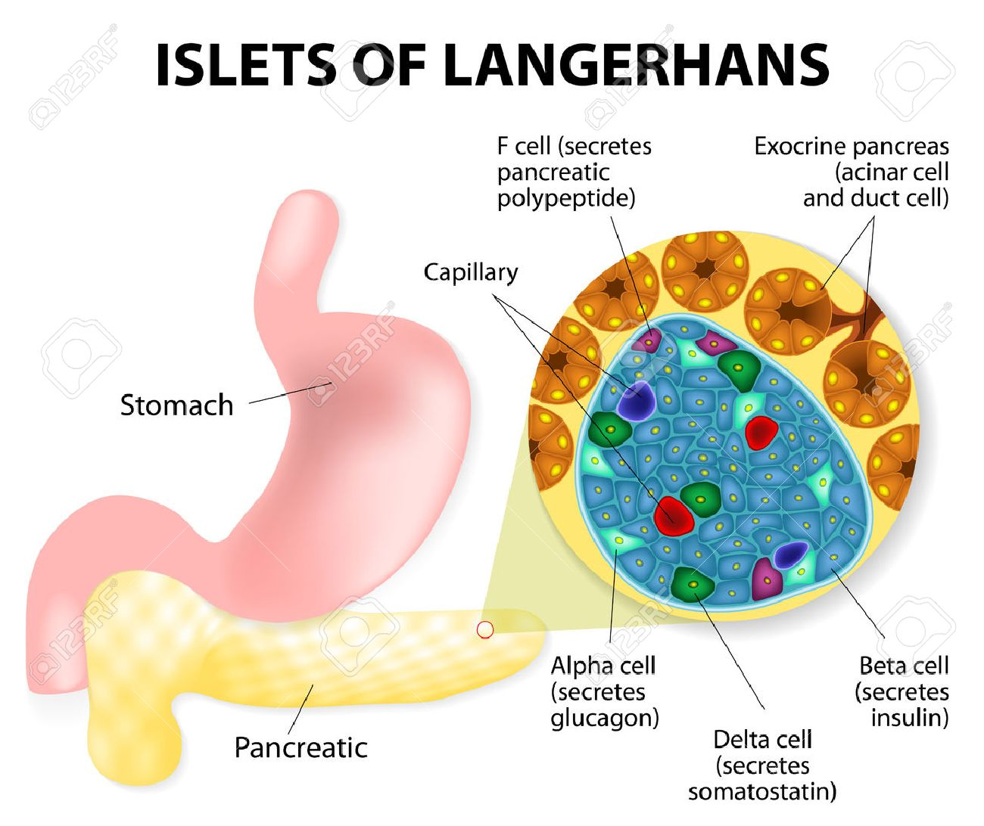
Normal Pancreas Function
Islets of Langerhans-Beta cells also secrete:
Amylin slows the rate of glucose entering the blood stream, making it a short-term regulator of BG levels.
C-peptide a marker of insulin creation.
Notes:
http://pathology.jhu.edu/pancreas/basicoverview3.php?area=ba

Slide 6
Normal Pancreas Function
Islets of Langerhans-Alpha cell:
- Secrete the hormone glucagon
  Released in response to ↓ BG levels and to events where the body needs additional glucose
    Stimulate the liver to break down glycogen to be released into the blood as glucose
    Activate gluconeogenesis, the conversion of amino acids into glucose
    Break down stored fat (triglycerides) into fatty acids for use as fuel by cells
Notes:
https://www.diabetes.co.uk/body/glucagon.html

Slide 7
The Burden of Diabetes Mellitus
40.1 million Americans have diabetes (~12% of the population)
>1 in 4 adults with diabetes are undiagnosed
2.1 million Americans have diagnosed T1DM
115.2 million U.S. adults have prediabetes
~8 in 10 adults with prediabetes are unaware

Slide 8
The Burden of Diabetes Mellitus
By 2050, if this trend continues, 1 of every 3-4 adults will have diabetes in the US
In 2017, 1 in 7 healthcare dollars was spent on DM for a total of $327 billion, and ½⁺ of which was spent on complications of the disease: MI, CVA, foot ulcers, ESRD
The life expectancy of persons with DM is reduced by 5-10 years and CV dz is the major cause of death

Slide 9
The Burden of Diabetes Mellitus
In the US, diabetes is the leading cause of
  ESRD
  Blindness
  Non-traumatic lower limb amputation
Diabetes is the seventh leading cause of death by disease and accounts for 18% of all deaths in the US, in people older than 25

Slide 10
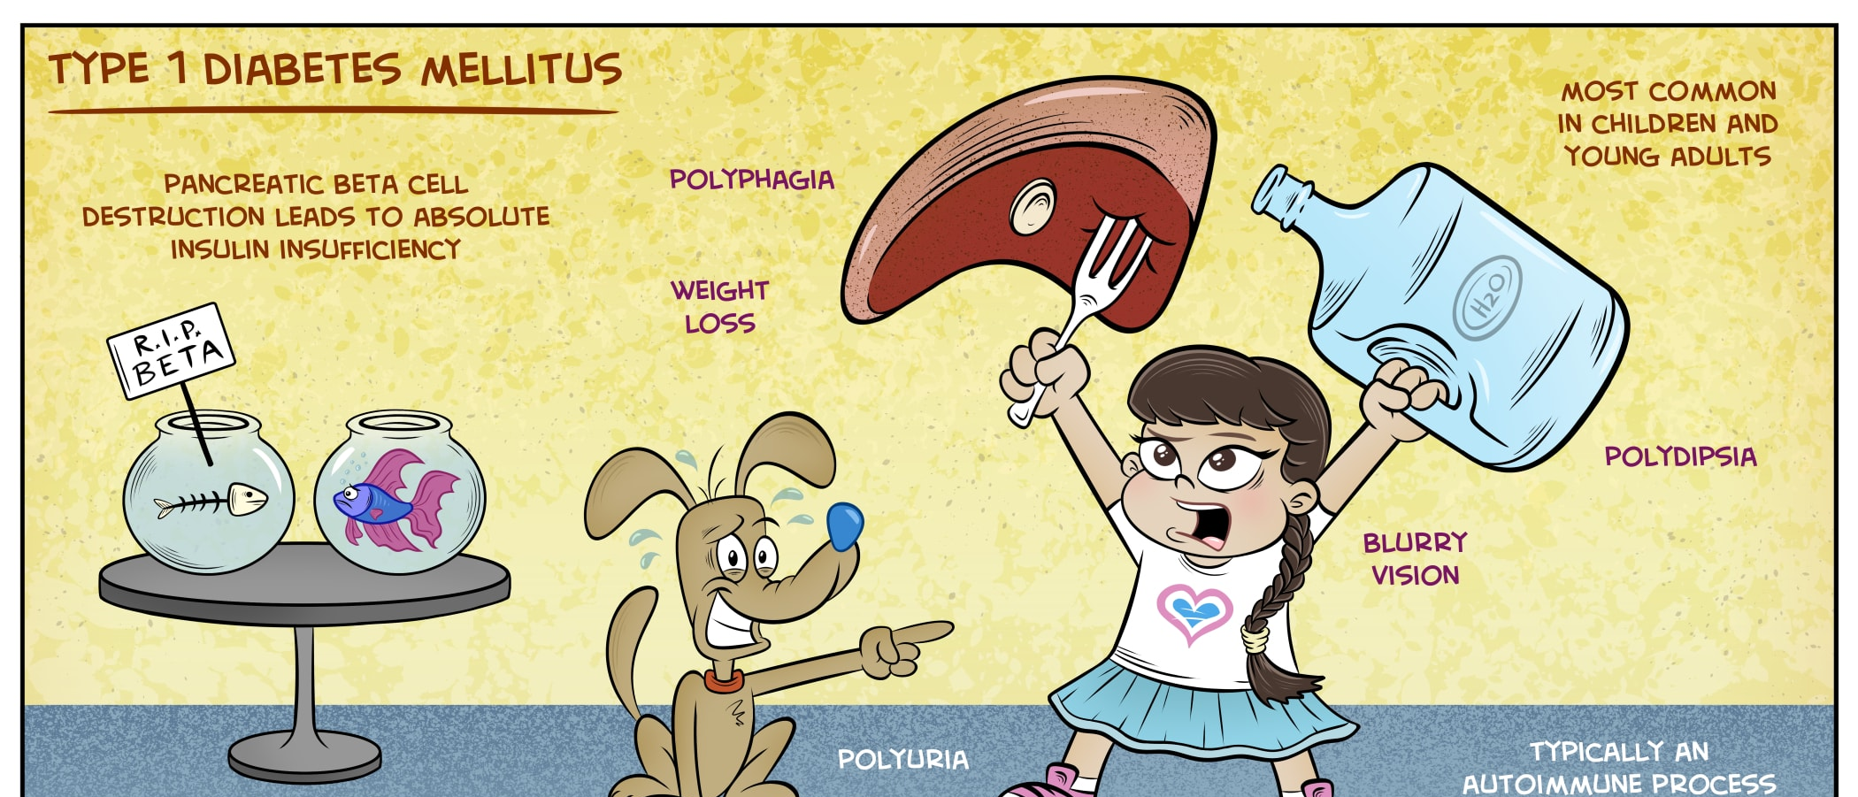
Type I Diabetes Mellitus

Slide 11
Type I Diabetes Pathophysiology
Autoimmune destruction of pancreatic β-cells
Autoantibodies may be present before clinical disease
Progressive β-cell destruction eventually results in absolute insulin deficiency
Genetic susceptibility + environmental factors likely contribute to disease development
  Associated autoimmune diseases:
  Autoimmune thyroid disease
  Celiac disease

Slide 12
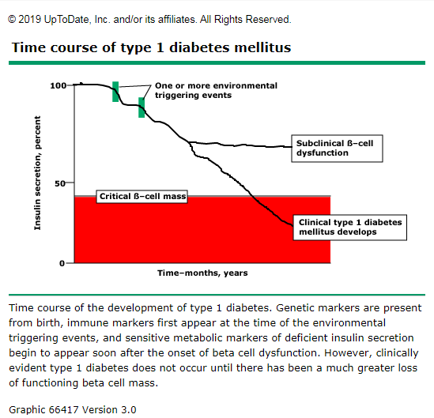
Type I Diabetes Pathophysiology
Notes:
https://www.uptodate.com/contents/image?imageKey=ENDO%2F66417&topicKey=ENDO%2F1800&search=type%201%20diabetes%20pathophysiology&rank=1~150&source=see_link

Slide 13
Type I Diabetes Pathophysiology
Absolute insulin deficiency →
↓ glucose uptake into muscle and adipose tissue
↑ hepatic glucose production
↑ lipolysis and ketogenesis → risk of DKA (more to come)
Hyperglycemia → osmotic diuresis → dehydration
↑ protein breakdown → weight loss/muscle wasting
Notes:
http://outpatient.aace.com/type1-diabetes/pathophysiology
https://www.youtube.com/watch?v=-B-RVybvffU&t=73s

Slide 14
Type I Diabetes Epidemiology
T1DM can occur at any age
Onset is common in childhood and adolescence, but also occurs in adults
Incidence varies significantly by geographic region and race/ethnicity
Rates are generally highest in populations of Northern European ancestry, but T1DM occurs in all racial and ethnic groups
Genetic susceptibility plays an important role
  Certain HLA genotypes are associated with increased risk
Environmental factors may contribute to triggering autoimmunity

Slide 15
Prediabetes

Slide 16
Prediabetes
Prediabetes may be diagnosed by:
  A1C: 5.7–6.4%
  Fasting plasma glucose: 100–125 mg/dL → impaired fasting glucose (IFG)
  2-hour OGTT: 140–199 mg/dL → impaired glucose tolerance (IGT)
  Clinical significance
  Increased risk of developing T2DM
  Associated with increased cardiovascular risk
  Lifestyle intervention is the foundation of prevention
  Metformin may be considered in selected high-risk patients

Slide 17
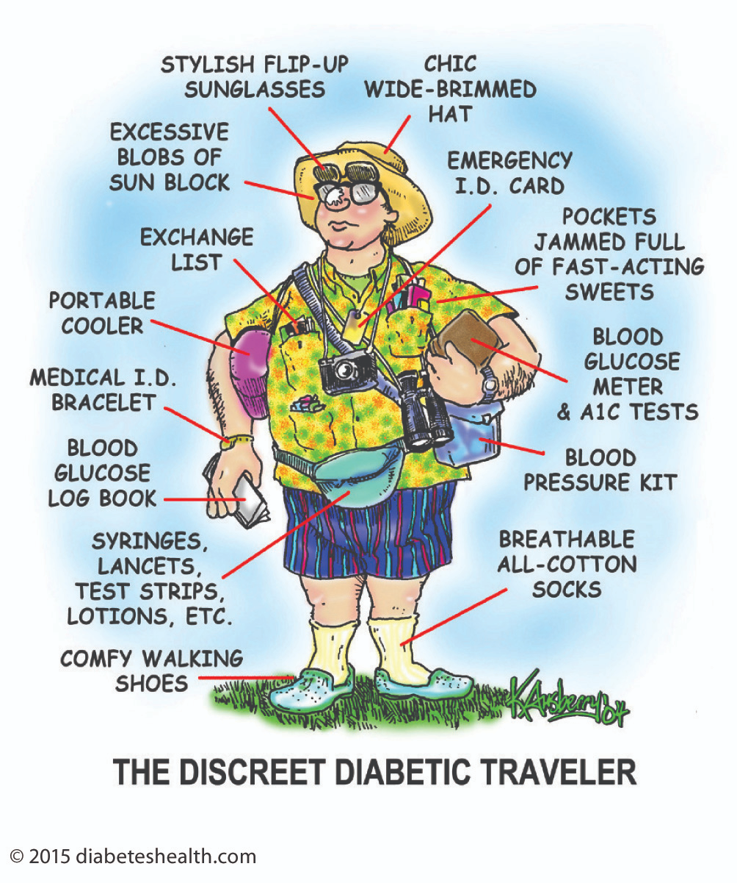
Type 2 Diabetes Mellitus

Slide 18
Type 2 Diabetes Pathophysiology
Insulin resistance
↓ tissue response to endogenous insulin
Influenced by genetics, aging, physical inactivity, excess visceral adiposity, and dietary patterns
Diets high in refined carbohydrates, added sugars, and highly processed foods can contribute to metabolic dysfunction and T2DM risk
Liver, skeletal muscle, and adipose tissue are major sites of insulin resistance
Notes:
https://www.youtube.com/watch?v=-B-RVybvffU&t=73s

Slide 19
Type 2 Diabetes Pathophysiology
Progressive β-cell dysfunction
Initially, β-cells compensate by increasing insulin secretion
Compensatory hyperinsulinemia may maintain near-normal glucose for years
Over time, β-cell function progressively declines
Insulin secretion can no longer meet metabolic demands → persistent hyperglycemia and T2DM

Slide 20
Type 2 Diabetes Pathophysiology
Hyperinsulinemia, hyperglycemia & elevated free fatty acids contribute to:
Endothelial dysfunction
  Impaired vasodilation
  Vascular dysfunction contributes to hypertension and atherosclerotic disease
Chronic low-grade inflammation
  Can further worsen insulin resistance
  Promotes endothelial dysfunction and atherosclerosis
Dyslipidemia
  ↑ triglycerides
  ↓ HDL
  Often associated with small, dense LDL particles
Notes:
https://www.youtube.com/watch?v=-B-RVybvffU&t=73s

Slide 21
Type 2 Diabetes Epidemiology
T2DM has historically been associated with adulthood, but is increasingly diagnosed in children and adolescents
Prevalence increases significantly with age
T2DM affects all racial and ethnic groups, but prevalence is not equal across populations
In the U.S., prevalence is higher among several historically underserved racial/ethnic populations, including American Indian/Alaska Native, Black, and Hispanic populations
Differences reflect a complex interaction of genetic susceptibility, social determinants of health, environmental exposures, access to care, and metabolic risk factors

Slide 22
Type 2 Diabetes vs. Type 1 Diabetes

Slide 23
Type 2 Diabetes vs. Type I Diabetes
Distinguishing T1DM from T2DM is not always straightforward
Both T1DM and T2DM can occur at any age
All patients with T1DM require insulin, but many patients with T2DM may also require insulin
DKA strongly suggests insulin deficiency/T1DM, but can also occur in T2DM
Overweight/obesity does not exclude T1DM
No single clinical feature definitively distinguishes T1DM from T2DM

Slide 24
Type 2 Diabetes vs. Type I Diabetes
When Should You Question T2DM?
Consider testing for islet autoantibodies when T1DM is clinically possible, especially with:
Younger age at diagnosis (particularly <35 years)
BMI <25 kg/m²
Unintentional weight loss
DKA/ketosis at presentation
Marked hyperglycemia at presentation
Poor response to noninsulin therapy or rapid progression to insulin requirement
Personal/family history of autoimmune disease may increase suspicion

Slide 25
What other diabetes variants are out there??

Slide 26
Latent Autoimmune Diabetes in Adults (LADA)
Slowly progressive autoimmune β-cell destruction occurring in adults
Islet autoantibodies are present, most commonly GAD antibodies
Patients may initially appear to have T2DM and may not require insulin at diagnosis
Progressive β-cell loss typically leads to insulin requirement
Sometimes called “type 1.5 diabetes”
ADA classifies LADA within the spectrum of T1DM, rather than as a separate diabetes type

Slide 27
Maturity-Onset Diabetes of the Young (MODY)
Monogenic diabetes caused by a pathogenic genetic variant affecting β-cell function
Often diagnosed in adolescence or early adulthood
Usually demonstrates autosomal dominant inheritance
Often lacks typical features of T1DM or T2DM
Correct diagnosis matters because treatment differs by MODY subtype

Slide 28
Maturity-Onset Diabetes of the Young (MODY)
Consider MODY when:
Diabetes occurs at a young age
Strong family history across successive generations
Negative islet autoantibodies
No obesity or other typical features of insulin resistance
Stable, mild fasting hyperglycemia may be a clue
→ Confirm with genetic testing

Slide 29
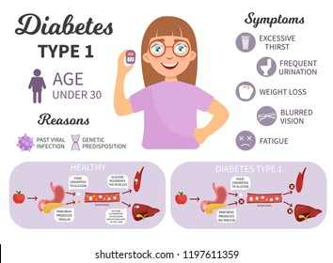
Type I Diabetes Mellitus

Slide 30
Symptoms of Type I Diabetes Mellitus
Weight loss despite normal or increased po intake (polyphagia)
Increased urination (polyuria)
Thirst/ Polydipsia
Blurred vision
Postural Hypotension
Paresthesia

Slide 31
Symptoms of Type I Diabetes Mellitus
Incidental discoveries do occur- asymptomatic patient
Patients with adult onset type I DM generally present with a slower onset of hyperglycemia.
Peds: more likely to be acute onset

Slide 32
Tests Used to Assess Glycemia
Plasma glucose
Fasting plasma glucose can be used for screening and diagnosis
Random plasma glucose can diagnose diabetes when ≥200 mg/dL with classic symptoms or hyperglycemic crisis
Point-of-care glucose
Useful for monitoring
Standard glucometer testing should not be used to establish the diagnosis
A1C
Reflects average glycemia over approximately 2–3 months
Weighted more heavily toward recent glycemia
Can be used for screening, diagnosis, and monitoring

Slide 33
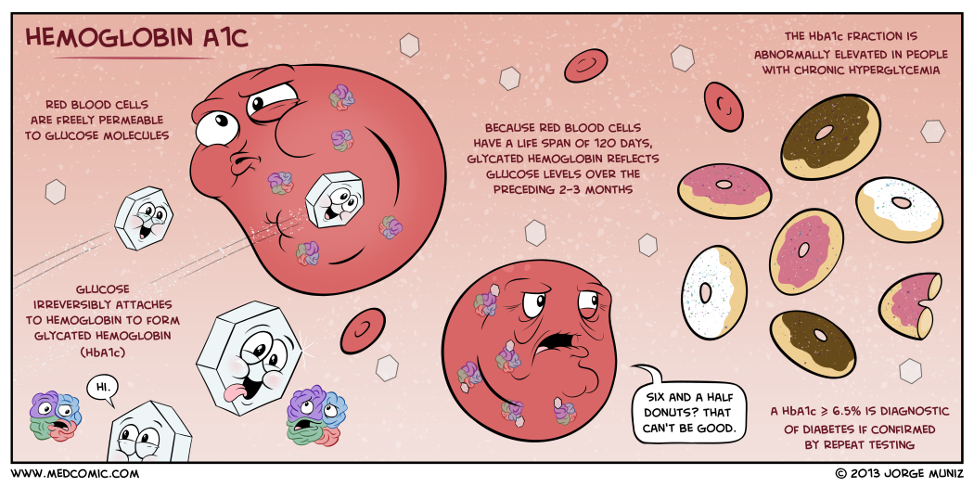
Tests Used to Assess Glycemia

Slide 34
Diagnosis of Diabetes
Any of the following:
A1C ≥6.5% *
Fasting plasma glucose ≥126 mg/dL
2-hour plasma glucose ≥200 mg/dL during 75-g OGTT
Random plasma glucose ≥200 mg/dL with classic symptoms of hyperglycemia or hyperglycemic crisis
In the absence of unequivocal hyperglycemia, confirm the diagnosis with repeat testing.

Slide 35
What does an A1c Mean about DM Control?
HgbA1c | Mean Plasma Glucose Level
6 | 126 mg/dL
7 | 154 mg/dL
8 | 183 mg/dL
9 | 212 mg/dL
10 | 240 mg/dL
11 | 269 mg/dL
12 | 298 mg/dL

Slide 36
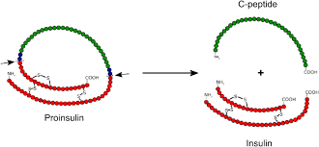
Diagnostic testing- T1DM
C-Peptide
C-peptide is released when proinsulin is cleaved into insulin + C-peptide
Therefore, C-peptide is a marker of endogenous insulin production
Low/undetectable C-peptide suggests significant loss of β-cell function
Normal or elevated C-peptide indicates preserved endogenous insulin secretion
C-peptide can help distinguish insulin deficiency from insulin resistance, particularly when the diagnosis is unclear

Slide 37
Diagnostic testing- T1DM
Tests for autoantibodies
  Insulin
  Glutamic acid decarboxylase (also termed islet cell auto-antibodies) - an enzyme found in beta cells
  IA-2, ZnT8

Slide 38
Treatment of Type 1 DM
Treatment will involve a multispecialty team and pharmacologic/ non-pharm treatment.
Registered dietician will give recommendations on total number of calories and division of calories between meals/snacks as well as division of calories by macro type (fat, proteins, carbs).
Pts should be encouraged to exercise but may develop hypoglycemia if exercising > 30 min without an adjustment in insulin or a pre-exercise snack.

Slide 39
Treatment of Type 1 DM
T1DM will require lifelong treatment with insulin.
The goal of glucose control is to provide insulin therapy in a manner that is as physiologic as possible for a goal HgbA1c of 7% as a pediatric patient.
  Guidelines from American Diabetic Association (ADA)
  More or less stringent goals need to be tailored to the individual patient

Slide 40
Treatment of Type 1 DM – Across the lifespan
Pediatric Considerations in T1DM
Insulin is required for treatment of T1DM
CGM is recommended for most children and adolescents with T1DM
Insulin pumps / automated insulin delivery (AID) systems may improve glycemic management
Hypoglycemia prevention and recognition are especially important in young children
Insulin and carbohydrate needs vary with growth, activity, illness, and puberty
Diabetes management should gradually transition toward the child while maintaining age-appropriate caregiver supervision
Consider psychosocial impact, including diabetes distress, depression, and eating disorders in adolescents

Slide 41
Treatment of Type 1 DM – Across the lifespan
Adults
In adults, a target A1C of <7 % best balances the risks of long-term sequelae and hypoglycemia
  Avoiding long term complications of hyperglycemia-
    Delayed onset of microvascular disease
    Slowed progression of already-present microvascular disease
    Decreased the incidence of cardiovascular disease
  Hypoglycemia
    Avoiding complications from hypoglycemic events
Notes:
https://www.uptodate.com/contents/management-of-type-1-diabetes-mellitus-in-children-and-adolescents?search=type%20I%20diabetes&source=search_result&selectedTitle=2~150&usage_type=default&display_rank=2#H720270993

Slide 42
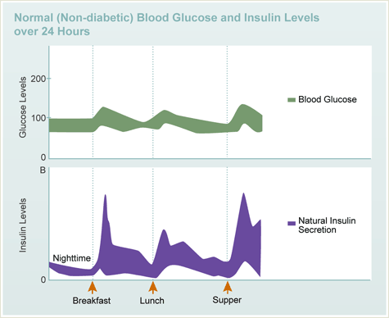
Treatment of Type 1 DM
Working to mimic normal insulin fluctuation
Insulin regimens:
    Basal bolus therapy- multiple daily injections of different forms of insulin
    Continuous subcutaneous insulin infusion (CSII) or an insulin pump

Slide 43

Type 2 Diabetes Mellitus

Slide 44
Type 2 DM Risk Factors
Overweight/obesity, particularly visceral adiposity
Physical inactivity
Family history/genetic susceptibility
Increasing age
Higher-risk racial/ethnic ancestry
History of prediabetes or gestational diabetes
PCOS
Cardiovascular disease, hypertension, and dyslipidemia
Other conditions associated with insulin resistance (e.g., acanthosis nigricans, MASLD)
Certain medications, including glucocorticoids and second-generation antipsychotics

Slide 45
Screening For Prediabetes & T2DM
Begin screening at age 35 for all adults
Screen earlier at any age in adults with overweight/obesity plus ≥1 risk factor:
  First-degree relative with diabetes
  Higher-risk racial/ethnic ancestry
  History of CVD
  HTN
  HDL <35 and/or triglycerides >250
  PCOS
  Physical inactivity
  Other evidence of insulin resistance
  If normal: repeat at least every 3 years
  Prediabetes: test yearly
  History of GDM: test every 1–3 years

Slide 46

Symptoms of Type II DM
Frequently asymptomatic and discovered on routine laboratory testing
When symptomatic:
  Polyuria
  Polydipsia
  Blurred vision
  Fatigue
  Unintentional weight loss
Other clues:
  Recurrent candidiasis/infections
  Poor wound healing
  Acanthosis nigricans
  Neuropathic symptoms may be present at diagnosis

Slide 47
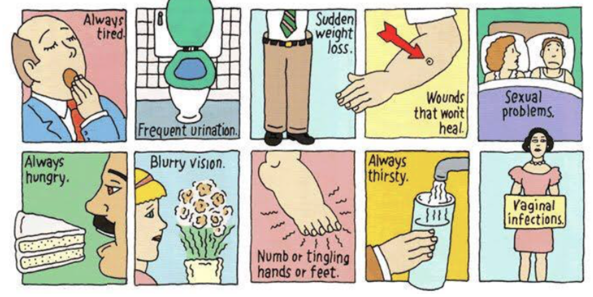
Symptoms of Type II DM

Slide 48
Tests Used to Assess Glycemia
Plasma glucose
Fasting plasma glucose can be used for screening and diagnosis
Random plasma glucose can diagnose diabetes when ≥200 mg/dL with classic symptoms or hyperglycemic crisis
Point-of-care glucose
Useful for monitoring
Standard glucometer testing should not be used to establish the diagnosis
A1C
Reflects average glycemia over approximately 2–3 months
Weighted more heavily toward recent glycemia
Can be used for screening, diagnosis, and monitoring

Slide 49
Tests Used to Assess Glycemia

Slide 50
Diagnosis of Diabetes
Any of the following:
A1C ≥6.5% *
Fasting plasma glucose ≥126 mg/dL
2-hour plasma glucose ≥200 mg/dL during 75-g OGTT
Random plasma glucose ≥200 mg/dL with classic symptoms of hyperglycemia or hyperglycemic crisis
In the absence of unequivocal hyperglycemia, confirm the diagnosis with repeat testing.

Slide 51
What does an A1c Mean about DM Control?
HgbA1c | Mean Plasma Glucose Level
6 | 126 mg/dL
7 | 154 mg/dL
8 | 183 mg/dL
9 | 212 mg/dL
10 | 240 mg/dL
11 | 269 mg/dL
12 | 298 mg/dL

Slide 52
Diabetes Education
Medical nutrition therapy
  MNT involves a more detailed discussion of calories, grams, and other metrics as well as intensive implementation of dietary recommendations aimed at optimizing glycemic control and reducing the risk for complications.
  Recommendations should be personalized

Slide 53
Diabetes Education
Carb Counting
  Requires time and effort on the part of the patient and the educator.
  Usually done with a specialized diabetes educator or nutritionist, but many patients come with internet/app based resources.
  Carbohydrate intake should be individualized; there is no single ideal amount of carbohydrate for all patients with diabetes.

Slide 54
Diabetes Education
Weight reduction
  Weight management is an important component of T2DM treatment for patients with overweight or obesity
  Even modest weight loss can improve glycemia and cardiometabolic risk
  Greater sustained weight loss may provide greater metabolic benefit
  Treatment should be individualized and may include lifestyle intervention, pharmacotherapy, and/or metabolic surgery

Slide 55
Diabetes Education
Exercise
  ≥150 min/week moderate-to-vigorous aerobic activity
  Spread over ≥3 days/week
  No more than 2 consecutive inactive days
  Resistance exercise 2–3 times/week
  Reduce sedentary time; interrupt prolonged sitting

Slide 56
Diabetes Education
Sleep
  Adequate rest is important for maintaining energy levels and well-being, and all patients should be advised to sleep on average approximately 7+ hours per night.
  Evidence supports an association of 6 to 9 hours of sleep per night with a reduction in cardiometabolic risk factors.
  Sleep deprivation aggravates insulin resistance, hypertension, hyperglycemia, and dyslipidemia and increases inflammatory cytokines.

Slide 57

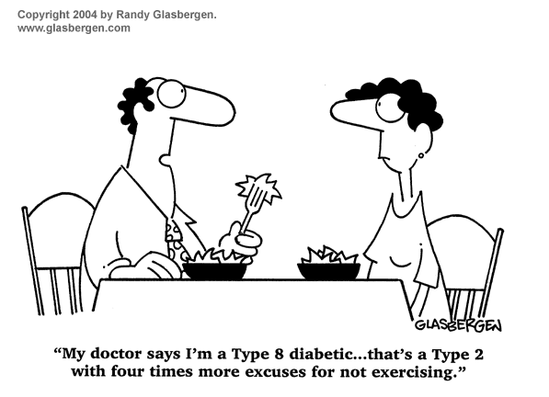

Slide 58
Health Maintenance in Diabetes - Monitoring
Follow-up: generally every 3–6 months, individualized
A1C: typically every 3 months if therapy changed/goals not met; at least twice yearly if stable
Blood pressure: every routine visit
Lipids: assess and monitor based on age, treatment, and cardiovascular risk
Kidney: UACR + eGFR at least annually when indicated
Feet: visual inspection regularly; comprehensive foot exam at least annually
  Inspect every visit if sensory loss, prior ulcer, or amputation
Eye exam: dilated retinal examination according to diabetes type, duration, and prior findings
Notes:
https://www.cdc.gov/diabetes/managing/problems.html

Slide 59
Health Maintenance in Diabetes –
Preventative Care
Tobacco: assess use and counsel cessation
Mental/behavioral health: assess for depression, anxiety, diabetes distress, disordered eating, etc.
Dental care: regular dental/periodontal care
Vaccinations: follow age-appropriate recommendations; diabetes may affect indications for hepatitis B and pneumococcal vaccination
Reproductive planning: contraception and preconception counseling when applicable
Cancer screening: follow routine age- and sex-appropriate recommendations
Assess hearing, sleep, sexual health, and other comorbidities when indicated
Notes:
https://www.cdc.gov/diabetes/managing/problems.html

Slide 60
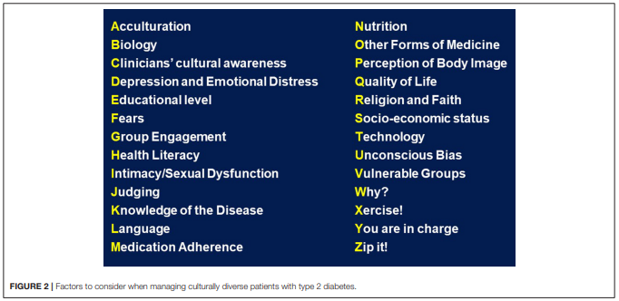
Cultural Considerations in Diabetes
Notes:
https://www.ncbi.nlm.nih.gov/pmc/articles/PMC6127640/pdf/fendo-09-00479.pdf

