Slide 1
Diabetes Special Considerations, Complications and Emergencies
Endocrinology Module
Fall Semester
Sarah Brandell MPAS, PA-C

Slide 2
Outline
Special Considerations:
    AM Hyperglycemia
  Surgery Implications
  Pregnancy:
      Preconception
      Gestational Diabetes
  Weight loss
Complications:
DM Vascular Complications
  Macrovascular
      Lipid abnormalities
      HTN
      Cardiovascular Risk
  Microvascular
      Retinopathy
        Other Ocular DM Complications
      Neuropathy
      Nephropathy
  Emergencies
    Foot Ulcers
    DKA
    HHS

Slide 3
DM Special Considerations

Slide 4
AM Hyperglycemia

Slide 5
AM Hyperglycemia
Common Causes
Dawn phenomenon: early-morning glucose rise without preceding hypoglycemia
Insufficient overnight insulin: inadequate dose/duration or pump delivery
Administration issues: missed insulin, injection/site problems
Evening intake/illness/medications
How do you determine the cause?
→ Review the overnight CGM/glucose pattern
Notes:
https://en.wikipedia.org/wiki/Chronic_Somogyi_rebound

Slide 6
Surgery Implications

Slide 7
DM and Surgery
Perioperative Goals:
Hyperglycemia is associated with increased infection and postoperative complications
Excessively aggressive treatment increases hypoglycemia risk
Perioperative glucose goal: 100–180 mg/dL
For elective surgery: aim for A1C <8% within 3 months, when appropriate
Monitor glucose throughout the perioperative period

Slide 8
DM and Surgery
Medication Management:
Metformin and most oral agents: hold day of surgery
SGLT2 inhibitors: hold 3–4 days before surgery due to risk of perioperative/euglycemic DKA
GLP-1–based therapy: individualize based on GI symptoms, dose, procedure/anesthesia, and aspiration risk
Basal insulin: generally reduce rather than eliminate
NPH: ~50%
Long-acting basal analog: ~75–80%
T1DM always requires basal insulin — avoid complete insulin interruption
Insulin pumps may sometimes continue depending on procedure and institutional protocol

Slide 9
Pregnancy
Pre-Conception DM vs Gestational DM

Slide 10
Pregnancy and DM - Patho
Pregnancy is a progressively insulin-resistant state, particularly during the 2nd and 3rd trimesters
The placenta produces hormones that oppose insulin action, helping ensure glucose and other nutrients remain available to the developing fetus
Normally, pancreatic β-cells compensate by increasing insulin secretion
If β-cell compensation is inadequate → maternal hyperglycemia / gestational diabetes

Slide 11
Pregnancy and DM - Screening
Screen for GDM at 24–28 weeks in individuals not already known to have diabetes
Earlier pregnancy: evaluate for preexisting diabetes when risk factors are present
Screening may use either a one-step 75-g OGTT or two-step approach
In the two-step approach:
  50-g 1-hour glucose challenge
  If abnormal → 100-g 3-hour OGTT

Slide 12
Pregnancy and DM – Preexisting DM
Preconception counseling is essential
Goal before conception: A1C <6.5%, if safely achievable
Assess diabetes complications, particularly retinopathy and kidney disease
Review medications for pregnancy safety
Hyperglycemia around conception/early pregnancy increases risk of congenital anomalies
Later pregnancy hyperglycemia increases risk of macrosomia/LGA, obstetric complications, stillbirth, and neonatal complications

Slide 13
Pregnancy and DM – Treatment
Lifestyle and medical nutrition therapy are first-line for GDM
If medication is required, insulin is preferred
  Metformin may be considered but has less data
Glucose goals:
Fasting <95 mg/dL
1-hour postprandial <140 mg/dL
2-hour postprandial <120 mg/dL
Delivery timing is individualized based on diabetes type/control and maternal-fetal status.

Slide 14
Managing Adiposity in Diabetes

Slide 15
Weight Management in T2DM
Weight management is a primary treatment goal alongside glycemic management
Lifestyle/behavioral treatment remains foundational
5–7% weight loss improves glycemia and cardiovascular risk factors
>10% sustained weight loss generally provides greater metabolic benefit and may lead to diabetes remission
Consider anti-obesity pharmacotherapy in appropriate patients

Slide 16
Weight Management in T2DM
In T2DM with overweight/obesity, prioritize diabetes medications that also promote weight loss
  Semaglutide and tirzepatide have high weight-loss efficacy
Treatment should be individualized based on comorbidities, goals, risks, access, and patient preference

Slide 17
Weight Management in T2DM
Consider metabolic surgery in appropriate surgical candidates with T2DM and:
BMI ≥30 kg/m²
BMI ≥27.5 kg/m² in Asian American individuals
Potential benefits include:
Substantial and durable weight loss
Improved glycemic control
Reduced medication requirements
Possible T2DM remission
Improved cardiovascular outcomes and mortality
Requires experienced multidisciplinary care and long-term nutritional/metabolic monitoring.

Slide 18
Complications of Diabetes

Slide 19
Chronic Complications of Diabetes
Diabetes causes both microvascular and macrovascular complications.
Microvascular
  Retinopathy
  Kidney disease
  Neuropathy
Macrovascular (ASCVD)
  Coronary artery disease / MI
  Cerebrovascular disease / stroke
  Peripheral artery disease
  Risk increases with duration of diabetes and cumulative glycemic exposure.

Slide 20
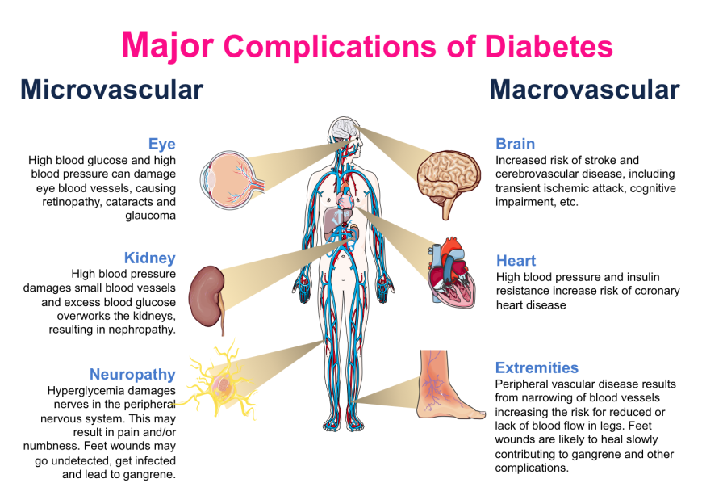

Slide 21
Why Does Diabetes Cause Vascular Damage?
Chronic hyperglycemia contributes to:
Formation of advanced glycation end products (AGEs)
Oxidative stress
Inflammation
Endothelial dysfunction
Vascular injury
Microvascular disease is strongly associated with duration and degree of hyperglycemia.
Macrovascular disease is multifactorial:
Hyperglycemia
Hypertension
Dyslipidemia
Smoking
Insulin resistance/obesity
Kidney disease

Slide 22
Macrovascular Complications

Slide 23
Lipoprotein Abnormalities
Macrovascular Complications

Slide 24
Macrovascular: Lipoprotein Abnormalities
T2DM commonly associated with:
  ↑ triglycerides
  ↓ HDL
  More atherogenic LDL particles
Diabetes substantially increases ASCVD risk
Treatment of dyslipidemia is an important component of ASCVD prevention
Statins are first-line therapy
Intensity depends on age, ASCVD status, and cardiovascular risk
Additional LDL-lowering therapy may be needed when LDL goals are not achieved

Slide 25
Hypertension
Macrovascular Complications

Slide 26
Macrovascular: Hypertension
Hypertension is common in diabetes and increases cardiovascular and kidney risk.
Goal BP <130/80 mmHg, if safely attainable
Lifestyle management:
  Weight management
  Physical activity
  Sodium reduction
  Appropriate alcohol intake
Antihypertensive therapy is often required
Choice of medication should consider ASCVD, heart failure, and kidney disease

Slide 27
CAD
Macrovascular Complications

Slide 28
Macrovascular: Cardiovascular Complications
Diabetes significantly increases risk of ASCVD:
Coronary artery disease / MI
Ischemic stroke
Peripheral artery disease
Risk reduction requires comprehensive management:
  Glycemic management
  BP control
  Lipid management
  Smoking cessation
  Physical activity/weight management
  Use medications with cardiovascular benefit when indicated

Slide 29
PVD
Macrovascular Complications

Slide 30
Macrovascular: Peripheral Vascular Disease
Diabetes increases the risk of atherosclerotic PAD.
Clinical clues
  Claudication
  Diminished/absent pedal pulses
  Nonhealing wounds
  Ischemic rest pain in advanced disease
Notes:
UpToDate

Slide 31
Macrovascular: Peripheral Vascular Disease
Evaluation
  Vascular examination including pedal pulses
  ABI when PAD is suspected
  ABI ≤0.90 is abnormal
  Diabetes can cause noncompressible/calcified arteries, potentially producing falsely elevated ABI → additional vascular testing may be needed
Risk reduction: smoking cessation, lipid/BP/glycemic management, foot care + appropriate PAD treatment.
Notes:
UpToDate

Slide 32
Microvascular Complications

Slide 33
Ocular Complications
Microvascular Complication

Slide 34
Microvascular: Ocular Complications
Retinopathy:
Nonproliferative (NPDR): microaneurysms, retinal hemorrhages, exudates, ischemia/cotton-wool spots
Proliferative (PDR): retinal ischemia → neovascularization
  Can lead to vitreous hemorrhage and tractional retinal detachment
Diabetic macular edema (DME) can occur at any stage and threatens central vision.
Notes:
https://webeye.ophth.uiowa.edu/eyeforum/tutorials/Diabetic-Retinopathy-Med-Students/Classification.htm

Slide 35
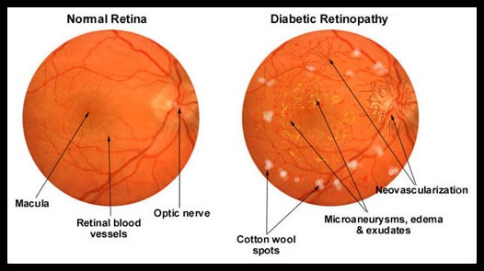

Slide 36
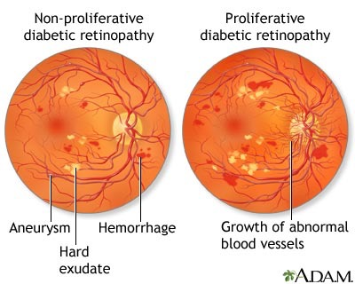

Slide 37
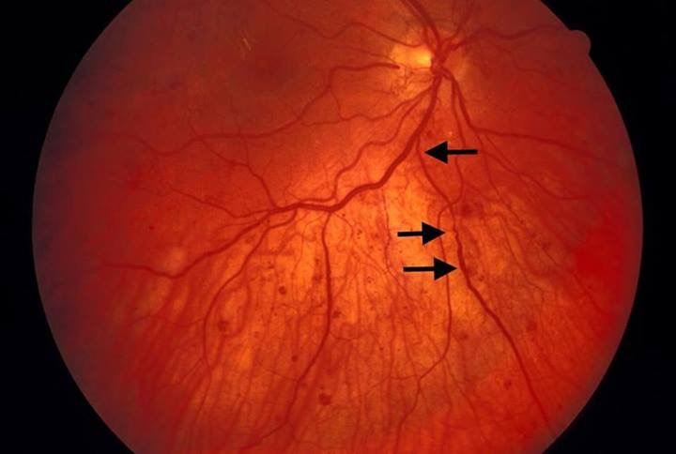
Proliferative Retinopathy

Slide 38
Microvascular: Ocular Complications
Retinopathy Screening
T1DM: initial dilated comprehensive eye exam 5 years after onset
T2DM: initial exam at diagnosis
If no retinopathy and glycemia is at goal: every 1–2 years may be considered
If retinopathy is present: at least annually, more often if progressing/sight-threatening

Slide 39
Microvascular: Ocular Complications
  More frequent exams for:
  Pregnant women and in the first year postpartum
  Patients with existing retinopathy
  Those receiving treatment for macular edema
  Those starting GLP1 therapy from a “high” A1C (9+)

Slide 40
Microvascular: Ocular Complications
Clinical Presentation & Management
Often asymptomatic initially
Later: blurred vision, floaters, visual loss
Optimize glycemia, BP, and lipids
Refer DME, moderate-or-worse NPDR, or PDR to ophthalmology
Treatment may include anti-VEGF therapy and/or laser photocoagulation

Slide 41
Neuropathy
Microvascular Complication

Slide 42
Microvascular: Neuropathy
Diabetic neuropathy is classified into distinct clinical syndromes.
A characteristic set of s/s exist for each syndrome
Each variant has a different component of the peripheral nervous system that is affected.
Types:
Distal symmetric poly neuropathy
Isolated peripheral neuropathy/mononeuropathy
Acute painful DM neuropathy
Autonomic neuropathy

Slide 43
Microvascular: Neuropathy
Screening for DM neuropathy is performed annually and begins at:
        5 years after diagnosis of T1DM
        At the time of diagnosis in T2DM
Screening involves a thorough assessment of the feet looking for DM ulcers, skin temp and pulses. Then a monofilament exam, as well as assessing for vibratory, touch, heat, cold and pinprick sensation. Ankle reflexes are tested.

Slide 44
Microvascular: Neuropathy
Diabetic Foot Exams:
  Inspect skin and assess deformities
  Assess neurologic function/loss of protective sensation
  10-g monofilament + at least one additional sensory assessment
  Palpate lower-extremity pulses
  Inspect feet at every visit in patients with sensory loss or prior ulcer/amputation.

Slide 45
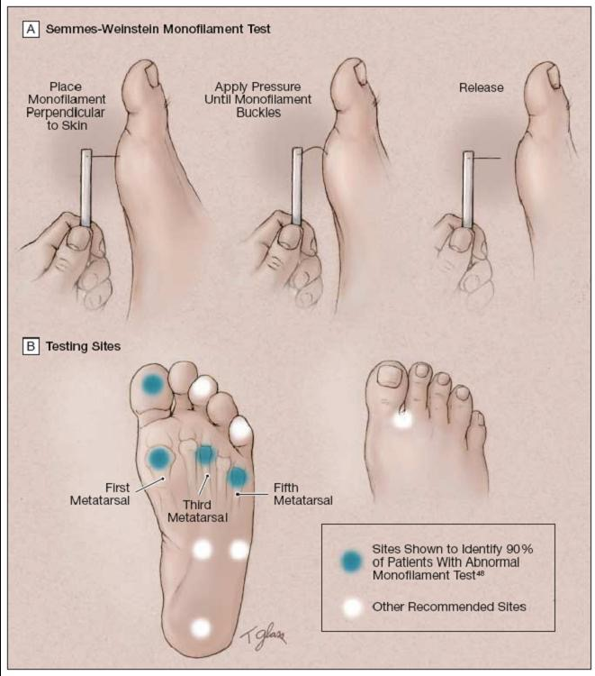
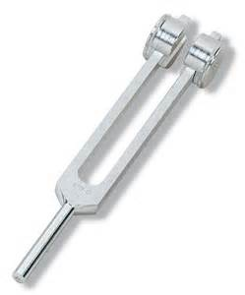
Microvascular: Neuropathy
Done every 12 months

Slide 46
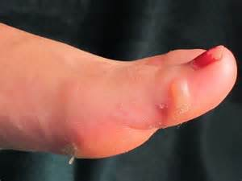
Microvascular: Distal symmetric poly neuropathy
45 yo Caucasian female with poorly controlled DM II for 15 years
She comes in for the first time in six months
She has gradually noticed that both of her feet seem to be going numb in the past six months
She now presents with
several blisters that began
yesterday when she wore
a new pair of heels to
work all day

Slide 47
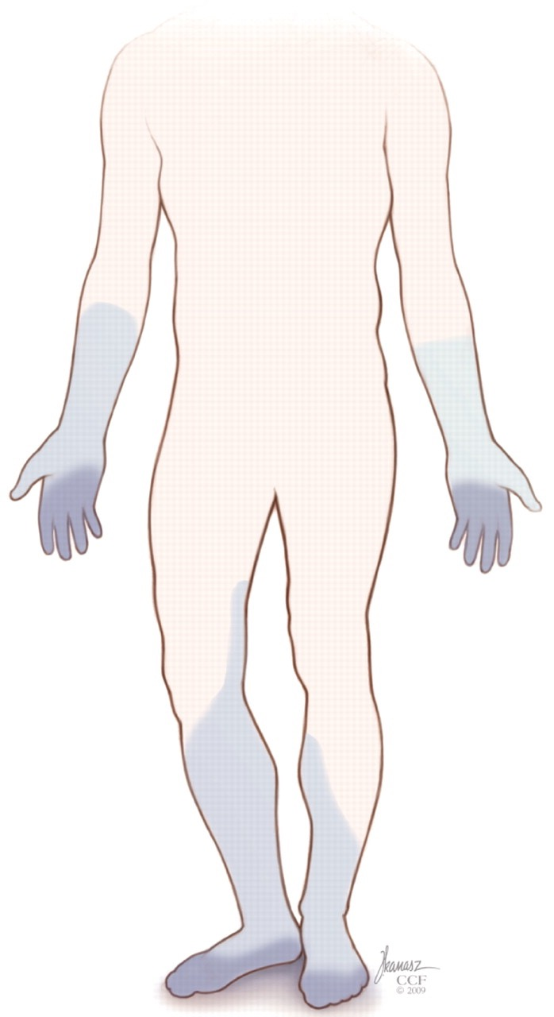
Microvascular: Distal symmetric poly neuropathy
MC form DM neuropathy
Presents in a stocking- glove pattern and is due to an axonal neuropathic process
Sensory involvement occurs first with dulled perception of vibration, pain and temperature.

Slide 48
Microvascular: Distal symmetric poly neuropathy
Progressive disease leads to denervation of the small muscles of the foot. This results in clawing of the toes and fat pad displacement.
These changes alter the biomechanics of the foot and increase plantar pressures
Decreased pain threshold, abnormally high foot pressures and repetitive stress leads to calluses/ ulcerations of high pressure areas.

Slide 49
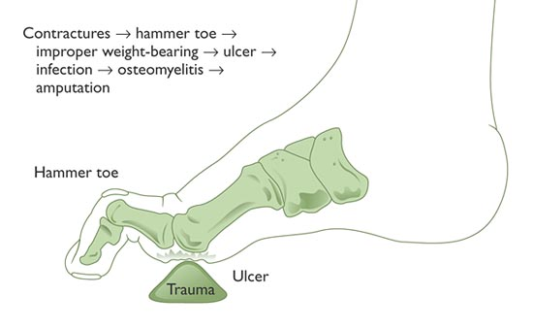

Slide 50
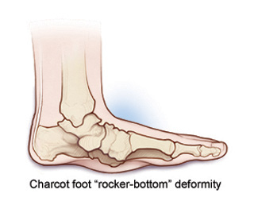
Microvascular: Distal symmetric poly neuropathy
Charcot’s foot: a further progression
Pain and swelling of the soft tissues with joint subluxation and periarticular fractures
If untreated, progresses to a “rocker-
bottom” deformity with frank
osteoclastic destruction, with unstable
joints, particularly of the midfoot
Pts are at high risk of infections

Slide 51
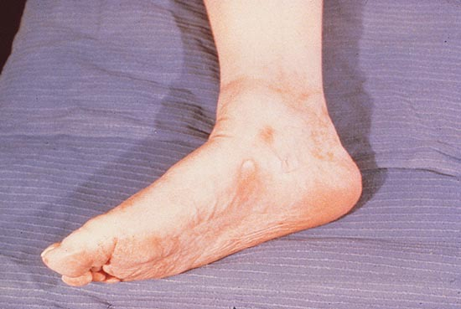

Slide 52
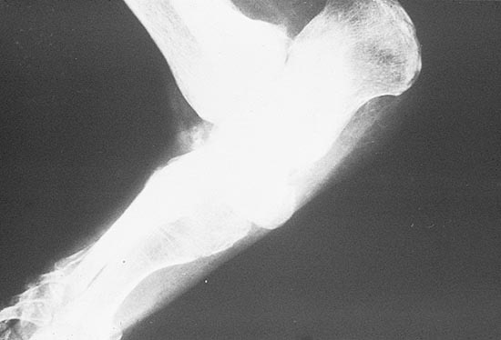

Slide 53
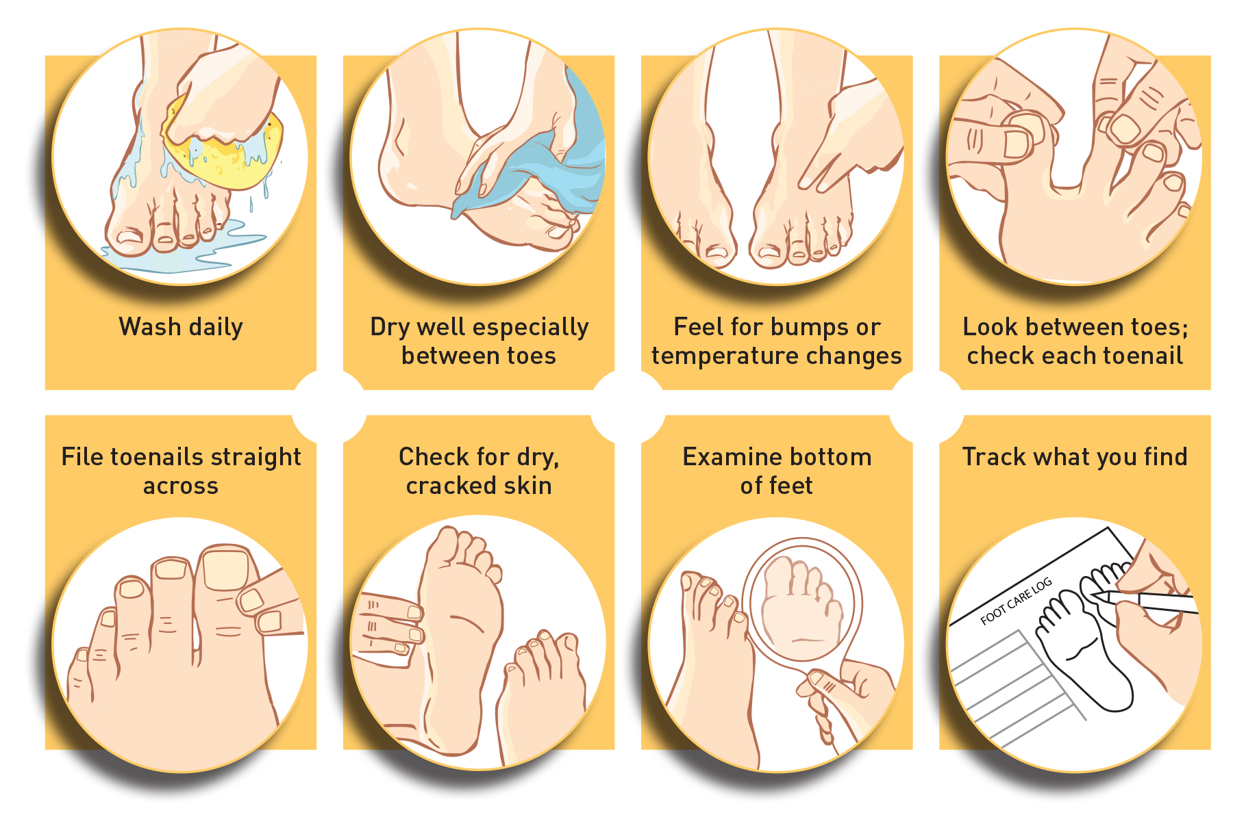
Microvascular: Distal symmetric poly neuropathy
Protecting the Feet:
Appropriate footwear distributing the weight load over as large an area as possible
Daily foot inspection for reddened areas, blisters, abrasions or lacerations
Meticulous hygiene

Slide 54
Microvascular: Distal symmetric poly neuropathy
There are NO effective treatments to reverse DM neuropathy once it is present
Better glycemic control, lipid and HTN control may prevent progression
Aggressive protection of feet, therapy/ strengthening exercises and surgical correction of deformities cause by neuropathy may be helpful.

Slide 55
Microvascular: Isolated peripheral neuropathy
55 yo female reports the abrupt onset of HA and blurred vision four weeks ago. She was on a cruise and her sugars had been running high due to poor adherence to her diet.
Examination by the ship’s doctor revealed PERRLA but some left sided weakness of extra-ocular movements. Otherwise no other focal abnormalities. Neuroimaging was negative for TIA or CVA The previous exam findings seem unchanged at this time.

Slide 56
Microvascular: Isolated peripheral neuropathy
Involves either:
  one nerve (mononeuropathy) or
  multiple nerves in one area (mononeuropathy multiplex)
Characterized by the sudden loss of function of the nerve, with subsequent slow recovery of all or most function
Causes of isolated peripheral neuropathy include vascular ischemia and traumatic damage

Slide 57
Microvascular: Isolated peripheral neuropathy
Cranial/ femoral nerves frequently involved, and there is a predominance of motor abnormalities
Treatment includes analgesics and improved DM control.

Slide 58
Microvascular: Acute painful DM neuropathy
64 year old Caucasian man with Type II DM for 20 years.
He states that for the past year he has had progressively worsening burning pain to his feet at night. Lately the pain has become so severe that he has rigged up a tent-like support structure for his bedding so that it does not contact his feet. He confides that he has not had a full night’s sleep in the past six months.

Slide 59
Microvascular: Acute painful DM neuropathy
Characterized by a hypersensitivity to light touch and occasionally severe burning pain, most often in the lower extremities
Occurs particularly at night, can become physically and emotionally disabling.
Diabetic neuropathic cachexia: profound and rapid weight loss and unremitting pain. Most commonly occurs in older men. Treat with insulin to improve DM control and analgesics, generally very difficult to successfully treat.

Slide 60
Microvascular: Acute painful DM neuropathy
  Treatment Options: (continue above neuropathy tx plus:)
  Antiepileptic Drugs:
  Pregabalin (Lyrica) is first line; Gabapentin (Neurontin) works well but sedation side effects. Other AEDs are third line.
  Antidepressants
    Duloxetine ( ) is first line or venlafaxine ( ), SSRI’s or TCAs are second line
  Topical agents
    Capsaicin cream: works by depleting substance P in nerve fibers, hurts first few applications.
    Topical lidocaine

Slide 61
Microvascular: Autonomic Neuropathy
Diabetic autonomic neuropathy is a common and debilitating form of neuropathy.
A wide spectrum of manifestations can occur just depending on which organ systems are affected:
  Cardiovascular
  GI
  GU
  Pupillary
  Sudomotor
  Neuroendocrine
Treatment can be challenging and it is therefore desirable to prevent this complication if possible, or if established, slow disease progression.
ALL diabetic autonomic neuropathy patients should have a goal to decrease modifiable risk factors- hyperglycemia, smoking, HLD, and HTN.

Slide 62
Microvascular: Autonomic Neuropathy
Manifestations of Autonomic Neuropathy:
Postural hypotension: patients develop dizziness, orthostasis, syncope when upright
Treatment?

Slide 63
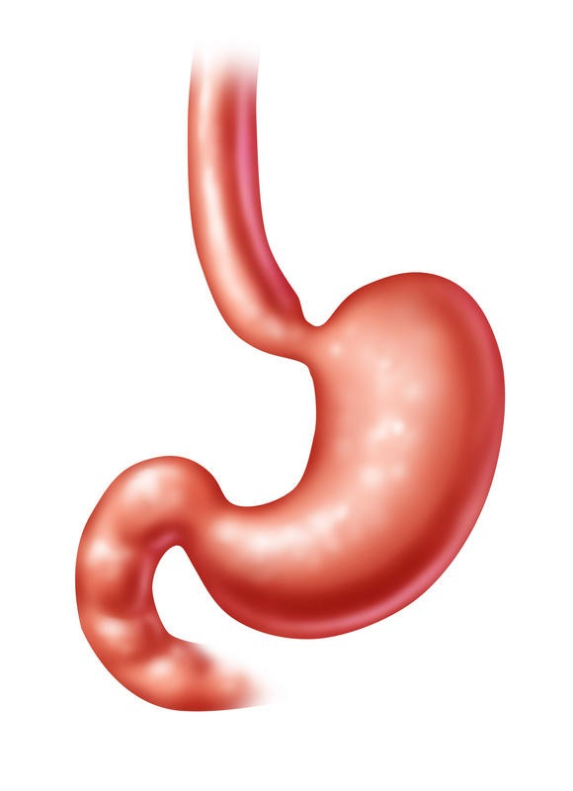
Microvascular: Autonomic Neuropathy
Manifestations of Autonomic Neuropathy:
GI autonomic neuropathy
    Gastroparesis: slow gastric emptying (Diet modification, Reglan, erythromycin, gastric stimulator)
    Diarrhea with sometimes alternating constipation (anti-diarrheals, clonidine or fiber therapies)

Slide 64

Microvascular: Autonomic Neuropathy
Manifestations of Autonomic Neuropathy:
Inability to fully empty bladder resulting in urinary retention
Treatment?

Slide 65
Microvascular: Autonomic Neuropathy
Manifestations of Autonomic Neuropathy:
Erectile Dysfunction (medical, mechanical and surgical treatment)
Treatment?

Slide 66
Nephropathy
Microvascular Complication

Slide 67
Microvascular: Nephropathy
Diabetic Kidney Disease
Diabetes is a major cause of CKD and kidney failure.
DKD may manifest as:
Albuminuria
Declining eGFR
Or both
Chronic hyperglycemia and hypertension contribute to progressive glomerular injury.

Slide 68
Microvascular: Nephropathy
Assess both:
Spot urine albumin-to-creatinine ratio (UACR)
eGFR
Begin:
T1DM: after ≥5 years duration
T2DM: at diagnosis
If normal → at least annually
If CKD present → monitor 1–4 times/year, depending on severity.

Slide 69
Microvascular: Nephropathy
Albuminuria
UACR <30 mg/g: normal to mildly increased
UACR 30–299 mg/g: moderately increased albuminuria
UACR ≥300 mg/g: severely increased albuminuria
Because UACR varies, abnormal results should generally be confirmed with repeat testing

Slide 70
Microvascular: Nephropathy
DKD Treatment:
Optimize glycemic and blood pressure control
ACE inhibitor or ARB recommended in diabetes + hypertension with UACR ≥30 mg/g
Strongly recommended with UACR ≥300 mg/g and/or eGFR <60
Monitor creatinine/eGFR and potassium
Do not discontinue ACEi/ARB for a mild–moderate creatinine increase (≤30%) without volume depletion
SGLT2 inhibitors provide important kidney and cardiovascular protection in appropriate patients with T2DM + CKD

Slide 71
Diabetic Emergencies

Slide 72
Foot Ulcers

Slide 73
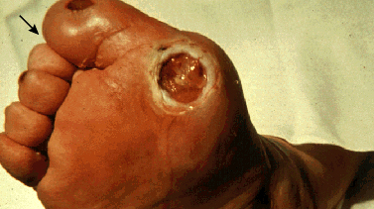
DM Foot Ulcers - Patho
Generally start as an area of irritation, blistering, or reddening that occurs in a patient wearing ill fitting footwear
Irritated area does not heal well and skin breakdown occurs
Foot ulcers are prone to progression, why?
Notes:
UPToDate

Slide 74
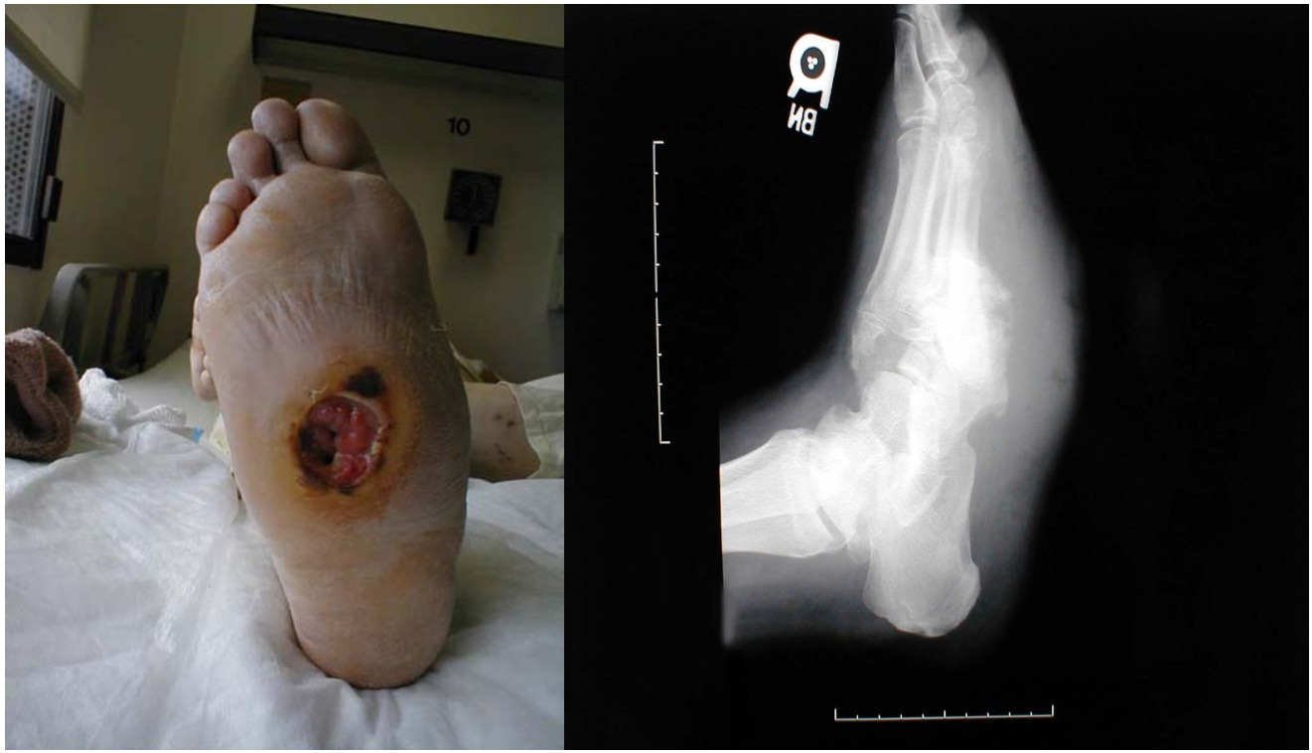
DM Foot Ulcers - Patho
Contractures
Hammer toes/Charcot
Improper weight bearing
Ulcer
Infection
Osteomyelitis
Amputation

Slide 75
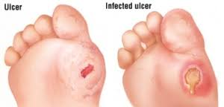
DM Foot Ulcers – Work Up
Can be deep, should be probed with a sterile swab to determine depth
Ulcers that probe the bone are very likely to contain osteomyelitis
Imaging: xray/mri and bone scan to eval for osteomyelitis
Ulcers can be non infected, with cellulitis,
with osteomyelitis or both

Slide 76
DM foot ulcers - Management
• Off-loading pressure from the ulcer
• Wound care/debridement as appropriate
• Assess for infection — antibiotics only when clinically infected
• Assess vascular status
• PAD/poor perfusion → consider revascularization
• Severe infection, necrosis, or non-salvageable tissue may require surgery/amputation
Do NOT give antibiotics to a clinically uninfected diabetic foot ulcer.

Slide 77
DM Foot Ulcers - Infected
MC pathogens: anaerobes, gram – rods, gram + from skin
Treatment:
Outpatient:
  Strep - dicloxacillin or cephalexin
  MRSA -TMP-SMX or doxycycline or clindamycin
Inpatient:
  IV Unasyn or IV Zosyn
  Vancomycin for MRSA coverage

Slide 78
Diabetic Ketoacidosis

Slide 79
Diabetic Ketoacidosis
Life-threatening acute complication of diabetes
Hospitalizations for DKA have increased substantially in recent decades
Mortality is now <1% with appropriate treatment, but risk increases substantially with severe illness/comorbidities
Can occur in T1DM or T2DM

Slide 80
Diabetic Ketoacidosis
  Diagnosis requires ALL 3:
Diabetes/hyperglycemia: glucose ≥200 mg/dL OR known diabetes
Ketosis: β-hydroxybutyrate ≥3.0 mmol/L or urine ketones ≥2+
Metabolic acidosis: pH <7.3 and/or HCO₃ <18 mEq/L

Slide 81
Diabetic Ketoacidosis Etiologies
Missed or inadequate insulin
Infection- usually UTI or pneumonia
The initial presentation of acute type I DM
In the setting of illness: MI, pancreatitis, surgery or trauma when insulin requirements increase
Severe stress in type II DM, such as sepsis or trauma
Complication of SGLT-2 usage (euglycemic DKA)
As a complication of insulin pump failure or insulin leakage

Slide 82
Symptoms of DKA
Onset within 24-48 hours
    Polyuria and polydipsia
    Fatigue/ weakness
    Anorexia/ nausea/ vomiting
    Tachypnea
    Mental stupor progressing to coma
    Abdominal pain
May be subtle, especially early in course, but progresses rapidly.

Slide 83
Signs of DKA
Evidence of dehydration: dry MM, ↓ skin turgor, initially ↑ UOP that decreases
Rapid deep breathing (Kussmaul respirations)
Fruity breath odor
Hypotension and tachycardia 2/2 to fluid/ electrolyte loss
Abdominal pain: corresponds with severity of hyperglycemia
Progressively worsening mental status/ lethargic stuporous patient- reflects the worsening acidosis

Slide 84
Lab Findings in DKA
Hyperglycemia, degree varies: often 250-600 mg/dL
  May be <200 in euglycemic DKA
↑ β-hydroxybutyrate: ≥ 3.0 mmol/L
↓ pH: <7.30
  Severe DKA may be <7.0
↓ bicarbonate: <18 mEq/L
Usually ↑ anion gap: often >12 mEq/L
Urine/serum ketones positive
Blood β-hydroxybutyrate is preferred for diagnosis and monitoring

Slide 85
Lab Findings in DKA
↑ BUN/creatinine from dehydration
Sodium may be low due to hyperglycemia
Serum K⁺ may initially be normal or elevated
BUT total-body potassium is depleted
Leukocytosis may occur from stress and does not automatically indicate infection

Slide 86
Why has my patient become so ill, so quickly?
Hyperglycemia
In DKA there is insufficient insulin causing increased hepatic production of glucose and diminished glucose uptake by peripheral tissues.
In DKA there are ↑ counterregulatory hormones, especially glucagon, released in response to intracellular energy deficit, causing increased hepatic glucose output

Slide 87
Why has my patient gotten so ill, so quickly?
Ketoacidemia
In DKA there is too little insulin and an excess of stress hormones causing breakdown of fat and creation of ketone bodies.
Insulin insufficiency also causes reduced ketone breakdown in peripheral tissues
There is a too much glucagon causing increased lipolysis and hepatic ketogenesis

Slide 88
Why has my patient gotten so ill, so quickly?
Fluid and Electrolyte Depletion
Osmotic diuresis results from hyperglycemia with loss of water and electrolytes.
Ketonuria causes an osmotic diuresis as well
The average water loss in DKA is 5L

Slide 89
Prevention of DKA
Patient education to recognize early s/s, as well as situations when DKA is likely
Home measurement of urine ketones if s/s of infection or if unexpected persistently high glucose levels noted
Education in the way to obtain supplemental liquids and electrolytes
Extra insulin on a sliding scale, education

Slide 90
Prevention of DKA
  If persistent ketonuria occurs x2 on urine tests: patients should contact their physician
  Especially if vomiting develops, or if increased insulin doesn’t correct the hyperglycemia
  Patient will likely need ED eval/ hospitalization
  Recurrent episodes of DKA usually indicate poor compliance with therapy and diet. PCP counseling and more provider oversight is required.

Slide 91
Emergent Treatment of DKA
Step 1:
Begin with a brief H&P, looking for precipitants
Place patient on tele, large bore IV of NS wide open
Check CBC, lytes, cultures, ABG if critically ill. EKG, CXR and UA.
Where are the major sources of infection? What will you expect to see on labs?

Slide 92

Hospital Treatment of DKA
Fluid Replacement:
Begin isotonic saline or balanced crystalloid
Initial rate: 500–1,000 mL/hr for the first 2–4 hours
Then adjust based on:
  hemodynamics
  fluid balance/urine output
  sodium
  comorbidities
Use smaller boluses/caution in older adults, HF, or kidney disease

Slide 93
Emergent Treatment of DKA
Step 2:
More detailed H&P while awaiting labs
Next step depends on the serum potassium
K⁺> 5 mEq- begin an insulin gtt
K⁺ of 3.5-5 mEq - begin K⁺ replacement and insulin gtt
K⁺ < 3.5 mEq - begin K⁺ replacement and hold off on insulin gtt

Slide 94
Hospital Treatment of DKA
Insulin Replacement
IV regular insulin: 0.1 units/kg/hr
Routine IV insulin bolus is not necessary
Prevent cerebral edema from a rapid decline in serum osmolality with IV fluid choice, initially 0.9 or 0.45% NS.
Convert to D5 once BG < 250. Continue insulin until ketoacidosis resolves; do not stop solely because glucose normalizes.

Slide 95
What does insulin replacement do physiologically?
Insulin corrects acidosis by:
  reducing hepatic ketone production
  improves ketone removal from the blood
  reducing fatty acids
Insulin reduces hyperosmolality by:
  increasing tissue uptake of glucose
  decreasing hepatic production of glucose.
Insulin reduces hyperglucagonemia

Slide 96
Hospital Treatment of DKA
Potassium Replacement
  Potassium loss occurs from vomiting/ polyuria
  Acidosis shifts K⁺ into the extracellular space so initially measurements may be high or normal
  Correction of acidosis causes K⁺ to shift into cells so begin replacement in the 2nd or 3rd hours as acidosis resolves
  (10-30mEq/ hr)
  If pts are uremic, have poor UOP or persistent K >5, hold off on potassium supplementation until UOP improves.

Slide 97
Hospital Treatment of DKA
Phosphate replacement
  May or may not be needed, replace slowly
Hyperchloremia
  Hyperchloremia should self resolve within 12-24 hours of stopping saline administration
Sodium Bicarbonate
  Used to correct a very severe acidosis (pH< 7.0)
  Use is highly controversial as it may predispose to harm, reserved for the most critical acidosis

Slide 98
Hospital Treatment of DKA
Treatment of associated infections
Meticulous documentation/ communication with family and other providers
Strict I/ Os
Anti-emetics
May need an NG tube placement to decompress the stomach and prevent aspiration and continued vomiting.
Avoid sedatives/ narcotics

Slide 99
Hospital Treatment of DKA
DKA Resolution
DKA is considered resolved when:
  β-hydroxybutyrate <0.6 mmol/L
  AND venous pH ≥7.3 OR HCO₃⁻ ≥18 mEq/L
  Ideally glucose <200 mg/dL

Slide 100
Hospital Treatment of DKA
Once the acidosis resolves and the precipitant improves, the patient may be restarted on their home DM meds.
Often, DKA indicates poor control, so consider medication adjustment and DM education to address this.
Discuss with the patient that they were seriously/ critically ill.
Arrange for close PCP/endo follow up

Slide 101
Hyperglycemic Hyperosmolar State

Slide 102
Hyperglycemic, Hyperosmolar State
Life-threatening hyperglycemic emergency
Occurs most commonly in older adults with T2DM, but can occur with any type of diabetes
Develops more gradually than DKA, typically days to weeks
Characterized by severe hyperglycemia, hyperosmolality, and profound dehydration
Mortality remains approximately 5–10× higher than DKA

Slide 103
Hyperglycemic, Hyperosmolar State
Common precipitating factors:
  Infection
  MI or stroke
  Surgery/acute illness
  Inadequate diabetes treatment or newly diagnosed diabetes
  Medications that worsen hyperglycemia or dehydration
  Limited access to fluids / inability to maintain hydration

Slide 104
Pathogenesis of HHS
A partial or relative insulin deficiency reduces glucose utilization in peripheral tissues.
There is usually enough insulin to largely suppress lipolysis and ketogenesis, but not enough to prevent severe hyperglycemia.
↑ counterregulatory hormones (including glucagon) further increase hepatic glucose production.

Slide 105
Pathogenesis of HHS
Severe hyperglycemia exceeds the renal threshold → glucosuria and osmotic diuresis
If the patient cannot maintain adequate fluid intake, profound dehydration develops.
↓ circulating volume → ↓ renal perfusion → decreased glucose clearance → worsening hyperglycemia

Slide 106
Pathogenesis of HHS
Declining renal perfusion/function develops, the kidney is less and less able to rid the body of glucose.
Increasing glucose + profound free-water loss → hyperosmolality
Increasing hyperosmolality can cause progressive neurologic dysfunction
Confusion, lethargy, focal neurologic deficits, seizures, and coma may occur.

Slide 107
HHS Clinical Findings
Onset may be insidious over days or weeks
Weakness, polyuria, and polydipsia
Lethargy, confusion and progressive decrease in cognition.
Convulsions and deep coma if untreated
Low fluid intake may occur in
  Nausea, inappropriate lack of thirst
  Elderly, bedridden pts with inaccessibility to fluids

Slide 108
HHS Laboratory Findings
Diagnosis of HHS Requires ALL 4
Glucose ≥600 mg/dL
Hyperosmolality
  effective serum osmolality >300 mOsm/kg
  OR total serum osmolality >320 mOsm/kg
No significant ketonemia
  β-hydroxybutyrate <3.0 mmol/L
  or urine ketones <2+
No significant acidosis
  pH ≥7.3
  bicarbonate ≥15 mEq/L

Slide 109
HHS Laboratory Findings
CBC: hemoconcentration; leukocytosis may occur from physiologic stress
BUN/Cr: often elevated from profound dehydration/AKI
Na⁺: variable; may be low, normal, or high
K⁺: variable initially, despite total-body potassium depletion
Ketones: absent to mild
Acid-base status: generally no significant metabolic acidosis

Slide 110
Treatment of HHS
Fluid Replacement
Fluid replacement is the cornerstone of treatment
Begin 0.9% saline or balanced crystalloid
Typical initial rate: 500–1,000 mL/hr for first 2–4 hours
Then adjust based on:
  hemodynamics
  sodium
  urine output/fluid balance
  serum osmolality
Use caution with older adults, HF, or kidney disease

Slide 111
Treatment of HHS
Insulin
Fluid replacement alone may substantially lower glucose
After initial fluid resuscitation, IV regular insulin may be started
IV insulin: 0.05 units/kg/hr
Monitor glucose and potassium closely
Add dextrose as glucose approaches 250 mg/dL so insulin can continue while hyperosmolality resolves

Slide 112
DKA vs HHS
 | DKA | HHS
Onset | Hours–days | Days–weeks
Glucose | Variable; may be <200 | ≥600 mg/dL
Ketosis | Significant | Minimal/absent
Acidosis | Present | Absent/minimal
Hyperosmolality | Variable | Marked
Dehydration | Significant | Profound
Neuro changes | Variable | Often prominent
Initial insulin | 0.1 U/kg/hr | 0.05 U/kg/hr
Mortality | Lower | 5–10× higher

