Slide 1
Pharmacology of Diabetes Mellitus
Endocrinology Module
Fall Semester
Sarah Brandell MPAS, PA-C

Slide 2
DAWN and DAWN2: large international studies surveying patients, their families and their clinicians
24% of diabetics reported that their HCP asked them on a regular basis how DM affects their lives
Just over 36% of people with diabetes felt that they were capable of self-managing their DM
33% of people with diabetes were encouraged by their HCP to ask questions during the visit
29% of people with DM said that their HCP asked for their input when making treatment plans
Notes:
Diabetes Attitudes Wishes Needs Study

Slide 3
Motivational Interviewing
We must be patient centered!!
Discuss the disadvantages of the status quo, point out the advantages of change, have optimism for change, enforce patient’s intention to change
We must express
Genuine interest: pay attention to the patient
Empathy: willingness to see it their way
Positive regard: roll with patient resistance, see the positive in everything

Slide 4
Motivational Interviewing
Varying levels of health literacy/ numeracy
Teach back method- but don’t quiz
Other factors to consider:
  Ethnicity and cultural beliefs
  Food security
  Economics
  Family members opinions

Slide 5
Motivational Interviewing
Integrate concepts- discuss how increased exercise will reduce BP and glucose
Create specific goals, WITH the PATIENT and create a realistic way to reach them
Consider the patient’s situation, insurance coverage, willingness to use different forms of the medications, and culture
LISTEN to patient beliefs, particularly about meds
Goal is long term risk reduction- review, review, review
Persistence- “slow” progress is better than none

Slide 6
Diabetes Self Management, Education and Support
Overall medication adherence rates are about 70%- shared decision making is critical in improving this outcome
Involve the family and friends- get loved ones to assist you with helping your patient make wise choices
Be relentlessly positive!

Slide 7
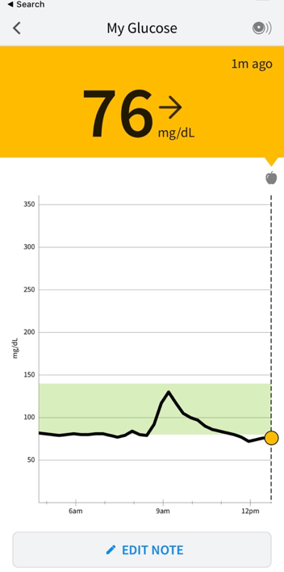

Diabetes Treatment- Monitoring Equipment
Blood Glucose Monitors with Lancets & Strips
CGM – Continuous Glucose Monitors
Logs to track their data

Slide 8
Diabetes Treatment- Monitoring Equipment
Individualize monitoring based on treatment and hypoglycemia risk
CGM users should have access to a backup glucometer

Slide 9
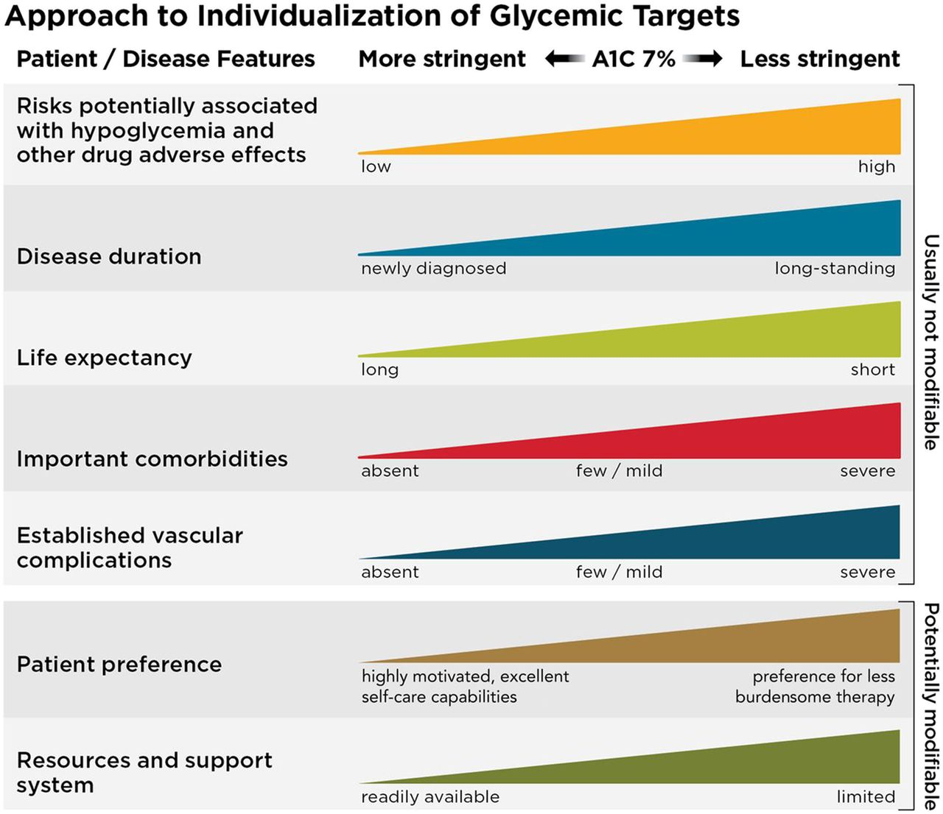
Diabetes Treatment Goals

Slide 10
Diabetes Treatment Goals
Goal A1C of < 7% is common for most non pregnant adults
Consider <6.5% if safely achievable
    Good Health/ Long Life Expectancy
    Low hypoglycemia risk
    Low treatment burden
Goal of A1C <8% is suitable for a few selected pts
    Limited life expectancy
    Frailty or extensive medical comorbidities
    High hypoglycemia risk

Slide 11
Antidiabetic Pharm Classes
Biguanides
Incretin Therapy
  GLP – 1 receptor agonists
  GIP/GLP-1 receptor agonist
  DPP-4 Inhibitor
SGLT2 Inhibitor
Sulfonylureas
Thiazolidinediones
Meglitinides
Alpha-Glucosidase Inhibitor
Insulins

Slide 12
Biguanides

Slide 13
Metformin (Glucophage)
Drug class: biguanides (the only drug in the class)
MOA:
  ↓ hepatic production of glucose
  ↓ absorption of glucose from GI tract
  ↑ insulin sensitivity / peripheral glucose uptake
  Formulations: Immediate-release (IR) and Extended-release (ER)
  Typical Max Dose: The maximum dose is 2000mg per day

Slide 14
Metformin (Glucophage)
Indications: Treatment of T2DM
Off-label uses
Pre-diabetes prevention
Polycystic ovarian syndrome
Gestational Diabetes
Elimination: renal
Pregnancy: crosses placenta, insulin preferred
Lactation: does enter breastmilk, relative infant dose (RID) is low

Slide 15
Metformin: Advantages
Metformin is effective
↓ A_{1C} by 1-1.5%
Wt neutral to modest weight loss
Low risk of hypoglycemia when used as monotherapy
FDA approved for age ≥ 10 years

Slide 16
Metformin: Side Effects
GI side effects *
  Diarrhea, N/V
  Metallic taste
  Minimized by slow titration and/or XR formulation
Vitamin B-12 deficiency with long term use
  Consider periodic B12 monitoring
Lactic Acidosis, rare but serious (BBW)

Slide 17
Metformin: Clinical Considerations
Dosing
Start low and titrate gradually
Example: 500 mg daily → 500 mg BID
XR may improve GI tolerability
Renal
Do not use if eGFR <30
Starting at eGFR 30–45 is not recommended
If eGFR falls <45 → reassess benefits/risks
Iodinated contrast
Hold metformin in at-risk patients
Recheck renal function after 48 hr before restarting

Slide 18
Incretin Therapy

Slide 19
Incretin Therapy
Endogenous incretin hormones (GLP-1 and GIP) are released from the gut in response to nutrients and stimulate glucose-dependent insulin secretion.

Slide 20
Incretin Therapy
The incretin effect is reduced in T2DM
Incretin-based medications enhance or mimic incretin activity:
  GLP-1 receptor agonists mimic GLP-1 activity
  Dual GIP/GLP-1 receptor agonists activate both receptors
  DPP-4 inhibitors prolong endogenous incretin activity

Slide 21
Incretion Therapy: GLP-1 Receptor Agonists

Slide 22
GLP-1 Receptor Agonists, MOA
GLP-1 is an endogenous incretin hormone released from the intestine in response to nutrients.
GLP-1 receptors are present in multiple tissues, including the pancreas, GI tract, and CNS.
GLP-1 receptor activation:
↑ Glucose-dependent insulin secretion
↓ Inappropriate glucagon secretion
↓ Gastric emptying
↑ Satiety / ↓ food intake

Slide 23
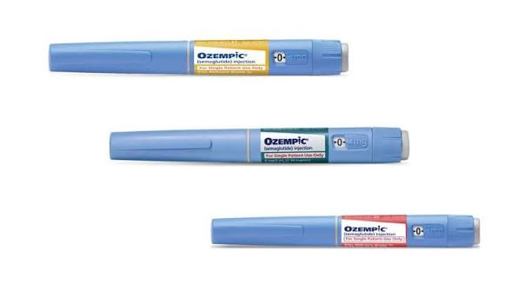
GLP-1 Receptor Agonists
Liraglutide (Victoza) SQ daily
Semaglutide (Ozempic) — SQ weekly
Semaglutide (Rybelsus) — oral daily
Dulaglutide (Trulicity) — SQ weekly
Exenatide (Byetta) — SQ twice daily
Exenatide ER (Bydureon BCise) — SQ weekly

Slide 24
GLP-1 RA: A1C + Renal Function
Expected A1C reduction: ~1–2%
Low intrinsic risk of hypoglycemia
Renal considerations are agent-specific
  Most GLP-1 RAs do not require renal dose adjustment
  Exenatide has greater renal restrictions
Monitor for volume depletion/AKI with significant GI adverse effects

Slide 25
GLP-1 Receptor Agonists: Adverse Effects
GI effects are most common *
  Nausea, vomiting diarrhea, or constipation
  Usually greatest during initiation and dose escalation
  Slow titration may improve tolerability
  Counsel patients to eat smaller meals and stop when full
  Significant vomiting/diarrhea – risk of dehydration and AKI

Slide 26
GLP-1 Receptor Agonists: Adverse Effects
Acute pancreatitis
Has been reported with GLP-1 RAs
Counsel: persistent, severe abdominal pain ± radiation to the back
Discontinue if pancreatitis is suspected
Use caution/consider alternatives with a history of pancreatitis
Injection-site reactions
May occur with injectable agents
Rotate injection sites

Slide 27
GLP-1 Receptor Agonists: Adverse Effects
Thyroid C-cell tumors
Thyroid C-cell tumors occurred in rodent studies
Human relevance is unknown
Several GLP-1 RAs carry an FDA boxed warning
Contraindicated with:
  Personal or family history of medullary thyroid carcinoma (MTC)
  Multiple Endocrine Neoplasia syndrome type 2 (MEN 2)

Slide 28
GLP-1 RAs: Cardiovascular Benefit
Several GLP-1 RAs have demonstrated reduction in major adverse cardiovascular events (MACE)
CV benefit has been demonstrated with:
  Liraglutide
  Semaglutide (SQ and oral)
  Dulaglutide
In T2DM with established ASCVD or high ASCVD risk, use a GLP-1 RA with demonstrated CV benefit regardless of A1C
Benefits extend beyond glucose lowering alone
Notes:
https://www.sciencedirect.com/science/article/pii/S2666667724000473#:~:text=GLP%2D1RAs%20significantly%20reduced%20MACE,reduced%20MACE%20in%20both%20sexes.
comprising 83,258 patients were included

Slide 29
Incretion Therapy: Dual GIP/GLP-1

Slide 30
Dual GIP/GLP-1 Receptor Agonist
Tirzepatide (Mounjaro) — SQ once weekly
Mechanism of Action
  Activates both GIP and GLP-1 receptors
  ↑ Glucose-dependent insulin secretion
  ↓ Glucagon secretion
  ↓ Gastric emptying
  ↑ Satiety / ↓ food intake
Clinical effects
  Very high glucose-lowering efficacy
  Significant weight loss

Slide 31
Incretin Therapy: DPP-4 Inhibitors

Slide 32
DPP-4 Inhibitors
DPP-4 breaks down endogenous incretin hormones, including GLP-1 and GIP.
DPP-4 inhibitors ↓ incretin degradation → prolong endogenous incretin activity.

Slide 33
Choices of DPP-4 Inhibitors
      Linagliptin (Tradjenta)
      Sitagliptin (Januvia)
      Saxagliptin (Onglyza)
      Alogliptin (Nesina)
      Renal dosing: Most require dose adjustment in CKD; linagliptin does not.

Slide 34
DPP-4 Inhibitors
Modest glucose-lowering efficacy
  ↓ A1C approximately 0.5–0.8%
Weight neutral
Low risk of hypoglycemia when used alone

Slide 35
DPP-4 Inhibitors: Adverse Effects
Generally well tolerated
Pancreatitis — rare; discontinue if suspected
Severe joint pain — rare FDA warning
Bullous pemphigoid — rare
Hypersensitivity reactions — rare

Slide 36
DPP-4 Inhibitors: Cardiovascular Safety
DPP-4 inhibitors have not demonstrated cardiovascular benefit
Saxagliptin: increased risk of hospitalization for heart failure
FDA labeling includes HF warnings for saxagliptin and alogliptin
Other DPP-4 inhibitors have not demonstrated increased HF hospitalization in cardiovascular outcomes trials

Slide 37
DPP-4 Inhibitors + GLP-1 Based Therapy
Do not combine a DPP-4 inhibitor with a GLP-1 receptor agonist or dual GIP/GLP-1 receptor agonist.
There is no meaningful additional glucose-lowering benefit from combining these therapies.

Slide 38
SGLT2 Inhibitors

Slide 39

SGLT2 Inhibitors: Mechanism of Action
SGLT2 is a sodium-glucose cotransporter in the proximal renal tubule
Responsible for the majority of filtered glucose reabsorption
SGLT2 inhibition → ↓ glucose reabsorption → ↑ urinary glucose excretion
Results in glucosuria and osmotic diuresis
Mechanism is independent of insulin

Slide 40
SGLT2- Inhibitors: Indications / Major Clinical Uses
Type 2 diabetes
Heart failure — HFrEF or HFpEF
Chronic kidney disease
Cardiovascular risk reduction in selected patients with T2DM

Slide 41
SGLT2 Inhibitors: Clinical Effects
Expected A1C reduction: ~0.5–1%
Low risk of hypoglycemia when used alone
Modest weight loss
Modest reduction in blood pressure
Intermediate glucose-lowering efficacy
Glucose-lowering effect decreases as renal function declines

Slide 42
SGLT2 Inhibitors: Medications
Empagliflozin (Jardiance)
Dapagliflozin (Farxiga)
Canagliflozin (Invokana)
Ertugliflozin (Steglatro)

Slide 43
SGLT2- Inhibitors Adverse Effects
Genital mycotic infections*
Volume depletion / hypotension
Polyuria
Euglycemic DKA
  DKA may occur with normal or only mildly elevated glucose
Rare: Fournier gangrene

Slide 44
SGLT2- Inhibitors: Safety Considerations
Euglycemic DKA risk increases with:
  Acute illness / prolonged fasting
  Surgery
  Significant insulin reduction
Hold before surgery
  Most SGLT2 inhibitors: 3 days
  Ertugliflozin: 4 days
Renal function
Glucose-lowering efficacy ↓ as eGFR declines
Cardiorenal benefits may persist despite reduced glucose lowering

Slide 45
Sulfonylureas

Slide 46
Sulfonylureas
Insulin secretagogues: stimulate pancreatic β-cells to release insulin
Insulin secretion occurs regardless of blood glucose level
Major adverse effects:
  Hypoglycemia*
  Weight gain

Slide 47
Sulfonylureas: Efficacy
Expected A1C reduction: ~1–1.5%
Require functioning pancreatic β-cells
Effectiveness may decline over time as T2DM progresses
No demonstrated cardiovascular or kidney benefit

Slide 48
Sulfonylureas: Medications
Glimepiride (Amaryl)
Glipizide (Glucotrol)
Glyburide (Micronase, Diabeta)
  Glyburide has a higher risk of prolonged hypoglycemia and should generally be avoided in older adults and patients with impaired renal function.
Place in Therapy:
Advantages: inexpensive, oral, effective
Limitations: hypoglycemia, weight gain, no cardiorenal benefit

Slide 49
Sulfonylurea: Cautions
Renal impairment / older adults
  ↑ risk of prolonged hypoglycemia
  Avoid glyburide in these patients
G6PD deficiency
  May cause hemolytic anemia
  Use caution / consider an alternative
Sulfonamide antibiotic allergy
  Cross-reactivity with sulfonylureas is unlikely

Slide 50
Sulfonylurea Overdose
Sulfonylurea overdose can cause severe hypoglycemia
Hypoglycemia may be prolonged and recurrent
Patients require extended glucose monitoring
Duration may be prolonged further with renal impairment

Slide 51
Thiazolidinediones

Slide 52
Thiazolidinediones MOA
Increase insulin sensitivity in peripheral tissues
↑ Glucose uptake in muscle and adipose tissue
↓ Hepatic glucose production
Do not stimulate insulin secretion
Medications:
  Pioglitazone (Actos)
  Rosiglitazone (Avandia)

Slide 53
Thiazolidinediones: Clinical Effects
Expected A1C reduction: ~0.5–1%
Low risk of hypoglycemia when used alone
Weight gain
Effects develop slowly — may take several weeks for full benefit

Slide 54
Thiazolidinediones: Adverse Effects
Weight gain*
Fluid retention / edema*
May cause or worsen heart failure
↑ Risk of fractures, particularly in women
Hypoglycemia is uncommon when used alone
Heart Failure
Fluid retention may cause or worsen heart failure
FDA Boxed Warning
Contraindicated in NYHA Class III-IV heart failure

Slide 55
Meglitinides

Slide 56
Meglitinides
Short-acting insulin secretagogues
Stimulate pancreatic β-cells to release insulin
Taken before meals to target postprandial glucose
Skip the dose if the meal is skipped
Medications
Repaglinide (Prandin)
Nateglinide (Starlix)

Slide 57
Meglitinides: Clinical Effects
Expected A1C reduction: ~0.5–1%
Hypoglycemia can occur, but risk may be lower than with sulfonylureas
May cause weight gain
Short duration of action provides flexibility around meals
Limited role in current diabetes therapy

Slide 58
Alpha-glucosidase Inhibitors

Slide 59
Alpha-glucosidase Inhibitors MOA
Inhibit intestinal enzymes that break down complex carbohydrates
Delay carbohydrate digestion and glucose absorption
↓ Postprandial glucose
Taken with the first bite of each meal
Medications
Acarbose (Precose)
Miglitol (Glyset)

Slide 60
Alpha-glucosidase Inhibitors
Clinical Effects
Expected A1C reduction: ~0.5–0.8%
Low risk of hypoglycemia when used alone
Weight neutral
Adverse Effects
Flatulence*
Diarrhea / abdominal discomfort
Slow titration may improve GI tolerability
Place in therapy
Infrequently used due to modest efficacy, GI adverse effects, and frequent dosing

Slide 61
Insulin

Slide 62
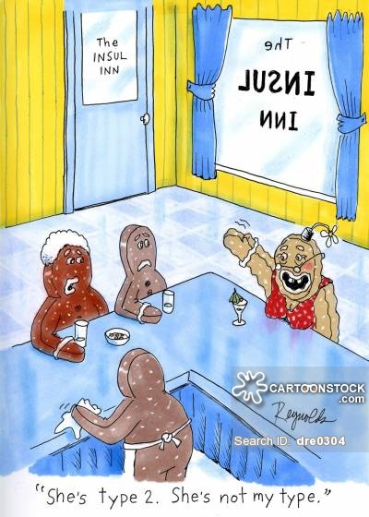
Insulin
Required for treatment of T1DM
May be used in T2DM when clinically indicated
Insulin use in T2DM is sometimes delayed because of patient and clinician barriers/stigmata

Slide 63
Insulin- A History Lesson
Prior to the 1920’s patients with diabetes tried to control their disease using a very strict diet. Unfortunately, type I diabetics generally died within a year of diagnosis as their insulin production ceased.
In the early 1920’s MacLeod, Banting, Collip, and Best were able to extract insulin from animal pancreatic tissue and purify it to be safe in humans- MacLeod and Banting won the 1923 Nobel Prize for this discovery.

Slide 64
Insulin- A History Lesson
For the next 60 years, people relied on beef or pork insulin to treat diabetes, while researchers sequenced the insulin protein (Nobel prize in 1959) and determined its crystalline structure (1969).
Then, in 1978, researchers perfected the technique to mass produce the A chain and the B chain of insulin using recombinant DNA technology and then combined the chains using a chemical reaction to create human insulin on a large scale.

Slide 65
Biosynthetic human insulin is now made by genetically engineered bacteria containing the gene for human insulin proteins.
Bacteria are grown in fermentation tanks, and when adequate amounts of A or B proteins have been made, the bacteria are lysed, and the insulin proteins harvested, purified and chemically combined.

Slide 66
Insulin: Storage
Unopened insulin is generally stored refrigerated
Do not freeze; protect from excessive heat and direct light
In-use insulin can often be stored at room temperature
In-use expiration varies by product — check manufacturer instructions

Slide 67
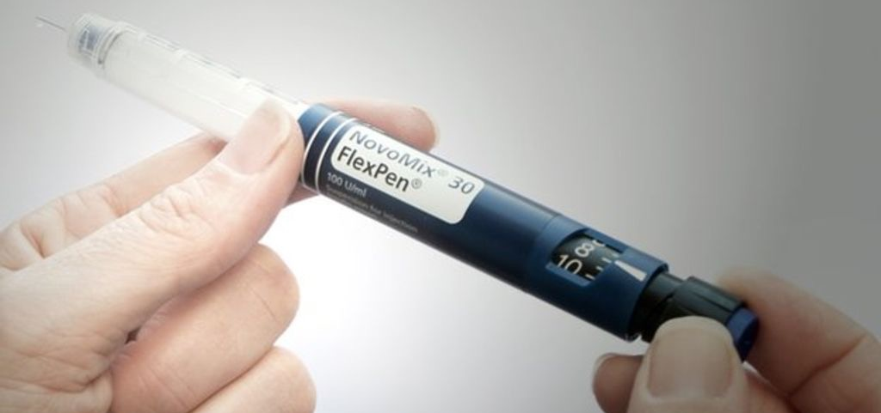
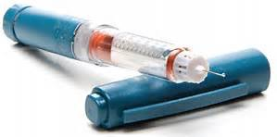
Insulin pens simplify administration and may reduce dosing errors

Slide 68
Insulin Therapy
Insulin Pumps
Deliver rapid-acting insulin continuously
Provide basal insulin + mealtime/correction boluses
Basal and bolus dosing can be individualized
Automated Insulin Delivery (AID)
Integrates an insulin pump + CGM + control algorithm
Automatically adjusts insulin delivery based on sensor glucose
Improves time in range and reduces hypoglycemia
Patients still require education and active diabetes self-management

Slide 69
Insulin
Insulin preparations differ primarily by their onset, peak, and duration of action.
Rapid acting
Short-acting (regular)
Intermediate-acting (NPH)
Long acting
Ultra-long acting

Slide 70
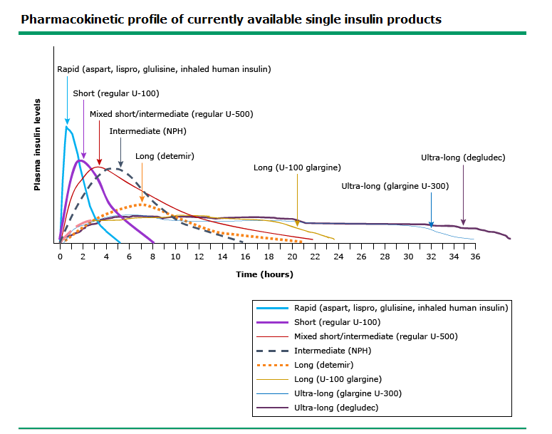
Notes:
Uptodate

Slide 71
Mealtime (Prandial) Insulin
Rapid-acting
Lispro (Humalog)
Aspart (NovoLog)
Glulisine (Apidra)
Give at/around mealtime
Faster onset, shorter duration
Short-acting
Regular insulin (Humulin R, Novolin R)
Give approximately 30 minutes before meals
Slower onset and longer duration than rapid-acting
Can be given IV
Pump pearl: Insulin pumps typically use rapid-acting insulin for both basal and mealtime insulin delivery.

Slide 72
Intermediate-acting (Basal) Insulin
NPH (Humulin N, Novolin N)
Intermediate-acting
Provides basal insulin coverage
Has a pronounced peak → greater hypoglycemia risk than long-acting basal analogs
Cloudy suspension — must be gently resuspended before use
May be given once or twice daily

Slide 73
Long-acting (Basal) Insulin
Insulin glargine
Lantus / Basaglar / Semglee — U-100
Toujeo — U-300
Provides relatively peakless basal insulin coverage
Usually dosed once daily
Do not mix with other insulins in the same syringe

Slide 74
Ultra-Long-acting (Basal) Insulin
Insulin degludec (Tresiba)
Ultra-long-acting basal insulin
Duration of action >42 hours
Minimal peak
Dosed once daily
Available as U-100 and U-200

Slide 75
Insulin Therapy
Starting Basal Insulin in T2DM
A common starting dose is:
  10 units/day, OR
  0.1–0.2 units/kg/day
Titrate based primarily on fasting glucose
Individualize based on hyperglycemia and risk of hypoglycemia

Slide 76
Insulin Therapy
Basal Insulin Titration
Adjust based on fasting glucose trends
Common approach: adjust by approximately 2 units every 3–4 days
Increase until fasting glucose is at goal
Decrease for hypoglycemia
Titration should be individualized

Slide 77
Insulin Administration: Patient Education
Notes:
https://www.youtube.com/watch?v=fJPzkzyuMZ8

Slide 78
Sites of Insulin Administration
Insulin is injected into subcutaneous tissue:
Abdomen
Outer/lateral thigh
Buttocks
Upper arm
Clinical Pearls
Rotate injection sites to prevent lipohypertrophy
Avoid injecting into areas of lipohypertrophy
Avoid intramuscular injection → unpredictable absorption and hypoglycemia risk
Short pen needles (e.g., 4 mm) reduce risk of IM injection

Slide 79
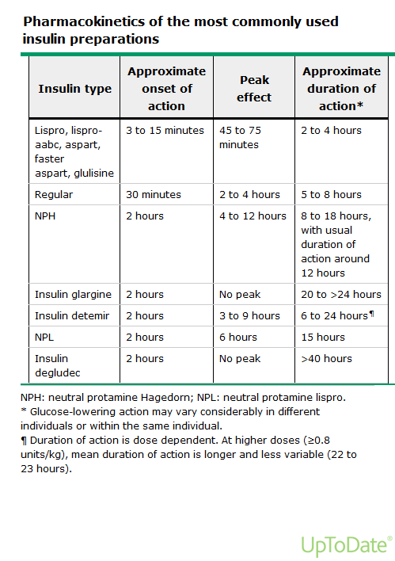

Slide 80
Premixed Insulin
Premixed insulin combines basal/intermediate + mealtime insulin in a fixed ratio.
Examples
Humulin/Novolin 70/30: 70% NPH + 30% regular insulin
NovoLog Mix 70/30: 70% insulin aspart protamine + 30% insulin aspart
Humalog Mix 75/25: 75% insulin lispro protamine + 25% insulin lispro

Slide 81
Premixed Insulin
Advantages
Fewer injections
Simpler regimen
Provides both basal and mealtime coverage
Disadvantages
Fixed ratio → less flexibility
Cannot independently adjust basal vs. mealtime insulin
Requires more consistent meal timing/intake
Hypoglycemia risk if meals/activity vary

Slide 82
Complications of Insulin Therapy
Major adverse effects/complications
Hypoglycemia*
Weight gain
Lipohypertrophy / injection-site changes
Insulin allergy — rare

Slide 83
Complications of Insulin Therapy
Lipohypertrophy
Thickened/enlarged subcutaneous tissue from repeated injections
More common when repeatedly using the same site
Can cause unpredictable insulin absorption
Prevent with site rotation
Avoid injecting into affected areas
Lipoatrophy
Loss of subcutaneous fat at injection site
Rare with modern insulin preparations

Slide 84
Complications of Insulin Therapy
Hypoglycemia is the most important acute adverse effect of insulin.
Higher risk with:
  Intensive insulin therapy
  Prior/recurrent hypoglycemia
  Impaired hypoglycemia awareness
  Older age/cognitive impairment
  Kidney disease
  Missed/delayed meals or increased activity
  β-blocker therapy may blunt adrenergic warning symptoms
Remember from Hypoglycemia:
  Recurrent episodes can → impaired hypoglycemia awareness
  Severe hypoglycemia can → confusion, seizure, LOC/coma
  CGM/AID can help reduce hypoglycemia risk

Slide 85
Diabetic Therapy Guidelines

Slide 86
T2 DM Treatment Guidelines
Adapted from: American Diabetes Association. Standards of Care in Diabetes—2026.
Notes:
https://diabetesjournals.org/care/article/49/Supplement_1/S183/163934/9-Pharmacologic-Approaches-to-Glycemic-Treatment

Slide 87
T2DM Treatment – Where do I Start?
Lifestyle + Diabetes Self-Management Education and Support (DSMES) for everyone
2. Look FIRST for compelling comorbidities
ASCVD / high CV risk → GLP-1 RA and/or SGLT2 inhibitor with demonstrated CV benefit
Heart failure → SGLT2 inhibitor
CKD → SGLT2 inhibitor and/or GLP-1 RA with demonstrated kidney/CV benefit
Key Point: These therapies may be indicated regardless of A1C or metformin use.

Slide 88
ASCVD: What Do We Mean?
Atherosclerotic Cardiovascular Disease (ASCVD) includes:
Coronary disease: MI, acute coronary syndrome, coronary revascularization
Cerebrovascular disease: ischemic stroke or TIA
Peripheral arterial disease (PAD)
Why does this matter in diabetes?
Presence of ASCVD can directly influence medication selection.

Slide 89
T2DM Treatment - If No Compelling Comorbidity Drives Therapy
1. Determine the individualized A1C goal
2. How far is the patient from goal?
      <1.5% above goal → generally start one agent
      ≥1.5% above goal → consider initial combination therapy
Example:
Goal <7%, current A1C 9% → 2% above goal → consider combo therapy

Slide 90
T2DM Treatment - If No Compelling Comorbidity Drives Therapy
3. Choose medication(s) based on:
Glucose-lowering efficacy
Weight goals
Hypoglycemia risk
Adverse effects
Cost/access
Patient preference
Metformin remains a common first-line option when there is no other reason to select a different medication.

Slide 91
T2DM Treatment - When to Consider Insulin in T2DM
Consider insulin when:
Symptoms of significant hyperglycemia (polyuria, polydipsia)
A1C >10%
Blood glucose ≥300 mg/dL
Evidence of catabolism (e.g., unexpected weight loss or ketosis)
Glycemic goals cannot be achieved with noninsulin therapy
Important:
In the absence of severe hyperglycemia or hyperglycemic crisis, GLP-1–based therapy is preferred before insulin for initial/add-on injectable therapy.

Slide 92
T1 DM Treatment Guidelines
Adapted from: American Diabetes Association. Standards of Care in Diabetes—2026.
Notes:
https://diabetesjournals.org/care/article/49/Supplement_1/S297/163923/14-Children-and-Adolescents-Standards-of-Care-in

Slide 93
T1DM Treatment: Core Principles
Insulin is required for treatment of T1DM
Goal is physiologic replacement of:
  Basal insulin
  Prandial insulin
  Correction insulin
CGM is standard of care for most patients
Automated insulin delivery (AID) is preferred when appropriate and accessible
A1C goal: generally <7%, individualized to the patient

Slide 94
T1DM Treatment: Insulin
Multiple Daily Injections (MDI)
  Long-acting basal insulin
  Rapid-acting mealtime/correction insulin
OR
Insulin Pump / Automated Insulin Delivery
Rapid-acting insulin provides basal + bolus insulin
AID integrates pump + CGM + algorithm
Automatically adjusts insulin delivery based on glucose data
Goal: mimic physiologic insulin secretion

Slide 95
T1DM Treatment: Starting Insulin
Typical total daily insulin requirement
Individualized based on age, weight, activity, illness, etc.
Approximately 30–50% basal
Remainder used for prandial/correction insulin
Honeymoon (partial remission)
Temporary recovery of residual β-cell insulin secretion after treatment begins
Insulin requirements may decrease temporarily
Insulin must be continued
Insulin needs eventually increase as endogenous insulin production declines

Slide 96
Case Study #1
Drew is a 53 year old man who is seen in the clinic, no medical care x 20 years.
He had shoulder surgery in August and his blood sugar was noted to be high- he was advised to establish care with a PCP.
Review of the records reveals the following:
8/1- blood glucose 170 fasting, A1c: 7.4%
8/20- blood glucose 165 fasting, A1c: 7.2%

Slide 97
Case Study #1
Drew is a 53 yo male, no known ASCVD, HF, or CKD.
8/1- blood glucose 170 fasting, A1c: 7.4%
8/20- blood glucose 165 fasting, A1c: 7.2%
History/PE Taken today:
  He was also noted on labwork to have HLD for which you will need to treat and is considered obese.

Slide 98
Case Study #2
Heather is a 67-year-old woman with T2DM x 2 years, taking metformin 1000 mg BID.
3 months ago: A1C 7.6%
Counseled regarding nutrition and exercise
Today: A1C 7.9% despite adherence to lifestyle changes and medication
What additional history do you need before choosing her next medication?

Slide 99
Case Study #3
Richard is a 68-year-old man with T2DM x 5 years taking:
Metformin 1000 mg BID
Glimepiride (Amaryl) 4 mg daily
Saxagliptin (Onglyza) 5 mg daily
A1C: 7.3%
He reports 3 episodes of hypoglycemia in the last month.

Slide 100
Case Study #4
Maria is a 46-year-old woman with newly diagnosed T2DM.
A1C 11.4%
Fasting glucose 326 mg/dL
Reports polyuria, polydipsia, fatigue, and 12-lb unintentional weight loss
No known ASCVD, HF, or CKD

