Slide 1
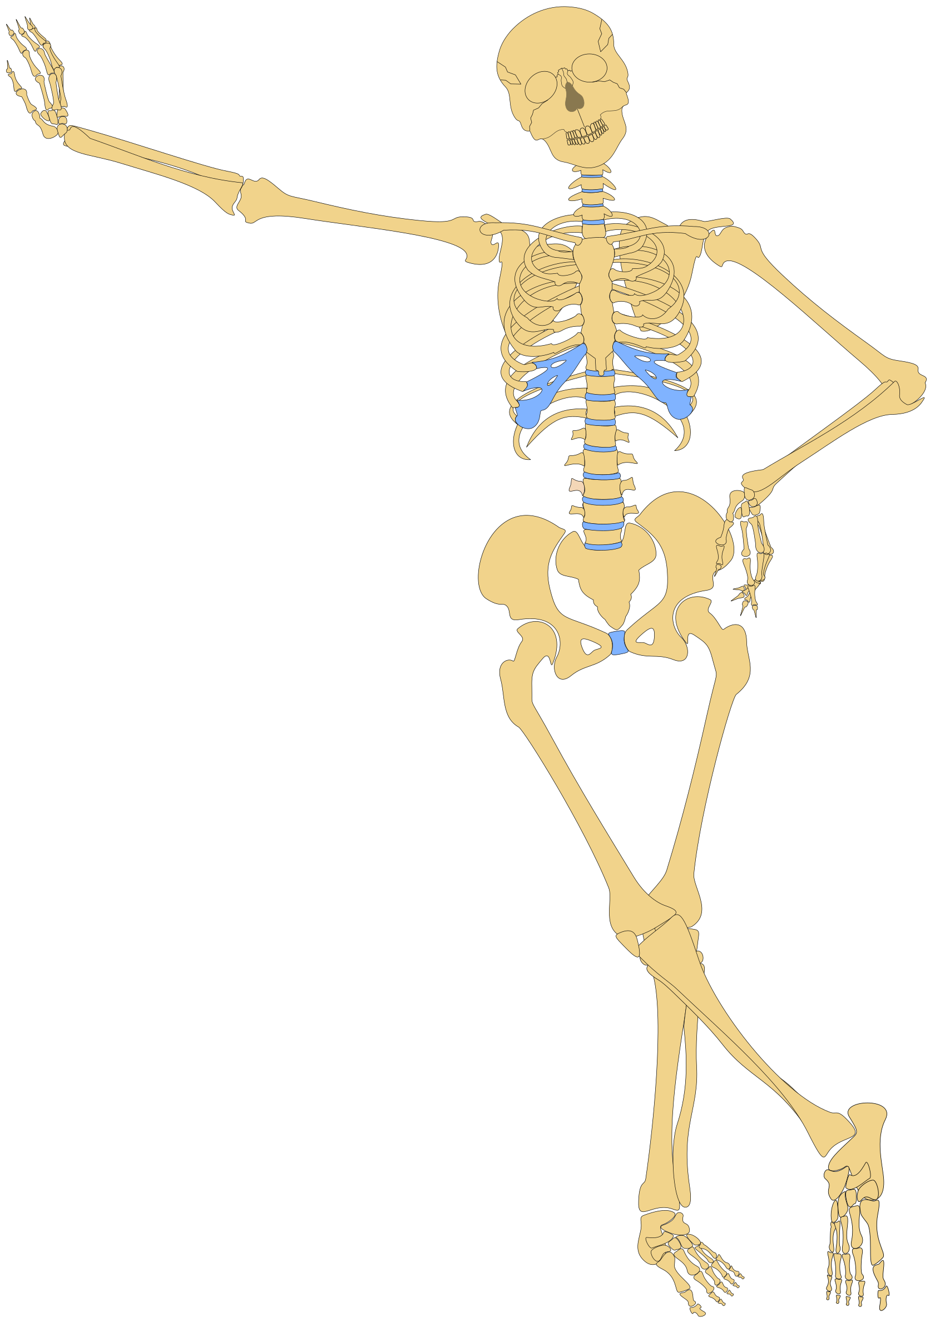
Paget’s Disease of the Bone
Breanna Veal, MHS, PA-C

Slide 2
Paget’s Disease of the Bone
Also known as osteitis deformans
Paget’s is characterized by an accelerated rate of bone remodeling, resulting in overgrowth of bone at single site (28%) or multiple sites (72%) with impaired bone integrity.

Slide 3
Paget’s Disease of the Bone
Most patients with Paget’s are diagnosed after bone lesions are discovered incidentally on XR or a high level of serum alkaline phosphatase is discovered incidentally.
Paget’s disease usually involves multiple bones of the skeleton.
Paget’s most commonly affects bones of the axial skeleton; the vertebrae, pelvis, femur, skull, sacrum, humerus and tibia.

Slide 4
Paget’s Disease Epidemiology
The incidence of Paget’s is declining overall and the age of diagnosis is increasing
Men>Women
Age>40
Prevalence is greatest in Western Europe or of European ancestry
  Europeans immigrated to Australia, New Zealand
In the US the disease occurs in ~1% of Caucasians ≥ age 55.

Slide 5
Paget’s Disease Etiology
The etiology is unknown however, genetic and viral factors are believed to play a role.
    Approximately 15-25% of patients with Paget’s report a positive family history of the disease.
        Increases the prevalence 7-10x in 1st degree relatives
    There is evidence that measles virus is a causative factor, and the widespread use of the MMR vaccine may be preventative.
There are no known risk factors for Paget’s disease that are modifiable.

Slide 6
Pathophysiology of Paget’s Disease of the Bone
Paget’s disease has three phases, and different areas of the skeleton may have disease in different phases and may progress at different rates.
Phases of Paget’s:
Lytic: rapid bone resorption and hypervascularization (Osteoclasts)
Mixed lytic and blastic: bone resorption and haphazard bone creation (Osteoclasts & Osteoblasts)
Sclerotic: Decreased vascularity and bone turnover

Slide 7

Pathophysiology of Paget’s: Lytic Phase
In Paget’s disease there is an increased number and increased activity of osteoclasts.
  Osteoclasts in Paget’s are large, 7-100x the size of normal and have many more nuclei than normal.
  These large osteoclasts have 7x the resorptive capacity of normal osteoclasts and in Paget’s the rate of bone resorption/erosion is up to 9µg/d (normal is 1µg/d).
The first phase of Paget’s is characterized by increased osteoclast activity.

Slide 8
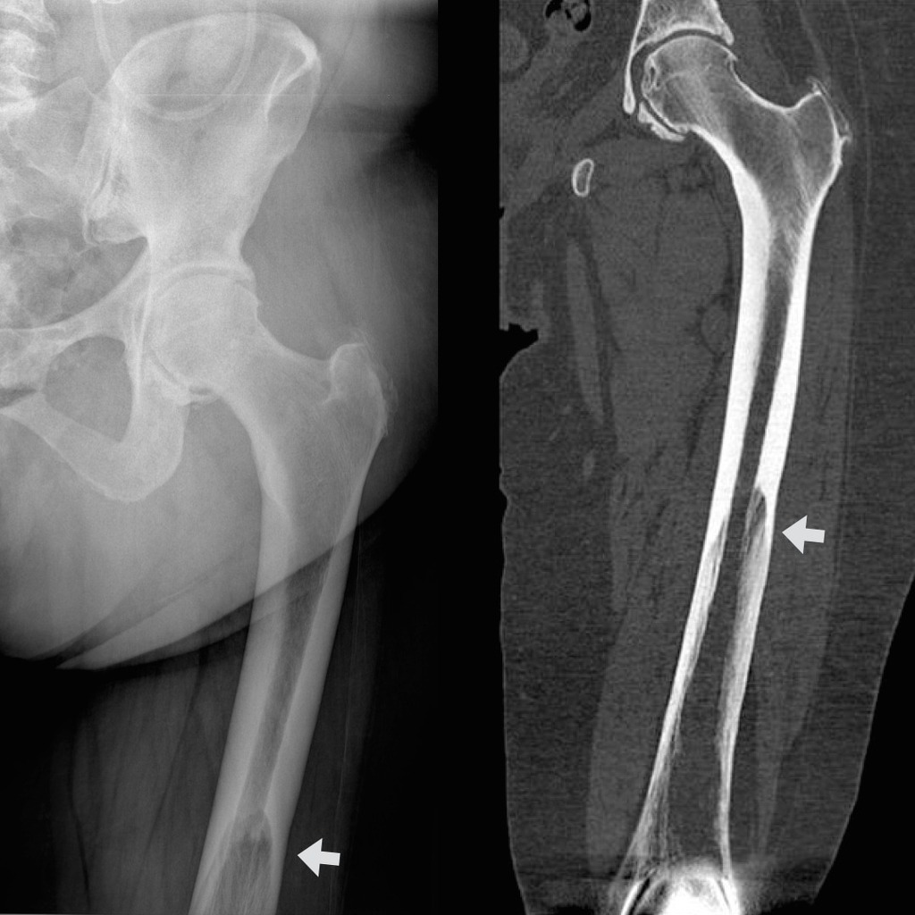
Pathophysiology of Paget’s: Lytic Phase
Increased osteoclast activity causes lytic lesions in bone (“blade of grass” lesion).
Refers to the lucent leading edge in a long bone seen during the lytic phase.
Also called the “candle flame sign”

Slide 9

Pathophysiology: Lytic/ Blastic Phase
Following the onset of bone resorption by the abnormal osteoclasts, large numbers of normal osteoblasts are recruited to the sites of bone resorption.
These normal osteoblasts respond to this abnormally rapid absorption of bone by producing new bone matrix rapidly and haphazardly.
This bone appears woven and has a “mosaic pattern” or “cotton wool pattern”.

Slide 10
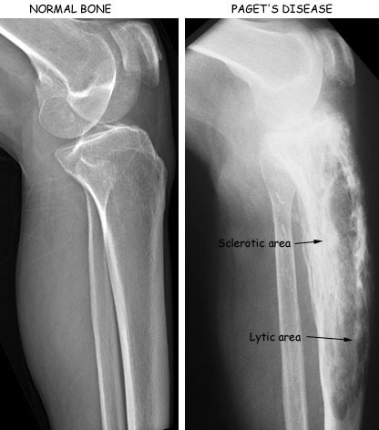
Pathophysiology: Lytic/ Blastic Phase
This pattern of bone lysis and formation repeats itself again and again, leading to high bone turnover.
Additionally, some of the bone marrow is replaced by fibrous tissue and there is a marked increase in the number of blood vessels within the bone.

Slide 11

Paget’s Pathophysiology : Sclerotic Phase
Finally, bone resorption ceases but abnormal formation continues leading to hard, dense, vascular pagetic (mosaic) bone.
The "burnt out" sclerotic phase of Paget's; further remodeling is minimal.
Because of it’s disorganization,
pagetic bone is actually weaker
than normal adult bone.

Slide 12
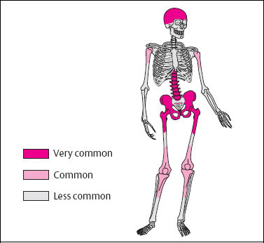
Paget’s Pathophysiology
Paget’s involves multiple bones simultaneously in 72% of cases and only a single bone in 28%.
Although the disease may progress at a given site, the development of new sites of disease occurs uncommonly.
Paget’s has a predilection for the axial skeleton and the long bones. (Skull, spine, sacrum, pelvis, femur, humerus, tibia)
It rarely affects the hands/feet or rib cage.

Slide 13
Presenting Clinical Manifestations of Paget’s
75% of patients with Paget’s disease are asymptomatic, or mild sx and the disease is found incidentally.
If symptomatic, the most frequent symptom is bone pain: dull, constant, aching, deep pain, often worse at night.
Pagetic bone is very prone to fracture as well.

Slide 14
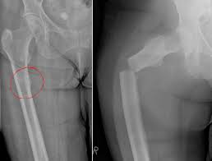
What does the pagetic process lead to?
Bony manifestations:
Increased risk of fracture: often incomplete (fissure) stress fractures that can transition to complete fractures over time. Fractures are usually transverse and perpendicular to the cortex “chalk stick fractures”.
Fractures most commonly involve the femur
A higher incidence of non-union and re-fracture occur in pagetic bone as well.

Slide 15

What does the pagetic process lead to?
Bony manifestations:
Bony enlargement of the skull/ face
  Frontal bossing and prominent scalp veins leading to increased head size (pt may c/o increased hat size)
  Headaches
  Narrowing cranial foramens
    Compression of the auditory nerve: mixed conductive and sensorineural hearing loss, tinnitus, vertigo
    Optic nerve involvement: vision loss
  Loss of teeth/spreading of teeth causing malalignment

Slide 16
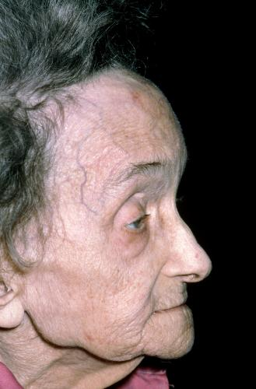
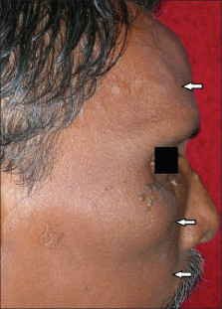
Frontal bossing and “scalp vein sign”

Slide 17
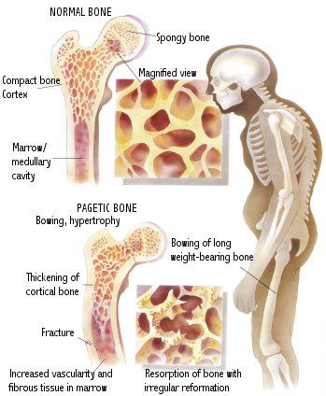
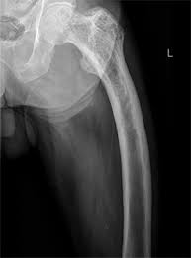
What does the pagetic process lead to?
Bony manifestations:
Vertebral enlargement and kyphosis
  Spinal cord compression or Nerve entrapment: spinal stenosis, cauda equina, paralysis
  Vertebral compression fractures
Bowing of long bones and periarticular osteoarthritis

Slide 18
What does the pagetic process lead to?
Other less common manifestations:
Increased bleeding: increased blood loss during orthopedic procedures due to hypervascularity.
Vascular steal: blood flow to hypervascular bone may “steal” the vascular supply of other tissues leading to ischemia.
CV: high output heart failure (rare).

Slide 19
Complications of Paget’s
The most feared complication is malignant transformation of the pagetic bone into osteosarcoma, which is rapidly fatal.
Fortunately, malignant transformation in Paget’s disease is quite rare, occurring in 0.2-1% of patients.
It is marked by increasing bone pain or alkaline phosphatase levels, mass development, or pathologic fracture.

Slide 20
Lab Abnormalities of Paget’s
Serum calcium and phosphorus levels are normal in the untreated patient with Paget’s disease.
Lab abnormalities include elevated serum alkaline phosphatase (found on LFTs) and elevated uric acid from bone turnover.

Slide 21
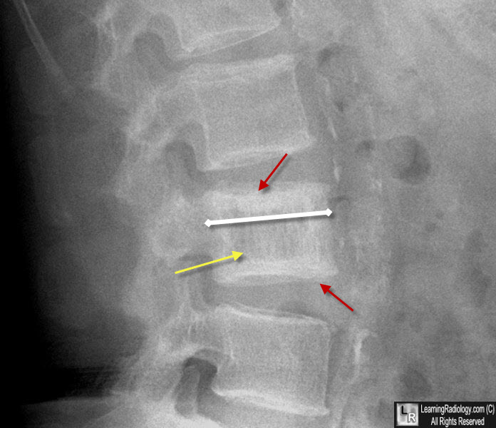
Radiologic Diagnosis of Paget’s
Additional characteristic signs seen on x-rays: Cotton wool, ivory vertebra
X-ray Findings:
Thickened cortices outlining the vertebral body (“picture frame appearance”) (red)
Vertebral body larger than the others (white)
Trabecular markings thickened and coarse (yellow)

Slide 22
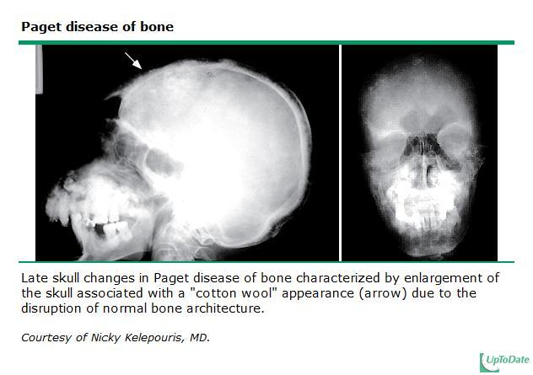

Slide 23
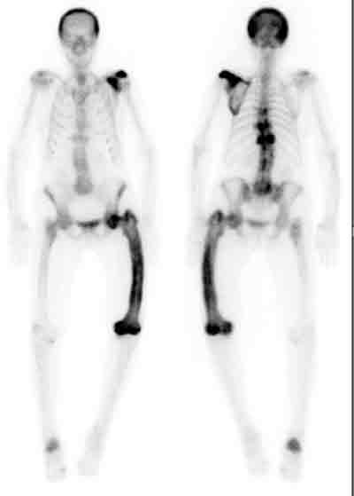
Radiologic Diagnosis of Paget’s
X-rays often initial tests as incidental or due to pain. Results: lytic lesions with blade of grass or candle flame sign, mixed lytic and sclerotic lesions, incomplete or complete fractures, ivory appearance of spine, cotton wool
X-rays also confirm “hot” spots seen on bone scan.
Bone scan is more sensitive and assess the extent of the disease but is not specific.
CT or MRI are used for diagnosis of malignant transformation, or to evaluate complications, such as nerve entrapment.
Polyostotic Paget’s disease involving the skull, left scapula, thoracic vertebrae (T7, T9, T11), left femur, right calcaneus.

Slide 24
How do you Make the Diagnosis?
Combination of clinical or laboratory findings suggestive of disease upon the demonstration of characteristic radiographic changes at one or more affected skeletal sites.

Slide 25
Treatment of Paget’s
Pharmacologic treatment is indicated in all patients with Paget’s who have symptomatic disease and in asymptomatic patients with Paget’s who have a high risk of complications.
    Young patients with Paget’s disease
    Skull or vertebral involvement
    Paget’s around a joint
    Paget’s of a weight bearing bone
    Planned surgery at an active pagetic site
    Patients with high levels of alkaline phosphatase
Treatment begins with the usual modalities for bone/joint disease: OTC pain relievers, heat/ice and physical therapy.

Slide 26
Treatment of Paget’s
The treatment of choice for Paget’s is Bisphosphonates due to its antiresorptive properties.
Among bisphosphonates Zoledronic Acid (Reclast) is first line.
  5mg single dose IV
  96% remission rate after a dose
  Remission last 5-10 years
The following oral bisphosphonate drugs all have an indication for Paget’s treatment:
  Risedronate (Actonel) PO 30mg once daily for 2 months
  Alendronate (Fosamax) PO 40mg once daily for 6 months

Slide 27
Bisphosphonates
MOA: bisphosphonates inhibit osteoclast activity by attaching to hydroxyapatite binding sites on bony surfaces, especially surfaces which are undergoing active resorption.
“First dose effect” – patients receiving bisphosphonates will frequently experience a paradoxical increase in pain at sites of active disease soon after commencing therapy.

Slide 28
Bisphosphonates
Oral bisphosphonates are poorly absorbed, from the GI tract so they should NOT be taken concurrently with any food, drink or medications/supplements.
  Should be taken first thing in the morning 30-60min prior
  All need to be taken with a full 8oz of water and the patient must sit or stand upright for 30-60 minutes after taking due to the risk of esophageal ulceration.
All Bisphosphonates are not recommended with kidney disease, GFR less than 30-35ml/min.

Slide 29
Adverse Effects of Bisphosphonates
  Flu-like symptoms- fever, chills, myalgias, arthralgias with initiation of bisphosphonates
    Self-limited after a few days and can be treated with acetaminophen or NSAIDs.
  Hypocalcemia: supplement with calcium (1200 mg/day) and vitamin D (400 IU/day), but not at the exact same time as the bisphosphonate.
    Can be exaggerated by patients taking _loop_ diuretics
  Urticaria/ angioedema
  Esophageal ulceration/stricture: these drugs can be very damaging to the esophageal mucosa if not passed fully into the stomach. Relatively contraindicated in patients with achalasia, esophageal stricture, esophagitis, hiatal hernia, dysphagia

Slide 30
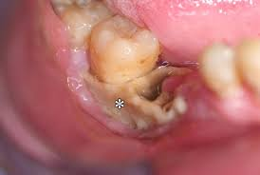
Adverse Effects of Bisphosphonates
  MSK Pain- syndrome that can occur days, months or years after starting a bisphosphonate. Pain may not completely resolve after discontinuation
Osteonecrosis of the jaw: higher risk with tooth extraction, dental surgery or trauma, CA of the mandible, chronic steroid use, CTX, poor oral hygiene.
Results in exposure of the bone, death of the bone and loss of teeth.

Slide 31
Calcitonin
Salmon Calcitonin is a second line agent in those who can’t tolerate bisphosphonates due to side effects or contraindications
It has antiresorptive properties but not as potent as bisphosphonates and does not produce a sustained remission
Subcutaneous administration at bedtime every 1-3 days indefinitely
Side effects: nausea, vomiting, or flushing

Slide 32
Goals of Therapy
If planned surgery at pagetic site, bisphosphonate therapy should be instituted 3mth prior in hopes of reducing blood loss
Success of bisphosphonate treatment is measured in the normalization of alkaline phosphatase levels within a short time and improvement of symptoms.
Initially remission is assessed using alkaline phosphatase levels every 3-6 months, and once normalized can be checked every 6-12 months.
If alkaline phosphatase levels are normal at baseline, a follow-up bone scan can be obtained in 6 months to assess disease activity.

Slide 33
Prognosis of Paget’s Disease
Prognosis is generally favorable
  By 6.5 years after initial therapy, the recurrence rate is 12.5% after treatment with zoledronic acid and 62% after risedronate
Patients who develop the disease at a younger age have the poorest prognosis.
Rapid institution of effective treatment should reduce the likelihood of complications. Osteosarcoma that arises at sites of Paget disease results in a 2-year survival rate of only 25%.

Slide 34
Clicker Time
What laboratory finding will MOST likely lead you to suspect Paget's disease?
An elevated serum calcium level
A low serum calcium level
A high alkaline phosphatase level
Laboratory findings are usually normal in Paget's. It is generally found after an abnormal radiograph.

Slide 35
Clicker Time
How is the severity of disease evaluated in a patient with newly diagnosed Paget's?
Radionuclide bone scan
Whole body radiograph surveillance
PET scan
CT scan of the skeleton
MRI scan of the skeleton

Slide 36
Clicker Time
Which of the following is the MOST common symptom of Paget's?
Spontaneous hemarthosis
Bone pain
Pathologic fracture
Nerve entrapment causing radiculopathy

