Slide 1
VASCULAR SURGERY
November 9, 2026
Scott Gardner, MD

Slide 2
HOW I LECTURE
The slides are meant to be an outline, a springboard for comment, not a textbook.
I try to follow the objectives
Pay attention to highlighted or bolded content, you probably will see it again.
My APPs will let you know what I deem important and what you should be careful to study and understand
If there is a contradiction with what another professor said, bring it to my attention sooner rather than later.

Slide 3
WHAT WE ARE GOING TO TALK ABOUT TODAY
Vascular surgery in general
  Indications
  Risks/complications
Carotid Surgery
Amputations

Slide 4
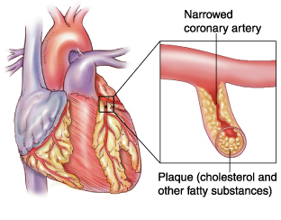
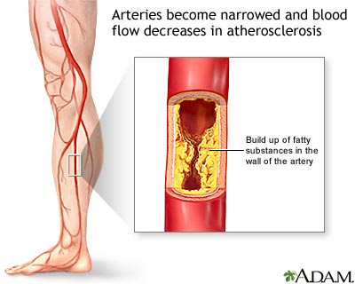
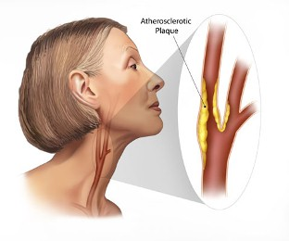
Vascular Patients differ from “regular” patients
When the narrowing happens in heart, it is called coronary artery disease.
The same situation in the body is called peripheral vascular disease (PAD) or (PVD) carotid artery stenosis (CAS).
Notes:
Disease is diffuse, if it is in one artery it will be in others
If treating for PAD have to be aware of CAD and possible CAS

Slide 5
When Do You Need to Call a Surgeon?
Signs/Symptoms
  Acute Changes (Ischemic)
  Chronic – Failed Medical Therapy
    Rest pain
    Ulceration/Gangrene

Slide 6
On What Do Surgeons Base Their Decision To Operate?
Risks/Benefits
Is the patient a good surgical candidate (are they likely to survive the surgery?)
Is there a realistic chance surgery will benefit the patient?
Are there any other non-operative treatments?
What is the best operation to maximize function/quality of life?

Slide 7
Vascular Surgical Treatment
All about hemodynamics
Inflow
Outflow

Slide 8
Surgical Treatment Options
Angioplasty
Stents
Endarterectomy
Bypass grafts
  Synthetic
    PTFE
    Dacron
  Autologous vein graft - BEST
  Cadaver graft

Slide 9
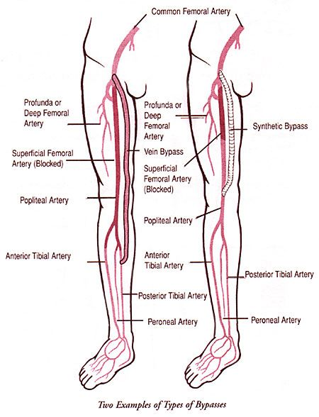
Notes:
Bypass better for long term management over percutaneous stenting.

Slide 10
Surgical Complications
Complications are related to:
The wound
Anesthesia/trauma of surgery
The surgery itself

Slide 11
Surgical Complications
Complications related to the wound:
Bleeding/Hematoma
Infection
Ischemia/Wound breakdown->Hernia

Slide 12
Surgical Complications
Complications due to anesthesia/trauma:
  MI
  Stroke
  Renal Failure
  Liver Failure
  Pulmonary Failure
  Ischemic Bowel

Slide 13
Surgical Complications
Complications related to vascular surgery
Bleeding/Hematoma
Pseudoaneurysm
Emboli/Thrombus/Stenosis→Occlusion
→Limb ischemia

Slide 14
Diagnosis of Surgical Complications
Bleeding/Hematoma-When significant it is usually obvious with mass or visible blood. Also hypotension/tachycardia
Pseudoaneurysm-Pulsatile mass
Emboli/Thrombus/Stenosis→Occlusion→Limb Ischemia-Loss of pulses and acute/chronic ischemic changes (pain, pallor etc.)

Slide 15
Therapy for Surgical Complications
Bleeding/Hematoma-If in PACU probably needs rapid return to OR.
Pseudoaneurysm-Typically needs repaired
Thrombus/Stenosis/Occlusion-Typically needs dilated or redone
Limb ischemia-Typically needs an intervention
Emboli-Embolectomy and where did it originate?

Slide 16
Peripheral Vascular Disease
Follow-up
Watch for return of symptoms
Measurement of ABI at rest and after exercise
Regular screening with Duplex U/S-every 3 months. (Intervention based on duplex surveillance protocol leads to significantly higher 5 year patency rates)
Oral anticoagulants and/or antiplatelet therapy long term post-op

Slide 17
Peripheral Vascular Disease
Peripheral Vascular Surgery is a temporizing measure.
If the patient does not change their lifestyle the bypass, the angioplasty, the stent will ultimately fail.
This just buys them time.

Slide 18
CAROTID DISEASE

Slide 19
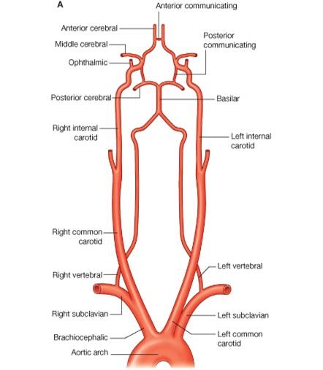
Notes:
Four arteries supply the brain
Circle of Willis
Note take-off of the Common Carotids

Slide 20
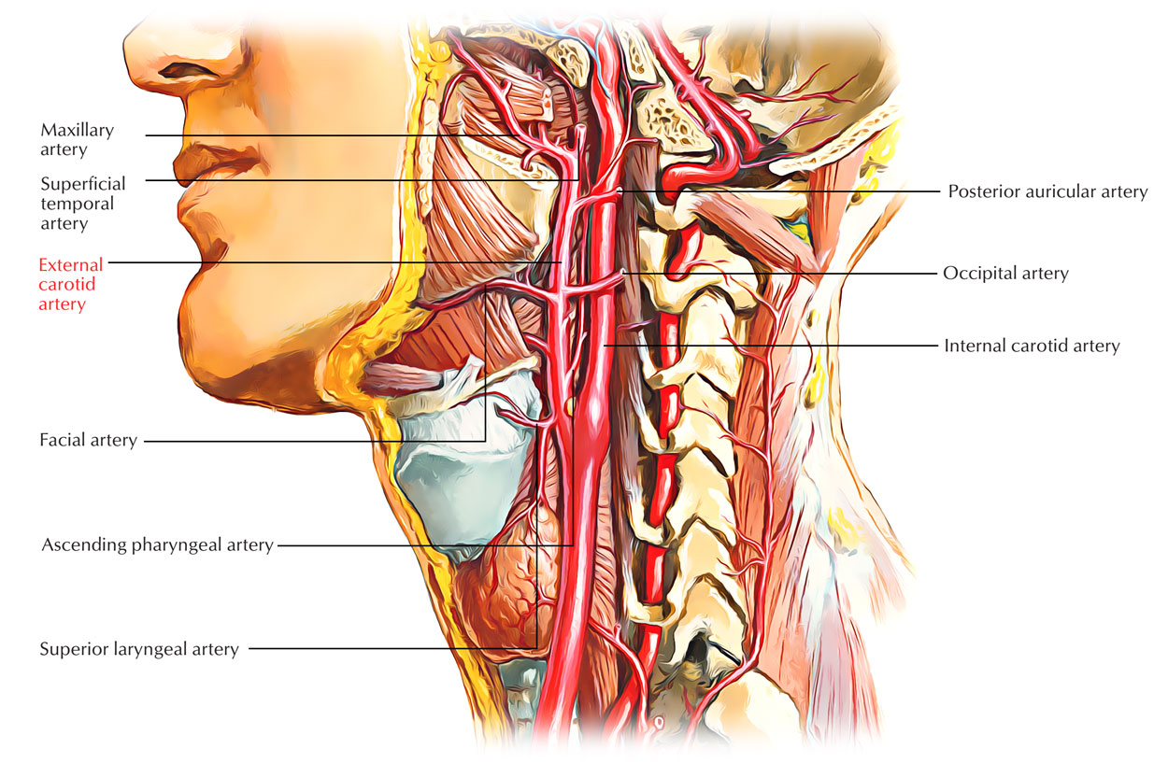
Notes:
Carotid Sinus controls BP
Carotid Body chemoreceptor for O2 and CO2

Slide 21
CAROTID DISEASE
Asymptomatic
Thrills
Bruits
Thyroid U/S
CT of Neck
Screening due to PAD
Notes:
A

Slide 22
CAROTID DISEASE
Symptomatic Disease:
Contralateral focal neurologic symptoms within 6 months in distribution of internal Carotid
Ipsilateral Monocular blindness (Amaurosis Fugax)
Ipsilateral focal findings on brain CT or MRI
Memory and Thinking problems(?)
NOT vertigo or syncope
Notes:
Monocular blindness - Amaurosis Fugax
Due to emboli to ophthalmic artery

Slide 23
Risk Factors
Diabetes
Hypertension
Cigarette Smoking
Genetics
Age
Hyperlipidemia

Slide 24
Carotid Disease Treatment
Medical
Statins
Antiplatelet
Control of HTN; DM
Mediterranean Diet
Smoking Cessation

Slide 25
Carotid Disease Treatment
Stenting and Surgical-CEA
Symptomatic and 70-99% stenosis
Asymptomatic and 80-99% Stenosis
Surgically accessible lesion
Absence of severe cardiac/pulmonary/systemic disease
Non-debilitating stroke
Life expectancy > 5 years.

Slide 26
Carotid Disease Treatment
Why not operate on everyone with stenotic disease?
Carotid surgery is prophylactic
Stroke Risk:
Operative (1-3%)
Non-operative (dependent on the degree of stenosis)
DO NOT OPERATE
***Total Occlusion of Carotid***

Slide 27
Pre-op Considerations
Control of Cardiac disease especially BP
Control of Co-morbid Disease, ie DM, CAD
Anesthesia
Local
General
Notes:
Can do under local so low risk from anesthesia

Slide 28
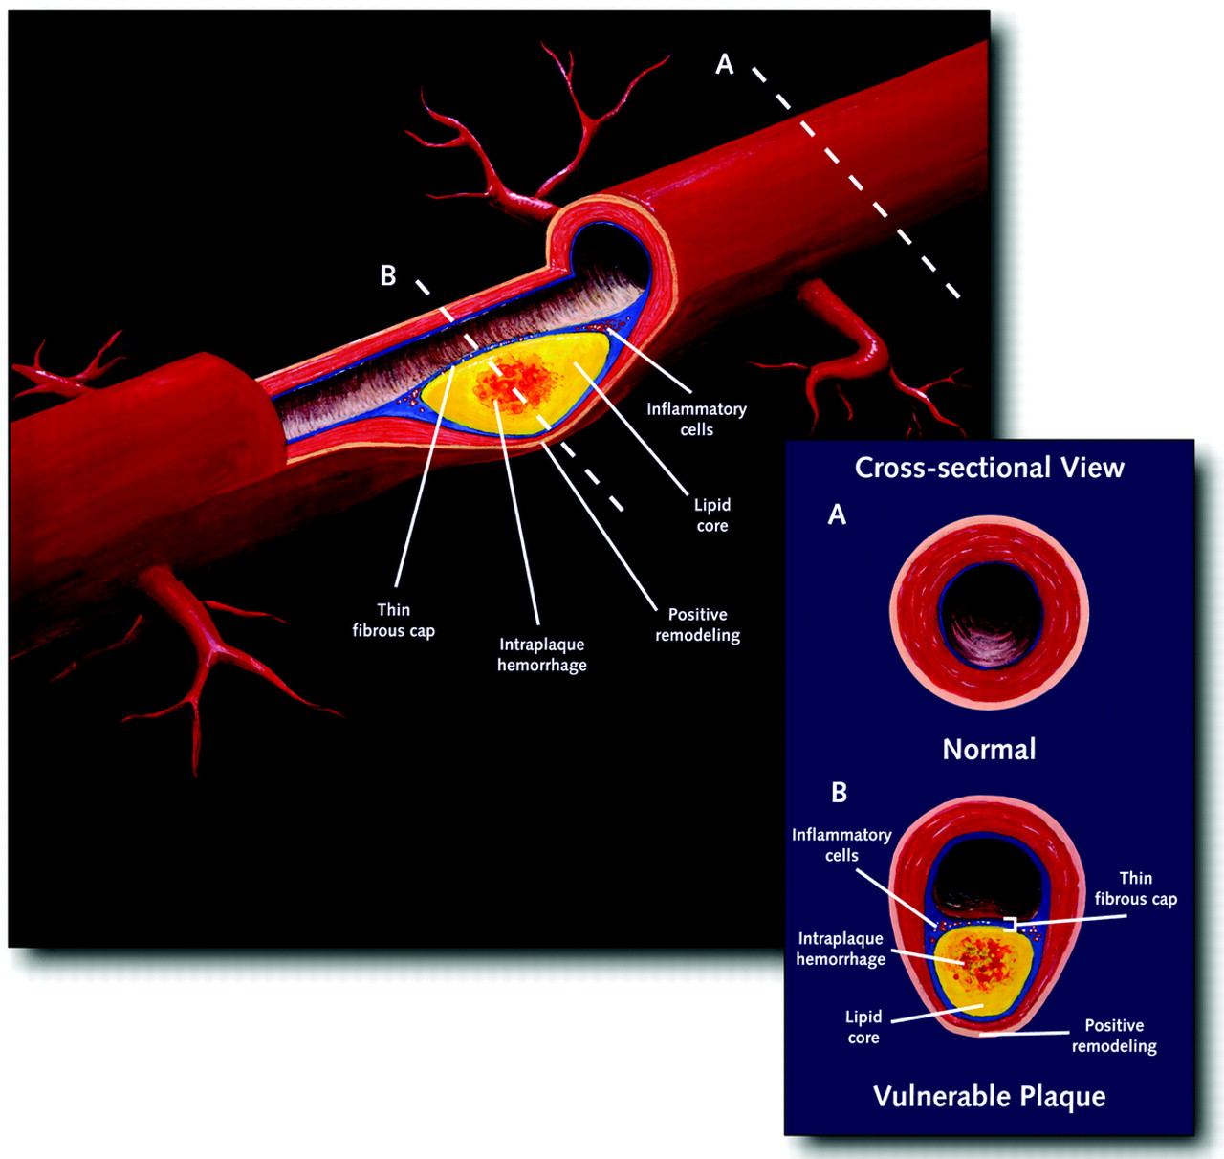

Slide 29
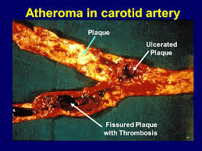

Slide 30
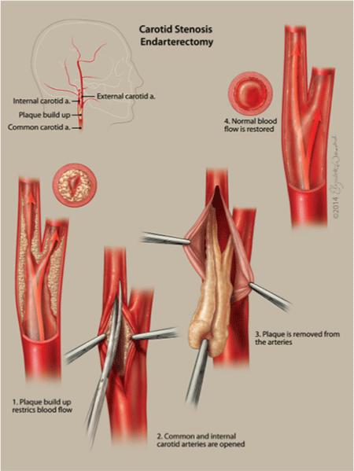

Slide 31
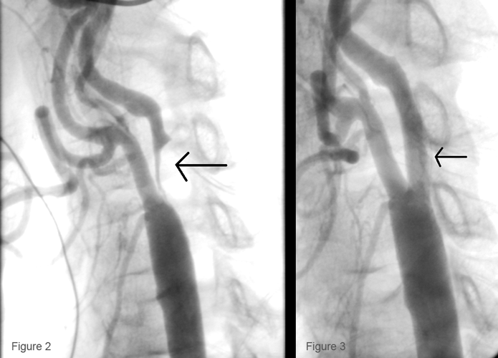

Slide 32
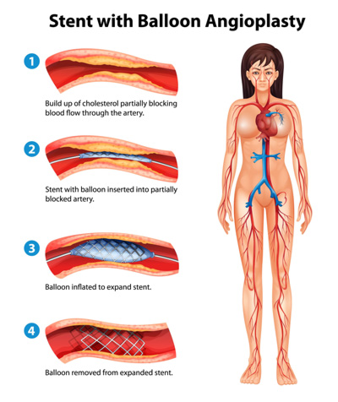

Slide 33
Surgical Complications
Complications related to:
The wound
Anesthesia/trauma of surgery
The surgery itself

Slide 34
Surgical Complications
Complications related to the wound:
Bleeding/Hematoma
Infection
Ischemia/Wound breakdown

Slide 35
Surgical Complications
Complications due to anesthesia/trauma:
  MI
  Stroke
  Renal Failure
  Liver Failure
  Pulmonary Failure
  Ischemic Bowel

Slide 36
Surgical Complications
Complications related to carotid surgery:
BP Lability – Carotid Sinus
Chemoreceptor – Carotid Body
Hematoma
Stroke (1-3%)
Cerebral Hyperperfusion Syndrome (Headaches, seizures, focal neurologic deficits)
Notes:
Carotid Sinus controls BP
Carotid Body chemoreceptors sensitive to PO2 and CO2, pH and temp
Cerebral Hyperperfusion syndrome - H/A, seizures, focal neurologic deficits

Slide 37
What To Do?
Complications related to carotid surgery:
BP Lability – Monitor in ICU/Step-down
Hematoma—Rapid return to OR
Stroke (1-3%)—Supportive Care
Cerebral Hyperperfusion Syndrome—BP Control; Edema control; Anticonvulsants
Notes:
Carotid Sinus controls BP
Carotid Body chemoreceptors sensitive to PO2 and CO2, pH and temp
Cerebral Hyperperfusion syndrome - H/A, seizures, focal neurologic deficits

Slide 38
Surgical Complications
Complications related to carotid surgery:
  Nerve injury
  Vagus
  Recurrent Laryngeal
  Hypoglossal
  Sympathetic Nerves
  Horner Syndrome (Miosis, Ptosis, Anhydrosis)
Notes:
Vagus nerve injury leads to abd pain, acid reflux, changes to HR, BP, difficulty swallowing, hoarseness, N/V
Hypoglossal nerve injury leads to tongue deviation to the contralateral side

Slide 39
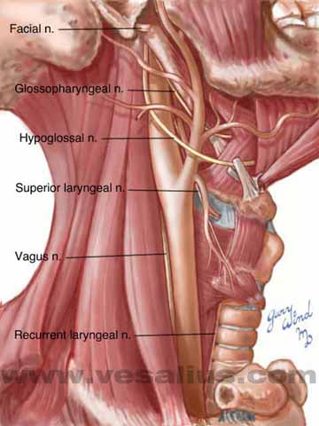

Slide 40
Amputations
Indications
Non-salvageable or non-functioning limb/appendage
  Infection
  Ischemia
  Trauma
  Tumor
  Congenital

Slide 41
Amputations
Levels
Toe/Finger
Forearm
Upper arm
Transmetatarsal
Below Knee
Above Knee
Guillotine
Notes:
Tricky part is determining the level

Slide 42
Amputations
Level Depends On:
Blood Supply
Level of Infection/Necrosis
Joint Function
Prosthesis Fitting

Slide 43
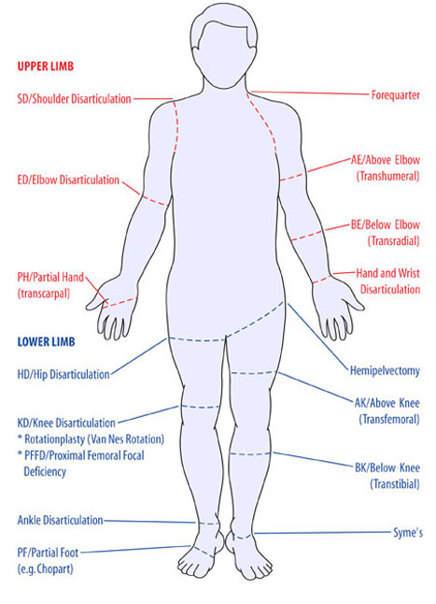

Slide 44
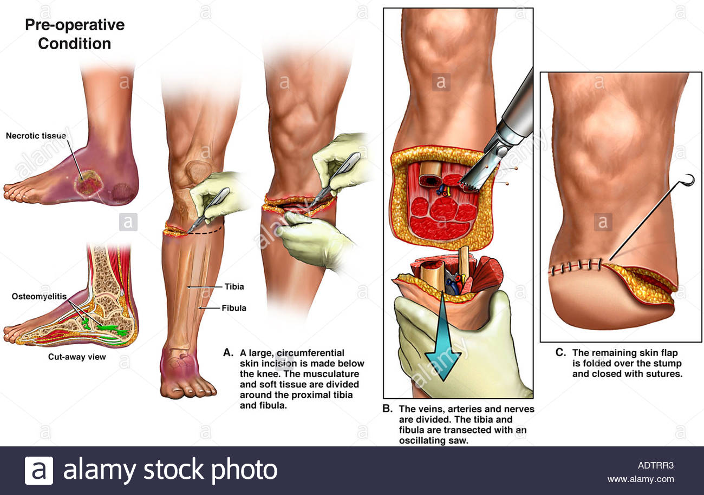

Slide 45
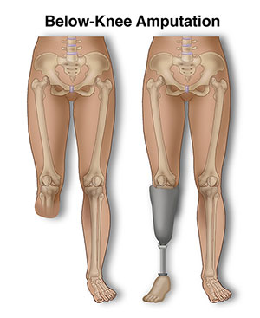

Slide 46
Surgical Complications S/SX
Complications related to the wound:
Bleeding/Hematoma-expanding mass, pulsatile, s/sx of hypovolemia
Infection-Hot, red, swollen, painful
Ischemia/Wound breakdown-discoloration, pale or dark, necrotic skin, wound falling apart

Slide 47
Surgical Complications
Complications due to anesthesia/trauma:
  MI
  Stroke
  Renal Failure
  Liver Failure
  Pulmonary Failure
  Ischemic Bowel

Slide 48
Surgical Complications
Complications related to amputations:
Infection or Ischemia->Wound Complications
Bleeding/Hematoma
Cardio/Vascular
DM Control
Death—Mortality rate of ~15-30%
AMPUTATIONS TREAT THE RESULT OF A DISEASE PROCESS, THEY TYPICALLY DO NOT TREAT THE UNDERLYING DISEASE!

Slide 49
What to do? Surgical Complications
Complications related to the wound:
Bleeding/Hematoma-Return to Operating room if significant
Infection-antibiotics and drainage (open the wound)
Ischemia/Wound breakdown-Debridement, revision, healing by secondary intention

Slide 50
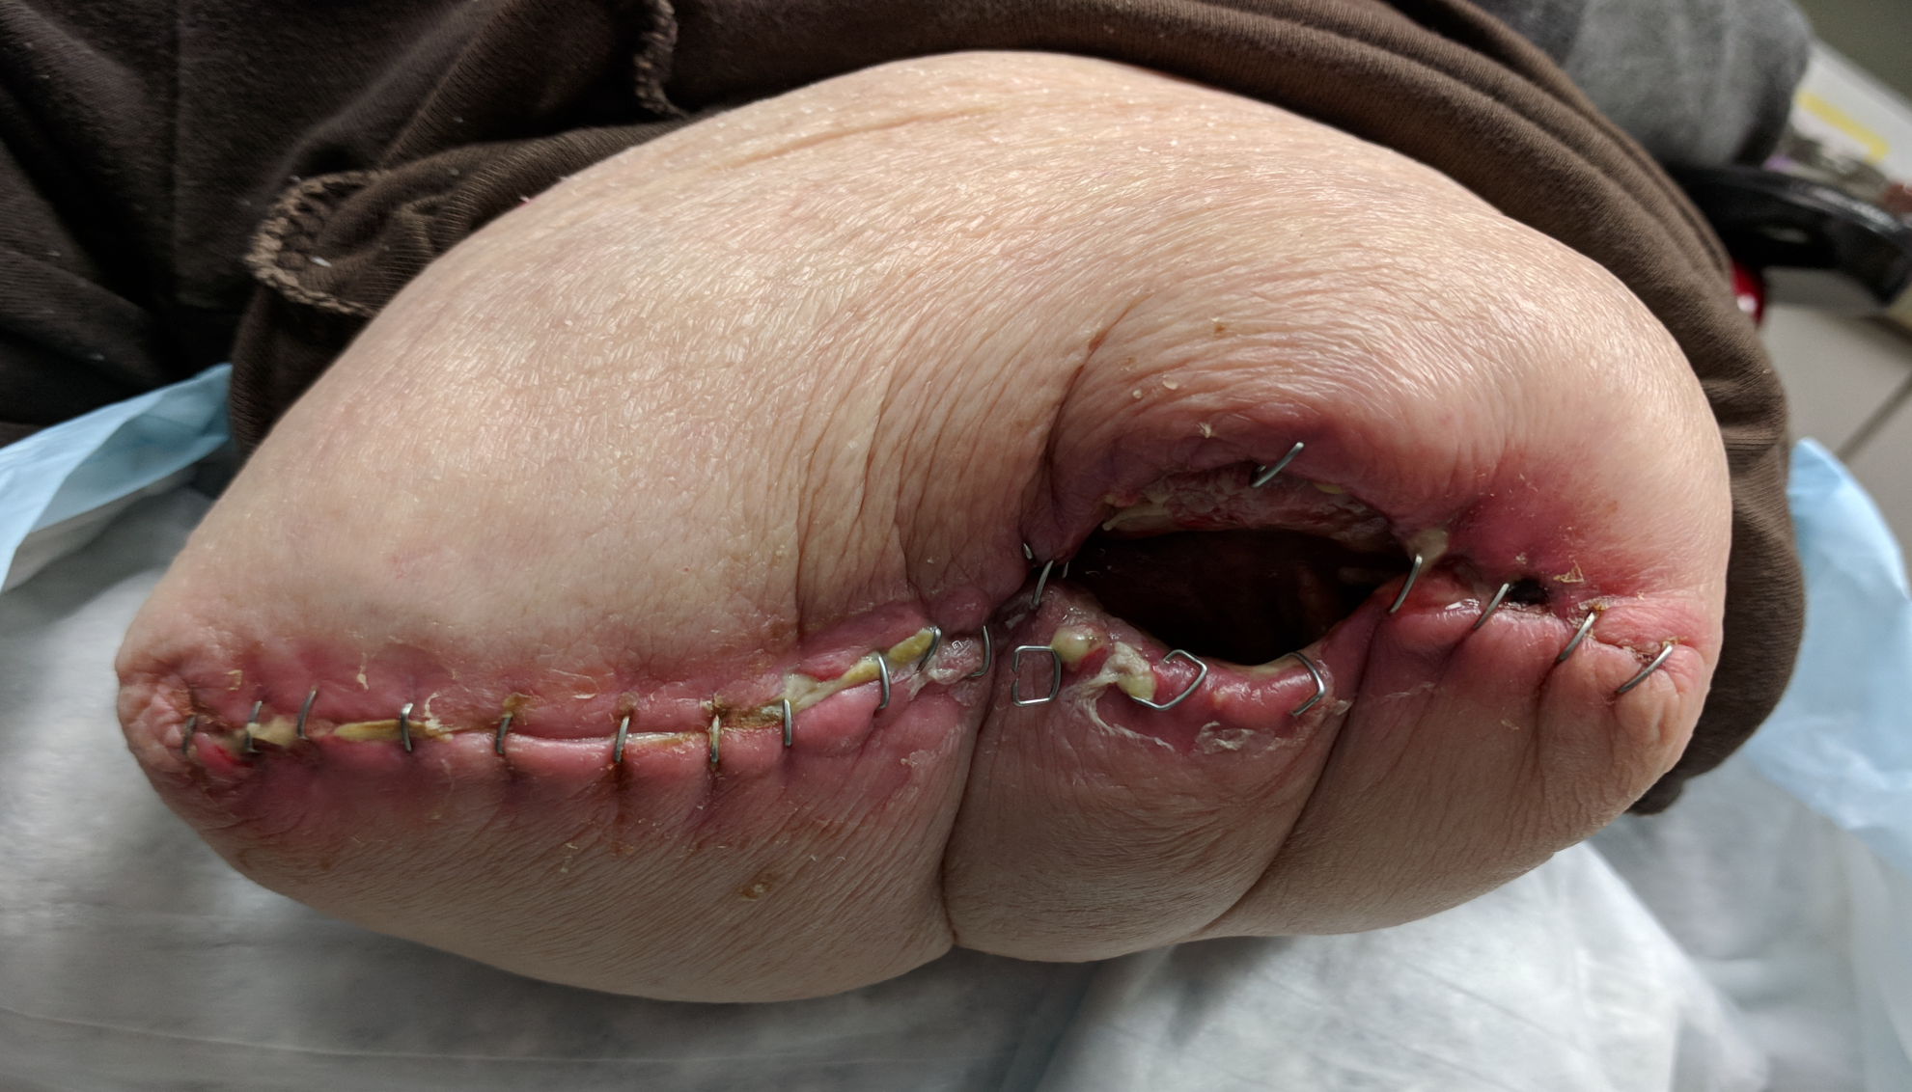
The End

