Slide 1
Cardiovascular System
Anatomy
Caroline Palmer, MPAS, PA-C
Assistant Professor
Physician Assistant Department

Slide 2
The Thoracic Cage
Formed by ribs and costal cartilages, the sternum, and thoracic vertebrae
Ribs – 12 pair (7 true [1-7], False [8-10], and Floating [11 & 12])
Sternum – 3 segments (Manubrium, body, & xiphoid process)
Thoracic Vertebrae –articulates with heads and tubercles of ribs
Blood vessels (costal arteries & veins) and nerves lie on the inferior internal aspect of each rib
Notes:
Thorax = sternum, thoracic vertebrae, and the ribs
Thoracic cavity- space in between

Slide 3
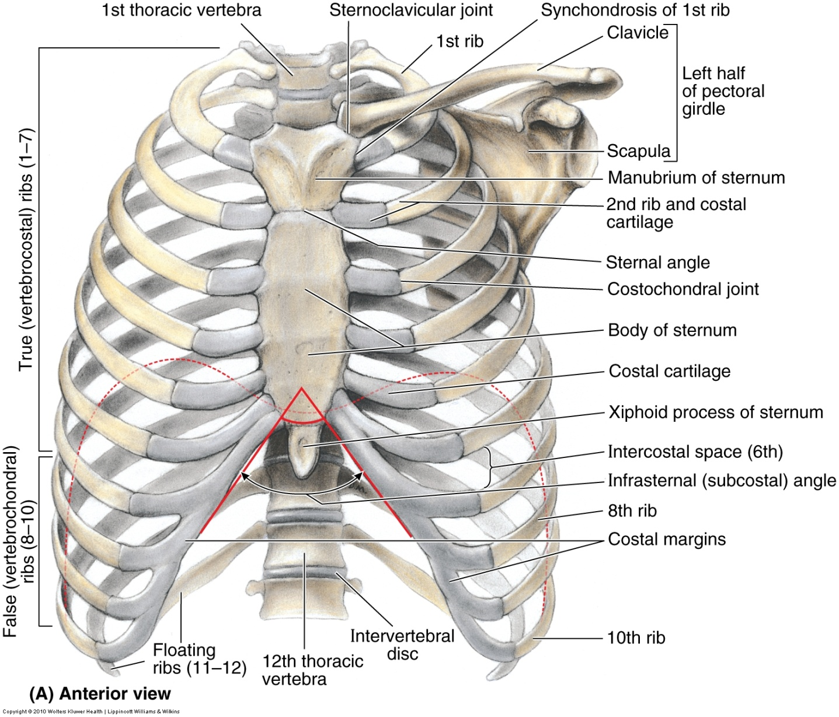
The Thoracic Cage

Slide 4
The Sternum
Flat, elongated bone that forms middle of anterior part of thoracic cage
Protects mediastinal viscera and most of heart
3 parts:
  Manubrium
  Body
  Xiphoid process

Slide 5
The Sternum
Manubrium
  Widest and thickest part of sternum
  The concave center Jugular notch (or Suprasternal notch) is easily palpated
  It articulates with clavicles superior and laterally and articulates with 1st rib laterally
  Junction of the manubrium to the body of the sternum is called the sternal angle
    Manubriosternal joint
    Palpable immediately lateral to the sternal angle is the articulation of the 2nd rib

Slide 6
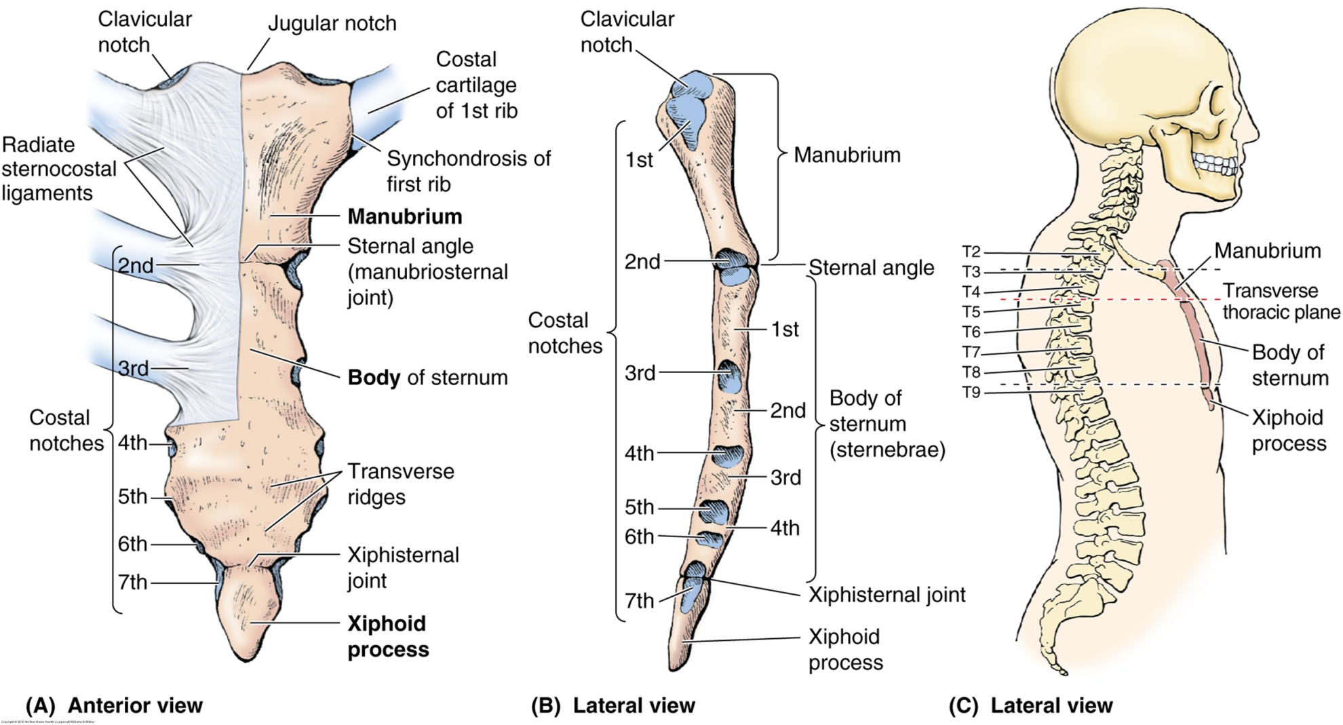
The Sternum

Slide 7
The Sternum
The body
  Longer, narrower, and thinner than manubrium
  T5-T9
  Costal cartilages prolong ribs and contribute to elasticity of thoracic wall, flexible attachment for their ends

Slide 8
The Sternum
The xiphoid process
  Junction of the body and the xiphoid process is called the infrasternal or subcostal angle
  It marks the inferior limit of the heart, superior limit of the liver and diaphragm
  It is also the location of articulations with the 7th ribs
The inferior tip of the xiphoid process is at the level of T-10

Slide 9
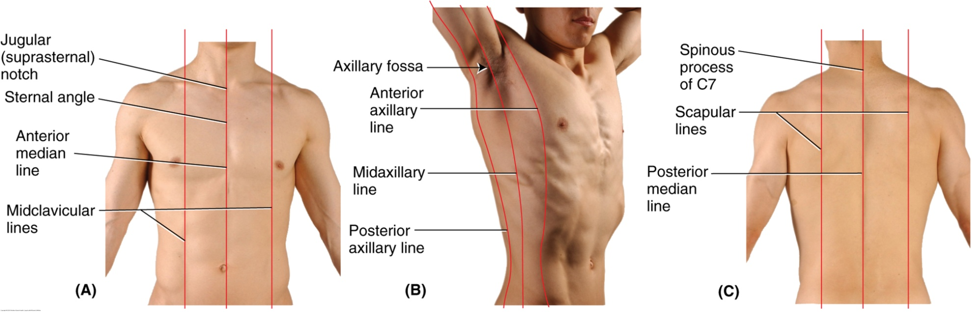
Surface lines of the Thorax

Slide 10
The Thoracic Cavities
The Thoracic Cavity is divided into 3 spaces
  Mediastinum housing the heart and associated structures
  Left and right pulmonary cavities for lungs and associated structures
For this module, we will focus on only the mediastinum and its contents

Slide 11
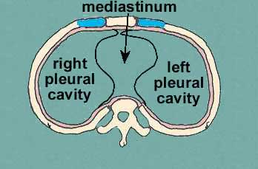
The Thoracic Cavity

Slide 12
The Mediastinum
Central cavity of the thoracic cavity
Divided into superior and inferior segments
Superior mediastinum
  Extends from superior thoracic aperture to sternal angle anteriorly
  Passes through the junction of IV disk of T4 and T5
    Transverse thoracic plane
  It contains great vessels, trachea, esophagus, and thymus gland

Slide 13
The Mediastinum (cont)
Inferior mediastinum is divided into 3 sections
  Anterior section contains fat, connective tissue, lymph nodes, nerves, and blood vessels
  The middle section (largest) contains the pericardium, pericardial fluid, heart, and root of great vessels
  Posterior section contains descending aorta, trachea, and esophagus

Slide 14
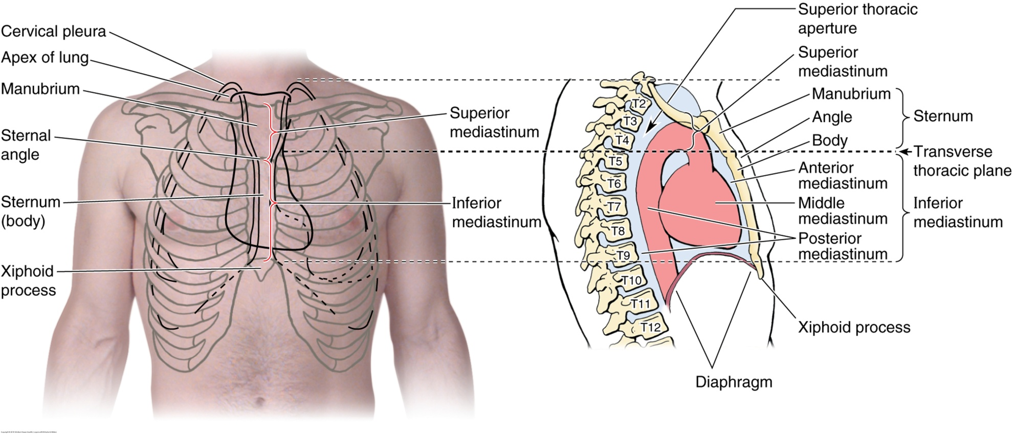
The Mediastinum

Slide 15
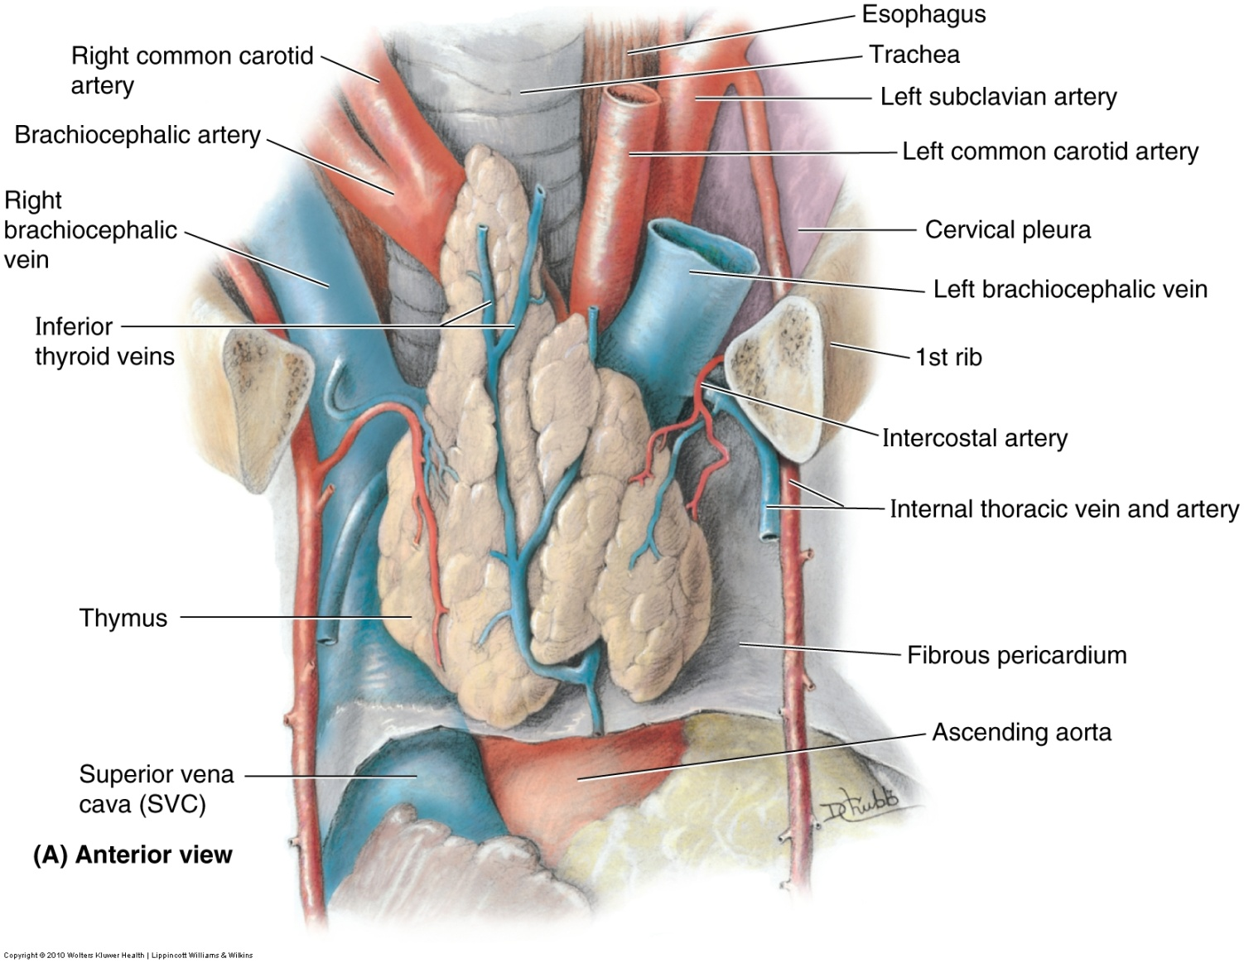
Superior Mediastinum

Slide 16
Inferior Mediastinum
Anterior division contains lymph nodes & vessels, fat & loose connective tissue, branches of the internal thoracic vessels, and in children the inferior part of the thymus gland.
Middle division contains the heart (inside its pericardium), and the root of the major vessels (Aorta, SVC & IVC)
Posterior division contains the thoracic aorta, thoracic duct and lymphatic trunks, lymph nodes, azygos and hemiazygos veins, esophagus and esophageal nerve plexus.

Slide 17
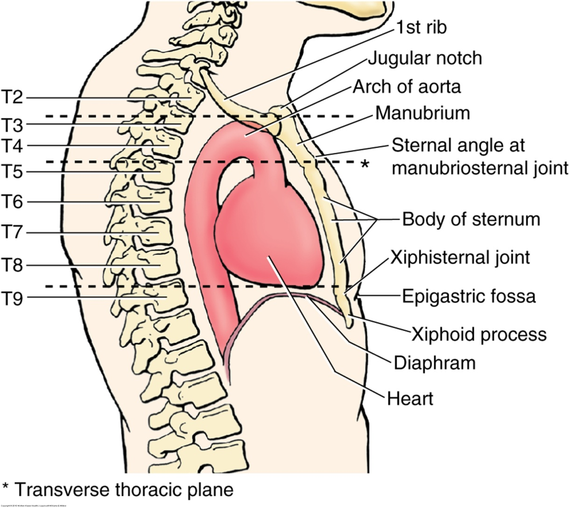
Cardiac Landmarks

Slide 18
Pericardium
Composed of fibrous and serous layers
Fibrous layer blends with fibrous layer of roots of great vessels and central tendon of diaphragm for stability
Serous layer produces pericardial fluid (~ 30 – 50 mL) to allow smooth contractions of the heart within the pericardial cavity (a potential space); two portions – parietal and visceral
  Parietal is lining of fibrous pericardium
  Visceral is the epicardium covering the heart

Slide 19
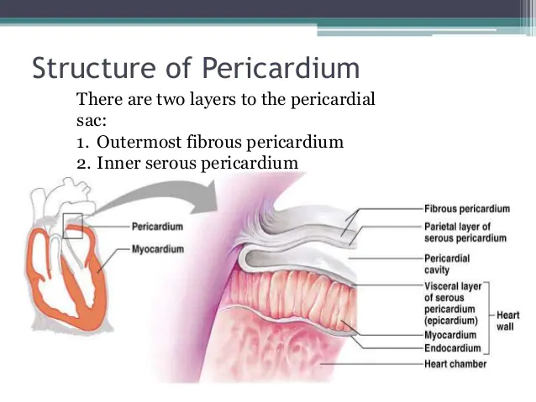
Pericardium

Slide 20
Pericardium
The heart and roots of great vessels within the pericardial sac lie posterior to the sternum, costal cartilages, and anterior ends of 3rd-5th ribs
2/3 of heart sits to the left of midsternal line and 1/3 to the right

Slide 21
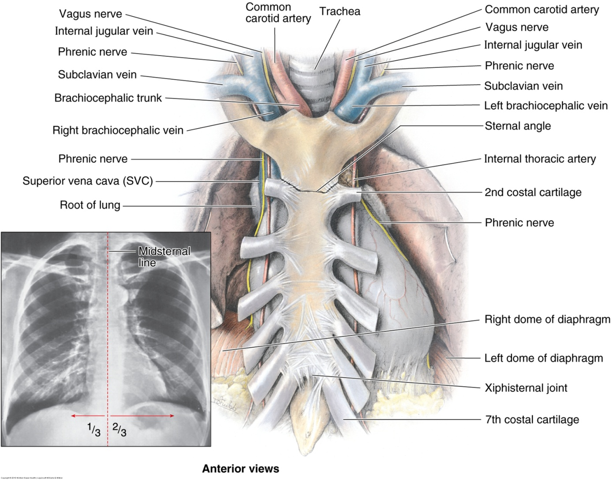
Middle Mediastinum - Pericardium

Slide 22
Pericardium
Transverse pericardial sinus
  Passage that separates the ascending aorta and pulmonary trunk from the SVC, IVC, and pulmonary veins
  During cardiac surgery, the sinus allows a surgeon to isolate the pulmonary trunk and ascending aorta and apply a clamp
Oblique pericardial sinus
  Posterior pocket-like recess within the pericardium
    Fluid builds up here during pericardial effusion and can be seen on imaging

Slide 23
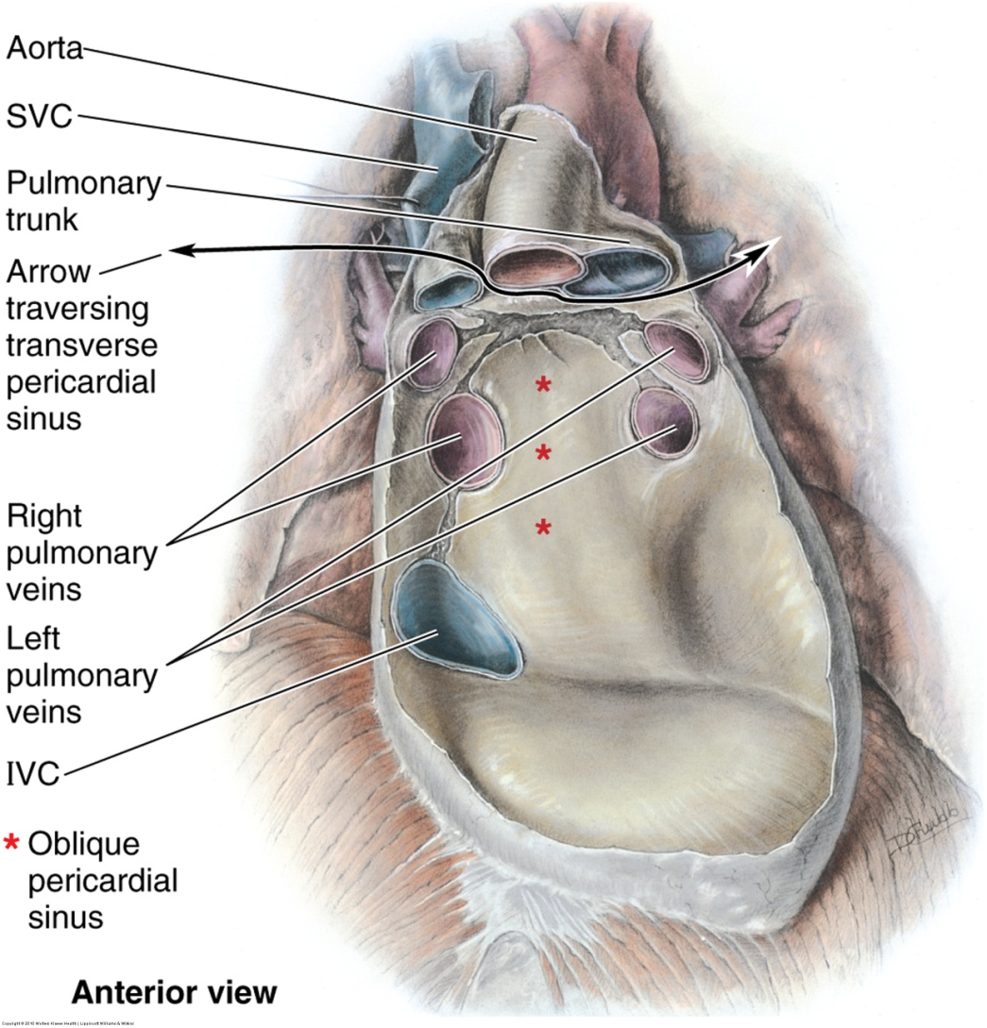
Middle Mediastinum - Pericardium

Slide 24
The Heart
(External surface anatomy)
Apex
  Blunt rounded end of heart formed by left ventricle
  Lies in the left 5th ICS slightly medial to the MCL ~ 9cm from midline
  Sounds of mitral valve closure are maximal here
Base
  Posterior aspect of heart formed mostly from left atrium & some right atrium
Right border – IVC, SVC, & Rt. Atrium

Slide 25
The Heart
(External surface anatomy - cont)
Left border – left ventricle, aortic arch, pulmonary trunk, left auricle
Coronary sulcus – groove on external surface of heart that separates atria from ventricles
Anterior and Posterior interventricular sulci – grooves on front and back of heart that delineate the right from left ventricle

Slide 26
The Heart
Inferior border
  Right ventricle and slightly by left ventricle
Superior border
  Formed by right and left atria and auricles anteriorly
  Ascending aorta and pulmonary trunk and SVC on right side
    Boundary of the transverse pericardial sinus

Slide 27
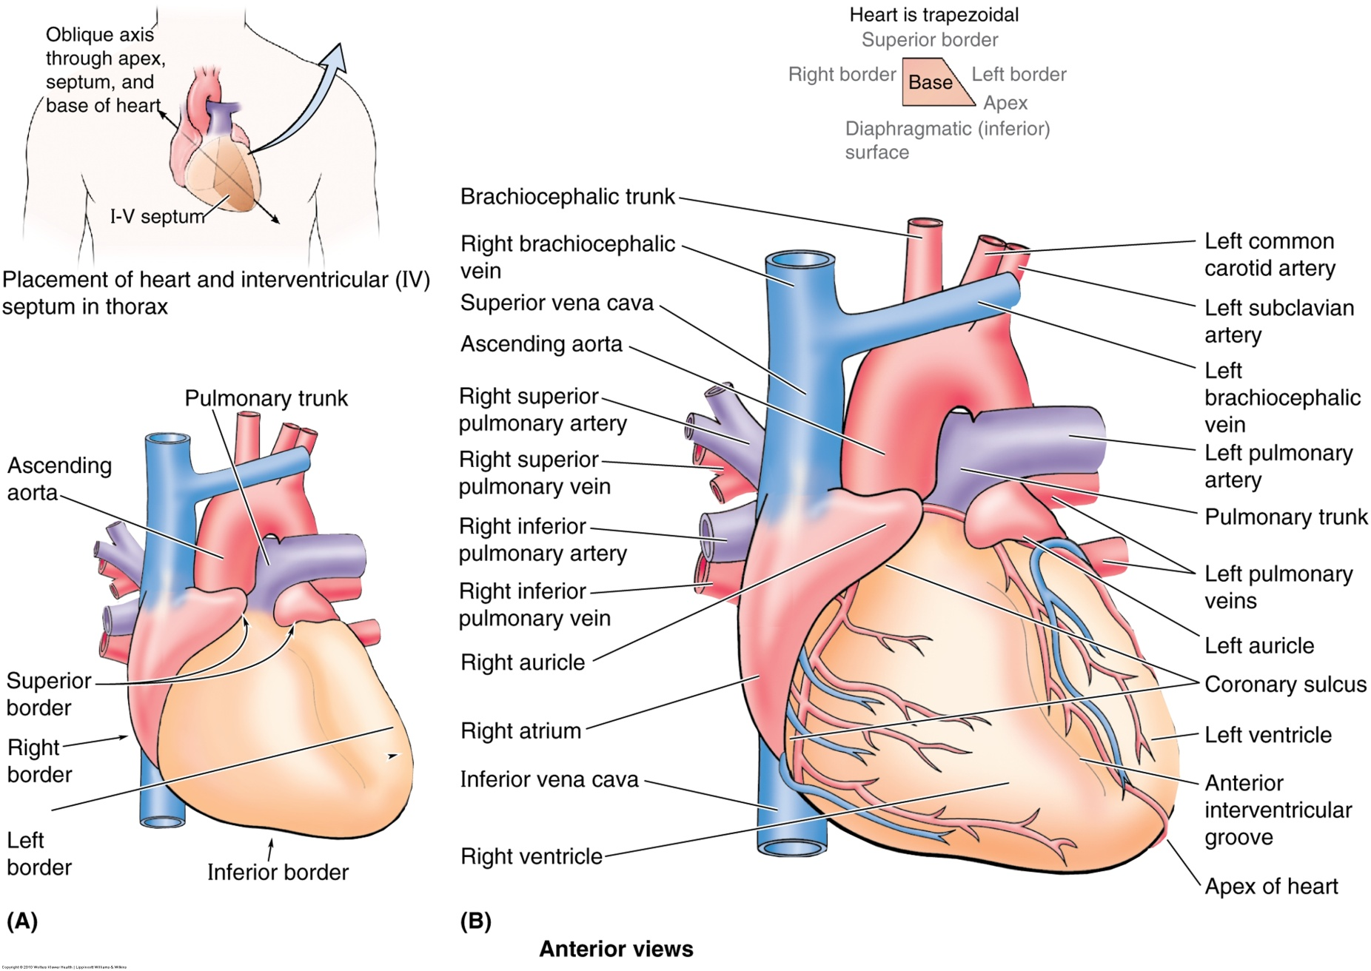
The Heart

Slide 28
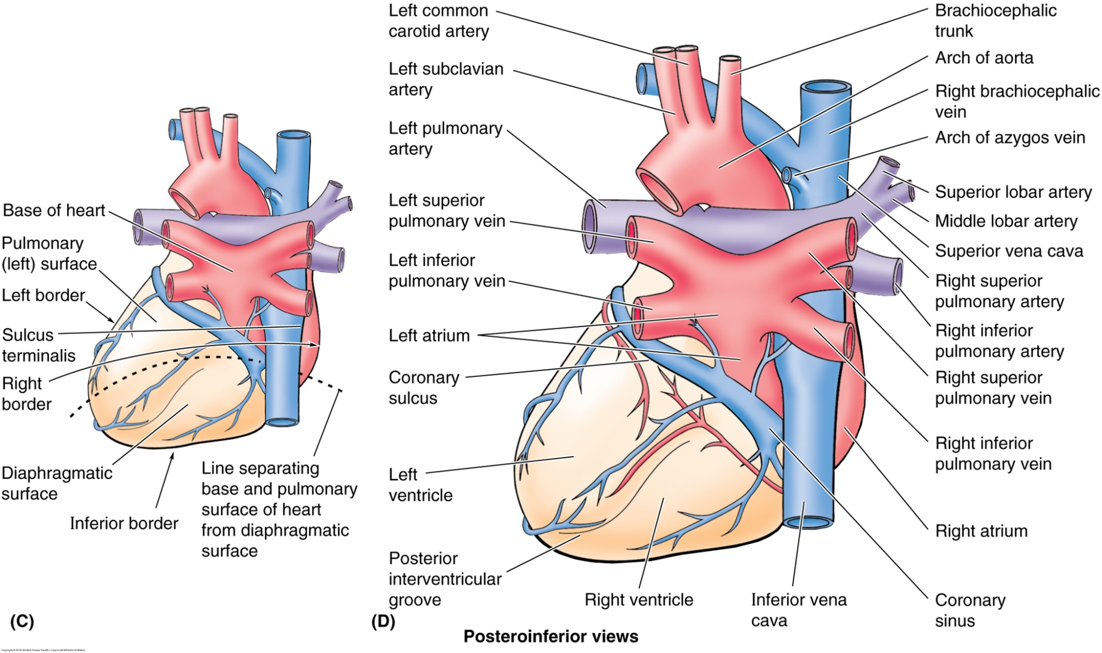
The Heart

Slide 29
The Heart
Three tissue layers
Epicardium – thin external layer formed by the visceral pericardium.
Myocardium – thickest layer; cardiac muscle tissue; left ventricle thickest muscle
Endocardium – thin inner layer of epithelial tissue covering entire chambers and valves

Slide 30
The Heart- 4 chambers
Right Atrium
  Receives blood from body via IVC & SVC plus from the heart via coronary sinus during systole
  Right auricle is extra room when needed
  Has opening into the right ventricle
  Fossa ovale – remnant of foramen ovale in embryo (site of ASD if fails to close)
Notes:
Ear shaped projection= auricle

Slide 31
The Heart (cont)
(Four Chambers)
Right Ventricle
  Makes up major portion of the anterior surface of the heart and almost entire inferior border
  The upper portion of the chamber leading to the pulmonary trunk is called the “Conus Arteriosus”
  Receives blood from the right atrium during diastole
  Tricuspid valve opens into ventricle and is attached to papillary muscles via chordae tendineae

Slide 32
The Heart (cont)
(Four Chambers)
Right Ventricle
  The “Moderator Band” (Septomarginal Trabecula) connects the Interventricular Septum to the Anterior papillary muscle acting as a “moderator”
    Prevents overdistension of the ventricle and contains part of the right AV bundle of the conducting system
  The IV Septum is mostly muscle, but the upper portion is membranous and the site of a potential VSD
  Blood exits the chamber during systole through the pulmonic valve into the pulmonary trunk

Slide 33
The Heart (cont)
Four chambers
Left Atrium
  Receives blood from 4 pulmonary veins
    2 superior and 2 inferior
  Slightly thicker wall than the RA
  Opening into Left ventricle
  A larger smooth walled part and smaller muscular auricle containing pectinate muscle

Slide 34
The Heart (cont)
Four chambers
Left Ventricle
  The apex of the heart
  Walls are 2-3 times thicker than RV
  Nearly all the left pulmonary surface and border, and most of the diaphragmatic surface
  Mitral (bicuspid) valve attaches to papillary muscles via chordae tendineae
  Papillary muscles are also larger than RV
  Opening superiorly to the aorta through aortic valve

Slide 35
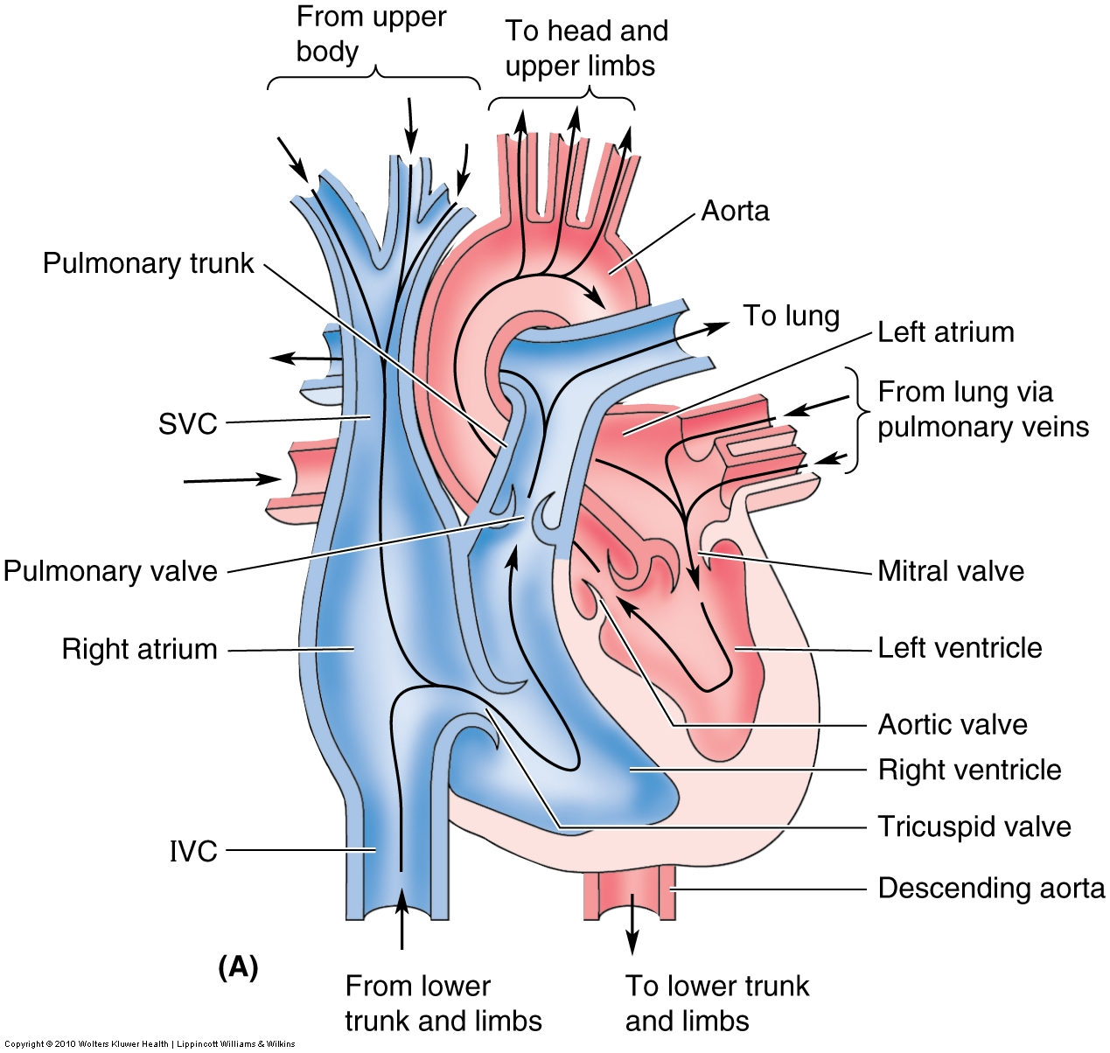
The Heart Blood Flow

Slide 36
The Heart (cont)
Four one way valves
Tricuspid – lies behind the right half of the sternum at the 4th ICS; most audible at left lower costal margin; opens with diastole and closes with systole; closure contributes to 1st heart sound (“lub”)
Pulmonic – lies behind medial end of left 3rd costal cartilage; most audible at left second ICS sternal border; opens with systole and shuts just slightly after aortic valve; part of 2nd heart sound (“dub”)

Slide 37
The Heart (cont)
Bicuspid (Mitral) – lies behind left half of sternum at 4th costal cartilage; most audible at apex (left 5th ICS MCL); closes slightly before tricuspid & contributes to 1st heart sound (“lub”)
Aortic – Lies behind left half of sternum opposite 3rd ICS; most audible at right 2nd ICS sternal border; closure at start of diastole contributes to 2nd heart sound (“dub”)

Slide 38
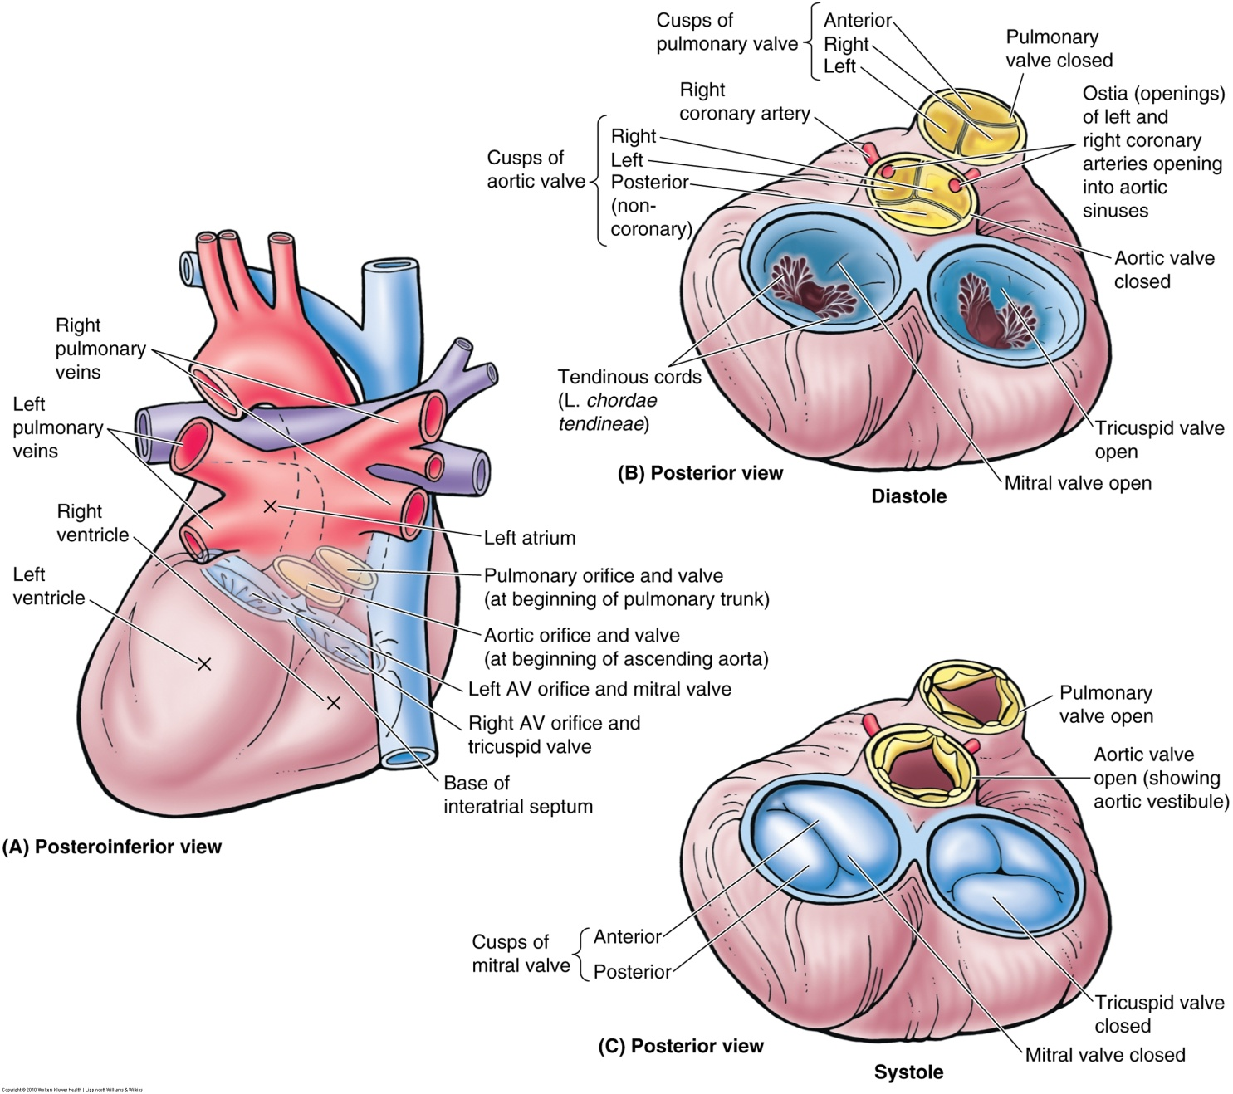
The Heart Valves
Notes:
Semilunar valves = pulmonary and aortic
AV valves = tricuspid and mitral

Slide 39
The Heart
Thick connective tissue forms 4 connecting rings for heart valve attachment
Fibrous skeleton:
  Separates atria from ventricles
  Keeps orifices of the AV and semilunar valves patent and prevents them from being overly distended by increased volume of blood pumping through
  Provides attachment for the leaflets and cusps of the valves
  Provides attachment for the myocardial muscles
  Forms an electrical “insulator” by separating the conducted impulses of the atria and ventricles so that they conduct independently
Notes:
Diseased valves become stiff or leaky

Slide 40
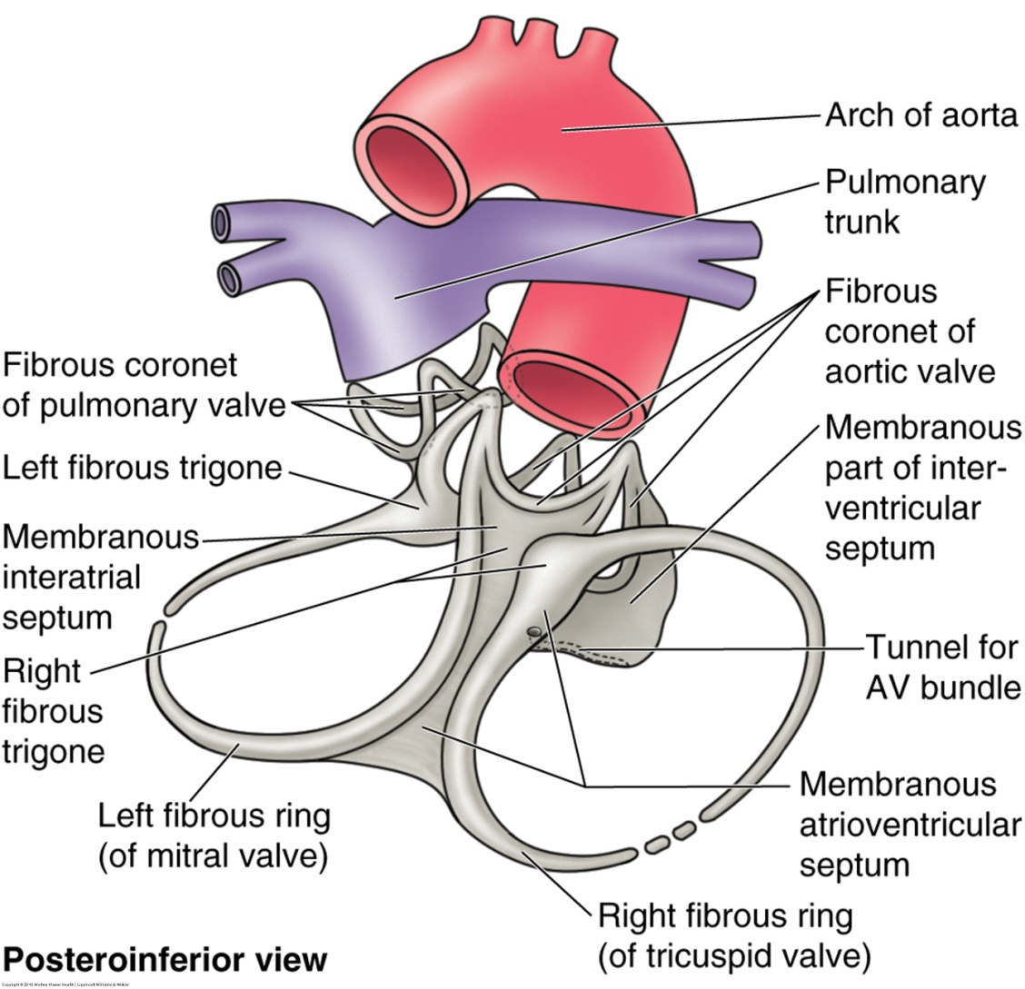
Cardiac Internal Fibrous “Skeleton”

Slide 41
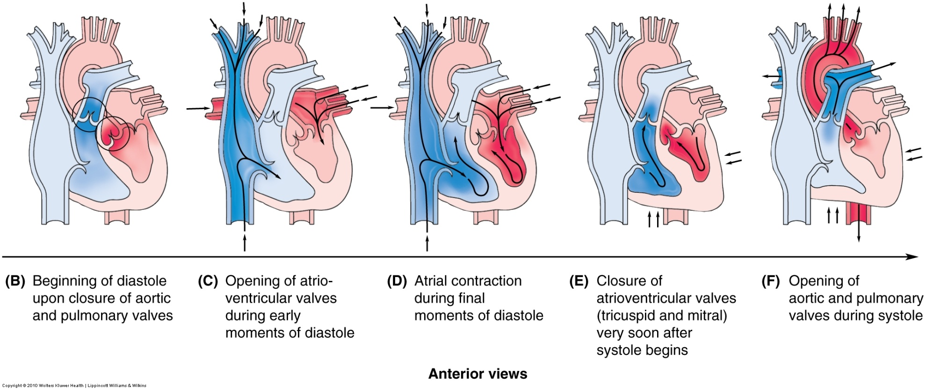
The heart valves
(during cardiac cycle)

Slide 42
Heart valves and Fibrous Skeleton
To prevent the AV valves from being pushed up into the atrium (prolapse) the valves are attached to the myocardium via Chordae Tendineae & Papillary muscles
Aortic and pulmonary valves catch blood flowing backward toward heart and seal together preventing backflow (when healthy tissue)
Diseased or worn-out cusps don’t close efficiently, and murmurs can be detected again by the turbulent flow of the moving blood

Slide 43
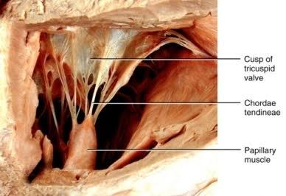

Slide 44
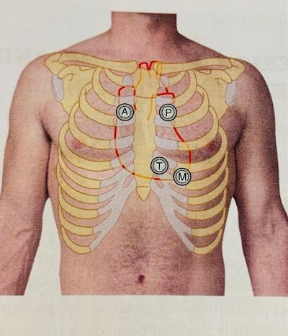
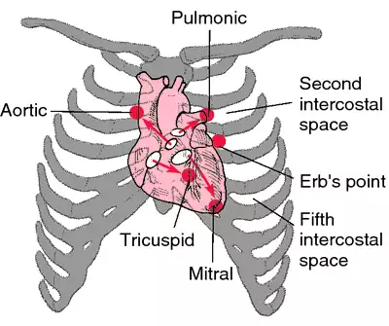
Heart sounds
Blood carries the sound in the direction of its flow. The auscultation areas are in direction of blood flow and not at exact position of valve

Slide 45
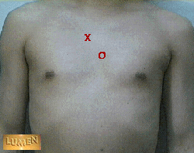
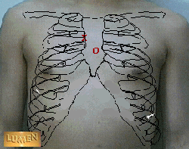
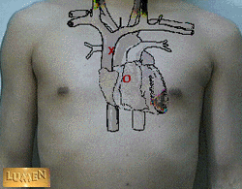
Aortic Valve in relationship to heart sounds
O = surface projection of valve location
X= Auscultation point of valve
Direction of blood flow and sound
Note that the surface projection is behind the sternum opposite the 3rd intercostal space whereas the valve is auscultated at the second intercostal space to the right of the body of the sternum.

Slide 46
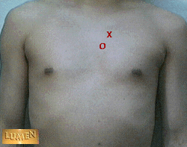
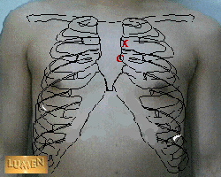
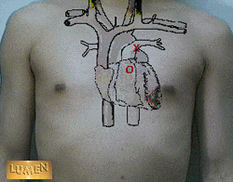
Pulmonic valve in relationship to heart sounds
O = surface projection of valve location
X= Auscultation point of valve
Direction of blood flow and sound
The surface projection is on the left side of the sternum opposite the left 3rd intercostal junction whereas the valve is auscultated on the left side of the sternum at the 2nd intercostal junction

Slide 47
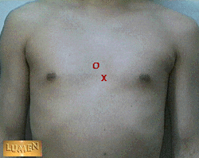
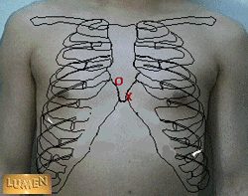
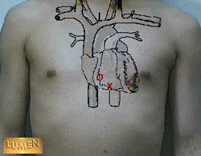
Tricuspid valve in relationship to heart sounds
O = surface projection of valve location
X= Auscultation point of valve
Direction of blood flow and sound
The surface projection is behind the sternum opposite the 4-5th intercostal junction whereas the valve is auscultated at the lower left quadrant of the body of the sternum

Slide 48
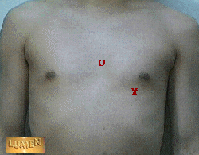
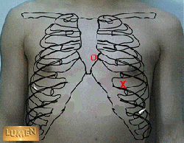

Mitral valve in relationship to heart sounds
O = surface projection of valve location
X= Auscultation point of valve
Direction of blood flow and sound
The surface projection is to the left of the 4th intercostal junction whereas the valve is auscultated at the 5th intercostal space in the mid-clavicular line.

Slide 49
Cardiac Circulation
Coronary Arteries – first branches off aorta; supply epicardium and myocardium; much variation in distribution.
Right coronary (RCA) – arises from right aortic sinus passing to the right side of the pulmonary trunk in the coronary sulcus; branches include –
Right marginal – supplies rt. border of heart toward apex (doesn’t reach it)
SA nodal – supplies SA node (60% of people)
AV nodal – supplies AV node (80% of people)
Posterior (Descending) Interventricular (PIV) – supplies posterior adjacent areas of both ventricles
Interventricular septal – penetrating branch of PIV; supplies posterior 1/3rd of septum and part of left ventricle
Notes:
Supplies the right atrium and most of rt ventricle

Slide 50
Cardiac Circulation (cont)
Coronary Arteries (cont)
Left coronary artery (LCA) – arises from left aortic sinus of aorta; passes between left auricle and left side of pulmonary trunk and continues in the coronary sulcus; its branches are as follows:
Left anterior (IV) descending – supplies anterior parts of both ventricles, anterior 2/3 of IVS, the apex, & many times anastomoses with Rt. PIV
Lateral branch – supplies anterior surface of heart
Circumflex – follows sulcus around left border to posterior surface of heart supplying the left atrium, mitral valve, and most of the posterior left ventricle
Left marginal – supplies left ventricle

Slide 51
Cardiac Circulation
Left Coronary artery (LCA) supplies:
  Left atrium
  Most of left ventricle
  Part of right ventricle
  Most of IVS (anterior 2/3) including AV bundle of conducting system
  SA node in 40% of people

Slide 52
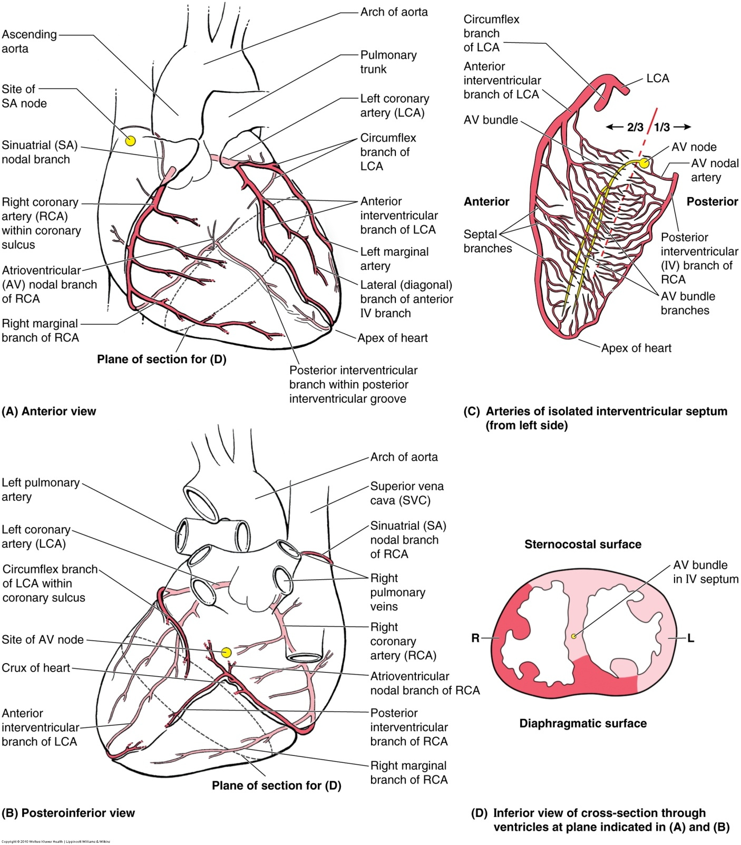

Slide 53
Coronary Venous Return
Coronary Sinus – Main blood return to right atrium; all veins empty into it (except smallest cardiac veins that empty directly into atria)
Great cardiac vein – main contributor
  IV vein – 1st part, begins near the apex of heart and returns blood from area supplied by LCA
Middle cardiac vein (aka posterior IV) – returns blood from area supplied by RCA
Small cardiac vein – travels from the area supplied by the right marginal artery of the RCA
Posterior vein of LV – drains LV into Coronary sinus
Some smaller anterior cardiac veins either empty directly in to RA or connect to small cardiac vein

Slide 54
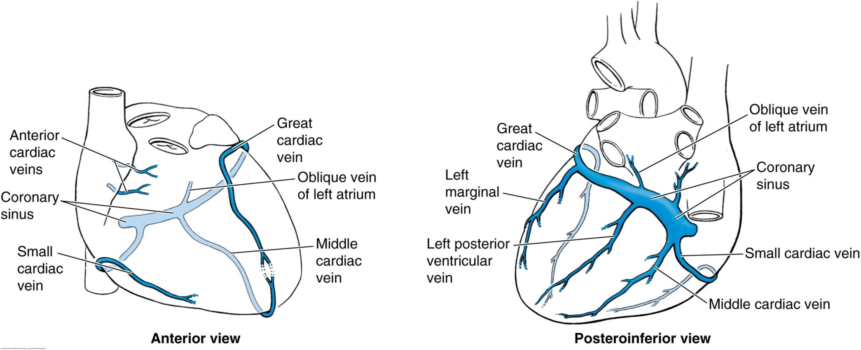
Venous system of heart

Slide 55
Electrical Conducting System
Sinoatrial (SA) node
  The pacemaker of heart
  Initiates and regulates the impulses for contractions
  Located anterolaterally just deep to the epicardium at the junction of the SVC & Rt. Atrium
  Stimulated by sympathetic autonomic nervous system (ANS) & inhibited by the parasympathetic ANS
Atrioventricular (AV) node
  Smaller than SA node
  Located in posteroinferior region of interatrial septum near opening of coronary sinus
  The signal generated by the SA node passes through the walls of the right atrium to the AV node
  Which then distribute the signal to the ventricles through the AV Bundle

Slide 56
Electrical Conducting System
AV Bundle (Bundle of His)
  Only electrical connection between atria and ventricles
  Passes through fibrous skeleton of heart and along the membranous part of IVS
  At the junction of the membranous and muscular parts of IVS, the AV bundle divides into the right and left bundles
Right & left bundle branches
  Right branch supplies right ventricle, left branch supplies left ventricle
  These branches proceed on each side of muscular IVS and then become the Purkinje fibers
Subendocardial branches (Purkinje fibers)
  Extend into the walls of each respective ventricle and stimulate the muscles along with the IVS.

Slide 57
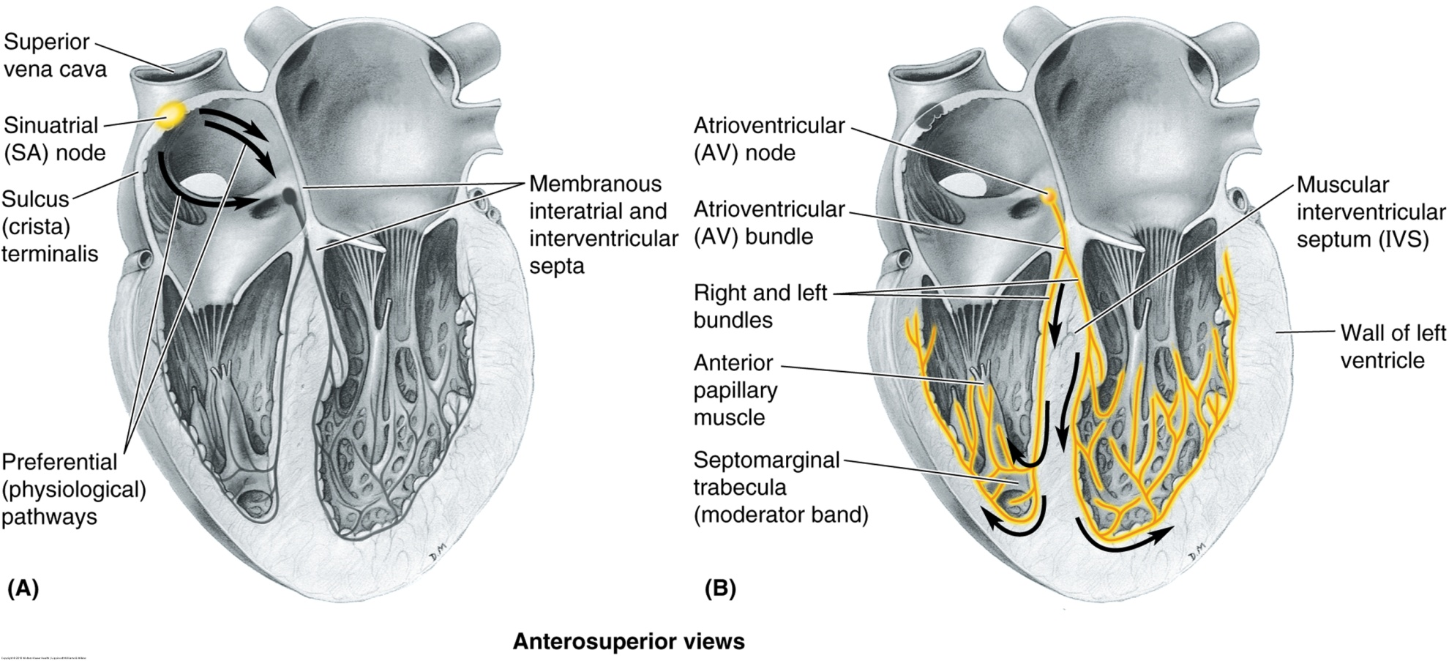
Electrical Conducting System

Slide 58
Major Vessels of Body Circulation
(Thorax)
All arteries & veins have 3 layers
  Tunica intima (inner layer of endothelium)
  Tunica media (middle layer of smooth muscle)
  Tunica Adventitia (outer layer of connective tissue)
Aortic root (Ascending aorta)
  Coronary arteries first vessels off aorta
Aortic arch
Brachiocephalic trunk
Right subclavian
Right Common Carotid
Left Common Carotid
Left Subclavian
Thoracic (Descending) Aorta
Posterior Intercostals, subcostals, phrenic, and visceral branches

Slide 59
Major Vessels of Body Circulation
Arch of the aorta
  Begins posterior to the 2nd right sternocostal joint at level of sternal angle
  3 main branches
    Brachiocephalic truck
      First and largest branch, posterior to manubrium, anterior to trachea and posterior to left brachiocephalic vein
    Left common carotid
      2nd branch, posterior to manubrium, slightly posterior and to left of the brachiocephalic trunk, anterior to trachea and enters neck passing posterior to left SC joint
    Left subclavian artery
      3rd branch, posterior part of arch and just posterior to left common carotid; ascends lateral to trachea and as it leaves thorax and enters the neck it passes posterior to the SC joint

Slide 60
Major Vessels of Body Circulation
Thoracic (descending) aorta
  Esophageal and pericardial branches anteriorly
  Bronchial arterials laterally
  Posterior intercostal and subcostal arteries arise posterolaterally

Slide 61
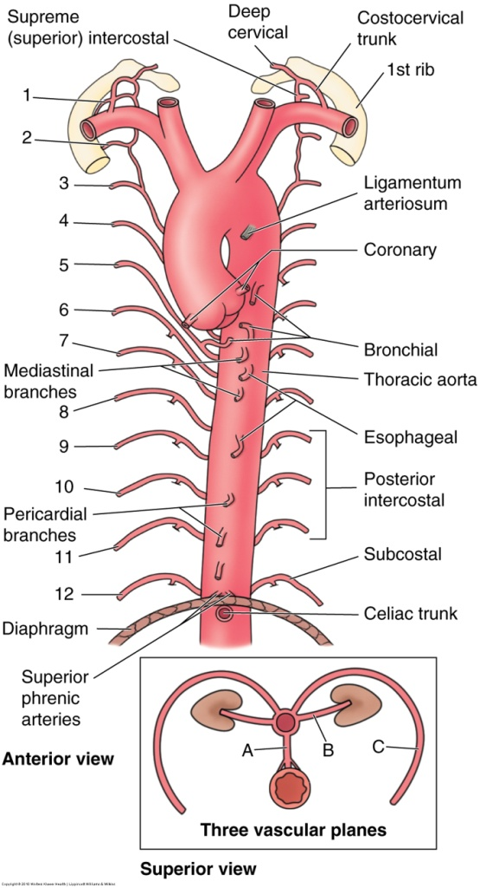
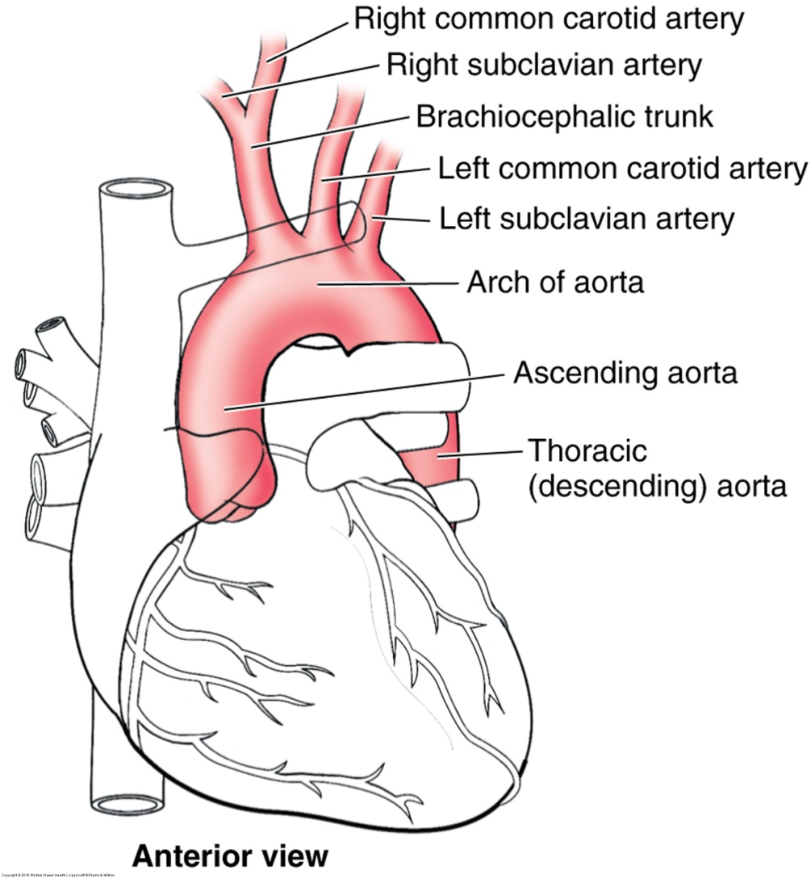

Slide 62
Major Vessels of Body Circulation
Vessels of the wall of the abdomen
  Superior epigastric artery- from internal thoracic artery
    Enters the rectus sheath posteriorly
    Supplies part of the rectus abdominis and anastomoses with inferior epigastric a.
  Musculophrenic- from internal thoracic artery
    Descends along costal margin
    Supplies superficial and deep abdominal wall
  Posterior intercostal arteries (10th and 11th ribs)- aorta
    Continue beyond ribs to descend in abdominal wall between internal obliques and transverse abdominis muscles
  Inferior epigastric artery, deep and superficial circumflex iliac, and external iliac- below aorta

Slide 63
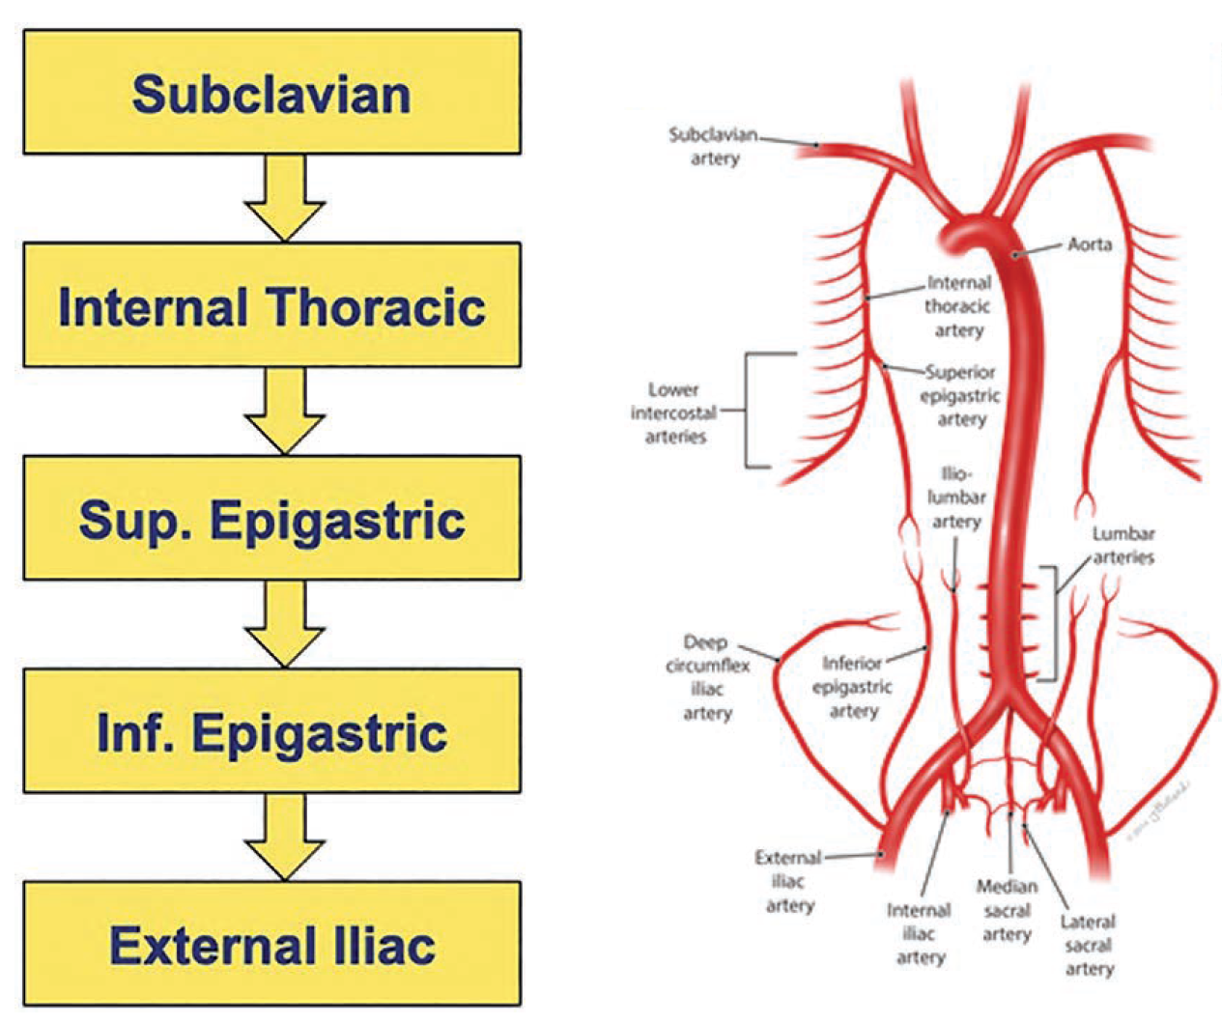

Slide 64
Major Vessels of Body Circulation
Abdominal (Descending) aorta
Vessels of the Viscera
Celiac trunk (off aorta)
Left gastric
Splenic artery
Hepatic (common) divides into right and left proper hepatics
Superior Mesenteric
Renals & Suprarenals (Kidneys & Adrenals)
Right and Left Testiculars (Ovarians)
Inferior Mesenteric
Common iliacs

Slide 65
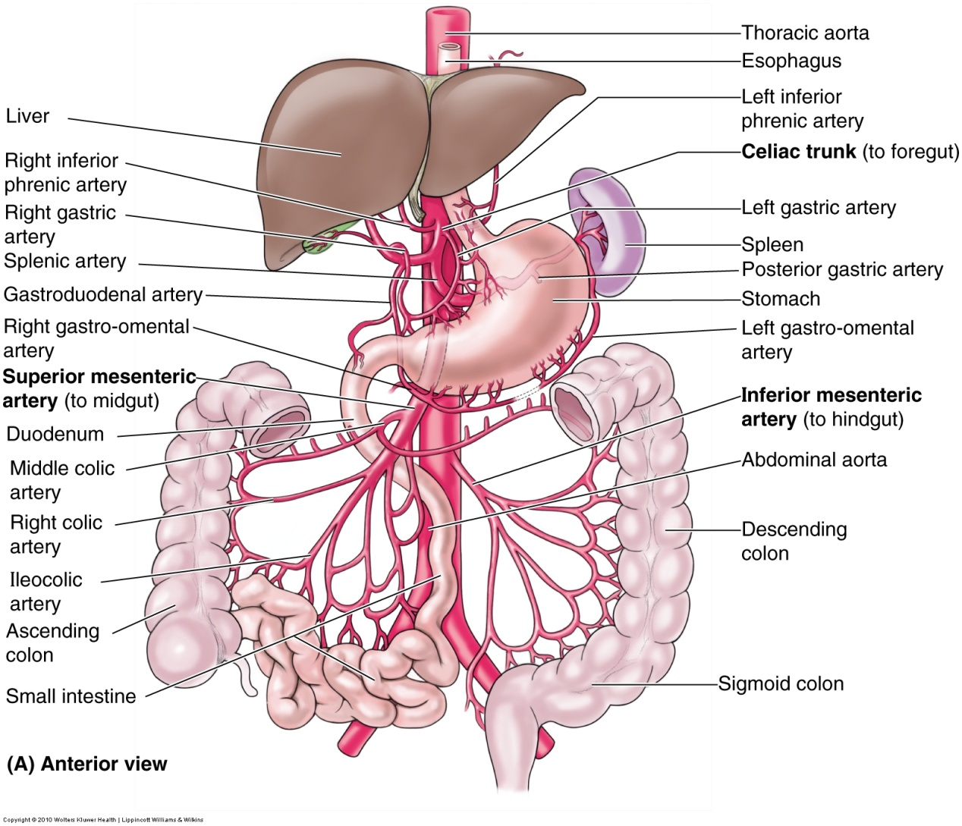
Abdominal Arteries

Slide 66
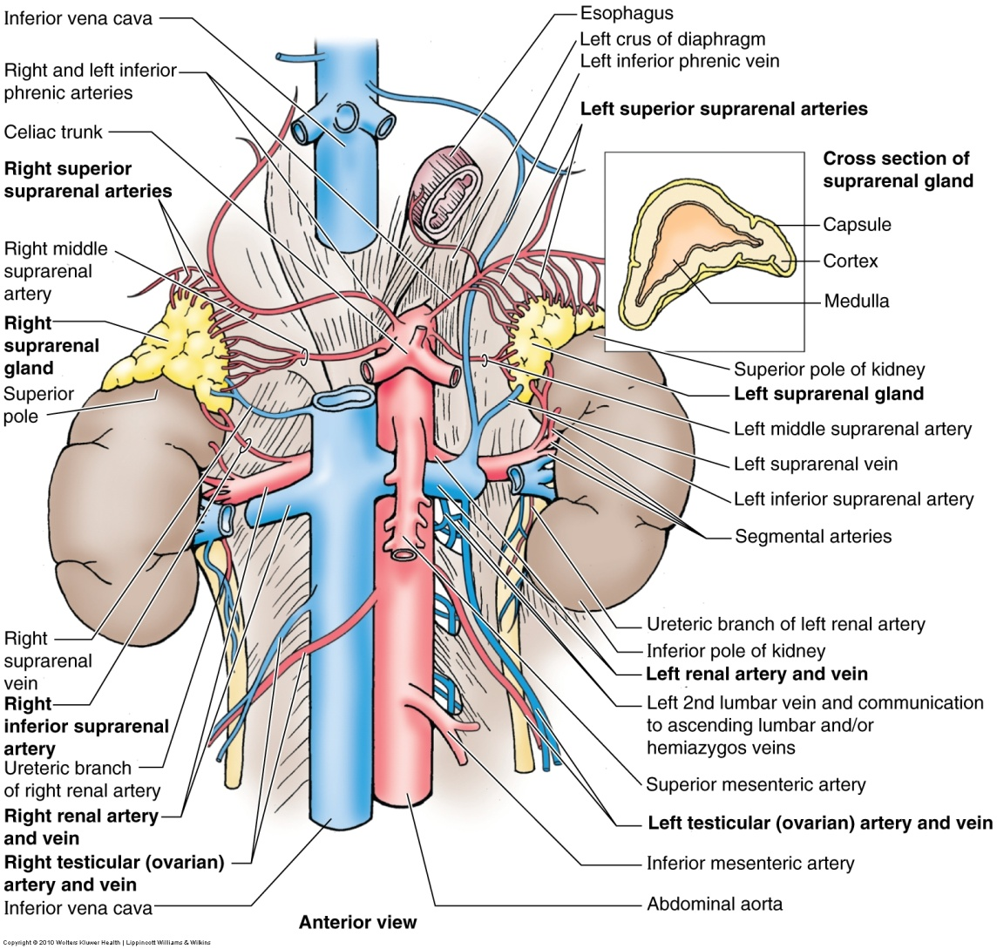
Abdominal Arteries (cont)

Slide 67
Venous Return System
Superior Vena Cava (SVC)
  Right Brachiocephalic Vein
    Right subclavian vein (from right upper extremity)
    Right Jugular vein (from right head & neck)
    Left Brachiocephalic Vein
    Left subclavian vein (from left upper extremity)
    Left Jugular vein (from left head & neck)
    Brachiocephalic veins shunt blood from the head, neck, and upper limbs to the right atrium

Slide 68
Venous Return System
SVC
  Returns blood from all structures superior to the diaphragm except lungs and heart
  Passes inferiorly and ends at 3rd costal cartilage and enters right atrium
  Lies to the right of superior mediastinum, anterolateral to trachea, and posterolateral to ascending aorta

Slide 69
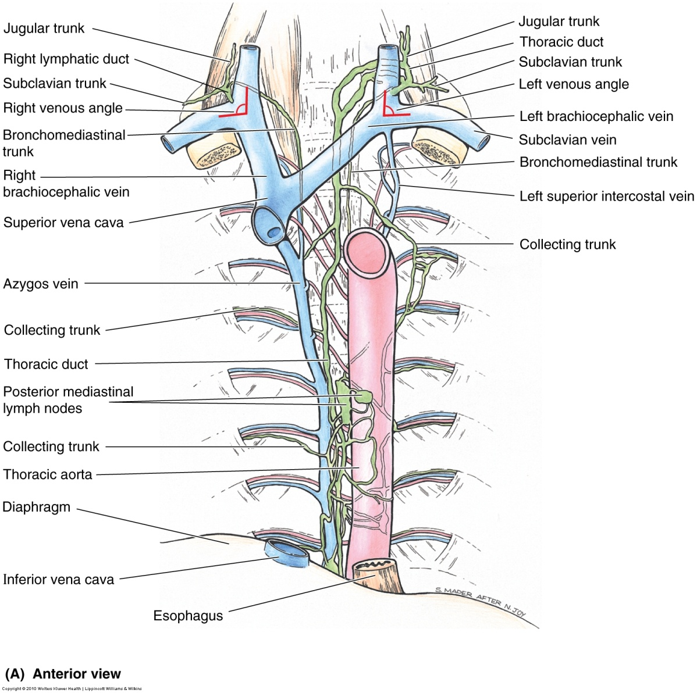
SVC venous return

Slide 70
Inferior Vena Cava
Branches into:
Right Common Iliac vein (from right lower extremity)
Left Common Iliac vein (from left lower extremity)
Ascending lumbar veins (contiguous with azygos & hemi-azygos veins)
Multiple veins from viscera of abdomen (will be discussed more in the GI module)

Slide 71
Azygos System
On each side of the vertebrae
Consist of Azygos vein, hemi-azygos vein, and accessory hemi-azygos vein
Drains the back and thoracoabdominal walls and mediastinal viscera
Large amount of variation

Slide 72
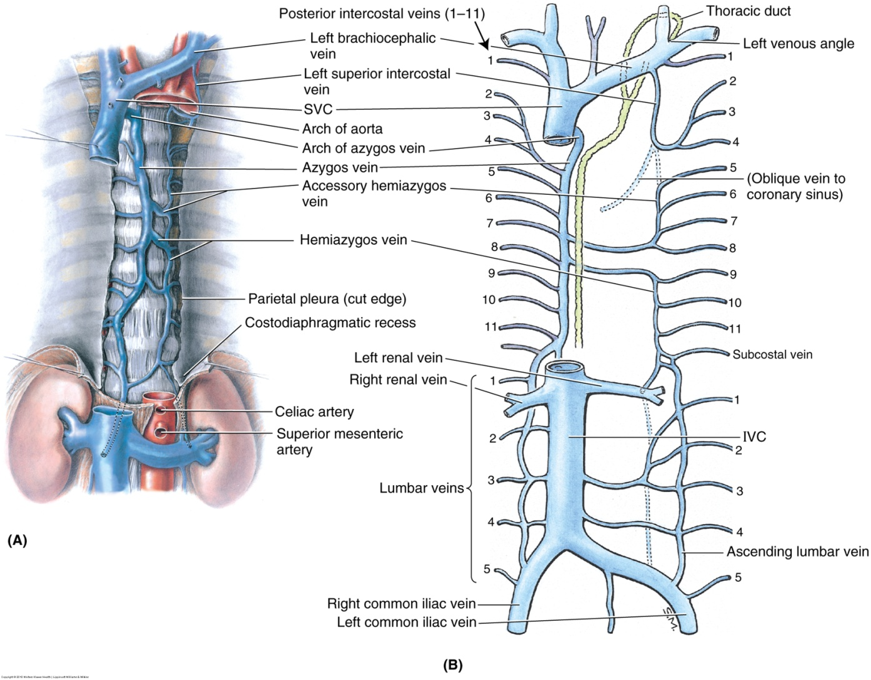
Azygos venous system

Slide 73
Arteries of the Lower Extremity
Gluteal region – branches of Internal iliac
Anterior Thigh – branches off Femoral
Posterior Thigh – branches off Internal iliac
Medial Thigh – branches off Femoral
Anterior leg – Anterior Tibial
Lateral leg – Posterior Tibial & Fibular
Posterior leg – Posterior Tibial
Foot – Dorsalis Pedis, medial & lateral plantar

Slide 74
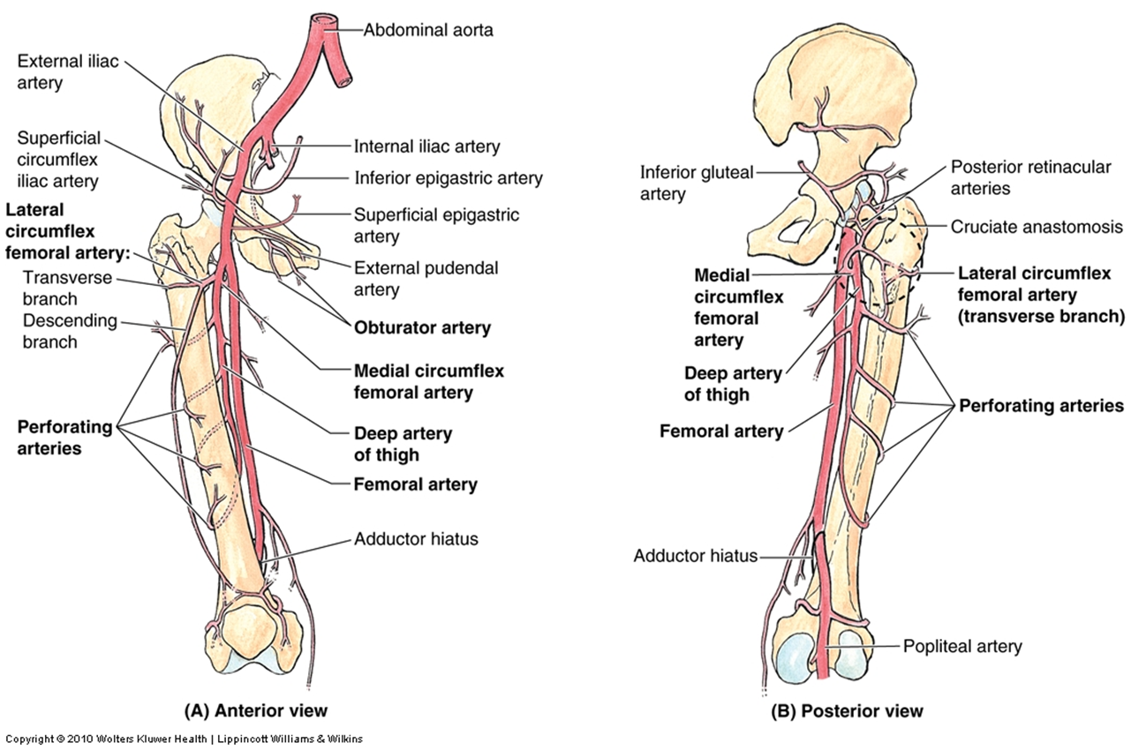
Arteries of the lower extremity

Slide 75
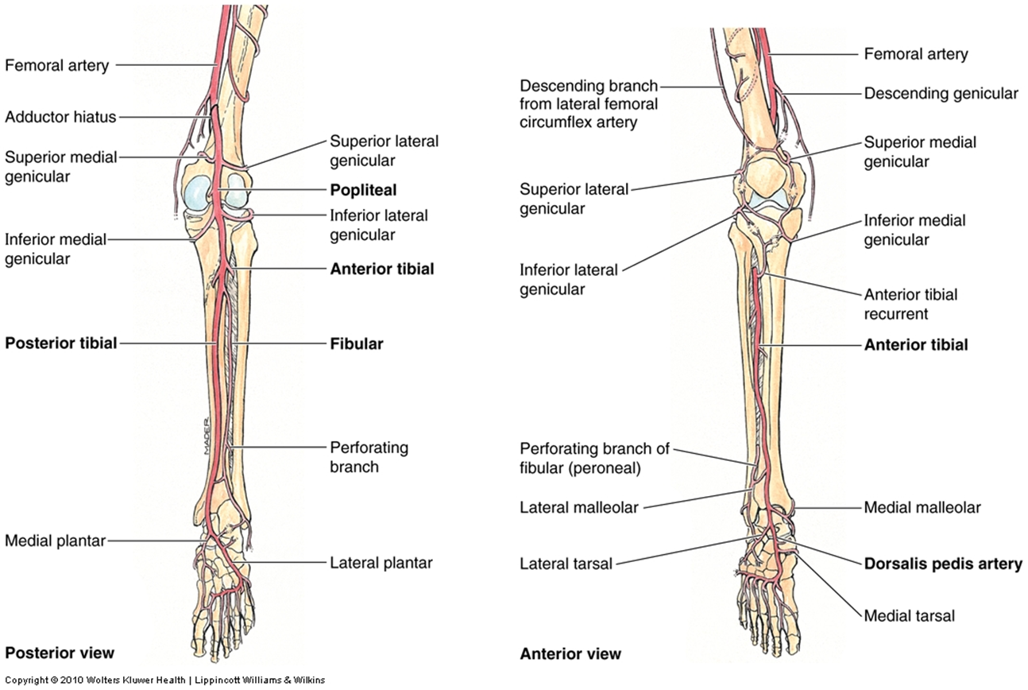

Slide 76
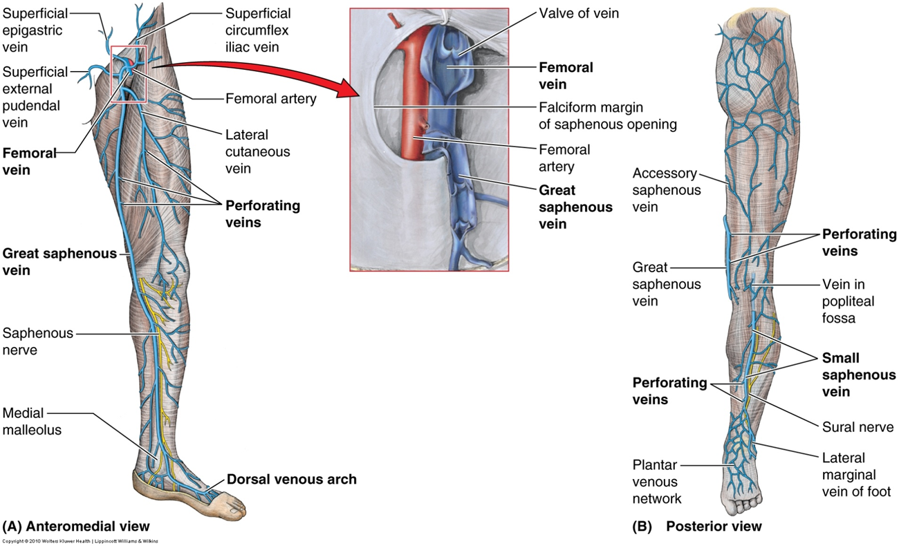
Veins of the lower extremity

Slide 77
Deep vs superficial veins
Superficial veins
  Great saphenous vein
  Small saphenous vein
Deep veins of the foot
  plantar veins
  dorsal veins
Deep veins of the leg
  anterior tibial veins
  posterior tibial veins
  fibular veins
Deep veins of the knee
  popliteal vein
Deep veins of the thigh
  femoral vein and its tributaries
Notes:
Superficial veins found in the subcutaneous tissue and deep in the fascia
Deep run with the major arteries
Great saphenous is a continuation of the medial marginal vein of the foot and ends in the femoral vein, distal to the inguinal ligament
Small saphenous is continuation of the lateral marginal vein

Slide 78
Arterial supply to the arm
All blood supply to the shoulder and arm are supplied from branches off the Subclavian, Axillary, or Brachial arteries
Subclavian branches – Internal thoracic, Thyrocervical, suprascapular (may branch from thyrocervical)
Axillary branches – Superior thoracic, thoraco-acromial, Lateral thoracic, circumflex humeral
Brachial – deep brachial, superior ulnar collateral, & inferior ulnar collateral

Slide 79
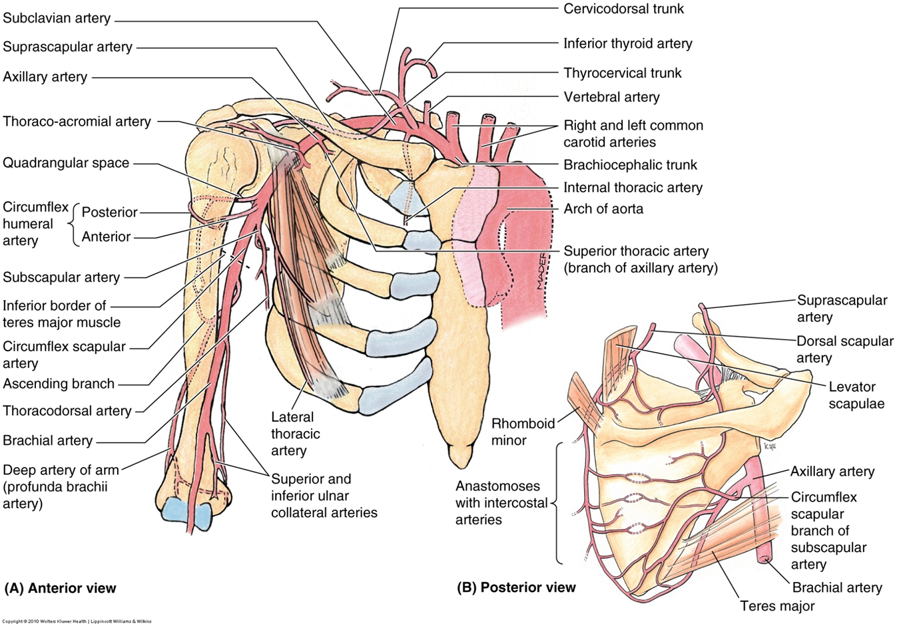
Notes:
The subclavian artery becomes the axillary artery at the lateral border of 1st rib
The axillary artery becomes the brachial artery at the inferior border of Teres Major (perforated line)

Slide 80
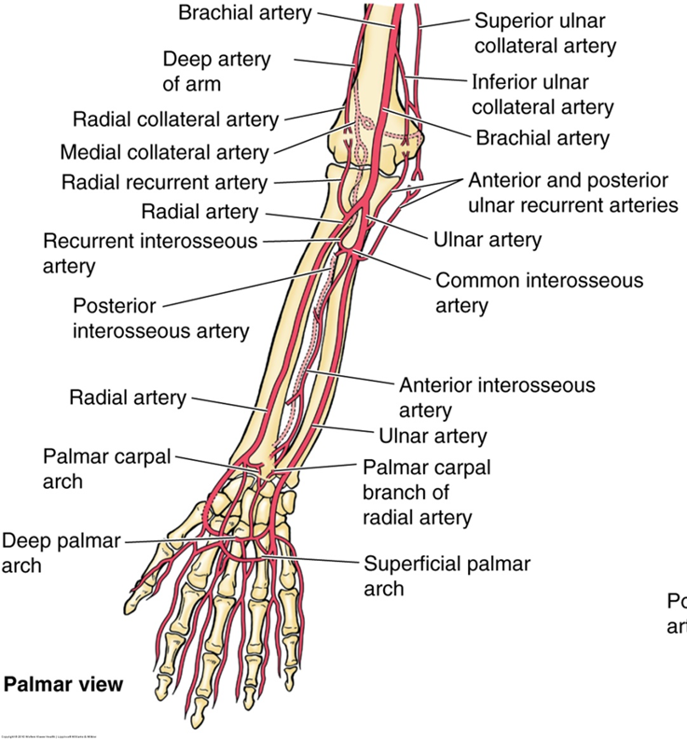
Notes:
Forearm: branches of the radial and ulnar arteries
Hand: anastomosing of those arteries

Slide 81
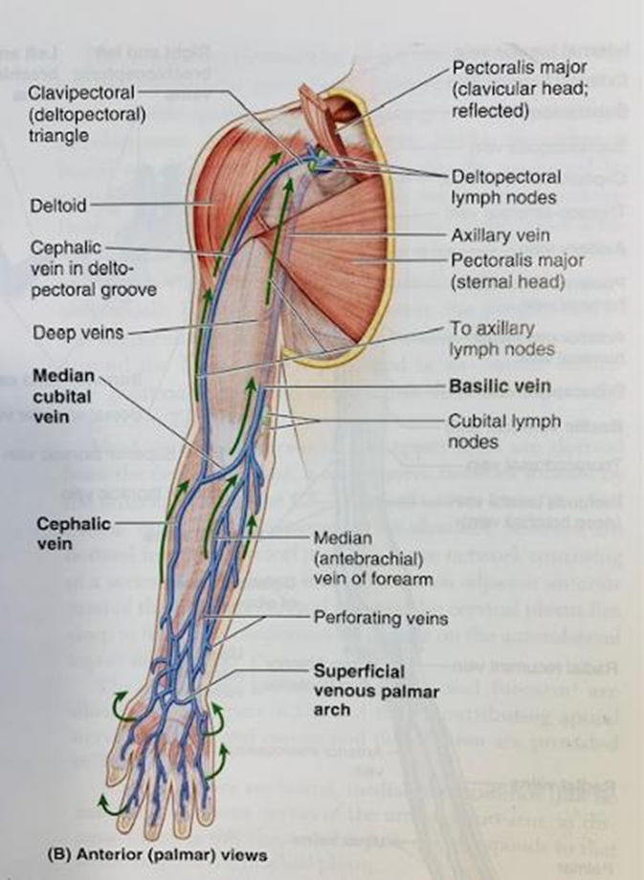
Superficial venous supply to arm
Notes:
Main superficial veins of upper limb are the cephalic and basilic
Perforating veins form communications between the superficial and deep veins

Slide 82
Superficial vs deep veins of upper extremity
Veins of the arm and axilla
  Superficial veins: Basilic vein, cephalic vein
  Deep veins: Brachial veins, axillary vein, subclavian vein
Veins of the forearm
  Superficial veins: Basilic vein, cephalic vein
  Deep veins: Anterior and posterior interosseous veins, ulnar veins, radial veins
Veins of the hand
  Superficial veins: Dorsal digital veins, palmar digital veins, dorsal venous network
  Deep veins: Superficial venous palmar arch, deep venous palmar arch, dorsal metacarpal veins, palmar metacarpal veins

Slide 83
Quick quiz!
Where is the apex of the heart located?
Which valves close during the 1st heart sound?
What does the right coronary artery (RCA) and branches supply? Think main sections of the heart

Slide 84

The End

