Slide 1

Cardiomyopathies
Pamela E. Wireman, MPAS, PA-C

Slide 2
TOPIC OUTLINE
General Overview
Genetic
Mixed
Hypertrophic Cardiomyopathy (HCM)
Arrhythmogenic Right Ventricular Cardiomyopathy (ARVC)
What cardiomyopathy is and isn’t
Dilated Cardiomyopathy (DCM)
Restrictive Cardiomyopathy (RCM)
Acquired
Myocarditis
Peripartum Cardiomyopathy (PPCM)
Tako-Tsubo Cardiomyopathy

Slide 3
cardiomyopathy
Cardio = “heart”
Myo = “muscle”
Pathy = “disease”

Slide 4
Cardiomyopathies
There have been multiple changes to the classification of cardiomyopathies over the last few decades
  In the past, all causes of heart muscle damage were included
    Most notably were the known cardiovascular causes (HTN, CAD, CHD, and valve disease)
  The current definition is more limiting: a group of conditions in which the heart muscle (myocardium) is structurally and functionally abnormal in the absence of known cardiovascular causes sufficient to explain the abnormality

Slide 5
Cardiomyopathies (CM)
CM had been considered idiopathic but modern advances in genetics and imaging have helped identify the pathological and genetic basis of CM
  We now know that most cardiomyopathies have a genetic basis
The classifications of CM are undergoing a transition based on their genetic association rather than the phenotype
  Genetic
  Mixed (genetic and acquired)
  Acquired

Slide 6
Cardiomyopathies
However, it’s still important to recognize that heart muscle damage can occur as a sequelae of valve disease, congenital heart disease, HTN, coronary artery disease (CAD) but they are no longer classified as a cardiomyopathy (instead they may cause the generic term = left ventricular hypertrophy)
  You have separate lectures on those topics
  “ischemic cardiomyopathy” is an old-fashion term that describes heart muscle damage as a result of vessel disease (CAD)
  “valvular cardiomyopathy” is again, old-fashion and describes when damage of the heart muscle occurs due to abnormal valves

Slide 7
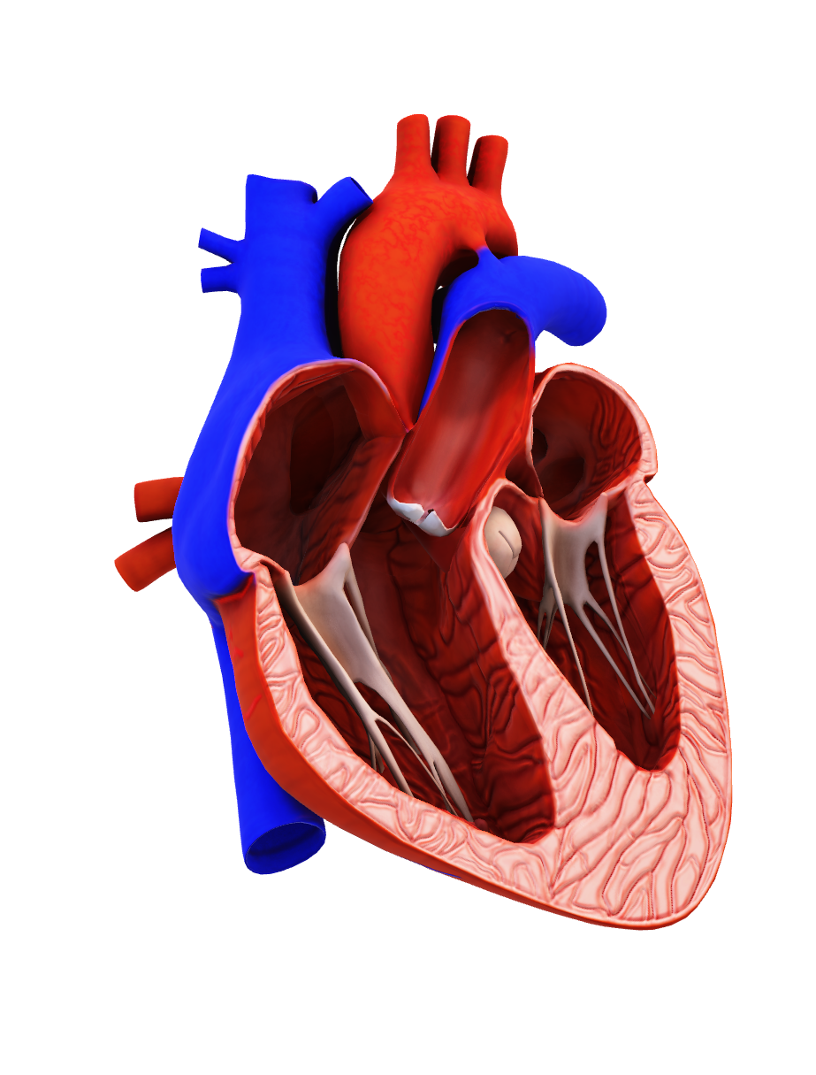
The heart is
The myocardium needs to contract more than 100,000 times a day without stopping or tiring
It requires the ability to respond rapidly to physiologic changes; instantaneously varying the rate and strength of contractions
A heartbeat can be detected 3 weeks after conception
Even at rest, the heart is still working twice as hard as the leg muscles of a sprinter
AMAZING
Because it has its own electrical system, it can beat when removed from the human body
It generates enough electricity in a day to drive a truck 20 miles

Slide 8
Cardiomyopathies
The myocardium is composed of myocytes (muscle tissue) which allow for contractility and electrical conduction
A healthy myocardium requires the ability to respond rapidly to physiologic changes
  i.e., Exercise, fight or flight response, sleeping, medications, test-taking
CM can result from changes to the shape, size, or thickness of the myocardium. These abnormalities can impair contraction and electrical conduction
  The way the myocardium is affected depends on the phenotype

Slide 9
Cardiomyopathies
Spectrum of symptoms are variable and can range from asymptomatic to severe heart failure or sudden death
  If symptomatic, generally present with chest pain, exertional intolerance, SOB, palpitations
PE is normal in many cases but may show a gallop rhythm, atrioventricular valve regurgitation, displaced PMI, cardiac lift/heave, rales (crackles), JVD, peripheral edema, ascites
The final common pathways of the various CM etiologies usually result in heart failure, arrythmias and death

Slide 10
Cardiomyopathies
Progression of heart failure in CM
  Early symptoms are often related to exertional intolerance, usually due to insufficient cardiac reserve during exercise
    Breathlessness (dyspnea on exertion = DOE), fatigue, dizziness, syncope, chest pain
    Vague symptoms → may be overlooked or attributed to other causes such as aging or deconditioning

Slide 11
Cardiomyopathies
Usually over time (though it can be rapid in acute heart failure), fluid retention leads to increased filling pressures in the heart which will worsen symptoms
  Shortness of breath (dyspnea) during routine activity
  Wet cough with frothy sputum
  Orthopnea: dyspnea when lying down, typically described as # of pillows needed to alleviate SOB
  Paroxysmal nocturnal dyspnea (PND): SOB or coughing attack waking pt up at night
  Peripheral edema, ascites, abdominal discomfort
  Increased JVP

Slide 12
Cardiomyopathies
Arrythmias
  Atrial and ventricular tachyarrhythmias
  Sudden death is typically due to sustained ventricular tachycardia (VT), ultimately progressing to ventricular fibrillation (VF) and then asystole
Many patients will have increased risk of thromboembolism

Slide 13
Cardiomyopathies
Workup typically includes:
Labs: BNP is helpful in setting of heart failure; troponins may be helpful in acute settings; other labs as indicated to rule out other etiologies
EKG/Holter monitor: assess electrical activity; provides clues but does not diagnose CM
  Atrial and ventricular tachyarrhythmias are common
CXR: suggestive but not specific; normal in many early cases
  May show enlarged cardiac silhouette if cardiomegaly is present
    Incidental cardiomegaly on CXR should prompt a cardio evaluation with echo and EKG
  May show fluffy infiltrates (“kerley lines”) if CHF is present

Slide 14
Cardiomyopathies
Echocardiogram (“echo”): the test of choice to diagnose cardiomyopathy; defines both anatomical and functional characteristics of the heart with high sensitivity and specificity for myocardial dysfunction
Cardiac MRI (aka CMR): used as an additional study after CM is confirmed on echo
  better definition of anatomy and evaluation of R ventricle
  identifies/localizes fat, iron or amyloid infiltration, inflammation, fibrosis (scar), focal hypertrophy, aneurysm

Slide 15
Cardiomyopathies
Cardiac biopsy is rarely needed anymore; provides a definitive diagnosis for tissue pathology in subtypes of CM (such as infiltrative disease) if etiology is equivocal
Cardiac stress testing (“stress test”) is typically performed at some point during the CM evaluation; helps characterize a patient’s exercise tolerance

Slide 16
Cardiomyopathies
Generally, there is no cure (some exceptions)
Management goals: reduce morbidity and prevent mortality
  Heart rate control: beta-blockers (i.e. metoprolol)
  Reduce thromboembolism risk: anticoagulants (i.e. warfarin or DOAC)
  *Reduce fluid retention: diuretics (i.e. furosemide/Lasix)
  Rhythm control: Implantable pacemakers
  Rhythm control and shock: implantable cardioverter defibrillators (ICDs)
  In select cases: surgical excision of myocardial areas or heart transplant

Slide 17
Cardiomyopathies
Because many CMs have a substantial genetic basis, recommendations are given for families of a patient with confirmed CM
  Detailed, thorough FHx for at least 3 generations
  Clinical screening of first-degree relatives which consist of H&P, EKG, and Echo
  Genetic testing of family members should be considered if index case has a known genetic mutation

Slide 18
Cardiomyopathies
The AHA classifications of CM:
Genetic
  Hypertrophic Cardiomyopathy (HCM)
  Arrhythmogenic right ventricular cardiomyopathy/dysplasia (ARVC/D)
Mixed (genetic and acquired)
  Dilated cardiomyopathy (DCM)
  Restrictive cardiomyopathy (RCM)
Acquired
  Myocarditis (infectious/inflammatory)
  Peripartum cardiomyopathy (PPCM)
  Stress-related “Tako-Tsubo” cardiomyopathy

Slide 19
Genetic
    Hypertrophic Cardiomyopathy
    Arrhythmogenic Right Ventricular Cardiomyopathy

Slide 20
Hypertrophic
cardiomyopathy

Slide 21
Hypertrophic cardiomyopathy
A disorder of the myocardium caused by mutations of the cardiac sarcomere or sarcomere-associated proteins (encodes components of the contractile apparatus)
The genetics of HCM involve an autosomal dominant pattern of inheritance, with 60–70% of patients having an affected family member
  Age-dependent (rarely present at birth, usually develops later)
  Incomplete penetrance (varied extent of disease and clinical outcomes)
Results in Left Ventricular Hypertrophy (LVH)

Slide 22
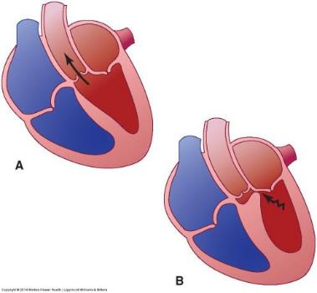
Hypertrophic cardiomyopathy
Characteristics:
  Asymmetric thickening of the left ventricular septum, especially the sub-aortic area
  Ventricular wall thickness and loss of elasticity impairs cardiac relaxation, making it harder to fill the heart (diastolic dysfunction)
  2⁄3 of patients experience left ventricular outflow tract (LVOT) obstruction

Slide 23
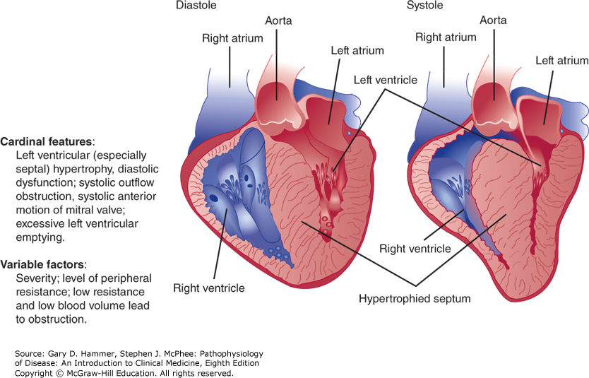

Hypertrophic cardiomyopathy (left lateral view). The cardinal features are displayed. (Redrawn, with permission, from Cheitlin MD et al, eds. Clinical Cardiology, 6th ed. Originally published by Appleton & Lange. Copyright © 1993 by The McGraw-Hill Companies, Inc.)
Citation: Chapter 10 Cardiovascular Disorders: Heart Disease, Hammer GD, McPhee SJ. Pathophysiology of Disease: An Introduction to Clinical Medicine, 8e; 2019. Available at: https://accessmedicine.mhmedical.com/content.aspx?bookid=2468&sectionid=198221738 Accessed: October 13, 2020
Copyright © 2020 McGraw-Hill Education. All rights reserved

Slide 24
Hypertrophic cardiomyopathy
Clinical features may be variable from no symptoms in one patient to sudden cardiac death in another
May be identified through familial screening or upon workup of suggestive clinical and EKG findings

Slide 25
Hypertrophic cardiomyopathy
While many patients are asymptomatic, some may develop symptoms such as dyspnea on exertion, exertional chest pain, exertional syncope (or presyncope), palpitations
Advanced heart failure symptoms (orthopnea, PND, edema) are possible as disease progresses
Patients with mild to moderate limitation usually experience slow progression of symptoms with advancing age, related to modest deterioration in LV function

Slide 26
Hypertrophic cardiomyopathy
The physical exam is normal in many cases but may reveal nonspecific abnormalities such as a 4th heart sound (S4), systolic murmur, or cardiac lift/heave
LVOT obstruction may have a characteristic harsh crescendo-decrescendo systolic murmur heard best at the apex and LLSB
Mitral regurgitation murmur may also occur

Slide 27
Extra Heart Sound: s4
Heard in hypertrophic cardiomyopathies
Also called the atrial diastolic gallop or “Tennessee murmur”
Low-pitched, heard at the end of diastole immediately before S1 (ta-lub-dub)
Best heard at the cardiac apex with the bell of the stethoscope
Augmentation: auscultate while pt performs a Valsalva strain or stands from the squatting position

Slide 28
Hypertrophic cardiomyopathy
An electrocardiogram (ECG) is typically abnormal. It can suggest the diagnosis, but the findings are nonspecific and cannot be used to make a definitive diagnosis of CM
EKG findings may include:
  Left Ventricular Hypertrophy (LVH)
    Compensatory mechanisms may cause atrial hypertrophy as well, resulting in abnormal p waves
      LVH with abnormal P waves strongly suggests HCM
  Deep narrow (“dagger-like”) Q waves
  One variant (apical) may result in deeply inverted T waves, aka “Giant Negative T Waves”
  May see atrial and ventricular arrythmias

Slide 29
Hypertrophic cardiomyopathy
ALL patients with the associated abnormal ECG findings or clinical concern for HCM need to have an echocardiogram (“echo”)
Echo is performed transthoracic (TTE) and uses doppler imaging to evaluate blood flow. It can demonstrate cardiac morphology, systolic and diastolic function, presence and severity of LVOT, and valvular abnormalities

Slide 30
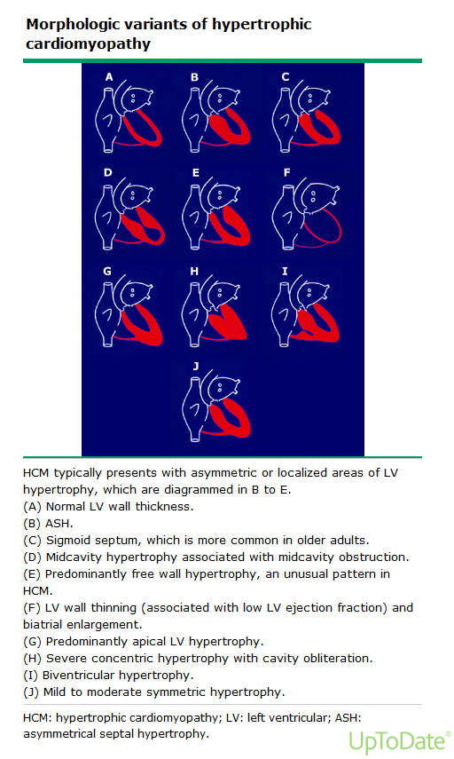
Hypertrophic cardiomyopathy
HCM is confirmed when there is any increase in LV wall thickness ≥ 15mm on echo, in the absence of another cause
The increased thickness is usually asymmetric and may occur in any segment of the LV wall
  Most often in the septum or anterolateral wall

Slide 31
Hypertrophic cardiomyopathy
LVOT obstruction ≥50 mmHg is a strong and independent determinant of progressive heart failure (HF) symptoms and stroke death in patients with HCM
The presence of LVOT obstruction may include additional treatment options for heart failure symptoms, as well as the need to avoid some medications

Slide 32
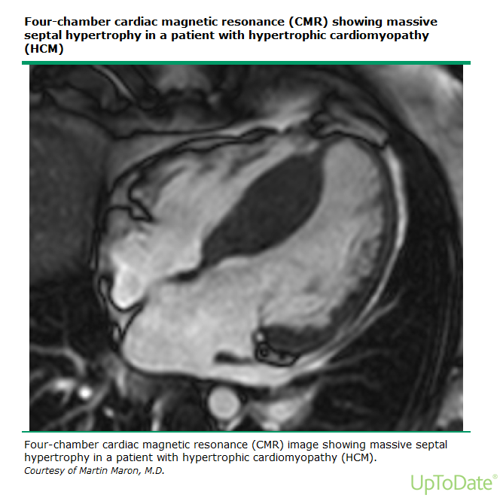
Hypertrophic cardiomyopathy
CMR is typically then ordered to more reliably assess LV morphology and maximal LV wall thickness
  Anatomy is also better defined for select patients considering septal reduction (alcohol septal ablation or surgical myectomy)

Slide 33
Hypertrophic cardiomyopathy
Patients will also undergo an exercise stress test as part of the HCM evaluation
  most have LVOT obstruction following exercise
  Evaluates for exercise-related ischemia or arrythmias
  Abnormal findings may include:
    Symptoms (angina, dyspnea, palpitations, presyncope)
    Failure of BP to increase appropriately or exercise-induced hypotension
    Arrythmias (AF, VT) at maximal intensity or immediately after exercise
    Severe ST depression (reflecting myocardial ischemia)

Slide 34
Hypertrophic cardiomyopathy
Due to large genetic influence, all first-degree family members of an affected individual should be evaluated
Family screening includes: H&P, ECG, and echo
If an HCM-causing mutation is identified in the index case, then family members should be genetically screened

Slide 35
Hypertrophic cardiomyopathy
Many cardiac etiologies can result in LVH which must be distinguished from HCM. These include acquired causes such as HTN, aortic stenosis, cardiac amyloid, and Athlete’s heart
“Athlete’s heart” – Athletic LVH
  Athletic Left Ventricular Hypertrophy is NOT a cardiomyopathy!
  With endurance training, there can be physiologic increased thickness of the left ventricular wall
  These individuals can experience several benign arrhythmias
  Ventricular wall thickness is symmetric and usually measures between 13-15 mm during echocardiogram

Slide 36
Hypertrophic cardiomyopathy
Treatment for asymptomatic HCM patients include close clinical observation and follow-up
All patients should be counseled on activity restriction: avoid competitive and strenuous exercise

Slide 37
Hypertrophic cardiomyopathy
Heart failure symptoms or angina due to LVOT obstruction are treated with a beta-blocker (BB), such as metoprolol
  Nondihydropyridine CCB (such as diltiazem or verapamil) is typically used if there are contraindications to BB (such as asthma) or those who are unwilling to tolerate BB due to side effects (i.e. feeling sluggish)
  Initially monotherapy, but may try a combo of BB and nondihydropyridine CCB if further management needed – greater likelihood of bradyarrhythmia and intolerance

Slide 38
Hypertrophic cardiomyopathy
If HF symptoms are refractory to drugs, surgical septal myectomy or ETOH septal ablation may help alleviate the LVOT obstruction
  Surgical septal myectomy: removes a portion of the ventricular septum to enable a wider outflow tract for exit of blood
  Alcohol septal ablation involves injecting absolute ethanol (1-3mL) percutaneously into a septal perforator branch (usually from the LAD coronary artery) that supplies the hypertrophied portion; this induces a local transmural infarction in that zone

Slide 39
Hypertrophic cardiomyopathy
AVOID in patients with significant LVOT obstruction as they can worsen LVOT obstruction and symptoms
  Positive inotropes (i.e. dopamine, dobutamine, digoxin)
  Vasodilators
    dihydropyridines CCB (nifedipine, amlodipine)
    ACE/ARBs (lisinopril/losartan)
    Nitrates (nitroglycerin)
  Diuretics (i.e. furosemide)

Slide 40
Hypertrophic cardiomyopathy
Treatment of HCM patients with atrial fibrillation: due to increased risk of thromboembolism (clot formation), oral anticoagulation with either warfarin (Coumadin) or DOAC
Treatment of HCM patients with ventricular arrythmias or higher risk for sudden cardiac death (SCD) is an Implantable Cardio Defibrillator (ICD) - only effective prevention strategy against sudden cardiac death

Slide 41
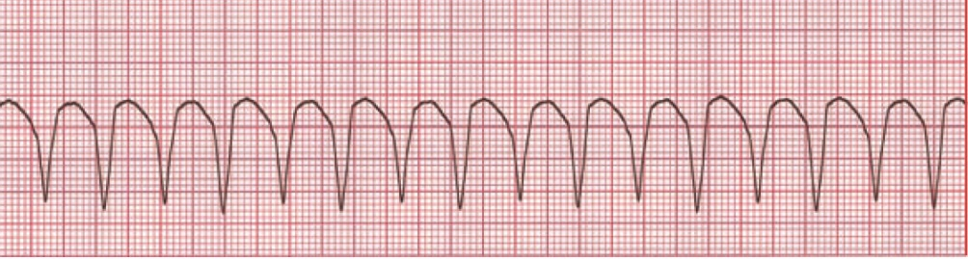
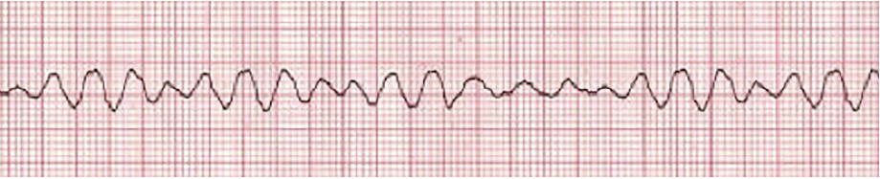
HCM and sudden cardiac arrest
HCM is the leading cause of sudden cardiac death in young athletes
Sudden cardiac arrest (SCA)/death is rare, but immediate and drastic
  A person (typically young adult athlete in HCM) suddenly collapses, with absent pulse and respirations. Occasional there is chest discomfort/dyspnea/palpitations immediately prior to the arrest, but it often occurs without warning
  Caused by ventricular arrythmias (sustained Ventricular Tachycardia / Ventricular Fibrillation)

Slide 42
HCM and sudden cardiac arrest
Risk is greatest in pts <40yoa, previously identified non-sustained VT, massive hypertrophy, hypotension on stress test, and FH of SCA
In patients with acute hemodynamic collapse / SCA
  Life-saving interventions will be discussed in ACLS and arrythmias lecture, but prompt defibrillation and CPR is necessary

Slide 43
Arrhythmogenic right ventricular
Cardiomyopathy

Slide 44
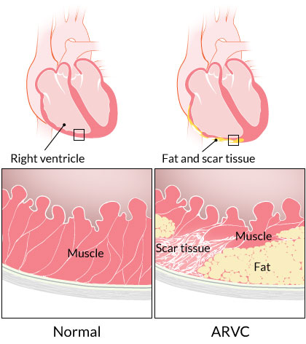
Arrhythmogenic Right Ventricular Cardiomyopathy
Autosomal dominant disorder
Mutations in genes encoding for desmosomal proteins, which cause myocyte detachment and apoptosis. The myocytes are then replaced by fibro-fatty tissue

Slide 45
Arrhythmogenic Right Ventricular Cardiomyopathy
Presents typically with right-sided heart failure symptoms and various rhythm disturbances, particularly VT
Often precipitated by release of catecholamines during exercise and is the 2nd MCC of sudden death in athletes
Often diagnosed in the 2nd or 3rd decade of life

Slide 46
Arrhythmogenic Right Ventricular Cardiomyopathy
Three phases of clinical presentation:
  Concealed phase- asymptomatic patients
  Electrical phase - patients present with palpitations or syncope
  Diffuse phase - patient’s present with right sided heart failure
Results in:
  Right sided heart failure (JVD, peripheral edema, ascites, etc.)
  V-Tach
  Sudden death

Slide 47
Arrhythmogenic Right Ventricular Cardiomyopathy
EKG is suggestive, but nonspecific
  50% of patients will have a normal EKG at presentation
  However, all patients had one or more EKG findings in a retrospective study performed over 6 years
  PVCs, QRS prolongation, V-Tach, bundle branch blocks, T wave inversions, Epsilon wave

Slide 48
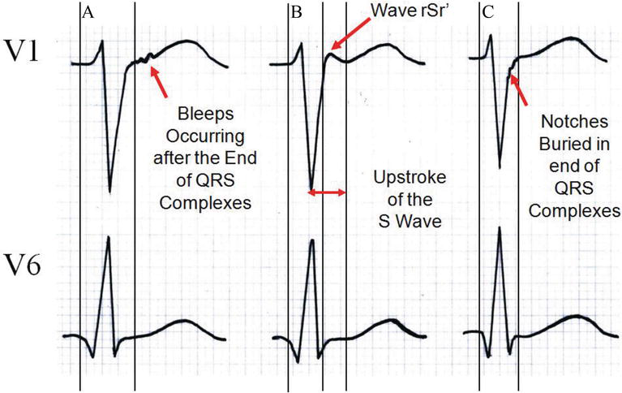
Arrhythmogenic Right Ventricular Cardiomyopathy
Epsilon waves: notches/blips/wiggles at the end of the QRS complex in precordial leads (particularly V1)
  Caused by delayed excitation of the myocytes strands that are scattered between fibrous and fatty tissue

Slide 49
Arrhythmogenic Right Ventricular Cardiomyopathy
Echocardiogram is again, the test of choice for diagnosis
  Demonstrates enlarged/dilated RV with RV wall motion abnormalities and possibly fatty tissue in the RV wall
  Left ventricle is normal (until later stages)
Cardiac MRI
  Used as a follow up study
  Best study to identify the fibro-fatty infiltrates in patient with RV findings on echo

Slide 50
Arrhythmogenic Right Ventricular Cardiomyopathy
Treatment consists of:
  Activity restriction (avoid competitive/strenuous exercise)
  Anti-arrhythmic drugs – first line are BB
  Implantable cardio defibrillator (ICD) - appropriate for the secondary prevention of sudden cardiac death in those who have experienced a sustained ventricular arrhythmia
  Last resort is cardiac transplantation

Slide 51
Mixed
    Dilated cardiomyopathy (DCM)
    Restrictive cardiomyopathy (RCM)

Slide 52
Dilated
cardiomyopathy

Slide 53
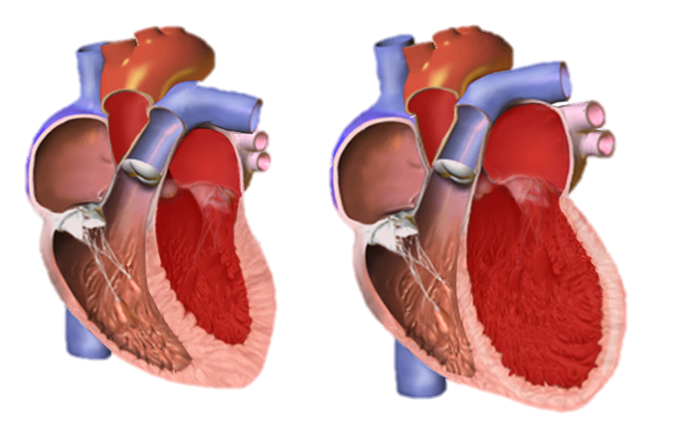
Dilated cardiomyopathy
The most common form of cardiomyopathies
Characterized by dilation of the ventricle (typically left but can also include right) and impairment of ventricle contraction
  Systolic dysfunction (ejection fraction ≤ 40%) with left ventricular enlargement
  Usually presents with features of cardiomegaly and s/s of heart failure that are progressive, often becoming severe
Normal
DCM

Slide 54
Dilated cardiomyopathy
Causes are mixed: genetic and acquired
  Acquired from ETOH use; early stages may be reversible if able to abstain from alcohol
  Acquired from pregnancy (PPCM); though there may be some underlying genetic factors
  About 35% of DCM are attributed to genetics
    Muscular Dystrophy: mutation in the dystrophin encoding gene causes lysis of the cardiomyocytes
  Drugs/Toxins represent another source of acquired DCM
    Chemotherapy agents: doxorubicin (Adriamycin) – generally develops within 3 months of last dose
    Anti-rheumatic agents: hydroxychloroquine (Plaquenil)
  Idiopathic (50%) – family members in half of idiopathic DCM patients are found to also have abnormal cardiac evaluations

Slide 55
Dilated cardiomyopathy
Clinical symptoms:
  Typical present with left-sided heart failure, which include exertional intolerance/dyspnea early and PND/orthopnea in later stages. Cough with frothy sputum (signifying pulmonary edema), and right heart failure symptoms will then occur, such as anasarca, LE edema, and abdominal distension
Physical exam:
  May see signs of left-sided heart failure +/- right-sided HF
    S3 heart sound and regurg murmurs (tricuspid and mitral)
    Rales
    Elevated JVP, peripheral edema, ascites

Slide 56
Extra Heart Sound: s3
Heard in dilated cardiomyopathies
Also called the ventricular diastolic gallop or “Kentucky murmur”
low-pitched sound occurring at the beginning of diastole shortly after S2 (lub-dub-ta)
Best heard at the cardiac apex with the patient in the left lateral position
Accentuated in more tachycardic patients

Slide 57
Dilated cardiomyopathy
Workup includes:
  Echo will provide the most useful information and is the test of choice for diagnosis
    Findings: dilation of the cavity of the left ventricle with a normal or decreased wall thickness, reduced inward endocardial systolic motion, EF ≤ 40%
      May also include enlargement of the atria and RV as well

Slide 58
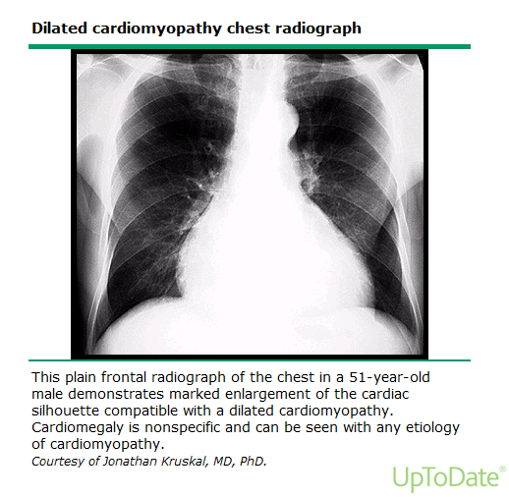
Dilated cardiomyopathy
Workup includes:
  CXR: suggestive but not specific enough to diagnosis DCM. Findings include:
    Cardiomegaly and fluffy infiltrates (known as Kerley lines)
      Kerley A lines: long (at least 2cm) un-branching lines coursing diagonally from the hila out to the periphery of the lungs
      Kerley B lines: short, fat horizontal lines in the periphery
      Kerley C lines: short, fine lines throughout the lungs (least common)
    May also see pleural effusions

Slide 59
Dilated cardiomyopathy
Workup includes:
  ECG: sinus tach and LBBB are most common; a-fib is 2nd most common (again, these are not specific to DCM)
  BNP: helps establish prognosis and severity of HF (increasingly elevates as heart failure worsens)
  Troponins not useful except to rule out acute coronary event
  Stress test
  Cardiac cath may be included to evaluate for ischemic causes

Slide 60
Dilated cardiomyopathy
Treatment:
  Correct reversible causes if possible (i.e. ETOH)
  Treat heart failure
    Beta-Blockers (reduce heart rate and myocardial O2 demand)
    Vasodilators: ACE inhibitors (for afterload reduction) and nitroglycerin (for preload & afterload reduction)
    Diuretics (i.e. furosemide)

Slide 61
Dilated cardiomyopathy
Treatment:
  Prevent thromboembolism with anticoagulants
  Manage dysrhythmias
    Beta blockers
    Digoxin (positive inotrope used for dilated cardiomyopathy)
    Implantable cardioverter/defibrillators (ICD)
  Cardiac transplantation: DCM is most common reason

Slide 62
restrictive
cardiomyopathy

Slide 63
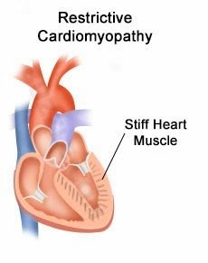
Restrictive cardiomyopathy (RCM)
Less common than DCM or HCM
Distinct characteristics as compared to DCM and HCM:
  Non-dilated ventricles with (usually) normal wall thickness (although infiltrative disease may cause increase LV wall thickness)
  Ventricular walls are rigid (“stiff ventricles”), resulting in severe diastolic dysfunction and restrictive filling with elevated filling pressures and dilated atria
  LV systolic function usually remains normal (though will start to become impaired when RCM is severe)

Slide 64
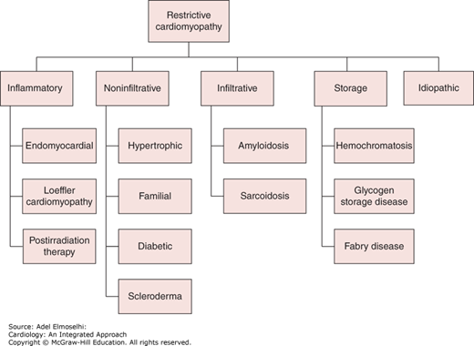
~50% of RCM
Classification of restrictive cardiomyopathy. (Reproduced, with permission, from Crawford MH, ed. Current Diagnosis and Treatment: Cardiology. 4th ed. New York, NY: McGraw-Hill; 2014.)
Citation: Chapter 14 Myocardial Diseases, Elmoselhi A. Cardiology: An Integrated Approach; 2017. Available at: https://accessmedicine.mhmedical.com/content.aspx?sectionid=171661981&bookid=2224 Accessed: October 09, 2020
Copyright © 2020 McGraw-Hill Education. All rights reserved

Slide 65
Restrictive cardiomyopathy (RCM)
RCM develops Left and Right heart failure, and progression is usually rapid
  SOB
  Orthopnea
  PND
  JVD, peripheral edema, ascites
  Gallop rhythm (S3 or S4) and regurg murmurs

Slide 66
Restrictive cardiomyopathy (RCM)
Workup includes:
ECG: nonspecific abnormalities, may show decreased QRS amplitude
CXR: may show cardiomegaly (secondary to enlarged atria) and pulmonary congestion
Echocardiogram: TOC – shows non-dilated, non-hypertrophied ventricles with bi-atrial enlargement, preserved systolic LV but abnormal diastolic function

Slide 67
Restrictive cardiomyopathy (RCM)
Workup includes:
Cardiac MRI: provides data regarding the presence or absence of myocardial infiltration and fibrosis, patterns which inform the diagnosis of specific forms of RCM
Endomyocardial biopsy: most accurate, but invasive and less commonly used. It may be necessary to confirm the presence of infiltrative disease if MRI is unclear/equivocal

Slide 68
Restrictive cardiomyopathy (RCM)
No cure; management is aimed at HF and arrhythmia
RCM has the lowest one-year survival rates when compared to DCM and HCM; most patients die within a few years of diagnosis
Heart transplant may be performed but seldom advised because of the underlying primary disease

Slide 69
Acquired
    Myocarditis (infectious/inflammatory)
    Peripartum cardiomyopathy (PPCM)
    Stress-related “Tako-Tsubo” cardiomyopathy

Slide 70
Myocarditis
Cardiomyopathy

Slide 71
Myocarditis
An inflammatory process with necrosis that involves the myocardium
The histologic hallmark is a focal patchy or diffuse inflammatory infiltrate with adjacent myocyte injury
Course of illness varies:
  Asymptomatic, self-limiting
  Fevers, chest pain, chills, N/V/D, arthralgia, myalgia
  Acute HF, arrhythmias and death

Slide 72
Myocarditis
Etiologies:
  Most commonly initiated by viral infection
    The most common viruses associated with myocarditis in the United States and Western Europe in immunocompetent persons are adenoviruses, coxsackievirus B (enterovirus), parvovirus B19, herpes simplex, influenza A, and cytomegalovirus (CMV)

Slide 73
Myocarditis
Etiologies also include:
  Bacteria: (mycoplasma, staph, strep, haemophilus, tuberculosis…)
  Fungus: (toxoplasmosis, coccidiomycosis, histoplasmosis)
  Parasites: (Amebiasis)
  Protozoan: (Chagas disease - South America)
  Autoimmune conditions: (Giant-Cell Myocarditis)
  Drugs, toxins, hypersensitivity reactions, collagen vascular diseases, and autoimmune reactions may also be contributing factors

Slide 74
Myocarditis
Myocarditis may initially be overshadowed or completely masked by the constitutional symptoms of the illness
  i.e. fever, malaise, fatigue, arthralgias, myalgias, and skin rash
Red flag: frequently seek medical attention days/weeks after an acute flu-like syndrome
  C/o of chest pain or present with s/s of acute onset of HF (dyspnea, fatigue, decreased exercise tolerance, palpitations, JVD, peripheral edema, ascites)
  Other presentations may include syncope, ventricular arrhythmias, complete heart block, or emboli (such as a PE)

Slide 75
Myocarditis
Workup:
  ECG: Tachycardia and non-specific ST and T wave changes
  Positive cardiac enzymes
  +/- cardiomegaly on CXR
  Echo: many presentations; left ventricular dysfunction is commonly seen but findings can mimic HCM, DCM, RCM and ARVC

Slide 76
Myocarditis
Supportive care
  Hospitalize and monitor closely for HF, arrhythmias
  Rest
  NSAIDs
  Oxygen
  +/- antibiotics

Slide 77
Myocarditis
Heart Failure management
  Restrict fluids
  Diuretics (acutely, then continue depending on course)
  ACE inhibitors or Beta Blockers (ongoing management)
Anticoagulation necessary if embolic event (such as PE) or mural thrombi detected on ECHO
In severe cases: arrhythmia suppression, hemodynamic support, vasopressors, positive inotropes, intra-aortic balloon pumps
Prolonged courses can result in the need for a heart transplant

Slide 78
Peripartum
Cardiomyopathy

Slide 79
Peripartum cardiomyopathy (PPCM)
Rare form of CM that is acquired in late pregnancy or early post-partum (mc during 1st month after delivery)
LV systolic dysfunction with ejection fraction of ≤45%
LV is frequently dilated; typically presents like a dilated cardiomyopathy
Etiology is unknown

Slide 80
Peripartum cardiomyopathy
Risk factors:
  Age > 30 years
  African descent
  Multiple gestation pregnancy
  Hx preeclampsia, eclampsia, or postpartum hypertension
  Maternal cocaine use
  Prolonged tocolytic therapy with oral beta-adrenergic agonists (i.e. terbutaline)

Slide 81
Peripartum cardiomyopathy
The clinical presentation is variable and similar to the other CMs
  Dyspnea, cough, orthopnea, PND, pedal edema
    Initial diagnosis may be delayed because of ‘normal’ pregnancy symptoms such as nonspecific fatigue, SOB, swelling of feet
  PE findings may include an elevated JVP, a displaced apical impulse, S3, mitral regurgitation murmur

Slide 82
Peripartum cardiomyopathy
For diagnosis, must meet all 3 criteria:
  HF toward end of pregnancy or within 6 months of delivery
  Absence of another identifiable cause of HF
  LV systolic dysfunction = LVEF ≤ 45%

Slide 83
Peripartum cardiomyopathy
Workup needs to include Echo and ECG
Other studies such as BNP, CXR, cardiac MRI, cardiac catheterization, and endomyocardial biopsy may be helpful in selected cases

Slide 84
Peripartum cardiomyopathy
Treatment of PPCM is similar to other forms of dilated CM but modifications are usually needed for safety of mother and unborn/breastfeeding baby
  Avoid ACEi/ARBs in pregnancy/breastfeeding
Prompt delivery is suggested in women with PPCM with advanced HF and hemodynamic instability

Slide 85
Peripartum cardiomyopathy
Half of patients with PPCM will spontaneously recover; the other half will have persistent left ventricular dysfunction, heart failure and early death
  1 in 10 PPCM diagnoses will be fatal
Advised to avoid future pregnancies due to risk of recurrence, HF progression and maternal death

Slide 86
Tako-tsubo
Cardiomyopathy

Slide 87
Tako-tsubo Cardiomyopathy
AKA “stress-induced CM” and “broken-heart syndrome”
Transient LV dysfunction without significant coronary artery disease
Precipitated by acute emotional or psychological distress
Surge of catecholamines causes coronary artery spasm – presents like a STEMI

Slide 88
Tako-tsubo Cardiomyopathy
First described in Japan – 1990s; demonstrated impaired myocardial contractility of the heart’s apex with hypercontractility of the left ventricle base
  Results in transient apical ballooning, resembling its Japanese namesake (a pot used to trap octopus)

Slide 89
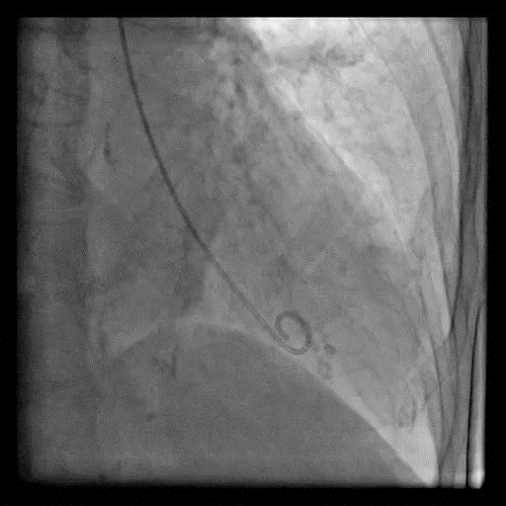
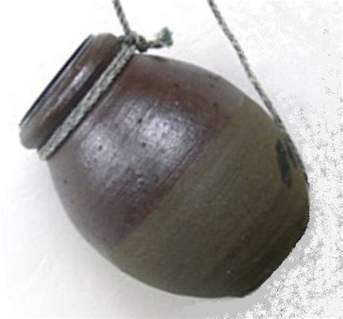
Tako-tsubo Cardiomyopathy
Stress cardiomyopathy, apical variant.
Left ventriculography shows akinesis of the anterolateral, apical, and inferior apical segments with hyperdynamic function of the basal segments.
Graphic 112457 Version 1.0

Slide 90
Tako-tsubo Cardiomyopathy
In the acute situation, you’ll first treat this as a STEMI due to clinical picture, EKG findings, and elevated troponin levels
  However, a cardiac cath will visualize LV wall motion abnormalities and find no evidence of significant CAD
Some patients may develop acute complications such as cardiogenic shock and acute HF, requiring intensive care

Slide 91
Tako-tsubo Cardiomyopathy
Patients who survive the acute episode typically recover LV function within 4 weeks
  Benzodiazepines (i.e. diazepam & lorazepam) may be used once pt is stable to reduce stress and decrease catecholamine release
2% yearly risk of recurrence; some specialists may prefer life-long BB but efficacy is unknown

Slide 92


