Slide 1
Lipid Physiology and Dyslipidemia
Sarah Brandell MPAS, PA-C
Fall Semester

Slide 2
Outline
Atherosclerosis
Lipoprotein Metabolism
What is a lipoprotein
FFA mobilization
Ingestion
From Adipose Stores
Liver Production
Cholesterol mobilization
Ingestion
Liver Production
Dyslipidemia
Primary vs Secondary Prevention
CAD/HLD Risk Factors
Clinical Features
Genetic
Familial Hypercholesterolemia
Familial Hypertriglyceridemia
Dyslipidemia Diagnostics
Lipid Panel
NMR
Hs CRP
CAC
Timing appropriate labs/diagnostics
Diagnostic Interpretation (Framingham)
Algorithm
Dyslipidemia Treatment
Lifestyle
Medications
Algorithm
Follow Up

Slide 3
Atherosclerosis

Slide 4
Atherosclerosis
MCC of CV morbidity and mortality
Progressive disorder which leads to Coronary Heart Disease, Cerebrovascular Disease, PAD, Aortic Atherosclerosis/Aneurysm
1:6 American Teenagers noted to have beginning stages
“Narrowing and Hardening of arteries”
Endothelial Injury
Accumulation of lipoproteins
Inflammation

Slide 5
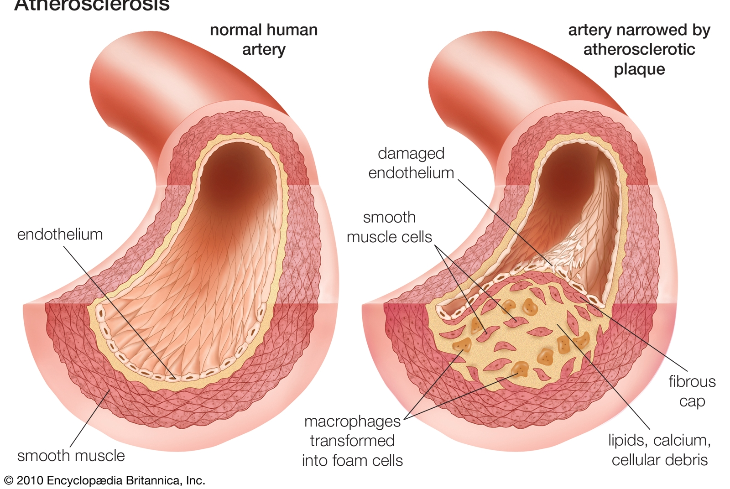
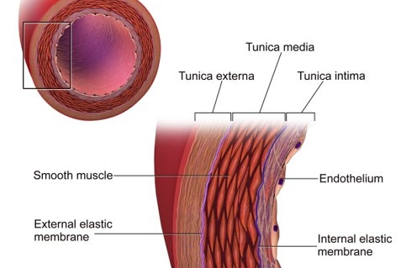
Atherosclerosis Pathophysiology

Slide 6
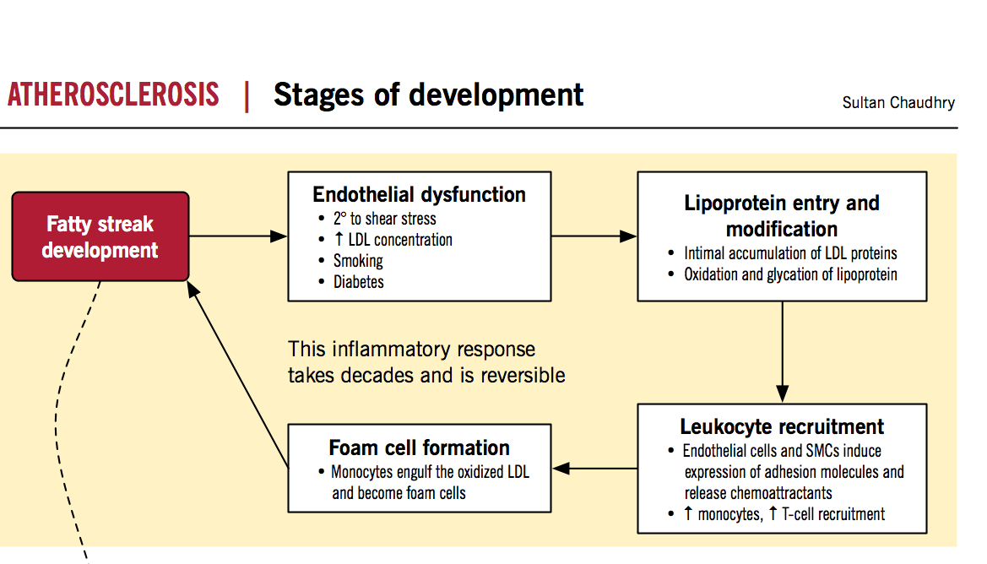
Atherosclerosis Pathophysiology
Early Phase: small lipoprotein particles penetrate the vascular endothelium where they are oxidized & gather within the intimal layer
  This process is accelerated at sites of endothelial damage within the vessel lumen (HTN, smoking, sheer forces)

Slide 7
Atherosclerosis Pathophysiology
Accumulation of lipoproteins in the intima causes ↑ adhesion molecules on the endothelial layer forming a “fatty streak”
Circulating Monocytes (macrophages) in the blood bind to these streaks ingesting the lipoprotein groups creating “foam cells”

Slide 8
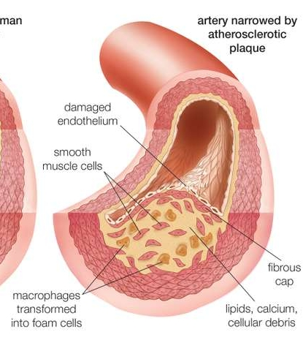
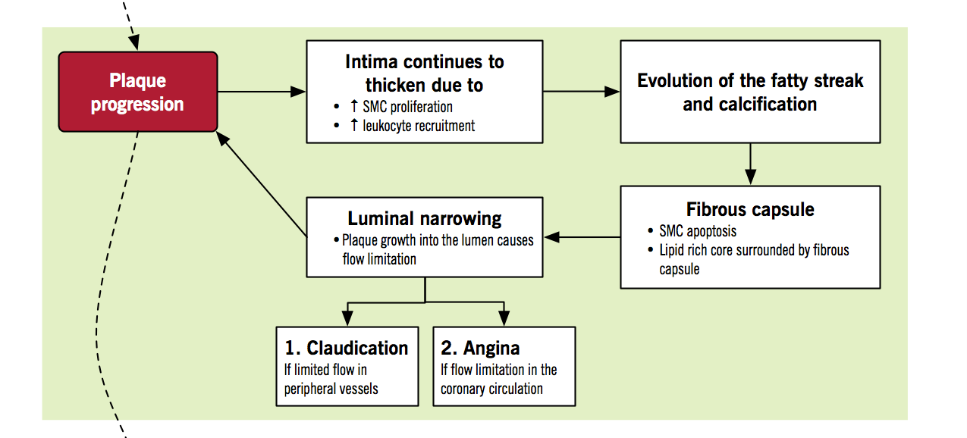
Atherosclerosis Pathophysiology
The Smooth Muscle layer of the vessel wall attempts to protect this lesion by:
  Depositing Calcium – hardening the arteries → vasodilation now inhibited in this area
  Creating a “Fibrous Cap” – narrowing the arteries
This area is now considered an “Atherosclerotic Plaque”
Inflammation causes the area to become locally Prothrombotic

Slide 9
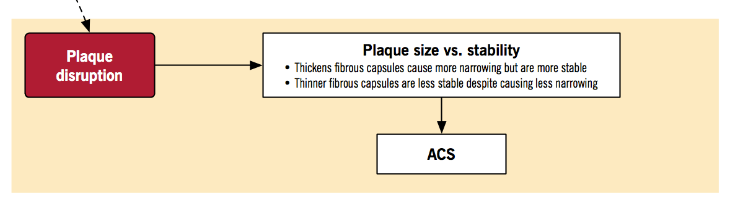
Atherosclerosis Pathophysiology
This Plaque is predisposed to fissure/rupture
If this occurs the core the plaque being exposed can possibly cause formation of a thrombus or embolus 2/2 platelet aggregation

Slide 10
Atherosclerosis Pathophysiology
This leads to oxygen deprivation…and inherent risk to the Heart and Brain!​
- ACS: STEMI/NSTEMI/UA/SA ​
- Cerebrovascular phenomenon as well: TIA/CVA ​
In addition to impairment of blood flow to kidney’s and/or lower extremities ​
  Which contributes to morbidity and mortality in afflicted patients​
All these are associated into the broader clinical arteriosclerotic cardiovascular disease (ASCVD) risk.

Slide 11
Clinical Arteriosclerotic Cardiovascular Disease (ASCVD) Defined in the following:
Stable Angina
Acute Coronary Syndromes (ACS)
  MI- STEMI/NSTEMI
  Unstable angina- UA
Stroke (ischemic): CVA or TIA
Peripheral arterial disease (PAD)
Hx of a need for coronary or other arterial revascularization

Slide 12
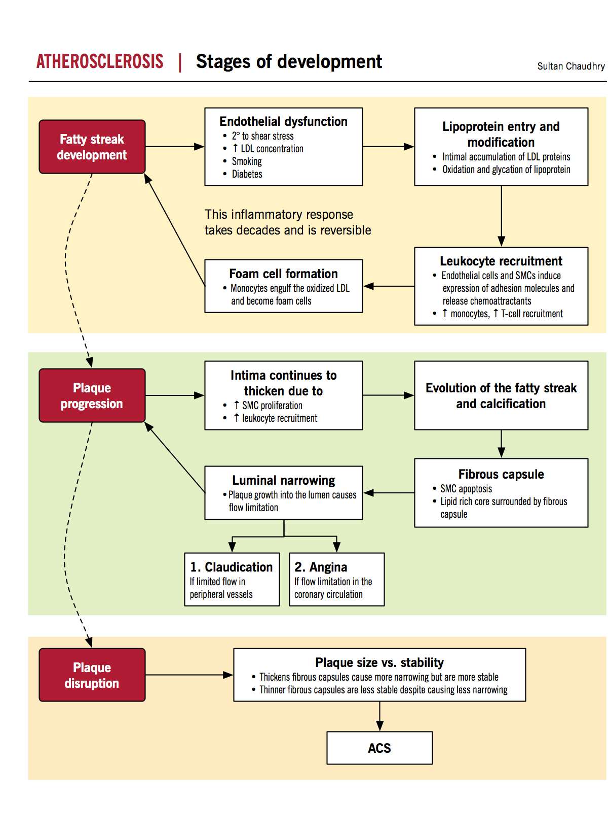
Atherosclerosis Pathophysiology

Slide 13
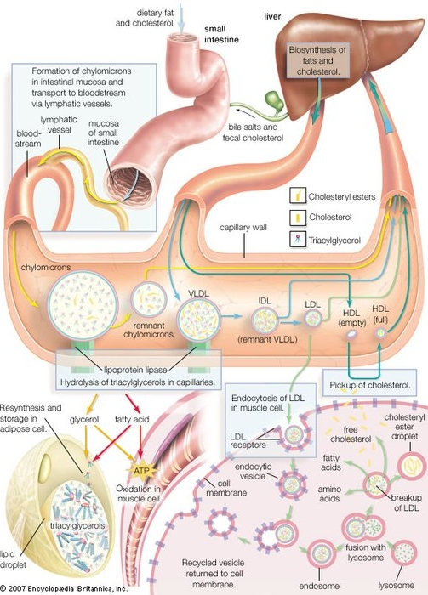
Lipoprotein Metabolism

Slide 14
Lipoprotein Metabolism
Lipids (triglycerides and cholesterol): are hydrophobic therefore they are commonly transported in lipoproteins

Slide 15
Free Fatty Acids/Triglycerides
Free Fatty Acids (FFAs) are mobilized for tissues in 3 ways
  Ingestion from Diet - chylomicrons
  Adipose Cells release them – via albumin
  Liver Produces them - VLDL, IDL, LDL
Tissues such as Muscle cells can absorb fatty acids for ATP production
If not needed, stored in adipose cells

Slide 16
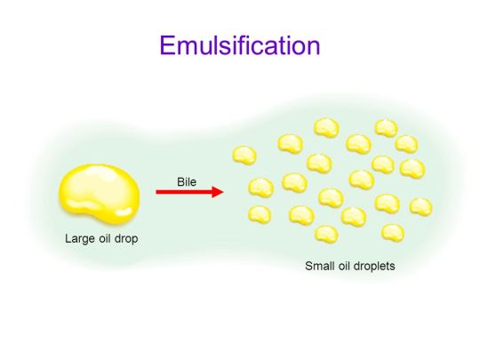
Lipoprotein Metabolism
– Free Fatty Acids
1. Ingestion from Diet:
  Consumed Fat is emulsified by Bile Acids during digestion
    Bile Acids: synthesized by LDL cholesterol, and reabsorbed in the small intestine
  Lipase is then able to break fat down into fatty acids
  The small intestine cells are able to absorb FFAs
  Within the cell: the FFAs are repackaged for transport into a Chylomicron Lipoprotein

Slide 17
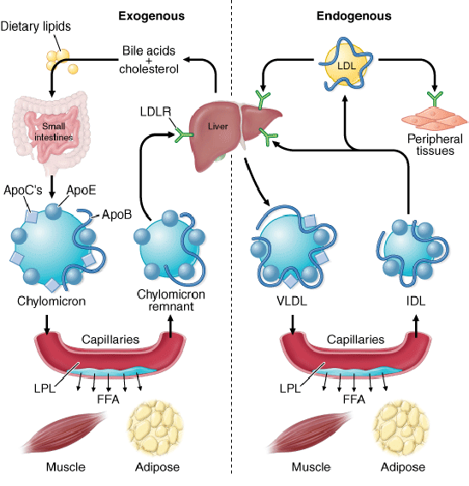
Lipoprotein Metabolism
– Free Fatty Acids
1. Ingestion from Diet (cont.):
  At the level of the capillaries LPL-Lipoprotein Lipase breaks up the chylomicron into FFAs the tissue can absorb for use/storage
    Tissues (muscle cells) oxidize FFAs into ATP
    LPL is activated by insulin
    Apo C-II receptor on Chylomicron binds with LPL
  Chylomicron Remnants (CR) : leftover FFAs and cholesterol can be utilized in the liver

Slide 18
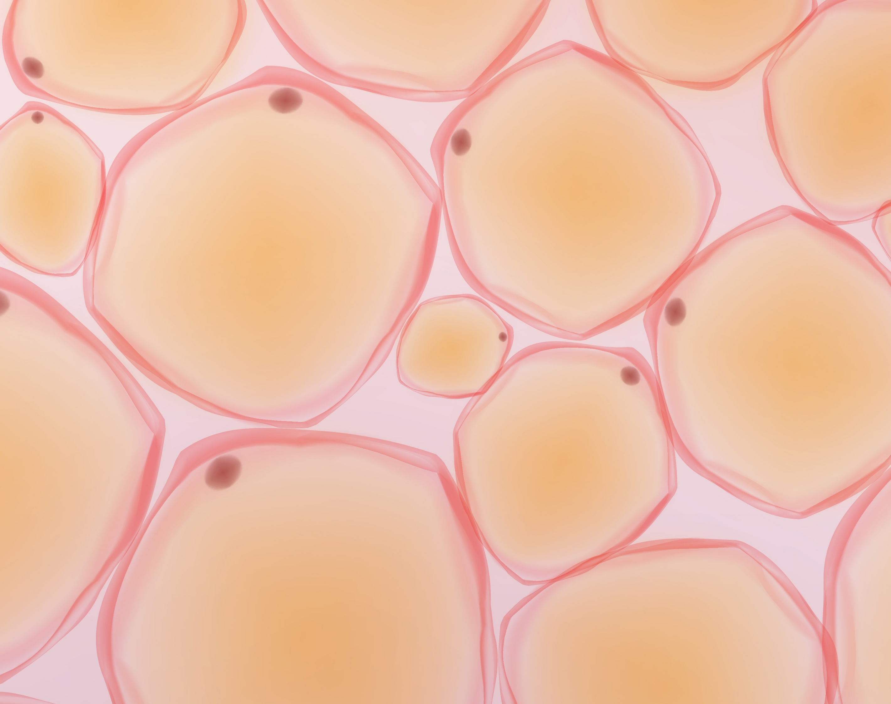
Lipoprotein Metabolism– Free Fatty Acids
2. Adipose Cells:
Stored FFA globules are located on the adipocytes.
FFAs are able to travel in the blood stream attached to Albumin
1-2 hours after a meal: ↓ insulin, ↑ glucagon
This signals FFAs to release from the adipose cells

Slide 19
Lipoprotein Metabolism – Free Fatty Acids
3. Liver Production:
The liver is able to take excess glucose and turn it into FFAs that it then stores onto a lipoprotein called VLDL
Cytoplasm
Mitochondria
Acetyl CoA (2C)
Glucose (6C)
Glycolysis
Pyruvate (3C)
Pyruvate (3C)
KREBS Cycle
OAA
Citrate (6C)
Citrate (6C)
OAA
Acetyl CoA
Free Fatty Acids

Slide 20
Lipoprotein Metabolism
– Free Fatty Acids
3. Liver Production (Cont.):
The Liver can absorb those CR (chylomicron remnants) and add these FFAs produced in the image below to create VLDL (Very low-density lipoproteins)

Slide 21
Lipoprotein Metabolism – Free Fatty Acids
3. Liver Production (Cont.):
VLDL are similar to chylomicrons in function, they can be transported to capillaries of tissues that may need to use/store FFAs
APO C-II receptor on the surface of VLDL activates LPL (lipoprotein lipase) allowing for FFAs to released and absorbed by the tissues
Remaining VLDL remnants are cleared from circulation or hydrolyzed to create IDL (intermediate density lipoprotein) and LDL (Low Density Lipoprotein)
  APO B on the surface of the LDL facilitate LDL clearance

Slide 22
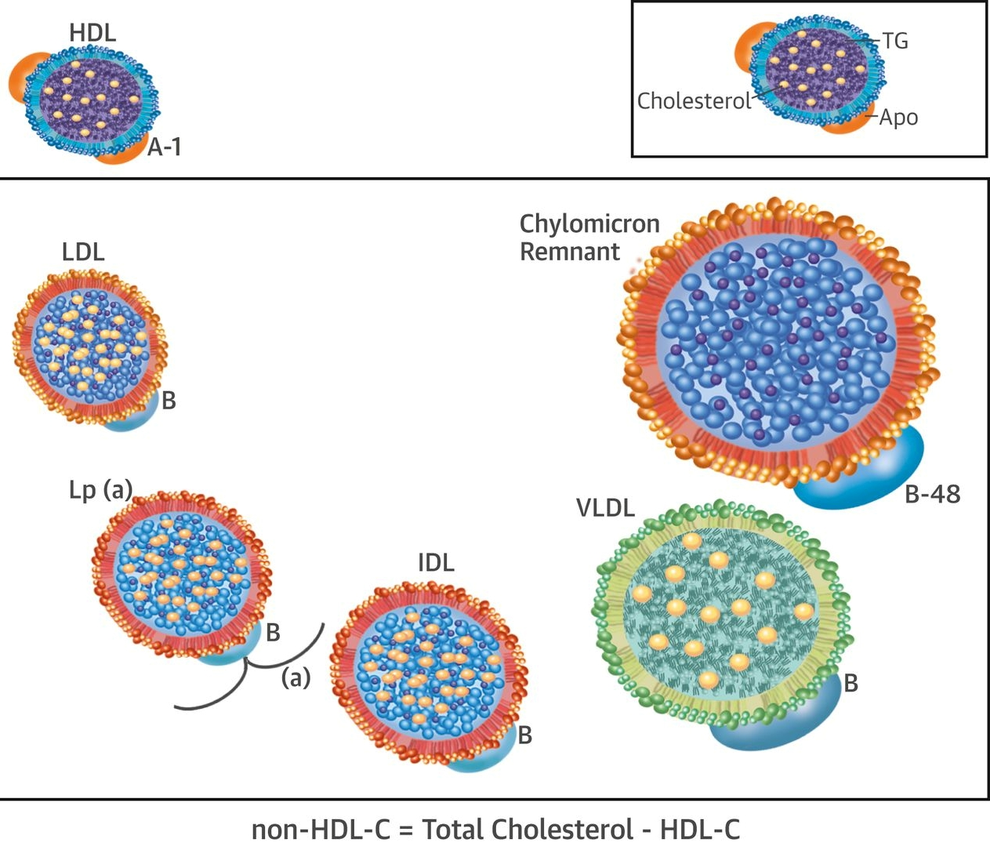
Lipoprotein Metabolism

Slide 23
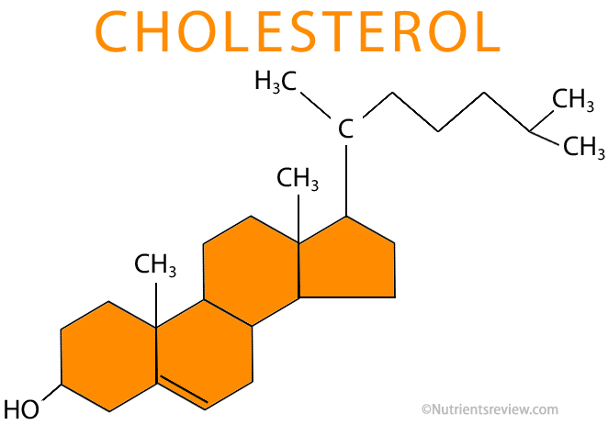
Lipoprotein Metabolism – Cholesterol
Esterified Complex Lipid
Cholesterol is used for hormone synthesis, bile acid production, cell membrane production, and stores energy.
Present in combination with TGs to form lipoproteins

Slide 24
Lipoprotein Metabolism – Cholesterol
Niemann-Pick C1-Like1 (NPC1L1) Transporter
Cholesterol Metabolism:
The Small intestine absorbs ingested cholesterol on a gradient
Liver Parenchymal Cells can synthesize cholesterol as well
Clearance of Cholesterol is completed by recycling cholesterol into bile acids OR free form liver excretion.
Acetate
HMG CoA
HMG CoA Reductase
Mevalonic Acid
Cholesterol

Slide 25
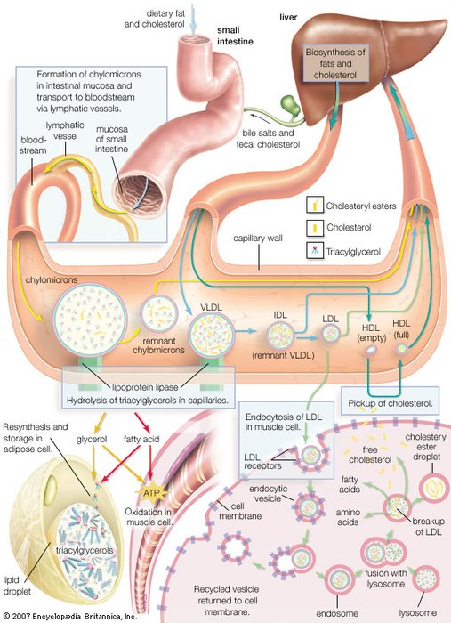

Slide 26
Dyslipidemia

Slide 27
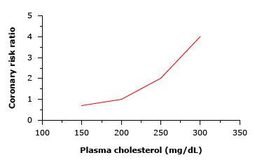
Dyslipidemia: Why do we care about Lipids?
Elevated LDL c (hyperlipidemia) increase the risk for CAD
Elevated HDL c may be cardioprotective
Elevated TG (Hypertriglyceridemia) risk factor for atherosclerosis, and if severe can cause pancreatitis

Slide 28
CAD Prevention- Primary vs Secondary
Primary prevention: management strategies provided prior to the onset of CVD related events. ​
  This of course requires recognition! ​
  But acting here provides the best long term results.
  ​
Secondary prevention is a management plan for those who have already experienced CVD events: ​
- The efforts to prevent progression and/or recurrence

Slide 29
CAD Prevention
Approximately 37% of patients that have an acute coronary event will die of a coronary event in the same year​
​
- So, catching before secondary prevention treatment is implemented is ideal!​
​
- However, still of benefit to treat at any time…

Slide 30
CAD Prevention
​- Since 1968 death rates from CVD have decreased. ​
- In fact, since 1980 the reduction in deaths have been attributed to the success of both recognition and various management strategies:​
- 50% 2/2 improvement in treatments​
- 50% 2/2 improvement in risk factors

Slide 31
CAD Risk Factors
Modifiable
Blood Lipid Abnormalities*​
Diabetes Mellitus​
Hypertension​
Sedentary Lifestyle​
Abdominal Obesity
Cigarette Smoking​
Psychosocial Factors​
Diet
Too much Alcohol​
Non-Modifiable
Familial History​
- The younger the onset of a 1st degree relative the ↑ the risk ​
Male Sex
Genetic Disorders

Slide 32
CAD Risk Factors Effects on Lipids
Smoking
​
- Causes endothelial dysfunction
- ↑ oxidative arterial deposition of LDL​
​- ↓ HDL levels
- Tissue hypoxia 2/2 oxidant stress​
- ↑ platelet and leukocyte adhesions​
- ↑ SNS activity 2/2 nicotine​
- Displacement of O2 from Hgb
HTN
- Elevated BP causes damage to endothelium, ↑ permeability to vessel walls for lipoproteins “shear forces”

Slide 33
CAD Risk Factors Effects on Lipids
DM
Glycation of lipoproteins, enhances uptake of cholesterol by scavenger macrophages (foam cells) AND ↑ pro-thrombotic tendency
Causes oxidative damage of endothelial lining
Can cause an over production of LDL and TG
Physical Activity
Lack of physical activity =
weight gain, ↑LDL, ↓HDL
​Routine physical activity =
weight loss, ↓LDL, ↑HDL

Slide 34
CAD Risk Factors Effects on Lipids
Obesity
Can lead to an over production of LDL/total cholesterol
EtOH Abuse
Can lead to an over production of LDL/total cholesterol

Slide 35
CAD
Despite Risk Factor Modification… the burden of disease is still felt!​
- CAD still responsible for 1 in 5 deaths every year​
- CAD still afflicts more than 16M people every year, and this is expected to increase due to an aging population​
Possibly because: ​
Only 1 out of every 3 adults with high LDL cholesterol has the condition under control​
Less than half of adults with high LDL cholesterol get treatment​

Slide 36
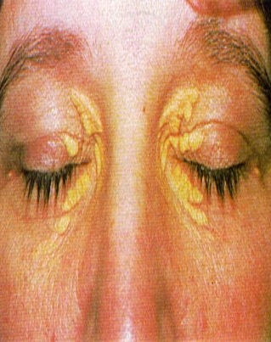
Dyslipidemia
Clinical Features:
MC asymptomatic ***
Xanthelasma: ​Yellowish plaques that occur most commonly near the inner canthus of the eyelid, more often on the upper lid than the lower lid. Can be permanent.

Slide 37
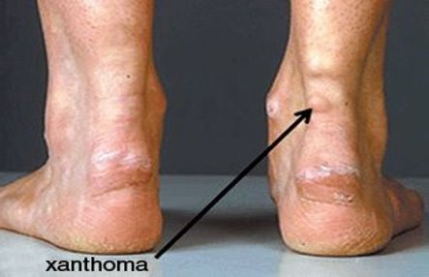
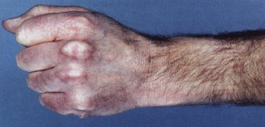
Dyslipidemia
Clinical Features:
Tendon Xanthoma: cholesterol can collect within prominent tendons if very elevated
- Achilles​
- Patella​
- Back of the hand

Slide 38
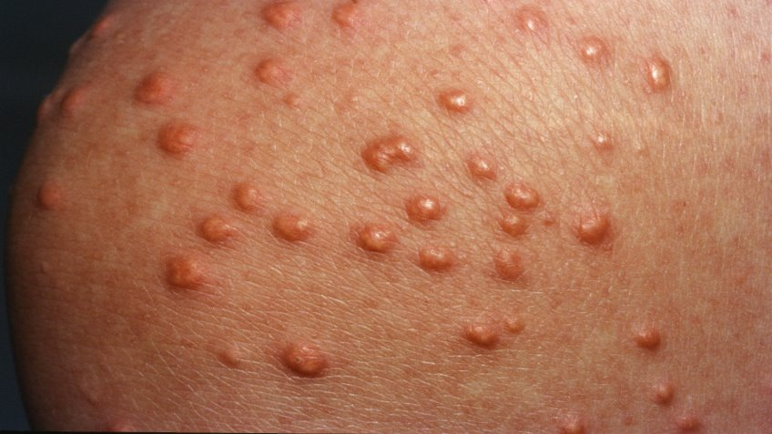
Dyslipidemia
Clinical Features:
Eruptive Xanthoma: sudden eruption on the skin, red, yellow papular eruptions, that are regarded as “firm pea-sized bumps” sometimes, “with a creamy center”. ​
  They may appear on the hands, feet, arms, legs and especially the buttocks. The papules may be even be pruritic. ​
  ​It is due to ↑ triglycerides
  ​The xanthomas usually disappear when the underlying condition is treated, such as when the diabetes comes under control.

Slide 39
Dyslipidemia
Causes:
Genetic
  Familial HLD, Familial Hypertriglyceridemia
More Commonly Secondary to Risk Factors
  DM, Alcohol, hypothyroidism, obesity, sedentary lifestyle, renal or liver disease, smoking, medications, dietary intake

Slide 40
Genetic Causes of Dyslipidemia
Familial Hypercholesterolemia
Familial Hypertriglyceridemia

Slide 41
Genetic Disorders of Lipid Metabolism
Familial Hypercholesterolemia
Suspect when:
LDL-C >190 mg/dL
AND
either a first degree relative with LDL-C>190 mg/dL or with known premature coronary heart disease
(<55 years men; <65 years women)

Slide 42
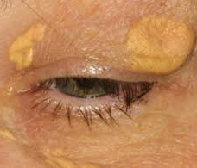
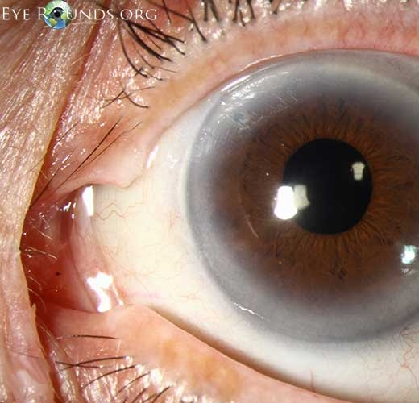
Familial Hypercholesterolemia:
1. Familial Defective LDL Receptor:
  Mutation in gene that encodes LDL APO B/E receptor on the surface of the liver
  This decreases the clearance of LDL
  Clinical Symptoms:
    Excess LDL causes increased intravascular Plaque formation
    Skin/tendon – xanthoma
    Eyelids – xanthelasma
    Iris – corneal arcus

Slide 43
Familial Hypercholesterolemia:
1. Familial Defective LDL Receptor:
Homozygous FH, autosomal dominant, rare
  Presents early in life
  These patients develop CAD, aortic stenosis, and tendon xanthomas
  Commonly can die of MI < 20 yo without early intervention
Heterozygous FH, 1 in 500 individuals
  Cells display ½ the normal amount of functional LDL receptors
  CAC scores noted as early as 11 yo
  Premature CAD (< 55 in men, < 65 in women), and clinical signs
TX: Early Intervention of Lipid Management

Slide 44
Familial Hypercholesterolemia:
2. Familial Defective Apolipoprotein B
  Autosomal dominant disorder
  Defect in the Apo B protein results in impaired binding of LDL particles to LDL receptor
  1 in 750 Caucasians with HLD
  Clinical Manefestations: Similar to Defective LDL Receptor, cholesterol deposit symptoms and Early Coronary Artery Dz
  Treatment: Early Intervention of Lipid Management

Slide 45
Genetic Disorders of Lipid Metabolism
Familial Hypertriglyceridemia
Two main causes: over production, under utilization
TG levels >750 can cause pancreatitis

Slide 46
Familial Hypertriglyceridemia
1. Overproduction
Overproduction of hepatic VLDL, mutation/cause unknown
Secondary factors (DM, alcohol, estrogen) can exacerbate this condition
Tx: Low carbohydrate diet trial and or low fat intake (to avoid worsening the problem), Fish Oil/Vacepa, Historically Fibrates (we will discuss in the pharm section)

Slide 47
Familial Hypertriglyceridemia
2. Under Utilization
Lipoprotein Lipase Deficiency
  Mutation in the LPL gene resulting in deficiency of LPL synthesis/function
  This leads to increased circulating Chylomicron and VLDL and severe hypertriglyceridemia
  Tx:
    Low fat diet is primary treatment (avoid creating chylomicrons)
    Secondary factors should be addressed
    VLDL/TG lowering medications ( fish oil/Vacepa)

Slide 48
Dyslipidemia Diagnostics

Slide 49
Dyslipidemia Diagnostics
Labs checked in a fasted state (9-12 hours)
  In order to allow Chylomicrons to clear from circulation.
Lab results should be confirmed with 2nd check if abnormal and no historical data

Slide 50
Dyslipidemia Diagnostics
LIPID PANEL
Measured directly: Total Cholesterol, TG, HDL cholesterol
Calculated: VLDL cholesterol, LDL cholesterol
  IF TG < 400:
    VLDL c = TG/5
    Friedewald Equation: LDL c = Total Cholesterol – VLDL c – HDL c
  IF TG > 400, VLDL c and LDL c unable to be determined

Slide 51
Dyslipidemia Diagnostics
Example:
Directly Measured:
  Total Cholesterol = 200
  Triglycerides = 150
  HDL = 50
What are the LDL cholesterol and VLDL cholesterol values?
  VLDLc = 150/5 =30
  LDLc = 200-30-50=120

Slide 52
Dyslipidemia Diagnostics
Lipid Diagnostics
LDL cholesterol (mg/dL) |  | Total Cholesterol (mg/dL) |  | HDL cholesterol (mg/dL) |  | TG (mg/dL)
Optimal | < 100 | Desirable | < 200 | Protective | > 60 | Normal | <150
Near Optimal | 100-129 | Borderline High | 200-239 | Borderline | 41-59 | Borderline High | 150-199
Borderline High | 130-159 | High | > 239 | At Risk | < 40 | High | >200
High | 160-189 |  |  |  |  | At risk for Pancreatitis | >500
Very High | >189 |  |  | ♀- goal 50​+ ♂- goal 40+

Slide 53
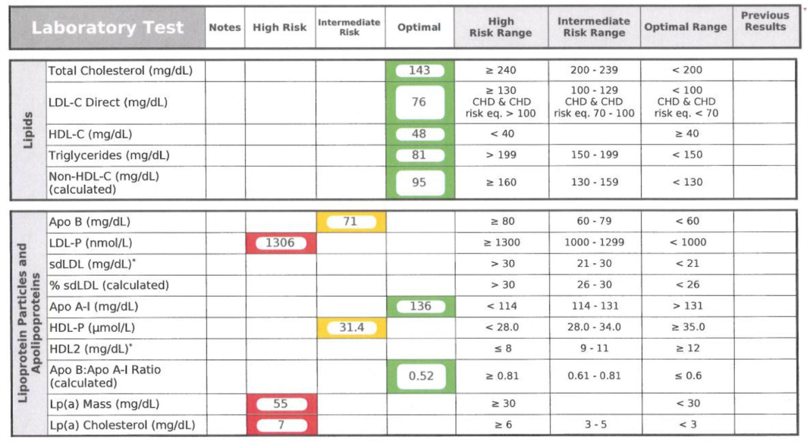
Dyslipidemia Diagnostics NMR

Slide 54
Dyslipidemia Diagnostics hs-CRP
The acute phase reactant Value appears to be associated with underlying atherosclerosis and has been postulated to reflect the risk of acute coronary syndrome (ACS)​
​
CRP is associated with the risk of future events in patients with stable angina, but is only weakly associated with the extent of CAD…​
​
Among patients with known stable coronary disease, a strong positive correlation between CRP measured at baseline and future acute coronary events has been demonstrated in most studies

Slide 55
Dyslipidemia Diagnostics hs-CRP
In a large study using the above recommendations from the CDC/AHA to categorize patients as:​
​
Low: < 1 mg/L​
Average: 1-3 mg/L​
High-risk: > 3 mg/L​
​
Patients had hs-CRP measured at baseline and were followed for outcomes of cardiovascular death, MI or stroke over a mean follow-up of 4.8 years.

Slide 56
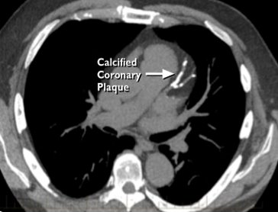
Dyslipidemia Diagnostics CAC
Low dose CT multi-detector scan that measures calcium plaques within the coronary arteries for the sake of risk stratification. A positive scan confirms the presence of coronary artery disease.​
Generally performed in ~10-20 min​
Prep: No caffeine, smoking or exercise for 4 hours prior to your appointment.
Plaque burden: ​
0: No identifiable dz​
1-99: Mild dz​
100-399: Moderate dz​
>400: Severe Dz

Slide 57
Dyslipidemia Diagnostics
What patients should we order HLD labs on? ​
Clear evidence supports those with ASCVD or risk equivalent
However, the evidence in screening those without est. heart disease (including first degree relative) is less clear: ​
​
2013 ACC/AHA guidelines recommend screening: ​
- All adults > 21 y/o​
- Then repeated every 3-5 years there after (unless targeted tx)

Slide 58
Dyslipidemia Diagnostics
There are calculations that can aid clinicians in discussing relative ASCVD risks to the patient, in a general 10 year survival: ​
-- Framingham Risk Assessment​
-- 10 year Atherosclerotic Cardiovascular Disease Risk Calculator (ASCVD)
These are a means to provide estimates and probability of CVD to assist in providing the patient with the most ideal preventive strategy

Slide 59
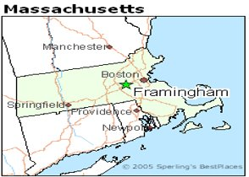
Framingham Heart Study
Helped to lay the foundation of CVD risk assessments and predictive mortality​
- Study began in 1948 with > 5,000 pts, first published in 1998​
​- Though originally male Caucasian population of patients of European descent; it has come to include Black patients and Women​
​
Predictive score is based on: ​
- Age​
- Gender​
- Total or LDL cholesterol (mg/dL)​
- HDL cholesterol (mg/dL)​
- Systolic blood pressure (mmHg)​
- Diabetes mellitus (yes or no)​
- Current smoking (yes or no)
End Points of risk: ​
- CHD death​
- Nonfatal MI​
- Unstable angina​
- Stable angina

Slide 60
Dyslipidemia Diagnostics - Interpretation
Many Calculators Exist:
  Framingham Risk Score
  MESA score
  ACC/AHA ASCVD Risk
    Some argue the ACC/AHA may over-estimate risk
  http://tools.acc.org/ASCVD-Risk-Estimator-Plus/#!/calculate/estimate/

Slide 61
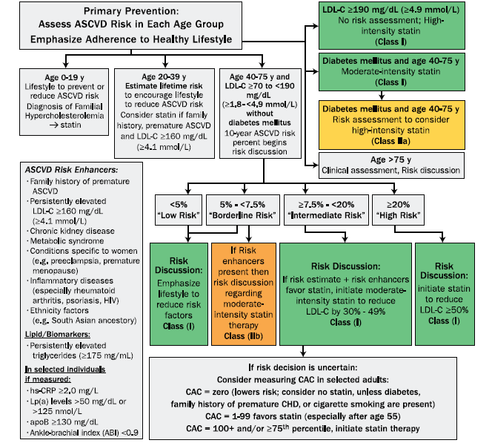
ASCVD Risk

Slide 62
Dyslipidemia Treatment

Slide 63
Dyslipidemia Treatment
↑ TC or LDL c
  Treatment has been shown to slow down CAD dz progression
  15% ↓ in CAD mortality for every 10% ↓ in serum cholesterol
Impact of HDL/TG less clear
  Elevated TG shows some correlation with CAD
  A Low HDL shows some correlation with CAD

Slide 64
Dyslipidemia Treatment
Lifestyle changes first line
↓ Fat intake, mainly saturated fat intake
  Mediterranean diet has been shown to lower LDLs
  Encourage poly unsaturated fats, Omega 3’s (fish, nuts)
    Found to be ♥protective: ↓ VLDL, ↓ platelet aggregation, ↓ CAD
  If ↑ TG main concern: consider cutting back on carbs & alcohol
Smoking Cessation
Manage HTN, DM, CKD, Obesity/Metabolic Syndrome
Exercise
Increase antioxidants from fruits/veggies, Soluble fiber may reduce LDL

Slide 65
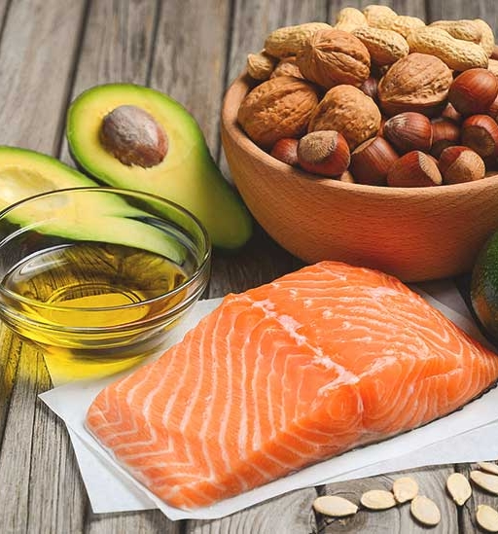
Dyslipidemia Treatment Dietary Changes
Typically, modest reductions in cholesterol have been reported (5-10% reduction in LDL​)
Bigger impact of dietary changes → improving comorbidities (weight, BP, Blood Glucose, inflammation)

Slide 66
Dyslipidemia Treatment
IF Medication treatment is necessary: Discuss ALL risk & benefits
(Mortality↓, SE, and Cost)​
Continue to assess patient preferences, medication management and tolerance​
GOAL: “Maintain maximum benefit from clinical care while aligning with patient preferences and goals”​

Slide 67
Dyslipidemia Treatment Statins
HMG CoA Inhibitors:
  MOA: inhibits HMG CoA reductase enzyme involved in the cholesterol synthesis pathway
  ↓ liver cholesterol production
  Statins ↓ LDLc 35% on average
  Decrease in All Cause Mortality with statin use
  Limits progression and may even cause regression of atherosclerosis

Slide 68
Dyslipidemia Treatment Statins
HMG CoA Inhibitors:
  Dosing: PO, recommend to take 1x per day
  SE:
    MC myalgias (approx. 10%)
    Myositis (a bit more common) and Rhabdomyolysis (rare)
    GI sx (upset stomach, flatus, dyspepsia)
    ↑Liver enzymes, liver failure
    Risk of hyperglycemia and possibly new onset DM
  Pregnancy: Generally discontinue statins during pregnancy; avoid routine use.

Slide 69
Dyslipidemia Treatment Statins
HMG CoA Inhibitors: (Monitoring)
Liver
Because Statins work in the liver, Liver Enzymes (ALT/AST/Alk Phos) must be taken prior to initiating therapy, and monitored if concerns arise.​
Meds known to also alter liver function can complicate this as well: ​
- E-mycin, antifungal medications, and immunosuppressive agents​
Conventional wisdom: ​
- Do not need to d/c the use of statin until 3x’s high end NML​

Slide 70
Dyslipidemia Treatment Statins
HMG CoA Inhibitors:
  Low-intensity statin therapy:
    Simvastatin (Zocor) 10 mg​
    Pravastatin (Pravachol) 10-20 mg​
    Lovastatin (Mevacor) 20 mg
~ < 30% Cholesterol Reduction

Slide 71
Dyslipidemia Treatment Statins
HMG CoA Inhibitors:
  Moderate-intensity statin therapy:
    Pravastatin (Pravachol) 40 mg daily
    Simvastatin (Zocor) 40 mg daily
    Atorvastatin (Lipitor) 10 - 20 mg daily
    Rosuvastatin (Crestor) 5 - 10 mg daily
~ 30-50% Cholesterol Reduction

Slide 72
Dyslipidemia Treatment Statins
HMG CoA Inhibitors:
  High-intensity statin therapy:
    Atorvastatin (Lipitor) 40 - 80 mg daily
    Rosuvastatin (Crestor) 20 - 40 mg daily
~ 50% Cholesterol Reduction

Slide 73
Dyslipidemia Treatment Statins
4 Main Groups who benefit from statin use:
Secondary prevention in individuals with clinical ASCVD​
​
Primary Prevention in individuals with elevations of LDL-C > 190 mg/dL​
​
Primary Prevention in individuals with diabetes 40-75 y/o who have an LDL-C 70-189 mg/dL​
​
Primary Prevention in individuals without diabetes and an estimated 10-year ASCVD risk > 7.5%, 40-75 y/o who have an LDL-C 70-189 mg/dL

Slide 74
Dyslipidemia Treatment Ezetimibe
Cholesterol Absorption Inhibitors:
  MOA: Inhibits absorption of cholesterol at the brush border of the small intestine via the sterol transporter, Niemann-Pick C1-Like1 (NPC1L1)
  ↓ the amount of cholesterol entering enterocytes, therefore less cholesterol available for chylomicron formation
  Dosing: 10 mg PO daily
  Cardio vascular benefits

Slide 75
Dyslipidemia Treatment Ezetimibe
Cholesterol Absorption Inhibitors:
IMPROVE-IT study:​
- Published in 2015, NEJM​
- Multi-center, double blind, randomized controlled trial of 18,144 patients hospitalized for ACS/followed over 6 years​
- Statin + Ezetimbe (Experiment Group)​
- Statin alone (Control Group)​
​
Among patients with recent ACS, adding ezetimibe to statin therapy provides a modest but statistically significant reduction in major cardiovascular events compared with statin therapy alone, without a demonstrated reduction in cardiovascular or all-cause mortality.

Slide 76
Dyslipidemia Treatment Ezetimibe
Cholesterol Absorption Inhibitors:
  SE: rare in monotherapy possibly some GI symptoms (diarrhea), ↑liver enzymes when used with statins
  Monitoring: Caution Use in significant Hepatic impairment
  Pregnancy Category: C
  Ezetimibe (Zetia) 10 mg daily PO

Slide 77
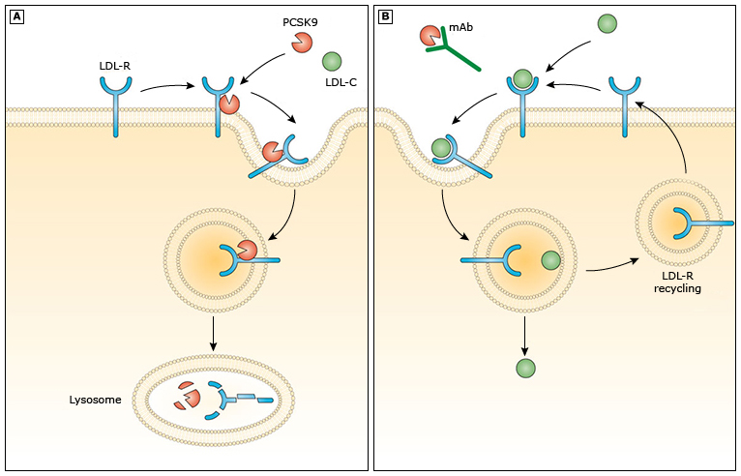
Dyslipidemia Treatment PCSK9 Inhibitors
PCSK9 Inhibitors
MOA: PCSK9 inhibition leads to better clearance/recycling of LDL particles in hepatocytes
↓ LDL-C, TG
↑ HDL
Injection, Cost
SE: some mild injection site reactions
Research: PCSK9i decrease CV Events and Mortality

Slide 78
Dyslipidemia Treatment PCSK9 Inhibitors
PCSK9 Inhibitors
  Evolocumab (Repatha)
    SubQ: 140 mg every 2 wks or 420 mg once monthly
  Alirocumab (Praluent)
    SubQ: 75 mg once every 2 wks or 300 mg once monthly

Slide 79
Dyslipidemia Treatment Bile Acid Sequestrants
Bile Acid Sequestrants:
  MOA: Binds to bile acids which leads to increased fecal excretion of fats & cholesterol
  ↓ LDL, ↑ HDL
  SE: nausea, bloating, cramping, diarrhea or constipation, complications with absorption of other medications, inhibition of absorption of fat soluble vitamins, ↑ TGs
  ↓ incidence of coronary events, BUT NO evidence of mortality benefit
  Cholestyramine (Questran) Oral: Initial: 4 g 1 to 2 times/day; increase gradually over ≥1-month intervals; maintenance: 8 to 16 g/day divided in 2 doses; maximum: 24 g/day
  Medication of choice for dyslipidemia in pregnancy

Slide 80
Dyslipidemia Treatment Fibric Acid Derivatives
Fibric Acid Derivatives
MOA not well understood
NOT indicated unless a hypertriglyceridemia component
↓ TG, ↑ HDL
No significant evidence of improved cardiovascular event or mortality outcomes in general populations
Monitoring: ALTs, Contraindicated in hepatic impairment
Fenofibrate (Fibricor) can interact with coumadin
Gemfibrozil (Lopid) shown to increase muscle toxicity caused by statins

Slide 81
Dyslipidemia Treatment Niacin
Niacin (AKA Vitamin B3)
  MOA not well understood, Goal: ↑ HDL
  SE:
    flushing, tachycardia, pruritis (especially in the immediate release form)
      May be reduced with ASA 81 co-administration
    NVD
    Hepatotoxicity
    Worsened insulin resistance
  No evidence of improved event or mortality outcomes

Slide 82
Dyslipidemia Treatment Fish Oil
Omega-3 Fatty Acids: (Fish Oil, O3-FA, EPA, DHA)​
MOA: Decrease hepatic VLDL production, lowering triglycerides.
Lipid effects: Prescription omega-3 fatty acids (4 g/day) can reduce TG by approximately 20–45%.
Medications:
Icosapent ethyl (Vascepa): EPA-only, 2 g PO BID.
Omega-3-acid ethyl esters (Lovaza): EPA + DHA, 2 g PO BID.
SE: GI upset, increased risk of atrial fibrillation; possible increased bleeding risk.
CV outcomes: Vascepa has demonstrated reduced major cardiovascular events in selected high-risk patients receiving statin therapy. This benefit has not been established for Lovaza or OTC fish oil supplements.

Slide 83
Dyslipidemia Treatment
Lipid Lowering Effects | % LDL-C drop | % HDL-C increase | % TG drop
Statins | 20-60 | 5-10 | 10-33
PCSK9 Inhibitors | 38-72 | 4-9 | 2-23
Cholesterol Absorption Inhibitor | 17 | 1 | 7-8
Bile Acid Sequestrants | 15-30 | ~ | Increases
Fibric Acid Derivatives | 6-20 | 5-20 | 35-53
Niacin | 10-25 | 15-35 | 25-30
Omega 3 Fatty Acids | Variable | 5-9 | 23-45

Slide 84
Dyslipidemia Treatment
Algorithm

Slide 85
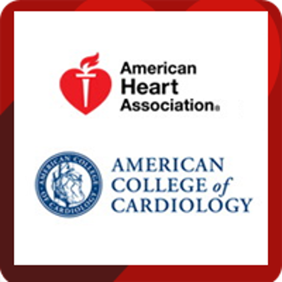
Dyslipidemia Treatment ACC/AHA 2019
Suggests Statin Therapy in four populations: ​
1. Clinical Atherosclerotic Disease​, high intensity
2. LDL cholesterol ≥190 mg/dL, high intensity
3. Diabetics who are aged 40-75 y/o​, moderate intensity
4. Estimated 10-year atherosclerotic risk of 7.5% or more when aged 40-75 y/o ​(no DM, LDL 70-190), Moderate-High intensity
​
- Of note, there is no target LDL​

Slide 86
Dyslipidemia Treatment ACC/AHA 2019
ASCVD Risk Enhancers:
Family hx of premature ASCVD
LDLc ≥160
CKD
Metabolic Syndrome
Preeclampsia
Premature menopause
Inflammatory Diseases (rheumatoid, psoriasis, HIV)
Ethnicity (South Asian Ancestry)
TG ≥175
hs CRP ≥2
ABI < 0.9
Lp(a) >50
apoB ≥130
Special Cases
75 +: risk/benefit discussion to be had with the patient
20-39 yo: consider statin if family hx of premature ASCVD and LDLc ≥160
“Borderline Risk” 5-<7.5% risk: if risk enhancers present shared decision making of possible moderate intensity statin

Slide 87
What is Metabolic Syndrome?
Diagnosed if the patient has 3+ of the following:
Waist circumference > 40 inches in men and > 35 inches in women
Triglycerides ≥ 150 milligrams per deciliter of blood (mg/dL)
High-density lipoprotein cholesterol (HDL) < 40 mg/dL in men or < 50 mg/dL in women
Fasting glucose ≥ 100 mg/dL
BP values of systolic ≥ 130 mmHg and/or diastolic ≥ 85 mmHg

Slide 88
Dyslipidemia Treatment ACC/AHA 2019
Special Cases
If uncertain consider Coronary Calcium Score:
CAC = zero, low risk, consider no statin unless DM, Family hx of premature ASCVD, or Cigarette smoking
CAC = 1-99 favors statin, esp if > 55 yo
CAC = 100+ statin indicated

Slide 89
Dyslipidemia Treatment ACC/AHA 2019
Consider non-statin therapy for additional LDL lowering after statin and lifestyle has been maximized​
​
- Maximized in dose OR maximized in patient tolerance…​
- This is ultimately a shared clinical decision…

Slide 90
Dyslipidemia Treatment ACC/AHA 2019
Follow Up
Assess the following within 4-12 weeks following initiation of Statin, or change in the existing regimen: ​
- adherence​
- response to therapy​
- adverse effects ​
Measure fasting lipid levels
Follow ALT/AST
  Some have argued not to routinely monitor ALT/AST levels unless symptomatic​
However, CK does not need to be assessed unless significantly symptomatic

Slide 91
Dyslipidemia Treatment ACC/AHA 2019
What if you are not getting the response you want from Statin therapy?
Reinforce improved adherence to lifestyle and drug therapy ​
​
Evaluate for secondary causes of hyperlipidemia if indicated ​
Increase statin intensity, or if on maximally tolerated statin intensity, consider addition of non-statin therapy in select high-risk individuals

Slide 92
Dyslipidemia Treatment ACC/AHA 2019
Follow Up if no adjustments are needed?
Regularly monitor adherence to lifestyle and drug therapy every 3 to 12 months after adherence has been established​
​
Continue assessment of adherence for optimal ASCVD risk reduction and safety
Continue to monitor for the development of secondary causes

Slide 93
Dyslipidemia Treatment ACC/AHA 2019
What are those secondary causes again?
Diabetes Mellitus​
Hypothyroidism​
Excessive alcohol consumption​
Obstructive liver disease (Cholestatic Liver Dz)​
Chronic renal failure​
Cigarette Smoking​
Obesity ​
Drugs: ​
  Rx: progestins, anabolic steroids, corticosteroids, protease inhibitors​
  Illicit: Cocaine

Slide 94
Knowledge Check:
A 56 yo male with hx of DM, HTN, HLD, and OSA is following up in office today. Family hx of DM, HTN, HLD, MI, CVA. Pt does not smoke. Surgical hx of T&A, mesh hernia repair and coronary stent placement.
Cholesterol treatment plan?

Slide 95
Knowledge Check:
A 47 year old Black smoker presents for his yearly physical. He has hx of OSA, HTN, and OA. His BP today is 132/78 on lisinopril. His recent lipid panel; TC 284, LDLc 153, TG 178, HDL c 35
Cholesterol treatment plan?

Slide 96
Knowledge Check:
A 58 year old Caucasian Female presents for her work physical. She has hx of HTN and HLD. She has been trying to control her cholesterol with diet for the past 6 months. Her BP today is 148/81 on lisinopril. She is a nonsmoker. Her most recent recent lipid panel; TC 256, LDLc 187, TG 192, HDL c 42
Cholesterol treatment plan?

