Slide 1
Adrenal Disease, Part I
Introduction and Glucocorticoids
CMM: Endocrinology Autumn 2026
Jill-Renae Gulczinski MS, PA-C

Slide 2
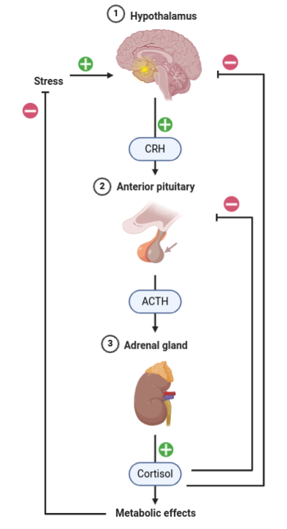
The HPA Axis
The adrenal gland is the target organ of the HPA axis.
  The hypothalamus produces CRH, corticotropin releasing hormone.
  CRH stimulates the anterior pituitary to produce ACTH, or adrenocorticotropic hormone.
  ACTH acts at the adrenal gland to stimulate cortisol secretion and to a much lesser extent, to stimulate aldosterone secretion.

Slide 3
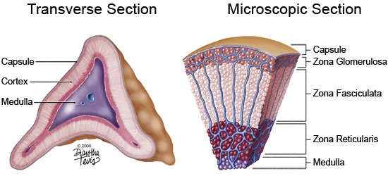
Adrenal Gland
The adrenal cortex: consists of three layers which secrete steroid hormones. From the outside in, the layers of the adrenal gland synthesize:
  Mineralocorticoids
  Glucocorticoids
  Sex hormones- adrenal androgens
Adrenal medulla: a separate organ in function, the medulla produces epinephrine and norepinephrine.

Slide 4

Roids?
When most people think about steroids, they are considering anabolic androgenic steroids, based on testosterone.
These drugs are prescribed legitimately for testicular failure and hypotestosteronism, as well as illegally to improve sports performance.
We’ll talk about the legitimate uses for androgenic steroids in GU, for now, we’ll focus on
glucocorticoids and mineralocorticoids.

Slide 5

Glucocorticoid Function
Glucocorticoids are our stress hormones:
  Decrease the uptake of glucose by non-essential tissues.
  Increase breakdown of fat and protein for energy.
  Increase gluconeogenesis (glucose synthesis).
  Inhibit protein synthesis (tissue building, healing).
  Suppress the inflammatory reaction.
Small amounts of glucocorticoid help us respond to stressful events. Too little or too much glucocorticoid is problematic.

Slide 6


Mineralocorticoid &
Adrenal Androgens
Mineralocorticoids help to keep our intravascular fluid balance optimal and are a major part of blood pressure control.
The major mineralocorticoid produced by the adrenal gland is aldosterone.
The innermost layer of the adrenal gland produces androgens- which are important in female sexual health but are negligible in a male.

Slide 7
Cortisol’s Effect
Cortisol: the hormone that makes you get up and go! The human body produces the equivalent of 0.5mg of Decadron per day (therapeutic dose 4mg)
Cortisol has multiple effects on the body:
Cardiovascular:
  Cortisol increases cardiac output and vascular tone
  Cortisol increases sodium retention by the kidney
Calcium homeostasis/ connective tissue:
  Cortisol stimulates bone and connective tissue loss

Slide 8
Cortisol’s Effect
Metabolic:
  Cortisol increases catabolism (breakdown of tissues).
  Cortisol increases insulin levels and gluconeogenesis.
  Inhibits the growth and reproductive functions.
Immunity:
  Suppresses inflammation on multiple levels.
  Cortisol increases intravascular leukocytes.
When are levels of cortisol lowest?

Slide 9
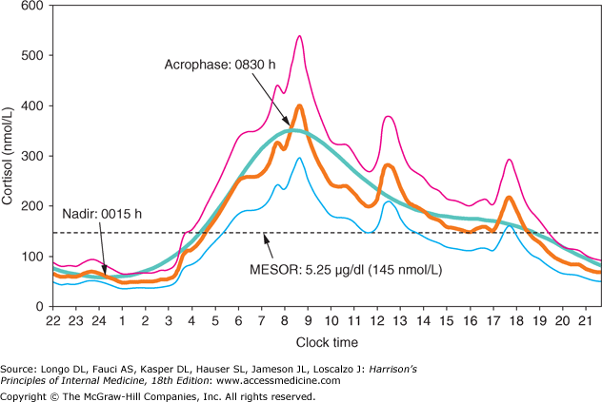
Circadian Rhythm of Cortisol

Slide 10
Glucocorticoid Disorders
Persons with disordered glucocorticoid secretion may either have too much or too little cortisol.
If a person has too little cortisol, then they have adrenal insufficiency.
If a person has too much cortisol secretion, then they an endogenous glucocorticoid excess.
Because steroids are prescribed for a variety of reasons, sometimes patients can have iatrogenic exogenous causes of adrenal insufficiency or excess.

Slide 11
Iatrogenic Adrenal Insufficiency
Adrenal insufficiency is very often acquired, due to the sudden withdrawal of prescribed glucocorticoids.
Whenever clinicians prescribe long-term steroids, we must be clear to patients that these drugs are not to be discontinued abruptly.
Oral corticosteroids are far more likely than inhaled corticosteroids to cause adrenal insufficiency if they are withdrawn.

Slide 12
Iatrogenic Adrenal Insufficiency
Oral steroids are particularly likely to cause iatrogenic adrenal insufficiency if they are high dose, if they are taken daily, or for a long time.
Strategies to avoid this include lower dose or every-other-day steroid therapy for a chronic disease that is under good control.
As little as two weeks of oral steroid treatment may precipitate adrenal insufficiency if they are abruptly withdrawn. What are the names of these steroids?

Slide 13
Types of Steroids
Hydrocortisone (Cortef)- the most biosimilar to our own naturally occurring glucocorticoid, cortisol.
Other synthetic glucocorticoids include:
  Betamethasone (Celestone)
  Prednisone
  Prednisolone (Prelone)
  Triamcinolone (Kenalog)
  Methylprednisolone (Solu-Medrol)
  Dexamethasone (Decadron)

Slide 14
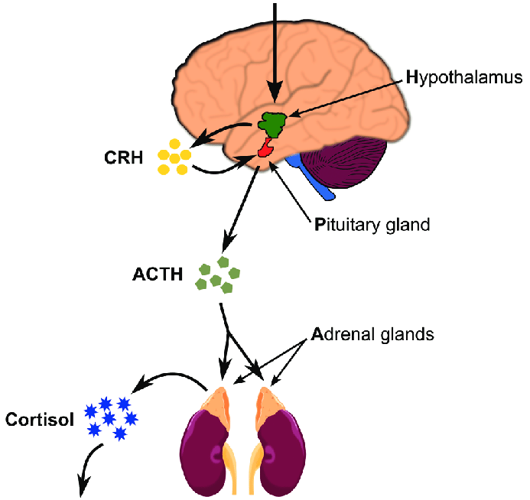
Adrenal Insufficiency
Adrenal insufficiency is often primary:
Adrenal insufficiency may rarely be secondary or tertiary:

Slide 15
Etiologies of Primary Adrenal Insufficiency: Autoimmune Destruction
Autoimmune destruction of the adrenal gland is also known as Addison’s disease.
Addison’s disease accounts for 80% of adrenal insufficiency in the USA, and 65% of adrenal insufficiency in the industrialized world.
70% of pts with Addison’s disease have anti-adrenal antibodies that are detectable in the blood.

Slide 16
Etiologies of Adrenal Insufficiency: Autoimmune Destruction
Addison's disease may occur alone or as part of a polyglandular autoimmune syndrome.
  PGA Type I: hypoparathyroidism, Addison’s and mucocutaneous candidiasis. Generally, presents in the first 10 years of life.
  PGA Type II: Addison’s, autoimmune thyroid disease (Graves/ Hashimoto’s) and T1DM. Generally, presents in the teens and twenties.

Slide 17
Addison’s Disease: Autoimmune Adrenal Destruction
Addison's disease results in destruction of the entire adrenal cortex, affecting cortisol (glucocorticoid), aldosterone (mineralcorticoid) and adrenal androgen synthesis.
Most commonly occurs in women ages 30-50 years, unless it is part of a polyglandular autoimmune syndrome. No racial differences.
Rare: In the US, 40 cases per million persons.

Slide 18
Etiologies of Primary Adrenal Insufficiency: Infections
Tuberculosis (TB) has historically been the most common cause of adrenal insufficiency.
Now, TB is still a frequently seen etiology where it is common, but accounts for far fewer cases in the industrialized world. TB is responsible for 15-20% of adrenal insufficiency worldwide.
Disseminated fungal infections, such as histoplasmosis, can also cause adrenal insufficiency.

Slide 19
Other Etiologies of Primary Adrenal Insufficiency
Bilateral adrenal hemorrhage/ infarctions
  Sepsis, anticoagulation, embolic disease, major surgery or trauma.
Infiltrative diseases
  Metastatic cancers, lymphoma, sarcoidosis
Iatrogenic causes
  Bilateral adrenalectomy, medications: RU-486 ketoconazole, etodimate

Slide 20
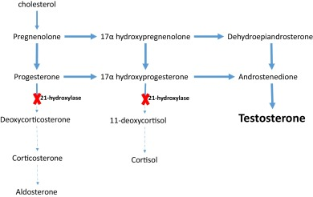
Etiologies of Adrenal Insufficiency
Congenital causes: Congenital adrenal hyperplasia (CAH): affected individuals lack the enzyme necessary to produce cortisol. 21-hydroxylase deficiency is most common;
In these persons, the sterol precursors are shunted into an alternate hormone pathway.

Slide 21
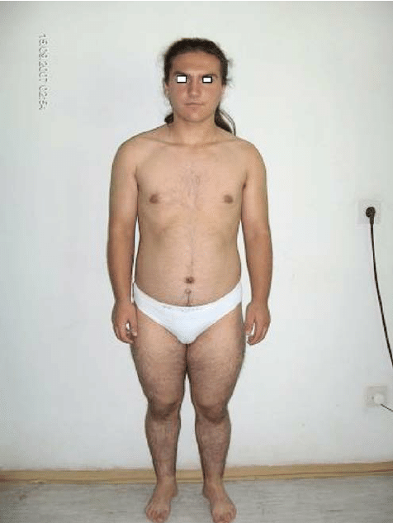
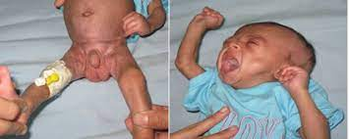
Etiologies of Adrenal Insufficiency
Congenital adrenal hyperplasia is very rare and is often recognized in infancy when female children have ambiguous genitalia and virilization at birth. Or shortly after birth when the child develops hypotension, N/V and other symptoms of adrenal crisis.
Above: Newborn girl with an enlarged clitoris that resembles a penis and enlarged labia majora that may be mistaken for a scrotum. Right: 12.4-year-old female with virilization.

Slide 22
Adrenal Insufficiency . . . Almost but not quite
HIV may cause a relative adrenal insufficiency.
This is not generally severe enough to require steroid and be missed easily because the person has just enough cortisol and aldosterone to manage daily life.
But these patients are living on the edge . . . when they become ill from something else, they can decline precipitously and develop adrenal crisis.

Slide 23
Adrenal Insufficiency- Summarize
Adrenal insufficiency may be iatrogenic or endogenous. If a person suddenly discontinues a prescribed steroid they can develop adrenal insufficiency.
Adrenal insufficiency is most commonly caused by autoimmune destruction of the adrenals in the US.
Other causes include fungal infections, cancer, hemorrhage/trauma or medications.
HIV may also cause a borderline adrenal insufficiency

Slide 24
Primary Adrenal Insufficiency
Regardless of the etiology, in a person with primary adrenal insufficiency there is a chronic deficiency all of the products of the adrenal cortex:
  Cortisol
  Aldosterone
  Adrenal androgens
Adrenal medulla function is spared in most cases but may be affected.

Slide 25
Symptoms of Adrenal Insufficiency
In most cases, the onset is insidious:
Hyperpigmentation: especially of sun exposed or traumatized skin- the skin creases, pressure areas like the bra or belt lines, knuckles, elbows and knees. New scars are affected but generally old scars are not.
Hyperpigmentation is often the first symptom of adrenal insufficiency to appear, preceding other symptoms by months to years.
Notes:
ACTH binds to the melanocortin 1 receptor on melanocytes, which stimulates them to produce melanin

Slide 26
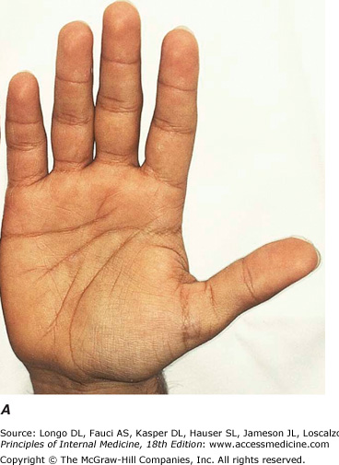
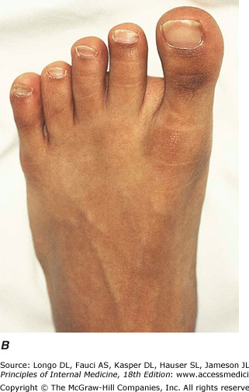
Primary Adrenal Insufficiency

Slide 27
Symptoms of Adrenal Insufficiency
Persons also have insidious onset of:
Weakness and fatigue, dizziness and orthostasis
Weight loss and poor appetite, occasional N/V
Myalgias/ arthralgias (due to hyperkalemia)
Heightened sense of smell, taste or hearing and a craving for salt.

Slide 28
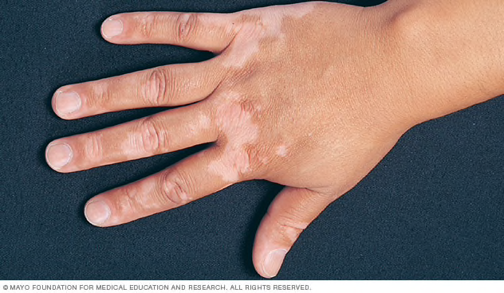
Signs of Primary Adrenal Insufficiency
Pigmentary changes of skin
  Hyperpigmentation in the typical pattern
  Vitiligo (10%) if Addison’s disease
Hypotension/ Lowish BP, usually under 110 mmHg
Dehydration, orthostasis
Hypoplasia of lymphoid tissues
Scant axillary or pubic hair in women due to loss of adrenal androgens.

Slide 29
Lab Findings of Adrenal Insufficiency
Hyponatremia and hyperkalemia, why?
Hypoglycemia, especially children and people with low body weight
Metabolic acidosis and renal failure, why?
If the adrenal insufficiency is primary, what will the levels of CRH and ACTH look like?

Slide 30
Lab Findings
If the adrenal insufficiency is secondary or tertiary, how will the electrolyte abnormalities be different?
 | Primary | Secondary | Tertiary
Cortisol
ACTH
CRH

Slide 31
Radiology Findings
Adrenal glands may be evaluated with a CT of the abd/pelvis or an MRI of the adrenals. Usually, these studies are done with contrast.
 | CT | MRI
Advantages
Drawbacks
  Enlarged adrenals/ mass in metastatic disease
  Adrenal calcifications if tuberculosis, fungal disease
  No radiologic findings in other etiologies

Slide 32
Secondary Adrenal Insufficiency
Secondary adrenal insufficiency presents the same as primary insufficiency, but with a few important differences:
    Hyperpigmentation does not occur (ACTH levels are low)
    Symptoms of salt craving, and lab findings of metabolic acidosis and hyperkalemia are absent (mineralocorticoid levels are normal)
    S/S of other endocrine diseases occur, why?
Notes:
Other endocrine disease includes: hypothyroidism, growth hormone deficiency, or hypogonadism

Slide 33
Adrenal Insufficiency- Summarize
Adrenal insufficiency presents subtly!
Hyperpigmentation, lowish blood pressure/ orthostasis dehydration, and fatigue are the most common signs/symptoms.
Lab abnormalities include hyponatremia (low sodium), hyperkalemia (high potassium) and metabolic acidosis in primary adrenal insufficiency.
Imaging is generally not helpful.

Slide 34
Making the Non-Emergent Diagnosis of Cortisol Deficiency
First, a random serum cortisol level is drawn. Levels > 25 mcg/dL exclude adrenal insufficiency but should be interpreted with caution in the critically ill patient. Illness may cause a cortisol surge, masking a borderline or early deficiency.
If the random cortisol level is not reassuring, testing to assess the synthetic function of the adrenal glands is performed with a cosynotropin stimulation test.

Slide 35
How is this done?
A baseline serum aldosterone level and cortisol level are drawn.
Cosynotropin (0.25mg of synthetic ACTH) is injected IM or IV and then cortisol and aldosterone levels are remeasured at either 30 or 60 minutes.
A cosynotropin test is positive if the stimulation fails to raise the level of cortisol by a specific amount in either 30 or 60 minutes.
Notes:
Interpreting the rapid adrenocorticotrophic hormone test:
Two criteria are necessary for diagnosis: (1) an increase in the baseline cortisol value of 7 mcg/dL or more and (2) the value must rise to 20 mcg/dL or more in 30 or 60 minutes, establishing normal adrenal glucocorticoid function.
A low aldosterone value of less than 5 ng/100 mL that fails to double or increase by at least 4 ng/100 mL 30 minutes after ACTH administration denotes abnormal mineralocorticoid function of the adrenal cortex.
The 30-minute aldosterone value is more sensitive than the 60-minute value because aldosterone levels actually have been shown to decrease in the 60-minute sample.
The absolute 30- or 60-minute cortisol value carries more significance than the incremental value, especially in patients who may be in great stress and at their maximal adrenal output. These patients may not show a significant increase in cortisol output with ACTH stimulation.
A normal 30- or 60-minute rapid ACTH test excludes Addison disease but may not adequately exclude mild impairment of the hypothalamic pituitary adrenal axis in secondary adrenal insufficiency.

Slide 36

Differential Dx of Adrenal Insufficiency
GI disease that may cause N/V/D, anorexia and weight loss
HIV/ AIDS: may cause adrenal insufficiency as well
Hemachromatosis: causes skin color changes (may also cause adrenal insufficiency)
Occult malignancy
Anorexia nervosa
Death by tanning booth

Slide 37
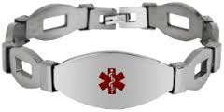
Adrenal Insufficiency Treatment
ALL patients with adrenal insufficiency MUST wear medic alert jewelry and consider emergent IM hydrocortisone injection kits.
Patients will require lifelong treatment with both glucocorticoid and mineralocorticoid.
Unfortunately, most patients receive too much glucocorticoid and too little mineralocorticoid.

Slide 38
Adrenal Insufficiency Treatment
Hydrocortisone (Cortef): 15-25 mg daily in two doses: 2/3 in AM, 1/3 in PM to mimic circadian rhythm (most physiologic).
  The Cortef dose is titrated to the lowest amount that stops symptoms of joint pain.
  Thin patients may need less, and obese patients may need more.
  Medications that induce cytochrome P450 will reduce serum Cortef concentrations; whereas liver disease will result in higher serum Cortef levels due to decreased clearance.

Slide 39
Cytochrome P450- Inducers
Recall that when drug A INDUCES the metabolism of drug B (Cortef), a higher dose of drug B must be given because the liver will metabolize and excrete drug B more rapidly and its’ clinical effect will be less.
AEDs: carbamazepine, fosphenytoin, phenytoin, primidone
Antibiotics active against mycobacteria (TB, MAC): rifampin
St. John’s wort
Estrogen/progesterone
Steroids: Dexamethasone, megace, prednisone

Slide 40
Cytochrome P450- Inhibitors
When drug A INHIBITS the metabolism of drug B (Cortef), a lower dose of drug B must be given because the liver will metabolize and excrete drug B more slowly, magnifying its’ clinical effect and predisposing to the build-up of a high drug level.
Anti-retrovirals: telapavir, bocepavir, indinavir
Azole antifungals: ketoconazole, itraconazole, voriconazole
Macrolide antibiotics: clarithromycin, erythromycin,
Fluoroquinalone antibiotics: ciprofloxacin, levofloxacin
CCBs: verapamil, diltiazem

Slide 41
Adrenal Insufficiency Treatment
Fludrocortisone (Florinef): a potent mineralocorticoid, typically given in doses of 0.05- 0.1 mg daily.
      No need for mineralocorticoid stress dosing.
      Dose is titrated to maintain normal BP, Na and K+ levels- no orthostasis!
Consider: DHEA: 50mg daily for women only
      Converted to testosterone by peripheral tissue
      Improvement in libido, mood and well-being

Slide 42
What if the patient becomes ill?
  Minor illness (nausea, vomiting, fever > 100.5) will require a doubling of the glucocorticoid dose and close outpatient follow-up.
  Major stressful events (trauma, surgery requiring general anesthesia) will require parenteral hydrocortisone 50 mg every eight hours, weaned quickly following a planned surgery, more slowly for a clinical illness.
  Look at clinical condition and for hypotension.

Slide 43
Let’s talk scenarios to get some clinical judgement. . .

Slide 44
Prognosis of Adrenal Insufficiency
Patients with adrenal insufficiency must be especially cautious of stressors which may precipitate adrenal crisis.
Most patients do okay but overall will have a decreased life expectancy. Risk of death from any illness is more than 2x average.
All patients with adrenal insufficiency are on medication for the remainder of their lives.

Slide 45
Adrenal Crisis: Why?
A medical emergency caused by cortisol deficiency.
Stress in a patient with mild adrenal insufficiency who hasn’t been diagnosed or failure to increase steroid in a diagnosed patient.
  Surgery, infection, prolonged fasting, trauma
Sudden withdrawal of corticosteroid in a patient with chronic insufficiency.
  Prednisone, megestrol (possibly inhaled steroid too!)

Slide 46
Adrenal Crisis: Why?
Temporary insufficiency due to exogenous suppression by taking oral steroids.
Adrenal or pituitary surgery: bilateral adrenalectomy, removal of a suppressing tumor.
Sudden destruction of the pituitary gland, Sheehan’s syndrome.
Bilateral adrenal injury: Trauma, hemorrhage, anticoagulant therapy, thrombosis, infection or metastasis.

Slide 47
S/S of Adrenal Crisis
The patient is acutely ill
    Hypotension, especially if refractory to IV fluid resuscitation
    Metabolic acidosis
    Confusion and coma
    Nausea/ vomiting and abdominal pain
    Fever and hyperpyrexia (up to 105 degrees)
    Cyanosis
    S/S and laboratory findings of chronic adrenal insufficiency, if it is present.

Slide 48
Making the Diagnosis of Crisis
Acute adrenal insufficiency is a medical emergency!
Do not delay medical treatment of suspected adrenal insufficiency pending laboratory results.
Instead, if adrenal insufficiency is suspected in the acutely ill patient, draw blood for:
    Random cortisol level, ACTH, aldosterone and renin levels, in addition to standard labs and treat empirically with stress dose steroid.

Slide 49
Differential Diagnosis of Crisis
Other causes of shock
  Septic, hypovolemic or cardiogenic shock
Other causes of hyperkalemia
  GIB, rhabdomyolysis, meds (spironolactone, ACEI)
Other causes of hyponatremia
  Hypothyroidism, diuretics, heart failure, vomiting
Acute abdomen
  We will generally see a significantly increased neutrophil count with acute abdomen but not necessarily with adrenal crisis

Slide 50
Treatment of the Acutely Ill Patient in Adrenal Crisis
Steroid replacement- stress dosing:
Hydrocortisone 100mg IV bolus, then by continuous infusion (10-12 mg/hr)- this is most physiologic
Alternatively, hydrocortisone 50-100mg IV push every 6-8 hours can be used.
At this high dose of glucocorticoid (>100 mg/day), Cortef acts as a mineralocorticoid as well, so no Florinef is needed.

Slide 51
Treatment of the Acutely Ill Patient
Stress dose steroid replacement
Clinical improvement (BP) should be evident in 4-6 hours if adrenal crisis is the culprit.
Over 2-3 days the amount of steroid is reduced to 100 mg/day to avoid GI ulceration and bleeding, regardless of patient condition.
It is tapered further over the next 4-5 days to the oral dose and mineralocorticoid is begun when glucocorticoid dose is < 100mg/day.

Slide 52
Treatment of the Acutely Ill Patient in Adrenal Crisis
Aggressive IV fluid replacement: to assist with correction of hypotension.
Electrolyte correction: most commonly patients have hyponatremia, hyperkalemia, and metabolic acidosis.
Consideration for empiric antibiotics and endocrinology referral, address thyroid status.

Slide 53
Prognosis of Adrenal Crisis
Rapid treatment of adrenal crisis results in an excellent outcome considering how ill the patient is from the stressor.
However, adrenal insufficiency is frequently unrecognized and untreated.
Mortality in these cases is dependent upon the stress of the event and the degree of adrenal insufficiency.

Slide 54
Question Time
What is the most common etiology of adrenal insufficiency in the United States?
Autoimmune destruction
Tuberculosis
Infiltrative disease, such as sarcoidosis
Metastatic disease to the adrenals
Congenital absence of the adrenals

Slide 55
Question Time
Which of the following are the most common symptoms of adrenal insufficiency in an otherwise healthy patient?
Fevers and chills
Hypertension and tachycardia
Weakness and fatigue
Anorexia and paradoxical weight gain

Slide 56
Question Time
Which of the following tests would be suggestive of primary adrenal insufficiency if a low level was found- although it is NOT how we make the diagnosis?
Cosynotropin level
Cortisol level
CRH level
None of the above

Slide 57
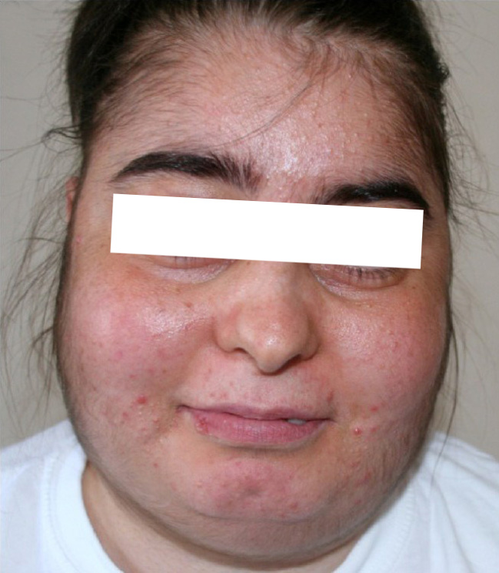
Glucocorticoid Excess
Glucocorticoid excess or Cushing’s syndrome is often suspected on the basis of patient appearance
  and symptoms.
Patients with a typical appearance of glucocorticoid excess are often referred to as having a “Cushingoid appearance”.

Slide 58
Glucocorticoid Excess
Glucocorticoid excess has many causes and is frequently iatrogenic- the unfortunate by-product of treating another disease with chronic steroid.
What are some of these diseases?

Slide 59
Cushing’s Syndrome: Pathophysiology
Cushing’s syndrome is endogenous glucocorticoid excess which is caused by:
  ~70% of cases due to ACTH hypersecretion by a benign pituitary adenoma: F:M= 5:1
  ~15% are a non-pituitary neoplasm that secretes ACTH (SCLC or carcinoid tumors)
  ~15% are due to excessive autonomous adrenal cortisol secretion: either an adrenal adenoma (small, common), a carcinoma (large, less common) or bilateral adrenal hyperplasia.

Slide 60
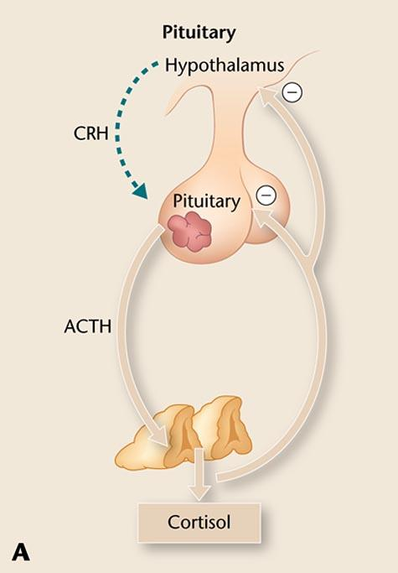
70% of Cushing’s syndrome is due to a benign pituitary adenoma that over-secretes ACTH: this is also known as Cushing’s disease.
Excessive ACTH forces the adrenal gland to produce excessive cortisol.
What will happen to the rest of the ACTH producing pituitary tissue?

Slide 61
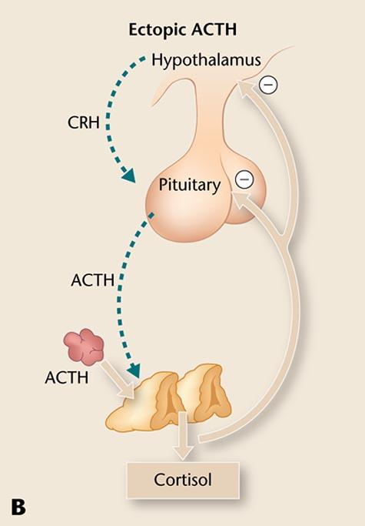
15% of Cushing’s syndrome patients have a non-pituitary neoplasm that secretes ACTH as part of a paraneoplastic process.
SCLC is well known for this.
Carcinoid tumors of the GI system and lung are also likely.
Notes:
SCLC= small cell lung cancer

Slide 62
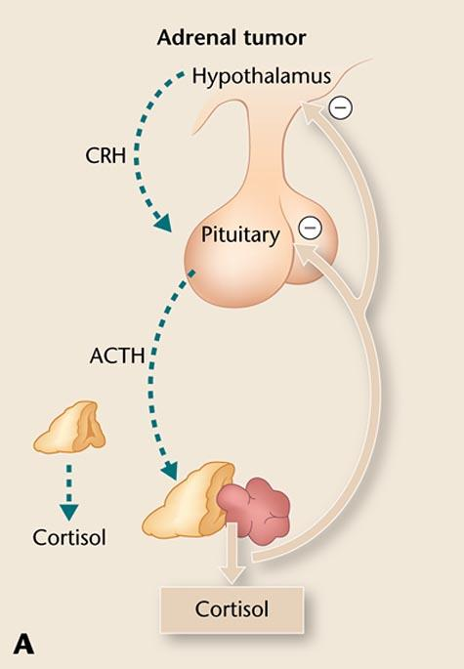
15% are due to excessive adrenal cortisol secretion:
Adrenal adenoma
Adrenal carcinoma
Bilateral hyperplasia (rare)
This adrenal secretion does NOT involve any stimulation from the hypothalamus or pituitary and is therefore ACTH independent.

Slide 63
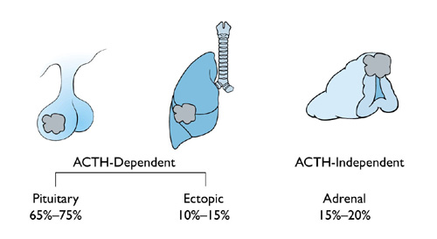
Causes of Cushing’s

Slide 64
Signs/Symptoms of Glucocorticoid Excess
Purple (violaceous) striae: stretch marks
Hirsutism: male pattern hair growth on face, chest in women, deepening voice.
Skin findings: thin skin with visible vessels, easy bruising, slow to heal if injured.
Immunosuppression: poor wound healing and easy development of skin infections.

Slide 65
Signs/Symptoms of Glucocorticoid Excess
Central obesity: weight gain in the abdomen, with thin, wasted extremities and large muscle group weakness in the hip and shoulder girdles.
Moon face with plethora (reddening)
Buffalo hump and supraclavicular fat pads: deposition of fat at the high thoracic spine and above the clavicles.

Slide 66
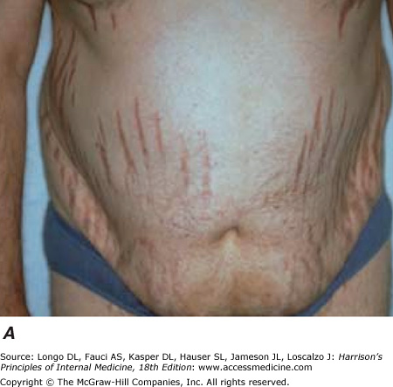
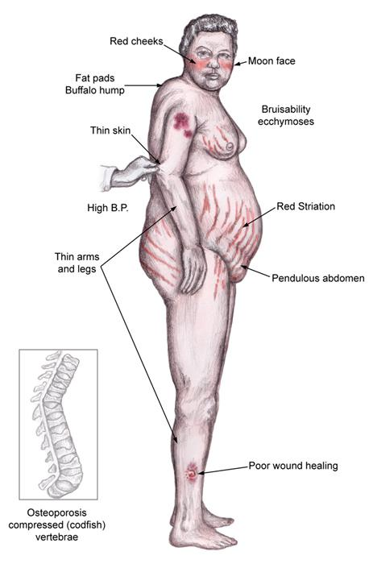
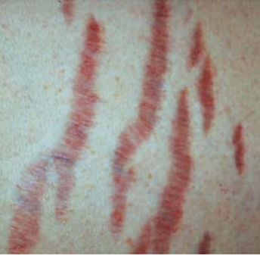

Slide 67
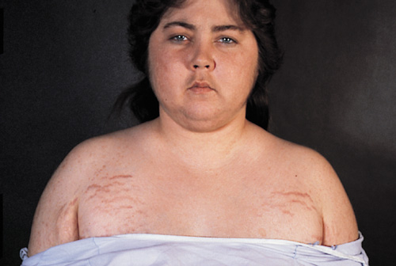

Slide 68
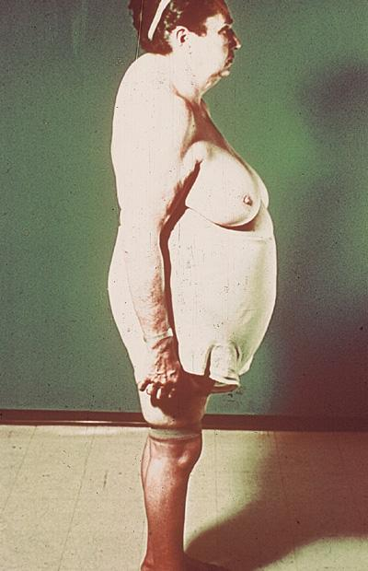
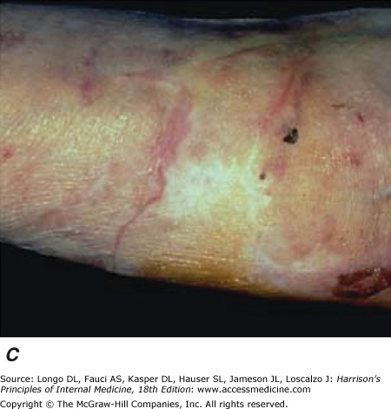
Fragile Skin of Glucocorticoid Excess

Slide 69

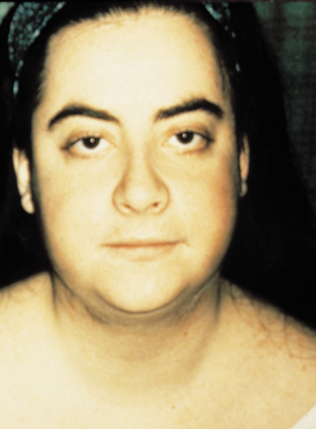

Slide 70
Signs/Symptoms of Glucocorticoid Excess
Hypertension and diabetes mellitus
Proximal muscle weakness/ osteoporosis/ avascular necrosis of the femoral heads
Renal calculi
Oligo or amenorrhea, impotence, decreased libido and decreased fertility
HA, psychiatric illness, cognitive dysfunction

Slide 71
Glucocorticoid Excess- Summarize
Cushing’s syndrome has lots of symptoms:
Thin skin that heals poorly, with prominent red stretch marks.
Changes in fat distribution causing supraclavicular fat pads, a buffalo hump, central obesity and moon facies.
Persons have proximal muscle weakness of the hip and shoulder muscles.

Slide 72
Glucocorticoid Excess- Summarize
Glucocorticoid excess can be iatrogenic or endogenous.
If endogenous, there are 3 main causes: pituitary adenoma (MC), paraneoplastic syndrome and adrenal adenoma.
Cushing’s causes or contributes to several chronic diseases: HTN, DM, avascular necrosis (AVN), osteoporosis, kidney stones and fertility changes. May also cause decline in mental health.

Slide 73
Cortisol Excess: Making the Diagnosis
There are multiple tests can be used for the initial work-up- pick one.
Dexamethasone suppression test: 1mg decadron is given po at 11pm, then we check the serum cortisol level at 8am.
Knowing what you do about the HPA axis, what finding would indicate a positive test?
  Test may be skewed by anticonvulsants, rifampin and estrogens (pregnancy, OC, HRT)

Slide 74
Cortisol Excess: Other Tests
Salivary cortisol level: patient awakens at 11pm and collects a saliva specimen. Cortisol levels are lowest at this time, so if high, is suggestive.
This test is readily done by the patient at home and swabs are stable at room temp.
Often the test must be done multiple times to obtain a valid result. Would be skewed by sleep-wake disturbance, stress, illness, 3rd shift work

Slide 75
Cortisol Excess : Other Tests
Random urinary free cortisol levels: check a random urine specimen for the amount of cortisol compared to the amount of creatinine excreted. A cortisol level 3x the creatinine level is highly suggestive of Cushing’s.
This test works best in patients less than 50 years of age because their excretion of creatinine is predictable- after age 50 renal function declines at an irregular rate.

Slide 76
Next, Localizing the Source
Measure a serum ACTH level
  If the ACTH is elevated, then there is either a pituitary source or ectopic secretion.
    Recall that a pituitary source means a pituitary adenoma.
    An ectopic source most often means an undiagnosed cancer- either small cell lung cancer or a carcinoid tumor in the lung or GI tract.
  If the ACTH levels are undetectable then there is autonomous adrenal secretion.
    Most likely from an adrenal adenoma or carcinoma or rarely, adrenal hyperplasia.

Slide 77
Third, Differentiating Between ACTH dependent Cortisol Excess-
Ectopic vs Pituitary Source
CRH stimulation testing is performed to evaluate the source of elevated ACTH levels.
  For this test, ACTH and cortisol levels are obtained at baseline, and subsequently at 15, 30, 45, 60, 90, and 120 minutes after administration of 1 mcg/kg of CRH.
Increasing ACTH and cortisol = a pituitary source
Constant ACTH and cortisol = an ectopic source

Slide 78
Localizing the Source with Imaging
Diagnostic imaging is performed only after serum testing determines the area to be imaged- there is a 10% incidence of non-functioning pituitary adenomas.
If a pituitary source is indicated by the biochemical testing, a pituitary MRI with IV gadolinium contrast is obtained.

Slide 79
Localizing the Source with Imaging
Diagnostic imaging is performed after serum testing determines that there is a pituitary or an ectopic source.
A CT scan of chest and abdomen/pelvis with IV iodated contrast to look for disease of the lungs, thymus, GI tract, pancreas and adrenals.
  Octreotide scintigraphy can be used to detect ectopic ACTH secreting tumors if the initial CT is negative. Radiolabeled octreotide (somatostatin) is injected intravenously and then SPECT imaging is obtained using to pick up any tissues with high concentrations of the isotope.

Slide 80
Whoa! Can we back up???

Slide 81
Differential Diagnosis of Cortisol Excess
Many conditions, in addition to exogenous steroids, can cause patients to have a Cushingoid appearance- such as antiretrovirals for HIV, obesity, and bulimia.
Elevated levels of cortisol are found in alcoholism, anorexia nervosa, and depression. This may cause these patients to have a Cushingoid appearance that will resolve if the underlying disorder is treated.

Slide 82
Treating Cortisol Excess
It is important to treat a person with cortisol excess quickly, as glucocorticoid excess can cause considerable morbidity and mortality.
The first step in treatment is to find the source- pituitary, paraneoplastic or adrenal?
Most etiologies of cortisol excess are treated surgically, to remove the source of the disease.

Slide 83
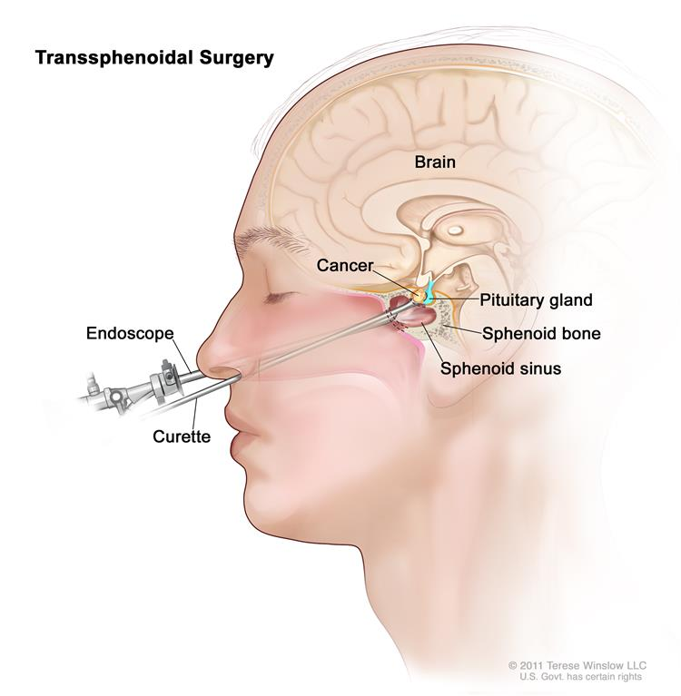
The primary treatment of pituitary adenomas is surgical and is performed by a neurosurgeon skilled in this type of surgery.

Slide 84
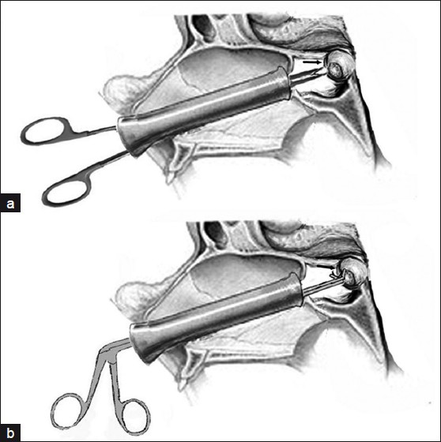
Treatment of Pituitary Adenoma
Transsphenoidal resection of the pituitary adenoma;
Technically difficult
May destroy additional pituitary tissue
70-80% success, May require repeat surgery or XRT if surgery fails

Slide 85
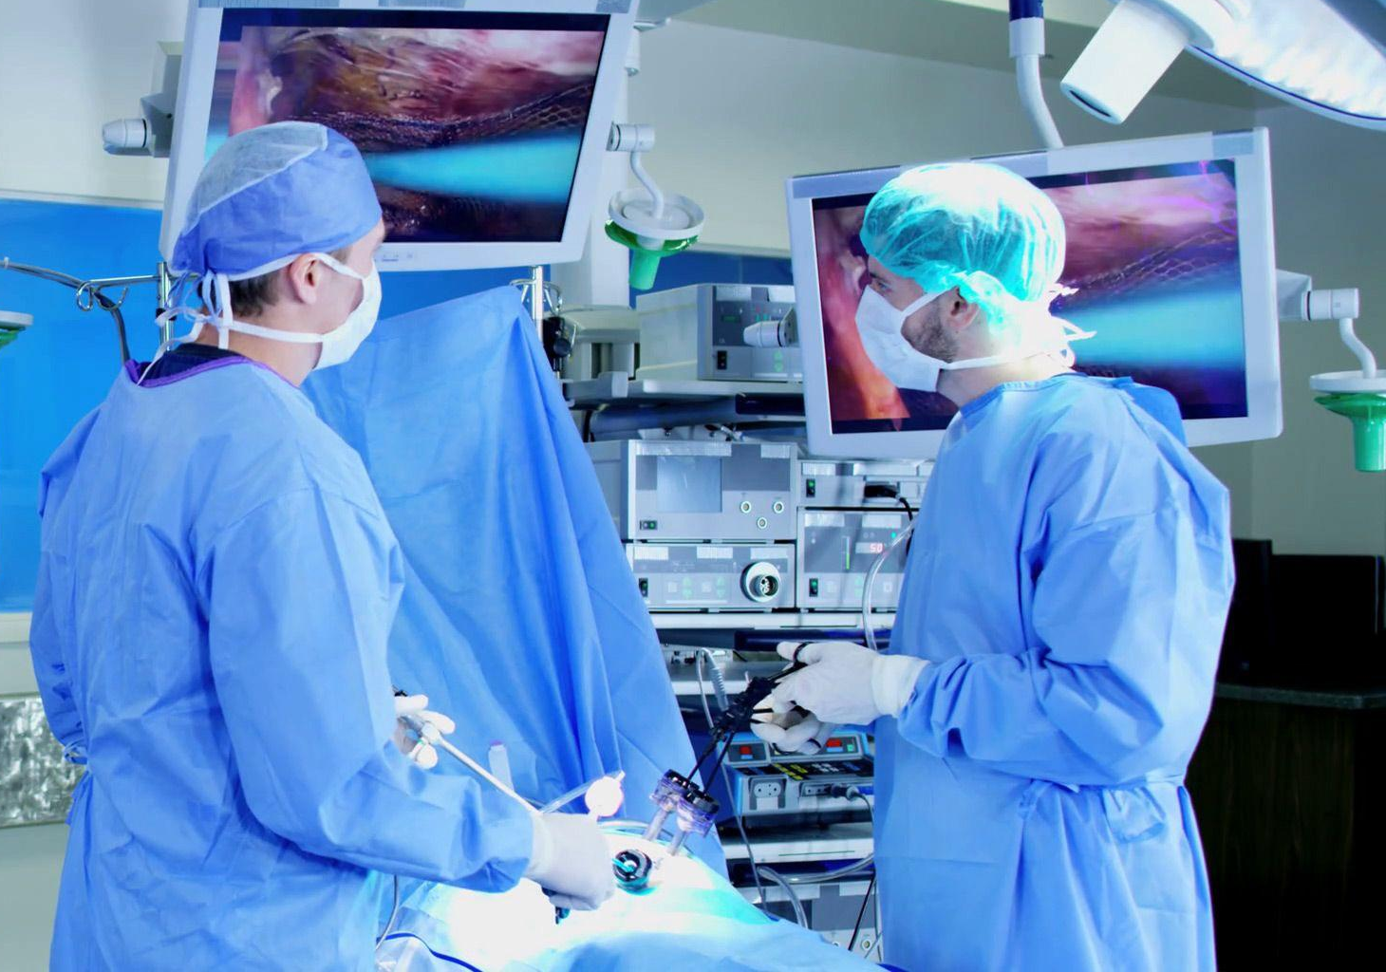
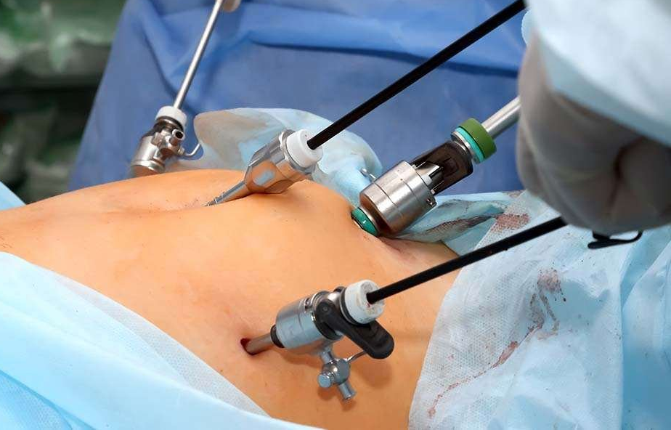
Treatment of Cortisol Excess- Adrenal Etiologies
Adrenal adenomas: the most common adrenal source of Cushing’s, laparoscopic adrenal resection, sometimes done open with unilateral or bilateral flank incisions.

Slide 86
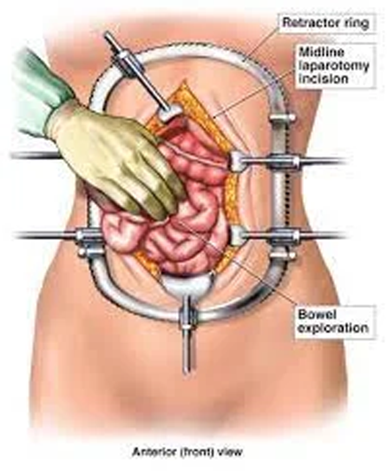
Treatment of Cortisol Excess- Adrenal Etiologies
Adrenal carcinomas are more highly suggested by androgen excess rather than cortisol. All should be aggressively resected with an open abdominal laparotomy and exploration.

Slide 87
Treatment of Cortisol Excess- Adrenal Etiologies
In children and teens, all adrenal masses should be resected- in this population there is a fairly high chance of a mass being malignant.
If adrenal cancer is present, with aggressive treatment, median survival has improved to 4 years.
If an adrenal adenoma is found, then there is excellent survival.

Slide 88
Treatment of Cortisol Excess: Ectopic Sources
Surgical resection is first line- but we have to find the source then resect it- survival depends on the primary disease.
    Carcinoid tumors are the most common ectopic source- lung, proximal GI tract- these tumors are slow growing but may be malignant with distant metastases.
    Neuroendocrine tumors- SCLC, pancreas, pheo, medullary thyroid CA (MEN syndromes)

Slide 89
Treatment of Cortisol Excess: Ectopic Sources
Medical therapy for SCLC or another aggressive primary CA better treated by chemotherapy would be used. These tumors are not treated surgically.
If the source cannot be found . . . medical suppression of steroidogenesis with ketoconazole is used most commonly. Many other drugs can be used, usually doses that are effective have some toxicities. Imaging studies to continue to search for the source are repeated every 6 months.

Slide 90
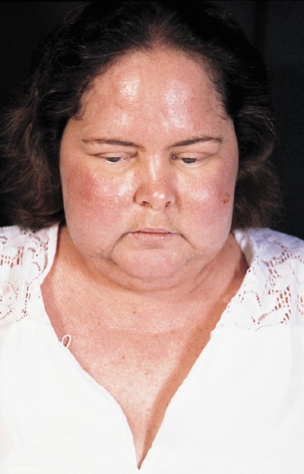


Slide 91
Prognosis of Cortisol Excess
Untreated Cushing’s disease is LETHAL, and M&M is usually related to the steroid excess:
CAD complications of HTN/ dyslipidemia/ DM.
Multisystem complications of diabetes.
High risk of opportunistic infections- bacterial and fungal, with poor wound healing.
High risk of perforated abdominal viscera.
Osteoporosis and increased fracture risk.

Slide 92
Pseudo-Cushing’s Syndrome
Pseudo-Cushing’s syndrome is a well-recognized condition that occurs when people who ingest large quantities of alcohol develop signs, symptoms and the biochemical abnormalities of Cushing’s.
May also occur in obesity and depression. These patients have dysregulation of cortisol secretion.
Complete abstinence from alcohol will completely reverse this process.

Slide 93
Question Time
Which of the following results of a dexamethasone suppression test would indicate a positive test for Cushing's?
11pm cortisol level high
8am cortisol level high
11pm cortisol level low
8am cortisol level low

Slide 94
Question Time
Which of the following is NOT a symptom or sign of cortisol excess?
Purple, angry-looking stretch marks
Non-healing wounds
Hypertension
"Pear shape" obesity

Slide 95
Question Time
Which of the following is the treatment of choice for Cushing's disease caused by an adrenal adenoma?
Unilateral adrenal resection
Ketoconazole
Transsphenoidal pituitary resection
Bilateral adrenalectomy

