Slide 1
Adrenal Disease, Part II
Mineralocorticoids and Adrenal Androgens
CMM: Endocrinology Autumn 2026
Jill-Renae Gulczinski MS, PA-C

Slide 2
Renin-Angiotensin-Aldosterone
Renin (an enzyme) is secreted by the kidney when there is not enough renal blood flow or when hyperkalemia is sensed.
Renin converts angiotensinogen (in the liver) to angiotensin I.
Angiotensin I is converted to angiotensin II by ACE within the lungs and other tissues.

Slide 3
Renin-Angiotensin-Aldosterone
Angiotensin II is a vasopressor itself and causes vasoconstriction. Angiotensin II also stimulates aldosterone secretion from the adrenal gland.
Aldosterone causes sodium to be reabsorbed and K⁺ and H⁺ secretion into the urine via pumps in the distal renal tubule. Water follows sodium.
Increased volume in the blood vessels raises BP, dilutes K⁺ and suppresses renin release.

Slide 4
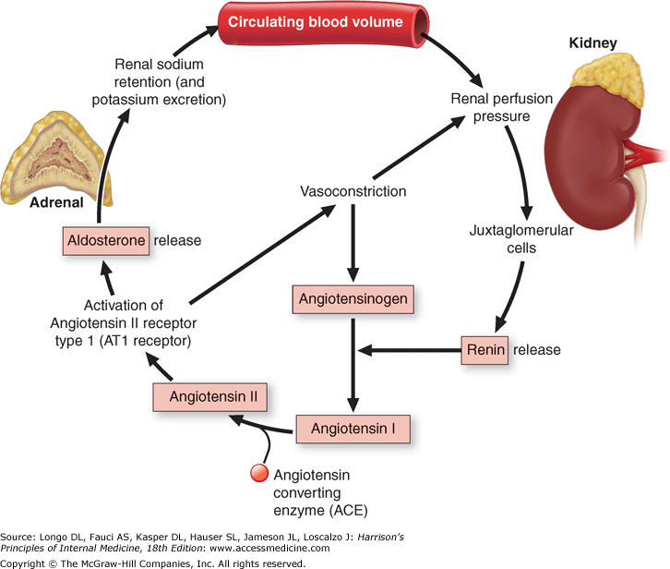
The RAA System

Slide 5
Hypoaldosteronism
Deficiency of aldosterone is usually secondary to deficient renin production by a diseased kidney and not a problem with production of aldosterone from the adrenal gland.
Therefore, this disorder is most commonly NOT due to an adrenal problem but instead due to chronic kidney disease, most often caused by diabetes and hypertension - this is hyporeninemic hypoaldosteronism.

Slide 6
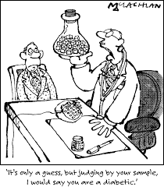
Hypoaldosteronism
Hyporeninemic hypoaldosteronism is most commonly caused by diabetic nephropathy or chronic tubulointerstitial kidney disease.
We try to prevent this with strict BP and glucose control
Once present, hyporeninemic hypoaldosteronism is permanent.

Slide 7
Hypoaldosteronism Pathophysiology
Patients present with hyperkalemia, hyperchloremia and a non-anion gap metabolic acidosis, why?
Also known as type 4 renal tubular acidosis, a non-anion gap metabolic acidosis caused by normally functioning kidneys that fail to acidify the urine.
    Plasma sodium concentration is normal
    Plasma volume is usually decreased
Notes:
Renal tubular acidosis is when otherwise normally functioning kidneys fail to acidify the urine resulting in excess acid in the body- a metabolic acidosis. Types 1 and 2 are caused by tubular problems, type 3 is excluded from modern classification systems and type 4 is due to aldosterone deficiency.

Slide 8
Hypoaldosteronism
What symptoms will this cause?
In most patients, not many symptoms since significant sodium wasting will be prevented by other hormones that preserve sodium balance (angiotensin II and norepinephrine). Is this good for the patient?

Slide 9
Hypoaldosteronism, Making the Dx
Hypoaldosteronism should be suspected in the right patient when there is persistent hyperkalemia without another cause.
If hyperkalemia is noted, repeat K⁺ level stat and if still high (> 6), check an EKG, this could be a medical emergency!
Hypoaldosteronism not attributable to hyporeninemic hypoaldosteronism or primary adrenal disease is best worked up by nephrology.

Slide 10
Hypoaldosteronism Treatment
If primary adrenal deficiency is present, treatment is with fludrocortisone to prevent orthostasis and normalize potassium levels.
Fludrocortisone will exacerbate HTN and edema. Therefore, despite being effective, Florinef is rarely used in hyporeninemic hypoaldosteronism.
Instead, a low K⁺ diet, with or without a loop or a thiazide diuretic are the mainstays of treatment in hyporeninemic hypoaldosteronism.

Slide 11
Primary Hyperaldosteronism
Also known as Conn’s syndrome, and most frequently caused by:
Bilateral adrenal hyperplasia (60%)
Aldosterone producing adenoma (40%)
Adrenal CA is extremely rare
Aldosterone excess results in:
  Sodium retention causing hypertension, but not hypernatremia (equal Na⁺ and water retention)
  Low-normal potassium or hypokalemia
  Metabolic alkalosis

Slide 12
Primary Hyperaldosteronism
Hyperaldosteronism accounts for up to 5% of hypertension and is potentially curable.
Persons with PA usually present with significant HTN at 30- 50 years and F:M ratio is 2:1.
Primary hyperaldosteronism is suspected in any patient with persistent hypokalemia (not always seen) and resistant hypertension, when both are present, 50% of persons will have PA.

Slide 13
Primary Hyperaldosteronism
Patients with primary aldosteronism have an increased risk of morbidity and mortality beyond just their elevated BP.
Their risk for certain cardiovascular outcomes is significantly higher than those with primary HTN.
    Myocardial infarction (4% versus 0.6%)
    Atrial fibrillation (7.3% versus 0.6%)
    Stroke (12.9% versus 3.4%)

Slide 14
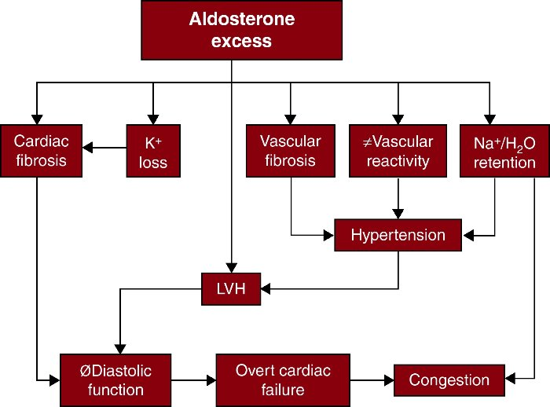

Slide 15
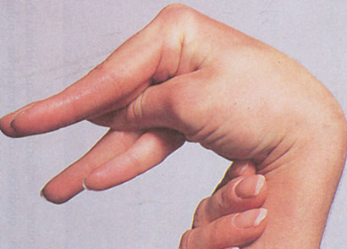
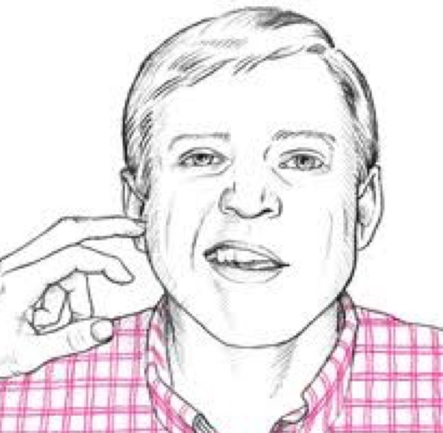
Hyperaldosteronism S/S
Most of the symptoms are related to low K⁺
Fatigue, weakness, nocturia, HA
If severe, patients may present with polydipsia, polyuria, and paresthesias.
If severe, patients may have intermittent paralysis, tetany, positive Trousseau’s or Chvostek’s sign
--Trousseau’s sign- carpal or pedal spasm in response to inflation of a BP cuff on the arm or leg. Chvostek’s sign- tapping the facial nerve (CN VII) elicits twitching of the face. These signs are more commonly seen in hypocalcemia but may be present in hypokalemia.

Slide 16
Signs and Symptoms of Hyperaldosteronism
In primary hyperaldosteronism, blood pressure may be severely elevated, causing:
  End organ damage: retinal, renal, cardiac
  Hypertensive encephalopathy
  Facial flushing/ headache
The major differential diagnosis of primary hyperaldosteronism includes other causes of secondary HTN, such as Cushing’s and renovascular hypertension/ renal artery stenosis.

Slide 17
Who Should Be Tested for PA?
Patients with HTN and spontaneous hypokalemia or low-dose, diuretic-induced hypokalemia
The following patients should undergo testing even if they are normokalemic :
  Drug-resistant severe hypertension (not controlled on 3+ medications at maximal doses)
  Persons with hypertension in whom an adrenal incidentaloma is found (an adrenal mass discovered incidentally on imaging)

Slide 18
Who Should Be Tested for PA?
The following patients should undergo testing even if they are normokalemic :
  Hypertension with sleep apnea.
  Hypertension and family history of early-onset HTN or CVA at a young age (<40 years).
  All hypertensive 1st degree relatives of persons with primary aldosteronism.
  Younger patients with hypertension and atrial fibrillation.

Slide 19
Making the Hyperaldosteronism Diagnosis
Testing is by obtaining a plasma aldosterone concentration and a plasma renin activity level, then calculating the aldosterone to renin activity ratio (ARR).
The test is ideally done in mid-morning after the patient has been up and ambulatory for 2 hours, then sits for 15 minutes.

Slide 20
Making the Hyperaldosteronism Diagnosis
Hypokalemia must be corrected before the test as this may cause a falsely low aldosterone.
All MRAs, amiloride and triamterene are discontinued 4 weeks prior to the test.
The diagnosis depends on finding both an inappropriately high aldosterone concentration, and an inappropriately low renin activity level.
Notes:
MRA- mineralocorticoid receptor antagonists or aldosterone antagonists (spironolactone (Aldactone), eplerenone (Inspra) and finerenone (Kerendia)).

Slide 21
Making the Hyperaldosteronism Diagnosis
Disease State | Aldosterone | Cortisol | Renin
Primary hyperaldosteronism | High | Normal | Low
Secondary hyperaldosteronism (Renal artery stenosis) | High | Normal | High
Adrenal Insufficiency (Addison dz) | Low | Low | High
Cushing’s syndrome | Low | High | Low
All positive tests require confirmatory testing.

Slide 22
Making the Hyperaldosteronism Diagnosis
If aldosterone is very high compared to renin, and this finding is confirmed, then imaging is ordered to distinguish between an adrenal adenoma and adrenal hyperplasia.
  CT of abdomen/pelvis with iodated contrast, or
  MRI of the adrenals with gadolinium contrast
    Bilateral adrenal vein sampling of aldosterone levels to clarify if a patient has bilateral adrenal adenomas.

Slide 23
Hard Stop, Let’s Review Hyperaldosteronism
Hyperaldosteronism is most often caused by bilateral adrenal hyperplasia or an autonomous adenoma in one of the adrenal glands.
Young persons (2x women) with resistant HTN and hypokalemia should be suspected.
It is important to find, because the hypertention is potentially curable.

Slide 24
Hard Stop, Let’s Review Hyperaldosteronism
Hyperaldosterone is also important to find because if untreated it increases the risk of stroke, atrial fibrillation and myocardial infarctions.
The diagnosis is made by assessing the plasma aldosterone concentration, the plasma renin activity level and the ratio between the two.
The adrenal glands are then imaged to differentiate between hyperplasia and adenoma.

Slide 25
Treatment of An Adrenal Adenoma causing Hyperaldosteronism
An adrenal adenoma is treated surgically with a unilateral adrenal resection, often performed laparoscopically.
This will remove the source of high aldosterone secretion and allow the other adrenal gland to respond normally to renin stimulation.
60-70% of patients become normotensive within a year of the surgery.

Slide 26
Treatment of Hyperaldosteronism caused by Bilateral Adrenal Hyperplasia
Unilateral adrenalectomy has very minimal effects on the aldosterone level and BP in a patient with bilateral adrenal hyperplasia.
Therefore, adrenal hyperplasia is treated medically with an aldosterone antagonist to control the effects of aldosterone on the body:
    Aldactone (Spironolactone)
    Eplerenone (Inspra)

Slide 27
Question Time
In which of the following situations should hyperaldosteronism be suspected?
When a patient younger than 25 has hypertension and persistent hyponatremia
When a 50-year-old patient with ESRD has resistant hypertension and persistent hyperkalemia
When a teen has hypertension and persistent metabolic alkalosis

Slide 28
Question Time
Which of the following is the most common cause of hypoaldosteronism?
Insensitivity of the adrenal gland to angiotensin II
Tumor or infiltrative disease of the adrenal gland
Inability to produce renin by the diseased kidney
Insensitivity of the renal tubule to aldosterone
Circulating antibodies to aldosterone

Slide 29
Question Time
Which of the following is one of the first screening tests that should be obtained for hyperaldosteronism?
Ultrasound of the kidneys and adrenals
MRI of the adrenal gland
Aldosterone to renin ratio
Random serum cortisol level

Slide 30
Normal Physiology of Androgens
The ovaries and the adrenal glands are the two major sources of androgens in women, with the adrenal glands being the predominant source.
Fat tissue and skin also convert weak androgens into more potent ones. Increasing adiposity (fat mass) means greater androgen conversion.
In men, the testes and the adrenal glands are the two major sources, with the testes being the predominant source.

Slide 31
Androgen Excess Etiologies
Androgen excess is the most common endocrine disorder that occurs in women of reproductive age.
The most common etiology of androgen excess is polycystic ovarian syndrome (PCOS) which accounts for 80-90% of cases.
Other rare causes include androgen secreting tumors, Cushing’s syndrome and prolactinomas.

Slide 32
Androgen Excess
Androgen excess affects about 8% of women of reproductive age and occurs equally in all ethnicities. It is rare in post-menopausal women.
Androgen excess causes insulin resistance, dyslipidemia, elevated BP and vascular disease, leading to high rates of diabetes and CAD.
Other manifestations of androgen excess are irregular menstrual cycles, male pattern baldness, hirsutism and acne.

Slide 33
Androgen Excess Diagnosis
Initial diagnostic testing focuses on measuring levels of androgens (total testosterone, DHEAs), 17-hydroxyprogesterone, TSH, and prolactin.
In women, a transabdominal or transvaginal ultrasound of the uterus and adnexa is ordered in all to evaluate for ovarian cysts or masses. In men, an ultrasound of the testicles.
If an adrenal cause is suspected after negative U/S, a contrasted MRI of the adrenal glands is obtained.

Slide 34
Androgen Excess Treatment
The standard of care for adrenal tumors resulting in androgen excess is surgical removal of the mass.
Prognosis is excellent for a benign mass, but less optimal for a malignancy.
Non-adrenal causes of androgen excess will require different treatments.

Slide 35
Adrenal Androgen Deficiency
Part of primary adrenal insufficiency.
Loss of adrenal androgens in men does not cause clinically significant disease. Women may experience decreased sex drive/ libido and loss of a general feeling of well being.
Supplementation with DHEA 50mg daily is helpful for symptom relief.
DHEA is converted peripherally into testosterone.

Slide 36
Incidentalomas
These are clinically inapparent adrenal masses that are discovered on imaging done for another reason. Incidentalomas are fairly common.
Some are biologically active and most commonly secrete small amounts of cortisol that may not be enough to cause obvious clinical disease.
Occult malignancy must always be on the differential in persons with an incidentaloma.

Slide 37
Incidentalomas
All patients should have an ACTH level and dexamethasone suppression testing performed when the incidentaloma is discovered.
Hypertensive patients should also have work-up for primary hyperaldosteronism (PAC, PRA, ARR) and pheochromocytoma.
Surgical removal is indicated if the mass is > 5cm or it is hormonally active. If it is not, repeat monitoring is recommended.

Slide 38
Pheochromocytoma
A pheochromocytoma is a tumor of the chromaffin cells of the adrenal medulla, which secrete catecholamines like epinephrine, norepinephrine.
90% of pheochromocytomas are found in the adrenal medulla, but they may also occur in the mediastinum or abdomen.
    Common extra-adrenal locations include the origin of the inferior mesenteric artery, bladder, and heart.
5% of persons with pheochromocytoma have bilateral tumors.

Slide 39
Pheochromocytoma
10% of adrenal pheochromocytomas and 35% of extra-adrenal pheochromocytomas are malignant.
Benign pheochromocytomas carry a good prognosis once resected, but malignant tumors carry a poor prognosis despite resection and chemotherapy.
The most common sites for metastasis for malignant pheochromocytoma include the bone, liver and the lymph nodes.

Slide 40
Pheochromocytoma
Pheochromocytoma is rare, occurring in up to 0.2% of hypertensive individuals, so it is a much less common cause of secondary HTN.
10% of pheochromocytomas occur in children and the incidence peaks in persons 30-50 years of age.
~30% are associated with other disorders:
  Multiple endocrine neoplasia (MEN) syndromes
  von Hippel-Lindau (VHL) syndrome
  Neurofibromatosis type 1 (NF1)
Notes:
von Hippel-Lindau (VHL) disease, or von Hippel-Lindau syndrome, is a rare genetic disorder characterized by visceral cysts and benign tumors in multiple organ systems that have subsequent potential for malignant change. Clinical hallmarks of VHL disease include the development of retinal and central nervous system (CNS) hemangioblastomas (blood vessel tumors), pheochromocytomas, multiple cysts in the pancreas and kidneys, and an increased risk for malignant transformation of renal cysts into renal cell carcinoma.
Neurofibromatosis type 1 (NF1) is a multisystem genetic disorder that is characterized by cutaneous findings, most notably café-au-lait spots and axillary freckling, by skeletal dysplasias, and by the growth of both benign and malignant nervous system tumors, most notably benign neurofibromas.

Slide 41
Symptoms of Pheochromocytoma
Paroxysmal hypertension
Headache
Palpitations
Sweating
Skin blanching/ pallor
Anxiety
Orthostatic hypotension
Fatigue
Weight loss
Chest pain
Abdominal pain
Wide fluctuations in blood pressure
Nausea
Symptoms may occur daily- monthly, lasting minutes to hours and tend to worsen over time as the tumor grows.

Slide 42
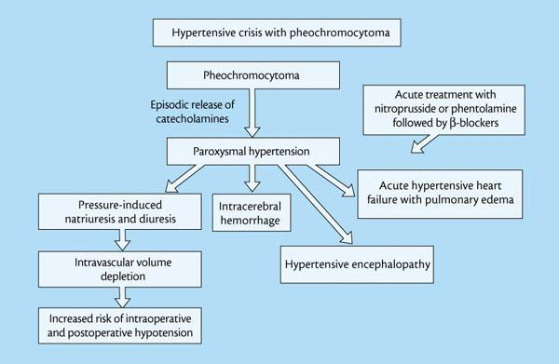

Slide 43
Making the Diagnosis of Pheo
Pheochromocytomas are best diagnosed by measuring the levels of catecholamine metabolites in the plasma or the urine.
Use plasma free metanephrine testing in patients who are at high risk of having pheochromocytoma
  Those with predisposing genetic syndromes
  Persons with a family/personal history of pheo
Plasma free metanephrine testing is more sensitive but less specific.

Slide 44
Making the Diagnosis of Pheo
For persons at lower risk of having pheo, use a 24-hour urine collection measuring levels of creatinine, catecholamines, vanllylmandelic acid and metanephrines.
    Time the test to occur during or immediately after a hypertensive crisis if possible.
If either biochemical test is positive, obtain imaging to evaluate for the pheochromocytoma location.
        CT of the abdomen/pelvis with IV contrast
        Contrasted MRI of the adrenals (if CT is non-diagnostic)

Slide 45
Treatment of Pheo
Hypertension that is associated with a pheo is typically resistant to standard medications.
Patients are begun on pre-op alpha blockade, with doxazosin then beta blockade is added if needed. Avoid unopposed beta blockade and encourage sodium intake and good hydration.
After 1-2 weeks, a laparoscopic or open subtotal adrenalectomy (or larger surgery) is performed.

Slide 46
Treatment of Pheo
During surgery, nicardipine and/or nitroprusside are used to control hemodynamic swings from tumor manipulation.
Post-operatively, serum free metanephrine levels will normalize within 2 weeks and should be checked yearly for ten years. Patients with MEN syndromes will require lifelong testing.
If the pheochromocytoma is inoperable, the patient is treated with lifelong alpha blockers

Slide 47
MEN Syndromes
Multiple endocrine neoplasia syndromes are inherited disorders that predispose a person to developing multiple endocrine tumors, some of which may be malignant. Two types:
  MEN1: caused by loss of MEN tumor suppressor gene
  MEN2: caused by mutations of the RET gene
A person who reaches middle age with only one endocrine tumor likely does not have MEN.
Children of persons with an MEN syndrome have a 50% chance of inheriting the disorder.

Slide 48
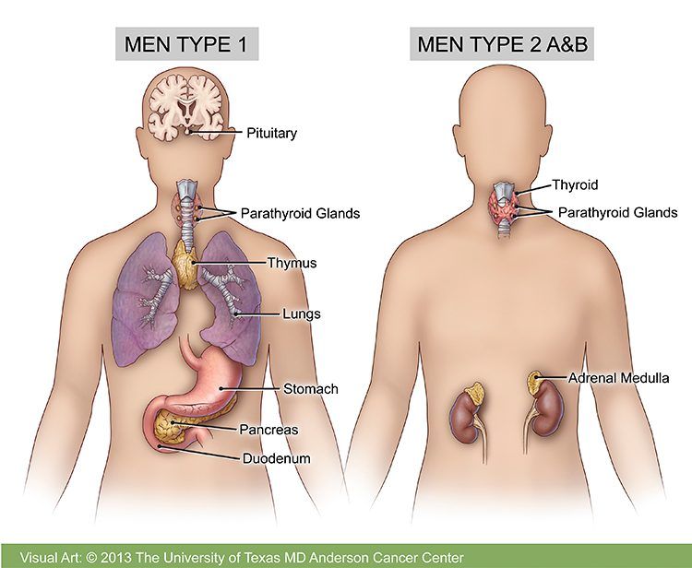
MEN1 Manifestations
Parathyroid adenoma resulting in primary hyperparathyroidism, affects almost all patients with MEN1 and is usually the first tumor to occur.
Anterior pituitary tumors, may be non-functional, if functional, usually prolactinoma.
Enteropancreatic tumors (most commonly gastrinomas, insulinomas) and less commonly tumors of the skin, adrenal glands or carcinoid tumors

Slide 49
MEN2 Syndromes
Persons with any of the MEN2 syndromes have a 95% chance of medullary thyroid cancer.
They also have a 50% chance of developing pheochromocytoma, but it is rarely malignant.
MEN2 is divided into 3 types- MEN2A, MEN2B and FMTC (familial medullary thyroid CA)
    Multiple other endocrine abnormalities distinguish each type of MEN2.

Slide 50
Question Time
Which of the following is the most likely cause of androgen excess in women?
Benign adenoma of the adrenal gland
Hyperplasia of the adrenal glands
Polycystic ovarian syndrome
Malignant adrenal tumor

Slide 51
Question Time
Which of the following symptoms is most likely to occur in women with androgen deficiency?
Patchy hair loss
Lack of sexual desire
Unintentional weight loss
Early menopause

Slide 52
Question Time
Which of the following features of hypertension are most closely associated with pheochromocytoma?
Intermittent
Resistant to control
Rapidly escalating
Sensitive to medications
Occurring at an early age

