Slide 1
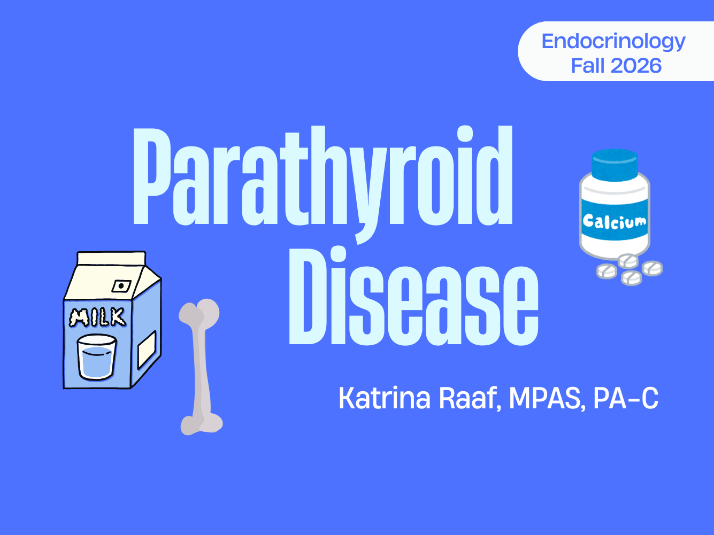
Parathyroid Disease
Katrina Raaf, MPAS, PA-C
Fall 2025

Slide 2
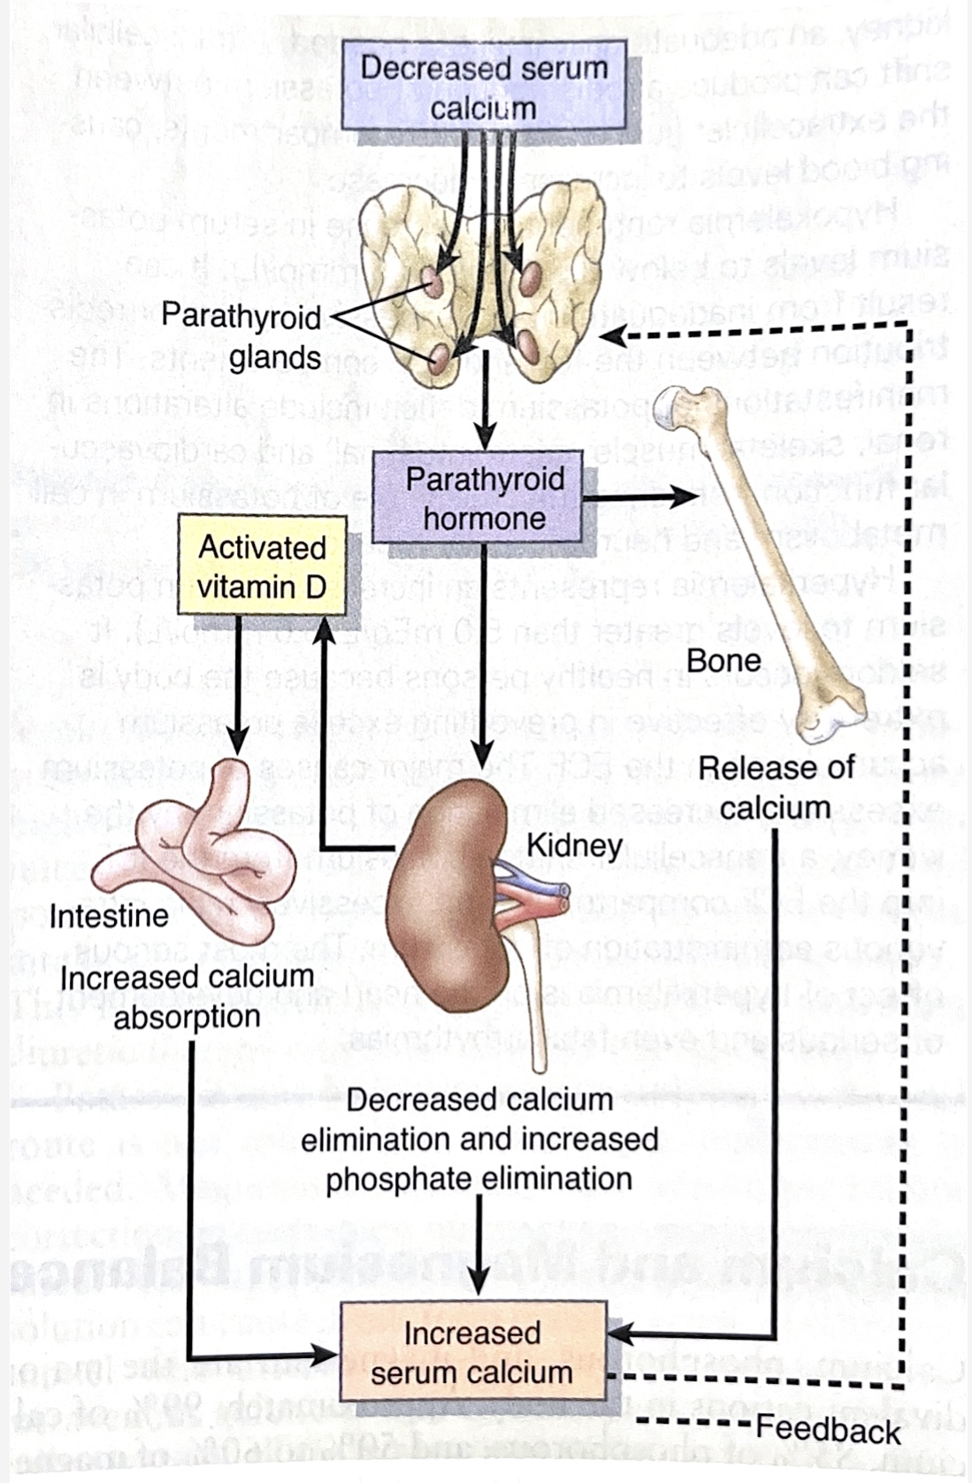
Notes:
Roles of PTH:
Activates osteoclasts and causes bone breakdown, which releases calcium into the bloodstream
Causes kidneys to hold on to calcium and release phosphorus in its place in the urine
Stimulates the kidneys to produce active vitamin D, which is necessary for the gut to absorb calcium from our diet.

Slide 3
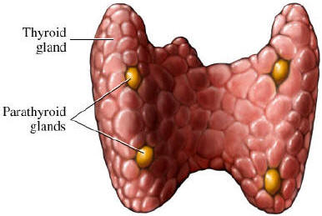
Parathyroid Glands
The parathyroid glands are
four tiny glands that rest on
the thyroid.
Often ectopic (intra-thyroid, carotid sheath, mediastinum) and extra may be present
Parathyroid glands produce parathyroid hormone (PTH), which is a major player in the regulation of calcium homeostasis.
Notes:
https://thyroid.com.au/finding-the-parathyroid-gland/, Accessed 11/24/25

Slide 4
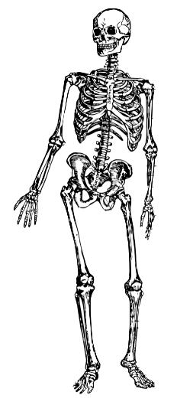
Calcium in the Body
Only 1% of body calcium circulates, yet that fraction drives nerve, muscle, clotting, and cell signaling.
99% of total body calcium is in the skeleton, which serves as both structural framework and the body’s calcium reservoir.
1% of total calcium is in blood and soft tissue – this is tightly regulated by the parathyroid glands.
  Half is ionized, or metabolically active.
  Half is bound to albumin.

Slide 5
The Four Functions of Calcium
1. Skeletal mineralization – structural role; bone also acts as a source of calcium when needed
2. Intracellular second messenger – the resting cytoplasmic calcium is very low. A tiny influx produces a rapid, reversible rise in intracellular calcium – which triggers muscle contraction, hormone, and neurotransmitter release.

Slide 6
The Four Functions of Calcium
3. Enzyme cofactor – calcium is required to activate many enzymes. Many clotting factors are inactive without adequate ionized Ca.
4. Regulation of membrane excitability – extracellular calcium sets the excitability of nerves and muscles by influencing the threshold of voltage-gated sodium channels.

Slide 7
Calcium & the Nerve/Muscle Membrane
Ionized calcium plays a critical role in setting the threshold for cell membrane depolarization.
Clinical rule of thumb:
  Low calcium → more excitable
  High calcium → less excitable

Slide 8
Hypocalcemia – more excitable
Mechanism: Low ionized calcium lowers the activation threshold of Na channels and partially depolarizes the resting membrane. Nerve and muscle cells then fire with little or no stimulus → neuromuscular hyperexcitability
Clinical findings:
  Perioral paresthesias
  Cramps and carpopedal spasm
Notes:
Intracellularly, the levels of calcium are very low. Even tiny changes of calcium moving into the cell cause rapid reversible changes in the concentration of calcium.
Think about your early biology days.
What is a second messenger? A hormone comes along in the blood stream, and it binds to the cell membrane, and by binding to the cell membrane, we get movement of calcium into the cell and we set off a chain reaction. The hormone itself never enters the cell, it’s the movement of calcium into it, that causes that change.

Slide 9

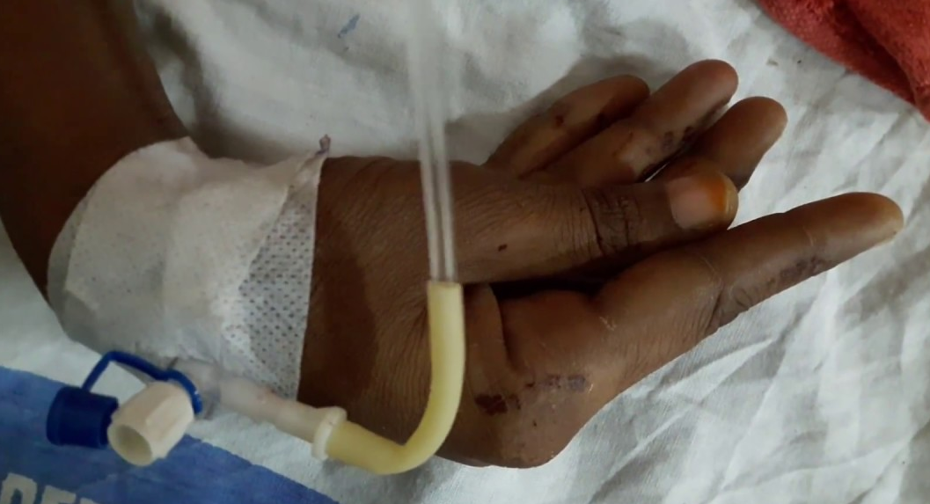
Hypocalcemia
Too little calcium causes the cell membrane to become “twitchy” and easily excitable
Involuntary carpopedal spasm

Slide 10
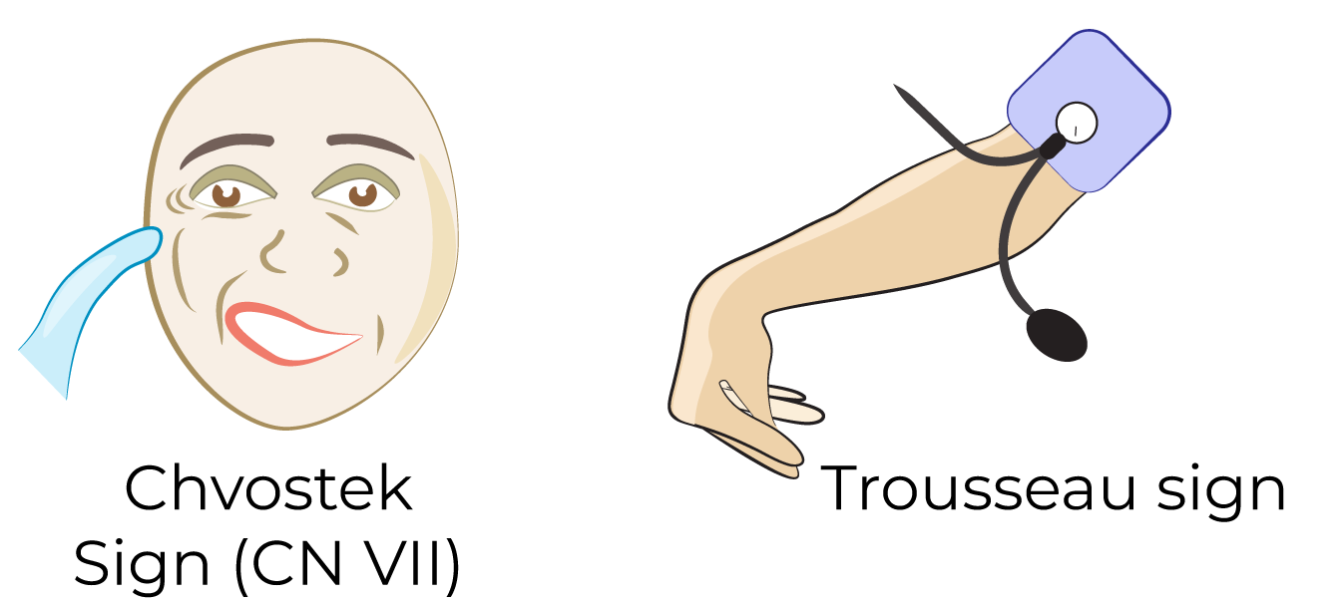
Hypocalcemia
Hallmarks of hypocalcemia include Chvostek and Trosseau sign
Involuntary contraction of hand/wrist with inflation of blood pressure cuff
Gently tapping the facial nerve causes twitching of the facial muscles

Slide 11
Hypercalcemia – less excitable
Mechanism: High ionized calcium raises the threshold for depolarization, making nerve/muscle cells resistant to stimulation.
Clinical findings:
  Muscle weakness, hyporeflexia, easy fatigability
  Neuro: confusion, labile mood, poor memory
  GI: nausea/vomiting, constipation, ileus
  Renal: volume depletion, AKI, polyuria
  Cardiac: shortened QT

Slide 12
Quick Recap
Hypocalcemia | Hypercalcemia
More excitable Cramps, spasms Oral paresthesias Tetany Chvostek/Trosseau sign Severe: Laryngospasm, bronchospasm, seizures | Less excitable Weakness, lethargy Constipation, nausea Confusion Volume depletion, AKI Severe: stupor/coma

Slide 13
Calcium Levels
Total plasma calcium levels are normally at about 8.5-10.2 mg/dL
  About half is bound to protein (albumin)
  About half is free, ionized and active
Calcium homeostasis is maintained by the kidney, intestine, and bones
Hydroxylated vitamin D and parathyroid hormone play major roles in the GI and renal maintenance of calcium homeostasis

Slide 14

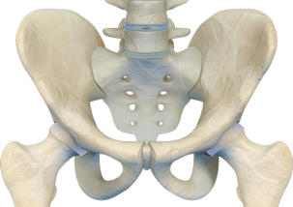
Calcium Balance in the Body
The bones act as a calcium reservoir for the body, and bone is constantly being turned over.
Calcium can be extracted or deposited to keep serum calcium levels constant

Slide 15
Response to Low Ca levels
Any decrease in serum calcium levels is quickly sensed by the parathyroid gland, and secretion of PTH increases.
PTH stimulates the kidney to hold on to calcium and the bones to release calcium to quickly bump up serum levels.
In the long term, PTH also stimulates the kidneys to produce dihydroxy vitamin D, which in turn, stimulates GI absorption of calcium.

Slide 16
Response to High Ca levels
When serum calcium rises, the thyroid gland secretes calcitonin into the blood.
High calcitonin levels inhibit osteoclasts, reducing bone resorption and the release of calcium from bone into the blood.
Higher serum calcium suppresses PTH secretion. This causes kidneys to lose calcium in the urine and hold on to phosphorus.

Slide 17
Actions of PTH
Causes immediate mobilization of calcium from the bone by stimulating osteoclasts
Causes kidneys to retain calcium and excrete phosphorus in its place in the urine
Stimulates kidney’s production of active vitamin D. Active vitamin D increases absorption of dietary calcium from the gut
Notes:
Parathyroid hormone (PTH) acts in four ways to increase serum calcium levels.

Slide 18
Vitamin D
Vitamin D is naturally present in few foods (fatty fish, eggs), is added to others (milk), and is available as a supplement.
Vitamin D is produced endogenously when UV rays from sunlight hit the skin and trigger vitamin D synthesis.
Vitamin D from sun exposure, food, and supplements is biologically inactive and must undergo 2 hydroxylations to become active.

Slide 19
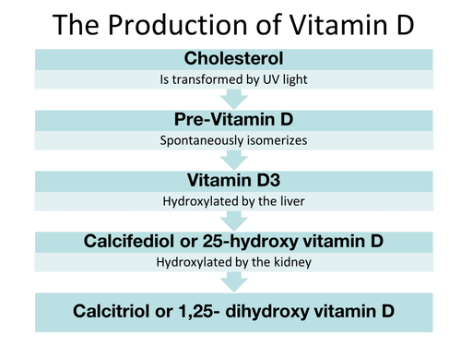
(vitamin D precursor)
25(OH)D
1,25(OH)2 D

Slide 20
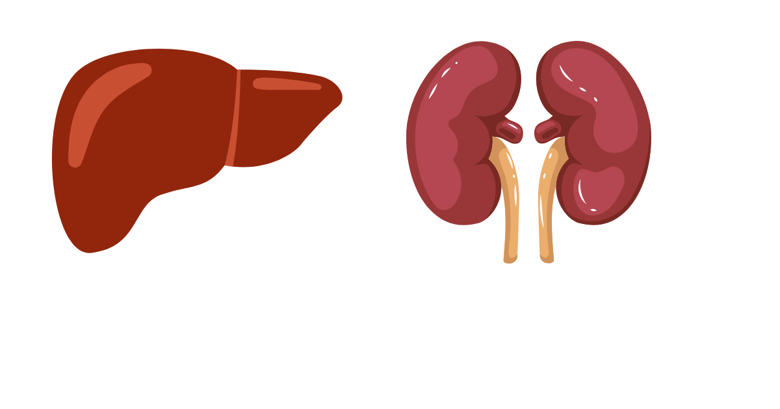
Vitamin D
1st hydroxylation ─ Occurs in the liver and converts vitamin D to 25-hydroxy-vitamin D [25(OH)D]
2nd hydroxylation ─ Occurs in the kidney and forms physiologically active 1,25-dihydroxy-vitamin D (calcitriol)
The serum concentration of 25(OH)D is the best indicator of vitamin D status

Slide 21

Vitamin D
In supplements and food, vitamin D is available in two forms: D₂ (ergocalciferol) and D₃ (cholecalciferol). Both considered equal.
Overproduction of di-hydroxy (active form) vitamin D commonly occurs in granulomatous diseases including lymphoma, sarcoidosis, and tuberculosis.

Slide 22
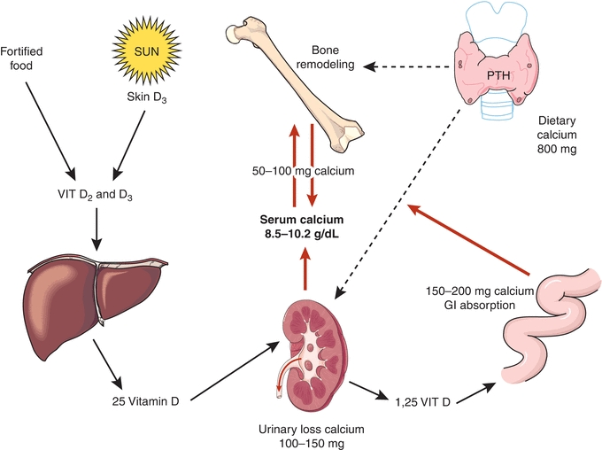
Supplements
Granulomatous disease
(TB, lymphoma, sarcoidosis)
1st hydroxylation
25(OH)D
Active vitamin D
2nd hydroxylation
Notes:
https://basicmedicalkey.com/calcium-homeostasis-and-hormonal-regulation/ Accessed 11/30/25

Slide 23
Too much of a good thing…
Vitamin D toxicity is possible because it is fat-soluble. It can cause nonspecific symptoms such as anorexia, weight loss, polyuria, and arrhythmias.
It can also raise blood levels of calcium which leads to vascular and tissue calcification ─ subsequently damaging the heart, blood vessels, and kidneys.

Slide 24

Bone Balance
Positive bone balance (bone formation) is stimulated by exercise and anti-resorptive drugs (bisphosphonates), and conditions that promote bone formation over bone resorption.
Negative bone balance (bone loss) is caused by immobilization, weightlessness, and sex steroid deficiency
Bone density is assessed using a DEXA scan

Slide 25
Calcium Lab Values
Normal calcium levels 8.5 – 10.2 mg/dL
  Severe hypocalcemia < 7 mg/dL
  Severe hypercalcemia > 12 mg/dL
Normal ionized calcium levels: 4.5 – 5.6 mg/dL or 1.09 – 1.03 mmol/L
When determining true serum calcium levels, we must “correct” the Ca value with a serum albumin level

Slide 26
Lab Confounders
Decreased or increased albumin are one of the most common causes of an abnormal calcium level.
Because albumin acts as calcium’s ‘shuttle,’ changes in albumin concentration affect how much total calcium appears on a blood test, even when biologically active free calcium remains normal.
Half of serum calcium is bound to albumin. If a pt has low albumin, total Ca will look (falsely) low.

Slide 27
Normal albumin
Normal iCa
Albumin bound
Ionized (free)
Low albumin
Normal iCa
Albumin bound
Ionized (free)
Total calcium appears falsely low

Slide 28
Total serum calcium = Ionized + Albumin bound
If albumin is low, total calcium will appear low.
The ionized serum calcium level will usually be normal. Quick correction of calcium level for albumin is (Ca + 4) ─ albumin
You can calculate corrected calcium level, or order an ionized level.
Example: If Ca is 7.2 (low), and albumin is 2.4 (low), then true calcium will be what?

Slide 29
Calcium Disorders:
Symptomatic or Asymptomatic?
Multiple factors affect whether symptoms develop from a low or high calcium level:
Severity of derangement (farther from normal, more likely to develop symptoms)
Speed at which calcium derangement develops (slower, more likely asymptomatic)
Age and comorbidities of patient

Slide 30
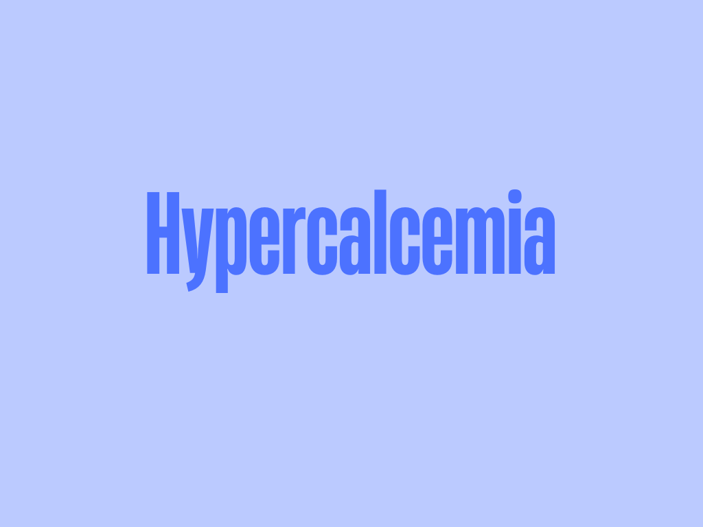

Slide 31
Hypercalcemia Signs & Symptoms
General: Muscle weakness and easy fatigability because normal nerve stimulation will no longer cause movement (hypercalcemia – less excitable)
GI: Smooth muscle hypoactivity in the GI tract causes constipation, ileus, nausea/vomiting. Can also cause GI ulcers, or even pancreatitis.
Renal: include volume depletion and AKI.
Neuropsych: Mental status changes, mild depression, poor memory/concentration.

Slide 32
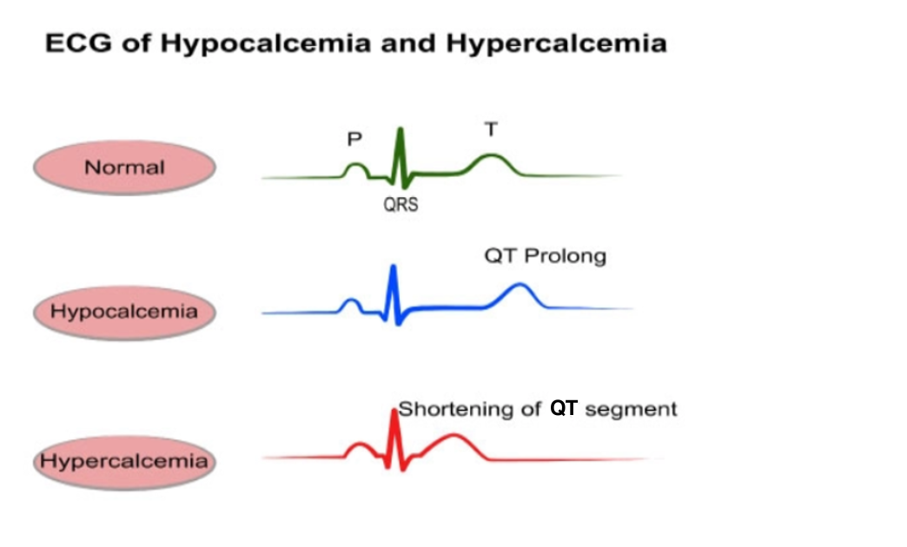
Hypercalcemia Signs & Symptoms
Cardiac effects include
  Shortening of QT interval
  Hypertension
  Bradycardia
Notes:
Jill’s trick: One more “O” in the cardiac effect for calcium disorders. Hypercalcemia

Slide 33
Helpful Mnemonic
Rule of O’s = Add one more “O” in the cardiac effect for calcium disorders.
Hypercalcemia (0 “O”s) + 1 = 1 O (Shorten QT)
Hypocalcemia (1 “O”) + 1 = 2 O’s (Prolong QT)

Slide 34
Workup of Hypercalcemia
Initial hypercalcemia is seen on routine labs
On another day, confirm this finding with repeat calcium and an albumin at the same time for correction (Alternatively, ionized Ca)
Check intact PTH with same lab draw. What is the appropriate response level of PTH if patient has a high calcium level?
  If calcium and intact PTH are both high, then _______ hyperparathyroidism is diagnosed.
primary
Notes:
Appropriate response: Low levels of PTH.
Intact PTH is high and calcium is high, means that the parathyroid gland is autonomously secreting PTH on its own.

Slide 35
Workup of Hypercalcemia
If the intact PTH is (appropriately) low, the next step is to order PTHrP level and vitamin D metabolites.
PTHrP is parathyroid hormone related peptide, which can be produced by solid cancers as a paraneoplastic syndrome. This acts similarly to PTH, but it is biochemically different.
  If PTHrP is high, it is suggestive of malignancy
Notes:
A paraneoplastic syndrome are clinical symptoms that are caused INDIRECTLY by the tumor rather than by the physical presence of or spread of the cancer itself.
Check 25-hydroxyvitamin D and 1,25-dihydroxyvitamin D and PTHrP. PTHrP suggestive of a paraneoplastic syndrome caused by cancer. Vitamin D levels are checked to rule out a vitamin D toxicity as a cause of hypercalcemia.
If PTHrP is high, we know patient has a malignancy and we will start looking for that cancer.

Slide 36
Workup of Hypercalcemia
Levels of vitamin D metabolites look for hypervitaminosis and granulomatous disease as a cause for hypercalcemia.
  25 hydroxy-vitamin D: high in cases of excessive vitamin D supplementation
  1,25 dihydroxy-vitamin D: elevated in granulomatous disease (Hodgkin’s Lymphoma or sarcoidosis)
Notes:
Checking to see if a patient is taking too much vitamin D. We cannot get too much Vitamin D from sun exposure, but we can from a dietary supplement.

Slide 37
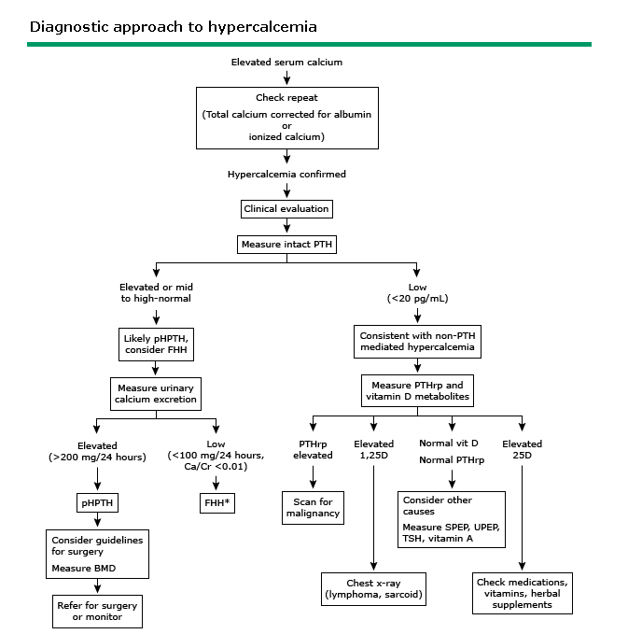
Notes:
After elevated serum calcium, we want to check 1) is it real and 2) why is it happening. Repeat calcium first.

Slide 38

What lab findings do you expect to see in hypercalcemia due to malignancy?
Pause to check for understanding. Discuss
with your neighbor.
Calcium -
Intact PTH -
PTHrP -
What is it called when a malignant tumor releases substances that disrupt normal tissue?

Slide 39
Treatment of Hypercalcemia
Asymptomatic hypercalcemia (<12 mg/dL):
Aggressive oral hydration
Avoid factors that worsen hypercalcemia: prolonged bed rest, immobility, and volume depletion
Avoid drugs that worsen hypercalcemia: thiazide diuretics, antacids (Tums), lithium
Notes:
Bed rest and immobility promote bone resorption or breakdown and increase osteoclast activity.
Drink lots of water so as little calcium is in the renal tubule as possible to prevent kidney stones
Aggressive oral hydration – good rule of thumb is take the patient’s weight in lbs and multiply by 0.5. That will be number of oz to aim for. Quite a lot of water!
Example. Patient weighs 160 lbs, goal is to drink 80 oz or 10 cups of water per day. Day in and day out.

Slide 40
Treatment of Hypercalcemia
Severe hypercalcemia (> 13 mg/dL):
Aggressive IV hydration to expand volume and facilitate renal excretion of calcium
IV bisphosphonate: DOC is zoledronic acid which quickly lowers blood calcium
Moderate hypercalcemia (between 12-13) may be treated with combination of these two approaches based on the clinical picture.
Notes:
Zoledronic acid only requires 1 dose
0.9 NS. 100 cc/hr is a pretty good clip if patient is also drinking water by mouth.
Zoledronic acid is a one time dose. Lowers calcium down by the next day.

Slide 41
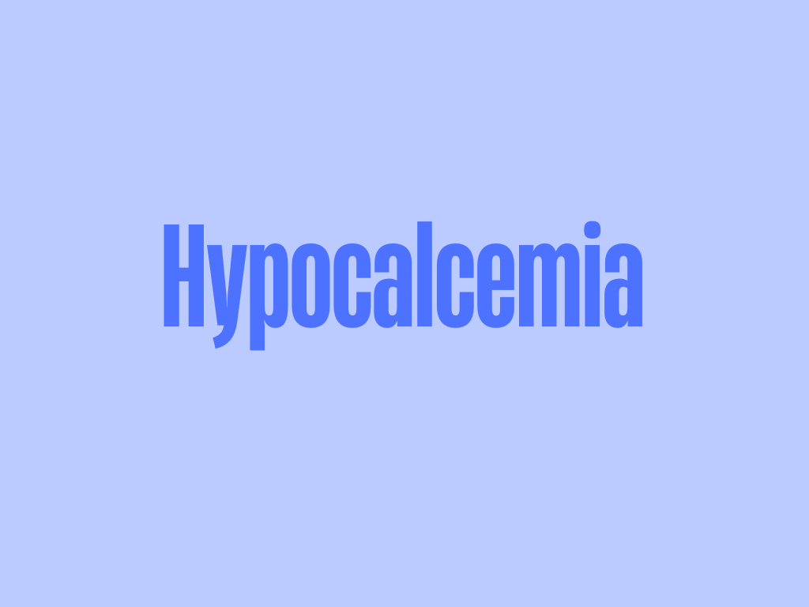

Slide 42
Hypocalcemia S/S
Low calcium makes nerve and muscle cells hyperexcitable.
Paresthesia: most commonly perioral or in the hands or feet
Muscle spasms / tetany
Laryngospasm
Seizures
Prolongation of the QT interval
Notes:
Muscle spasms due to prolonged muscle contraction. Muscle cells need very little stimulation to twitch.
Prolongation of QT may lead to arrhythmia.
Laryngospasm is rare to be the single presenting symptom, without signs of overt tetany or seizure.
https://www.nytimes.com/2024/06/30/movies/inside-out-2-anxiety-character.html, Accessed 11/30/25

Slide 43
Hypocalcemia Work-up
Begin with measurement of intact PTH, magnesium, creatinine, phosphate, and vitamin D metabolites.
Treatment depends on cause, severity, symptoms, and how rapidly the hypocalcemia developed.
Notes:
From UpToDate: Check PTH, phosphorus, magnesium, 25(OH)D, 1,25 (OH) 2D, and creatinine
Common causes of hypocalcemia:
Vitamin D deficiency, renal failure, hypomagnesemia, hypoparathyroidism
the vitamin D metabolites calcidiol (25-hydroxyvitamin D [25(OH)D]) and calcitriol (1,25-dihydroxyvitamin D, the active vitamin D hormone),

Slide 44
Hypocalcemia Treatment
Mild or asymptomatic hypocalcemia is treated with oral replacement.
  Increase dietary intake or add oral supplement.
IV replacement is indicated in symptomatic or severe hypocalcemia with cardiac arrhythmias or tetany.
Notes:
For mild or asymptomatic: Can give tums as an option every meal if patient prefers over taking calcium pills because those are very big to swallow.
IV replacement – monitor calcium very 4-6 hours in the hospital setting.

Slide 45
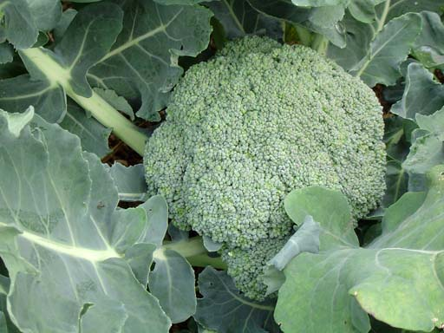

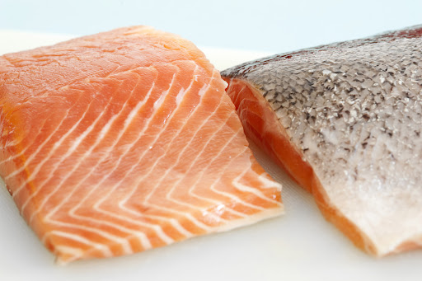
Hypocalcemia Treatment
Increasing dietary calcium
  Dairy products: cheese, milk
  Dark green leafy vegetables: broccoli, kale
  Fish: sardines, salmon
  Calcium-fortified foods: soy products, cereal
Patients who take in adequate calcium can still have low Ca levels due to poor GI absorption.
Notes:
Poor GI absorption – such as celiac disease or Crohn’s.

Slide 46
Hypocalcemia Treatment
Oral replacement
Calcium supplements can interfere with absorption of many meds from the gut – BP, thyroid, bisphosphonates, and antibiotics.
Age Group | Daily Intake | Upper Limit
19-50 years | 1,000 mg/day | 2,500 mg/day
51 years and up | 1,200 mg/day | 2,000 mg/day

Slide 47
Hypocalcemia Treatment
Oral replacement
Calcium carbonate – cheapest option
Calcium citrate
IV replacement
Calcium gluconate – IV, commonly used
Calcium chloride – central line, only used in emergencies (such as seizures)

Slide 48
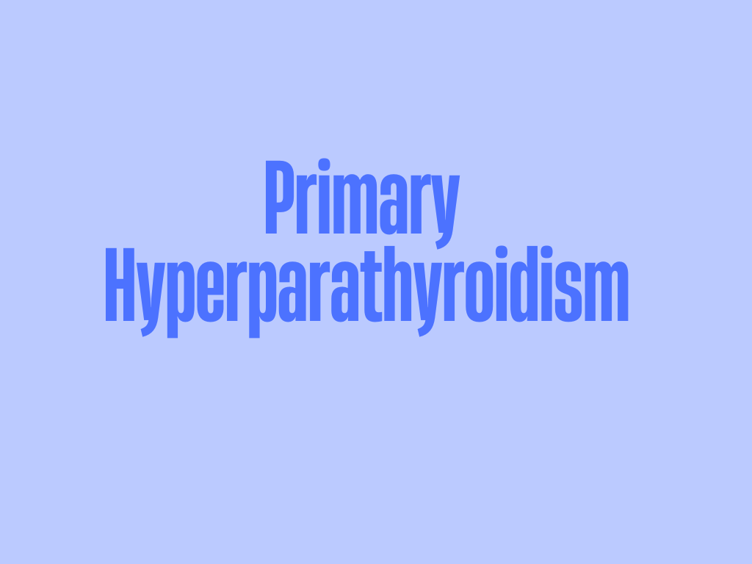

Slide 49
Primary Hyperparathyroidism
The most common cause of hypercalcemia among healthy outpatients
Single autonomous parathyroid adenoma ~85%
Parathyroid hyperplasia ~15%
Parathyroid cancer <1%

Slide 50
Primary Hyperparathyroidism
More frequent in patients over 50 and is 3x more common in women
Primary hyperparathyroidism usually causes a mild elevation of serum calcium and is relatively asymptomatic
The diagnosis is made by finding an elevation in serum calcium (measured on more than 1 occasion) and an elevated intact PTH

Slide 51
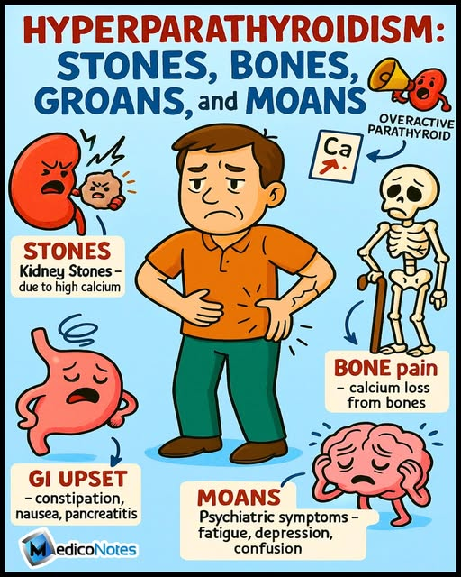
Classically, primary hyperparathyroidism presents as stones, bones, groans, and moans
Notes:
https://www.threads.com/@medico_notes/post/DMVrY3wq6Tg/hyperparathyroidism-remember-it-with-a-smilethis-classic-mnemonic-helps-you-reca, Accessed 11/30/25

Slide 52
Primary Hyperparathyroidism
If symptomatic, primary hyperparathyroidism classically presents with stones, bones, moans, and groans.
Stones (Renal):
  Renal calculi: hypercalciuria causes calcium to precipitate out to form kidney stones.
  CKD: hypercalcemia decreases GFR
  Polydipsia and polyuria: hypercalcemia causes renal tubular dysfunction.

Slide 53
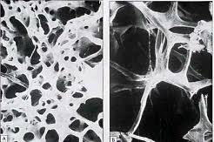
Primary Hyperparathyroidism
Bones: High levels of parathyroid hormone cause a loss of bone mass and strength as calcium is leached away.
Healthy bone
      The bone is replaced by fibrous cysts resulting in:
      Bone pain (most common)
      Osteomalacia: soft bones
      Osteoporosis: brittle bones
      Pathologic fracture
Weakened bone

Slide 54
Primary Hyperparathyroidism
Moans: abdominal symptoms of constipation, dyspepsia, nausea and vomiting. Hypercalcemia will slow GI transit, increase gastric acid production and in rare cases, cause acute pancreatitis.
Groans/ Psychiatric overtones: lethargy, memory loss, impaired concentration, depression, delirium, psychosis, ataxia or coma

Slide 55
Primary Hyperparathyroidism Labs
Serum calcium levels: HIGH (> 10.5 mg/dL)
Ionized serum calcium levels: HIGH
Serum intact PTH levels: INAPPROPRIATELY HIGH
Serum phosphate levels: LOW (<2.5 mg/dL)
  The kidney is forced to excrete phosphorus under the influence of very high PTH

Slide 56
Primary Hyperparathyroidism
Asymptomatic patients with primary HPT may be monitored and treated conservatively with large fluid intake.
Development of significant symptoms or lab abnormalities is indication for a parathyroid resection.
  Who may require surgery: Patients who develop kidney stones, hypercalciuria, bone pain, or osteoporosis

Slide 57
Primary Hyperparathyroidism
Even “asymptomatic” patients with primary HPT may notice an improvement in anxiety, phobias and mood after parathyroidectomy.
Once parathyroid resection surgery is finished, PTH levels fall rapidly, often resulting in hypocalcemia during the first 24 hours.
Frequent measurements of ionized calcium levels and supplementation of calcium and magnesium are needed if this happens.

Slide 58
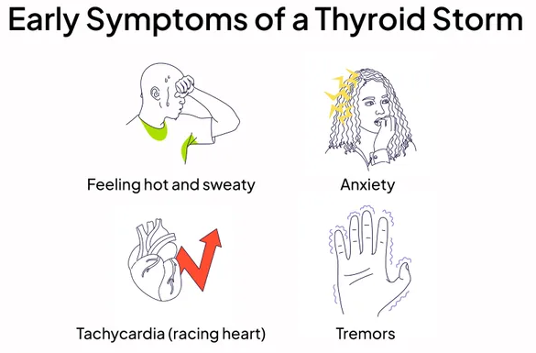
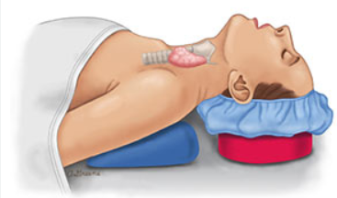
Surgery for Primary HPT
Thyrotoxicosis (tachycardia, fever, and diaphoresis) is also common due to thyroid manipulation during a parathyroidectomy.
Hyperthyroid symptoms are best managed with propranolol
Notes:
https://ent-specialist.org/parathyroid-surgery/ Accessed 11/30/25
https://www.health.com/thyroid-storm-symptoms-8707002 Accessed 11/30/25

Slide 59

“Hungry Bones” syndrome
“Hungry bones” occurs after parathyroid glands are removed, the bones suddenly soak up so much calcium from the blood that the patient becomes dangerously low in calcium
Think of it as “starving bones” grabbing all the Ca they can

Slide 60
“Hungry Bones” syndrome
Before surgery:
The patient has too much parathyroid hormone (usually from adenoma)
High PTH constantly breaks down bone (resorption), dumping Ca into blood
Before surgery, the body is used to fast rate of bone breakdown and hypercalcemia

Slide 61
“Hungry Bones” syndrome
After surgery:
Parathyroidectomy removes the overactive glands, and once it’s out:
  PTH levels crash almost instantly
  Bone breakdown stops quickly (no PTH to drive it)
  Kidneys stop holding onto calcium (PTH normally helps to reabsorb it), so more Ca is lost in urine

Slide 62
“Hungry Bones” syndrome
Repeated episodes of hypocalcemia occur despite multiple rounds of supplementation
Why does calcium drop so rapidly?
Bone breakdown STOPS fast
Bone formation KEEPS GOING at the old rate (utilize calcium from blood)
Result: Calcium pours out of blood and INTO the bone to build it up

Slide 63
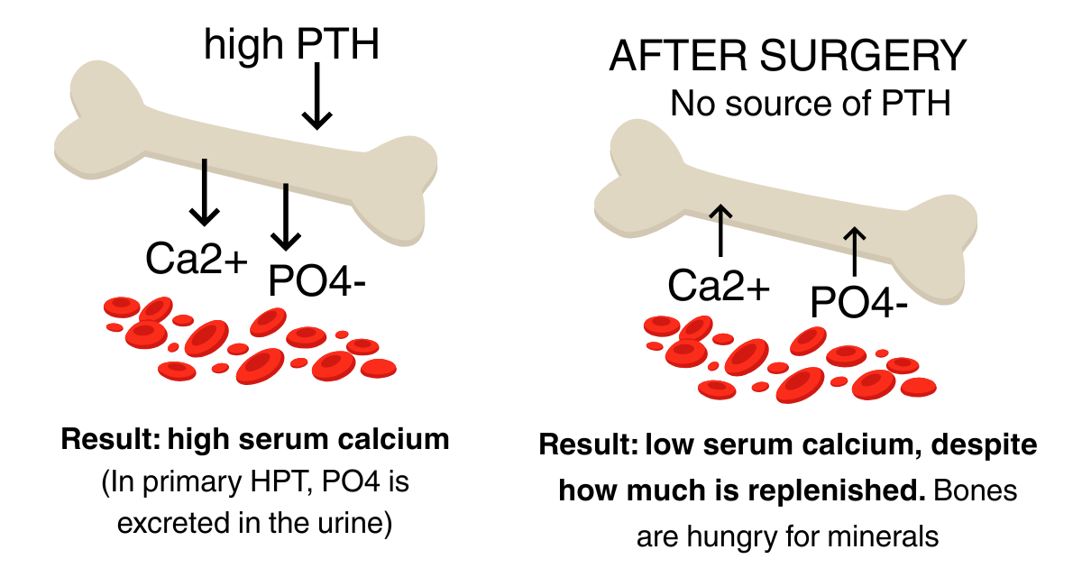
Hungry Bones Syndrome
BEFORE SURGERY

Slide 64
“Hungry Bones”
This would be manifest by what symptoms?
Hungry bones syndrome is present if calcium does not normalize within 4 days of parathyroid resection.
Persons with secondary hyperparathyroidism due to ESRD are especially prone to development of hungry bones.
Notes:
Tingling of mouth, hands and feet, and muscle spasms.
More severe – tetany, seizures, cardiac arrhythmias

Slide 65
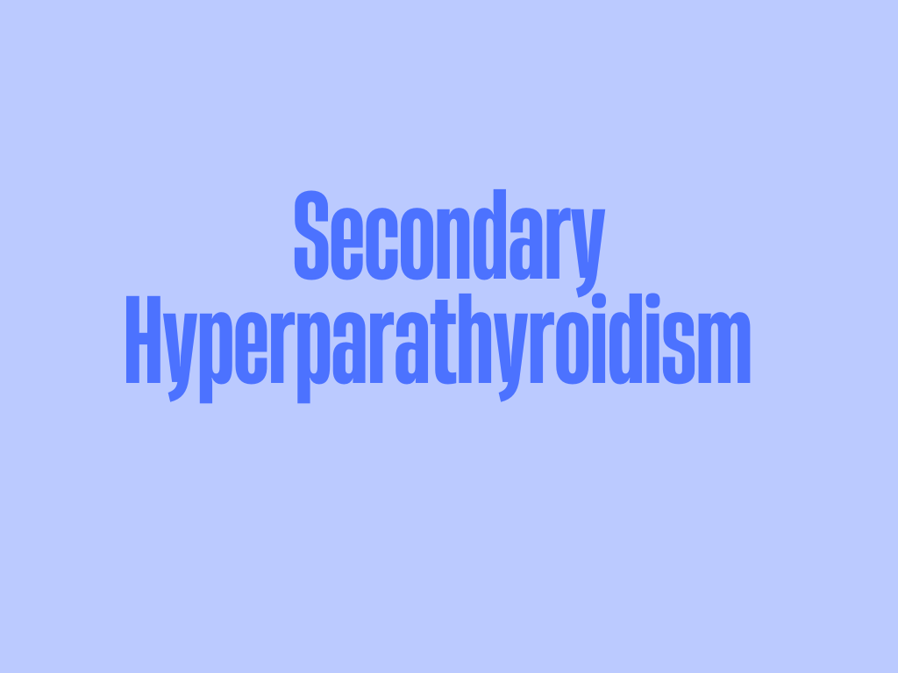

Slide 66
Secondary Hyperparathyroidism
Etiologies:
Chronic kidney disease *
Vitamin D deficiency (severe)
Malabsorptive states

Slide 67
Secondary Hyperparathyroidism
Chronic kidney disease
In CKD, the kidneys cannot convert vitamin D into the active form → reduced intestinal absorption of calcium (Hypocalcemia).
The kidneys fail to excrete phosphorus normally (Hyperphosphatemia), and the diseased kidney excretes calcium in its place.
Persistent hypocalcemia stimulates parathyroid hyperplasia.

Slide 68
Secondary Hyperparathyroidism
Higher levels of phosphorus in the plasma may form insoluble salts with calcium ions, thereby worsening hypocalcemia.
Deposition of the calcium phosphate salts in the body tissues, like the blood vessels and heart valves, making them less contractile.
Calcium deposits also occur in other soft tissues of the body leading to calciphylaxis.

Slide 69
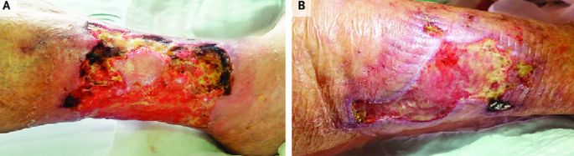
Calciphylaxis
Calciphylaxis is rare and is usually seen in ESRD patients with either secondary or tertiary HPT.
Characterized by ischemic necrosis of the skin due to calcium phosphate crystal deposition and subsequent inflammation in small-to-medium–sized vessels.
Notes:
https://www.researchgate.net/figure/Clinical-Images-of-a-Patient-with-Calciphylaxis-before-and-6-Months-after-Treatment-with_fig2_326655783, Accessed 11/30/25

Slide 70
Secondary Hyperparathyroidism in CKD
Serum PTH levels will be
Serum calcium will be
Ionized serum calcium will be
Serum phosphate level is

Slide 71
Secondary Hyperparathyroidism
Severe vitamin D deficiency
Patients with severe vitamin D deficiency (25 OH(D) <20 ng/mL) are unable to absorb calcium from their diet (hypocalcemia), resulting in overstimulation of the parathyroid (high PTH).
This is a less common cause of secondary HPT.
Certain malabsorptive states such as chronic pancreatitis and gastric bypass can cause a similar clinical picture.

Slide 72
Low Vitamin D and 2nd Hyperparathyroidism
Very low active
Vitamin D
Loss of intestinal calcium absorption
Hypocalcemia
PTH release
Severe vitamin D deficiency 25(OH) D < 20 ng/mL

Slide 73
Secondary Hyperparathyroidism
3. Malabsorptive States
Certain malabsorptive states such as chronic pancreatitis, celiac disease, and gastric bypass can cause a similar clinical picture due to difficulty absorbing calcium and vitamin D
Chronic pancreatitis – characterized by inability to break down and absorb fat-soluble vitamins (A, D, E, and K)
Notes:
Remember the role of vitamin D. The active form of vitamin D is necessary for the gut to absorb calcium in the gut.
Chronic pancreatitis is caused by(inability to break down and absorb fat soluble vitamins. Significant/severe vitamin D deficiency- a 25-hydroxyvitamin D level of less than 20 ng/mL (50 nmol/L), while 21-29 ng/mL is relative insufficiency
Excess parathyroid hormone promotes a urinary loss of phosphate and mobilizes calcium from the bones to maintain normal serum levels, but . . .
In the case of vitamin D deficiency, the kidney can excrete phosphate, but not indefinitely.

Slide 74

Let’s pause and make sure we understand all of that…

Slide 75
Why does CKD cause a secondary hyperparathyroidism?
Failing kidney cannot excrete ____
Failing kidney cannot make active ____
Low calcitriol → gut absorbs less _____ → serum ___ falls
High phosphate and low calcium and low calcitriol each independently tell the parathyroid to “make more PTH”
Over time the parathyroid glands ______ and become harder to control.

Slide 76
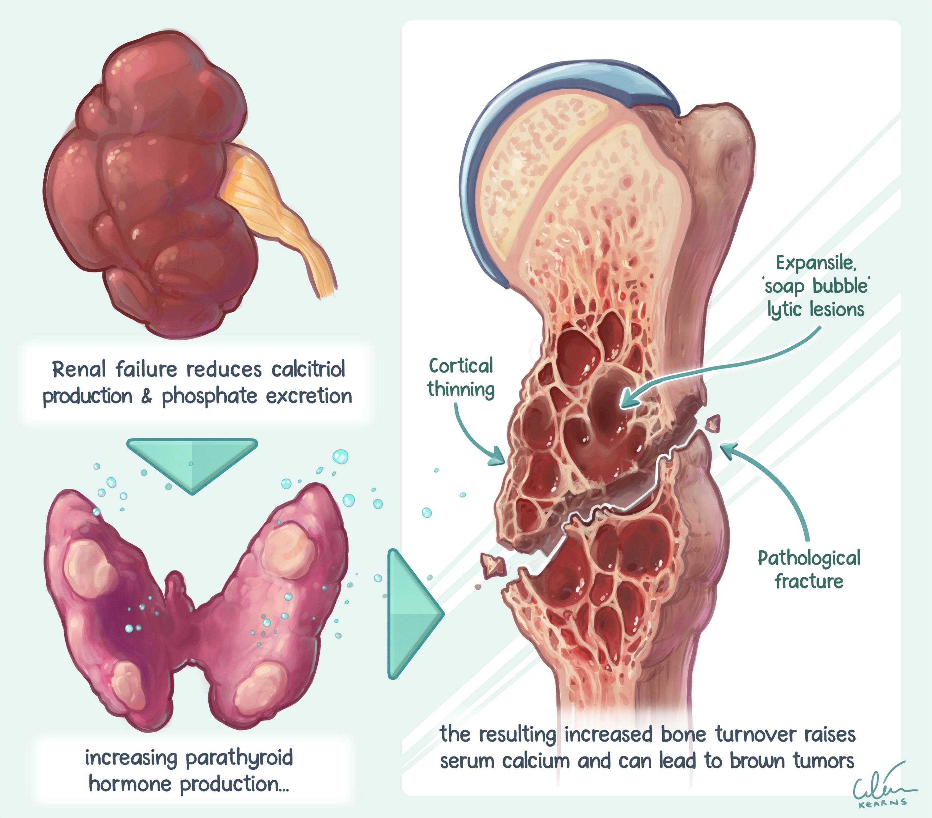
Secondary Hyperparathyroidism
Effects of CKD on the bones
Recall that bones are an immediate ‘bank’ where we can get calcium.
Excess PTH secretion draws too much calcium from the bones, weakening them.
Notes:
CKD patients have a few different things working against them in terms of bone health. Inability to make Vitamin D and constant exposure to high PTH will draw calcium out of the bones

Slide 77
Secondary Hyperparathyroidism
The CKD patients develops demineralized bones due to constant leaching of calcium.
This causes bone pain, spontaneous fracture, and muscle weakness.
In CKD this is called renal osteodystrophy.

Slide 78
Treatment of Secondary HPT in CKD
Reduce phosphates in the diet with a minimally processed diet
Foods high in phosphate include:
Liquids: beer, soda, milk, chocolate drinks
Dairy: milk, cheese, puddings, yogurt
Protein: oyster, caviar, sardines
Others: pizza, chocolate candy, caramels
Notes:
First line treatment is the dietary restriction of phosphorous. This should be started around CKD late stage IIIB as phosphorous levels begin to increase. Normal phosphate is 2.5-4.5 mg/dL.

Slide 79

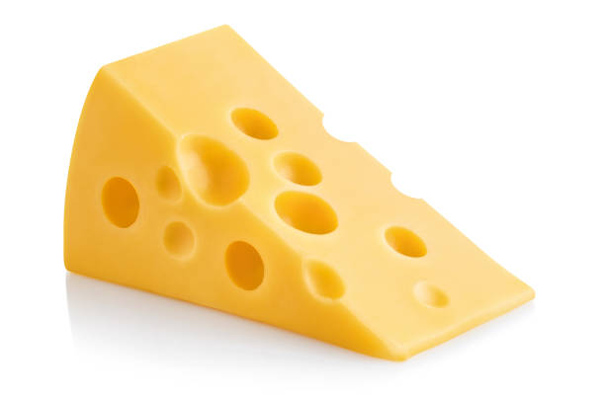
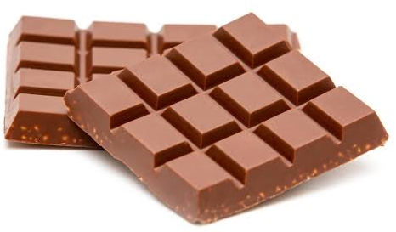



Treatment of Secondary HPT in CKD
Reduce phosphates in the diet with a minimally processed diet
  Start dietary restriction around CKD IIIb as phosphorus levels start to increase.
Notes:
Foods high in phosphate include:
Liquids: beer, soda, milk, chocolate drinks
Dairy: milk, cheese, puddings, yogurt
Protein: oyster, caviar, sardines
Others: pizza, chocolate candy, caramels

Slide 80
Treatment of Secondary HPT in CKD
2. Give phosphate binders if high serum phosphate persists despite diet restrictions in CKD
These drugs are taken with each meal and bind to the ingested phosphates, letting them pass out of the GI tract without being absorbed.
May be calcium based or non-calcium based, depending on the serum calcium levels- remember we want to keep calcium levels at low normal to prevent calciphylaxis.
Notes:
Only use calcium based phosphate binders in patients with concurrent low calcium because we don’t want to cause hypercalcemia.

Slide 81
Phosphate Binders
Used for hyperphosphatemia despite dietary restriction
Contains calcium | Does not contain calcium
Calcium acetate (PhosLo) | Selevamar (Renvela, Renagel)
 | Lanthanum (Fosrenol)
 | Sucroferric oxyhydroxide (Velphoro)
Notes:
Indication to use these: If patient has cut out pizza, soda, and dairy from their diet and phosphate remains high.

Slide 82
Treatment of Secondary HPT in CKD
3. Treating low vitamin D will improve calcium absorption from the gut. These medicines can be given IV after dialysis or orally.
Calcitriol: the active metabolite of vitamin D
Doxercalciferol: synthetic vitamin D2 analog, must be metabolized to the active form of vitamin D
Paricalcitol: a synthetic vitamin D analog that simulates the vitamin D receptor
Notes:
Our goal is to give enough vitamin D so patients can start to pull calcium out of the gut. If we can keep calcium at low normal levels, we can prevent bone resorption.
Calcitriol, doxercalciferol, paricalcitol

Slide 83
Treatment of Secondary HPT in CKD
The last option to treat secondary HPT caused by ESRD is a calcimimetic that enhances the sensitivity of the parathyroid calcium receptor.
These drugs make the parathyroid receptor more sensitive to calcium, so the gland decreases secretion of PTH. Utilized in dialysis patients when PTH stays elevated.
      Cinacalcet (Sensipar): oral, most common
      Etelcalcetide (Parsabiv): IV after HD, used less often
Notes:
Calcimimetics fool into thinking lower calcium levels are normal.
Cinacalcet Etelcalcetide
Add calcimimetic for dialysis patients when PTH stays elevated despite active vitamin D, especially if calcium is high.

Slide 84
Summary of Medical Treatment of Secondary HPT in the CKD patient:
Treatment | Medications
First line – limit phosphate in diet | None ☺ Patient education
Second line – phosphate binders | Phosphate binders may contain calcium, or not
Vitamin D supplements | Calcitriol Doxercalciferol Paricalcitol
Calcimimetics (for HD pts only) | Cinacalcet Etelcalcetide
Notes:
Calcimimetics fool into thinking lower calcium levels are normal.
Escalate therapy based on combined trends in phosphate, calcium, and PTH; target PTH 2–9× ULN in dialysis patients (no defined target in non-dialysis CKD), keep phosphate toward normal, and avoid hypercalcemia; add a calcimimetic for dialysis patients when PTH stays elevated despite active vitamin D, especially if calcium is high.

Slide 85
Surgical Treatment of Secondary
(and Tertiary) HPT
Patients who fail aggressive medical management of their secondary hyperparathyroidism may undergo a partial parathyroidectomy with removal of 3 ½ parathyroid glands to decrease the secretion of PTH.
Alternatively, a total parathyroidectomy with or without auto transplantation is done. Parathyroid tissue may be cryopreserved in the event of hypoparathyroidism development.

Slide 86
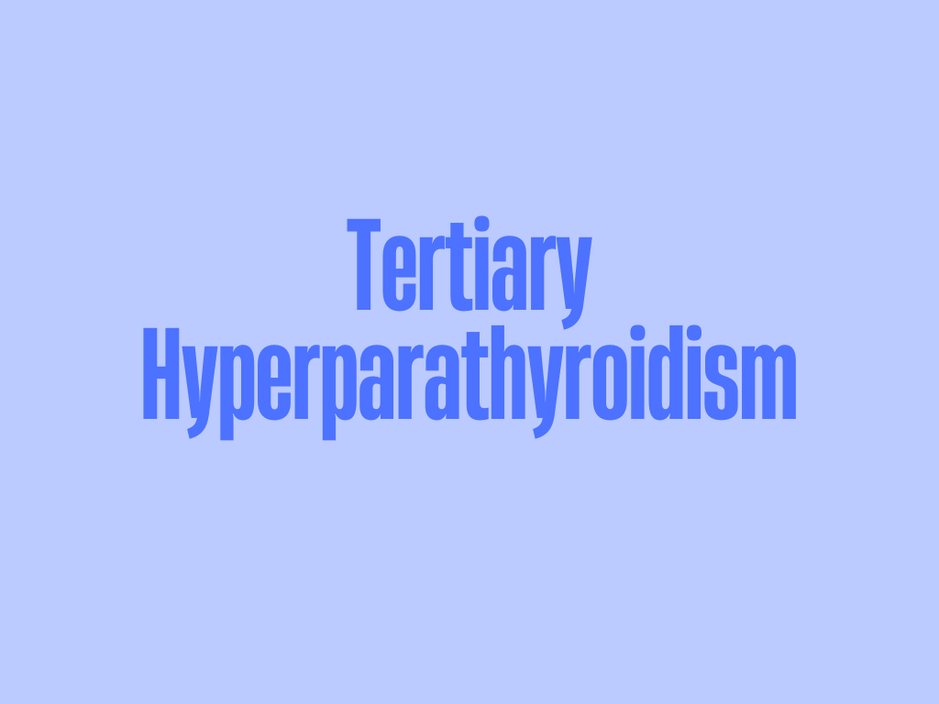
Notes:
This occurs in an even smaller subset of patients. This occurs in patients with chronic kidney disease after they get a renal transplant.

Slide 87
Tertiary Hyperparathyroidism
Occurs in patients with long-standing CKD after renal transplant.
Parathyroid glands that have been excessively stimulated for several years by CKD, fail to recognize normalization of serum calcium levels following the renal transplant.
The parathyroids continue to autonomously produce excessive parathyroid hormone resulting in hypercalcemia and hypophosphatemia.
Notes:
A patient has been on dialysis for a long time and then all of a sudden we drop in a 20-year-old kidney which acts perfectly. The parathyroid gland is so used to producing excessive PTH for such a long time that it fails to recognize the normalization of serum calcium.

Slide 88
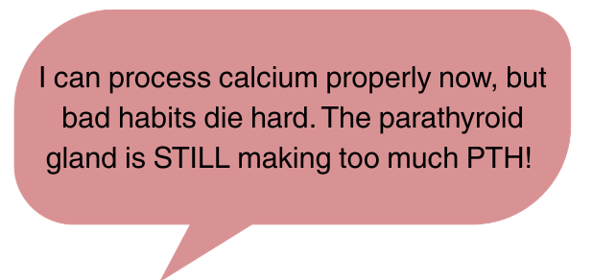
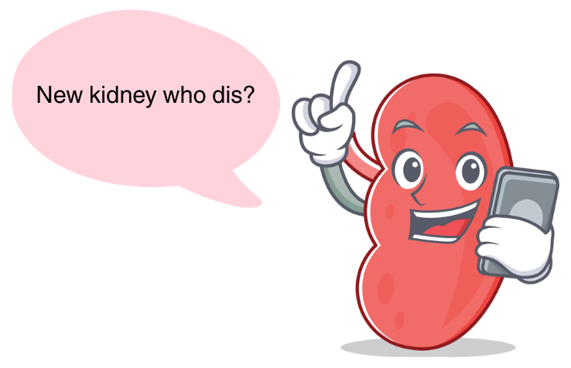
Post kidney transplant in ESRD patient:
PTH levels persist → high Ca and low PO4

Slide 89
Tertiary Hyperparathyroidism
This type of hyperparathyroidism may become resistant to calcimimetic treatment.
This is particularly dangerous because such high levels of calcium in the blood may lead to diffuse calcification can occur in the body tissues.
Treatment is surgical – with either a total parathyroidectomy with auto transplantation or subtotal parathyroidectomy (3.5) as previously described.
Notes:
We cannot treat these patients medically. The only way to treat tertiary hyperparathyroidism is with surgery. We don’t mess around with medical treatment.

Slide 90

DDx of Hyperparathyroidism
Hypercalcemia of malignancy
This is the most common cause of hypercalcemia in hospitalized patients.
Most often, this is caused by tumor release of a peptide from the cancer cells: parathyroid hormone -related peptide (PTHrP) and patients will have low/undetectable intact PTH levels.
Less commonly, hypercalcemia results from osteolytic lesions or from granulomatous lesions
Notes:
These calcium levels will be very high, in comparison with the mild hypercalcemia we see in primary hyperparathyroidism.

Slide 91
Hypercalcemia of Malignancy
Hypercalcemia of malignancy requires treatment if calcium levels are >14 mg/dL or the patient is symptomatic.
What are treatment options?
What cancers are most likely to cause hypercalcemia of malignancy?
  Squamous cell carcinoma of the head/neck, multiple myeloma, breast, lung, renal and ovarian cancers.

Slide 92
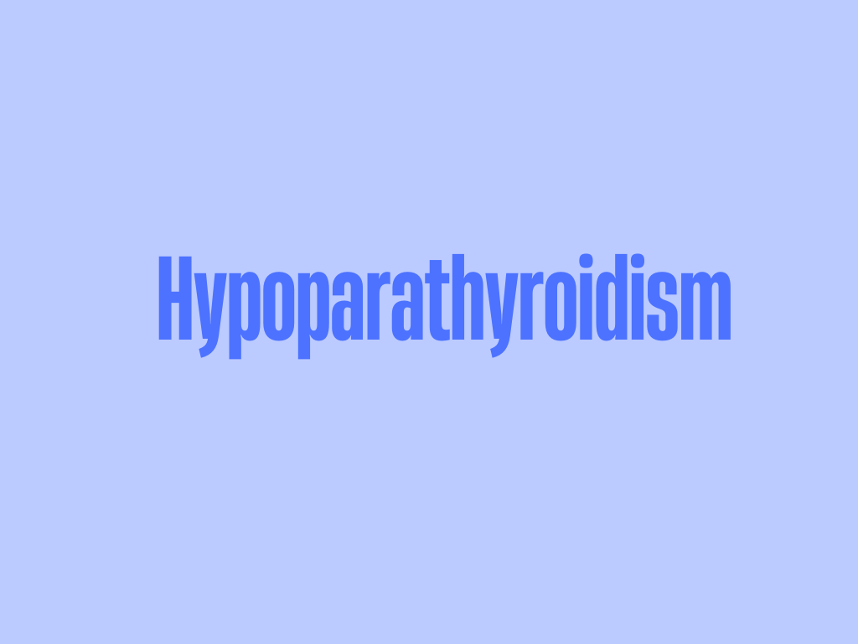
Notes:
Let’s switch our focus to hypoparathyroidism. We don’t see this often, we are much more likely to see a hyperparathyroidism rather than a hypoparathyroidism.

Slide 93
Hypoparathyroidism: Etiologies
1. Iatrogenic (MC): following thyroid or parathyroid surgery: may be transient or permanent
2. Autoimmune destruction of the parathyroids or autoantibodies to the calcium sensing portion of the parathyroid.
3. Additional rare causes include:
  Irradiation or infiltrative diseases, such as Wilson’s or hemochromatosis
  Genetic defect, occurs in childhood
Notes:
Can be transient – we traumatized tissue during surgery, or permanent – where we accidentally removed the parathyroid glands.
Acquired hypoparathyroidism is most often the result of postsurgical or autoimmune damage to the parathyroid glands. In adults, the most common cause is surgical. In a retrospective analysis of adults evaluated in a metabolic bone unit of an endocrinology service in Brazil, over 80 percent of cases of acquired hypoparathyroidism were postsurgical, whereas less than 20 percent were autoimmune

Slide 94
Hypoparathyroidism: Etiologies
Reversible hypoparathyroidism may be caused by persistent hypomagnesemia, which will create parathyroid hormone resistance and decrease PTH secretion.
Hypomagnesemia is a common electrolyte abnormalities in patients who consume heavy alcohol or in malnourished persons.
Pseudohypoparathyroidism: Target organ (kidney) resistance to PTH

Slide 95
Hypoparathyroidism
The signs and symptoms of hypoparathyroidism are due to hypocalcemia and include:
Muscular: diaphoresis and muscular cramping, hoarseness due to laryngospasm, wheezing due to bronchospasm.
Neurologic: paresthesia, seizures.
GI: biliary colic
Psychiatric: hyperirritability, mood swings and personality disorders.

Slide 96
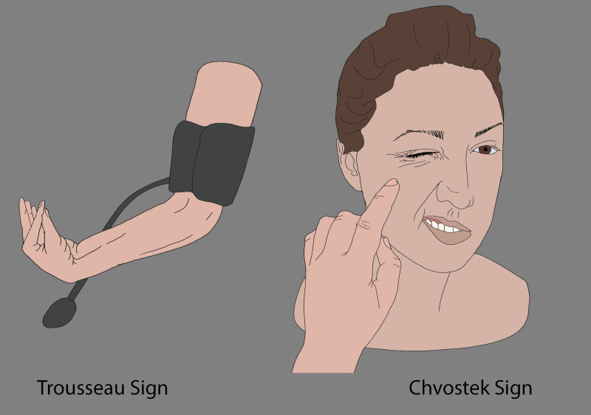
Hypoparathyroidism
Lab abnormalities include:
  Low intact parathyroid hormone
  Low calcium
  Low magnesium
  High phosphorus
Patients will demonstrate
signs of hypocalcemia:
  Trosseau sign
  Chvostek sign

Slide 97
Hypoparathyroidism Treatment
Treated initially with IV calcium gluconate to alleviate symptoms.
  Once ionized calcium levels are normalized, repeated calcium levels must stay normal on oral medications before discharge.
Then high oral calcium intake and supplements, vitamin D (sometimes magnesium) are used to maintain calcium in the low normal range.

Slide 98
Hypoparathyroidism Treatment
Thiazide diuretics are sometimes used for hypoparathyroidism because they will decrease urinary calcium excretion.
Recombinant PTH is available for treatment of hypoparathyroidism.
  One of these medications has a BBW because it can increase the risk of osteosarcoma - only use this drug in persons who cannot be controlled on supplemental Ca and vitamin D.

Slide 99
Pseudohypoparathyroidism
Caused by several rare genetic disorders.
All cause tissue insensitivity to PTH, with resulting hyperphosphatemia and hypocalcemia.
Hypocalcemia cases elevation of PTH levels, and ultimately bone disease.
Treatment is aimed at normalizing serum calcium levels, preventing renal excretion of calcium and lowering PTH levels.

Slide 100
Pseudohypoparathyroidism
PTH released from parathyroid
Targets of therapy
Tissues are not sensitive to PTH
No calcium is released into blood
Calcium is easily
lost in the urine
Phosphorus is not excreted in urine
Hypocalcemia
Hyperphosphatemia
Stimulates high
PTH release
Notes:
HIGH PTH → Tissues Not Sensitive to PTH → No calcium is released, Calcium lost easily in urine → Low Calcium Levels → Stimulates HIGH PTH and cause bone disease

