Slide 1



Patient Education & Follow up
Megan Bonk MPAS, PA-C

Slide 2

Objectives
Recognize the importance of patient education in the clinical setting, being able to describe when it should be used, what should be included, and the best methods to implement it into patient care.
Describe the importance of follow up and the best way to approach decisions on the timeline for follow up with primary care and referrals to specialists.
Recognize appointment types and the general recommendations for their follow up time frames.
Begin to identify appropriate follow up time frames based on condition seen for and environment patient is going to be seen at.
Complete the required PEARL assignment for the module prior to the end of the module.
2

Slide 3
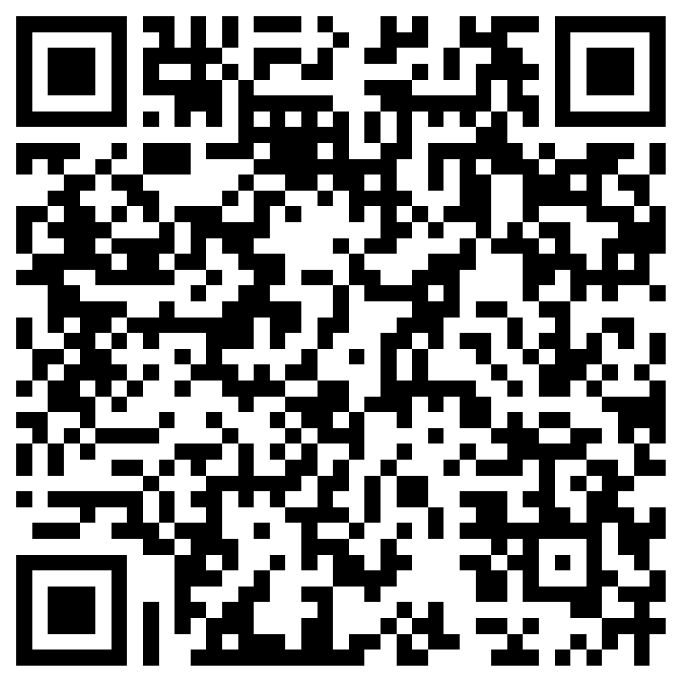
Pre-Quiz
https://forms.office.com/r/fS0xHUbKTy

Slide 4
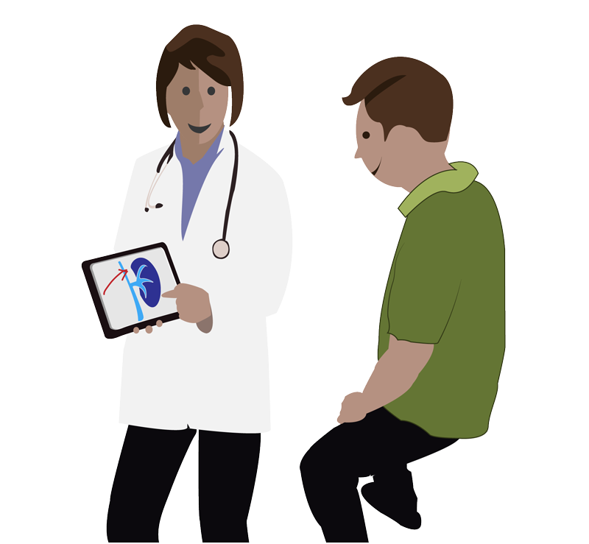
Patient Education
“Patient education is a process by which health professionals impart information to patients and their caregivers to improve health status and encourages involvement in decision making related to ongoing care and treatment.”
-Fereidouni et al, 2019
Patient education should be included in every visit, every time.
Notes:
“This process helps patients incorporate knowledge, skills, values, and attitudes that relate to specific or general medical topics, preventive services, the adoption of healthy lifestyles, correct use of medicine, and the care of disease and injuries at home.”

Slide 5
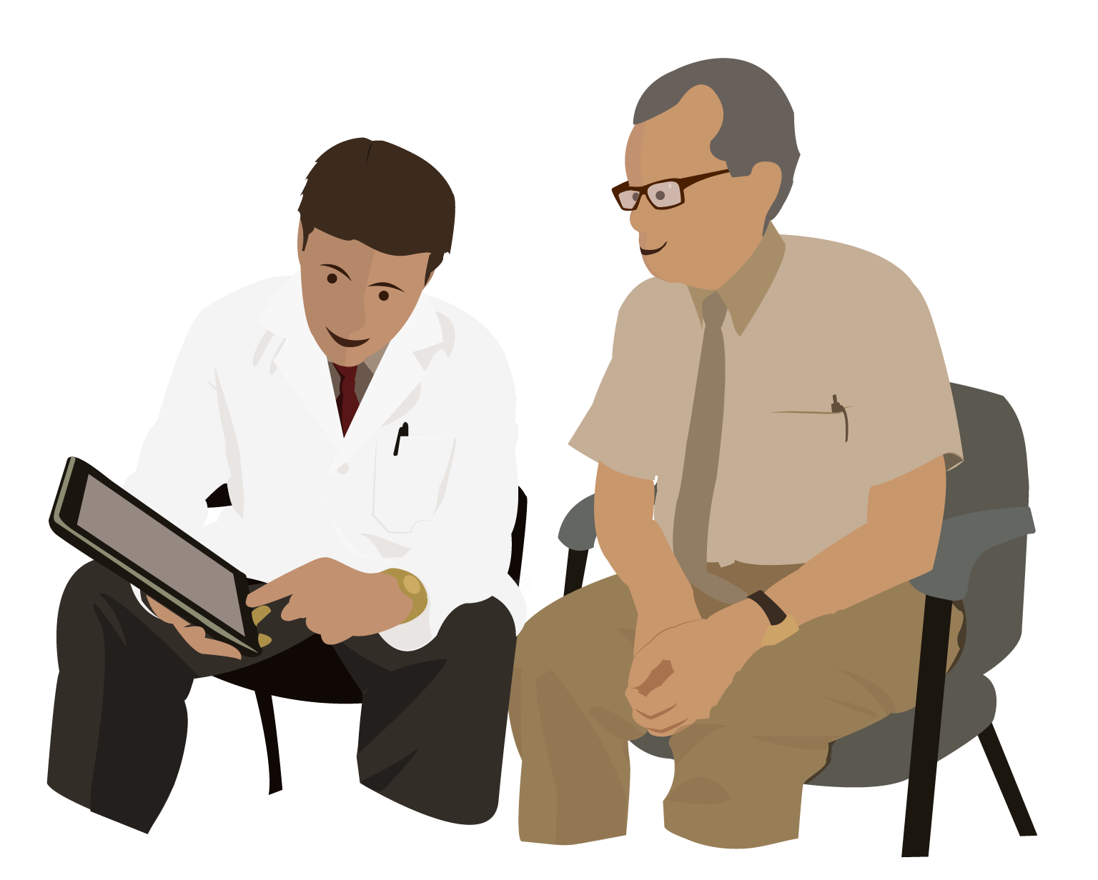
The Need
There is an increased need for patient education and its importance continues to grow
Increasing prevalence of chronic illnesses
Limited number of hospital facilities
Economic constraints on hospital fees
High rate of hospital infections
Need for better, safer care at home
5
Notes:
About half of U.S. adults say they have difficulty affording health care costs. About four in ten U.S. adults say they have delayed or gone without medical care in the last year due to cost, with dental services being the most common type of care adults report putting off due to cost.
https://www.kff.org/health-costs/issue-brief/americans-challenges-with-health-care-costs/

Slide 6
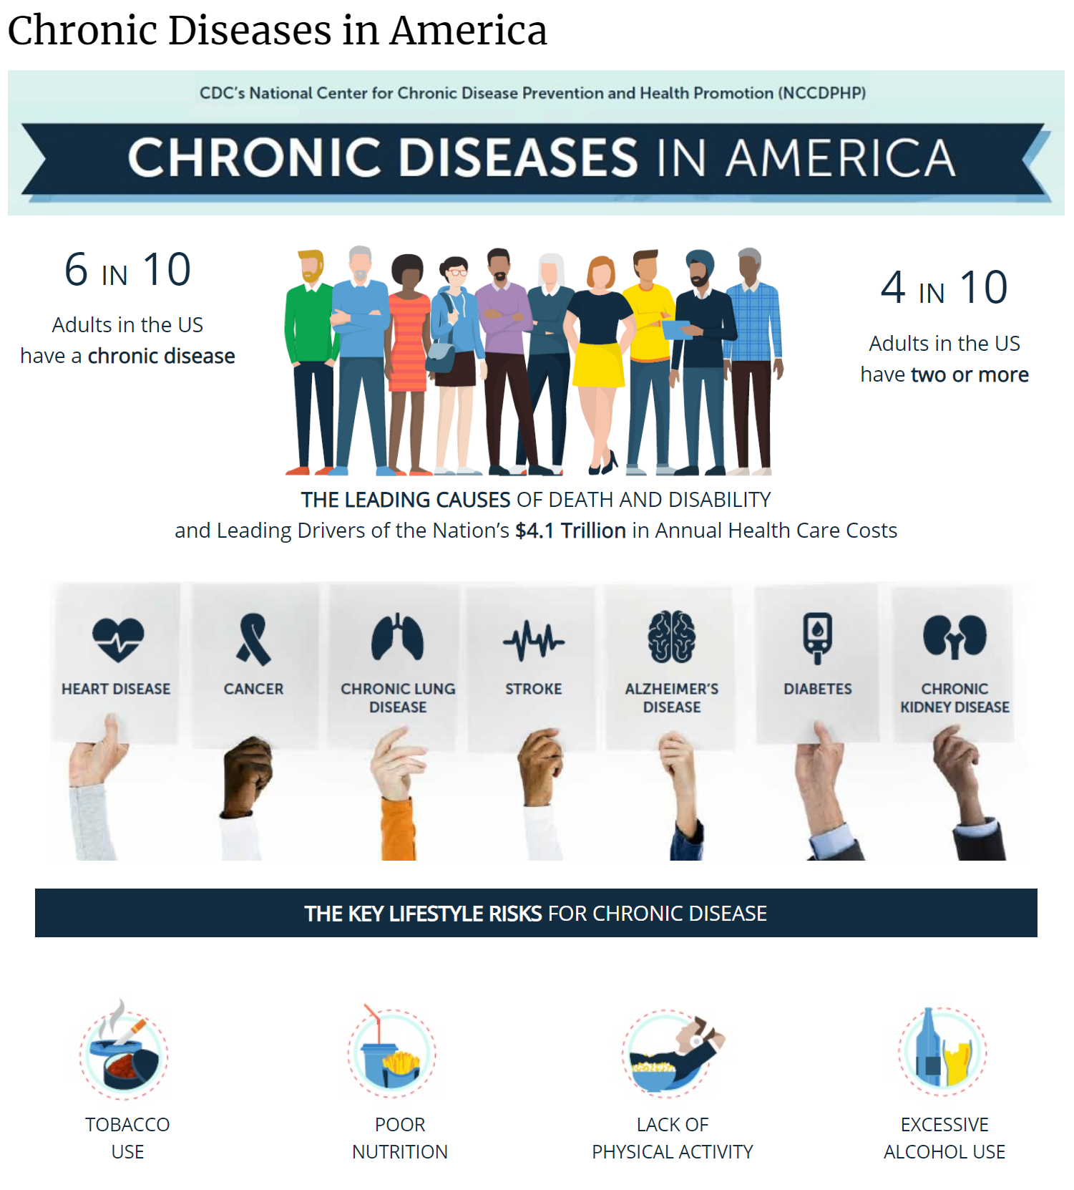
https://www.cdc.gov/chronicdisease/resources/infographic/chronic-diseases.htm

Slide 7
Getting the Patient Involved
“Increasing levels of literacy and development of mass media in recent years have encouraged recipients of healthcare to demand more information about their illness process and care plans.”
Well educated patients understand and manage their own health and medical care better
Education promotes patient compliance, satisfaction with care, healthy lifestyles, and self-care skills
7
Notes:
Education is used to empower patients and is an important aspect of quality improvement, given that it is associated with improved health outcomes.
In addition, patient education has also helped to decrease unpleasant patient experiences in hospitals, including reduced levels of pain and anxiety
Patient education reduces readmissions and ER visits, saves money. Chelsey Ledue. Patients who have a clear understanding of their after-hospital care instructions are 30 percent less likely to be readmitted or visit the emergency department than patients who lack this information, according to a new study funded by the Agency for Healthcare Research and Quality.

Slide 8
What’s Included?
Basic skills
  Identify patient’s educational needs, information about patient’s daily activities, health beliefs, level of understanding and preferred language.
  Tailor education to the patient’s educational level and cultural background
  Encourage questions
  Utilize appropriate written, audiovisual, and computer-based materials
Notes:
https://www.aafp.org/pubs/afp/issues/2000/1001/p1712.html#:~:text=Identify%20patient's%20educational%20needs.,of%20findings%20clearly%20and%20concisely.
The average American reads at the 7th- to 8th-grade level, according to The Literacy Project. [5]
Medical information for the public should be written at no higher than an eighth-grade reading level, according to the American Medical Association, National Institutes of Health and Centers for Disease Control and Prevention
Basic Skills:
inform patient of findings clearly and concisely.
Discuss treatment plans in terms of specific behaviors.
Encourage questions and provide appropriate answers.

Slide 9
What’s Included?
Short-term plans for acute illness
  Prepare patient for symptoms and effects of condition, examination, and/or treatment.
  Assess patient’s ability to carry out treatment plan; identify barriers and personalize treatment accordingly
  Assess patient’s understanding of the education by having them restate the treatment plan
  Document educational efforts in specific terms in the record
Notes:
https://www.aafp.org/pubs/afp/issues/2000/1001/p1712.html#:~:text=Identify%20patient's%20educational%20needs.,of%20findings%20clearly%20and%20concisely.

Slide 10
What’s Included?
Long-term strategies for chronic disease
  Provide patient with understandable explanation of their disease state and what that means for them.
  Involve patient in setting treatment goals and the treatment plan
  Provide opportunities for patient to discuss feelings
  Assess patient's background, home and work environment and adapt education and plan accordingly
  Document educational efforts in specific terms in the record
Notes:
Provide patient with adequate feedback on their progress toward goals
Present manageable amounts of information to the patient over time

Slide 11
What’s Included?
Health promotion
  Determine patient’s health-risk behaviors
  Introduce health promoting topics, assessing patient’s priorities and readiness to change health-related behaviors
  Motivational interviewing
  Enlist assistance of other health care professionals (nutritionist, nurses, athletic trainers)
Incorporation of patient education in practice
  Evaluate commercial education resources, such as brochures, books, and internet materials
  Develop systems to involve office staff in assisting with patient education
  Utilize family conferences when appropriate
  Be aware of emerging technologies

Slide 12
Things to keep in mind:
Because patients pay more for healthcare services, demand for high-quality care has increased
“Every $1.00 spent on patient education on health-promoting behaviors is estimated to save as much as $3.00–$4.00 in healthcare costs.”
“In the United States, about USD $69–100 million is spent on problems that are caused by lack of education.”
https://www.ncbi.nlm.nih.gov/pmc/articles/PMC6369867/
12
Notes:
https://www.ncbi.nlm.nih.gov/pmc/articles/PMC6369867/

Slide 13
Places to practice how to give patient education this year:
Ideas (not all-inclusive list)
  H&P practice
  OSCEs
  Documentation days
  Application sessions
  Studying with classmates
  Helping out family members
13
Notes:
https://www.ncbi.nlm.nih.gov/pmc/articles/PMC6369867/

Slide 14

The Importance of Follow Up
14

Slide 15
Patient Follow Up
Follow up should be a core topic discussed at the end of every medical encounter.
Can help provider identify areas of misunderstanding, answer questions, make further assessments, and adjust treatments.
Follow up also helps promote a good relationship between provider and patient.
Appropriate follow up has been shown to help reduce risk of readmission to the hospital.
Notes:
https://journals.plos.org/plosone/article?id=10.1371/journal.pone.0200691
Try to classify patients based on their overall picture as you go into the decision of when to bring back for follow up: Younger? Older? Comorbidities? Otherwise healthy? Lots of medications? Good home care/support/resources? Trustworthy?

Slide 16
Patient Follow Up
Timing of follow up should be thought of on a spectrum based on:
  The medical environment the patient is in
  The conditions they have
  The type of follow up that is needed
Patients need specific instructions on when, where, and why they need to seek follow up care.
Identify who the patient will follow up with and how (i.e. the format of the follow up- office visit, phone, MyChart))
Notes:
Reasons for follow up: Monitor health, reinforce knowledge and action plans, confirm medicine regimens, schedule appts, verify follow through on referrals, share lab results
Ask patients to record information
BE SURE TO SPECIFY IF THEY, THE PATIENT, NEED TO SET UP THE APPT OR NOT

Slide 17
Patient Follow Up – Inpatient Discharge
Inpatient environment
  Typically recommends follow up in 1 week with PCP post hospital stay
      Exceptions: Inpatient warfarin initiation, uncommon/challenging med changes have recommendation for sooner follow up with PCP
  Specialists: the discharging hospitalist will often contact specialist to see when they want to see them in office outpatient after discharge.
    Typically, specialists will request 2-4 weeks timeline to follow up with the patient after being discharged from the hospital
      Exception: Decompensated heart failure typically has cardiologist follow up within a week
  If hospitalist wants labs done post discharge request will typically involve getting lab work done before follow up with PCP or specialist
17

Slide 18
Patient Follow Up – ER Discharge
Emergency environment
Typically, recommends follow up in 48 hours with PCP
If specialist is involved in follow up: On average 1-2 weeks, unless they deem follow up sooner is recommended.
  Exceptions: Urology (longer wait)
  Emergency rooms and specialists have contracts that the specialist office will see ER discharges “within a timely manner”.
  Patient’s leave the ER and call the specialist office to schedule an appt
ER providers always give specific details to the patient on returning to the ER for care.
18

Slide 19
Patient Follow Up – Primary Care
Classify the reason for visit
Acute
Chronic care
Preventative
  Annual physical
  Well woman
  Medicare Annual Wellness exam
Follow up (Hospital discharges and new problems)
Procedures
19
Notes:
Acute problems must be assessed for the need to follow up and how quickly. Give ER protocol/on call protocol/in-office protocol
Family practice really should ALWAYS have a follow-up date given to the patient. It may just be the date they are due for their next preventative visit, but don’t ever just leave a patient with “follow up as needed”.

Slide 20
Patient Follow Up – Primary Care
Acute Visit Follow Up:
    24-48 hours: ____________________________________
    3-5 days: ________________________________________
    1-2 weeks: ______________________________________
    “Follow up as needed if symptoms are not improving, resolving, or if they worsen.” “Due back for annual physical exam in ** months.”
    Chronic Care Follow Up:
      Typically, a 3,6, or 12-month follow up pattern
      More complex the patient the shorter the follow up timeframe
20
Notes:
24-48 hours: Concerning acute condition that doesn’t warrant ER but deems very close follow up to assure condition improvement.
Consider patient’s wishes here too.
Example: Acute respiratory illnesses- patients who are struggling or have multiple comorbidities
Follow up in 3-5 days
Usually assessing improvement or resolution of a higher acuity illness or after completion of a medication treatment.
Example: Recheck a cellulitis in patients with risk factors for complications to assure it is improving.
Follow up in 1-2 weeks
Assessing improvement or resolution of a less severe illness or after completion of a medication treatment.
Examples:
Rechecking viral gastroenteritis in patients that are of concern if they can’t keep medicine or food down for extended period, making sure symptoms have improved.
Rechecking an acute MSK complaint after trialing RICE and NSAIDs
Rechecking constipation after trial on Miralax
PRN- This is to be used in that patient that is most likely to do completely fine in their treatment and you trust will return if they are not getting better.
The patients that have little to no risk of not healing up well.
I will often add in my note documentation to the patient “If we do not hear from you, we will assume your condition resolved.”
Examples: Common cold in the otherwise healthy individual, strep throat, uncomplicated ear infections.
Chronic
How many chronic conditions do they have? Examples: Diabetes, Hypertension, Hyperlipidemia, COPD, Asthma, Hypothyroidism, Depression, Anxiety, etc.
Age?
How many medications are they on? Were any new medications initiated?
How often do they need labs drawn?
Are their chronic conditions well controlled or uncontrolled?
What kind of patient is it, motivated or unmotivated?
3-month follow ups:
Multiple chronic conditions, typically uncontrolled, older age, with multiple medications.
6-month follow ups:
1-3 chronic conditions, well controlled or very mildly uncontrolled in a motivated patient. Middle aged or younger.
12-month follow ups:
Younger patients with one or more chronic conditions, well controlled and stable.

Slide 21
Patient Follow Up – Primary Care
Preventative visits
Annual physical exam- Every 12 months
  Insurance term, meant to address patient preventative medicine
    Includes health maintenance, update chart and labs, do good thorough ROS and physical exam
  Problems will need to be billed as additional office visit fee, if addressed
    Follow up from those problems would be addressed as they fall into the categories of the previous slides.
Well woman exam- Every 12 months
  Typically, a female’s annual exam with or without pap smear
21

Slide 22
Patient Follow Up – Primary Care
Preventative visits
Medicare Annual Wellness Exam
  Medicare term for an annual visit in their patient population. Completely free for patient.
  Medicare does not pay for an “annual physical”
  Medicare HRA questionnaire provided to patient→ they answer prior to visit → give to nurse/MA at time of visit and answers are recorded into the computer → Provider is then responsible for going over any individual responses that are “flagged” by Medicare as “attention needed” with documentation in the note and patient education of issues addressed at the end of the visit.
22
Notes:
Questionnaire posted on Canvas if you are interested in seeing

Slide 23
Patient Follow Up – Primary Care
Preventative visits
Medicare Annual Wellness Exam
  Updating chart, getting labs updated, immunizations/health maintenance, vision screening, full set of vitals. EKG included with first “Welcome to Medicare Exam”.
  Problems should not be addressed at these visits
  Ideally make chronic care visits separate from these visits
23
Notes:
Questionnaire posted on Canvas if you are interested in seeing

Slide 24
Patient Follow Up – Primary Care
New Problem Follow Up Visits
  Visits that follow up on acute/subacute problem visit. Follow up time frames can vary significantly just based on individual patient and problem.
    Psychiatric complaints (prior to chronic condition diagnosis): 1-2 week follow up for patients with acute psychiatric difficulties, 4-6 week follow up with SSRI/SNRI initiation, sooner as needed.
    ENT complaints: A large variation in follow up times, just dependent on the complaint
    MSK complaints: typically, 2-4 week follow ups
24
Notes:
MSK complaints: typically, 2-4 week follow ups
Psychiatric complaints (prior to chronic condition diagnosis): 1-2 week follow up for patients with acute psychiatric difficulties, 4-6 week follow up with SSRI/SNRI initiation, sooner as needed.
GI complaints: Huge variation, shorter term follow ups for more distressing symptoms, longer term follow ups for less distressing symptoms/chronic GERD
ENT complaints: Also, large variation in follow ups, just dependent on particular complaints
Etc.

Slide 25
Patient Follow Up – Primary Care
Hospital follow ups
  TCM (Transitional Care Management)
    Communication: Initial contact with patient required within 2 business days of hospital discharge
    Medical decision making of moderate to high complexity during the service period
    Face to face visit within 7-14 days of discharge
  Purpose of these visits are to ease transition from inpatient to outpatient and avoid readmission.
  Review of hospital documentation, updating chart, assuring patient is improving and closely monitoring through their personal recovery.
  Follow up from these visits should be decided on patient’s acute/subacute problem that hospitalized them alongside their chronic conditions and overall picture.
Notes:
Small outpatient procedures can be performed in the family practice setting.
Procedures such as but not limited to:
Cryotherapy of warts, superficial skin lesions, molluscum contagiosum
No follow up needed unless warts need additional treatments, typically about 2-3 weeks after cryotherapy session.
Shave excision with electrocautery of assumed benign superficial skin lesions
Skin tags, inflamed seborrheic keratoses, etc.
Typically, no follow up needed unless patient sees signs of infection or delayed healing.
Punch biopsy for full thickness assessment of lesions
Typically follow up for suture removal- timing based on location of lesion removal
Full resection of skin lesions, cysts, lipomas
Same as punch biopsy, follow up for suture removal and to check on healing status.
Sooner follow up if signs of infection develop
Suturing of skin lacerations
Follow up for suture removal, timing based on location of injury
I&D of abscesses with packing as needed
Follow up timing depends on size and amount of packing material required.

Slide 26


Resources
American Academy of Family Physicians. (2000, October 1). Patient education. American Family Physician. Retrieved August 22, 2022, from https://www.aafp.org/pubs/afp/issues/2000/1001/p1712.html#:~:text=Identify%20patient's%20educational%20needs.,of%20findings%20clearly%20and%20concisely
Fereidouni, Z., Sabet Sarvestani, R., Hariri, G., Kuhpaye, S. A., Amirkhani, M., & Kalyani, M. N. (2019, February 5). Moving into action: The master key to patient education. The journal of nursing research : JNR. Retrieved August 22, 2022, from https://www.ncbi.nlm.nih.gov/pmc/articles/PMC6369867/
Tong, L., Arnold, T., Yang, J., Tian, X., Erdmann, C., & Esposito, T. (2018, July 17). The association between outpatient follow-up visits and all-cause non-elective 30-day readmissions: A retrospective observational cohort study. PLOS ONE. Retrieved August 22, 2022, from https://journals.plos.org/plosone/article?id=10.1371%2Fjournal.pone.0200691
Young, M. (2020, December 1). Better patient education can lead to lower medical costs: 2020-11-03. Relias Media | Online Continuing Medical Education | Relias Media - Continuing Medical Education Publishing. Retrieved August 22, 2022, from https://www.reliasmedia.com/articles/147129-better-patient-education-can-lead-to-lower-medical-costs
Notes:
https://www.reliasmedia.com/articles/147129-better-patient-education-can-lead-to-lower-medical-costs
https://www.classpoint.io/interactive-quiz-in-powerpoint/

Slide 27
Don’t forget to take the post-quiz!

