Slide 1

HYPERTENSION
Part I
Breanna Veal, MHS, PA-C
Epidemiology
Review of Blood Pressure Regulation
Pathophysiology and Risk Factors of Primary
Secondary Hypertension

Slide 2
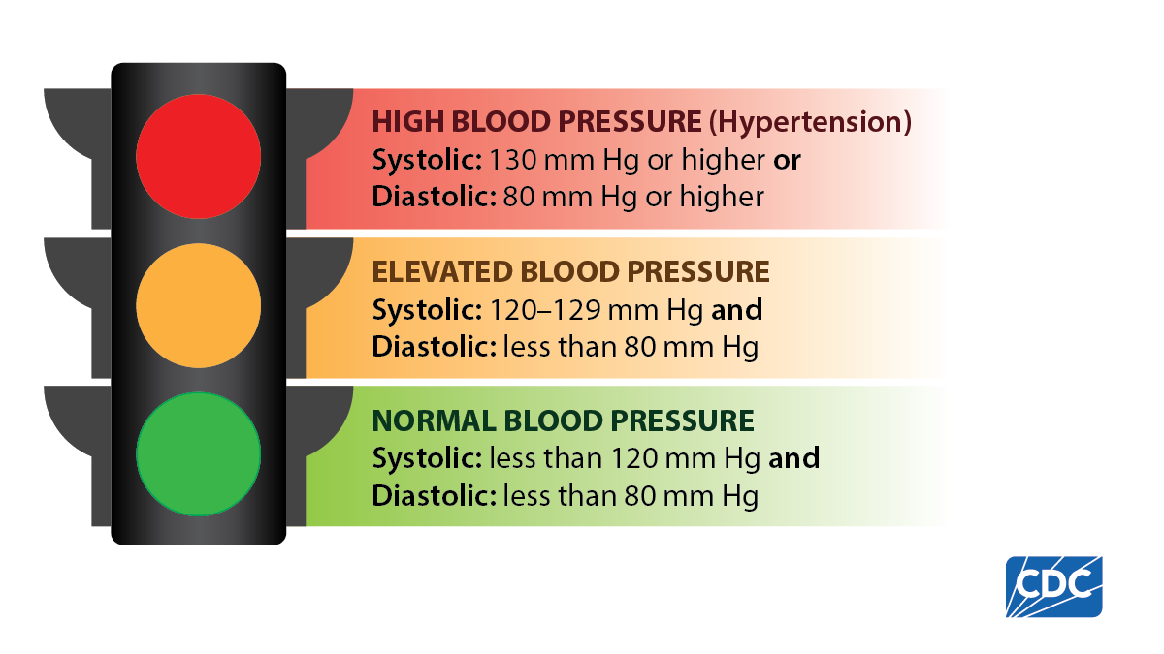
Hypertension Definition

Slide 3
HTN Epidemiology

Slide 4
HTN: GLOBAL EPIDEMIOLOGY
Hypertension is a global problem and is the leading cause of cardiovascular disease and premature death worldwide
  Affects > 1 billion people worldwide
    Highest prevalence of HTN in Africa (27%)
    Lowest prevalence of HTN in Americas (18%)
  Accounts for more than 9.4 million deaths/year worldwide
  46% are unaware they have HTN
  Less than 50% who have HTN are treated
  1 in 5 have HTN under control

Slide 5
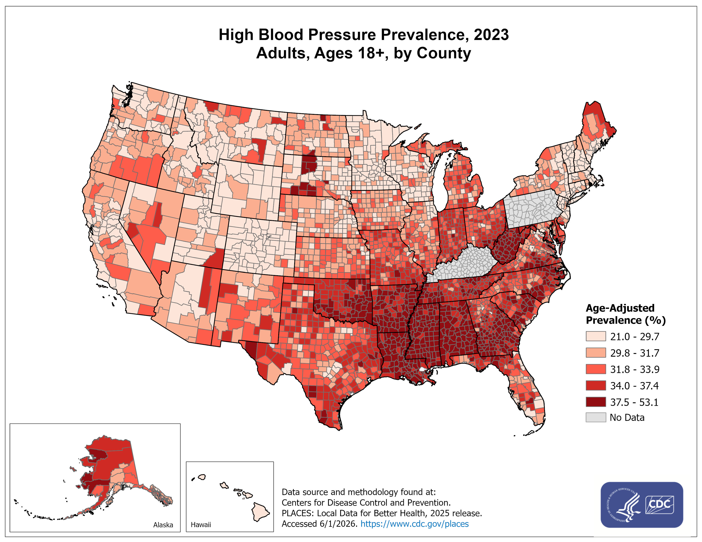
HTN: US EPIDEMIOLOGY
Hypertension is the most common cardiovascular disease in the US, affecting 119 million people with BP ≥130/80 or about 48% of all American adults.
HTN contributed to more than 685K deaths in the US

Slide 6
HTN: US EPIDEMIOLOGY
Men (50%) > Women (44%)
Blacks (56%) > Whites (48%) > Asians (46%) > Hispanics (39%)
Hypertension prevalence increases with age.
  70% > age 65
HTN is the most common reason for non-pregnant adults to visit their PCP and the most common indication for a prescription drug in the US.
HTN costs the United States $131 billion annually.

Slide 7
Do US citizens have control?
Only about 1 of every 4 adults with hypertension have their disease under control.
  Blood pressure control is highest in Whites (32%) and lowest in Asians (19%), with about the same level of control in Blacks and Hispanics (25%).
~45% with uncontrolled HTN have a blood pressure >140/90.
1 of every 5 adults are unaware that they have HTN and another 10% know they have hypertension and chose not to treat it.

Slide 8
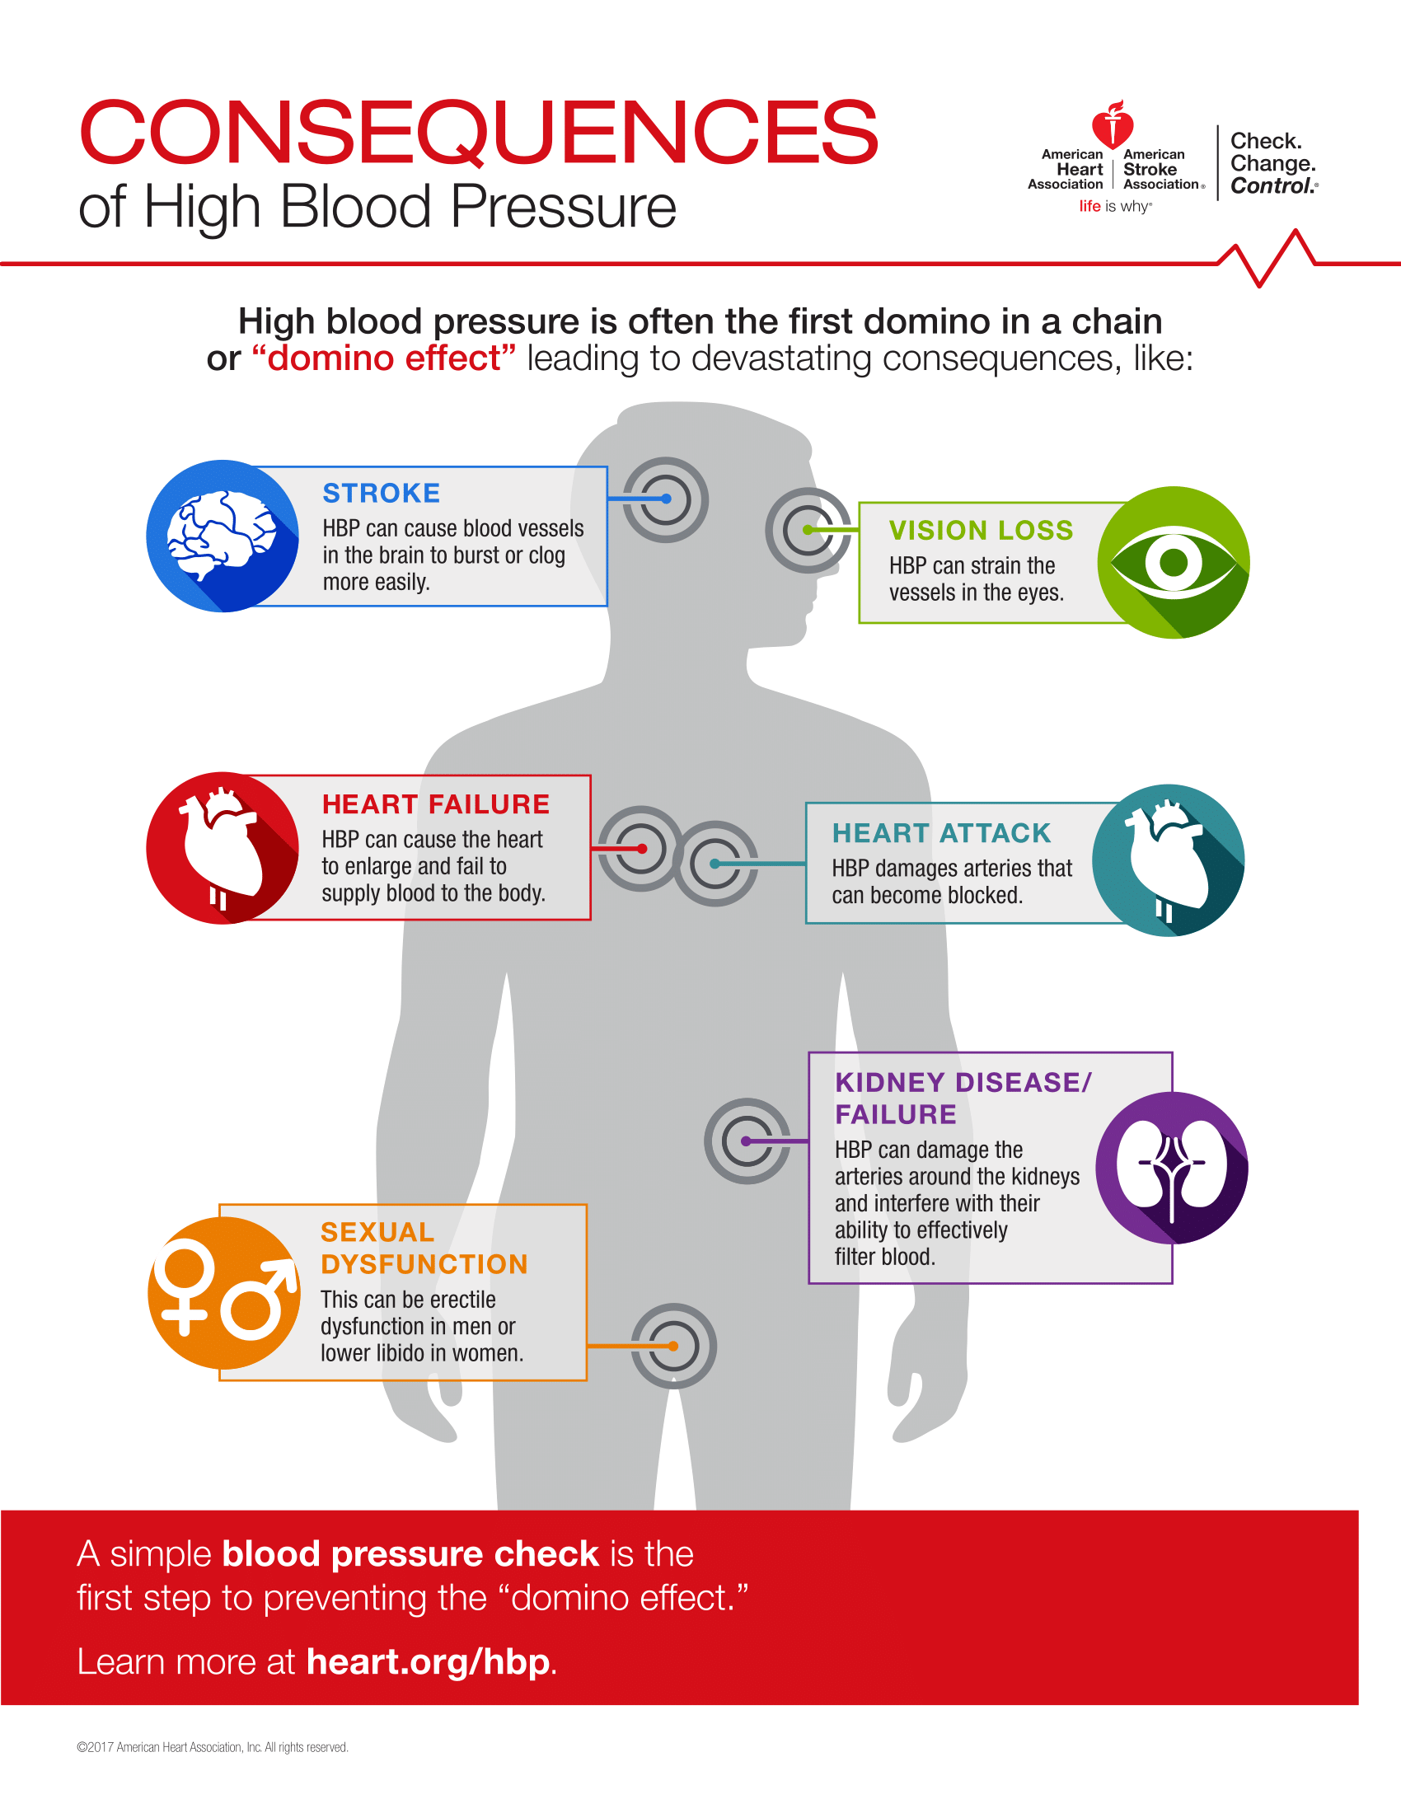
HTN increases the relative risk for CAD, HF, stroke, AF, CKD, PAD, and dementias (vascular/ AD) by 2-4 fold
The lowest risk of CV and renal complications is seen with a BP of about 115/75 or less.

Slide 9

Shutting the Gate!
For all persons with HTN, controlling their BP to goal will result in:
  20-25% reduction in the risk of MI
  50% reduction in risk of heart failure
  30-40% reduction in the risk of stroke
  11% reduction in overall mortality
Benefits are likely even greater for those persons above 65 years.

Slide 10
Social Determinants of Hypertension
Social determinants of health are conditions in the places where people live, learn, work, and play that affect a wide range of health and quality-of life-risks and outcomes.
SDOH as defined by the CDC include 5 key areas:
  Healthcare access and quality
  Education access and quality
  Social and community context
  Economic stability
  Neighborhood and work environment

Slide 11
Social Determinants of Hypertension
Persons who are economically disadvantaged have higher rates of hypertension and are less likely to have control of their blood pressure.
When talking to patients about their HTN diagnosis we need to determine their level of health literacy and tailor counseling to this level.
The clinician should also talk with the patient to identify barriers to successful treatment that may be part of SDOH- what are some of these?

Slide 12
Review Normal BP Physiology

Slide 13
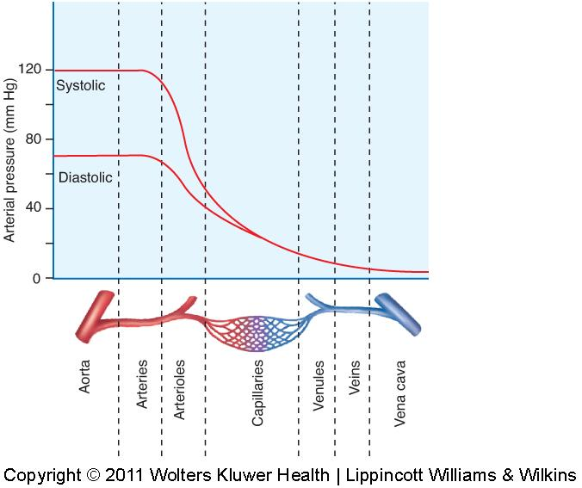
Normal Hemodynamics
Maintaining mean arterial pressure (MAP) between 70-100mmHg is required to provide a constant flow of blood to all of the body tissues, delivering oxygen and nutrients to the tissues and removing CO₂ and waste
This helps push the blood from the arteries into the capillaries
In the capillaries, gas exchange, nutrients and waste occur
MAP = CO X total peripheral resistance (TPR)

Slide 14
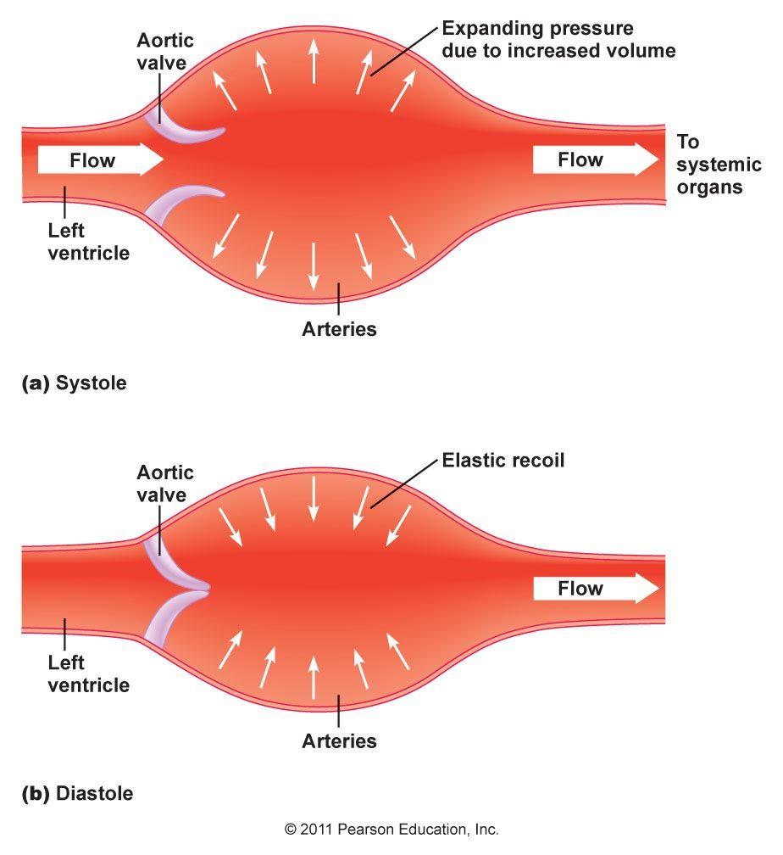
Normal Systole Hemodynamics
During systole (ventricular ejection), the pressure (force of blood) on the arteries increases as the heart pumps blood into the arterial system, accounting for the higher systolic BP than diastolic BP.
As the pressure increases, the elastic walls of the arteries stretch (compliance). This can be felt as a pulse in the arteries

Slide 15
Normal Diastole Hemodynamics
In diastole, there is recoil of the elastic arteries. The diastolic pressure generated is the remaining force of blood on the walls of the artery when the heart is relaxing and recorded as the minimum pressure just before the start of systole.

Slide 16
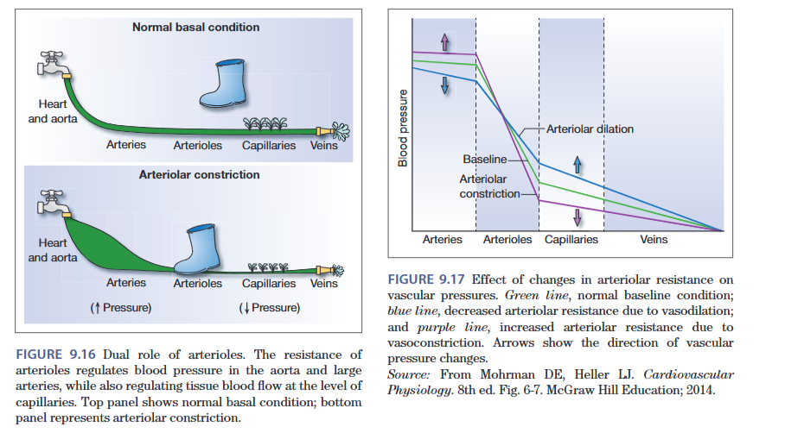

Slide 17
Important Terms
Preload
Pre-Contraction load. The load on cardiac musculature, the stretch, caused by blood entering the heart from the venous system, PRIOR to heart contracting. Measured as end diastolic volume (EDV)
Inotrope
A medicine that changes the force of contraction (“Ino” meaning “fiber” or muscle fiber and “tropic” meaning “turning” or “changing”) A muscle fiber changing medication.
Chronotrope
A medicine that changes the rate of contraction (“chrono” as in “chronological” or timing) A “time changing” medication
Afterload
The amount of pressure that the heart needs to exert to eject the blood during ventricular contraction. This is the systolic blood pressure.

Slide 18
Normal BP Physiology
BP regulation is very complex, depending on:
Cardiac output: the amount of blood pumped from the heart every minute (SV x HR), which is affected by sodium intake, renal function, mineralocorticoids and sympathetic/parasympathetic nervous system.
Peripheral vascular resistance: the resistance to arterial distention dependent upon the sympathetic nervous system, humoral factors, and local vasculature autoregulation.

Slide 19
Normal BP Physiology
Size of the Vascular Compartment
Myocardial Contractility
Stroke Volume
Heart Rate
Vascular Structure
Vasoconstriction/ Vasodilation
Cardiac Output
Vascular Resistance
Systemic Arterial Pressure

Slide 20
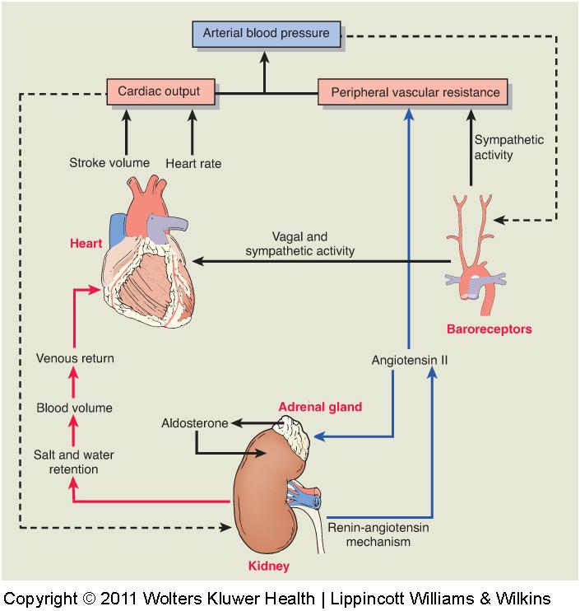
The Physiology of Blood Pressure

Slide 21
Normal Blood Pressure Regulation
Short-term regulation of BP (minutes- hours) is neural.
  The medulla and pons in the deep brain integrate autonomic input from carotid and aortic baroreceptors (stretch receptors) & chemoreceptors (sampling O₂, CO₂ and H⁺)
Baroreceptors sense arterial pressure indirectly from the degree of stretch of the elastic arterial walls
  Increased stretch will increase action potential frequency to signal increased pressure to the medullary cardiovascular center in the medulla oblongata
  Increased input simultaneously inhibits the sympathetic nervous system and triggers the parasympathetic nervous system
  The opposite occurs with decreased stretch, activating the sympathetic nervous system

Slide 22
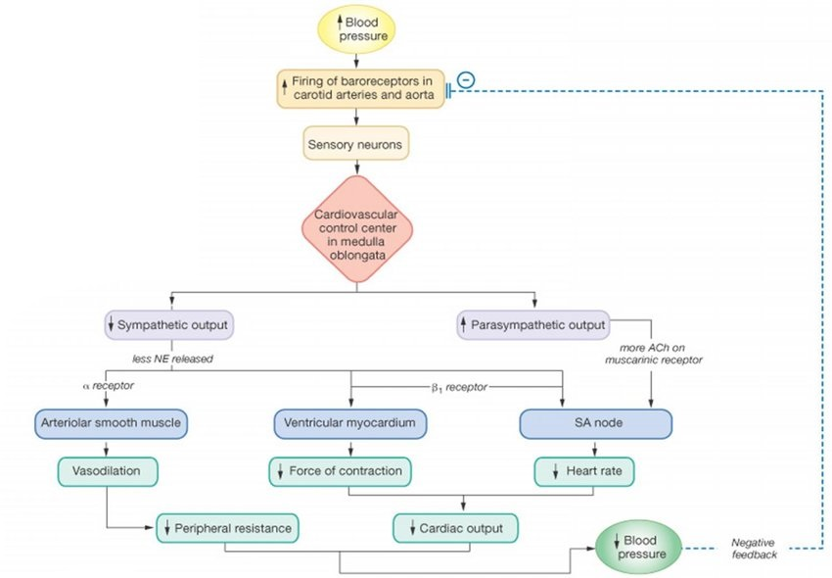
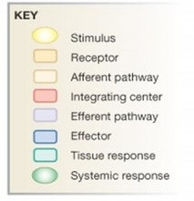
Blood Pressure Regulation: Baroreceptor Reflex

Slide 23
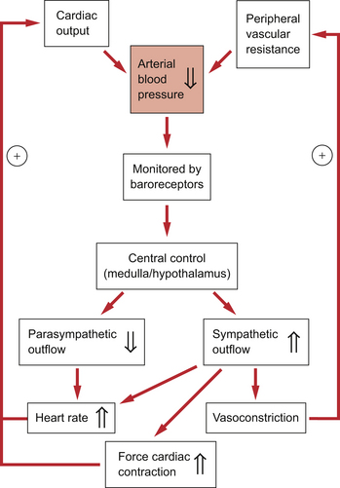
Normal Blood Pressure Regulation

Slide 24
Normal Blood Pressure Regulation
Long term control of the BP is humoral:
RAAS activation increases the vascular pressure and promotes sodium and water retention by the kidney and is regulated by 3 methods:
  Indirect activation of renal sympathetic nerve fibers in response to the carotid and aortic baroreceptors sensing low stretch. This leads to NE release acting upon β₁ adrenergic receptors of juxtaglomerular cells, causing release of renin.
  Baroreceptors in the juxtaglomerular cells which sense decreased volume and pressure in the afferent arteriole the same as in the carotids. This decreased pressure allow for increased renin secretion.
  Macula densa, which is found in the thick ascending limb, will sense sodium concentration via Tubulo-glomerular feedback
  Either low sodium or low pressure will stimulate release of renin

Slide 25
Normal Blood Pressure Regulation
Tubulo-glomerular feedback refers to the ability of the kidney to regulate the glomerular filtration rate (GFR) in response to the solute concentration in the distal renal tubule.
Tubulo-glomerular feedback:
When GFR (sodium concentration) is moderately increased, the macula densa releases ATP causing afferent arteriolar vasoconstriction, thereby reducing GFR and allowing for sodium reabsorption to occur.
Low tubular sodium at the macula densa releases prostaglandins causing vasodilation and increased filtration.

Slide 26
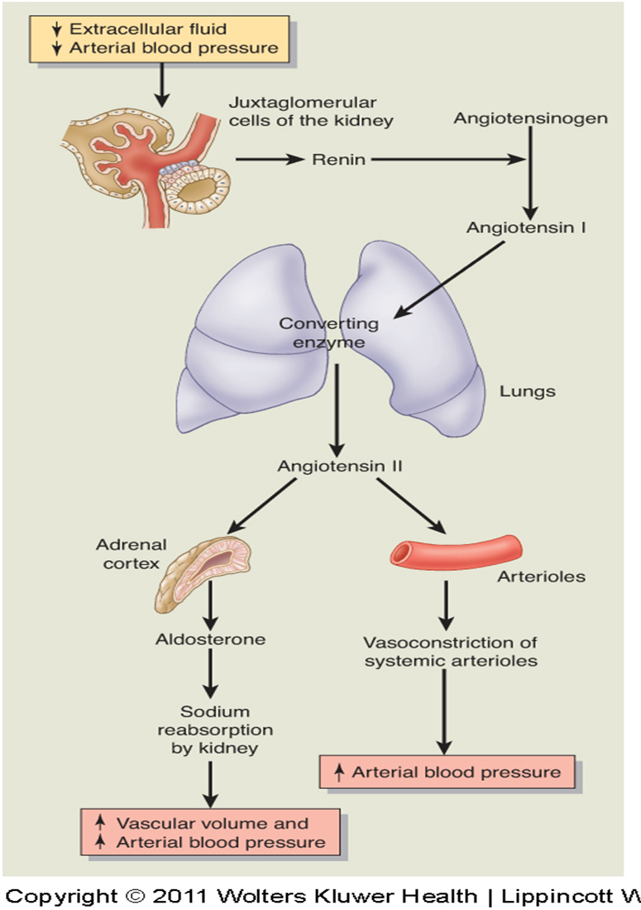
  Angiotensin II functions
Vasoconstriction
Stimulate Aldosterone
Reabsorb Na and Bicarb in the renal proximal tubule
Stimulate thirst center in hypothalamus to promote water intake and release Vasopressin (ADH) from the posterior pituitary mobilizing aquaporin channels, decreasing water loss from the kidney

Slide 27
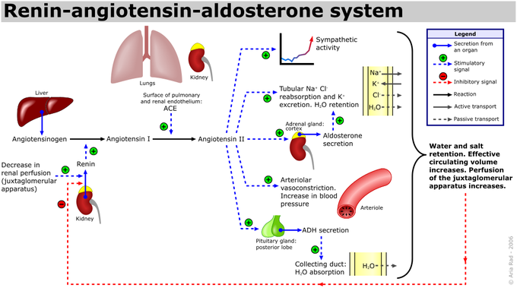

Slide 28
Normal Blood Pressure Regulation
Other Regulators
Peripheral Chemoreceptors- located in common carotid artery and aortic arch. Stimulated by decreasing arterial PO₂, leading to arteriolar vasoconstriction in the skeletal muscle, renal and splanchnic vascular beds
Central Chemoreceptors- located in the medulla. Stimulated by change in the arterial PCO₂ and the cerebrospinal fluid pH leading to sympathetic outflow and arteriolar vasoconstriction in several organs
Volume Receptors- located on the venous side. Sensitive to blood volume. Increase stretch leads to decreased ADH, increased atrial natriuretic peptide (causing vasodilation) and decreased RAAS.

Slide 29
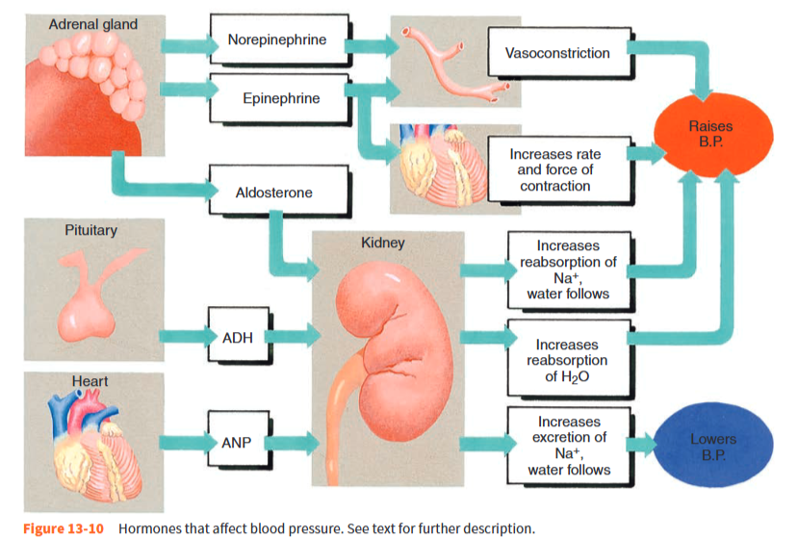

Slide 30
Low BP Physiology
As BP falls, neural mechanisms (short term regulation) will kick in to compensate for lower BP and preserve essential organ perfusion. Humoral mechanisms will also activate to provide a slower but more durable correction of BP.
The MAP or mean arterial pressure can be calculated with a clinical calculator: [(2x DBP) + SBP]/3. MAP is used clinically to determine the adequacy of BP following an intervention for hypotension. A “good” MAP is between 70 and 100.
130/80 = MAP of 97 | 120/70 = MAP of 87 | 100/50 = MAP of 67

Slide 31
Primary (Essential) Hypertension
Pathophysiology
Risk Factors

Slide 32
Primary Hypertension
90-95% of hypertension is primary (formerly called essential) hypertension.
In primary hypertension, there are identified risk factors or contributors but there is not an exact known pathophysiologic process.
Advanced age | Race | High sodium/ low potassium diet
Obesity | Chronic kidney disease | Excessive alcohol intake
Family history | Reduced nephron mass | Physical inactivity/ sedentary lifestyle

Slide 33
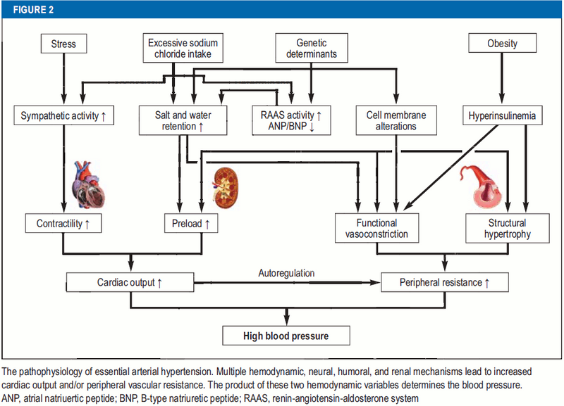

Slide 34
Pathophysiology of Primary HTN
Multifactorial and complex. Possible mechanisms include:
  Sympathetic nervous system hyperactivity: over-activity of the sympathetic tone leads to increased vascular tone and HTN.
  Genetics: HTN is twice as common in subjects who have 1-2 hypertensive parents and multiple epidemiologic studies support this conclusion.

Slide 35
Pathophysiology of Primary HTN
Multifactorial and complex. Possible mechanisms include:
  Reduced adult nephron mass may predispose to hypertension, may be related to genetic factors, fetal and lifetime events.
  Sodium intake: increased salt intake triggers an increase in blood pressure followed by increased sodium excretion in urine normally by natriuretic peptides. In primary HTN this process may be disordered.

Slide 36
Pathophysiology of Primary HTN
Multifactorial and complex. Possible mechanisms include:
  Immunologic: HTN is associated with renal infiltration of immune cells. Pharmacological immunosuppression decreases BP.
  Cardiac malformation: abnormal development of aortic elasticity or reduced development of the microvascular capillary network in fetal life (prematurity) causes adult onset HTN.

Slide 37

Non-Modifiable Risk Factors for HTN
Age: advancing age increases the risk, particularly of systolic hypertension.
Genetics: Hypertension is twice as common in persons with 1-2 first degree relatives with HTN
African American race: On average African Americans develop hypertension about 10 years prior to Caucasians, is more severe, and associated with more complications than other ethnic groups
Males
Psychosocial stress- Personality traits (hostile attitude, impatience), and depression.
Low socioeconomic status

Slide 38

Modifiable Risk Factors for HTN
Obesity: associated with an increase in intravascular volume, elevated cardiac output, increased sympathetic outflow, and activation of the renin-angiotensin system. Weight reduction lowers BP modestly.
Diabetes and dyslipidemia: Both cardiovascular risk factors themselves, these diseases also increase the risk of developing hypertension.
CKD: any decrease in adult nephron mass increases the risk. The higher the stage of CKD, the more likely the patient is to have hypertension, and often, difficult to control HTN.

Slide 39

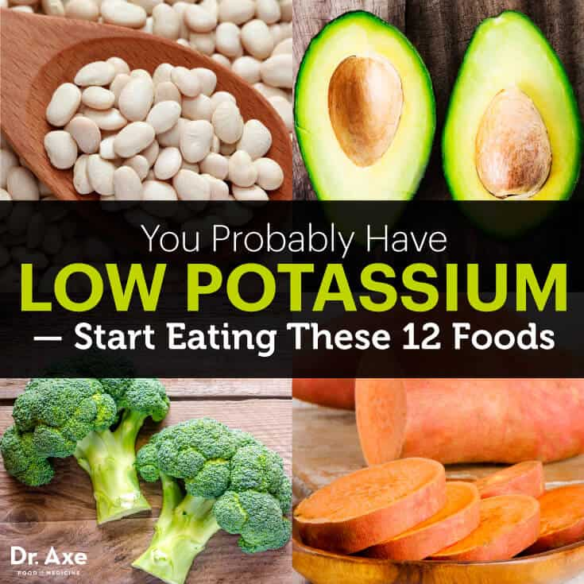
Modifiable Risk Factors for HTN
Excessive alcohol intake: Greater than 2 drinks/day will increase the risk of developing HTN.
  raises BP, perhaps by increasing plasma catecholamines. HTN can be difficult to control in patients who consume more than 40 g of ethanol (two drinks) daily or those who drink in "binges."
High sodium, low potassium diet: excessive sodium intake increases the risk of HTN, and sodium restriction lowers BP
  increased salt probably increases BP in some individuals so dietary salt restriction of 2 gm per day is recommended in patients with hypertension. Low serum potassium level may also contribute to hypertension. Intake of 90 mmol/day of potassium is recommended.

Slide 40
Modifiable Risk Factor for HTN
Lifestyle: Weight gain and obesity, sedentary lifestyle and lack of physical activity will all increase the risk of developing HTN
  Aerobic exercise lowers BP in previously sedentary individuals, but increasingly strenuous exercise in already active subjects has less effect.
Smoking raises BP by increasing plasma norepinephrine.
  Synergistic effects of smoking and high blood pressure on cardiovascular risk are well documented.
Insufficient sleep: <7hr nightly associated with HTN

Slide 41
Other Contributors to Primary HTN
Polycythemia: increases blood viscosity raises blood pressure.
NSAIDs produce increases in BP averaging 5mm Hg and are best avoided in patients with borderline or elevated blood pressures.

Slide 42
HTN Counseling and Management
So, in primary hypertension, we basically explain to the patient that numerous factors, only some of which they can change, are responsible for their disease.
We will counsel the patient about therapeutic lifestyle changes with motivational interviewing.
Often, we’ll need to give medication to control the patient’s blood pressure while they make these lifestyle changes.

Slide 43
Secondary Hypertension Causes

Slide 44
Secondary HTN Classifications
In 5% of cases, the elevated blood pressure is secondary to another identifiable illness which causes HTN.
Often found in those diagnosed prior to age 20 or after age 50.
Although these cases constitute a small part of overall hypertension, these disorders account for a considerable amount (20%) of resistant HTN.
  Resistant HTN: BP that remains above goal despite treatment with maximal meds from 3 drug classes, including a thiazide diuretic

Slide 45
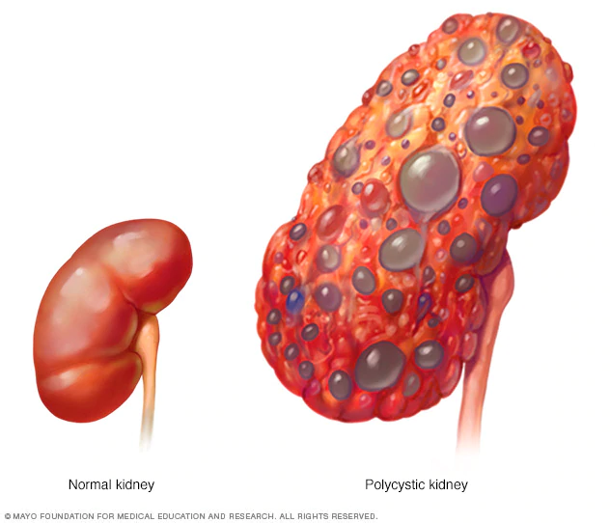
Secondary HTN Etiologies
Polycystic kidney disease (PCKD)- an autosomal dominant disease
  The kidneys progressively enlarge (up to 5x normal size) due to a large number of growing cysts.
  Patients have flank pain, hematuria, UTI, renal calculi and difficulty concentrating their urine.

Slide 46
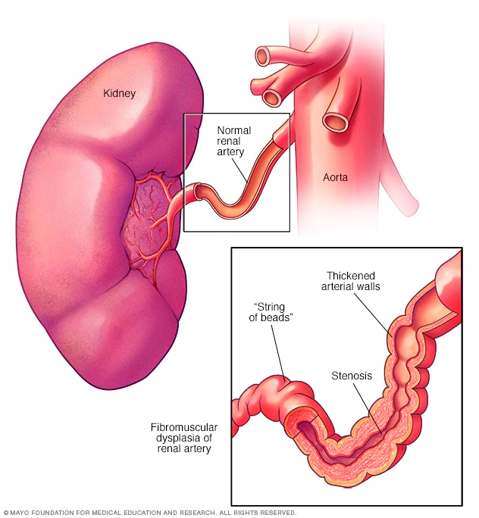
Secondary HTN Etiologies
Renovascular HTN due to renal artery stenosis
Occurs in two different populations:
  Atherosclerosis in men> age 50 with CAD risk factors
    HLD, tobacco abuse, DM, CKD, PAD
  Fibromuscular dysplasia in women under 50 years
    “String of beads” finding on imaging

Slide 47
Secondary Hypertension Etiologies
Renovascular Hypertension
When renal artery stenosis occurs, the renin-angiotensin-aldosterone system is constantly activated by the kidney that has low blood flow.
High levels of plasma renin causes conversion of angiotensin I to angiotensin II, causing severe arteriolar vasoconstriction and aldosterone release-> plasma volume expansion and elevated BP.

Slide 48
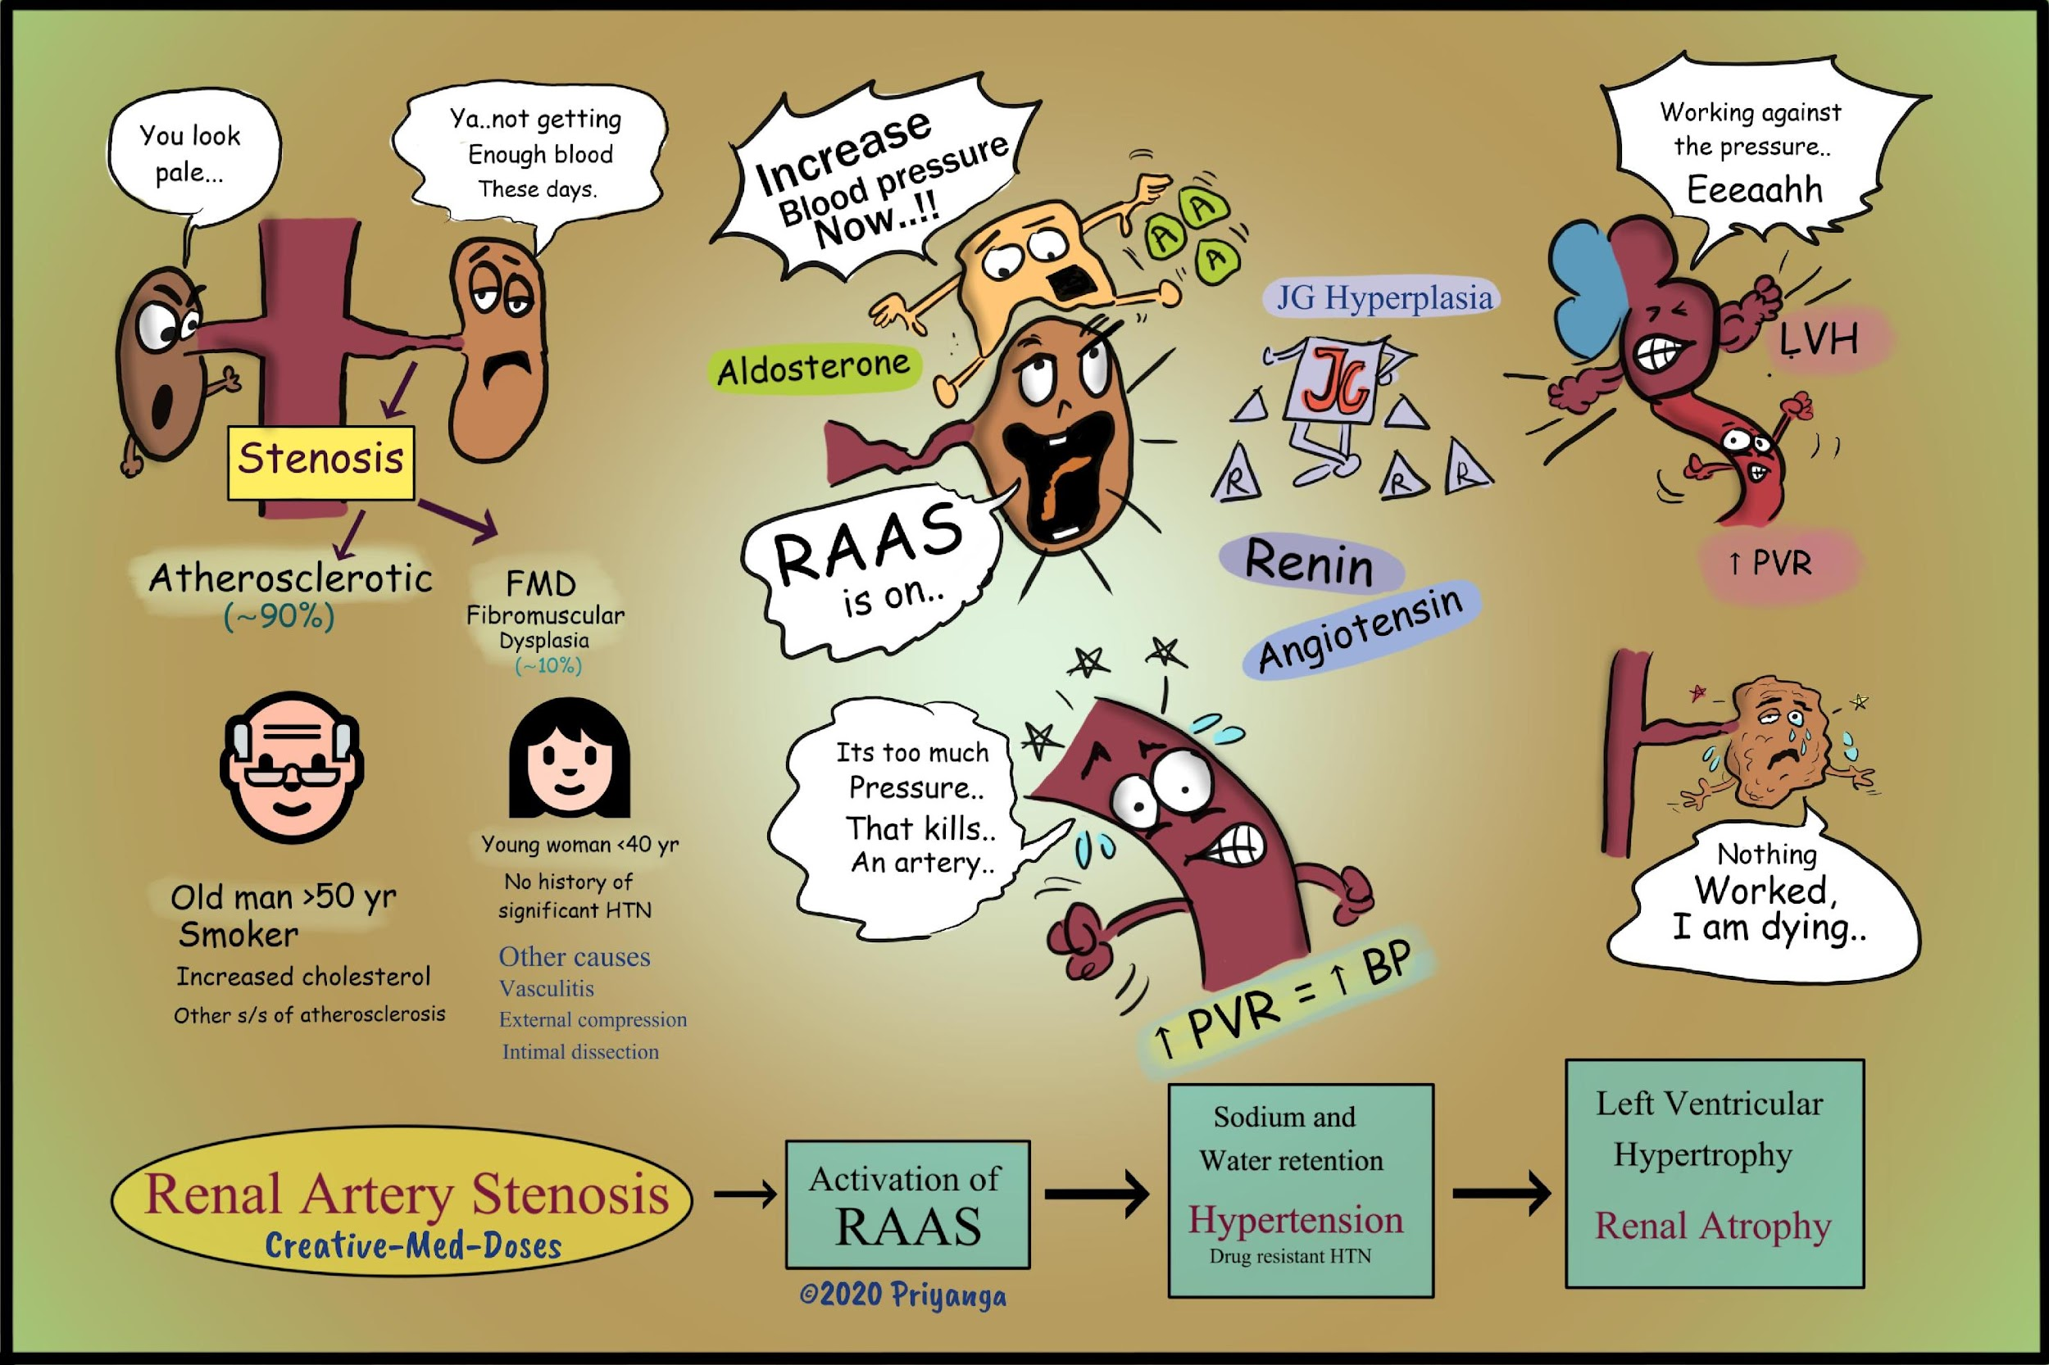

Slide 49
Secondary Hypertension Etiologies
Renovascular Hypertension
Volume expansion and increasing the BP don’t solve the low blood flow problem to the affected kidney though, because there is a fixed obstruction- the stenosis.
Constant high BP increases cardiac work and causes remodeling of the heart and blood vessels. It also stresses the normal kidney by creating very high vascular pressures.

Slide 50
Secondary Hypertension Etiologies
Renovascular Hypertension
Suspect renal artery stenosis if:
  Acute kidney injury develops with initiation of an ACEI/ARB- always check a chemistry panel within a week of drug initiation.
  Refractory HTN occurs in a patient with risk factors for renal artery stenosis.
  The patient has recurrent flash pulmonary edema.
  An abdominal bruit is noted over the renal artery on exam.

Slide 51
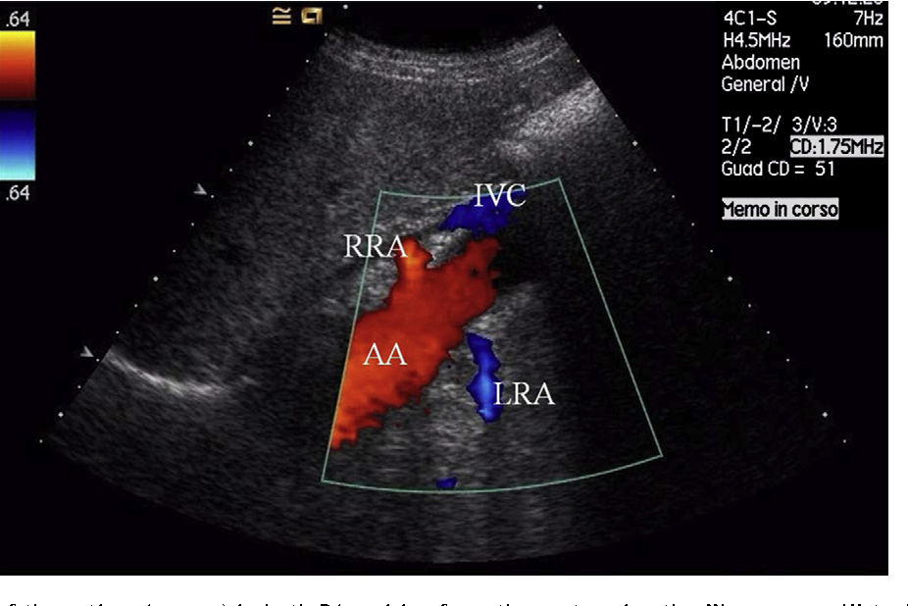
Secondary Hypertension Etiologies
Renovascular Hypertension
Diagnostic studies:
  Duplex Doppler Renal artery U/S: cheap, non-invasive, and no radiation exposure. U/S is highly dependent on ultrasonographer and radiologist skill
Ultrasound is generally used as an initial test when suspicion for RAS is low.

Slide 52
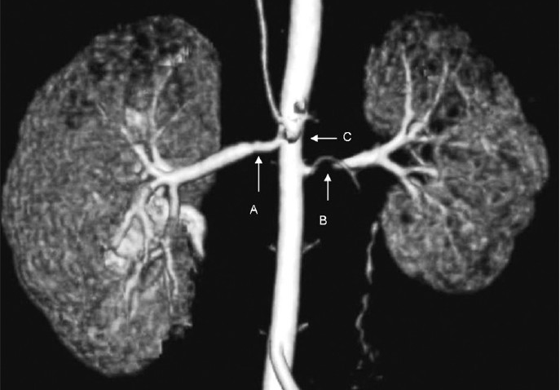
Secondary Hypertension Etiologies
Renovascular Hypertension
Diagnostic studies:
  CT or MR angiography of renal vessels: more expensive but non-invasive; dye load, radiation exposure with CT.
Reconstructed CT angiography showing a small area of right renal artery stenosis (A), a much more significant area of left renal artery stenosis (B) with loss of renal parenchyma and mild narrowing of the abdominal aorta (C).

Slide 53
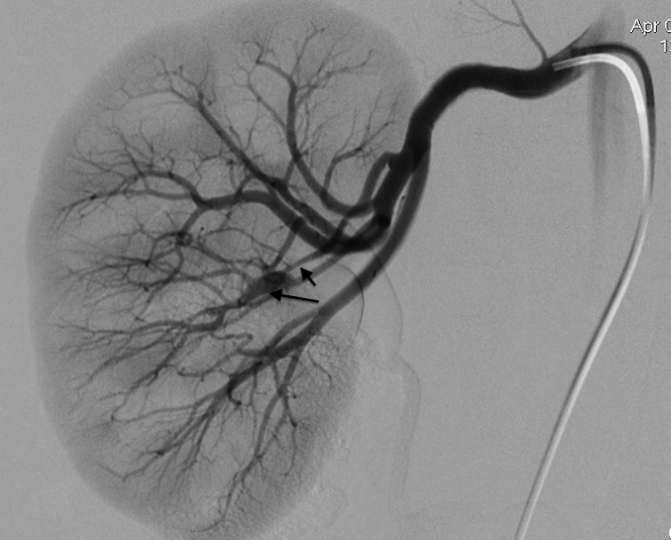
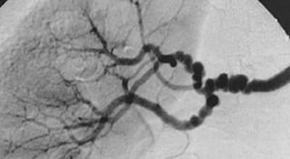
Secondary Hypertension Etiologies Renovascular Hypertension Dx
Angiogram of the abdominal aorta and renal arteries: Gold Standard. Invasive, dye load, but can also intervene at the same time.
Classic “string of pearls” appearance of RAS 2/2 fibromuscular dysplasia.
RAS short arrow, aneurysm long arrow

Slide 54
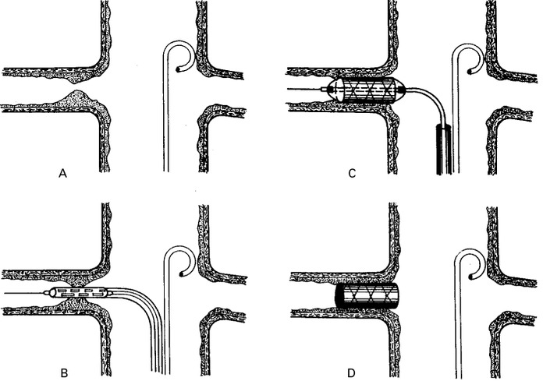
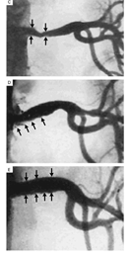
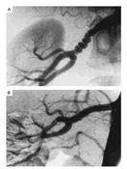
Fibromuscular Dysplasia, before
and after PTRA
Atherosclerotic RAS before and after stent
Safian & Textor. NEJM 344:6;

Slide 55
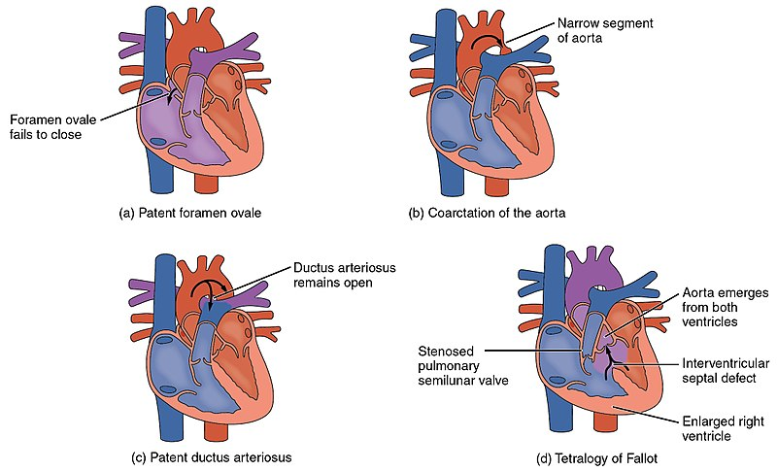
Secondary HTN Etiologies
Coarctation of the aorta
  An uncommon cause of secondary hypertension.
  Is usually discovered in
childhood, as it is a congenital anomaly of the aorta, resulting in narrowing after the take-off of the great vessels that go to the head and upper extremities.
  ECHO diagnostic in children, CTA in adults.

Slide 56
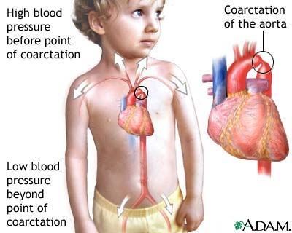
Secondary HTN Etiologies
Coarctation of the aorta signs:
UE pulses and BP are higher than LE pulses or BP
There is an audible bruit in the chest
Rib notching is noted on CXR

Slide 57
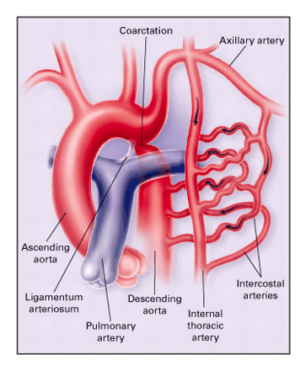
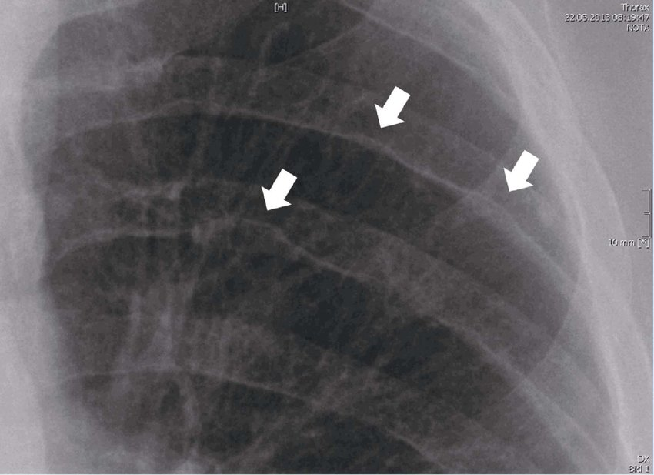
Coarctation of the Aorta
Inferior rib notching- Roesler sign due to dilated intercostal collateral vessels which form to bypass the coarctation and supply the descending aorta
Brickner, et al. NEJM 2000;342:256-263

Slide 58
Secondary HTN Etiologies
4. Thyroid disease
Either hypo/hyperthyroidism
  use a TSH to screen.
Hypothyroidism is very common, but HTN due to hypothyroidism is relatively uncommon.

Slide 59
Secondary HTN Etiologies
Pheochromocytoma
  A pheochromocytoma is a rare tumor of the adrenal medulla.
  Usually benign, the tumor is made of cells that synthesize catecholamines (norepinephrine, epinephrine) and the tumor will often release the catecholamines in an uncontrolled and sudden fashion.
  This causes paroxysms of very high blood pressure, palpitations, diaphoresis and pallor when it dumps catecholamines into the bloodstream unexpectedly.

Slide 60
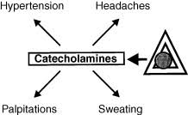
Secondary HTN Etiologies
Pheochromocytoma
  The patient will have normal to modestly elevated BP most of the time, but can have very severe and sudden elevations of blood pressure leading to flash pulmonary edema, MI (heart attack) and stroke.
--A 24-hour urine collection to measure metanephrines and catecholamines is ordered, and if elevated then adrenal CT or MRI with IV contrast is obtained.

Slide 61
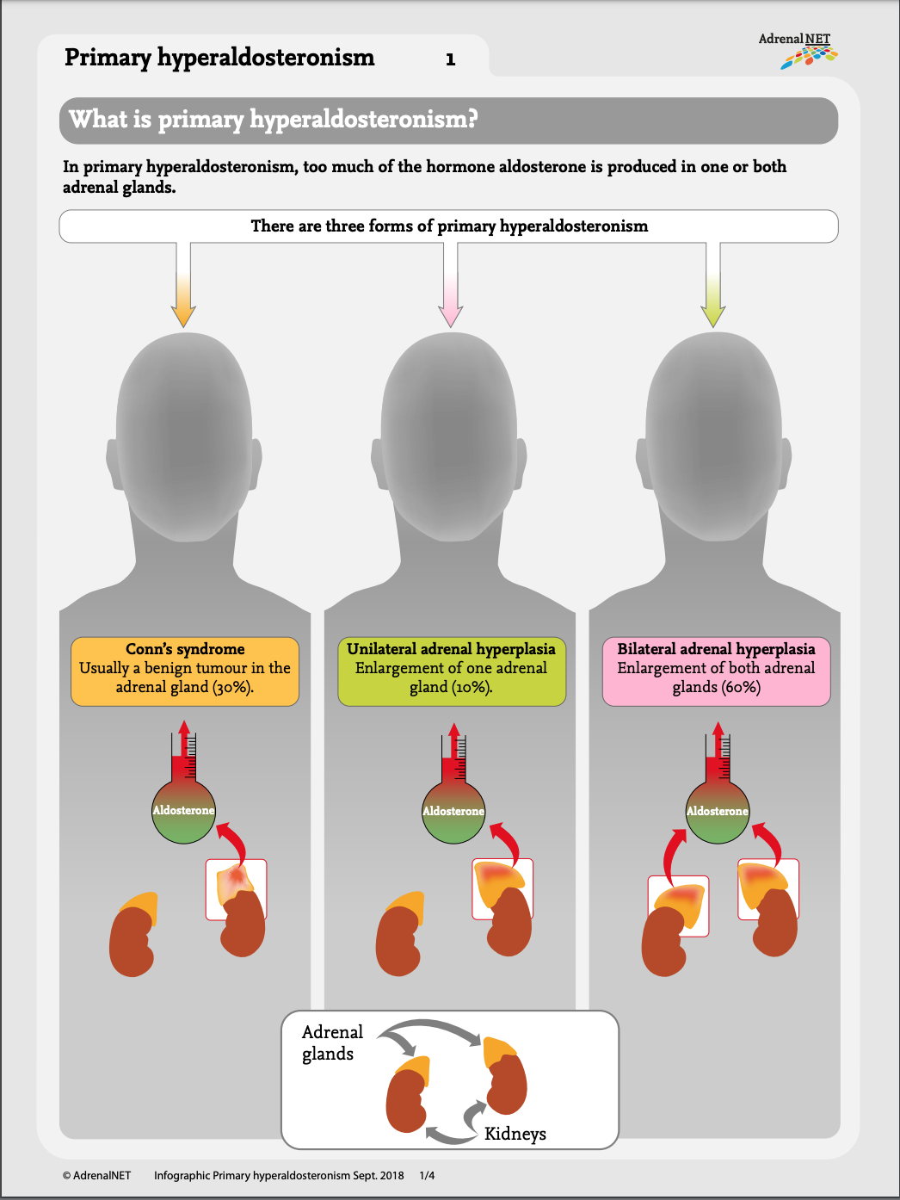
Secondary HTN Etiologies
Primary hyperaldosteronism
Is due to overproduction of aldosterone by hyperplasia of the adrenal gland or by an autonomous adrenal adenoma.

Slide 62
Secondary HTN Etiologies
Hyperaldosteronism
In primary hyperaldosteronism the patient secretes excessive aldosterone, causing sodium and water retention.
Constantly reabsorbing sodium creates a metabolic alkalosis and persistent hypokalemia, as H+ and K+ are wasted in the urine
Patients primarily complain of generalized weakness due to persistent hypokalemia.

Slide 63
Secondary HTN Etiologies
Cushing’s syndrome: glucocorticoid excess from
  An autonomous pituitary adenoma that over-secretes ACTH
  An autonomous adrenal adenoma/hyperplasia that oversecretes cortisol
  A paraneoplastic syndrome from an ectopic source- usually a tumor that oversecretes ACTH, most often SCLC
  Excess glucocorticoid causes retention of Na and water → HTN from volume expansion and mild increase in aldosterone levels.

Slide 64
Secondary HTN Etiologies
OSA
  Occurs in >50% of individuals with HTN
  Should be considered in individuals with resistant HTN, snoring, obesity
  Hypoxia triggers SNS activity leading to HTN
  CPAP is effective treatment for OSA, however may not relieve HTN but make antihypertensive medication more responsive.

Slide 65
Secondary HTN Etiologies
Medications
  Ethanol: chronic alcohol use is a common cause of hypertension and can be very difficult to treat
  Illicit sympathomimetic drug use: cocaine, methamphetamine
  Estrogens
  Ephedra/ Pseudoephedrine
  NSAIDS
  Black licorice or licorice root in herbal supplements contains a chemical that lowers K+ and raises BP

Slide 66
Secondary HTN, Let’s Summarize
Acquired etiologies
  Renal artery stenosis
  OSA
  Medications
Endocrine etiologies:
  Hyperaldosteronism
  Cushing’s disease
  Pheochromocytoma
  Thyroid disease
Congenital etiologies:
  Polycystic kidney disease
  Coarctation of the aorta

