Slide 1

HYPERTENSION
Part II
Breanna Veal, MHS, PA-C
Blood Pressure Screening, Classification and Diagnosis of HTN
BP Measurement and Technique
End Organ Damage of HTN
History Taking and Laboratory w/u of HTN

Slide 2
Making the Diagnosis

Slide 3
Blood Pressure Screening Recommendations
Every 3-5 years
  Beginning age 18-39 without elevated BP or cardiovascular risk factors
Annually
  Age >40
  Risk factors: prior BP >130/80, African American, overweight or obese
  Additional risk factors: dyslipidemia, DM, smoking, high-salt diet
Exceptions

Slide 4
AHA/ACC Adult Classification of BP
Classification | Systolic BP mmHg |  | Diastolic BP mmHg
Normal | Less than 120 | and | Less than 80
Elevated BP | 120-129 | and | Less than 80
Stage I HTN | 130-139 | or | 80-89
Stage II HTN | > 140 | or | > 90
Isolated systolic HTN | 130 or higher | and | Less than 80
Isolated diastolic HTN | Less than 130 | and | 80 or higher
Hypertensive Urgency | >180 | or | >120
Hypertensive Emergency (end organ damage) | >180 | or | >120

Slide 5
Making the Diagnosis of HTN
BP varies dramatically in a 24-hour period and from day to day, so a single BP reading is ALMOST NEVER used to make a diagnosis of HTN.
  Exception: BP > 180 systolic or >120 diastolic
          BP > 160 systolic or >100 diastolic with known end organ target damage
Clinical criteria for defining hypertension:
  Average of 2 or more seated BP readings separated by at least 1-2 min, during each of 2 or more outpatient visits.
  Out of office monitoring is preferred via home BP monitoring or ambulatory BP monitoring when making the diagnosis.
    If out of office monitoring can’t be achieved, office BP reading should be repeated within 1-2wk after initial screening.

Slide 6
Measurement of BP- OBPM Technique
BP needs to be measured with an appropriately sized cuff and the bladder should be 80% of the patient’s arm length.
Arm Circumference | Usual Cuff Size
22-26cm | Small Adult
27-34cm | Adult
35-44cm | Large Adult
45-52cm | Adult thigh

Slide 7
Measurement of BP- OBPM Technique
No exercise, caffeine or smoking for 30 minutes prior to checking the BP. The patient should have an empty bladder prior to sitting down.
Seat the patient in a chair with feet firmly on the floor and back supported firmly for at least 5 minutes prior to readings (taken two times in both arms-at initial visit).
Blood pressure cuff should be applied to bare arm (avoid simply rolling up the sleeve as this acts as a tourniquet)

Slide 8
Measurement of BP- OBPM Technique
The arm should be supported at the level of the heart, otherwise the BP will be elevated by 10-12 mmHg due to added hydrostatic pressure from gravity.
The person taking the blood pressure and the patient should NOT TALK at all.
Ideally, BP is measured with an automated oscillometric meter with no clinical staff in the room.

Slide 9
Measurement of BP-OBPM Technique
BP should be measured in both arms, at least at the initial visit, and if disparity exists, the arm with the higher reading should be used for future readings.
BP should also be measured after 5 min supine and then at 1 to 3 minutes after standing to evaluate for the effect of postural change (particularly important in the older adult)
  Systolic drop of 20mmHg and/or Diastolic drop of 10mmHg

Slide 10
Measurement of BP-OBPM Technique
“Blood pressure reading does not seem to be done correctly in any clinic…It appears to be so simple that anyone can do it, but they can’t…” JAMA 2008; 299:2842
Technique | Change in BP if not done correctly
Rest quietly for 5+ minutes | 12/6
Seated, back supported | 6/8
Correct cuff size | 6-18/4-13 if too small, 7/5 if too large
No talking during measurement | 17/13

Slide 11
Measurement of BP-HBPM Technique
The accuracy of the home device should be verified in the clinician's office
The patient should measure BP properly- seated (with feet flat on the floor), arm supported and after >5min rest
Measure BP for 2wk after medication change or 1wk prior to clinic visit.
  Measure BP twice in the morning before medication and in the evening prior to dinner, with each reading separated by 1min.
  Patients BP should be stored in the memory of the automated oscillometric meter or recorded on paper.
Home blood pressure should not be used for diagnosis and management if it cannot be performed adequately.

Slide 12
Measurement of BP-ABPM Technique
ABPM: the preferred method for diagnosing hypertension and white coat hypertension.
ABPM predicts target-organ damage and cardiovascular events better than OBPM.
ABPM records the BP at preset intervals over 24 hours-usually every 15-20 minutes during day and every 30 to 60 minutes during sleep.
It is also the only method of BP measurement that can reliably obtain nocturnal readings.

Slide 13
Hypertension Comparable Values
Blood Pressure Stage | Clinic | HBPM | Daytime ABPM | Nighttime ABPM | 24-HOUR ABPM
Elevated BP | 120-129/80 | 120/80 | 120/80 | 100/65 | 115/75
Stage 1 HTN | 130-139/80-89 | 130/80 | 130/80 | 110/65 | 125/75
Stage 2 HTN | 140/90 | 135/85 | 135/85 | 120/70 | 130/80
HTN dx at single visit if end organ damage | 160/100 | 145/90 | 145/90 | 140/85 | 145/90

Slide 14
BP Measurement Techniques
Method | Notes
In-office | At least 2 readings, at least 1-2 minutes apart, sitting in chair, confirm elevated reading in contralateral arm.
Ambulatory BP Monitoring | Of increasing importance as absence of 10-20% BP decrease during sleep may indicate increased CVD risk. Used more extensively in England, the problem in the US is getting ABPM paid for by insurance. Potentially useful for evaluation of “white coat hypertension”.
Patient self-check | Requires an accurate BP monitor, so have patient bring it in to the office for evaluation. Provides info on response to therapy. May help improve adherence to therapy and is useful for evaluating “white coat hypertension”.

Slide 15
Elevated BP . . . Now what?
So, to summarize, after an elevated BP reading is detected, the patient and provider determine the best method for follow-up of blood pressure measurements.
  Ambulatory BP monitoring
  Home BP monitoring
  Office BP monitoring
A second visit with the provider is arranged in about 2 weeks to follow-up on the BP readings.

Slide 16
BP ≥180/ ≥ 120
Or
BP ≥160/ ≥ 100 with known target organ damage
Visit #1
History, Physical and Diagnostic Labs
Hypertension
If ABPM or HBPM are not available- obtain at least one or more additional office blood pressure readings.
OBPM ≥130/ ≥ 80, perform out of office assessment. ABPM preferred
Visit #2
Daytime ABPM ≥130/ ≥80,
Or
HBP ≥130/≥80 mmHg
No- Patient has white coat hypertension.
Periodically reassess for development of hypertension
Visit #2
If the OBPMs average ≥130/≥80 mmHg, hypertension is diagnosed.
Yes- Hypertension is diagnosed
Yes- Hypertension is diagnosed

Slide 17
Making the HTN Diagnosis
A diagnosis of HTN can be made, without further confirmatory readings, in the following uncommon scenarios:
A patient with hypertensive urgency or emergency (blood pressure ≥180/≥120)
A patient who presents with an initial screening blood pressure ≥160/≥100 mmHg and who also has known target end-organ damage (coronary artery disease, heart failure, left ventricular hypertrophy, stroke, hypertensive retinopathy, chronic kidney disease)

Slide 18
Let’s Practice . . .
A 49-year-old woman with a history of hypertension from age 40-42, resolved after bariatric surgery and 90 lb weight loss.
Unfortunately, the pt gained back about 40 lbs over the last two years and on routine visit has a BP of 138/82. Home and ambulatory BP monitoring cannot be done, so you ask her to return to the clinic for 4-5 nurse visits over the next 14 days to check her BP and make an appointment for her for two weeks from today.

Slide 19

Let’s Practice . . .
The first time she returns, the nurse declines to check her BP, noting that she has consumed half of a pumpkin spice latte with extra espresso.
Precautions are reiterated and she does better on subsequent visits:
Wednesday Right Left |  | Monday Right Left |  | Thursday Right Left |  | Friday Right Left
144/81 | 134/68 | 128/80 | 130/64 | 140/62 | 126/66 | 129/70 | 126/75
142/78 | 132/66 | 134/72 | 128/58 | 150/76 | 132/67 | 134/74 | 124/68

Slide 20
Let’s Practice . . .
Average the two readings, spaced 1-2 minutes apart, for each arm followed by averaging the week values of each arm.
Wednesday Right Left |  | Monday Right Left |  | Thursday Right Left |  | Friday Right Left
144/81 | 134/68 | 128/80 | 130/64 | 140/62 | 126/66 | 129/70 | 126/75
142/78 | 132/66 | 134/72 | 128/58 | 150/76 | 132/67 | 134/74 | 124/68
143/80 | 133/67 | 131/76 | 129/61 | 145/69 | 129/67 | 132/72 | 125/72
Average right arm = 138/74
Average left arm = 129/68
Conclusion?

Slide 21
Hypertension Defined
These definitions apply to adults on no anti-HTN medications and who are not acutely ill.
If there is a disparity in category between the systolic and diastolic pressures, the higher value determines the severity of the hypertension.
Once on anti-HTN meds, patients are always referred to as hypertensive regardless of BP, unless they make lifestyle changes and come off drug treatment, maintaining normal BP

Slide 22
All Hypertension Is NOT Created Equal
Non-Dippers
Blood pressure generally decreases by 15% during periods of sleep, however some persons do not have this decline.
Failure of the BP to decrease nocturnally in these “non-dippers” confers additional cardiovascular disease risk
This is only readily detectable on ambulatory BP monitoring.

Slide 23
All Hypertension Is NOT Created Equal
Young vs Old patients
In younger patients without comorbidities, it is the diastolic BP that is most closely associated with cardiovascular risk.
As we age, many older adults have isolated systolic hypertension with normal diastolic BP’s and therefore a wider pulse pressure (systolic BP- diastolic BP), reflecting vascular non-compliance.
In adults over 60, systolic BP remains the primary determiner of cardiovascular risk.

Slide 24
All Hypertension Is NOT Created Equal
Black Patients
Hypertension is a particularly common finding in black individuals.
Hypertension in black patients is generally more responsive to sodium intake, obesity and diet than white persons.
Hypertension occurs at a younger age and is often more severe in terms of blood pressure levels in black patients than in white persons.

Slide 25
All Hypertension Is NOT Created Equal
Black Patients
Black patients with hypertension are particularly vulnerable to strokes and hypertensive kidney disease.
Blacks have a 1.3 times greater risk of nonfatal stroke, 1.8 times greater risk of fatal strokes.
Blacks are 4 times as likely as whites to have renal complications and end-stage kidney disease due to hypertension.
There are significant medication efficacy differences between blacks and whites.

Slide 26
HTN Complications
A closer look at the pathophysiology surrounding the complications in the heart, brain and kidneys

Slide 27
Natural History of HTN
Prehypertension: asymptomatic increased cardiac output and intermittently elevated BP
Early hypertension: persistently increased peripheral resistance
Established hypertension: vascular remodeling changes are occurring and there is progressive damage
Complicated hypertension causes end-organ damage

Slide 28
HTN Complications
Chronic hypertension contributes to the progression of chronic kidney disease (CKD).
Left ventricular hypertrophy
Heart failure, both systolic and diastolic
Ischemic stroke
Intracerebral hemorrhage
Ischemic heart disease, including MI and coronary interventions
Hypertensive retinopathy

Slide 29
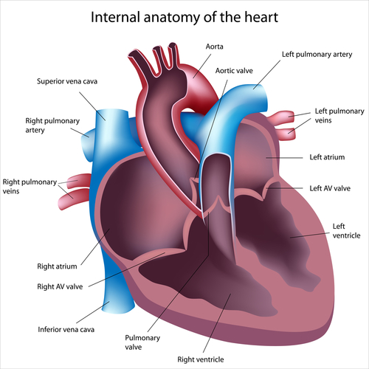
Vascular Remodeling of HTN
Chronic hypertension (increases afterload) causing increased arterial wall stiffness (less compliance), increased systolic blood pressure (BP), and widened pulse pressures.

Slide 30
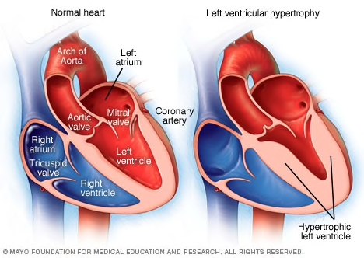
Cardiac Pathophysiology of HTN
The increased afterload of hypertension
  Decreases coronary perfusion pressures to an already overworked myocardium,
  Increases myocardial oxygen consumption
Leads to hypertrophy of the left ventricular myocytes (LVH)→ hypertensive heart disease.

Slide 31
Cardiac Pathophysiology of HTN
When left ventricular hypertrophy is present, the myocardium has undergone structural changes in response to increased afterload.
Cardiac myocytes have hypertrophied, allowing the heart to pump more strongly against the elevated vascular pressure in the aorta due to vascular resistance.
Diastolic dysfunction occurs first in HTN and is caused by an incomplete passive relaxation of the stiff, hypertrophied left ventricle during diastole.

Slide 32
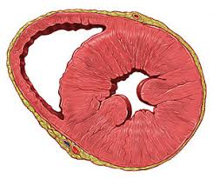
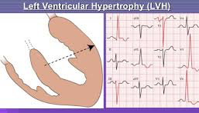
Cardiac Pathophysiology of HTN
As the hypertrophied LV does not relax completely during early diastole, left ventricular end-diastolic pressure increases, further increasing left atrial pressure in late diastole, causing distortion of the cardiac and great vessel architecture.

Slide 33
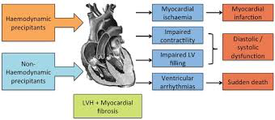
Cardiac Pathophysiology of HTN
Eventually, LVH begins to impinge on the heart cavity, limiting diastolic filling and stroke volume.
Once this occurs, the long preserved systolic function of the heart begins to fail.

Slide 34
Cardiac Pathophysiology of HTN
Hypertensive heart disease manifests as a continuum of changes:
  Left ventricular hypertrophy and HFpEF (diastolic)
  Left atrial enlargement
  Systolic heart failure, HFrEF, leads to . . .
  Aortic root dilatation and valve incompetence
  Atrial and ventricular arrhythmias
  Ischemic heart disease/ cardiomyopathy
LVH is associated with an increased risk of premature death and morbidity.

Slide 35
Pathophysiology of HTN in the CNS
In normotensive or mildly hypertensive patients, a rapid rise in BP can cause:
  Hyperperfusion/increased cerebral blood flow
  Increased intracranial pressure
  Cerebral edema (end organ damage)
  Cerebral/ carotid artery dissection
  Ischemic stroke due to in situ thrombus or arteriosclerotic embolus
  Hemorrhagic stroke
  CPP = MAP − ICP

Slide 36
Pathophysiology of HTN in the CNS
Cerebral autoregulation is the ability of the cerebral vasculature to maintain a constant cerebral blood flow across a wide range of perfusion pressures coming from the heart.
  If systemic blood pressure drops, cerebral perfusion is preserved through vasodilation of arteries in the brain to allow for increased blood volume to flow in the brain to continue perfusion
  If systemic blood pressure increases, arteriolar vasoconstriction occurs to prevent hyperperfusion
When chronic elevated BP is present, the CNS will, over time, become accustomed to these elevated perfusion pressures and begin to consider them normal.

Slide 37
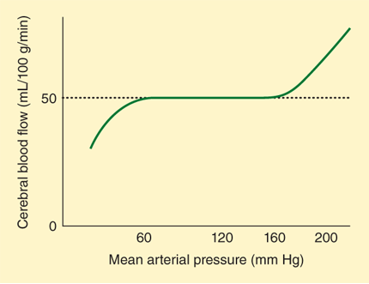
Cerebral Autoregulation
Cerebral flow is constant with MAP 60-150mmHg

Slide 38
Pathophysiology of HTN in the CNS
Chronic hypertensive patients adapt by increasing the cerebral vascular resistance and are more prone to cerebral ischemia when flow decreases, especially if the BP is decreased rapidly into the normotensive range.
Therefore, for patients with long-standing HTN, it can be just as dangerous to lower their BP too precipitously as it is to let it stay elevated.
In patients with long-standing HTN it is best to allow the BP to normalize slowly over a period of a few weeks as medications are gradually titrated to allow for autoregulation to return back to the normal set point.

Slide 39
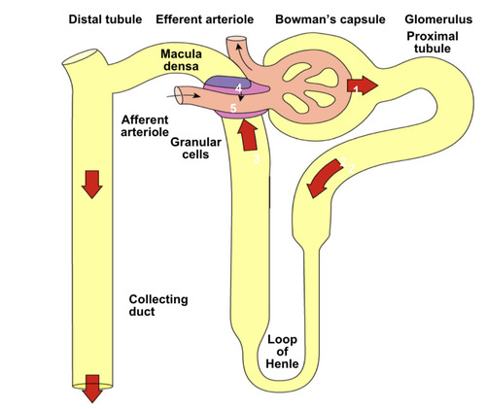
Pathophysiology of HTN in the Kidney
Chronic HTN causes pathologic sclerotic changes to the small arteries of the kidney, resulting in endothelial cell dysfunction and impaired vasodilation.
This damage alters renal autoregulation of blood flow to the glomerulus.
When the renal autoregulatory system is disrupted, the intraglomerular pressure starts to vary directly with the systemic arterial pressure, which means that the kidney has no protection during swings in BP.
Volume expansion plays a key role in hypertension in patients with glomerular disease (nephrotic and nephritic syndrome), as the patient becomes volume overloaded.

Slide 40
Pathophysiology of HTN in the Kidney
In patients with renal vascular disease (RAS), hypertension is the result of the near- constant activation of the renin-angiotensin system, which is often secondary to tissue ischemia.
The combination of volume expansion and the activation of the renin-angiotensin system is believed to be the main factor behind HTN in patients with chronic renal failure.

Slide 41
History
Physical Exam
Diagnostics

Slide 42
History in the Diagnosis of HTN
Often, high blood pressure is only one of several cardiovascular risk factors that require attention when a person is diagnosed with hypertension.
When diagnosing a patient with hypertension, the clinician is assessing the history for the possibility of end organ damage from hypertension as well as evaluating risk factors for cardiometabolic disease that may be modified to improve future health outcomes.

Slide 43
History in the Diagnosis of HTN
Important previous events include:
  Heart failure or s/s suggestive of heart failure
  Obstructive sleep apnea
  Chronic kidney disease
  Stroke or TIA
  Diabetes or glucose intolerance
  Peripheral arterial disease

Slide 44
History in the Diagnosis of HTN
End organ damage may also be present on diagnostic studies or uncovered by history:
  Heart: chest pain, sob, fatigue, leg swelling?
  Eval for left ventricular hypertrophy, diastolic dysfunction, systolic dysfunction, wall motion abnormalities on EKG or echocardiogram
  Brain: headaches?
  Cerebral atrophy greater than expected for age on CT or MRI, dementia
  Chronic kidney disease: Oliguria, Anuria, hematuria, flank pain?
  Routine labs
  Vasculature: extremity pain, hair loss, pallor, cool?
  Peripheral arterial disease
  Eye: retinopathy

Slide 45
Physical Exam in HTN
Vitals: BP, height, weight, waist circumference
Eyes: Cotton wool spots, AV nicking, arteriolar narrowing, hemorrhages, exudate, papilledema
Vessels: Palpation and auscultation of pulses
  Delay in the femoral pulse when compared to the radial pulse could indicate coarctation of aorta
  Weak or absent pedal pulses could indicate PAD
  Bruits in carotid, abdomen or femoral could indicate stenosis or atherosclerosis
Heart: Inspect and palpate for heaves. Palpate for displaced apical impulse. Auscultate for S4
Lungs: Auscultate for rales
Brain: Neurologic examination

Slide 46
History in the Diagnosis of HTN
Following a diagnosis of hypertension, we must also make an assessment of the patients’ cardiovascular risk status.
  Tobacco use (cigarettes, chewing tobacco)
  Elevated LDL or low HDL cholesterol
  Diabetes mellitus
  Obesity (BMI ≥30 kg/m²)
  Lack of exercise

Slide 47
History in the Diagnosis of HTN
Assessment of a patient’s cardiovascular risk status
  Age >55 years for men or >65 years for women: increased risk begins at the respective ages
  Estimated GFR < 60 mL/min (stage III CKD)
  Microalbuminuria: spot urine protein to creatinine ratio
  Family history of premature CAD (male relatives < 55; female relatives < 65 yrs)

Slide 48
History in the Diagnosis of HTN
We must also exclude secondary causes of hypertension
  OTC meds, oral contraceptives, EtOH and illicit drugs (meth, cocaine)
  Elevated creatinine, abdominal masses or bruits, anemia suggests CKD or RAS
  Episodes of sweating, labile hypertension, HA and palpitations suggests pheochromocytoma.

Slide 49
History in the Diagnosis of HTN
We must also exclude secondary causes of hypertension
  H/o cold or heat tolerance, sweating, lack of energy, and bradycardia or tachycardia may indicate thyroid disease.
  A history of obstructive sleep apnea, heavy snoring, daytime sleepiness
  A history of generalized weakness coupled with hypokalemia suggests hyperaldosteronism.

Slide 50
Screening for Secondary HTN
Testing is expensive and requires clinical suspicion and knowledge of limitations of different tests
When to screen:
  New onset HTN if younger than 20-25 years old
    Can occur at younger age in black patients
  HTN refractory to medical Rx (>3-4 meds)
  Specific clinical/lab features typical for disease
    Persistent hypokalemia, epigastric bruits, different BP in arms, episodic HTN/flushing/palpitations, etc

Slide 51
Causes of Drug Induced Hypertension
Prescription drugs:
  NSAIDs, COX-2 inhibitors
  Psych meds (SSNRI, tricyclic antidepressants)
  Carbamazepine
  Metoclopramide
  Migraine meds
  High dose OCs
  Pseudoephedrine
Situations with prescription drugs
  Abrupt d/c of β-blocker or centrally acting α-agonists
  β-blocker without α-blocker first when treating cocaine- induced HTN or pheo
Food substances:
  Sodium
  Ethanol
  Black licorice

Slide 52
Causes of Drug Induced Hypertension
Street drugs, other natural products:
  cocaine
  cocaine withdrawal
  ephedra alkaloids (e.g., ma-huang)
  “herbal ecstasy”
  phenylpropanolamine analogs
  nicotine withdrawal
  anabolic steroids
  narcotic withdrawal
  methylphenidate
  phencyclidine
  ketamine
  ergot-containing herbal products
  St. John's wort

Slide 53
Diagnostic Work-up of New Onset HTN
Initial laboratory tests include:
  Urinalysis, looking for protein
  Fasting blood glucose and A1c, looking for diabetes
  CBC: looking at hematocrit
  Electrolytes: serum sodium, potassium, creatinine (estimated glomerular filtration rate-GFR), and calcium
  TSH
  Fasting lipid profile following a 12-hour fast (total cholesterol, HDL, LDL cholesterol, and triglycerides).
  Baseline EKG to assess for LVH, consider echo if abnormal

