Slide 1

HYPERTENSION
Part III
Breanna Veal, MHS, PA-C
Treatment

Slide 2
Treatment of Hypertension
Although drug treatment may be required, lifestyle modifications should always be incorporated into managing HTN.
This means taking time EACH VISIT to discuss the importance of lifestyle changes that are realistic and attainable for that patient.
Motivational interviewing is KEY here!! What are the components of motivational interviewing?

Slide 3
Motivational Interviewing in the Treatment of Hypertension
How does your hypertension affect you?
What will happen to you if your hypertension is not controlled?
What changes can you make to cause a positive change in your lifestyle?
How do you plan to make these changes and what can I do to support you?
What goals can we set together today?

Slide 4
How Do Clinicians Decide On BP Treatment?
Common diseases in the US population, like hypertension, are studied and clinical guidelines, by multiple expert groups, developed for diagnosis and treatment.
  American College of Cardiology (ACC), the American Heart Association (AHA), the American Society of Hypertension (ASH), the Joint National Committee (JNC), the International Society on Hypertension in Blacks (ISHIB).

Slide 5
Who is Running This Show?
Joint National Committee 7th Meeting (JNC7) established guidelines in 2003 that were in place until December 2013 when the long overdue JNC 8 guidelines were published.
  The JNC 8 guidelines were controversial and characterized by many as “likely to harm patients” and “as clear as mud”. There were calls for retraction of the guidelines- but they have now become largely ignored.
Most US clinicians now use the American College of Cardiology/ American Heart Association (ACC/AHA) guidelines.

Slide 6
Goals of Antihypertensive Treatment
BP goal <130/80 is desired for those undergoing treatment for HTN
                The overall goal of reducing blood pressure is to reduce the risk of future adverse outcomes of CVD, thus all potential risk factors must be assessed and potential CV risk calculator used (PREVENT or ASCVD plus).
CVD risk will double if the BP is greater than 115/75 for every 20/10 increment of BP elevation.

Slide 7
Lifestyle Management Recommendations in HTN
As systolic BP increases with age, the goal should always be considering lifestyle modifications to help prevent HTN in all patients.
Lifestyle modification is an important approach either alone for those persons with elevated BP or in combination with antihypertensive medication for patients with Stage 1 or 2 HTN.
If lifestyle modification is insufficient to get to goal, drug treatment must be initiated.

Slide 8
Lifestyle Management Recommendations in HTN
A heart healthy DASH diet:
  Eating vegetables, fruits, and whole grains
  Including fat-free or low-fat dairy products, fish, poultry, beans, nuts, and vegetable oils
  Limiting foods high in saturated fat, such as fatty meats, full-fat dairy, and tropical oils such as coconut, palm kernel, and palm oils
  Limiting sugar-sweetened beverages and sweets

Slide 9
Lifestyle Management Recommendations in HTN
Weight loss, for patients who are overweight or obese.
  Assess a patient’s nutritional knowledge
  Recommend an app, like My Fitness Pal, or a structured program, like Weight Watchers
Physical activity: the goal is 150 mins/week of physical activity in divided sessions.

Slide 10
Lifestyle Management Recommendations in HTN
Tobacco cessation if needed
  Cutting down is better than continuing
  Multiple options for nicotine replacement or non-nicotine adjuncts for cessation
  Uncertain effects of vaping
Moderation or abstinence of alcohol consumption:
  Maximum daily safe limit is 1 drink for women or smaller men, 2 drinks for larger men.
    1 drink = 12 oz beer, 5 oz wine, or 1.5 oz 80-proof liquor

Slide 11
Lifestyle Management Recommendations in HTN
Dietary salt restriction
  <1500-2000mg/day of sodium
  Consider switch to salt substitute

Slide 12
Treatment: Lifestyle Modifications
Modification | Recommendation | Approximate SBP Reduction
Weight loss | Maintain normal body weight (body mass index 18.5–24.9 kg/m²) | 5–20mmHg per 10-kg weight loss
DASH-type diet | Consume a diet rich in fruits, vegetables, and low-fat dairy products with a reduced content of saturated and total fat | 8–14mmHg
Reduced salt intake | Reduce daily dietary sodium intake as much as possible, ideally to 2.4 g/day sodium, or 6 g/day sodium chloride. Consume enough K, Ca and Mg for good health | 2–8mmHg
Exercise | Regular aerobic physical activity (at least 30 min/day, most days of the week) | 4–9mmHg
Alcohol | Limit consumption to 2 drinks/day in men and 1 drink/day in women and lighter-weight persons | 2–4mmHg

Slide 13
Long Term Management of HTN
What should we do at a chronic care visit with the hypertensive patient:
Blood pressure readings
  If able use automated oscillometric meter to check BP, otherwise check manually, and compare them to previous visits.
  Evaluate the patient’s home BP log, noting:
    Average SBP and DBP
    Highest reading and lowest reading. Ask about any symptoms of low blood pressure.
  Compare home cuff to in-office manual reading, if not already done at previous visit, to assure accuracy and reliability of the home BP log.

Slide 14
Long Term Management of HTN
Chronic care visit with the HTN patient:
Assess for HTN associated symptoms:
    ENT: Headaches, visual disturbances, epistaxis, lightheadedness/dizziness, tinnitus
    CV: Diaphoresis, chest pain, palpitations, edema, dyspnea or decreased exercise tolerance.
  Check for compliance with currently prescribed medications and monitor for side effects.

Slide 15
Long Term Management of HTN
Chronic care visit with the HTN patient:
Perform a physical exam:
    General assessment, HEENT, cardio and vascular exams, lungs, GI, neuro, lymph, psych
Review lab results if present, or if due, order regular labs.
    Frequency depends on chronicity and HTN control.
    Will likely include chemistry panel, and screening for comorbid conditions (A1c and lipid panel).

Slide 16
Long Term Management of HTN
Chronic care visit with the HTN patient:
Assess how lifestyle change is going
    At minimum address one needed lifestyle management goal per chronic visit.
    Needs to be measurable, attainable, and should be reassessed at all chronic care visits.
Treatment plan: Decide if the medication regimen needs to be adjusted or if any additional work-up is needed.

Slide 17
Long Term Management of HTN
Chronic care visit with the HTN patient:
Follow-up care
  Decide on office follow up visit time frame:
    Uncontrolled and noncompliant pts: 2-4 weeks
    Slightly uncontrolled and compliant: 3 months
    Controlled and compliant with risk factors for progression: 3-6 months
    Chronically well controlled, compliant, and otherwise healthy: 6 months

Slide 18
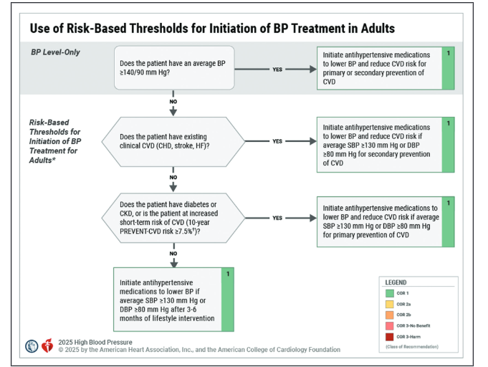
Indications for Treatment

Slide 19
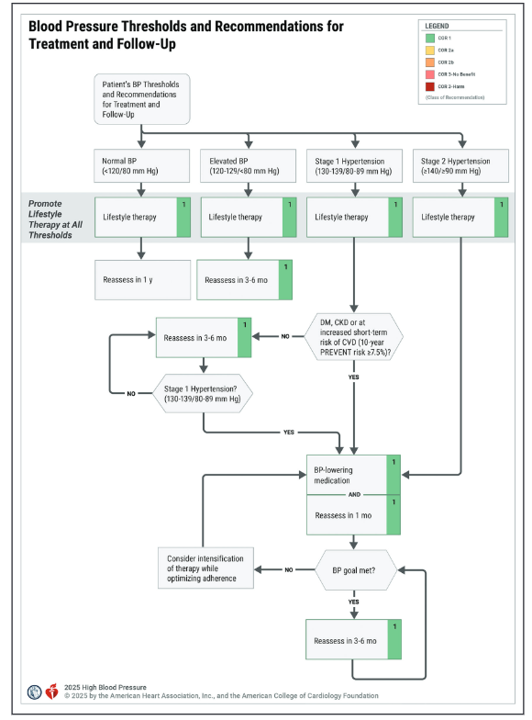
Indications for Treatment
Notes:
2025 AHA/ACC/AANP/AAPA/ABC/ACCP/ACPM/AGS/AMA/ASPC/NMA/PCNA/SGIM Guideline for the Prevention, Detection, Evaluation and Management of High Blood Pressure in Adults: A Report of the American College of Cardiology/American Heart Association Joint Committee on Clinical Practice Guidelines

Slide 20
BP Category Pressure Ranges | Recommendations
Normal BP <120/<80 mmHg | Promote healthy lifestyle; reassess BP annually.
Elevated BP 120-129/ <80 mmHg | Start with nonpharmacologic (TLC) therapy, reassess BP in 3-6 months.
Stage 1 Hypertension Systolic 130-139 or Diastolic 80-89 mmHg | CVD, DM, CKD or 10-year CVD risk ≥7.5%: Start with both nonpharmacologic and pharmacologic therapy. Reassess BP in 1 month. If at goal, reassess every 3-6 months. If not at goal, assess for medication adherence and consider intensification of therapy.
 | No CVD and 10-year CVD risk <7.5%: Start with nonpharmacologic therapy, reassess BP in 3-6 months. If at goal continue lifestyle management and reassess every 3-6months. If not at goal, initiate pharmacologic therapy.
Stage 2 Hypertension Systolic ≥140 or Diastolic ≥90 mmHg | Start with both nonpharm and pharmacologic therapy for all. Reassess BP in 1 month. If at goal, reassess every 3-6 months. If not at goal, assess for medication adherence and consider intensification of therapy.

Slide 21
Withholding Drug Treatment of HTN
Consider withholding antihypertensive treatment and tolerating a higher BP in stage I HTN (130-139/ 80-89) in patients who are over age 75 with:
  Recurrent falls
  Dementia
  ECF residence
  Multiple comorbidities (not HTN risks)
  Orthostatic hypotension
  Limited life expectancy

Slide 22
Antihypertensive Drug Classes
Diuretics- thiazide, loop, potassium sparing, aldosterone antagonist
Angiotensin converting enzyme inhibitors
Angiotensin receptor blockers
Calcium channel blockers
Beta blockers
Alpha 1 adrenergic blockers
Alpha/beta blockers
Centrally acting adrenergic agonists

Slide 23
Treatment of Hypertension
For patients indicated to begin antihypertensive medication beyond lifestyle changes consider the following:
  Determine if monotherapy or combination therapy is needed
  Determine if there is a compelling indication such as associated comorbidities for a particular class of anti-hypertensive.
  Look at other patient characteristics such as child-bearing, pregnant, and race to determine if there is a strong reason to chose or avoid a drug class.

Slide 24
HTN Drug Treatment Principles
Mono- or Combination Therapy
In stage 1 hypertension, a single agent is generally sufficient to lower the blood pressure to goal of <130 and <80 mmHg.
In stage 2 hypertension, strongly consider initiation of two drugs at low dose (except ACE-I or ARB) within a fixed dose combination pill to improve your chances of getting to goal.
  Combination therapy lowers blood pressure more than monotherapy
  Increases the likelihood that target blood pressure will be achieved in a reasonable time period
  Reduced risk of dose dependent side effects
  Improves adherence

Slide 25
Compelling Indications
Compelling indications: High-risk conditions that are direct sequela of HTN or are commonly associated with HTN.
In these disease states, a specific class of drugs should be initiated because the class has evidence-based survival benefit.
Some compelling indications are:
  Heart Failure Post MI
  CAD *PAD
  Afib Stroke
  Diabetes Mellitus CKD

Slide 26
Drug Treatment Principles
The following drugs are indicated in the presence of these compelling indications
Heart failure (Systolic Dysfunction): ACEI or ARB + beta-blocker + aldosterone antagonist + diuretic, try to get at least the first 2-3 on board (avoid non-DHP CCB)
*Post-myocardial infarction: beta blocker + ACEI or ARB, try to get both on board

Slide 27
Drug Treatment Principles
CAD: Beta blocker, ACEI or ARB, then a DHP-CCB or thiazide
Afib: Beta blocker or non-DHP CCB, ACEI or ARB, then thiazide diuretic
Diabetes: ACEI or ARB, then either a DHP-CCB or thiazide
Chronic kidney disease/ Proteinuria: ACEI or ARB, then either a DHP-CCB or a thiazide
Recurrent stroke prevention: ACEI or ARB, then either a thiazide or a DHP-CCB

Slide 28
Drug Treatment Principles
Other factors to consider when choosing a drug regimen.
Pregnancy potential: NO ACEI or ARB; however, thiazides, DHP-CCB or BB are okay
Age >60 years: Thiazide, ACE-I or ARB preferred
  Gout, urinary incontinence, SSRI treatment or low serum sodium: avoid thiazide diuretics.

Slide 29
Drug Treatment Principles
Race/ Ethnicity:
ACEI and ARBs work best in a Caucasian or Asian patients with hypertension.
Calcium channel blockers and thiazide diuretics work best in AA patients with hypertension.

Slide 30
Drug Treatment Principles
First Line Drug Classes for HTN
Should be initiated for those w/o other compelling indications or contraindications
    ACEIs or ARBs
    Calcium channel blockers (CCBs)
    Thiazide-type diuretics
However, the clinician may need to use other options if the patient develops compelling indications for a class or comorbidities that preclude the use of some drug classes.

Slide 31
Drug Treatment Principles
Several medications are now designated as later-line alternatives for the treatment of hypertension but are still routinely used.
    Aldosterone antagonists (spironolactone)
    Alpha1/beta-blockers (carvedilol)
    Beta-blockers (metoprolol)
    Alpha-blockers (doxazosin)
    Central alpha2-adrenergic agonists (clonidine)
    Direct arterial vasodilators (hydralazine)

Slide 32
Diuretics
Diuretics stimulate the production of urine by the kidneys, by decreasing the kidney’s ability to reabsorb water from the filtrate passing through the nephron.
Increasing urine production lowers blood volume and CO temporarily, leading to increased PVR, however 6-8wk later CO normalizes and PVR reduces.
Types of diuretics that lower blood pressure include thiazides, loop, and potassium sparing diuretics.

Slide 33
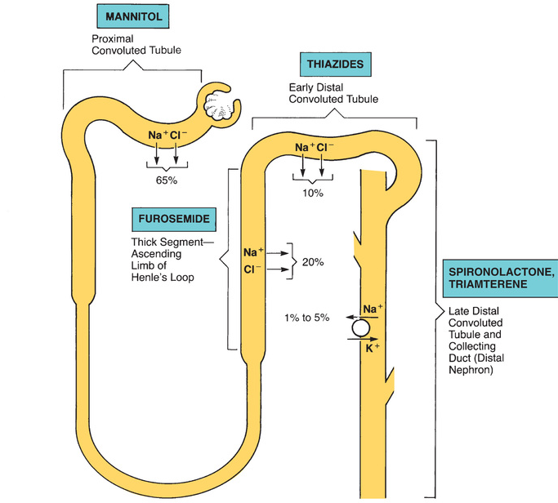
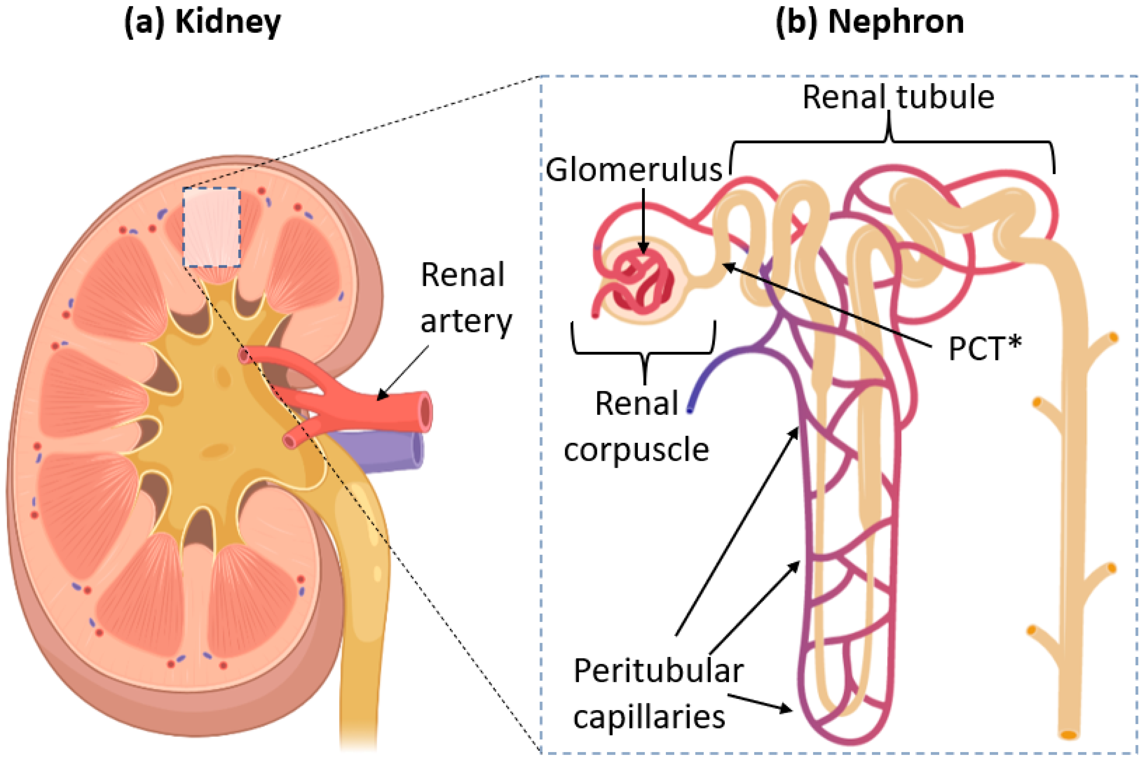
Diuretics
Thiazide diuretics
Loop diuretics
Potassium sparing diuretics
Diuretics reduce the rate at which water is reabsorbed. This results in more water being lost from the body and ultimately a fall in blood volume

Slide 34
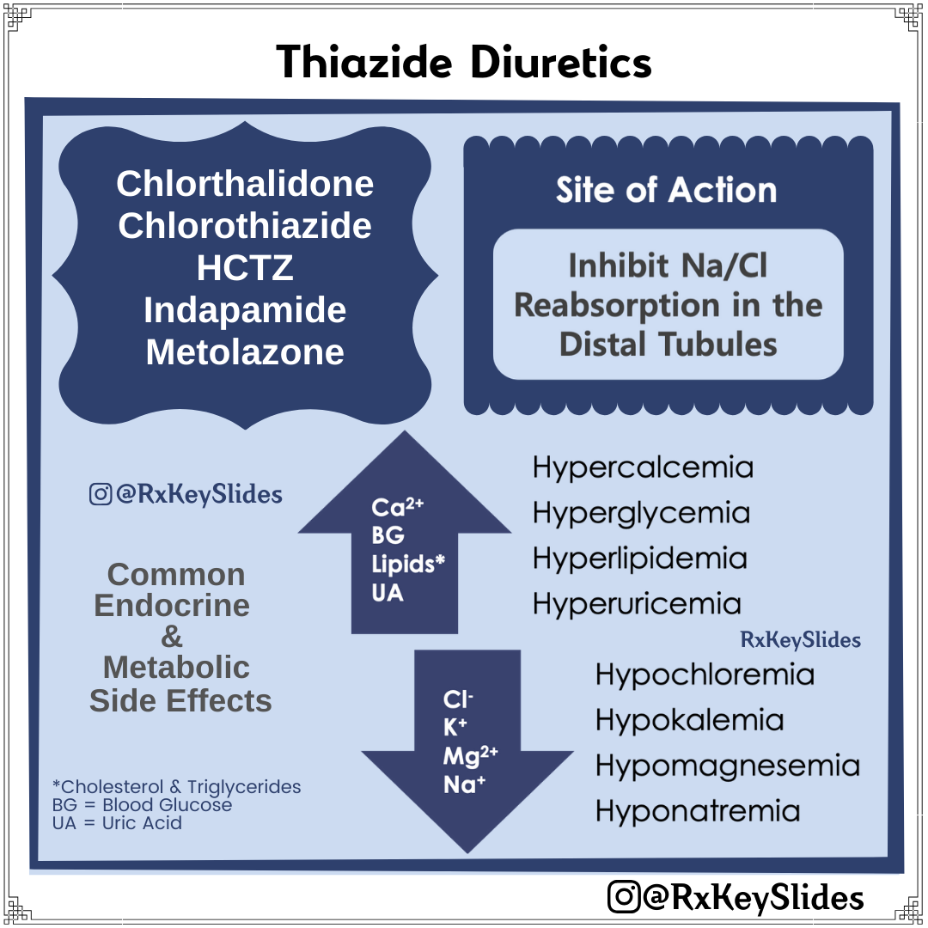
Thiazide Diuretics
  Preferred due to a longer duration of action, effective BP lowering although a greater risk of hypokalemia, hypercalcemia and relatively cheap
  Chlorthalidone-longest duration
  of action of thiazides. 12.5-25mg daily
  Indapamide (Lozol) 1.25-2.5mg daily
  Metolazone (Zaroxolyn)
  Hydrochlorothiazide/HCTZ 12.5-25mg

Slide 35
Thiazide Diuretics
These drugs work by increasing renal excretion of sodium and may have some vasodilator effects.
Clinical outcome benefits (reduction of strokes and major cardiovascular events) have been best established with chlorthalidone, and indapamide. No benefit has been noted with HCTZ
Efficacy in reduction of BP is more so seen with chlorthalidone (1.5-2x greater) and indapamide vs HCTZ. Efficacy improves with addition of ACEI or ARB
Diuretics are relatively weak anti-hypertensives and most effective when combined with ACEI or ARBs, may be used with CCBs.

Slide 36
Thiazide Diuretics
These drugs are given in the morning to avoid nocturnal diuresis
Adverse effects:
  Electrolyte abnormalities: hypokalemia, hyponatremia, hypoMg, hyperCa (usually seen in first 2 weeks of therapy until body adjusts)
  Gout- hyperuricemia
  Hyperglycemia- worsening DM control
  Hypovolemia (overdiuresis)
SBP and LDL cholesterol levels were lower in patients taking chlorthalidone compared to HCTZ

Slide 37
Thiazide Diuretics
Due to their mild glucose raising effects, clinicians should avoid prescribing thiazides as first line in diabetic patients, although they can be used.
Patients newly started on a thiazide or loop diuretic or if prescribed a dosage increase should have a chemistry panel checked within 5-7 days of initiation to evaluate for:
  Hypokalemia
  Hyponatremia

Slide 38

Loop Diuretics
Loop diuretics are not usually used for hypertension treatment, instead they are frequently used for symptomatic
management of heart failure, ascites,
CKD and edema.
However, these drugs do contribute to blood pressure lowering, so their effects must be taken into account when discussing an anti-hypertensive regimen.

Slide 39
Loop Diuretics
Account for most of sodium excretion in the thick ascending limb, are sulfonamide derivatives and relatively cheap except ethacrynic acid.
Furosemide (Lasix) 20-80 mg PO daily or bid, less bioavailable than other loops, so an IV dose of the same milligram is roughly twice as effective as an oral dose
Bumetanide (Bumex) 0.5-2 mg daily or bid, highly bioavailable
Torsemide (Demadex) 10-80 mg daily/bid, highly bioavailable
Ethacrynic acid (Edecrin)-a non-sulfa loop for those patients with severe sulfa allergy.

Slide 40
Loop Diuretics Dosing
In equipotent doses, the effects of each of the loop diuretics is very similar.
Lasix 40 mg = Bumex 1 mg = Demadex 20mg.
All the loop diuretics are available IV, and the degree of diuresis is largely determined by the rate at which the drug reaches its’ site of action in the nephron.

Slide 41
Loop Diuretics Dosing
Higher doses of loop diuretics may be needed in patients with:
Significantly decreased glomerular filtration rate from CKD or AKI or
If the patient is accustomed to the medication
IV formulations (bolus/ drip) of loops are given:
In acutely decompensated heart failure
When there is poor GI absorption (edema of the bowel from volume overload)

Slide 42
Loop Diuretics Dosing
Loop diuretics are almost always given with supplemental potassium in order to avoid hypokalemia.
In a healthy kidney, about 20mEq of potassium is given for every 40 mg of Lasix- although this can vary, and chemistry panel should be used to adjust this dose if needed.
Loop diuretics are given in AM or afternoon (if bid no later than 5pm) to avoid a nocturnal diuresis

Slide 43
Loop Diuretics- Adverse Reactions
Diuretic effects:
  Electrolytes: hypokalemia, hyponatremia
  Overdiuresis/ hypovolemia and contraction alkalosis
  Gout/ hyperuricemia
Hypersensitivity reactions: rash and rare acute interstitial nephritis
Ototoxicity (tinnitus and hearing loss), transient to irreversible, usually occurs with very high dose

Slide 44

Potassium Sparing Diuretics
Triamterene (Dyazide or Maxzide) when used in combination with HCTZ
Amiloride (Midamor)
Spironalactone (Aldactone)
Eplerenone (Inspra)
Triamterene and amiloride directly block sodium channels in the distal tubule leading to a weak diuretic effect, but conservation of potassium. Amiloride is better tolerated and less nephrotoxic than triamterene.

Slide 45
Potassium Sparing Diuretics
Like all diuretics, give in the morning to avoid nocturnal diuresis, and if used BID, avoid giving after 5pm
Adverse effects of the potassium sparing diuretics include:
  Hyperkalemia: particularly in diabetics and CKD patients, or patients on an ACEI or ARB
  Crystalluria and cast formation is seen with triamterene- leading to kidney stones and AKI

Slide 46
Potassium Sparing Diuretics/ Aldosterone Antagonists
Two of the potassium sparing diuretics work by a different mechanism, competitively inhibiting the mineralcorticoid (aldosterone) receptor in the distal tubule which decreases the number of Na-K pumps and increases serum potassium, while increasing sodium loss in the urine.
Eplerenone (Inspra)
Spironolactone (Aldactone)

Slide 47
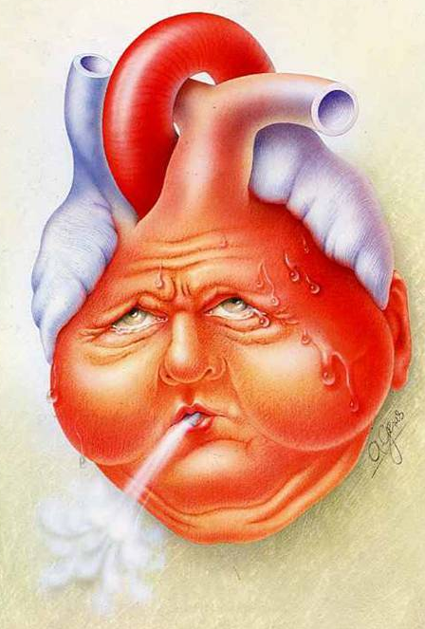
Aldosterone Antagonists
Although they are beneficial for their weak diuretic effect- they are more commonly valued for their ability to block the effects of aldosterone on the kidney, vasculature and heart.
For that reason, they carry a compelling indication for HFrEF and are the initial diuretic of choice in a patient with ascites from chronic liver disease.

Slide 48
Aldosterone Antagonists: Adverse Effects
Hyperkalemia especially if given in combination with ACEI, ARB or potassium supplements, use with caution and monitor chem panel, especially in GFR < 50, diabetics and pts with proteinuria.
Endocrine side effects: spironolactone is less specific to the mineralocorticoid receptor, and binds to estrogen and progesterone receptors, resulting in gynecomastia, irregular menstrual periods and impotence.
  Eplerenone (Inspra) more selective thus reducing potential for endocrine SEs.

Slide 49

Angiotensin Converting Enzyme (ACE) Inhibitors
Benazepril (Lotensin)
Captopril (Capoten)
Enalapril (Vasotec) PO- Enalaprilat IV
Fosinopril (Monopril)
Lisinopril (Prinivil, Zestril)
Moexipril (Univasc)
Perindopril (Aceon)
Quinapril (Accupril)
Ramipril (Altace)
Trandolapril (Mavik)
Relatively Cheap

Slide 50
Angiotensin Converting Enzyme (ACE) Inhibitors
ACE inhibitors work by blocking conversion of angiotensin I to angiotensin II
  End result- inhibiting both vasoconstriction and release of aldosterone.
ACEI also increase bradykinin levels, a potent vasodilator.
Generally, ACEI are more effective for antihypertensive treatment in Whites and less effective in Blacks.

Slide 51
Lots of Uses for ACE Inhibitors
ACEIs are used to treat HTN and certain disease states who don’t have HTN.
  ACEI are the treatment of choice in patients with chronic kidney disease and proteinuria to prevent progression.
  ACEI reduce morbidity and mortality rates in patients with HFrEF and recent myocardial infarctions.
  ACEI may halt or may regress remodeling of the left ventricle in HF, CAD and cardiomyopathies

Slide 52
ACE Inhibitors:
Nephroprotective and Nephrotoxic
Some patients with a specific disease process have constant or near constant activation of the RAAS in an attempt to keep their glomerular pressure and filtration at normal levels.
Who are these patients?
What will happen when you suddenly block their RAAS?

Slide 53
ACE Inhibitors:
Nephroprotective and Nephrotoxic
ACE-I can worsen kidney function during times of illness.
  Primarily this occurs when the patient develops hypovolemia- due to poor po intake, N/V/D, a GI bleed or overdiuresis.

Slide 54
ACE Inhibitor Monitoring
Monitor serum potassium and BUN/Cr within 5-10 days of initiation or dose increase. Usually, creatinine will temporarily increase a little as GFR falls, then improves.
The drug must be stopped if the patient develops a persistent hyperkalemia or increasing serum creatinine (>30%).
A nephrologist may initiate an ACE inhibitor in more severe CKD than an IM/FP provider.

Slide 55
Adverse effects of ACE Inhibitors
Dry cough: typically occurs 1wk-6mth after initiation of the medication however may occur at any time even if the pt has been tolerating the drug for years
  More common in women
  Discontinuation of the medication resolves the cough
Hyperkalemia: particularly in CKD IV or V and diabetics, also if an aldosterone antagonist (spironolactone or eplerone) is used concurrently.

Slide 56
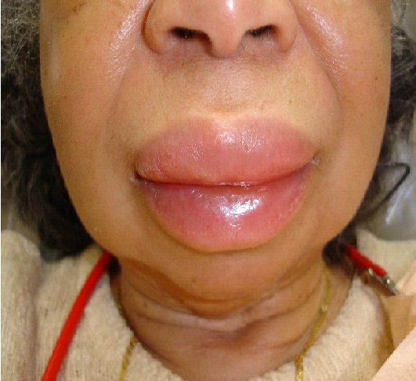
Adverse effects of ACE Inhibitors
Angioedema: Life Threatening
  Sudden swelling of the lips, tongue and pharynx.
  More common in Blacks and Asians.
  50% of cases occur w/in 1st week of initiation
  Treat with Benadryl, Solumedrol and Pepcid. Protect airway and intubate if required
  Discontinue the medication and never prescribe another ACE-I
Contraindicated in pregnancy: Category X due to risk of renal agenesis in the fetus.

Slide 57
ARBs (Angiotensin II Receptor Blockers)
Losartan (Cozaar) Candesarten (Atacand)
Valsartan (Diovan) Eprosartan (Teveten)
Olmesartan (Benicar) Azilsartan (Edarbi)
Telmisartan (Micardis) Irbesartan (Avapro)
Relatively Cheap
ARBs have efficacy similar to ACEI and are generally more effective in white patients

Slide 58
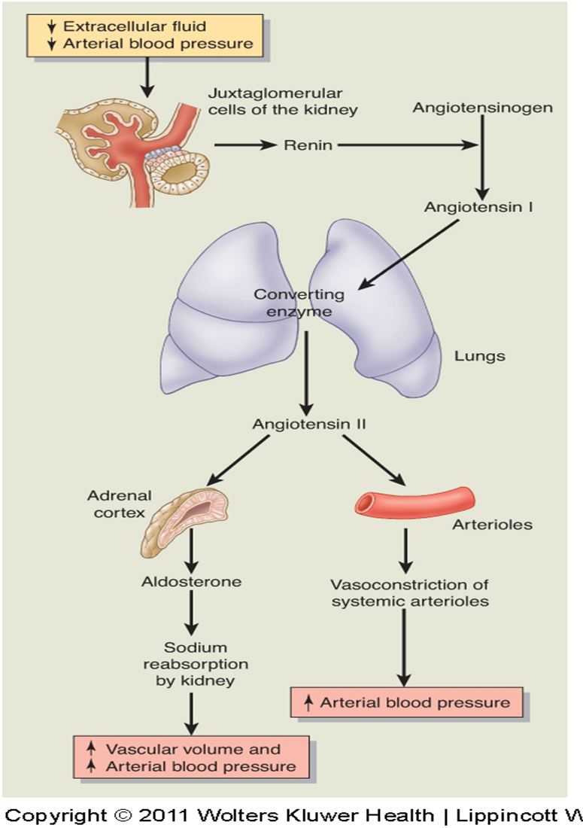
(Angiotensin II Receptor Blockers)
ARBs inhibit the action of angiotensin II by blocking angiotensin II from binding to AT1 and AT2 receptors.

Slide 59
ARBs (Angiotensin II Receptor Blockers)
ARBs are generally preferred over ACE inhibitors because they cause less cough and have a lower risk of angioedema.
ARBs can be utilized in patients who have a history of ACEI associated angioedema. (use caution and provide education)
ARBs can be trialed in patients with an ACE associated cough, just counsel them to discontinue the ARB if a persistent cough occurs.

Slide 60
ARBs (Angiotensin II Receptor Blockers)
Like ACE inhibitors, angiotensin II receptor blockers are contraindicated in pregnancy due to the risk of renal agenesis.
Clinicians need to monitor their patient’s renal status and potassium when initiating an ARB or after a dosage escalation by obtaining a serum chemistry panel in 5-7 days.

Slide 61
Should we combine and ACEI and an ARB?
Absolutely NOT
ONTARGET Trial: ONgoing Telmisartan Alone and in combination with Ramipril Global Endpoint Trial
Prospective, randomized, multicenter, double-blind trial; patients randomized to ramipril, telmisartan, or a combination of both
  25,620 patients > age 55 yr with DM & end-organ damage or established atherosclerotic vascular dz
Combination therapy reduces proteinuria more than monotherapy but worsens major renal outcomes

Slide 62
Calcium Channel Blockers (CCBs)
Calcium channel blockers inhibit the influx of calcium (and possibly sodium) across cardiac and smooth muscle cell membranes.
This results in:
Slower electrical impulse conduction through the SA & AV node leading to lower heart rate.
A decreased in cardiac contractility.
A decrease in blood pressure due to peripheral arterial vasodilation.

Slide 63
Calcium Channel Blockers (CCBs)
There are two main sub-classes of calcium channel blockers: dihydropyridine CCBs and non-dihydropyridine CCBs
DHP CCBs act more strongly on peripheral vessels while non-DHPs act more strongly at the heart.
Both have similar antihypertensive efficacy, but one sub-class is often selected over the other when prescribed for hypertension with consideration for their effects on the heart.

Slide 64
Calcium Channel Blockers (CCBs)
Dihydropyridine CCBs primarily block calcium channels in the peripheral vasculature causing vasodilation. They are considered heart rate neutral.
Dihydropyridine CCBs:
Amlodipine (Norvasc)
Felodipine (Plendil)
Nifedipine (Procardia, Adalat)
Nicardipine (Cardene) IV

Slide 65
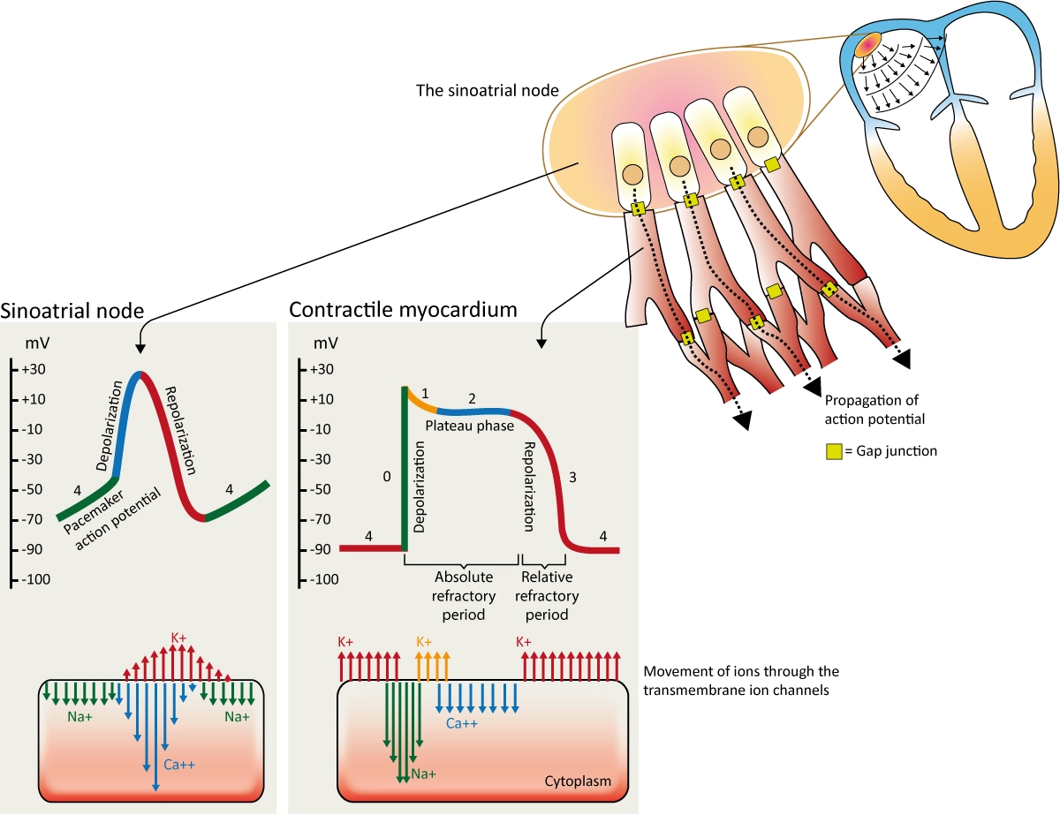
Calcium Channel Blockers (CCBs)
Non-dihydropyridine CCBs block cardiac calcium channels primarily, with less effect on the peripheral vasculature. Non DHP CCBs will decrease cardiac contractility (negative inotropic effect) and SA & AV node conduction (negative chronotropic effect).
  Non- Dihydropyridine CCB: AFIB (indication)
  Diltiazem (Cardizem, Tiazac, Cartia) PO/IV
  Verapamil (Calan, Verelan) PO/IV

Slide 66
Dihydropyridine CCB | Non-dihydropyridine CCB
Potent arteriolar vasodilators with negligible effect on AV nodal conduction | Decrease HR by blocking the SA and AV nodes, used to slow atrioventricular nodal conduction may treat supraventricular tachyarrhythmias
Adverse Effects: baroreceptor-mediated reflex tachycardia due to potent vasodilating effects (avoid short acting forms), may cause or worsen peripheral edema | Adverse Effects:bradycardia, atrioventricular block, systolic HF, less likely to cause or worsen edema. Caution with concurrent use with β-blockers.

Slide 67
  DHP CCBs Adverse Reactions
  Amlodipine (Norvasc), Felodipine (Plendil)
  Nifedipine (Procardia, Adalat)
DHP CCBs can cause flushing, lightheadedness, dizziness, and HA in 10- 20% of patients.
DHP CCBs, in their short acting form, can cause reflex tachycardia. This is because the short acting form stimulates a very sudden and significant drop in blood pressure. For this reason, short acting forms are very rarely used.

Slide 68
  DHP CCBs Adverse Reactions
  Amlodipine (Norvasc), Felodipine (Plendil)
  Nifedipine (Procardia, Adalat)
DHP CCBs increase vascular permeability, which may lead to peripheral edema- this is less common when administered at the same time as a RAAS blocker, but the edema is not usually responsive to diuretics because it is not due to increased plasma volume.
If significant edema occurs the clinician may need to stop the DHP calcium channel blocker.

Slide 69
Non-DHP CCBs Adverse Reactions
Verapamil (Calan, Verelan) or Diltiazem (Cardizem, Tiazac, Cartia)
Verapamil and to a lesser degree diltiazem will decrease cardiac contractility and heart rate- therefore these drugs should not be used in bradyarrhythmias- such as sick sinus syndrome (SSS), or higher degree heart blocks (2nd/3rd AVB).
Because of their effect on heart rate, the clinician must be cautious when prescribing non-DHP CCBs with a beta blocker.

Slide 70
Non-DHP CCBs Adverse Reactions
Verapamil (Calan, Verelan) or Diltiazem (Cardizem, Tiazac, Cartia)
In addition, non-DHP CCBs may worsen heart failure and should not be used in acutely decompensated HFrEF.
Once HF decompensation has been addressed (usually 24 hours of diuresis), non DHP CCBs can be resumed.
Constipation- especially verapamil (25%)

Slide 71
CCB Overdose
At 5-10x the usual dose, patients develop bradycardia and prolongation of the PR interval in addition to hypotension due to the effects of the CCB, even a DHP CCB, on the AV node.
Patients develop hyperglycemia as the pancreas is prevented from releasing insulin, although this is rarely clinically significant.

Slide 72
CCB Overdose
Despite hypotension, CCB-poisoned persons may maintain clear mentation, but neurologic status may deteriorate precipitously once their cerebral perfusion becomes critically low- recheck their neuro status frequently!!
Initially give IVF resuscitation for hypotension, atropine for bradycardia- it may not be effective.
GI decontamination (AC), administration of IV calcium, glucagon, pressors (norepi) and high dose insulin therapy can all be used.

Slide 73
β-Receptors
Distributed throughout the body and concentrated differently in certain organs & tissues
β1 receptors: heart, kidney
  stimulation increases HR, heart contractility, renin release
β2 receptors: lungs, liver, pancreas, arteriolar smooth muscle
  stimulation causes bronchodilation and vasodilation
  mediate insulin secretion and glycogenolysis

Slide 74
β-Blockers MOA
Cardioselective Beta-blockers bind to and block the cardiac beta 1 receptors reducing responsiveness to sympathetic activity (epinephrine/norepinephrine); at higher doses they may also target beta 2 receptors in the lungs
Non-Cardioselective Beta-blockers bind to and block B1 and B2 receptors.
Therefore, use caution in the setting of asthma or chronic obstructive pulmonary disease (COPD), regardless of beta-selectivity profile.

Slide 75
Indications for β-Blockers
Beta blockers are not recommended as first line treatment of hypertension except in the case of a compelling cardiac indication:
    Post-MI: started after STEMI or NSTEMI, beta blockers are first line
    Compensated HFrEF and any symptomatic or asymptomatic left ventricular dysfunction. Patients with a decrease in LV EF < 50% are begun on beta blockers
    CAD and Afib are other indications
BB have not been shown to reduce risk of stroke or mortality associated with HTN

Slide 76
Indications for β-Blockers
Beta blockers are less effective for hypertension in Black patients than in other ethnicities.
  But remember that compelling indications trump all else- so beta blockers should be used first line for HTN in a Black patient with prior MI, HF or asymptomatic LV dysfunction.
Beta blockers are to be used with caution in patients older than 60 years in the absence of compelling indications.

Slide 77
β-Blockers Side Effects
Just like the DHP CCBs, beta blockers may also precipitate heart block or bradyarrhythmia.
If a patient develops a bradycardic arrhythmia or heart block while on a beta blocker, the drug should be d/c.
Other side effects associated with b-blockers include reduced sexual function in men (impotence), fatigue, and reduced exercise tolerance.

Slide 78
Diabetics and β-Blockers
When a person becomes hypoglycemic, the hypoglycemia activates the sympathetic nervous system → causing tremors, sweating, increased heart rate and +/- palpitations.
If a patient is taking a beta blocker, the target receptors of the sympathetic system are blocked.
Therefore, in patients taking beta blockers, these warning signs of hypoglycemia may be absent, allowing dangerously low glucose levels to develop without patient awareness.

Slide 79
Diabetics and β-Blockers
Beta blockers have an adverse effect on glucose metabolism, because they decrease insulin release from pancreatic beta cells.
Therefore beta blockers are not recommended for HTN treatment in diabetics- unless there is a compelling indication.

Slide 80
Types of β-Blockers
Cardioselective: Indicated to control tachyarrhythmias, such as atrial fib or sinus tachycardia. But remember: β1 selectivity is lost at higher doses
  Bisoprolol (Zebeta)
  Metoprolol succinate (Toprol XL), once daily dosing
  Metoprolol tartrate (Lopressor), twice daily dosing
  Atenolol (Tenormin)

Slide 81
Types of β-Blockers
Non- selective: Inhibit both β1 & β2 receptors at all doses, often not used for hypertension.
Instead, non-selective BB are commonly used for migraine prophylaxis, anxiety, essential tremor, portal hypertension and thyrotoxicosis.
    Nadolol (Corgard)
    Propranolol (Inderal)
    Timolol (Biocadren)

Slide 82
Types of β-Blockers
Intrinsic Sympathomimetic Activity: Partial β-receptor agonists, do not reduce resting heart rate or cardiac output.
ISAs have a niche place in therapy, possibly patients with bradycardia in need of BB, but they are contraindicated post-MI or in high-risk patients.
Not as cardioprotective as a selective BB.
Acebutolol (Sectral)

Slide 83
β-Blockers
Beta blockers must be started at a low dose and titrated up cautiously in persons with LV dysfunction and HFrEF due to the drug’s depressive effects on myocardial contractility and heart rate.
Beta blockers should not be abruptly discontinued, if possible, since this may cause rebound HTN, worsening angina or MI. If able, slowly wean the beta blocker dose down over 1-2 weeks.

Slide 84
β-Blocker Overdose
Findings of beta blocker overdose include hypotension, bradyarrhythmia, confusion, hyperkalemia and hypoglycemia. Profound myocardial depression and cardiogenic shock are sometimes seen.
Propanolol and carvedilol are the most lipophilic of the beta blockers and because they can cross the BBB easily, will therefore cause the most neurotoxicity, precipitating seizures and delirium.

Slide 85
β-Blocker Overdose
BB overdose is treated with IV fluids and atropine initially.
Additional treatments include
  IV calcium: increases heart rate
  IV glucagon: augments cardiac contractility
  Vasopressors
  High dose IV insulin and glucose: insulin improves cardiac contractility
  Lipid emulsion: surrounds lipophilic meds rendering them ineffective

Slide 86
Mixed α1- & β-blockers
These drugs block β receptors which decreases HR and myocardial oxygen demand as well as blocking α1 receptors causing peripheral vasodilation.
Carvedilol has been shown to reduce mortality in patients with systolic dysfunction and HFrEF.
Adverse effects: Lowers standing BP more than supine BP, so the additional blockade produces more orthostatic hypotension than a BB alone.

Slide 87
Mixed α1- & β-blockers
Carvedilol (Coreg): Frequently used for BP lowering in patients with HFrEF, has been shown to have mortality benefit.
Considered to have less of an effect on glucose metabolism than a straight BB.
Labetalol (Trandate):
  Used as an oral med for BP
  Frequently given IV prn to control BP or when pts cannot take their usual dose of oral BB.
  Used in pregnancy- lots of experience, safe.

Slide 88
α₁-Blockers
Terazosin (Hytrin)
Doxazosin (Cardura)
Prazosin (Minipress)
Not appropriate monotherapy for HTN but are often used when both HTN and comorbid BPH needs to be treated.
Blockade of α₁ causes peripheral vasodilation of veins and arteries leading to BP lowering; these drugs also block α₁ receptors on the prostate, allowing for easier urine flow

Slide 89
α₁-Blockers
Dosed at bedtime to limit the effect of orthostasis
Adverse effects:
  Orthostatic hypotension: especially in older patients
  1st dose phenomenon: transient dizziness, faintness, palpitations, syncope within 1 to 3 hours of the 1st dose
  Edema, may give with a diuretic, but monitor for worsening orthostasis

Slide 90
Central α₂-Agonists
Clonidine (Catapres) PO or Patch
Methyldopa (Aldomet)
Guanfacine (Tenex)
These drugs stimulate α₂-adrenergic receptors in the brain
  Reduces sympathetic outflow from the CNS and increases vagal tone
  Peripheral stimulation of presynaptic α₂-receptors may further reduce sympathetic tone

Slide 91
Central α₂-Agonists
Methyldopa: one of the safest drugs to use in pregnant hypertensives. Rarely used otherwise.
Clonidine:
  Compliance issues: PO bid-tid; may be given by patch once weekly ($$$).
  ESRD: safe in renal failure and fairly strong- used in ESRD pts with severe HTN.
  Alcohol withdrawal: directly counteracts the withdrawal symptoms mediated by increased sympathetic CNS tone.

Slide 92
Central α₂-Agonists: Adverse Effects
Abrupt discontinuation may cause rebound HTN (clonidine), this is a significant risk.
Orthostatic hypotension
Bradycardia
Dizziness, drowsiness, HA and fatigue
Anticholinergic side effects (clonidine)- dry mouth, constipation, flushing, abdominal pain from a slow gut.
Sodium/water retention leading to edema

Slide 93
Central α₂-Agonists Overdose
Overdose with tablets becomes symptomatic in one hour, OD with patch maybe longer.
Clonidine overdose presents like an opioid overdose with pinpoint pupils, depressed LOC, hypotension, coma and respiratory depression.
Patients also develop hypothermia.
Treatment with naloxone, IV fluids, atropine, pacing, and vasopressors.

Slide 94
Direct Arterial Vasodilators
Directly relaxes arterial smooth muscle causing an antihypertensive effect with little/no venous vasodilation.
Hydralazine: commonly used IV but also used PO to control BP, is heart rate neutral. May be used as part of a combination of drugs in a pts with heart failure. Also used for ESRD patients, safe in CKD/ AKI.
Minoxidil: often used for renal failure patients with difficult to control hypertension.

Slide 95

Direct Arterial Vasodilators: Adverse Effects
Sodium/water retention causing edema, may use with diuretic (loop) in order to minimize
Angina, caution in patients with CAD, may cause vascular steal.
Reflex tachycardia due to excessive vasodilation.
Hydralazine is known to cause drug induced lupus.
Excessive hair growth with minoxidil.

Slide 96
Putting it all Together
Treating the Hypertensive Patient
Evaluate the BP appropriately and determine the stage of HTN. - Evaluate if h/o CVD risk, DM, CKD and calculate the patient’s 10-year CVD risk using Prevent Calculator.
Review the patient’s medical history and determine if there is a compelling indication.
Review the history and demographics to consider other factors (race, comorbidities, age).

Slide 97
Putting it all Together
Treating the Hypertensive Patient
If Stage II HTN >140 or >90 → then the patient should be started on combination medication (dual therapy) immediately along with TLC
    Goal systolic <130 and diastolic < 80.

Slide 98
Putting It All Together
If the patient’s CVD risk is less than 7.5% with no known CVD risk factors and Stage I HTN: SBP 130-139 or DBP 80-90
  First, lifestyle management with close monitoring and f/u BP in 6 months.
  Second, addition of monotherapy is begun in stage I HTN after 6 months of unsuccessful lifestyle management.
  Goal systolic <130 and diastolic <80

Slide 99
Putting It All Together
If risk ≥ 7.5%, DM, CKD, known CVD and Stage I HTN: SBP 130-139 or DBP 80-90:
  Begin monotherapy and TLC
  Goal systolic <130 and diastolic <80

Slide 100
Putting It All Together
Evaluate for any compelling indications
  See Slides 26-27

Slide 101
Putting It All Together
Factor in other needs/ benefits/ patient characteristics
African American patients of any age: CCB and thiazide diuretics are more effective, whereas ACE inhibitors and ARBs are less effective but still considered second or third line.
Caucasian or non-white patients (< 60 yrs): ACEI or ARB are the first choice, followed by CCB or thiazide.

Slide 102
Putting It All Together
Factor in other needs/ benefits/ patient characteristics
Elderly patients often develop isolated systolic HTN and may be more sensitive to drug effects.
  In Caucasians- ACEI or ARBs are first line
  In Blacks- CCB or thiazides are first line
Therapy in these patients should be started at low dose and titrated gradually with a single agent. The target BP may be less aggressive.

Slide 103
Putting It All Together
Factor in other needs/ benefits/ patient characteristics.
Pregnancy potential- avoid ACE/ ARB due to teratogenicity
Advanced CKD/ ESRD- CCB, BB, direct arterial vasodilators and alpha 2 agonists are frequently used because they are safe in ESRD.
Balance issues, urinary incontinence, SSRIs, gout or hyponatremia→ avoid thiazide diuretics

Slide 104
Resistant Hypertension
Resistant hypertension is defined as hypertension that is not controlled to goal using the maximum tolerated dosage of three anti-hypertensives, one of which is a thiazide diuretic.
The most widely used three-drug combination for hypertension is an ACEI + CCB + thiazide or an ARB + CCB + thiazide, which will control BP in 80% of patients.

Slide 105
Resistant Hypertension
If BP is not controlled by adding a third drug, ensure medication compliance, monitor BP at home, and assure no use of another med/ intake that would cause resistant HTN.
Add a 4th drug: an aldosterone antagonist, b-blocker, centrally acting agent, a-blocker, or a direct vasodilator.
Consider referral to a HTN specialist and/or a work-up for secondary HTN.

