Slide 1
Chronic Arrhythmia Management
A couple little issues . . . But mainly AF.
CMM: Cardiology Fall 2026
Jill-Renae Gulczinski, MS, PA-C

Slide 2
NSVT in the Hospital
“Say, aren’t you the PA for Dr. Never-answers-his-phone? His patient in room 3423 just had a 12-beat run of VT”.
Non-sustained ventricular tachycardia is extremely common when we are monitoring so many patients on telemetry.
NSVT is a potential marker for the development of a sustained ventricular dysrhythmia and should always be investigated.

Slide 3
NSVT in the Hospital
First, look at the telemetry strip- artifact may look like NSVT. Compare it to the patient’s 12-lead.
Patients are usually asymptomatic, but the clinician will want to ask about CP, dyspnea, palpitations and syncope/pre-syncope symptoms.
The patient’s physical exam is generally normal, with normal sinus rhythm on the telemetry monitor by the time you arrive to assess them.

Slide 4
NSVT in the Hospital
Reversible causes of NSVT are evaluated. How?
  Electrolyte derangements: potassium and magnesium are the most common
  Anemia
  Myocardial ischemia: obtain an immediate 12 lead EKG and a HS troponin done now and in 6 hours in all patients.
  Hypoxia
  Hypotension
  Heart failure decompensation
  Adverse drug effect

Slide 5
NSVT in the Hospital
For a single episode of NSVT, the 12 lead EKG, troponins and evaluation of potentially reversible causes is all that is needed.
In a patient with recurrent episodes of NSVT or one who is highly symptomatic, additional work-up is appropriate.
  Start with a 2D echo- generally the study of choice to evaluate cardiac fxn and structural heart disease.
  Stress testing may be done if onset of ventricular tachycardia seems to correspond to exercise.

Slide 6
Other Arrhythmia Issues- Sinus Tach
Sinus tachycardia is a physiologic response to stress, that may be seen in many illnesses.
Patients may complain of palpitations, but the majority of symptoms are usually related to the underlying illness that caused sinus tachycardia.
When persistent sinus tachycardia is noted with an apparent underlying cause, treatment is aimed at correction of that cause.

Slide 7
Inappropriate Sinus Tachycardia
Also called chronic non-paroxysmal sinus tach, is a diagnosis of exclusion in persons without structural heart disease or other cause for sinus tachycardia.
These patients frequently have an exaggerated HR response to exercise, which is out of proportion to the physiologic needs of the body.

Slide 8
Inappropriate Sinus Tachycardia
Most of the patients with inappropriate sinus tachycardia are young and female.
The pathophysiologic mechanism is thought to be hyperactivity of the SA node, depressed vagal response and beta-adregenergic hypersensitivity.
Is this really dangerous?

Slide 9
Inappropriate Sinus Tachycardia
The first step in the evaluation of the patient is to confirm that sinus tachycardia- not atrial tach- is present with a 12 lead EKG.
Sinus tachycardia usually occurs in response to patient stress or illness, whereas atrial tachycardia is paroxysmal and often unrelated to events.
Atrial tachycardia usually occurs with a very high heart rate, often > 140 bpm.

Slide 10
Inappropriate Sinus Tachycardia
If no reversible cause can be found for the sinus tachycardia, then it is reasonable to consult cardiology and obtain a 2D echo.
Inappropriate sinus tachycardia is generally treated with low dose metoprolol. Ivabridine, an antiarrhythmic, is more efficacious (although off label in the US) for inappropriate sinus tachycardia.

Slide 11
POTS
Postural tachycardia syndrome- patients have an exaggerated HR response to standing, but an intact autonomic reflex in the baroreceptors.
This means that the patient’s heart races when they stand up suddenly, but they vasoconstrict appropriately to the postural change.
So, rarely does a patient with POTS have syncope- but often have they have orthostatic hypotension and pre-syncope symptoms.

Slide 12
Postural Tachycardia Syndrome-
POTS
POTS is most common in adolescent and young adult women.
There are multiple proposed mechanisms for POTS- genetics, hypovolemia, cardiac deconditioning, distal extremity denervation, and decreased venous return- but there is no definitive pathophysiology that is common to all patients.

Slide 13
POTS
Patients diagnosed the postural tachycardia syndrome have variable symptoms in response to position changes:
  CNS: dizziness, weakness, lightheadedness, blurred vision and fatigue with standing
  Orthostatic: palpitations, tremors, anxiety
  GI: nausea, abdominal cramps, constipation/ diarrhea.
In general, they don’t feel well everyday.

Slide 14
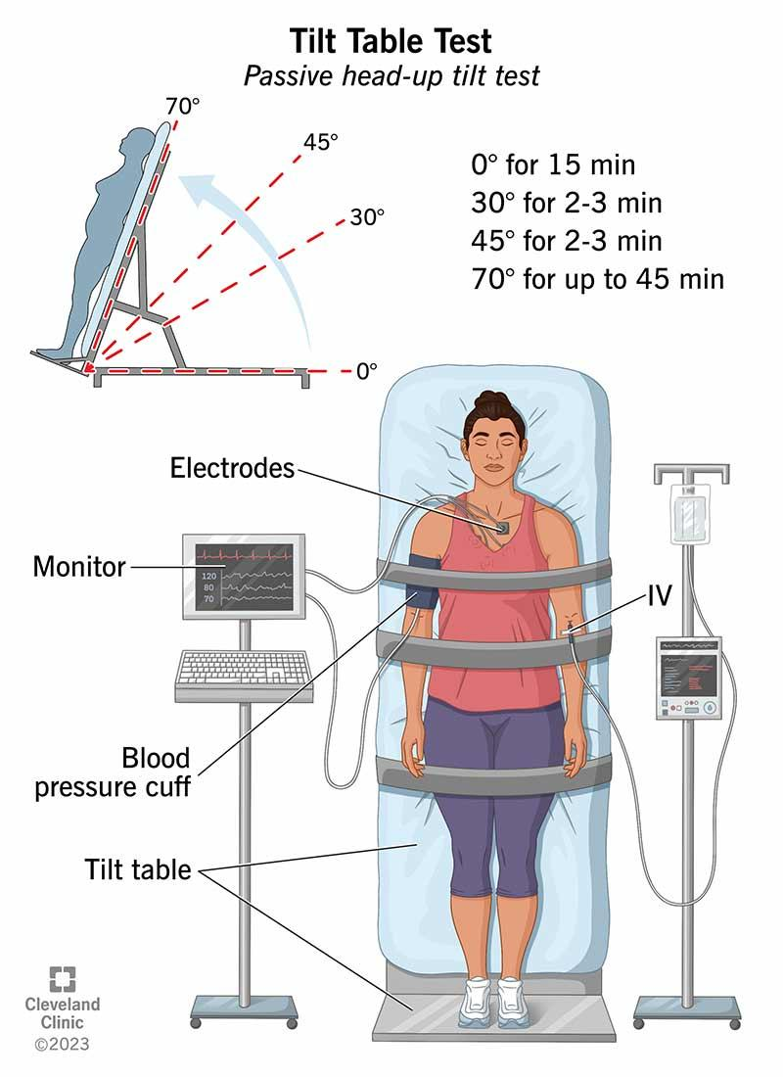
POTS
Tilt table testing can be used for diagnosis.
A positive test will have the heart rate increase by about 10 bpm while the BP drops < 20/10 mmHg

Slide 15
POTS
An optimal treatment strategy has not yet been elucidated-
  Increase physical activity/ exercise
  Maintain good oral rehydration
  Midodrine: a selective alpha-1 agonist, causing vasoconstriction and a rise in BP
  Fludrocortisone: a mineralocorticoid
  Low dose BB- can prevent palpitations
Likely a combination.

Slide 16
Atrial Dysrhythmias
The major atrial dysrhythmias include atrial fibrillation, atrial flutter and multifocal atrial tachycardia.
Many times, atrial flutter and MAT management is similar to that of atrial fibrillation.
The risk factors, epidemiology and symptoms are also very similar.

Slide 17
Atrial Flutter
Atrial Flutter Characteristics
  Rapid, regular narrow complex tachycardia
  Common AV Block Ratios:
    2:1 block: Ventricular rate of 150 bpm
    3:1 block: Ventricular rate of 100 bpm
Atrial depolarizations have:
    A single morphology with downward deflection in a ”sawtooth" pattern.
    Best Seen: In inferior leads and V1

Slide 18
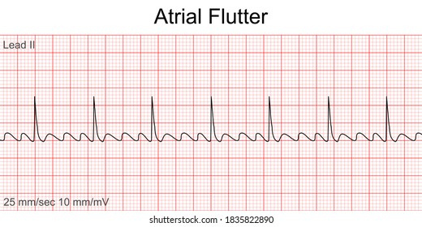
Atrial Flutter
Atrial Flutter Characteristics
  Rapid, regular narrow complex tachycardia
  Common AV Block Ratios:
    2:1 block: Ventricular rate of 150 bpm
    3:1 block: Ventricular rate of 100 bpm
Atrial depolarizations have:
    A single morphology with downward deflection in a ”sawtooth" pattern.
    Best Seen: In inferior leads and V1

Slide 19
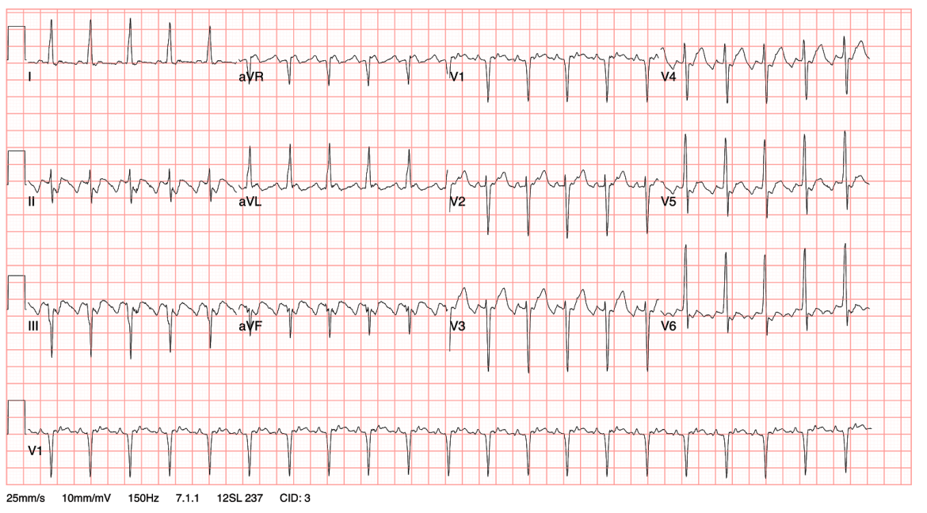
Atrial Flutter with 2:1 Conduction
Most often caused by a re-entry circuit in the right atrium (typically along the tricuspid annulus) with passive activation of the left atrium.

Slide 20
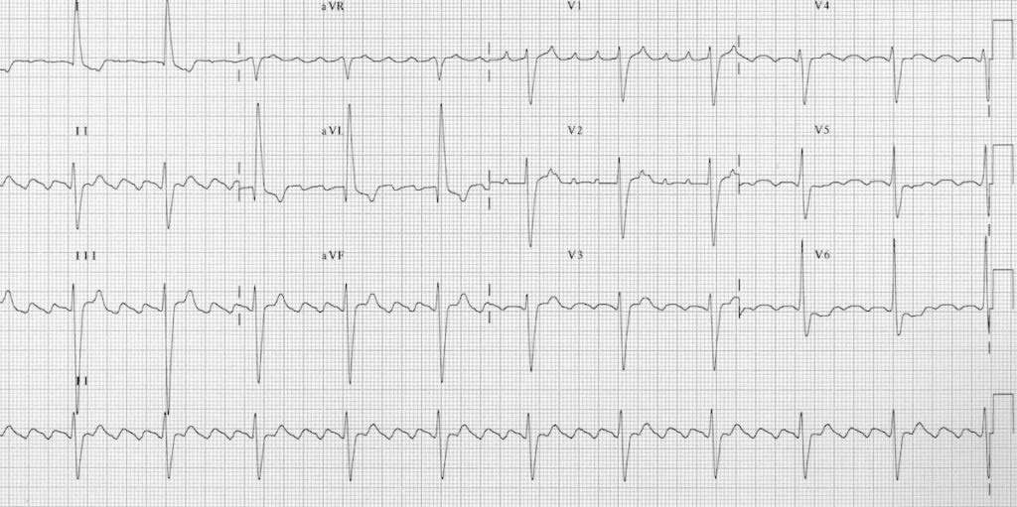
Atrial Flutter with 4:1 Conduction

Slide 21
Multifocal Atrial Tachycardia (MAT)
A supraventricular tachycardia with rapid, irregular atrial rhythm caused by firing of multiple ectopic foci.
  Characteristics of MAT
    Tachycardia, HR >100 bpm
    3 or more distinct P-wave morphologies
    Most often seen in elderly patients
    Frequently associated with COPD
    Treated with AV nodal blocking agents.
    Cardioversion and RFCA have no effect.

Slide 22
Marty is a 90-year-old man who is still going strong. He likes to golf, and frequently enjoys going out for drinks and dinner with his 70-year- old wife. He’s “never been sick a day in his life!”
Today Marty comes into your office c/o an early morning episode of left-hand numbness. It lasted about 10 minutes, then resolved spontaneously.
On PE, you note that Marty’s pulse is about 80 and irregular, his BP is 104/55. His lungs are clear and his heart is irregularly irregular, but without M/R/G.

Slide 23
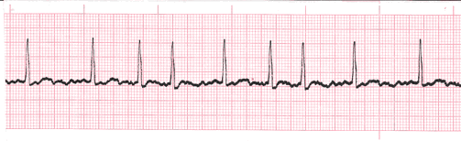
His rhythm strip:

Slide 24
EKG Features of Atrial Fibrillation
Rhythm: "Irregularly irregular”
P Waves are absent, and the rhythm has a flat or chaotic isoelectric baseline.
QRS Complexes: Narrow, unless the patient has a bundle branch block or preexcitation syndrome.
The heart rate is variable. RVR will be a rate of greater than 100, we treat to control the rate when above 110 bpm.

Slide 25
Risk Factors for Atrial Dysrhythmia Development
Increasing age- especially above 70
Valvular heart disease- especially the mitral valve
Dilated cardiomyopathy
Arteriosclerotic heart disease (CAD)
Genetics
Pulmonary disease (COPD)
Severe anemia
Hypertension
Diabetes
Chronic kidney disease
Obesity

Slide 26
Triggering Factors for Atrial Dysrhythmia Development
Thyrotoxicosis
EtOH intake/ withdrawal
Surgery, particularly heart/ lung surgery
Pericarditis
Chest trauma
Excessive caffeine
Hypoxia
Medications: theophylline, beta agonists (Albuterol)

Slide 27
Epidemiology of AF
AF affects 4.48% of the US population and rates are increasing! It is the most common arrhythmia
AF prevalence increases with age: 12% of people older than 80 years.
AF is more prevalent in women than men, but men are more likely to develop atrial fibrillation.
Atrial fib is also more common in persons of European descent than in Blacks.

Slide 28
Pathophysiology of AF
The mechanism by which other CV risk factors cause an increased risk of AF is poorly understood.
  Catecholamine excess, insulin resistance, atrial ischemia/inflammation, hemodynamic stress
Many theories of AF initiation/ propagation exist, and the research is not yet clear.
What we do know is that AF requires a trigger and a permissive atrial substrate- atrial tissue that will “let it happen”.

Slide 29
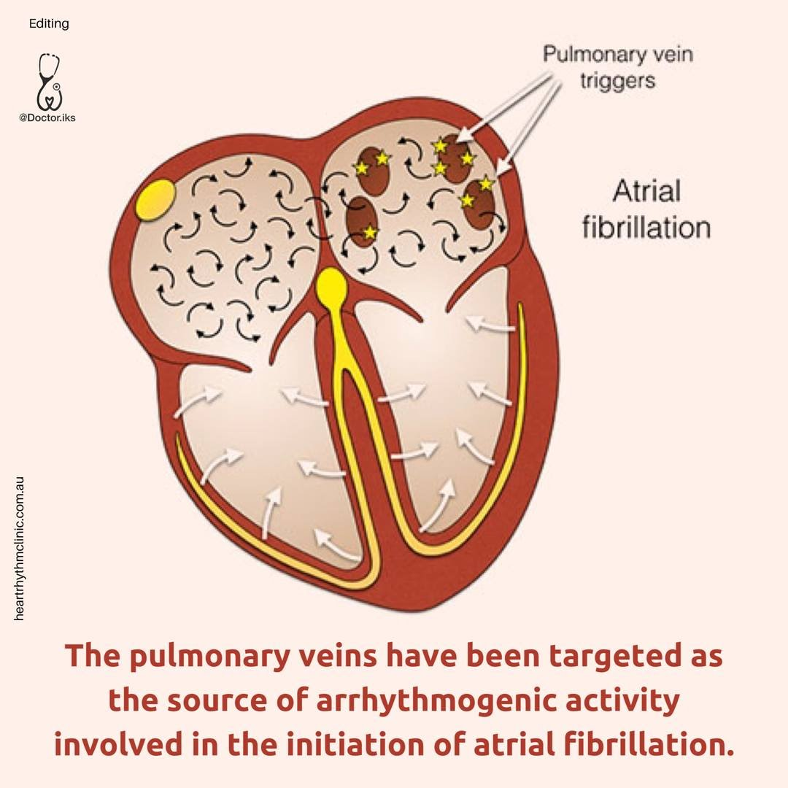
Pathophysiology of AF
Atrial fibrillation often originates from the pulmonary veins in the left atrium, specifically from sleeves of arrhythmogenic atrial tissue extending into the pulmonary veins.
Notes:
Patients with atrial fibrillation have more muscle sleeves extending into the pulmonary veins.

Slide 30
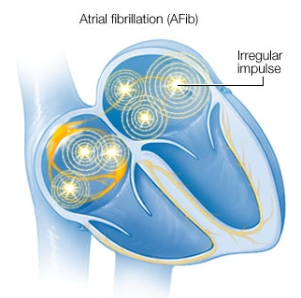
Pathophysiology of AF
As these foci within the left atrium fire, multiple small areas of atrium are depolarized.
The atria are essentially quivering, with no effective contraction and the “atrial kick” is lost.
Notes:
Graphic from the Mayo Foundation for Medical Education and Research

Slide 31
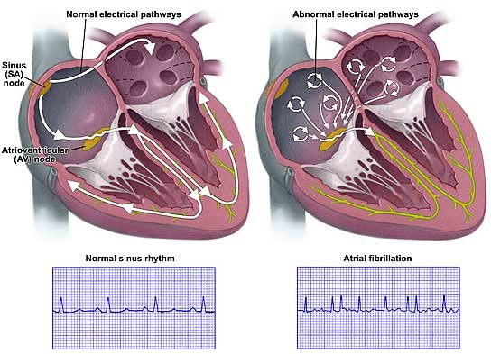
The atria fail to contract in a coordinated fashion, and electricity is conducted irregularly through the AV node.
Notes:
Graphic from the Mayo Foundation for Medical Education and Research

Slide 32
Pathophysiology of AF
In atrial fibrillation, the AV node is frequently bombarded with up to 400 impulses/minute and therefore conducts electrical impulses irregularly and rapidly to the ventricles.
Because conduction follows the normal conduction system pathways, the QRS duration remains normal.
    Except in cases of aberrant conduction when the ventricular system is diseased, like in a BBB.

Slide 33
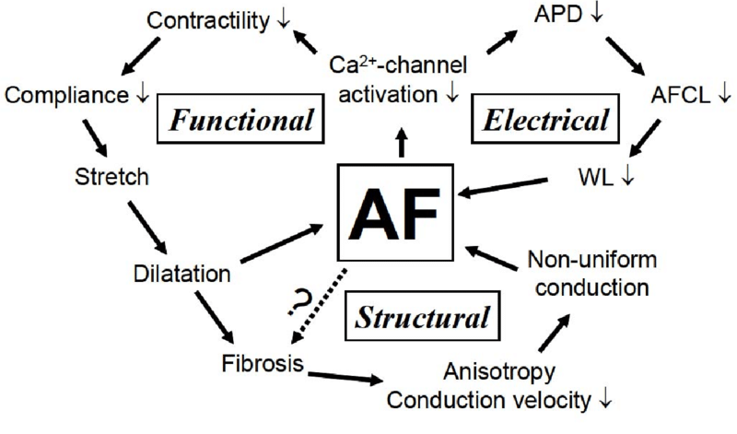
Pathophysiology of AF
If AF is triggered and continues, there is electrical and structural remodeling of the atria which promotes the continuation of atrial fibrillation.
Thus, atrial fibrillation is a self promoting process.

Slide 34
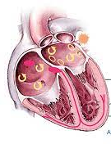
Classification of AF
Atrial fibrillation can be triggered by a variety of correctable or temporary causes therefore, if a patient has this type is classified separately.
    For example: post-operative atrial fibrillation or trauma-induced atrial fibrillation

Slide 35
Classification of AF
Atrial fibrillation that is unrelated to a correctable cause can be classified as:
Paroxysmal atrial fibrillation: AF that is self-terminating or intermittent lasting less than 7 days, often lasting less than 24 hours. This is abbreviated pAF.
Persistent AF: if AF fails to self terminate within 7 days. Persistent AF requires pharmacologic or electrical cardioversion.
Notes:
A patient who met the criteria for persistent atrial fibrillation but becomes paroxysmal with medication will still be classified as persistent since the outcomes are similar to persistent.

Slide 36

Classification of AF
Long-standing persistent AF fails to terminate on its own by 1 year.
Permanent AF: atrial fibrillation that lasts > 1 year and is accepted- no further treatments are attempted to restore or maintain normal sinus rhythm.
Lone AF: atrial fibrillation of any type in young individuals (under 60 years of age) in the absence of any structural heart disease or risk factors.

Slide 37
Classification of AF- Lone AF
Lone AF usually occurs in young male patients and may be associated with a specific trigger.
Greater than one third of persons with lone AF have a family history of atrial fibrillation, which suggests an inherited component.
  These patients may have more muscle sleeves and a greater number of arrhythmogenic foci in the pulmonary veins.
  There may be other physiologic predisposing factors which have yet to be discovered.

Slide 38
Clinical Presentation of Atrial Dysrhythmias
Minimal symptoms are common in older or inactive individuals if AF is rate controlled.
Common Symptoms:
  Palpitations
  Fatigue
  Weakness
  Dizziness/ lightheadedness
  Reduced exercise capacity
  Dyspnea

Slide 39
Clinical Presentation of Atrial Dysrhythmias
Severe Symptoms
  Dyspnea at rest
  Angina
  Presyncope, rarely, patients can syncopize
Potential Complications:
  Embolic event
  Heart failure (pulmonary edema, peripheral edema, weight gain, ascites)

Slide 40
Clinical Presentation of Atrial Dysrhythmias
Persons presenting with atrial dysrhythmias may range from asymptomatic to abrupt onset of heart failure symptoms. What are the primary drivers that determine symptom severity?
Most commonly, patients with atrial dysrhythmias complain of fatigue, exertional dyspnea (DOE) and decreased endurance.

Slide 41
Making the Diagnosis
The diagnosis may be suspected on clinical grounds but is made by seeing atrial fibrillation or flutter on the 12-lead EKG.
The 12-lead EKG evaluates for the presence of atrial fibrillation/flutter, as well as;
  LVH
  Evidence of prior MI
  Conduction system disease
  Establishes a baseline QTc interval

Slide 42
Additional Diagnostic Testing in AF
TSH and free T4 to evaluate for thyrotoxicosis.
Baseline CBC, renal function, glucose level and a UA to evaluate for proteinuria.
Consider pulmonary embolus in a patient with persistent rapid AF resistant to meds. What study?
Consider stress testing/LHC in patients who report symptoms of ischemic heart disease/ CAD.

Slide 43
Further Diagnostic Work-up
All patients with new onset AF should undergo a transthoracic echocardiogram at the time of diagnosis, looking for valvular disease, atrial size, LVH, systolic and diastolic function.
What important finding in AF is a TTE unable to definitively exclude?
Serial HS troponins q6 hours x 3 sets and a BNP (brain natriuretic peptide) are also ordered.

Slide 44
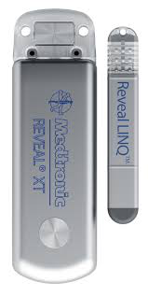
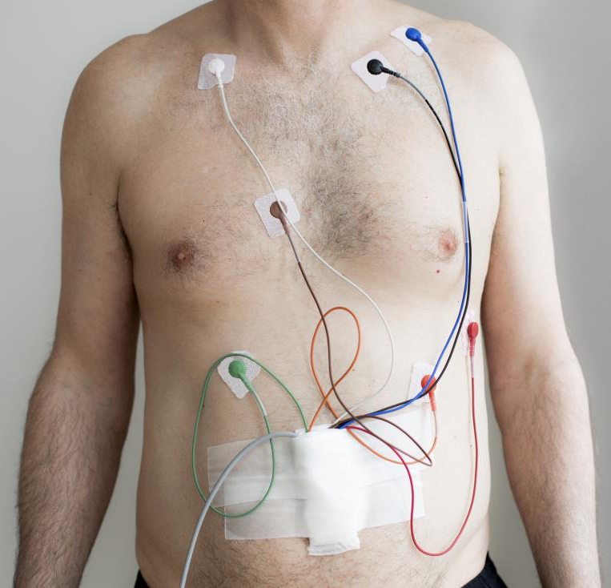
Additional Diagnostic Testing When
AF is Suspected, but Hasn’t Been Captured on an EKG
Holter monitoring or event device implantation may establish the diagnosis of pAF in a patient with suspected AF and normal EKGs.

Slide 45
Review Please!
Atrial fibrillation is diagnosed on a 12-lead EKG.
ER evaluation is the 12-lead, a CBC and chemistry panel, and HS troponin. What contributors to AF do each of these test for?
Further inpatient work-up is some additional HS troponin, thyroid function testing and the echocardiogram.
Both settings need to consider PE as a cause.

Slide 46
Immediate Management of AF: Unstable Patient
What qualifies a patient as unstable?
Immediate synchronized cardioversion, 150-200 J
If cardioversion is unsuccessful, load the patient with medications, and if the patient still remains unstable, repeat cardioversion.

Slide 47
Immediate Management of AF:
The Stable Patient
Consider hospitalization, telemetry admission
Who needs hospitalization?
  Not all patients with atrial fibrillation need to be hospitalized.
  If a patient has known paroxysmal atrial fibrillation and good cardiology follow-up, it is reasonable to adjust medications in the ER and have them follow-up as an outpatient with their cardiologist.

Slide 48
Immediate Management of AF:
The Stable Patient
Consider hospitalization, telemetry admission
Who needs hospitalization?
  However, any new onset patient will benefit from a 23-hour admission to work-up for possible etiologies and establish a treatment plan.
  Any atrial fibrillation patient with evidence of complications (like pulmonary edema) also needs to be admitted to evaluate these.

Slide 49
Immediate Management of AF: Stable Pt
2. Rate control if RVR: there are several choices.
Cardizem 10- 20 mg IV bolus, followed by a titrated IV drip for a HR < 100. DOC for most, can also be given without the bolus if the BP is soft.
Metoprolol IV boluses- drug of choice for cardiac ischemia/ infarction or in a patient with CAD
  Amiodarone IV drip- potential for cardioversion
  Digoxin IV bolus, infrequently used, not as effective

Slide 50
Management of AF: Stable Pt
3. Begin the evaluation for reversible etiologies
  Chemistry panel
  CBC
  TSH and free T4
  HS troponin q6 x 3
  Brain (or B-type) natriuretic peptide (BNP)
  Transthoracic 2D echo

Slide 51
Management of AF: Stable Pt
4. Anti-coagulate if appropriate. Is more important if the AF has been present > 48 hours.
Patients can either be placed on:
Therapeutic Lovenox (enoxaparin) 1 mg/kg SQ twice daily.
Heparin gtt, titrated to aPTT or anti-Xa levels
Direct oral anticoagulant- apixaban (Eliquis), rivaroxaban (Xarelto) or dabigatran (Pradaxa).

Slide 52
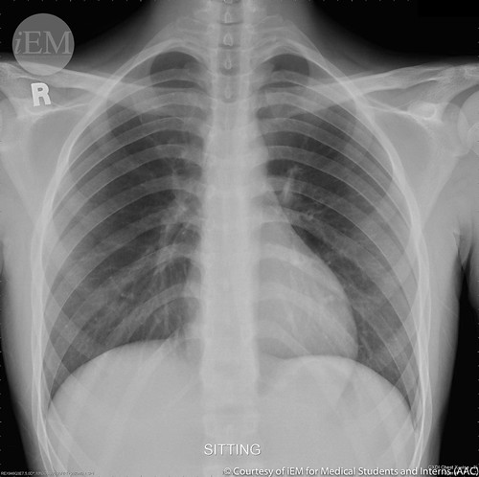
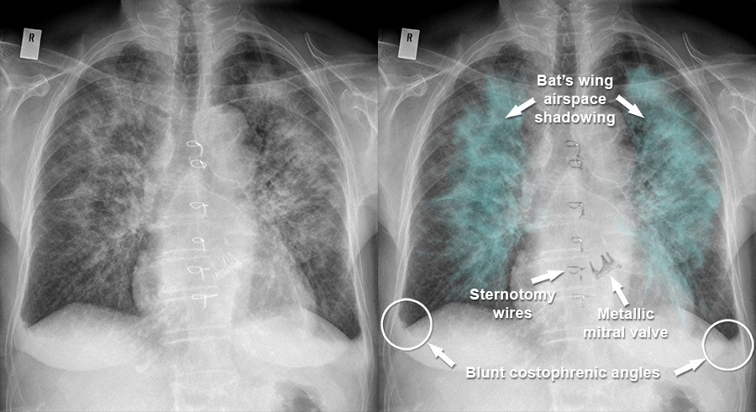
Treatment of AF Complications
Most symptoms of atrial fibrillation are related to a rapid ventricular response.
Sometimes a rapid ventricular response will cause a patient to develop pulmonary edema.

Slide 53
Treatment of AF Complications
What is the pathophysiology of pulmonary edema in AF RVR and what treatment will be needed?

Slide 54
Inpatient Treatment of New Onset AF
When treating a patient with new onset AF who doesn’t convert spontaneously, two important questions must be answered during the hospital stay:
How will we manage the atrial fibrillation? Rhythm control vs rate control strategy.
What is the embolization risk and what will be done to minimize it?

Slide 55
Long Term Management of New Onset AF
The rate control strategy uses medications to control the person’s resting heart rate to an optimal 80 bpm.
This strategy is generally recommended for frail persons 80 and older, since rate controlling meds have fewer drug-drug interactions and side effects than antiarrhythmics.
Medications used are those that block the AV node: BB or non-DHP CCB are first line for this.

Slide 56
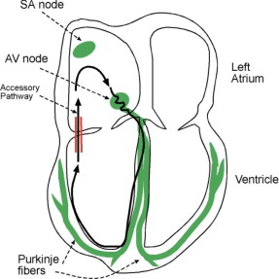
Rate Control of AF
Patients with acutely decompensated systolic heart failure, who cannot tolerate these first line agents, may be treated with amiodarone or digoxin initially.
  Caution because amiodarone promotes cardioversion.
In addition, before using a BB or CCB, a clinician MUST exclude the presence of a pre-excitation syndrome in AF! If we block down the AV node, we will promote tachyarrhythmias via an accessory pathway.

Slide 57
Treatment of New Onset AF
The rhythm control strategy attempts to convert AF to NSR and uses antiarrhythmic medications to keep the patient in NSR.
Initially, cardioversion is used in an attempt to re-establish normal sinus rhythm.
Ideally, a patient is loaded with an antiarrhythmic medication and taken to the cardiac lab for cardioversion under controlled circumstances.

Slide 58
Cardioversion Procedure
Electrolytes (especially K) and O₂ sats are normalized, and the pt is npo for at least 6 hours.
If the patient is on an antiarrhythmic, this is at therapeutic levels.
Conscious sedation is used while vitals, O₂ sat and capnography are monitored.
An electrical shock using 120-200j is delivered from a biphasic defibrillator. (preferred)

Slide 59
Cardioversion Procedure
How does this happen for a patient?
  The patient is admitted to IM and a cardiology consult is placed. The patient is kept npo at midnight.
    Rate control and AC if appropriate.
  The cardiology service evaluates the patient to determine if they are an appropriate candidate to undergo a cardioversion.

Slide 60
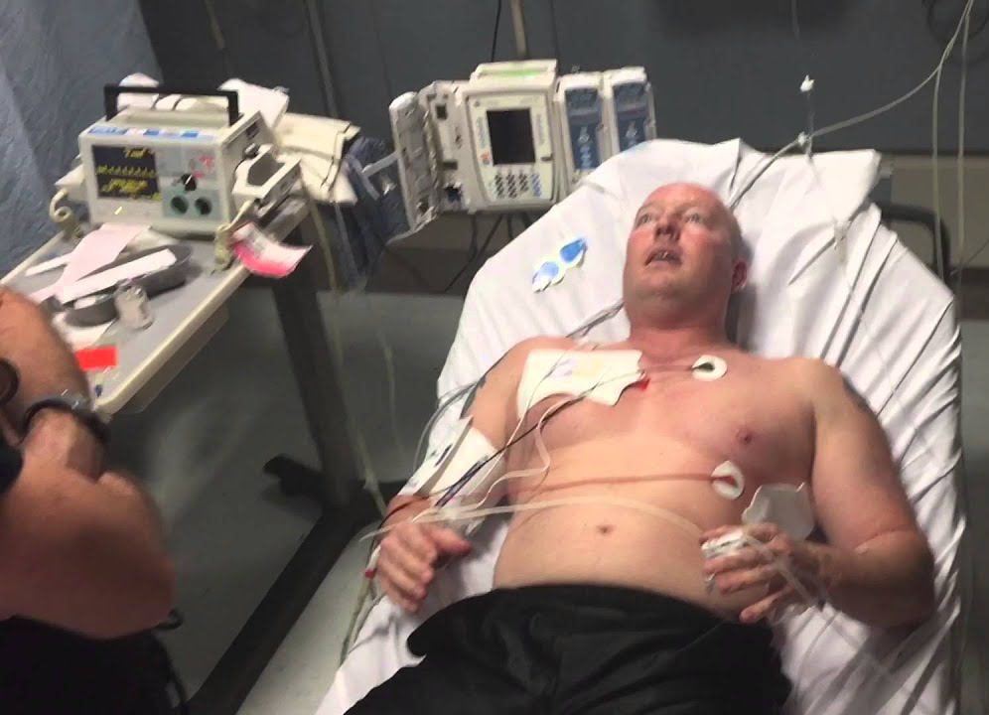
Cardioversion Procedure
If the cardiologist and the patient agree to move forward, the patient is taken to the cardiac lab under controlled conditions for a TEE and if no LA thrombus is seen, a cardioversion.
The patient is then maintained on antiarrhythmic medications for rhythm control, such as sotalol, amiodarone or dronedarone.

Slide 61
To Shock or Not To Shock:
New Onset AF
Cardioversion is highly recommended in most younger patients with new onset AF of short duration- success rate is 90%
In most patients, ventricular function improves almost immediately after cardioversion, but atrial function takes longer to recover.
Anticoagulation is continued after cardioversion, and the patient follows up with cardiology as an outpatient.

Slide 62
Rhythm vs Rate Control
Although antiarrhythmics have multiple DDI and side effects, at this point, most persons with new onset atrial fibrillation undergo treatments to try to re-establish NSR.
There is done to avoid the cardiomyopathies caused by the remodeling of atrial fibrillation.
Only in very frail, elderly persons is a rate control strategy pursued for new-onset atrial fibrillation.

Slide 63
Why Do We Restore NSR
AF is an independent predictor of CV mortality.
Restoration of NSR improves cardiac hemodynamics and exercise tolerance- patients can exercise.
Maintaining the atrial kick improves the signs and symptoms of HF and overall quality of life.
Persistent AF contributes to pathologic atrial and ventricular remodeling, so restoration of NSR can slow or, in some cases, reverse atrial dilatation and LV dysfunction.

Slide 64
Vaughn-Williams Classification of Antiarrhythmics
Class of Antiarrhythmics | Mechanism of Action
IA | Sodium channel blocker (Intermediate duration) Procainamide
IB | Sodium channel blocker (Short duration) Lidocaine
IC | Sodium/potassium channel blockers (Long duration) Flecainide, Propafenone (Rhythmol)
II | Beta blockers Nonselective: Carvedilol, sotalol Selective: Metoprolol, bisprolol
III | Potassium channel blocker Amiodarone (Pacerone), Dofetilide (Tikosyn), Dronedarone (Multaq), Sotalol (Betapace)
IV | Calcium channel blockers Diltiazem (Cardizem), Verapamil (Calan)

Slide 65
Rhythm Control: Antiarrhythmics
Class IC antiarrhythmics: propafenone and flecanide.
These drugs are indicated for patients with AF and supraventricular tachycardia in persons without structural heart disease.
  Generally, not used in patients with concomitant LV dysfunction and/or CAD.
Sometimes used as a “pill in the pocket”- the patient takes the med for a few days when they have atrial fibrillation symptoms.

Slide 66
Rhythm Control: Anti-Arrhythmics
Class III antiarrhythmic agents: this class includes amiodarone, sotalol and dofetilide.
These drugs are used for maintenance of sinus rhythm following cardioversion for atrial fibrillation and for other atrial dysrhythmias.
All have associated QT interval prolongation and the potential for torsade de pointes- monitor the QTc, potassium and magnesium!

Slide 67
Rhythm Control: Anti-Arrhythmics
Amiodarone (Pacerone, Cordarone)
Amiodarone is considered safer in persistent AF compared to other antiarrhythmic drugs.
In patients with cardiac disease such as CAD or systolic or diastolic heart failure, amiodarone becomes the drug of choice because of its has less pro-arrhythmic effects compared with other antiarrhythmic drugs.

Slide 68
Rhythm Control: Amiodarone
Amiodarone was found to be more effective than other antiarrhythmics in the treatment of persistent atrial fibrillation.
Intolerable ADRs are common with amiodarone
  Thyroid abnormalities: hypothyroid and hyperthyroid
  Lung fibrosis
  Liver damage/ cirrhosis
  Neuropathy, gait ataxia
  Skin discoloration and corneal deposits

Slide 69
Rhythm Control: Sotalol (Betapace)
The proarrhythmic effect of sotalol is increased in patients with HF, so Sotalol is generally contraindicated in HF patients or persons with a prolonged QT interval.
Hypokalemia should be corrected and potassium monitored during administration of sotalol because it may exacerbate QT prolongation.
Sotalol can be used in persons with coronary artery disease.

Slide 70
Rhythm Control: Dofetilide (Tikosyn)
The FDA mandates inpatient cardiac monitoring for dofetilide initiation-so patients need to be hospitalized for 3 days while starting or resuming dofetilide, if more than 2 doses are missed.
  Even when reloaded with the same dose they had previously tolerated, a significant number of persons were unable to tolerate the same dose due to QT prolongation.
Dofetilide must be given at the same time twice daily and has many drug drug interactions.

Slide 71
Rhythm Control: Dofetilide (Tikosyn)
Dofetilide is indicated for maintenance of sinus rhythm, and for conversion of AF to sinus rhythm (~50%) in patients with persistent atrial fib.
Dofetilide has no effect on cardiac output, cardiac index, stroke volume index, or systemic vascular resistance in patients with V tach, mild to moderate HF, angina, and either normal or reduced LVEF- making dofetilide a fairly safe antiarrhythmic in persons with HFrEF and CAD.

Slide 72
Rhythm Control: Dronedarone (Multaq):
Dronedarone (Multaq) is a miscellaneous agent, having properties of all 4 anti-arrhythmic classes.
Dronedarone is for patients with paroxysmal AF or after conversion of persistent AF in order to maintain sinus rhythm.
Dronedarone can be used in persons who have risk factors for CAD.

Slide 73
Rhythm Control: Dronedarone (Multaq):
Contraindications to dronedarone are:
  Permanent atrial fibrillation: studies found increased mortality in persons with permanent atrial fibrillation
  Heart failure: persons taking dronedarone had a 2-fold increase in the risk of death, stroke and hospitalization for HF.

Slide 74
Common DDI’s of Antiarrhythmics
There are several commonly used drugs that have significant interactions with the antiarrhythmics:
  Other antiarrhythmics: these drugs must be washed out then a new one loaded
  Haldol, Seroquel and other antipsychotics
  Zofran and for some phenergan
  Macrolide antibiotics: azithromycin, clarithro
  Quinolone antibiotics: cipro, levaquin
  Azole antifungals
  HAART for HIV

Slide 75
Long-Term Treatment of AF
A patient who is successfully cardioverted and remains in NSR must still be prescribed AC or ASA if indicated, because they may relapse at any time.
Cardioversion may be used multiple times over several years for a patient with a history of atrial fibrillation who relapses.
Cardiology will frequently adjust the antiarrhythmic regimen before repeating the cardioversion.

Slide 76
Other Options for Rhythm Control
If a patient has had multiple cardioversions which have failed or they continue to relapse despite compliance with multiple antiarrhythmics, then they may be candidates for additional treatments to maintain sinus rhythm.
These include:
  Catheter ablation: done when patients are failing cardioversion after multiple attempts.
  Maze procedure: done when the patient is having cardiac surgery for another reason.

Slide 77

Rhythm Control in AF
Radiofrequency catheter ablation of the left atrium may be done to electrically isolate the pulmonary veins from the rest of the heart.

Slide 78
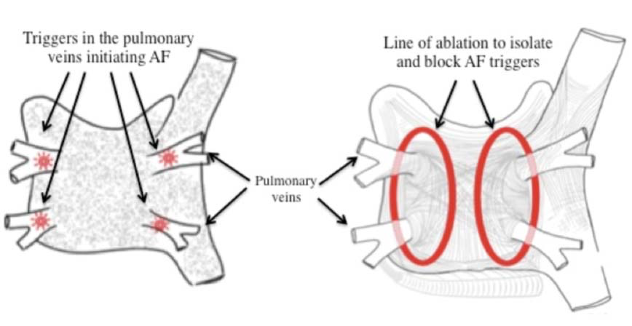
Pathophysiology of AF
Atrial fibrillation often originates from the pulmonary veins in the left atrium, specifically from sleeves of arrhythmogenic atrial tissue
extending into the pulmonary veins.

Slide 79
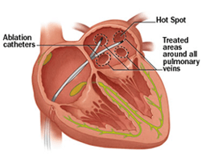
Radiofrequency Catheter Ablation
This procedure isolates the arrhythmogenic tissue of the pulmonary veins so that it cannot affect the remainder of the atrial tissue.
Catheter ablation is a prolonged procedure and invasive, therefore patients must fail more conservative therapy first.

Slide 80
Rhythm Control: Catheter Ablation
Radiofrequency catheter ablation is indicated in:
  Lifestyle-impairing atrial fibrillation and
  Inefficacy/ intolerability of at least one antiarrhythmic agent.
RF catheter ablation is not always a cure the first time it is tried, but it has been shown to be more effective than antiarrhythmics.
    60% success with one ablation, up to 80% with multiple ablations.

Slide 81
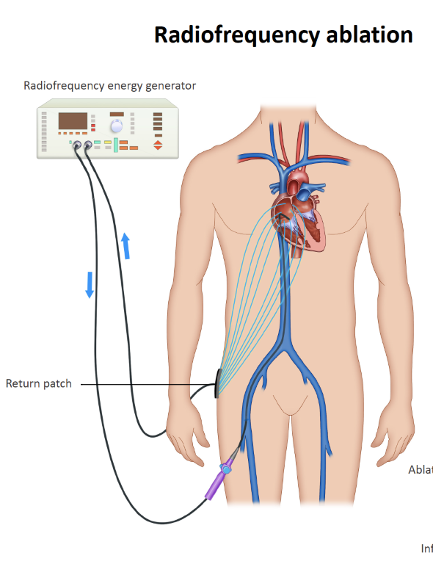
RF Catheter Ablation
Radiofrequency catheter ablation has the BEST success when performed with short duration AF.
How RF ablation is done:
The femoral vein is entered with a sheath and a catheter is deployed up to the right atrium using fluoroscopic guidance.

Slide 82
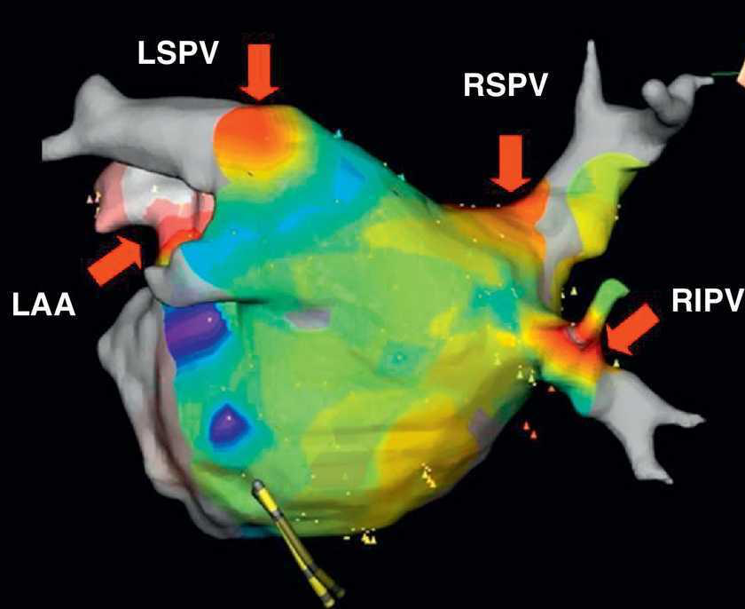
Catheter Ablation
Going through the intra-atrial septum, the electrophysiologist creates a three-dimensional map of the electrical currents in the left atrium using an electromagnetic probe.

Slide 83
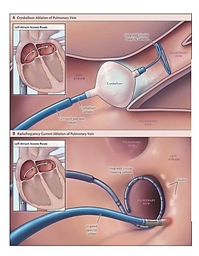
Catheter Ablation- The Procedure
The electrophysiologist then burns small lesions into the atrial tissue to isolate the pulmonary veins from the rest of the atria.
Colchicine, ACE inhibitors, statins all may decrease AF recurrence after ablation and are under investigation.

Slide 84
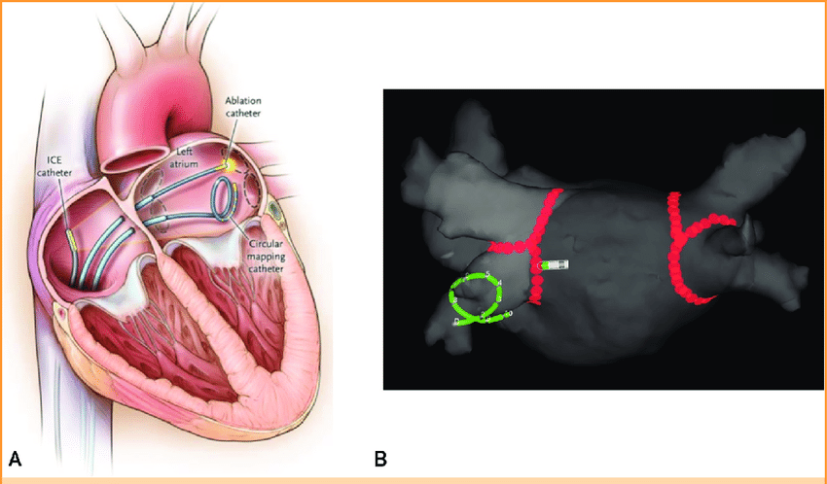
Rhythm Control in AF

Slide 85
Rhythm Control: Catheter Ablation
Complications of ablation include cardiac perforation, tamponade, atrial flutter, vascular access complications from the venous puncture.
HS troponin will elevate because of the procedure.
At this time, there is NO mortality benefit to ablation and NO change in anticoagulation strategy. (RFCA is not done to “get off anticoagulation”)

Slide 86
Rhythm Control in AF
A Cox-Maze procedure may be done at the time of a cardiac surgery that is being done for other reasons, such as a valve replacement or a CABG.
In the procedure, the atria are surgically cut and repaired. The scar tissue that forms is electrically neutral, creating a limit to the spread of arrhythmogenic impulses from the pulmonary veins.
The sinus node takes over pacing again.

Slide 87
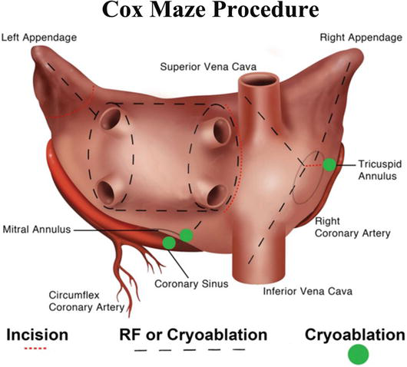
Many patterns, one principle.
Many iterations of the Cox-Maze procedure exist.

Slide 88
Difficult Atrial Fibrillation
Sometimes a patient is not a candidate for one of the rhythm control strategies and either has episodes of tachycardia and bradycardia- likely due to underlying sick-sinus syndrome or has a low blood pressure at baseline.
These patients are very difficult to manage, because they cannot tolerate rate control medications-beta blockers or calcium channel blockers and may intermittently have atrial fibrillation with RVR.

Slide 89
Difficult Atrial Fibrillation
If a patient cannot tolerate medications to block down their AV node because of hypotension or bradycardia, then the best solution is an AV node ablation and placement of a permanent pacemaker.
If this is done, the cardiologist does a much shorter procedure to ablate the AV node. Now the atria and ventricles are electrically isolated from each other.

Slide 90
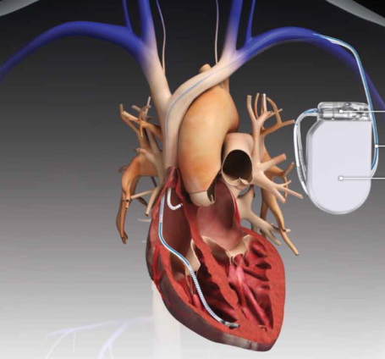
Difficult Atrial Fibrillation
The patient loses their atrial kick, but the atria can no longer cause a rapid ventricular response because impulses cannot get through.
The patient is permanently paced.
And they will still require anticoagulation because the atria are still fibrillating.

Slide 91
Let’s Summarize- Rate or Rhythm Control
Frail, elderly patients with limited activity at baseline are best suited to rate control when they develop atrial fibrillation.
We make no effort to restore the patient to NSR but place them on a medication to prevent AF RVR- usually a BB or non-DHP CCB.
Granny is a 90-year-old woman who lives with 3 of her children. She walks with a walker in the home and folds laundry. She has CLL and is legally blind.

Slide 92
Let’s Summarize- Rate or Rhythm Control
Most patients, especially younger age or those that are symptomatic with loss of the atrial kick, are best suited to a rhythm control strategy to maintain NSR.
First line, non-invasive option: Cardioversion with antiarrhythmic, may be done repeatedly.
Invasive options used after non-invasive options have failed: radiofrequency catheter ablation or Maze procedure (if an opportunity exists)

Slide 93
Let’s Summarize- Rate or Rhythm Control
Arnold is a 55-year-old man who presents with AF RVR after a 3-day alcohol binge following the death of his sister.
He has no cardiac history and is healthy but remains in AF despite initiation of a diltiazem drip in the ER on HD #1.
HD #2- cards consult, optimize electrolytes, begin an antiarrhythmic. TTE no valve dz, preserved EF.
HD #3- NPO MN, TEE and cardioversion
HD #4- discharge home on AC with outpt F/U

Slide 94
Let’s Summarize- Rate or Rhythm Control
1 month later- Arnold follows-up, doing well. No change in therapy.
1 year later, F/U visit, no AF symptoms at all. Cards stops AC, continue antiarrhythmic.
3 years later- palpitations and dyspnea- back in AF with a controlled rate at outpt appt. Resume AC, discontinue antiarrhythmic #1 and start BB or CCB, after washout begin antiarrhythmic #2 and schedule for elective cardioversion.

Slide 95
Let’s Summarize- Rate or Rhythm Control
2nd cardioversion only works for 2 months, and Arnold is back in AF, he has continued AC and antiarrhythmic since cardioversion but is symptomatic.
Cardiology could
Perform a 3rd cardioversion after switching to a 3rd antiarrhythmic like we did 3 months ago, but it is more likely that they will . . .
Recommend a RF catheter ablation procedure.

Slide 96
Let’s Summarize- Rate or Rhythm Control
Over time, patients may graduate from a rhythm control to a rate control strategy as their heart grows older/ degenerates and their AF recurs.
Patients who cannot be maintained in NSR despite multiple attempts but also have problems staying on rate control meds (BB, CCBs) due to bradycardia or hypotension, become candidates for AV node ablation and pacemaker implantation. The patient is then pacer dependent.

Slide 97
Let’s Summarize- Rate or Rhythm Control
Nan is a 70-year-old female who has been miserable with her AF over the last 3 years. She is symptomatic with palpitations but passes out easily with Lopressor or Cardizem at low doses. Digoxin has been ineffective.
Her cardiologist has tried to cardiovert her four times, but the meds haven’t been able to help her maintain NSR for more than 10 days.
Nan just wants to quit going into the hospital for this and live her life!

Slide 98
Let’s Summarize- Rate or Rhythm Control
The EP cardiologist schedules Nan for an AV node ablation and PPM.
The 2-hour procedure goes smoothly and Nan is able to discontinue all her cardiac meds except for her Xarelto.
Now she is back on the pickleball court and ready to kick some . . .

Slide 99
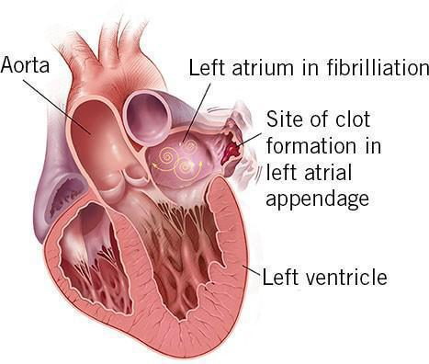
Second Issue in Atrial Fibrillation: Thrombus Formation
In atrial fibrillation, the atria are quivering, with little effective emptying of the atria occurring.
The blood becomes relatively static- especially in the left atrial appendage (LAA).

Slide 100
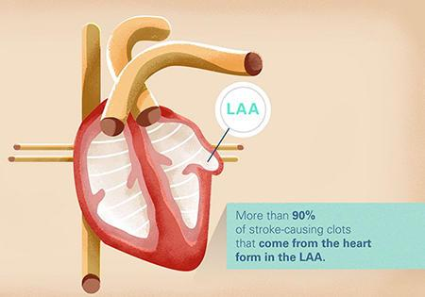
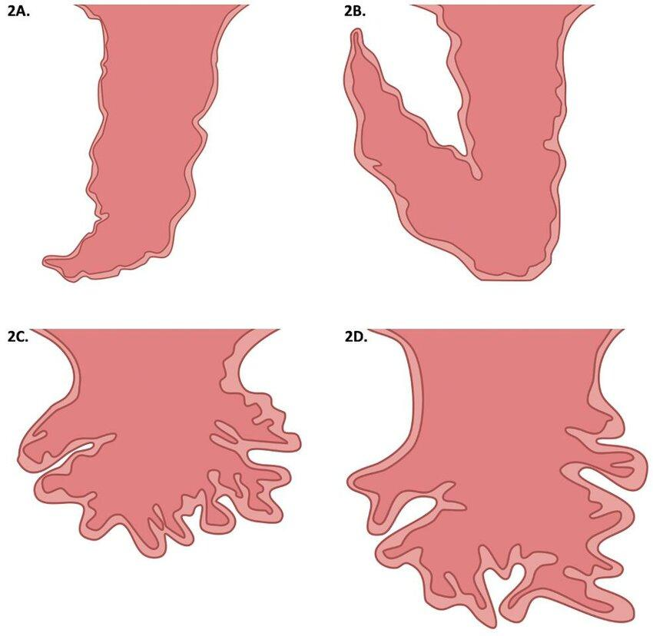
Left Atrial Appendage Morphologies
A: Windsock; B: Chicken wing; C: Cauliflower; D: Cactus
Chicken wing is 79% less likely than other morphologies to have a thromboembolic stroke

Slide 101
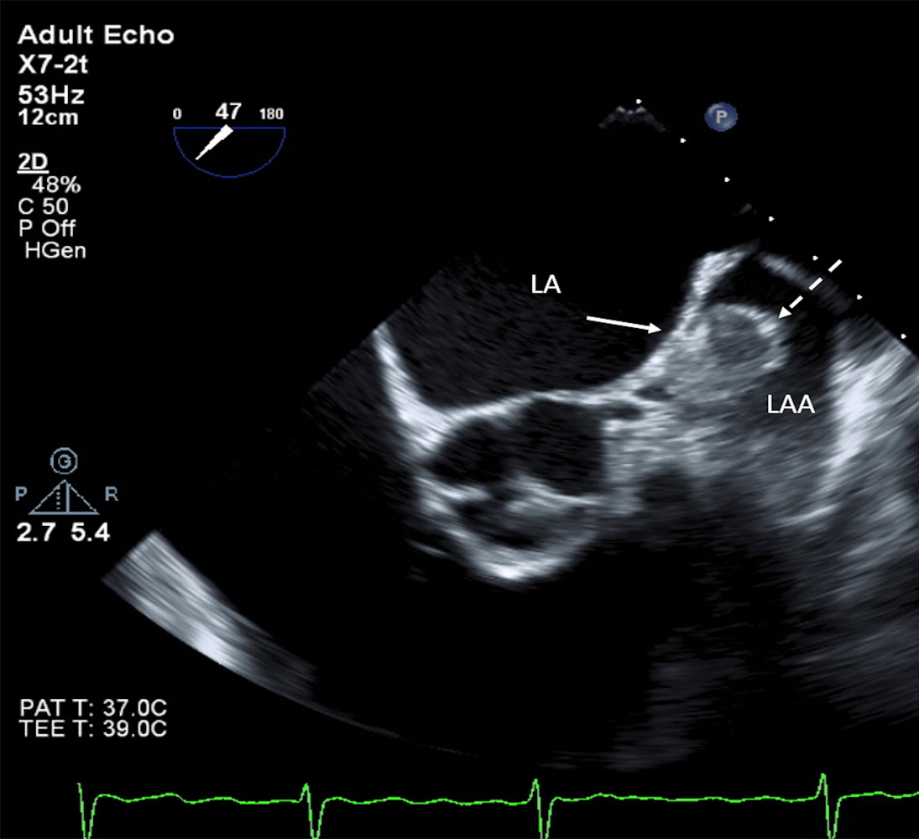
Second Issue in Atrial Fibrillation: Thrombus Formation
The development of thrombus within the left atrium is assumed to be present in AF that has been ongoing for 48 hours or more- even if it is paroxysmal.
Thrombi may occur earlier.

Slide 102
AF and Stroke Risk
20 % of all ischemic strokes in the US are believed to be caused by atrial fibrillation, >70,000 per year.
Patients with atrial fibrillation have 5 times the risk of stroke compared to persons in NSR.
Strokes attributable to atrial fibrillation are more likely to be larger and are more likely to undergo hemorrhagic conversion than strokes that are not attributable to AF.

Slide 103
AF and Stroke
The rate of embolic stroke is 5-6% per year in patients with AF and is > 10% per year if concomitant rheumatic valvular disease exists.
Stroke risk is higher in women compared to men with atrial fibrillation.
The rate of stroke is significantly increased with increasing age.
  7.3% in pts 60-69, but 30.8% in patients 80=89 years

Slide 104
AF and Stroke
The rate of stroke is no different in patients with paroxysmal or permanent atrial fibrillation
Therefore, any patient with persistent, paroxysmal or permanent AF should be on stroke prophylaxis, unless there is a direct contraindication to this prophylactic medication.
Each person is considered on an individual basis by calculating their CHADS₂-VASc score.

Slide 105
How Do Clinicians Prevent Stroke
Congestive heart failure/ LV dysfxn: 1 point
Hypertension (any hx): 1 point
Age ≥ 75: 1 point
Diabetes mellitus: 1 point
Secondary prevention of embolic events (ischemic stroke, TIA, others): 2 points
Vascular dz (MI, PAD, Aortic arteriosclerosis): 1 point
Age ≥ 65 years: 1 point (pts >75 now have 2 points for age)
Sex category (women): 1 point

Slide 106
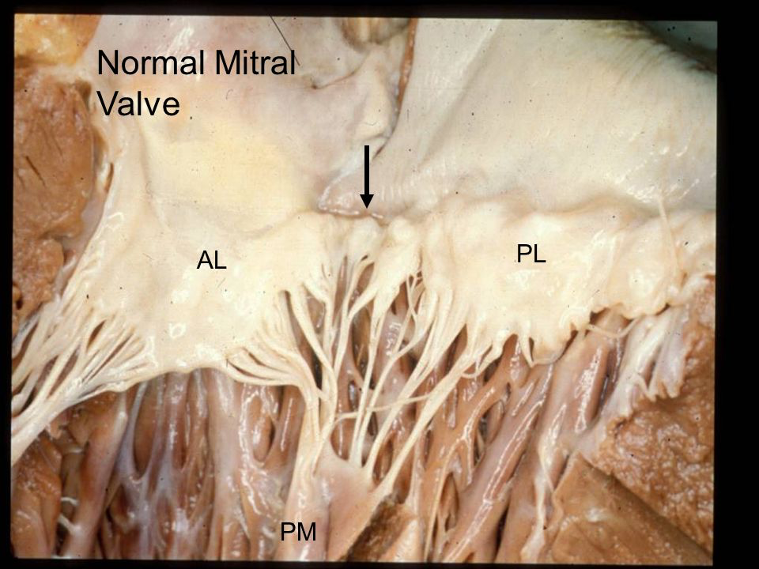
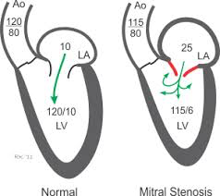
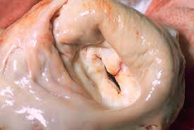
Valvular Atrial Fibrillation
These scoring systems were developed for NON-VALVULAR AF, and for atrial fib not associated with cardiac surgery.

Slide 107
How Do Clinicians Prevent Stroke?
For example, our 90-year-old patient, Marty, who has “never been sick a day in his life” - if he does have a transient ischemic attack which caused his numbness to his left hand, has a CHADS₂-VASc score of ____.

Slide 108
Total Score | CHADS₂-VASc risk of stroke
0 | 0.2%
1 | 0.6%
2 | 2.2%
3 | 3.2%
4 | 4.8%
5 | 7.2%
6 | 9.7%
7 | 11.2%
8 | 10.8%
9 | 12.2%
Congestive heart failure/ LV dysfxn
Hypertension (any hx)
Age ≥ 75
Diabetes mellitus
Secondary prevention of embolic events (ischemic stroke, TIA, others)
Vascular dz (MI, PAD, Aortic arteriosclerosis)
Age ≥ 65 years
Sex category (women)

Slide 109
How Do Clinicians Prevent Stroke?
CHADS₂VASc score of 0-1: treat with EC ASA alone 81-325 mg/day to prevent stroke
CHADS₂VASc score of 2: individualize ASA vs anticoagulation. (anticoagulation preferred)
CHADS₂VASc score 3 or more: anti-coagulate with warfarin or a DOAC (DOAC preferred)
What is the risk?

Slide 110
HAS-BLED: Assessing the Risk of Bleeding on Warfarin
Hypertension: SBP > 160 mmHg = 1 point
Abnormal renal and/ or liver function = 1 point for each
Stroke = 1 point
Prior major Bleeding history = 1 point
Labile INRs = 1 point
Elderly age (age > 65 years) = 1 point
Drugs (antiplatelet agents) and/ or heavy alcohol concomitantly = 1 point each

Slide 111
HAS-BLED: Risk of Bleeding on Warfarin
Major bleed= intracranial, hospitalization, Hgb decrease >2 gm or requiring transfusion
Risk Factors/ Score | Major Bleeds per 100 patient years
0 | 1.13%
1 | 1.02%
2 | 1.88%
3 | 3.74%
4 | 8.70%
5 | 12.5%
6 | ++++

Slide 112
How Do We Use These Scores?
HAS-BLED score > 3 indicates a “high risk” of bleeding.
  Use caution and regularly review indications for anticoagulation. Correct bleeding risks (for example: control HTN)
HAS-BLED score > CHADS₂VASc score?
  The risk of major bleeding may exceed the potential benefit of oral anticoagulation
These rules are not yet study proven!

Slide 113
Long Term Anticoagulation Agents
DOACs-direct oral anticoagulants: may be used in patients with non-valvular atrial fib only (no mitral valve disease)!
DOACs are also NOACs- novel oral anticoagulants
Apixaban (Eliquis) given 5 mg bid, is a factor Xa inhibitor
  Dose adjust to 2.5mg bid if 2 of 3 are present:
    SCr ≥1.5, age ≥80 years, weight ≤ 60kg
  Cautious but acceptable use in stage IV or V CKD (ESRD)

Slide 114
Long Term Anticoagulation Agents
2. Rivaroxaban (Xarelto) 20 mg once daily given with the largest meal of the day.
  Xarelto is a factor Xa inhibitor
  Dose adjust Xarelto in renal disease: GFR 15-50 mL/min use 15 mg qday
  All others DOACs we just avoid if the GFR ≤ 30

Slide 115
Long Term Anticoagulation Agents
NOACs/ DOACs: Novel/ direct oral anticoagulants:
Dabigatran (Pradaxa) 150 mg twice daily, a direct thrombin inhibitor, a reversal agent is available, but costly. May be used until stage IV CKD (avoid if GFR ≤ 30)
Edoxaban (Savaysa) 60 mg daily, factor Xa inhibitor, dose adjust to 30mg daily if GFR ≤ 50, cannot be used if GFR ≥ 95 or ≤ 30.

Slide 116
Long Term Anticoagulation Agents
All DOACs are considered superior to warfarin in the prevention of ischemic stroke, when persons have AF with a CHADS₂-VASc > 2. Why?
However, DOACs cannot be used in patients with
mechanical valves, significant native mitral valve disease or ESRD (Apixaban is okay)- warfarin is considered the drug of choice in these persons. Also, a caution in DOACs in persons with BMI> 40

Slide 117
Long Term Anticoagulation Agents
Warfarin/Coumadin (Jantoven): dose adjusted to maintain an INR of 2-3. How is this done?

Slide 118
Long Term Anticoagulation Agents
Warfarin/Coumadin (Jantoven)
Advantages:
Disadvantages:

Slide 119
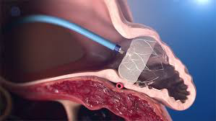
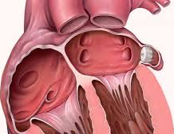
The Watchman Device
An umbrella like device that is deployed into the left atrial appendage.
Over 4-6 weeks, heart tissue grows over the device, completely sealing off the appendage

Slide 120
The Watchman Device
When do we use a Watchman?
  In patients with atrial fibrillation who have bleeding issues on anti-coagulation and have a high risk of strokes.
  Increasingly being used to take patients off their DOAC or warfarin.
Once deployed, patients will need to remain on anti-coagulation for 4-6 weeks while the device epithelializes and can then be taken off anticoagulation and maintained on ASA alone.

Slide 121
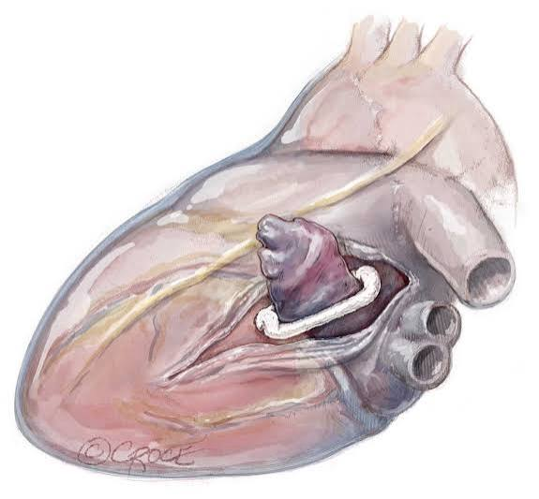
Reducing Thrombus Risk- LAA Clipping
Another option to reduce stroke risk in patients having cardiac surgery is to occlude the LAA with an external clip.
LAA clipping is only done if the person is having cardiac surgery for another reason.
Clipping eliminates the need for anticoagulation and allows a patient to be on antiplatelet therapy alone (low dose ASA) to prevent stroke.

Slide 122
I “know” when I go into atrial fibrillation . . .
The patient might think so, but in a continuous monitoring study:
  90% of pAF patients have recurrent AF
  Up to 90% of episodes are not recognized by the patient
  Asymptomatic episodes lasting > 48 hours occur in 17% of patients
  40% of patients reported AF-like symptoms but were actually in sinus rhythm at the time.

Slide 123
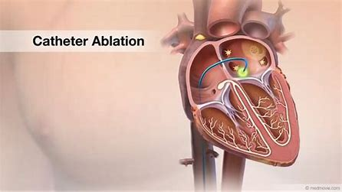
Atrial Flutter: Treatment
  Because atrial flutter is most often caused by an accessory tract near the tricuspid valve, the preferred treatment is radiofrequency catheter ablation of the accessory tract.patients with no prior episodes or those declining ablation
Radiofrequency catheter ablation is highly successful for atrial flutter.
Alternatively, synchronized cardioversion can be used.

Slide 124
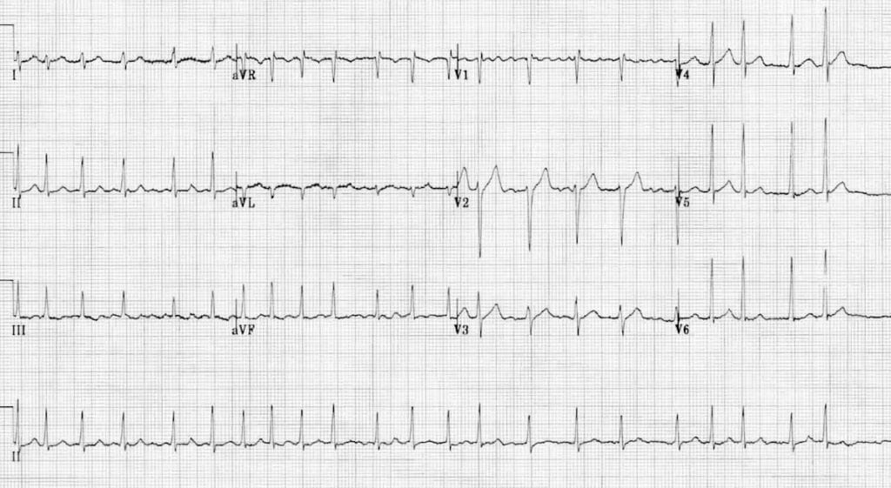
So, let’s put it all together . . .
A 57-year-old female patient presents to the hospital with symptoms of palpitations and a “tight chest feeling”.
In the ER, she is found to have:

Slide 125
So, let’s put it all together . . .
Her BP is 121/68, and her HR is variable 90-155. RR is 14 and she is maintaining a RA O2 sat of 95%
What actions should the ER PA take?

Slide 126
So, let’s put it all together . . .
The IM/cardiology PA is called for an admission.
What issues will this PA take care of?

Slide 127
So, let’s put it all together . . .
How would care be different if her BP is 78/30, and her HR is 130-140?
How would care be different if her BP is 90/48, and her HR is 130-140?
How would care be different if her BP is 120/78 with a heart rate of 70-90?
How would care be different if recent GI bleed?

