Slide 1
Infective Endocarditis and Pericardial Disease
Elizabeth Diem, MPAS, PA-C
Cardiovascular Disease Sub-Module 3

Slide 2
Case #1
Cynthia is a 41-year-old woman with no known medical history. She became addicted to Percocet after a back injury and began using heroin when she became dependent on the opiates.
She usually uses twice a day and has made several attempts to quit. She does have an appointment in two weeks for intake at a local inpatient drug rehab which was set up by her case worker.
She has had fevers and shaking chills, nausea and bilious vomiting x 3 days when she shows up in the ER.

Slide 3
Case #1
On PE, Cynthia does appear acutely ill.
Vitals: HR:112, R:22, BP:100/53, T: 102.4
HEENT: oral mucosa dry but non-erythematous, no cervical LAD
Lungs: clear
Heart: RRR, soft systolic murmur noted LSB, she denies a history of known murmur.
Skin: track marks are noted on the skin of the arms and there is a small fluctuant area of erythema on the left forearm.

Slide 4
Case #2
Anne is a 65-year-old woman with no known medical history. Three months ago, she had a routine root canal in her dentist’s office.
Four weeks ago, Anne began to have some episodes of confusion and a few fevers which were noted by her husband. She was seen in her PCP’s office and diagnosed with a UTI and treated with Bactrim for 3 days. She improved briefly but then began to have recurrent AMS within a week.
Anne’s husband took her to the ER two weeks ago where she was again noted to have a UTI and this time placed on Levaquin. This time a urine cx was sent, but nothing grows.

Slide 5
Case #2
Anne returns to the ER tonight and her husband reports that she has once again deteriorated with confusion. She did see her PCP shortly after the last ER visit and her Levaquin was stopped at 3 days because her urine culture was negative.
On PE, Anne looks unkempt and fatigued. She is clearly confused.
Vitals: HR:72, R:20, BP:140/73, T: 99.4
HEENT: oral mucosa without lesions
Lungs: few basilar rales bilaterally
Heart: RRR, no murmurs
Abdomen: +BS, soft and non-tender

Slide 6
Infective endocarditis (IE)
A bacterial or fungal infection of the valves or endocardium including the great vessels.
Risk factors for native valve infectious endocarditis (NVE):
  Rheumatic
  Congenital or degenerative valve disease
    Including MVP with mitral regurgitation
  Congenital heart defects: VSD, Tetralogy of Fallot, coarct, PDA
  IVDA
  Poor dentition or frequent dental infection
  HACIE: Healthcare-associated IE, up to 15-30%
    Intravascular devices, hyperalimentation catheters, pacemakers, shunts
Notes:
Tetralogy of Fallot: Stenosis of the pulmonary artery, ventricular septal defect(VSD), origin of the aorta overriding the right and left ventricles and concentric RV hypertrophy
PDA: patent Ductus arteriosus

Slide 7
IE Pathophysiology
IE occurs on native valve when bacteria or fungi gain access to the valve during a transient bacteremia
How does this happen?
Why are pts with cardiac valve abnormalities predisposed to IE especially if everyone has transient bacteremia?

Slide 8
IE Pathophysiology
For IE to develop you must have:
  1. Damaged or change to normal endothelial surfaces,
  2. Bacteremia, and
  3. Adherence to the surface
Undamaged endothelium is resistant to infection by most bacteria and thrombus formation.
Therefore endothelial injury is initial step
This is followed by platelet and fibrin adherence
  Serves as a scaffold
This becomes secondarily infected by transient bacteria

Slide 9
IE: Pathophysiology and the Development of Vegetation
The typical lesion of IE is a vegetation: a mass of fibrin and cellular elements of the blood, that becomes a haven for bacteria to attach.
Vegetations most commonly found at areas of congenital malformation or areas of valve damage, on the left side of the heart.

Slide 10
IE: Development of Vegetation - common locations
Vegetations are most commonly found on the lower pressure side when blood travels through a narrow orifice.
  Atrial side of mitral valve; corde tendineae of the ventricle of the aortic valve
IE is most likely with small, tight lesions.
  A high-pressure differential between the two chambers connected by the defect predisposes to IE
    Small VSD more likely this will occur over a larger VSD

Slide 11
IE: Pathophysiology
The bacterial infection of the endocardium causes a inflammatory reaction that can cause erosions and further damage.
  Without tx vegetation enlarges leading to regurgitation due to destruction of the leaflet or scarring and retraction of the leaflet
  Erosions may lead to perforation

Slide 12
IE Pathophysiology
Underlying disease present in IE
Valves most commonly affected by IE
Congenital: 10-20%
Atherosclerotic/pre-existing heart disease: 30-40%
  Rheumatic, MVP, aortic, aortic stenosis
PVE: 15-30%
IVDU: 10-20%
Cardiac devices: ~5%
Mitral: ~41%
Aortic: ~37%
Mitral and Aortic: 5-15%
Tricuspid: ~15-20%
Pulmonary: 1%
Notes:
PVE: Prosthetic valve

Slide 13
IE Epidemiology
The average age of a patient with endocarditis in the US has become older.
Due to:
  Decreasing rates of rheumatic heart disease
  Increases in instrumentation, invasive procedures and lines predisposing the patient to bacteremia
  People living longer with immunosuppression
  Significant number of IE are nosocomial now

Slide 14
IE: Native Valve Organisms
Typical causes:
Staphylococcus aureus…most common
Streptococcus viridans ~ 17%
Enterococci
Streptococcus bovis (Group D streptococcus - S. Gallolyticus)
HACEK organisms ~2%: oral commensal species
  Haemophilus aphrophilus
  Actinobacillus actinomycetemcomitans
  Cardiobacterium hominis
  Eikenella corrodens
  Kingella kingae

Slide 15
IE: Special populations – Prosthetic Valve
Prosthetic valve replacement:
  Highest risk in the first year, but remains elevated through the life Early PVE:
  If IE occurs with valve replacement likely related to contamination from surgery
  hematogenous seeding from extra-cardiac site
    Such as UTI at time of surgery causing seeding
  Commonly staph and strep, gram neg bacilli and Candida
Late PVE: >12 months
  Bacteria is similar to native valve infections
  Usually a result of oral or skin site that seeds the valve
IE can cause prosthetic valve dehiscence and perivalvular leak

Slide 16
IE: Special populations - IVDA
IVDA: majority do not have known valve dz
IE is more likely to affect the tricuspid valve in these patients. Why?
Same organisms as native valve IE are likely
S. Aureus is the most common bug in IVDA ~70% of cases
Strep and enterococci are second leading cause.
Pseudomonas, serratia, Candida, unusual pathogens, and polymicrobial infections – cause hygiene not great.

Slide 17
Natural History of IE
IE has a wide spectrum of illness:
Increasingly, rapid valvular destruction and CHF when highly virulent organisms invade, such as S. aureus, Strep pneumoniae, Strep pyogenes and Neisseria gonorrhea.
Indolent course with few symptoms despite valve destruction with bacteria such as Strep viridans, Enterococcus faecalis and some GNRs, is becoming more rare

Slide 18
IE: Clinical presentation
Fever common (90%)
  But may be low grade particularly in the elderly and debilitated
Heart murmur (85%)
  Either new or changing
Embolic phenomena (>50%) may be cutaneous or to other organs

Slide 19
IE: Clinical Presentation
Additional symptoms include general illness:
  Child and night sweats
  Cough and dyspnea
  Arthralgias, myalgia, and back pain
  Diarrhea, anorexia, N/V, abd pain and wt. loss
  Headache and malaise
Timing of symptoms may lead to clues regarding the pathogen

Slide 20
IE: Classic Physical Exam Presentation
These symptoms occur in only about 25% of pts
Splinter hemorrhages subungual, usually vertical
Petechiae: may be found on palate, conjunctiva
Roth spots: edematous hemorrhagic retinal lesions with pale centers
  Immunologic cause

Slide 21
IE: Classic Physical Exam Presentation
Janeway lesions: painless erythematous or hemorrhagic macules of the palms or soles
  neutrophil invasion of capillaries
    Due to micro-abscesses
  More common in acute than subacute
Osler nodes: painful raised violaceous lesions, occur in crops on the tips of fingers and toes or on hands/feet
  Thought to be secondary to microemboli in the pulp of finger that leads to localized immune-mediated vasculitis
  Was seen in a more protracted time of endocarditis

Slide 22
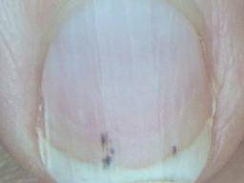
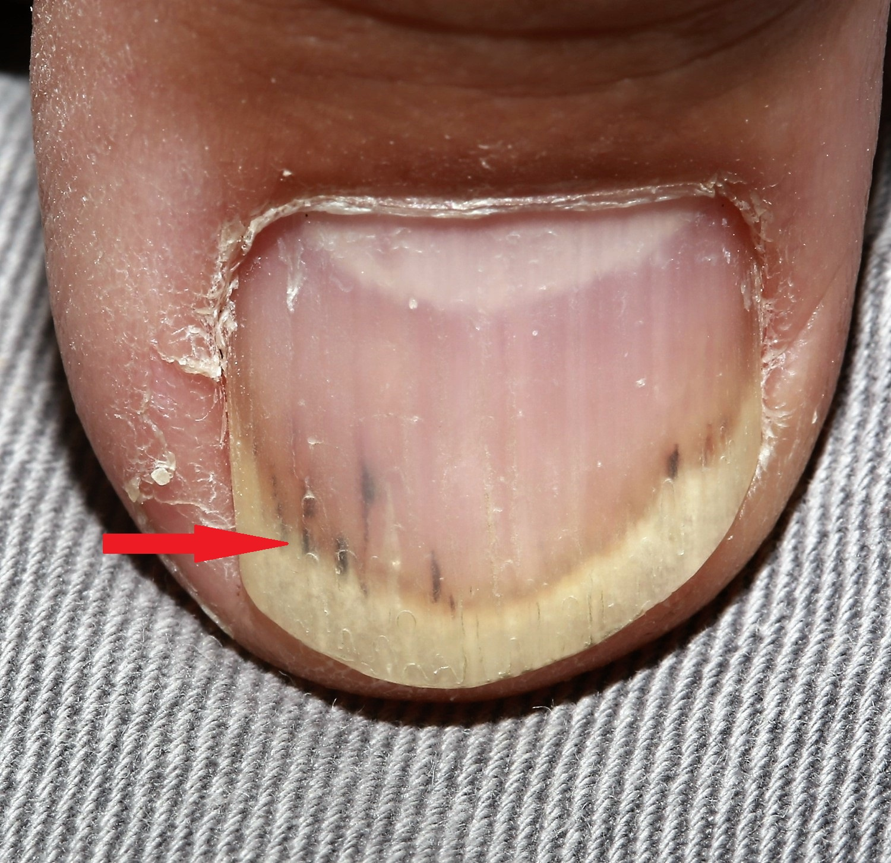
Splinter Hemorrhages: Characteristically vertical

Slide 23
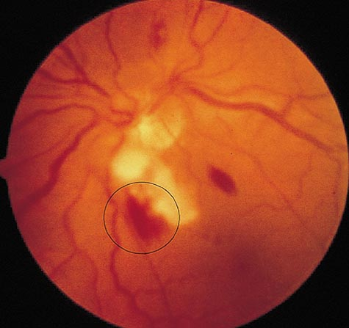
Roth Spots

Slide 24
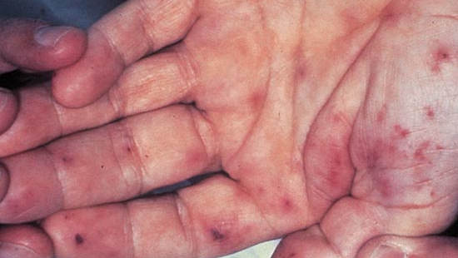
Janeway Lesions
Notes:
Macules or nodular hemorrhages on the palms and soles.

Slide 25
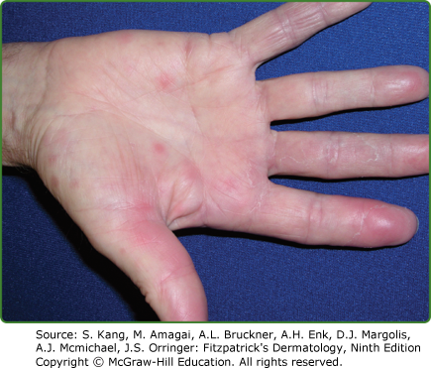
Janeway Lesions: Painless

Slide 26
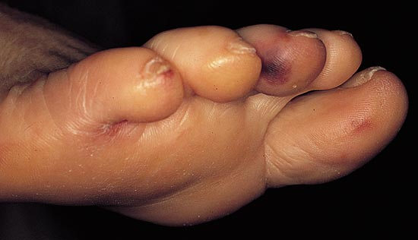
Osler Nodes
Painful, violaceous
Occur on tips of fingers, toes
Occur in crops, may be transient

Slide 27
IE: Diagnostic Studies
In the pt with suspected endocarditis, most the time the diagnosis will be made with:
Echocardiogram-trans thoracic
  If negative may need to get transesophageal echo
Blood culture q 15 min x 3
From separate sites
As medicine advances there have been new imaging modalities used. See Dukes criteria

Slide 28
Diagnostic Studies
Other studies in the work-up
CXR
EKG
CBC, CMP, additional labs as indicated
  Anemia:
  Elevated ESR/CRP: 90-100%
  Leukocytosis: 20-30% nml WBC
  Proteinuria (50-65%, microhematuria (30-60%)

Slide 29
Duke criteria:
Microbiology criteria (+ in either blood culture or lab test)
    Positive blood cultures
      Positive blood culture for typical (common) organisms from 2+ or more cultures OR
      Microorganism that occasionally or rarely causes IE from 3+ (non-typical)
    Positive Laboratory tests
      + PCR or other nucleic acid-based technique for Coxiella burnetii, Bartonella species, or Tropheryma whipplei from blood OR
      Coxiella burnetti antiphase I IgG antibody titer >1:800, or isolated from a single blood culture OR
      Indirect immunofluorescence assays (IFA) for detection of IgM and IgG antibodies to Bartonella henselae or Bartonella quintana with IgG titer >1:800
Major Diagnostic Criteria
2023

Slide 30
Dukes Criteria
Imaging:
  Echo and/or cardiac CT showing:
    vegetation, valvular/leaflet perforation, valvular/leaflet aneurysm, abscess, pseudoaneurysm, or intracardiac fistula OR
    Significant new valvular regurgitation on echo compared to previous. Worsening pre-exiting regurgitation is NOT sufficient. OR
    New partial dehiscence of prosthetic valve
  PET/CT imaging
    Abnormal metabolic activity involving a native or prosthetic valve, ascending aortic graft, intracardiac device leads or other prosthetic material
  Surgical major criteria
    Evidence of IE documented by direct inspection during heart surgery neither major imaging or histologic or micro-confirmed
Major Diagnostic Criteria
2023
Notes:
Endocarditis-Vegetations

Slide 31
Duke criteria:
1. Predisposing condition:
Previous hx of IE
Prosthetic valve
Previous valve repair
Congenital heart disease
More than mild regurgitation or stenosis of any etiology
Endovascular Cardiac implantable electronic device (CIED)
Hypertrophic obstructive cardiomyopathy
IVDA
2. Fever (100.4 F or higher)
3. Vascular phenomena:
Arterial emboli
Septic PE
Cerebral or splenic abscess
Mycotic aneurysm
Intracranial hemorrhage
Conjunctival hemorrhages
Janeway lesions
purpura
Minor Diagnostic Criteria
2023

Slide 32
Duke criteria:
Immunologic Phenomena
  + RF
  Osler nodes
  Roth Spots
  Immune complex-mediated glomerulonephritis
Microbiologic evidence that does not meet major criteria
  + blood culture for a microorganism consistent with IE but not meeting the requirement for major criterion
  + culture, PCR for an organism consistent with IE from a sterile body site other than cardiac tissue, cardiac prosthesis, or embolus; or a single finding of a skin bacterium by PCR on a valve or wire w/o additional clinical or micro supporting evidence.
Minor Diagnostic Criteria
2023

Slide 33
Duke Criteria
To make a definite IE diagnosis based on pathologic and clinical criteria you need:
2 major OR
1 major and 3 minor OR
5 minor clinical criteria

Slide 34

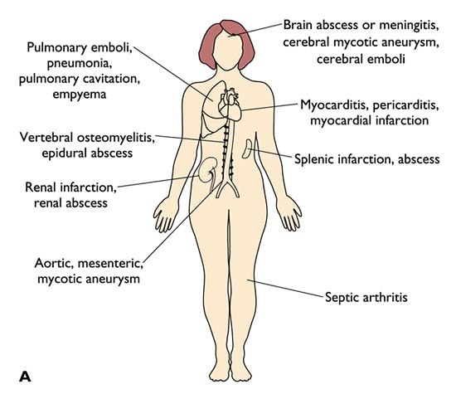
IE: Complications
Cardiac valve destruction
Metastatic infection:
  Infection breaks off and spread in other areas
    Brain leading to abscess
    Kidney, spleen, liver, lung (septic emboli)

Slide 35
IE: Complications
Embolization: Vegetations may be swept to the pulmonic or systemic circulation with resultant infarction.
  Where?
Myocardial abscess: an indication for surgical management
  ATB alone will not be enough
  I&D
  Can affect electrical conduction system
Conduction derangements: New heart block
Immune-mediated effects: Kidney, lungs fibrosis, DIC

Slide 36
IE: Treatment
If there is suspicion of IE pt should be hospitalized for appropriate diagnostic work up
Empiric ATB after blood cultures are drawn.
  Initial Coverage should include gram + and gram –
  If Hx suggest, consider fungal pathogen
    What in pts HX would make you suggest this?

Slide 37
Empiric Therapy
For Native value IE tx:
  Initial ABX should include Vancomycin plus ceftriaxone
    Alternatives to ceftriaxone would be Unasyn, cefepime or Zosyn
PVE tx:
  Initial ABX would be Vancomycin and Zosyn
    This covers pseudomonas
After organism is identified through blood cultures ABX can be tailored.

Slide 38
IE : Treatment
Staph aureus:
  Nafcillin IV x 6+ weeks for MSSA
  Vancomycin IV x 6 + weeks for MRSA
Most Strep:
  Aqueous PCN G IV x 4 weeks
Enterococcus:
  Ampicillin, gentamycin and daptomycin IV may be used depending on culture and sensitivity
ID should always be involved with these cases

Slide 39
IE : Surgical Treatment
Acute heart failure unresponsive to maximal medical therapy
  Severe valvular dysfunction
Infections unresponsive(complicated) to medical therapy
  OR difficult to tx pathogen like fungal or multi-drug resistant bacteria.
Abscess formation or recurrent embolization
Large mobile vegetation with high embolic risk

Slide 40
IE : Clinical Course
Pts with strep or enterococci will defervesce within 3-4 days
Those with staph and pseudomonas may take up to 7 days
What should we look for if fevers persist?

Slide 41
Prophylactic Antibiotic guidelines
Based more on theoretical rather than data from clinical trials
  No human study has definitively demonstrated that prophylactic ABX prevent endocarditis after invasive procedures.
However, if patient is having a high risk procedure AND has high risk cardiac condition the suggestion is to prophylactically treat for endocarditis.

Slide 42
Prevention: Patients at Highest Risk
AHA IE recommends prophylaxis for:
  All prosthetic heart valves including TAVR, mechanical and bioprosthetic valves, all prosthetic valve repairs
  Pts with ventricular assist device
  Anyone with a h/o IE
  Valve disease in cardiac transplants
  Congenital hear conditions…see next slide

Slide 43
Prophylaxis for endocarditis: Congenital Heart Conditions
  Unrepaired or incompletely repaired cyanotic congenital heart disease, including those with palliative shunts and conduits
  Completely repaired congenital heart defect with prosthetic material or device, during the first six months after the procedure
  Any repaired congenital heart defect with residual defect at the site or adjacent to site of a prosthetic patch or a prosthetic device

Slide 44
Prophylactic Antibiotic guidelines: Procedure
Procedures for which IE prophylaxis is recommended:
Dental:
  Any manipulation of the gingiva or oral mucosa perforation: cleaning, extractions, abscesses.
  These are the most high risk
Respiratory:
  Tonsillectomy & adenoidectomy, bronchoscopy with biopsy of the tract
Cardiac procedures with prosthetic material
GI or GU: no routine prophylaxis
Skin:
  Surgical procedure for the management of infected skin, skin structure, or musculoskeletal tissue
    Example: abscess
  Skin flora should be covered

Slide 45
Prevention
Prophylaxis is not routinely recommended for(Intermediate risk):
  Rheumatic heart disease
  MVP
  Bicuspid aortic valve
  HOCM
  ASD
  h/o pacers, stents, ICD or CABG procedure
AHA IE prophylaxis recommendations:
  Drug of choice: Amoxil 2 gm po 1 hr. before dental procedure
  Cephalexin, doxycycline, or azithromycin are all alternative agents
  Depending on procedure prophylaxis ABX may vary

Slide 46
Pericardial Disease

Slide 47
The Pericardium
A protective two layer sac around the heart.
Parietal pericardium (outer layer) is tough fibrous layer, and the inner visceral pericardium is a delicate overlay of the myocardial surface.
Normally, 5-15 ml of pericardial fluid, secreted by the parietal pericardium
  Provides lubrication between heart and surrounding viscera

Slide 48
Pericardial Disease
Acute Pericarditis:
  Inflammation of the sac surrounding the heart
Pericardial effusion:
  A collection of inflammatory fluid that forms between the visceral and parietal pericardial layers.
Chronic pericarditis:
  Diffuse and symmetric permanent scarring of the pericardium secondary to inflammation

Slide 49
Acute Pericarditis: Etiologies
Acute inflammation of the pericardium from a number of etiologies that include:
Viral: Most common
  Likely etiology of idiopathic
  Coxsackievirus, echoviruses, influenza, EBV, HIB
Tuberculosis: rare in the US but common in undeveloped nations
  Other bacterial causes are rare

Slide 50
Acute Pericarditis: Etiologies
Uremia:
  Mechanism is unknown
  Occurs in stable dialysis patients and those with untreated renal failure
Neoplastic:
  Spread of primary CA to pericardium
  Lung, breast, renal cell, Hodgkin's and NHL
Inflammatory
  Dressler’s: usually a few days to weeks after transmural MI, an inflammatory response to infarct
  Connective tissue disorder: RA, SLE, drug reaction can provoke pericarditis
Trauma

Slide 51
Acute Pericarditis: Symptoms
Chest pain: sharp, substernal chest pain that begins abruptly and is pleuritic
Exacerbating factor:
  Supine
Relieving factor:
  Sits up and leans forward
Dyspnea
Fever

Slide 52
Acute Pericarditis: signs
Friction rub
Symptoms of altered hemodynamics-possible if effusion is present
EKG changes:
  Diffuse ST segment elevations (multiple areas of the heart) without reciprocal changes
Differential diagnosis:
  Cardiac
  Pulmonary
  MS causes of CP

Slide 53
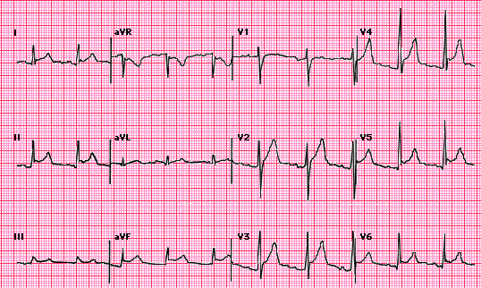
EKG

Slide 54
Diagnostic Studies
Diagnosis is made clinically and supported by EKG, labs and echo to evaluate for effusion.
Additional testing includes:
  CBC and chemistries
  Cardiac markers: may be elevated due to inflammation
  ESR and/or CRP +++
  Thyroid function test
  ANA, +/- RF
  PPD
  CXR
  Echo

Slide 55
Acute Pericarditis: Treatment
Depends on etiology
Treat underlying cause
If idiopathic: (both are used)
  NSAIDS: relieve pain and inflammation, but will not alter the course of pericarditis. ASA or ibuprofen are the preferred agents
    use for 2 weeks
  Colchicine: low dose is continued for 3 months, improves symptoms and reduces rate of recurrence

Slide 56
Acute Pericarditis: Treatment
Oral corticosteroids may be used when NSAIDS are contraindicated, or when pericarditis caused by connective tissue dz, autoimmune dz or uremia not responding to dialysis
  There is some evidence that it may increase the risk of pericarditis recurrence.
If pericarditis resulting in pericardial effusions is significant or recurrent, a pericardial window may be performed

Slide 57
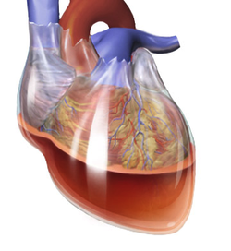
Pericardial Effusion
What will determine if a pericardial effusion will be symptomatic?
Pericardial effusions are usually asymptomatic
If symptoms occur:
  Chest pressure
  Dyspnea

Slide 58
Pericardial Effusions
Signs:
Usually none but can have:
  A rub if large
  Muffled heart sounds
  Inability to palpate the PMI
Etiologies: can be the result of any disease causing acute pericarditis.
Most commonly:
  Idiopathic
  Uremia
  Neoplastic
  Pericarditis
Less common would be sharp of blunt trauma (including interventional procedure) and also dissections

Slide 59
Cardiac Tamponade
Occurs when a pericardial effusion grows too large or accumulates too rapidly resulting in impaired pumping of the heart
  Filling of the right will initially be impaired followed by the left heart
In response to the decrease in cardiac output the body will do what?
This response may compensate for a short time, but eventually pt will develop s&s of tamponade

Slide 60
Cardiac Tamponade: S & S
S&S will depend on the rate of effusion accumulation, hydration, and severity of cardiac tamponade
Acute cardiac tamponade:
  More sudden in onset and may be associated with chest pain, tachypnea, dyspnea, JVD and hypotension. Will have symptoms related to decreased cardiac output
Subacute Cardiac tamponade:
  Less dramatic. Pt may be asymptomatic early but once pressure on heart reaches critical levels they will complains of SOB, chest discomfort or fullness, peripheral edema, fatigability

Slide 61
Cardiac Tamponade: S & S
Tachycardia
Classic triad: Hypotension, JVD, muffled heart sounds
Narrow pulse pressure
Elevated jugular venous pressure
Pulsus paradoxus: fall in SBP > 10mmHg during inspiration

Slide 62
Diagnosis: Effusions/Tamponade
Diagnosis will be made based on history and physical exam findings in conjunction with an echo
Echocardiogram will be the test of choice
  Will show effusion and evidence of tamponade
CXR: enlargement of the cardiac silhouette
EKG:
  dampened EKG voltage
  QRS alternans

Slide 63
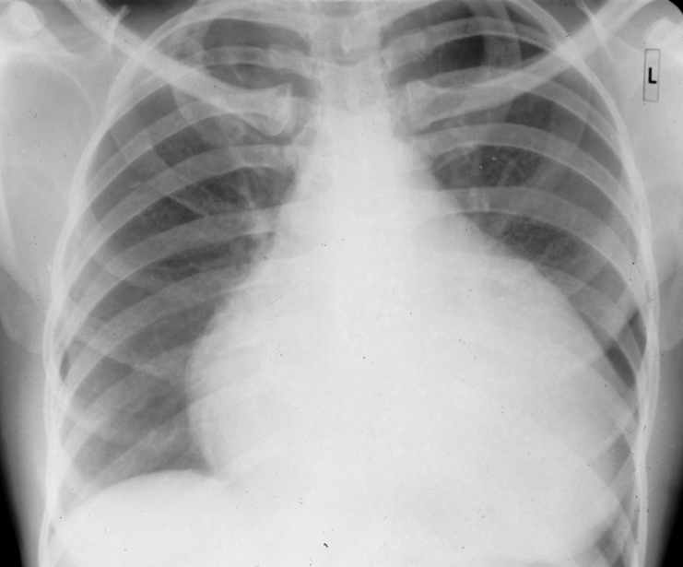
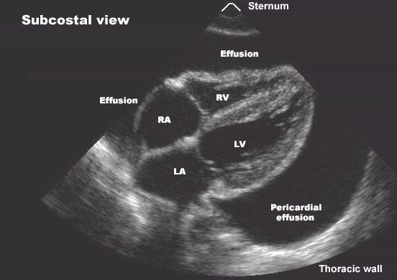
Pericardial Effusions

Slide 64
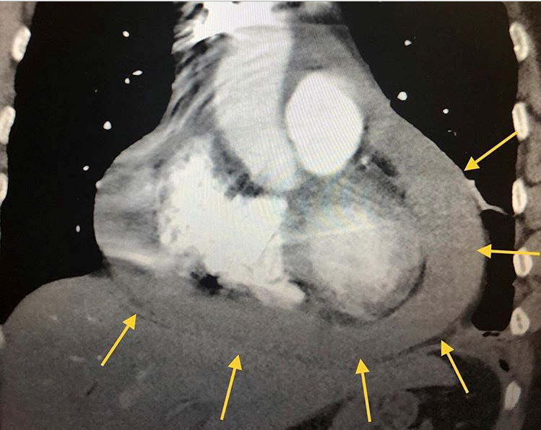

Slide 65
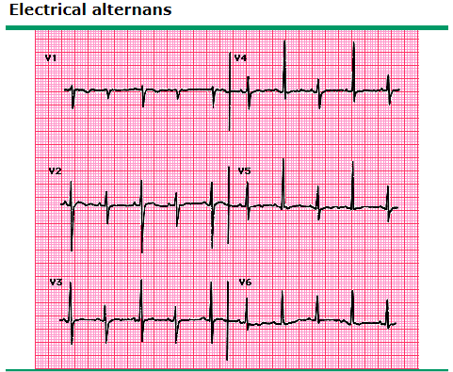
Electrical Alternans

Slide 66
Effusion/Tamponade: Management
Observation with serial echocardiograms for small asymptomatic effusion
Effusions causing cardiac tamponade are a medical emergency
  Hydrate pt and use vasopressors if hypotension
  Perform a pericardiocentesis
  Pericardial window may be needed for a recurrent or loculated effusion

Slide 67
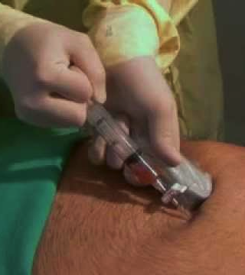
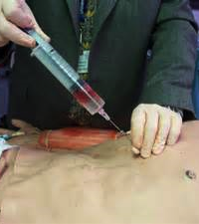

Slide 68
Constrictive Pericarditis
The pericardium becomes thickened and fibrotic, and occasionally calcified.
  This restricts diastolic filing of the heart
  What does this cause?
Etiologies are same for acute pericarditis
  Idiopathic or viral is most common in developed countries
  Post radiation
  Post cardiac surgery
  Connective tissue disorder
  TB(MC developing countries), uremia and other potential causes

Slide 69
Constrictive Pericarditis
Signs and symptoms are consistent with slowly advancing heart failure:
  DOE
  Fluid overload type picture
  Decrease exercise tolerance
  Chest pain
  Elevated JVP
Pericardial “Knock”: an early diastolic sound at LSB, as the apex recoils from systole

Slide 70
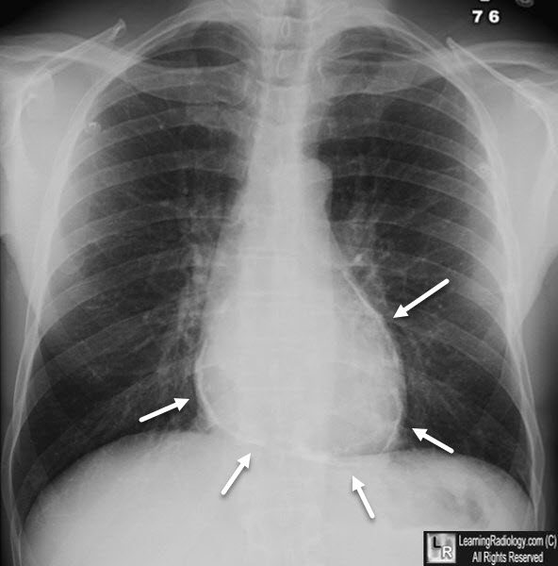
Constrictive pericarditis X-ray: calcified pericardium

Slide 71
Constrictive Pericarditis: Diagnosis
CXR: thickened and calcified pericardium and/or Pleural effusions
EKG: non-specific ST-T wave changes and QRS voltage
  Atrial dysrhythmias are common
Echo: thickened and immobile pericardium with septal motion abnormalities
  This usually makes the diagnosis. (essential diagnostic test)
  Not moving the way it should and increased pericardial thickness
CT/MRI: gives additional anatomic info if surgery considered. Can show extent of pericardial thickening/calcification/scarring
If patients echo is non-diagnostic or poor quality:
  Cardiac cath is needed to make the diagnosis and evaluate cardiac function

Slide 72
Constrictive Pericarditis: Treatment
Constrictive pericarditis is a progressive disease
Early disease is treated similar to acute pericarditis with NSAIDS and colchicine for 2-3 months
Tachycardia is a protective mechanism
  Beta blockers and calcium channel blockers should be avoided
Medical therapy such as diuretics and salt restriction can be used if patients are not a surgical candidate in late disease
Pericardiectomy for patients with moderate to severe disease.

Slide 73

The End

