Slide 1
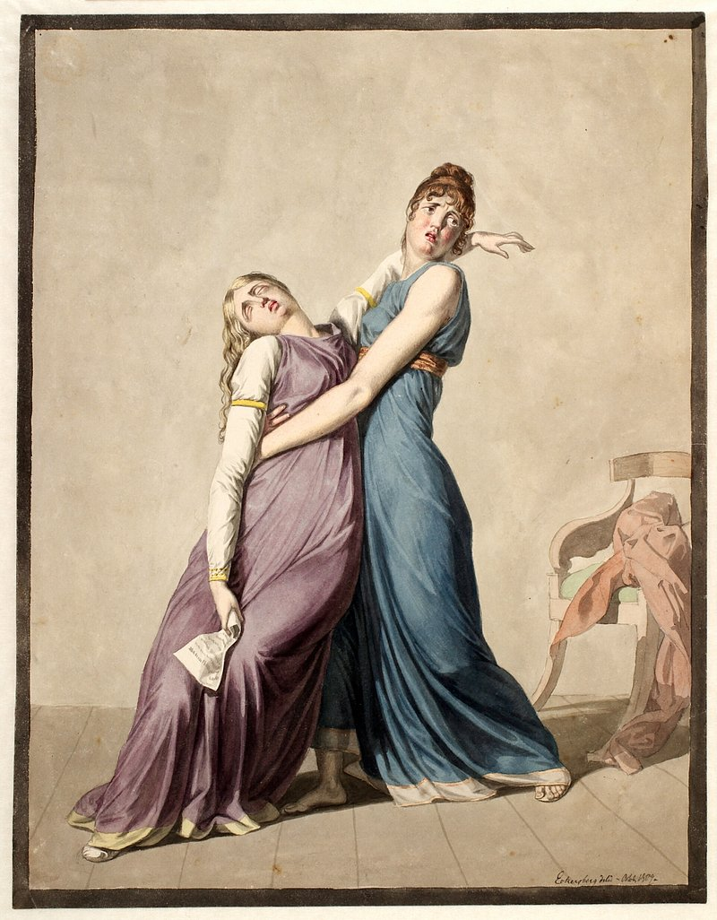
Syncope
Cardiology Fall 2026
Katrina Raaf, MPAS, PA-C

Slide 2

Case Study
Mick, 82 y/o M
Mick was found by his partner on the floor after coming back from the bathroom in the middle of the night. She woke up because she had heard a thud. He regained consciousness in about a minute, but his partner was concerned and called 911. His vital signs are stable, but he has a laceration on his forehead and his nose.
Notes:
Our first case study is based on Mick, an 82 year old male.

Slide 3

Mick Case Study
PMHx includes HTN (well controlled). His meds include amlodipine and hydrochlorothiazide. On exam he is alert and oriented, but he does not remember falling
Physical exam:
3/6 systolic ejection murmur at the RUSB
Workup:
CBC, BMP: WNL
EKG: signs of LVH and occasional PVCs
Echo: Aortic valve calcification (severe)
CT head: Non acute
Notes:
He tells you, that the last thing he remembers is finishing going to the bathroom then coming back to his room.
One reason why I like this case is because in the elderly patient, syncope may actually present as unexplained or unwitnessed fall, and syncope will be on the DDx.

Slide 4

Case Study
Jessie, 38 y/o F
Jessie is a 38-year-old female w/ no significant PMH. She was walking home after performing at a concert. She felt a palpitation, and the next thing that she knew, she was on the ground. She was with a partner at the time, who witnessed this, and called 911.

Slide 5

Jessie Case Study
EMS report: Pt was hypotensive when they arrived on the scene. EKG showed a wide-complex tachycardia at 240 bpm and BP was 70/50. They attached an AED, which found a shockable rhythm. Pt was shocked, and her BP immediately improved to 110/60, after which she felt much better.
Repeat EKG: Sinus tach rate 110 w/ Delta waves.
She is on no medications. In the ED, her physical exam and labs were unremarkable.

Slide 6
Definition
Syncope is a transient, self limited loss of consciousness and inability to maintain postural tone due to acute global impairment of cerebral blood flow
Onset:
Duration:
Recovery:
Sudden
Brief
Spontaneous, complete
Notes:
https://upload.wikimedia.org/wikipedia/commons/d/dc/A_girl_fainting_and_collapsing_into_the_arms_of_a_woman%2C_in_Wellcome_L0043649.jpg?utm_source=commons.wikimedia.org&utm_campaign=index&utm_content=original
The definition here is important because it is how we differentiate syncope from presyncope or from other conditions that cause loss of consciousness, such as seizures.
Transient – brief, lasting less than 1 minute.
defined as a transient loss of consciousness and inability to maintain postural tone that spontaneously resolves without medical intervention

Slide 7
Definition
Presyncope: The prodromal symptoms before syncope, including lightheadedness, which could either progress to syncope or resolve.
Is presyncope less serious than syncope?
Notes:
Presyncope describes the prodromal symptoms before syncope, including lightheadedness, which could either progress to syncope or resolve.1 Presyncope should be investigated in the same way as syncope because it carries the same prognosis, and unwitnessed falls in older patients could indicate syncope.2

Slide 8
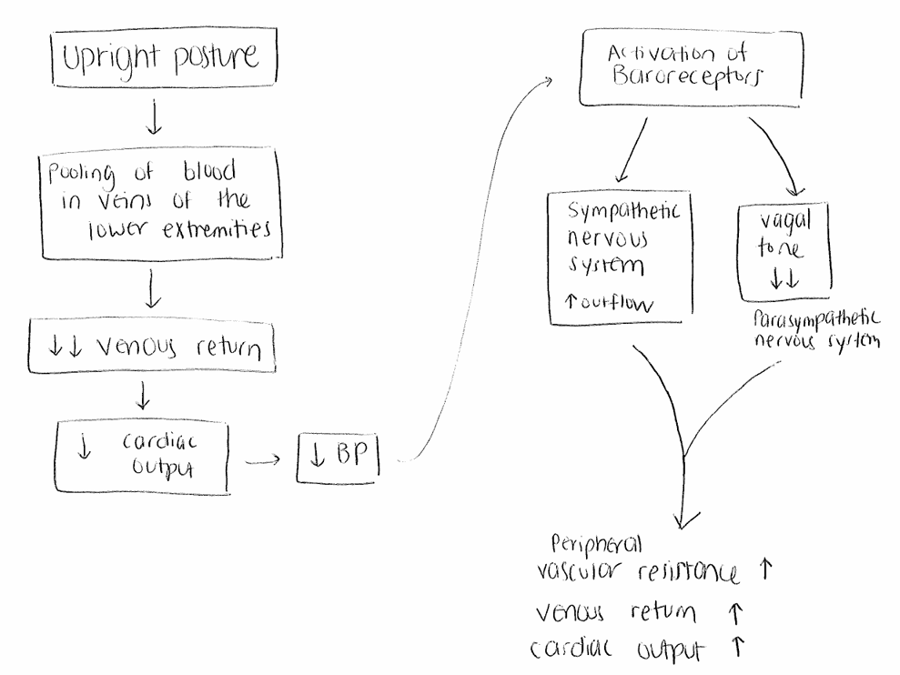
What happens when we stand up?
Carotid sinuses
Aortic arch
Peripheral vasoconstriction
+ Chronotropy (HR)
+ Inotropy (SV)
Notes:
In syncope, essentially we have a temporary cerebral hypoperfusion.
The blood flow to the brain has either been impaired or reduced.

Slide 9

Pathophysiology of Syncope
In syncope, an inciting event causes a drop in cardiac output, which decreases oxygen delivery to the brain
Global impairment of blood flow to the brain (either reduction or complete disruption)

Slide 10
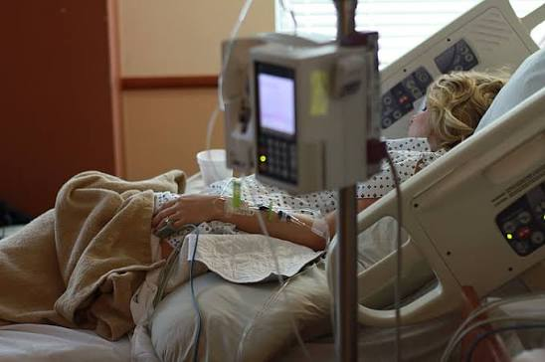
Epidemiology
Syncope accounts for 1-2% of ED visits each year
The elderly have the highest incidence and risk for morbidity
Cause remains idiopathic in 40% of cases

Slide 11
Major Causes of Syncope
Reflex Mediated
Orthostatic
Cardiac
(Structural, Arrhythmia, Cardiopulmonary Obstruction)
Notes:
These categories are based on modern syncope frameworks from 2017 ACC/AHA define true syncope as transient global cerebral hypoperfusion and sort it into 3 major categories.
Notice there is no accepted ‘neurologic syncope’ category
Instead consider neuro as a DDx as a cause of transient LOC that must be distinguished from syncope

Slide 12
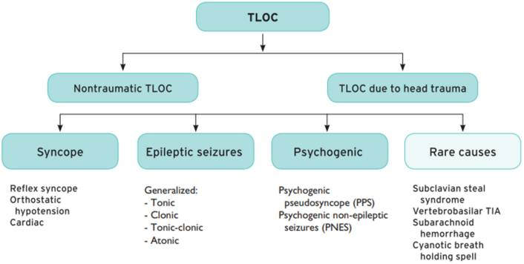
“Transient loss of consciousness”
This is our focus for today
Adapted from the 2018 European Society of Cardiology Guidelines for the Diagnosis and Management of Syncope
Notes:
Loss of consciousness defined as:
A cognitive state in which one lacks awareness of oneself and one’s situation, with an inability to respond to stimuli.

Slide 13
What else to consider if someone passes out or collapses?
DDx of syncope:
Seizures*
Drug or alcohol intoxication
Metabolic disturbances
Concussion due to head trauma
Coma
AMS, confusion
Hypoglycemia
These are not classified as syncope according to ACC/AHA

Slide 14
Reflex Syncope
Reflex Syncope
Vasovagal
Situational
Carotid Sinus Syndrome

Slide 15
How does reflex syncope work?
Trigger occurs: prolonged standing, fear, or seeing blood
Initial response: Increased sympathetic activity
Reflex vagal activation: The autonomic nervous system overcorrects, increasing parasympathetic activity and decreasing sympathetic activity
BP drops: Blood vessels dilate, and HR may slow
Temporary decreased blood flow to the brain
Syncope: Patient faints
Notes:
Key takeaway: The autonomic nervous system overreacts to a trigger, causing blood pressure to drop (and sometimes heart rate to drop), temporarily reducing blood flow to the brain.

Slide 16
Reflex Syncope
Includes vasovagal syncope, situational syncope, and carotid sinus syndrome
Reflex syncope accounts for 90% of cases among younger adults but only 40% of cases among older adults
Most common type of syncope
Mechanism:
  Vasodilation and/or bradycardia → Systemic hypotension → Cerebral hypoperfusion → Fainting
Notes:
Vasovagal syncope usually results from: either, systolic blood pressure of no more than 80 mmHg, heart rate of < 40 bpm, asystole lasting at least 3 seconds

Slide 17
Reflex Syncope: Vasovagal Syncope
Trigger:
  A stimulus produces an abnormal autonomic response: vagal tone increases
  Vasodilatory hypotension ± bradycardia
Causes:
  Unexpected/unpleasant sight, sound, or smell
  Fear, severe pain, emotional distress
  Prolonged standing or kneeling
Hallmark prodromal symptoms:
Feeling warm
Lightheadedness
Tunnel vision
Nausea
Pallor
Sweating

Slide 18

Vasovagal Syncope
Benign prognosis
Keep in mind that injuries occur in 30% of episodes
  Older age and recurrent syncope or falls increase the likelihood of injury
  Or if patient lacks recognizable prodrome

Slide 19

Vasovagal Syncope
Initial non-pharm treatment:
  Identify, avoid precipitating factors
  Supine position during prodrome
  Hydrate well (2-2.5 L)
  May need salt supplementation
Note that older patients may not have exhibit the autonomic activation that causes prodromal symptoms or may not remember such symptoms

Slide 20

Reflex Syncope: Situational Syncope
A subtype of reflex syncope that is triggered directly by a bodily function or activity that stimulates the vagus nerve or increases intrathoracic pressure.
Urination or defecation
Coughing
Swallowing
Eating a meal

Slide 21
Carotid sinus syndrome
Carotid sinuses
Aortic arch
Peripheral vasoconstriction
+ Chronotropy (HR)
+ Inotropy (SV)
Carotid sinus syndrome:
Significant drop in in HR and/or BP in response to stimulation of the carotid artery baroreceptors → Syncope

Slide 22
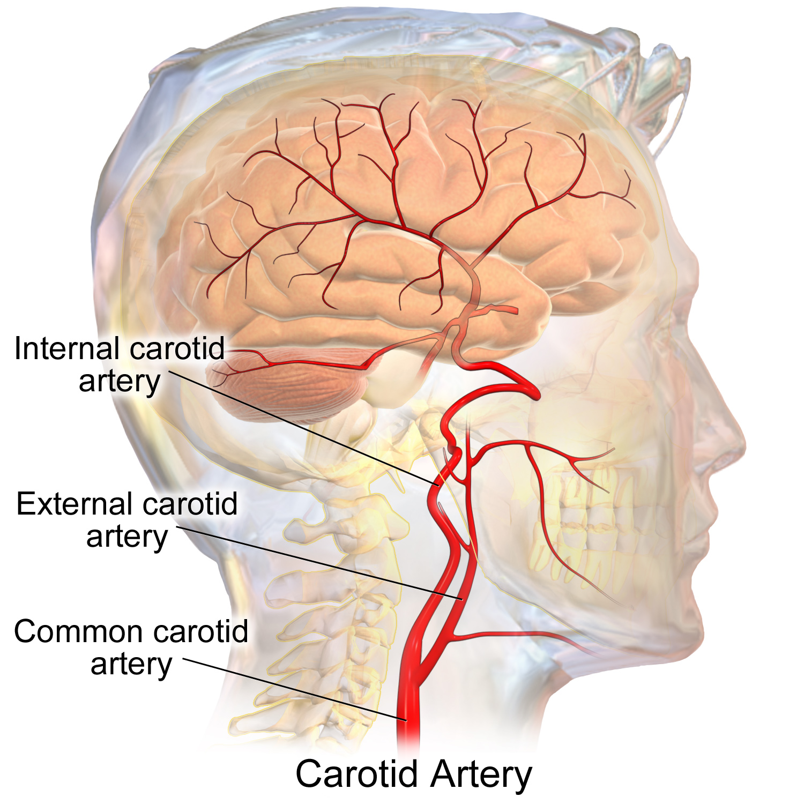
Reflex Syncope: Carotid Sinus Syndrome
Mechanism:
  Stimulation of the carotid sinus causes bradycardia, asystole (>3 sec), or hypotension
Clinical presentation:
  Syncope or near syncope triggered by ADLs that put pressure on the carotid sinus
    Shaving
    Turning the neck
    __________
    __________

Slide 23

Reflex Syncope: Carotid Sinus Syndrome
Risk factors:
  Elderly men > 65 (almost exclusively)
  Atherosclerotic disease
  Head and neck cancers
Clinical pearl: Consider this DX in older patients >50 with recurrent syncope and negative cardiac evaluations.

Slide 24
Reflex Syncope: Carotid Sinus Syndrome
Symptoms:
  Lightheadedness/presyncope
  Syncope
  Unexplained falls in older patients
Assessment:
  Perform carotid sinus massage both while the patient is supine and while the patient is upright, with simultaneous HR+BP monitoring
Positive test result =

Slide 25
Take home: What clinical clues suggest reflex syncope?
Long history of recurrent syncope, especially if it started before the age of 40
Occurs w/ unpleasant sight, smell or pain
Occurs with prolonged standing; or in a crowded or hot place
Pallor, sweating, nausea, vomiting beforehand
Occurs w/ head rotation or pressure on neck

Slide 26
Orthostatic Syncope
Drug induced
Volume depletion
Autonomic failure

Slide 27
Orthostatic Syncope
Mechanism:
  Change to upright posture → blood shifts to lower body → cardiac output drops
  Inadequate compensation (autonomic failure, volume depletion or drug SE) → cerebral hypoperfusion → syncope
Orthostatic hypotension is defined as a sustained reduction of systolic BP ≥ 20 mmHg or diastolic BP ≥ 10 mmHg within 3 minutes of standing.

Slide 28
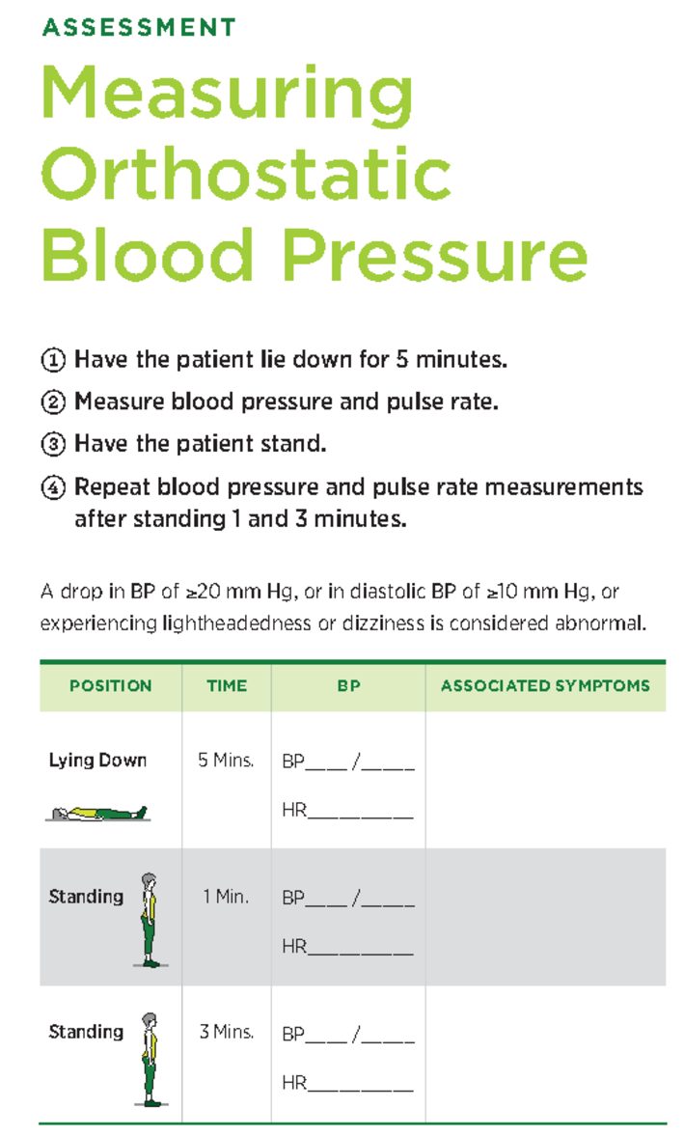
Orthostatic hypotension most often occurs following movement from lying or sitting to standing position.
Orthostatic hypotension is a measurable sign, and orthostatic syncope is a symptom.
Notes:
https://website-assets.studocu.com/img/document_thumbnails/c80462c32ad973ac4e9087d24baba21f/thumb_1200_1530.png

Slide 29
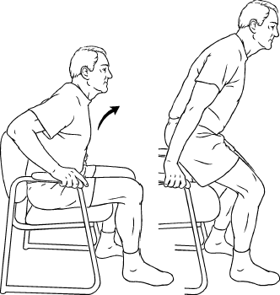
Orthostatic Syncope
Symptoms:
  Dizziness/ lightheadedness
  Generalized weakness
  Cognitive slowing
Associated with:
  Medications
  Aging
  Hypovolemia (vomiting, diarrhea, hemorrhage)
  Autonomic dysfunction (such as Parkinson’s)

Slide 30
Orthostatic Syncope
Prevalence increases with age
  Affects less than 5% of persons younger than 50
  More than 20% of persons over 70
Historical features suggestive of orthostatic syncope:
  Syncope after standing up
  Decreased intravascular volume – inadequate fluid intake, excessive fluid loss
  Certain meds – diuretics, BP medications (alpha + beta blockers), vasodilators/nitrates, TCAs, antipsychotics
  Autonomic neuropathy, Parkinson’s
Notes:
Excessive fluid loss -- hemorrhage/anemia, vomiting, diarrhea

Slide 31
Cardiac Syncope
Cardiac Syncope
Structural Heart Disease
Arrhythmia or Conduction dz
Cardiopulmonary Obstruction
Aortic stenosis
WPW, AV block
PE, MI
Syncope during exertion
Sudden, no prodrome
Notes:
Cardiac syncope results from conditions that reduce cardiac output or cerebral perfusion.
Such as conditions include bradyarrhythmias, tachyarrhythmias, structural heart disease causing outflow obstruction, pulmonary hypertension, and acute vascular disorders such as PE or aortic dissection.

Slide 32
Cardiac Syncope
Most often caused by structural heart disease or dysrhythmia, and is a harbinger of sudden death
Typically sudden, usually without prodrome
May have palpitations or exertion prior to syncope
Major causes of cardiac syncope
  Structural heart disease
  Arrhythmia
  Pulmonary obstruction
Notes:
1 year mortality of greater than 30% with documented cardiac syncope

Slide 33
Structural Heart Disease
Epidemiology:
  In older patients, MC due to aortic stenosis
  In younger patients, MC due to HOCM
Mechanism:
  Inability to increase cardiac output in response to exercise-induced peripheral vasodilation → exertional syncope
Trigger: Often occurs during or after exertion

Slide 34
Structural Heart Disease + Syncope
Hypertrophic
Cardiomyopathy
Aortic stenosis

Slide 35
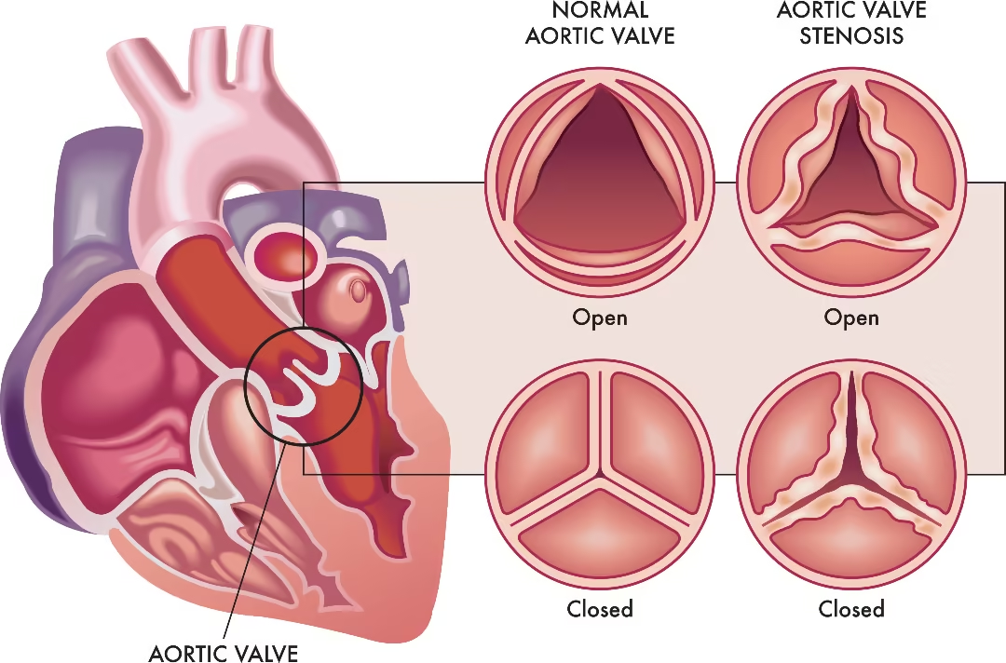
Structural Heart Disease as a Cause for Syncope: Aortic Stenosis

Slide 36
Cardiac Syncope: Aortic Stenosis
Mechanism:
  Narrowing of the aortic valve → increased resistance for LV to pump blood to the body
Clinical features:
  Most commonly in elderly men
  Loud, harsh systolic murmur

Slide 37
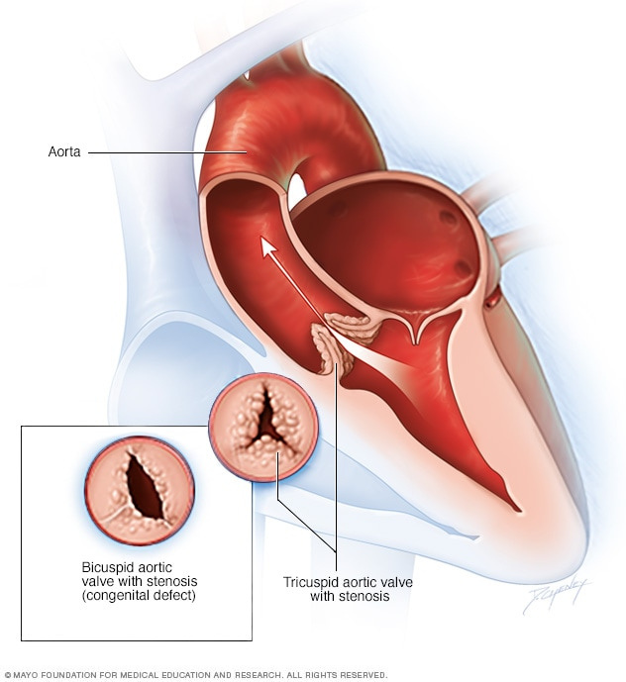
Structural Cardiac Syncope:
Aortic Stenosis
Severe aortic stenosis presents w/
  Dyspnea on exertion
  Presyncope or syncope
  Angina on exertion
Diagnosis: Echo
Prognosis:
  High mortality if untreated
  Aortic valve replacement usually indicated

Slide 38
Structural Cardiac Syncope:
Hypertrophic Cardiomyopathy (HCM)
Prevalence:
  About 1 in 4 will have syncope or presyncope
  Autosomal dominant pattern – ask about family history of HCM or sudden cardiac death
Mechanism:
  Stiff, thick left ventricle → Poor filling (↓SV)
  Septum hypertrophy → Left ventricle outflow obstruction (↓ CO), worse w/ exertion/dehydration

Slide 39
Structural Cardiac Syncope:
Hypertrophic Cardiomyopathy (HCM)
Clinical presentation:
  May be asymptomatic
  Dyspnea on exertion
  Exertional angina or syncope
  Palpitations
Physical exam:
  May be normal
  Nonspecific abnormalities such as S4, systolic murmur, and/or cardiac lift/heave
Notes:
S4 best heard with the bell of the stethoscope

Slide 40
Structural Cardiac Syncope:
Hypertrophic Cardiomyopathy (HCM)
Concerning red flags:
  Family history of HOCM
  Systolic ejection murmur (< >)
  Abnormal EKG with LVH
Diagnostics:
  Transthoracic echo

Slide 41
Syncope due to
Arrhythmias
AV block
(2º and 3º)
Sinus Node
Dysfunction
Torsades
De Pointes
Brugada
Syndrome
VTach
WPW

Slide 42
Cardiac Arrhythmias and Syncope
Mechanism:
Heart rate is too slow or too fast to maintain adequate cardiac output, so cerebral perfusion drops suddenly → Syncope
These episodes have little or no warning
Notes:
Symptoms depend on the autonomic nervous system’s ability to accommodate the change in cardiac output, as well as the presence or absence of underlying vascular disease.

Slide 43
Cardiac Arrhythmias and Syncope
Bradyarrhythmias:
Sick sinus syndrome
AV block (2nd Mobitz II and 3rd degree)
Pacemaker/ICD malfunction
Drug-induced bradycardia
Notes:
High grade AV block includes Mobitz type 2 2nd degree and 3rd degree or complete heart block.
Sick sinus syndrome: sinus pauses greater than 3 s in an awake patient.

Slide 44
Cardiac Arrhythmias and Syncope
Tachyarrhythmias:
Ventricular tachycardia
  Monomorphic V-Tach
  Torsades de pointes
Wolff-Parkinson-White Syndrome
Brugada syndrome

Slide 45
Bradyarrhythmias

Slide 46
Bradyarrhythmias and Syncope
Sick sinus syndrome/Sinus node dysfunction
Syncope is commonly reported, seen in ~50% of patients who get a pacemaker inserted for SSS
Sinus node dysfunction | Sick sinus syndrome
Disorder of the SA node caused by impaired pacemaker function and impulse transmission | When a patient with sinus node dysfunction develops symptoms, such as syncope
Notes:
Sinus node dysfunction: Disorder of the SA node caused by impaired pacemaker function and impulse transmission
Sick sinus syndrome → when the patient becomes symptomatic (such as with syncope)

Slide 47
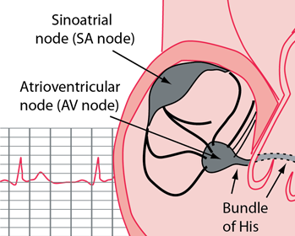
Sick Sinus Syndrome
Most commonly due to age- related degeneration of SA node
Usually seen in older adults
ECG findings:
  Sinus bradycardia
  Sinus pauses > 3 s or sinus arrest
  Alternating bradycardia and tachycardia

Slide 48
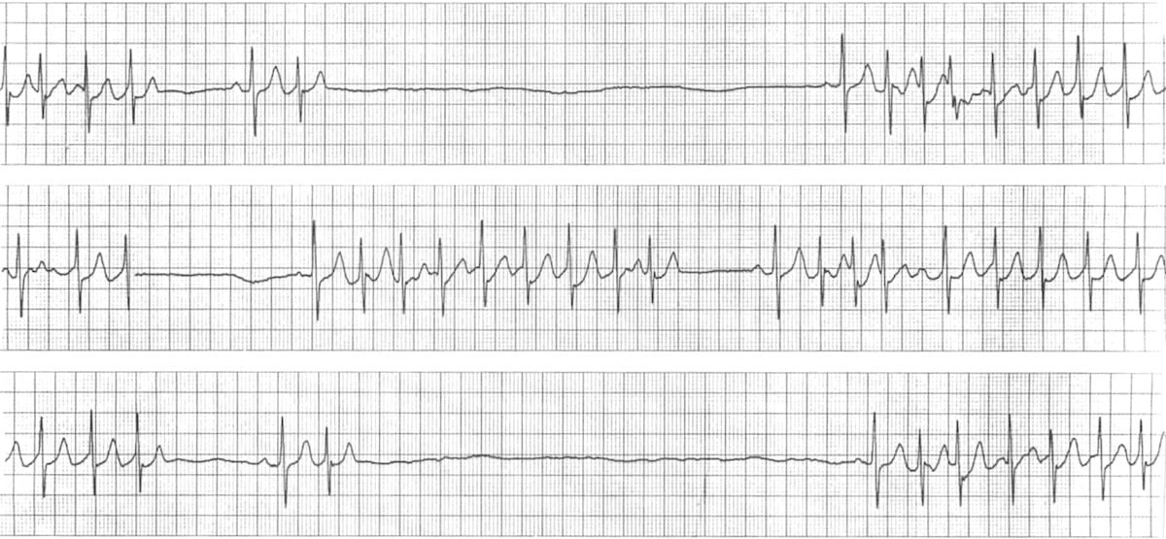
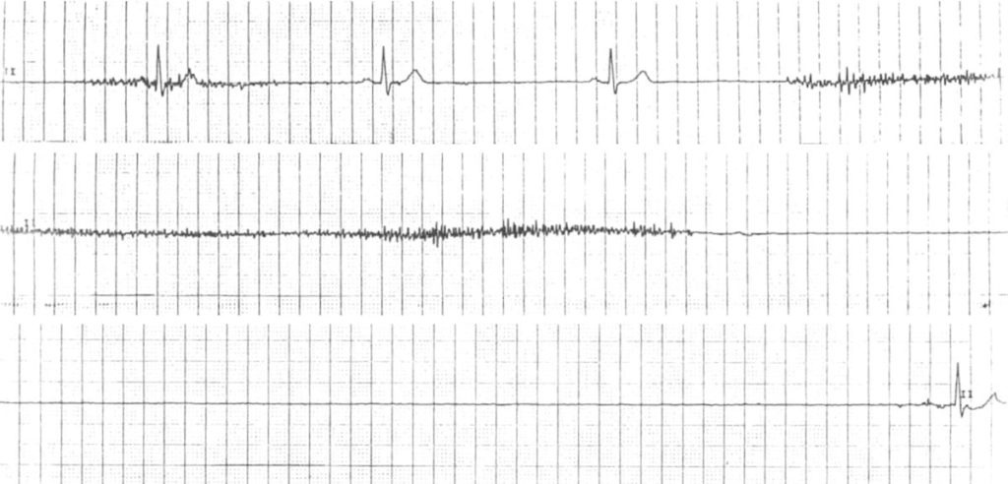
Sick Sinus Syndrome (SSS)
Tachy-brady syndrome
Sinus arrests

Slide 49
AV Block as cause of syncope
Atrioventricular Block
2nd degree Mobitz Type II
3rd degree (Complete heart block)
Mechanism: Caused by underlying structural damage to the conduction system (such as MI or fibrosis)
Complete dissociation b/w atria and ventricles

Slide 50
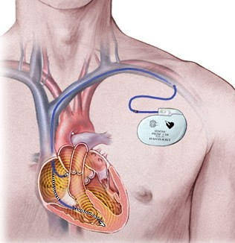
Bradyarrhythmias and Syncope
Pacemaker/ICD malfunction
Due to issues with the battery, leads, or infection
Common symptoms:
  Lightheaded or dizzy
  Palpitations
  Syncope
  Chest pain, SOB

Slide 51
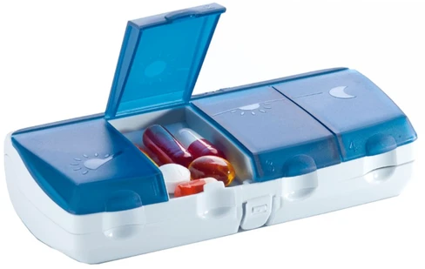

Bradyarrhythmias
Drug-induced bradycardia
Common culprits:
  Antihypertensives: beta-blockers, non-DHP CCBs (verapamil, diltiazem, clonidine)
  Antiarrhythmics: amiodarone, sotalol, flecainide
  Digoxin
Clinical pearl: Combination of meds increase the risk, and these drugs often unmask underlying conduction disease.

Slide 52
Tachyarrhythmias

Slide 53
High Risk for Tachyarrhythmia
Induced Syncope
Risk Factors:
Underlying heart disease (previous MI)
Long QT syndrome or Brugada syndrome
Hypertrophic cardiomyopathy
Congenital heart disease
Significant vascular disease
Clinical Presentation:
Often occurs without warning
Difficult to diagnose due to paroxysmal and infrequent nature

Slide 54
Tachyarrhythmias and Syncope
Long QT Syndrome
Can be congenital or acquired (medications)
Can develop into Torsades de Pointes (polymorphic VT)
Definition: Disorder of ventricular repolarization with prolonged QT interval, leading to symptomatic ventricular arrhythmias and increased risk of sudden cardiac death
Normal QT interval:
  ≤ 470 ms in males
  ≤ 480 ms in females

Slide 55
Long QT Syndrome
Acquired
Congenital
Electrolyte
Abnormalities
Medications

Slide 56
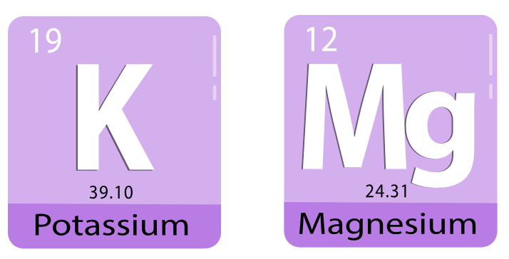
Acquired Long QT Syndrome
Etiologies
Medications
Antiarrhythmics
Psychiatric meds
Antimicrobials
Antiemetics
Electrolyte abnormalities
Hypokalemia
Hypomagnesemia
(Quinidine, procainamide, sotalol)
(Haloperidol, ziprasidone, SSRIs, TCAs)
(FQs, macrolides, azoles)
(Ondansetron)
Notes:
.

Slide 57
Long QT Syndrome
Clinical Presentation
Asymptomatic – identified by QT prolongation EKG
Symptomatic – palpitations, syncope, sudden cardiac arrest
Any unstable pt without a pulse → ACLS protocol
Electrolyte abnormalities
Hypokalemia
Hypomagnesemia

Slide 58
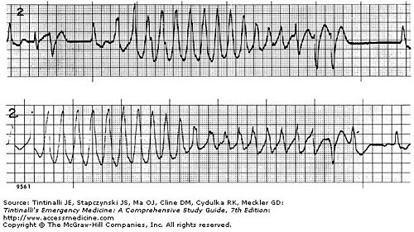
Ventricular Tachycardia
Defined as 3 or more consecutive PVCs
Monomorphic V-Tach (Rapid and regular, MC type)
Torsades de Pointes (Polymorphic VT w/ long QT)
  Usually resolves on its own within seconds, which is why it presents most commonly as brief syncope rather than cardiac arrest
Torsades de Pointes

Slide 59
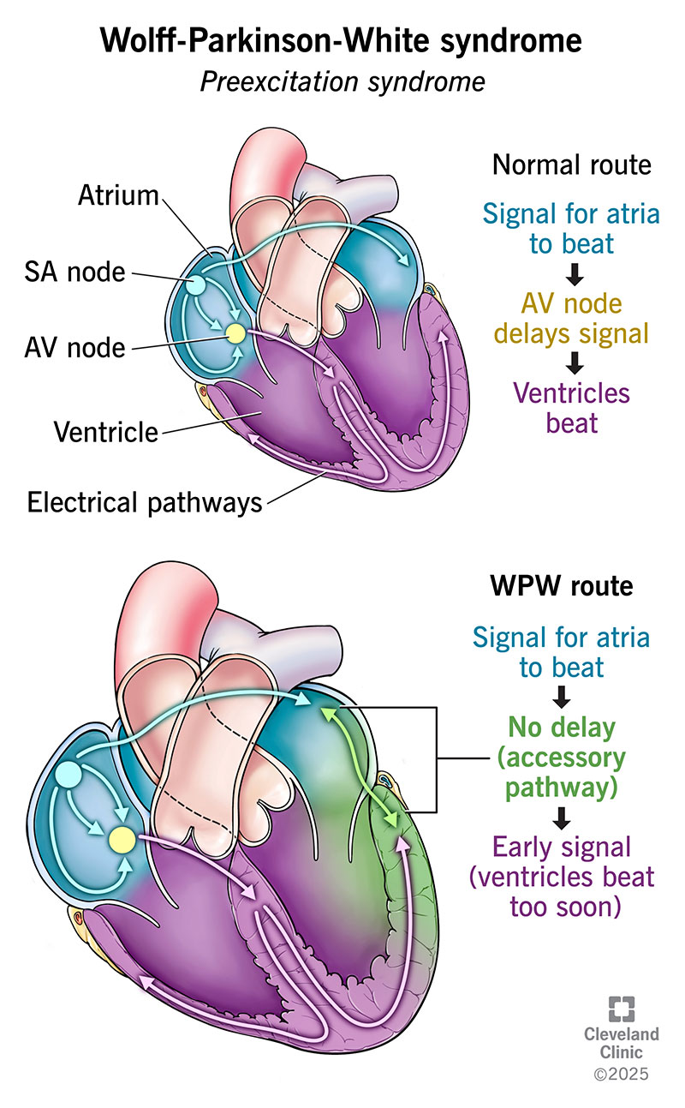
Wolff-Parkinson-White Syndrome
Mechanism: An accessory pathway bypasses the AV node, causing early ventricular activation
  May progress to AVRT (atrioventricular reentrant tachycardia)
  Most concerning is progression to Afib
Source: Cleveland Clinic

Slide 60
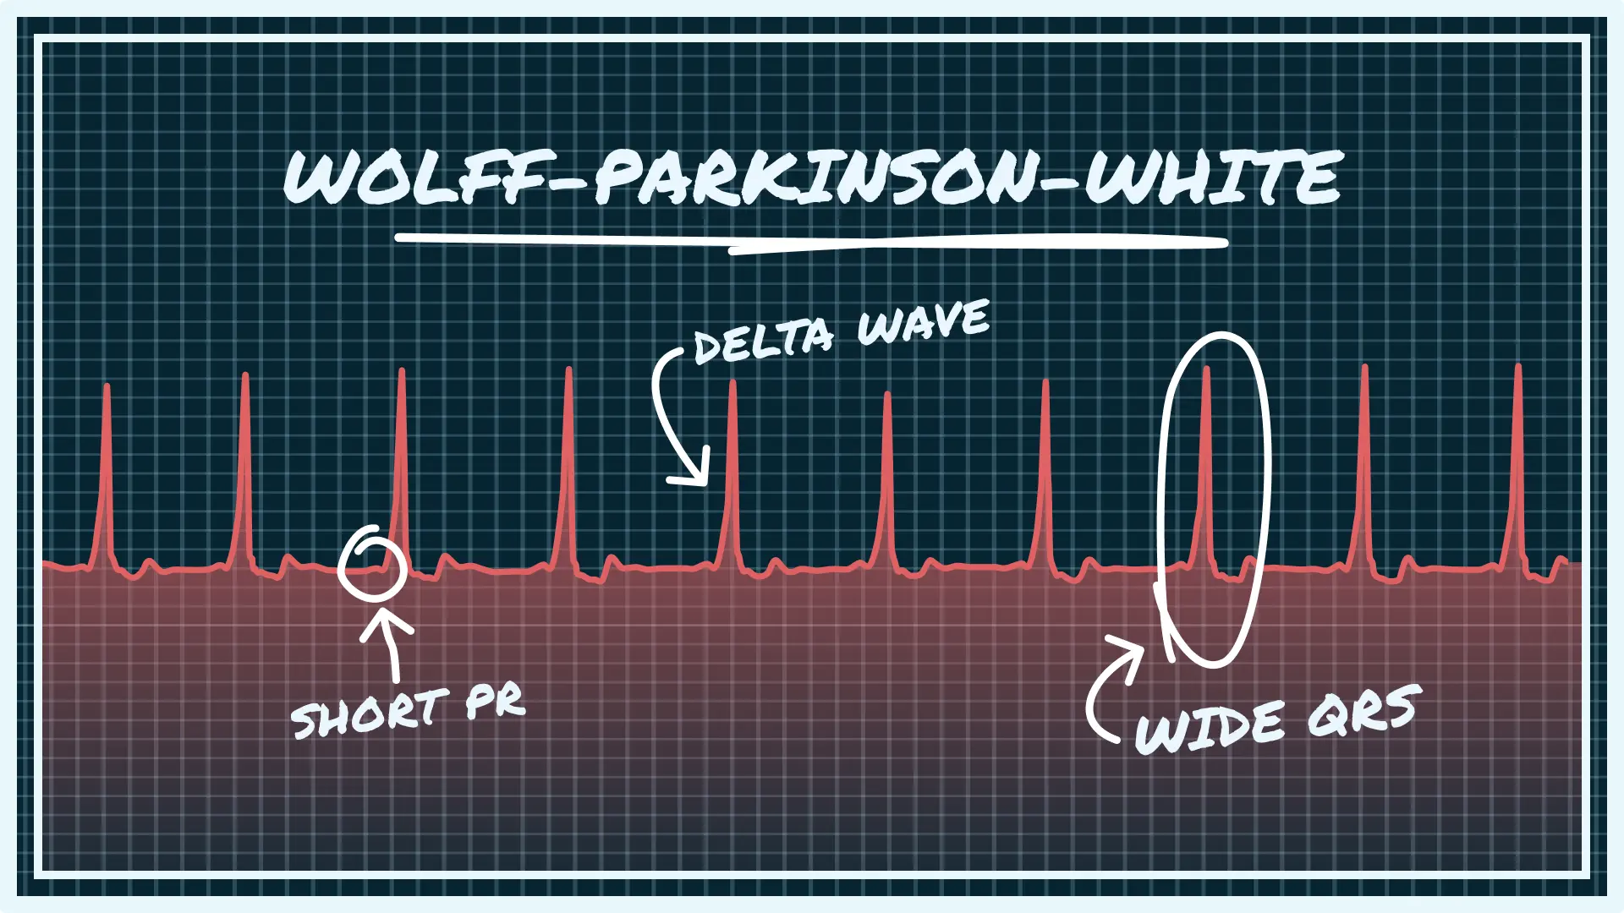

Slide 61
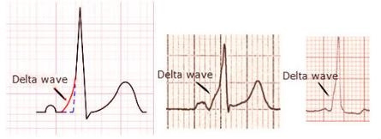
WPW Syndrome
EKG findings:
Short PR interval
Delta wave (slurred upstroke at start of QRS)
Wide QRS
Symptoms: Most patients with WPW pattern are asymptomatic. A minority of patients develop paroxysmal arrhythmias
  Palpitations, CP, SOB, syncope, SCD

Slide 62

Brugada Syndrome
Autosomal dominant genetic disorder
Epidemiology:
  Majority are of Southeast Asian descent, M > F
  Typically diagnosed in adulthood
  Brugada Syndrome less prevalent than Brugada Pattern (EKG findings only)
Increases the risk of ventricular tachyarrhythmias and sudden cardiac death

Slide 63
Brugada Pattern vs. Brugada Syndrome
Brugada Pattern:
  Typical EKG features
  Asymptomatic with no other clinical criteria
Brugada Syndrome:
  Typical EKG features
  History of sustained ventricular tachyarrhythmia, sudden cardiac death, or other associated clinical criteria (such as syncope)

Slide 64
Brugada Syndrome
Clinical presentation:
  Sudden cardiac arrest – initial presentation in up to 1/3 of pts, due to VF or polymorphic VT
  Syncope
  Palpitations
EKG findings:
  Pseudo-right bundle branch block
  Persistent ST elevation in leads V1 and V2

Slide 65

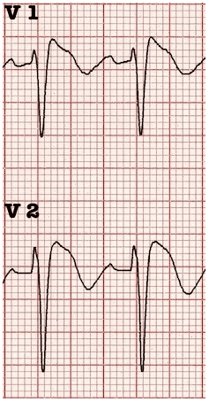

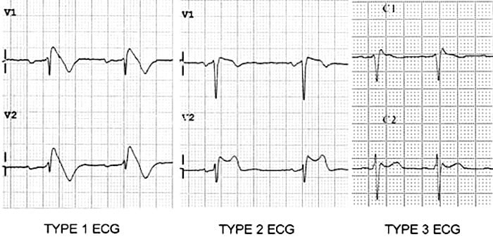
Types of Brugada Patterns
Type 1:
Elevated ST segment descends with an upward convexity to an inverted T wave (“coved,” shark fin)
Type 2:
“Saddleback” appearance
Elevated ST segment descends towards the baseline then rises to an upright T wave

Slide 66
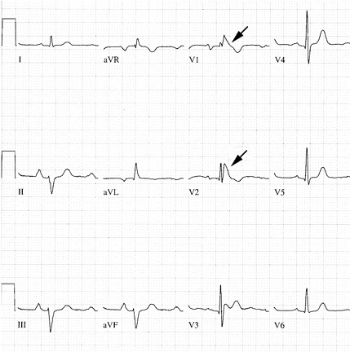
Characteristic down-sloping ST elevation
Type 1 Brugada

Slide 67
Brugada Syndrome
Provoking Factors
Fever
Medications
  Sodium channel blocker, such as flecainide
  Beta blockers
  Tricyclic antidepressants
  And others
Toxins – alcohol, cocaine

Slide 68
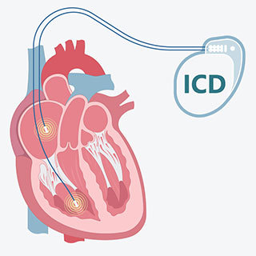
Brugada Syndrome
Management
First line therapy – ICD device
  If recurrent ventricular arrhythmias occur, may add antiarrhythmic or ablation
Brugada pattern does not require treatment if no other clinical criteria are present

Slide 69
Cardiopulmonary Obstruction + Syncope
Pulmonary Embolism
Myocardial
Infarction
Aortic
Dissection
Cardiac
Tamponade

Slide 70
Cardiopulmonary Obstruction
Pulmonary Embolism
  Pulmonary embolism → Acute obstruction of the pulmonary vascular bed → Reduced CO
Myocardial Infarction
  Syncope caused by myocardial dyskinesia following an acute MI → Reduced CO

Slide 71
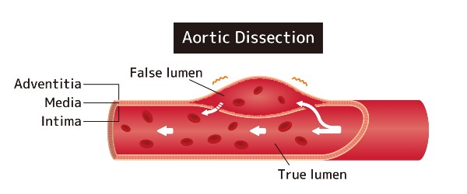
Cardiopulmonary Obstruction: Aortic Dissection
  Mechanism:
  A tear in the inner lining of the aortic wall → False lumen is created → Physically compresses the true lumen → Systemic blood flow drops instantly

Slide 72
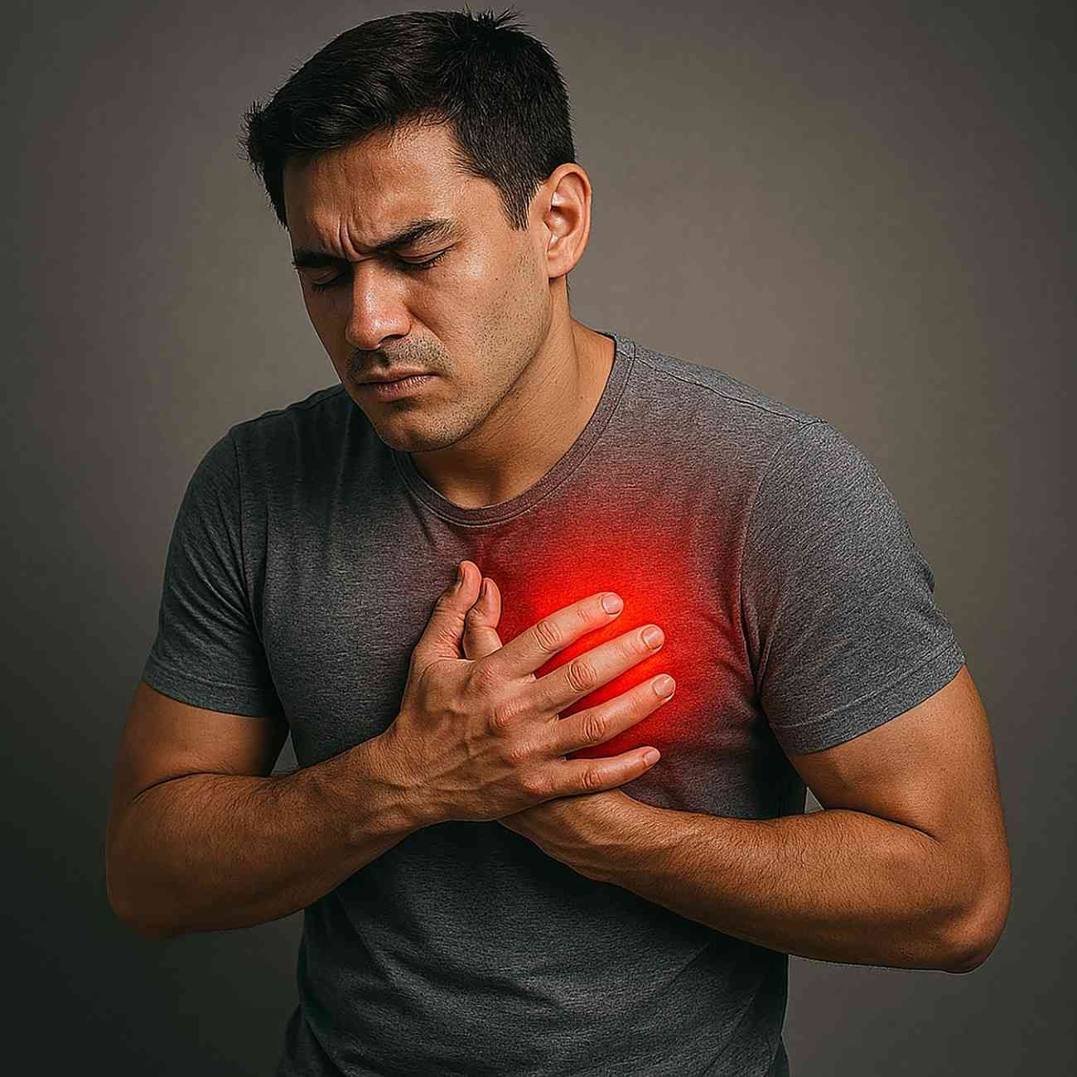
Cardiopulmonary Obstruction
Aortic Dissection
Symptoms:
  Tearing or “ripping” chest pain radiating to back
Diagnosis:
  CT with contrast
  Echo
  Chest XR (widened mediastinum)

Slide 73
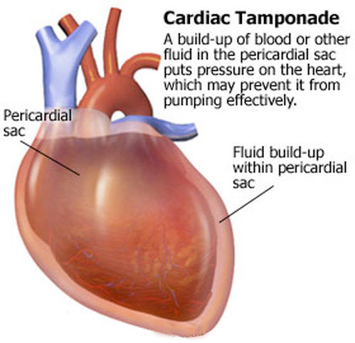
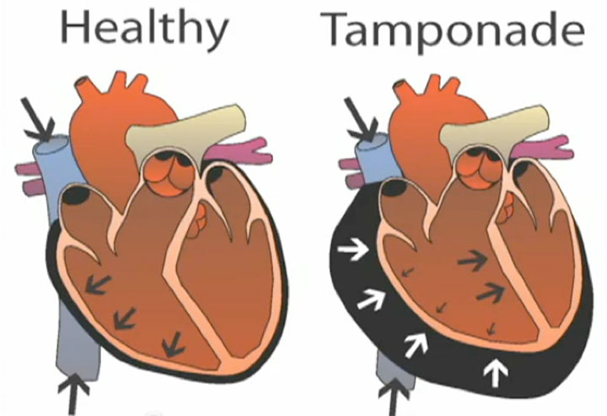
Cardiac Syncope due to Obstruction:
Cardiac Tamponade

Slide 74
Cardiopulmonary Obstruction
Cardiac Tamponade
  Mechanism: Excess fluid builds up around the heart → Puts pressure on the heart → Poor diastolic filling → Decreased CO
  Symptoms:
    Hypotension, JVD, distant heart sounds
  Diagnosis:
    ECG: Low voltage or electrical alternans
    Best diagnosed with bedside or formal echo

Slide 75
It’s All in the History!
Careful history taking about present and previous attacks, as well as eyewitness accounts
Details of triggers, symptoms, signs before, during, and after the syncopal event
Any PMHx of cardiac or neurologic disease?
Any family history of sudden cardiac death?
Red flags – falls or single car crashes w/o apparent cause, or history of driving off the road

Slide 76

What symptoms associated with syncope should raise concern for a life-threatening emergency?
Symptom | Possible Diagnoses
Chest pain | Acute MI, aortic dissection, PE, aortic stenosis
Palpitations | Arrhythmias
Shortness of breath | PE, CHF
Abdominal or back pain | Leaking AAA or ruptured ectopic pregnancy
Sudden syncope w/o warning or associated w/ exertion | Suspect possible arrhythmia or structural cardiopulmonary lesion

Slide 77
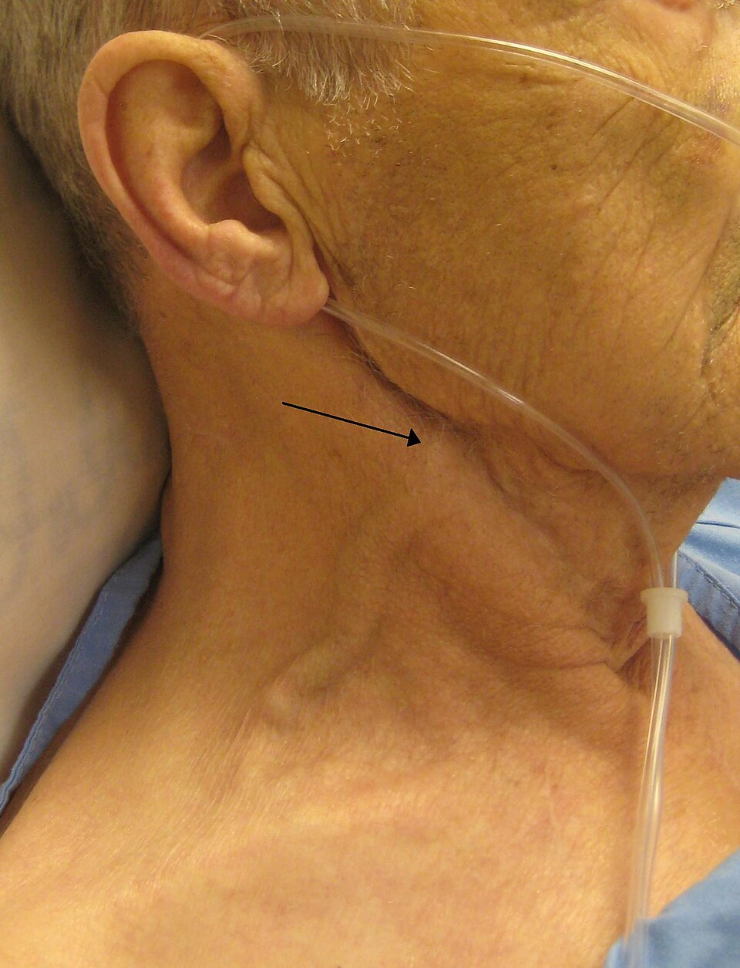
Physical Exam in Cardiac Syncope
Possible abnormalities on physical exam:
Irregular rhythm
New murmur
S3/S4 gallop
Jugular venous distension
LE edema, pulmonary rales
Notes:
https://en.wikipedia.org/wiki/Jugular_venous_pressure

Slide 78
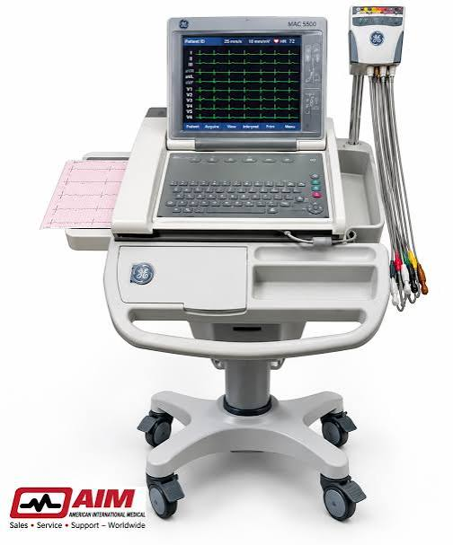
Evaluation of Syncope
The American College of Emergency Physicians state that history, physical exam, and 12-lead EKG are the only Level A recommendations for the evaluation of syncope.
Our best way to identify life-threatening or arrhythmogenic causes!

Slide 79
Diagnostic Evaluation
Initial tests:
  Obtain a 12-lead EKG
  Place the patient on a cardiac monitor
Laboratory tests:
  CBC, BMP
  Urine pregnancy test
  Troponin, BNP
  D-dimer
Assess for:
Prior cardiopulmonary dz
Acute ischemia
Arrhythmia
Heart block
Abnormal QT

Slide 80
High-risk EKG findings in syncope
Diagnostic findings:
  Mobitz II or 3rd degree AV block
  Alternating bundle branch block
  Sinus pauses >3 s or sinus brady < 40 bpm while awake
  Sustained VT or SVT > 160 bpm
  Acute ischemia
Notes:
These are more for reference. But you can walk through these diagnostic and concerning/suspicious findings and try to match what diseases they are associated with.

Slide 81
High-risk EKG findings in syncope
Suspicious (needs monitoring or workup):
  Bifascicular block
  Q waves
  Delta wave
  Long or short QT
  Brugada type 1
  LVH pattern
  Paced rhythm

Slide 82
Post-ED Testing for Syncope
Test | Indication | Utility
CARDIAC SYNCOPE
ECG monitoring | Admission Outpatient event/Holter if no significant cardiac disease suspected | Cardiac syncope confirmed if recurrent symptoms occur during monitored arrhythmia; excluded if recurrent sx reported during sinus rhythm
Echo | History, exam, or ECG suggestive of structural heart disease | Confirms and quantifies structural heart disease

Slide 83
Post-ED Testing for Syncope
Test | Indication | Utility
CARDIAC SYNCOPE
Stress testing | Exercise-related syncope | Identifies exercise-induced arrhythmia and post-exercise syncope
REFLEX SYNCOPE
Tilt-table testing | Recurrent syncope, cardiac etiology excluded | Identifies vasovagal syncope and POTS

Slide 84
Risk Stratification
Admit vs Discharge
Admission:
  Obvious cardiac or neurologic causes
  Concerning EKG, comorbidities, symptoms
Discharge
  Vasovagal, orthostatic, medication-induced syncope (no increased morbidity and mortality)
Unclear cause:
  For well-appearing, asymptomatic pts, assess risk for adverse outcomes before deciding to discharge

Slide 85
Who is a high-risk patient?
High risk indicators
Abnormal EKG Suspicion of structural heart disease, especially a history of heart failure Persistently low BP (systolic < 90 mmHg) Hematocrit < 30 Shortness of breath SBP < 90 mm Hg Family history of sudden cardiac death Advanced age with comorbidities

Slide 86
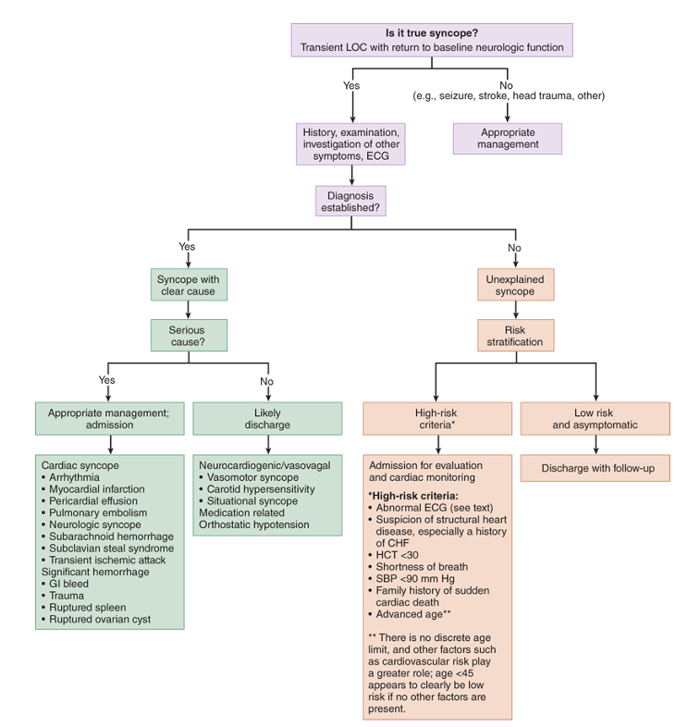
Source: Tintinalli’s Emergency Medicine 8e

Slide 87
Important Mimics
of Syncope

Slide 88
Syncope vs. Seizure
Syncopal Episode | Epileptic Seizure
Presyncope present Spontaneous return of consciousness Decreased muscle tone No postictal state No tongue biting | Tonic-clonic movements Postictal confusion Tongue biting (lateral) Increased muscle tone during event Witnessed head turning, unusual posturing
Urinary incontinence or evidence of trauma can be in either.
Notes:
Distinguishing between epilepsy and syncope from history alone can be difficult.
For example, urinary incontinence does not distinguish between syncope and epilepsy and may occur in 10-20% of syncopal events, especially in older adults.

Slide 89
But what about syncope with convulsions?
Syncope with convulsions
→ Limb-jerking is brief, typically few seconds
True seizures
→ Sustained rhythmic convulsive activity lasts for >30 seconds, or generalized tonic-clonic movements from the outset is more consistent with a seizure
Clinical pearl: 10:20 rule

Slide 90
Special Populations
In Syncope

Slide 91
Taking Pt History for Special Populations
Elderly:
  Common issues: physiological problems, cardiovascular disease
  Aortic stenosis is a common structural issue
  Always review meds – check for meds that can cause bradycardia, orthostatic hypotension, QT prolongation
Children and adolescents:
  Assess if syncope is related to activity or sports
  Possible causes: HOCM, septal defects, breath holding
  Family history – heart disease, QT prolongation, arrhythmia, sudden cardiac death

Slide 92

Syncope in Pregnancy
Etiologies to consider:
Dehydration (hyperemesis gravidarum)
Ectopic pregnancy
Pulmonary embolism
3rd trimester – enlarged uterus compresses IVC, decreasing venous return
Notes:
https://i0.wp.com/post.medicalnewstoday.com/wp-content/uploads/sites/3/2020/07/GettyImages-187594790_header-1024x575.jpg?w=1155&h=1528

Slide 93
Case Study
Mick, 82 y/o M
Syncope after going to bathroom
New systolic murmur on exam
Aortic valve calcification on echo
What is the DDx for his case?
What is the most likely cause of his syncope?

Slide 94
Case Study
Jessie, 38 y/o F
Syncope after walking home from her concert. She had palpitations beforehand then suddenly fainted. Hypotensive with wide complex tachy on EKG and after AED shock, EKG showed sinus tach w/ Delta waves.
What is the most likely cause of her syncope?

Slide 95
Associated with Noncardiac Syncope
Younger age Syncope only in standing position Positional change from supine or sitting to standing Presence of prodrome: nausea, vomiting, feeling warm Presence of specific triggers: dehydration, pain, medical environment (hospital/clinic) Situational triggers: cough, laugh, micturition, defecation

Slide 96
Associated with Cardiac Syncope
Older age (>60 years) Male sex Presence of known ischemic heart disease, structural heart disease, previous arrhythmias, or reduced EF Brief prodrome, such as palpitations or sudden LOC without prodrome Syncope during exertion Syncope in the supine position Low number of syncope episodes (1 or 2) Abnormal cardiac examination Family history of sudden cardiac death

Slide 97
References
Benditt D. Carotid sinus hypersensitivity and carotid sinus syndrome. In: UpToDate. Wolters Kluwer. Updated December 10, 2025. Accessed October 29, 2026. UpToDate: Carotid Sinus Hypersensitivity and Carotid Sinus Syndrome
Benditt D. Syncope in adults: Epidemiology, pathogenesis, and etiologies. In: UpToDate. Wolters Kluwer. Updated December 3, 2024. Accessed October 29, 2026. UpToDate: Syncope in Adults
Helman A. Best practices for emergency department syncope risk assessment. ACEP Now. December 31, 2022. Accessed October 29, 2026. ACEP Now article
Hawks MK, Paul MLB, Malu OO. Sinus node dysfunction. Am Fam Physician. 2021;104(2):179-185. American Family Physician article
Kenny RA. Syncope. N Engl J Med. 2026;395(6):582-591. doi:10.1056/NEJMcp2517255. NEJM article

Slide 98
References
Larkin J, Cadogan M, Buttner R. Brugada syndrome. Life in the Fast Lane. Updated October 22, 2024. Accessed October 29, 2026. LITFL: Brugada Syndrome
Quinn J. Syncope. In: Tintinalli JE, Stapczynski JS, Ma OJ, et al, eds. Tintinalli's Emergency Medicine: A Comprehensive Study Guide. 8th ed. McGraw Hill; 2016. Chapter 52. AccessMedicine: Chapter 52—Syncope
Statz GM, Evans AZ, Johnston SL, et al. Can artificial intelligence enhance syncope management? A JACC: Advances multidisciplinary collaborative statement. JACC Adv. 2023;2(3):100323. doi:10.1016/j.jacadv.2023.100323. JACC: Advances article
Wylie JV. Brugada syndrome: Clinical presentation, diagnosis, and evaluation. In: UpToDate. Wolters Kluwer. Updated September 8, 2026. Accessed October 29, 2026. UpToDate: Brugada Syndrome

