Slide 1
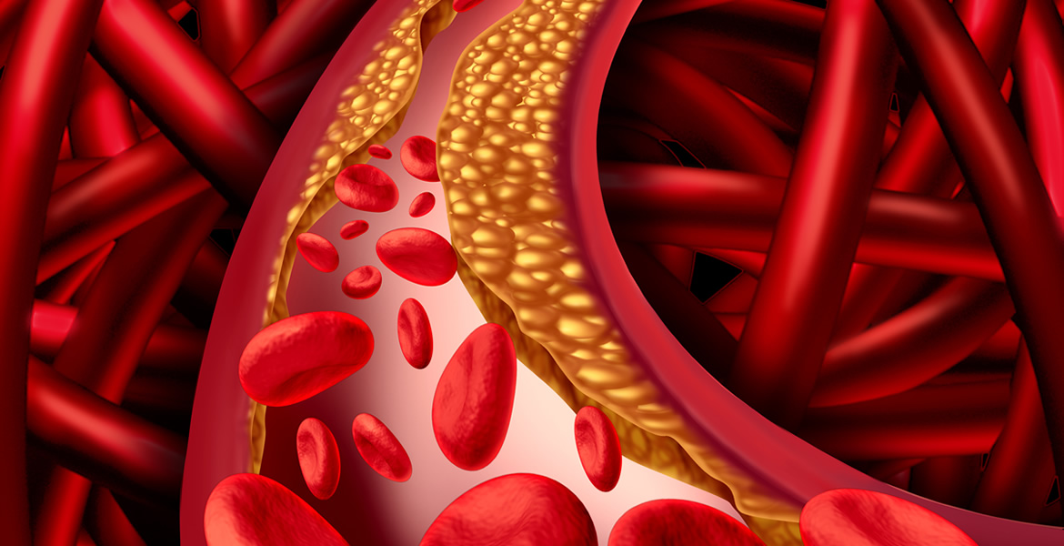
Vascular Disease
Elizabeth M. Diem MPAS, PA-C

Slide 2
Vascular Disease
Peripheral Arterial Disease
Aortic Aneurysm/Dissection
Arterial Thrombosis/embolism/vasculitis
Phlebitis/Thrombophlebitis
Venous Insufficiency / Varicose veins
Venous Thromboembolism

Slide 3
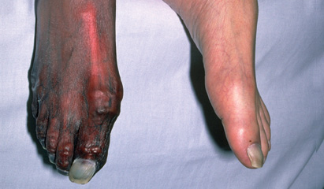
Peripheral Arterial Disease (PAD)

Slide 4
PAD
Atherosclerosis of the lower extremities
  Can involve upper extremities too
  Subintimal accumulation of lipids and fibrous material that can:
    Narrow vessel lumen (stenosis)
    Plaque can rupture and cause embolism (occlusion)
Higher incidence in MEN, and African American
  Increases with age, can affect women as well
Patients may describe this as “poor circulation”

Slide 5
PAD
Risk Factors that contribute to atherosclerosis:
  Smoking
  Diabetes mellitus
  Hyperlipidemia
  Hypertension
  Age
  FH
Same risk factors for cardiovascular disease
Presence of PAD confers high 10-year Cardiovascular disease (CVD) risk

Slide 6
PAD-Intermittent Claudication
Defined as a pain (ache or cramp), numbness, or a sense of weakness in leg muscles.
  It occurs during exercise and is relieved by rest
    The supply of blood may be adequate to meet the demands of inactive muscle, therefore no pain at rest
    Due to atherosclerosis, a mismatch develops between the supply of blood and increased demand induced by activity.
    Site of claudication symptoms will be distal to location of lesion

Slide 7
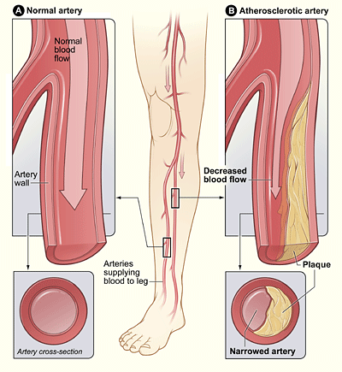
This causes a supply and demand problem

Slide 8
Pseudeoclaudication (Lumbar spinal stenosis)
Can mimic PAD
NOT a condition caused by PAD
Important to differentiate from claudication
Persistent muscle pain, weakness, tingling in lower extremities
Exacerbated by standing erect
Most patients report relief with sitting down or flexion at the waist (leaning forward) while walking.
  No pain with sitting was the most specific finding.

Slide 9
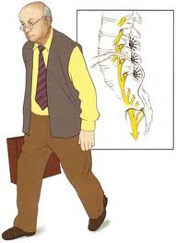
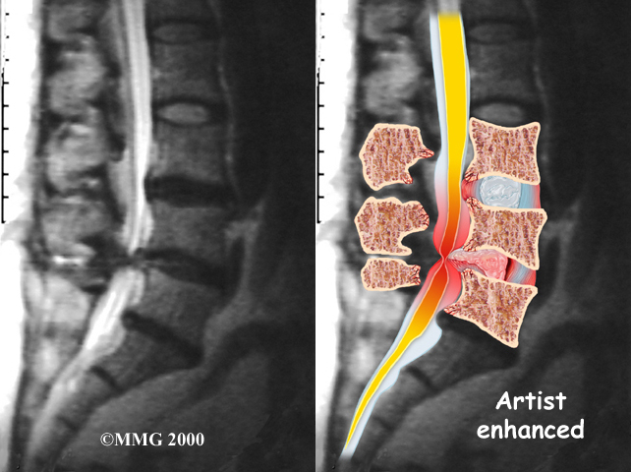
Pseudoclaudication

Slide 10
DDx for Calf pain
Can’t miss:
  Claudication-PAD
  Ischemic leg
  DVT
Other DDx:
  Muscular strain
  Bakers (popliteal cyst)
  Superficial thrombophlebitis
  Varicose veins
  Achilles tendon rupture
  Myositis (ex: polymyositis, dermatomyositis)
  Vasculitis (big umbrella)
  Spinal stenosis

Slide 11
PAD
History
Complains of claudication symptoms
Cardiovascular risk factors
  DM, HTN, HLD, Age, Sex, smoking
Established hx of CAD, CVA, MI

Slide 12
PAD: PE
Poor peripheral pulses
Presence of bruit over narrowed artery
Muscle atrophy
With more severe disease:
  Smooth thin, and shiny skin
  Hair loss
  Skin changes (dusky color, bluish, cool)
  Ulcerations
  Thickened nails
  Dependent rubor
  If there is edema it is mild

Slide 13
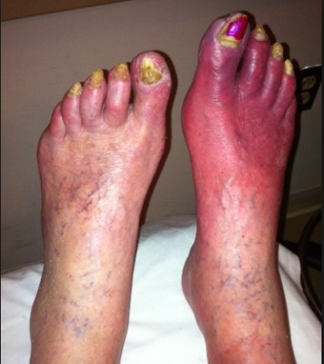
What do you suspect this is?

Slide 14
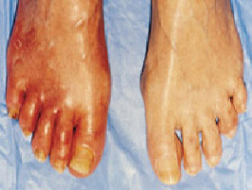
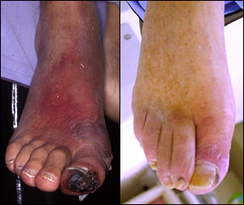
PAD Skin Changes

Slide 15
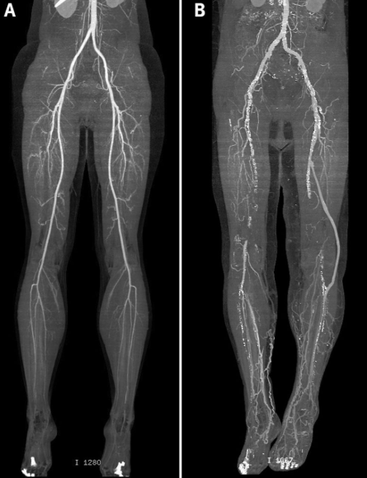
PAD
CTA of lower extremities
A: normal
B: PAD
Other than the obstruction what else do you notice that’s different?

Slide 16
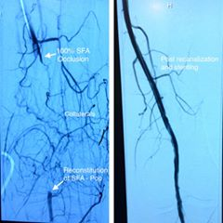
Collateral Circulation
Notice the network of small vessels on the left
On the right collaterals are no longer seen after the blockage is opened up
Collaterals are a natural bypass our body does to protect itself…how AWESOME!

Slide 17
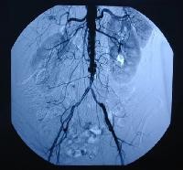
Leriches Syndrome: Aortoiliac Occlusive Disease
Due to severe atherosclerosis of abdominal aorta and iliac arteries
Causes claudication symptoms in buttock, thigh, and hip
Often associated with erectile dysfunction/impotence
Physical exam denotes poor femoral pulses
Treatments options are:
  Aortoiliac Bypass Graft

Slide 18
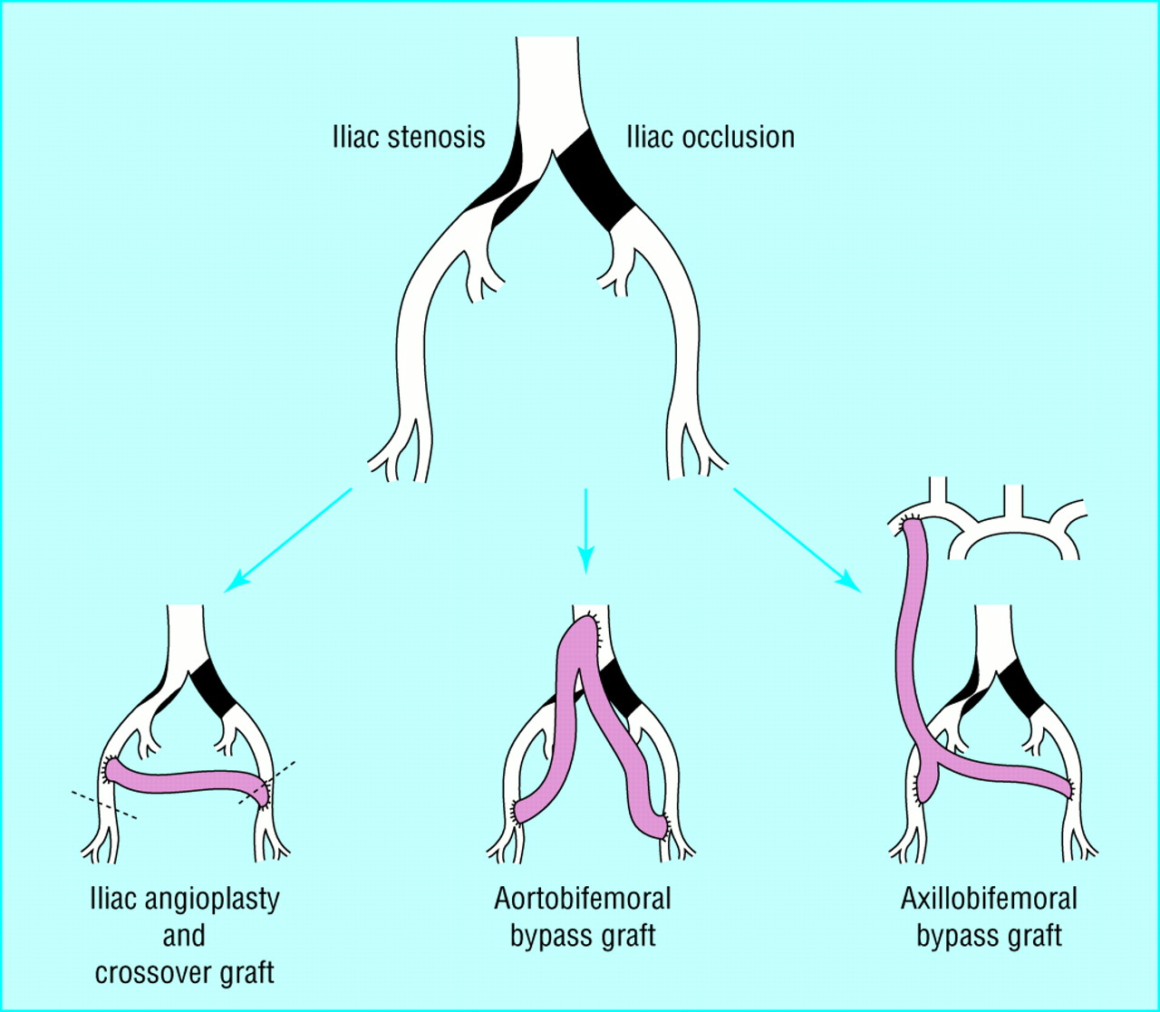
Aortoiliac Bypass grafts

Slide 19
Complication of PAD
Claudication
    ~20% of patients have worsening claudication over time
Ischemic ulcerations of lower extremities
    Need for revascularization surgery
    ~10%
Amputations
    ~1-2%
Increased risk of Cardiovascular Event (CVA, AMI)
    ~20%

Slide 20
PAD: Diagnosis with ABIs
Based on clinical suspicion and Ankle-Brachial Index can be done at the bedside
  Calculation of the ankle-brachial index (ABI) is simple and inexpensive method to confirm the clinical suspicion of lower extremity arterial occlusive disease.
  The resting systolic blood pressure at the ankle is compared with the systolic brachial pressure and the ratio of the two pressures defines the ankle-brachial (or ankle-arm) index.
  This index provides a measure of the severity of disease.

Slide 21
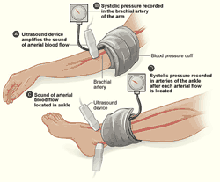
ABI
Calculation of the ankle-brachial index (ABI) at the bedside is usually performed with a Continuous-wave Doppler probe

Slide 22
Obtaining an ABI
The patients must rest for 15 to 30 minutes prior to measuring the ankle pressure.
To obtain the ABI, place a blood pressure cuff just above the ankle. While listening to either the dorsalis pedis or posterior tibial artery signal with a continuous wave Doppler, insufflate the cuff to a pressure above which the audible Doppler signal disappears. Slowly release the pressure in the cuff just until the pedal signal returns and record this systolic pressure. Repeat the measurement process in the contralateral lower extremity.
Measure the systolic brachial artery pressure bilaterally in a similar fashion with the blood pressure cuff placed around the upper arm and using the continuous wave Doppler.
The ABI for each lower extremity is calculated by dividing the ankle pressure in each lower extremity by the brachial artery systolic pressures.

Slide 23
Classification of PAD based on ABI
ABI Value | Interpretation | Clinical Recommendation
>1.4 | Calcification/Vessel Hardening (Non-compressible arteries) | Refer to Vascular
1.0-1.4 | Normal | None
0.91 - 0.99 | Acceptable/Borderline | None
≤0.90 | Abnormal - PAD | Treat lifestyle risk factors, medical therapy, Refer to Vascular
ABI confirms the presence of PAD but does not independently determine clinical severity of the need for revascularizing

Slide 24
PAD: Diagnostics
Arterial Duplex US helpful for calcified vessel.
  Gives info on location and severity of lesion
Exercise treadmill tests are useful for assessing patient’s limitations with claudication

Slide 25
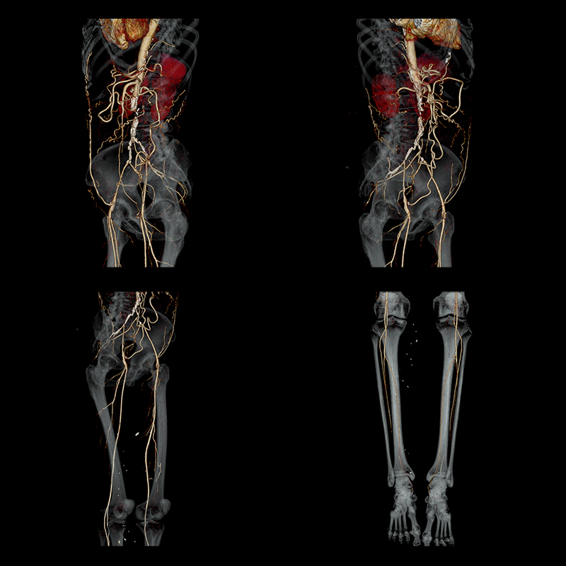
PAD: CTA
CT Angiography (CTA) or Magnetic Resonance Angiogram (MRA) of lower extremities
  Very helpful for anatomy
  For patients that will undergo revascularization, catheter directed angiography is done.

Slide 26
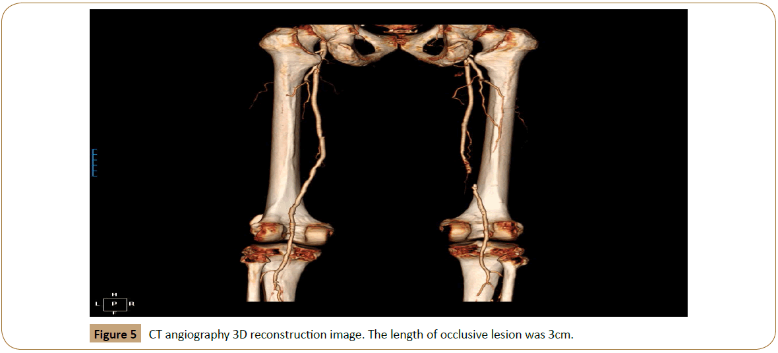
CTA of Extremity

Slide 27
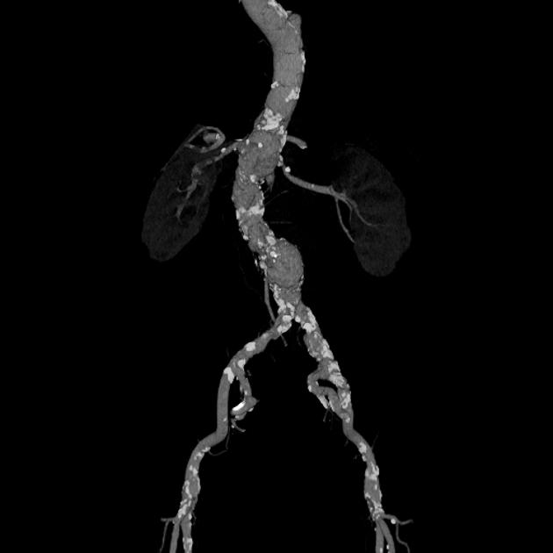
Atherosclerosis appearance on CT

Slide 28
So how do we use all these studies to diagnose PAD?
History and physical exam + resting ABIs
    If ABI is ≤0.90 this confirms PAD
      Consider referral to vascular
        Advanced imaging (duplex US, CTA, MRA or catheter angiography) is generally reserved for patients being considered for revascularization
        Suspect limb-threatening ischemia requires emergent referral
Claudication or exertional leg symptoms with normal or borderline ABI (0.91-1.40) obtain Exercise treadmill testing
If ABI is inconclusive ( >1.4) or diagnosis is uncertain toe-brachial index (TBI) can be ordered.
    If diagnosis remains uncertain additional vascular testing may be considered.

Slide 29
When to choose alternative imaging
Arterial Duplex US can be used:
  If ABI uncertain
  Exercise testing is positive, more advanced imaging can be considered
  ABI confirms PAD and arterial localization is needed
  Evaluating suspected restenosis or bypass graft stenosis
  When iodinated contrast should be avoided
  If serial vascular surveillance is needed
CTA with contrast when:
  Detailed arterial mapping is needed for revascularization
    Vascular surgeon needs lesion length, distribution and detailed mapping of anatomy
  Multilevel or aortoiliac disease is suspected
  Duplex ultrasound is technically limited or inconclusive

Slide 30
Review of Diagnostics
ABI: Establishes the physiological diagnosis of PAD.
Duplex ultrasound: Evaluates arterial blood flow and localizes stenosis or occlusion.
CTA: Provides detailed arterial anatomy for intervention planning and revasculaization.
Catheter angiography: Invasive evaluation that can also permit immediate endovascular treatment.
  Done by interventionalist or vascular surgery.

Slide 31
Vascular Testing in Asymptomatic Patients
Abnormal or absent pulse
Age ≥65
Age 50–64 with PAD risk factors
Measure ABI
Less than or equal 0.9
0.91-1.4
>1.4
PAD confirmed
No further testing needed if asymptomatic
Obtain TBI

Slide 32
Clinical Categories of PAD
Asymptomatic PAD:
  Objective evidence of PAD without recognized leg symptoms
  Focus: Cardiovascular risk reduction
2. Chronic Symptomatic PAD
  Claudication or other chronic exertional leg symptoms
  Focus: Risk reduction and symptom relief
Chronic Limb-Threatening Ischemia
  Ischemia rest pain, nonhealing wounds, or gangrene, typically lasting more than 2 weeks.
  Focus: Urgent vascular evaluation and limb preservation
4. Acute Limb Ischemia
Sudden reduction in limb perfusion threatening limb viability
Focus: Immediate emergency vascular evaluation

Slide 33
PAD: Primary Care Management
Goal: Reduce major adverse cardiovascular events (MACE) and major adverse limb events (MALE), improve symptoms and functional status, and preserve limb function.
Cornerstone of therapy is treatment of risk factors for atherosclerosis, lifestyle modification, and antiplatelet therapy.
  HTN and DM control
  LDL to goal using high intensity statin therapy
  Smoking cessation
  Healthy diet
  Weight loss if obese
  Structured exercise therapy improves symptoms

Slide 34
PAD: Pharmaceutical Management
Aspirin 81-325 mg daily( 81 mg commonly used)
  Option for symptomatic and asymptomatic PAD
  Decreases risk of cardiovascular event
Clopidogrel 75 mg daily
  Option for symptomatic and asymptomatic PAD
  Decreases risk of cardiovascular event
Rivaroxaban (Xarelto) + Aspirin
  Reduces risk of cardiovascular event and limb events
  Recommended for symptomatic PAD and following revascularization
  Consider bleeding risk before
Cilostazol (Pletal)
  Improves walking distance and claudication
  Maybe initiated alongside structured exercise therapy
  Contraindicated in CHF (increases mortality)
Cardiovascular/Limb Reduction
SYMPTOMATIC
BENEFIT

Slide 35
PAD Antiplatelet Therapy Recommendations
Symptomatic PAD: Single antiplatelet therapy is recommended (Class I).
Asymptomatic PAD: Single antiplatelet therapy is reasonable (Class IIa), with consideration of bleeding risk.
  Clinical Pearl: Asymptomatic PAD still carries increased cardiovascular risk, but the evidence supporting antiplatelet therapy is less definitive than in symptomatic PAD

Slide 36
Clinical Classification of PAD
2024 ACC/AHA Guidelines
  PAD is classified into fourth categories listed previously. They help determine:
    Appropriate treatment and management
    Urgency of vascular evaluation
    Need for potential revascularization
Additional Classification Symptoms:
  Rutherford: Describes chronic PAD severity, from asymptomatic disease to tissue loss.
  Fontaine: Classifies chronic PAD by symptoms, walking limitations, rest pain, and tissue loss
  Wifl (Wound, Ischemia, Foot infection): Assess limb threat in patients with chronic limb-threatening ischemia (CLTI)

Slide 37
Revascularization
Percutaneous revascularization
  Indicated for small stenosis whereas
Arterial Bypass
  Indicated for:
    Longer areas of stenosis.
    SEVERE claudication (ABI < 0.4) with symptoms REFRACTORY to medical management
    ACUTE LIMB ISCHEMIA (ALI)
      Caused by an arterial embolus or thrombosis in situ
      Vascular emergency
    For vasculogenic erectile dysfunction (Leriche syndrome)

Slide 38
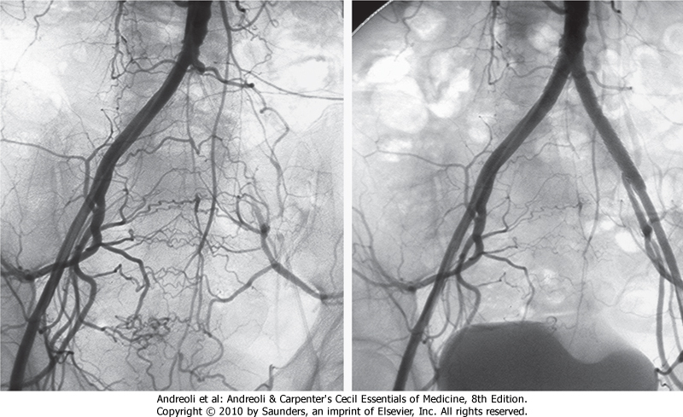
Percutaneous Revascularization with Stent Placement
OCCLUDED ILIAC
STENT
COLLATERAL

Slide 39
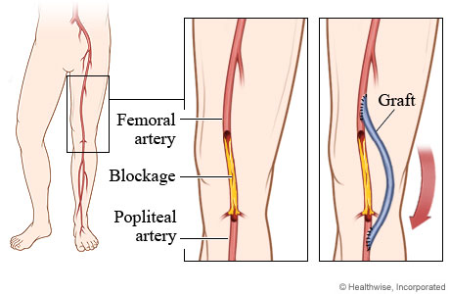
Femoral-Popliteal Bypass

Slide 40
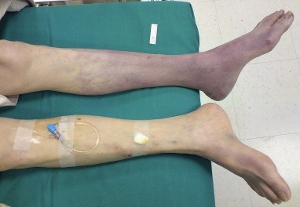
Acute Limb Ischemia

Slide 41
Acute Limb Ischemia
Sudden occlusion of lower (or upper) extremity artery secondary to:
  Arterial embolism:
    left ventricular mural thrombus
    atrial thrombus from atrial fibrillation
    valvular thrombus
    septic emboli
    Atherosclerotic plaque rupture
  Thrombosis in situ:
    thrombosis of atherosclerotic plaque

Slide 42
Acute Limb Ischemia: Symptoms
Sudden onset of symptoms
The 6Ps of acute ischemic limb:
  Pain
  Pallor
  Pulseless
  Poikilothermic
  Paresthesias
  Paralysis
Crescendo pattern over hours to days
Late findings

Slide 43
Acute Ischemic Limb
PAD
O: sudden
L: right leg; knee down to foot
D: 2 hours
C: Crampy, achy
A: nothing!!!!
A: movement, walking
R: None
T: progressively getting worse. constant
S: 20/10
O: gradual
L: right calf
D: 2 months
C: crampy, ache, heavy, burning, numb
A: sitting; when I stop walking
A: when I walk…How long till it comes on?
R: None
T: maybe it’s gotten worse or maybe it has stayed the same
S: 4/10 when walking; 0/10 when sitting

Slide 44
Acute Limb Ischemia: Exam
Extremity will be pale or cyanotic (bluish)
Skin may be mottled initially
Absent distal pulses
Diminished motor/sensory functioning (neurovascular damage):
Paralysis is a later finding

Slide 45
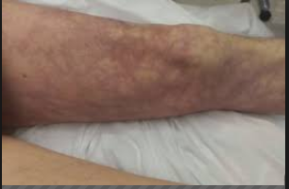
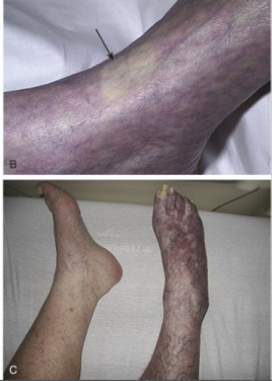
Acute Limb Ischemia: Exam

Slide 46
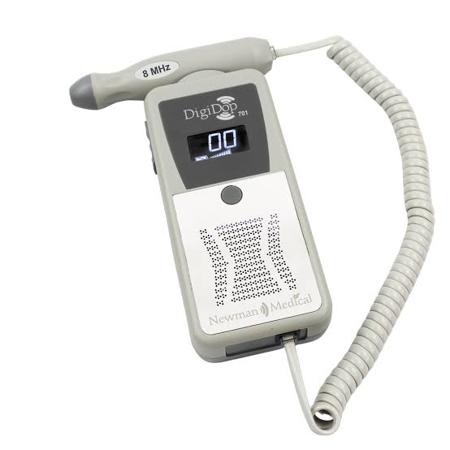
Acute Ischemic Limb: Diagnostics
Vascular Surgeon consult should be initial first step and is done in unison with other ongoing studies
Doppler is used to confirm evidence of pulses
CTA with run off is helpful especially if going to surgery. Keep in mind there may be contraindications.
ABIs: Is that really needed when you can’t feel a pulse and limb is ischemic looking?- often not done and not practical in acute scenarios

Slide 47
Acute ischemic Limb: Diagnostics
Lactic acid, CK
CBC, BMP, coagulation studies
EKG…looking for arrhythmia that may have caused this such as atrial fibrillation

Slide 48
Acute Limb Ischemia: Tx (Surgical Emergency)
Anticoagulation
  Unfractionated Heparin IV
For threatened limb urgent revascularization is treatment
  Several surgical techniques decided on by surgeon (intra-arterial thrombolysis, open embolectomy, percutaneous embolectomy
Limb can be unsalvageable in as little as 4-6 hours, but not an absolute
Evidence of gangrene (tissue necrosis)
  Management is detailed in next several slides.

Slide 49
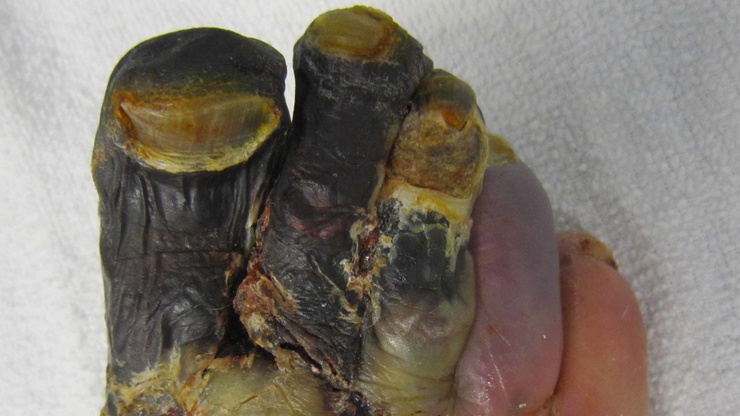
Gangrene

Slide 50
Gangrene
Tissue that has inadequate blood supply and is undergoing necrosis
Types:
Dry gangrene
  Risk factors are PAD
  Other disease processes independent of PAD cause this as well
Wet gangrene
  Tissue necrosis complicated by bacterial infection
  May develop in previously ischemic tissue
Gas gangrene (clostridial myonecrosis)
  Rapidly progressive, toxin-mediated infection of skeletal muscle

Slide 51
Dry Gangrene
Sterile ischemic necrosis
  Results from prolonged, severe reduction in arterial blood flow. (impaired blood flow)
  Tissue death occurs WITHOUT superimposed infection
Etiology:
  PAD
  Vasculitis
  Cold related injuries (frostbite)

Slide 52
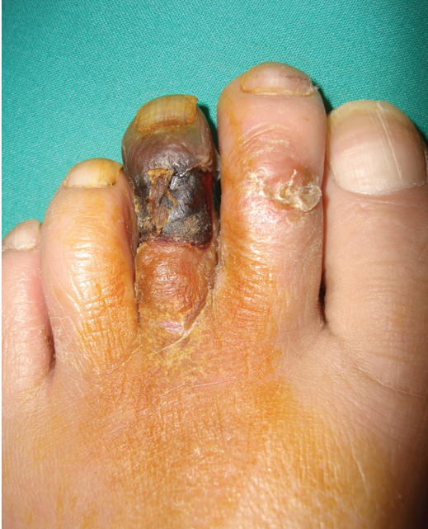
Dry Gangrene
Clinical Presentation
Dry, black eschar, which most commonly begins distally at the extremities
There is a clear demarcation between healthy tissue and necrotic tissue
  Autoamputation will eventually occur if not surgically removed

Slide 53
Dry Gangrene: Tx
Vascular surgery consult
Revascularization when indicated; does not restore what is dead
Not a surgical emergency
ABX not indicated unless superimposed infection present
Amputation and debridement when indicated of dry gangrene
ATB often not needed unless infection suspected
Managing underlying disease process medically

Slide 54
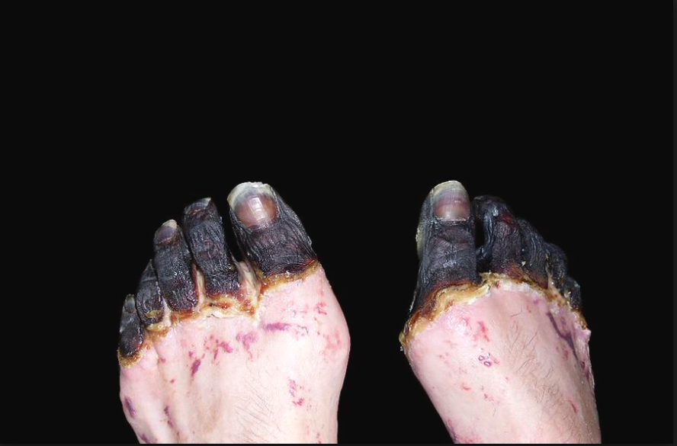
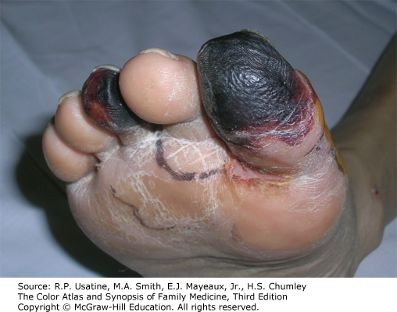
Dry Gangrene

Slide 55
Wet Gangrene
Tissue necrosis complicated by bacterial infection
  Often develops in ischemic tissue with superimposed infection
  Infection causes inflammation, edema, and rapid tissue destruction
Risk factors/Associated conditions:
  PAD, DM, acute limb ischemia
  Trauma, burns, or severe soft-tissue infection
Clinical impression

Slide 56
Wet Gangrene
Clinical presentation:
  Swollen, moist, discolored tissue
  May have bullae, drainage and foul odor
  Rapid progression with potential for sepsis
Surgical emergency:
  Requires urgent surgical evaluation and source control

Slide 57
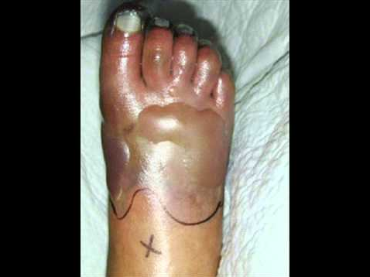
Wet Gangrene

Slide 58
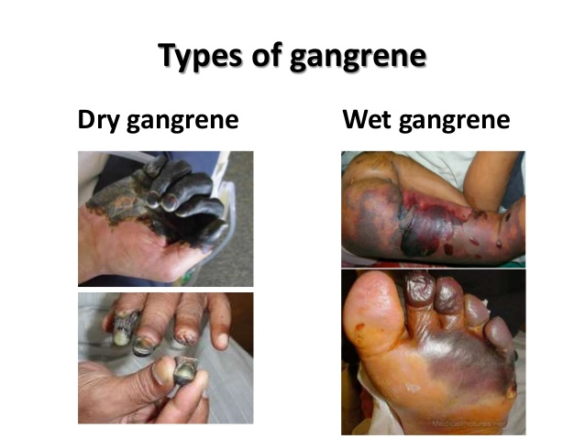
Dry Gangrene
Wet Gangrene
Moist Appearance
Blistering
Starts as an infectious processes
Corelated to an infectious process
Surgical emergency
Total tissue death
Well demarcating margins
Starts as an ischemic process
Not Infected
Will need surgery, not emergent like wet

Slide 59
Gas Gangrene (Clostridial Myonecrosis)
Pathophysiology:
  Rapidly progressive, toxin-mediated necrosis of skeletal muscle
  Most commonly caused by Clostridium perfringens
  Bacterial toxins cause muscle destruction, vascular injury, and systemic toxicity
  May progress to shock and multiorgan failure
Risk Factors:
  Deep traumatic wounds or contaminated injuries
  Recent surgery, Particularly GI/GU
  Injection drug use
  Spontaneous infection

Slide 60
Gas Gangrene: Signs & Symptoms
Early Presentation:
  Severe pain out of proportion to examination
  Rapid progressive swelling and pain
  Skin may initially appear normal or pale
  Tachycardia and systemic toxicity may develop early
Progression/Late Presentation:
  Bronze, purple, or dusky skin discoloration
  Bullae, sometimes hemorrhagic
  Crepitus from gas
  Thin, serosanguinous drainage(“dish water” appearance) with possible foul odor
  Hypotension, shock, multiorgan dysfunction

Slide 61
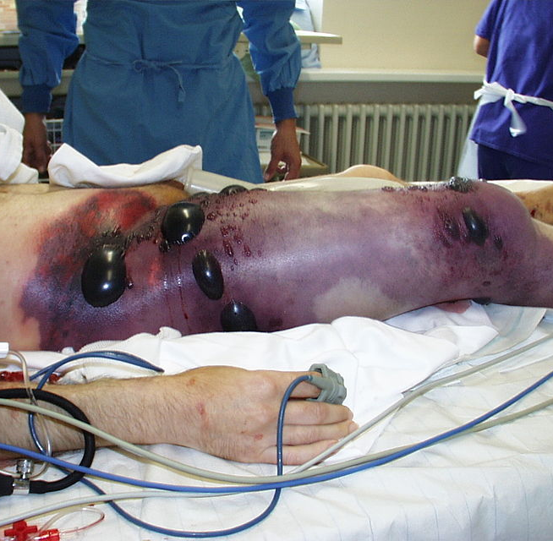
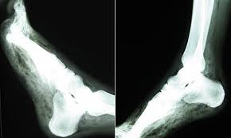
Gas Gangrene

Slide 62
Wet and Gas Gangrene: Diagnosis
Clinical diagnosis…urgent surgical consolation
  Severe pain, rapid progression, tissue necrosis
Lab evaluation:
  CBC, CMP, lactate, CRP/ESR
  Blood cultures and deep tissue gram stain/culture when feasible
  Normal labs due not exclude
Imaging:
  X-ray: may demonstrate soft-tissue gas
  CT: may show gas and extend of tissue involvement
  CTA: done if arterial perfusion assessment is indicated
Surgical exploration must not be delayed.

Slide 63
Clostridium myonecrosis : Tx
Immediate surgical exploration and debridement
Immediate IV ABX
  Empiric coverage initially: Vanc + Zosyn + Clindamycin initially
    MRSA, broad gram-pos, gram-neg, and anaerobic coverage
    (Clindamycin: inhibits bacterial protein synthesis and helps suppress clostridial toxin production
  Once confirmed: IV pen G + clindamycin
Supportive management:
  IV fluid resuscitation
  Tetanus prophylaxis if indicated

Slide 64
Gas Gangrene “ Clinical Pearls”
Clostridial infection should be considered in patients presenting with low-grade fever, tachycardia out of proportion to fever, and pain out of proportion to physical exam findings with recent surgery or trauma
Shock and multi-organ failure may be rapidly progressive. Mortality is 80-90% if untreated, 10-25% when treated appropriately
Clindamycin may improve survival by inhibiting toxin production

Slide 65
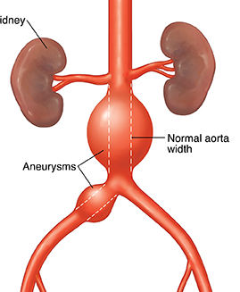
Aortic Aneurysm

Slide 66
Case #1: Family Medicine
During a routine physical examination, a primary care physician identifies an asymptomatic pulsatile mass in the abdomen of a 62-year-old man. An ultrasound evaluation revealed a 4.8-cm aneurysm in the infrarenal aorta. This patient is subsequently referred to the vascular surgeon for evaluation and management. The patient’s past medical history is significant for hypertension and stable angina. He has a 40-pack-year smoking history. His current medications include aspirin, a beta-blocker, and nitrates. The patient describes himself as an active man who just retired and plays 18-holes of golf two times a week. On examination, the carotid pulses and upper extremity pulses are normal. The abdomen is nontender with a prominent aortic pulse. Pulses in the femoral and popliteal regions are readily palpable and appear more prominent than usual.

Slide 67
Case 2: Emergency Medicine
A previously well 41-year-old woman, with a past medical history significant only for SLE, presented to the Emergency Department with acute onset of severe LLQ abdominal pain radiating to her left flank and back. Her pain began abruptly approximately 5 hours prior to her arrival and started while she was resting in bed. She denied any nausea, vomiting, or diarrhea. She had been PO tolerant earlier in the evening and was feeling fine until her pain started. The patient reported that she had not sought regular medical care for at least several months prior to this visit and did not take any medications, smoke, or use illicit substances.
On her initial presentation and physical exam, the patient was in extreme pain, writhing in pain on the bed. She was noted to have diffuse abdominal tenderness to palpation and severe left flank pain, with guarding and rigidity. Her initial vital signs were stable, with a heart rate of 70 and blood pressure 127/84.

Slide 68
Another Example
OR…A 75-year-old male presents to the ED after a syncopal episode prior to arrival. He now complains of abdominal pain and is found to have a blood pressure of 95/60. He has a past medical history of HTN, smoking…

Slide 69
Aneurysm
Definition: Dilation of the arterial wall to ≥1.5 times its normal diameter
Classifications:
  True aneurysms: Dilation involving all layers of the vessel
    Wall is intact
  Pseudoaneurysms (false aneurysm): disruption of the arterial wall with blood contained by surrounding tissues.
    Develops usually at a site of vessel catheterization, trauma or anastomoses
  Mycotic aneurysm: dilation that develops because of infection in the vessel wall causing a weakness

Slide 70
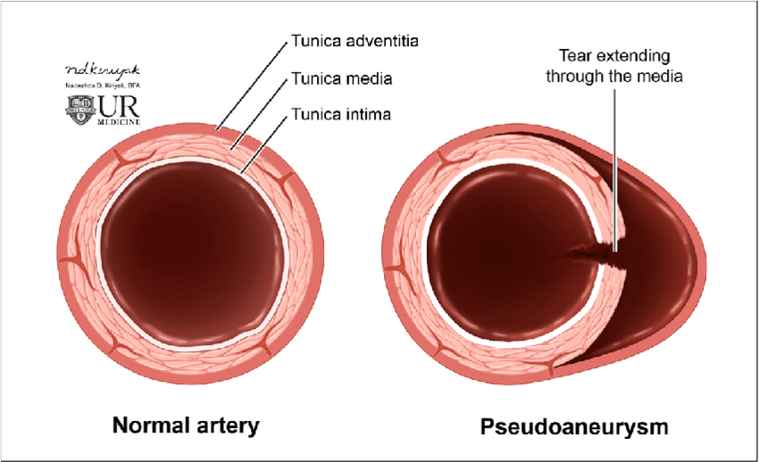
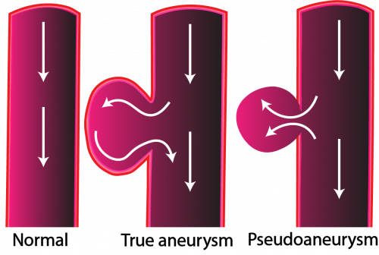
True vs False aneurysm

Slide 71
Aneurysm
Arterial aneurysms:
  Abdominal Aortic Aneurysm ≥3 cm
    Risk of rupture and hemorrhage,
  Cerebral (Berry aneurysm) Risk of rupture and subarachnoid hemorrhage
  Peripheral (Popliteal, Femoral, Carotid)
    Risk of thrombus formation and embolism
Etiologies and risk factors vary by location:
  AAA: age, smoking, FH, atherosclerotic disease
  Thoracic: age, atherosclerotic genetic, bicuspid aortic value
  Cerebral: HTN, female, substance abuse smoking, genetic

Slide 72
Aneurysm
Aneurysm development is multifactorial, leading to progressive expansion at a variable rate.
  Dilation in smokers with aneurysms tends to be more rapid
  Less rapid in diabetics
Decrease in elastin collagen resulting in thinning of vascular wall and decrease in tensile strength.

Slide 73
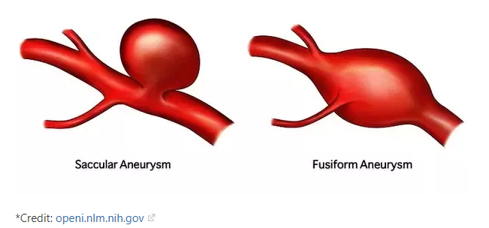
Types of Aneurysms

Slide 74
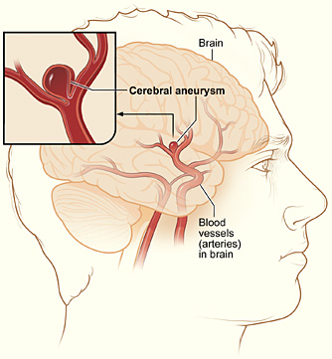
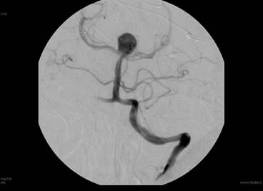
Intracranial Aneurysms
“Berry Aneurysms”

Slide 75
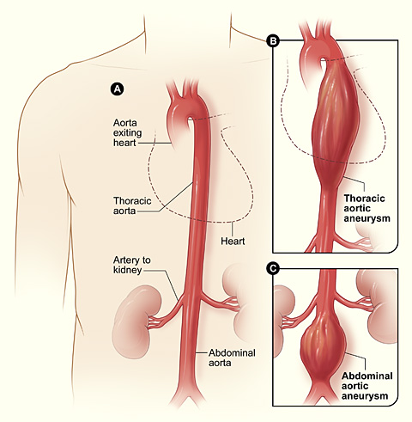
Aortic Aneurysm

Slide 76
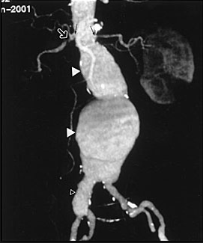
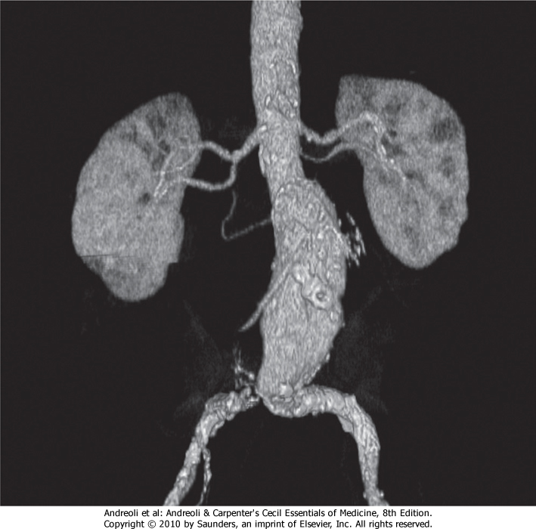
Abdominal Aortic Aneurysm (AAA)

Slide 77
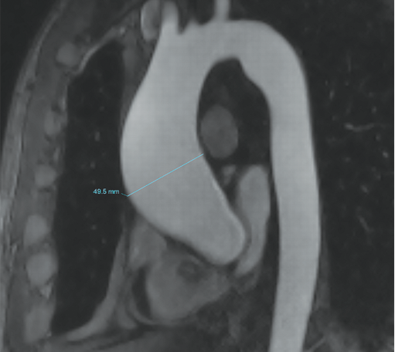
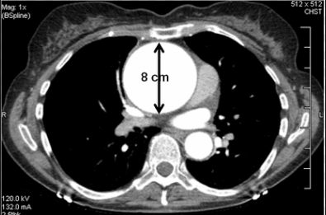
Thoracic Aortic Aneurysm

Slide 78
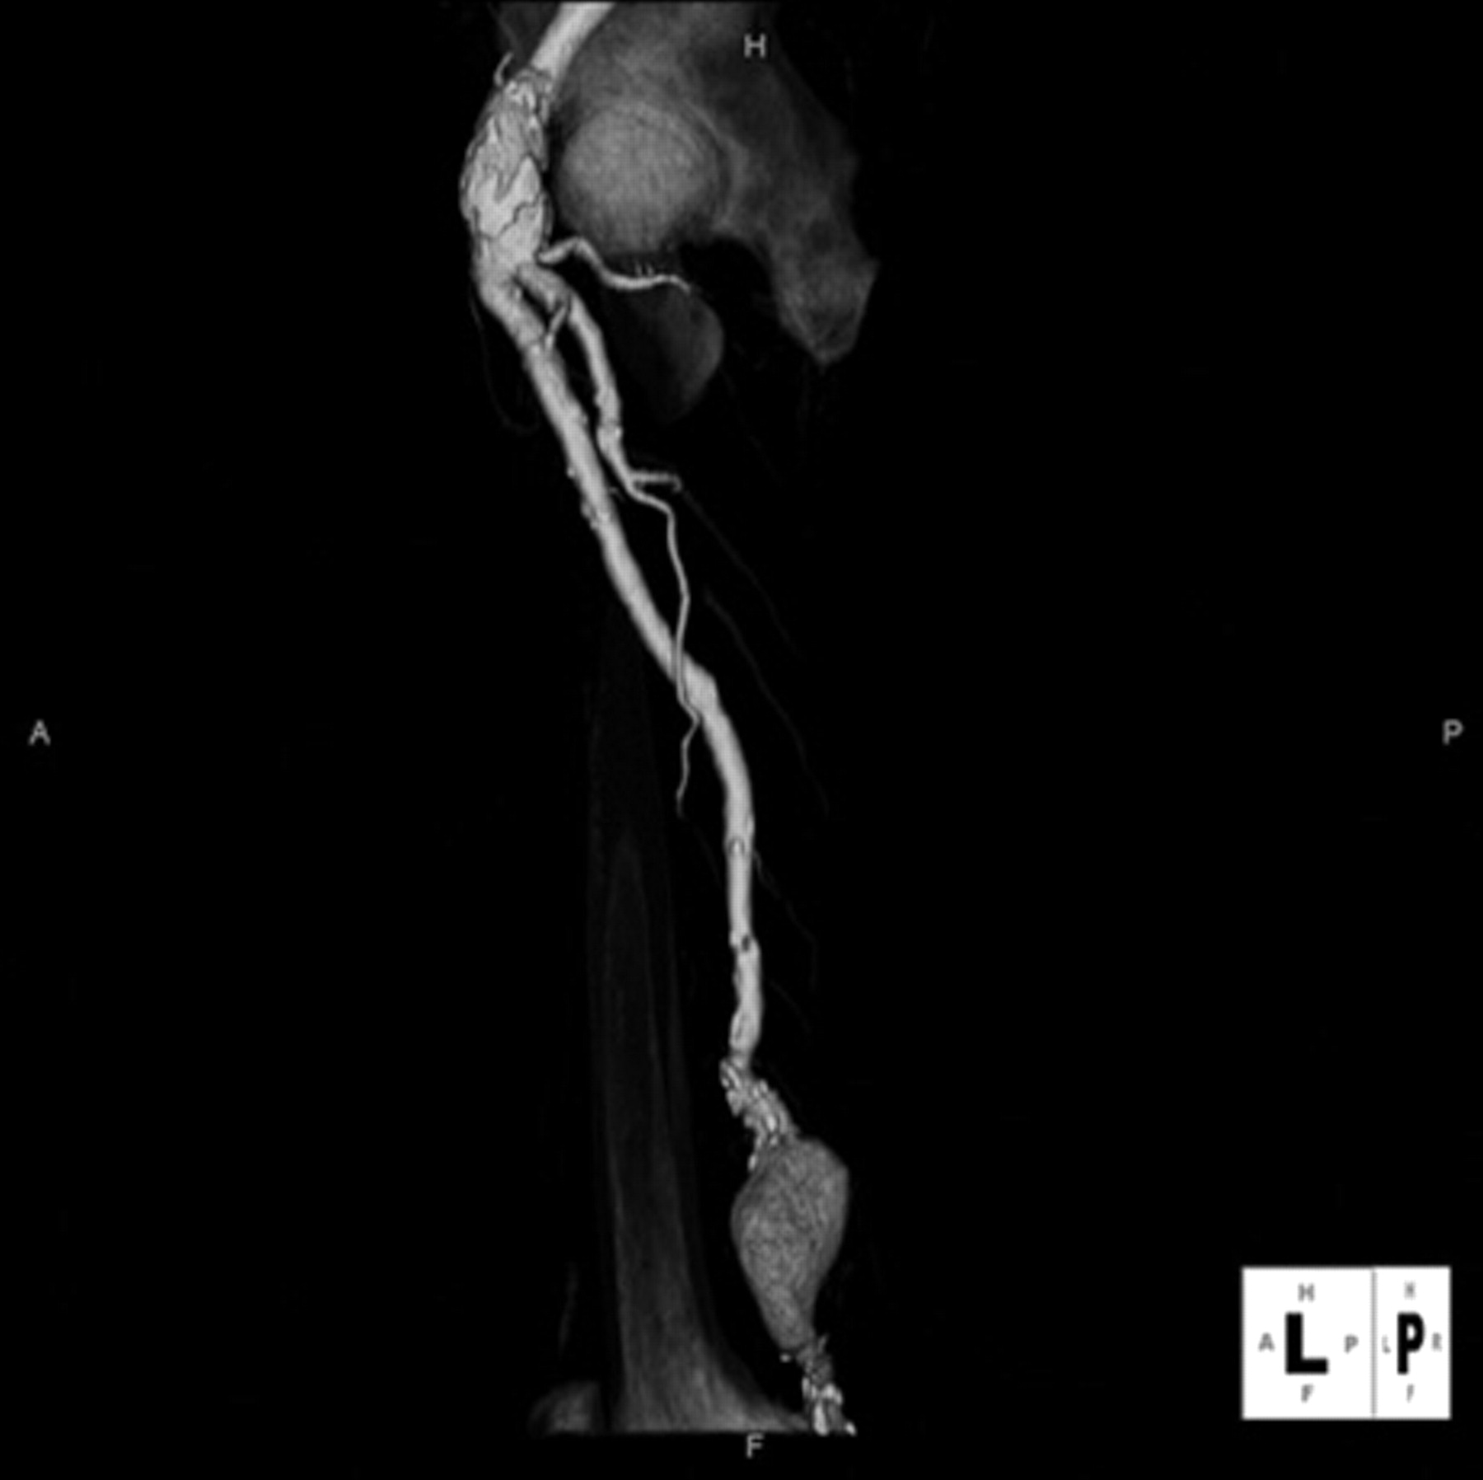
Femoral/Popliteal Aneurysm

Slide 79
Aortic Aneurysm: Epidemiology
Abdominal Aortic Aneurysm occurs in 3-8% affecting predominantly men:
  White men develop AAA more than double the rate of black men
  Incidence rises sharply after 60 y/o
  Death from rupture is about 5-10K a year
Thoracic Aortic Aneurysm-about 5-10 cases per 100K

Slide 80
Abdominal Aortic Aneurysms: Mortality
Risk of rupture increases with aneurysm diameter:
  Small AAA (3.0–4.9 cm): generally low annual rupture risk
  Large AAA (≥5.5 cm): substantially increased rupture risk
  Risk also influenced by female sex, rapid expansion, and symptoms
Growth can be variable but approximately 1-4 mm per year
Other complications:
  Formation of mural thrombi can also develop leading to emboli
  Compression of adjacent structures…not as common

Slide 81
Aortic Aneurysm: Risk Factors
Abdominal Aortic Aneurysm (AAA)
Thoracic Aortic Aneurysm (TAA)
Smoking (strongest modifiable risk factor)
Advanced age
Male sex
Family history
Atherosclerotic cardiovascular disease
Hypertension
Advanced age
Hypertension
Family history/genetic predisposition
Bicuspid aortic valve
Heritable aortopathies:
  Marfan syndrome
  Loeys-Dietz syndrome
  Vascular Ehlers-Danlos syndrome
  Turner syndrome
Vasculitis (giant cell arteritis, Takayasu arteritis)

Slide 82
AAA: S&S
Usually are asymptomatic
Found on routine screening or incidental on imaging
Exam findings may be:
  Palpable, pulsatile, expansile and non-tender mass
  Bruit may be audible
  This is usually felt once AAA is >5.5cm

Slide 83
AAA: Clinical presentation
As aneurysms expand, they can become symptomatic
  Compression of adjacent structures causes symptoms of abdominal discomfort
    Iliac aneurysms can compress ureter and cause hydronephrosis on the ipsilateral (same) side causing flank pain.
    A mural (wall) thrombus may form and embolize resulting in lower extremity ischemia or mesenteric ischemia
Exam may denote pulsatile mass below umbilicus
  Not abnormal in normal THIN individuals to feel Aorta but NOT below the umbilicus

Slide 84
AAA Diagnostics
Abdominal Aortic Ultrasonography for suspected Abdominal and Iliac aneurysms
  For screening and monitoring
  Can be used in an acute situation…more to come
Contrasted CTA (contrasted exam)
  Evaluates size, anatomy, branch vessels and evidence of rupture. (Surg planning)
  Used to evaluate thoracic aneurysms
  Not routinely used for AAA screening/monitoring due radiation/contrast
  CTA in the ED: Preferred for symptomatic hemodynamically stable patients with suspected symptomatic or ruptured AAA.
Magnetic Resonance Angiography
  Not as commonly used

Slide 85
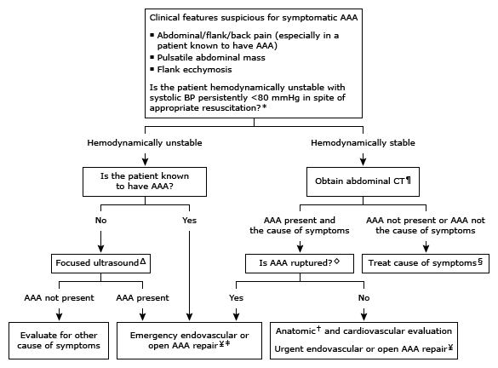
Diagnostic and management symptomatic AAA

Slide 86
Abdominal Aortic Aneurysm: High risk Patient Screening
Indications for one-time US screening:
Men aged ≥65 years who ever have smoked
Men and women ages 65-75 who have a first-degree relative with a AAA
Women ≥65 years who have ever smoked
  Screening is reasonable per ACC/AHA
  USPSTF: Insufficient evidence to determine net benefit
Men 65–75 years who have never smoked
  Consider selective screening based on risk factors (USPSTF)

Slide 87
AAA: Monitoring ACC/AHA
Aortic Diameter | Monitoring Recommendation
3.0 to 3.9 cm | Ultrasound (US) every 3 years
4.0-4.9 cm (Men) | US every 12 months
4.0-4.4 cm (Women) | US every 12 months
5.0-5.4 (Men) | US every 6 months
4.5-4.9 cm (Women) | US every 6 months

Slide 88
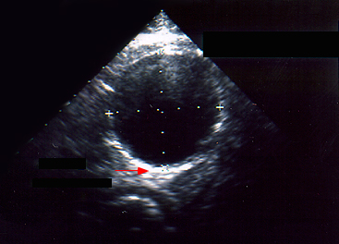
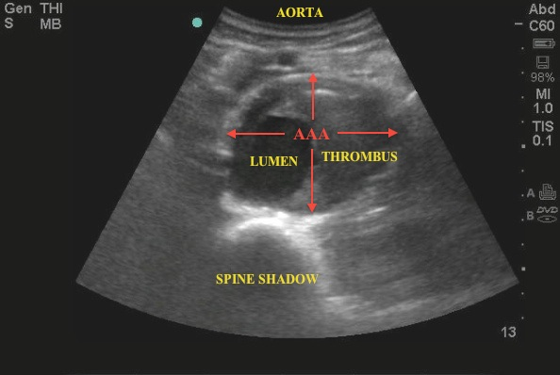
AAA: Ultrasound

Slide 89
AAA: Management
INDICATIONS FOR SURGICAL TREATMENT OF ANEURYSMS
SYMPTOMS OF EXPANSION OCCULSION/COMPRESSION of blood flow
RUPTURE OF ANEURYSM
RAPID AORTIC ANEURYSM EXPANSION > 1 CM/YEAR
ASCENDING AORTA > 4.5 CM (Marfan), > 5 CM (other pts)
DESCENDING THORACIC ANEURYSMS > 5 CM
ASYMPTOMATIC ABDOMINAL AORTIC ANEURYSM ≥ 5.5 CM in men and ≥5.0 in women
ILIAC ANEURYSM > 3 CM
Repair is recommended in asymptomatic:
  men with AAA diameter ≥5.5 cm
  women with AAA diameter ≥5.0 cm

Slide 90
AAA: Medical Management
For AAA < 5.5 cm in men or <5.0 cm in women
Smoking cessation!
Exercise
Cardiovascular risk reduction:
  Cholesterol reduction (STATINS)
    Atherosclerosis
  Blood pressure control
    Beta-blockers and Angiotensin receptor antagonists
      Used for BP control; not proven to slow AAA growth.
Avoidance of fluoroquinolones if able

Slide 91
AAA: Management
For AAA ≥5.5 cm in men or ≥5.0 cm in women:
Surgical option
    OPEN (gortex graft within the aneurysm)
      Elective open mortality rate is about 3-5%
    Percutaneous ENDOVASCULAR ANEURYSM REPAIR (EVAR)
      EVAR mortality rate ~1%
Mortality rate after rupture is ~70-80%

Slide 92
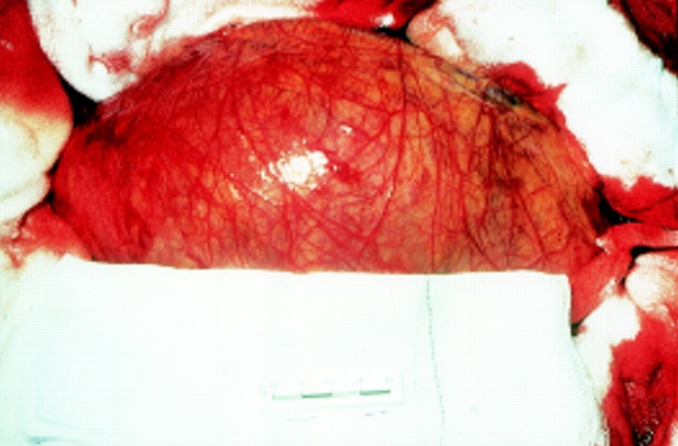
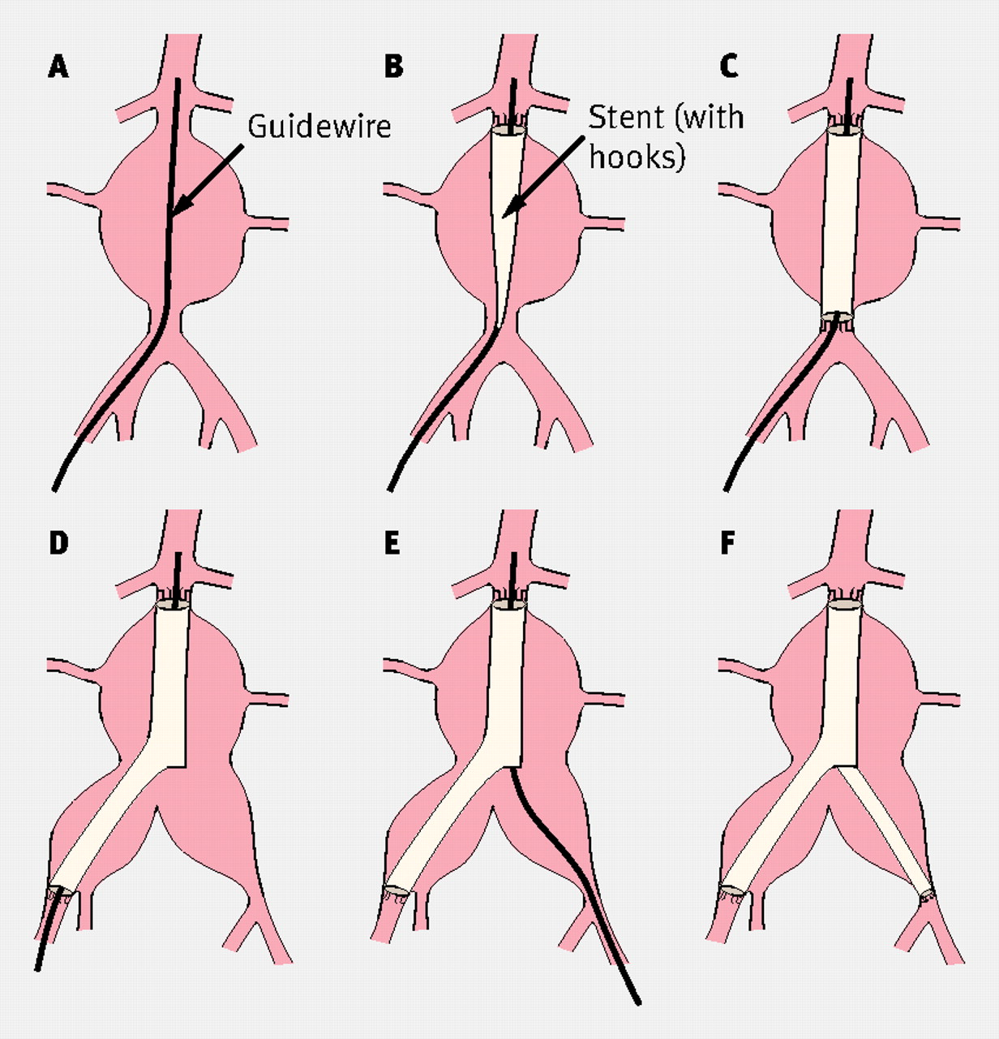
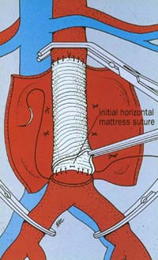
OPEN EVAR

Slide 93

AAA: Management
If rupture → abdominal pain and hypotension
  Should suspect in older pt with syncope and abd pain
Rupture of AAA is a Cardiovascular Emergency requiring aggressive fluid resuscitation with blood, isotonic saline → Emergent Surgery
Ruptured AAA becomes a vascular surgical emergency…TICK TOCK!
  How much blood can the abdomen hold?

Slide 94
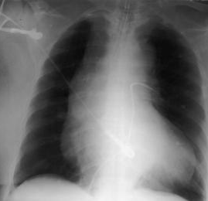
Aortic Dissection

Slide 95
Case 1
A 77-year-old Korean woman came to the ED, presenting with chest pain that started the day before. She had a medical history of hypertension and had been on medication (losartan and aspirin) for 5 years. The day before, at about 7 PM she suddenly felt a strong chest pain of 8/10 in the substernal area. She described the character of the pain as “oppressive” without radiating pain. This excruciating pain lasted for about 10 minutes combined with a doomed feeling, diaphoresis, and difficulty in taking deep breaths. She also felt slight faintness. She visited a local clinic pta and chest pain was relieved to a 3-4 after 3 tablets of sublingual nitroglycerin. On arrival to ED, she presented with moderate chest pain of 3/4. She looked acutely ill, and nothing specific was detected in her heart and lung sounds.

Slide 96
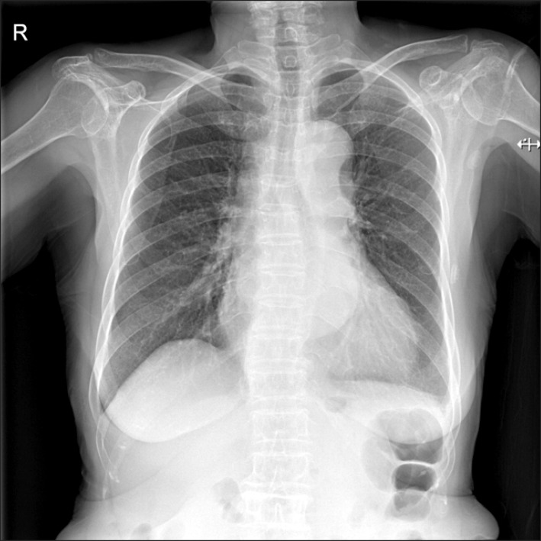

Case 1: Type A dissection starting from distal ascending aorta

Slide 97
Aortic Dissection
Acute Aortic syndrome:
Aortic Dissection
    intimal tear allows blood to enter into false lumen parallel to true lumen.
    Separation of the layers of the aortic wall due to intimal tear
Incomplete Dissection
    Tear without dissecting blood
Intramural hematoma
    Due to Vasa vasorum rupture → hemorrhage in wall of Aorta → hematoma
Penetrating Atherosclerotic Ulcer- rare
    Ulceration of plaque penetrating intima into media layer
Trauma related to catheterization

Slide 98

Aortic Dissection

Slide 99


Slide 100
Aortic Dissection-Risk Factors
HTN-stress on aortic wall is most important factor
Atherosclerosis
Genetic Connective tissue Disease (Marfan syndrome, Ehlers-Danlos Syndrome)
Bicuspid Aortic Valvu
Pre-existing aortic aneurysm
FH
Prior cardiac or aortic surgery
Additional Assoicatesions/Potential Triggers:
  Pregnancy and postpartum period particularly with underlying aortopathy
  Heavy lifting/straining- elevate BP
  Cocaine or methamphetamine use-elevate BP

Slide 101


Dissection

Slide 102



Classification of Aortic Dissection
MORTALITY 1-2%/HOUR
MORTALITY 1-2%/HOUR
Percentage | 60% | 10-15% | 25-30%
Type | DeBakey I DeBakey II |  | DeBakey III
 | STANDFORD A (PROXIMAL) |  | STANDFORD B (DISTAL)
Notes:
In the DeBakey classification of aortic dissection:
Type I involves the ascending aorta, arch, and descending thoracic aorta and may progress to involve the abdominal aorta.
Type II is confined to the ascending aorta.
Type IIIa involves the descending thoracic aorta distal to the left subclavian artery and proximal to the celiac artery.
Type IIIb dissection involves the thoracic and abdominal aorta distal to the left subclavian artery.
In the Stanford classification of aortic dissection:
Type A involves the ascending aorta and may progress to involve the arch and thoracoabdominal aorta.
Type B involves the descending thoracic or thoracoabdominal aorta distal to the left subclavian artery without involvement of ascending aorta.
Ascending aortic dissections are almost twice as common as descending dissections
Why do you think most dissections occur proximal? Pressure is high and hits the wall there and turbulent
Altered integrity

Slide 103
Aortic Dissection: Mortality
Standford Type A – Ascending Aorta
  Life-threatening cardiovascular emergency
  Untreated mortality increases rapidly over time
  Historically mortality increases 1-2% per hour early after symptoms
  Risk of death from rupture, cardiac tamponade, aortic regurgitation and organ malperfusion
Stanford Tye B- Descending Aorta
  Lower early mortality when uncomplicated
  Complicated dissection may require urgent repair

Slide 104



Victims of Aortic Dissection

Slide 105
Aortic Dissection: S&S
Sudden onset of anterior sharp chest pain (‘tearing’ quality) and/or back pain (between Scapula)
  Chest pain more common in Type A
  Back pain and abd pain more common in Type B
  Painless dissection is RARE
Abdominal pain, flank/back pain, syncope, and stroke can also be commonly seen at presentation
  Stroke caused by occlusion of carotid arteries
Syncope: 5-10% of patients

Slide 106
Aortic Dissection: S&S
Symptoms may change as the dissection extends along aorta and involves other arteries or organs
20% of patients with type A will have neurologic finding -poor prognosis
    Focal Deficits: Interruption of blood supply to the spinal cord may lead to paraplegia
Proximal dissection to the aortic root can lead to cardiac tamponade-usually fatal
If dissection involves ascending aorta it can dissect against Coronary Arteries and cause a Myocardial infarction.
If dissection is distal it can cause ischemia to lower extremities and result in an ischemic neuropathy.

Slide 107

Aortic dissection: PE
Exam can, at least initially, be normal
Patients can appear pale and clammy
  Can’t fake sweating!
Pulse deficits (weak or absent carotid, brachial or femoral pulses)-15-20%
Dissection back toward heart can cause Aortic regurgitation, diastolic murmur.
If there is a greater than 20mmHg difference between BP of two upper extremities this increases concern

Slide 108

Aortic dissection: PE
Horner’s syndrome
Hypotension and JVD suggest dissection back into the heart and bleeding into pericardial space → Hemopericardium and Cardiac Tamponade:
  Becks Triad:
    JVD
    Hypotension
    Distant heart sounds or “muffled” heart sounds
It is important to note that physical findings can vary significantly

Slide 109
Aortic Dissection: Diagnosis
Clinical suspicion
  (“tearing chest or back pain”) in setting of risk factors
Chest radiograph
  Can be helpful but has limitations; nml does not exclude
  May see mediastinal widening
CT Angiography with IV contrast of Chest, Abdomen & Pelvis
  Preferred diagnostic imaging
Transesophageal echo (TEE)
  Useful in hemodynamically unstable pts or when CTA not feasible
MRA of Chest, Abdomen & Pelvis…sure, but not practical in an emergency

Slide 110


Aortic Dissection:
Chest X-ray (Widening of Mediastinum)
Widening seen in dissection
Normal chest XR
Notes:
Chest radiograph
Conventional chest radiographs may show widening of the aorta with aortic dissections.
Review of 464 patients found that mediastinal widening was present in 63 % with type A dissections, while 11 % of patients had no abnormality on chest radiography.
Radiographic evidence of a pleural effusion was found in 19 % of dissections; this finding is more common in women than in men.
Because of the limited sensitivity of the chest radiograph, additional imaging studies are obtained in almost all patients

Slide 111



Aortic Dissection on CT Angiography
Axial View
Sagittal view
Coronal View
Notes:
T=True lumen
F=False Lumen

Slide 112


Aortic Dissection- TEE or TTE
In a patient hemodynamically unstable TEE or TTE can be useful to visualize a tamponade, wall motion abnormalities, valve abnormalities, and proximal arch dissection. However, more distal imaging or intramural hematoma is not visualized.

Slide 113
Aortic Dissection: Acute Medical Management
ICU management
Pain management
Reduction of HR
  Anti-impulse therapy reduces the velocity of the left ventricular contraction which decreases shear stress
  This minimizes the progression of dissection
  Antihypertensives, such as IV beta-blockers are initially used

Slide 114
Aortic Dissection: Acute Medical Management
Initial goal is to reduce HR about 60-80 bpm
    IV Esmolol or Labetalol
      Blunts increased heart rate
    Alternatives are verapamil, diltiazem IF Beta-blockers are contraindicated.
If after beta-blocker use systolic pressure remains > 120 mmHg then ADD nitroprusside
  Systolic BP goal is 100-120 mmHg
  Nicardipine could be an alternative to nitroprusside
  You should not use a vasodilator before a beta-blocker as HR control is key.

Slide 115
Aortic Dissection: Management
Stanford Type A (PROXIMAL)
  Emergent Surgical Repair (Aortic) + Medical Therapy as stated on previous slide (anti-impulse therapy)
Stanford Type B (DISTAL)
  Uncomplicated:
    MEDICAL THERAPY (anti-impulse therapy)
  Complicated: intervention then indicated
    Rupture or malperfusion (branch vessel)
    Dissection extension or progressive enlargement
    Persistent pain or uncontrolled HTN
Long-Term Management:
  Blood pressure control, typically including a beta-blocker
  CT or MRI surveillance typically at 1, 6, and 12 months, then annually if stable

Slide 116
Vasculitis

Slide 117
Vasculitis
Inflammation of blood vessels (arteries, veins)
  Arterial inflammation → Arteritis
  Venous inflammation → Phlebitis
Pathophysiology:
Inflammatory cells infiltrate and damage vessel wall, compromising vascular integrity.
  Leads to:
    Vessel narrowing or occlusion
    Downstream ischemia
    Vessel wall weakening – leads to aneurysms formation
    Vessel rupture – hemorrhage

Slide 118
Vasculitis
Etiology
Primary vasculitis:
  Immune-mediated inflammation w/o underlying systemic dx
  Examples: ANCA-associated vasculitis, giant cell artertisi, Takayasu arteritis
  Buerger disease-idiopathic
Secondary vasculitis:
  Associated with systemic autoimmune disorders (SLE, RA)
  Underlying infection (Hep B/C, HIV or bacterial)
  Medications (allopurinol, minocycline)
  Malignancy

Slide 119
Thromboangitis Obliterans
Previously known as Buerger Disease
Thrombo → clotting
Angitis → inflammation of vessel
Obliterans → arterial/venous occlusion
NON-atherosclerotic disease of small to medium peripheral arteries and veins resulting in recurring inflammation and occlusion.
Can be segmental
Progressive disease that can cause ulceration and dry gangrene

Slide 120
Thromboangitis Obliterans
Epidemiology and Risk Factors:
  Heavy tobacco use is strongly associated
  2/3 of pts have severe periodontal disease
  More common in males, although females can be affected too
  Typically presents under age 45-50 y/o
Patho:
  Pathophysiology is poorly understood
  Tabacco exposure is implicated in dz development and progression.
  Proposed mechanisms include:
  Endothelia injury leading to inflammation
  Abnormal immune mediated response
  Lead to thrombosis and occlusion

Slide 121
Buerger Disease: Thromboangitis Obliterans
Results in narrowing of smaller vessels which leads to decreased blood and O2 to extremities
Superficial thrombophlebitis and cold sensitivity can be early manifestation
Claudication symptoms of feet, lower legs, arms, and hands with some patients presenting with ischemic changes to the distal portion of the digits.
  Pale/dusky (decreased capillary refill)
  Ulcerations-painful
  Ischemic rest pain
  Necrotic eschar formation
  Ultimately gangrene and Auto-amputation- severe disease

Slide 122



Thromboangitis Obliterans
Collateralization around areas of occlusions: Corkscrew collaterals

Slide 123

Buerger’s disease
A: Normal Hand
B: Burger’s Disease

Slide 124
Buerger Disease: Diagnosis
A suggestive PE finding is a positive Allen test at wrist in young smoker with lower extremity ischemia
ABI-nml does not exclude due to disease due to it being segmental
  Toe and finger index may show impaired perfusion
Laboratory work up: ESR,CRP, rheumatology panel, hypercoagulability panel, tox screen

Slide 125
Buerger Disease: Diagnosis
CTA with runoff to extremities will show:
  No evidence of atherosclerosis
  No source for thromboembolism (aneurysmal disease)
  Segmental occlusion to small to medium vessels
  Cork-screw collaterals (collateral development around segmental occlusion)
    A Classic finding

Slide 126
Buerger Disease: Diagnosis
Diagnosis based upon presentations in young adult with smoking hx with exclusion of other causes
Clinical criteria — A clinical diagnosis can be established with the following commonly used criteria :
  Age less than 50 years
  Current or recent history of tobacco use
  Distal extremity ischemia (objectively noted on vascular testing)
  Typical arteriographic findings of thromboangitis obliterans
  Exclusion of autoimmune disease, thrombophilia, diabetes, and proximal embolic sources

Slide 127
Buerger Disease: Treatment
Treatment:
  Smoking cessation is the only way to halt the progression of the disease
  Vasodilator therapy
    May help alleviate ischemic symptoms
    This is investigational and in some cases like CCB have not been well studied.
  Vascular surgery (sometimes amputation)
    Revascularizaton often limited by small vessel involvement

Slide 128
Raynaud’s Phenomenon
Exaggerated vascular response to cold temperature or emotional stress
Vasospastic disease of small digital arteries
Primary Raynaud’s
  No underlying disorder
Secondary Raynaud’s or Raynaud syndrome
  Scleroderma (CREST Syndrome)
  Polymyositis
  Rheumatoid arthritis
  Systemic Lupus Erythematosus
  Repetitive trauma (e.g. jackhammer operators)
  Buerger Disease
  Drugs like chemo and amphetamines can exacerbate

Slide 129
Raynaud’s Phenomenon
 | Primary | Secondary
Sex | More common in Female | Male or Female
Age of onset | 15-30 | >30
Severity of symptoms | More mild | More severe
Finger Edema | None | May occur
Arthritis | None | May occur
Autoantibodies | Absent | May be +

Slide 130


Slide 131
Raynaud’s Phenomenon
Clinical Features:
  Recurrent episodes of color changes to toes, fingers, nose, ears due to vasospasm of digital (small) arteries.
  Often precipitated by cold and emotional stress
WHITE (pallor) → BLUE (cyanosis) → RED (reactive hyperemeia)
Physical exam usually normal between episodes
  Severe secondary Raynaud's may lead to digital ischemia and ulcerations or thickening of fat pads (sclerodactyly)
Treatment (initial):
  Avoidance of triggers (gloves in winter)
  Calcium channel blockers → vasodilation

Slide 132

Takayasu Arteritis

Slide 133
Takayasu Arteritis
Vasculitis that affects aorta and major branches (large vessel vasculitis)
  Subclavian, brachiocephalic, carotid, vertebral, pulmonary, and aorta and abdominal aorta vessels
Most commonly affect younger women, often presenting before 40 y/o.
More prevalent in Asian women
80-90% of pts are female

Slide 134
Takayasu Arteritis
Narrowing (stenosis) due to fibrosis secondary to inflammation
Inflammation may be localized or segmental or may involve the entire vessel
  Idiopathic Granulomatous inflammation in vessel wall results in stenosis and aneurysm formation
    Patho is poorly understood
    Shares some histologic/patho similarities to Giant cell (temporal) arteritis

Slide 135


Slide 136
Takayasu Arteritis: S&S
Fatigue, wt. loss, low-grade fever are early symptoms
Arthralgia/myalgia occurs in about ½
Syncope, dizziness, vertigo, HA, blurry vision, AMS
  Due to decreased blood flow to brain
Abd pain, diarrhea, GI bleed
  Due to mesenteric ischemia
Dyspnea, CP

Slide 137
Takayasu Arteritis: PE Findings
Absent or diminished pulse that may be variable between upper extremities
Blood pressure discrepancy between arms
Cool extremities, claudication, ischemia in advanced disease
HTN can occur in up to ½ due to renal artery stenosis or coarctation of aorta
Aortic regurgitation murmur hear along left sternal boarder
Arterial Bruits – esp carotid, subclavian or abdominal

Slide 138
Takayasu Arteritis
Diagnosis:
  Clinical presentation/exam consistent
  High ESR/CRP
  Angiographic evidence of stenosis of Aorta or its branches
  Biopsy, but is impractical
Treatment:
  Corticosteroids
  Disease-modifying antirheumatic drugs (DMARDs)
  Vascular surgery consult

Slide 139

Takayasu Arteritis

Slide 140

Takayasu Arteritis

Slide 141

Kawasaki Disease

Slide 142
Kawasaki Disease (KD)
Vasculitis affecting children typically younger than 5
Affects medium-sized arteries, with particular involvement of coronary .
Complications are:
  Coronary artery aneurysm
  Heart failure
  MI
  Arrhythmias
  Peripheral arterial occlusions
  Death
Initial therapy includes immune globulin (IVIG) single infusion plus aspirin (30-50 mg/kg), followed by low-dose aspirin 3-5 mg/kg/day after defervescence

Slide 143
KD: General Overview
Pts typically have a fever with mucocutaneous inflammation
  Bilateral nonexudative conjunctivitis
  Erythema of the lips/oral mucosa
    Strawberry tongue
  Rash- erythema followed by desquamation
  Cervical lymphadenopathy
  Joint pain may occur
Fever usually not responsive to antipyretic agents, often high
Unexplained fever ≥ 5 days is consistent with KD

Slide 144



KD

Slide 145
KD Diagnostic Criteria
Typically fever ≥5 days plus ≥4 of the following 5 clinical features:
Bilateral conjunctival injection
Oral mucous membrane changes, including injected or fissured lips, injected pharynx, or strawberry tongue
Peripheral extremity changes, including erythema of palms or soles, edema of hands or feet (acute phase), and periungual desquamation (convalescent phase)
Polymorphous rash
Cervical lymphadenopathy (at least one lymph node >1.5 cm in diameter)

Slide 146

Arteriovenous Malformations (AVMs)

Slide 147
AVMs
Abnormal communication between artery and vein resulting in shunting blood from arterial system directly into venous system (bypassing capillaries).
Generally congenital (AVM)
  Distinct from acquired (trauma or vascular surgery developing an AV fistula for dialysis)-AVF
Physical exam may denote pulsatile mass if superficial or bruits.
AVMs in bone cause pathologic fractures
AVM in brain may cause seizures, neurologic deficits or even hemorrhage

Slide 148

AVM
These vessels become dilated secondary to elevated pressure and this can weaken the vessel making them more prone to hemorrhage.

Slide 149

AVM

Slide 150
AVMs
Diagnostic Radiographic Studies
  CTA
  MRA
Management:
  Depends on location, symptoms, and risk of complication
  surgical removal or endovascular embolization
  Observation may be fine for asymptomatic AVMs
  Tx is individualized
Can be seen in several syndromes:
  Hereditary Hemorrhagic Telangiectasia (Osler-Weber-Rendu Syndrome)

