Slide 1
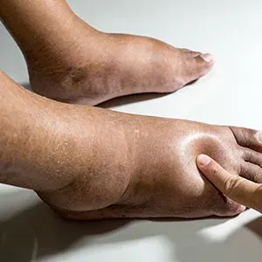
Vascular Disease Part 2:
Venous disease
Elizabeth Diem, MPAS, PA-C
CCM Cardio

Slide 2
Venous Insufficiency

Slide 3
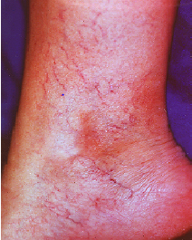
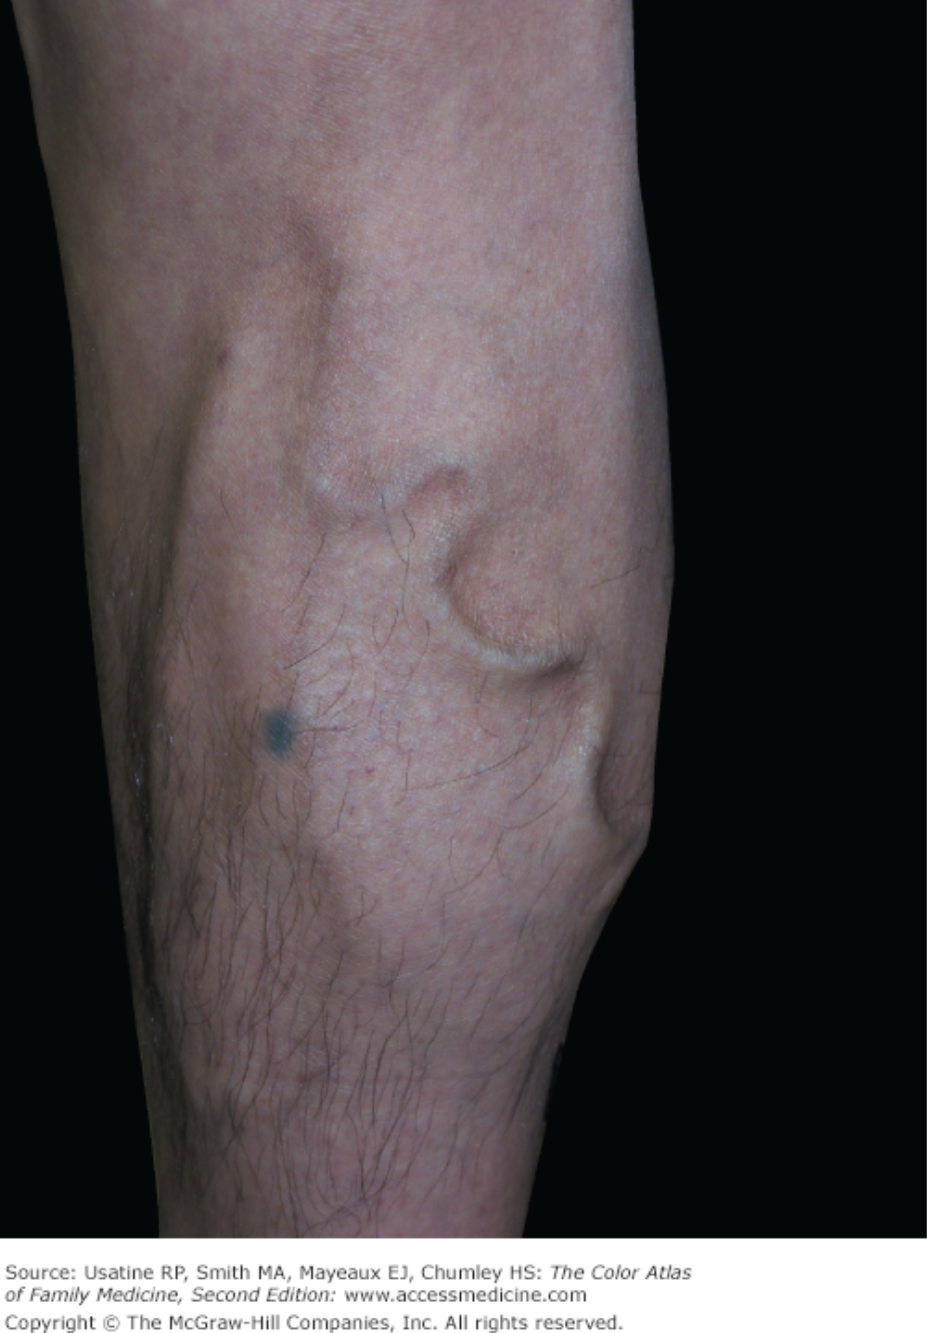
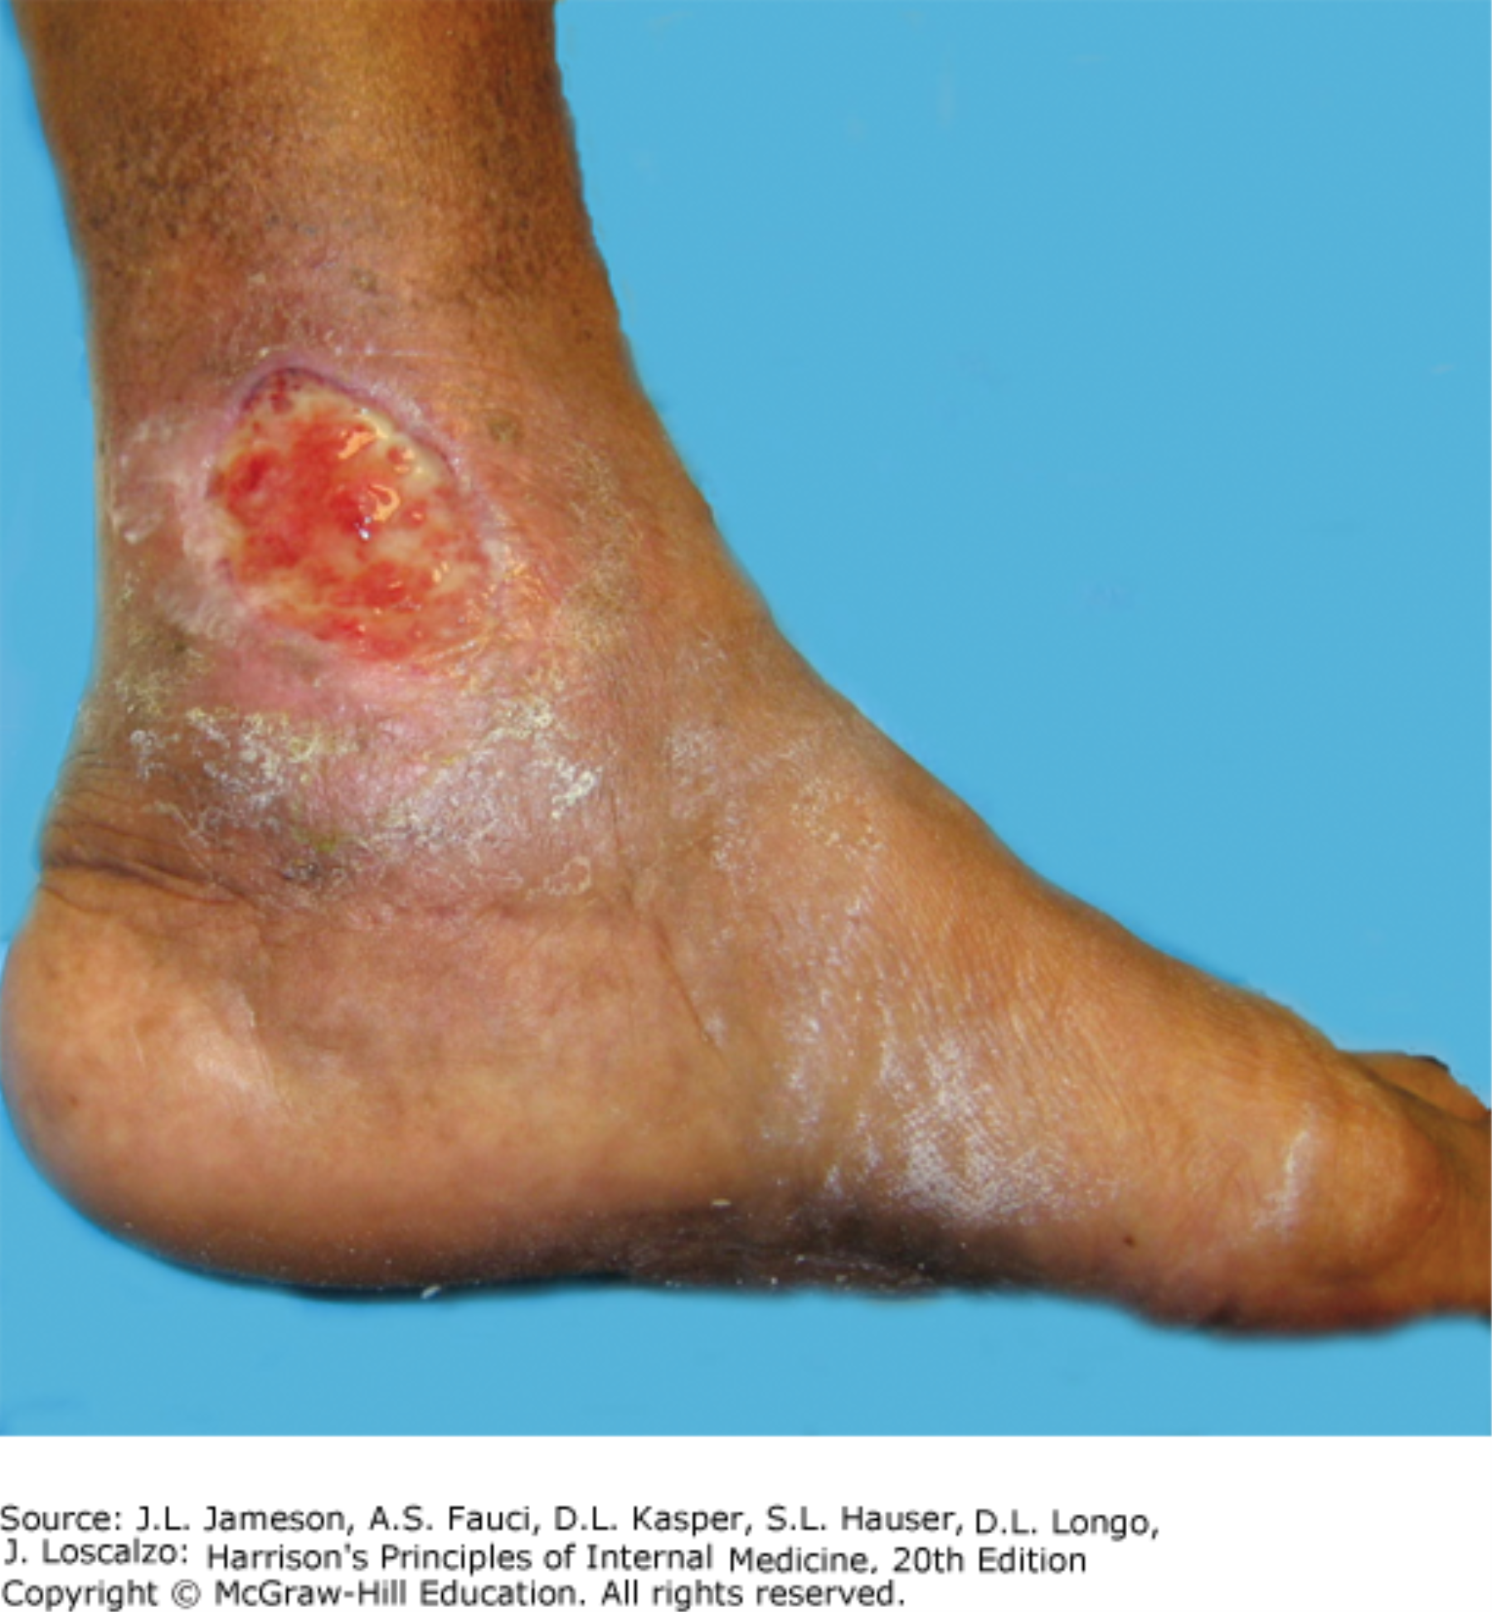
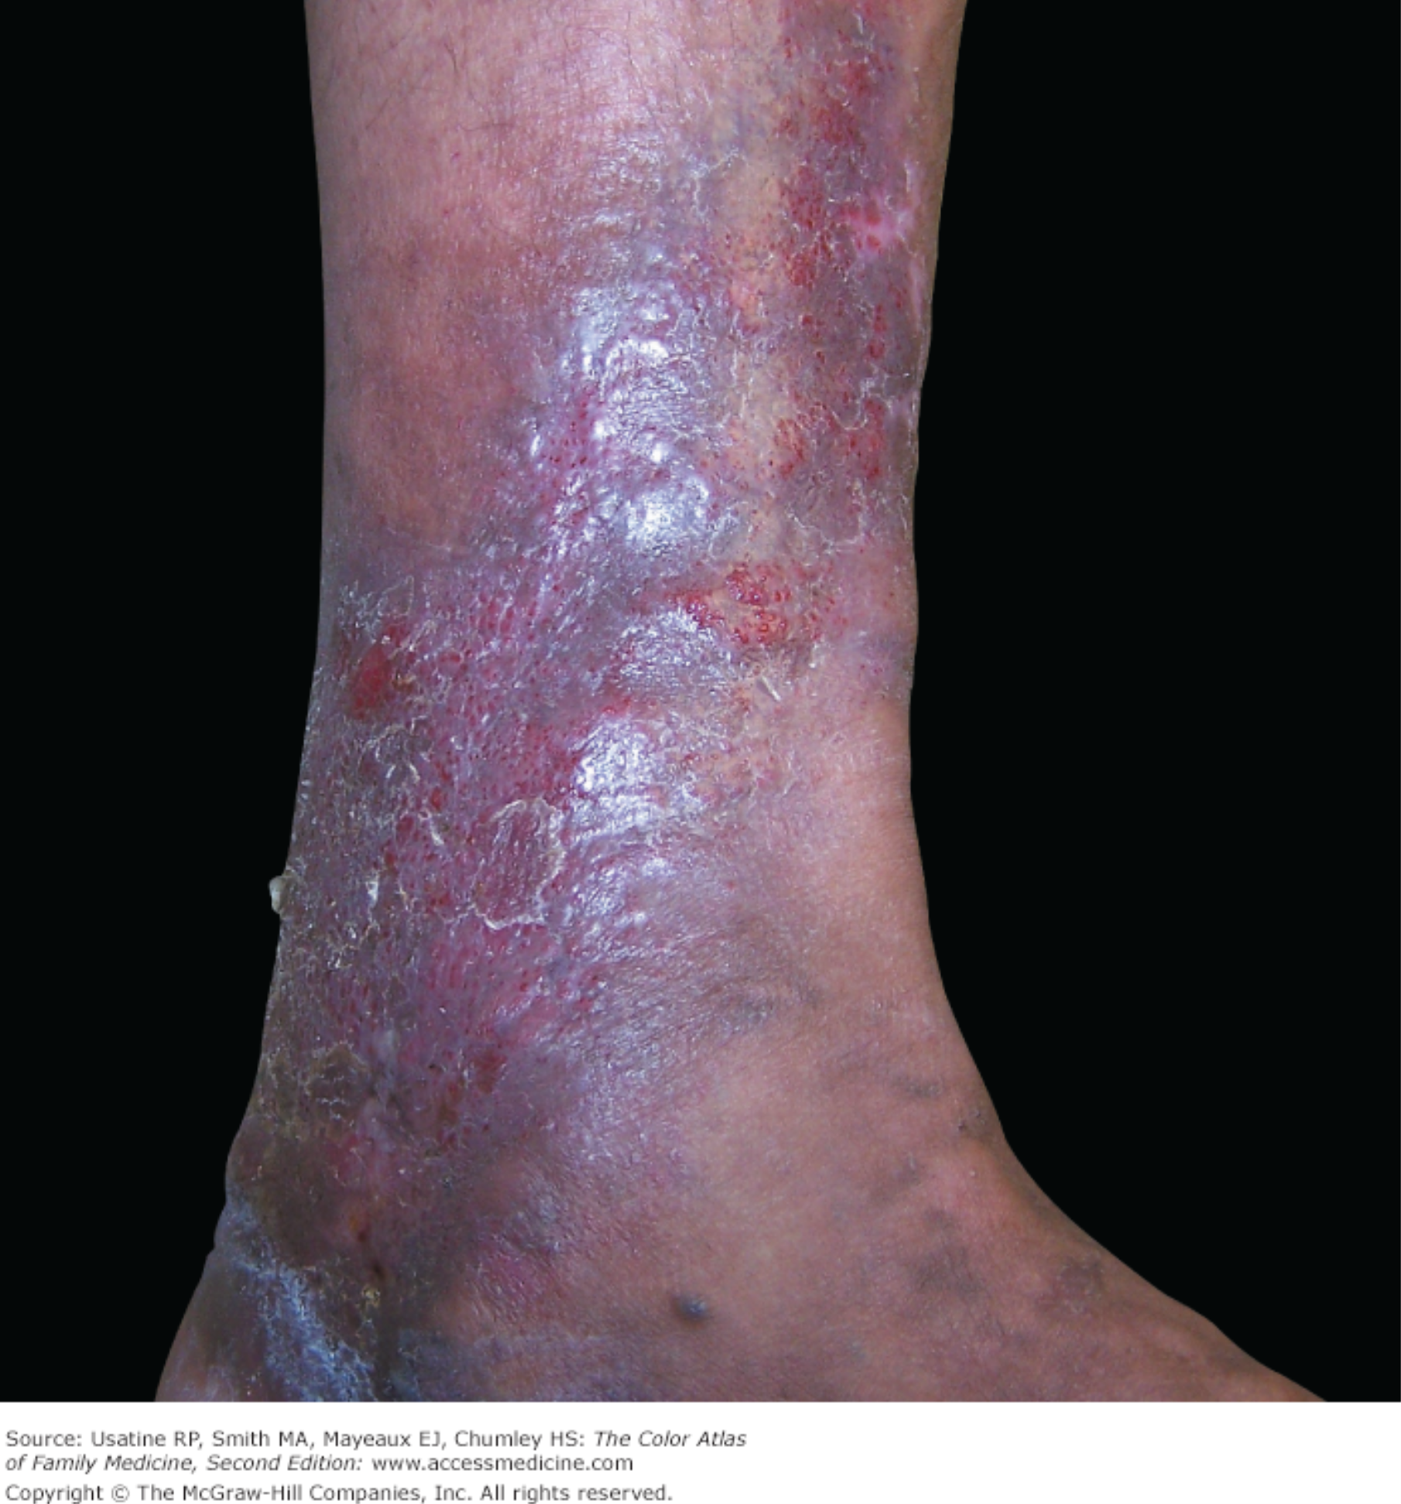
Venous Disease
Venous disease can vary from:
  Telangiectasia: dilated intradermal veins, less than 1 mm in diameter
Varicose Veins: tortuous, dilated and elongated typically more than 3mm in diameter in the SubQ
  Chronic venous insufficiency with edema and skin changes such as pigmentation and ulcers

Slide 4
Varicose Veins
Varicose veins are dilated, tortuous veins of the lower extremity
  Common (20-30% prevalence in adults)
Can remain asymptomatic or worsen and becomes painful
Hereditary component
Increase in frequency during and after pregnancy

Slide 5
Venous Insufficiency: Patho
Normal venous return: adequate muscle contraction and competent venous valves.
Insufficiency occurs by one of the below mechanisms:
  Venous value incompetence: Blood refluxes and pools in lower extremity…results in increased venous pressure.
    Persistent venous HTN causes further damage of the bicuspid valves and dilated tortuous veins.
  Inadequate muscle pump function
  Venous outflow obstruction
  Or a condition that results in increased venous pressure (Obesity, heart failure, venous compression)

Slide 6
Venous Insufficiency Patho
Reflux
Venous Hypertension
Capillary Leak- edema
Inflammation
&
Dermatitis
Histamine Release
Pruritis
&
Skin Breakdown

Slide 7
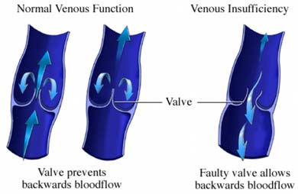
Venous Insufficiency

Slide 8
Venous Insufficiency: Risk Factors
Primary risk factors:
  Family History
  Female sex
    Elevated estrogen (hormone replacement, pregnancy, oral contraceptives)
  Advanced age
  Obesity
  sedentary lifestyle
  Prolonged standing
Secondary risk factors:
  DVT
    Post-thrombotic syndrome
  Venous trauma

Slide 9
Venous Insufficiency: H&P
Asymptomatic in mild disease
Early, common signs of chronic venous insufficiency
  Heaviness/leg pain that gets worse with prolonged standing
    Not really in the AM, improves with leg elevation overnight
  Burning/pruritus
  Leg edema- Dependent
Later findings:
  Skin changes (Stasis dermatitis)
  Ulceration (venous stasis ulcers)

Slide 10
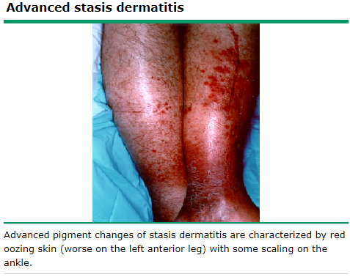
Chronic Venous Insufficiency: Stasis Dermatitis
Late process
Inflammatory process that looks like eczema rash
  Itching
  Erythema
  Scaling
  Weeping
  Erosions
  crusting

Slide 11
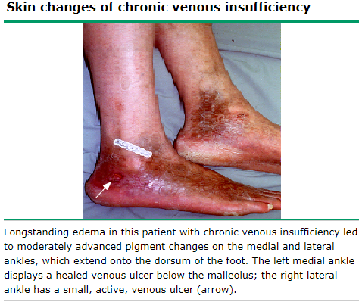
Venous Insufficiency-skin changes
Pigmentation changes are most prominent in medial ankle but may extend to lower leg and foot.
Described as a Brown hyperpigmentation
Secondary to hemosiderin deposition from breakdown of RBC have extravasated from the capillaries into dermis

Slide 12
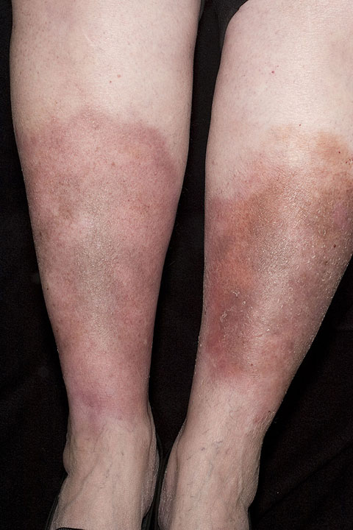
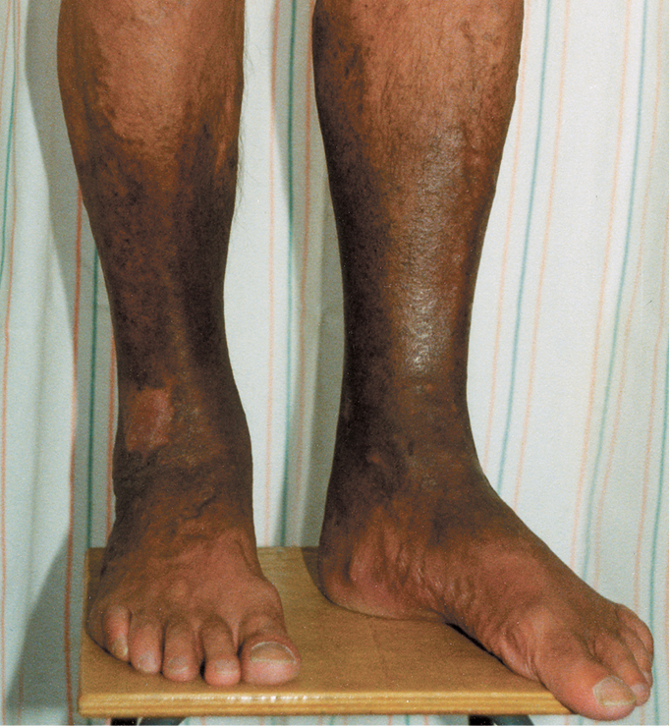
Skin Changes of Venous Insufficiency

Slide 13
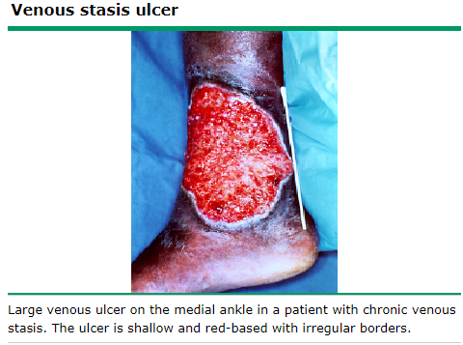
Venous Stasis Ulcer
Usually located low on medial ankle over the smaller saphenous veins
  Usually only occurs below the knee
Shallow, exudative ulcer with a red granulation base
May extend circumferentially
Borders are irregular
Painful assuming no neuropathy

Slide 14
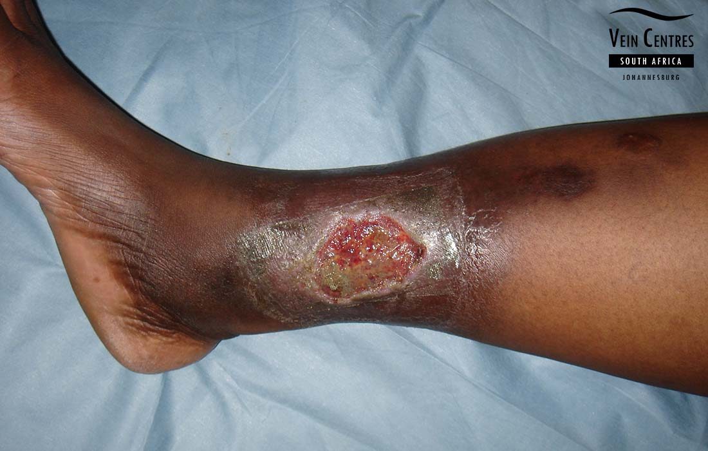
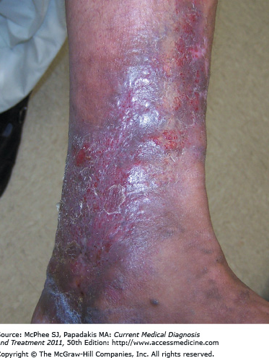
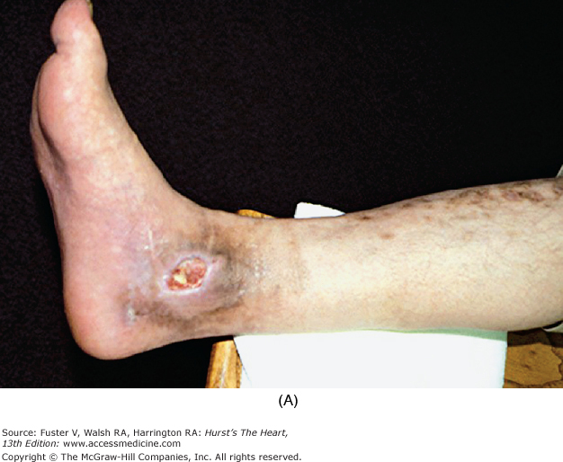
Skin Changes of Venous Insufficiency

Slide 15
Venous Insufficiency: Diagnosis
Clinical Exam/Hx
Venous Duplex US (B-mode + Doppler)
  B-mode evaluates venous anatomy and compressibility
  Doppler: shows flow direction and reflux
    Show retrograde flow of >0.5 sec in duration
    evaluate the nature and extent of venous reflux
  Evaluates location and extend of superficial and deep insufficiency
  Excludes or includes other diagnoses too

Slide 16
Venous Insufficiency: Primary Care Tx
Conservative tx:
Lifestyle modifications-avoid prolonged standing/sitting, wt. loss when indicated
Leg elevation-when able
Exercise: walking and calf muscle exercises to improve venous return.
Discuss proper skincare
  Prevention of dryness and developing fissures
  Don’t itch/scratch to prevent development of ulcers.
Compression therapy/stockings
  Reduces edema and improves venous sx
  Also indicated for ulcer management
  Assess for PAD if indicated

Slide 17
Venous Insufficiency: Tx
Venous ulcer management:
Compression therapy – assuming ABI nml
Wound care and appropriate dressing
Unna boot(zinc oxide compression dressing)
Refer to a wound care specialist or vascular surgeon for non-healing or complicated ulcers
Surgical tx:
Wound debridement of devitalized tissue in ulcers
Vein ablation
Other interventions may be considered by surgeon.

Slide 18
Venous insufficiency(Vascular/Derm/Wound): Indications for Referral
Coexisting PAD with venous disease
Active, nonhealing ulcers, or recurrent ulcers
Persistent stasis dermatitis
Resistant or recurrent cellulitis
Diagnostic uncertainty

Slide 19
Superficial Phlebitis/
Thrombophlebitis

Slide 20
Superficial Phlebitis vs. Thrombophlebitis
Superficial phlebitis- is inflammation of vein without thrombus
Superficial thrombophlebitis- inflammation and confirmed thrombosis within a superficial vein.
  Not considered a DVT, but may extend into deep venous system
    SVT near saphenofemoral junction carries increased risk of DVT and PE
Signs and symptoms include:
  Localized pain, tenderness, redness, swelling along the course of a superficial vein
  Vein feels like a palpable cord

Slide 21
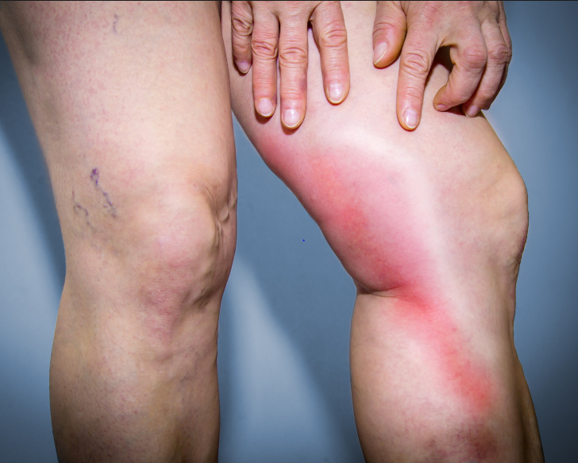
Superficial phlebitis / Thrombophlebitis

Slide 22
Superficial phlebitis / Thrombophlebitis
Risk Factors:
Intravenous catheter and chemical irritation:
  IV promethazine and potassium
Varicose veins due to venous stasis
Hypercoagulable Conditions
  Pregnancy
  Malignancy
  Exogenous estrogen use
Thrombophlebitis migrans (Trousseau Syndrome)

Slide 23
Thrombophlebitis migrans (Trousseau Syndrome)
Migrating thrombophlebitis due to thrombosis of superficial veins in multiple areas of the body at the same time.
Associated with hypercoagulability
  Glioma
  Adenocarcinoma of pancreas, lung
Patients have multiple superficial areas of thrombophlebitis
Can sometimes be an early sign of cancer
Known as Trousseau’s Syndrome or Migratory thrombophlebitis

Slide 24
Superficial phlebitis /
Thrombophlebitis: Diagnosis
Clinically you will suspect this based on H&P
  However, you should rule out the presence of coexistent DVT
Obtain a venous duplex US
  Confirms SVT and rules out DVT
  Also determines the proximity of the SVT to the deep venous system

Slide 25
Superficial phlebitis /
Thrombophlebitis: Treatment
Treatment depends on location, extent, and risk of thrombus extension.
Conservative tx:
  NSAIDS- for pain/inflammation
  Warm compresses
  Removal of IV catheter if possible
Antibiotics
  Not indicated for uncomplicated superficial thrombophlebitis
  If infectious thrombophlebitis cover with empiric antibiotics
Anticoagulants generally not indicated for most SVT
  Unless near saphenofemoral or saphenopopliteal junction

Slide 26
Venous Thromboembolism

Slide 27
Venous Thromboembolism
Deep vein thrombosis and Pulmonary embolism
Common occurrence
This is either acquired or inherited
Pathogenesis of VTE is referred to as Virchow’s Triad

Slide 28
Virchow’s Triad
Three basic theory explaining the pathogenesis of venous thromboembolism
  Venous Stasis (alterted blood flow)
  Endothelial injury
  Hypercoagulable state (inherited or acquired)

Slide 29
Virchow’s triad- Stasis
Prolonged immobilization
  Hospitalization with bed rest or limited mobility
  Long car ride or plane ride(more of a risk traveling transcontinental)
    ≥4 hours
  Long surgical procedurs
  Varicose veins

Slide 30
Virchow’s triad- Endothelial injury
Trauma
  Fx, major tissue injury or surgery
Long-term use of venous cathers such as PICC, Central, Ports/catheters
Inflammation
  Endothelial activation and dysfunction can promote clot formation

Slide 31
Virchow’s triad- Hypercoagulable state
Hereditary
  Factor V Leiden
  Protein C and S deficiency
  Deficiency of antithrombin III
  Prothrombin gene mutation
  Antiphospholipid syndrome
Acquired
  Cancer
  Pregnancy
  Hormone
    hormone replacement or birth control
    testosterone
  Nephrotic syndrome (10-40% increase)

Slide 32
Deep Vein Thrombosis

Slide 33
Venous Thromboembolism: Pathogenesis
DVT:
Commonly originated in the calf, but can be in upper extremities too
15-30% progress proximally
With proximal progression risk of embolism increases:
  Risk of PE increases from 10% to 50%
  PE occurs when a DVT breaks loose and travels to the lungs

Slide 34
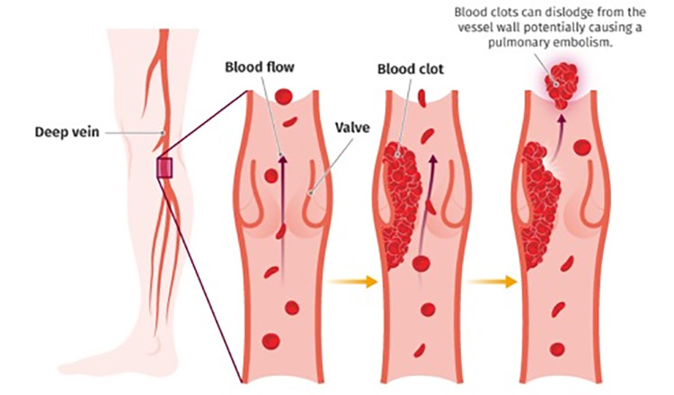

Slide 35
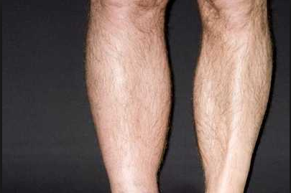
Deep Vein thrombosis: S&S
Patient complains of:
Calf pain
Calf/leg edema
Maybe redness
PE:
Dilated superficial veins
Unilateral leg edema
Warmth/tenderness/palpable cord (most DVT will not have palpable cord because they are DEEP)
Homan’s sign (pain in calf with dorsiflexion of foot)

Slide 36
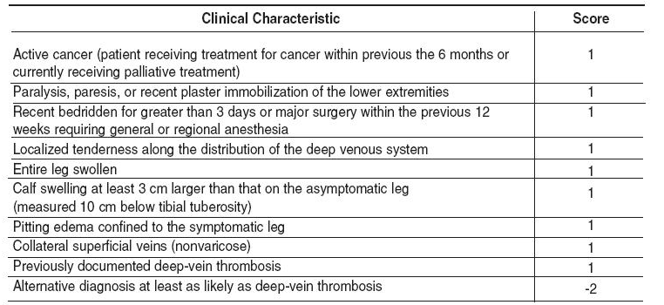
Wells Criteria for DVT
Score of ≥3 → High Probability
Score of 1 or 2 → Moderate Probability
Score of 0 → Low Probability

Slide 37
DVT: D-Dimer vs. US
Low probability
  D-Dimer
    Degradation product of fibrin (i.e. clot)
    If elevated → perform Ultrasound
    If normal → DVT ruled out
Moderate/High
  Venous compression duplex ultrasound of lower extremities
    95% Sensitivity, Specificity
    CT in cases where a DVT within the abdomen is a concern
    Negative US does not always rule out a DVT; repeat in a week may be indicated if negative and high clinical suspicion.

Slide 38
DVT: Disposition and Treatment
Treatment will be discussed later
Outpatient management:
Hemodynamically stable
Low risk of bleeding
Adequate renal function for anticoagulation
Social support at home
Inpatient management:
Massive DVT (iliofemoral DVT)
Presents with a PE as well
Active bleeding or high risk for bleeding
Severe renal impairment complicating anticoagulants
Other comorbid conditions that warrant in-hospital care

Slide 39
DVT Discharged home
What patient education/instructions should you give when discharging a patient with a DVT on an anticoagulant?

Slide 40
Post-thrombotic Syndrome
Syndrome of venous insufficiency AFTER DVT (extends beyond resolution of thrombosis)
Pain, swelling in lower extremity affected by DVT
Treatment includes: compression stockings, elevation and pain management
PREVENTION →Prevent recurrent DVTs

Slide 41
Phlegmasia Cerulea Dolens
Rare, limb- and life-threatening complication of deep vein thrombosis (DVT)
Occurs when major venous outflow is obstructed, causing congestion of the superficial venous system
Results in massive venous hypertension, leading to severe swelling, pain, and ischemia
May progress to gangrene and limb loss if untreated
Urgent vascular surgery consultation required

Slide 42
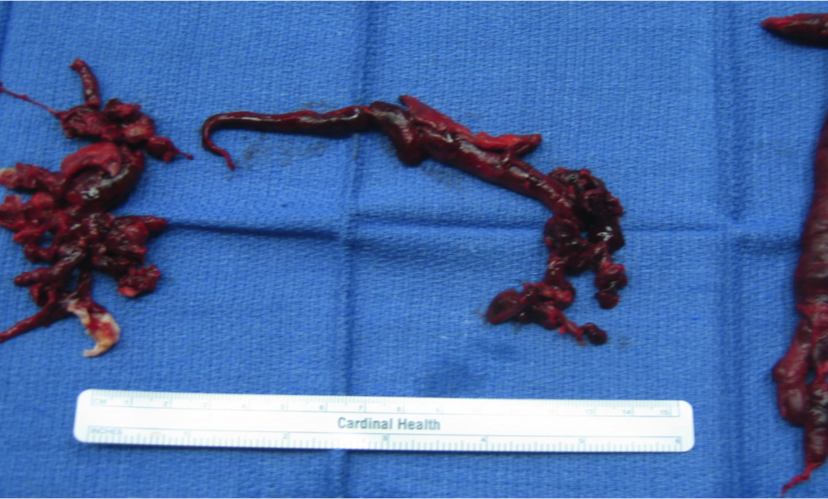
Pulmonary Embolism

Slide 43
Pulmonary Embolism (PE): Definition
Obstruction of the Pulmonary Artery or of its branches.
  Thrombus
    Usually from a deep vein thrombosis (DVT) that breaks loose and travels ultimately settling in the lungs.
    Lower extremity DVT above the knee is likely to travel vs below the knee stay
  Other causes:
    Tumor
    Fat
    Air
Purpose of this lecture will focus on thrombus as this is the most common

Slide 44
PE: Pathophysiology
DVT breaks off section causing embolus
Embolus travels through right heart to pulmonary artery ending in lung
This blocks blood flow to lung resulting in inadequate O2 exchange leading to hypoxia
As heart struggles to push against increased resistance patient can develop increased right heart strain
This decreases preload to left heart → heart failure, death
Results in decreased cerebral perfusion, shock and death

Slide 45
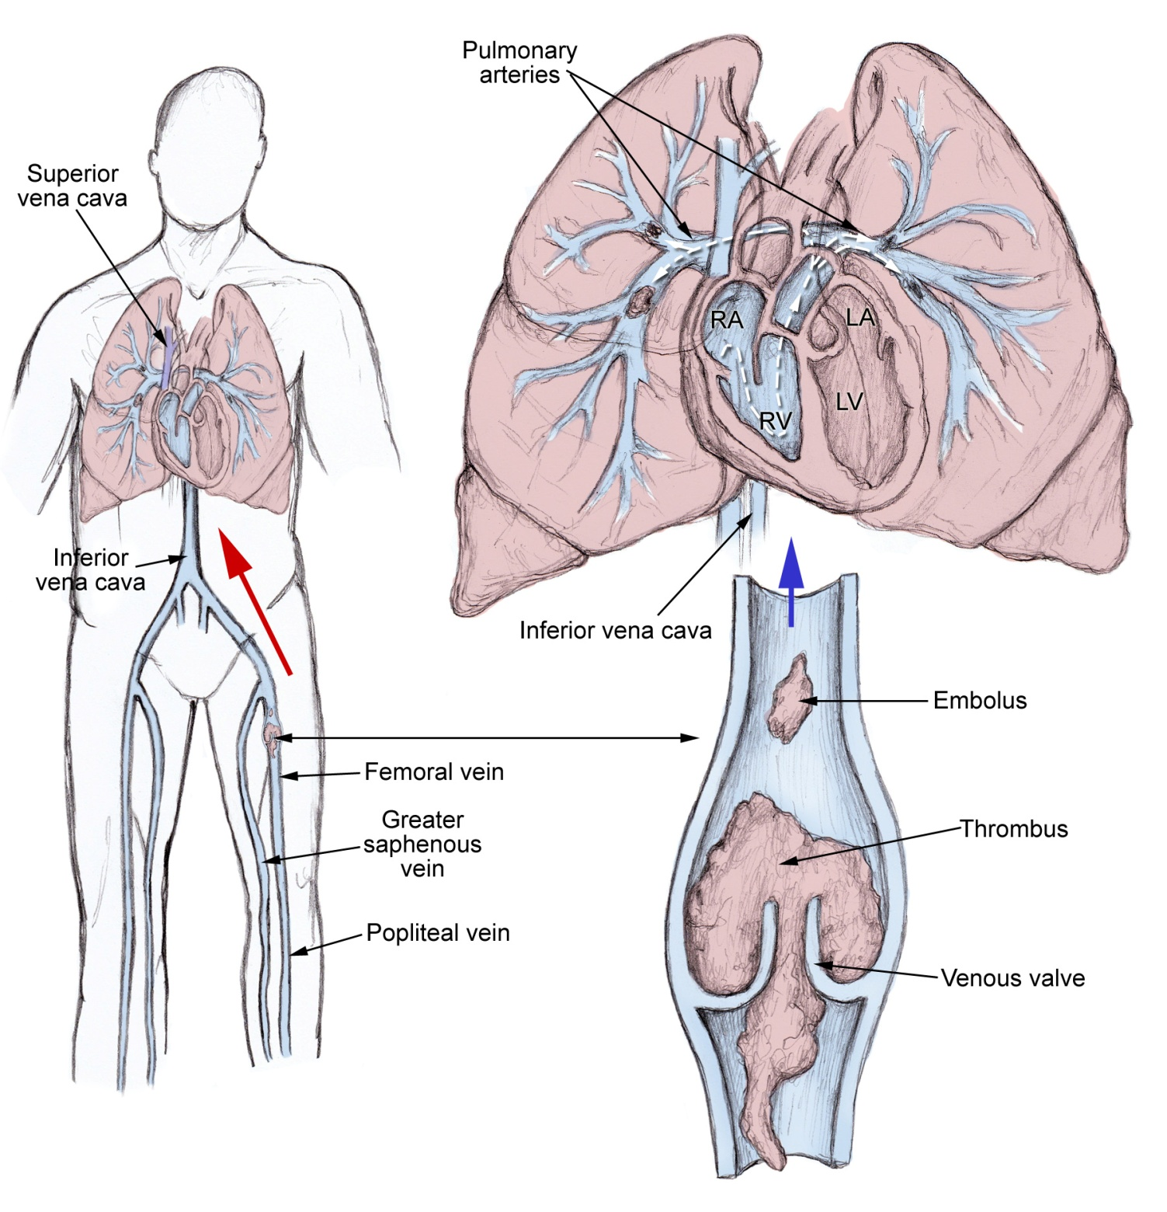
DVT → PE

Slide 46

This telephone could have a PE!!!

Slide 47
Locations of PE
Saddle
  Thrombus that straddles the bifurcation of main pulmonary artery and usually extending into main right and left pulmonary arteries
Lobar
  Branch of main pulmonary artery to the lobes of lung
Segmental
  Lobar arteries branch into segmental
Sub-segmental
  Branches of the segmental artery
Bilateral vs unilateral

Slide 48
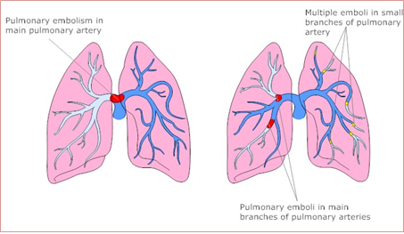
PE Locations

Slide 49
Epidemiology
Venous thromboembolism (VTE) affects up to 900K annually (CDC estimates)
Sudden death in about 25% of PEs.
VTE slightly higher in men, although risk varies with age and hormonal factors.
Risk increases with age, particularly after 60.
Special populations risk is significantly higher:
  Hospitalized pts
  Pts undergoing major surgery
  Pts with active malignancy
  Pregnant and postpartum pts

Slide 50
Clinical symptoms
Common symptoms:
  Dyspnea
  Pleuritic/chest pain/upper back pain
  Hemoptysis
  Calf/thigh pain and or swelling
  Cough
Less common symptoms:
  Back pain
  Abdominal pain
  Atrial fibrillation
Severe PE may present with:
  Syncope
  Hypotension
  Hemodynamic collapse or cardiac arrest

Slide 51
Clinical exam finding with PE
Common or possible findings:
  Tachypnea (about half)
  Tachycardia (~ 24%)
  Calf swelling, erythema, edema, tenderness or palpable cord…Homans sign not reliable
  Lung exam often normal
  Occasional decreased breath sounds
  Splinting
  Fever; mimicker of pneumonia (~3%)
Findings concerning for severe PE/RV strain:
  Hypotension
  Associated with Right heart strains:
    Rales
    Accentuated or split second heart sound
    JVD
  Signs of poor perfusion

Slide 52
PE Workup
Obtain a complete history and PE.
  Ask specific questions such as travel, surgery, family history of PE, surgery or injury, hormone etc.…
Once history obtained you can use two clinical prediction tools to determine if a D-dimer or more advnaced imaging should be done (assuming they are hemodynamically stable):
  PERC: May exlude PE w/o further testing in very-low risk pts
  Wells: estimates pretest probability and guild D-dimer vs imaging.

Slide 53
D-Dimer
Bi-product of fibrin degradation
If D-dimer is +, it's not specific to a PE, but will warrant advanced imaging to rule out a PE
If D-dimer is negative, because it is so sensitive, you can rule out a PE.
  No further testing warranted
This number can be adjusted by patient's age
Not typically done in pregnancy as it is usually elevated

Slide 54
PERC Criteria
PERC is used only in patients with low clinical suspicion for PE. If all eight criteria are negative, PE can be excluded without additional testing. If any criterion is positive, further assessment is needed.
  Age ≥50 years old
  Pulse ≥100 bpm
  SaO2 < 95%
  Hemoptysis
  Estrogen use
  Surgery /trauma/ hospitalization in the last 4 weeks
  Prior venous thromboembolism
  Unilateral leg swelling
If I have even one on this list that is positive what’s the next step? D-Dimer or CTA PE protocol?

Slide 55
Wells Clinical Prediction rule for PE
Criteria | Score
Clinical signs and symptoms of DVT | 3
PE is #1 diagnosis or equally likely | 3
HR > 100 | 1.5
Immobilization at least 3 days, or Surgery in the last 4 weeks | 1.5
Previous diagnosed PE or DVT | 1.5
Hemoptysis | 1
Active malignancy (Tx ongoing, w/I past 6 months, or pallative) | 1

Slide 56
Wells risk score interpretations
> 6 points: high risk
  Proceed to advanced imaging such as a CTA or VQ scan
  D-dimer NOT recommended
2 to 6 points: moderate risk
  Obtain a high-sensitive D-dimer
  Negative D-Dimer → PE can generally be excluded.
  Positive D-Dimer → CTPA or V/Q scan as appropriate
<2 points: low risk
  Consider PERC only if clinical suspicion is sufficiently low.
    PERC negative → No additional testing.
    PERC positive → Obtain D-dimer
  Positive D-Dimer → Diagnostic imaging
Document decision making section
Notes:
Don’t memorize this scoring

Slide 57
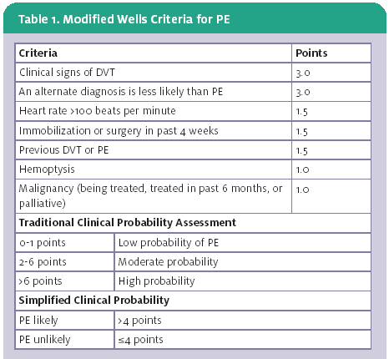
Modified Wells
Notes:
Know the modified

Slide 58
Modified Wells Score
Modified Wells score ≤ 4 PE is not likely
  Obtain a high-sensitivity D-dimer.
  Negative D-dimer → PE excluded; no further testing.
  Positive D-dimer → CT pulmonary angiography (CTPA).
Modifies Wells score >4 PE is likely
  Proceed to a CTAPE
  Do not use D-Dimer to exclude PE

Slide 59
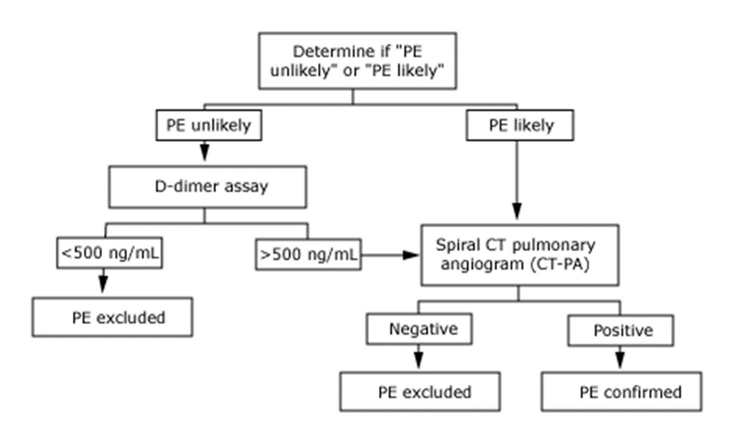

Slide 60
D-Dimer in Pregnancy: Evaluation for PE
D-Dimer can be used to exclude PE in pregnancy with low clinical suspicion.
  A negative high-sensitivity D-Dimer, combined with low clinical probability, can safely exclude PE.
  Three month VTE rate following a neg D-Dimer: 0.32%
Limitations during pregnancy:
  D-Dimer levels increase with gestational age.
  Fewer than 5% of suspected PE in third trimester have a negative D-Dimer using traditional cutoff.
  No universally accepted pregnancy-adjusted cutoff exists.
Clinical application:
  A positive D-dimer does not diagnose PE; further evaluation is required.
  Pregnancy-adapted YEARS criteria with D-Dimer may be used.

Slide 61
Work up: Labs
CBC: anemia, infection, platelet count
BMP: Need to evaluate for renal function and lytes
Troponin
  Can be elevated in PE secondary to right heart strain
BNP
  Elevation can indicate concern for right heart strain
+/- D-Dimer: Depending on your scoring tools
Tox screen if indicated
Pregnancy test if of reproductive age
Consider LFT and lipase if upper abd pain: May suggest an alternative diagnosis.

Slide 62
Work Up
EKG
Chest XR
Doppler US of lower extremity if there is pain, swelling, or physical exam finding suspicious for a DVT
Echo:
  Evaluates RV dilation and dysfunction
  Useful in unstable patients; also assists with risk stratification
Consider Arterial blood gas (ABG) in critically ill

Slide 63
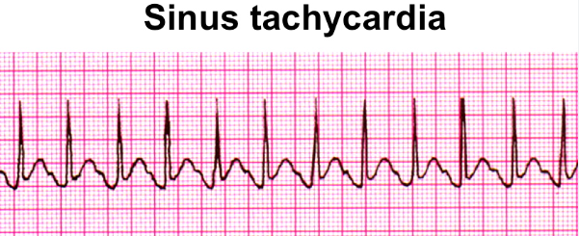
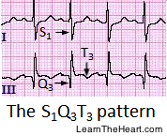
EKG
Most common finding is sinus tachycardia!
EKG could be normal and does not exclude PE
S1Q3T3 (also indicative of right heart strain)
  Not so specific or sensitive but can be seen in pts with a PE
  Not diagnostic in PE; can be seen in other heart conditions.

Slide 64
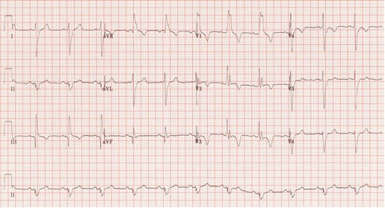
S1Q3T3: right Ventricular Strain Pattern
S1
Q3
T3
Notes:
S1: Prominent S wave in lead I.
Q3: Q wave in lead III.
T3: T-wave inversion in lead III.

Slide 65
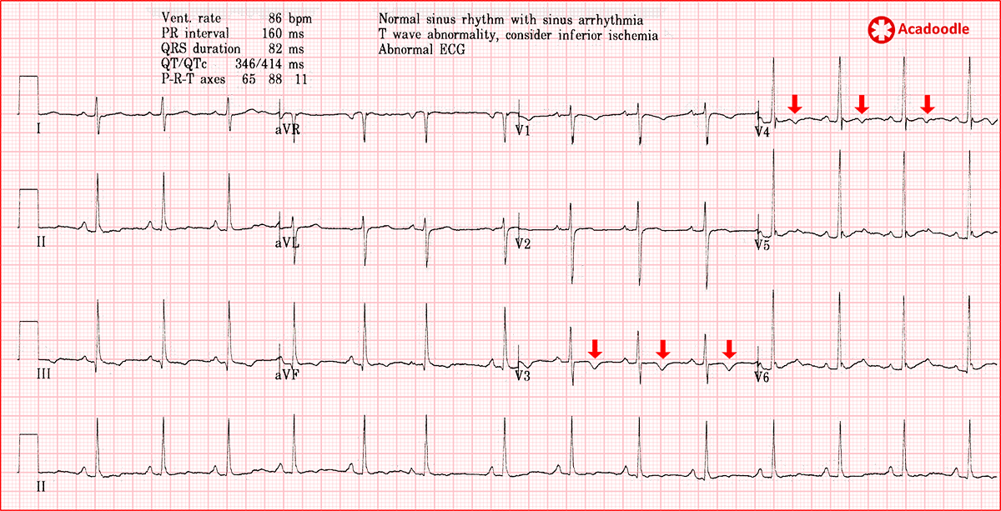
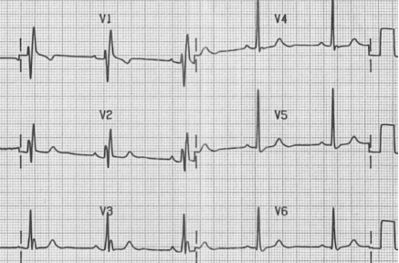
EKG Continued…
T wave inversions in precordial leads (V1-V4) and +/- inferior leads
  May indicate right heart strain secondary to PE
New incomplete or complete RBBB
  Can be associated with more significant PE

Slide 66
Chest XR findings
Normal is the most common finding
Atelectasis
Effusions
Hampton Hump
  Peripheral, pleural-based, wedge-shaped opacity
  Represents a pulmonary infarction
  Uncommon finding in PE
Westermark sign
  Dilation of pulmonary arteries proximal to the embolus
  Collapse of distal vasculature
  Sharp cutoff on CXR

Slide 67
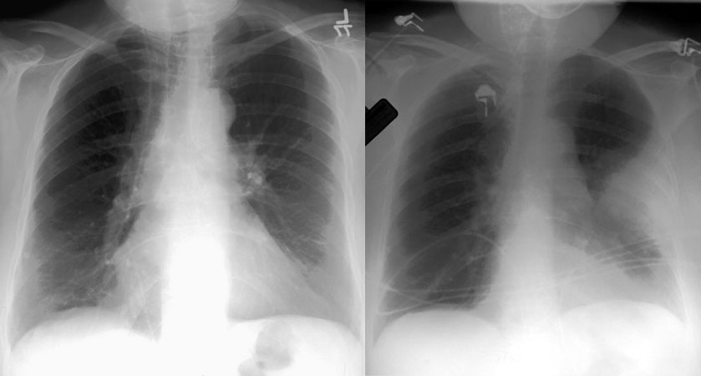
Hampton’s Hump

Slide 68
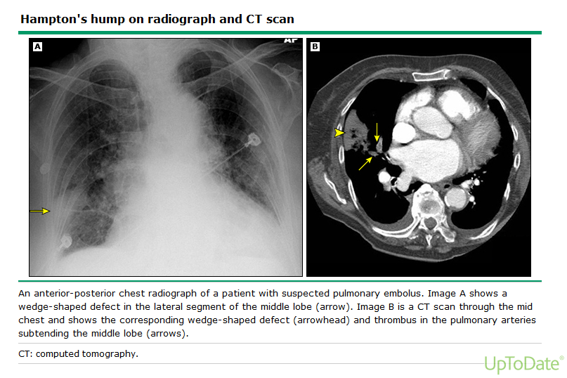

Slide 69
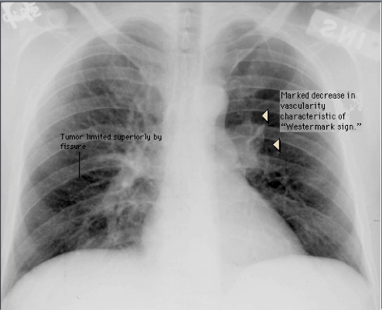
Westermark Sign

Slide 70
Duplex Doppler US
Compression US evaluates deep vein compressibility
  Nml veins compress with probe
  Non compressibility suggests DVT
  Doppler evaluates blood flow
Role in pregnancy pts with suspected PE
  Perform lower-extremity compression US when S&S of DVT are present.
  Positive proximal DVT: Initiate anticoagulation; chest imaging may not be necessary.
  Negative US: Does not exclude PE; continue appropriate PE evaluation.
  D-Dimer:

Slide 71
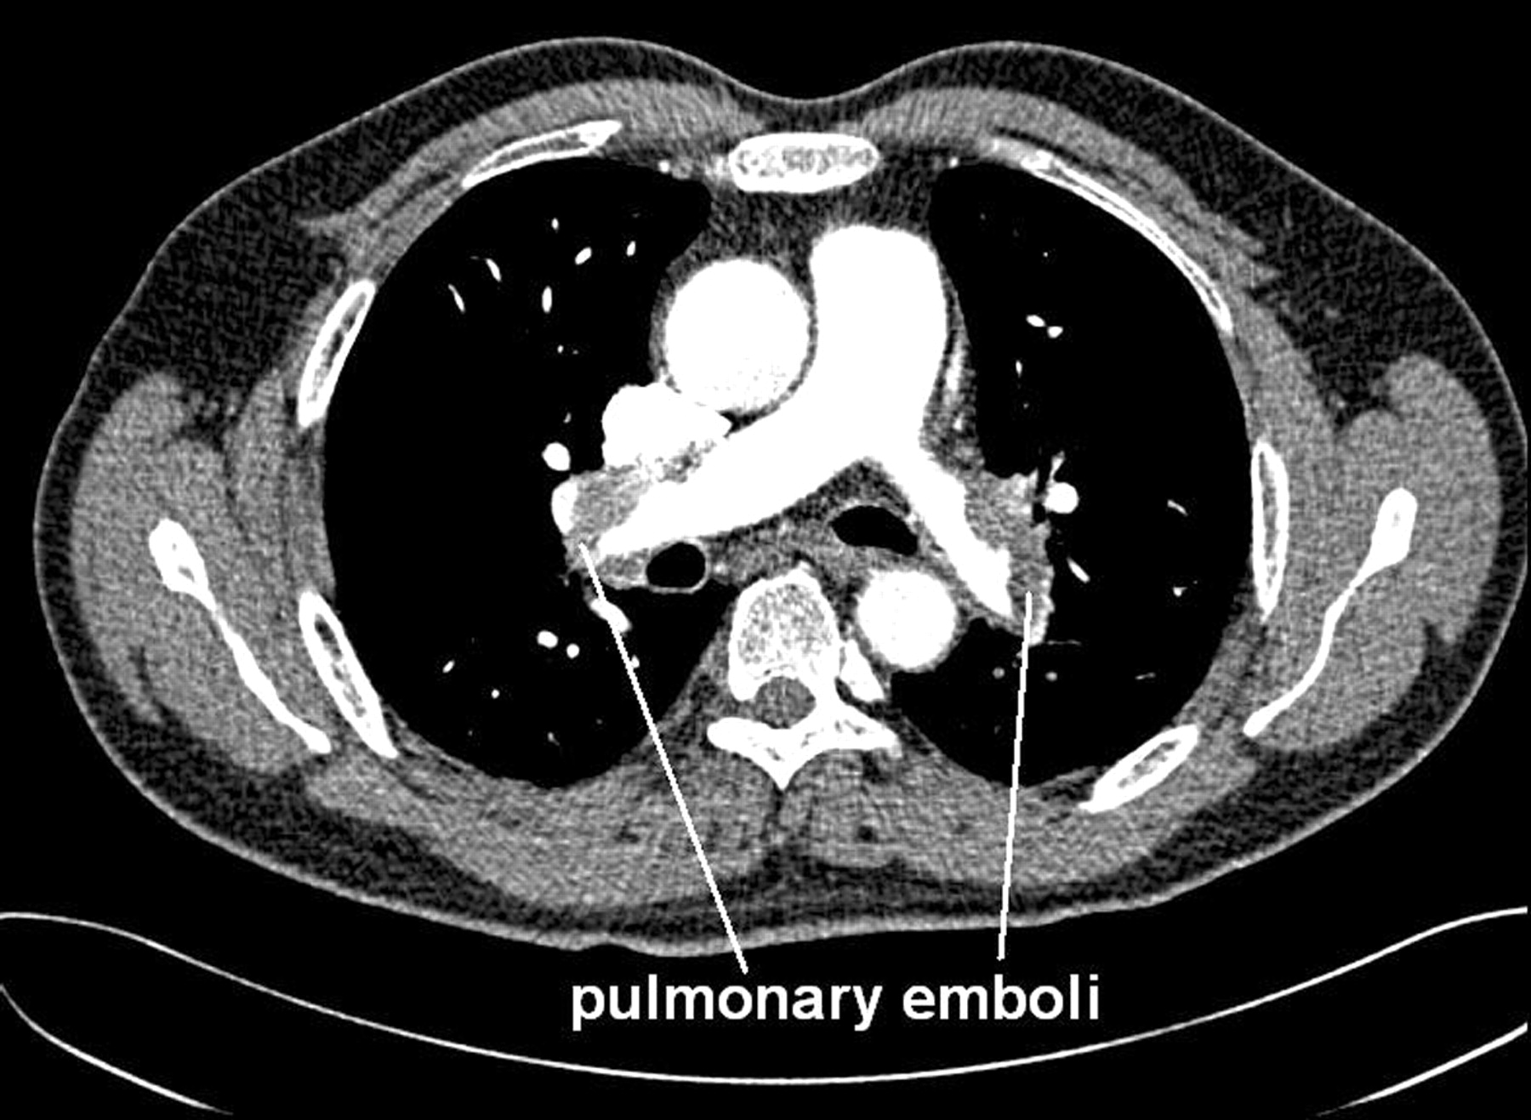
Advanced Imaging- CTA
CT pulmonary angiography (CTAPE)- Preferred first-line imaging test
Uses timed IV contrast to visualize filing defect
  PE appears as the dark filling defect seen on imaging.
  Can identify other pulmonary condition, including pneumonia and plural effusion

Slide 72
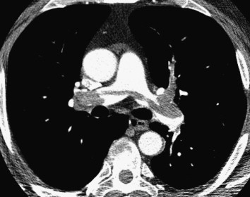
Advanced Imaging- CTA
Situations requiring caution or alternative imaging:
    Severe renal impairment (GFR < 30) or acute kidney injury
      Consider renal risk vs. benefit.
    H/O severe allergy to iodinated contrast
    Unable to lie flat or tolerate breath-holding
CTA in pregnancy:
  Can be safely considered when pulmonary imaging is indicated.
  CTA and VQ scan are accepted but have been hotly contested over the years.
    Imaging selection depend on clinical circumstances and chest x-ray findings.

Slide 73
Advanced Imaging -VQ scan
Nuclear medicine scan that looks at perfusion and ventilation by injecting and inhalation of nuclear material.
Study looks for a miss-match in ventilation and perfusion
  In the case of a PE:
    Decreased perfusion
    No change in ventilation
Ideal if the chest x-ray is nml
Can be used in pregnant pt.
Preferred test for:
  Can be useful for severe renal impairment or AKI
  Severe allergic rxn to contrast allergy

Slide 74
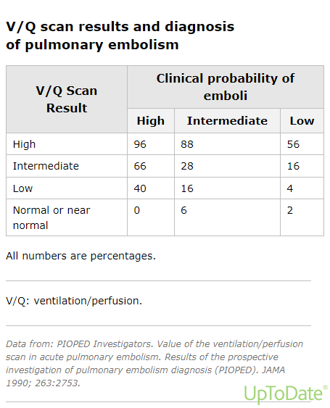

Slide 75
PE work-up in Pregnancy
Initial Eval:
  Assess suspicion and hemodynamic status.
  D-Dimer can be used in pregnancy when clinical suspicion is low and diagnostic algorithm followed
    A neg result may exclude PE
    D-dimer becomes less useful as pregnancy progresses
Symptoms of DVT are present:
  Obtain US
  If Positive tx; chest imaging may not be needed
  If negative does not r/o PE
If no DVT symptoms:
  Routing bilateral leg US not necessary
  If PE cannot be excluded, proceed with pulmonary imaging.

Slide 76
PE in Pregnancy – Imaging
Chest X-ray:
  Evaluate for alternative causes of chest pain or SOB
  Helps determine which pulmonary imaging study to obtain
Advanced imaging:
  Nml Chest X-ray: V/Q scan or CTA
  Abnormal Chest X-ray: CTA

Slide 77
General management to consider in PE

Slide 78
Classification of PE
High risk (Massive) PE
  Hemodynamically unstable
    Sustained SBP <90 mmHg or a drop in systolic of ≥ 40mmHg from baseline
    Often have right ventricular dysfunction
    Massive refers to hemodynamic compromise not the size of the PE
Intermediate risk (Submassive) PE
  Hemodynamically stable
  Nml vitals or near nml
  Right ventricle dysfunction and/or elevated cardiac markers(Troponin or BNP)
Low-risk PE
  No evidence of right ventricle strain or elevation of biomarkers
  Hemodynamically stable

Slide 79
PE : ED Treatment
During work up possible treatment options:
  Oxygen – target O2 >90%
  IV fluids
    Be cautious if EKG shows signs of right heart failure
  Anticoagulation
  Thrombolytic
If hemodynamically unstable
  ICU admit
  mechanical ventilation
  Pressor for BP support such as Dopamine
Majority of patients will be stable
  Telemetry bed will be sufficient
Anticoagulation is cornerstone of treatment

Slide 80
VTE Treatment- Anticoagulation
Patient Education:
Prevents blood from clotting from growing and reduces formation of new clots
Does not directly dissolve clot
Increased bleeding risk
Medication compliance is important

Slide 81
Treatment-Anticoagulants: Fast Acting
Low-molecular wt heparin (LMWH):
Enoxaprin (Lovenox): SQ injection
  Rapid onset
Used as a bridge till Warfarin is therapeutic(If indicated)
  LMWH would be taken simultaneously with warfarin for 5 days till INR is therapeutic for at least 24 hours.
Treatment of choice in pregnancy
Renal failure: avoid in late-stage CKD IV or V

Slide 82
Treatment-Anticoagulants: Fast Acting
Heparin unfractionated:
Given IV; typically, a bolus followed by a continuous infusion.
  Starts immediately with a bolus followed by drip
May be preferred in:
  Unstable PEs when thrombolysis or an urgent procedure is anticipated
  Severe renal failure
  Pts requiring rapid reversal
Notes:
Can cause HITS

Slide 83
Treatment-Anticoagulants: slow acting
Vit K. Antagonist: Warfarin/Coumadin
Oral anticoagulant with delayed therapeutic effect; bridge with LMWH
  Requires INR monitoring
Preferred anticoagulant for Pts with antiphospholipid syndrome
Can be used in renal failure patients
Not used in pregnancy!
Many drug interactions to consider

Slide 84
Treatment – Factor Xa inhibitors
Apixaban (Eliquis)- half life 9-14 hours or Rivaroxaban (Xeralto)- half life is 5-13 hours
  Given orally with rapid onset (1-2 hour onset)
  Preferred over coumadin
    No need for INR monitoring
  Medication is costly $$$
  DVT/PE tx can be started in the ED then D/C home with appropriate F/U

Slide 85
Treatment – Factor Xa inhibitors
Rivaroxaban (Xarelto):
  DVT/PE treatment: 15 mg BID for 21 days followed by 20 mg once daily with food
  If CrCL < 15 ml/min avoid use
Apixaban (Eliquis):
  DVT/PE tx: 10 mg PO BID x 7 days followed by 5 mg BID daily
  Avoid use with a CrCL <15 ml/min

Slide 86
PE: Treatment-Tissue Plaminogen Activator (tPA)
Actively breaks down existing blood clot.
Systemic thrombolysis:
  Consider for high-risk PE with persistent hypotension, obstructive sock or cardiac arrest
    Reserved for severe hemodynamic compromise due to bleeding risk
Catheter-directed therapies:
  May consider in selected pts with impending cardiopulmonary failure or clinical deterioration
Major risk: Significant bleeding, including intracranial hemorrhage
There are contraindications to tPA such as…

Slide 87
TPA - Absolute contraindications
Intracranial hemorrhage
Ischemic stroke within 3 months
Suspect aortic dissection
Active bleeding
Recent head/face injury with radiology evidence bony fx or brains injury
Recent surgery on brain or involving spinal canal
Known malignant neoplasm of brain/spinal cord
Notes:
Relative contraindications include
age >75 years;
current use of anticoagulation;
pregnancy;
noncompressible vascular punctures;
traumatic or prolonged cardiopulmonary resuscitation (>10 minutes);
recent internal bleeding (within 2 to 4 weeks);
history of chronic, severe, and poorly controlled hypertension;
severe uncontrolled hypertension on presentation (systolic blood pressure >180 mm Hg or diastolic blood pressure >110 mm Hg);
dementia;
remote (>3 months) ischemic stroke; and
major surgery within 3 weeks.

Slide 88
Treatment – Anticoagulation contraindication
Allergy
Bleeding issue such as GI
Hemorrhagic stroke history
Spinal cord/intracranial tumors

Slide 89
PE Treatment- Embolectomy
Embolectomy- mechanical removal of a PE
Two approaches:
  Surgical: clot removed through open surgery
  Catheter-based thrombectomy: Clot removed through a catheter
Considerations:
  High risk PE
  Impending cardiopulmonary failure or deterioration
  Contraindication to thrombolysis
  Persistent instability despite thrombolytic tx

Slide 90
Treatment-IVC filter
Inferior Vena Cava (IVC) filter
  Purpose: Traps blood clots traveling from the lower extremities towards the lung.
  Does not treat VTE
Primary indication:
  Acute DVT/PE with absolute contraindication to anticoagulation
  Ex: Cancer pts with DVT or PE and having active bleeding
Other indications:
  Recurrent PE despite use of anticoagulant
Not routinely recommended in pts who can receive anticoagulation.

Slide 91
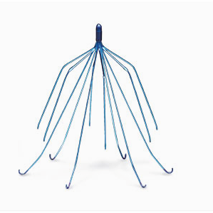
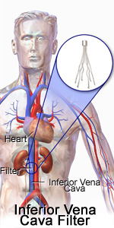
IVC

Slide 92
PE Tx: Low Risk
Low risk PE:
  They have symptoms, but nml vitals and no heart strain
    A Pulmonary embolisms severity index (PESI) can help determine low-risk patients who can be treated as out-patient
Initiate anticoagulation:
  DOAC preferred for most eligible pts
  Minimum tx is 3 months.
Disposition:
  Output tx or early discharge may be appropriate
  Use validated risk assessment tool (PESI) to help determine eligibility

Slide 93
PE Tx: Intermediate risk
Clinical presentation:
  Hemodynamically stable- no persistent hypotension or shock
  RV dysfunction and/or elevated cardiac biomarkers (troponin or BNP)
Tx:
  LMWH for most pts
  Consider unfractionated heparin (UFH) when rapid adjustment or urgent procedure anticipated
  Admit telemetry vs ICU vs step down
  Advanced interventions:
  Not routinely done
  Consider urgent consult if pt develops impending cardiopulmonary failure
Discharge:
  Continue anticoagulation for at least 3 months, with individualized according to recurrence and bleeding risk. See up coming slide.

Slide 94
High-Risk PE Tx
Clinical Presentation:
  Persistent hypotension, obstructive shock, or cardiac arrest
  Often significant RV dysfunction
Immediate management:
  Urgent ICU level care
  O2 and hemodynamic support; vasopressors are needed
Reperfusion therapy:
  Systemic thrombolysis (alteplase) is recommended as a primary options
  Other considerations:
    Catheter directed thrombolysis or mechanical thrombectomy
    Surgical embolectomy considered when thrombolysis contraindicated
While advanced therapies are being arranged immediate anticoagulation must be initiated: LMWH
  Held during systemic TPA

Slide 95
Long Term VTE Anticoagulant Selection
General population:
  Factor Xa inhibitors (DOACS) preferred
Patients with active cancer:
  DOACS
  LMWH
Pregnancy:
  LMW Heparin preferred
Antiphospholipid syndrome (APS)
  Warfarin (Coumadin) preferred

Slide 96
Venous Thromboembolism: Long Term Tx
Duration of long-term anti-coagulation is dependent on clinical scenario:
  First proximal DVT or PE due to provoked cause
    Ex: Surgery, trauma, temp immobilization, long flight to Asia.
    Anticoagulation 3 months
  First DVT/PE unprovoked:
    No identifiable precipitating factor
    At least 3 months then reassess risk/benefit.
    Extended anticoagulation often recommended (6-12 months)
  Recurrent DVT/PE:
    Indefinite anticoagulation
  Persistent Risk Factors:
    Ex: Active cancer or APS
    Extended treatment often indicated

Slide 97
Venous Thromboembolism:
Long Term Anticoagulation
Things that are considered during reassessment:
  Unprovoked DVT/PE
    Extended or indefinite anticoagulation is often recommended if bleeding risk is acceptable
  Factors considered when determining duration
    Risk of Recurrence
      Provoked vs Unprovoked VTE
      H/O previous VTE
      Persistent risk factors (Active CA, APS)
    Risk of major bleeding
    Pt preferences and ability to maintain tx
  Important considerations:
    Routine D-dimer, repeat US, and thrombophilia testing are generally not needed solely to determine tx duration
This decision must be made with the pt and is individualized based on risk factors, provoked/unprovoked and risk for recurrence and bleeding.

Slide 98
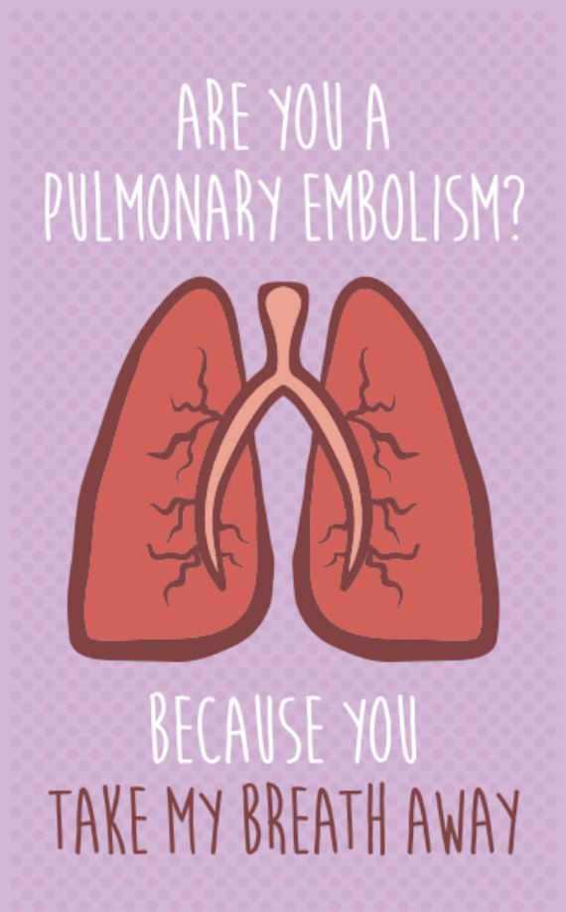
The
End!

