Slide 1
INTRO TO RADIOLOGY
Part 2
Presented by: Aaron Perry, PA-C

Slide 2
ULTRASOUND

Slide 3
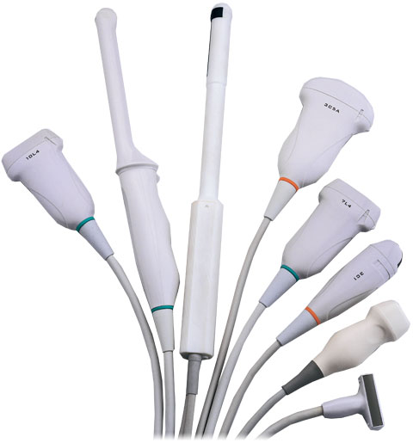
ULTRASOUND
An ultrasound transducer (probe) sends a high frequency inaudible sound wave pulse and receives echoes back.
The design of the transducer will determine the shape and the field-of-view of the ultrasound image

Slide 4
ULTRASOUND
Ultrasound gel is placed between the transducer and the patient’s skin. The gel is water-soluble and uses the ability of sound waves to travel through water to transmit the pulse.
As sound waves hit an “interface” some of the sound waves pass though and some are reflected back and picked up by the probe.
The strength of the returning echoes as well as the time it takes for them to return create the picture that we see.

Slide 5
ULTRASOUND
The difference between adjacent structures is translated into spatial and contrast information and is viewed as a moving 2 dimensional grayscale image.
3D ultrasound is created by computationally combining multiple 2D US images and 4D uses 3D plus time- these are most commonly used in OB

Slide 6
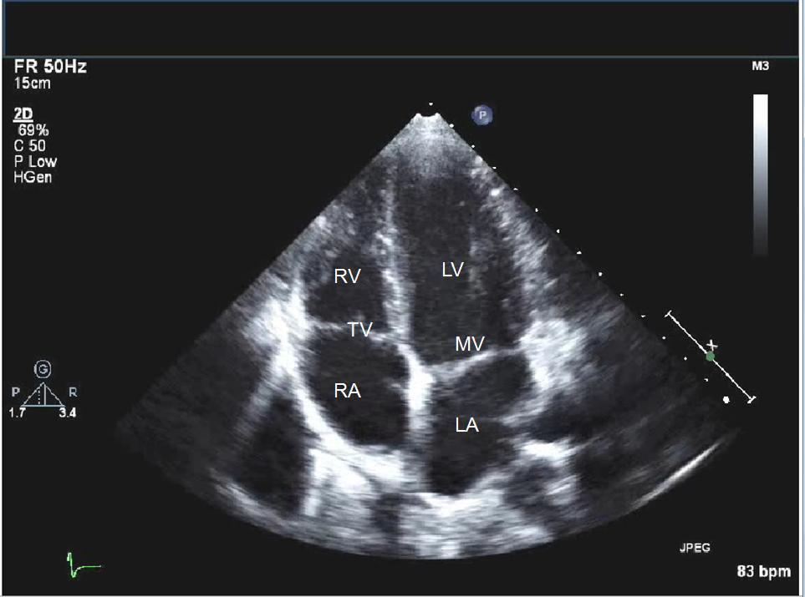
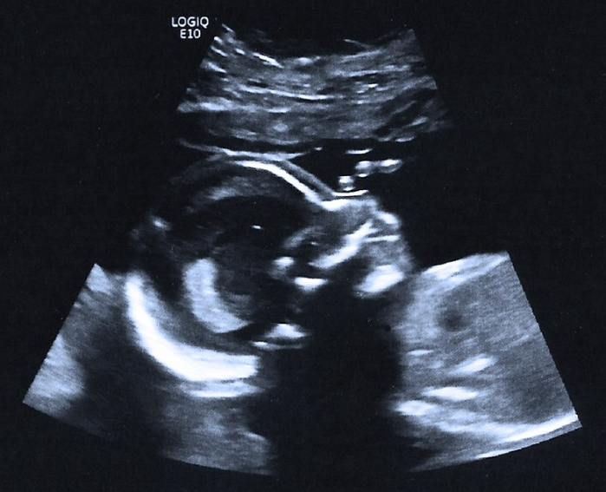
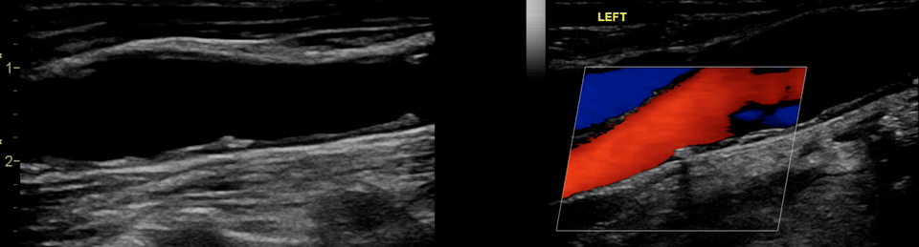
ULTRASOUND

Slide 7
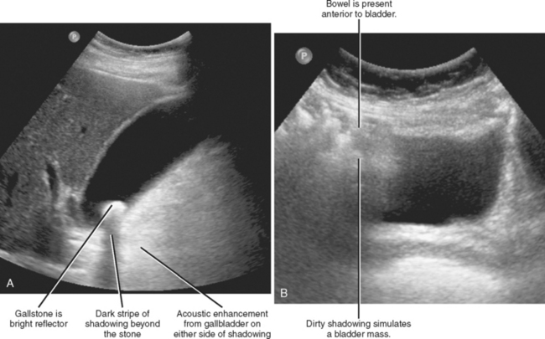
ULTRASOUND TERMS
Echogenicity is the difference in reflected echoes caused by different tissue densities.
If the difference in echogenicity between two tissues is great, the waves are completely reflected back causing acoustic shadowing. This occurs behind bones, stones and air.

Slide 8
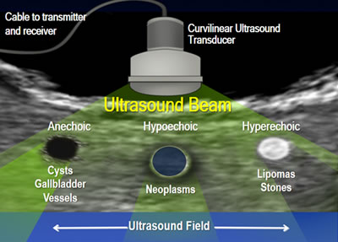
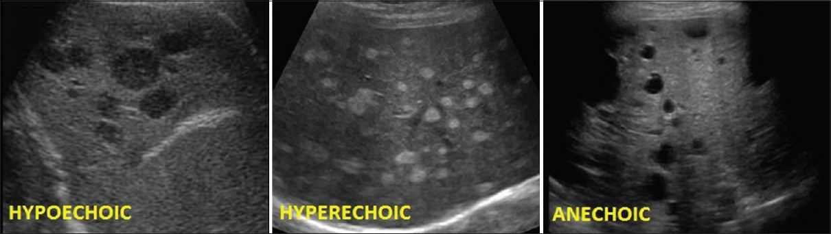
DESCRIBING ECHOGENICITY
Hypoechoic: appears gray (medium echoes)
Hyperechoic: appears white (strong echoes)
Anechoic: appears black (no echo)

Slide 9
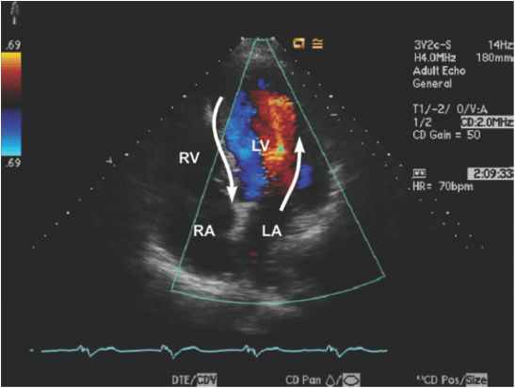
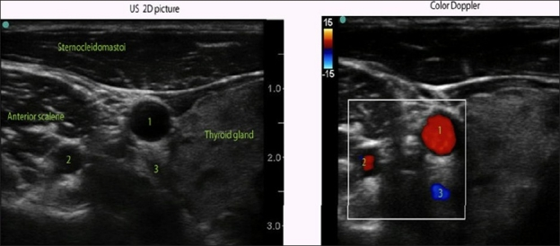
Doppler is a feature of ultrasound that can detect a frequency shift (tissue movement) in the echoes and whether the tissue is moving away or toward the transducer.
This is used to evaluate vascular structures such as blood vessels or the heart (echocardiogram). Blood flow can be seen as moving color superimposed on the grayscale image.
BART: Blue away, Red toward- the probe only- does not identify artery or vein!!

Slide 10
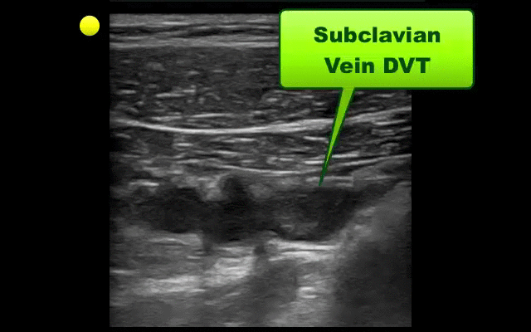
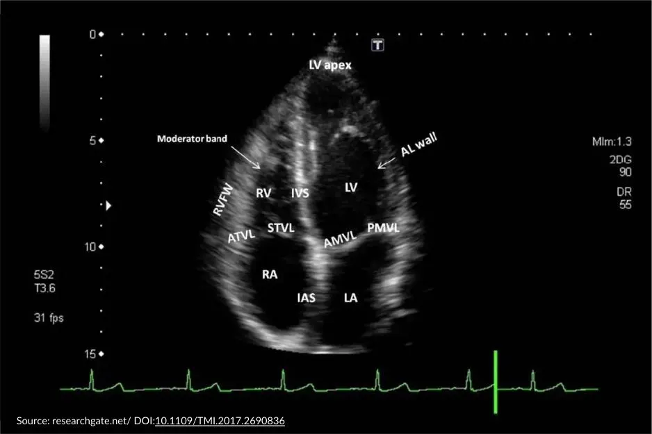
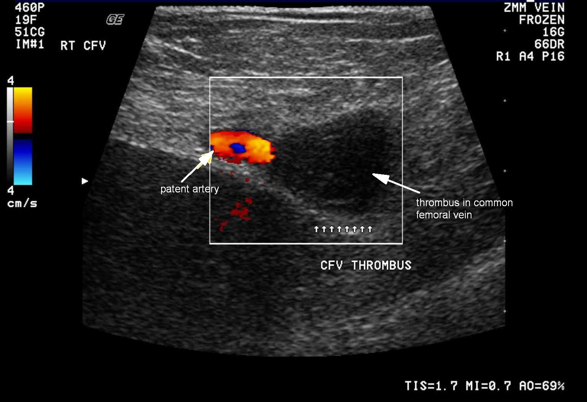
M-Mode: Activates motion-mode acquisition, which generates time-motion graphs for analysis of moving structures, such as the heart
Blood vessels: anechoic
  Veins: easily collapsible
  Arteries: pulsatile and do not collapse

Slide 11
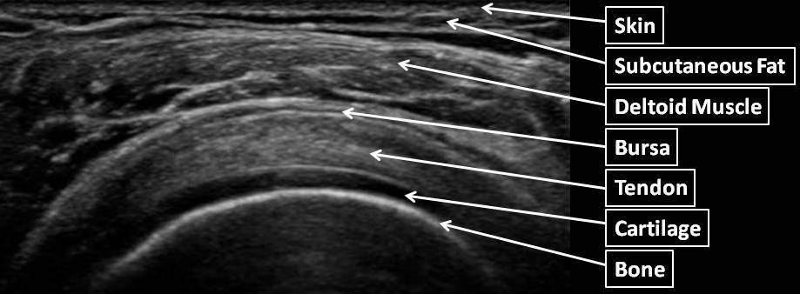
ULTRASOUND APPLICATIONS
Ultrasound is used for routine diagnostic evaluation, image guided procedures, and bedside emergency diagnostics.
Musculoskeletal
Visualization of muscles, tendons, ligaments and fluid filled joints in order to perform arthrocentesis (joint aspiration) or injections
Evaluation of ligamentous tears, dislocations, inflammation, cysts, neuroma (foot)

Slide 12
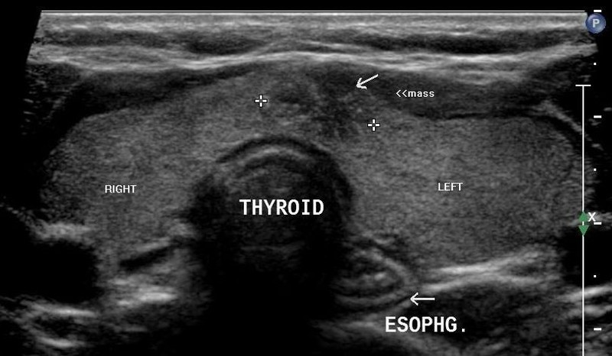
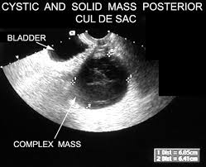
ULTRASOUND APPLICATIONS
Ultrasound is the initial diagnostic study of choice to evaluate the:
Liver, spleen, gallbladder, and thyroid.
Genitourinary tract in females: uterus, fallopian tubes, ovaries, cervix
Genitourinary in males: prostate, testicles and scrotum
It is also used for certain evaluations of the kidney, bladder, appendix, heart, & parathyroid

Slide 13
ULTRASOUND APPLICATIONS
Breast:
  Targeted breast ultrasound is an important diagnostic tool, often complementary to mammography. May be first line in younger or pregnant/lactating patients.
  Evaluation of lesions (malignant, infectious) and ductal abnormalities
Heart:
  Echocardiogram- evaluates heart chambers, valves, myocardium; can detect fluid around the heart or cardiac abnormalities
Arterial and venous structures:
  Patency of vessels and flow through them, as well as any flow limiting stenosis
  Aneurysmal dilatation, thrombosis or embolism
Obstetrics: many applications!
Fluid or fat collections, ie abscess, lipoma, cysts
Malignant lymph nodes

Slide 14
BIOLOGICAL EFFECTS OF ULTRASOUND
Cellular and animal studies have shown that high-power (high intensity) ultrasound used in therapeutic and surgical applications, can cause potential biological effects in the body.
  High frequencies can cause thermal heating or mechanical injury to tissues at the microscopic level.
At lower levels of exposure, such as diagnostic ultrasound, there is no established evidence of any specific harmful effect
  Commercial souvenir scans, ie. detailed 3-D and 4-D sonography (facial imaging and recording of the baby's movement in the womb) require prolonged and more intense ultrasound exposure.

Slide 15
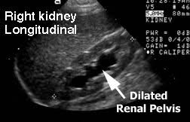
WHEN DO WE WANT TO USE ULTRASOUND OVER OTHER MODALITIES?
The dynamic evaluation of vascular structures and organs:
  Arterial and venous doppler: demonstrates patent flow or lack of flow
  Chambers of the heart: dynamic view of functional pumping of the heart (ejection fraction), its great vessels, and valves.
  Liver, Nephro-urinary system
    Vascular structures within the organs
    Kidneys, ureters and bladder
      US easily detects hydronephrosis
When we want a focused exam, ie. we know what we want to target

Slide 16
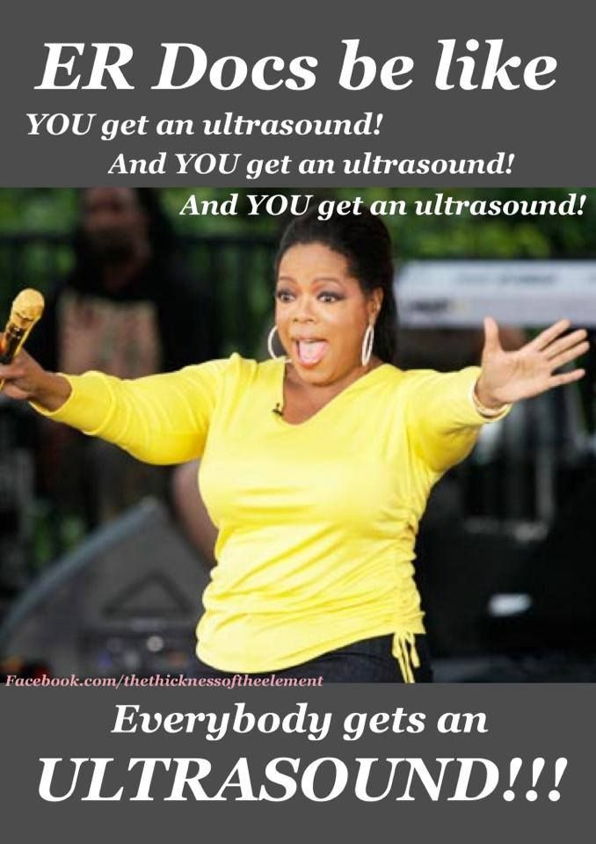
WHEN DO WE WANT TO USE ULTRASOUND OVER OTHER MODALITIES?
When we want to avoid using ionizing radiation:
  Females of reproductive age and children
Contraindication to other modalities
  Contrast allergy for CT or MRI
  Metal implants or shrapnel for MRI
Lower cost than other modalities
Ease of use and portability.
  Readily available at most centers, and increasingly at the bedside, i.e. the FAST scan

Slide 17
MAGNETIC RESONANCE IMAGING

Slide 18
MAGNETIC RESONANCE
In the 1930’s and 40’s, scientists discovered that the nuclei of some atoms, when placed in a static magnetic field and stimulated by a second, oscillating magnetic field, can absorb and then re-emit some of this energy in the form of radiowaves.
This principle is used in nuclear spectroscopy to study the structure of chemicals and the interactions between atomic nuclei in analytical and physical chemistry.

Slide 19
MAGNETIC RESONANCE
Further research has allowed this chemical information to be localized in space, creating the foundation for nuclear magnetic resonance imaging.
The nuclear was eventually dropped (marketing reasons) and MRI has evolved as an essential technique of imaging.
MRI is best used for soft tissues with a high water content but image acquisition takes much longer than CT- so the area of the body to be studied must remain as still as possible.

Slide 20
MRI: THE MACHINE
Most MRI systems use a superconducting magnet, which consists of many coils or windings of wire through which a current of electricity is passed, creating a magnetic field of up to 3.0 tesla.
Maintaining such a large magnetic field requires significant energy, which is accomplished by superconductivity, or reducing the resistance in the wires to almost zero.
To reduce the resistance to zero, the wires are continually bathed in liquid helium at 452 degrees below zero Fahrenheit (269 below zero degrees Celsius).

Slide 21
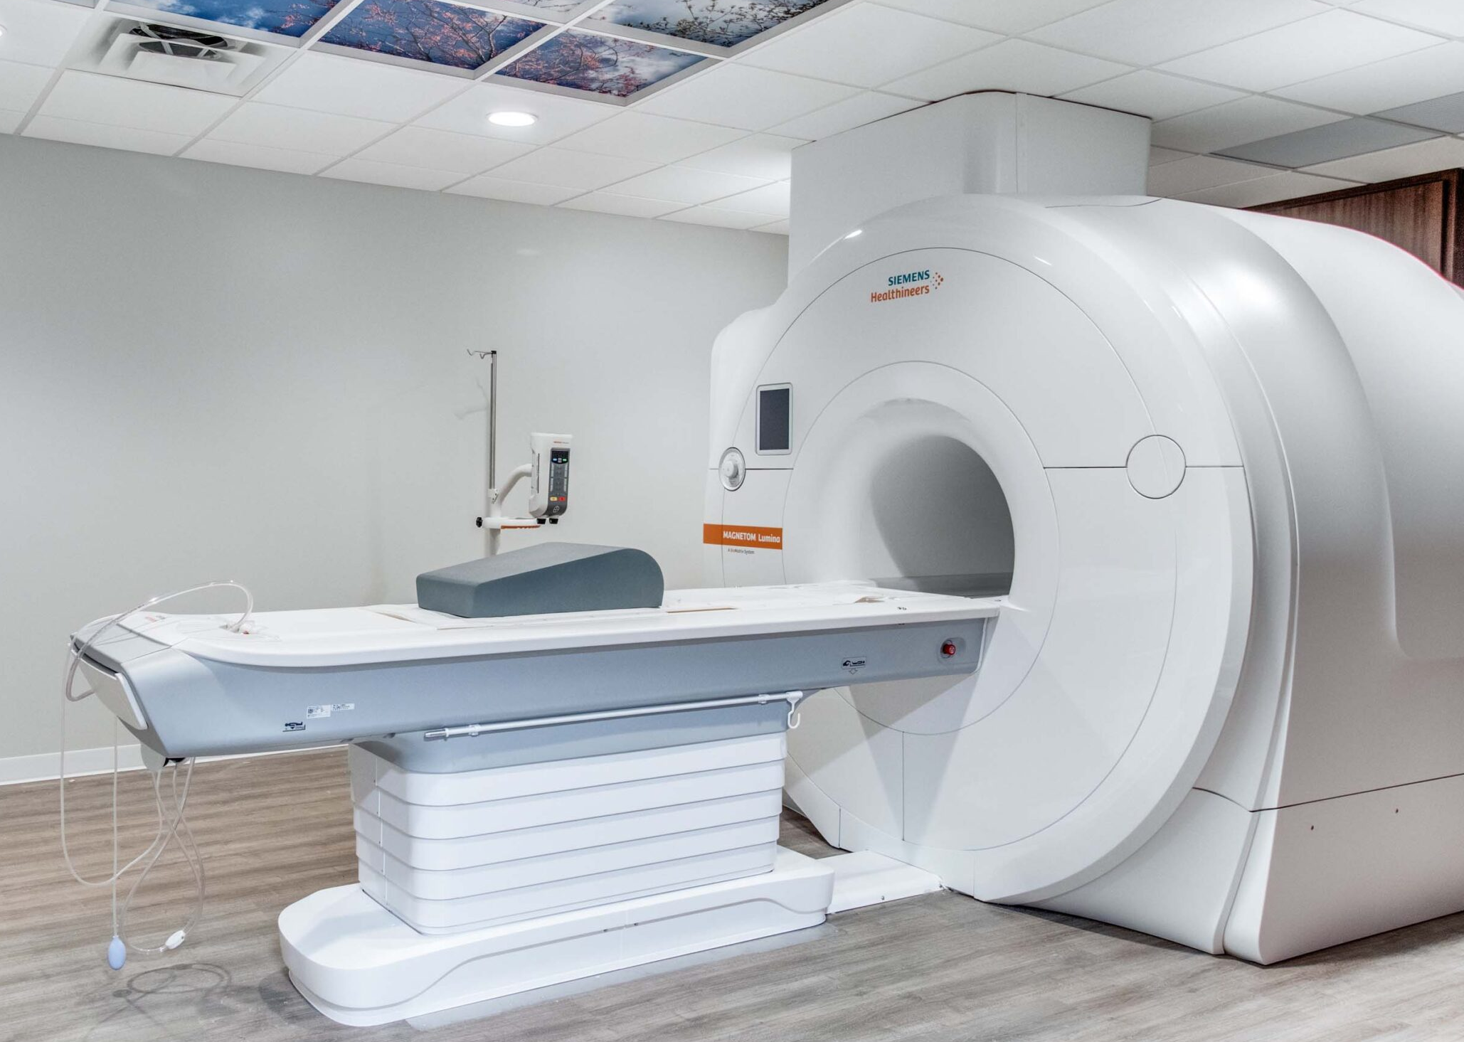
MRI: THE MACHINE
There is a horizontal tube, called the bore, which runs through the superconducting magnet from front to back. This is where the patient enters.
Whether the patient goes in head or feet first is determined by what part of the body needs to be examined.
There are several other magnets in an MRI
machine which are less powerful, but essential in creating the magnetic field around the patient to obtain the correct views.

Slide 22
MRI: THE SCAN
Once the body part to be scanned is in the exact center, or isocenter, of the magnetic field, the MRI scan can begin.
An MRI takes advantage of the fact that the human body is made up of large amounts of water and fat- both of which contain numerous hydrogen ions- or protons.
These atoms are randomly spinning, or precessing, on their axis, like a child's top. All of the atoms are going in various directions, but when placed in a magnetic field, the atoms line up in the direction of the field.

Slide 23
MRI: THE SCIENCE
Next, the MRI machine applies a radio frequency (RF) pulse that is specific only to hydrogen. The system directs the pulse toward the area of the body we want to examine.
When the pulse is applied, the unmatched protons absorb the energy and spin again in a different direction.
This is the "resonance" part of MRI. The radiofrequency pulse forces them to spin at a particular frequency, in a particular direction.

Slide 24
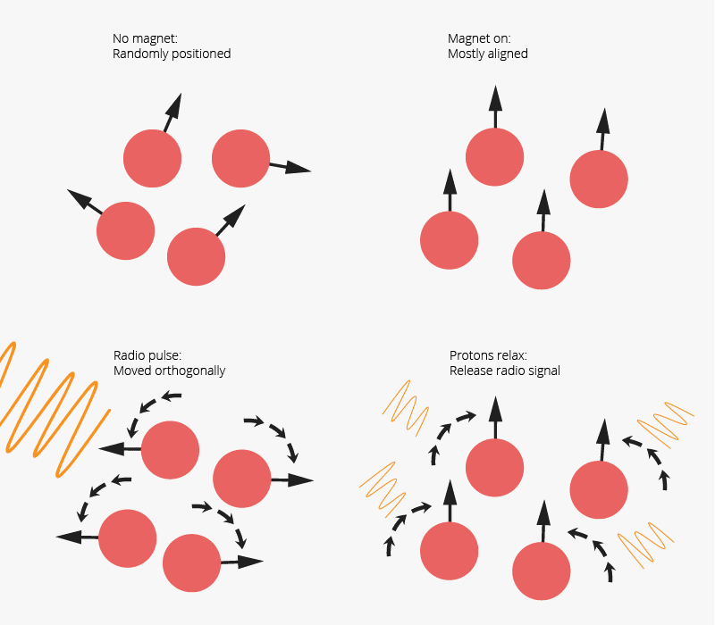
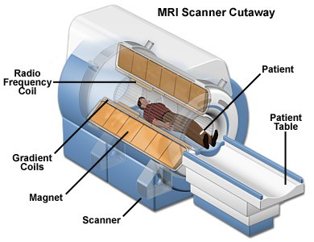
MRI: THE SCIENCE
Detectors measure the different energies released by realignment from the varying tissues.

Slide 25
MRI: THE SCIENCE
The MRI scanner can pick out a very small point inside the patient's body and ask it, essentially, "What type of tissue are you?"
The system goes through the patient's body point by point, building up a map of tissue types. It then integrates all of this information to create 2-D images or 3-D models with a mathematical formula.
The computer receives the signal from the spinning protons as mathematical data; then converts the data into an image. That’s the "imaging" part of MRI.

Slide 26
READING AN MRI
The contrast between different tissues occurs from different relaxation times and are translated to the shades of gray on the image that we see.
Images are viewed in the same planes as in CT; axial, coronal, sagittal, and a new one, oblique.

Slide 27
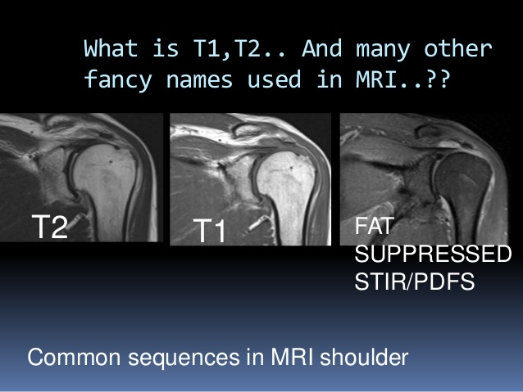
READING AN MRI: SEQUENCES
Manipulation of the settings on the MRI machine as it is acquiring images yields different views, called sequences.
Sequences will brighten or darken the appearance of the tissue in order to make it easier to discriminate from surrounding tissues.
There are several sequences that the modern MRI scanner can utilize.

Slide 28
READING AN MRI: SEQUENCES
T1 weighted (T1W) sequences are part of almost all MRI protocols and are best thought of as the most 'anatomical' of images (historically known as the anatomical sequence), resulting in images that most closely approximate the appearances of tissues macroscopically, although even this is a gross simplification.
T2-weighted images generally make fluid bright. Many pathologic processes increase tissue water, so edema and inflammation are often clearly visable on T2.
  T2 → think “water bright”
  Useful starting rule—not every high-signal finding is simply water, and tissue appearance still depends on the sequence and pathology.

Slide 29
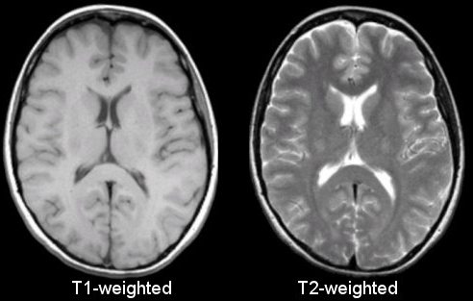
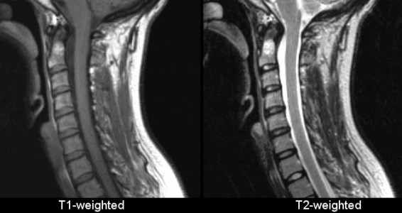
CSF appears dark in T1-weighted images but bright white in T2-weighted images.

Slide 30
READING AN MRI: SEQUENCES
Other sequences are calculated to enhance or omit other tissue types
FLAIR is T2-weighted with suppression of free fluid, especially CSF.
  CSF becomes dark while many pathologic abnormalities with increased water remain bright.
Diffusion weighted Imaging (DWI): is sensitive to restricted water diffusion
  Clinical use: Acute ischemic cytotoxic edema produces restricted diffusion and becomes bright on DWI, with corresponding low signal on the ADC map.

Slide 31
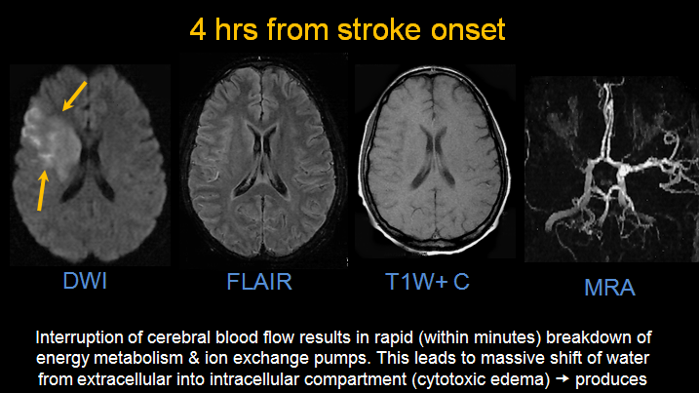

Slide 33
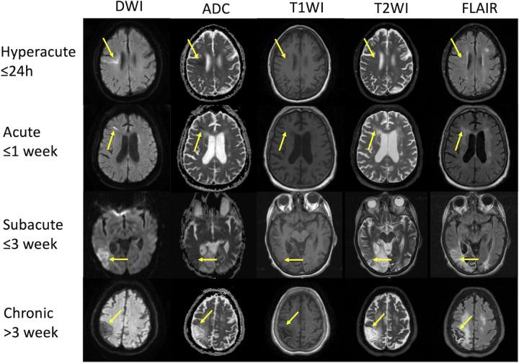

Slide 34
MRI WITH CONTRAST
Gadolinium contrast can also be used during T1-weighted image acquisition.
Gadolinium causes the T1 signal to be increased.
Pathological tissues (tumors, areas of inflammation/infection) will demonstrate accumulation of contrast (mostly due to leaky blood vessels) and therefore appear as brighter than surrounding tissue.
Often post contrast T1 sequences are also fat suppressed to make this easier to appreciate.

Slide 35
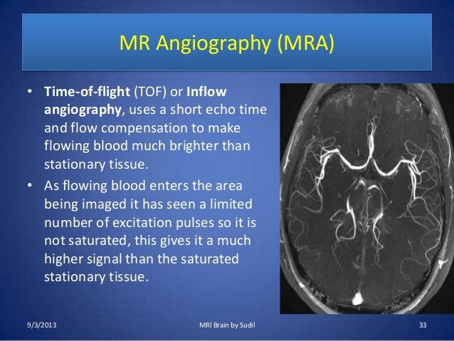
MR ANGIOGRAPHY (MRA)
MR angiography (MRA): uses gadolinium contrast to maximize visualization of arteries, which appear bright.
Exception, MRA of the brain typically does not require contrast as the blood flow in the cerebral arteries is fast enough to be seen without the aid of contrast.
Many other MRI sequences exist

Slide 36
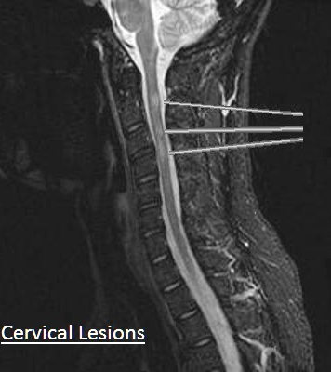
MRI APPLICATIONS
MRI provides exquisite detail and contrast, especially to soft tissues.
Neurological assessment of
  CNS lesions/plaques (MS)
  Ischemic infarctions (stroke)
  Nerves and fine structures such as the internal auditory canal and pituitary gland
  Degenerative disease and spinal cord injury

Slide 37
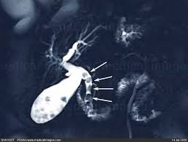
MRI APPLICATIONS
Gastrointestinal/ Abdomen
  Can be used to view with biliary system and pancreas (MRCP)
  Can be used to assess liver tumors, renal and adrenal masses within the abdomen.
  MR elastography can be used in place of a liver biopsy to assess the severity of cirrhosis.

Slide 38
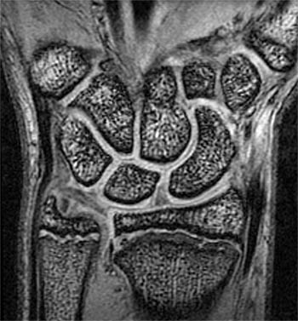
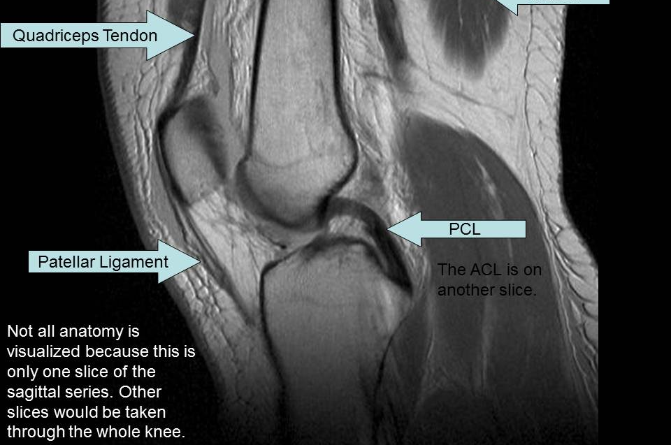
MRI APPLICATIONS
Musculoskeletal applications
  Excellent bone and soft tissue detail.
  Gold standard for diagnosis of soft tissue tears.

Slide 39
Mentimeter Cases

Slide 40
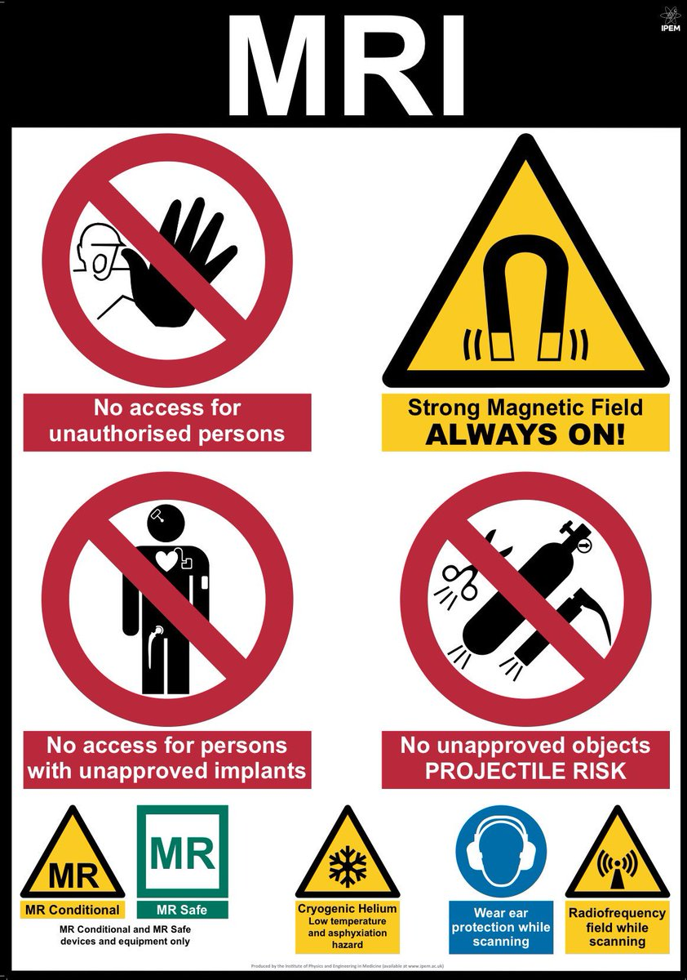
MRI CONSIDERATIONS
Patients with metal implants must be screened by MRI tech prior to scan. Certain implants are ferromagnetic and are a contraindication to scan.
Identifying the specific device is critical as newer devices can be MRI safe

Slide 41
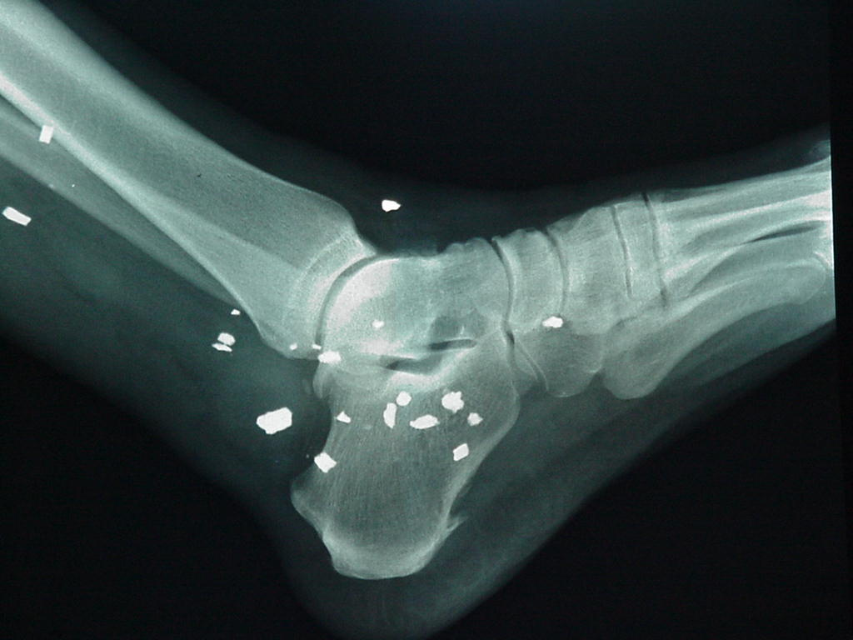
MRI CONSIDERATIONS
Patients with foreign bodies, such as shrapnel, BBs, or metal workers with foreign bodies to eye must be screened carefully
Remember: we can check a radiograph to look for shrapnel or metal foreign bodies if the patient is not sure.

Slide 42
MRI CONSIDERATIONS: GADOLINIUM CONTRAST
When ordering an MRI with gadolinium-based contrast agents (GBCAs), the patient’s kidney function and allergies must be assessed.
Group I GBCAs – high risk of nephrogentic systemic fibrosis (NSF). These have been withdrawn from use in the US
Group II GBCAs – low risk of NSF and generally considered safe in all patients including eGFR<30 and AKI
Ultimately, the radiologist or hospital policy will dictate use of contrast in these patients but risk assessment is a must.

Slide 43
MRI CONSIDERATIONS: GADOLINIUM CONTRAST
Allergies to gadolinium are not nearly as common as allergies to iodinated contrast; so when a patient describes a contrast allergy, they are almost always referring to iodinated contrast.
Gadolinium contrast should be avoided in pregnancy when possible. Gadolinium does cross the placenta and its use is controversial. Long-term fetal effects are uncertain.

Slide 44
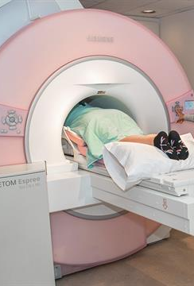
MRI CONSIDERATIONS
  An MRI scan is a much longer test than a CT, between 35- 90 minutes.
  In addition, the patient must remain very still- even a little motion will produce artifact that makes the very expensive scan useless.
  The MRI machine also makes a tremendous amount of noise during a scan, which sounds like a continual rapid hammering.

Slide 45
MRI CONSIDERATIONS: PREGNANCY
  The conclusion of a recent large cohort study states, “Exposure to MRI during the first trimester of pregnancy compared with non-exposure was not associated with increased risk of harm to the fetus or in early childhood.”
  The American College of Gynecology and Obstetrics recommends that pregnant patients should be reviewed on a case-to-case basis, and the risk-benefit ratio needs to be made by the physicians involved.

Slide 46
DIAGNOSTIC NUCLEAR MEDICINE

Slide 47
DIAGNOSTIC NUCLEAR MEDICINE: THE SCIENCE
Nuclear medicine studies use a radioactive compound or radiotracer and the ionizing radiation from the decay is quantitatively detected, measured, and imaged with instruments.
Nuclear medicine studies interrogate physiologic or pathologic processes at a molecular level and provide targeted therapy for a variety of diseases.
Nuclear medicine studies are clinically used to assess most organ systems with almost 100 different types of studies or therapies performed in the US. Many more play a crucial role in research.

Slide 48
DIAGNOSTIC NUCLEAR MEDICINE: THE SCIENCE
The amount of radiopharmaceutical prescribed for a study should be the lowest dose able to create diagnostic images for the expected patient population, termed the “as low as reasonably achievable” principle (ALARA).
Radiation Delivered | CXR: 0.1 mSv | CT chest: 7 mSv | Stress Test: 11 mSv
Prescribing of radiopharmaceuticals is restricted to physicians who have undergone specialized training and fulfilled the requirements for an authorized user (AU) set out by the Nuclear Regulatory Commission (NRC) and the states.

Slide 49
DIAGNOSTIC NUCLEAR MEDICINE: THE SCIENCE
Radiopharmaceuticals contain radioactive atoms that are unstable and produce ionizing radiation when they decay.
High-energy rays produced by the decay interact with special crystals in nuclear medicine cameras to produce light, and this light is used by the technology to create the images.
The types of imaging rays from radioisotope decay can be broadly placed in two categories: gamma rays or positron emission.

Slide 50
DIAGNOSTIC NUCLEAR MEDICINE: THE SCIENCE
Radioactive tracers are bound tightly to carrier molecules, like albumin, although this varies depending on the tracer and the purpose of the scan/ area of the body to be enhanced.
Tracers can be inhaled, taken by mouth, directly injected to an organ, or (most commonly) injected intravenously.
A patient and their bodily fluids remain mildly radioactive for a period of time after the study. Caution must be exercised when patient is around children or pregnant females.

Slide 51
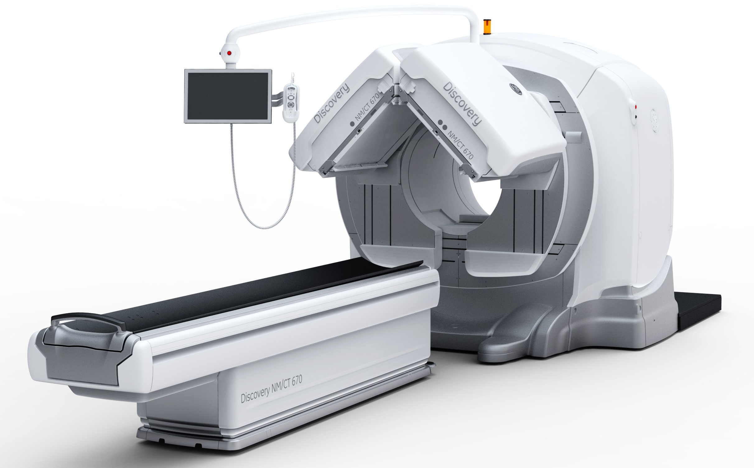
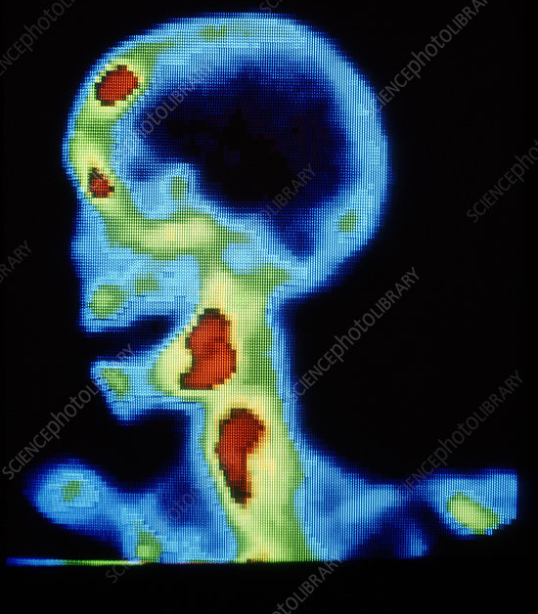
DIAGNOSTIC NUCLEAR MEDICINE: THE SCIENCE
Gamma camera studies most commonly use the radioisotope technetium-99m. The camera collects the gamma rays being emitted from the patient as the technetium decays and electronics process this information into viewable nuclear images or scintigrams.
The gamma camera creates planar (two-dimensional) images.

Slide 52
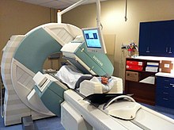
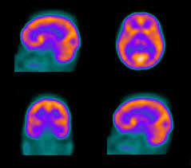
SINGLE PHOTON EMISSION COMPUTED TOMOGRAPHY (SPECT)
When the gamma camera is rotated around the patient, a three-dimensional data is collected in a process termed single photon emission computed tomography (SPECT) and displayed in a multiplanar format—axial, coronal, and sagittal.

Slide 53
SINGLE PHOTON EMISSION COMPUTED TOMOGRAPHY (SPECT)
SPECT images can better localize positive findings than planar images and can aid in the visualization of lesions which would be obscured by overlying tracer activity on the planar gamma camera.
Increasingly, gamma cameras are equipped with an integrated CT scanner allowing for SPECT-CT studies. The merging of a functional image (SPECT) and anatomic data (CT) allows for very precise localization of abnormalities.
  CT- an enlarged lymph node
  SPECT- a lymph node with hyperactivity

Slide 54
Positron Emission Tomography (PET)
Decay of positron emitters, such as fluorine-18, leads to a matter-antimatter reaction, which produces a pair of gamma rays that travel 180° apart.
A positron emission tomography (PET) machine uses a ring of crystals to take advantage of the two rays and requires near-simultaneous detection of the rays.
The result is better spatial resolution in the image than a gamma camera study can achieve.

Slide 55
Positron Emission Tomography (PET)
PET studies are three-dimensional data sets that are typically displayed in the axial, sagittal, and coronal planes.
Today, PET machines have an integrated CT scanner that provides anatomic images and quick attenuation correction. The anatomic data provided by the CT complements the functional data leading to a higher specificity and some improvement in sensitivity in detection of many cancers: PET-CT.
PET-MRI machines have recently come into the commercial market, and their clinical role is still being defined.

Slide 56
Positron Emission Tomography (PET)
PET is commonly used for oncology to detect the presence of metastasis and as part of multimodality staging
          For example: a patient presents to the hospital with a cough and undergoes a chest CT which finds a small mass in the hilum. A metastatic work-up with a CT of the chest, abdomen and pelvis with IV contrast is obtained which shows no other masses. A biopsy reveals small cell lung cancer, and a PET scan is obtained before the start of chemotherapy treatment to improve staging and detect otherwise occult hypermetabolic disease.

Slide 58
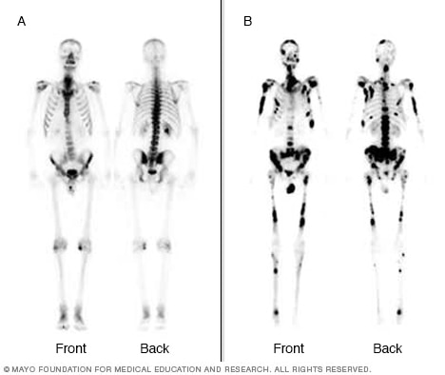
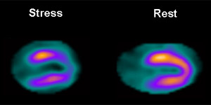
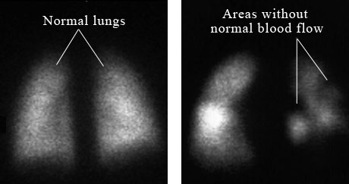
NUC-MED APPLICATIONS
Bone scan when MRI or CT cannot be used (bone scintigraphy)
Myocardial perfusion testing to assess for ischemia
V/Q scan to evaluate for pulmonary embolism

Slide 59
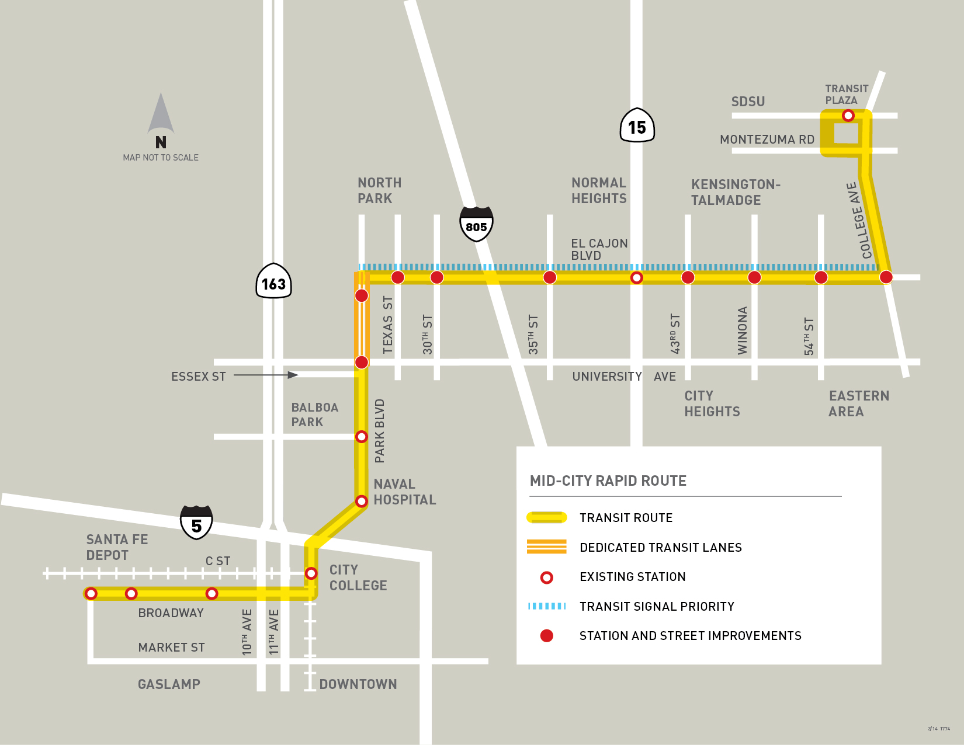
NUC-MED APPLICATIONS
Thyroid uptake scan to assess the metabolic activity of thyroid nodules in a patient with subnormal TSH levels
Sentinel lymph node biopsy: Technicium-99 is injected at a site around the
tumor. Using the preoperative images as a guide, the surgeon uses a small handheld probe to detect gamma-ray emissions from the radiotracer by means of auditory signals and meter readout of counts. By placing the probe over the region of highest counts, an incision can be made directly over the sentinel lymph node.

Slide 60
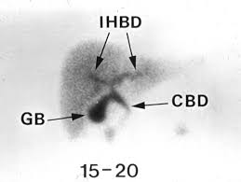
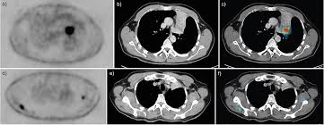
NUC-MED APPLICATIONS
Hepato-biliary imaging
  HIDA scan: measures ejection fraction of gallbladder
Gastrointestinal bleeding evaluation
Kidneys, ureters and bladder
Oncology

Slide 61
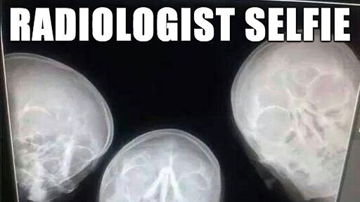

Slide 62
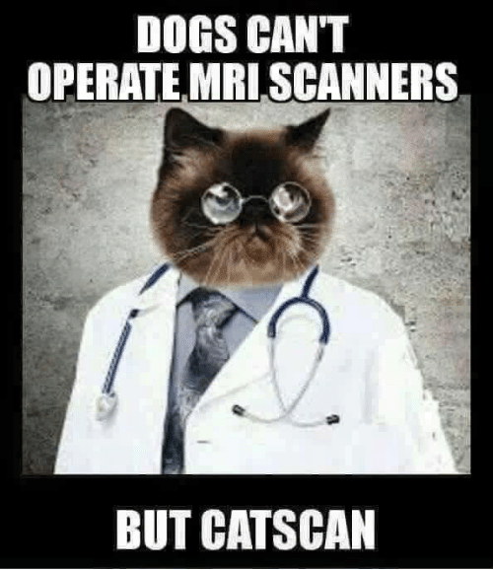
ONLINE RADIOLOGY RESOURCES
http://learningradiology.com/
http://www.radiologyassistant.nl/en/p42023a885587e/welcome-to-the-radiology-assistant.html
https://radiopaedia.org/
https://www.med-ed.virginia.edu/courses/rad/
http://headneckbrainspine.com/index.php
http://eradiology.bidmc.harvard.edu/

Slide 63
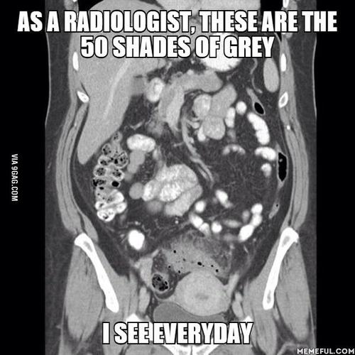
REFERENCES
Zaer N.F., & Amini B, & Elsayes K.M. (2014). Overview of diagnostic modalities and contrast agents. Elsayes K.M., & Oldham S.A.(Eds.), Introduction to Diagnostic Radiology. McGraw-Hill. https://accessmedicine-mhmedical-com.proxy.kc.edu/content.aspx?bookid=1562&sectionid=95875179
Chen M.M., & Whitlow C.T. (2011). Chapter 1. scope of diagnostic imaging. Chen M.M., & Pope T.L., & Ott D.J.(Eds.), Basic Radiology, 2e. McGraw-Hill. https://accessmedicine-mhmedical-com.proxy.kc.edu/content.aspx?bookid=360&sectionid=39669007
Brandon D.C., & Thomas A.J., & Ravizzini G.C. (2014). Introduction to nuclear medicine. Elsayes K.M., & Oldham S.A.(Eds.), Introduction to Diagnostic Radiology. McGraw-Hill. https://accessmedicine-mhmedical-com.proxy.kc.edu/content.aspx?bookid=1562&sectionid=95875470

