Slide 1
Cardiac Devices
CMM: Cardiology Fall 2026
Jill-Renae Gulczinski, MS, PA-C

Slide 2
Cardiac Devices
More than 3 million people in the US have a conventional permanent pacemaker (PPM) and more than 300,000 have an implantable cardioverter-defibrillator (ICD) with pacing capabilities.
Pacemakers are generally placed for disease of the AV node or the His-Purkinje system. Sometimes they are used for sinus node disease as well.

Slide 3
Do They Need a Pacemaker?
There are plenty of instances in which a patient has a bradyarrhythmia when a PPM is not warranted, including bradycardia/blocks occurring
While “under the influence” of medications that block the AV node
In the presence of severe electrolyte disturbances, or toxic/ metabolic abnormalities
During myocardial ischemia or infarction
Due to infectious etiology, such as Lyme dz or IE
After chest trauma

Slide 4
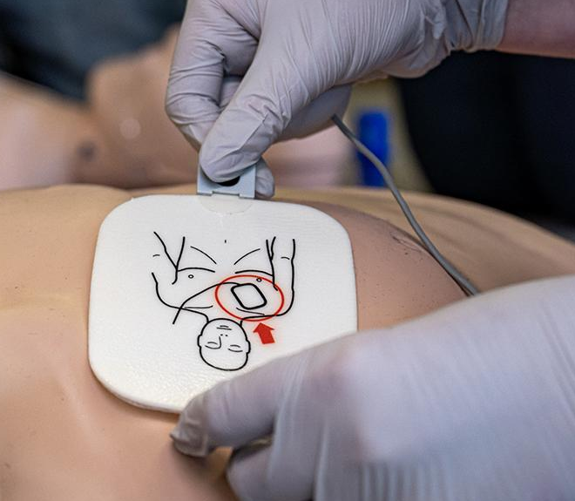
Do They Need a Pacemaker?
Instead, during these times, the offending drugs should be held, the metabolic disturbance corrected, or the underlying disease treated.
The heart should be monitored closely, and depending on the situation, the patient may have a crash cart nearby or even pacer pads applied while they are treated.

Slide 5
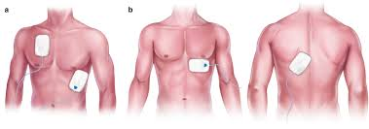
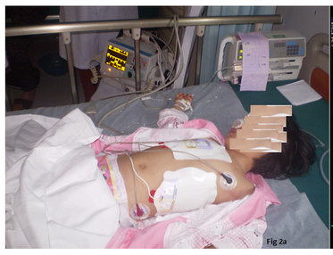
Types of Pacemakers
Transcutaneous: temporary and painful, used for a minimal time until a transvenous pacer can be placed. The patient often requires sedation during transcutaneous pacing.

Slide 6
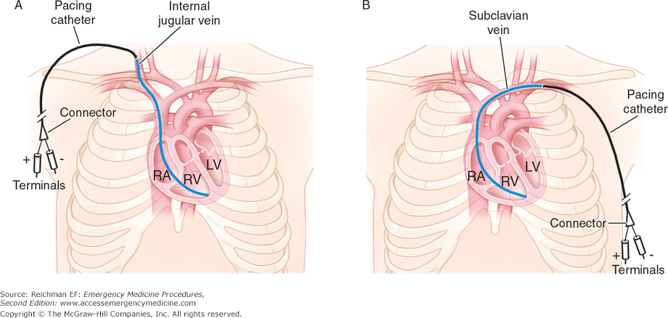
Types of Pacemakers
Transvenous: temporary pacing wires, placed for <24 hours in a patient who requires pacing in order to bridge them to the OR for a permanent pacemaker. Not painful, the patient is on strict bedrest.

Slide 7
Types of Pacemakers- Temporary
Temporary transcutaneous or transvenous pacing is only used for a short time when there is life-threatening lack of intrinsic cardiac pacing.
Major indications include:
  Bradyarrhythmias causing hemodynamic instability
  Transcatheter aortic valve replacement (TAVR)
  Prophylaxis during the post-op period surrounding cardiac valvular surgery
  Lyme disease or other infections (Chagas disease) that cause interval changes

Slide 8
Types of Pacemakers- Permanent
Single: one lead is connected to the right ventricle.
Dual chamber: two leads, one each to the right atria and right ventricle.
Biventricular: three leads, one to the RA and one each to the right ventricle and left ventricle, a resynchronization device that allows the heart to beat more efficiently. Cardiac resynchronization therapy (CRT) is used in HFrEF when altering the cardiac cycle may improve the cardiac output.

Slide 9
Pacemakers Parts
Pacemakers consist of a pulse generator, located in a subcutaneous pocket in the chest wall and electrical leads, which travel through a major vein of the chest to reach the right side of the heart (in most patients).
The pulse generator is the battery and brain of the pacemaker, creating the electrical impulse that travels though one or more leads to depolarize the heart chamber or augment the heart’s own electrical beat.

Slide 10
Pulse Generators
The battery typically has a 10-year lifespan, although technologic advances are constantly improving PPMs.
Pulse generators can be set to fixed-rate (asynchronous) or demand (synchronous) modes.
  In the asynchronous mode, impulses are produced at a set rate, independent of intrinsic cardiac activity. There is a small, but inherent, risk of causing a lethal arrhythmia if the impulse coincides with the T-wave’s vulnerable period.
  In the synchronous mode, the sensing circuit searches for an intrinsic depolarization potential. If this is absent, a pacing impulse is generated.

Slide 11
Pacemakers Parts
The leads carry the electrical impulse from the pulse generator to the heart or may be sensing leads only.
Most leads are transvenous- traveling through the subclavian vein to the heart.
Leads may also be epicardial, threaded through the chest tissue and surgically attached to the heart. This type of lead is used when there is an anatomical reason to avoid transvenous placement, such as venous stenosis.

Slide 12
Pacemakers Leads-
Clinical Implications
Transvenous pacemaker leads are associated with relatively small risks:
  Trauma to cardiac structures at the time of insertion (tamponade, perforation)
  Infection: bacteremia can seed a small clot on the leads
  Venous thrombosis and resultant subclavian vein occlusion
  Tricuspid valve injury, resulting in tricuspid regurgitation.

Slide 13
Pacemaker Indications
Symptomatic bradycardia due to sinus node dysfunction (sick sinus syndrome), usually seen with heart rates less than 40 bpm
Symptomatic AV block, usually complete heart block or second-degree AV block, type II
Periods of asystole longer than 3 seconds or at least 5 seconds in persons with atrial fibrillation
To facilitate AV node ablation
Cardiac resynchronization therapy with biventricular pacing

Slide 14
Pacemaker Codes
Electrophysiologists have developed a 5-letter code which describes the pacing mode of a device. Typically, the first 3 letters are documented.
Pacemaker Code:
  First letter: refers to the chamber being paced (A =atria, V = ventricle, D =dual, both)
  Second letter is the chamber being sensed (A =atria, V = ventricle, D =dual/ both, O =none)

Slide 15
Pacemaker Code
Third letter is the response mode of the pacemaker to the native cardiac electrical activity
  I = the device is inhibited if it senses the patient’s own native beat
  T =the device is triggered by the native atrial beat (PPM provides additive depolarization)
  D =the pacemaker is triggered after a sensed atrial event but inhibited after a sensed ventricular event
  O = none, usually means that the device is pacing continuously.

Slide 16
Pacemaker Code
The fourth letter refers to the rate modulation- an automatic response of the pacemaker to chronotropic incompetence.
R - Rate-response ("physiologic") pacing
O - No programmability or rate modulation
The fifth letter refers to multisite pacing (if the device is for CRT) and refers to the sites being electrically stimulated by the device.
A = Atrial, V =Ventricle, D =Dual/ both, O = none

Slide 17
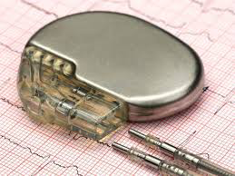
For Example
An ADI pacer will
  Pace the right atrium
  Will sense both the atria and ventricle
  And the atrial pacer impulse will be inhibited if the patient produces their own electrical depolarization which is sensed by the lead in the right ventricle.
If the atria fails to depolarize on its own what will happen?

Slide 18

Pacemakers may be interrogated, to determine the rhythm during events, such as a syncopal episode.
Although not used as an event monitor, pacemakers can determine how much time a patient spends in atrial fibrillation.
Interrogation is generally done by the pacemaker manufacturer’s representative in the hospital or by the cardiologist in the office.

Slide 19
Pacemaker Indications
Patients requiring a pacemaker will typically present with exertional dyspnea, loss of exercise tolerance, syncope and near syncope.
The patient or someone around them might note that their heart rate is low.
Before the decision is made to place a device, all reversible causes must be corrected. What are these?

Slide 20
Permanent Pacemaker Placement
A cardiac electrophysiologist will be consulted to evaluate the patient.
PPM placement can be a same day surgery, so the patient should be kept npo at midnight if admitted to the hospital until they are evaluated by the EP specialist. Hold AC and antiplatelet meds.
Pacemakers are typically placed under conscious sedation in the cath lab by the electrophysiologist.

Slide 21
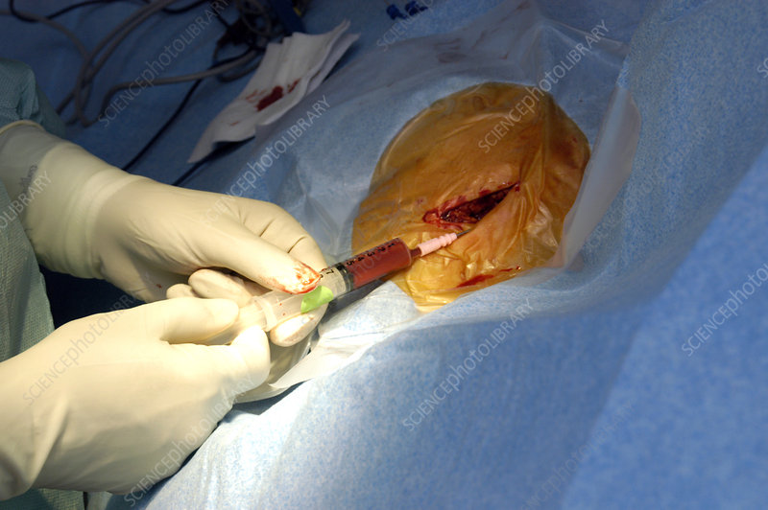
Placing the Pacemaker
A patient is placed under conscious sedation in the cath lab and after prepping a draping, a local anesthetic is used to numb the chest wall.
The veins of the chest are accessed directly, or by using the Seldinger technique.

Slide 22
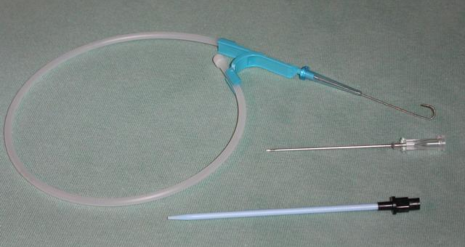
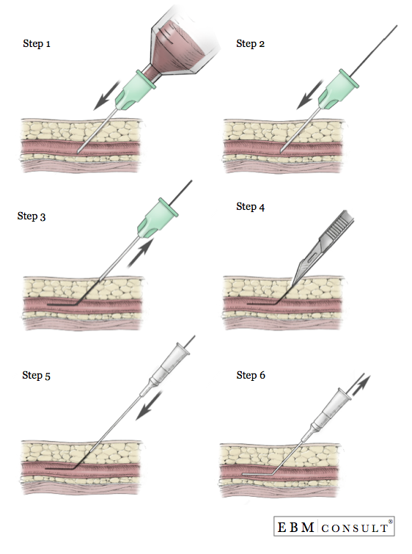
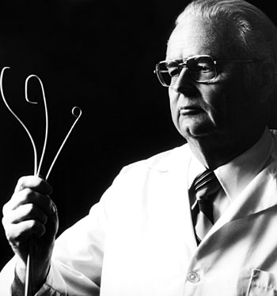
Dr. Seldinger and His Wire
Dr. Ivar Seldinger, a Swedish radiologist, developed a safe method for vascular access in 1953.

Slide 23
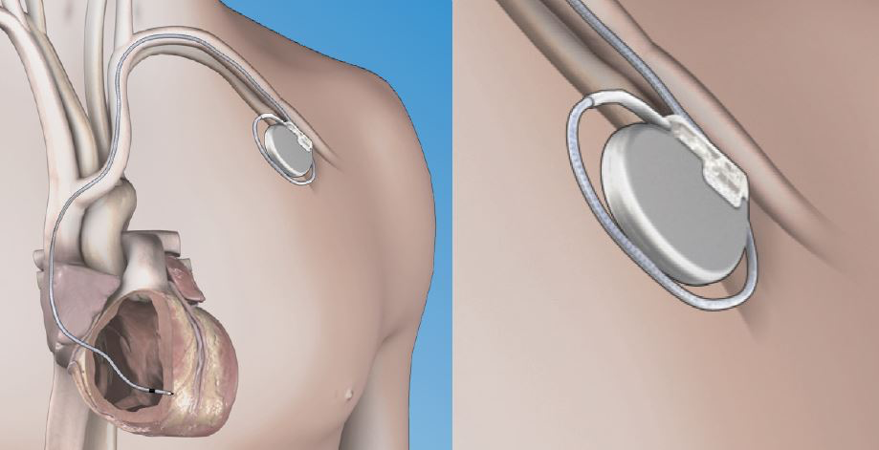
Permanent Pacemaker Placement
Pacing wires are run to the right side of the heart via the major veins in the chest (cephalic, axillary, subclavian) under fluoroscopic guidance.

Slide 24
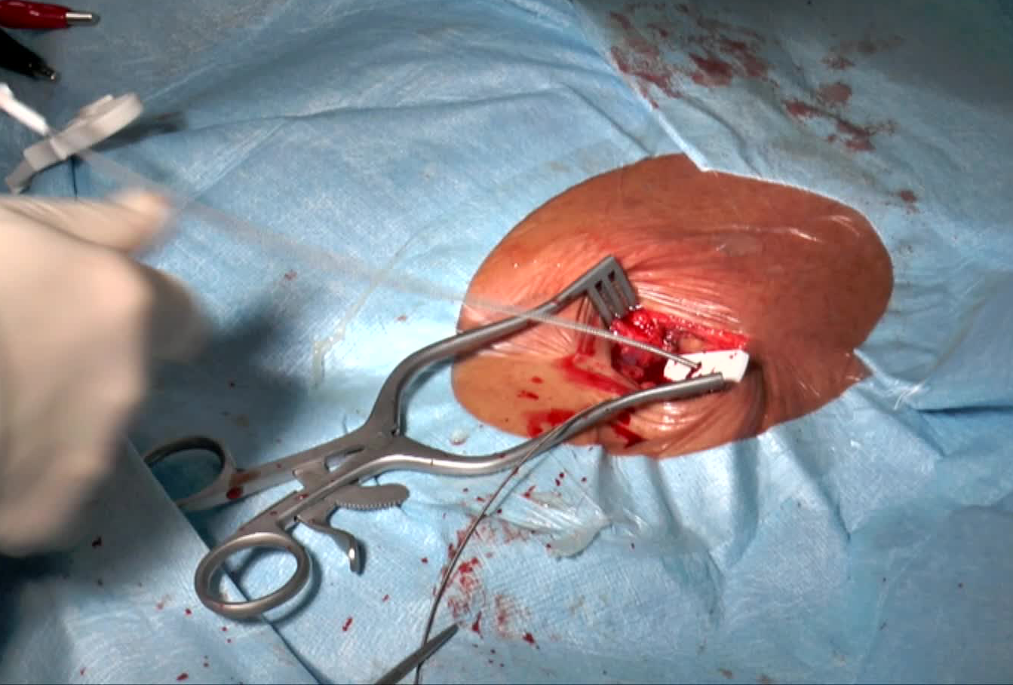
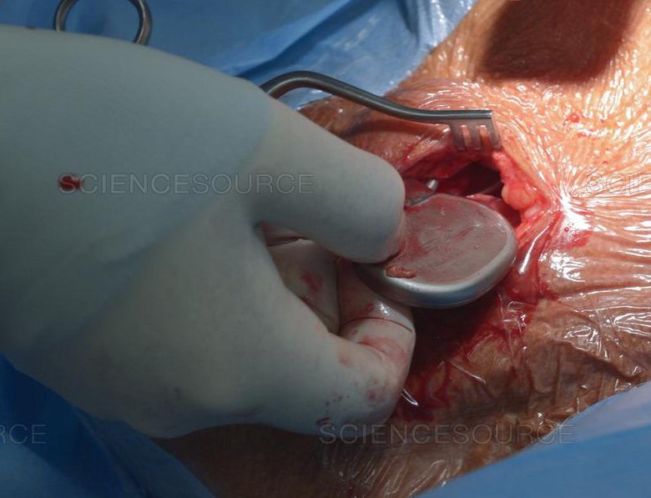
Permanent Pacemaker Placement
The cardiologist creates a subcutanous “pocket” in the chest wall between the skin and the pectoralis muscle at the time of insertion.
https://www.youtube.com/watch?v=HkUhXolsUp4

Slide 25
Permanent Pacemaker Placement
After placing a pacemaker, most patients can go home that day or the next. They then return to the cardiologist for care as follows:
  1-2 weeks for chest wound check
  1 month for pacemaker interrogation
  3 months for pacemaker interrogation
  Then every 6 months for pacemaker interrogation
Pacemakers may be reprogrammed in the office by a cardiologist while implanted if needed.

Slide 26
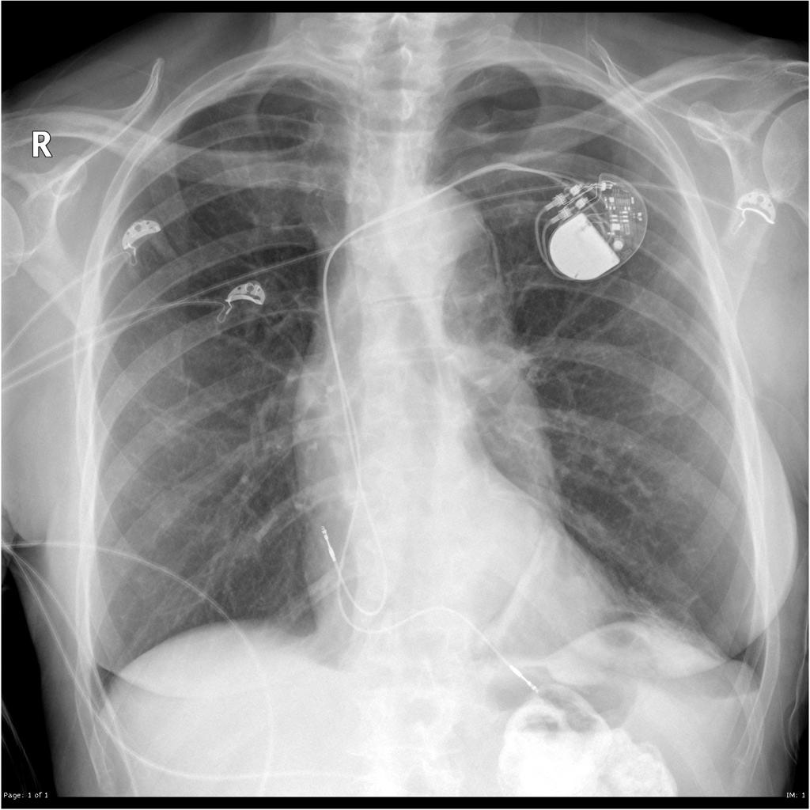

Slide 27
Implantable Cardioverter- Defibrillators (ICD)
The ICD has revolutionized the treatment of patients at risk for sudden cardiac death due to ventricular tachyarrhythmias.
First used in 1980 and approved by the FDA in 1985, the initial ICD device was big and bulky, requiring abdominal cavity placement and a thoracotomy to place epicardial leads.

Slide 28
ICD
Early ICDs were simple “shock boxes” and their battery life was limited to 2 years.
Modern ICDs are considerably smaller, with an average battery life of 8 years, and have a much more detailed algorithm for arrhythmias, in addition to recording cardiac events.
ICDs can perform dual-chamber, rate-responsive pacing for bradycardia for a short time.

Slide 29
ICDs
Modern ICDs have sophisticated discrimination algorithms minimize shocks for AF, sinus tach, and other non–life-threatening supraventricular tachyarrhythmias.
ICDs have a pulse generator and a shocking lead which travels to the ventricle.
Most ICD leads are implanted transvenously (TV-ICD) and the technique is very similar to implantation of a pacemaker.

Slide 30
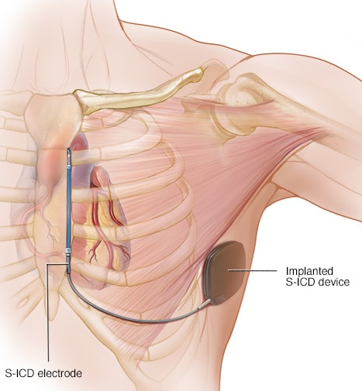
ICDs and Pacemakers
In 2012, a subcutaneous (S-ICD) was FDA approved. SubQ ICDs have a shocking lead, which is tunneled to the sternum. These devices have limited pacing capabilities.
A pacemaker should be combined with an ICD or a cardiac resynchronization device if one is required, so that all devices run off one pulse generator.

Slide 31
The Data Behind ICDs
Multiple trials conducted in survivors of life- threatening ventricular arrhythmias (such as VT) have proven that ICD placement is superior to multiple antiarrhythmics, although a few trials did not show benefit.
  Data is less robust for women and elderly
Multiple trials have also shown benefit for persons who have strong risk factors for life-threatening ventricular arrhythmias (such as long QT), although this data is not nearly as robust.

Slide 32
Indications for ICD Implantation
Secondary prophylaxis: ICDs are first line therapy for survivors of VT or VF arrest, not caused by a completely reversible factor.
This is a little controversial.
If a patient suffers a VT arrest due to MI and receives a stent that opens that artery . . .
If a patient suffers a VF arrest due to a QT prolonging medication and that medication is discontinued . . .

Slide 33
Indications for ICD Implantation
Primary prophylaxis indications
  LVEF ≤30%, if due to MI, at least 40 days post-MI
  LVEF ≤35% with NYHA Class II or III symptoms. If due to prior MI, at least 40 days post-MI.
  LVEF ≤40% due to prior MI, with inducible VT or VF on an electrophysiology study (EPS)
  Structural heart disease with sustained VT
  Syncope of undetermined origin, with inducible VT or VF on an electrophysiology study.
The above are class I indications, there are additional class IIa indications.
Notes:
Class I means that the treatment is useful, that its benefit greatly outweighs the risk, and that it should be administered.
Class IIa means that the benefit outweighs the risk and it is reasonable to administer the treatment. Class IIa indications include:
Unexplained syncope, significant LV dysfunction, nonischemic CM
Sustained VT, normal or near-normal ventricular function
Hypertrophic cardiomyopathy (CM) with 1 or more major risk factors
Arrhythmogenic right ventricular dysplasia/cardiomyopathy (ARVD/C) with 1 or more risk factors for sudden cardiac death (SCD)
Long QT syndrome, syncope or VT while receiving beta blockers
Nonhospitalized patients awaiting heart transplant
Brugada syndrome, with syncope or VT
Catecholaminergic polymorphic VT, syncope or VT while receiving beta blockers
Cardiac sarcoidosis, giant cell myocarditis, or Chagas disease

Slide 34
How Does an ICD Work?
ICDs deliver an 80-joule shock for defibrillation of ventricular tachyarrhythmias including monomorphic ventricular tachycardia (VT), polymorphic VT, and ventricular fibrillation (VF).
Following the shock, the device will re-evaluate the cardiac rhythm.
If VT or VF persists following the initial shock, the device will reverse polarity between the electrodes and deliver subsequent shocks.

Slide 35
Implantable Cardioverter Defibrillators
Sometimes the ICD will attempt to “overdrive pace” the arrhythmia rather than deliver a shock.
The ICD will deliver a maximum number of shocks for a single episode of a ventricular arrhythmia (this is programmed) and then will not deliver more.
The cardiology office is alerted that the device has delivered one or more shocks.

Slide 36
Implantable Cardioverter Defibrillators
Patients are instructed to go to the ER if their ICD fires and should generally be admitted to correct any reversible cause and see the cardiology service.
Modern transvenous ICDs are also capable of pacing a bradyarrhythmia and will record cardiac events. Order a device interrogation.

Slide 37
Device Precautions- All Devices
Patients with a pacemaker or ICD should carry a wallet card identifying their device.
Radio-opaque codes on the pulse generator are seen on a CXR and may help identify the make & model.
Patients with pacemakers and ICDs cannot generally have MRIs. There are some PPMs and ICDs that are safe- check with cardiology.

Slide 38
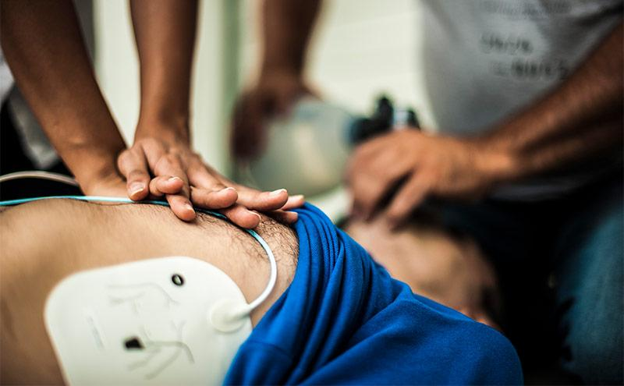
Device Precautions- ACLS and PPM
ACLS and defibrillation can be performed safely with a PPM, just place paddles/ pads 10 cm away from the pulse generator.

Slide 39
Device Precautions- ACLS and ICD
During an event that requires ACLS, an ICD should act to defibrillate the patient.
Rescuers can safely perform CPR- some of the current from defibrillation may enter the rescuer and cause mild discomfort, but there has never been a serious case of rescuer injury.
Again, place pads 10 cm away from pulse generator if external defibrillation is needed.

Slide 40
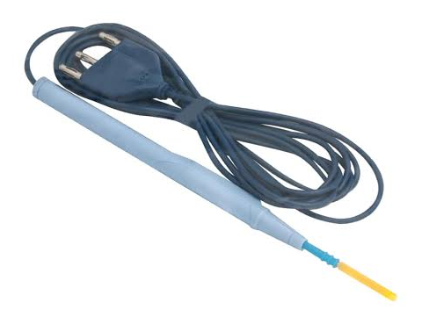
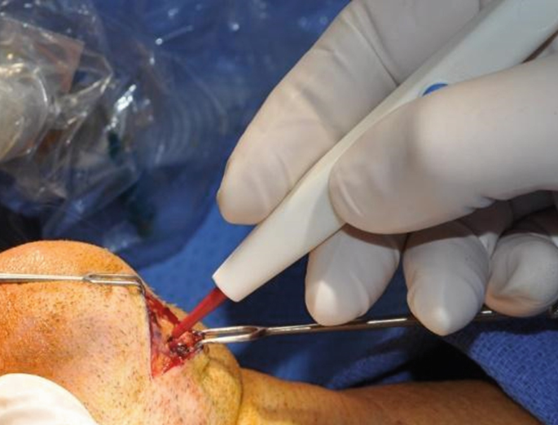
PPM Precautions- Surgery
Electrocautery during surgery can sometimes cause a pacemaker to malfunction, because the electromagnetic interference (EMI) from the cautery is picked up and interpreted by the PPM as cardiac electrical activity.

Slide 41
PPM Precautions- Surgery
In this situation, called “oversensing”, the pacemaker does not fire because it thinks that the heart has normal electrical activity.
However, what is actually happening is a profound bradycardia/ asystole in the pacemaker dependent patient during surgery.

Slide 42
ICD Precautions- Surgery
ICDs can also be problematic during surgery. EMI from cautery can be “oversensed” by an ICD and cause it to fire inappropriately during surgery, shocking the patient.
Because unwanted patient movement from an ICD shock would likely create a hazard to the patient or surgical personnel, the ICD should be disabled prior to surgery, and the patient will have defibrillator pads in place during surgery.

Slide 43
PPM Precautions- Surgery
Although electrocautery is the most significant issue, other electric devices used during surgery, such as nerve stimulators, can also create enough EMI to interfere with the PPM.
Therefore, when surgery is planned, especially a procedure above the umbilicus in a patient with a PPM or ICD, cardiology should assist in pre-op planning.

Slide 44
PPM Management During Surgery
For most permanent pacemakers, applying a magnet over the pacemaker will initiate asynchronous pacing at a fixed rate with a fixed AV delay.
The PPM will simply pace the heart for the entire surgical procedure.
However, if the pacemaker is at the end of battery life, the rate may not be adequate.

Slide 45
ICD Management During Surgery
The ICD function is suspended during surgery by placing a magnet over the device.
The surgical team should apply pacer/defib pads to the chest before prepping and draping, in case of an intra-op emergency.
  If needed, an external defibrillator/ pacer would be used to deliver a shock or pacing through these pads.

Slide 46
Device Precautions- Surgery
Post-op, the device is reprogrammed by cardiology, or the magnet is removed, and the patient is monitored carefully in the PACU or ICU on telemetry.
If surgery was emergent or the device delivered shocks or pacing during the surgery, a closer interrogation by cardiology is needed.

Slide 47
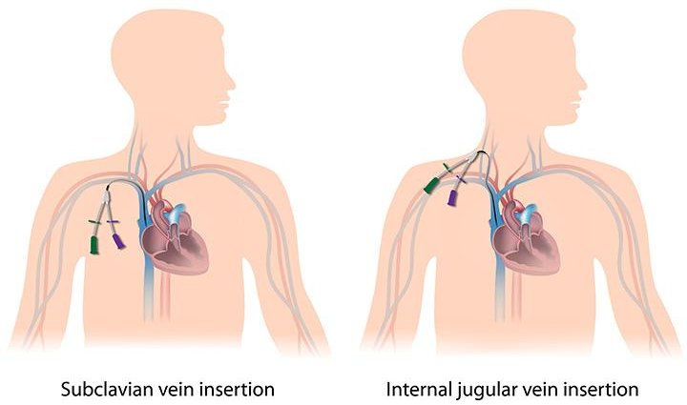
Device Precautions- Central Lines
Guidewires used to place central lines can short out or dislodge transvenous ICD or pacemaker wires and cause irreversible damage.
The risk of dislodging the wire is highest in the first 3 months after PPM or ICD insertion.

Slide 48
Device Precautions: EMI
Patients with PPM or ICDs are counseled to avoid:
Cell phones, mobile devices, magnets, headphones and wireless chargers: avoid placing these within 6 inches (about 15 cm) of an ICD site when on.
Security systems. ICDs may set off airport security alarms. Hand-held metal detectors should be limited to less than 30 seconds over the ICD site or make a request for a manual search.

Slide 49
Device Precautions: EMI
Patients with PPM or ICDs are counseled to avoid:
Power generators. Stand at least 2 feet (0.6 meters) from welding equipment, high-voltage transformers or motor-generator systems.
Devices that pose little or no risk to a PPM or an ICD include microwave ovens, televisions and remote controls, AM/FM radios, toasters, electric blankets, electric shavers and electric drills, computers, scanners, printers, and GPS devices.

Slide 50
Device Replacement
Replacement- A pacemaker or ICD battery life is about 7-10 years, depending on how much the device is used.
A pacemaker will begin slowing or changing their pacing mode as this dwindles.
When this happens patients are scheduled for a generator change- which replaces the pocket device but leaves the wires alone.

Slide 51
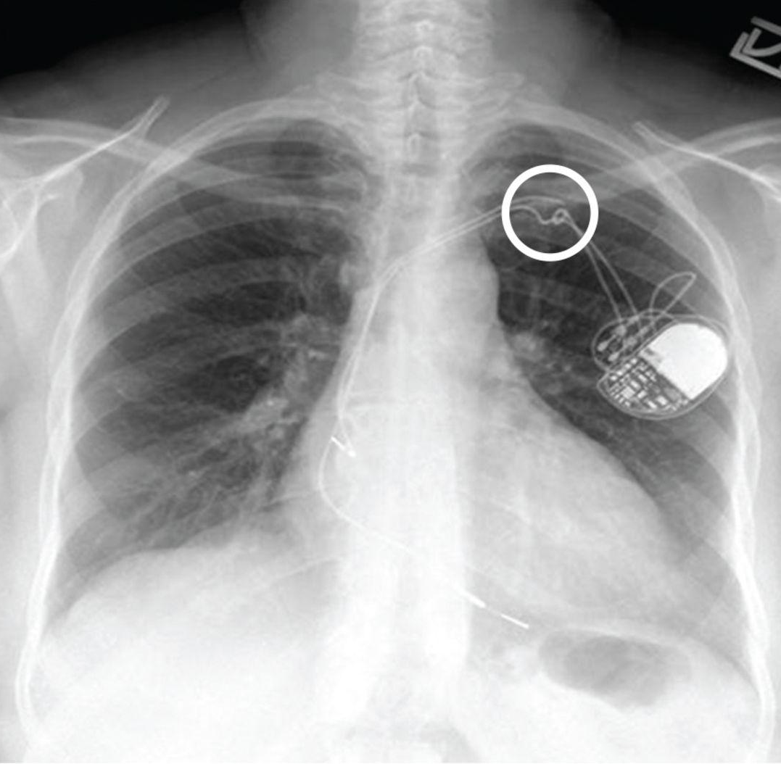
Lead Issues
Sometimes pacemaker or ICD leads may break/ fracture, leading to device malfunction.
If this happens, the lead will need to be replaced.

Slide 52
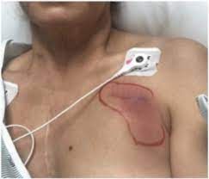
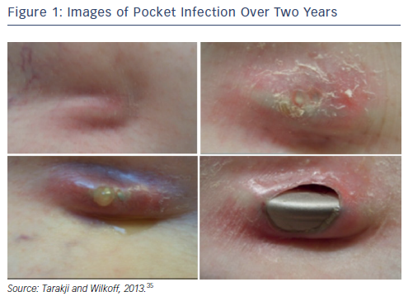
Device Infections
Sometimes a device will become infected.
  Pocket incision becomes infected at the time of insertion
  Pocket erodes due to weight loss

Slide 53
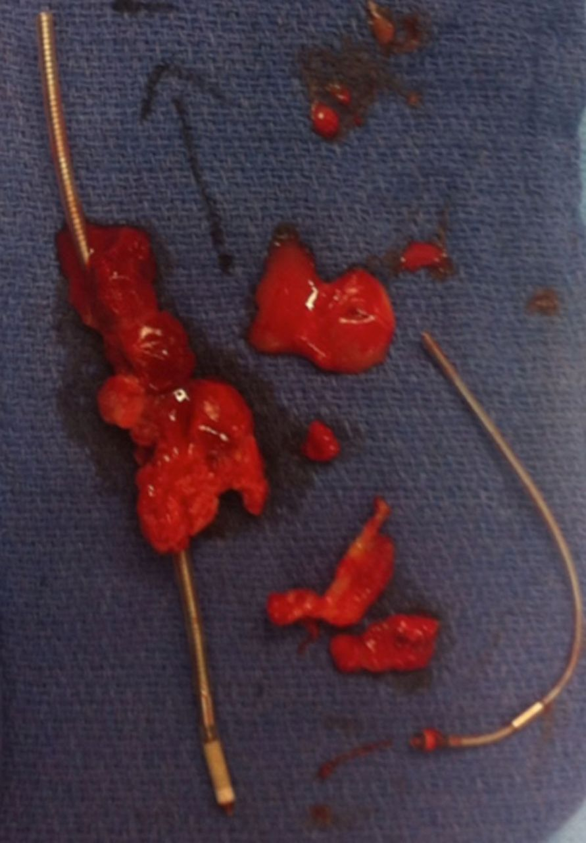
Device Infection
Sometimes a device will become infected.
  Device is seeded from a bacteremia- usually this affects the leads and will cause a persistent bacteremia. A vegetation may be seen on the lead during a TEE.

Slide 54
Device Infections
A generator change is more likely to cause a device infection than a de novo implant.
In addition, the presence of a hematoma in the pocket increases the risk of infection from 0.98% to 22.7%.
Anytime a pacemaker or ICD becomes infected, the device and the leads must be explanted.
Patients will require a period of antibiotic therapy before a new device can be implanted.

Slide 55
ICD Complication:
Inappropriate Shocks
A major issue with ICDs are inappropriate shocks, which are not precipitated by accurate detection of a malignant ventricular arrhythmia (VT or VF)
  One major trial revealed that 11.5% of the ICD pts received inappropriate shocks and that 31.2% of all ICD shocks were deemed inappropriate.
Typically, inappropriate ICD shocks result when an atrial arrhythmia accelerates the ventricular rate beyond the limit set for delivery of an ICD shock.

Slide 56
ICD Complication:
Inappropriate Shocks
Inappropriate shocks are a significant issue, since the patient is counseled to go to the ER immediately if their ICD shocks them.
In addition, ICD shocks HURT!
Lastly, most cardiologists will recommend that patients with an ICD be shock free for six months before they drive.

