Slide 1

HYPERTENSIVE URGENCY AND EMERGENCY
Breanna Veal, MHS, PA-C

Slide 2
Definition
Hypertensive urgency: systolic BP ≥ 180 and/or diastolic BP ≥ 120 mmHg
  no acute or progressing target-organ injury
Hypertensive emergency (AKA Hypertensive Crisis): systolic BP ≥ 180 and/or diastolic BP ≥ 120 mmHg
  acute or progressing target-organ damage
    CNS: CVA (stroke ischemic or hemorrhagic), encephalopathy,
    CV: acute LV failure with pulmonary edema, MI, aortic dissection, unstable angina, eclampsia
    Renal: AKI

Slide 3
Causes of Hypertensive crisis
Non-adherence to antihypertensive med (MC)
Undiagnosed Hypertension
Abrupt cessation of antihypertensive med- BB or clonidine
CKD
OSA
Drugs- Cocaine amphetamines, diet pills, phenylephrine

Slide 4
Pathophysiology of Hypertensive Emergencies
The cause and events of a hypertensive crisis are incompletely understood.
Failure of normal autoregulation
  Autoregulation at the level of each organ helps to prevent wide swings in blood flow whenever MAP changes.
    Example: When MAP increases, vasoconstriction occurs limiting hyper-perfusion of capillaries. When MAP decreases, vasodilatation allows for increased blood flow to organs. However, organs have their limits and autoregulation can fail during hypertensive emergencies.

Slide 5
Pathophysiology in Hypertensive Crisis
Abrupt rise in systemic vascular resistance (SVR) possibly mediated by humoral vasoconstrictors from the wall of a stressed blood vessel
The endothelium adapts to high blood pressure by smooth muscle hypertrophy and vasoconstriction (essentially protecting the walls of the vessel from the excessive force of blood)
Prolonged smooth muscle contraction leads to endothelial dysfunction, diminished nitric oxide production and failure of autoregulation
There will be focal vasodilatation and endothelial damage leading to vascular permeability
Fibrinoid necrosis
Activation of the clotting cascade
Inflammatory factors
Increasing release of vasoconstrictors (angiotensin II, norepinephrine, vasopressin)

Slide 6
HTN Emergency
End organ damage during hypertensive emergencies falls under three broad categories which are commonly affected:
    Central nervous system
    Cardiopulmonary manifestations
    Renal failure
Other hypertensive end organ damage from emergencies can affect the eyes, the vasculature, or in the cases of pregnancy, the mom and baby.

Slide 7
Neuro Damage in Hypertensive Emergency
Acute end-organ damage in the setting of HTN emergency may include neurologic damage.
Patients may develop hypertensive encephalopathy which is characterized by altered mentation/ confusion due to generalized edema of the brain from high hydrostatic pressures and cerebral congestion.

Slide 8
Neuro Damage in Hypertensive Emergency
A second neurologic syndrome caused by hypertensive emergency is posterior reversible encephalopathy syndrome (PRES).
PRES symptoms include vision changes, seizures, severe HA and edema of the brain. AMS may occur.
This edema most commonly affects the B/L occipital and parietal lobes and is seen best on MRI.

Slide 9
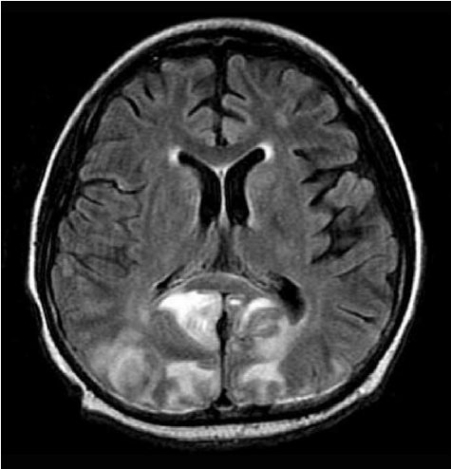
Neuro Damage in Hypertensive Emergency
Both PRES and hypertensive encephalopathy are generally responsive to gradual BP lowering therapy, will slowly improve over 2-4 days.
Typical neuroradiologic presentations in posterior reversible encephalopathy syndrome. Lesions with hyperintense signal on MRI locating prominently in both subcortical white matter and cortical gray matter of bilateral parieto-occipital regions.

Slide 10
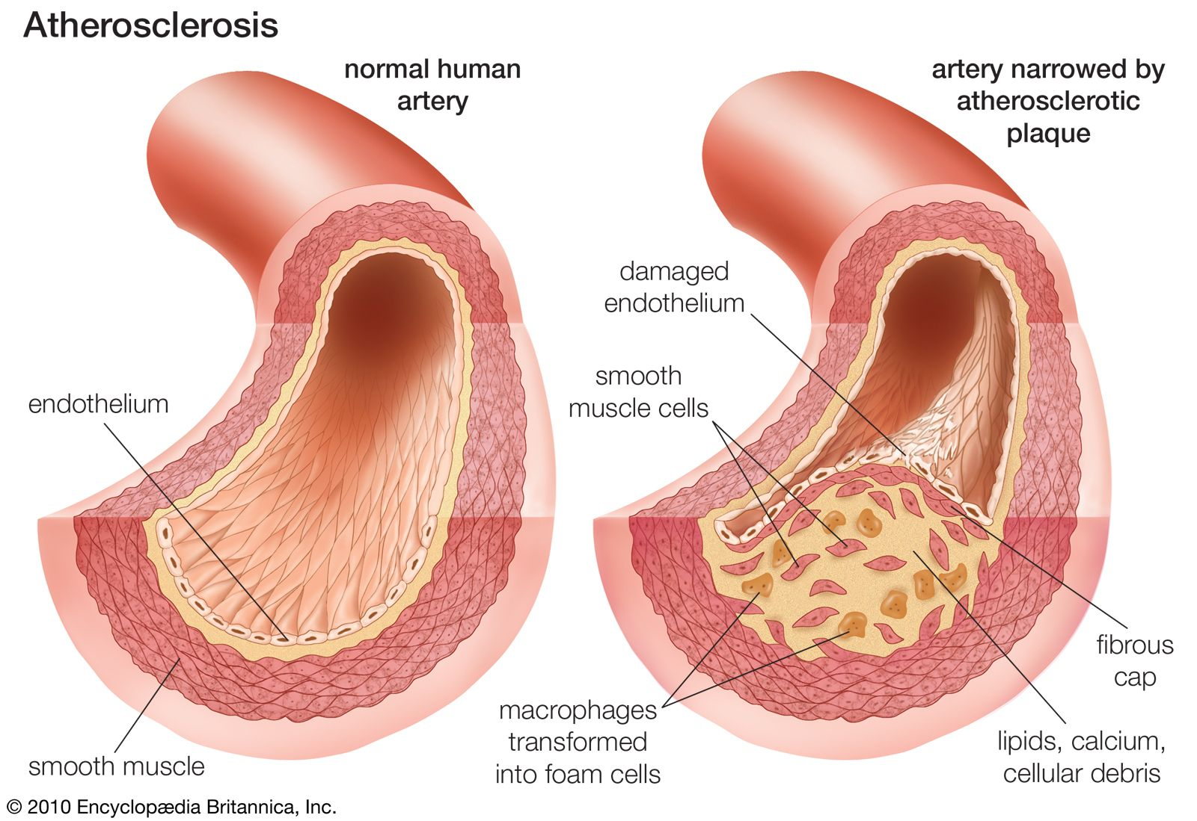
Neurologic Damage in Hypertensive Emergency
An ischemic cerebrovascular accident (stroke): may occur anywhere and will be due to embolus that travels
to the brain or rupture of an arteriosclerotic plaque that causes in situ thrombosis.

Slide 11
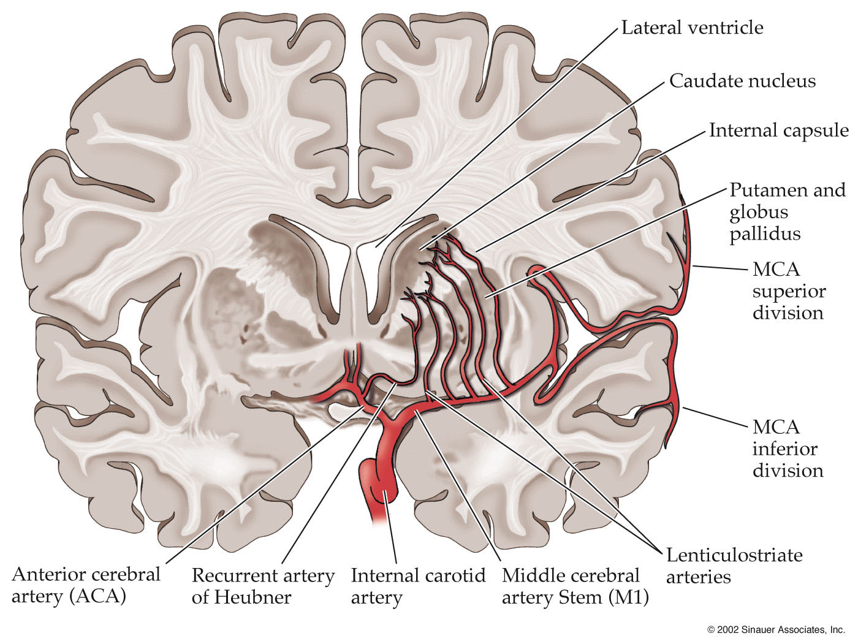
Neuro Damage in Hypertensive Emergency
Chronically uncontrolled hypertension classically causes lacunar strokes in small penetrating
arteries of the MCA affecting the basal ganglia.

Slide 12
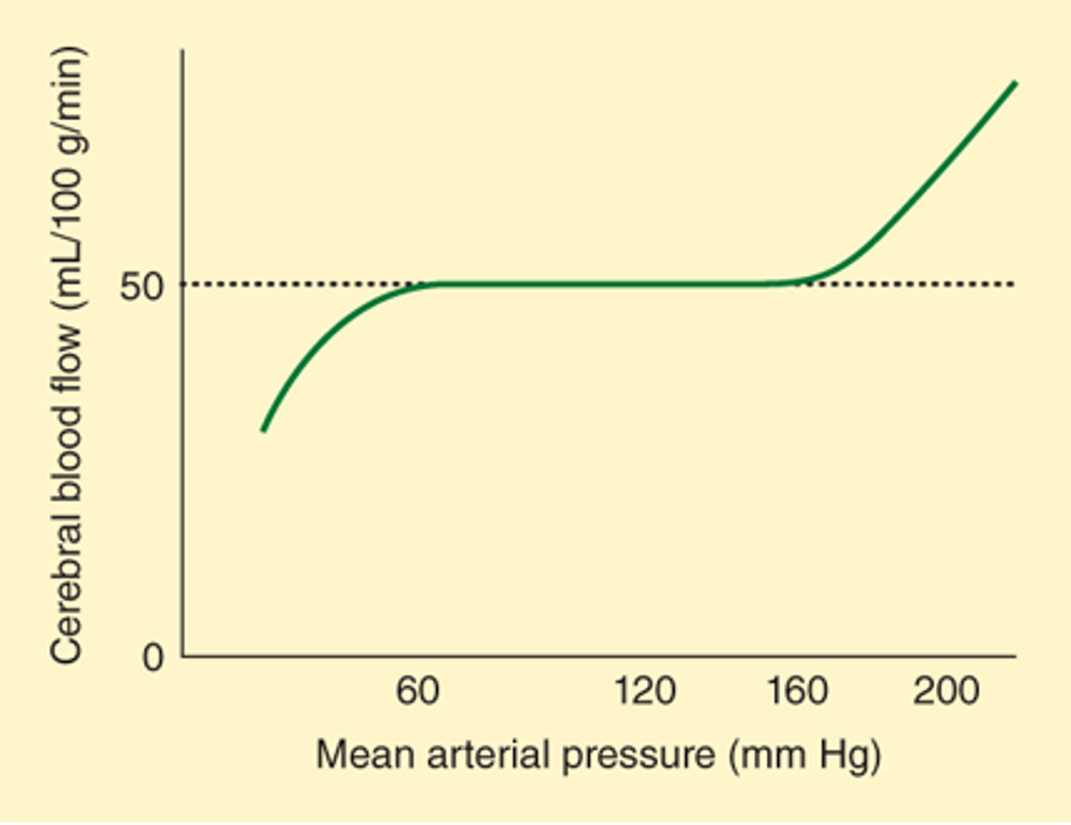
Neuro Damage in Hypertensive Emergency
An intraparenchymal hemorrhage, a hemorrhagic stroke can occur with acutely elevated BP or as a consequence of long standing poorly controlled HTN.
How does the brain respond to chronic HTN?
Intraparenchymal hemorrhages often occur in the basal ganglia, in the small penetrating arteries off the MCA.

Slide 13
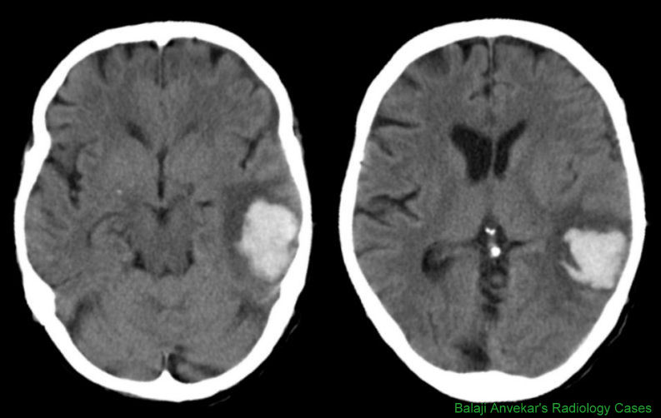
Neuro Damage in Hypertensive Emergency
Why is an intraparenchymal hemorrhage especially tricky to deal with in a patient with long-standing HTN?
CT of the brain with intraparenchymal blood, which appears bright white and surrounding vasogenic edema, which appears darker grey.

Slide 14
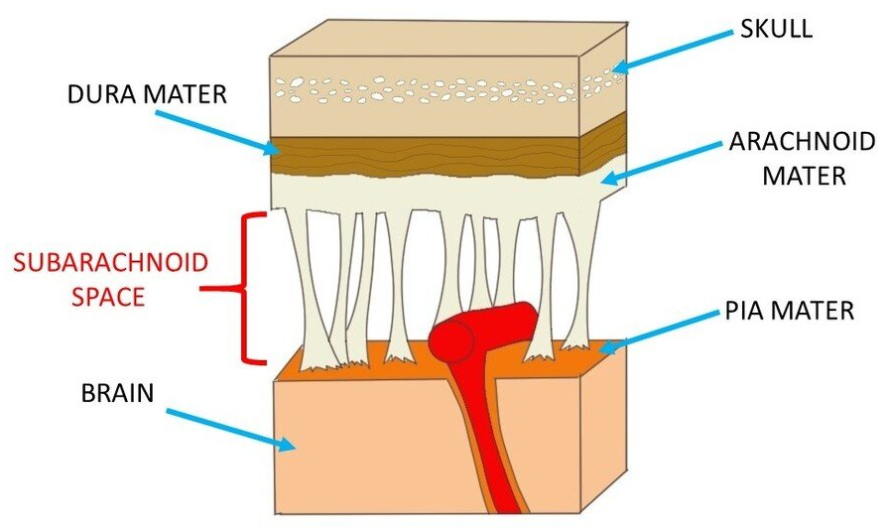
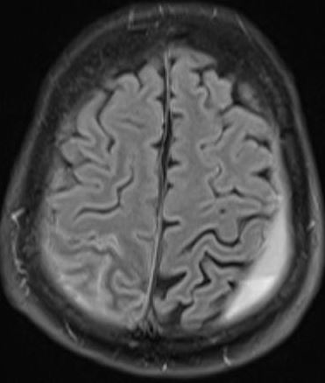
Neuro Damage in Hypertensive Emergency
Subarachnoid hemorrhage
  Blood collects between the skull and the brain- applying external pressure to cerebral tissue.
  Fairly easily treated with a burr hole and evacuation.
Concave hyperdense (white) blood following the curve of the skull and overlying the folds of the brain.

Slide 15
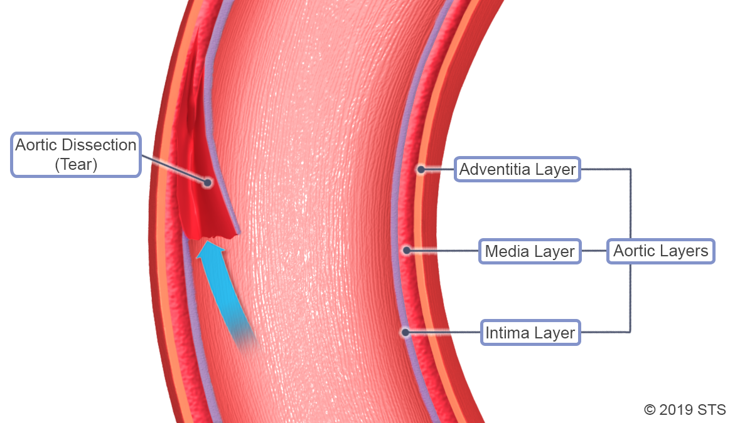
CV Damage in Hypertensive Emergency
Aortic dissection
  High pressures in the aorta can lead to tears in the intima that widen rapidly.
  As the blood is forced into the space between the intima and the media, the dissection worsens quickly and can rupture.

Slide 16
CV Damage in Hypertensive Emergency
Myocardial ischemia/infarction (STEMI, NSTEMI) or unstable angina (UA)
  The heart muscle is perfused by the coronary arteries when it relaxes during diastole.
  The pressure in the aorta from increased vascular resistance, severely elevated afterload, and hypertrophy of the heart means that the coronary arteries are less likely to perfused.

Slide 17
CV Damage in Hypertensive Emergency
If the heart muscle is too tensely contracted and overly stiff from hypertrophy, then the myocardium both
  Needs more oxygen for pumping demand and
  May not relax enough for diastolic filling
Patients will have troponin elevation and may develop EKG changes.

Slide 18
CardioPulm Damage in Hypertensive Emergency
Acute left ventricular dysfunction causing acute pulmonary edema
  In hypertensive crisis, the afterload (aortic pressure) becomes so high that forward movement of the blood out of the left ventricle is compromised.
  Blood backs up into the lungs causing pulmonary vascular congestion that progressively worsens.

Slide 19
Renal Damage in Hypertensive Emergency
Acute kidney injury or proteinuria
  As the cardiac output falls in the face of severely increased afterload, the kidney will be hypo-perfused and unable to maintain proper filtration to recondition the blood composition.

Slide 20
End-Organ Damage in Hypertensive Emergency
Acute end-organ damage in the setting of a hypertensive emergency may also include:
  Hypertensive retinopathy: vascular changes within the retina causing exudates and microinfarctions.
  Pre-eclampsia/ eclampsia: a pregnancy related hypertensive crisis marked by placental insufficiency, proteinuria and potential seizures.
  Microangiopathic hemolytic anemia: hemolysis as a result of high vascular pressures.

Slide 21
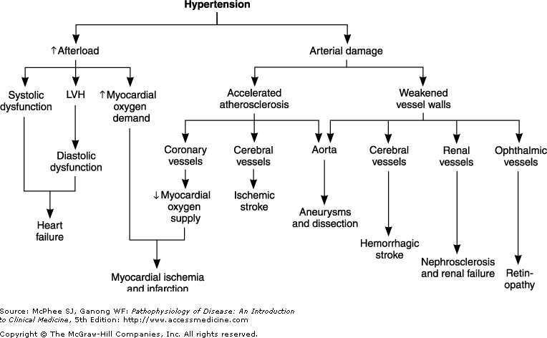

Slide 22
Hypertensive Crisis History
Duration and severity of the patient’s preexisting HTN, degree of control, medication history and compliance.
OTC meds/ supplements and use of illicit drugs (cocaine, meth)
Presence of previous end-organ dysfunction, particularly cardiovascular, renal and cerebrovascular disease

Slide 23
Hypertensive Crisis History
Recent head injury or trauma
Other medical problems: thyroid disease, Cushing’s, systemic lupus
Pregnancy
Recent use of prescription meds (MAOI’s), or recent discontinuation of BB or clonidine

Slide 24
Hypertensive Crisis Exam
Physical exam should assess for end-organ dysfxn
BP should be measured in supine position and the standing position to assess volume depletion and in both arms as a difference suggests aortic dissection.
  Pulses: Check for weak or absent carotid, brachial, or femoral pulse as this could suggest aortic dissection as well.

Slide 25
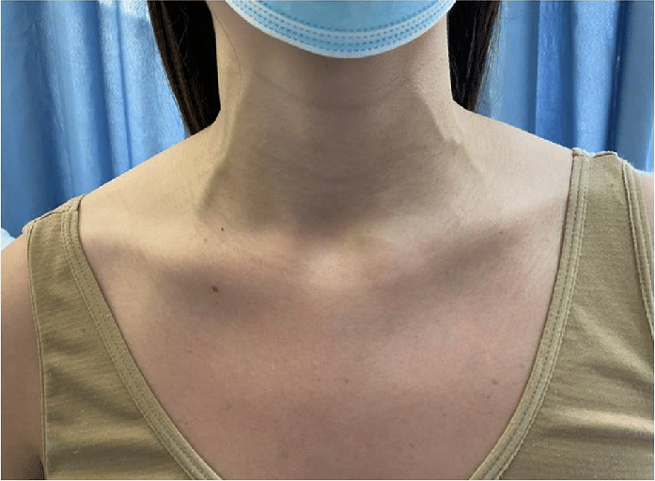
Hypertensive Crisis Exam
Eyes: fundoscopic exam to evaluate for new retinal flame hemorrhages, exudates, or papilledema
CV:
  Jugular venous distention
  Crackles in the lungs (rales) on auscultation
  Dyspnea/ orthopnea
  Peripheral edema
  Acute severe back pain

Slide 26
Hypertensive Crisis Exam
CNS findings:
  Agitation/ delirium
  Visual deficits
  Focal neurologic signs
  Seizures
  N/V may also suggest increased ICP
Abdominal masses or bruits may be noted.

Slide 27
Hypertensive Crisis Work-up
Serum chemistry panel to evaluate for a new AKI by looking at the BUN and Cr, as well as the calculated eGFR.
Urinalysis (U/A) to detect hematuria, proteinuria, red blood cells (RBCs) or RBC casts.
CBC, if a new anemia, consider a set of LFTs and a haptoglobin as well as a peripheral blood smear to exclude microangiopathic anemia.

Slide 28
Hypertensive Crisis Work-up
HS troponin now and in 60-90 minutes, if elevated repeat every 6-8 hours x 2.
Obtain a urine toxicology screen, pregnancy test, and consider endocrine testing if suspicious.
Imaging should be directed by the patient’s clinical presentation. Consider a CXR, if dyspnea or chest pain. Perform a non-contrast CT head for AMS or neurologic changes.

Slide 29
Hypertensive Management
Our concern stems from two competing concerns:
The potential risk of imminent CV events (aortic dissection, stroke, MI, AKI) that may result from severe hypertension if the blood pressure is not quickly and sufficiently reduced.
vs
The risk of adverse events (stroke, MI, AKI) that may occur if the blood pressure is lowered too rapidly or to a level below the ability for autoregulation to maintain adequate tissue perfusion.

Slide 30
Hypertensive Urgency Management
Studies have revealed, that hypertensive urgency patients who present to an ambulatory setting (urgent care, office) do NOT need to be sent to the ER for evaluation and management and should instead be lowered in the outpatient setting.
Elderly patients are at particular risk of complications if the BP is lowered precipitously.

Slide 31
Hypertensive Urgency Treatment
Just placing the patient in a quiet room to rest for 30min can cause BP to fall ≥ 20/10mmHg in 1/3rd of patients.
Patients with hypertensive urgency, judged to be at imminent risk of a CV event (known cerebral or aortic aneurysms) should be sent to the ER and can have their BP lowered over a period of 2-4 hours.
    These patients can be treated as if they have hypertensive emergency, and the same medications used.
Those with h/o DM, CAD or prior CVA should be considered for admission as well.

Slide 32
Hypertensive Urgency Treatment
If a patient has been non-compliant with previously prescribed and well tolerated treatment, this is restarted- provided that no contraindications exist.
Salt restriction may also be very helpful.
Patients with new onset HTN presenting with urgency can be started on appropriate guideline-based therapy- initiating 2 drugs at modest dosages (ACE or ARB, CCB, thiazide).
Prompt out-pt follow-up is needed to continue to reduce BP to goal over days to weeks.

Slide 33
Specific Strategies for HTN Urgency
Within 2-4 hours, the BP should be reduced to less than 160/100, or the MAP reduced by no more than 25-30% over 2-4 hours (whichever is greater). Then over 1-2 weeks the BP is gradually reduced to goal.
The patient should be monitored for 1-2 hours to make sure that they don’t develop signs of end organ damage. Patients can be released as BP comes down but must have close outpatient follow-up established.

Slide 34
Hypertensive Emergency Treatment
In hypertensive emergency, the treatment guidelines are to reduce the MAP no more than 10-20% over minutes to 1 hour, using IV medications.
Then reduce the MAP another 5-15% (from current BP value) over the next 23 hours in the ICU or stepdown unit under close monitoring with IV meds.
Over the next days to weeks the BP lowering is continued with oral meds.
There are a few exceptions to this rule in which certain processes require a faster reduction or no reduction in BP at all in the first day. (Slide 47-49)

Slide 35
Hypertensive Emergency Meds
Drug | Dose | Adverse Effects | Indications
Sodium nitroprusside | 0.25–10 mcg/kg/min intravenous infusion (requires special delivery system) | Nausea, vomiting, muscle twitching, sweating, thiocyanate and cyanide intoxication | Most HTN emergencies; caution with high intracranial pressure, azotemia, or in CKD
Nicardipine hydrochloride | 5–15 mg/h intravenous | Tachycardia, headache, flushing, local phlebitis | Most HTN emergencies except acute heart failure; caution with coronary ischemia
Esmolol hydrochloride | 250–500 mcg/kg/min IV bolus, then 50–100 mcg/kg/min infusion | Hypotension, nausea, asthma, first-degree heart block, decompensated HFrEF | Aortic dissection; perioperative
DiPiro JT, Talbert RL, Yee GC, Matzke GR, Wells BG, Posey LM: Pharmacotherapy:A Pathophysiologic Approach, 7th Edition: http://www.accesspharmacy.com/

Slide 36
Hypertensive Emergency Meds
Drug | Dose | Adverse Effects | Indications
Nitroglycerin | 5–100 mcg/min intravenous infusion | Headache, vomiting, methemoglobinemia, tolerance with prolonged use | Coronary ischemia and heart failure
Hydralazine hydrochloride | 10–20 mg intravenous 10–50 mg intramuscular | Tachycardia, flushing, headache vomiting, aggravation of angina | Eclampsia
Labetalol hydrochloride | 20–80 mg intravenous bolus every 10 min; 0.5–2.0 mg/min intravenous infusion | Vomiting, scalp tingling, bronchoconstriction, dizziness, nausea, heart block, orthostatic hypotension | Most hypertensive emergencies except acute heart failure
DiPiro JT, Talbert RL, Yee GC, Matzke GR, Wells BG, Posey LM: Pharmacotherapy:A Pathophysiologic Approach, 7th Edition: http://www.accesspharmacy.com/

Slide 37
Sodium Nitroprusside (Nipride) IV
Dilated in 5% Dextrose
Nitrates Vasodilate
Nitroprusside will cause a precipitous drop in BP within 2 minutes by causing direct venous and arteriolar vasodilation which equates to decreased PVR and venous return, lowering BP. Nitroprusside raises intracranial pressure (ICP).
The medication effect lasts up to 10 minutes

Slide 38
Sodium Nitroprusside (Nipride) IV
Sodium nitroprusside has two major adverse rxns:
Cyanide toxicity: nitroprusside administration causes large quantities of cyanide to be produced. Humans have limited ability to clear cyanide, especially if they have renal/liver dz. Treatment sodium thiosulfate
Methemoglobinemia: Hgb is oxidized from the ferrous (Fe²⁺) to ferric (Fe³⁺) state and no longer allows binding of oxygen. Patients develop cyanosis and can die of hypoxia despite high flow oxygen. Treatment is methylene blue.

Slide 39
Nitroglycerin
The nitroglycerin IV drip is titratable and works immediately to produce a vasodilatory effect on the peripheral veins and a lesser effect on the peripheral arteries.
Reduces preload, with less reduction of afterload, dilates the coronary arteries and improves collateral flow to areas of ischemic myocardium.
Onset of action 2-5 min
Antihypertensive effect disappears in 5-10 minutes

Slide 40
Nitroglycerin
Nitroglycerin causes headache, flushing and hypotension
Tachyphylaxis develops within 24-48 hours- must have a nitrate free interval
Concurrent use with PDE-5 inhibitors for erectile dysfunction or pulmonary HTN (sildenafil, tadalafil) may cause very severe hypotension.
May also cause methemoglobinemia.

Slide 41
Nicardipine (Cardene)
A dihydropyridine CCB in an IV drip, administered through a large peripheral vein or central line, titrated to a goal BP.
Lowers BP by inhibiting peripheral cardiac calcium channels causing vasodilation.
    It can affect cardiac calcium channels causing decreased strength of myocardial contraction.
Cardene may cause irritation of the vein, so site should be rotated every 12 hours.

Slide 42
Nicardipine (Cardene)
Peak BP lowering effect occurs in 1-2 hours and decreases sharply over 30 minutes after infusion stops but it takes about 50 hours for all the anti-hypertensive effect to resolve.
Effect is prolonged in kidney disease.
Contraindicated in persons with aortic stenosis, severe ventricular dysfunction (HFrEF) or hypertrophic cardiomyopathy.

Slide 43
Hypertensive Emergency:
Treating Cardiac Complications
Acute coronary syndromes, including acute STEMI, NSTEMI and unstable angina.
Treat if the SBP is >160 mm Hg and/or the DBP is >100 mm Hg. Nitroglycerin gtt or IV beta blockers (metoprolol, esmolol) are the preferred drugs.
Get cardiology involved early and trend troponin, obtain an echocardiogram if not going to the cardiac catheterization lab.

Slide 44
Hypertensive Emergency:
Treating Cardiac Complications
Acute heart failure, goal is a SBP < 140mmHg
A loop diuretic IV is often administered first if the patient is fluid overloaded to dry the lungs
A venous vasodilator- nitroglycerin is added next, which dilates the coronary arteries as well.
Drugs to avoid in acute decompensated HFrEF are:
  BBs and CCBs: depress cardiac contractility
  Hydralazine: increases cardiac work by arterial vasodilation

Slide 45
Hypertensive Emergency:
Treating Sympathetic Over Activity
Occurs with the following:
  Cocaine toxicity
  Methamphetamines/ Amphetamines (Ritalin, Adderall)
  Pheochromocytoma
  Severe autonomic dysfunction: cord injury, GBS
In these disease states, the sympathetic nervous system is releasing large amounts of catecholamines causing sudden severe HTN

Slide 46
Hypertensive Emergency:
Treating Sympathetic Over Activity
In these cases, the patient is quite tachycardic and hypertensive, perhaps with coronary ischemia.
However, administration of a beta blocker alone is contraindicated, since blocking of the beta receptors will result in all the catecholamine binding to the alpha receptors causing unopposed alpha-adrenergic vasoconstriction and a further rise in blood pressure.
Block both together with labetalol IV

Slide 47
Hypertensive Crisis Treatment Exceptions
A few exceptions exist for treatment of hypertensive emergency.
For acute ischemic stroke, treat only if the SBP is ≥ 220 mm Hg and the DBP is ≥ 120 mm Hg: preferred meds are labetalol and nicardipine.
  All others resume home antihypertensive regimen, pending no contraindications, 24-48hr after the stroke
For an ischemic stroke patient receiving IV or intra-arterial (IA) fibrinolysis with tPA, goal is <185 and <110 mmHg prior to reperfusion tx.

Slide 48
Hypertensive Crisis Treatment Exceptions
For acute intracerebral hemorrhage or subarachnoid hemorrhage, determine if increased ICP is present.
Goal BP is a difficult decision to make, with competing interests- why?
Preferred meds are nicardipine (DOC), could also use labetalol or esmolol; avoid nitroprusside and hydralazine, usually titrated to a systolic of 160.

Slide 49
Hypertensive Crisis Treatment Exceptions
For acute aortic dissection, the goal is to rapidly lower the SBP to 100-120 mm Hg within 20 min, unless signs of end-organ hypoperfusion occur.
Preferred treatment is a combination of:
  narcotic analgesics (morphine sulfate)
  beta blockers (esmolol, labetalol)
  vasodilators (nitroprusside)
Then the patient goes to the OR.

Slide 50
Hypertension in Pregnancy
Most women who become pregnant do not have issues with BP, however, the plasma volume increases to 150% of normal during pregnancy, the RBC volume increases by 30% and CV system is under increased stress. So HTN can occur in pregnancy.
It is important to differentiate preeclampsia from chronic, transient, & gestational hypertension during pregnancy.

Slide 51
Hypertension in Pregnancy
Chronic hypertension:
  Pre-pregnancy hypertension (prior diagnosis)
  > 140/90 mmHg before 20 weeks’ gestation
  HTN which persists > 12 weeks postpartum
Pregnancy induced hypertension/ gestational hypertension:
  > 140/90 after 20 weeks gestation without proteinuria, which resolves by 12 weeks post-partum

Slide 52
Hypertension in Pregnancy
Preeclampsia: hypertension that is either chronic or gestational with placental insufficiency and proteinuria- end organ kidney damage
  More common in nulliparous women, multiple gestation, in a woman with a h/o HTN or renal disease, family hx
  Restricted activity and possibly bed rest for mom, very close monitoring of the fetus
  Definitive treatment of preeclampsia is delivery
Eclampsia: HTN, proteinuria and seizure

Slide 53
Hypertension in Pregnancy
Methyldopa, labetalol and diltiazem are the drugs used most commonly during pregnancy for hypertensive disorders.
Labetalol: twice daily, well tolerated, good safety data
Methyldopa: 2-4 times daily, good safety data, some anti-cholinergic side effects
Nifedipine or Diltiazem: once daily, less safety data

Slide 54
HTN in Pregnancy
Drug/Class | Comments
Methyldopa | Preferred based on long-term follow-up data supporting safety
β-Blockers | Generally safe, but intrauterine growth retardation reported
Labetolol | Increasingly preferred over methyldopa because of fewer side effects
Clonidine | Limited data
Calcium channel blockers | Limited data; no increase in major teratogenicity with exposure
Diuretics | Not first-line, probably safe in low doses
ACE inhibitors, ARBs | Pregnancy category C in 1st trimester, category D in 2nd & 3rd trimester. Major teratogenicity has been reported with exposure (fetal toxicity, death)
DiPiro JT, Talbert RL, Yee GC, Matzke GR, Wells BG, Posey LM: Pharmacotherapy:A Pathophysiologic Approach, 7th Edition: http://www.accesspharmacy.com/

Slide 55
