Slide 1

Shock, Pressors, and Fluid Management

Slide 2
Definition of Shock
A state of cellular and tissue hypoxia due to
  Reduced oxygen delivery
  Increased oxygen consumption
  Inadequate oxygen utilization
  Combination of the above
Circulatory failure manifested as reduction in tissue perfusion
Initially reversible, but quickly progresses to irreversible organ dysfunction

Slide 3
Types of Shock
Four main types of shock:
Cardiogenic shock (today’s focus)
Hypovolemic shock
Obstructive shock
Distributive shock

Slide 4
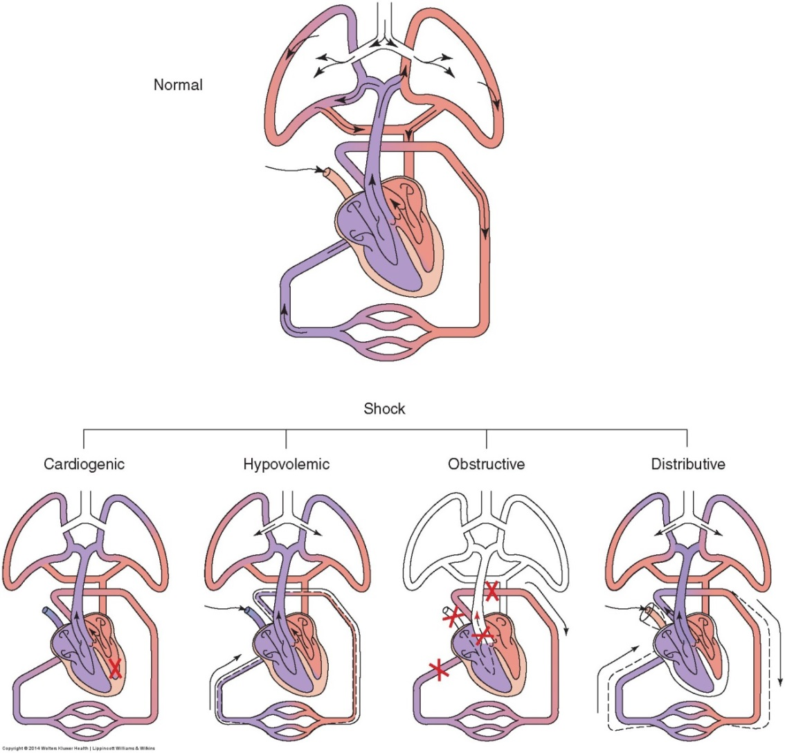
Types of Shock

Slide 5
Causes of Shock
Hypovolemic shock
  Hemorrhage
  Fluid loss due to vomiting, diarrhea, dehydration, pancreatitis
  Fluid loss due to 3rd spacing (burns)
Obstructive shock
  Pulmonary embolism
  Tension pneumothorax
  Cardiac tamponade
  Aortic dissection
Distributive shock
  Sepsis
  Neurogenic shock due to loss of sympathetic vasomotor tone
  Anaphylaxis

Slide 6
Continuum of Shock
Regardless of the type, there is a physiologic continuum
Begins with an inciting event, such as a myocardial infarction, an infection, or an injury (i.e. gunshot wound)
Produces a systemic circulatory abnormality that progresses through complex and intertwined stages:
  Pre-shock
  Shock
  End-organ dysfunction
Can culminate in irreversible end-organ damage and death

Slide 7
Stages of Shock: Pre-Shock
AKA: “warm shock” or “compensated shock”
Characterized by rapid compensation for diminished tissue perfusion by various homeostatic mechanisms
Compensatory mechanisms may allow an otherwise healthy adult to be asymptomatic despite a 10% reduction in total effective arterial blood volume
Most immediate of compensatory mechanisms are sympathetic and renin systems, which maintain cardiac output and blood pressure
  Tachycardia and peripheral vasoconstriction may be the only clinical signs of shock during this pre-shock phase

Slide 8
Stages of Shock: Shock
Eventually, compensatory mechanisms become overwhelmed
Signs and symptoms of organ dysfunction appear
  Tachycardia
  Hypotension
  Tachypnea
  Anxiety
  Diaphoresis
  Metabolic acidosis
  Oliguria
  Cool, clammy skin

Slide 9
Stages of Shock: End-Organ Dysfunction
Progressive end-organ dysfunction leads to irreversible organ damage and patient death
Urine output may decline further
  Acute renal failure
  Anuria
Decreased cardiac output
Altered mental status
  Anxiety evolves into delirium (irrational behavior and agitation), obtundation, and coma

Slide 10
Response to Shock
Carotid baroreceptors sense a decrease in volume and trigger a sympathetic mediated response
Surge of vasoactive hormones are released to maintain cardiac output and blood pressure
  Epinephrine
  Norepinephrine
  Cortisol

Slide 11
Response to Shock
Increase in heart rate
Increase in cardiac contractility, which results in increased stroke volume (CO = HR x SV)
Vasoconstriction of both arterioles and veins to maintain blood pressure and increase volume return to the heart
  Arteriole constriction maintains systemic vascular resistance to maintain blood pressure
    This response shunts blood away from liver, spleen, kidneys, and periphery
  Venous constriction results in increased return of blood to the heart

Slide 12
Response to Shock
Other mechanisms in place to help restore decreased cardiac output:
  Intestines: absorption of fluid from intestinal spaces
  Kidneys: sympathetic vasoconstriction of blood flow to the kidneys, shunting blood away from the kidneys
  Pituitary gland: 10% reduction in intravascular volume causes hypothalamus to stimulate posterior pituitary gland to release ADH, causing:
    Reabsorption of water by the kidneys
    Increased thirst
    Decreased urine production, resulting in oliguria

Slide 13
Cardiogenic Shock and Pressors

Slide 14
Cardiogenic Shock
Divided into 4 broad categories:
  Myocardial damage
    Myocardial infarction
    Myocardial contusion
    Cardiomyopathies
  Sustained arrhythmias
  Valvular or septal defects
  Cardiac surgery

Slide 15
Epidemiology
Myocardial infarction is the most common cause
6-8% of patients with AMI will develop cardiogenic shock
≥ 40% loss of myocardium causes cardiogenic shock
  Either one massive AMI or a series of AMIs
  Usually develops within 8 hours of a massive AMI

Slide 16
Risk Factors
Age > 65 years
Past medical history of CAD, heart failure, or diabetes
AMI involving the left main coronary artery and its branches, resulting in left ventricular dysfunction
Mechanical complications
  Chordae tendineae rupture
  Rupture of the ventricular septal or free wall

Slide 17
Etiology
Most commonly, patients have multiple vessel disease involving the left anterior portion of the heart
  Occlusion of the left main coronary artery and its branches
Right ventricular dysfunction occurs about 5% of the time secondary to an inferior wall AMI
  Right coronary artery

Slide 18
Cardiac Pump Failure
Occurs when heart fails to pump blood sufficiently to meet body’s demand
Poor cardiac output is due to decreased contractility, increased preload, and increased afterload
Eventually, coronary artery perfusion is impaired because of increased preload and afterload, and cardiac function decreases because of poor myocardial oxygen supply
  Results in decreased cardiac output, leading to hypotension, hypoperfusion, and tissue hypoxia

Slide 19
Symptoms
Chest pain
Dyspnea
Diaphoresis
Vomiting
Arm pain
Jaw pain
Altered mental status
Weakness
Cool extremities

Slide 20
Signs
Blood pressure
  In pre-shock phase, may be normotensive
  In shock phase, systolic blood pressure drops to <90 mmHg or ≥ 40 mmHg drop in systolic blood pressure
Heart rate
  Tachycardia is normal compensatory response
  Exceptions include:
    Bradycardia can occur due to nodal dysfunction from right sided or inferior AMI
    Normal heart rate can occur if normal compensatory response is blunted by beta blockers or calcium channel blockers

Slide 21
Signs
Heart sounds
  Heart murmurs may indicate valvular dysfunction
    Holosystolic heard over the apex indicative for mitral regurgitation from chordae tendineae rupture
  Displaced PMI suggests preexisting cardiomyopathy or CHF
Vascular
  Jugular venous distention > 8 cm
  Peripheral edema suggests preexisting heart failure (pitting edema)

Slide 22
Signs
Lungs
  Tachypnea
  Rales
  Frothy sputum
Genitourinary
  Decreased urine output

Slide 23
Signs
Skin
  Cool
  Clammy
  Mottled (livedo reticularis)
Decreasing mental status (continuum)
  Anxiety evolves into delirium (irrational behavior, agitation, confusion), then obtunded state, then coma

Slide 24
Diagnostic Tests
EKG to evaluate for myocardial infarction and the need for reperfusion
  First initial diagnostic test
  Patients with symptoms associated with ACS need to be placed on cardiac monitor and have EKG within 10 minutes
  ST elevation (1mm limb leads, 2mm precordial leads) in 2 contiguous leads is consistent with STEMI

Slide 25
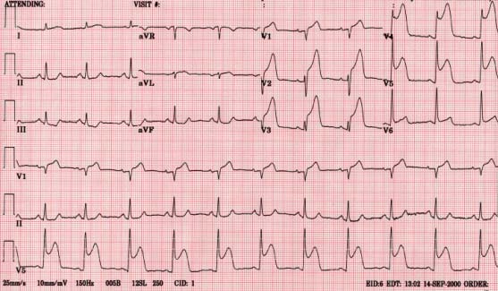
Evaluation: EKGs

Slide 26
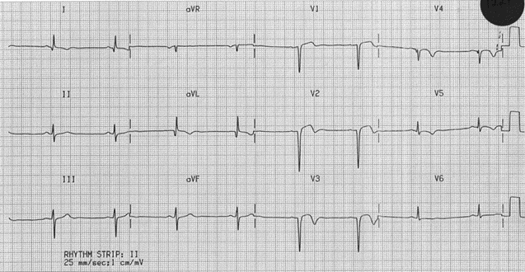
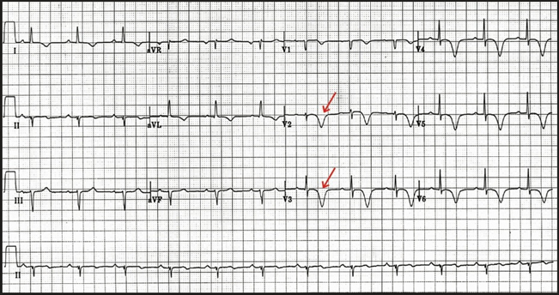
Evaluation: EKGs
ST elevation in 2 contiguous leads
“Wellen Waves”
Large LAD lesions can produce >2 mm of T wave depression in V2-V3

Slide 27
Diagnostic Tests
Portable chest x-ray to evaluate for evidence of
  Pulmonary edema
  Widened mediastinum
  Cardiomegaly
Echocardiogram to evaluate mechanical function and LVEF
  Demonstrates decreased stroke volume and ventricular wall motion abnormalities

Slide 28
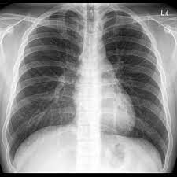
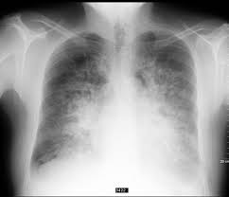
Evaluation: Chest X-ray (CXR)
Normal Appearance
Pulmonary Edema

Slide 29
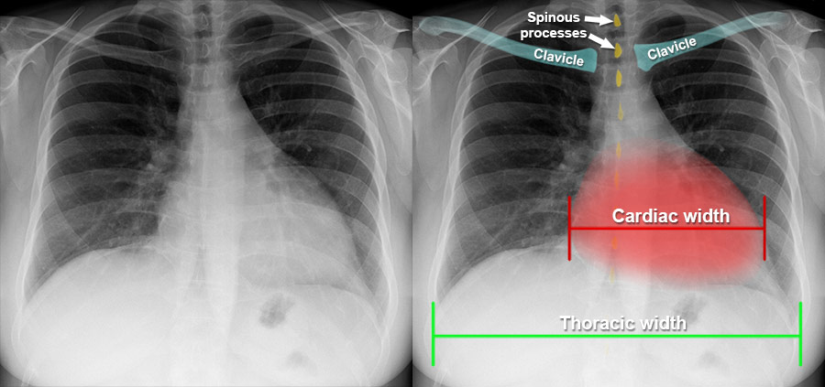

Slide 30
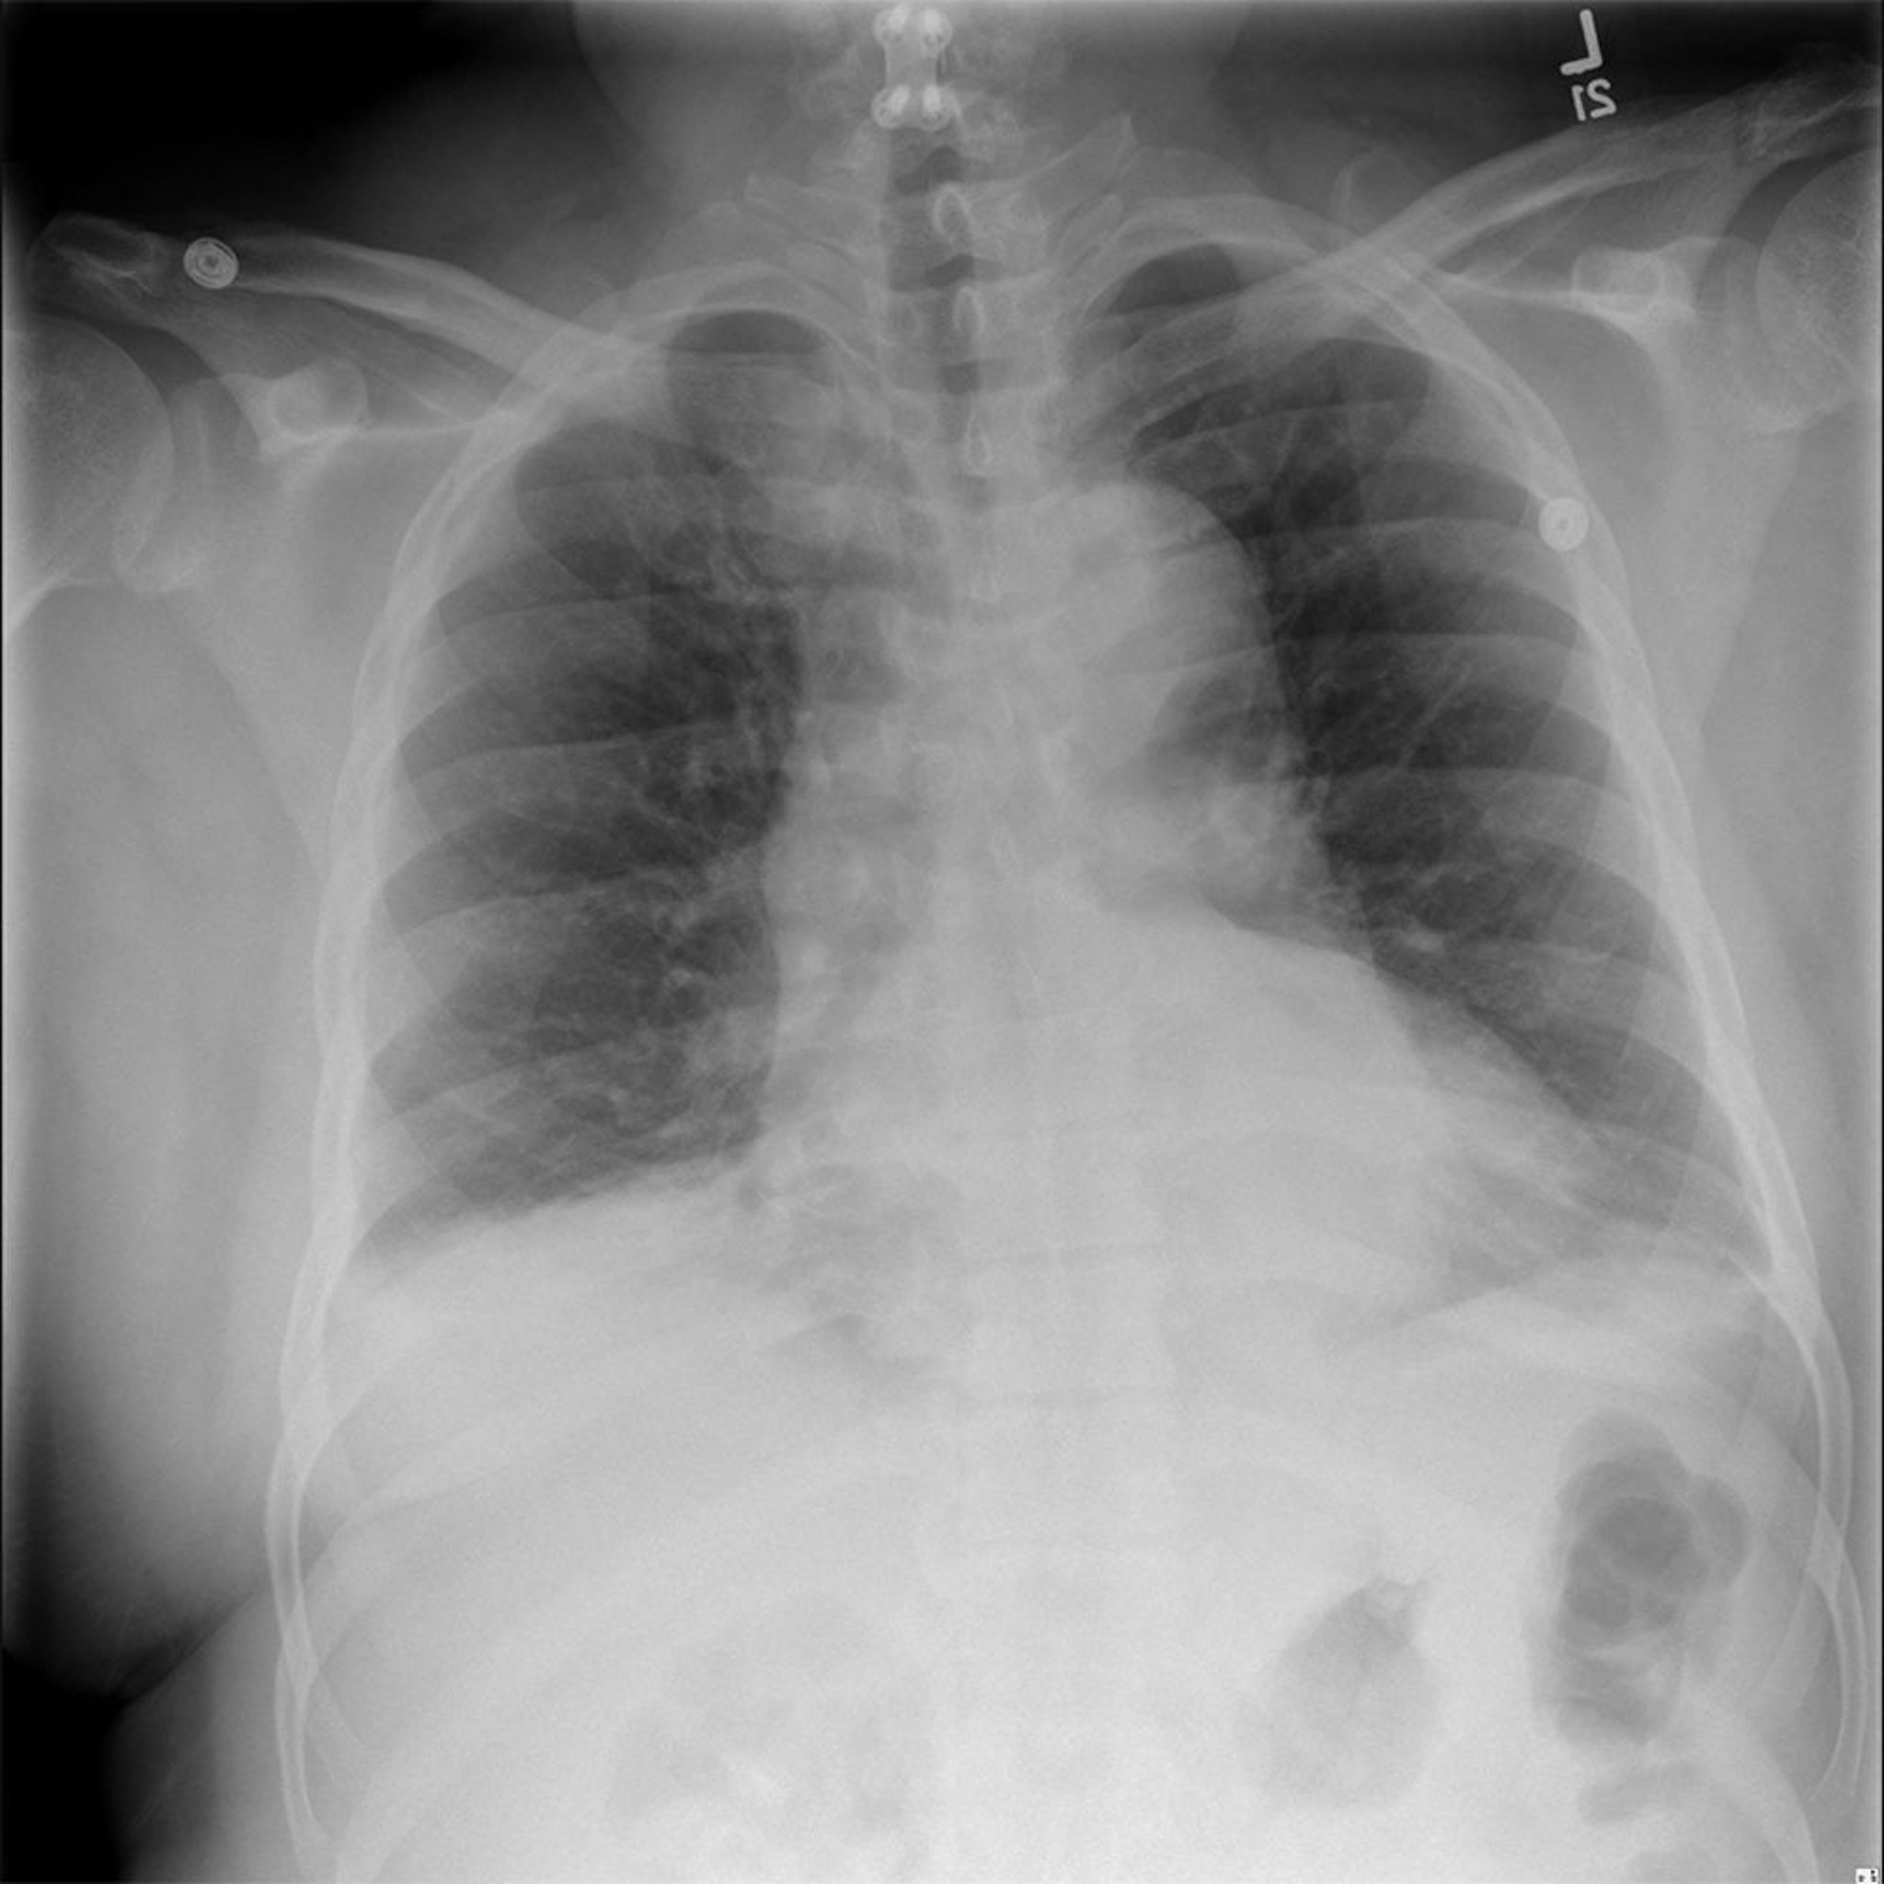

Slide 31
Diagnostic Tests
Laboratory studies
  Cardiac markers (troponin I, CK, CK-MB) to evaluate for myocardial infarction
  Serum lactate to evaluate for systemic ischemia or sepsis
  CBC to evaluate for infection or anemia
  CMP to evaluate for organ failure (liver or kidney) or electrolyte abnormalities
  BNP (B-type natriuretic peptide), a normal result should suggest a different diagnosis other than cardiogenic shock
  PT/INR, PTT to evaluate for coagulopathy

Slide 32
Emergency Management
Emergency care is a temporizing measure while arranging for revascularization/reperfusion in the cardiac catheterization lab for AMI or surgical intervention for mechanical catastrophe
Airway management and circulatory stabilization must occur simultaneously, and these will often precede complete history, exam, diagnostic studies, and pharmacologic agents

Slide 33
Airway Management
Supplemental oxygen
  Nasal cannula
  Non-rebreather mask
  Bag-valve mask (if patient is obtunded or comatose, prior to intubation)
Advanced airway device
  Endotracheal intubation
  Most patients in cardiogenic shock will ultimately require intubation and placement on a mechanical ventilator

Slide 34
IV Fluids
IV fluids boluses should be held in cardiogenic shock secondary to left ventricular dysfunction or with any evidence of respiratory distress from pulmonary congestion
  Establish IV access (saline lock) but hold large boluses of fluids

Slide 35
IV Fluids
Cautious 250 cc boluses can be given to treat mild hypotension if there is no evidence of LV dysfunction (respiratory distress, rales, JVD, or pulmonary congestion on chest x-ray)
Patient should be assessed before and after every 250 cc bolus of fluid
(more on fluids later)

Slide 36
Pharmaceutical Management
Treatment of cardiogenic shock requires striking a precarious balance
  Improve cardiac output
  Reduce the workload and oxygen needs of the myocardium
  Increase coronary perfusion
Blood thinners: prevent coagulopathy
  Aspirin 324 mg orally
  IV heparin

Slide 37
Pharmaceutical Management
Sympathomimetic inotropic and vasopressor agents: mainstay of first-line therapy
  Dobutamine
  Dopamine
  Norepinephrine (Levophed)
  Epinephrine
Avoid negative inotropes: beta-blockers and calcium channel blockers
  Block tachycardic response and worsen clinical situation

Slide 38
Vasopressors
Vasopressor agents have variable effects on the alpha adrenergic (α₁), beta adrenergic (β₁ and β₂), and dopaminergic receptors
Vasopressors improve perfusion pressure in the large vessels
If multiple vasopressors are used, they should be simplified as soon as the best therapeutic agent is identified
Administered ideally via central line but initial doses can be delivered through peripheral lines

Slide 39
Vasopressors
Alpha adrenergic
  α-1 adrenergic receptors in vascular walls induce significant vasoconstriction
Beta adrenergic
  β-1 adrenergic receptors in heart increase inotropy and chronotropy with minimal vasoconstriction
  β-2 adrenergic receptors in blood vessels induce vasodilation

Slide 40
Vasopressors
Dopaminergic
  Dopaminergic receptors in renal, splanchnic (mesenteric), coronary, and cerebral vascular beds induce vasodilation at lower doses of dopamine (< 10 mcg/kg per minute)
  Second subtype of dopaminergic receptors induce vasoconstriction by causing norepinephrine release at higher doses of dopamine (> 10 mcg/kg per minute)

Slide 41
Vasopressors
Drug | Action | Cardiac Stimulation | Vasoconstriction
Dobutamine | Primarily β₁ α₁ & β₂ (dose dependent) | ++++ | +
Dopamine | α₁ β₁ & β₂ Dopaminergic | ++ at 5 mcg/kg/min (intermediate dose) | ++ at 15 mcg/kg/min (high dose)
Norepinephrine (Levophed) | Primarily α₁ Some β₁ | ++ | ++++
Epinephrine | α₁ β₁ & β₂ | +++ | ++

Slide 42
Dobutamine
Synthetic sympathomimetic agent
  β₁ agonist = positive inotrope
  β₂ agonist = some peripheral vasodilation
Design leads to increase in myocardial contractility and vasodilation with minimal change in heart rate
  Increases cardiac output and decreases systemic vascular resistance

Slide 43
Dobutamine
Used for cardiogenic shock in the absence of profound hypotension
  Should only be used when the SBP is ≥ 90 mmHg (avoid when the SBP is < 90 mmHg)
Onset of action: 1-2 minutes
May be used in combination with dopamine

Slide 44
Dopamine
Stimulates dopaminergic receptors, α-1, and β-1
Inotropic (increased contraction) and chronotropic (increased rate) activity
Dopaminergic effect at lower doses (< 10 mcg/kg/min) stimulates renal and mesenteric vasodilation
At higher doses (> 10 mcg/kg/min) stimulates vasoconstriction

Slide 45
Dopamine
Indicated in hypotension state when SBP < 90 mmHg
Onset of action: 5 minutes
Can be used as a single agent or in combination with dobutamine
Can cause dose-limiting dysrhythmias

Slide 46
Dopamine
Lower dosing (< 3 mcg/kg/min)
  Arterial vasodilation
  Increases renal blood flow and urine output
Intermediate dosing (3-10 mcg/kg/min)
  Mixed dopaminergic and β-1 effects
  Increases SA node stimulation secondary to β-1 stimulation
  Improves myocardial contractility and cardiac output
Higher dosing (> 10 mcg/kg/min)
  Main effect on α-1 adrenergic receptors, provoking peripheral vasoconstriction
  Causes vasoconstriction of the kidneys, resulting in renal necrosis and failure

Slide 47
Norepinephrine (Levophed)
Preferred agent in cardiogenic shock
Stimulates primarily α-1 and β-1 adrenergic receptors
Inotropic (increased contraction) and chronotropic (increased rate) activity
Increases arterial and venous vascular tone
Increases heart rate, ventricular contraction, and peripheral vascular resistance
Shunts blood away from peripheral circulation

Slide 48
Norepinephrine (Levophed)
Indicated in hypotension states when SBP < 90 mmHg
Onset of action: 1-2 minutes
Used as a single potent vasopressor

Slide 49
Epinephrine
Stimulates α-1, β-1, and β-2 adrenergic receptors
β-1 inotropic (increased contraction) and chronotropic (increased rate) activity – leads to increased cardiac output
β-2 vasodilation, may ↓ systemic vascular resistance (SVR) at lower doses
α-1 vasoconstriction, becomes more prominent at higher doses, which increases SVR
Net effect of SVR is dose dependent

Slide 50
Epinephrine
Used as an alternative to norepinephrine
Onset of action: 1-2 minutes
However, associated with increased systemic acidosis, tachycardia, and dysrhythmias compared to norepinephrine

Slide 51
Devices to Manage Shock
Foley catheter
  Placed in the ED or ICU
  Used to measure urine output
Central venous access (central line)
  Placed in the ED or ICU
  Used to monitor central venous pressure and administer vasopressors and fluids
Arterial line
  Placed in the ED or ICU
  Used to monitor arterial pressures and blood gases

Slide 52
Devices to Manage Shock
Intra-aortic balloon pump
  Placed in the cath lab
  Used to mechanically decrease afterload and increase coronary perfusion
Pulmonary artery catheter (Swan Ganz Catheter)
  Placed in the ICU, CCU, or cath lab
  Used to measure systemic oxygen consumption (ScVO₂) of the blood returning to heart
Left Ventricular Assist Device (LVAD)
  Placed in the OR or cath lab
  Used to assist the LV short-term for stabilization

Slide 53
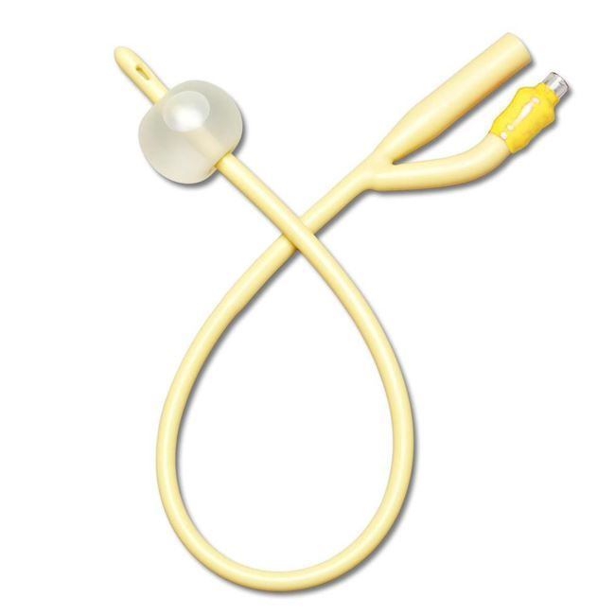
Foley Catheter
Placed in urinary bladder to accurately measure urine output
Provides information about perfusion status of patient
Goal is for urine output to be greater than 0.5 mL/kg/hr (35 mL/hr for 75 kg adult)

Slide 54
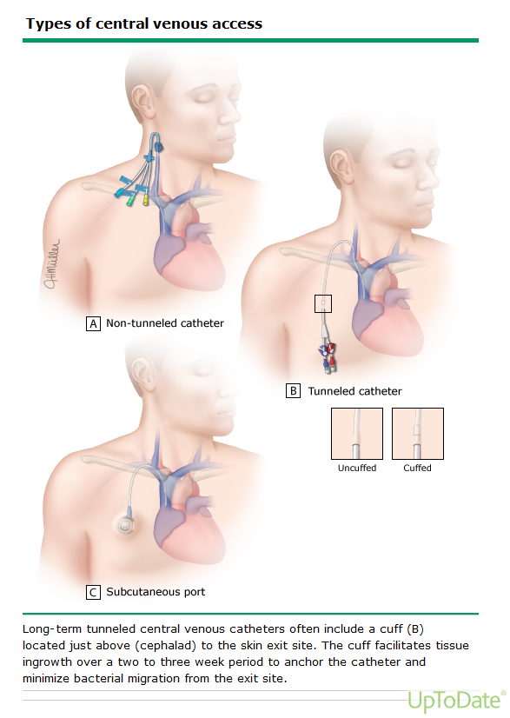
Central Venous Access
Peripheral intravenous lines should not be used when administering continuous vasopressor agents because they can cause venous sclerosis and tissue necrosis if extravasation occurs
Therefore, beyond emergency care, vasopressor agents must be infused via a central line

Slide 55
Central Venous Pressure (CVP)
Measure of pressure in the vena cava
Estimation of preload and right arterial pressure
Most accurately measured with central venous catheter in internal jugular vein at top of superior vena cava
Normal CVP is 8 to 12 mmHg

Slide 56
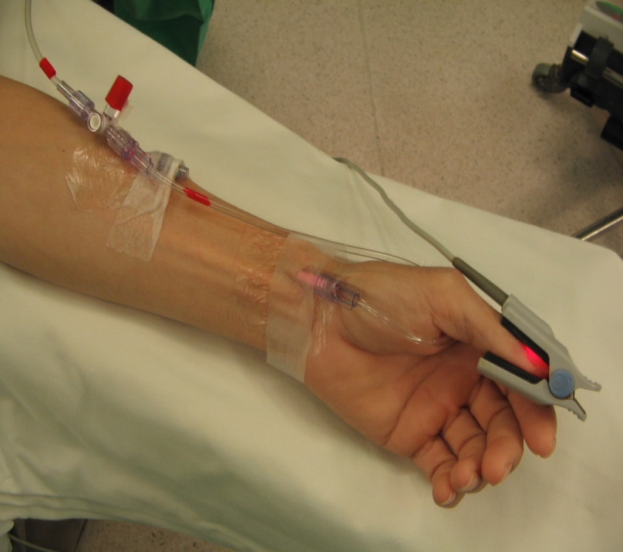
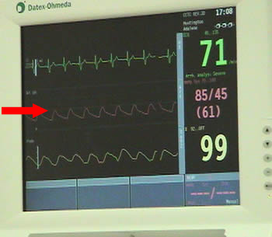
Arterial Line
Placed in radial (most common), brachial, dorsalis pedis, femoral, or axillary arteries
Measures arterial blood pressure, which is a more accurate way to monitor perfusion than BP
Collects blood sampling (ABGs)

Slide 57
Mean Arterial Pressure (MAP)
Average pressure in patient’s arteries during one cardiac cycle
Considered a better indicator of perfusion to vital organs than systolic blood pressure
Most accurately measured with a continuous pressure monitor via arterial line
Normal MAP is 65 to 90 mmHg

Slide 58
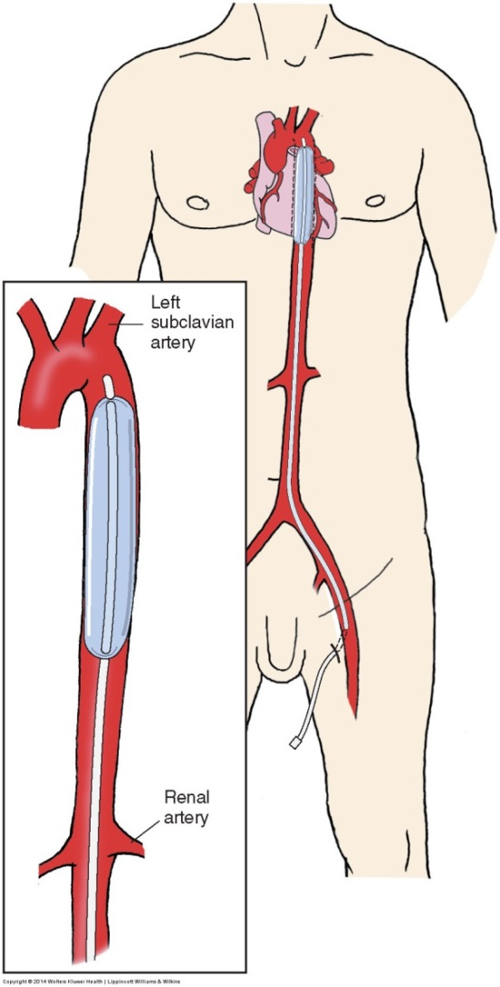
Intra-aortic Balloon Pump
10-inch-long balloon placed into the descending aorta
Pumps in synchrony with the heart
Enhances coronary and systemic perfusion
Decreases afterload and myocardial O₂ demand
Balloon is timed to inflate during ventricular diastole and deflate just before ventricular systole

Slide 59
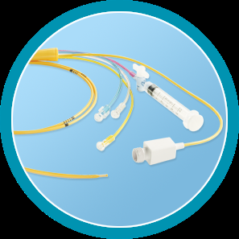
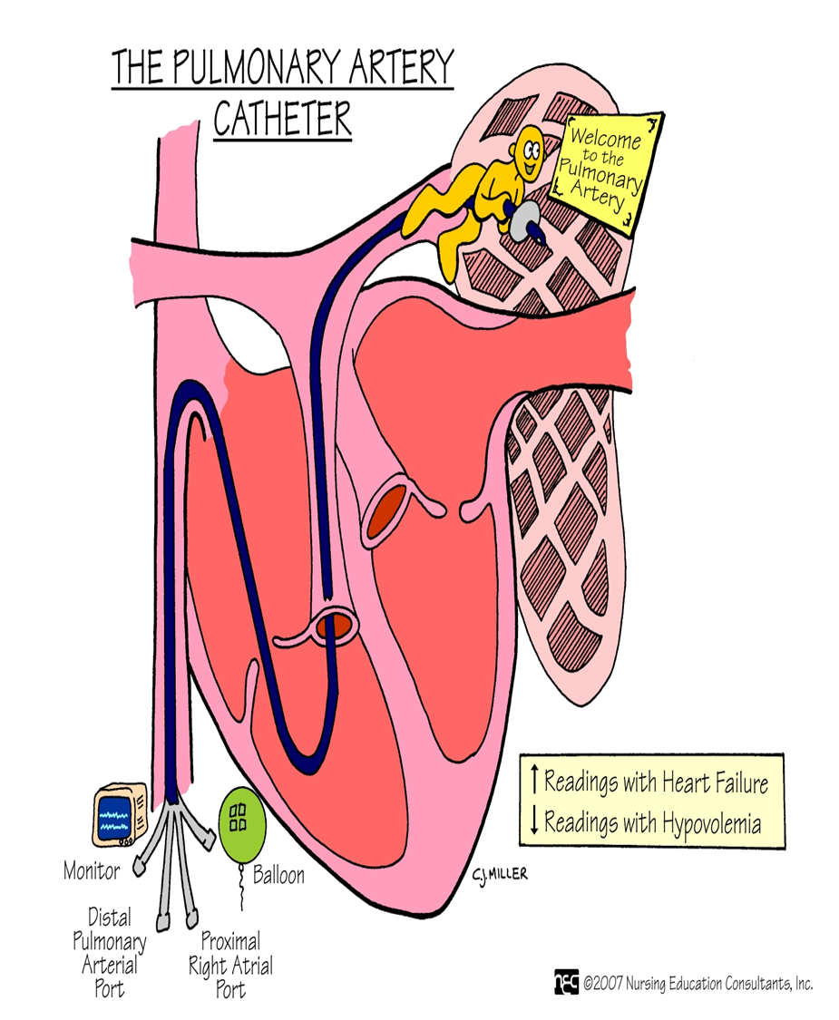
Pulmonary Artery Catheter
“Swan Ganz Catheter”
Usually placed in right jugular vein and passed into the pulmonary artery
Obtains variety of physiological measurements
  PA pressure
  Pulmonary capillary wedge
  CO
  Mixed venous saturation

Slide 60
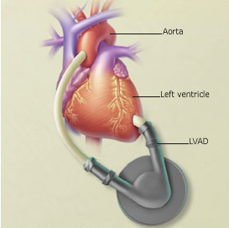
Left Ventricular Assist Device (LVAD)
Used for critically ill patients for stabilization, not a long-term solution
Pumps blood from left ventricle or left atrium to aorta

Slide 61
Goals of Resuscitation
Urine output: > 0.5 mL/kg/hr (35 mL/hour for average 70 kg adult)
Central venous pressure (CVP): ≥ 8 mmHg
Mean arterial pressure (MAP): ≥ 65 mmHg
Systolic blood pressure (SBP): ≥ 90 mmHg
SpO₂: ≥ 92%

Slide 62
SHOCK, PRESSORS & FLUID MANAGEMENT / CLINICAL SYNTHESIS
Treat the physiology—not the blood pressure alone
Assess shock phenotype → Choose an intervention → Reassess perfusion AND congestion
1 ASSESS
2 ACT
3 REASSESS
Is tissue perfusion impaired?
Nonhemorrhagic volume loss
Perfusion improving?
→ Reassessed isotonic crystalloid
MAP trend · mentation · capillary refill · urine output · lactate trend
Mentation · capillary refill · MAP · urine output · lactate trend
Active hemorrhage
→ Bleeding control + blood products
What mechanism fits?
Pump failure with congestion
Congestion emerging?
Volume loss · pump failure · vasodilation · obstruction
→ Treat cause; support output/pressure
Respiratory effort / O₂ need · JVP · lung findings · POCUS
Vasodilatory shock
Is fluid tolerance limited?
→ Treat cause; fluids / pressor as indicated
If response is poor:
JVP · crackles / O₂ requirement · focused echo or POCUS
Obstructive shock
→ Urgently relieve obstruction
Recheck phenotype, fluid responsiveness, source control and need to escalate.
Intervention depends on cause and clinical context.
Sources: ACC cardiogenic shock (2025); SCCM sepsis (2026).

Slide 63
Fluid Management

Slide 64
Basics of Fluid Management
Purpose of IV fluid resuscitation is to assist the body in maintaining organ perfusion and oxygenation by providing hemodynamic support to prevent systemic collapse
Reestablishment of tissue perfusion often re-equilibrates the fluid electrolyte and acid-base imbalance

Slide 65
Body Fluid Distribution
60% of an average normal adult body weight is water
There are 2 main compartments where the body fluid is found:
  Intracellular
  Extracellular
    Interstitial
    Intravascular (Plasma)
    Transcellular – minor component of ECF. Specialized fluids (ex: CSF, synovial fluid, peritoneal fluid, ocular)

Slide 66
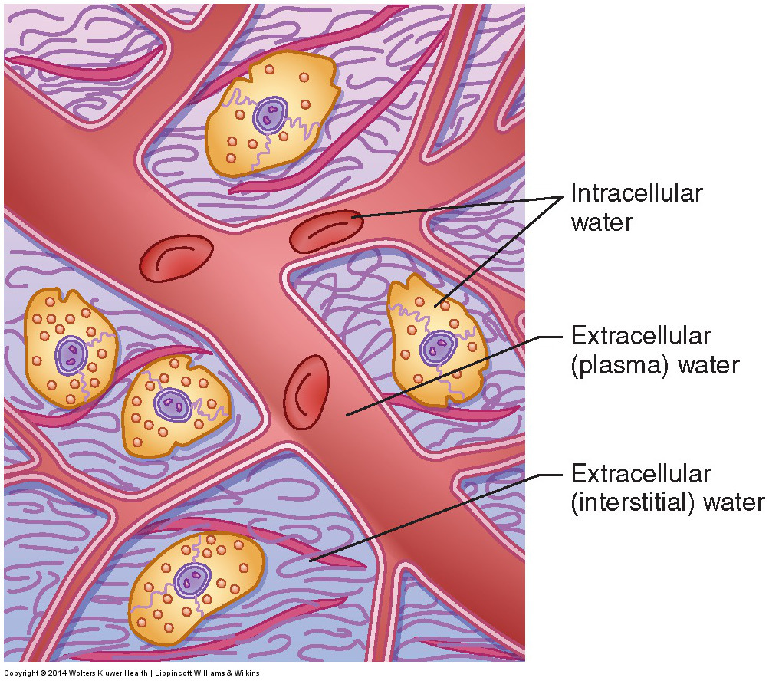
Body Fluid Distribution

Slide 67
Intracellular Space
The fluid inside the plasma membrane of the body’s cells
Average person has 28 liters of intracellular fluid (about 40% of body weight of average adult)

Slide 68
Interstitial Space
Filled with interstitial fluid (water)
Average person has 10 liters of interstitial fluid (about 14% of body weight of average adult)
Fluid is a solution that bathes and surrounds the cells
Provides environment that allows movement of ions, proteins, gases, and wastes across cell barrier

Slide 69
Interstitial Space
Fluid is generated by the systolic force of the heart pushing water out of the capillaries
Interstitial fluid is recollected into the intravascular space through the lymphatic system
When excessive fluid accumulates in the interstitial space, edema develops

Slide 70
Intravascular Space
Fluid is made up of plasma, platelets, and RBCs
  RBCs, platelets, and plasma proteins cannot pass through the walls of the capillaries
Average person has 5 liters of blood in the intravascular space
Intravascular volume regulated by osmotic pressure gradients, hydrostatic pressure gradients, and kidneys
  Hydrostatic pressure is the pushing force
  Osmotic pressure is the pulling force

Slide 71
Transcellular Space
Compartments which hold fluid found in the body, which are not readily available for use, to maintain hemodynamic support or correct electrolyte imbalances
  Pleural spaces
  Peritoneal space
  Pericardial space
  Cerebral Spinal Fluid (CSF) space
  Joint spaces
  GI tract

Slide 72
Third Spacing
Clinical term describing abnormal redistribution of extracellular fluid into tissues or body cavities
Important clinical concept:
  Pt can have excessive fluid in their body while simultaneously having inadequate circulating volume or tissue perfusion!

Slide 73
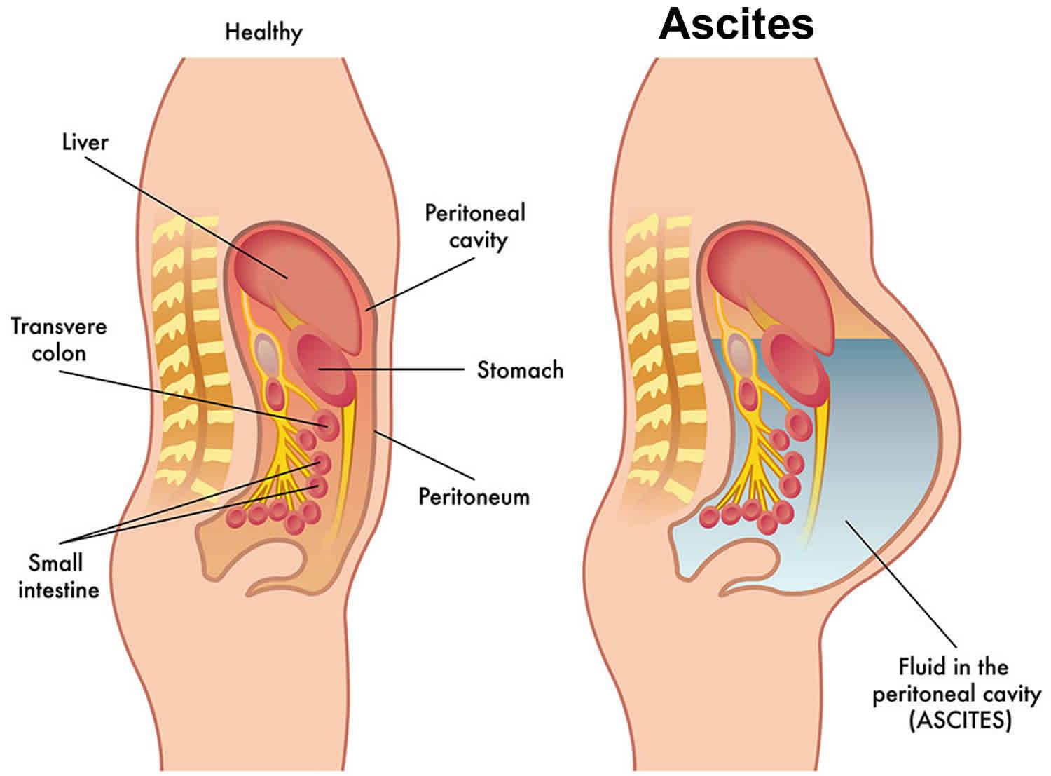

Slide 74
Basics of Fluids and Electrolytes
Electrolytes: substances that dissociate in solution to form particles or ions
  Cations: positively charged ions
  Anions: negatively charged ions
  Monovalent: ions that carry one charge (K⁺)
  Divalent: ions that carry two charges, usually a positive and negative charge (Ca2⁺;Mg2⁺)
Non-electrolyte particles: substances that do not dissociate into ions
  Glucose
  Blood urea nitrogen (BUN)

Slide 75
Basics of Fluids and Electrolytes
All body fluids contain equal amounts of cations and anions
Cations and anions may be exchanged for one another, provided they carry the same charge
  H⁺ ion may be exchanged for a K⁺ ion
  HCO⁻ ion may be exchanged for a Cl⁻ ion

Slide 76
Electrolyte Balance
Major intracellular electrolytes:
  Large amounts of potassium
  Moderate amounts of magnesium and phosphorus
Major extracellular electrolytes:
  Large amounts of sodium and chloride
  Moderate amount of bicarbonate
  Small amounts calcium

Slide 77
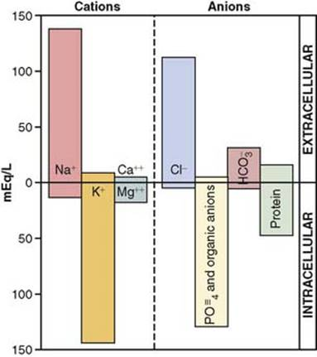
Electrolyte Balance

Slide 78
Diffusion
Diffusion: movement of charged or uncharged particles along an osmotic concentration gradient
In concentrated solution, there are more molecules in motion, creating energy forces that drive particles from areas of high concentration to areas of low concentration
Despite the significant difference in the concentration of solutes in intracellular and extracellular spaces, the total concentration gradient is the same in both compartments because of the osmotic movement of water

Slide 79
Osmosis
Osmosis: movement of water across a semipermeable membrane
As with solutes, water diffuses down its concentration gradient, moving from the side of the membrane with greater concentration of water (lesser concentration of solute particles) into a space with lesser concentration of water (greater concentration of solute particles)
As the water moves across the semipermeable membrane, it generates a pressure called the osmotic pressure

Slide 80
Osmolarity and Osmolality
The osmotic activity of a solution may be expressed in terms of osmolarity or osmolality, the amount of force per volume
Osmolarity: concentration of osmoles in 1 L of solution
Osmolality: concentration of osmoles in 1 kg of solvent
90-95% of serum osmolarity/osmolality is determined by NaCl and NaHCO³
5% of serum osmolarity/osmolality is determined by glucose and blood urea nitrogen (BUN)

Slide 81
Osmolal Gap
Osmolal gap: indication of unmeasured solute in the blood
osmolal gap = measured osmolality – calculated osmolality
normal osmolal gap is < 10 mosmol/kg
Measured osmolality: measured in lab using osmometer, measures how many osmoles are in plasma of patient
Calculated osmolality: lab measurement of the serum, calculated using the equation
serum osmolality = 2[Na⁺] + (glucose/18) + (BUN/2.8)
normal calculated osmolality is 275-295 mosmol/kg

Slide 82
Osmolal Gap
Normally, measured osmolality = calculated osmolality
  Hence, normal osmolal gap is usually less than 10 mosmol/kg
Osmolality of interstitium = osmolality of plasma = osmolality of intracellular fluid
If the osmolal gap is > 10 mosmol/kg, then there are abnormal solutes in the fluid compartments, which will affect the fluid balance

Slide 83
Tonicity
Tonicity: refers to the osmotic effect that a solution exerts on cell volume in terms of causing a cell to swell or shrink
Isotonic solutions: cells undergo no change in size
Hypotonic solutions: cells increase in size
Hypertonic solutions: cells decrease in size

Slide 84
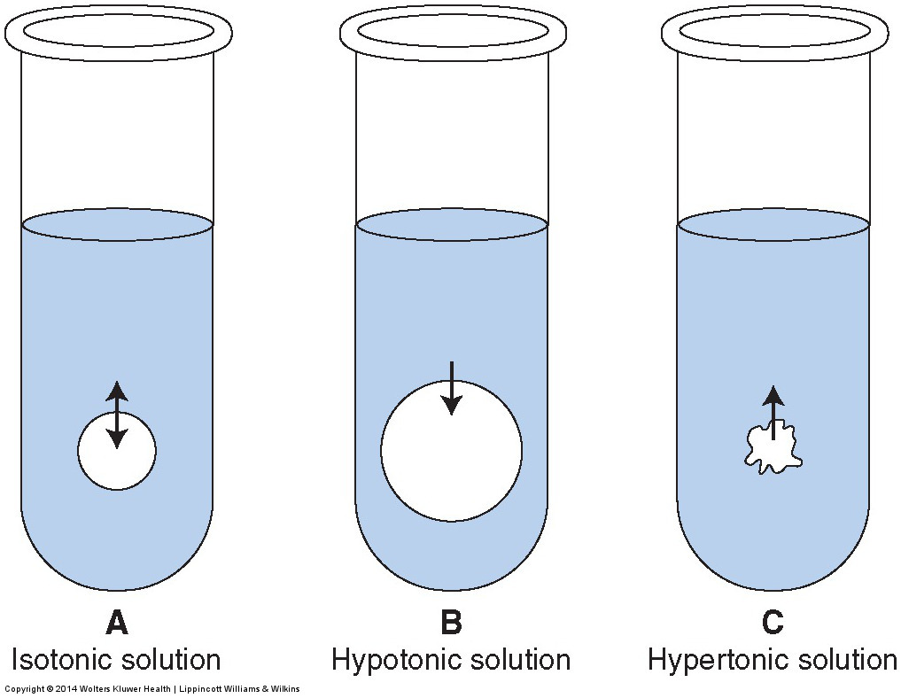
Tonicity

Slide 85
Classification of Intravenous Solutions
Crystalloids
Colloids
Solutions of electrolytes and sterile water
  Normal saline
  Lactated ringers
  Dextrose 5% water
May be isotonic, hypotonic, or hypertonic when compared to serum plasma
When infused, 20% stays within the intravascular compartment, while 80% enters the interstitial compartment within 30 minutes
Human derivatives
  Fresh frozen plasma
  Human albumin
  Whole blood
Semisynthetic
  Dextrins
  Gelatins
  Hetastarch
Colloids are primarily retained in the intravascular compartment, resulting in serum plasma expansion

Slide 86
Classification of Intravenous Solutions
Isotonic solutions
  0.9 normal saline solution (0.9NS)
  Lactated ringers solution (LR)
Hypotonic solutions
  0.45 normal saline (0.45NS or ½NS)
  Dextrose 5% in water (D5W)
Hypertonic solutions
  Dextrose 5% in normal saline (D5NS)
  3% saline solution (3%NS)

Slide 87
Sensible and Insensible Losses
Sensible losses: losses which are easily explained or measured by a clinician
  Not consuming enough fluids, excessive vomiting, diarrhea, etc.
  Examples: urine output (~500 mL/day), stool output (~200 mL/day)
Insensible losses: losses that are not easily measured, or quantified
  Examples: sweating (~500 mL/day), lungs (~400 mL/day)

Slide 88
Hypovolemia
Hypovolemia may refer to any condition of extracellular volume reduction
  Vomiting
  Blood loss
Severe hypovolemia produces a reduction in tissue perfusion
Hypovolemic shock is the most common form of shock
Fluid resuscitation (regardless of the cause) is essential for dealing with intravascular volume depletion

Slide 89
Hypovolemia
When there is volume loss, the body senses a loss in volume and:
  Stimulates the carotid and aortic baroreceptors, kicking off sympathetic nervous response and causing reduction in vagal stimulation
  Causes arterial vasoconstriction to shunt flow from areas of less need to areas of more need
  Increases HR and contractility, causing improved cardiac output
  Vasoconstricts venous system to augment venous return
  Releases vasoactive hormones (epinephrine, norepinephrine, dopamine, cortisol) to increase vascular tone
  Causes renal involvement of RAAS and ADH to cause extravascular volume to be shunted to intravascular volume

Slide 90
History of Hypovolemia
Vomiting
Diarrhea
Fever
Decreased fluid intake
Chronic disease
Altered mental status

Slide 91
Vitals Signs of Hypovolemia
Vital signs can be misleading when it comes to hypovolemia
Classically: tachycardia, hypotension, poor peripheral perfusion (weak pulses and prolonged capillary refill), and decreased mental status are signs of decreased perfusion
These findings may be delayed in presentation of hypovolemia

Slide 92
Physical Exam of Hypovolemia
Dry mucosa
Shrunken tongue
Decreased skin turgor
Decreased capillary refill
Lack of tears
Decreased urine output or wet diapers
Sunken fontanelles (infants)

Slide 93
Diagnostic Studies of Hypovolemia
Laboratory diagnostics are not always reliable indicators of fluid status
BUN, creatinine, hematocrit, and urine specific gravity are commonly used but not always sensitive to fluid volume

Slide 94
Clinical Assessment of Hypervolemia
Volume overload is a clinical diagnosis
  Edema (central or peripheral)
  Respiratory distress (pulmonary edema)
  Jugular venous distension
Risk factors for volume overload include
  Renal disease
  Liver disease
  Heart failure

Slide 95
Goals of IV Fluid Replacement
Goals of replacement therapy:
  Stop fluid loss
  Restore volume lost to sustain critical organ perfusion
  Maintain oxygen carrying capacity for adequate cellular oxygen delivery
  Correct derangements in electrolytes/coagulation
In short, assist the body in compensatory efforts, preventing hemodynamic compromise and ultimately systemic collapse

Slide 96
Evaluating the Fluid Deficit
There is no formula that can be used to accurately estimate the total fluid deficit
Clinical parameters can be used to assess the possible presence of volume depletion, including the blood pressure, heart rate, jugular venous pressure, and urine output
These parameters should be followed to assess the effectiveness of volume replacement

Slide 97
Evaluating the Fluid Deficit
In the acute (particularly the trauma) setting, fluid and blood products serve to expand volume and act as a bridge to determining source, then control and correct loss
IV fluid replacement is not an indefinite means of intervention
IV fluids are a temporizing measure, particularly as it pertains to volume loss from hemorrhage or any unresponsive condition

Slide 98
Intravenous Access
First, assume airway and breathing are accomplished and stable
Usually, establishing IV access occurs simultaneously with the assistance of the nursing staff
Options for intravenous access include:
  Peripheral line
  Central line
  Intra-osseous line

Slide 99
Crystalloids
Isotonic crystalloids are the preferred initial agent in fluid resuscitation
Due to the low oncotic pressure, crystalloid solutions experience a substantial shift from the intravascular space into the interstitial spaces
3:1 rule – theoretic concept for fluid resuscitation
  For every amount of blood lost, 3 times this amount of isotonic crystalloid is required to effectively restore intravascular volume, because at best only 30% will remain in the intravascular space
Actual determination of volume loss is made clinically

Slide 100
Colloids
No evidence of improved outcomes when considering crystalloid vs. colloid
In the presence of hemorrhagic disease and sepsis as sources of volume loss, the vessels become so permeable that even the proteins, once prohibited from traversing across the vessel, can flow freely into the interstitial space
Colloids are costly

Slide 101
Blood Transfusions
No hard or fast rule regarding blood transfusions
Most common transfused blood product is PRBCs
0.9NS is the only IV fluid that can be administered in conjunction with blood products
Following 2 L of rapid transfusion of a crystalloid solution, blood transfusion should be considered to avoid hemodilution
  Permissive hypotension in the treatment of hypovolemia due to hemorrhage from trauma

Slide 102
Blood Transfusions
Prior to blood transfusion (if possible):
  Discuss risks and benefits and obtain consent from patients
  Order a type and screen when anticipating the need for blood products
  Order a type and cross when urgent need for blood products

Slide 103
Blood Transfusions
If hemodynamic instability from a gross blood loss, then immediate transfusion may be necessary
  Emergency release blood (O negative)
  1:1:1 ratio (PRBCs : FFP : Platelets) – initial starting point for massive transfusion protocol (MTP)
  Massive transfusion (> 10 units/24 hours)
Remain mindful of the complications that can occur related to blood transfusions
  Acute febrile hemolytic reaction
  TRALI
  Anaphylaxis

Slide 104
Rate of Fluid Resuscitation
For mild or moderate hypovolemia, rapid fluid resuscitation is not necessary
To avoid worsening of the volume deficit, the rate of fluid administration must be greater than the rate of continued fluid losses
Usually, 1 liter isotonic saline bolus to correct existing fluid deficit followed by 100 cc/hour until clinical parameters improve

Slide 105
Rate of Fluid Resuscitation
Severe volume depletion or hypovolemic shock requires rapid resuscitation
Provide at least 1 to 2 liters of isotonic saline boluses wide open in an attempt to restore tissue perfusion
Monitor effects of fluid resuscitation
  Blood pressure
  Heart rate
  JVP
  Urine output
  Mental status

Slide 106
Indications for Isotonic Solutions
0.9 Normal Saline (0.9NS)
Most commonly used intravenous solution
Isotonic solution that matches blood serum osmolarity
Can be given simultaneous to blood products
Indications:
  Hypovolemia —Dehydration
  Blood loss —DKA
  Hyponatremia
Precautions:
  Heart failure from excessive use
  Acidemia with prolonged use (0.9 NS induced hyperchloremic metabolic acidosis)

Slide 107
Common IV Fluid Orders
Normal Saline
Common boluses
  250 cc
  500 cc
  1 liter (1000 cc)
  2 liters (2000 cc)
Common maintenance infusion orders
  75 cc/hour
  100 cc/hour
  125 cc/hour
  250 cc/hour
It is common to order a bolus followed by a drip for a patient in need of hydration

Slide 108
Indications for Isotonic Solutions
Lactated Ringers (LR)
Electrolyte composition similar to serum plasma
Commonly used with surgical patients
Lactate acts as a buffer to prevent metabolic acidosis
Indications:
  Acute blood loss (operating room, trauma)
  3rd spacing shift (burns, ascites, pleural effusions)
Precautions:
  Renal disease
  Liver disease
  pH > 7.5

Slide 109
Indications for Hypotonic Solutions
0.45 Normal Saline (0.45NS)
Indications:
  Hypertonic extracellular dehydration
  Hypernatremia
Precautions:
  Acute hyponatremia from excessive use (can result in cerebral edema)

Slide 110
Indications for Hypotonic Solutions
Dextrose 5% Water (D5W)
Indications:
  Used for free-water replacement, not for volume resuscitation
  Maintenance fluid only (100 cc/hour)
  Hypoglycemia (oral hypoglycemic overdose)
  Malnourished
Precautions:
  Hyperglycemia from excessive use

Slide 111
Indications for Hypertonic Solution
3% Normal Saline (3%NS)
Indications:
  Severe hyponatremia with symptoms (e.g., seizures, encephalopathy)
  Intracranial hemorrhage (to decrease intracranial pressure)
Precautions:
  Rapid net correction of sodium can result in osmotic demyelination syndrome (formally known as central pontine myelinolysis)
    Destruction of the myelin sheath down axons into the brain stem, causing death

Slide 112
SHOCK, PRESSORS & FLUID MANAGEMENT / CLINICAL SYNTHESIS
Treat the physiology—not the blood pressure alone
Assess shock phenotype → Choose an intervention → Reassess perfusion AND congestion
1 ASSESS
2 ACT
3 REASSESS
Is tissue perfusion impaired?
Nonhemorrhagic volume loss
Perfusion improving?
→ Reassessed isotonic crystalloid
MAP trend · mentation · capillary refill · urine output · lactate trend
Mentation · capillary refill · MAP · urine output · lactate trend
Active hemorrhage
→ Bleeding control + blood products
What mechanism fits?
Pump failure with congestion
Congestion emerging?
Volume loss · pump failure · vasodilation · obstruction
→ Treat cause; support output/pressure
Respiratory effort / O₂ need · JVP · lung findings · POCUS
Vasodilatory shock
Is fluid tolerance limited?
→ Treat cause; fluids / pressor as indicated
If response is poor:
JVP · crackles / O₂ requirement · focused echo or POCUS
Obstructive shock
→ Urgently relieve obstruction
Recheck phenotype, fluid responsiveness, source control and need to escalate.
Intervention depends on cause and clinical context.
Sources: ACC cardiogenic shock (2025); SCCM sepsis (2026).

